Slide 1
CLARON FIBREOPTICS PRIVATE LIMITED
THE FTTH COMPANY

Slide 2
ABOUT US . . . .
A Start-up created with a vision of contributing towards the Digital India, having exclusive focus on bringing Fiber To The Home technology (FTTH) to each corner of the country and to the reach of each and every individual in India
With more than 20 years experience in the Industry ranging from Optical Fibers to Cables, we strive for the development and contribution to the digital economy

Slide 3
WHAT WE DO . . . .
We are the first exclusive manufacturer of FTTH drop cables in India
We manufacture cables with 1F, 2F and 4F cables
We offer cables with G657A fiber and options of various strength members
We also offer technology support and take-up complete FTTH projects

Slide 4
OUR PRODUCT RANGE

Slide 5
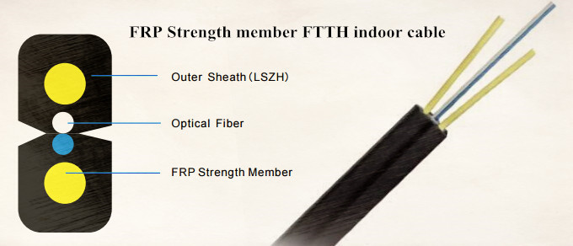
FTTH DROP CABLE

Slide 6
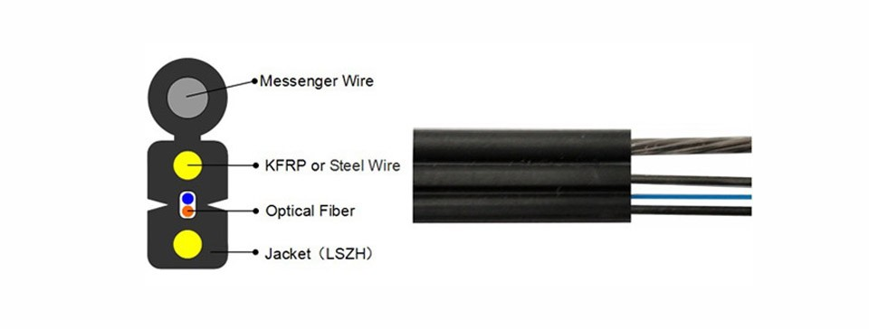
Steel Wire supported FTTH Cable

Slide 7
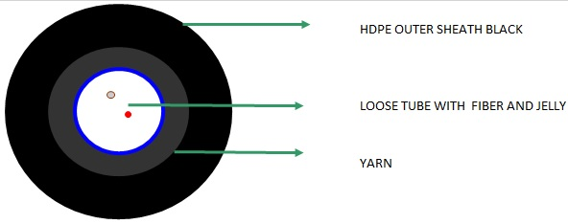
FTTH OUTDOOR CABLE

Slide 8
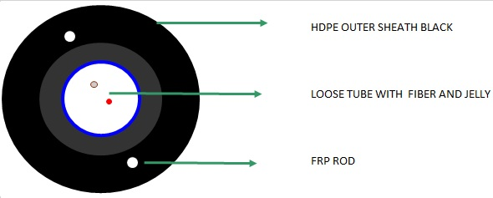
2F-12F UNITUBE OFC FOR CATV

Slide 9
Advantage CLARON
Primary focus on Quality
Strong Technical Knowledge
Exclusive FTTH Focus
Biggest Manufacturing capacity in India

Slide 10
CONTACT US
M/s. Claron Fibreoptics Private Limited
No.12-53/1, Survey No.807/part
Medchal Industrial Area
Medchal
Telangana – 501401
Tel : 9833934331
Email : Niranjan@claronfibreoptics.com
sales@claronfibreoptics.com
Web : http://www.claronfibreoptics.com

