Slide 1
Our handling know-how: sure profit for You
HRSIntroEN13Jun18Rev04

Slide 2
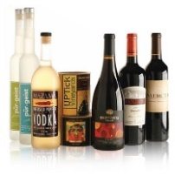
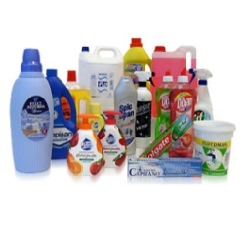
INTRODUCTION
Welcome to HRS
HRS design and manufacture an innovative range of secondary packaging machines: special projects, high automation multifunction handling center, blocks with 4 or 6 axis antropomorphous type robot arms and standard machines.
The sectors in which we have consolidated our experience for more than 25 years are:
FOOD
SECTOR
BEVERAGE
SECTOR
PHARMACEUTICAL
SECTOR
COSMETIC
SECTOR
CHEMICAL
SECTOR
Jars
Canned food
Pouches/bags
Cups
Glass/plastic bottles
Cups
Vials
Cases
Tubes
Plastic bottles/jars
Cases
Tubes
Plastic bottles
Cases
Cans

Slide 3
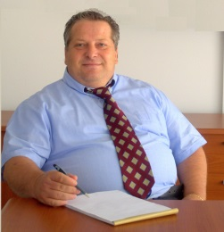
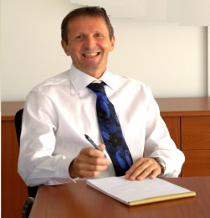
BACKGROUND
Primo Busselli
1983 – 1989 Mechanical Design Engineer
Alfa Costruzioni Meccaniche Spa Mantova – Italy
1990 – 2000 Head of Mechanical Design Dept.
Keber Srl Roverbella (MN) – Italy
2001 – 2012 Director – Mech. Design Dept. (company co-founder)
Apsol Srl Goito (MN) – Italy
2013 – Director – Mech. Design Dept. (company co-founder)
HRS Srl - Robotic Handling Systems Porto Mantovano (MN) – Italy
Roberto Pezzini
1986 – 1993 Automation Engineer
Alfa Costruzioni Meccaniche Spa Mantova – Italy
1993 – 2000 Head of Automation Dept.
Keber Srl Roverbella (MN) - Italy
2001 – 2012 Director – Automation Dept. (company co-founder)
Apsol Srl Goito (MN) – Italy
2013 – Director – Automation Dept. (company co-founder)
HRS Srl - Robotic Handling Systems Porto Mantovano (MN) – Italy
Alessandro Busselli
1997 – 2000 Automation Engineer
Keber Srl Roverbella (MN) - Italy
2001 – 2012 Director – Service Dept. (company co-founder)
Apsol Srl Goito (MN) – Italy
2013 - Director – Service Dept. (company co-founder)
HRS Srl - Robotic Handling Systems Porto Mantovano (MN) – Italy.

Slide 4
OUR CUSTOMERS

Slide 5
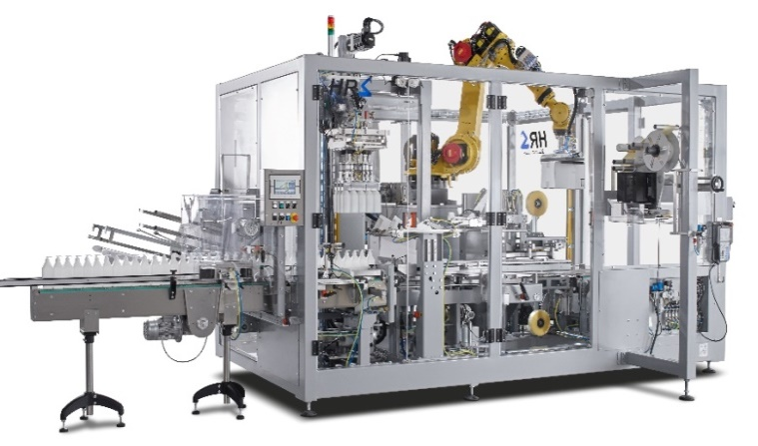
PRODUCT RANGE
MULTIFUNCTION ROBOT BLOCK
MULTIFUNCTION HANDLING CENTER

Slide 6
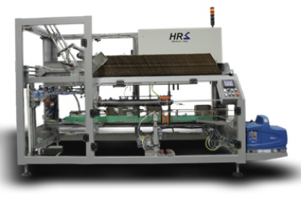
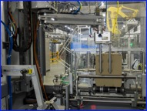
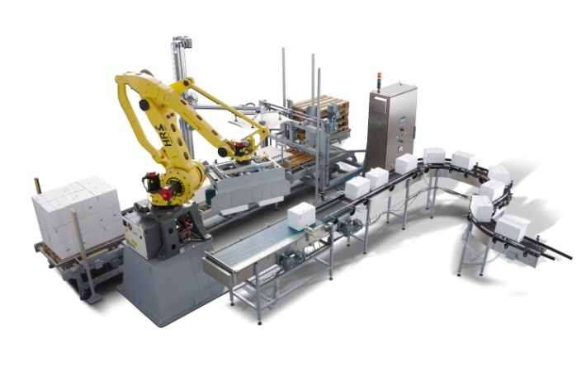
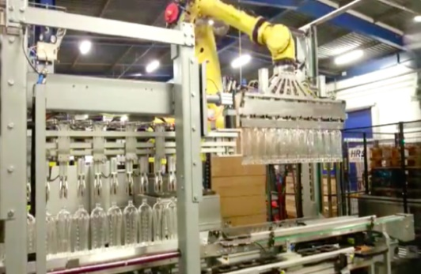
PRODUCT RANGE
CARTON FORMER
CASE PACKER
PARTITION INSERTER
CARTON SEALER
PALLETIZER
DEPALLETIZER

Slide 7
PRODUCT RANGE - STRENGTHS
Latest available automation technology
Simple mechanical construction – reduced components number
Multi-function machines with reduced footprint
Quick format change-over
Simple, intuitive operator interface
Easy access inside the machine (i.e. cleaning – maintenance work)
24/7 remote service assistance.

Slide 8
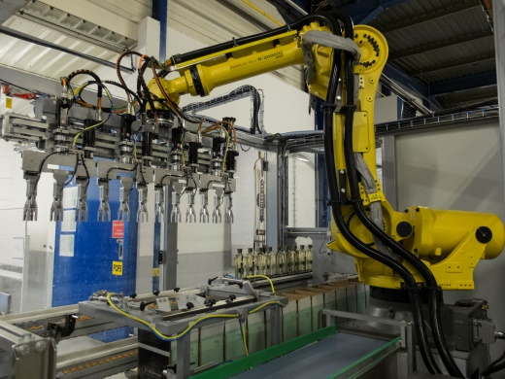
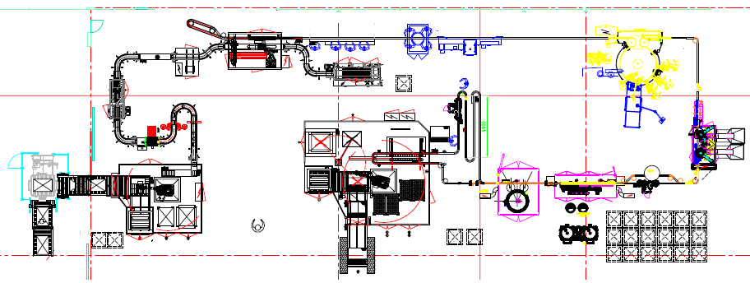
RANGE: SPECIAL PROJECT
Special Project
We are specialist in handling solutions: we are able to develop customized systems for the treatment of products and packaging such as:
bottles – vials – cans – jars
pouches - bags
boxes – wrap-around cartons
display type boxes
We design and build plants with high mechanical and automation complexity, based on a stringent analysis about the required sequences and cycle time.

Slide 9
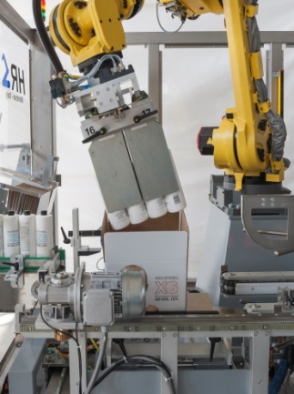
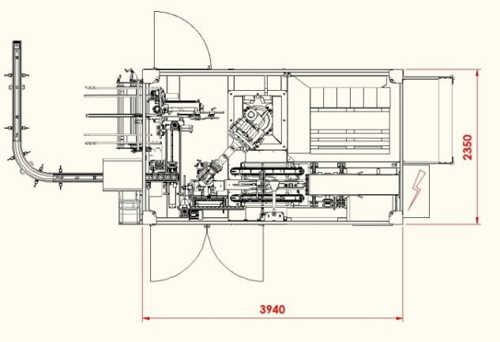
RANGE: MULTIFUNCTION ROBOT BLOCK
MRB – Multifunction Robot Block
Easy to use – reduced footprint machine; core of the system is the anthropomorphous type robot arm (4 or 6 axis), which carries out the main machine operations. The robot arm work is in addition assisted by several "work stations":
Carton extraction, formation and transfer to the filling station
Containers pick up from the collection preparation table and insertion into the carton box
Carton upper/lower flaps sealing (self adhesive tape or hot-melt glue)
Finished boxes coding (self adhesive label, print & apply, ink-jet, etc.)
Carton boxes palletization (pallet placed on the floor or motorized chain/roller conveyor).

Slide 10
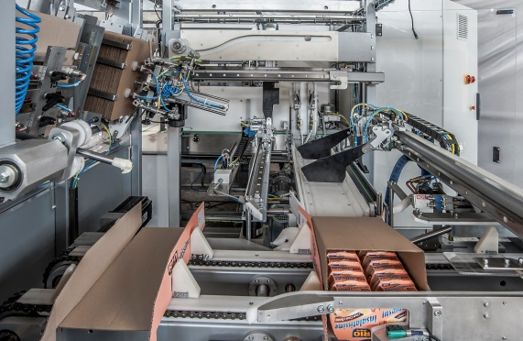
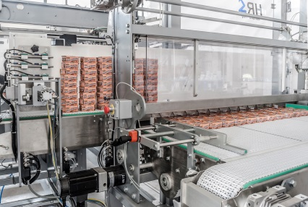
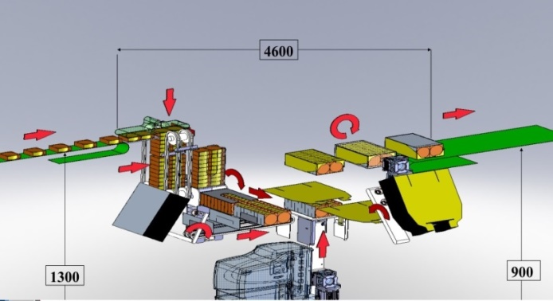
RANGE: MULTIFUNCTION HANDLING CENTER
MHC – Multifunction Handling Center
When the production speed becomes high and the shape of the product is complex, the Multifunction Handling Center represents the best solution:
Space saving
One operator only to supervise a multiple-task machine
High efficiency
Down time reduction during production
The development and the design of the machine start from Customer's specific requirements, together with the analysis of the sequences and the calculation of the relevant cycle times.

Slide 11
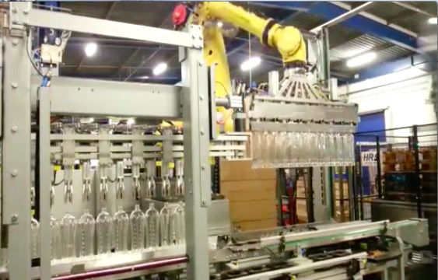
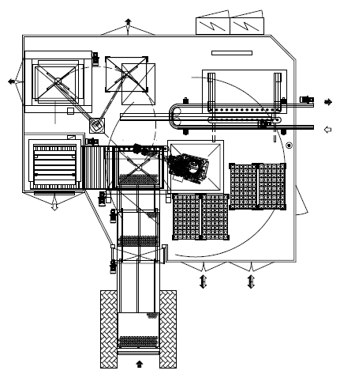
RANGE: DEPALLETIZER
DEM-R Depalletizer Robot
Production speed: up to 550 cycle/hour
Robot support pedestal made in Fe 360 steel plate, bolted to the floor
Metallic net perimeter safety guard
Motorized pallet conveyors (rollers or chain type)
Pallet film removal platform (full pallet loading point)
Column type tray/layer pad removing unit
Tray/layer pad magazine
Automatic empty pallet magazine
Containers pick up by rows
6 axis antrophomophous type robot arm
Picking head: several models available – according to the type/shape of product handled
Main control cabinet complete with top luminous beacon for machine status/alarm visualization, plc and touch-screen unit.

Slide 12
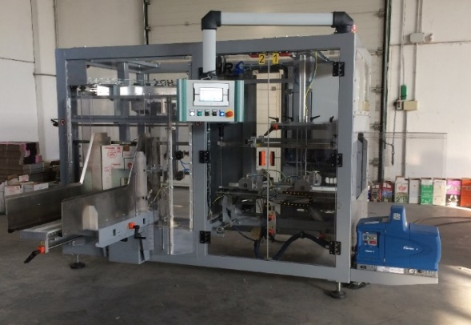
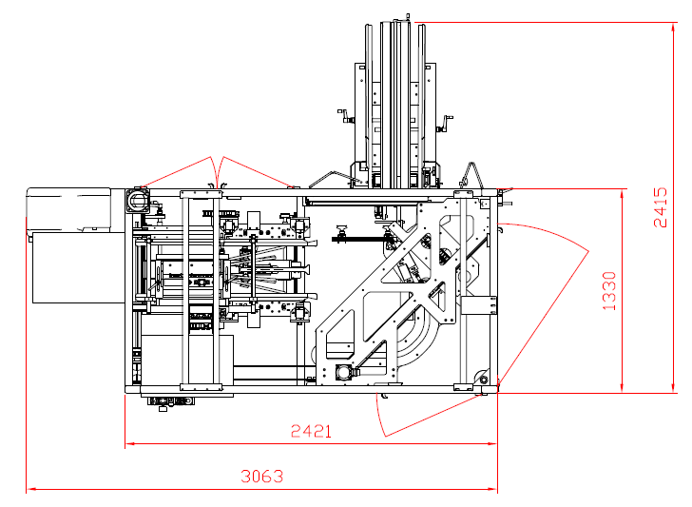
RANGE: CARTON FORMER
CEM-16-H Carton Former
Production speed: up to 16 carton/minute
All machine motions controlled by a single brushles type electric motor
Carton magazine located on the side of the machine (easy access); cartons forward motion by means of double motorized belt
Carton extraction: suction cups (Venturi)
Carton lower flaps sealing: hot-melt glue
Automatic hot-melt glue heating unit complete with alarm sensor (low glue level); spray guns controlled by photocells
Pneumatically operated pad for glued flaps final pressing.

Slide 13
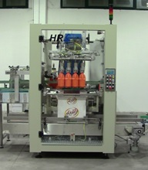
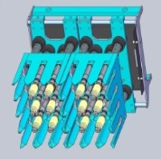
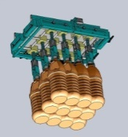
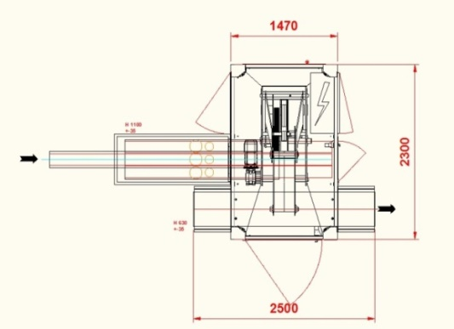
RANGE: CARTON PACKER
MCM-2T Mechanical Carton Packer
Several models available (i.e. from 1T to 4T)
Production speed: up to 600 cycle/hour
Incoming containers decelerating table plus collection formation table
Two sections mechanical arm made in welded Fe 360 steel profiles
Arm motion by means of hollow – desmodromic type cam track profile
Picking head: several models available – according to the type/shape of product handled
Pneumatic type centering device vith vertical stroke.

Slide 14
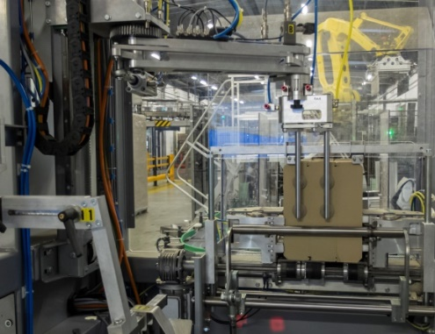
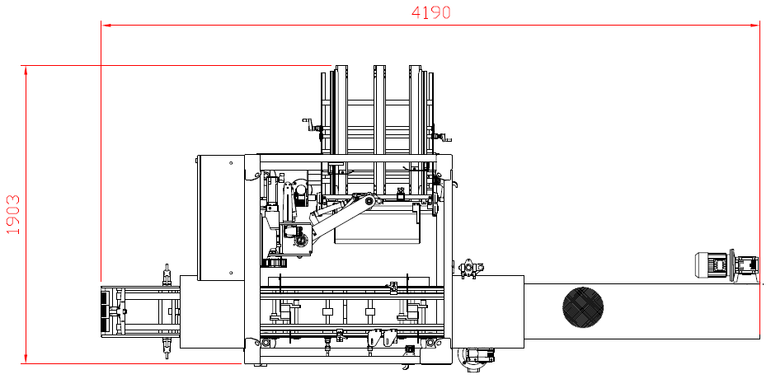
RANGE: PARTITION INSERTER
PIM-1T Partition Inserter
Several models available (i.e. from 1T to 4T)
Production speed: up to 500 cycle/hour
Partition magazine:
Horizontal type magazine located on the back of the machine
New design: side electropneumatic units plus frontal bar partition containment
Extraction head:
Suction cups (Venturi)
Vertical plus horizontal motions by brushless type electric motors
Partition opening: pneumatic cylinder plus lever system
Vibrating – rubber belt conveyor installed downstream the machine.

Slide 15
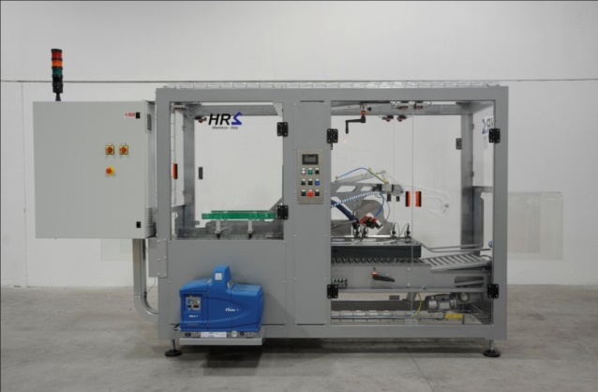
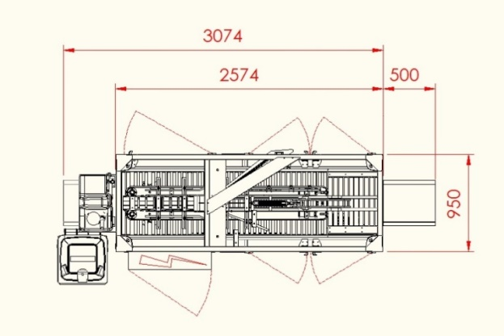
RANGE: CARTON SEALER
CSM-40-H Carton Sealer
Production speed: up to 40 carton/minute
Integral type safety guard
Carton motion across the machine by means of two lateral chains with prongs; incoming carton spacing by vertical moving infeed roller conveyor
Carton flaps bending by fixed plus pneumatically operated stainless steel rods
Automatic hot-melt glue heating unit complete with alarm sensor (low glue level); spray guns controlled by photocells (glue applied on the carton in transit across the machine)
Spring loaded contrast unit for glued flaps final pressing.

Slide 16
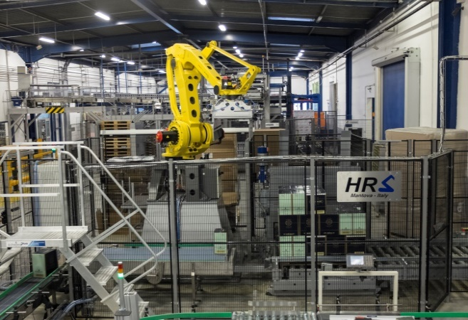
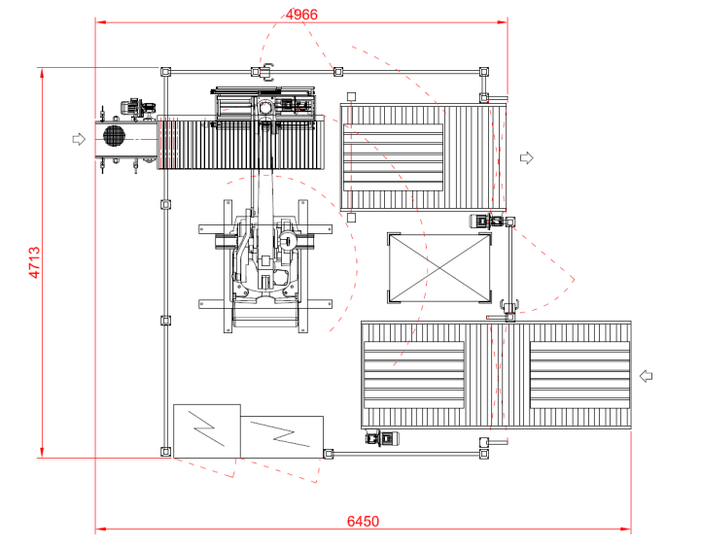
RANGE: PALLETIZER
PAM-R Palletizer Robot
Production speed: up to 600 cycle/hour
Robot support pedestal made in Fe 360 steel plate, bolted to the floor
Metallic net perimeter safety guard
Motorized pallet conveyors (rollers or chain type)
Empty pallet pick up from stack and placement on the palletization station
Manual loading type layer pad magazine, located inside the machine perimeter guard
Product preformation area: several models available – according to the type/shape of product handled
4 axis antrophomophous type robot arm
Picking head: several models available – according to the type/shape of product handled
Main control cabinet complete with top luminous beacon for machine status/alarm visualization, plc and touch-screen unit.

Slide 17
SERVICE
Each HRS machine is designed with the aim reduce to minimum standby and maintenance time, thanks to the wide adoption of high quality – long life components. The HRS Service Team is in any case at your disposal, to quickly help you with any request:
Spare Parts
Contact the Service Team for information about specific parts, wear & tear kits, emergency spare parts kit, etc.
Inspections and Planned Maintenance
Qualified technicians are available to carry out periodical inspections on the machine and thus agree with you the required level of maintenance work.
Planned maintenance packages, directly carried out by our technicians, are also available
Remote service
In HRS we have available the most sophisticated remote service systems, to be able to quickly help you in any part of the world, 24 hours a day; our specialists can at any time check, debug or modify any software installed onboard our machines.
HRS SERVICE TEAM
Alessandro Busselli
+39.331.758.5719
alessandro.busselli@hrs-italy.it
Roberto Pezzini
+39.331.758.5680
roberto.pezzini@hrs-italy.it

Slide 18
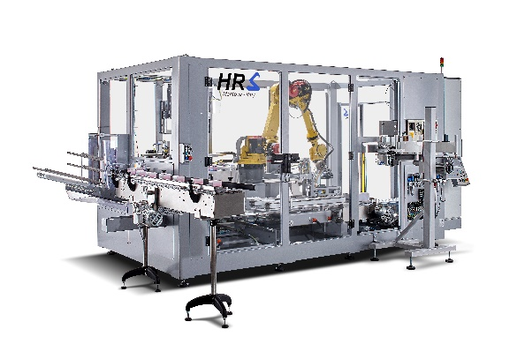
CONTACTS
HRS S.r.l. - Robotic Handling Systems
Via Londra, 14
46047 Porto Mantovano (MN) Italy
VAT No. 02374160204
Phone +39.0376.1504665
Fax +39.0376.1590981
Internet www.hrs-italy.it
Sales Rep. PAOLO DOMENEGATI
+39.345.018.1416
paolo.domenegati@hrs-italy.it
Tech. Office PRIMO BUSSELLI
+39.331.758.5759
primo.busselli@hrs-italy.it
Automation ROBERTO PEZZINI
+39.331.758.5680
roberto.pezzini@hrs-italy.it
Service ALESSANDRO BUSSELLI
+39.331.758.5719
alessandro.busselli@hrs-italy.it
Our handling know-how: sure profit for You

