Slide 1
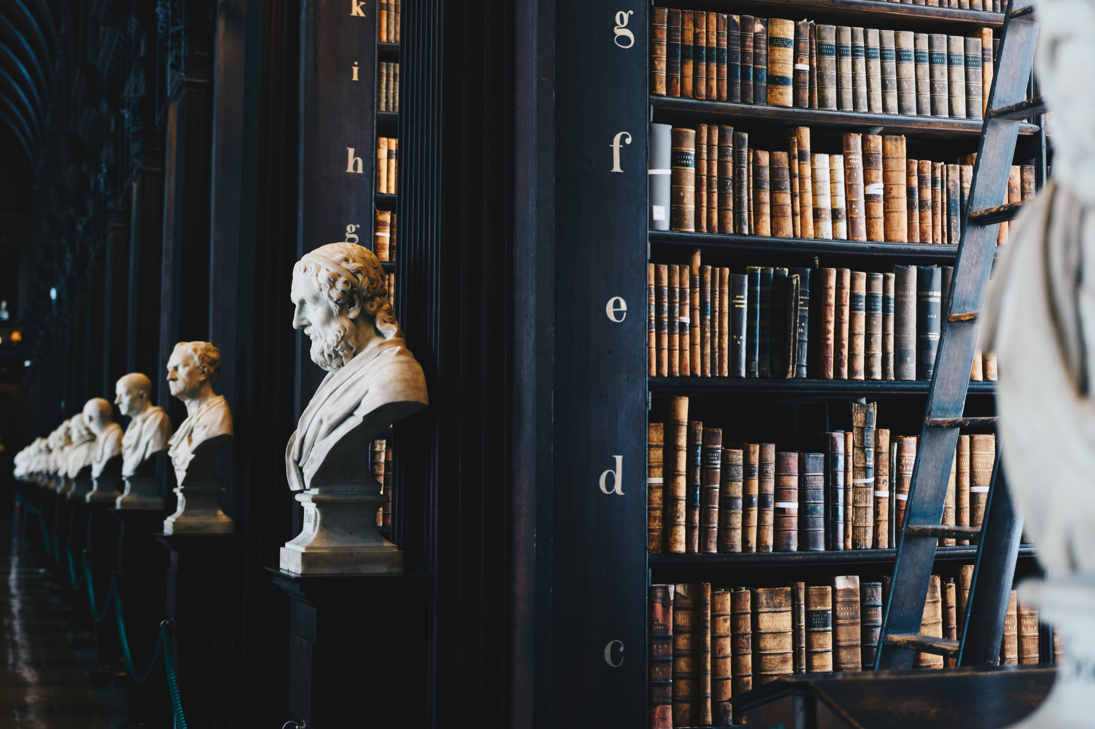
encouraging
Creativity, Excellence, Innovation, Knowledge and Justice
Across the Ages : Non Governmental Organisations and their Role in Sustainable Development
Marianne Ojo

Slide 2
The Centre & Institute for Innovation and Sustainable Development LLC: Goals and objectives
The goals and objectives of the Centre & Institute for Innovation and Sustainable Development (CIISD) include the following:
To serve as a national and global forum for the facilitation of exchange of ideas, ground breaking research and innovative ideas for sustainable development
To enhance and promote collaborative exchanges between educational institutions, as well as financial institutions which are related to vital and topical matters which are currently making the headlines – as well as affecting economic growth, development at global levels – as well as global peace
To link publishers with educational institutions, academia, scholars and other related organisations who may be interested in promoting their products, services – as well as institutes and facets of innovative development.
To serve as paradigms, citadels and centres of excellence in relation to the related topics which conferences will focus on, as well as provide high quality educational services and products, facilitating the stimulation of greater growth within local economies primarily, through job creation.

Slide 3
Facilitating access towards stimulating innovative and creative thinking
As well as providing high quality educational services and products, facilitating the stimulation of greater growth within local economies primarily, through job creation, the Institute also aims to deliver such services and products at the most competitive and affordable prices. This will be fostered and enhanced through channels which enable us to effectively maximize access to infrastructure and services which contribute to the competitive advantages inherent through our location and access to such facilities.

Slide 4
Facilitating the exchange of ideas and innovative thinking
The Institute is currently accepting submissions for forthcoming based conferences focusing on the theme “Sustainable Development and Trade Relationships: The Need for a More Defining Role for Actors in a Progressive World” . Submissions are welcomed in relation to the afore mentioned conference theme, but not restricted to selected areas which will constitute the basis of future publications and discussions with academic affiliates. Whilst focusing on the theme, “Sustainable Development”, it will innovate the topic by giving due consideration to topical matters impacting and influencing current developments – particularly trade issues and their significance on economic development.

Slide 5
Collaborative opportunities
In facilitating its goals and objectives, the Institute does not only hope to achieve these through conference organizing platforms for exchange of ideas, but also through vital links and affiliations with other non governmental organisations and institutions which are committed to the goal of promoting sustainable development.
In promoting its logo of facilitating “Creativity, Excellence, Innovation, Knowledge and Justice , Across the Ages”, the Centre & Institute for Innovation and Sustainable Development hopes to forge effective and productive relationships with other institutions which will realise these goals and objectives.

Slide 6
“Innovative programming” methods and techniques
Other non governmental organisations have preferred to focus on issues such as “Climate Change and Fragile States” whilst identifying the following vital themes (IISD, 2011:13):
“The relationship between climate change and peacebuilding, especially with regard to climate-proofing peace-building efforts, could be further explored through research and through new, innovative programming that draw on lessons learned;
Adaptation to climate change needs to be conflict-sensitive; developing best practices in how to accomplish this could be of great value for practitioners;

Slide 7
Coordination and cooperation
Further, benefits of effective collaboration, local knowledge through workshops, which “promote coordination and cooperation among practitioners” were also identified (IISD, 2011:13):
“Local knowledge and abilities are integral, so processes that can be shown to develop or strengthen local adaptive capacity could offer valuable lessons learned for other contexts.”

Slide 8
references
Centre & Institute for Innovation and Sustainable Development LLC
Visit https://ciinnovationsd.org/
International Institute for Sustainable Development (2011). Institut International du Developpement Durable, Climate Change and Fragile States Workshop September 28-29, 2011
Visit www.iisd.org

