Slide 1
Research on School Environment and Leadership: Important but mostly dreadful
Prof Rob Coe, Evidence Based Education
researchED National Conference, London, September 2022

Slide 2
School leadership: What I used to think
Leaders think leadership is very important, but most learning happens in classrooms, led by teachers. They probably overestimate their importance.
Most discussion of ‘leadership’ is pretty frothy
Common sense and ‘truthiness’
Poorly defined terms
Advice that is not actionable
Training with no evidence base
All the research is dreadful

Slide 3
School leadership: What I now think
Leadership is probably quite important
Teachers in troubled schools cannot turn things round without strong leadership
Good research now shows that environment and leadership matter
Most discussion of ‘leadership’ is pretty frothy
Common sense and ‘truthiness’
Poorly defined terms
Advice that is not actionable
Training with no evidence base
Most of the research is dreadful

Slide 4
Three big problems in the leadership research
Correlations interpreted as causal levers
Poorly operationalised constructs
Advice that is neither meaningful nor actionable

Slide 5
Correlation ≠ Causation
Teacher/principal individual/collective efficacy:
“beliefs in one's capabilities to organize and execute the courses of action required to produce given attainments” (Bandura, 1997)
Many studies find correlations between teacher efficacy beliefs and student attainment (after controlling for other things), and interpret them (uncritically) as evidence that high efficacy leads to better attainment.
But
High student attainment / progress / value-added could cause teachers to believe that they are effective
Correlations are small and inconsistent anyway (Kim and Seo, 2018)
Interventions that raise efficacy perceptions lead to no increase in attainment (Jacob et al. 2015)

Slide 6
Jingle-jangle (same word, different meaning, different word, same meaning)
Types of leadership
Instructional
Transformational
Distributed
(These are all meaningless / contested / vague)
We need
Clear definitions/operationalisations
Common usage across researchers
Validity evidence

Slide 7
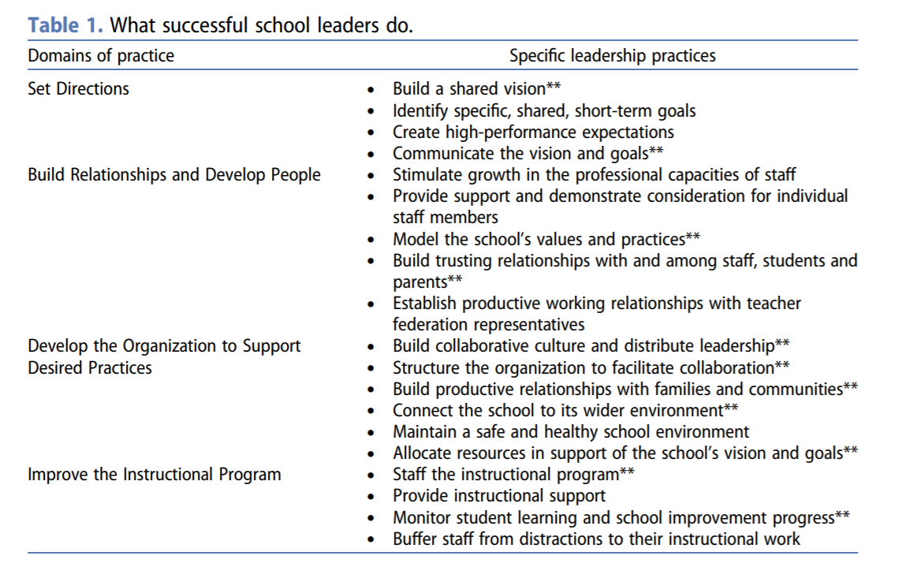
Advice for leaders
Work with the energy at hand rather than try to resist it. Tap into your emotions and use them to your advantage.
Make sure that you do not let your incredible creative talent go to waste. Make a plan as to how you can make this happen during the days ahead.
Sources:
www.horoscopes.com
Leithwood et al (2020): Seven strong claims about successful school leadership revisited
Notes:
Leithwood, K., Harris, A., & Hopkins, D. (2020). Seven strong claims about successful school leadership revisited. School Leadership & Management, 40(1), 5-22. http://www.profdavidhopkins.com/assets/docs/Seven%20strong%20claims%20about%20successful%20school%20leadership%20revisited.pdf

Slide 8
What can the research tell us?
There is no convincing evidence that any training or support programme for school leaders makes them better
We don’t know how to train effective school leaders
There is no convincing evidence about the qualities, skills/knowledge, or behaviours of school leaders we should select for or promote
We don’t know how to select effective school leaders
We can’t give evidence-based advice to school leaders about what to do
It seems likely that
A school’s environment does make some difference to student outcomes, over and above the impact of individual teachers and school context

Slide 9
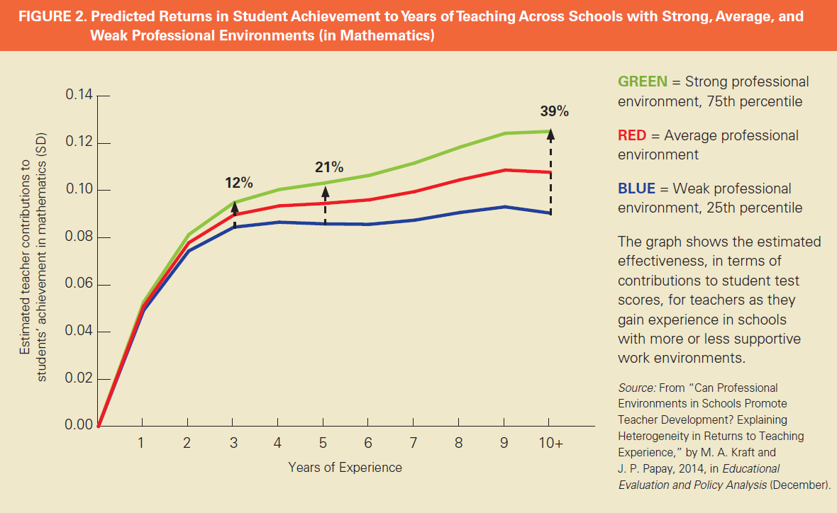
Papay & Kraft (2016)
Ordered environment: rules consistently enforced, teachers supported.
Professional development: time and resources for professional development that enhances teachers’ instructional abilities.
School culture of mutual trust, respect, openness, collaboration and commitment to student achievement.
Constructive monitoring: Fair performance management with meaningful feedback that helps teachers.
Not so much
Notes:
Papay, J.P. & Kraft, M.A. (2016) The myth of the performance plateau. Educational Leadership, May 2016
Original paper is
Kraft, M. A., & Papay, J. P. (2014). Can professional environments in schools promote teacher development? Explaining heterogeneity in returns to teaching experience. Educational Evaluation and Policy Analysis, 36(4), 476-500.

Slide 10
Bryk et al 2010 Organizing schools for improvement: Lessons from Chicago
Effective Leaders: curriculum, leader trust, teacher influence, instructional leadership
Collaborative Teachers: Collaboration, collective responsibility, Quality PD, commitment, teacher-teacher trust
Involved families: teacher-parent trust, parent involvement & influence
Supportive environment: safety, student peer press, student-teacher trust, high expectations
Ambitious instruction: quality of instruction, academic press
Notes:
Bryk, A. S., Sebring, P. B., Allensworth, E., Easton, J. Q., & Luppescu, S. (2010). Organizing schools for improvement: Lessons from Chicago. University of Chicago Press.

Slide 11
Caveats for school leaders
Before you invest in leadership training
Be clear what you hope to gain (eg confidence, feeling of support; it is unlikely to lead to higher student attainment)
Compare the costs/benefits with other things you could do (eg GTT courses ☻)
With a few exceptions, don’t bother reading the research about school leadership
Anyone who claims to have generalisable knowledge about school leadership is wrong – don’t give them attention
Think critically about any advice you hear. Be wary of
Survivorship bias
Context misfit
Opportunity costs and failure to prioritise

Slide 12
More constructive advice
Understand how/when/why different school-level factors may impact students’ learning
Monitor each factor in your context
Prioritise one factor to address, that is both a ‘red flag’ and a ‘lever’
Red flag: A factor whose current status significantly limits the effectiveness of teaching and learning
Lever: A factor that can realistically be changed by enough to make a difference
Contribute to the collection of better evidence and generation of stronger recommendations by using the GTT to share data about the status, progress and impact in your school

Slide 13
Our model (work in progress …)
Teacher
D2: Supportive environment
D1: Understand the content
D2
D1
Student
Curriculum
D4
D4: Activate student thinking

Slide 14
Teacher
D2
D1
Time
(D3+Other)
Student
Curriculum
D4
Homework
Timetable
Attendance

Slide 15
Learning supports
Collaboration
Collective teacher expertise
Professional learning
Teacher
Student
Curriculum
Goals and demands
Resources and materials
Family and community support
Student fundamental needs
Student beliefs and dispositions

Slide 16
Management factors
Strong relationships
Trust, support, safety, openness
Improvement mindset
Drive/belief in better, personal accountability, innovation, constructive evaluation
Delivery
Prioritisation, removing barriers, diagnosing & addressing problems, implementation
Strategic staffing
Recruiting, retaining high quality, staff allocation & training

Slide 17
School Environment and Leadership Evidence Review
Survey tool (in beta) Available 25 Sept
rob@evidencebased.education @ProfCoe

