Slide 1
Shining a light on great teaching
@ProfCoe
Rob Coe
researchEd Home
11 May 2020
Notes:
Since the publication of the ‘What makes great teaching?’ report in 2014, the evidence has continued to build about what great teaching is and how we can recognise and promote it. About a year ago, a team at Evidence Based Education began to think about updating the report, but it grew into a more ambitious project: to develop a set of tools to help teachers understand, get feedback on, and improve the effectiveness of their teaching. The active ingredient is feedback: ordinarily it is hard for teachers to get reliable feedback about the impact of their teaching, but good feedback is a requirement for learning complex tasks. In this session, Rob will explain the development of our thinking, the aims and principles behind the work and how we hope it will be used.

Slide 2
2014

Slide 3
Dimensions of great teaching
(Pedagogical) content knowledge (PCK)
Quality of instruction
Classroom management / behaviour / control
Classroom climate / relationships / expectations
Beliefs (theory) about subject, learning & teaching
Wider professional elements: collegiality, PD, stakeholder relationships
Notes:
Coe, R., Aloisi, C., Higgins, S. and Elliot Major, L. (2014) ‘What makes great teaching? Review of the underpinning research’. Sutton Trust, October 2014 http://www.suttontrust.com/researcharchive/great-teaching/

Slide 4
Why update the 2014 report?
Reviews of impact of CPD (eg Cordingley et al 2015; Kennedy 2016, 2019; Darling-Hammond et al, 2017)
My Teaching Partner (Allen et al, 2011)
Instructional coaching (eg Kraft et al, 2018)
Development of expertise and deliberate practice (Ericsson)
Research-based, internationally validated frameworks
International System for Teacher Observation and Feedback (ISTOF)
International Comparative Analysis of Learning and Teaching (ICALT)
German 3-d model
Teacher Education and Development Study in Mathematics (TEDS-M)
Cognitive science, eg Cognitive Load Theory, dual coding
Notes:
Kraft, M. A., Blazar, D., & Hogan, D. (2018). The effect of teacher coaching on instruction and achievement: A meta-analysis of the causal evidence. Review of Educational Research, 88(4), 547-588.
Cordingley, P., Higgins, S., Greany, T., Buckler, N., Coles-Jordan, D., Crisp, B., Saunders, L. & Coe, R. (2015). Developing great teaching: lessons from the international reviews into effective professional development. Teacher Development Trust. Available at https://tdtrust.org/wp-content/uploads/2015/10/DGT-Full-report.pdf
Darling-Hammond, L., Hyler, M. E., & Gardner, M. (2017). Effective teacher professional development. Palo Alto, CA: Learning Policy Institute. https://www.teacherscholars.org/wp-content/uploads/2017/09/Effective_Teacher_Professional_Development_REPORT.pdf
Kennedy, M. M. (2016). How does professional development improve teaching? Review of educational research, 86(4), 945-980.
Allen, J. P., Pianta, R. C., Gregory, A., Mikami, A. Y., & Lun, J. (2011). An interaction-based approach to enhancing secondary school instruction and student achievement. Science, 333(6045), 1034-1037.

Slide 5
What problem might this solve?
Many teachers and school leaders would value simple, clear advice about
The characteristics of teaching that do (and do not) make a difference to learning
Which ones are likely to be most important (for them)
Whether (and how well) they are currently doing these things
How to get better at these skills, behaviours, competencies

Slide 6
Can existing research and frameworks not tell us this?
A lot of the evidence is correlational, so may not tell us that student learning is a consequence of teacher behaviours
Most of the relationships between observed teacher competences and student outcomes are quite weak or inconsistently found
Evidence supports, and existing frameworks contain, more things than anyone can work on at once, but the evidence about which ones they should prioritise is quite limited

Slide 7
Is another framework/summary the answer?
Teachers have to do something with the students they teach today; a simple model that weighs and summarises the evidence from multiple frameworks gives them a clear guide to current ‘best bets’
In order to develop the evidence we need, we have to start with something that we can evaluate, improve and iterate
How readily can these competencies be improved?
How much impact on student attainment results (for a teacher with a given profile, in a given context)?
For that we need good measures and good models
The complexity of great teaching cannot be reduced to an atomised list of competences
But the best way to become better may be to work on these skills

Slide 8
A more ambitious project: The Great Teaching Toolkit
Develop a curriculum for teacher professional learning
Based on the best available evidence
Develop instruments and systems for creating actionable feedback for teachers
Scalable measures of competencies and environmental proxies
Validated against student learning growth
Create networks and guidance to support improvement
Coordinate peer and expert support
Evaluate and promote effective programmes/models

Slide 9
Feedback
Notes:
Coe, R. (1998). Can feedback improve teaching? A review of the social science literature with a view to identifying the conditions under which giving feedback to teachers will result in improved performance. Research Papers in Education, 13(1), 43–66. doi:10.1080/0267152980130104

Slide 10
Poor Proxies for Learning
Students are busy: lots of work is done (especially written work)
Students are engaged, interested, motivated
Students are getting attention: feedback, explanations
Classroom is ordered, calm, under control
Curriculum has been ‘covered’ (ie presented to students in some form)
(At least some) students have supplied correct answers, even if they
Have not really understood them
Could not reproduce them independently
Will have forgotten it by next week (tomorrow?)
Already knew how to do this anyway
Notes:
Coe, R. (2013) Improving Education: A triumph of hope over experience. Inaugural Lecture of Professor Robert Coe, Durham University, 18 June 2013. Essay version available at http://www.cem.org/attachments/publications/ImprovingEducation2013.pdf Video at https://vimeo.com/70471076

Slide 11
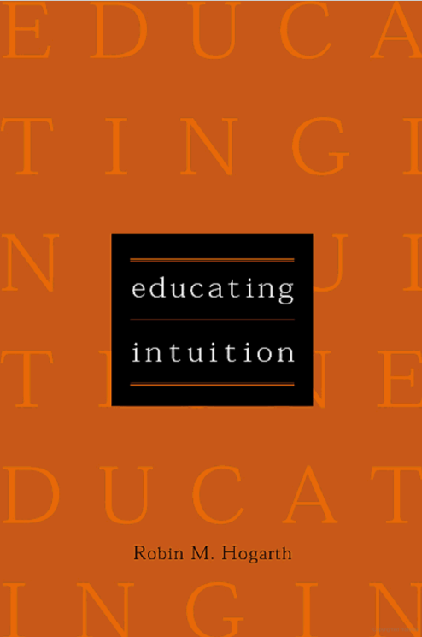
Educating Intuition (Hogarth 2001)
Intuition is mostly recognition and can be learnt
To maximise learning
Design/choose ‘kind’ environments (“where the information tacitly processed leads to valid inferences”)
Seek feedback
Make scientific method intuitive
Notes:
Hogarth, R. M. (2001). Educating intuition. Chicago, IL: The University of Chicago Press.

Slide 12
Feedback for teachers
Do students in your classroom feel
Safe to learn?
Motivated to learn?
Respect for their teacher and fellow students?
Can you predict where students will get stuck or misunderstand?
Do you have a good repertoire of different ways of explaining a hard idea?
How well did you respond to that potentially disruptive incident?
How good is your classroom questioning of students?
Are you helping students to embed their learning securely?
In each case, not an evaluation, but ‘How could you do this better?’ and ‘Is this aspect improving?’

Slide 13
Overview of our model
Great teachers:
understand the content they are teaching and how it is learnt
create a supportive environment for learning
manage the classroom to maximise opportunity to learn
present content, activities and interactions that activate their students’ thinking

