Slide 1

Fleet Connection:
Fleet Insights Data
Powering Your Fleet Sales Pipeline
Fleet information with the capacity to provide deeper understanding and drive sales growth

Slide 2
Fleet Insights reports provide fleet and owner contact information from multiple sources
FLEET DEMOGRAPHICS
Vehicle Types
Vehicle brands in operation
Engine Types and Alternative Fuel Use
Geographic Locations
SIC Codes
Fleet Sizes
Fuel types
Fleet Insights provides fleet and owner contacts from multiple sources including our proprietary database.
*Recordable accidents include accidents that involve an injury, a fatality, or required a tow away.

Slide 3
Fleet-Connection
Target fleets that are likely in-market for Used Trucks
Fleet-Connection
Fleet Prospecting Solution for Used Equipment Dealers and Suppliers
  Target fleets with the right fleet demographics for your used equipment messaging.
  Over 10 million VINS. Target fleets based on current fleet composition to find likely buyers.
  Target Fleets that have had recent significant accidents or major mechanical issues that are likely in-market for replacement inventory.
  Target prospects by fleet size, SIC code, fuel types in operation, or GVW.
  In-Depth firmographic and demographic detail available including addresses, phone numbers, email addresses, revenue, number of employees, along with full VIN level data on fleets.
  Email marketing support also available if you want the Fleet-Connection team to produce and manage your lead gen campaigns
Fill your sales pipeline with thousands of qualified sales leads each month!

Slide 4
Trailer-Connection
Target fleets with trailers
Trailer-Connection
Fleet Prospecting Solution for trailer manufacturers, distributors, and dealers
  800,000 fleets with over 4 million trailers in operation
    12,000 HAZMAT Fleets
    20,000 Reefer Trailer Operators
  Target by brands of trailer in operation
    Utility, Stoughton, East, Great Date, Wabash, Fontaine, Hyundai, Polar Tank
  Target by trailer types
    Dry Box
    Reefer
    Flat Bed
    Tanker
  Target prospects by fleet size, SIC code, fuel types in operation, or GVW.
  In-Depth firmographic and demographic detail available including addresses, phone numbers, email addresses, revenue, number of employees, along with full VIN level data on fleets.
  Email marketing support also available if you want the Fleet-Connection team to produce and manage your lead gen campaigns
Fill your sales pipeline with thousands of qualified sales leads each month!

Slide 5
Target Segments and Monthly Data Feeds available to support your internal campaigns
Target the right prospects at the right time
SMB Fleet File 200,000 Companies
  $40,000 with quarterly updates for $10,000
  200,000 verified small and midsize businesses and public entities with fleets of 10-500 units in operation
  350,000 verified email addresses with addresses and phone numbers
  Complete firmographic and demographic details on each fleet including VINS, number of employees, revenue, SIC and NAICS code categories, and location
  2 year history of all inspection/violation/accident data
Small Fleet File 800,000 Companies
  $20,000 with quarterly updates for $5,000
  800,000 verified small fleets and owner operators with 1-9 units in operation
    Over 1 million email addresses
    VIN level detail available for all registered DOT fleets
    2 year history of all inspection/violation/accident data
    Limited SIC/NAICS or firmographic detail
Fill your sales pipeline with thousands of qualified sales leads each month!

Slide 6
Safety-Connection
Target fleets with recent accidents and safety violations
Safety-Connection
Fleet Prospecting Solution for Fleet Safety Suppliers
  Target fleets with recent accidents and safety violations
    12,000 Fleets/month with reportable accidents
    20,000 Fleets/month with significant safety violations
      Speeding
      ELD/EOBR violations
      Tires
      Lighting
      Cargo Securement
  Target prospects by fleet size, SIC code, fuel types in operation, or GVW.
  In-Depth firmographic and demographic detail available including addresses, phone numbers, email addresses, revenue, number of employees, along with full VIN level data on fleets.
  Email marketing support also available if you want the Fleet-Connection team to produce and manage your lead gen campaigns
Fill your sales pipeline with thousands of qualified sales leads each month!

Slide 7
Safety-Connection
Target fleets with recent accidents and safety violations
Construction-Connection
Fleet Prospecting Solution supplers targeting the Construction industry
Over 70,000 Fleets
Construction
Contractors
Plumbing/HVAC
Landscapting
  Target prospects by fleet size, SIC code, fuel types in operation, or GVW.
  In-Depth firmographic and demographic detail available including addresses, phone numbers, email addresses, revenue, number of employees, along with full VIN level data on fleets.
  Email marketing support also available if you want the Fleet-Connection team to produce and manage your lead gen campaigns
Fill your sales pipeline with thousands of qualified sales leads each month!

Slide 8
In Market Fleets
Target fleets that are actively searching for your products
Lead-Connection
Fleet Prospecting Solution for suppliers looking for fleets that are actively searching for your solution
Segments available
    Safety Products
    Dash Cams
    Trailers
    Vehicles
    Telematics
    Load Boards
    TMS Products
Behavioral and demographic data to target fleets that are currently in market
Minimum of 200 qualified leads per month
  $10-$40 per lead based on volume
Fill your sales pipeline with thousands of qualified sales leads each month!

Slide 9
Clean-Connection
EV/Clean Transportation Targeting
Clean-Connection
EV-Clean Fleet Prospecting Tool
  Target known EV/Clean Fleet intenders with our new Clean-Connection database
    28,000 current owners and operators of EV/Hybrid/CNG/LNG powered vehicles
    40,000 additional public and private sector fleets that have indicated that they are looking to purchase clean tech products in the next 6-12 months.
    Perfect for Vehicles Manufacturers and clean tech suppliers including those that provide charging infrastructure, fueling services, fleet management, and safety products
  Target prospects by fleet size, SIC code, fuel types in operation, or GVW.
  In-Depth firmographic and demographic detail available including addresses, phone numbers, email addresses, revenue, number of employees, along with full VIN level data on fleets.
  List segments available for outright purchase
  Email marketing support also available if you want the Fleet-Connection team to produce and manage your lead gen campaigns
Fill your sales pipeline with thousands of qualified sales leads each month!

Slide 10
Target Segments and Monthly Data Feeds available to support your internal campaigns
Target the right prospects at the right time
New Fleet File
  10,000-12,000 newly registered fleets available each month
ELD/EOBR Violations 10,000 per month
Safety Violations and Accidents
  10,000+ fleets each month that have had recent safety violations or experienced a significant crash or accident.
Mechanical Violations
  Lighting 5,000 violations per month
  Brakes-15,000 per month
  Cargo related violations 5,000 per month
Fill your sales pipeline with thousands of qualified sales leads each month!

Slide 11
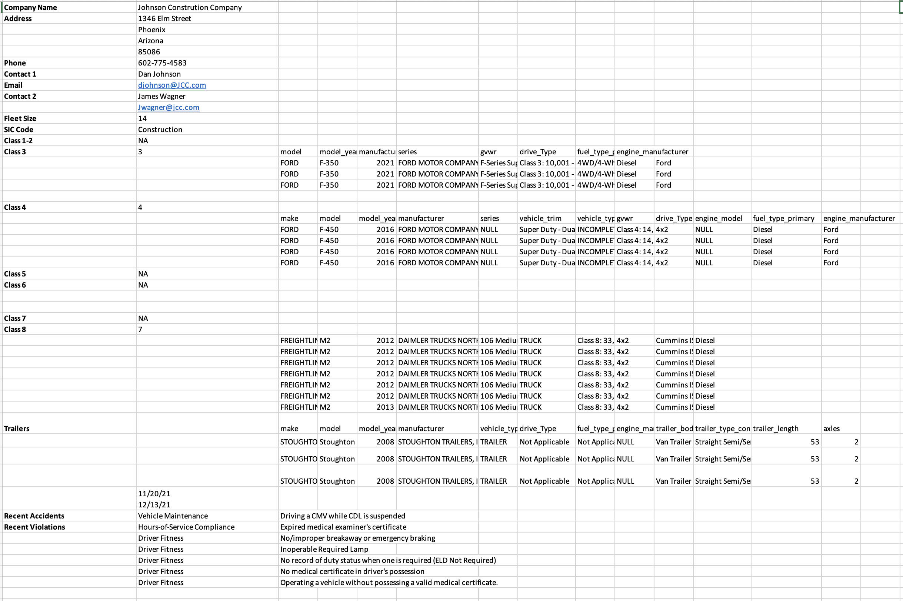
Fleet Insight Reports Include
(but are not limited to)
Contact & company name, address, phone & email
Secondary contact information
Fleet Size
SIC Code
Vehicle Classes
Vehicle Brands
Fill your sales pipeline with thousands of qualified sales leads each month!

Slide 12
Custom prospect lists for your fleet sales team
Email Marketing Support
We’ll email your content to the right fleets at the right time with our targeted campaigns. Let us warm up your prospects and convert marketing leads into actionable sales leads.
Nationwide Coverage
Target marketing qualified leads in your local area and nationwide
Save time
No more searching through endless, outdated databases for the right businesses
No Long-Term Commitment!
Boost your sales for a short time and revisit whenever you need to fill your sales pipeline
Clean Data
Tested for telephone number accuracy, email & postal deliverability
Fill your sales pipeline with thousands of qualified sales leads each month!

