Slide 1
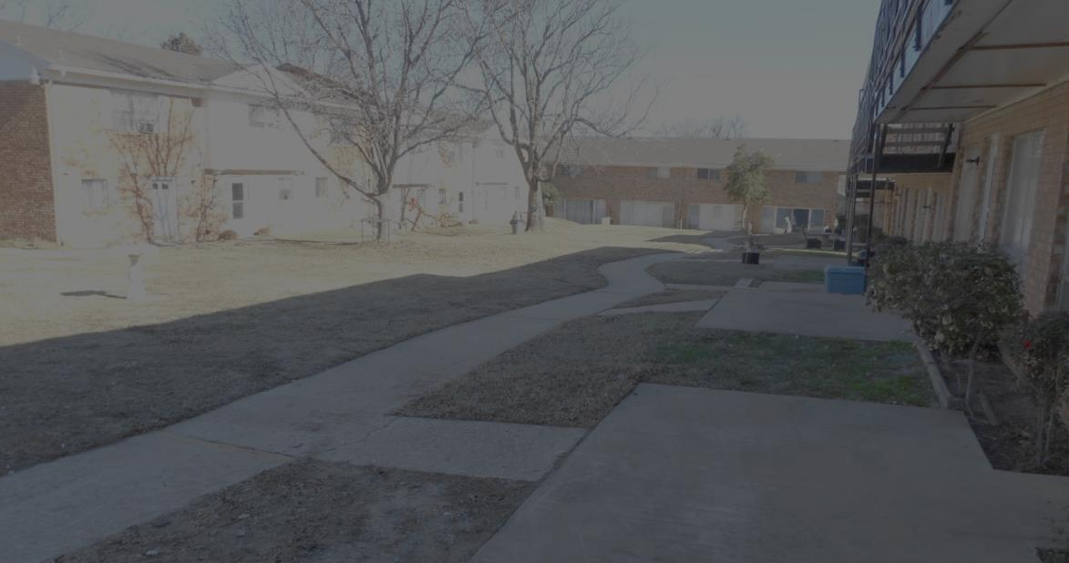
Pro-active empowerment
Crime Prevention Through Environmental Design
(CPTED)
The proper design and effective use of the built environment that can lead to a reduction in the fear and incidence of crime and an improvement in the quality of life.

Slide 2
Crime Prevention Through Environmental Design (CPTED)
Defined
The proper design and effective use of the built environment that can lead to a reduction in the fear and incidence of crime and an improvement in the quality of life.
The proper design and effective use of the built environment that can lead to a reduction in the fear and incidence of crime and an improvement in the quality of life. The perception of the environment for the most part dictates criminal behavior.
Notes:
CPTED, (pronounced sep-ted), is an initiative that helps us create healthy, safe communities through well-planned design.
• CPTED is based on the premise that the design of our environment directly affects our behavior. It influences both the opportunities for crime to take place and our fear of crime. This has an important impact on our quality of life.
• CPTED enhances safety by altering physical design and encouraging positive social interaction.

Slide 3
Crime Prevention Through Environmental Design (CPTED)
CPTED Principles
Natural Surveillance
Access Control
Territorial Reinforcement
Maintenance

Slide 4
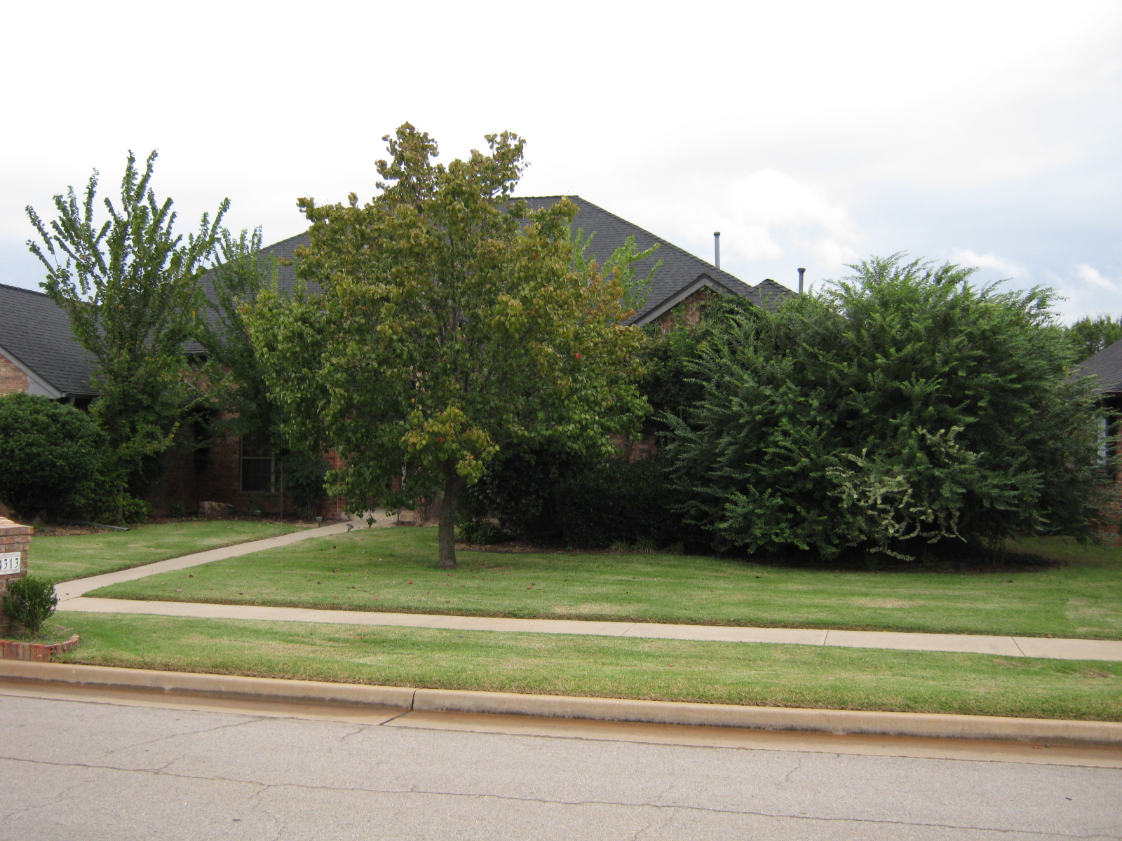
Crime Prevention Through Environmental Design (CPTED)
Natural Surveillance

Slide 5
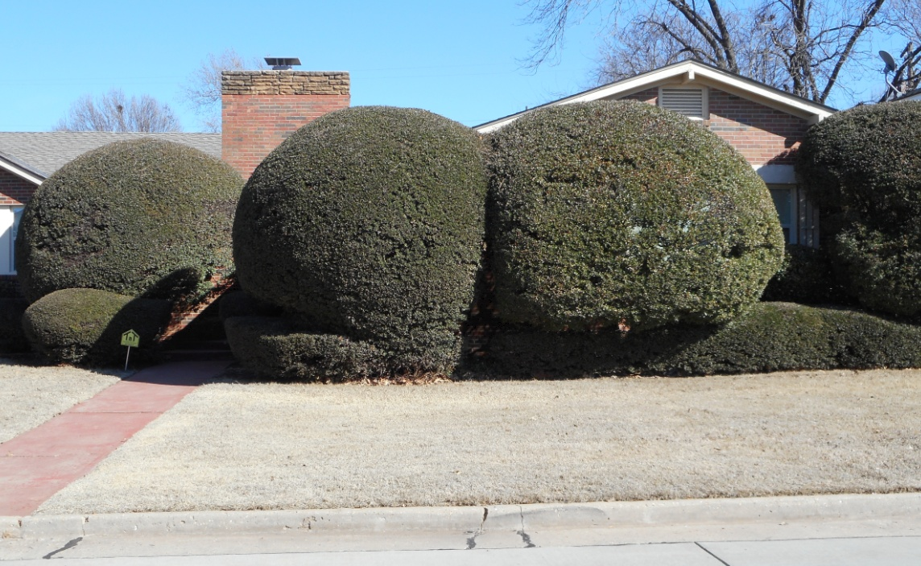
Crime Prevention Through Environmental Design (CPTED)
Natural Surveillance
Before CPTED
Notes:
Encouraging activities, such as art/community events, in public spaces that are intended for use by residents and other legitimate users discourages criminal acts

Slide 6
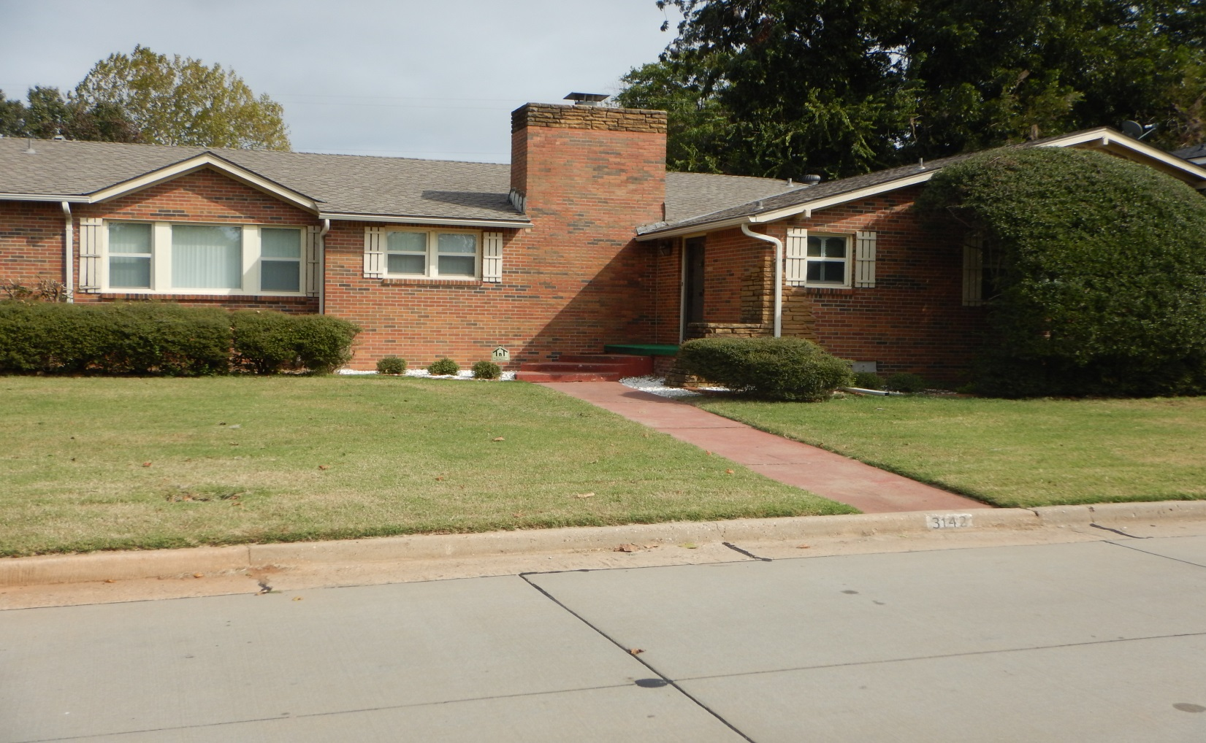
Crime Prevention Through Environmental Design (CPTED)
Natural Surveillance
After CPTED
Notes:
Encouraging activities, such as art/community events, in public spaces that are intended for use by residents and other legitimate users discourages criminal acts

Slide 7
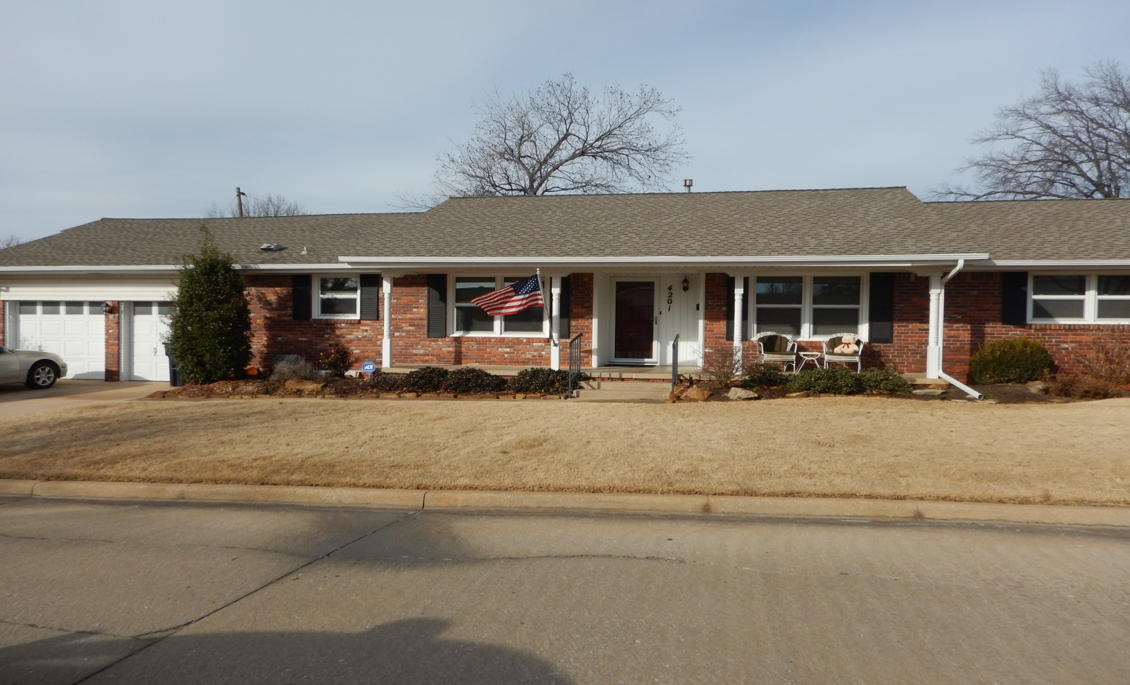
Crime Prevention Through Environmental Design (CPTED)
Natural Surveillance
Notes:
Encouraging activities, such as art/community events, in public spaces that are intended for use by residents and other legitimate users discourages criminal acts

Slide 8
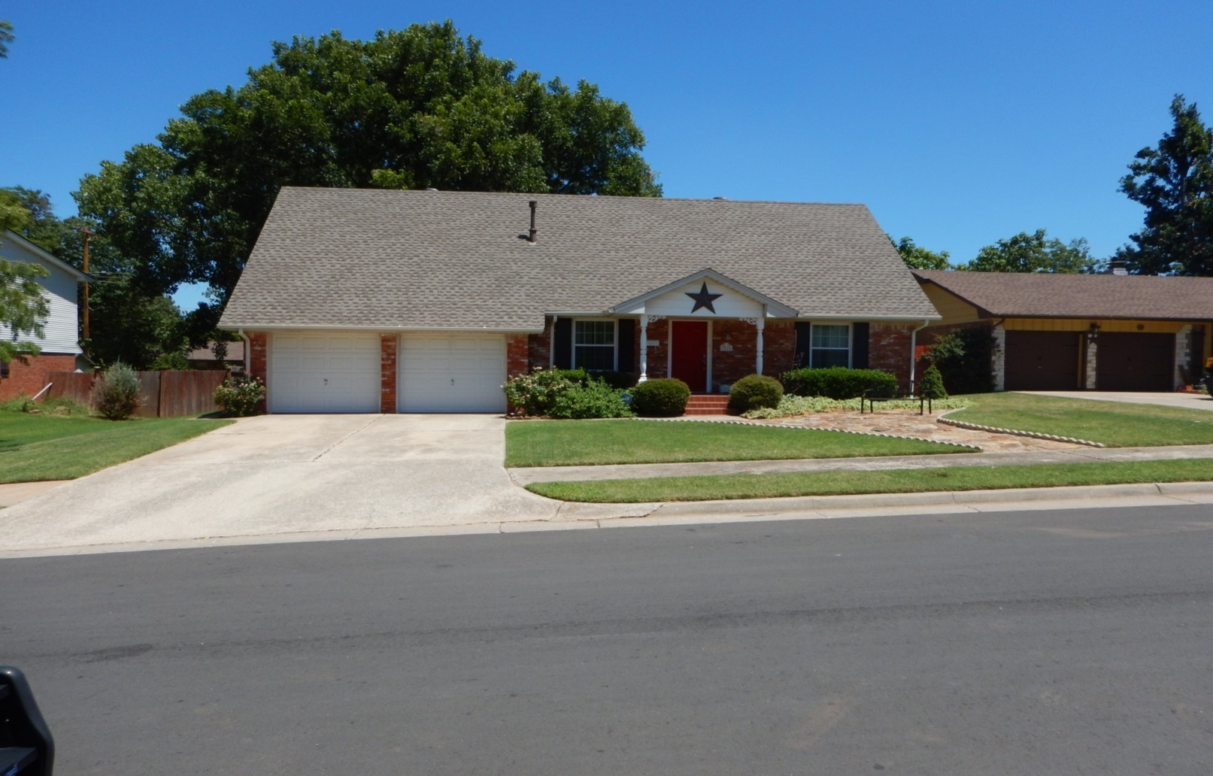
Crime Prevention Through Environmental Design (CPTED)
Natural Surveillance

Slide 9
Crime Prevention Through Environmental Design (CPTED)
Access Control
Relies on doors, fences, shrubs, and other physical elements to keep unauthorized persons out of a particular place. Access Control can be achieved in individual dwellings or commercial property by the use of adequate locks, doors and window barriers.
Notes:
Guides people entering and leaving a space through the placement of entrances, exits, fences, landscaping and lighting.
Access control can decrease opportunities for criminal activity by denying criminals access to potential targets and creating a perception of risk for would-be offenders.

Slide 10
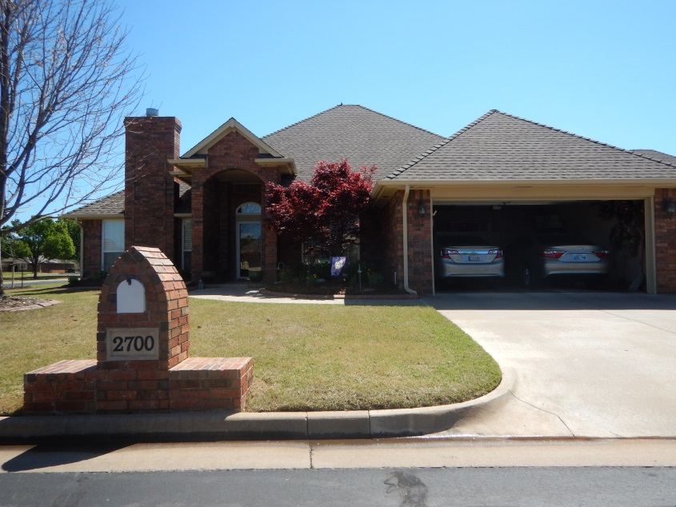
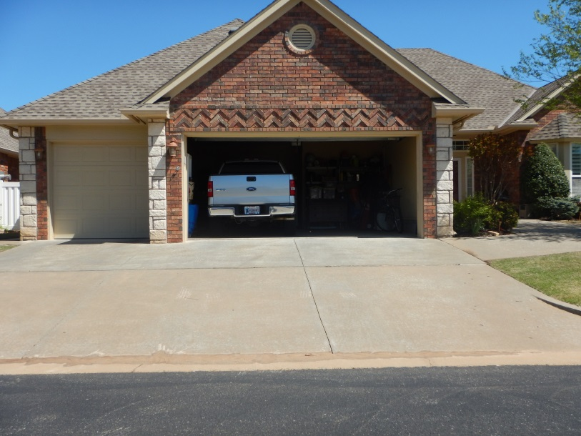
Crime Prevention Through Environmental Design (CPTED)
Access Control
Notes:
Guides people entering and leaving a space through the placement of entrances, exits, fences, landscaping and lighting.
Access control can decrease opportunities for criminal activity by denying criminals access to potential targets and creating a perception of risk for would-be offenders.

Slide 11
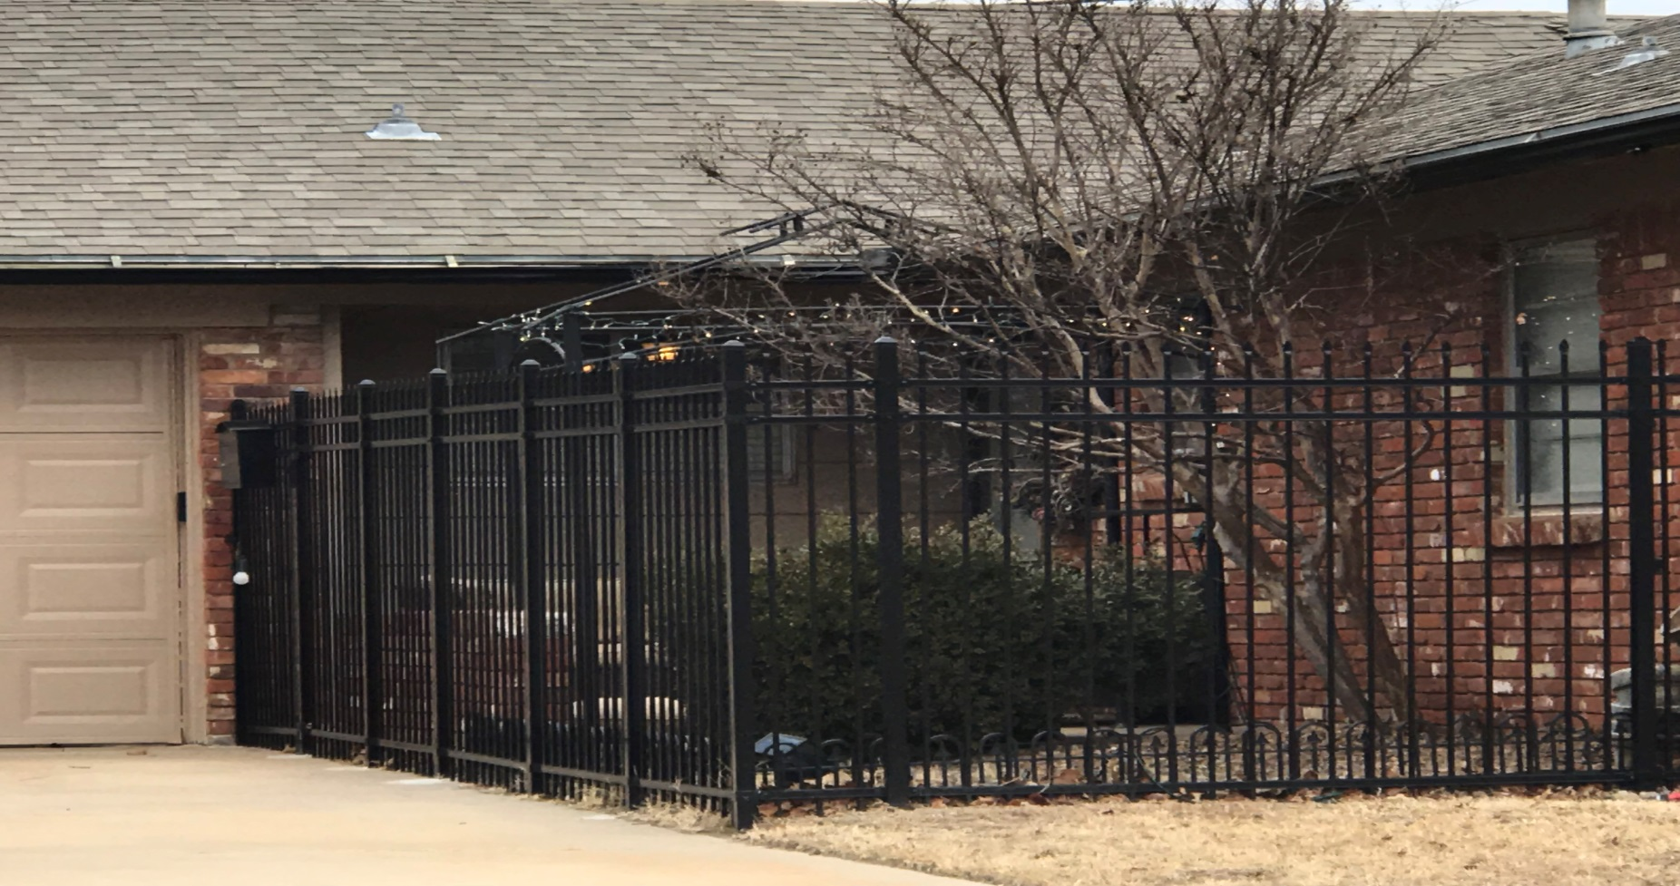
Crime Prevention Through Environmental Design (CPTED)
Access Control
Notes:
Guides people entering and leaving a space through the placement of entrances, exits, fences, landscaping and lighting.
Access control can decrease opportunities for criminal activity by denying criminals access to potential targets and creating a perception of risk for would-be offenders.

Slide 12
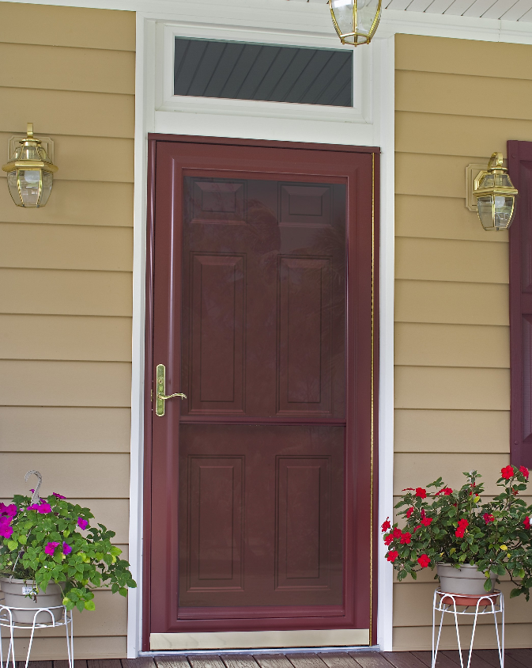
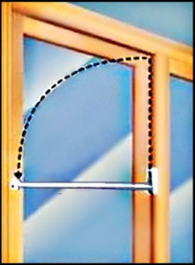
Crime Prevention Through Environmental Design (CPTED)
Access Control

Slide 13
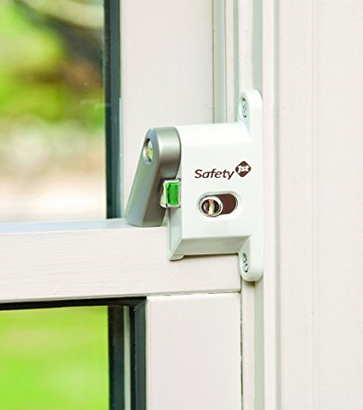
Crime Prevention Through Environmental Design (CPTED)
Access Control

Slide 14
Crime Prevention Through Environmental Design (CPTED)
Territorial Reinforcement
Features such as sidewalks, landscaping, and porches that help to distinguish between public and private areas, which create displays of “ownership” that send a “hands off” message to would-be offenders.
Notes:
The use of physical attributes that express ownership such as fences, signage, landscaping, pavement designs, defined property lines and clear distinctions between private and public spaces are examples of the application of territorial reinforcement.

Slide 15
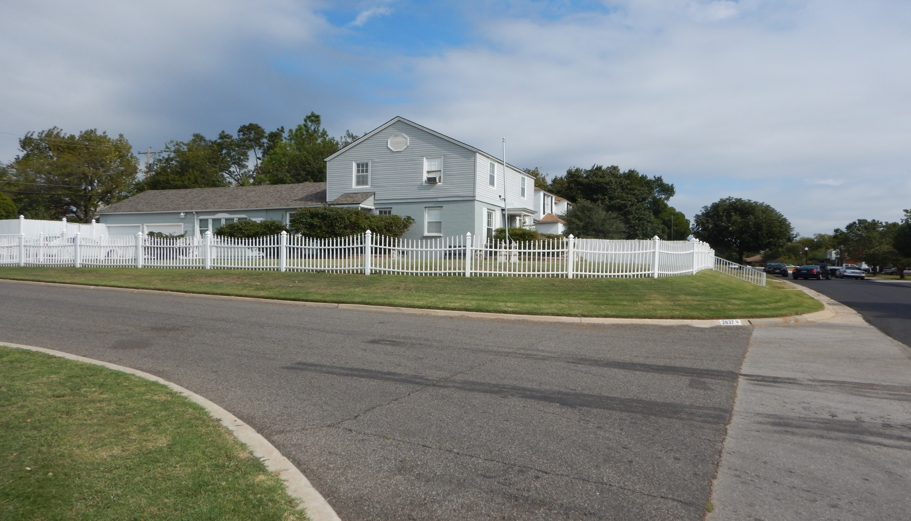
Crime Prevention Through Environmental Design (CPTED)
Territorial Reinforcement

Slide 16
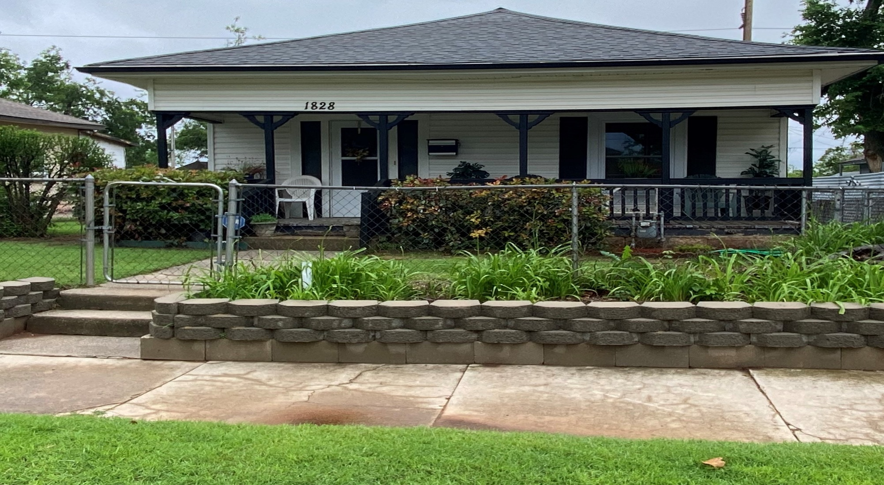
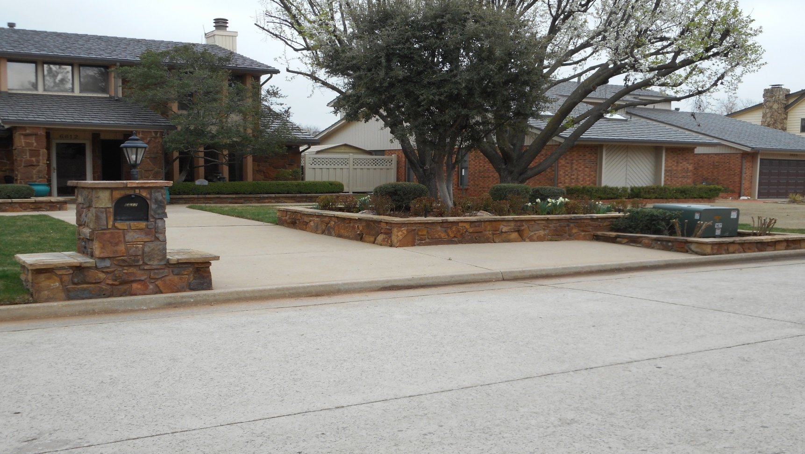
Crime Prevention Through Environmental Design (CPTED)
Territorial Reinforcement

Slide 17
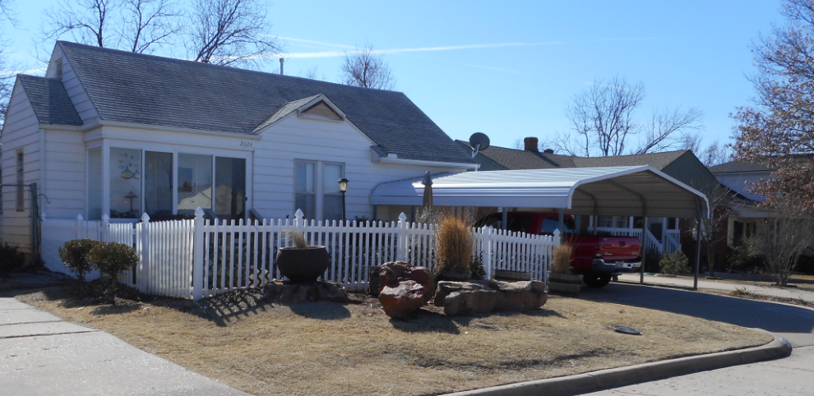
Crime Prevention Through Environmental Design (CPTED)
Territorial Reinforcement

Slide 18
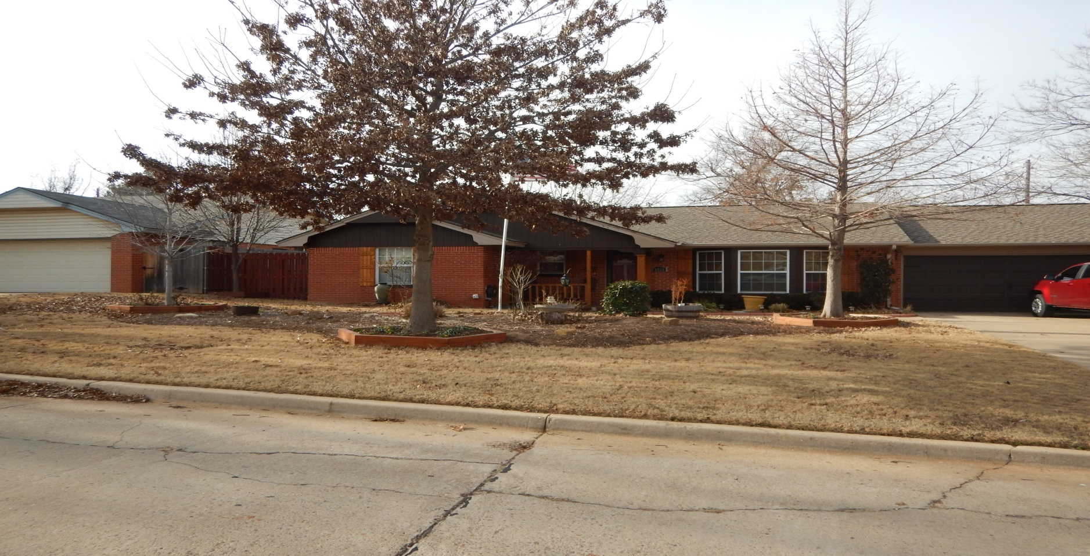
Crime Prevention Through Environmental Design (CPTED)
Territorial Reinforcement

Slide 19
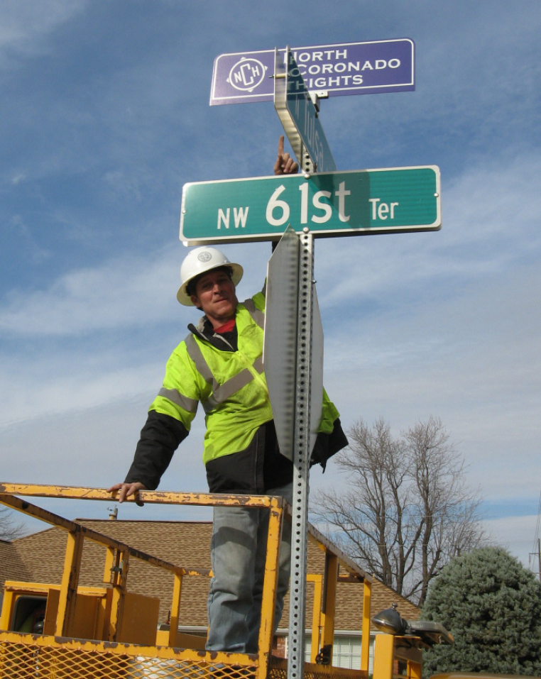
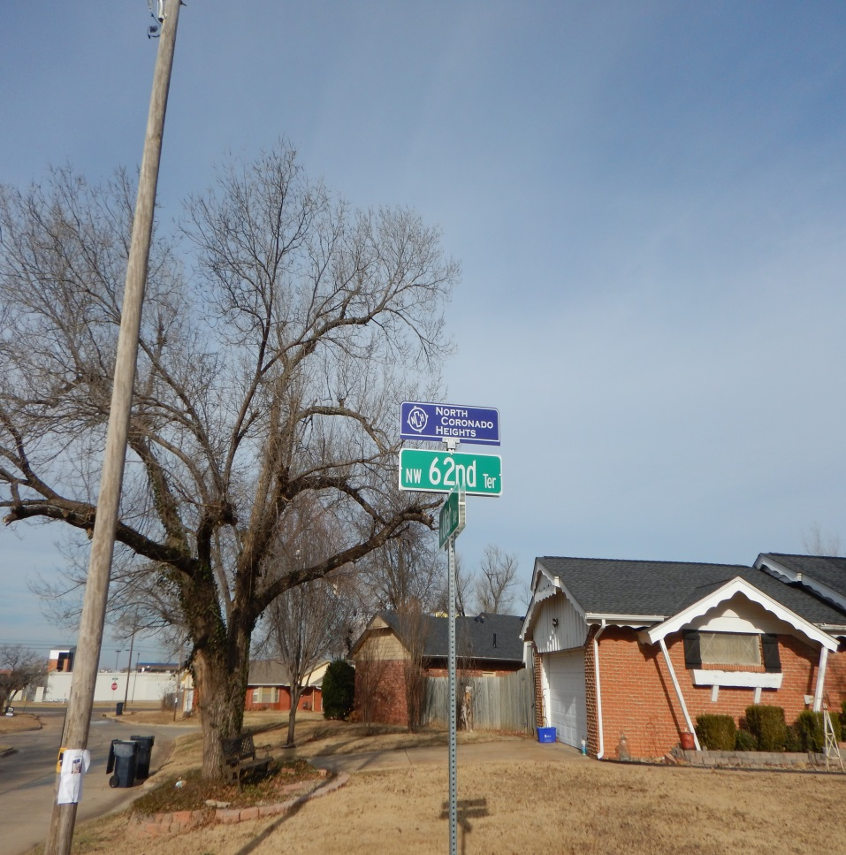
Crime Prevention Through Environmental Design (CPTED)
Territorial Reinforcement

Slide 20
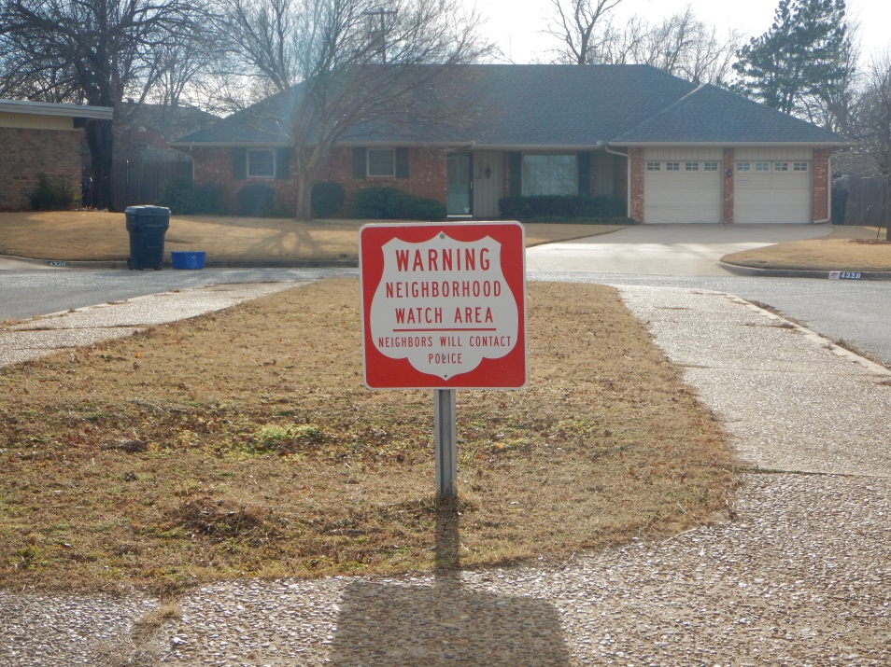
Crime Prevention Through Environmental Design (CPTED)
Territorial Reinforcement

Slide 21
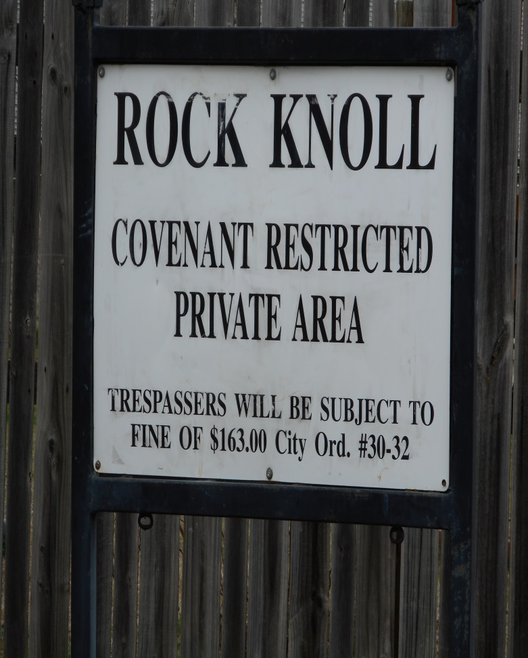
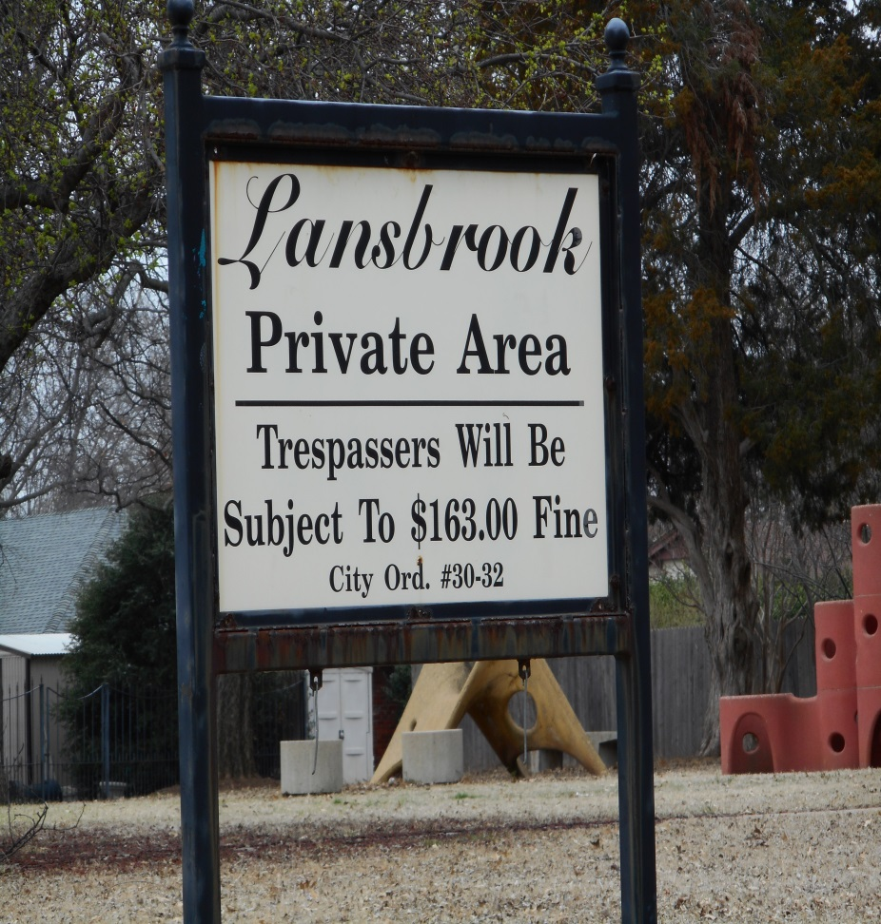
Crime Prevention Through Environmental Design (CPTED)
Territorial Reinforcement

Slide 22
Crime Prevention Through Environmental Design (CPTED)
Maintenance
Proper upkeep (mowing grass, trimming trees and landscaping, picking up trash, repairing broken windows and light fixtures, and painting over graffiti) signal location is well cared for and that owner/manager/neighbor is watching out for property and could spot illegal behavior.
Notes:
A well kept area tends to make someone feel like they will be observed by neighbors or business owners who care about the area. Without proper care, “grime leads to crime”.

Slide 23
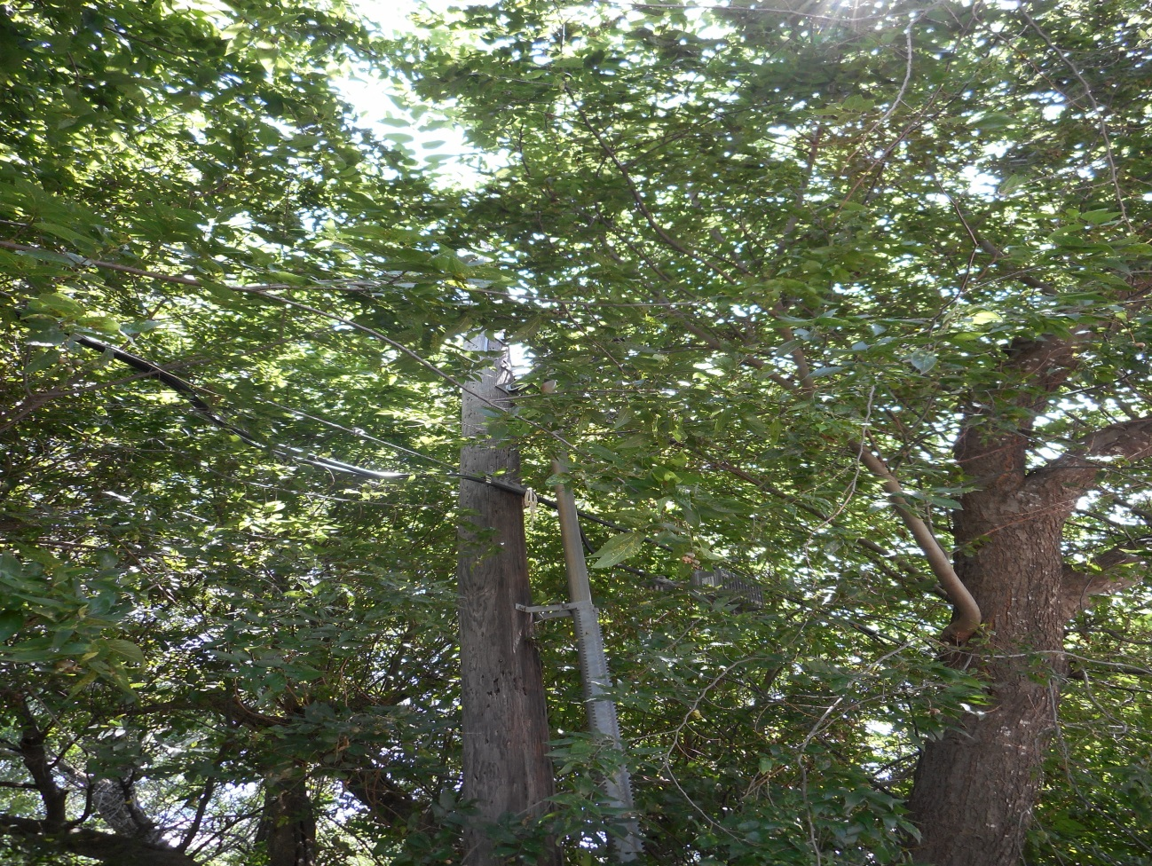
Crime Prevention Through Environmental Design (CPTED)
Maintenance

Slide 24
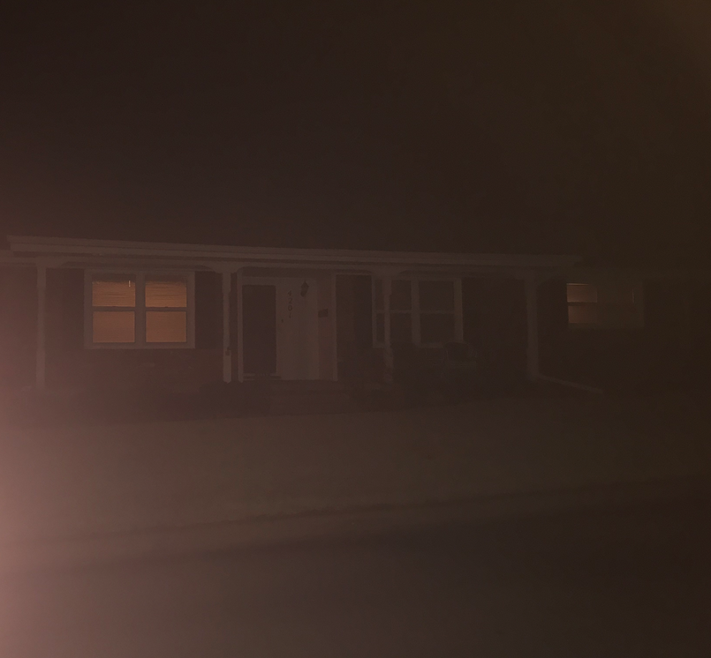
Crime Prevention Through Environmental Design (CPTED)
Maintenance

Slide 25
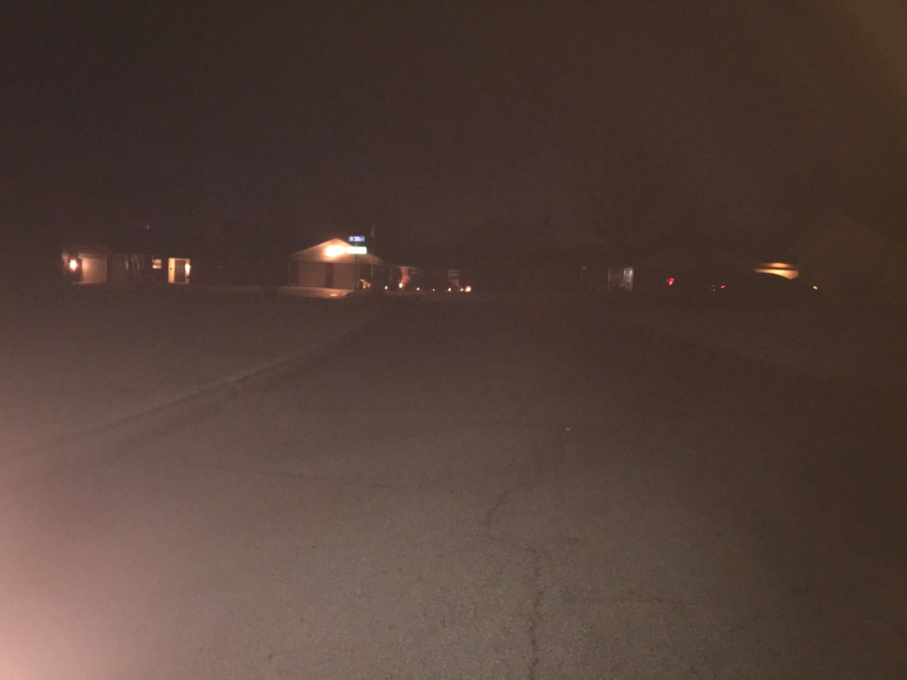
Crime Prevention Through Environmental Design (CPTED)
Maintenance

Slide 26
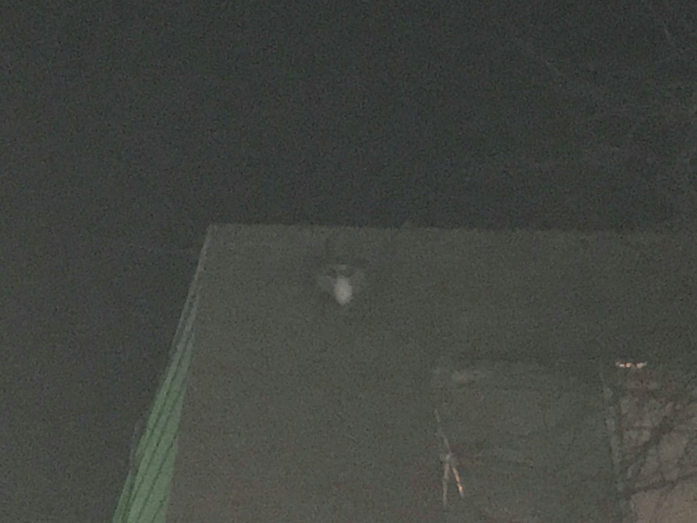
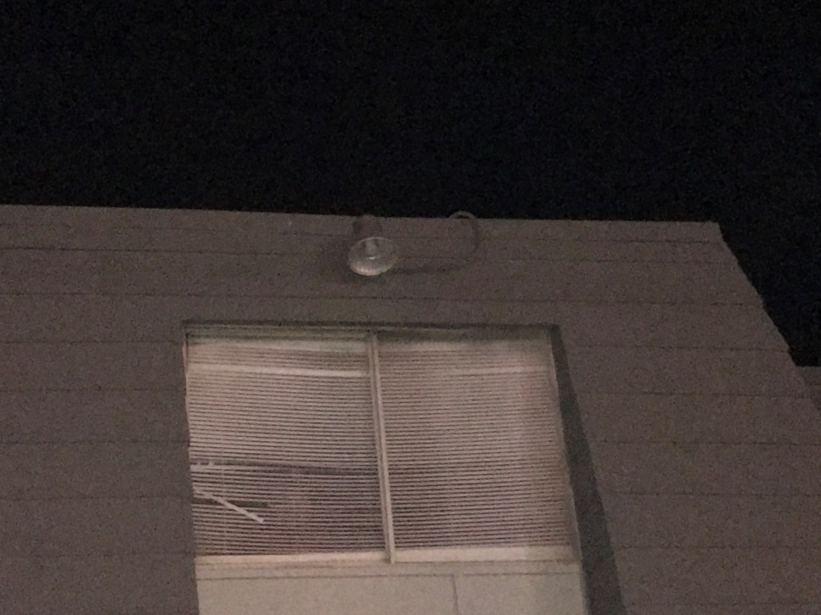
Crime Prevention Through Environmental Design (CPTED)
Maintenance

Slide 27
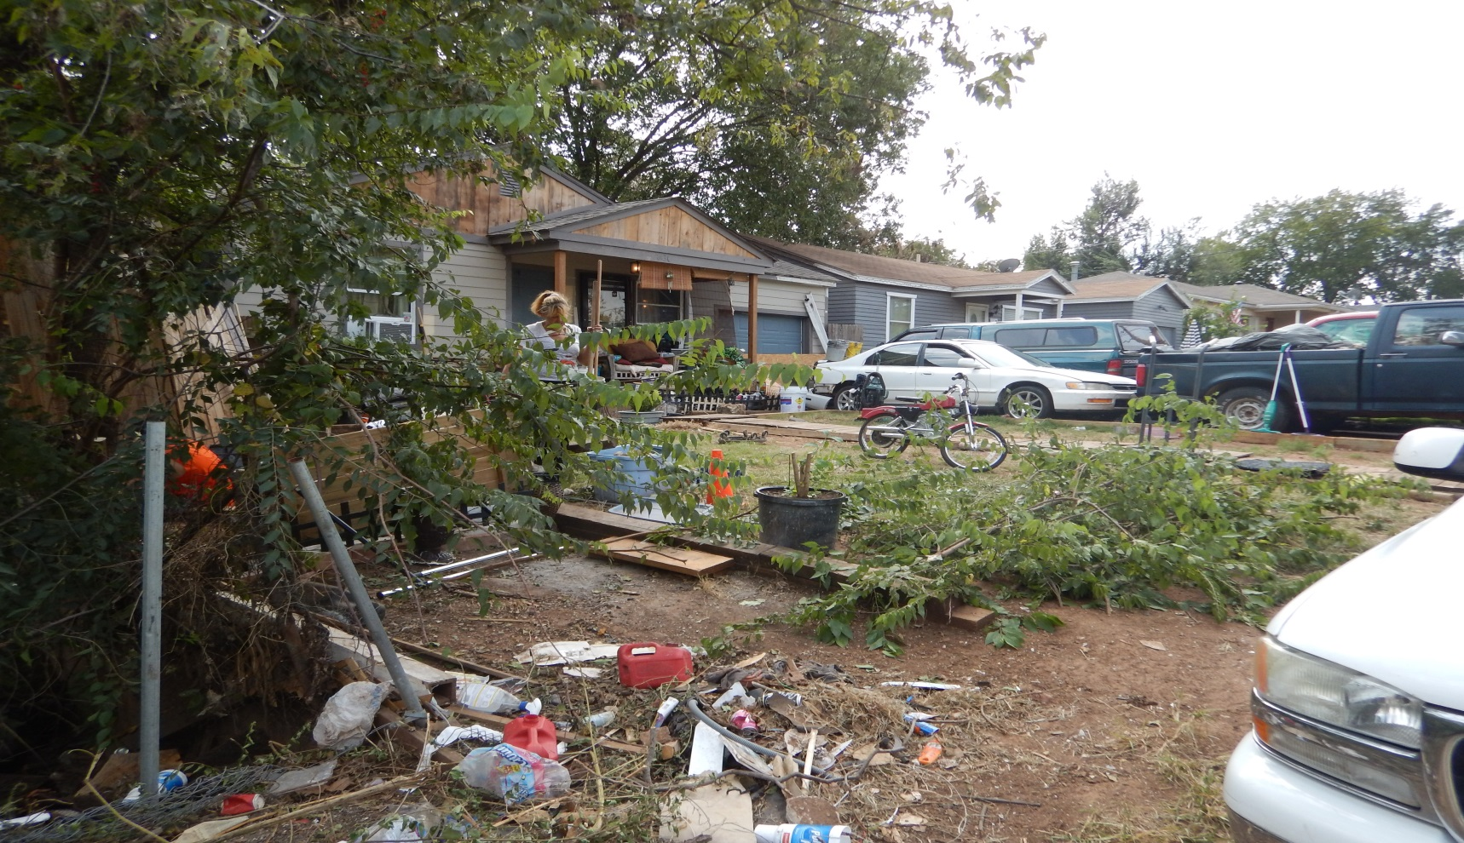
Crime Prevention Through Environmental Design (CPTED)
Maintenance

Slide 28
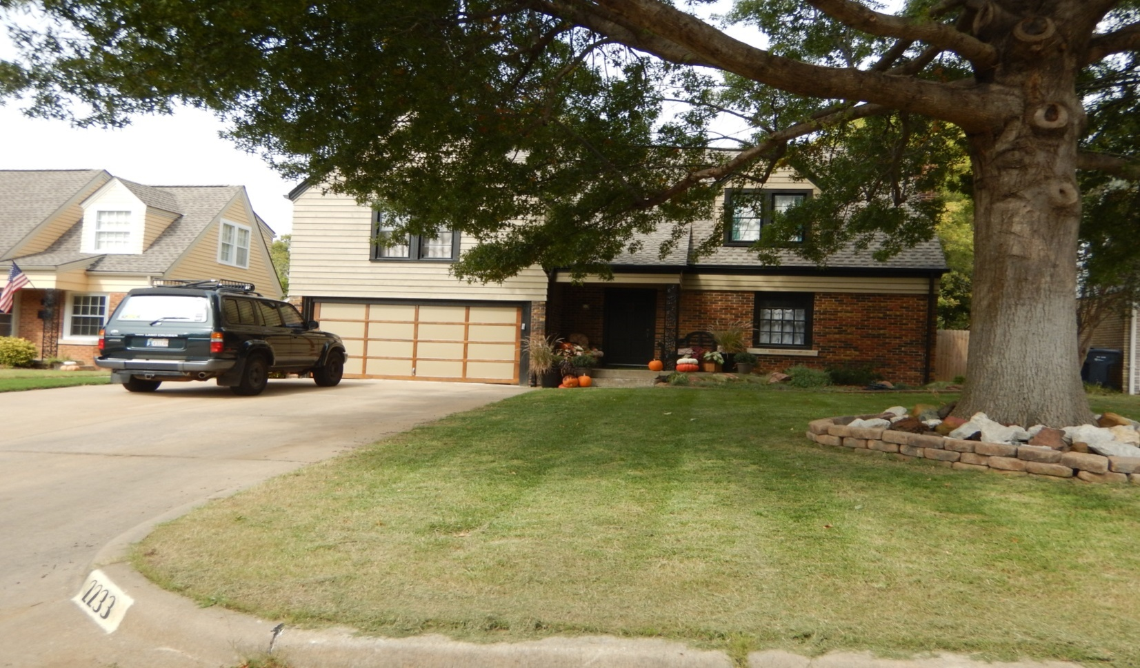
Crime Prevention Through Environmental Design (CPTED)
Maintenance

Slide 29
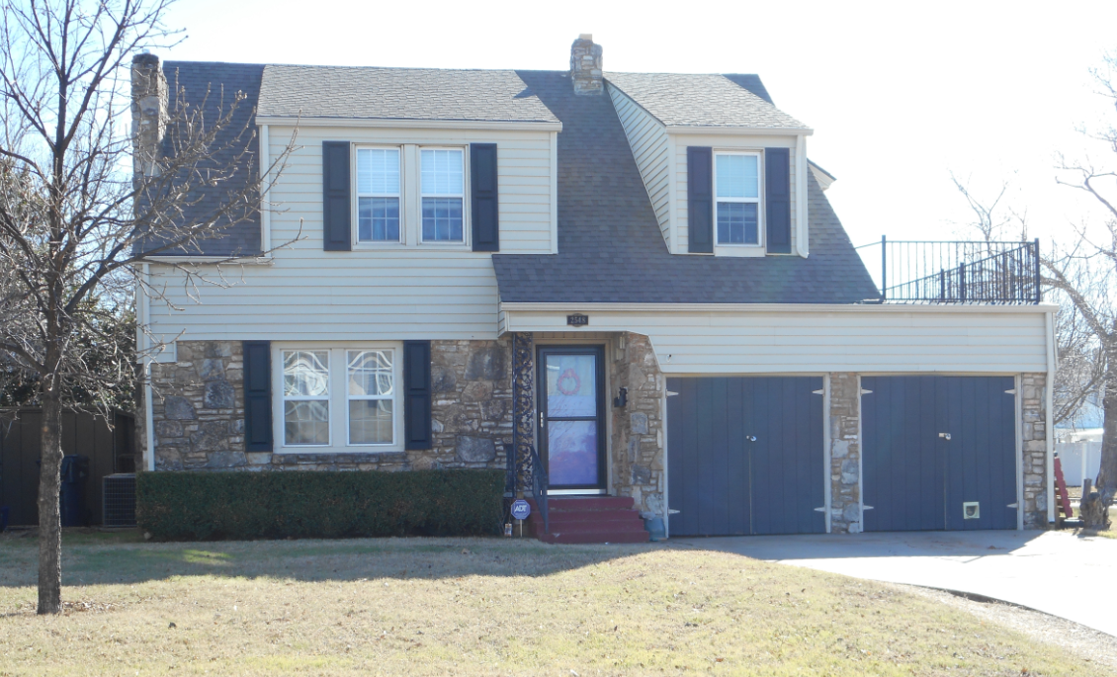
Crime Prevention Through Environmental Design (CPTED)
Maintenance

Slide 30
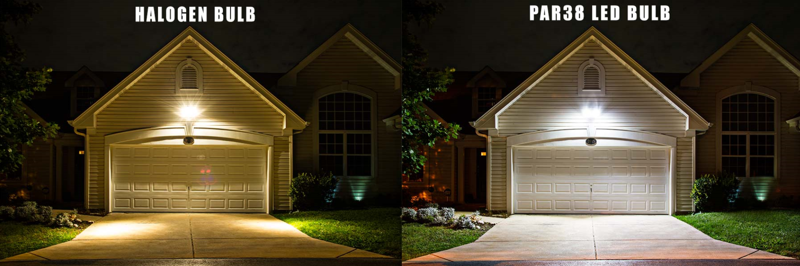
Crime Prevention Through Environmental Design (CPTED)
Maintenance
Power Consumption 150W
Power Consumption 18W

Slide 31
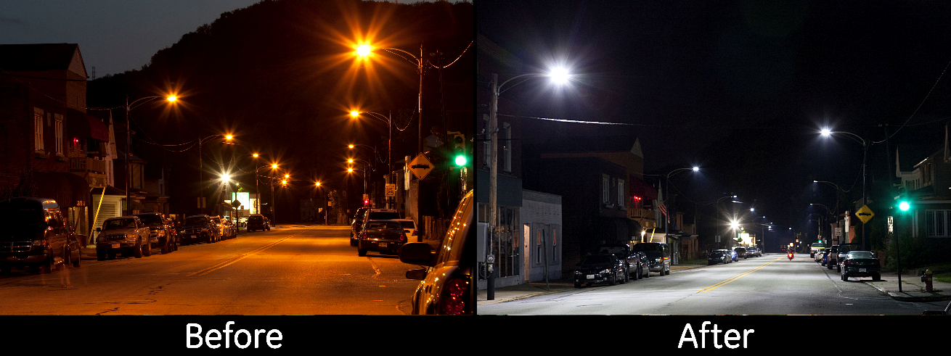
Crime Prevention Through Environmental Design (CPTED)
Maintenance
High Pressure Sodium
LED

Slide 32
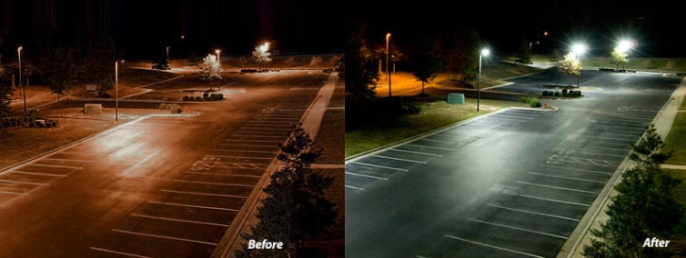
Crime Prevention Through Environmental Design (CPTED)
Maintenance
High Pressure Sodium
LED

Slide 33
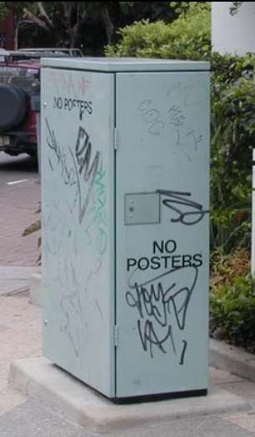
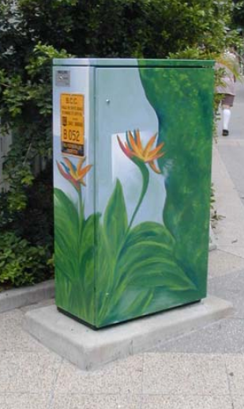
Crime Prevention Through Environmental Design (CPTED)
CPTED Public Art

Slide 34
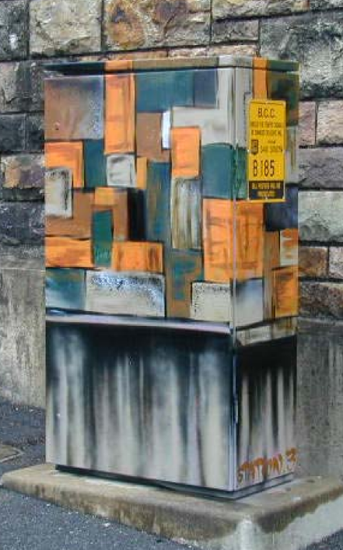
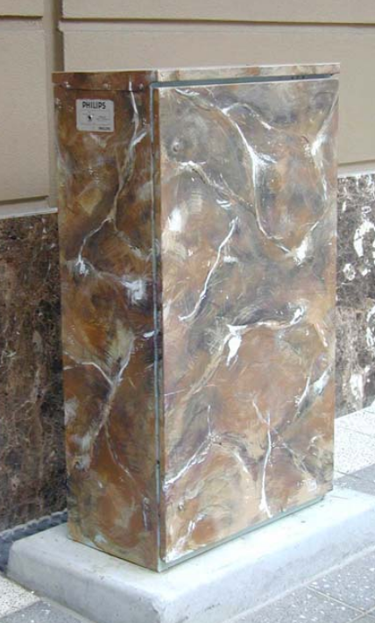
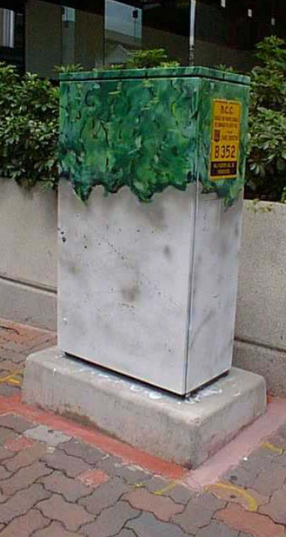
Crime Prevention Through Environmental Design (CPTED)
CPTED Public Art

Slide 35
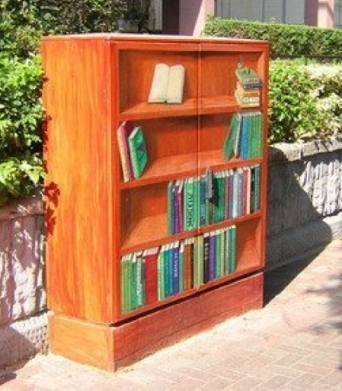
Crime Prevention Through Environmental Design (CPTED)
CPTED Public Art

Slide 36
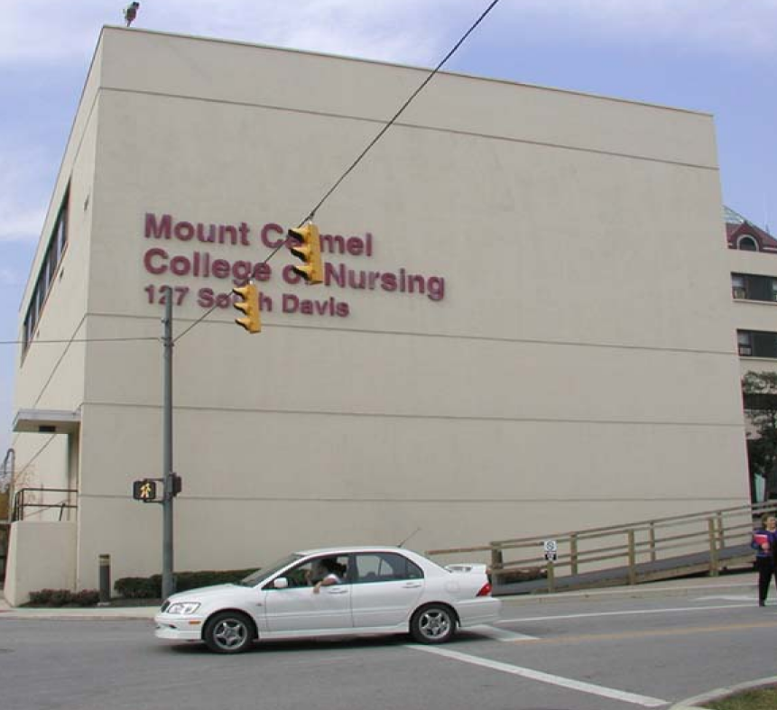
Crime Prevention Through Environmental Design (CPTED)
CPTED Public Art

Slide 37
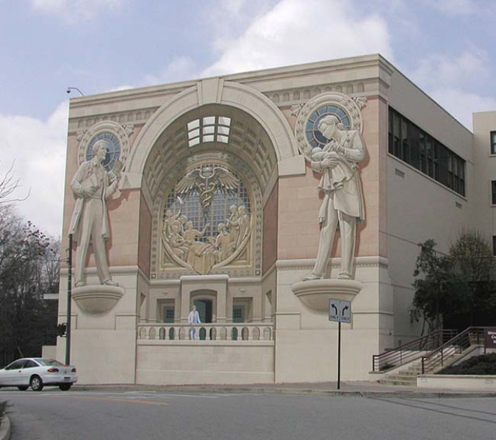
Crime Prevention Through Environmental Design (CPTED)
CPTED Public Art

Slide 38
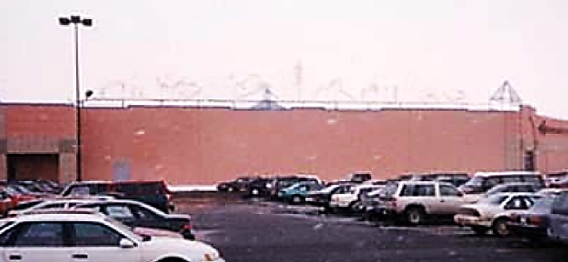
Crime Prevention Through Environmental Design (CPTED)
CPTED Public Art

Slide 39
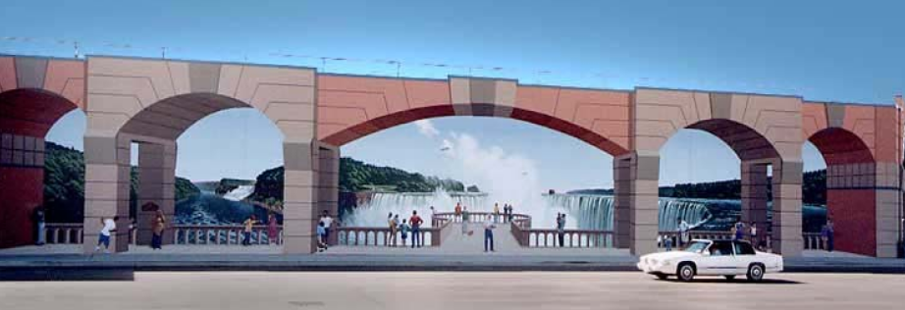
Crime Prevention Through Environmental Design (CPTED)
CPTED Public Art

Slide 40
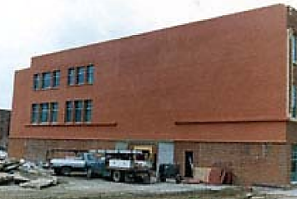
Crime Prevention Through Environmental Design (CPTED)
CPTED Public Art

Slide 41
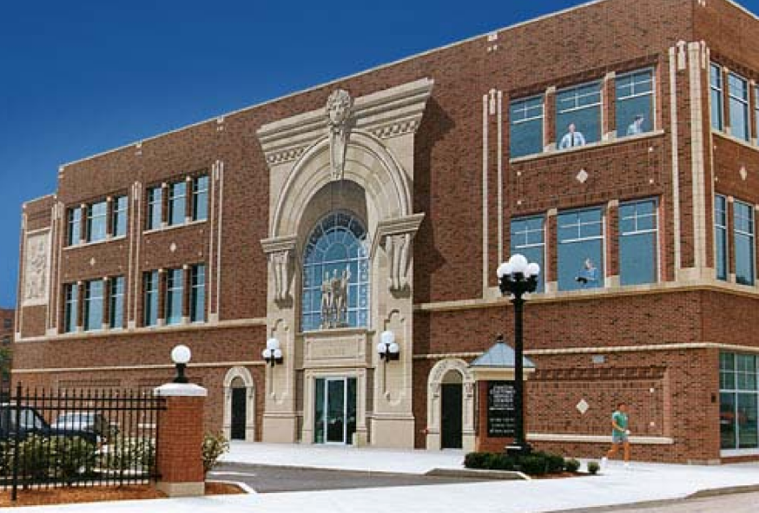
Crime Prevention Through Environmental Design (CPTED)
CPTED Public Art

Slide 42
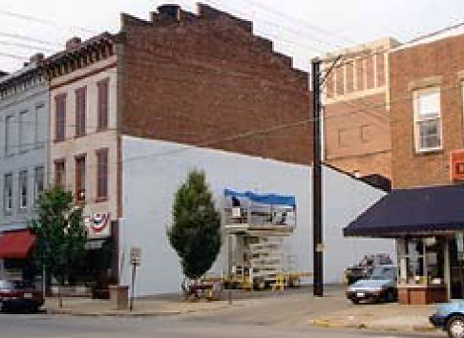
Crime Prevention Through Environmental Design (CPTED)
CPTED Public Art

Slide 43
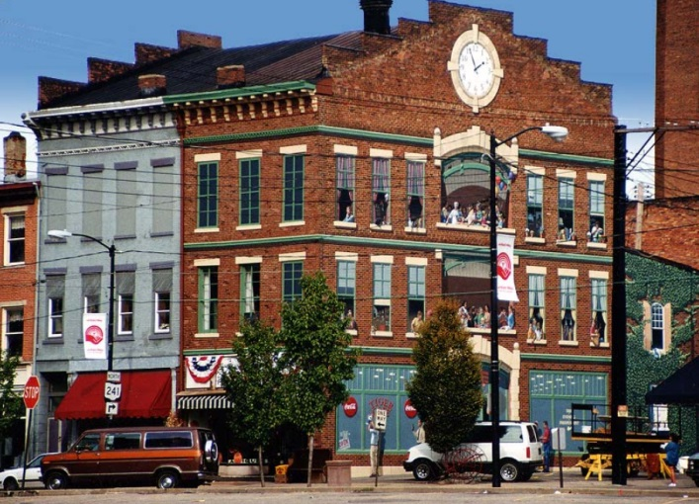
Crime Prevention Through Environmental Design (CPTED)
CPTED Public Art

Slide 44
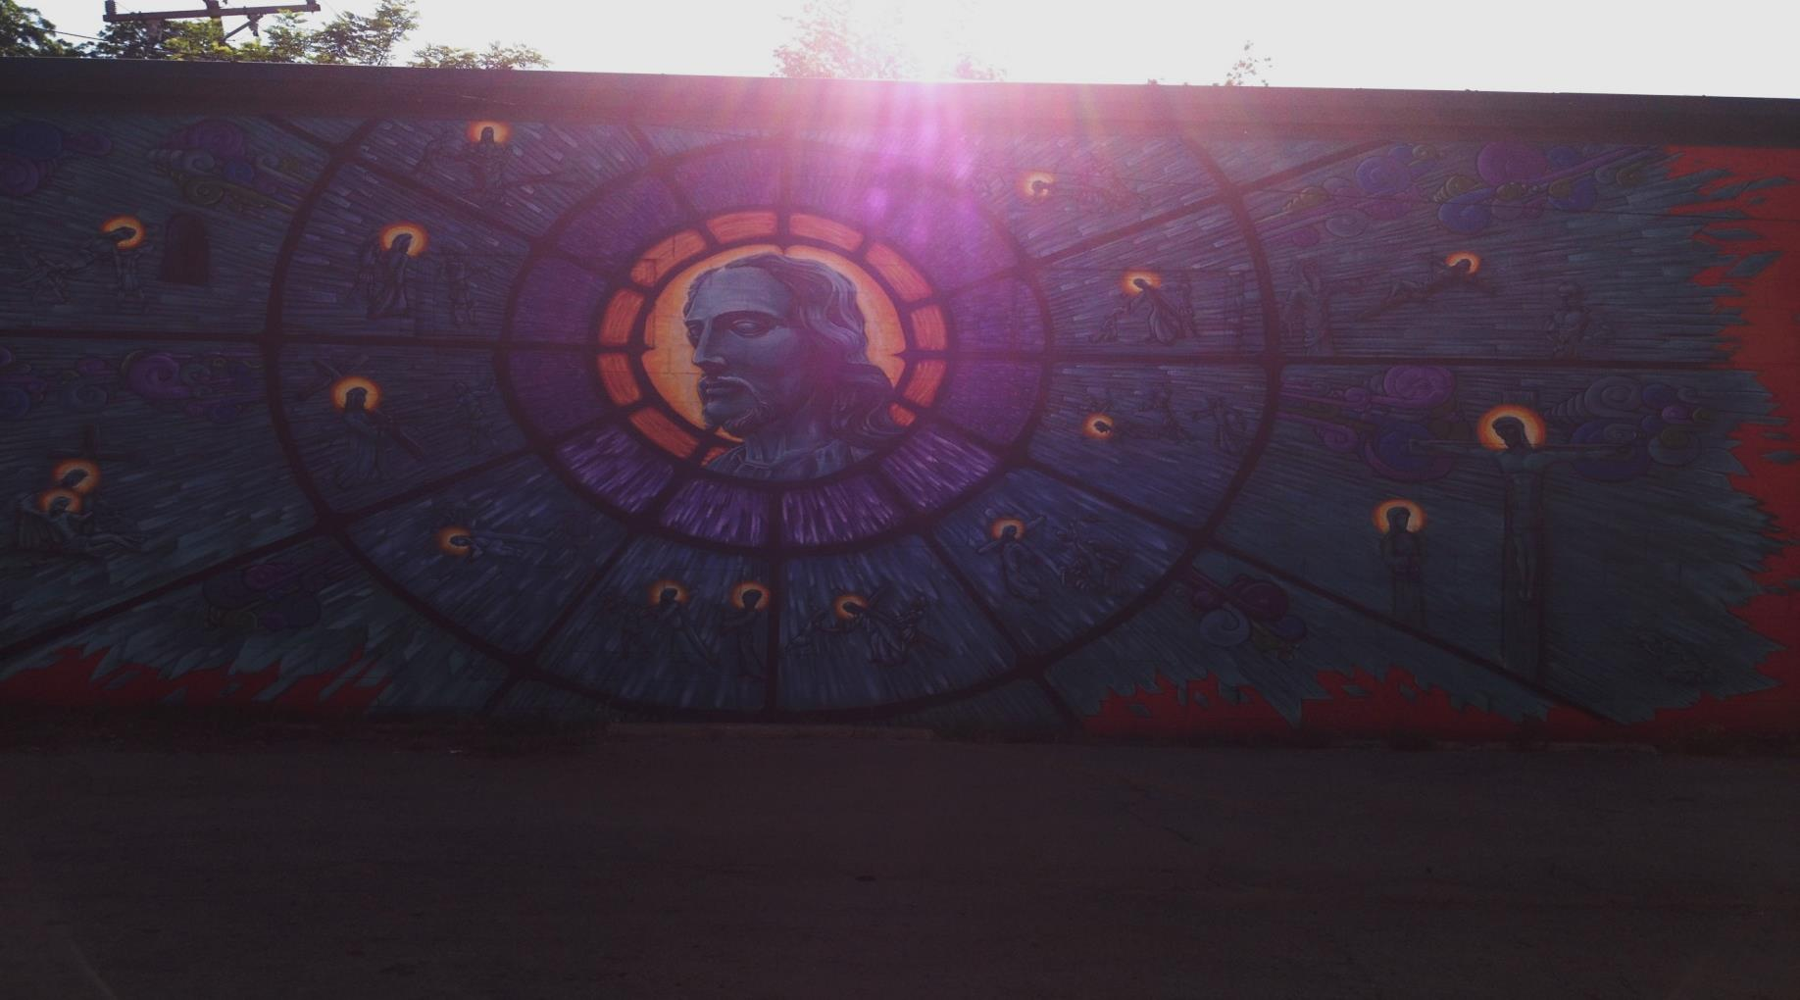
Crime Prevention Through Environmental Design (CPTED)
CPTED Public Art

Slide 45
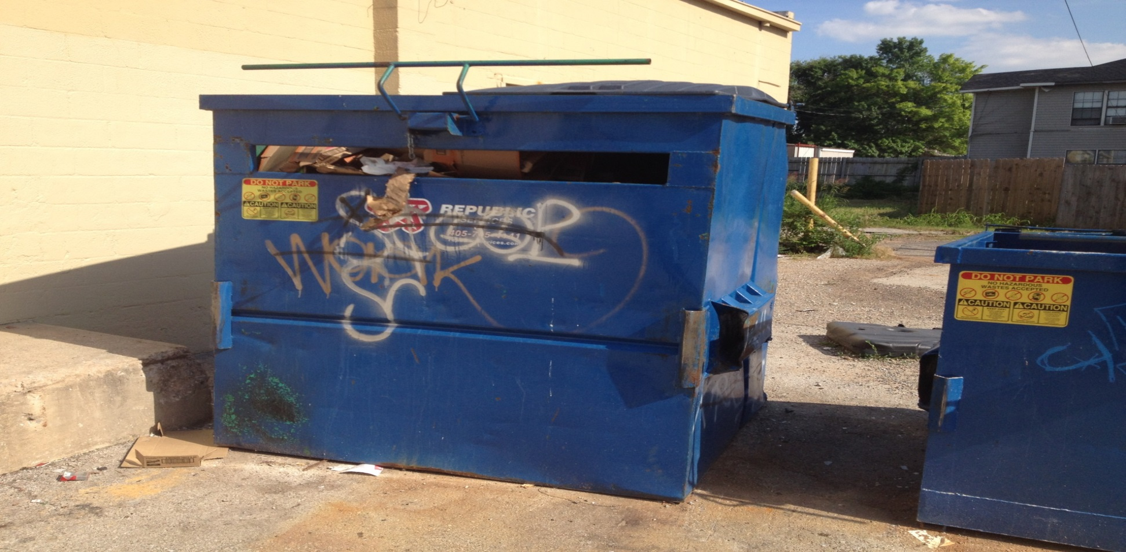
Crime Prevention Through Environmental Design (CPTED)
CPTED Public Art

Slide 46
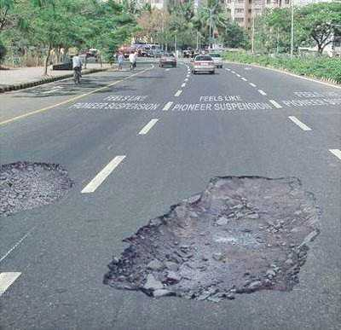
Crime Prevention Through Environmental Design (CPTED)
CPTED Public Art

Slide 47
Crime Prevention Through Environmental Design (CPTED)
CPTED Public Art

Slide 48
Crime Prevention Through Environmental Design (CPTED)
CPTED Principles
Natural Surveillance
Access Control
Territorial Reinforcement
Maintenance

Slide 49
Crime Prevention Through Environmental Design (CPTED)
CPTED Principles

Slide 50
Crime Prevention Through Environmental Design (CPTED)
CPTED Principles

Slide 51
Q & A
Questions?
MSgt. Robert Skalla
Hefner Division
(405) 316-5035
Robert.Skalla@okc.gov
MSgt. Robert Henderson
Hefner Division
(405) 316-5103
Robert.Henderson@OKC.gov

