Slide 1
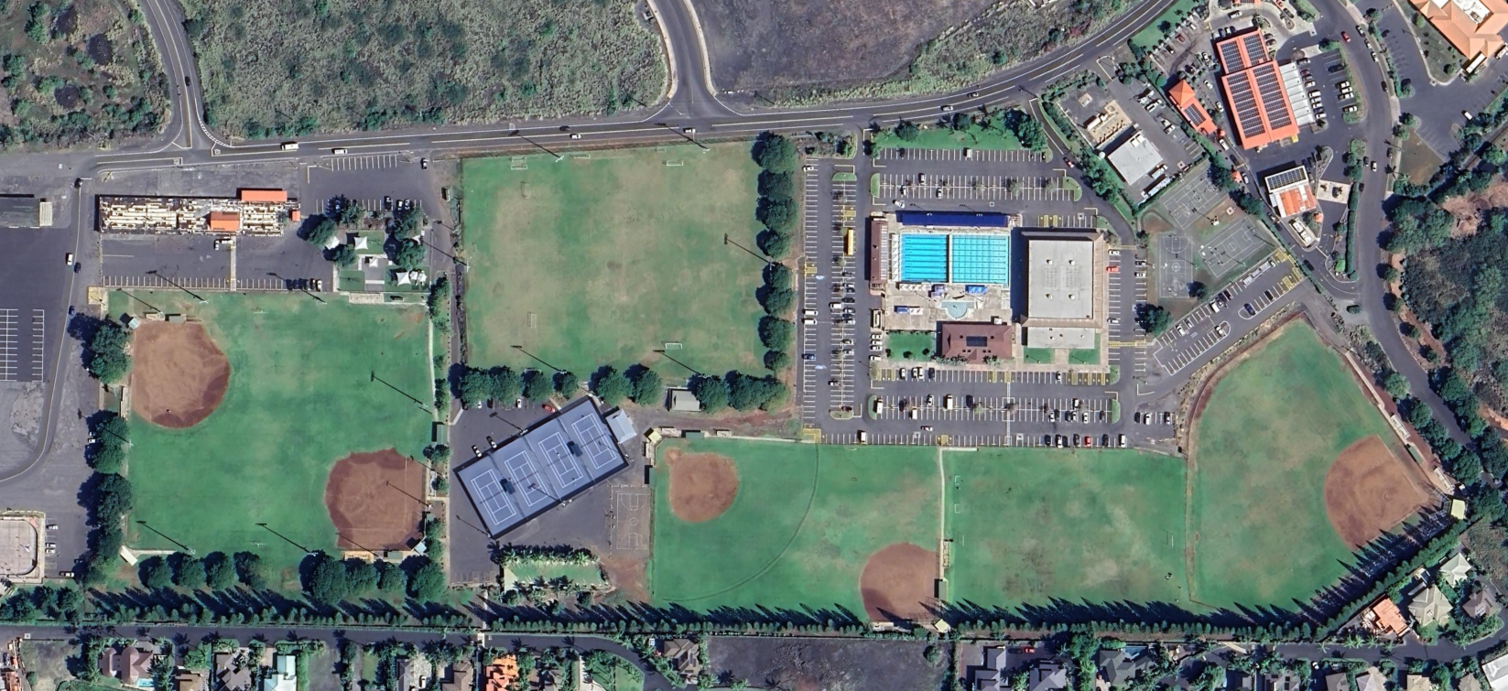
48th Annual Hawai`i State Senior Softball Tournament
Old A’s Ballfields, Kailua-Kona, Hi.
August 6 – 8, 2024
Loloku St
Makala Blvd
Kuakini Hwy
Kuakini Hwy
H Field
Aquatics
Center
Kona
Gym
G Field
A Field
B Field
Tennis Courts
C Field
E Field
D Field
F Field

