Slide 1
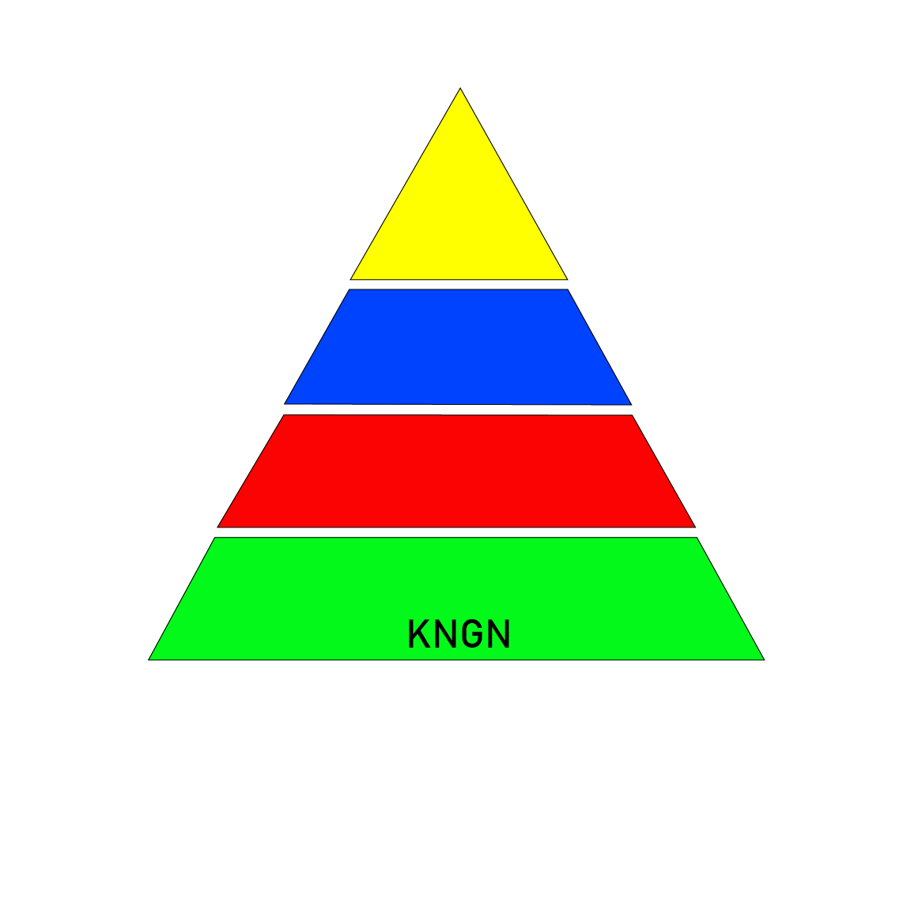

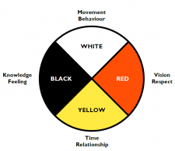

Wawēhisowin nosisim, kayas nehiyawewin takotîmakan – prepare yourself grandchild, the old way is here!”

Slide 2
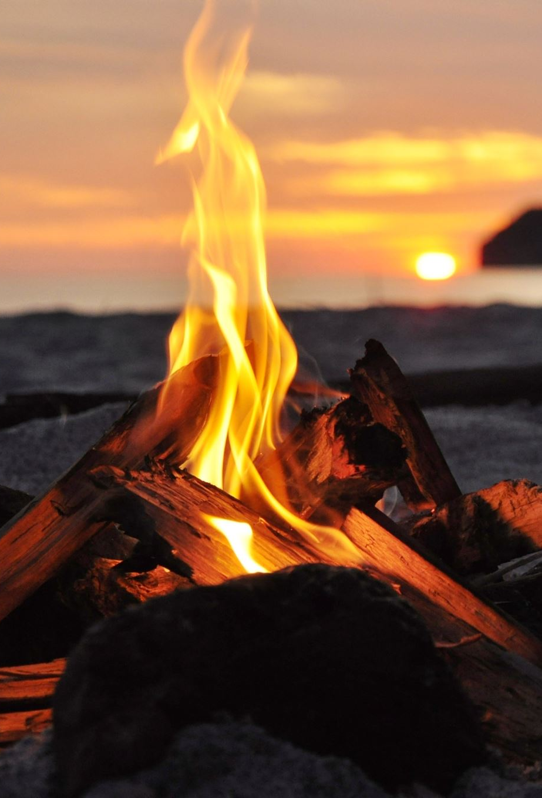

Miyo – Pimatisowin: to live a good life
Isōwin = energy it can neither be created or destroyed, it can only be converted
Natural Laws are all energies; when one is used, they all connect and work together, connecting to the universal laws that govern the spiritual and physical spaces.
Nistotamowin is a triad process of knowing in nehiyawewin - the Cree understanding of life:
Triad elements are:
iskotew - Fire produces 3 parts: kwakotew, kaskaskihsī, pihko.
Nipī - Water produces 3 parts: 2 hydrogens and one nihīwin – oxygen atom. H2o
yotin. The wind is formed from 3 parts: waskatkotew, eyahitatinak, ekwa pīsim okiseywatisowin,,,the sun’s compassionate heat.
askiy - The miteh is the core, The miskan is the mantel, the musakiy, the mihko, and the oyas are the crust and surface.
Notes:
Miyo Pimatiowin, Miyo atisowin,

Slide 3
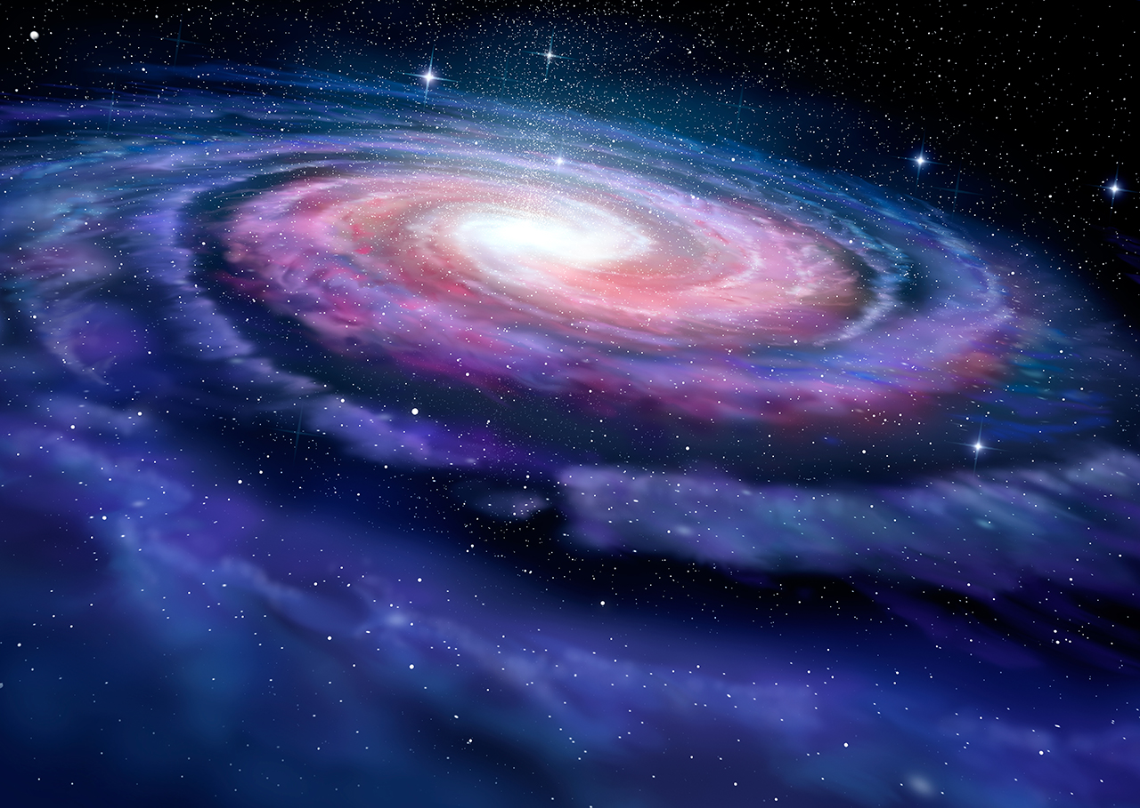
The Kihci oyasôwêwinan: Sacred Natural Laws of the nēhiyaw, Kimosominawak okiskinawasokimôwinôwawa.
These sacred laws - ancient teachings show us how to live and lead a good life.
Truth: tapowewin, tapwetamowin, and tapihsikototamowin with energy.
Honesty: kwayaskatisowin, kwayaskititamowin, kwayaskotiwin with energy
Love: sakitasôwin, sakihitôwin, sakîwētotakîwin with energy.
Respect: Manacisôwin, manacihowewin, manacimakanak with energy.
Courage: sokihtīhēwin, sokimowin, sakitasôwin with energy.
Humility: tapahtimisôwin, Tapatīmōwin, tapatatisôwin with energy
Wisdom: Nabonisowin, Nobontowin, Nabokîwin with energy.
The knowledge that ancient nēhiyaw people used comes from the study of nature, cosmos, and cycles of the seasons and how life, within all species, maintains the natural states to live in harmony to these natural laws.
For the nehiyaw, a good life was measured by how you walked on Mother Earth. This meant having knowledge of the other 6 life forms – fish, insects, plants and trees, the four-legged, and the flyers, and how these life forms maintained and lived in balance with their environment.

Slide 4
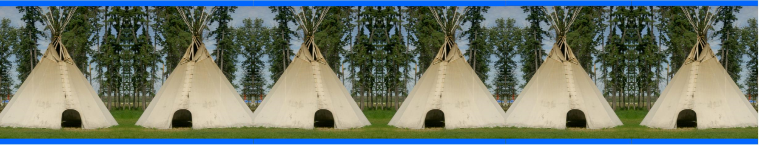
MIYO – PIMATISŌWIN
KIMĪKOWAPIM - YOU ARE THE FIRST CEREMONY
pikiskwewin--------Nabokîwin--------askīyowin ------- KIYA -------Kihkîwin--------sāwīmikosōwin-------ospokan
Medicine
Intelligence/
Intellect
Language
Frequency
Blessings from all energies
Laws
Of the sacred
Healthy balance
Land life
Relativity
Notes:
n. 1. A group of three. 2. Music A chord of three tones, especially one built on a given root tone plus a major or minor third and a perfect fifth.
Kiskinahamakīwin – kiskih = to remember / nahama = to role model and explain as you go forward/ kiwin = for health, mind or body balancing

Slide 5

Acahk
spirit (
Mīyaw
body
Itahamacihōwin
emotion
Mamitonīcikan
mind
Sakitasôwin
Sãkihitōwin
sakiwîtotatowin
love
Kiskīmisowin
Kistētamōwin
kiskisokîmowin
freedom
Nabokīwin
Nabonikîwin
Nabotisowin
mastery
Wīcitasōwin
wîcihitowin
wicôkamakîwin
service
Wakotōwin
Wîtisanitowin
wêkokîwin
unity
mēkinasōwin
mêkinamatôwin
mēkastiyihikiwin
Gift giving
Notes:
Energies attract to the centre
tīpakopatisowin

Slide 6
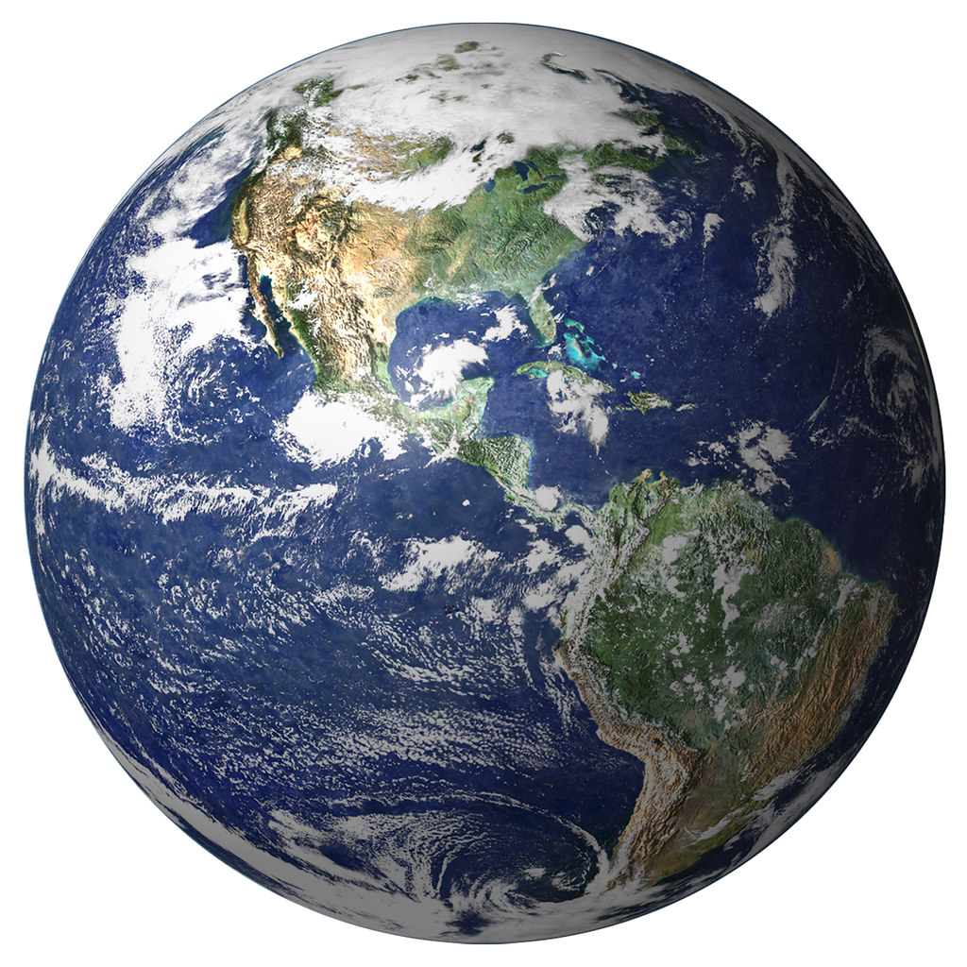



asiskew (earth)
Opikowin = (Oh) is up (pi) is extend (ko) inward place
itīcikan/pītahkwan/isôwin/asiskew
(thought/sound/energy/matter)
pîtahkwan (sound)
iskotew (Fire)
itīcikan (thought with spirit)
nipī (water)

Slide 7
5 STAGES OF NEHIYAW PIMATISIWIN
(Journey of Life Energy with Cipakop – 7)
Ohtinkēwin
To absorb
Ayihsinakēwin
To Mimic, copy
Wahwītamōwin
Starts to value
Kīsītamōwin
To value highly
Ītasōwin
Beliefs, faith, experience
At this stage, the spirit learns how to absorb energy.
At this stage, the spirit starts using askiy) energy and explores
At this point, the spirit embarks on an exciting journey of choices, carefully selecting the energies it wishes to harness.
At this stage the spirit knows what energies to use
At this stage the
spirit is the way
they are.
Notes:
Kiskih = to remember and follow/ naham to show explain and tell/ owaso = is to be in relation to the energy.

Slide 8
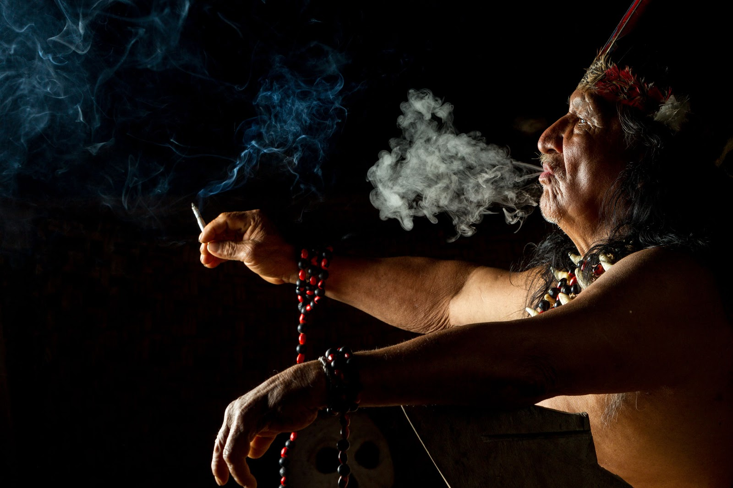
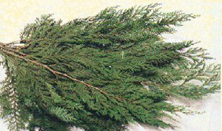
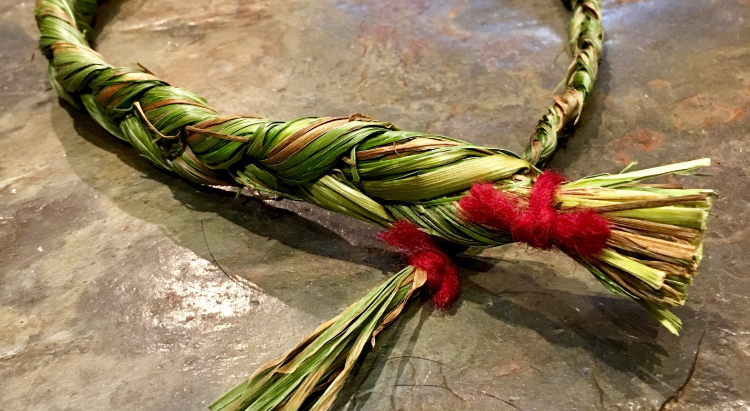
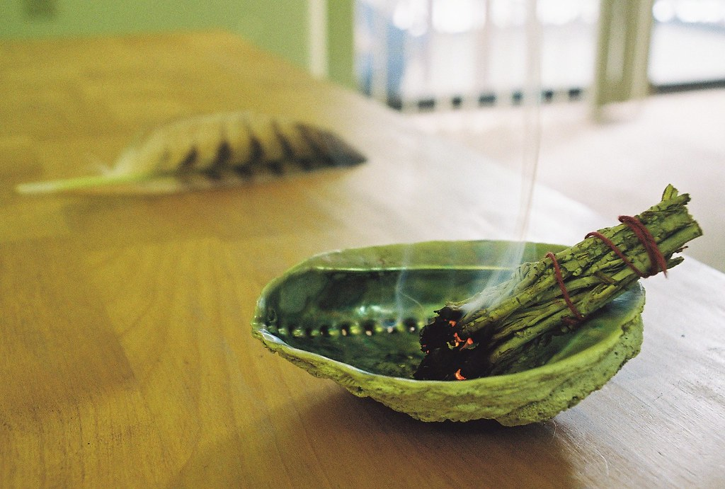
miya kasihkîwin = to balance energy
Napakasihtak motos weekusk
Cistiymow
Napakasihtak
wēkusk
Mostos wēkuskwa

Slide 9
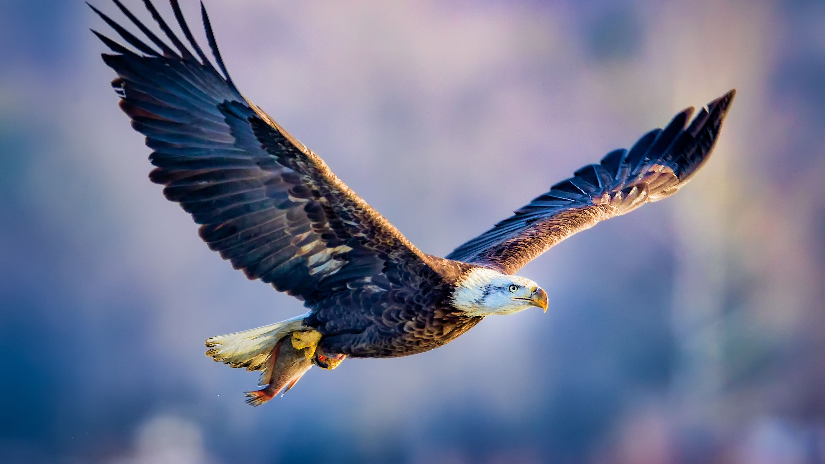
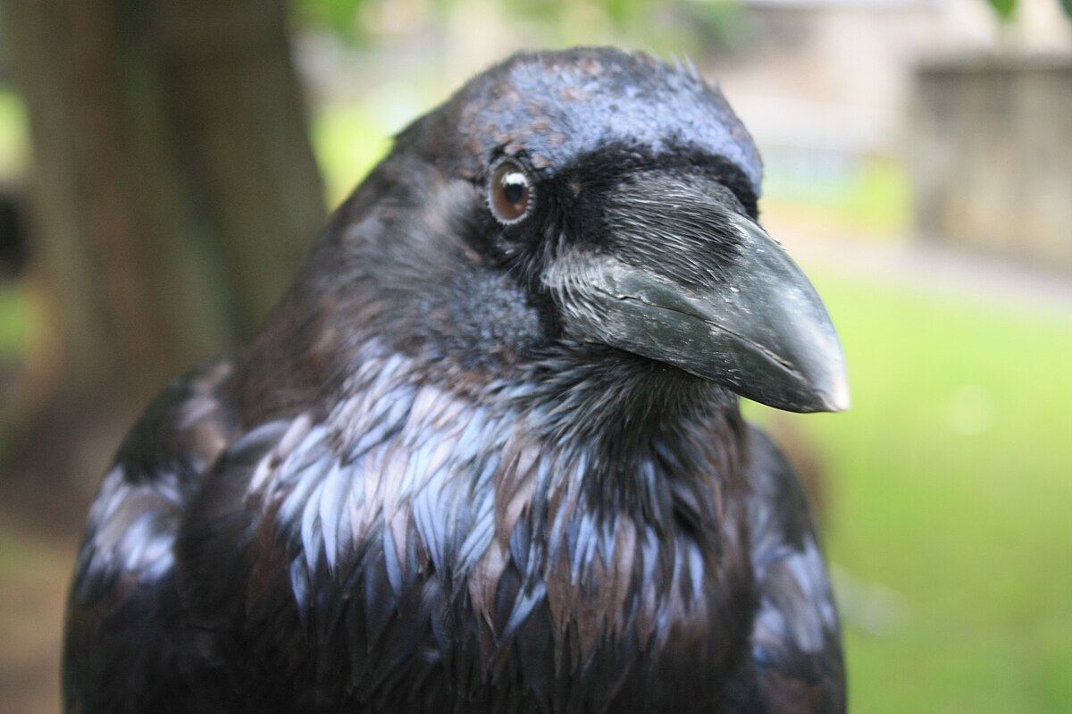
Kīhew comes from the word okiheyokew messenger for the creator and people
“This mosom eagle works for the pīsim and brings messages”
“Kahkako” okapīs – this mosom works for the eagle, prepares before and after the message.
This Photo by Unknown Author is licensed under CC BY-SA

Slide 10
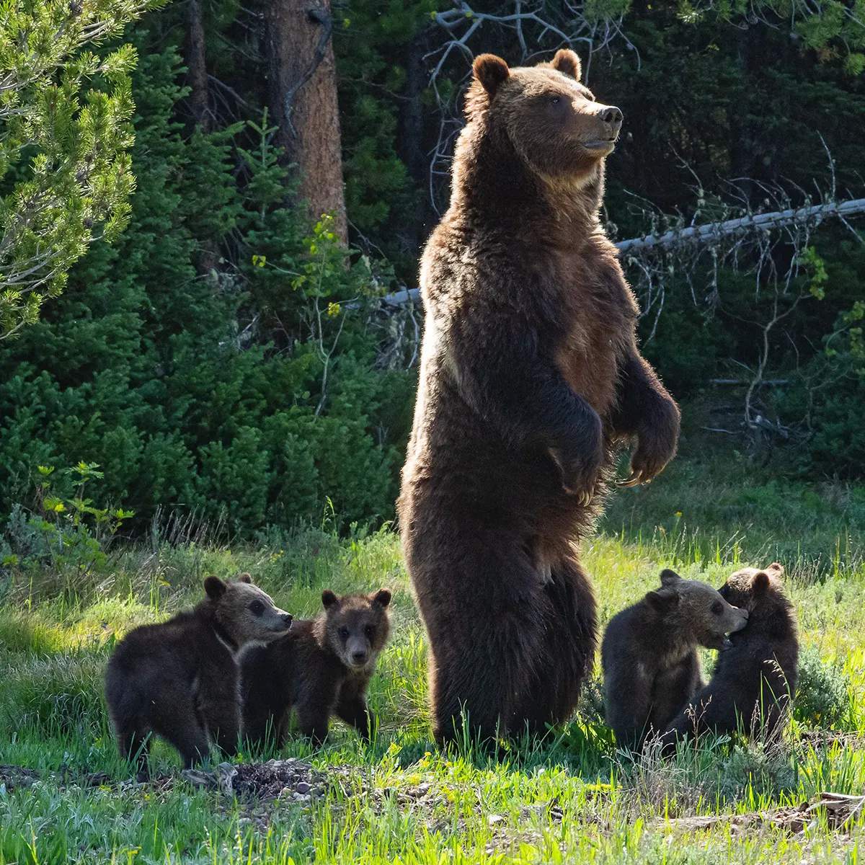
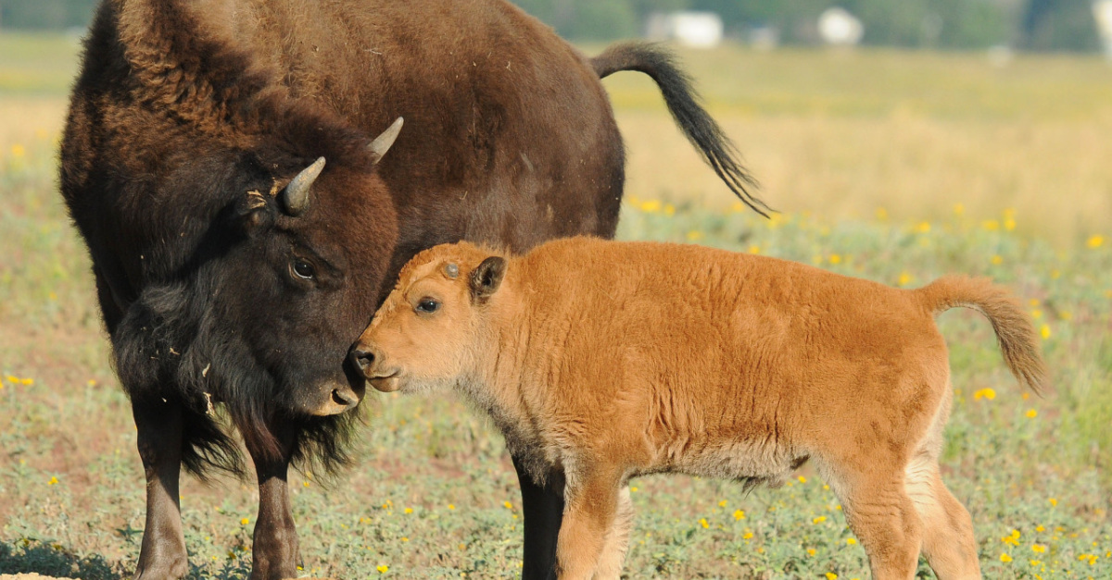
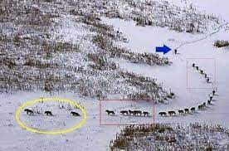
MuskihkÎwin Nabokiwin Nahakesôwin
Health/Medicine Wisdom/Knowledge Awareness/Safety
Muskwa Mostos Mahekan
Ohpikināhawasōwin
blessing each gives us:

Slide 11
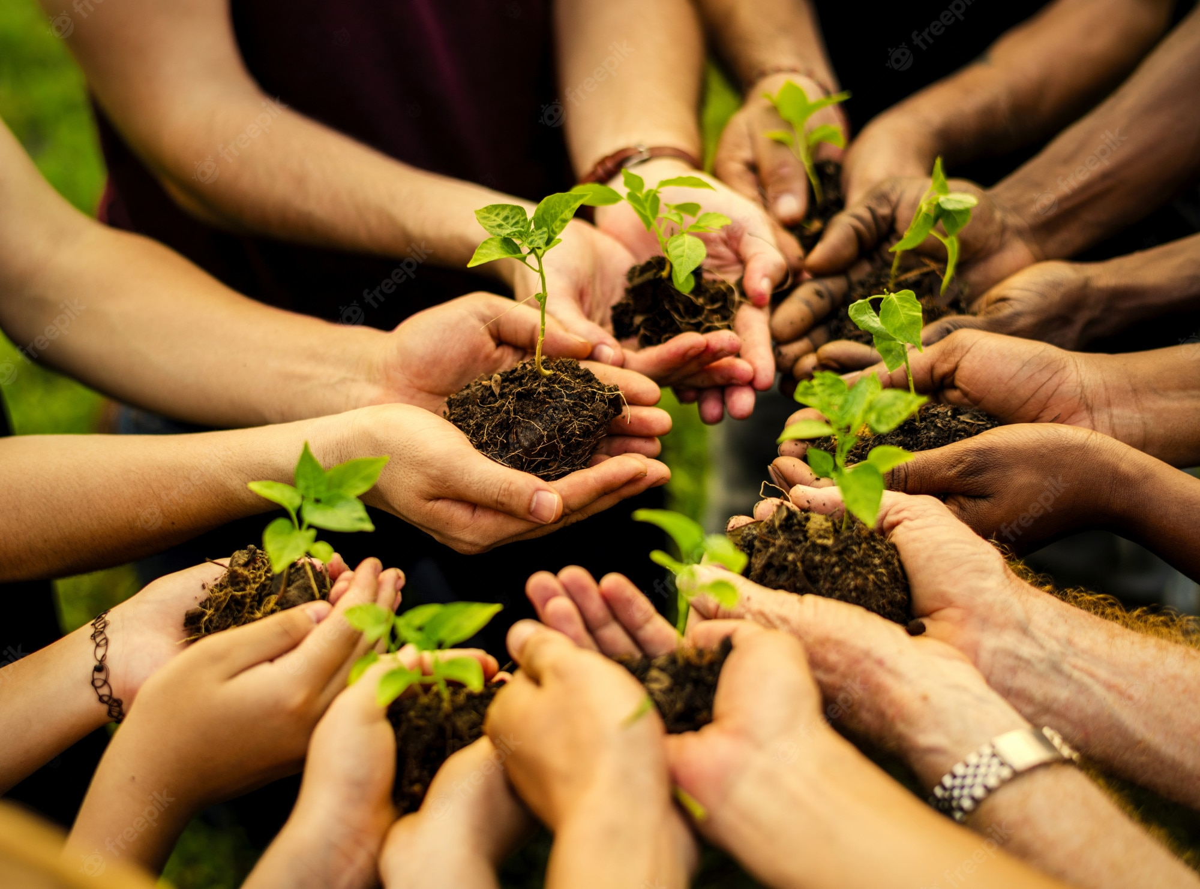
Kihkīwin = process of working with matter
Maskihkīwin

Slide 12


matōwin = water flowing out
Kiskinahamatōwin
Notes:
Flowers need water and light to grow and people are no different. Our physical bodies are like sponges, soaking up the environment. “This is exactly why there are certain people who feel uncomfortable in specific group settings where there is a mix of energy and emotions,” said psychologist and energy healer Dr. Olivia Bader-Lee.

Slide 13


isōwin = energy
Kiskinahamawasōwin

