Slide 1
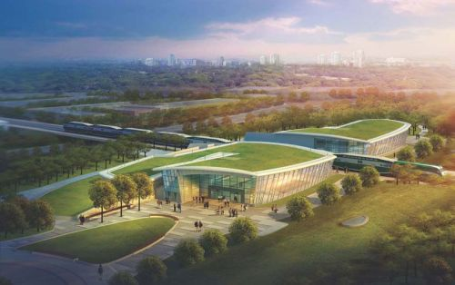
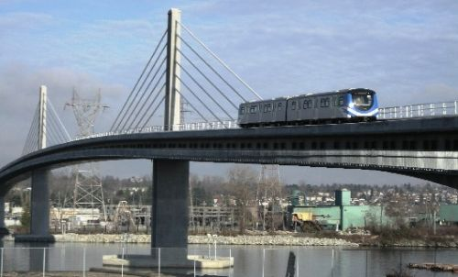
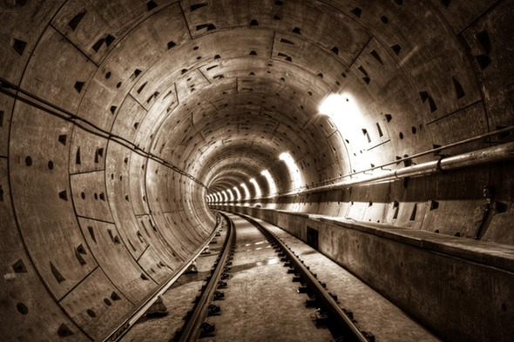
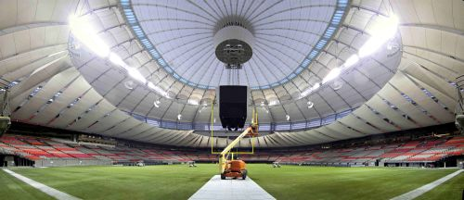

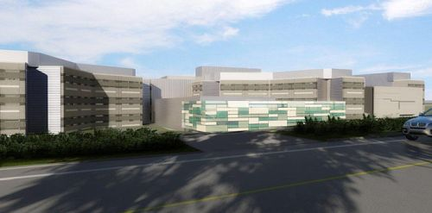
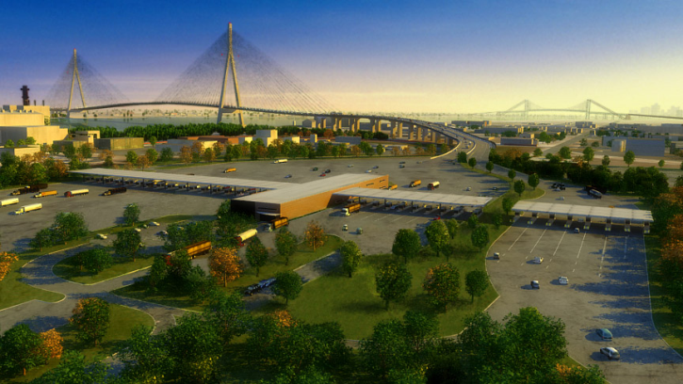
Lindsey Quality Solutions Inc.
“Providing quality management solutions to Public Private Partnerships, design/build projects and general construction”
Light Rail/Rapid Transit
Tunneling
Bridges, Roads & Highways
Buildings
Member of:
American Society for Quality
International Register of Certificated Auditors

Slide 2
Mission Statement
Lindsey Quality Solutions Inc. is committed to providing value added services to it's clients with a goal of achieving mutual success and customer satisfaction.

Slide 3
Specialists in the delivery of:
Quality Director services to Concessionaires of Public Private Partnerships both during the initial Design/Build phase and throughout the Operations and Maintenance term.
Development and implementation of Quality Management Systems for certification under the ISO 9001:2015 standard.
Quality management services to all types of construction and operations maintenance including:
  Quality System Development
  ISO 9001:2015compliant systems
  Quality Manuals including quality statements
  Quality Management Plans
  Work Procedures
  Work Methods
  Inspection & test plans
  Checklists and reports
  Systems for design/build phases
  Systems for operation/maintenance phases

Slide 4
Specialists in the delivery of (continued):
  Quality System Implementation
  Multi-level training and inductions
    Owner’s Personnel
    Concessionaire’s Personnel
    Design Builder Personnel
    Contractor Personnel
  Plan, lead and follow through with management reviews.
  Identify and carry out continual improvement initiatives and preventive actions.
  Identify non-conformances and implement corrective actions.
  Develop and implement non-conformance tracking systems.

Slide 5
Specialists in the delivery of (continued):
  Verification Services
  Plan & conduct management system audits including quality & environmental.
  Plan & conduct surveillance audits on construction activities.
  Quality evaluations of suppliers and subcontractors.
  Shop/offsite inspections/audits of fabrication and manufacturing globally.
  Progress monitoring/expediting services at fabrication and manufacture facilities globally.
  Onsite works inspections.
  Witnessing of tests performed as part of Inspection and Test Plans, including Factory Acceptance Tests (FATs)

Slide 6
Specialists in the delivery of (continued):
  Owner Liaison Services
  As part of Quality Director services act as the single point of contact with the Owner’s Representative for Public Private Partnerships and other project types.
  Organize presentations; chair Quality meetings and arrange training inductions with Owners’ personnel.
  Participate in partnering sessions with Owner’s personnel.

Slide 7
Canada Line Rapid Transit
Concessionaire – InTransit BC
The Concessionaire is responsible for design, construction, operation and maintenance of 22km of Automated Light Rapid Transit(ALRT) for a 35 year concession period.
Scope of Services - provide quality and environmental audit services for the Canada Line in Vancouver for the operations and maintenance period
Back to Current PPP

Slide 8

South Fraser Perimeter Road Concessionaire – Fraser Transportation Group Partnership
Scope of Services - provide Quality Director services to the Concessionaire for the design, construction, operation, maintenance and rehabilitation of the SFPR project.
This project includes 40km of new highway and associated bridges
Back to Current PPP

Slide 9

Windsor Essex Parkway Concessionaire – Windsor Essex Mobility Group
Scope of Services - provide Quality Director services to the Concessionaire for the design, construction, operation, maintenance and rehabilitation of the Windsor Essex Parkway project.
This project includes 11 kms of new 6 Lane highway connecting Ontario highway 401 with the US-Canadian border.
Back to Current PPP

Slide 10
SPSCEP Design/Builder – PCL Constructors Westcoast Inc.
Scope of Services - provide Quality Advisor services for the Surrey Pretrial Services Centre Expansion Project in Surrey.
This project includes construction of a high-security, state-of-the-art 216-cell expansion to the existing Surrey Pretrial Services Centre, together with associated renovations to the existing facility.
Back to Current PPP

Slide 11
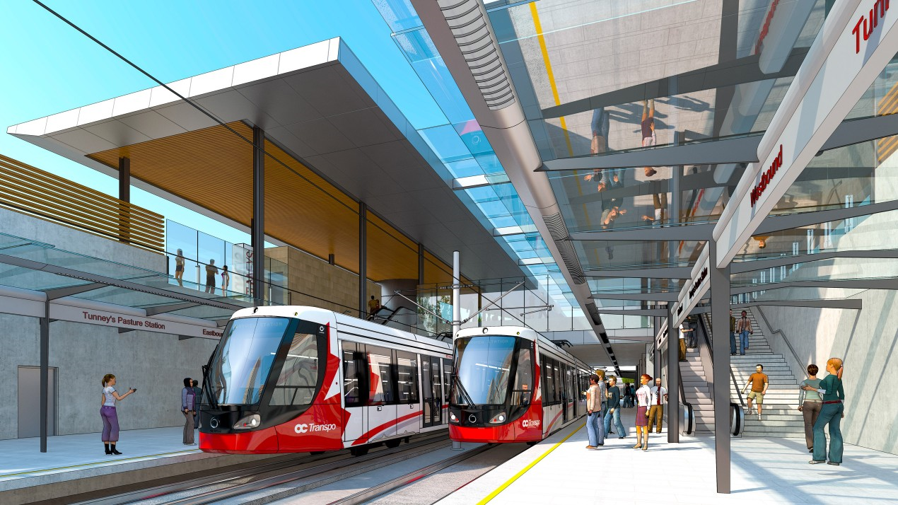
Ottawa Light Rapid Transit
Scope of Services – Stage 2 Procurement Phase – IMS Advisory Services
Development of IMS and related schedules for the Trillium Line and Confederation Line Extension
Back to Current PPP

Slide 12
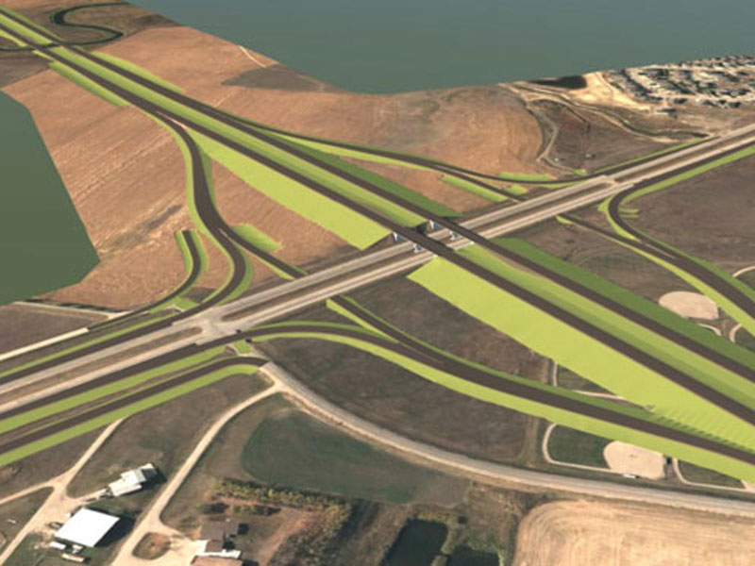
Regina By Pass Project
Scope of Services – Development and implementation of the Integrated Management System during design, construction, operation and maintenance stages.
Back to Current PPP

Slide 14
Contractor PCL – BC Place Stadium Roof Replacement and Structural Upgrade
Scope of Services – provide Quality Manager services for the BC Place Roof replacement project in Vancouver. Offsite inspections done globally for procured materials. Developed the Project Quality Plan and supporting documents, as well as conducted reviews and acceptance of subcontractor quality plans. Inspection locations throughout North America, Europe and Asia.
Overall Project Value $458 Million.
Back to Other Projects

Slide 15
Aecon – Toronto-York Spadina Subway Extension
Scope of Services - Providing Quality Management Support services through System Preparedness Audits; and Quality, Environmental, Health & Safety Audits.
This project includes the Sheppard West Station and Southern Tunnels. Total estimated cost of the overall extension project is $2.6 billion.
Back to Other Projects

Slide 16
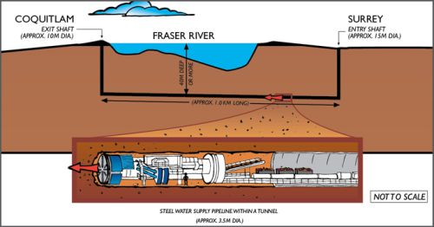
McNally-Aecon - Port Mann Water Supply Tunnel
Scope of Services - Providing Quality Management Advisory and Support services.
Construction of a new water supply main under the Fraser River, just downstream of the Port Mann Bridge. The water main will be constructed in a tunnel driven through soil, underneath the riverbed. It will cross between Surrey on the south side of the river, and Maquabeak Park in Coquitlam on the north side of the river.
When complete, this new, larger water main will help ensure the continued, reliable delivery of clean, safe drinking water to municipalities.
Total estimated cost of this project is $170 million.
Back to Other Projects

Slide 17
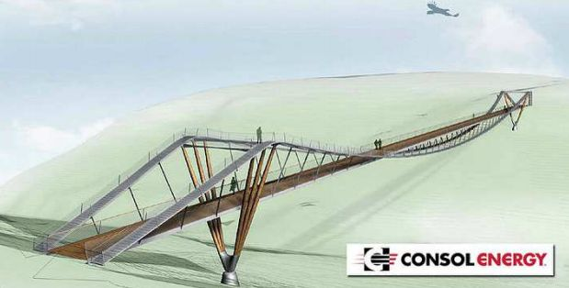
Freyssinet - CONSOL Energy Wingtip Bridge
Scope of Services - Providing Fabrication Quality Control, Quality Assurance and Production/Progress Monitoring services in Malaysia.
The CONSOL Energy Wingtip Bridge will be at The Summit Bechtel Family National Scout Reserve in West Virginia, USA. The bridge, more than 230 metres long above a massive ravine, will connect the main activity area to the eastern half of the property.
This one-of-a-kind bridge utilizes splayed wooden piers to support the main cables. The timber poles fan out radially to gently redirect the main cables. The resulting form is reminiscent of feathers at an eagle’s wing tip.
Back to Other Projects

Slide 18
Construction Complete!

Slide 19
Offsite Inspection Work
Lindsey Quality Solutions Inc. is a lean, progressive, company involved with approximately $10 Billion (CDN) of design, construction, operations, maintenance and rehabilitation projects across Canada and abroad.
For more than 30 years the founder and President of Lindsey Quality Solutions Inc. has been involved with major industrial and infrastructure projects around the globe. The President has worked internationally for more than 25 years on a variety of leading edge projects from transportation infrastructure to oil & gas industry, power industry, stadium, and the pulp and paper industry.
Key services:
Integrated Management System (IMS) development and implementation (combined HSQE and or discipline specific management plans, procedures and ITPs)
•IMS contract requirements development
•IMS implementation and auditing
•Corporate, subcontractor and supplier evaluations, and auditing (wide range of products and services globally)
•Quality Surveillance at facilities producing products globally
•Training and mentoring of IMS personnel
Off-site Fabrication Inspections completed:
Kevin Lindsey started conducting supplier inspections in 1989 in Indonesia and since then he has visited many shops in a number of countries. Following is a brief summary of those countries and types of manufacture/fabrication facilities he has conducted quality assessments, quality audits, product and facility inspections, expediting (progress estimating type) visits, and pre-shipping inspections-audits (note: a portion of the inspections noted below where conducted for the construction of the Malampaya Concrete Gravity Structure in the Philippines):
Back to Other Projects

Slide 20
Offsite Inspection Work (2)
Indonesia: Concrete block manufacture, Structural steel fabrication (approx. 6 shops), Steel Coating (painting) application shops (approx. 3), concrete pile manufacture (approx. 4 shops), Cement manufacturer (2), Concrete batching plants (8), HMAC batching plants (4), Fly ash facility (1), Concrete aggregate manufacture (approx. 10)
Malaysia: Structural steel fabrication (approx. 4 shops), Hot dip galvanizing plants (2), Steel pile manufacturers (longitudinal seam and spiral welded – 2 shops), Steel Coating (painting) application shops (2 supplier), Rebar fabrication shops (approx. 4), Pre-cast concrete shops (bridge segments) (1), Cement manufacturer (2), Fly ash facility (2), Concrete batching plants (4)
Philippines: Structural steel fabrication (approx. 6), Rebar fabrication shops (2), Large diameter fibre reinforced pipe manufacture (FRP and GRP) (2), Concrete pile manufacture shops (2), Cement manufacturer (2), Concrete batching plants (4), Fabric roof panel fabricator (1)
Thailand: Structural steel fabrication shops (2), Steel Coating (painting) application shops (2), Fabric roof membrane fabrication shop (1) Singapore: Structural steel fabrication shops (2)
Japan: Stressing strand manufacture India: Structural steel fabrication shops (3), Hot dip galvanizing plants (3), Steel pile (longitudinal seam)(2), Concrete block manufacture (2), Concrete batching plants (2), Concrete aggregate manufacture (4)
China: Structural steel welding shops (6), Large diameter plate rolling shop (1), Aluminum extrusion plant (1), Heavy steel machining shops (2), Hot dip galvanizing plant (1)
France: Foundry for cable clamp castings (2 suppliers), Machining shops (cable clamps) (2 suppliers)
Switzerland: Cable manufacture (1 supplier )
Italy: Large diameter cable manufacture (1 supplier )
Netherlands: Fabric roof panel fabricator (1) Spain: Specialized welding of plate steel to casting for cable clamps (1 supplier ) Turkey: Foundry (custom cable clamps), Steel machining shop (1 supplier)
Back to Other Projects

Slide 21
Offsite Inspection Work (3)
Canada: Structural steel fabrication (approx. 20), Steel Coating (painting) application shops (approx. 15), Heavy steel machining shops (approx. 6), Hot dip galvanizing plant (2), Pre-cast concrete shops (bridge segments and girders and transit guideway segments) (approx.12), Concrete pile manufacture shops (2), Rebar fabrication shops (approx. 6), Concrete batching plants (approx. 15), Rail welding facilities (portable)(4), Sliding and spherical bearing manufacture (1 supplier), Concrete aggregate manufacture (approx. 15)
USA: Structural steel fabrication (2), Fabric roof membrane fabrication shop (1)
Non-Destructive Examination of Welded Steel Products:
LQS Inc. is very familiar with the fabrication of steel products and has conducted inspections, tests, examinations and audits of steel products globally. For specialized NDE subcontractors are engaged to perform these activities. Currently our metallurgy specialist is working on a project in Ottawa, and our AWS Certified Welding Inspector is certifying welders in the Philippines.
Onsite Concrete Batching and Material Production:
Established and managed the on-site concrete laboratories for 2 major projects:
1. Kiani Kertas Pulp Mill – Indonesia – Approx. 300,000m3 of concrete batched from 2 onsite batch plants
2. Malapaya Concrete Gravity Structure – Philippines – 34,000m3 concrete produced from 2 on-site batch plants
100% of the concrete sampling and testing was performed under the overall supervision of Kevin Lindsey for these projects. A laboratory subcontractor was hired to perform the testing work
Back to Other Projects

Slide 22
Offsite Inspection Work (4)
Pre-cast Concrete Technology:
Some of the quality interactions we have had with precast are:
•Development and implementation of quality systems and procedures for short line segment casting, girders, and tunnel liner segments
•Auditing of the shop drawing preparation and approval processes including red line record drawing preparation
Auditing of raw materials used to meet mix design properties including fine aggregate, course aggregate cement, cementitious materials including fly ash and silica fume and chemical additives
Auditing and reviewing of the concrete batching processes
•Auditing calibrations of batching equipment and measure / testing equipment
•Assessment of sampling and testing methods of fresh and hardened concrete samples including mix design control (including RCPT requirements and processes)
•Pre-pour inspections including reinforcing, mechanical embedment's placing and geometric control
•Assessment of the concrete placing and consolidation methods
•Post casting inspection, identification, tracking and repair of issues and non-conformances that arise with pre-casting operations
•Review and auditing of testing information related to concrete, pre-stressing and post tensioning
•Review and auditing of curing methods and curing temperature control
•Compilation and review of pre-cast “Birth Certificates”
•Training and mentoring of QA and QC personnel assigned with pre-casting operations
•Auditing the implementation of quality processes for pre-casting operations and assisting with the implementation of process improvements
Back to Other Projects

Slide 23
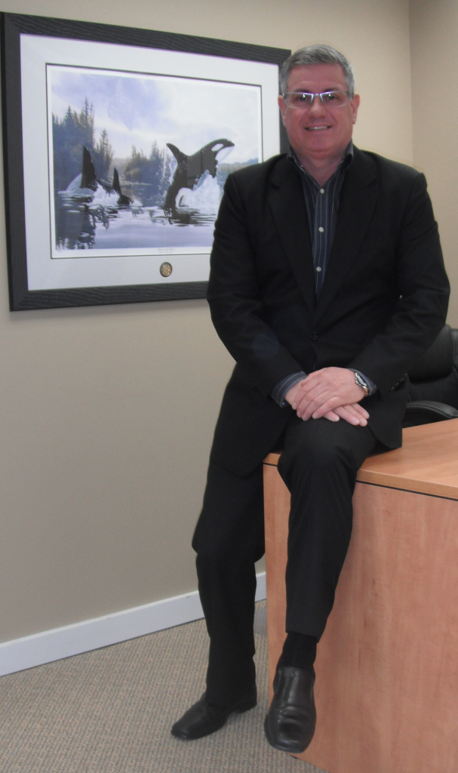
Kevin Lindsey
Project experience includes industrial and transportation infrastructure projects in Canada and internationally such as with elevated, at grade, cut & cover tunnel, and bored tunnel construction for light rapid transit installations in Canada, road works in Canada, Indonesia and Malaysia, major bridge installations in Canada, and Malaysia, railway installations in Canada and Indonesia, airport construction in Canada, and Industrial construction in Indonesia, India, Malaysia, the Philippines, The Netherlands and Canada.
Qualifications and Training
ISO 14001: Environmental Management Systems Lead Auditor
Certified Manager of Quality/Organizational Excellence
Certified Quality Auditor
IRCA ISO 9000:2000 Auditor
ISO 9000:2000 Series Auditor/Lead Auditor
Quality Assurance Auditing and Process Auditing
Quality Assurance Management
Civil and Public Works Inspection
Auto CAD
Materials Testing
Survey Technology
Award Winning Projects
The Cambie Street Bridge in Vancouver, BC, Canada
The Number 2 Road Bridge in Richmond, BC, Canada;
The Malampaya Concrete Gravity Structure in Subic Bay, Philippines;
Member of these reputable organizations:
American Society for Quality
International Register of Certificated Auditors
Back to Org Chart

Slide 24
Jim Starkey
Is currently the Quality Advisor for the Port Mann Water Supply Tunnel Project.
Bio:
A skilled professional with design, supervisory and managerial experienced combining over 25 years in the manufacturing and service industries.
Effective at interfacing with specialists and all managerial levels.
Particular expertise in planning and coordinating activities, analyzing and troubleshooting, developing policies and procedures within the quality audit functions.
Qualifications and Training:
ISO 9001 Auditor/Lead Auditor
Masters Degree in Business Administration
APENS examination and thesis
Higher National Diploma & Diploma of Mechanical Engineering
Member of:
    Association of Professional Engineers and Geoscientists of BC(non-practicing/life member)
    Toastmasters International/Past President (White Rock)
Back to Org Chart

Slide 25
Haydee Salvador, BSCE
Is an Auditor for Lindsey Quality Solutions Inc. that has involvement currently with:
Current Project Involvement:
South Fraser Perimeter Road Project
  QMS Monitoring
  Monthly Reporting
Windsor Essex Parkway Project
  QMS Monitoring
Canada Line
  Environmental Audits and Reports
Fraser River Pile & Dredge FRDP
  IMS documentation
Qualifications:
International Registered Certificated Auditor (IRCA) - Quality Management System Lead Auditor
Certified Lead Auditor – Quality, Environmental and Health and Safety Management Systems
Management of various omputer software document control such as Coreworx, Aconex, Sharepoint, OPUS, Procore and other project documents collaboration software.
Previous Experience:
+12 years Civil Engineering & Quantity Surveyor in the Philippines and Africa
Training:
  Development Approval – Subdivision and Design
  Computer Construction Estimating (Timberline)
  Steel Fabrication Works
Haydee has completed and certified to the following: ISO 9001:2015, ISO 14001:2015 ad ISO 45001 Lead Auditor Course
Back to Org Chart

Slide 26
Carmen Oraa
Is an Auditor for Lindsey Quality Solutions Inc. that has involvement with:
Current Projects:
Fraser River Pile & Dredge
  Development of Integrated
  Management System documentation
  Document Control /management
Other tasks including:
Administrative and Document Control Support
Quality & Procedure Manual Development/Review
Procedure/Work Method Draft Assist & Review
Quality Forms Development & Maintenance
Previous Experience:
11+ years as Quality Manager, SNC Lavalin Constructor Pacific
  EGRT - Environmental & Traffic Quality Manager
  CWLRT Project – QA Document Coordinator
  Coast Meridian Bridge Project
  Canada Line Rapid Transit Project – QA Coordinator
Carmen expertise
Transportation – Mass Transit Systems; Roads/ Highways
Back to Org Chart

Slide 27
Bita Ebadian
Is an Auditor for Lindsey Quality Solutions Inc. that has involvement with:
Current Projects:
South Fraser Perimeter Road SFPR
  Internal and External Auditing
LQSInc. Quality Manual and Procedure
  Development
Qualifications:
•Health and safety level 1 & 2 .SNC- Lavalin
•Environmental Risk Assessment and Management. •Environmental Law.
•ISO 14001 Lead Auditor Certificate
Previous Experience:
10+ years as quality and environmental management system consultant
ISO 14001 Registered – 3rd Party Auditor
Bita’s expertise
•Environmental Management system ISO14001
•BC Environmental law and Regulations
•Environmental Inspection and Audit
Back to Org Chart

Slide 28
Jo-Ann Paquet
Is an Auditor for Lindsey Quality Solutions Inc. that has involvement with:
Current Projects:
Ottawa Light Rail Transit Project
  Quality Director
Jo-Ann expertise includes:
•Competence in auditing and preparation of lessons learned from a project • management • Leadership, mentoring and accompanying analytical skills • process improvement • relationships with stakeholders • Communications and reporting • Strategic planning and implementation • budget controls
Qualifications:
•Bachelor of applied science (metallurgical engineering), Laval University, Quebec, Canada. • Member of the order of engineers of Quebec and member of its Board of Directors for three years. • Member of the Committee responsible for drafting the Chilean version of the standard ISO 31000 (risk management). • Member of the ASQ. • Lead auditor certification (ISO 9001: 2015).
Back to Org Chart

Slide 29
Sebastien Regragui
Is an Auditor and Project Coordinator for Lindsey Quality Solutions Inc.
Qualifications:
•PMP certification preparation course
•Contract negotiations
•Contract administration, Scheduling, Cost control, Estimation
•Member of the Quebec Order of Engineers (OIQ)
•Mechanical Engineering Bachelor degree
•ASP Construction Certification,
Sebastien expertise includes:
•Project management and engineering
•Quality assurance and control
•Commissioning
•Cost Control
Professional Experience::
Turner Construction Company – QA/QC & Commissioning Site Engineer
Surgold (Newmont), Suriname Jungle Camp- Mechnaical Site & Commissioning Engineer
Merian Gold Project – Mechanical team
GCM Consultants – Onsite Construction Manager
Back to Org Chart

Slide 30
Organizational Chart

Slide 31
What can we do for you?
ISO9001:2008
Quality Director Services
Internal, Source, Surveillance Auditing
Management Review
Supplier Quality Evaluations
Quality Management System –
Development, Implementation, and
Verification
Fabrication Quality Control
Document Review
Quality System Management & Training
NCR Tracking System
Environmental Auditing
ISO 14001:2004
System Preparedness Reviews
Quality Auditing
Production/Monitoring/Reporting
Quality Assurance
Continual Improvement
Customer Satisfaction

Slide 32
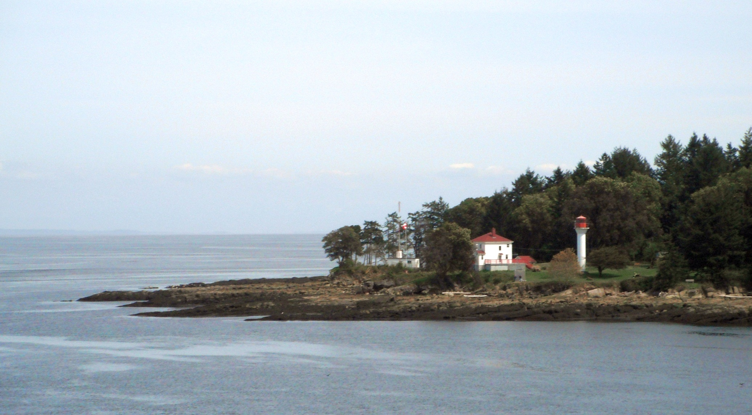
Thank you!
Business Contact
Phone No.: 604-247-2224
Email: info@lqsinc.ca
Website: www.lqsinc.ca
Kevin Lindsey Contact
Cell Phone: 604-785-4534
Email: kevin.lindsey@lqsinc.ca
Georgina Point Lighthouse, Mayne Island, BC

