Slide 1





I Am Me/Disability Friendly
YPI
Notes:
I Am Me Scotland is a Renfrewshire community charity that raises awareness of disability hate crime. They have two key initiatives; I Am Me and Disability Friendly. I Am Me is a package of resources which are used in schools to raise awareness of bullying, disabilities, hate crime, and much more.
Disability Friendly is a national network of places throughout Scotland where disabled and vulnerable people can feel valued, respected and included within their communities. All Disability Friendly places can be viewed on the Disability Friendly section of the I Am Me Scotland website; https://iammescotland.co.uk/disability-friendly

Slide 2
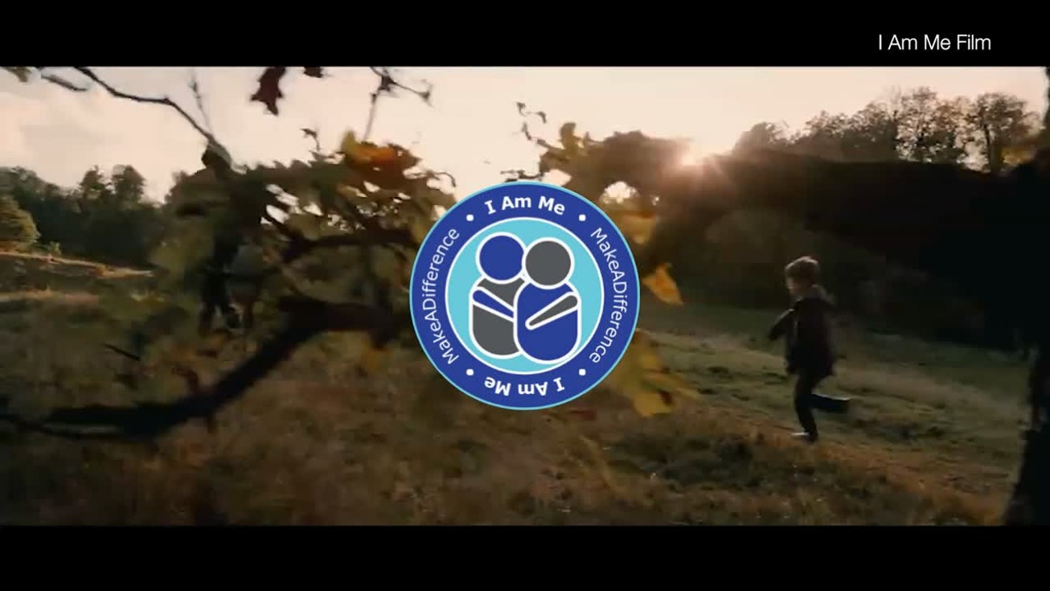

What is I Am Me Scotland?
Notes:
I Am Me Scotland is a Charity based in Renfrewshire. The charity has a small team of 4. Click on the image to watch the short charity introduction.
Video YouTube link: https://www.youtube.com/watch?v=kGUsGedGDAo

Slide 3
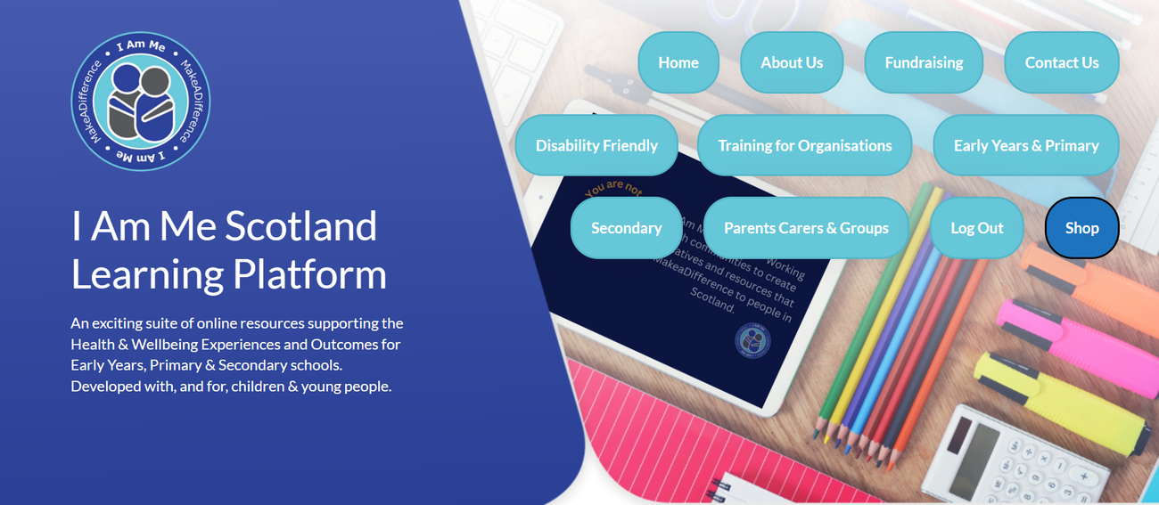
Education Platform
Our Education Platform is being utilised in all 32 local authorities by police officers, teachers, health & social care practitioners, and parents and carers. There are lessons and training resources on various topics. If you would like FREE access to the platform, you can register here
https://iammescotlandeducation.org.uk/register/
Notes:
I Am Me Scotland have 2 main initiatives. Education and Disability Friendly.
The I Am Me Scotland Online Education platform is available free for all teachers, police officers, health and social care, and any other practitioners that work with children, young people and vulnerable people.
The team work with children, young people, and people with lived and living experience to build lessons and training packages that raise awareness of different topics like disability, bullying, hate crime, children’s rights, alcohol & substances (including smoking and vaping), anti-social behaviour and exploitation.

Slide 4


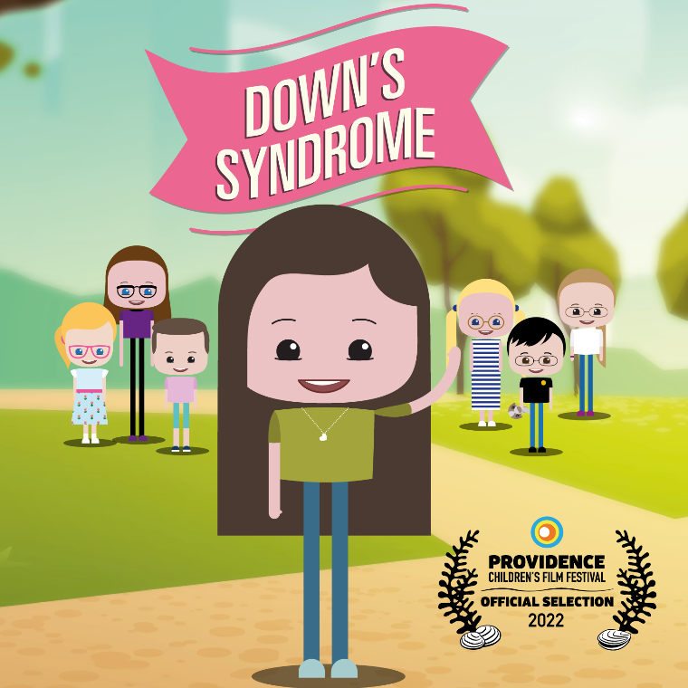
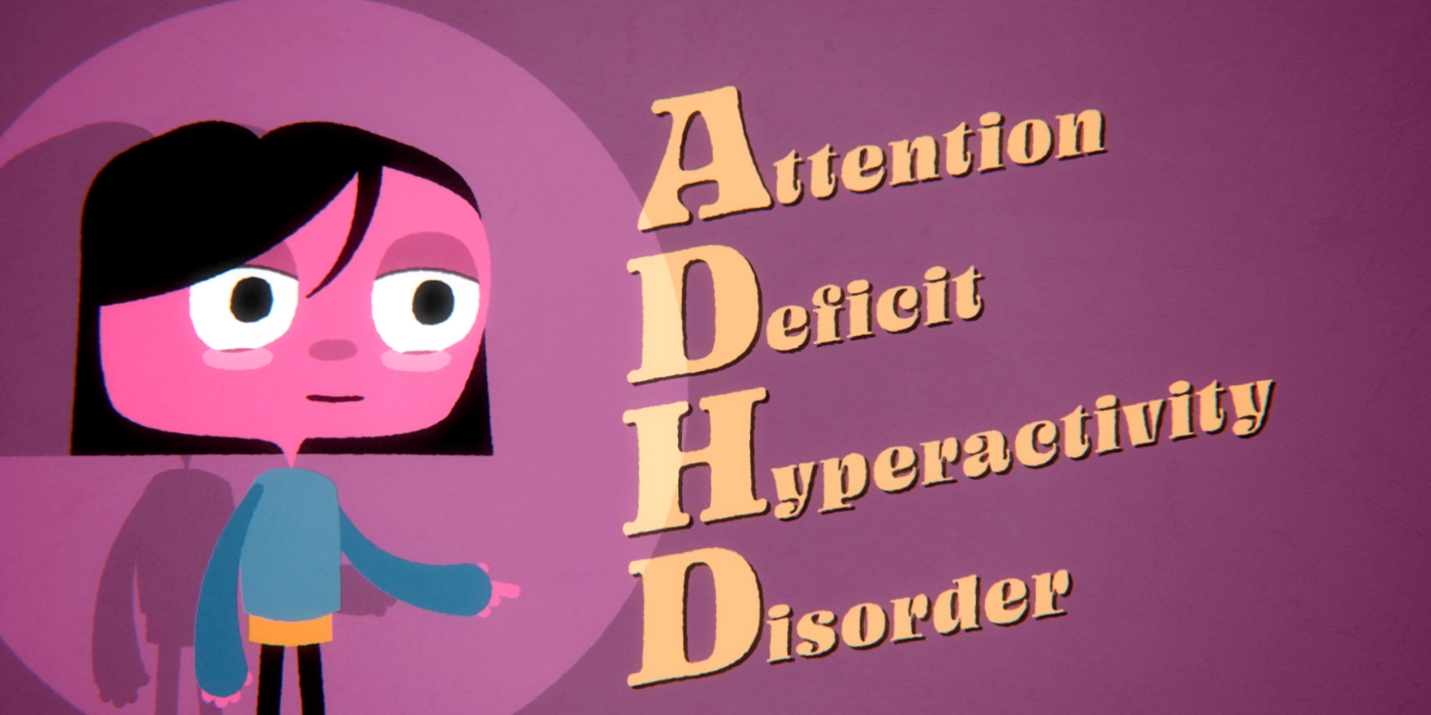



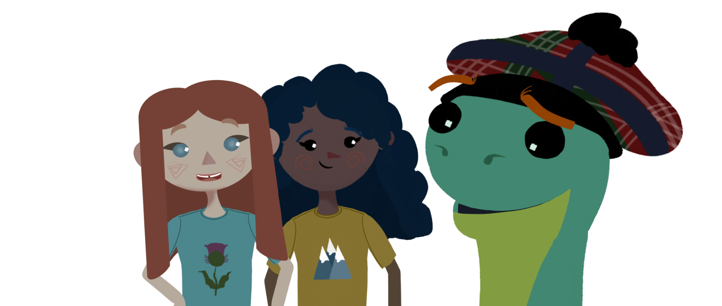


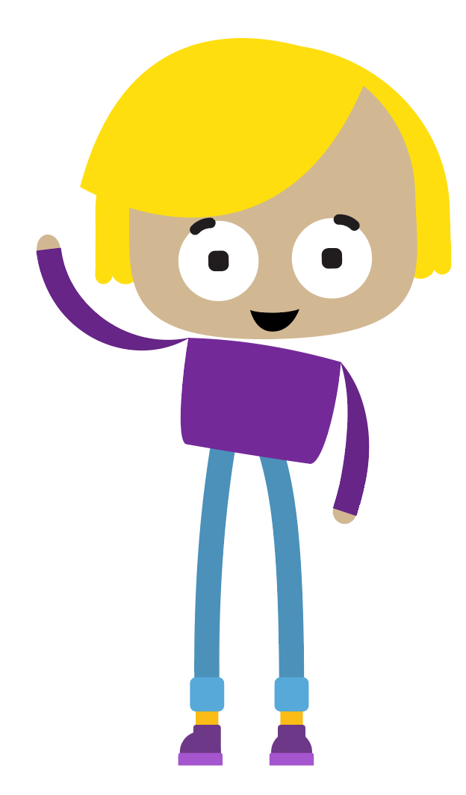

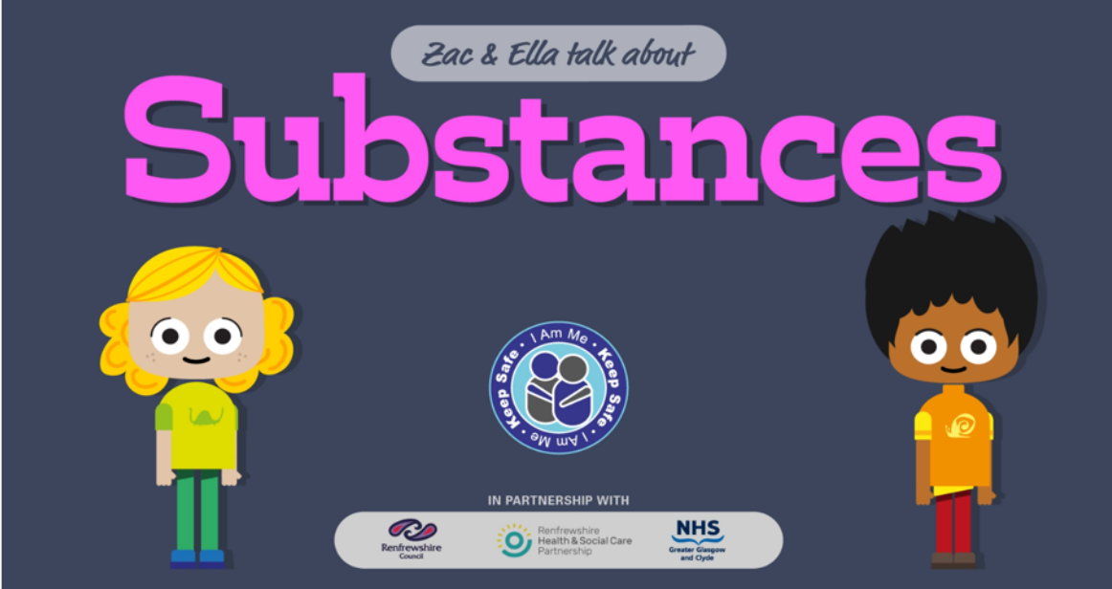
Notes:
Here are just a few of the projects I Am Me Scotland have available on the education platform. You can click on each of the pictures to watch the film or animation.

Slide 5
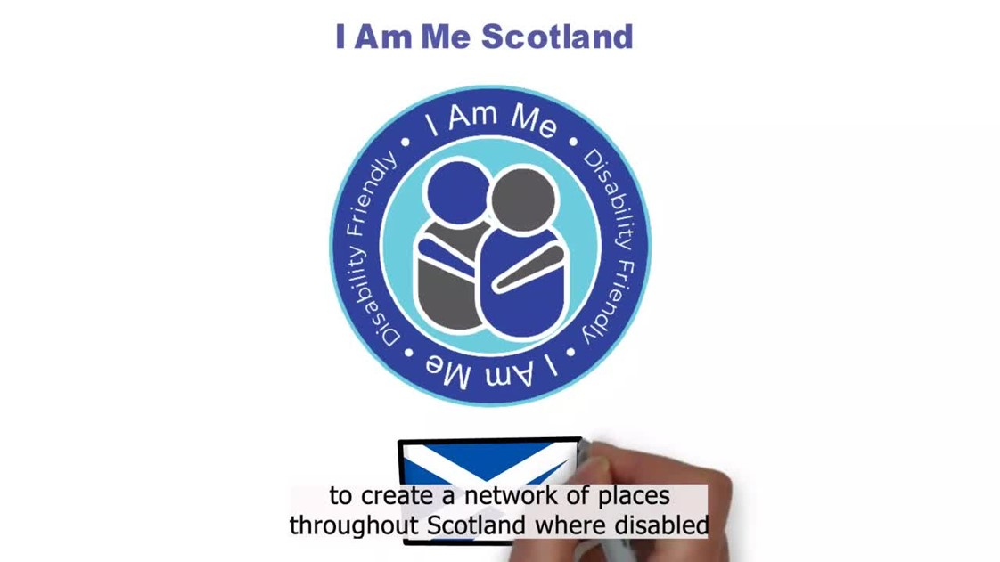
DISABILITY FRIENDLY
Notes:
So, what is disability friendly? Disability friendly is an initiative that creates a network of places across Scotland, where disabled and vulnerable people can feel valued, respected and included within their communities. Disability friendly places volunteer to receive staff training, helping them to be more inclusive and supportive, which helps people to remain socially active and independent across Scotland.
This is a short video that explains Disability Friendly.
Video YouTube link: https://www.youtube.com/watch?v=S4dFthGgA4w

Slide 6



HOW IS IT USED?
Create a network of places where disabled people feel welcome, are supported and feel confident that staff are disability aware.
To meet family friends and enjoy a more relaxed social experience.
Notes:
So how is it used? Disability Friendly spaces should give people the confidence to enjoy a more relaxed community based social experience.

Slide 7


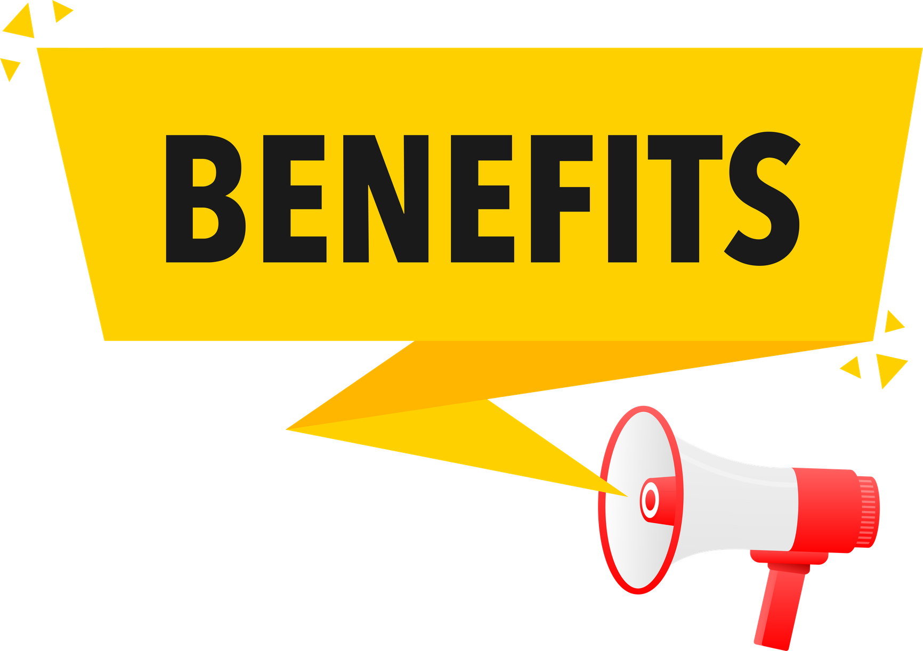
Promotes Social Cohesion
Supports disabled people to remain socially active & independent within their community.
Raises awareness of the range of disabilities, the impact of hate crime, and the importance of reporting.
Supports local businesses to be active in their local community.
Supports staff & volunteers to better understand small adjustments that can be made to help make a place more accessible and welcoming to disabled people.
Notes:
There are many benefits to Disability Friendly:
Disability friendly places help to promote social cohesion, this means that communities are working together to create more inclusive and welcoming spaces.
The initiative also helps to support people to remain socially active and independent within their community. Sometimes people may just need you to be a little more patient and if you understand some of the barriers that people may face, this helps you to provide a better service.
The training will help you to better understand the range of disabilities. Did you know that only around 7% of disabled people use a wheelchair? Isn’t it interesting that this is the universal symbol for disability, though the majority of disabilities are non visible.
Being part of the disability friendly network helps local organisations to be active in the community as the training helps staff and volunteers to better understand the small adjustments that can be made to help make spaces more accessible and welcoming to disabled people.
Finally, by supporting people in your community, you can help to tackle isolation and loneliness.

Slide 8
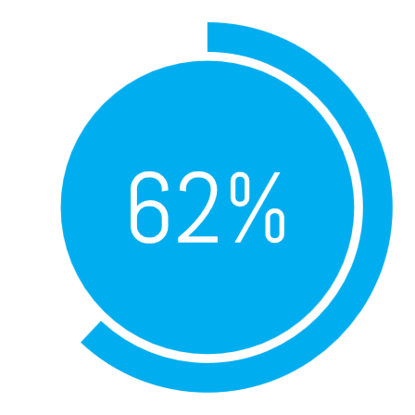


Why do we need Disability Friendly places?
Approximately 1 in 4 people in Scotland have a disability, many of which may be hidden disabilities. This means that 1 in 4 people in the community, potentially 1 in 4 customers and clients will have a disability.
3 out of 4 disabled people (72%) have experienced negative attitudes or behaviour towards them in the last 5 years
3 out of 4 disabled people (72%) have experienced negative attitudes or behaviour towards them in the last 5 years
9 out of 10 disabled people (87%) who had experienced negative attitudes or behaviour said it had a negative effect on their daily life.
64% of adults have witnessed someone be rude to or about a person with a learning disability at some point in their lifetime.
of disabled people reported that concerns about other people's views have stopped them from going outside.
Notes:
Why do we need disability friendly spaces? Recent Scottish Census data highlights that 24% of the Scottish population is registered as disabled or with a long-term illness. That is approximately 1 in 4 of us.
This means 1 in 4 people in the community have a disability.
Some of the statistics include;
3 out of 4 disabled people (72%) have experienced negative attitudes or behaviours towards them in the last 5 years.
56% of disabled people say that they have experienced hostility, aggression or violence from a stranger because of their condition.
9 out of 10 disabled people (87%) who had experienced negative attitudes or behaviour said it had a negative effect on their daily life.
64% of adults have witnessed someone be rude to or about a person with a learning disability at some point in their lifetime.
62% of disabled people reported that concerns about other people's views have stopped them from going outside.

Slide 9

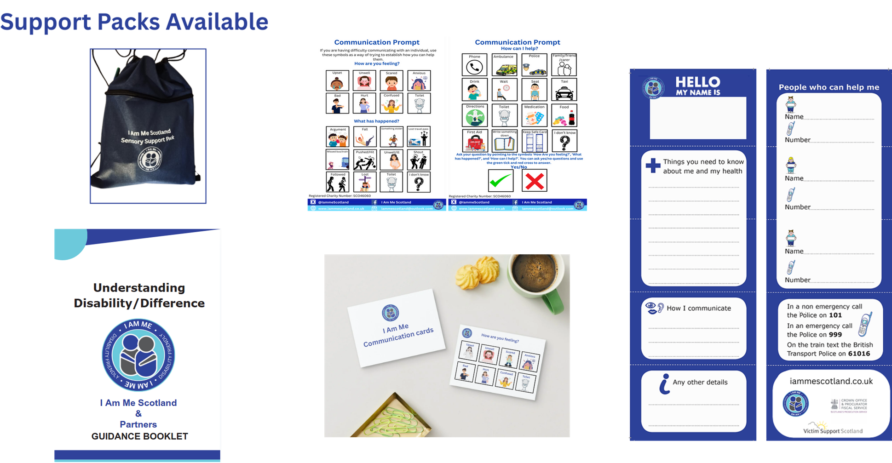
Notes:
I Am Me Scotland have some resources which can help to support people in your community. Their Understanding Disability booklet is free and provides links to a range of disability organisations across Scotland. It helps to identify some of the barriers that people can face in the community and provides links to each organisation. Their communication prompts are also free and can help to provide pictorial support to people, if they are having difficulty communicating. Contact cards are also free and available for anyone in the community. You can request any of the above by emailing Iammescotland@outlook.com.
Sensory packs can be customised for your individual settings and can be purchased via the I Am Me team.

Slide 10

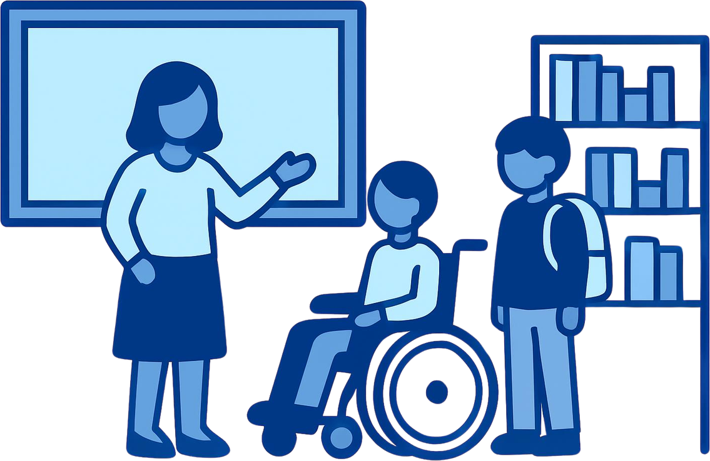

What can you do with YPI funds if you win?
You could help us develop a Disability Ambassador programme for young people in Scotland!
I Am Me
Notes:
What could you do with YPI funds if you win? You could help us to develop a Disability Ambassador programme for young people in Scotland.

Slide 11



Thank-you!
ANY QUESTIONS?
Iammescotland@outlook.com

