Slide 2
Discerning God’s Will
Outline
A Story
Decision Framework
Summary
AD Insights

Slide 3
Discerning God’s Will – A Story
AD Insights

Slide 4
Discerning God’s Will – A Story
Harbor
AD Insights

Slide 5
Discerning God’s Will – A Framework
Harbor
AD Insights

Slide 6
Discerning God’s Will – A Framework
Harbor
Biblical
Prayer & Fasting
Circumstance
Wise, Godly Counsel
Desire
Guts to act
AD Insights

Slide 7
Discerning God’s Will - Summary
Harbor
^{Romans 12:2}
Do not conform to the pattern of this world, but be transformed by the renewing of your mind.
Then you will be able to test and approve what God’s will is —His good, pleasing and perfect will.
Biblical
Desire
Prayer & Fasting
Circumstance
Wise, Godly Counsel
Guts to act
AD Insights

Slide 8
Discerning God’s Will
You can visit: ADInsights.com to download this summary slide and other helpful material
Thank you!
AD Insights

Slide 10
Discerning God’s Will
Harbor
Biblical
Desire
Prayer & Fasting
Circumstance
Wise, Godly Counsel
Guts to act
AD Insights

Slide 11
Discerning God’s Will
Harbor
Biblical
Desire
Prayer & Fasting
Circumstance
Wise, Godly Counsel
Guts to act
AD Insights

Slide 12
Discerning God’s Will
AD Insights

Slide 13
Discerning God’s Will – Romans 12:2
^{Romans 12:2}
Do not conform to the pattern of this world, but be transformed by the renewing of your mind.
Then you will be able to test and approve what God’s will is —His good, pleasing and perfect will.
AD Insights

Slide 14
Discerning God’s Will – Romans 12:2
^{Romans 12:2}
Do not conform to the pattern of this world, but be transformed by the renewing of your mind.
Then you will be able to test and approve what God’s will is —His good, pleasing and perfect will.
AD Insights

Slide 15
Discerning God’s Will
Harbor
Biblical
Desire
Prayer & Fasting
Circumstance
Wise, Godly Counsel
Guts to act
AD Insights

Slide 16
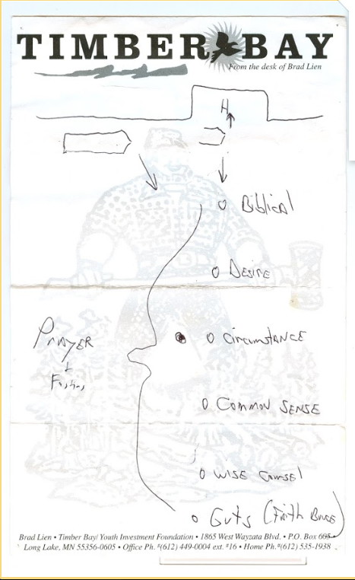
Discerning God’s Will
^{Romans 12:2}
² Do not conform to the pattern of this world, but be transformed by the renewing of your mind. Then you will be able to test and approve what God’s will is—his good, pleasing and perfect will.
^{Theme of good versus best}
^{My example}
MASTER Catch All SLIDE
AD Insights

Slide 17
Discerning God’s Will
Harbor
Biblical
Desire
MASTER SLIDE
Prayer & Fasting
Circumstance
Wise, Godly Counsel
Guts to act
AD Insights

