Slide 1
Planning & Pivoting
Lamb Data

Slide 2
Planning & Pivoting
Lambdata

Slide 3
Expectations and Errors (Part 1)
Outline
Apostle Paul’s Desire & Journey to Asia
Errors: Reducible and Non-Reducible
Vertical Insights

Slide 4
Acts 16:6
⁶ Paul and his companions traveled throughout the region of Phrygia and Galatia, having been kept by the Holy Spirit from preaching the word in the province of Asia.
⁷ When they came to the border of Mysia, they tried to enter Bithynia, but the Spirit of Jesus would not allow them to.
⁸ So they passed by Mysia and went down to Troas.
⁹ During the night Paul had a vision of a man of Macedonia standing and begging him, “Come over to Macedonia and help us.”
¹⁰ After Paul had seen the vision, we got ready at once to leave for Macedonia, concluding that God had called us to preach the gospel to them.
Vertical Insights

Slide 5
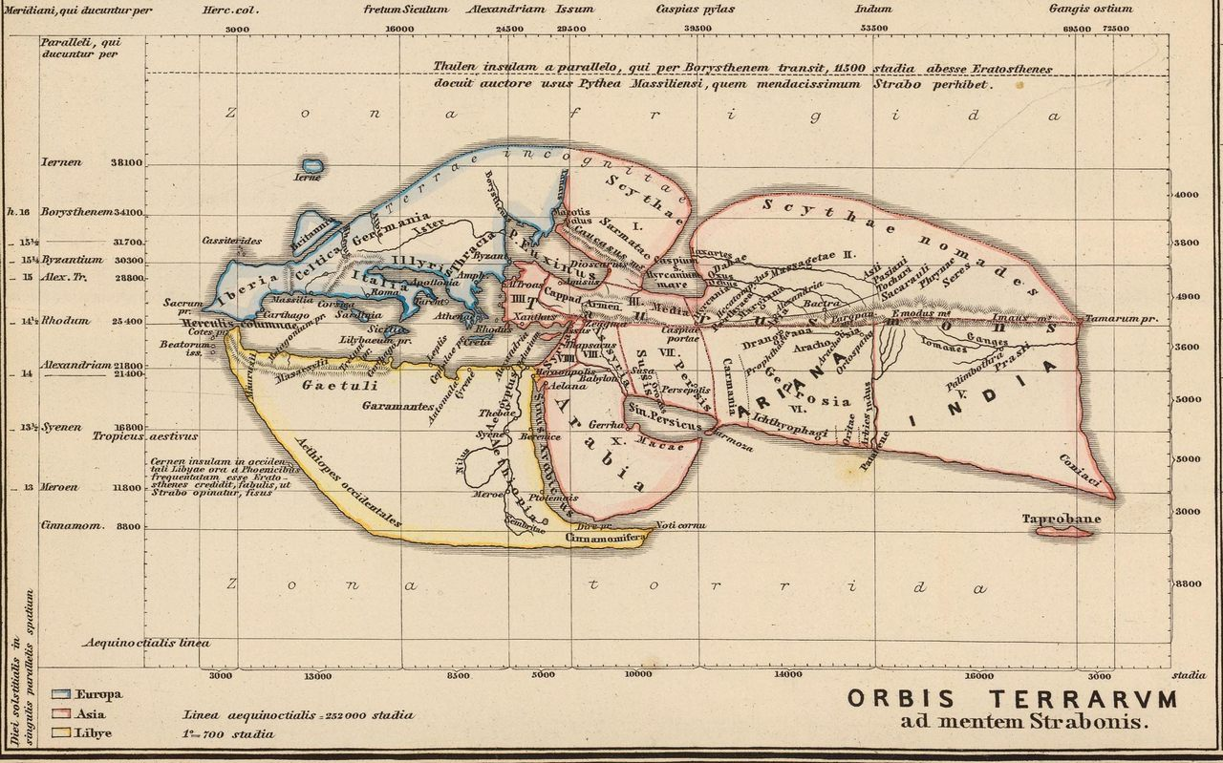
How a World Map Looked During the Time of Jesus & the Apostles
AD Insights
Source: According to Roman Geographers -
https://www.atlasobscura.com/articles/how-the-world-looked-when-jesus-was-born-according-to-roman-geographers

Slide 6
Acts 16:6-10
⁶ Paul and his companions traveled throughout the region of Phrygia and Galatia, having been kept by the Holy Spirit from preaching the word in the province of Asia.
⁷ When they came to the border of Mysia, they tried to enter Bithynia, but the Spirit of Jesus would not allow them to.
⁸ So they passed by Mysia and went down to Troas.
⁹ During the night Paul had a vision of a man of Macedonia standing and begging him, “Come over to Macedonia and help us.”
¹⁰ After Paul had seen the vision, we got ready at once to leave for Macedonia, concluding that God had called us to preach the gospel to them.
Vertical Insights

Slide 7
This is what Paul saw
Source - https://maprepublic.com/komodo-world-travel-map/
Vertical Insights

Slide 8
This is what God saw
Source - https://maprepublic.com/komodo-world-travel-map/
Vertical Insights

Slide 9
The Application
Even if…
you are walking with God,
your logic makes sense,
your perspective is wise,
but you are experiencing “left turns”…
Know that God is in it and see the whole picture
Be encouraged that even if you had all past knowledge, you would still make errors in what your plans / expectations would be
Vertical Insights

Slide 10
The Application
Even if…
you are walking with God,
your logic makes sense,
your perspective is wise,
but you are experiencing “left turns”…
Know that God is in it and sees the whole picture
Next, “Expectation and Error – Part 2,” shows statistically / mathematically shows how even if God gave you all past knowledge, you would still need to account for errors in what you expect / plan for.
Be encouraged that even if you had all past knowledge, you would still make errors in what your plans / expectations would be
Vertical Insights

Slide 12
Acts 16:6-10
⁶ Paul and his companions traveled throughout the region of Phrygia and Galatia, having been kept by the Holy Spirit from preaching the word in the province of Asia.
⁷ When they came to the border of Mysia, they tried to enter Bithynia, but the Spirit of Jesus would not allow them to.
⁸ So they passed by Mysia and went down to Troas.
⁹ During the night Paul had a vision of a man of Macedonia standing and begging him, “Come over to Macedonia and help us.”
¹⁰ After Paul had seen the vision, we got ready at once to leave for Macedonia, concluding that God had called us to preach the gospel to them.
Vertical Insights

Slide 13
Acts 16:6-10 How the World Looked During the Time of Jesus
(According to Roman Geographers)
https://www.atlasobscura.com/articles/how-the-world-looked-when-jesus-was-born-according-to-roman-geographers
AD Insights

Slide 14
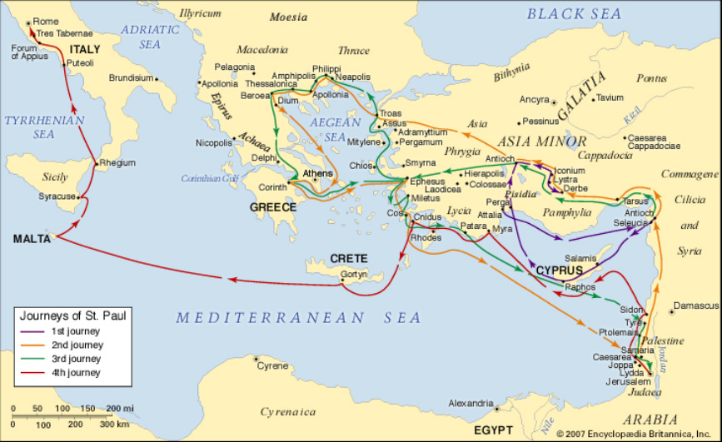
https://inthefootstepsofstpaulmcp.weebly.com/map.html

Slide 15
Acts 16:6-10 How the World Looked During the Time of Jesus
(According to Roman Geographers)
AD Insights
https://www.atlasobscura.com/articles/how-the-world-looked-when-jesus-was-born-according-to-roman-geographers

Slide 16
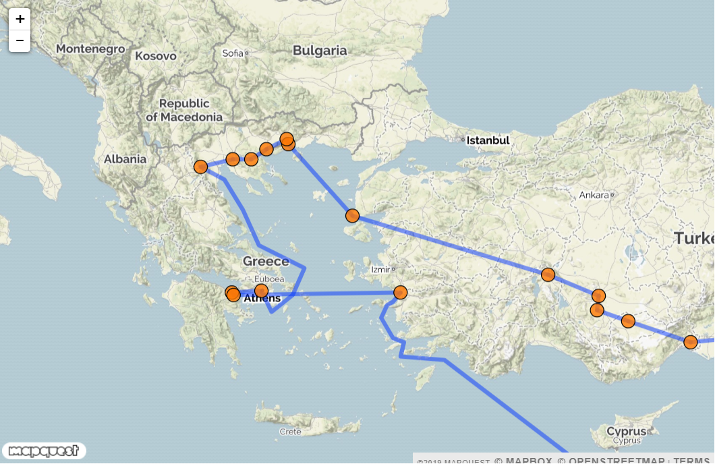
Acts 16:6-10
Do this but use old world map
Red Circle is where this passage takes place
Green circle is where they go
http://www.about-jesus.org/paul-second-missionary-journey-map.htm
Vertical Insights

Slide 17
Acts 16:6-10 How the World Looked During the Time of Jesus
(According to Roman Geographers)
AD Insights

Slide 18
Summary and Application
Outline
Apostle Paul’s Desire to go to Asia
Errors: Reducible and Non-Reducible
Vertical Insights

Slide 19
Errors: Reducible and Non-Reducible
Vertical Insights

Slide 20
Errors: Reducible and Non-Reducible
Reducible Error
Irreducible Error
Vertical Insights

Slide 21
Errors: Reducible and Non-Reducible
Irreducible Error
Vertical Insights

Slide 22
Errors: Reducible and Irreducible
Irreducible Error
Vertical Insights

Slide 23
Abc and 123
Vertical Insights

Slide 24
Abc and 123
Vertical Insights

Slide 26
Summary and Application
Summary
Application
Are you yielded to God and your logic makes sense and is wise but are experiencing a lot of left turns? God is in it
Be encouraged that even if you had all past knowledge, you would still make errors in what your plans / expectations would be
Vertical Insights

Slide 27
Abc and 123
Abc and 123
Vertical Insights

Slide 28
Abc and 123
Abc and 123
Vertical Insights

Slide 29
Abc and 123
Abc and 123
Vertical Insights

Slide 30
Abc and 123
Abc and 123
Vertical Insights

Slide 31
Abc and 123
Abc and 123
Vertical Insights

Slide 32
Abc and 123
Abc and 123
Vertical Insights

Slide 33
Abc and 123
Abc and 123
Vertical Insights

