Slide 1
Lion of Data
Planning & Pivoting
L
D

Slide 2

Outline: Planning & Pivoting
Challenge:
  Having a wise and logical plan, but then being sensitive enough to the Spirit to know when to pivot
Solution:
  Key Scriptures
  Seeing from Paul’s Eyes
  Seeing from God’s Eyes
  Application
  Summary

Slide 3
Key Scriptures: Acts 16:6
⁶ Paul and his companions traveled throughout the region of Phrygia and Galatia, having been kept by the Holy Spirit from preaching the word in the province of Asia.
⁷ When they came to the border of Mysia, they tried to enter Bithynia, but the Spirit of Jesus would not allow them to.
⁸ So they passed by Mysia and went down to Troas.
⁹ During the night Paul had a vision of a man of Macedonia standing and begging him, “Come over to Macedonia and help us.”
¹⁰ After Paul had seen the vision, we got ready at once to leave for Macedonia, concluding that God had called us to preach the gospel to them.

Slide 4
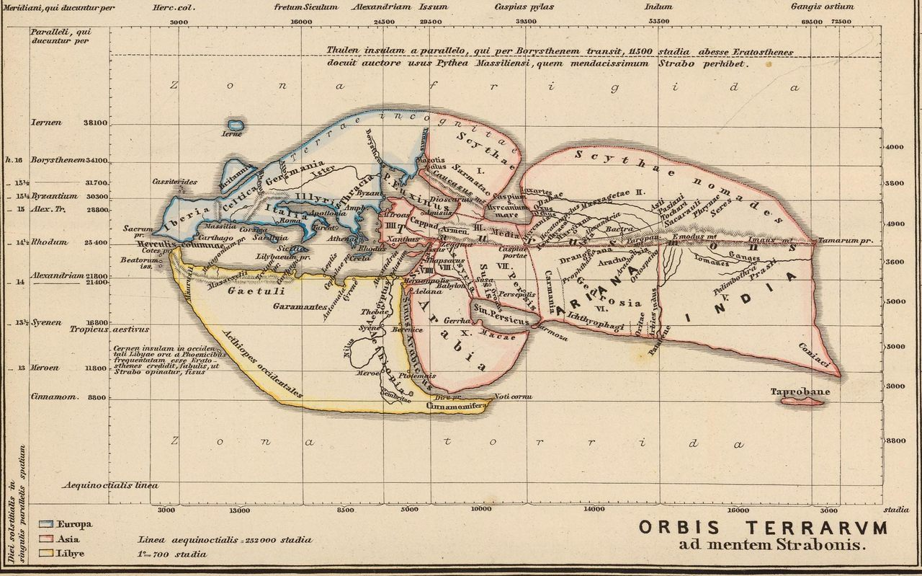
How a World Map Looked During the Time of Jesus & the Apostles
Source: According to Roman Geographers -
https://www.atlasobscura.com/articles/how-the-world-looked-when-jesus-was-born-according-to-roman-geographers

Slide 5
Key Scriptures: Acts 16:6-10
⁶ Paul and his companions traveled throughout the region of Phrygia and Galatia, having been kept by the Holy Spirit from preaching the word in the province of Asia.
⁷ When they came to the border of Mysia, they tried to enter Bithynia, but the Spirit of Jesus would not allow them to.
⁸ So they passed by Mysia and went down to Troas.
⁹ During the night Paul had a vision of a man of Macedonia standing and begging him, “Come over to Macedonia and help us.”
¹⁰ After Paul had seen the vision, we got ready at once to leave for Macedonia, concluding that God had called us to preach the gospel to them.

Slide 6
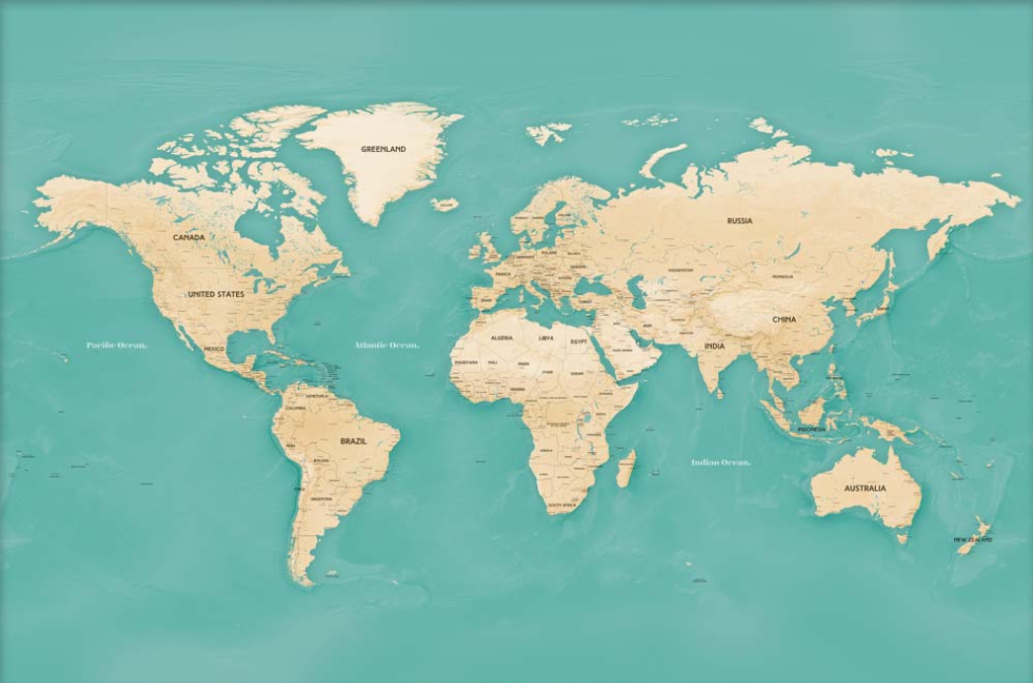
This is what Paul saw
Source - https://maprepublic.com/komodo-world-travel-map/

Slide 7
This is what God saw
Source - https://maprepublic.com/komodo-world-travel-map/

Slide 8
The Application: Planning & Pivoting
Even if…
  you are walking with God,
  your logic makes sense,
  your perspective is wise,
  but you are experiencing “No’s” / “left turns”…
  Know that God is in it and sees the whole picture

Slide 9
Summary: Planning & Pivoting
What God saw
What Paul saw

Slide 10

Planning & Pivoting
Lion Data

Slide 11

Planning and Pivoting
Challenge:
  Having a wise and logical plan, but then being sensitive enough to the Spirit to know when to pivot
Solution:
Key Scriptures
Seeing from Paul’s Eyes
Seeing from God’s Eyes
Application
Summary

Slide 12
Acts 16:6
⁶ Paul and his companions traveled throughout the region of Phrygia and Galatia, having been kept by the Holy Spirit from preaching the word in the province of Asia.
⁷ When they came to the border of Mysia, they tried to enter Bithynia, but the Spirit of Jesus would not allow them to.
⁸ So they passed by Mysia and went down to Troas.
⁹ During the night Paul had a vision of a man of Macedonia standing and begging him, “Come over to Macedonia and help us.”
¹⁰ After Paul had seen the vision, we got ready at once to leave for Macedonia, concluding that God had called us to preach the gospel to them.

Slide 13
How a World Map Looked During the Time of Jesus & the Apostles
Source: According to Roman Geographers -
https://www.atlasobscura.com/articles/how-the-world-looked-when-jesus-was-born-according-to-roman-geographers

Slide 14
Acts 16:6-10
⁶ Paul and his companions traveled throughout the region of Phrygia and Galatia, having been kept by the Holy Spirit from preaching the word in the province of Asia.
⁷ When they came to the border of Mysia, they tried to enter Bithynia, but the Spirit of Jesus would not allow them to.
⁸ So they passed by Mysia and went down to Troas.
⁹ During the night Paul had a vision of a man of Macedonia standing and begging him, “Come over to Macedonia and help us.”
¹⁰ After Paul had seen the vision, we got ready at once to leave for Macedonia, concluding that God had called us to preach the gospel to them.

Slide 15
This is what Paul saw
Source - https://maprepublic.com/komodo-world-travel-map/

Slide 16
This is what God saw
Source - https://maprepublic.com/komodo-world-travel-map/

Slide 17
The Application
Even if…
  you are walking with God,
  your logic makes sense,
  your perspective is wise,
  but you are experiencing “left turns”…
  Know that God is in it and sees the whole picture

Slide 18
Summary: Planning & Pivoting
What God saw
What Paul saw

Slide 20
The Application
Even if…
  you are walking with God,
  your logic makes sense,
  your perspective is wise,
  but you are experiencing “left turns”…
  Know that God is in it and sees the whole picture
Next, “Expectation and Error – Part 2,” shows statistically / mathematically shows how even if God gave you all past knowledge, you would still need to account for errors in what you expect / plan for.
Be encouraged that even if you had all past knowledge, you would still make errors in what your plans / expectations would be
Vertical Insights

Slide 21
Acts 16:6-10
⁶ Paul and his companions traveled throughout the region of Phrygia and Galatia, having been kept by the Holy Spirit from preaching the word in the province of Asia.
⁷ When they came to the border of Mysia, they tried to enter Bithynia, but the Spirit of Jesus would not allow them to.
⁸ So they passed by Mysia and went down to Troas.
⁹ During the night Paul had a vision of a man of Macedonia standing and begging him, “Come over to Macedonia and help us.”
¹⁰ After Paul had seen the vision, we got ready at once to leave for Macedonia, concluding that God had called us to preach the gospel to them.
Vertical Insights

Slide 22
Acts 16:6-10 How the World Looked During the Time of Jesus
(According to Roman Geographers)
https://www.atlasobscura.com/articles/how-the-world-looked-when-jesus-was-born-according-to-roman-geographers
AD Insights

Slide 23
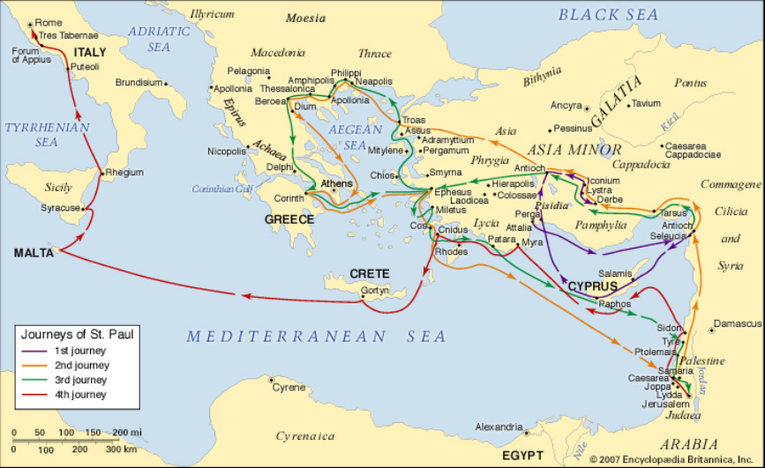
https://inthefootstepsofstpaulmcp.weebly.com/map.html

Slide 24
Acts 16:6-10 How the World Looked During the Time of Jesus
(According to Roman Geographers)
AD Insights
https://www.atlasobscura.com/articles/how-the-world-looked-when-jesus-was-born-according-to-roman-geographers

Slide 25
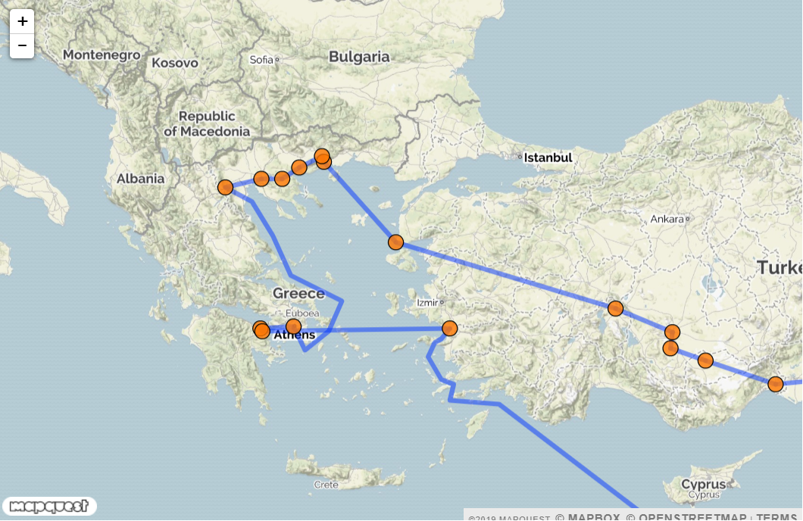
Acts 16:6-10
Do this but use old world map
Red Circle is where this passage takes place
Green circle is where they go
http://www.about-jesus.org/paul-second-missionary-journey-map.htm
Vertical Insights

Slide 26
Acts 16:6-10 How the World Looked During the Time of Jesus
(According to Roman Geographers)
AD Insights

Slide 27
Summary and Application
Outline
Apostle Paul’s Desire to go to Asia
Errors: Reducible and Non-Reducible
Vertical Insights

Slide 28

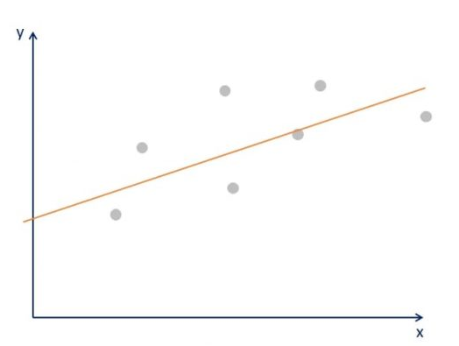
Errors: Reducible and Non-Reducible
Vertical Insights

Slide 29






Errors: Reducible and Non-Reducible
Reducible Error
Irreducible Error
Vertical Insights

Slide 30


Errors: Reducible and Non-Reducible
Irreducible Error
Vertical Insights

Slide 31
Errors: Reducible and Irreducible
Irreducible Error
Vertical Insights

Slide 32
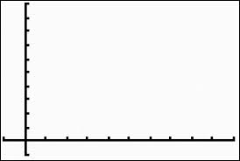
Abc and 123
Vertical Insights

Slide 33
Abc and 123
Vertical Insights

Slide 35
Summary and Application
Summary
Application
Are you yielded to God and your logic makes sense and is wise but are experiencing a lot of left turns? God is in it
Be encouraged that even if you had all past knowledge, you would still make errors in what your plans / expectations would be
Vertical Insights

Slide 36
Abc and 123
Abc and 123
Vertical Insights

Slide 37
Abc and 123
Abc and 123
Vertical Insights

Slide 38
Abc and 123
Abc and 123
Vertical Insights

Slide 39
Abc and 123
Abc and 123
Vertical Insights

Slide 40
Abc and 123
Abc and 123
Vertical Insights

Slide 41
Abc and 123
Abc and 123
Vertical Insights

Slide 42
Abc and 123
Abc and 123
Vertical Insights

