Slide 2
Argyle Archery 2022-2023
Welcome!
History – over 15 years, multi-Champions, 4th yr under AYSA
Location – Argyle Intermediate Campus
Board Members
Jeff Harbison – AYSA VP of Archery
Darlino Faria – Treasurer
Christine Faria – Schools Liaison
Katey Harbison – Volunteer Coordinator
Joan Wittmis – Education Director
David Wintermute – 3D Head Coach
Tom Cherms – Elementary Lead
Augustina Cherms – Hilltop Team Manager
Chris Kasallis – HS Bullseye Head Coach
Jay Kasallis – HS Bullseye Team Manager

Slide 3
Argyle Archery 2022-2023
Team Coaches and Managers
(These are your primary points of contact.)
School | High School | Middle School | Hilltop Elem | West Elem | South Elem
Head Coach | Chris Kasallis | Jeff Bouquio | Joan Wittmis | Shawn Stief | Craig Bates
Assist Coach | Scott Anderson | John Withers |  |  | Jennifer Zenuch
Manager | Jay Kasallis | Cheryl Listi | Augustina Cherms | Candace Rivet | Jennifer Zenuch
Remaining Coaching Roster
Brian Berney Daryl Brun Matt Chapman Kyle Cherms Jason Conway
Melissa Hawkes Marisol Hernandez Ellen Leuschner Mark Moellering
Plus Board Members

Slide 4
Argyle Archery 2022-2023
Practice Schedule
Week of Sept 19 and 26 New Archers ONLY
Mon, Tues, and Wed @ 5:30: All 19 New Archers from South & 5 from Hilltop.
Mon, Tues, and Wed @ 6:30: All 15 New Archers from West & 8 from Hilltop.
Tues and Wed @ 7:30: All Middle & High School New Archers.
Beginning Oct 3, all archers:
Elementary Schools @5:30 ( Hilltop – Mon; West – Tue; South - Wed)
Middle School (Mon, Tues, Wed) @ 6:30;
High School (Tues, Wed) @ 7:30.
3D - Thurs (Middle School 6:30; High School 7:30)
SignUpGenius for MS and HS to select primary practice day.
School breaks per coaching availability

Slide 5
Argyle Archery 2022-2023
Tournament Schedule
Tournaments - schedule on our website, up to Team Mgrs to register for individual flight times.
Annual Timeline
State – March 22 or 23
State Qualifier in January
National is in Salt Lake City, Utah suburbs around April 21-23??
Must shoot a good State Score to qualify
Open varies, over the summer, in Louisville, Orlando, Myrtle Beach??
Two tiers – same Tournament
Open: open to all archers
Championship: must score well at Nationals to qualify

Slide 6
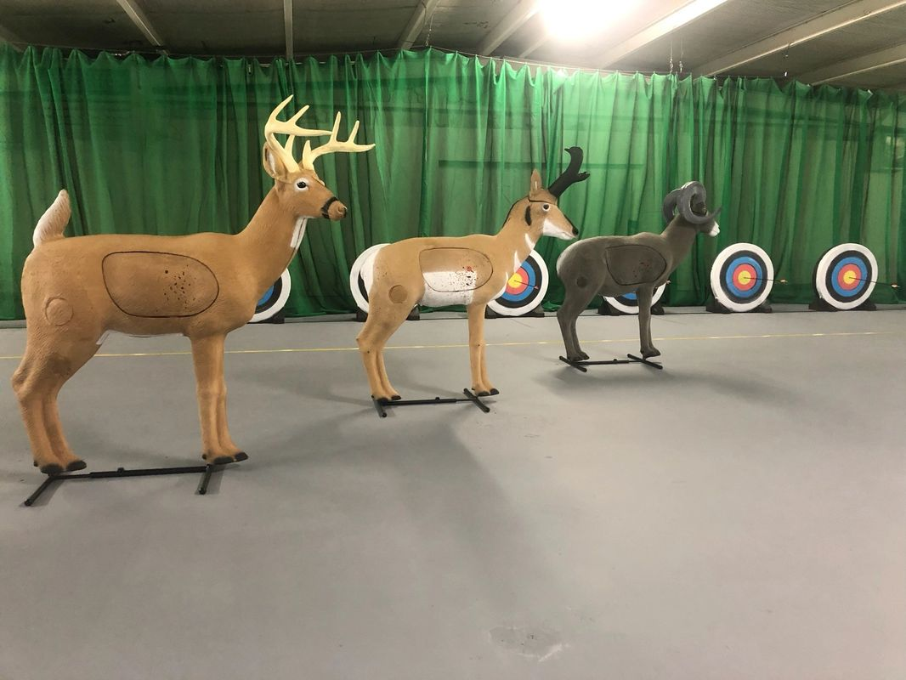
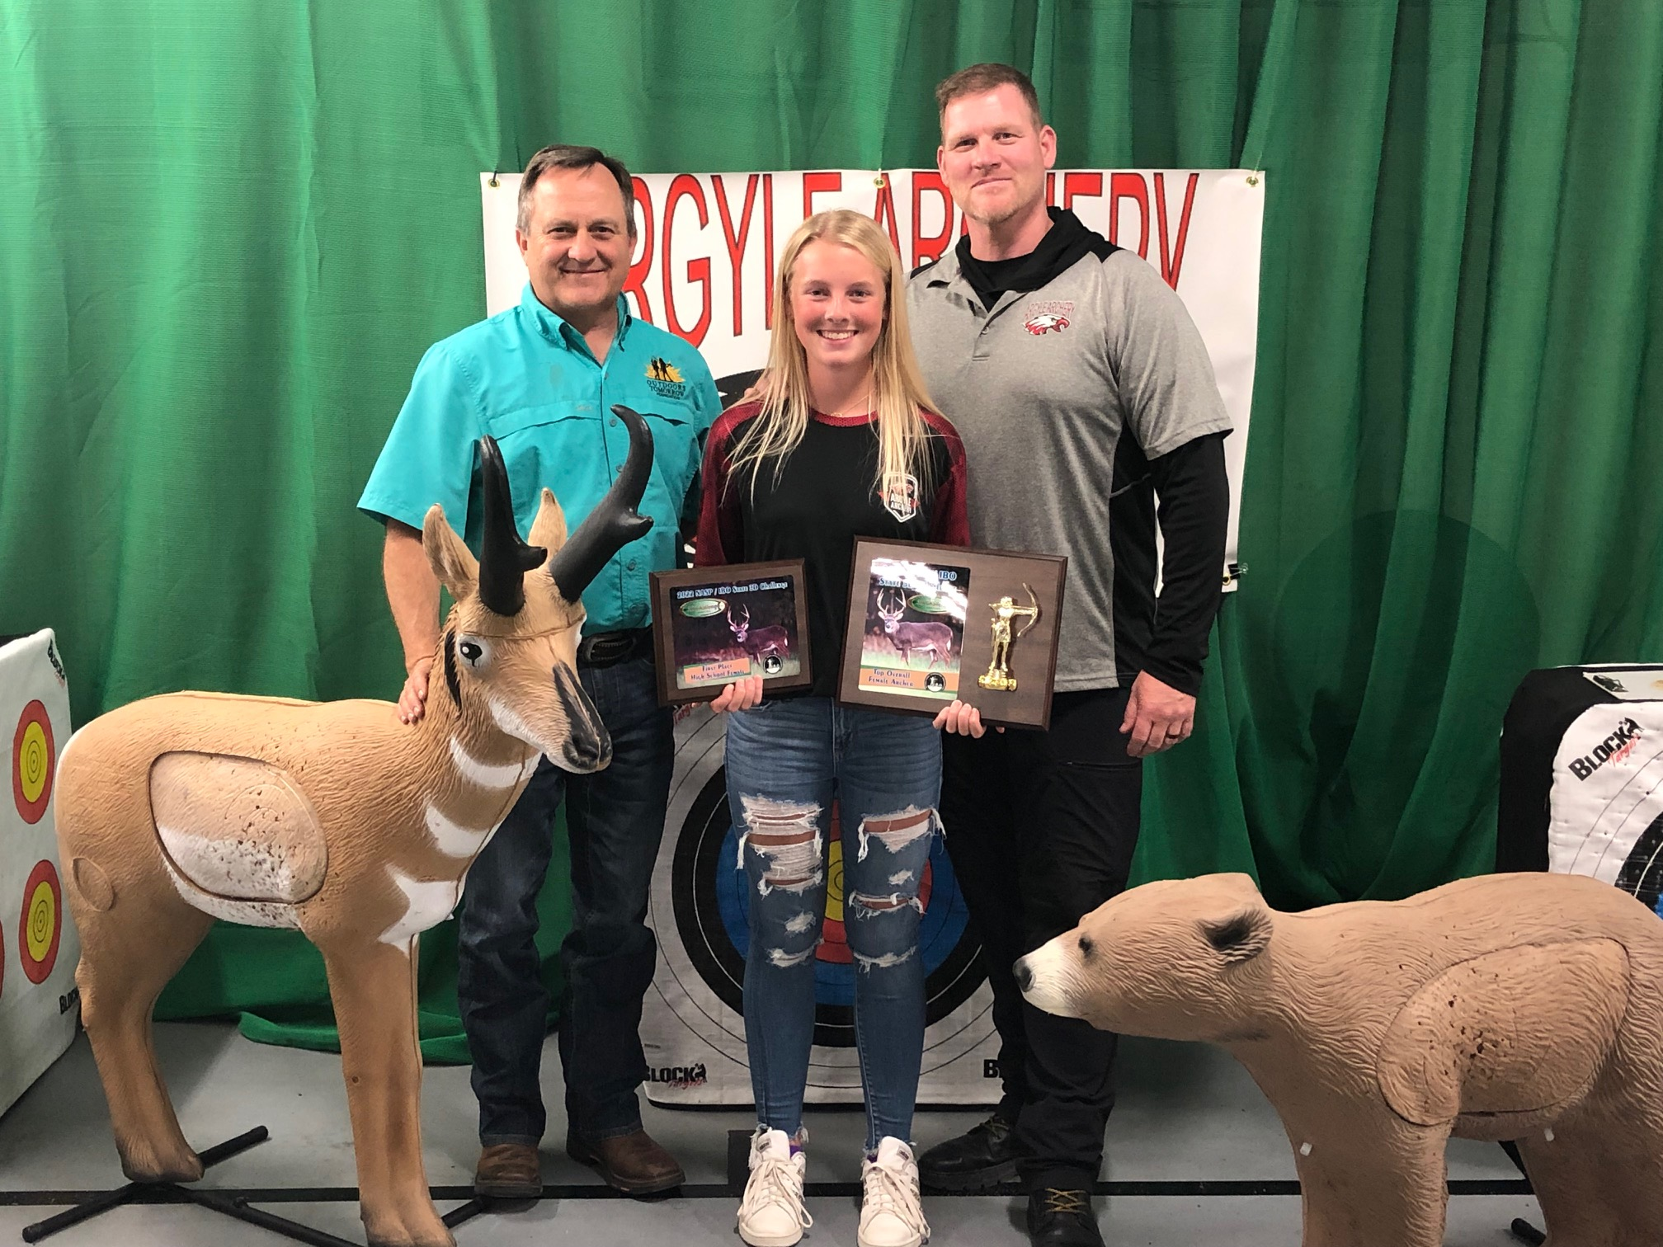
Argyle Archery 2022-2023
3D Coach Wintermute
3D is only open to Middle and High School archers.
Must demonstrate above average ability to be invited.
$70 payment via CheddarUp once invited.
Begins after first 2-3 weeks of season

Slide 7
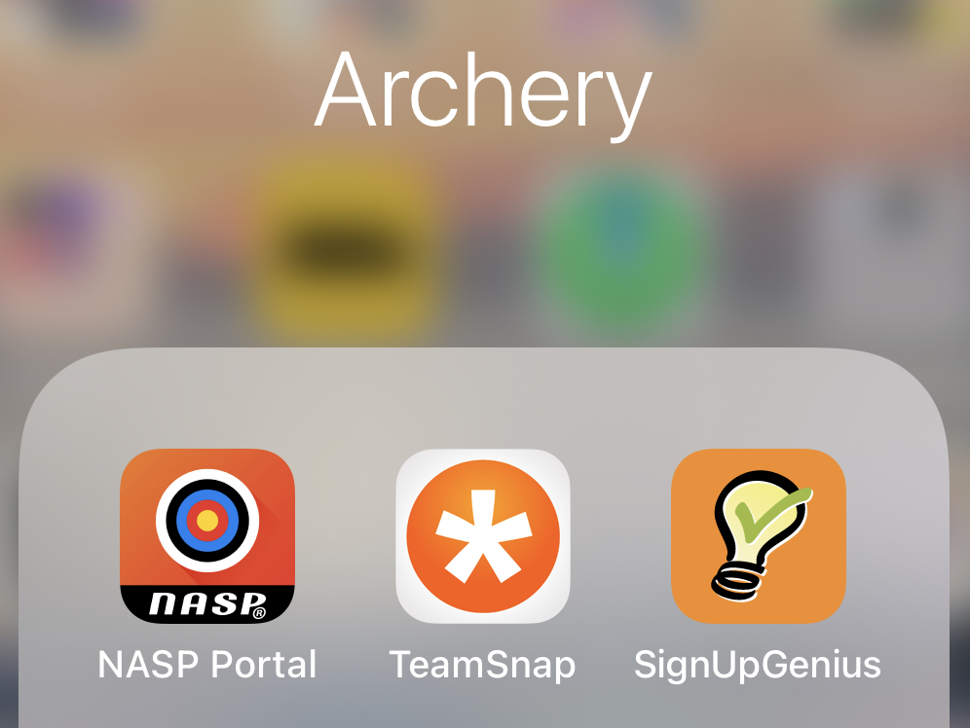
Argyle Archery 2022-2023
Web Apps
www.ArgyleArchery.com
TeamSnap
SignUpGenius
CheddarUp
Facebook – Argyle Archery
NASP Portal
NASPSchools.org
NASPTournaments.org
NASPBAI.org

Slide 8
Argyle Archery 2022-2023
Equipment – Genesis Original, Easton arrows
All on NASP’s and our websites.
Rosters
They are posted on our website.
Please review for accuracy. (Shirt size, bow rental, school, grade, M/F)
Spirit Wear – Erika Withers, Annalisa Stief
Medical Training – Holly Telford
Clean Up Day – Jay Kasallis
Private Lessons – Brian Lucas

Slide 9
Argyle Archery 2022-2023
SignUpGenius links on Parent Info tab of ArgyleArchery.com
For the Weeks of Sept 19 and 26 - New Archers ONLY:
Mon, Tues, and Wed @ 5:30: Need 5 from Hilltop.
Mon, Tues, and Wed @ 6:30: Need 8 from Hilltop.
Beginning October 3 and for remainder of season:
Need all Middle School archers to select primary practice day – Monday, Tuesday or Wednesday.
Need all High School archers to select primary practice day –Tuesday or Wednesday.
We will use SignUpGenius to reserve unused lanes for additional practice slots. Prefer you stay at your skill level.

