Slide 1
SentinelOne Threat Services
Vigilance MDR & DFIR
WatchTower Threat Hunting
September 2021

Slide 2



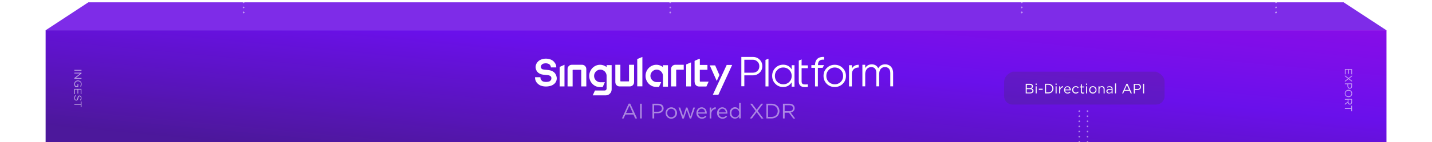




Prevention & Control
Detection & Response
Remediation & Recovery
THREAT HUNTING & RESPONSE SERVICES
Threat Hunting & Compromise Assessment
Managed Detection & Response (MDR)
Digital Forensics & Incident Response (DFIR)

Slide 3




Excellent
CUSTOMERS
ARE OUR #1
95%
Customer Satisfaction (CSAT) is ~95%
Net Promoter Score in the “great” to “excellent” range
Vigilance Locations
North America, EMEA, Asia Pacific
Supported Languages
English, Russian, Hebrew, Polish, German,
Portuguese, Arabic, Hindi, Spanish, French
“
Putting the customer back into “customer service.”
CISO
30B+ USD
Notes:
North America:
Mountain View, CA
Eugene, OR
Philadelphia, PA
Dallas, TX
Tampa, FL
Hawaii
EMEA:
Amsterdam
Prague
Poland
Munich
APJ:
Tokyo
India
Australia

Slide 4




Leading Technology Managed by Global Experts
96%
Of Reviewers Recommend SentinelOne Vigilance MDR
4.9 / 5
Rating by Reviewers
Challenge #1
Skills & Knowledge Gap
Challenge #2
Time & Resource Shortage
Challenge #3
Alert & Managerial Fatigue
Experience & Expertise
Augment Your SOC with
Elite Analysts & Responders
Global, 24x7
Peace-of-Mind
Refocus on More Strategic Initiatives by Offloading Day-to-Day Operations
Action, Not Alerts
See Fast Time to Value With a Human Lens Acting on Machine-Built Context

Slide 5


Tackle Every Threat With Breadth & Depth
Proactive Preparation, Rapid Response
Customized
Threat Hunting & Compromise Assessment
Active Campaign Threat Hunting & Intelligence
Managed Detection & Response (MDR)
Digital Forensics & Incident Response (DFIR)
Hunting and Reporting for Today’s Most Prolific Threat Actors, Crimeware, and Campaigns
24x7x365 Threat Analysis & Containment, Escalation When Necessary
Forensic Investigation &
Malware Analysis
Comprehensive Hunting for All Current & Historical Threats, IOAs, and Risky Security Practices
LEVEL OF TAILORED ENGAGEMENT

Slide 6



Threat Services at a Glance
MDR & DFIR
Threat Hunting
Customized Threat Hunting & Compromise Assessment
Comprehensive Hunting for All
Current & Historical Threats, Indicators of Attack, and Risky Security Practices
Digital Forensics & Incident Response (DFIR)
Forensic Investigation, Malware Analysis, and In-House Incident Response
Active Campaign Threat Hunting & Intelligence Reporting
Hunting for Today’s Most Prolific Threat Actors, Crimeware, and Campaigns
Managed Detection & Response
24x7x365 Threat Analysis & Containment, Escalation When Necessary

Slide 7
Seeing Success with SentinelOne
01
How the World’s Leading Enterprises Are Seeing Immediate Time-to-Value With SentinelOne Threat Services

Slide 8





How We Drive Response, Results, and ROI
Most Threats Resolved in <60 minutes
As an Extension of Your Team, We Handle >99%
of the Work and Escalate Only as Needed
SOC Augmentation
Accomplish More With Existing Time & Resources
Proven Expertise
Prepare for Tomorrow’s Threat Landscape Backed by Our Elite, Experienced Team
Fewer Alerts, More Context
Make Strategic, Informed Decisions for Your Program
“
The quick response of the Vigilance team has helped us finally find some peace during off-hours and weekends.
24x7 Global Coverage
Stay Reactive & Responsive, No Matter the Time or Location
Intelligence-Informed Offense
Take the Battle to Attackers, Before They Strike
CYBERSECURITY ENGINEER
50M - 250M USD
Peace of Mind
Gain Confidence in Every Move, From Prevention
Through Recovery

Slide 9

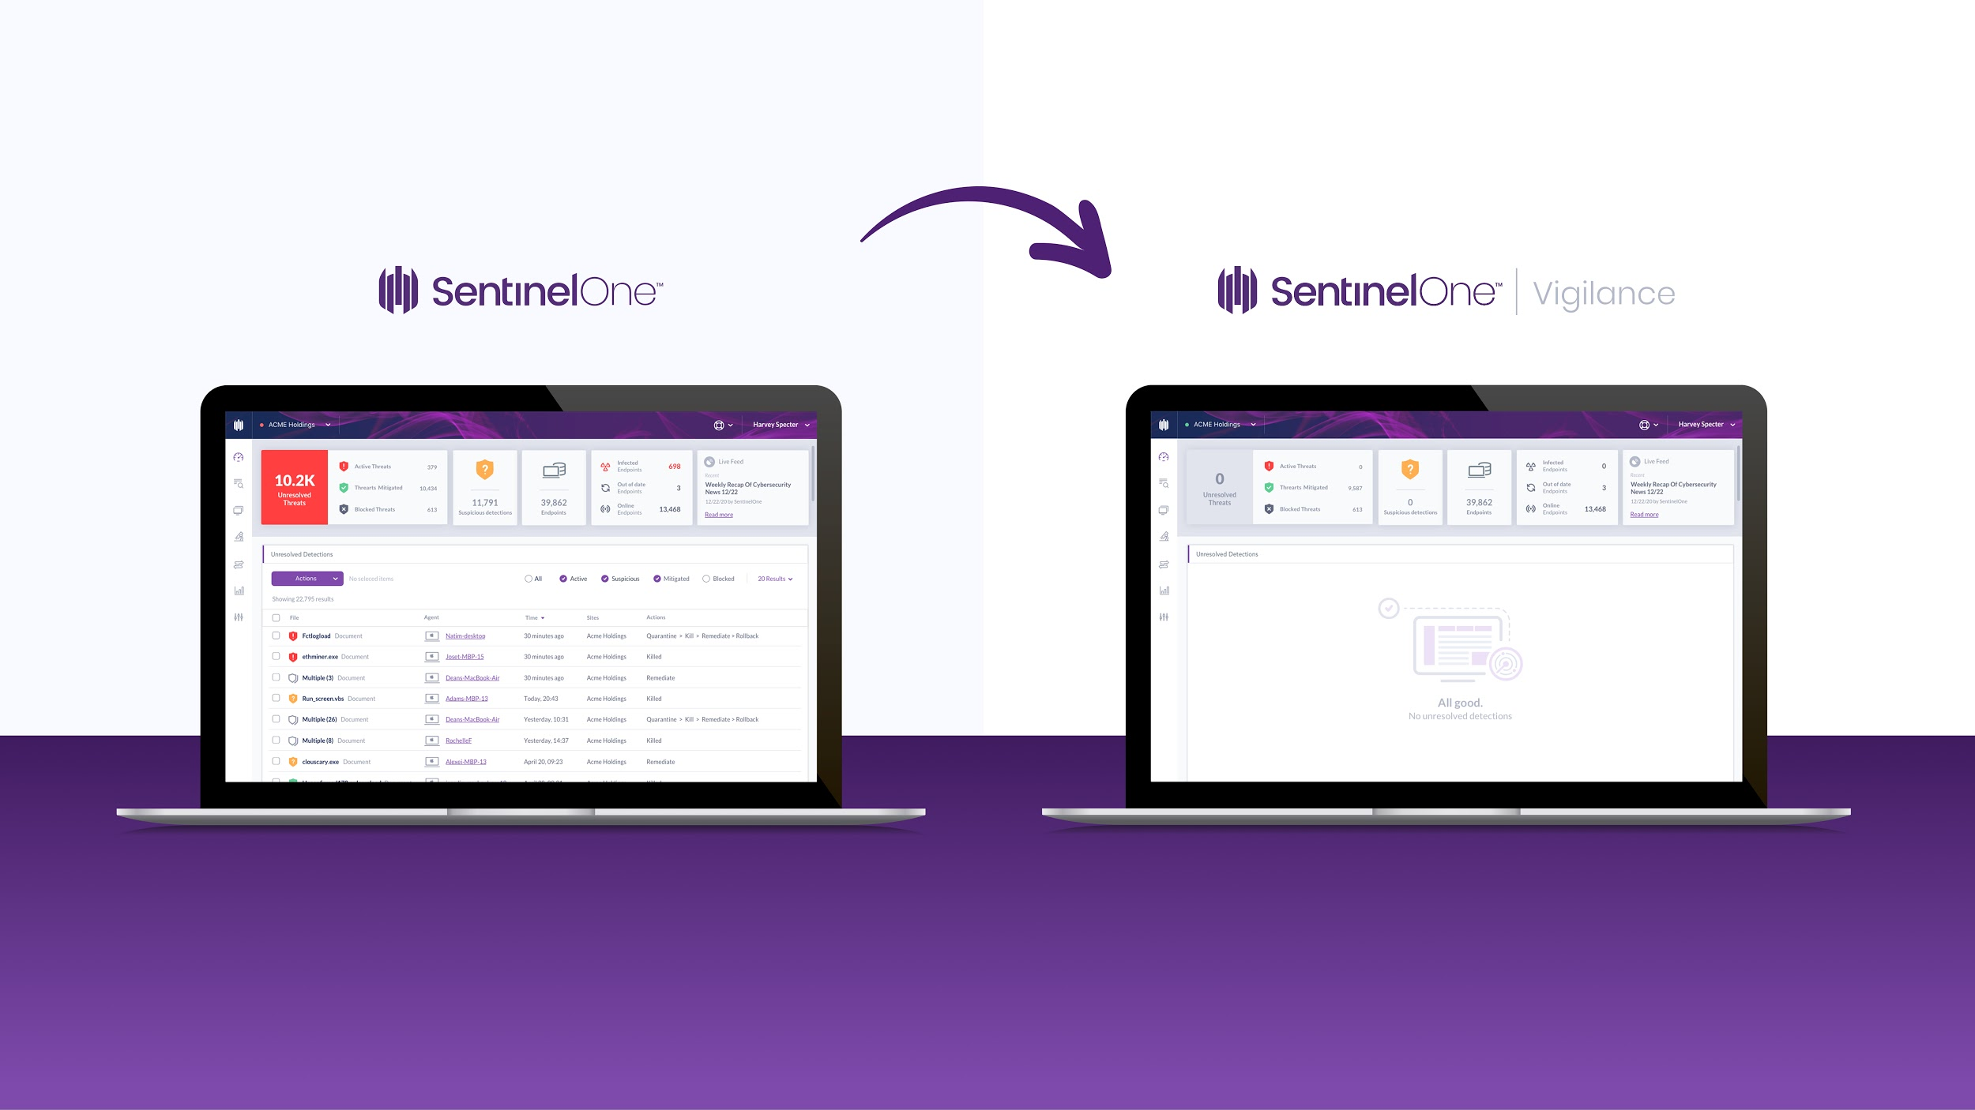
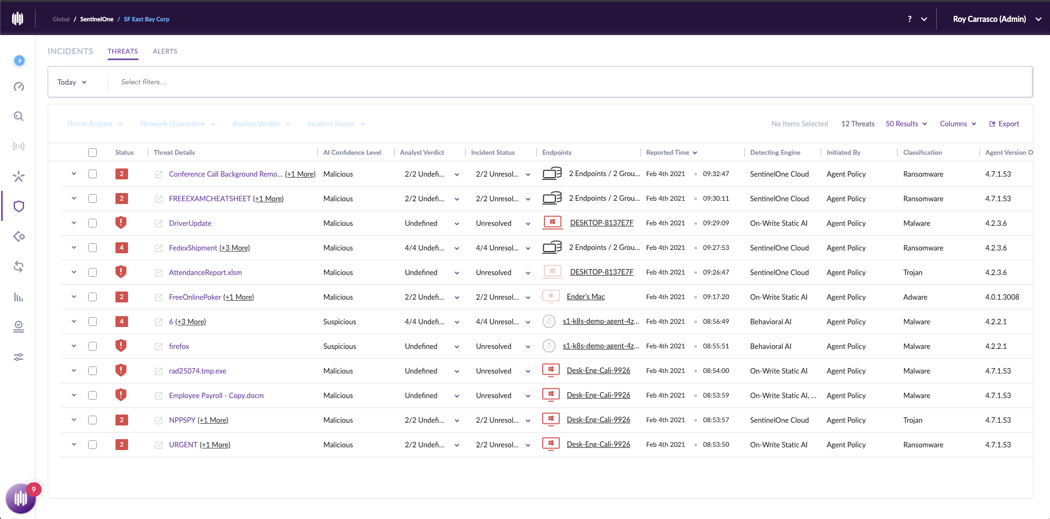
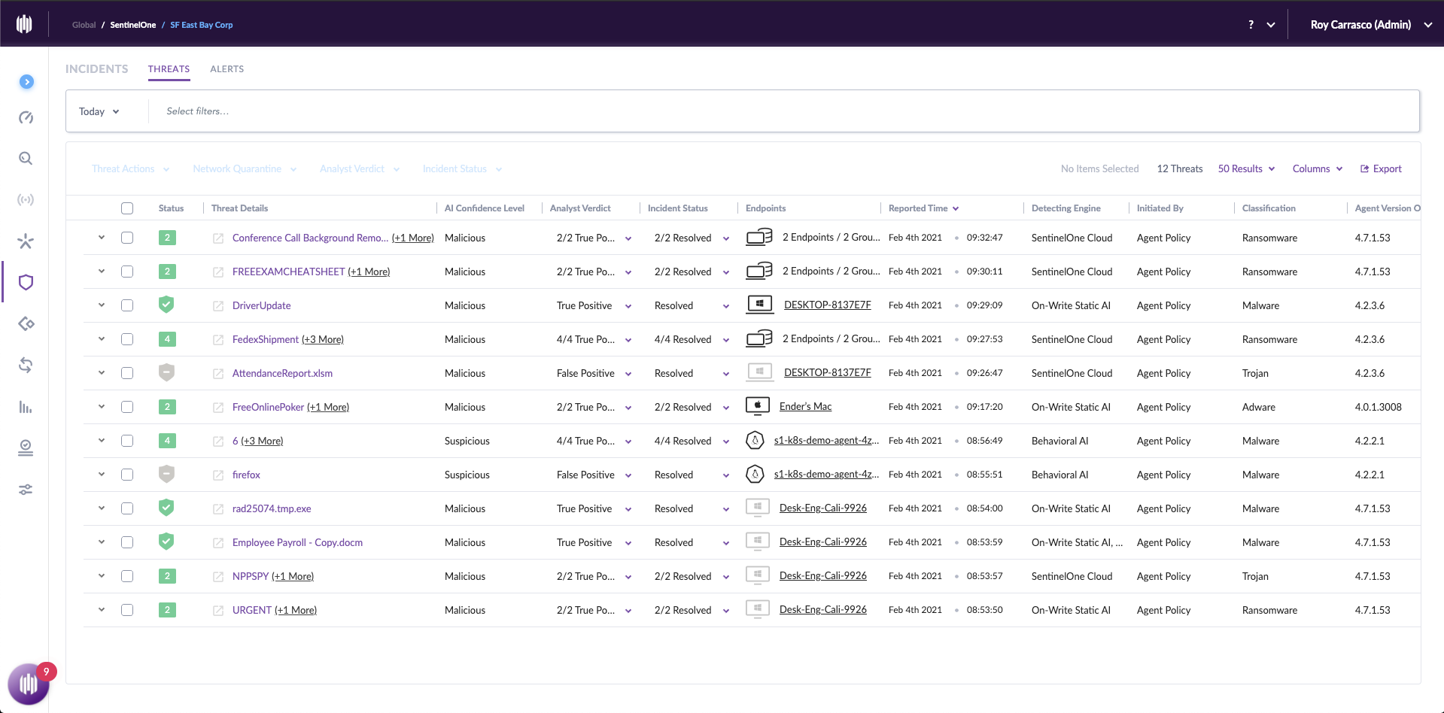

26 Unresolved Threats
All Remediated
& Resolved
© 2021 SentinelOne. All Rights Reserved.

Slide 10
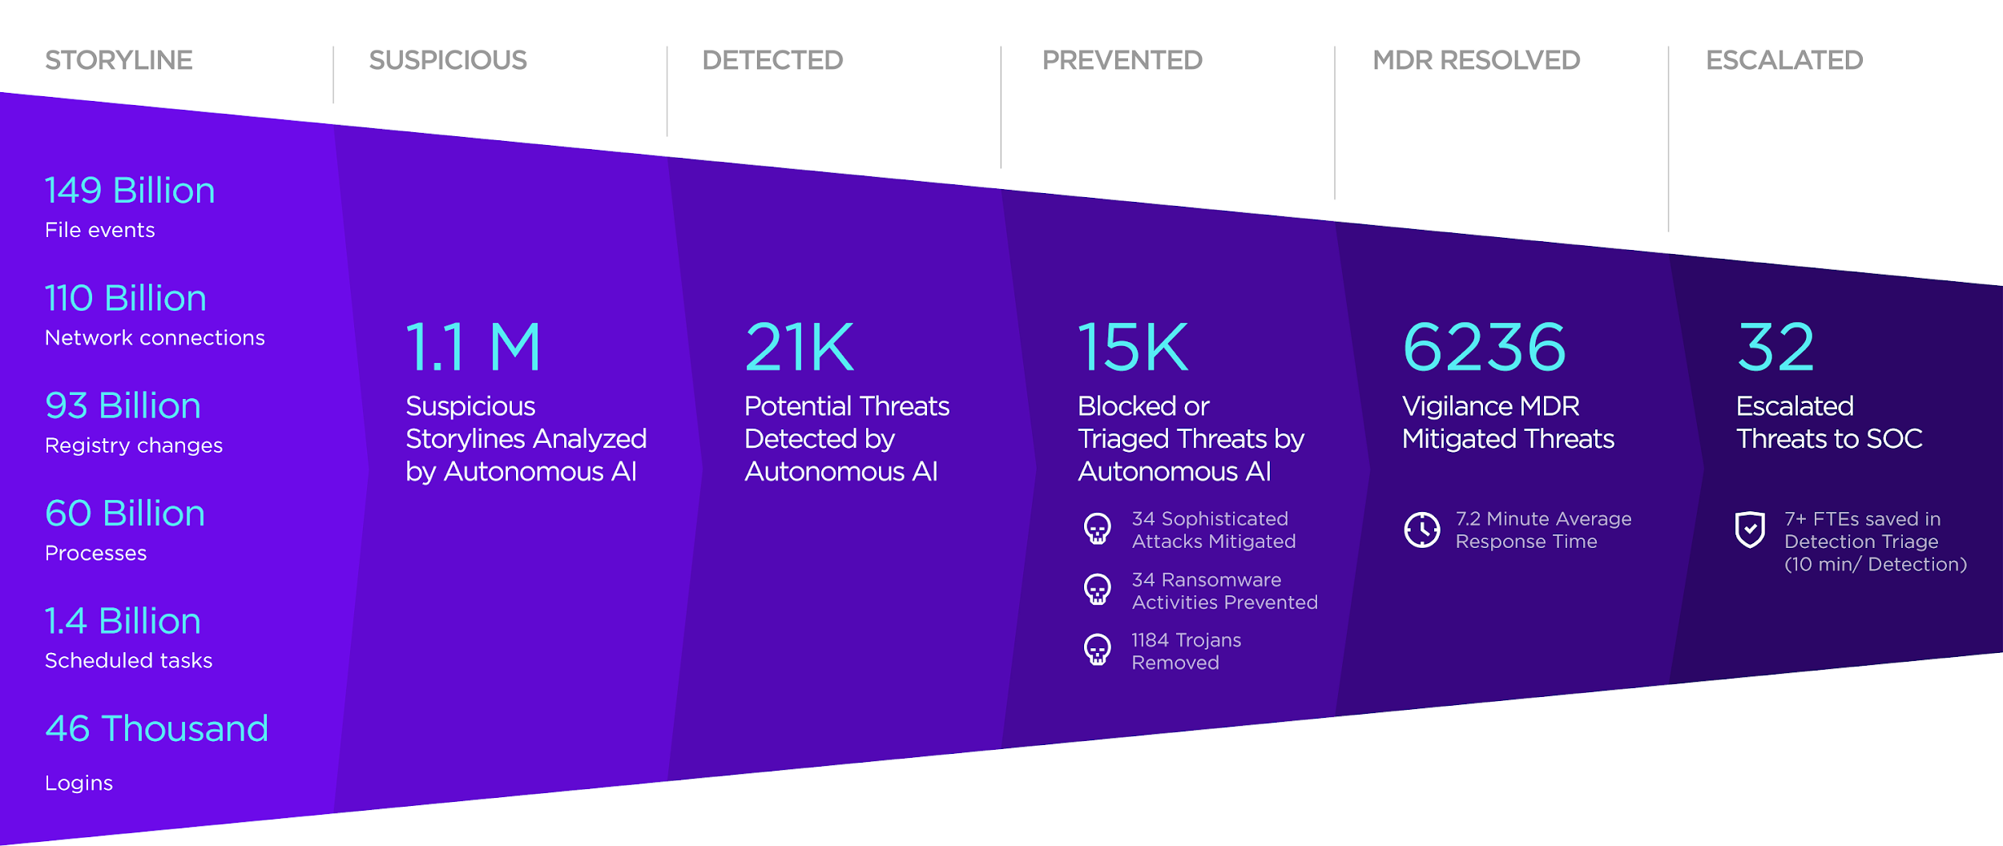


Real Customer. Real Results.
“We finally find some peace during the off-hours and weekend because we know our endpoints are protected 24/7 by the Vigilance team. One of our best investments.”
Notes:
Real Fortune 10 customer with 100k+ endpoints

Slide 11
Gartner Peer Insights: MDR
“I was blown away by how quickly and efficiently the Vigilance team picked up on the quirks of our environment.”
“Very good indeed. The most interesting thing is all the insights you can get by analyzing incidents.
4.8 / 5
July 17, 2020
Misc. Industry, 10B-30B USD
Security & Risk Management Role
September 19, 2021
Energy & Utilities Industry, 30B+ USD
Data & Analytics Role
Managed Detection and Response (MDR)
Services Reviews and Ratings
“Vigilance is a MUST! I can say with 100% certainty that you will not be disappointed. The best in the industry.”
“The SentinelOne console is very user friendly and the Vigilance service is very responsive. Each new version brings quality of life improvements.”
August 21, 2020
Finance Industry, <50M USD
Security & Risk Management Role
April 29, 2021
Healthcare Industry, 1B - 3B USD
Security & Risk Management Role
Source: Gartner Peer Insights MDR

Slide 12
Vigilance
Threat Services
02
Digital Forensics Incident Response (DFIR)
Managed Detection and Response (MDR)

Slide 13

Managed Detection & Response
The Team
MDR + Digital Forensics & Incident Response form a security safety net. Extended investigation and response, faster SLAs, and direct IR Pro access.
Tier-1, Tier-2, and Tier-3 cybersecurity experts
100% in-house, non-outsourced
Global, 24/7 operations
Millions of endpoints under management
Managed Detection & Response to augment your security operations. Triage, Resolution, and Escalation when necessary.
Vigilance Respond Adds Value
Every threat reviewed, acted on, & documented
Escalations occur as needed
Respond Pro level adds Digital Forensics & Incident Response (DFIR)
Includes hunting for active, emergent threats
Accelerate your threat response & minimize downstream costs and impact with Vigilance Respond Pro
Respond Pro brings incident response in-house to detect, investigate, and recover faster than possible with an external vendor, with only a 4 hour minimum retainer charge per engagement.
Notes:
Threat Intelligence is integrated into MDR by cross referencing VirusTotal, Reversing Labs, multiple dynamic analysis sandboxes, and the tracking of digital signers that are compromised or associated with PUPs.

Slide 14
How It Works
Threat
Detected
Analyst
Deep Dive
Threat
Insights
Action
& Next Steps
DFIR
Goes Deeper
AI queuing mechanisms
prioritize threats
Threats are classified by AI/ML, Signal threat intelligence, ActiveEDR+Storyline, MITRE® TTPs, logs, and analyst judgment
All console incidents are interpreted and annotated to keep you in the loop
Vigilance mitigates and resolves threats for you and opens proactive escalation as needed
Respond Pro customers can trigger forensic deep dives, targeted threat hunting, and IR
Expert Staff
~30 Min. Response Time
Adaptive Playbooks
Trusted
Never Outsourced
Our Current Average
Fit Your Needs
Deep dive on demand
By the World’s Largest Organizations
Notes:
Triage, Full Investigation, Full Investigation w/ formal reporting
A Detailed Timeline of all Relevant Incident Events:
Attack vector
Lateral movement
Malicious tool execution
Exfiltration
Anti-forensic actions
Deep dive digital forensic investigation, root cause analysis, infection vector identification, and exfiltration/breach determination
Malware Reverse Engineering - A full understanding of malicious tool capability, intent, and behavior in the network
Memory analysis and code extraction
Custom script creation for deobfuscation of malicious code or attacker footprints
Threat Intelligence Enrichment & Contextualization - Malware family, associated IOCs, active campaigns, and threat actor attribution (where possible)
Intel-driven Threat Hunting - Investigation and intelligence driven IOCs & TTPs searched and analyzed within environment
Active Containment & Remediation - Blacklist hashes, block domains, quarantine endpoints to ensure all avenues into the network are closed
Recommendations - Long-term security improvement guidance from our experts to avoid similar incidents
Professional Reporting - Clear, concise, and detailed written reporting covering all aspects of the investigation

Slide 15
Respond vs. Respond Pro
 |  | Respond | Respond Pro | What’s included?
1 | 24x7 MDR |  |  | Every console threat is, reviewed, acted upon, and documented Full response capabilities Proactive notifications
2 | Active Threat Hunting with WatchTower |  |  | Active hunting & tracking of attacker techniques, global APT campaigns, and emerging cyber crimes Alerting and remediation assistance if/when threats are detected in your environment Monthly threat hunting digest with key findings and trends from the global threat landscape
3 | Threat Response SLA* | Active/Suspicious 2 hours Mitigated/Blocked 4 hours | Active/Suspicious 1 hour Mitigated/Blocked 2 hours | The fastest MDR on the planet Analyst perform triage of active/suspicious alerts Analyst perform initial actions to mitigate/block as needed Respond Pro customers receive a 2x faster SLA
4 | Digital Forensic Analysis | Triage | Full Investigation | Full Investigation: RCA infection vector, exfil/breach determination, intelligence-informed enrichment, and contextualization, malware reversing, memory analysis, malicious code deobfuscation Triage: Console indicator and dynamic analysis
5 | IR Retainer |  |  | Preset # of retainer hours (use or lose) Investigation → Active Containment → Eradication → Reporting IR Service manager assign to each case 4 Hours minimum charge per incident
6 | Quarterly Security Review |  |  | Consultation guiding long-term remediation and security architecture Agent version alignment & exclusions review Threat / actor trends

Slide 16
WatchTower
Threat Hunting
03
Active Campaign Threat Hunting & Intelligence
Customized Threat Hunting & Compromise Assessment

Slide 17



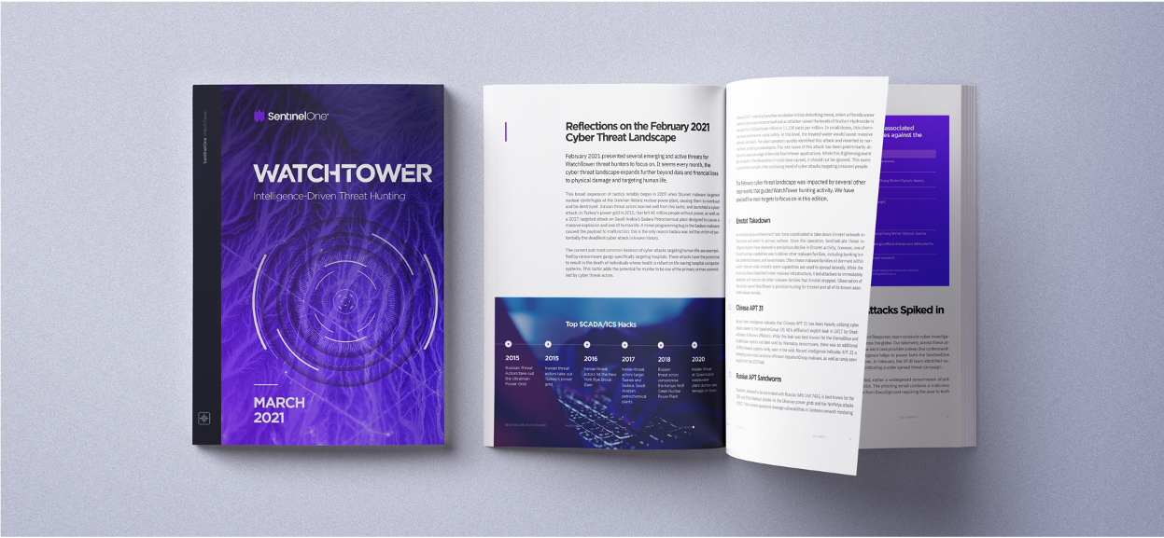
for Emerging Cyber Threats
Active Campaign Threat Hunting in Your Environment
Identification of emerging and proliferating attacker techniques, APT campaigns, and cyber crime
Curation & contextualization of threat intelligence research conducted by SentinelOne’s Signal CTI team
Alerting & remediation assistance when threats
are detected in your environment
Monthly digest of findings from global threat hunts
Cross-Geo, Cross-Industry Analysis
Actionable Intelligence & Insights
Human Lens to
Machine-Powered Hunting
Pre-Validated, Reviewed Threats
Faster Response & Preparedness

Slide 18


Approach
INGEST
OSINT
Malware
Web
Analysis &
Validation
Proactive Hunting
Customer
Communication
COLLECT
& ANALYZE
Ground Truth Sightings
Global Netflow Analysis
Active C2 & Botnet Tracking
Honeypots & More
Threat Intelligence
Platform
Emerging threats are identified and validated using Singularity Signal’s organic threat intelligence research and data analysis.
WatchTower
hunts for these identified
threats across its
user base, including Vigilance MDR.
Impacted customers are notified with threat bulletins and actionable recommendations. Vigilance MDR performs triage & remediation.
RESEARCH
IR & Community Engagements
Dark Web Research
Special Access

Slide 19









Customized Threat Hunting
Bespoke Hunts & Compromise Assessments Tailored to Your Environment
Dive deeper with comprehensive assessments of your attack surface, risk posture, and internal security practices
Build resilience, close gaps with tailored recommendations from your designatedthreat hunter
Hop into the driver’s seat any time with unrestricted access to targeted queries in the Signal Hunting Library
Hidden
APT
Insider Threats
Covert
Cyber Crime
Poor Security
Practices
Hunting Targets
Policy Misuse
Environmental
Vulns
Ongoing
Understand How You’re Uniquely Impacted
Gain insight into how you’re affected by emerging threats in your industry, sector, geographic region, and more
2x Per Year
Dive Deeper Into Your Security Posture
Collaborate with your dedicated team of hunters to search for covert threats, indicators of compromise, and risky practices
2x Per Year
Build Confidence in Your Defenses
Confirm if previously-identified issues still exist or have been successfully resolved with verification hunts

Slide 20





When to Engage Our Elite Team of Hunters
Health Check
Proactively assess the integrity and health of your global environment
Merger & Acquisition
Identify and mitigate risk before disparate data and systems are integrated
Post-Breach
Gain peace of mind that a threat has been comprehensively eliminated
Industry Breach
Stay ahead of attack vectors that may be shared and exploited across your industry
New or Changing Personnel
Capture your precise security posture and know where to focus your efforts
Notes:
Speak to audience for these use cases, what indicators in the SentinelOne customer base would make WT Pro a good upsell opportunity?

Slide 21
Threat Hunting & Compromise Assessment: What to Expect
1
Get Contacted Proactively by Your Designated Threat Hunter
Our experts diligently open and maintain communication lines for twice-yearly assessments, with full context of your organization’s changing needs and risk posture.
2
Customize Your Threat Hunt & Compromise Assessment
Collaborate with our team to identify and prioritize potential areas of concern—external and internal—for your unique business. Targeted hunting queries will then be added to the Signal Hunting Library, accessible by you at any time.
3
Gain Peace of Mind as Our Team Performs a Deep-Dive Hunt, Investigation, and Analysis
Based on data collected across your IT environment by the Singularity Platform, your team will cross-reference their findings with SentinelOne’s internal threat intelligence knowledge base to eliminate false positives and prioritize risk areas.
4
Better Understand Your Attack Surface & Risk Posture Through Customized Reporting
Your tailored report will include a bird’s-eye-view evaluation and commentary of our hunters’ findings, as well as prioritized recommendations for remediation and security best practices based on their criticality.
5
Ensure Your Progress Towards Airtight Security with Verification Hunts
One quarter later, your designated hunter will perform a verification hunt to ensure that previously-identified risks from the Compromise Assessment have been effectively remediated and cleaned up throughout your environment.

Slide 22
Targeted Campaign Tracking
Quickly detect & diagnose your exposure to
current APT and cyber crime
Comprehensive Hunting & Compromise Assessment
Understand how your environment is or has been impacted by even the
most covert attackers, insider threats, and environmental security issues
SCOPE
Emergency Triage & Response
Remediate quickly through Vigilance MDR or WatchTower-
provided instructions when hunting targets are detected in
your instance, with escalations to Vigilance DFIR as needed
Recovery for Real-Time & the Long Run
Take immediate steps to reduce your attack surface and clean up
indicators of attack, then apply tailored, expert-provided recommendations
to improve your organization’s overall risk posture
RECOVERY
Monthly Digest of Hunting Activity
Receive a global, landscape-level analysis of our
hunters’ findings across all WatchTower customers
Custom Reporting & Round-Ups
Dive deeper into your designated hunter’s observations & actions within
the context of your unique environment, and verify successful remediation
and mitigation of previously identified issues
REPORTING
Curated by Our Researchers
Maximize your limited time and resources for operationalizing
threat intelligence by relying on our experts to identify, prioritize, and hunt today’s most aggressive, pressing threats
Greater Control & Customization
Trust our expert hunters to identify relevant threats to your unique
organization with the flexibility to hunt on your own terms using the
Signal Hunting Library
ACCESS

Slide 23
Vigilance
IR Retainer
04
Subscription Overview:
Incident Response Retainer

Slide 24
Vigilance IR Retainer
What is it?
Who is it for?
Digital Forensics & Incident Response sold in 40-hour on-demand blocks of time
Similar to Vigilance Respond Pro MDR
24/7 IR expert access
Full investigative analysis:
  RCA infection vector identification
  Exfiltration and breach determination
  Intelligence-driven hunting, enrichment & contextualization
  Malware reversing, memory analysis and code extraction, malicious code deobfuscation
Designed for customers that are not currently Vigilance customers but who need the option of engaging digital forensic and incident response experts as they see fit.
The Output
Recommendations and actions for Investigation → Active Containment → Eradication → Reporting → Post-incident improvements

Slide 25
Appendix
05

Slide 26
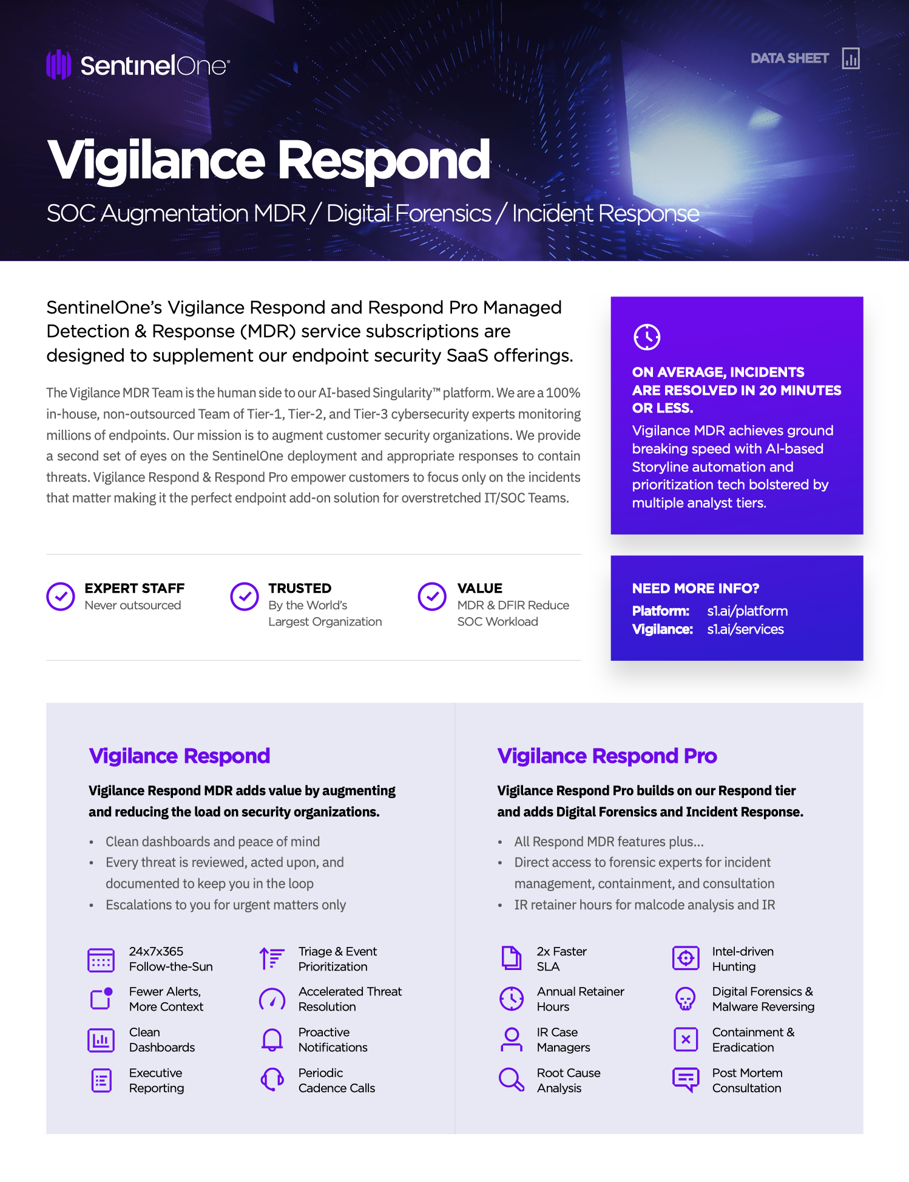
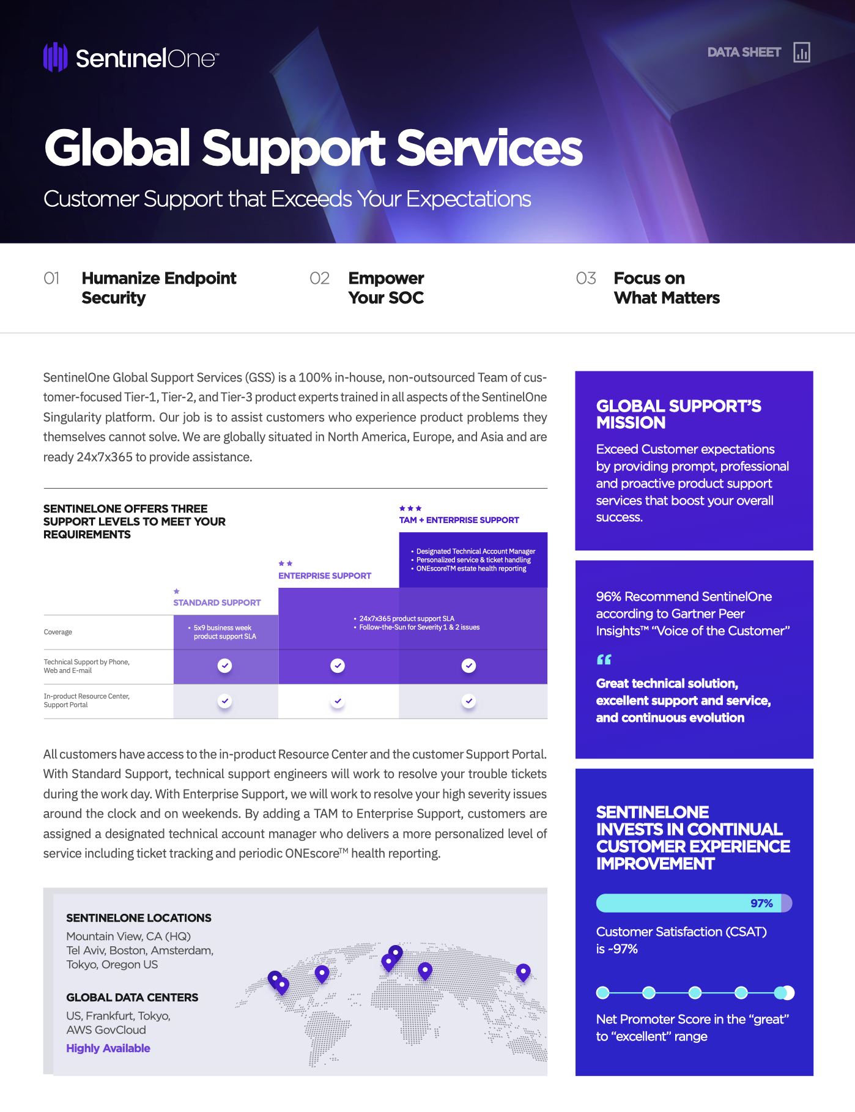
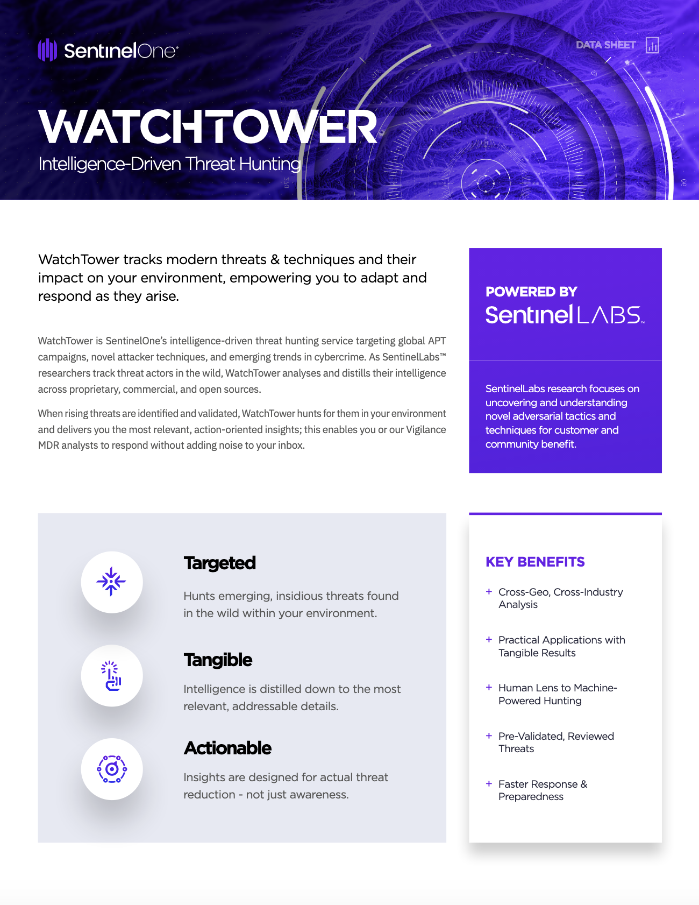
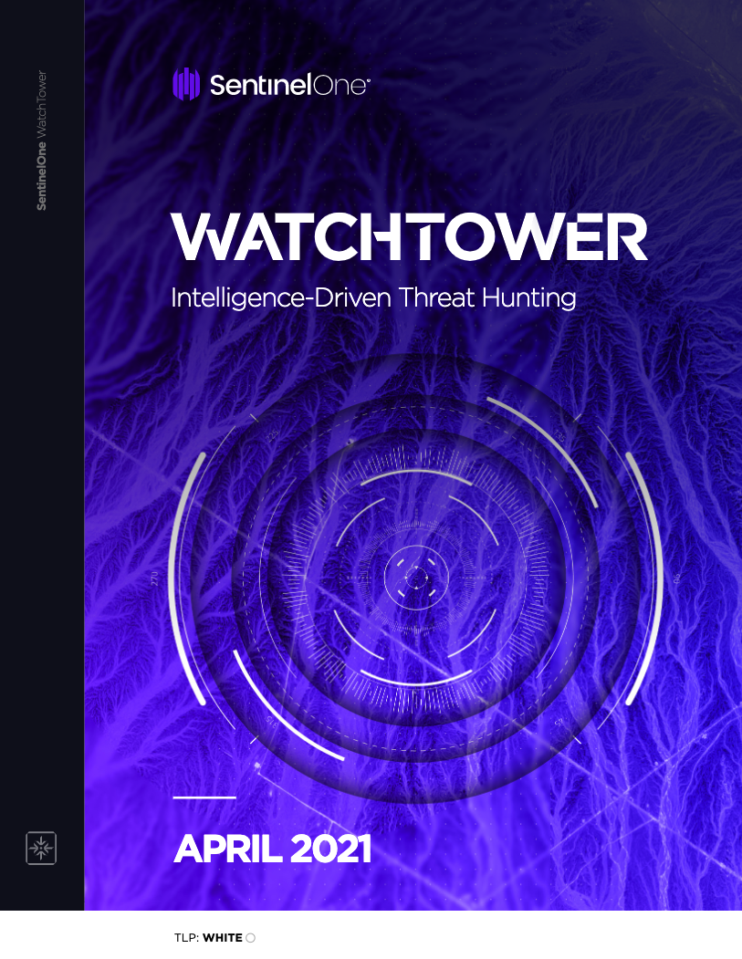
Datasheets & Digests
Vigilance Datasheet
WatchTower Datasheet
WatchTower Monthly Threat Hunting Digest

Slide 27
 |  | Respond | Respond Pro | What’s included?
1 | 24x7 MDR |  |  | Every console threat is, reviewed, acted upon, and documented Full response capabilities Proactive notifications
2 | Active Threat Hunting with WatchTower |  |  | Active hunting & tracking of novel techniques, global APT campaigns, and emerging cyber crimes Alerting and remediation assistance if/when threats are detected in your environment Monthly threat hunting digest with key findings and trends from the global threat landscape
3 | Compromise Assessment & Hunting with WatchTower Pro |  |  | Twice yearly deep-dive threat hunts and compromise assessments that search for hidden APT, covert cyber crime, policy misuse, insider threats, environmental vulns, and more Unrestricted access to Signal Hunting Library that saves custom and pre-built hunting queries
3 | Threat Response SLA* | Active/Suspicious 2 hours Mitigated/Blocked 4 hours | Active/Suspicious 1 hour Mitigated/Blocked 2 hours | The fastest MDR on the planet Analyst perform triage of active/suspicious alerts Analyst perform initial actions to mitigate/block as needed Respond Pro customers receive a 2x faster SLA
4 | Digital Forensic Analysis | Triage | Full Investigation | Full Investigation: RCA infection vector, exfil/breach determination, intelligence-informed enrichment, contextualization, malware reversing, memory analysis, malicious code deobfuscation Triage: Console indicator and dynamic analysis
5 | IR Retainer |  |  | Preset # of retainer hours (use or lose) Investigation → Active Containment → Eradication → Reporting IR Service manager assign to each case 4 Hours minimum charge per incident
6 | Quarterly Security Review |  |  | Consultation guiding long-term remediation and security architecture Agent version alignment & exclusions review Threat / actor trends

Slide 28
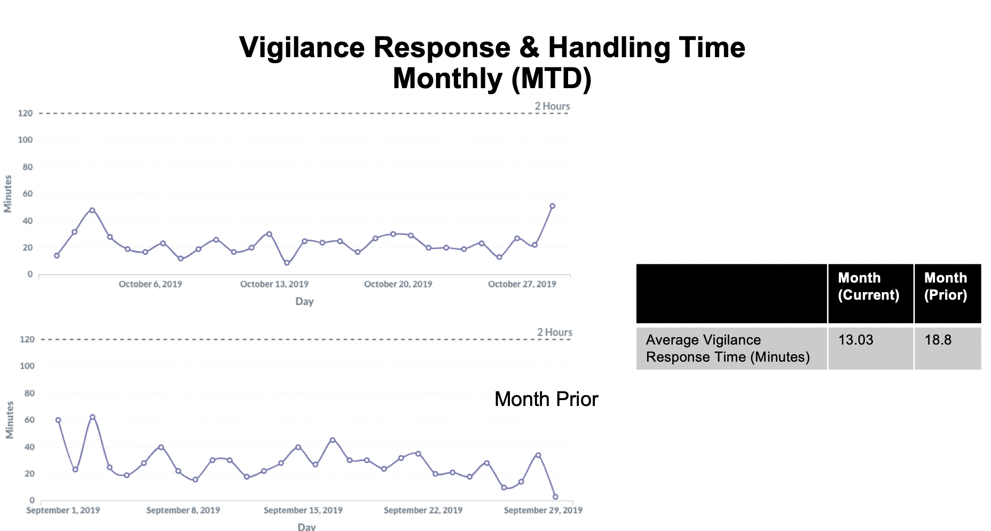
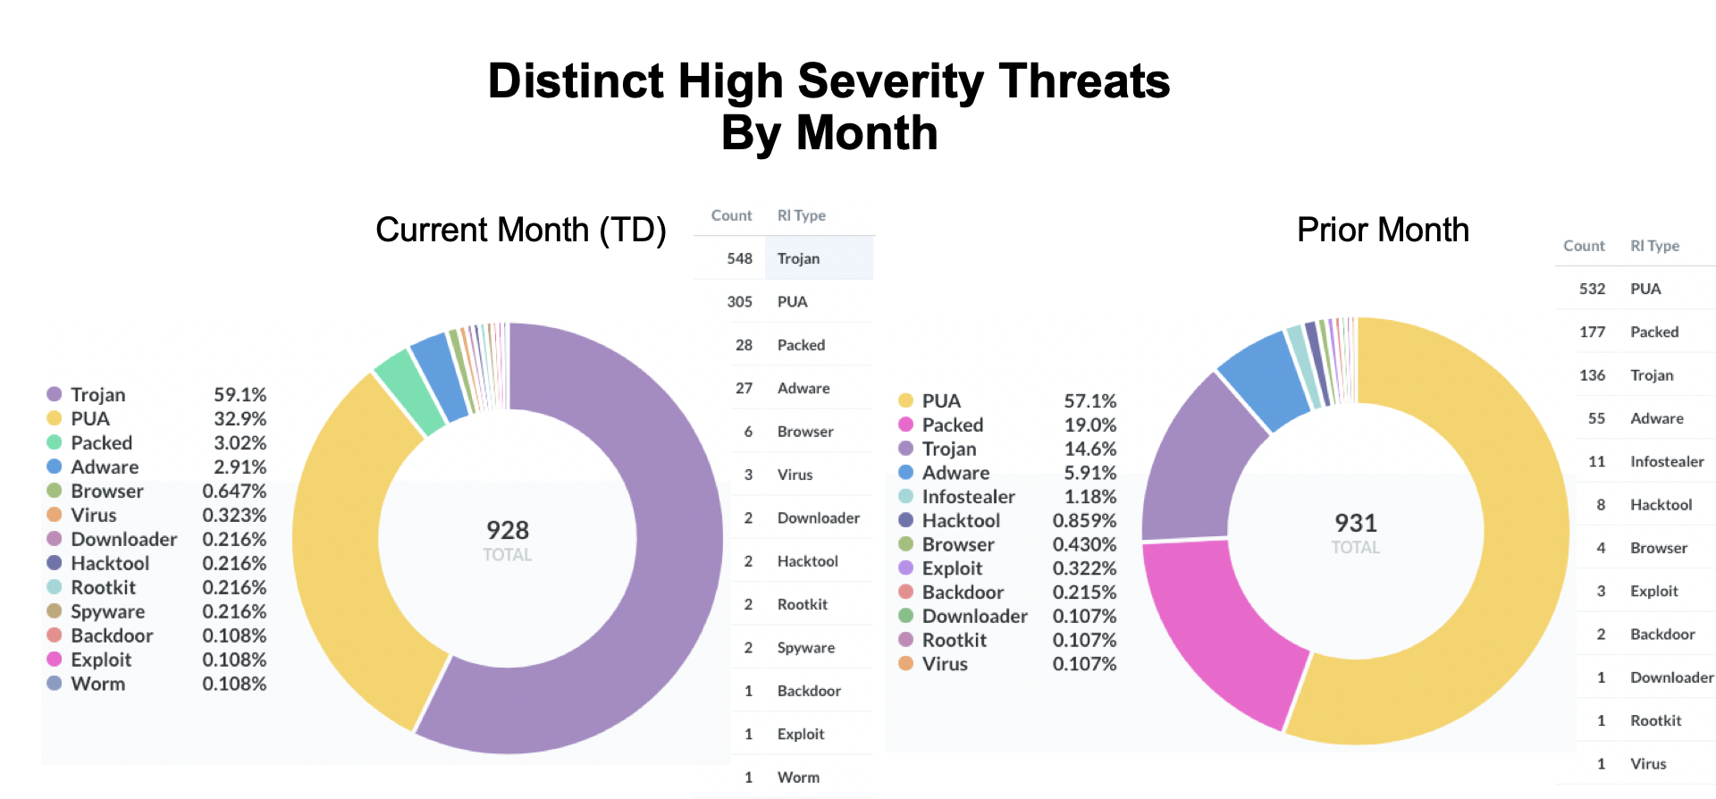
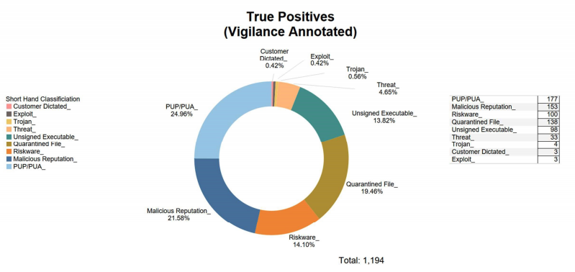
MDR Reporting
On-Demand Insight reports available within the console
Custom business intelligence (BI) reporting available

Slide 29

MDR Reviews
Vigilance is trusted by many of the largest worldwide brands across industries like financial services, manufacturing, government, healthcare, education, and more.
SentinelOne is the highest rated vendor in the 2020 Gartner Peer Insights™ ‘Voice of the Customer’ Endpoint Detection and Response Solutions report. Here’s what they say…
“When we were building our SOC, Vigilance was really a no brainer. Although it's a service that will deal with all of your threats, they still fully involve my team, which really is key.
It's a true partnership.”
Steve O’Connor, Director, IT, Aston Martin Lagonda Ltd.
“
Strongly recommend. Takes a lot of the day-to-day administration off of my team.
“
Vigilance MDR has been a terrific augment for our team.
29
“
Get the Vigilance service along with the product and they take care of all the basic security incidents, alert on the advanced issues, and provide great reports.
“
29
Notes:
FAQs:
What are the customer staffing requirements in order to take full advantage of Vigilance MDR? Do they have to have a SOC?
Vigilance is not an MSSP. Customers should have some sort of IT or Security Team function to whom the Vigilance Team can communicated.
Is Vigilance MDR available for S1 Complete only or is it also available for S1 Core and S1 Control?
MDR can be sold with any license level. However, when the customer has the Complete level there is more actionable information because EDR data is collected at that licensing level.
What’s the minimum number of licenses a customer must buy in order to add Vigilance MDR?
200
Should customers buy Vigilance MDR and S1 Readiness at the same time?
Yes, they can do that. MDR will handle threat-related issues. Readiness will assist with ongoing health and occasional upgrades.

Slide 30
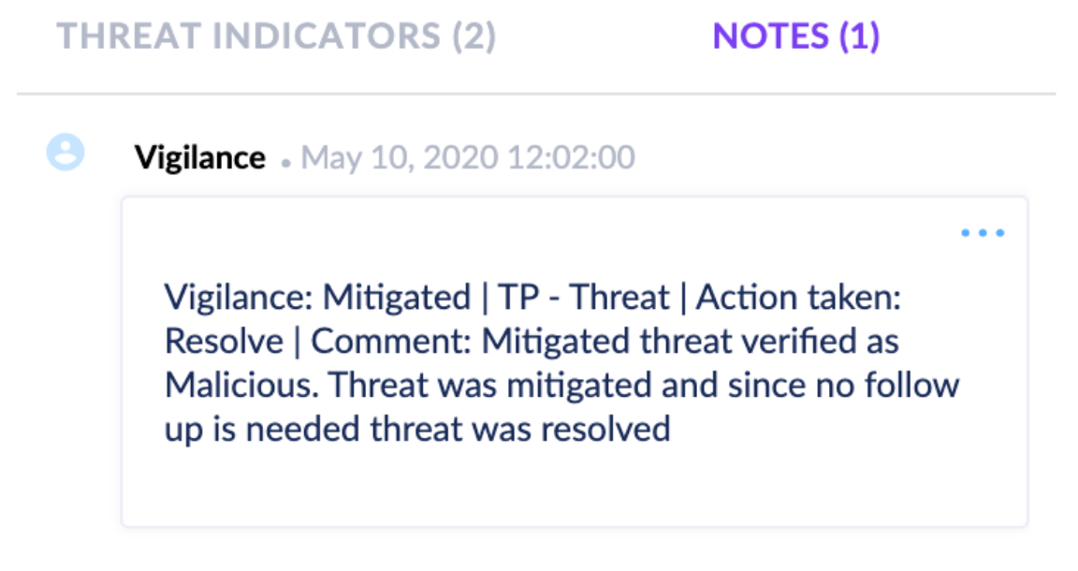
MDR Threat Insights
EVERY threat is reviewed and annotated
Status, classification, and next steps
Referencing ticket # in case of follow up

Slide 31
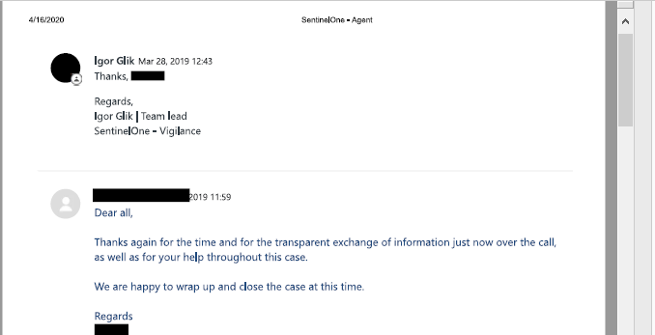
MDR Proactive Notifications
Distilled notifications for critical issues
Designed to help you focus on what matters
Contact us at any time via email vigilance@sentinelone.com or phone
(Support hotline)

Slide 32

MDR Threat Handling Hierarchy
Customer Action Not Required
Benign Alert - False Alarm
Threat
Vigilance Handles
Detected
benign
Possible tuning recommendation
No Further Action Needed
Malicious Alert - True Positive PuP
Threat
Vigilance Handles
Detected
TP/PuP
Possible blocklisting
No Further Action Needed
Malicious Alert (TP) - No Action Needed
Threat
Vigilance Handles
Detected
TP
Remediation Response
No Further Action Needed

Slide 33

MDR Threat Handling Hierarchy
Customer Action Required
Malicious Alert (TP) Non-Urgent - Action Needed
Vigilance Handles
Most Threats Resolved in
<60 Minutes
<1% Require Customer Involvement
Threat
benign
Remediation Response
Detected
Customer Follow-up Requested
Malicious Alert (TP) Urgent - Action Needed
Vigilance Aggressive
Customer
Vigilance disconnects device to prevent spread
Threat
TP
Remediation
notifed with
If no
Detected
Kill/Quarantine/
follow up
response
Investigate
requested

Slide 34
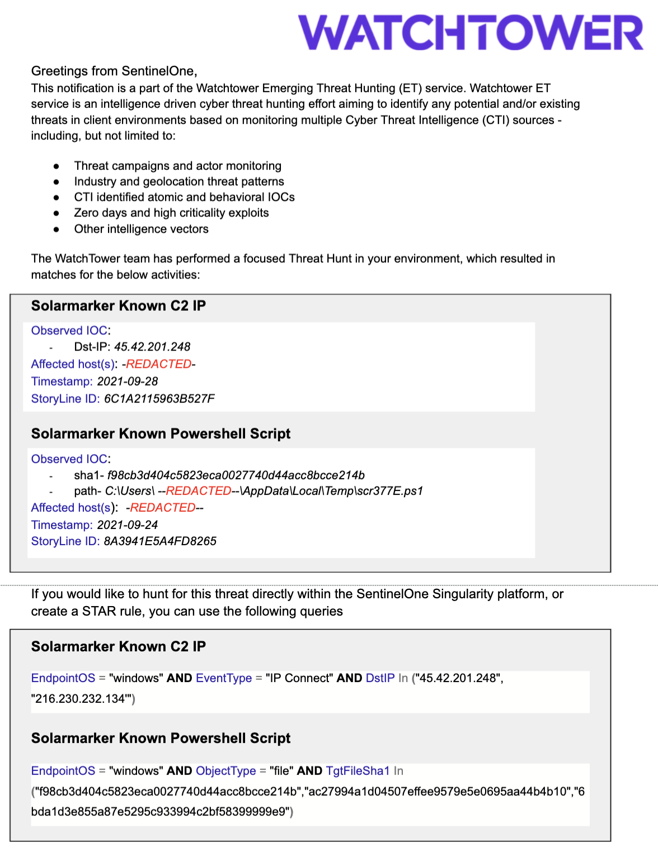
WatchTower Emerging Threats: Sample Notification
Description of Service
The WatchTower Emerging Threat Hunting service will provide notifications of threats identified within your network
Findings will include:
  Timeline
  Affected hosts
  Atomic or Behavioral IOCs
  SentinelOne Storyline ID
  Queries to leverage for hunting or STAR rules
WatchTower will provide recommendations for remediation and will refer to Vigilance DFIR services, if necessary
Summary of Threat Findings
Action Items to Hunt on Your Own

Slide 35
Thank you

Slide 36



SentinelOne Threat Services at a Glance
Customized Hunting & Compromise Assessment
Customized Threat Hunting & Compromise Assessment: Comprehensive Hunting for All Current & Historical Threats, Indicators of Attack, and Risky Security Practices
Includes WatchTower, available alone or as add-on
DFIR
DFIR
Digital Forensics & Incident Response (DFIR):
Forensic Investigation & Malware Analysis
Includes WatchTower, Vigilance Respond
MDR
MDR
MDR
Managed Detection & Response (MDR):
24x7x365 Threat Analysis & Containment, Escalation When Necessary
Includes WatchTower
Active Threat Hunting
Active Threat Hunting
Active Threat Hunting
Active Threat Hunting
Active Campaign Threat Hunting & Intelligence Reporting: Hunting for Today’s Most Prolific Threat Actors, Crimeware, and Campaigns
LEVEL OF TAILORED ENGAGEMENT
Notes:
Explain WatchTower at a High-Level vs. WatchTower Pro at a High-Level
Speak to customer profile
Use whatever win stories available as examples
Competitive comparison (especially to CrowdStrike) - add link to Module Comparison

Slide 37
Threat Services at a Glance
Customized Threat Hunting & Compromise Assessment
Digital Forensics &
Incident Response
Digital Forensics &
Incident Response
Managed Detection & Response
Managed Detection & Response
Managed Detection & Response
Active Campaign Threat Hunting
Active Campaign Threat Hunting
Active Campaign Threat Hunting
Active Campaign Threat Hunting
LEVEL OF TAILORED ENGAGEMENT
Active Campaign Threat Hunting & Intelligence Reporting: Hunting for Today’s Most Prolific Threat Actors, Crimeware, and Campaigns
Managed Detection & Response (MDR):
24x7x365 Threat Analysis & Containment, Escalation When Necessary
Includes WatchTower
Digital Forensics & Incident Response (DFIR):
Forensic Investigation & Malware Analysis
Includes WatchTower, Vigilance Respond
Customized Hunting & Compromise Assessment: Comprehensive Hunting for All Current & Historical Threats, IOAs, and Risky Security Practices
Includes WatchTower
Notes:
Explain WatchTower at a High-Level vs. WatchTower Pro at a High-Level
Speak to customer profile
Use whatever win stories available as examples
Competitive comparison (especially to CrowdStrike) - add link to Module Comparison

