Slide 1
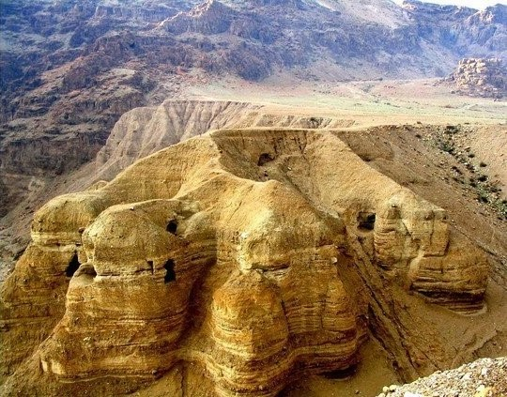
The Dead Sea Scrolls
House Church
January 20, 2019

Slide 2
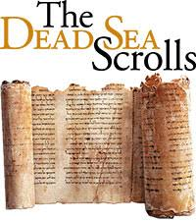
The Dead Sea Scrolls
Introduction
The Discovery of the Scrolls
What Was Found?
What Is a Scroll?
Who Wrote the Scrolls?
Dating the Scrolls: 200BCE-100CE
Preserving the Scrolls
Assembling Scroll Fragments
Translating the Scrolls
Why Are the Scrolls Significant?
The Scrolls and Christianity

Slide 3
Discovering the Scrolls
Historical Context: 1947, Palestine (west of Jordan River) is under British Administration (British Mandate, 1923), with Jerusalem as its Capital. Two nationalistic movements: Jews vs. Arabs, led to Civil War (1947-1948) and resulted in partition, establishing (1) the state of Israel, (2) Arab West Bank annexed by Jordan, (3) the Gaza Strip under Egyptian protectorate. Jerusalem is split: East (Jordan), West (Israel).
November, 1947. After a particularly rainy season, Bedouin goatherds and cousins Jum'a and Muhammed ed-Dib are grazing their sheep and goats by the caves at the northwest corner of the Dead Sea. Muhammed throws a rock into a cave, hears a crashing sound, and returns to his flock without entering the cave. Two days later, he returns, climbs up into the cave and makes what will become one of the most important archeological discoveries in history.
Inside the cave, he finds four jars. The first three are empty. He opens the fourth and is repelled by a terrible odor, but when it dissipates, he reaches in and finds four scrolls. The cousins bring the scrolls to their tent near Bethlehem and, having no idea what they’ve found, they unroll them and hang them on a tent pole, where the scrolls remain for several weeks. One scroll (The Community Rule) splits in half.
The cousins and their friends bring the four scrolls to an antiquities dealer in Bethlehem, who considers them worthless forgeries. Finally they approach Khalil Eskander Shahin (Kando), who shows interest and tells the cousins to go back to the cave to see if there are more. They go back and find three additional scrolls. They return to Kando and sell him the first four scrolls for $4, then go to another antiquities dealer Sahili, who buys the other three.
Kando (with the four scrolls) has a Syrian Christian friend in Jerusalem who thinks that his Bishop, Athanasius Yeshue Samuel might be interested. Kando sells his four scrolls to the Bishop for $64.
Bishop Athanasius contacts John Trevor, President of the American Schools of Oriental Research (ASOR), and delivers the scrolls to him for evaluation. Trevor opens the first, recognizes it as the Book of Isaiah, sees that it is written in an ancient script and considers it unique, perhaps the oldest existing manuscript of a biblical book. He photographs the four scrolls and send the photos to Professor William F. Albright (world’s preeminent archeologist, Johns Hopkins University) who, after reviewing the photos, describes their discovery as the “Greatest archeological find of the 20th Century.”
About the same time, Hebrew University Professor Eliezer Lipa Sukenik hears that Sahili has the three other scrolls and travels (sneaks) from Jerusalem to Bethlehem to see them. He immediately recognizes the scrolls as ancient Hebrew Scriptures and purchases them (see his reaction on the next slide).

Slide 4
Discovering the Scrolls
“My hands shook as I started to unwrap one of them. I read a few sentences. It was written in beautiful biblical Hebrew. The language was like that of the Psalms, but the text was unknown to me. I looked and looked, and I suddenly had the feeling that I was privileged by destiny to gaze upon a Hebrew Scroll which had not been read for more than 2,000 years.”
Hebrew University Professor Eliezer Lipa Sukenik

Slide 5
Discovering the Scrolls
Meanwhile Bishop Athanasius wants to sell his scrolls, thinks that he can get the best price for them in the United States, transfers them to the Syrian Church of New Jersey, and advertises them in the Wall Street Journal. He can’t find a buyer, but when Sukenik hears that the four scrolls are for sale, he sends his young colleague archeologist Yigael Yadin to NY to purchase the scrolls. He meets Athanasius at the Walldorf Astoria, purchases the scrolls for $250,000 and brings them back to Israel.
By 1955, all seven of the original scrolls are at the Hebrew University in Jerusalem. In the end, there will be only 11 mostly intact scrolls.
In 1949, the Jordanian Department of Antiquities led by Gerald Lancaster Harding and Roland de Vaux undertake the first excavation of Cave 1. Two years later (1951), de Vaux, a team from ASOR (American Schools of Oriental Research) and Bedouins excavate the village of Qumran, a small town near to the caves. The settlement was then thought to be the home of the Essenes, who, due to their proximity to the caves, were immediately considered to be the authors of the scrolls.
From 1951-1956, 10 other caves are discovered by de Vaux and his teams.
From 1951-1957, all the scrolls and fragments are transferred to the Palestinian Archeological Museum (Rockefeller Museum) in East Jerusalem (Jordan). Here, between 1952-1967, the scrolls and scroll fragments are assembled, studied and translated, by a small international team of 8 scholars, led by de Vaux. These scholars kept the scrolls from the rest of the scholarly world. In 1967, after the Seven Days War, the entire collection comes under the control of the Israelis and is moved to West Jerusalem. Still the same 8-person team continues to exert tight control, until during the 1980’s, under intense international pressure, the scrolls are increasingly made available to the broader international academic community (more about this later).
In February 2017, Hebrew University archaeologists announced the discovery of a new, 12th cave. There was one blank parchment found in a jar; however, broken and empty scroll jars and pickaxes suggest that the cave was looted in the 1950s. The blank parchment feeds theories about forgeries that regularly appear on the market (The Bible Museum in Washington, DC).

Slide 6
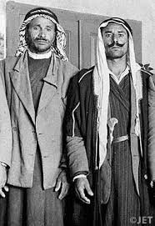
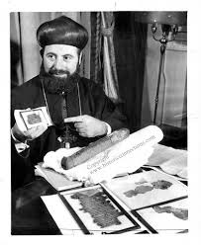
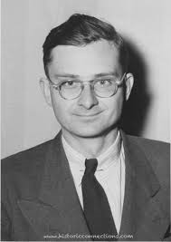
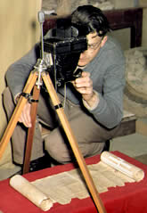
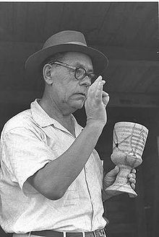
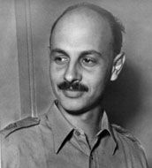
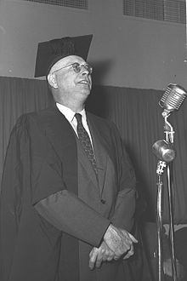
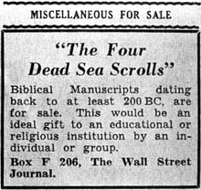
Discovery and Early Authentication of the Dead Sea Scrolls (1947-48)
Shepherds Muhammed edh-Dhib, his cousin Jum'a Muhammed discover the scrolls
John Trevor first scholar to see the scrolls, photographs and sends photos to Albright
Bishop Athanasius Yeshue Samuel, Syrian Christian purchases 4 scrolls for $64.00
Israeli Hebrew scholar Eliezer Lipa Sukenik buys 3 other scrolls from Bedouins and sends Yadin to NY to buy them
Yigael Yadin, archeologist, brings original scrolls to Jerusalem; they now reside at Shrine of the Book in Israel Museum. Yadin later Deputy Prime Minister of Israel.
Hebrew scholar and archeologist William F. Albright authenticates scrolls
Bishop Samuel comes to U.S. to sell 4 scrolls, sale is at the Walldorf for $250K to Yigael Yadin, who brings them to Israel

Slide 7
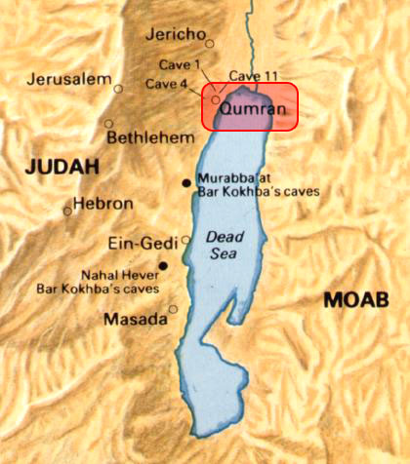
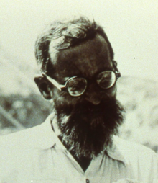
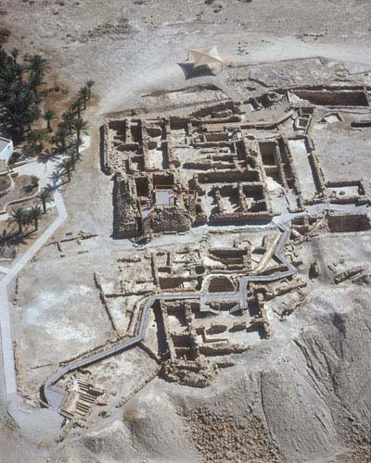
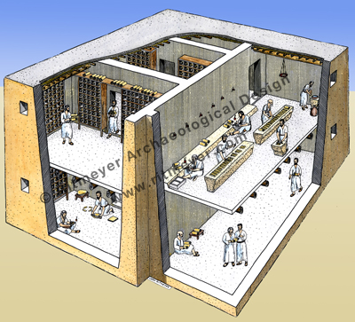
Archeologist Roland De Vaux, Excavates Qumran, Discovers other Caves (1951-1056)
Roland De Vaux, leads research into the scrolls until his death in 1971

Slide 8
What Was Found in the 11 Caves?
Fewer than a dozen mostly intact manuscripts, all found in Caves 1 and 11.
90,000+ fragments, many no larger than a fingernail, that belong to 980+ documents. Over 15,000 fragments were found in Cave 4 alone. More fragments continue to be discovered, some in cigar boxes in the dark corners of the museum (2013)!!!
Coins, pottery, textiles and leather from the soles of shoes.
Dead Sea Scrolls (DSS), including intact manuscripts and manuscripts reconstructed from fragments:
Canonical Books (30% of the entire collection): 225 manuscripts of books from the Hebrew Bible (OT); several copies of every book except Esther (Psalms, 39 copies; Deuteronomy, 33; Genesis, 24; Isaiah, 22; Exodus, 18, etc.). These manuscripts are approximately 1000 years earlier than any previously existing manuscript of a book in the Hebrew Bible (the Aleppo Scroll had been the earliest, approximately 900 A.D.).
Noncanonical books (20%): Jewish religious texts not considered a part of the Hebrew Bible, but included as Apocrypha in modern Catholic Bibles (e.g. Jubilees, Enoch, Tobit, Sirach). These are the earliest versions of these books, which previously had only existed in Greek and Latin.
Nonbiblical Religious and Nonreligious Books (about 50%). Non-biblical books that provide commentaries on Biblical books, descriptions of the Messiah and what will happen when he returns, rules for “synagogues” or Jewish communities, and great insight into Jewish religious life from 200 BCE to 100CE (e.g., the Community Rule; the War Scroll, The Copper Scroll, The Temple Scroll).

Slide 9
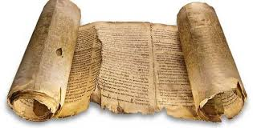
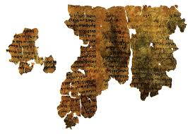
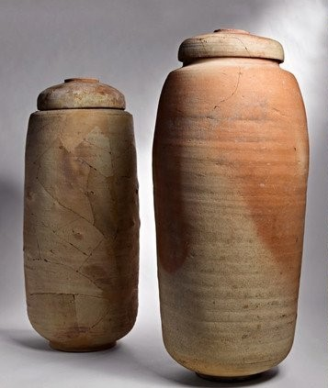
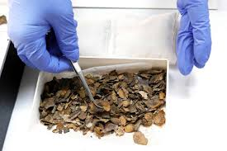
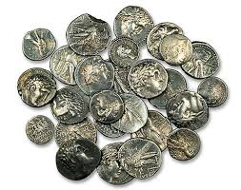
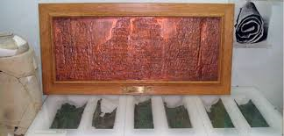
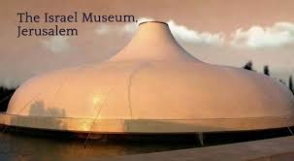
Discovered at Qumran
90,000+ fragments
The Great Isaiah Scroll
The Copper Scroll

Slide 10
What Is a Scroll?
Consecutive columns of writing on pieces of vellum/parchment, sewn together to make the scrolls.
Scrolls were written with black ink (carbon black mixed with olive oil, vinegar or honey), written with a reed pen on untanned animal skins (parchment or vellum); a few manuscripts are written on papyrus, and one on copper (a buried treasure map).
Four types of animal skins were used (goat, calf, gazelle and ibex)
Calf and goat were used for scrolls of greater significance
Gazelle and ibex were used for scrolls of lesser significance
Based on animal type, the thickness of the skin was an important clue for sorting fragments (discussed below)
Written from right to left, with no punctuation, no vowels, no space between words. The letters simply run together in a continuous stream. This is true of many ancient Greek NT manuscripts (uncials and minuscules).
Most of the scrolls were written in an old form of Hebrew; one of six were written in Aramaic; a few in Greek, and four in Cryptic Script (code), that was easily decoded.

Slide 11
Who Wrote the Scrolls?
Qumran and the Standard Model
The Essenes, an ascetic Jewish sect, who occupied Qumran from 200 BCE-70CE wrote the texts and stored them in the caves
Supported by Josephus and original archeology by de Vaux
Palestinian Jewish authors including Qumran Essenes
Josephus and de Vaux’s archeology questioned
Based on handwriting, more than 850 authors (also important for sorting fragments), many more than could have lived a Qumran
Many texts describe Jewish religious community life outside Qumran. Some are teaching manuals for leaders who are starting new synagogues
Written by Jews, some books may have been kept in libraries of the Temple in Jerusalem, moved to the caves for safe-keeping when Jerusalem was invaded by Romans (70 CE)
Provide a broad and diverse view of Jewish religious views during period from 200BCE-100CE

Slide 12
Dating the Scrolls (200 BCE-100 CE)
Evidence from coins and pottery.
Evidence from radio-carbon dating of the animal skins. Initial test in 1951 puts the date at 33 AD +/- 200 years; since then two sets of tests put the dates between 200 BCE-100CE.
Paleographic dating, the analysis of the writing, including the forms of the letters, size of the letters and style of writing put the date of authorship in the same range.
Internal evidence from the scrolls. Some scrolls describe attitudes and interactions with rulers and other leaders known to have lived during this period of time.

Slide 13
Preserving the Scrolls
The scrolls began to deteriorate as soon as they were taken out of the clay jars in which they were stored, out of the caves and away from the arid and low humidity conditions present in the Qumran area adjoining the Dead Sea.
At the beginning, lots of mistakes were made handling the fragments:
Lighting in the scrollery in Jerusalem faded the fragments that had been arranged under the glass in the tables
At first adhesive tape was used to join the fragments, destroying many
Every time they moved the fragments, many disintegrated
During the 1958 war with Egypt, the scrolls were stored in a damp vault where mildew destroyed many of them
Glue from the envelopes in which fragments were stored got on the fragments and destroyed some.
By 1990, approximately 20% of the scroll fragments had disappeared; they exist today only in photographs.
In 1991, the Israeli Antiquities Authority established a temperature-controlled laboratory for the storage and preservation of the scrolls.
Almost all of the DSS collection is currently owned by Israel, and housed in the Shrine of the Book on the grounds of the Israel Museum.
The Israel Museum Digital Dead Sea Scrolls website gives users access to searchable, high-resolution images of the scrolls, as well as short explanatory videos and background information on the texts and their history.

Slide 14
Assembling the Scrolls
Sorting 90,000 fragments into 950+ documents
Complicated by small size of fragments, illegibility or fading of writing, multiple copies of the same document
Work is very slow and continues to this day
Early work done in Jerusalem scrollery (see photo)
Initial sorting done by handwriting analysis. Over 850 separate scribes, with distinct styles of writing
Thickness of animal skin
Photography of fragments made the text stand out (more readable)
Pieces that seemed to fit together based on above criteria were grouped on long table and placed under glass.
During the 1980s, opportunities to work on the DSS were expanded to a few locations around the world for respected scholars (and their graduate students), who were not among the original group of 8, but had participated in some way in the discovery of the scrolls. In the 1990s, the Scrolls (photographs) we made available to a wider circle of scholars.
Beginning in 1993, the United States National Aeronautics and Space Administration (NASA) has used digital infrared imaging technology to produce photographs of DSS fragments. Recently NASA used multi-spectral imaging technique, adapted from its remote sensing and planetary probes, in order to reveal previously illegible text on fragments of the DSS.
Scientists with the Israeli Antiquities Authority have used DNA from the parchment on which the DSS fragments were written, in concert with infrared digital photography, to assist in the reassembly of the scrolls.

Slide 15
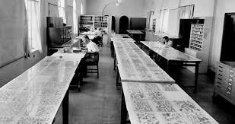
The Scrollery
In the Rockefeller Museum in the Palestinian Section of Jerusalem, scholars worked with 60,000 Dead Sea Scrolls fragments, sorting them on tables in a room called the Scrollery. The process of sorting, arranging and translating these fragments has continued for 70 years, to this day in locations around the world.

Slide 16
Translating the Scrolls
Fragments or manuscripts? If manuscript, proceed to last steps (transcription and translation)
For Fragments:
Match and group fragments (huge jigsaw puzzle): which cave, which language, handwriting, type of parchment, etc.
Take photographs and assign number
Working with photographs, try to reconstruct the original manuscript as much as possible
Try to read words, identify gaps and fill in gaps
Prepare a transcription—similar to a typed version of a handwritten letter [brackets where gaps exist]
Prepare “a” (not “the”) translation (usually a team)
Many words and phrases have no English equivalent
Sometimes conjectures about the meaning of idioms
Last step in an intricate and frequently uncertain process or reconstruction
The best translators are cautious and humble

Slide 17
Why Are They Significant?
The DSS provide a new understanding about the nature of Judaism in the years leading up to and including Jesus’ life. Before the DSS, only one ancient historical record written about Judaism during this period: Josephus, The Antiquities of the Jews, a sweeping history from Creation to Josephus’ time. DSS scrolls provide a new and more comprehensive view of Judaism and the roots of Christianity.
Impossible to adequately understand Jesus and the Gospel descriptions of him apart from this background.
The DSS push back the date of existing Jewish manuscripts (biblical and nonbiblical) almost 1000 years, demonstrating that the transmission of these texts was incredibly accurate and reliable. Less than 2% deviation.
In Non-Biblical religious texts, the DSS also demonstrate that authors took significant freedom to modify texts according to the purpose for which they would be used or for the recipients for whom they were intended.
There are some additions and changes to OT Biblical texts, compared to later Hebrew versions, around which Jews and Christians will have to make decisions about the canon of scripture (e.g., should the extra Psalms, the end of Leviticus and other variations be included in the Bible?).
There is an increasing search past theological jargon toward the beginnings of our faith and its original meaning. Who was Jesus, who was he originally understood to be, and what was his relationship to God? The DSS provide insight.

Slide 18
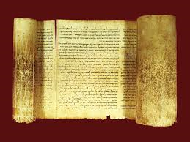
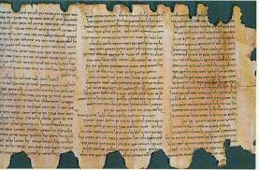
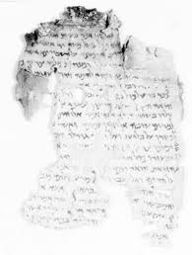
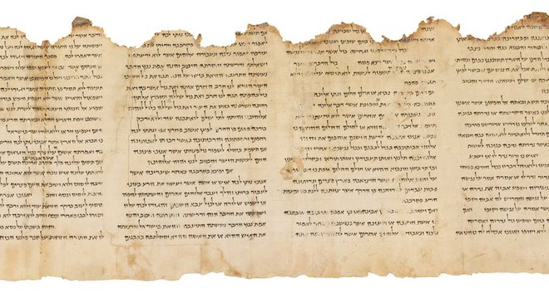
The Scrolls and Christianity
The Isaiah Scroll
The Community Rule or Manual of Discipline
Melchizedek Fragments
The Temple Scroll

Slide 19
The Scrolls and Christianity
Three Insights (a small sample):
Melchizedek Fragments and the early ministry of Jesus
The Community Rule and the ministry of Jesus
The Temple Scroll, Jesus as the Prophet like Moses, and the mission to the Gentiles

