Slide 1
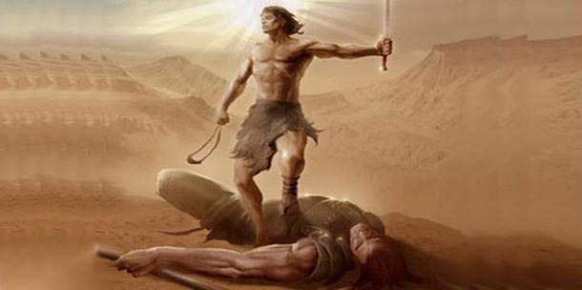
David and Goliath
A Christian's Guide to Managing Stress

Slide 2
2
1 Samuel 17

Slide 3
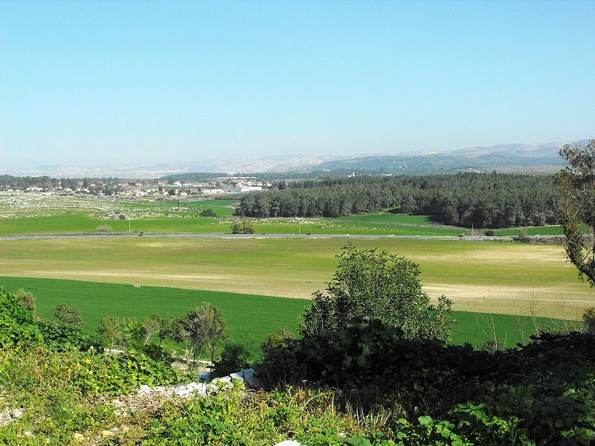
The Philistines
3
The Philistines were a sea-faring nation from Crete. They had established a settlement of five cities in Palestine by the Mediterranean coast.
Battle-tested and dangerous, they were the sworn enemies of the Israelites.
Around 1050 BC, they decided to move east up into the mountains toward Bethlehem, Hebron and Jerusalem and take on the army of the Israelites led by King Saul.

Slide 4
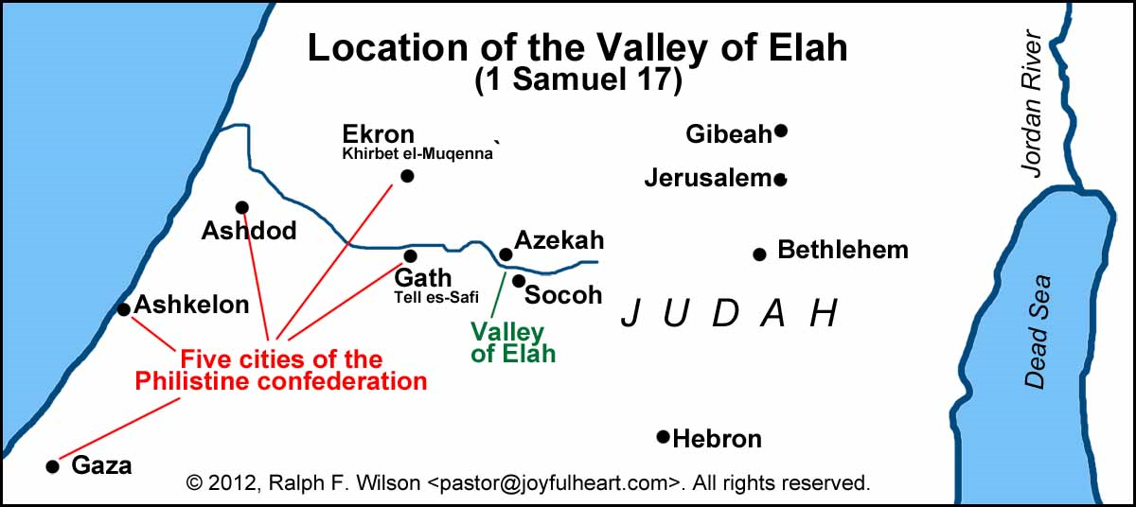
4
The Battlefield: The Valley of Elah
Saul, learning that the Philistines were attacking, led his army down from the mountains and camped on the ridge on the north side of the Valley of Elah
The Philistines arrived about the same time and camped along the south ridge.

Slide 5
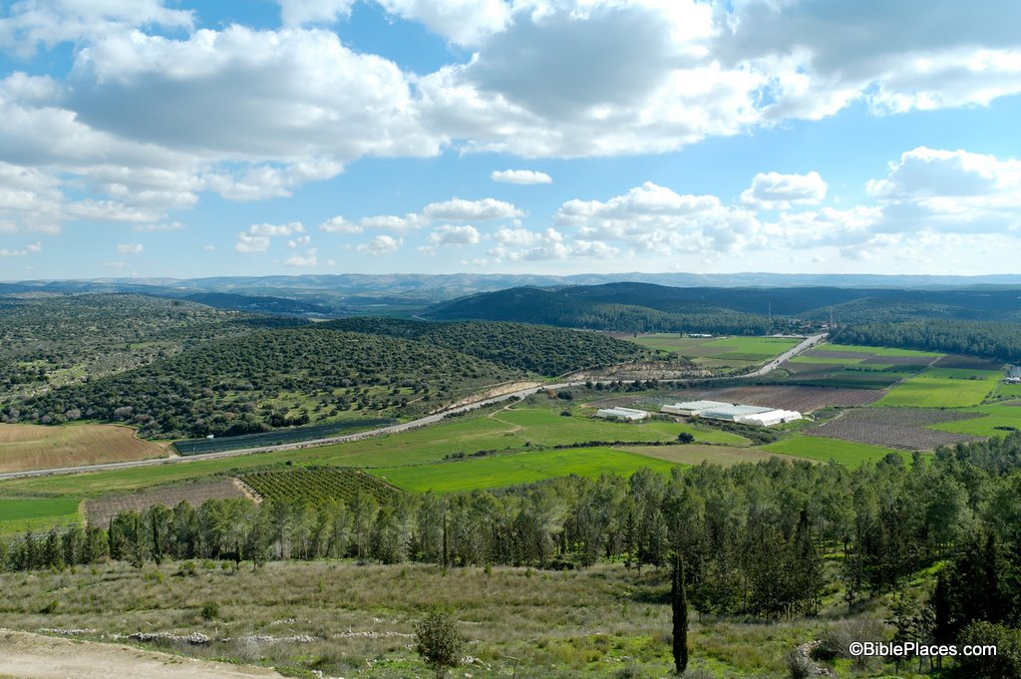
5
The Valley of Elah Looking North
Philistines encamped near where the photo was taken, the south side of the Valley
Forces of Saul occupy the hill on the north side of the valley

Slide 6
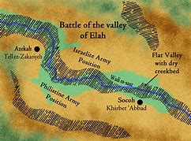
6
A Stalemate: Neither Army Wants to Attack
To attack meant to descend down a hill, cross the valley, then make a suicidal climb up the enemies ridge on the other side.
The Philistines send their greatest warrior, Goliath, down into the valley to resolve the standoff one-one one.

Slide 7
Goliath
7
The Philistines send their champion, a giant, down into the valley to settle the deadlock one-on one.
At least 6’9” (perhaps over 9’ tall)
Wearing full armor that weighed well over 100 lbs.!
  Body armor, bronze shin-guards, bronze plates covering his feet and a heavy metal helmet
  Three weapons optimized for close combat: a thrusting javelin, sword, short-range spear
  An attendant walks beside carrying a large shield
  Gives the challenge: “Choose a man and let him come down to me; if he wins we will be your slaves; if I win you will be our slaves.”
  In the Israelite camp no one moves. Fear overtakes them. Who could win against such a terrifying opponent?

Slide 8
One-on-One Combat
8
“Single Combat” was a common practice in the ancient world
Two sides in combat would hope to avoid the heavy bloodshed of open battle by choosing one warrior to represent each side in a duel. Winner takes all.
First Century historian Quadrigarious tells a similar story about a one-on-one battle between a Gaul warrior and a young Roman man named Titus Manlius, which took place amid great apprehension in front of both armies. The young boy won, cut off the Gaul’s head with his own sword, cut out his tongue and hung it around his own neck!
This is the type of battle the Goliath was expecting.

Slide 9
David before the Battle
9
This is no weak boy!!!
Glowing with health, a fine appearance and handsome features (1 Samuel 16:12)
Already has a reputation as a brave man and mighty warrior. He speaks well and is a “fine-looking man.” The Lord is with him. (1 Samuel 16:18)
Serves Saul as an armor-bearer (carries Saul’s shield and armor as Saul goes into battle) and as a musician, he knows how to calm Saul’s “soul” (1 Samuel 16:23)
Fast forward (chapter 17), Saul is now old, and is at war with the Philistines. David is still at Saul’s side but goes back and forth to Bethlehem to tend Jesse’s sheep
David excels with the sling and, while protecting sheep has killed lion’s and bears
David is away when Goliath shows up and challenges Israel

Slide 10
Ancient Warfare and Slingers
10
Three Kinds of Warriors
Cavalry, armed men on horseback or driving chariots
Infantry, foot soldiers wearing armor and carrying swords and shields
Artillery, archers and, most importantly, slingers
Slinging
A leather pouch attached on two sides by a long strand of rope
Put a rock or lead ball in the pouch
Swing it around in faster and faster circles
Release one end of the robe, hurling the rope forward
Effectiveness
Extremely accurate, capable of hitting birds in midflight
Could kill or seriously injure an opponent at a distance up to 200 yards
Romans had tongs to remove stones embedded in a soldier’s body
“At 35 yards, stone hits in less than a second, with the force of a .45 automatic pistol.” Eitan Hirsch, Israeli Defense Forces ballistics expert

Slide 11
David is No Underdog
11
This is not a story of some weak young boy, taking on a warrior with a simple little weapon. David is not an underdog taking on a champion.
This is the story of young man who is more than up to this challenge . . .
  David is a strong, fast, agile and an experienced “mighty warrior”
  David is a master of one of the most devastating weapons of ancient warfare, an expert marksman
  He has killed far more agile opponents in the past
  He has his wits about him, knows that wearing Saul’s armor is a bad strategy.
  The density of the stones in the Elah Valley make the sling more powerful
  Most importantly, David has the courage to confront his opponent when everyone was afraid, because he believed that God was with him.
  Goliath does not stand a chance.

Slide 12
What’s David’s Secret?
Everyone else is afraid. David manages his fear and courageously solves the problem.
He is physically in great shape (“glowing health”)
He is balanced (physical, mental, emotional, spiritual)
He has experience facing this type of challenge
He has skills appropriate for the challenge
He has a good strategy (won’t stand a chance in Saul’s armor; he has maneuverability and a weapon that can kill from a distance)
He is spiritually connected to God
His spirituality allows him to view the outcome in the context of God’s plan and God’s care

Slide 13
A Christian’s Guide to Managing Stress
How does David’s story align with the findings of modern neuroscience about the origins of our stress and the actions we can take to manage it?

Slide 14





Managing Stress: Four Main Points
1. Stress Model
2. You
Signs
Sources
Skills
Produce
Manage
3. Your Brain & Body
4. Manage ✓
Control
+
Self-Care
Learning
Notes:
Four main points help us to gain a better understanding of stress:
The Stress Model: the signs of stress you experience are related to the sources of stress in your life combined with the skills you have to deal with them.
You alone produce the stress you experience and you are capable of and responsible for managing it.
You produce your own stress through processes that happen in your brain and body. You can control these processes.
You are able to manage your stress through self-care and learning.

Slide 15
The Stress Model
Signs of Stress
Sources
of Stress
Skills to Deal with Sources
You
Notes:
Stress is an inevitable and even necessary part of life. However, when the sources of stress outweigh the skills we have to cope, we experience an increase in the signs or symptoms of stress that can damage our health, our relationships and our work performance.
Managing stress involves the twofold task of:
decreasing our stressors and
increasing our skills for coping with stress.

Slide 16
The Stress Model
Signs of Stress
Sources of Stress
Skills to Deal with Sources of Stress
You
Notes:
When the skills we have to cope the sources of stress, we experience a decrease in the signs or symptoms of stress and enjoy:
Better health
More stable relationships
Consistent, reliable work performance

Slide 17
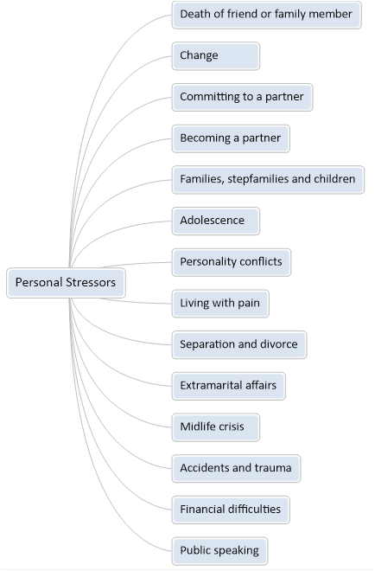
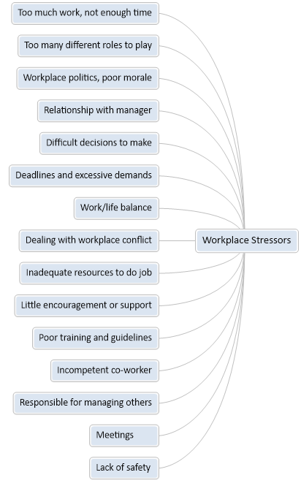






Sources of Stress
Notes:
What are your sources of stress? Stressors vary from person to person. Here’s a list of experiences or events that some people find stressful.
Personal stressors include:
Death of friend or family member
Change
Committing to a partner
Becoming a partner
Families, stepfamilies and children
Adolescence
Personality conflicts
Living with pain
Separation and divorce
Extramarital affairs
Midlife crisis
Accidents and trauma
Financial difficulties
Public speaking
Work-related stressors could be:
Too much work, not enough time
Too many different roles to play
Workplace politics, poor morale
Relationship with manager
Difficult decisions to make
Deadlines and excessive demands
Work/life balance
Dealing with workplace conflict
Inadequate resources to do job
Little encouragement or support
Poor training and guidelines
Incompetent co-worker
Responsible for managing others
Meetings
Lack of safety

Slide 18










Signs of Stress
1
Behavior
Body
Difficulty in sleeping
Early awakening
Emotional outbursts
Aggression
Overeating or loss of appetite
Excessive drinking
Excessive smoking /drug taking
Accident proneness/trembling
Avoidance of particular situations
Thinking
Increased heart rate
High blood pressure
Difficulty in breathing
Difficulty in swallowing
Feelings of nausea
Hyperventilation
Tense, contracted muscles
Backache
Immune system less efficient
Hot and cold flashes
Blushing
Difficulty in concentrating
Difficulty in making decisions
Frequent forgetfulness
Increased sensitivity to criticism
Negative self-critical thoughts
Distorted ideas
More rigid attitudes
Emotions
Health
Anxiety (nervousness, tension, phobias, panics)
Depression (sadness, lowered self-esteem, apathy, fatigue)
Guilt and shame
Moodiness
Coronary heart disease/strokes
Stomach ulcers; nausea; irritable bowel syndrome
Migraine; headaches
Asthma; hay fever
Skin rashes
Notes:
How do we know we are stressed? We can identify several signs of stress and these signs can be grouped into five major areas: body, behavior, thoughts, emotions, and health.
Several signs of stress manifest in our bodies. These signs include:
Increased heart rate
High blood pressure
Difficulty in breathing
Difficulty in swallowing
Feelings of nausea
Hyperventilation
Tense, contracted muscles
Backache
Immune system less efficient
Hot and cold flashes
Blushing
Our behavior can also let us know when we experience escalating levels of stress:
Difficulty in sleeping
Early awakening
Emotional outbursts
Aggression
Overeating or loss of appetite
Excessive drinking
Excessive smoking, drug taking
Accident proneness/trembling
Avoidance of particular situations
When we experience stress, our thinking will also be affected:
Difficulty in concentrating
Difficulty in making decisions
Frequent forgetfulness
Increased sensitivity to criticism
Negative self-critical thoughts
Distorted ideas
More rigid attitudes
Our emotions will change under stress:
Anxiety (nervousness, tension, phobias, panics)
Depression (sadness, lowered self-esteem, apathy, fatigue)
Guilt and shame
Moodiness
Ultimately, stress affects our general health and symptoms or conditions could include:
Coronary heart disease/strokes
Stomach ulcers; nausea; irritable bowel syndrome
Migraine; headaches
Asthma; hay fever
Skin rashes

Slide 19



Managing Your Stress
THINK…
You are the main source
of your stress
Notes:
You are the main source of your stress and you are the solution to managing the stress in your life.
You are the one who creates your stress. It’s your brain and body that produce the chemicals that make you feel stressed.
You are the one who can manage your stress. You can either consider yourself a victim, let life happen to you, and experience the debilitating effects of stress, or you can take control of your life and assertively do something about it that will benefit yourself and probably everyone around you.

Slide 20

Your Brain Creates Your Stress
This is your brain
Your brain creates your stress
Your Brain
?
HOW do things get into my brain?
THE ANATOMY OF STRESS
Notes:
This is your brain.
The big gray space behind your eyes is your brain and this is the story of how your brain creates stress.
Yes, it’s not your workload, or your irritable coworker, or your hangover, or the traffic jam that’s making you late for work that causes stress. It’s you’re brain!
And it does this by sending the things that you see, hear, touch, taste and feel through a loop in your brain in 1/30th of a second!
How do things that are outside your brain get in there?

Slide 21
Your Brain Creates Your Stress
The brain filters every perception to identify threats to your well-being.
Has this ever hurt me,
physically or emotionally?
Should I be afraid?
Is it going to kill me?
Thalamus
Notes:
The Thalamus
The doorway into the brain from the outside world is your senses: eyes, ears, nose, taste and touch.
Everything that comes from the senses into the brain goes first to brain’s receptionist: the thalamus. The thalamus then sends the signal to the parts of the brain designed to make sense of what’s coming in.
But before doing this the thalamus wants to get one question answered:
“Is this thing that I’m perceiving going to kill me?”
It answers this question in 1/30th of a second. Here’s how.
The brain filters every perception to identify threats to your well-being. Has this ever hurt me, physically or emotionally? Should I be afraid?

Slide 22
Your Brain Creates Your Stress
The Cerebral Cortex
Problem-Solving
Thalamus
Notes:
The Cerebral Cortex
The thalamus, as the receptionist, sends the signal to the part of the brain the solves problems. This problem solving part is known as the cerebral cortex.
The cerebral cortex is the outer layer of the brain that makes you smart and distinguishes you from birds, snakes and lizards. Before solving a problem, or even thinking about it, the cortex want to find out if this thing that you’re perceiving is a threat. So it sends the signal to yet another part of your brain.

Slide 23
Your Brain Creates Your Stress
The Cerebral Cortex
Problem-Solving
Thalamus
Amygdala
Notes:
The Amygdala
The amygdala is the seat of your emotions. This the primitive part of the brain that all animals, birds and reptiles share. It contains a memory of everything that has ever happened to you that caused you physical or emotional pain; everything the you have ever feared.
So again, in 1/30th of a second, everything you perceive is run through this amygdala filter to see if there is the potential of harm.

Slide 24
Your Brain Creates Your Stress
The Cerebral Cortex
Problem-Solving
NO Problem
Thalamus
The pathway from the Amygdala
back to the Cerebral Cortex
is very important for understanding stress.
Amygdala
Notes:
No Problem
If there’s nothing in your amygdala to indicate that the thing you’re perceiving has ever hurt you or made you afraid, the signal simply goes back up to the problem-solving part of your brain for you to think about it and take appropriate action.
This pathway from the Amygdala back to the Cerebral Cortex is very important for understanding your stress. We will come back to this in a minute.

Slide 25
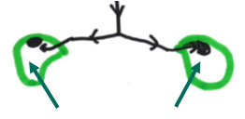

Your Brain Creates Your Stress
ALERT !!!
Problem-Solving
Amygdala
FLIGHT
FIGHT !!!
Kidneys and Adrenal Glands
Notes:
Alert!!!
If the amygdala senses anything from discomfort to outright danger, it immediately sends a signal down to the adrenal gland on top of the kidneys.
The adrenals produce two chemicals that flow into every part of your body, raising your pulse and blood pressure, opening your capillaries increasing the blood flow into your muscles, putting your whole body on alert to do one of two things: Fight or Flight

Slide 26

Your Brain Creates Your Stress
Problem-Solving
Amygdala
This Cup = Your Body
It would be very unusual for you
to have no stress chemicals in it.
Kidneys and Adrenal Glands
Notes:
Stress chemicals in your body.
This cup represents your body. It would be very unusual for you to have no stress chemicals in it.
The same stress chemicals that are stimulated by signals from the brain, are also produced by things we eat or drink like coffee or coke. A lack of sleep can also produce them.

Slide 27

Your Brain Creates Your Stress
Problem-Solving
Amygdala
This Cup = Your Body
A small to moderate level of stress
is actually good for us.
Kidneys and Adrenal Glands
Notes:
A little stress is actually good.
A small to moderate level of stress is actually good for us, motivating us to take action to reduce the threat.
Think about when you were back in school and on Thursday the teacher announced that there would be a test on Friday.
Would you be more likely to study more that night than on a normal Thursday night? Probably. That extra effort was motived by these stress chemicals or “pressure” you feel caused by the desire to do well on the test.

Slide 28

Your Brain Creates Your Stress
Problem-Solving
Amygdala
This Cup = Your Body
OVERLOAD!!!
Get rid of these chemicals
– or EXPLODE !
Kidneys and Adrenal Glands
Notes:
Overload!
While the brain operates at light-speed, the chemicals they produce can stay in our bodies for days, accumulating with every irritation, affecting our emotions, our rationality, and our physical health.
The more chemicals, the more we feel the affects of stress: anxious, out of control, afraid, annoyed, etc.
If we don’t do anything to get rid of these chemicals, they keep accumulating until we explode!

Slide 29
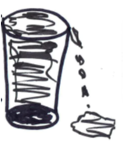
Your Brain Creates Your Stress
Connections to the part of our brain that solves problems get blocked.
Problem-Solving
Amygdala
This Cup = Your Body
Kidneys and Adrenal Glands
Notes:
An “Emotional Hijacking”
Ever feel like you’ve “lost it?”
Too much of the stress chemical in our bodies, and the connections to the parts of our brain that solves problems get blocked and we only have access to the “stupid” part of our brain that we share with birds, lizards and snakes.

Slide 30
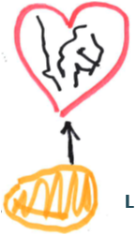
Your Brain Creates Your Stress
How Stress Affect Your Health
Problem-Solving
Heart
The same chemical that makes us feel stressed, goes to the liver and tells it to produce cholesterol, which is the tie between stress and heart disease.
Amygdala
Liver
Kidneys and Adrenal Glands
Notes:
How does stress affect our health?
The same chemical that makes us feel stressed, goes to the liver and tells it to produce cholesterol, which is the tie between stress and heart disease.
Test from Duke Medical School

Slide 31
The Stress Curve
Quality
of Performance
and
Decision-Making
Emotional Hijacking
Good Stress
Distress
Level of Stress
Notes:
What is the relationship between stress and performance?
A certain amount of stress is good and actually motivates high performance.
However, too much stress may cause us to reach a breaking point where performance drops off dramatically. This point is called an “Emotional Hijacking.” where we only have access to the primitive parts of our brain, not the thinking parts.

Slide 32
The Stress Curve
What’s the secret?
Quality
of Performance
and
Decision-Making
Good Stress
Distress
Level of Stress
Notes:
Stress Tolerance – Endurance
Some people are able to endure an incredible amount of stress and continue to live or work at a very high level of performance.
Think of test pilots or top-level athletes or people who work in dangerous environments.
What’s their secret?

Slide 33
The Stress Curve
Self-Care
and Learning
Manage ✓
Quality
of Performance
and
Decision-Making
2. Learn to Deal with the Problem
Self-Care
Learning
1. Eliminate Unnecessary Stressors
Level of Stress
Notes:
The Secret, The Solution
High performance in stressful conditions depends on two things:
1. Eliminating the unnecessary stressors, that is, the stress you can control through self-care (exercise, diet, strong relational support, spirituality)
2. Learning to deal with the stressors through experience and practice with the stimulus

Slide 34













Self-Care
Exercise regularly
Drink water
Enjoy healthy food
Get enough sleep
Relax and have fun
Seriousness is a symptom of chronic anxiety
Build strong
relationships
Ground your identity
and your future in God
Notes:
Self-care: Empty the cup to prevent overload
We all need to empty our cups to prevent overload and explosions. The two major ways to “empty the cup” and reduce the stress chemicals in your body, is through Peeing and Sweating. Following are several ways in which to care for your own well-being in a way that will enable you to manage stress effectively:
Exercise regularly. Physical exercise both makes you stronger and allows you to sweat out the chemicals (get a trainer or join a group).
To prevent dehydration, drink lots of water. Avoid caffeinated drinks which produce stress chemicals.
Eat healthy to help your body function well and avoid diseases.
Get enough sleep.
Learn to relax. Stop bringing stress into your fun, hobbies and interests. Plan regular breaks (“nests in time”).
Lose the perfectionism and become a life-long learner.
Challenge your own distorted thinking, don’t awfulize!
Keep your primary relationships strong.

Slide 35









Life-Long Learning
Use problem-solving
techniques
Become a
Subject Matter Expert
Cultivate communication,
collaboration
and negotiation Skills
Develop
coping strategies
Learn from others
LIFE-LONG
NO
Learn
to delegate
Learn to say “NO”
Develop time
management skills
“”This is an interesting objective problem”
Notes:
Learning – “This is an interesting objective problem”
Following are several suggestions that may get you on the road to life-long learning.
Learn and use problem-solving techniques.
Learn and sharpen your communication, collaboration and negotiating techniques.
Learn about the things you fear the most and get help to develop coping strategies.
Learn to say “No”.
Learn time management and delegation skills.
Become a subject matter expert.
Identify someone who seems to handle well things that drive you crazy and have a conversation to learn their secret.

Slide 36
Spirituality
Ground your identity
and your future in God’s Love
David’s Spirituality (See handout on the Psalms)

Slide 37
Thanks
Paul Feiler
pfeiler51@gmail.com
713-256-9039

