Slide 1
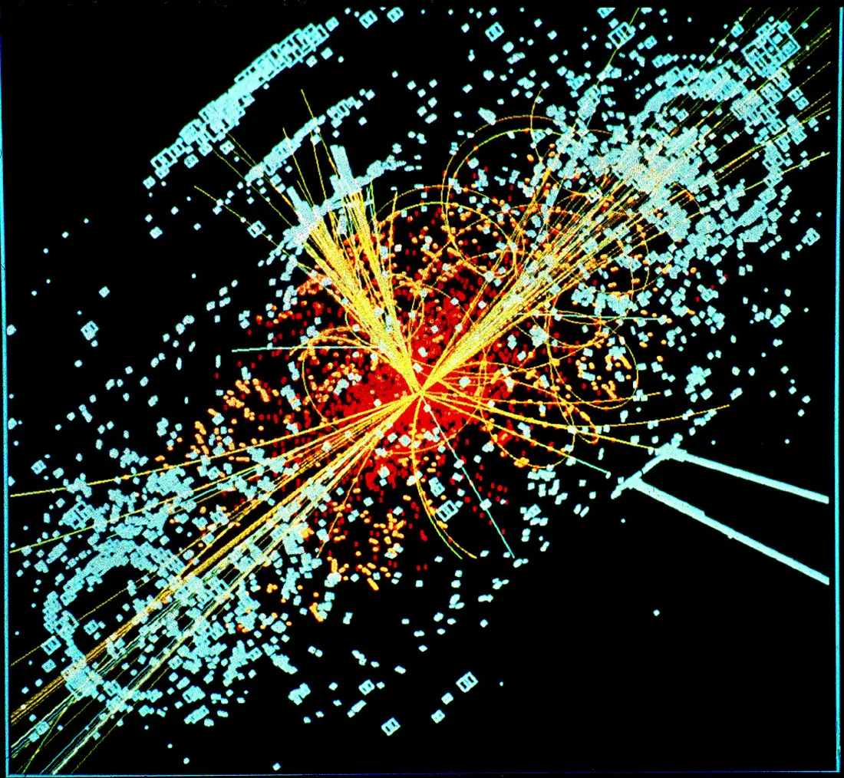
Recognizing God
“The man looked intently and saw everything clearly.” Mark 8:25
House Church
November 22, 2020
Discovered in 2012, the Higgs boson particle, known as the “God Particle” confirms the existence of an invisible energy field present throughout the universe that causes other particles to coalesce into stars, planets and everything else that has mass.

Slide 2
The Battle Hymn of the Republic
Mine eyes have seen the glory of the coming of the Lord; He is trampling out the vintage where the grapes of wrath are stored; He hath loosed the fateful lightning of His terrible swift sword; His truth is marching on.
Chorus:
Glory! Glory! Hallelujah!
Glory! Glory! Hallelujah!
Glory! Glory! Hallelujah!
His truth is marching on.
I have seen Him in the watch-fires of a hundred circling camps; They have builded Him an altar in the evening dews and damps; I can read His righteous sentence by the dim and flaring lamps, His day is marching on. (Chorus)
I have read His fiery gospel writ in rows of burnished steel! "As ye deal with my condemners, so with you My grace shall deal! Let the Hero, born of woman, crush the serpent with his heel,” Since God is marching on.
(Chorus)
He has sounded forth the trumpet that shall never call retreat; He is sifting out the hearts of men before His judgment seat; Oh, be swift, my soul, to answer Him; be jubilant, my feet! Our God is marching on.
(Chorus)
In the beauty of the lilies Christ was born across the sea, With a glory in His bosom that transfigures you and me; As He died to make men holy, let us live to make men free! While God is marching on. (Chorus)

Slide 3
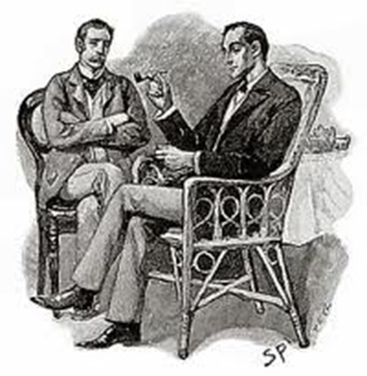
Mr. Sherlock Holmes and Dr. John Watson in the Short Story A Scandal in Bohemia
Holmes: You see, but you do not observe. The distinction is clear. For example, you have frequently seen the steps which lead up from the hall to this room. Watson: Frequently. Holmes: How often? Watson: Well, some hundreds of times. Holmes: Then how many are there? Watson: How many? I don't know. Holmes: Quite so! You have seen, but you have not yet truly observed. I know because I have both seen and observed. There are seventeen steps.
Is there a deeper meaning in the things that we see?

Slide 4
Recognizing God
House Church
Recognizing the Enormity and Boundless Power of God in Nature
Recognizing God’s Atomistic Attention to Detail
Recognizing God in the Commonplace
Recognizing God in the Life of Jesus
Recognizing God in Ourselves and Others
Recognizing God, Feeling Grateful, and Practicing Gratitude
Jesus took the blind man by the hand and led him out of the village. He asked him “Do you see anything? The man looked up and said, “I see people but they look like trees!” Jesus laid his hands on his eyes. The blind man looked intently and his sight was restored and he saw everything clearly.
Mark 8:22-25
In this presentation, two of the most important ways of knowing God are not explicitly discussed: prayer and reading scripture. Reading scripture is implied, everything described here is based on what we read in the Bible (before every topic listed above, I’ve included a slide with the Biblical verses that speak to that topic). Our primary resource for knowing God is the Bible. I’ve not discussed prayer here because recently we have had three great discussion about it by other teachers and also because last year, in one of our times together, I discussed “The Meaning of Prayer,” which, if you missed it, I’ll be happy to send to you. Prayer is our most intimate way of knowing God.

Slide 5
Knowing God and Other Ways of Interpreting Reality
Thomas Kuhn, The Structure of Scientific Revolutions (The most cited book in doctoral dissertations during the 20th century)
All ways of knowing are based on assumptions. Based on those assumptions, a language system, or “paradigm” is developed to describe reality in a particular way.
Examples of paradigms: physics, chemistry, biology, mathematics, poetry, fiction, theology, music, art.
No paradigm is comprehensive; each adds important information, each addresses important questions, each has unanswered questions (anomalies). Taken together they provide a more complete understanding of our world and our experience in it.
Richard Bube, The Human Quest (Christian, Chairman of the Department of Physics at Stanford)
Any experience in life can be described “comprehensively” on a number of different levels.
A “comprehensive” description on one level, does not necessarily discredit or eliminate a description on another level. These descriptions exist together to provide us with a more complete and satisfying description and experience of life.
Focuses specifically on science and belief in God
Examples: a kiss, landing on the moon, the Kennedy assassination.
Science cannot eliminate or discredit our knowledge or experience of God. For those who believe in God, science can enrich our knowledge and experience of God.

Slide 6
The Enormity and Boundless Power of God in Nature
“By faith we understand that the universe was formed at God’s command, so that what is seen was made out of what was invisible.” (Hebrews 11:3)
“For since the creation of the world, God’s invisible qualities—his eternal power and divine nature—have been clearly seen, being understood from what has been made, so that people are without excuse.” (Romans 1:20)
“The heavens declare the glory of God; the skies proclaim the work of his hands. Day after day they pour forth speech; night after night they reveal knowledge. They have no speech, they use no words; no sound is heard from them. Yet their voice goes out into all the earth, their words to the ends of the world. In the heavens God has pitched a tent for the sun. It is like a bridegroom coming out of his chamber, like a champion rejoicing to run his course. It rises at one end of the heavens and makes its circuit to the other; nothing is deprived of its warmth.” (Psalm 19:1-6)
What is visible to us, witnesses to the character of what is invisible.
Given what we know and about the universe today, is your God too small? Christians believe that the universe came into existence and continues to exist only through God’s sustaining power.

Slide 7
The Enormity and Boundless Power of God in Nature
The size of the universe over which God exercises power and control is almost incomprehensible.
The universe is comprised of billions of galaxies, and is about 93 billion light years in diameter (1 light year is 6 trillion miles)
There are over 1 septillion stars (1,000,000,000,000,000,000,000,000) in our universe
There may be multiple universes
In 2012, Physicists discovered the “Higgs Boson Particle,” known as the “God Particle,” which confirms the existence of an invisible energy field present throughout the universe that causes other particles to coalesce into stars, planets and everything else that has mass (“The invisible has brought into existence the visible” Hebrews 11:3)
Could our earth, or our galaxy, or our universe be no larger than a cell in the being of God?
The universe, the laws of nature, our world, and our lives exist moment by moment only by God’s ongoing sustaining power.
All movement, energy, life is made possible by the interaction of four fundamental forces:
Gravity: on earth, the force that pulls things down, allowing you to walk, drive, sit in your seat without floating away
Electromagnetism: the force which holds things together, and provides energy (keeps your seat together and powers your computer)
The Strong Force holds atoms together creating, “stability”
The Weak Force allows atoms to decay or deform, allowing “change”
Without the constant operation of these forces, we and everything else in the universe would simply disintegrate and float away. Is there a unifying Force? Does there need to be?
From a Christian’s perspective, these forces constitute the regular work of God that empowers life and allows the universe and us, moment by moment, to continue to exist.
God creates and sustains everything. Is God dead? For Christians who believe in a “big” God, the question is ludicrous. If God ceased to exist the forces of nature would cease, everything would disintegrate. We exist moment by moment only through God’s creative and sustaining power.

Slide 8
God’s Atomistic Attention to Detail: Recognizing God’s Personal Protection and Care
“For you [Lord] created my inmost being; you knit me together in my mother’s womb. I praise you because I am fearfully and wonderfully made; your works are wonderful, I know that full well.” (Psalm 139:13-14)
“I lift up my eyes to the mountains — where does my help come from? My help comes from the Lord, the Maker of heaven and earth.” (Psalm 121:1-2)
“O Lord, our Lord, your majestic name fills the earth! Your glory is higher than the heavens… When I look at the night sky and see the work of your fingers — the moon and the stars you set in place — what are mere mortals that you should think about them, human beings that you should care for them? Yet you have made them a little lower than Gods and have crowned them with glory and honor.” (Psalm 8:1-8)
“But ask the animals, and they will teach you, or the birds in the sky, and they will tell you; or speak to the earth, and it will teach you, or let the fish in the sea inform you. Which of all these does not know that the hand of the Lord has done this? In his hand is the life of every creature and the breath of all mankind.” (Job 12:7-10)
“The LORD is near to those who have a broken heart, and saves those who have a contrite spirit.” (Psalm 24:17-18)
“Look at the birds of the air; they do not sow or reap or store away in barns, and yet your heavenly Father feeds them. Are you not much more valuable than they? Can any one of you by worrying add a single hour to your life? And why do you worry about clothes? See how the flowers of the field grow. They do not labor or spin.” (Matthew 6:26-28)
“The Spirit of God searches our hearts, constantly making petitions to God on our behalf with groanings too deep for words.” (Romans 8:28)
Alongside the enormous and ubiquitous power of God, stands God’s particular and personal interest in each of us.

Slide 9
God’s Atomistic Attention to Detail: Recognizing God’s Protection and Care
How can God simultaneously hear the prayers of every human being?
Let’s use gravity as an example. The theory of gravity, as it pertains to earth, states that not only does the earth exert a downward force on every object, keeping it “grounded,” but also that simultaneously, gravity causes the earth to rise (an infinitesimally small amount) toward the object it is pulling down. There is a force that causes the earth to rise to meet every footstep. God is in that force.
If gravity can simultaneously cause the earth to rise toward every human footstep, or toward every car tire on the road, how hard is it for us as Christians to imagine that the force of God’s love is simultaneously able to hear and respond to every human prayer, even those that are unspoken.
If the power of God is working within every atom, keeping the universe from floating off into oblivion, how hard is it to imagine that God’s spirit is in us, holding us together, constantly making intercession to God on our behalf, working things together for what God knows is good for us.
How is God always with each of us, protecting us and preserving our lives?
We can recognize God’s constant protection in the way that God has constructed and continuously energizes our brain: God protects us by giving us a brain that is tuned to recognize danger, a brain that can learn to solve problems, a brain that can teach us to cope when things are difficult to change.
100 billion brain cells. A part from basic functions like keeping us breathing, our brain’s first task when perceiving anything is to evaluate whether or not the thing we are perceiving has the potential to cause us harm, physically or emotionally. It does this in 1/30th of a second.
If danger is perceived, the brain prepares us to address it: it scans our memory to see if we have learned a way to deal with the threat, it sends the signal to the part of the brain that solves problems, it motivates us to develop new capabilities to address the situation, it can tap into spiritual resources that can help us relieve stress, it can get us ready to run or fight or do what every we need to do to be safe. God gave us and constantly empowers a brain that protects us, alongside other resources God has given us to enrich our lives. You ask God for protection, God is already protecting you.

Slide 10
Recognizing God in the Commonplace
Biblical Metaphors for God
Father (Dt 32:6; Isa 64:8; Mal 2:10; Eph 4:6)
Rock (Dt 32:4, See also 1Sa 2:2; 2Sa 22:2; Ps 62:2; Ps 78:35)
Shepherd (Ps 23:1. See also Ps 28:9; Ps 80:1; Eze 34:11-16)
Uterus: The word “mercy” is the Hebrew word for “womb” “You must be like a woman’s womb as your Father in heaven is.” (Lk 6:36)
Mother (Dt 32:18, Hos 11:3-4; Is 49:15, 66:3; Ps 131:2)
Wisdom, King, Ruler, Clothing, Fortress, Deliverer, Potter, Sun and Shield, I AM
Metaphors for Jesus Christ
Bread of life (Jn 6:35-51)
Good shepherd (Jn 10:11,14)
Light of the world (Jn 8:12; Jn 9:5);
The “One-of-a-Kind” (Unique) Son of God. There were many other “Sons” in the Old Testament. Jesus is unique.
Word, Prophet, Mediator, Alpha and Omega, Advocate, Suffering Servant, Vine, Lion of the Tribe of Judah, Son of Man
Metaphor for the Holy Spirit
Counsellor (Jn 14:16,26; Jn 15:26; Jn 16:7)
Breath (Ge 2:7; Job 32:8; Job 33:4; Job 34:14); Wind (Jn 3:8)
Comforter, Dove, the Cloud, Fire, Voice of God, Water, Oil, Seal, First Fruits, Whirlwind, Chariot of Fire
Metaphors for the Church
Bride (Rev 19:7; Rev 21:2-9; Rev 22:17)
Household of God (Eph 2:19; 1Ti 3:15)
Body of Christ (Ro 12:4; 1Co 12:12-27; Eph 1:22-23; Col 1:24)
Bread: Body of Christ broken for you. “Whenever you eat!” (Something common given spiritual significance)
Wine: Blood of Christ shed for you. “Whenever you drink!”
Baptism: Spiritual washing signifying new birth into God’s kingdom, “Whenever you shower or wash!?
Metaphor: something commonplace that is used not literally, but symbolically, to help us make sense of something transcendent (something that we cannot describe adequately).

Slide 11
Recognizing God in the Commonplace
Use metaphors as ways of speaking about God
In the Old Testament and among early Jewish Christians, God’s people did not try to describe God literally. God was too great, too holy to describe adequately. They thought that to even mention God’s name was to “put God in a box,” to limit God. And so they restricted themselves to metaphors, things that were common to their experience in the world, to describe how they experienced God working in their lives. “God is like . . . (a Father, a Son, the wind, a rock, a shepherd, an advocate, a friend).”
As Christianity moved into the Greek world, where their philosophers (Plato, Aristotle, Sophocles) had well developed ideas about how things were in heaven and among the gods, Christians began talking about the being and substance of God (literally what is God made of; what the relationship of Jesus to God is), such as in the theological formulation of the Trinity (ca. 300-400 A.D.).
Much of our theology is based on the Greek way of thinking and interpreting the Bible. Sometimes it’s helpful for our spiritual and emotional experience of God to go back to the Hebrew way of seeing God in the commonplace aspects of our lives (being part of a loving family, standing in awe before beauty; reading a story about unexpected kindness).
Pay Attention to Interruptions
Despite all of our strategizing and planning, many of the major positive moves in our lives happen on days when we could have never expected to have the experience that changed our lives: a chance meeting, a sudden change of plans, a devastating disappointment or betrayal, a broken plan, can all be a part of God’s purpose in our lives, which we will see in retrospect.
The Apostle Paul had planned a mission trip to Bithynia, the most lucrative, influential part of Asia Minor, when one night his way was blocked and God told him to go to Troas, which was one of the worst towns in Greece. Paul went to Troas, and started a church there, the first church in Europe. Several centuries later all of Asia Minor and all of its churches were overrun by Islam, and Christianity would eventually extend it’s influence around the world from it’s base in Europe. Paul made the best of a broken plan and it changed the world (Acts 16:6).
Develop Christian “Habits of Mind” (Ways of Thinking about Life) – Count Your Blessings
Common habits of mind are often connected to anxiety and depression: overgeneralizing, black and white/all-or-nothing thinking, jumping to conclusions; imagining the worst/fortune telling; taking everything personally; awfulizing. Such habits of thought are often grounded in low self-esteem, guilt, shame or thoughts that we deserve the bad that we are getting. These thoughts are often rooted in bad theology—”God is punishing me; God hates me for what I did; I’m going to hell.”
Alternatively, God-inspired “habits of mind” begin from a place of grace and love. God made me and loves me; I am forgiven; God has surrounded me with blessings. Proven by randomized scientific studies, these habits of mind increase mental and physical health (significant increase in T-cells that strengthen immunity).

Slide 12
Recognizing God in the Life of Jesus
“The Son is the image of the invisible God, the firstborn over all creation. For in him all things were created: things in heaven and on earth, visible and invisible, whether thrones or powers or rulers or authorities; all things have been created through him and for him. He is before all things, and in him all things hold together.” (Colossians 1:15-17)
"But we know that there is only one God, the Father, who created everything, and we live for him. And there is only one Lord, Jesus Christ, through whom God made everything and through whom we have been given life.” (1 Corinthians 8:6)
“Jesus said, I and the Father are one.” (John 10:30)
“For God so loved the world he sent his “only-begotten’ (Greek: monogenes, meaning, “one of a kind,” “unique”) Son . . .” (John 3:16)
“Jesus answered: “Don’t you know me, Philip, even after I have been among you such a long time? Anyone who has seen me has seen the Father. How can you say, ‘Show us the Father’?” (John 14:9)
“Jesus, who, being in very nature God, did not consider equality with God something to be grasped …” (Philippians 2:6)
“For God was pleased to have all his fullness dwell in him and through him to reconcile to himself all things, whether things on earth or things in heaven, by making peace through his blood, shed on the cross.” (Colossians 1:19-20)
“For in Christ all the fullness of the Deity lives in bodily form.” (Colossians 2:9)
“God has in these last days spoken to us by his Son, whom he has appointed heir of all things, by whom also he made the worlds; Who being the brightness of his glory, and the express image of his person, and upholding all things by the word of his power, when he had by himself purged our sins, sat down on the right hand of the Majesty on high.” (Hebrews 1:2-3)

Slide 13
Recognizing God in the Life of Jesus
John 3:16: Jesus is the “unique” Son of God (Greek: mono-genes, one of a kind).
In the Old Testament the meaning of “Son of God” refers specifically those whom the Hebrews thought were appointed by God to reveal God to Israel. They had God’s authority. Their words and deeds were thought to be equivalent to God’s words and deeds. This understanding was a metaphor that came out of a cultural understanding of the role of the “son” in the Hebrew family. When the father was involved in a business deal or negotiations with a neighboring tribe, he could send his son, whose words and actions were considered to have the authority of the father. Thus, theologically, in the OT, the people of Israel (Hosea 1:10), David (Psalm 2:7, 12; 2 Samuel 7:12, 14, 16), Solomon (1 Chronicles 28:6) and other kings of Israel were called, individually or collectively the “Son of God.” In the New Testament, Jesus and the Apostles refer to Christians as the “Sons” or “Children” of God (Matthew 5:9; Luke 6:35; Luke 20:34-36; John 1:12-13; Ro 8:12-25; Gal 3:24-25).
Jesus, however, is not just another “Son”, he is the unique son of God (Jn 3:16). He reveals the Father like no one ever, before or after. His words and actions are God’s words and actions. He provides our best understanding of who God is.
Grasshopper analogy: if a human being wanted to communicate to a grasshopper what it means to be a human, the most effective way to do that would be somehow to convert him/herself into a grasshopper, yet retain the basic qualities of humanity, communicating to grasshoppers the way that grasshoppers communicate (if that makes any sense). That’s Jesus’ Sonship.
2. What do we learn about God from listening to Jesus and observing his interactions with others?
Jesus’ forgiveness is the forgiveness of God, God gives us second chances and opportunities for new beginnings.
Jesus’ preaching about the coming of God’s Kingdom and God’s love for all humanity is God saying, “I am here, I will never leave you, and I love you no matter what. Your destiny is fixed in my love”
Jesus’ teaching about how to live a blessed and abundant life (e.g. blessed are the peacemakers, blessed are the pure in heart, etc.,) and his new commandments, are God’s teaching and God’s commandments, and can be experienced by all who love God.
Jesus’ miracles are demonstrations of God’s power, God’s faithfulness, and the power available to us in times of trouble.
Jesus’ criticism of the tyranny of religion without love and service, of rigorous obedience to the law without a grasp of God’s grace, of the priority of honesty and faith over perfection points us to God’s idea of true religion.
Jesus’ accepting, healing and eating with those who could have never expected to receive God’s grace, show us that God’s love is extended toward all humanity.
Jesus’ ministry and attention to the poor and other outcasts, show us God’s unique concern for them.
Jesus’ death on the cross, shows us that God knows and has experienced in God’s being the suffering that we experience.
Jesus’ resurrection shows us that God will ultimately triumph over death and wants for us an abundant and eternal life with him, if we will only trust him, and walk by faith with him, as Jesus did.

Slide 14
Recognizing God in Ourselves and Each Other
“God spoke: ‘Let us make human beings in our image, make them reflecting our nature so they can be responsible for the fish in the sea, the birds in the air, the cattle, and, yes, Earth itself, and every animal that moves on the face of Earth.’ God created human beings; he created them godlike, Reflecting God’s nature. He created them male and female. God blessed them: ‘Prosper! Reproduce! Fill Earth! Take charge! Be responsible for fish in the sea and birds in the air, for every living thing that moves on the face of Earth.’” (Genesis 1:26-28)
“Beloved, let us love one another, because love is from God; everyone who loves is born of God and knows God. Whoever does not love does not know God, for God is love. Beloved, since God loved us so much, we also ought to love one another. No one has ever seen God; if we love one another, God lives in us, and God’s love is perfected in us.” (1 John 4:7-12)
“The earth is full of God’s unfailing love.” (Psalm 33:5)
“But the fruit of the Spirit is love, joy, peace, forbearance, kindness, goodness, faithfulness, gentleness and self-control.” Galatians 5:22-23
“The kingdom of God does not come with observation; nor will they say, ‘See here!’ or ‘See there!’ For indeed, the kingdom of God is within you” (Luke 17:20-21)
“Do you not know that your body is a temple of the Holy Spirit, who is in you, whom you have received from God? Therefore honor God with your bodies.” 1 Corinthians 6:19-20
The church is the body of Christ (see Romans 12:5, 1 Corinthians 12:12–27, Ephesians 3:6, 4:15–16 and 5:23, Colossians 1:18 and 1:24)
“Jesus said, ‘For I was hungry and you gave me something to eat, I was thirsty and you gave me something to drink, I was a stranger and you invited me in, I needed clothes and you clothed me, I was sick and you looked after me, I was in prison and you came to visit me.’ Then the righteous will answer him, ‘Lord, when did we see you hungry and feed you, or thirsty and give you something to drink? When did we see you a stranger and invite you in, or needing clothes and clothe you? When did we see you sick or in prison and go to visit you?’ The King will reply, ‘Truly I tell you, whatever you did for one of the least of these brothers and sisters of mine, you did for me.’” (Matthew 25:35-40).

Slide 15
Recognizing God in Ourselves and Each Other
You are the human face of God
You are created in the Image of God (Genesis 1:26-28)
Your body as the temple of the Holy Spirit (The Kingdom of God is within you; the Fruits of the Spirit)
You are the human face of God in your marriage and to your family (Love your spouse as Christ loved you)
You are the human face of God to your friends (Love your neighbor)
The Church is the Body of Christ in the world
Christ in culture: Christians working in the world, innovating, healing, creating art and music
Christ against culture: Christians opposing injustice, corruption, abject evil wherever it surfaces
Christ transforming culture: Christians in word and deed, changing the lives of those in need
God is at work in all humanity, not just Christians
The earth is full of God’s unfailing love.” (Psalm 33:5)
God loves the world (Jn 3:16)
God is present wherever there is love (1 John 4)
God is present in the suffering of the poor (Matthew 25)
God can use evil and corruption to accomplish God’s purposes. It is just as easy for God to use the acts of the corrupt and immoral for God’s purposes as it is for God to use the acts of the righteous for God’s purposes
Joseph to his brothers: “As for you, you meant evil against me, but God meant it for good, to bring it about that many people should be kept alive, as they are today” (Genesis 50)
The crucifixion and resurrection, “This Jesus whom you crucified, God has made Christ and Lord” (Acts 3)
Balaam’s ass. If God could use Balaam’s ass to set Balaam straight, God can use anyone or anything to accomplish God’s purposes (Numbers 22:21-38) (Buchanan/Lincoln; Carter/Reagan)

Slide 16
Experience God, Feel Grateful, and Practice Gratitude through Acts Kindness on God’s Behalf
Know God
Train your mind and heart to recognized God’s power and love in the commonplace aspects of life.
Practice Gratitude
Feel Grateful
Be the human face of God to yourself and to others
Count your blessings. Thank God. Develop Christian “Habits of Mind”
Knowing God generates gratitude, in word and deed

Slide 17
Practicing Gratitude
Ten Simple Acts of Kindness for Those Who Are Grateful to God
Tell someone how much they mean to you
Show respect to those around you
Do something unexpected for someone
Give hope and encouragement to someone in need
Improve your relationships by not taking loved ones for granted
Stop complaining
Say thanks to God for the trials that come your way. With God, difficulties can turn into the greatest blessing of our lives
Clean up after yourself, in private and public
Notice what’s going right in life as much as what’s going wrong
Listen, truly listen, to others
From Gala Gorman, https://spiritualfitclub.com/practicing-gratitude-positive-thinking-live-happier-life

Slide 18
All Creatures of Our God and King
All creatures of our God and King, Lift up your voice and with us sing, Alleluia! Alleluia!
Thou burning sun with golden beam, Thou silver moon with softer gleam!
O praise Him! O praise Him! Alleluia! Alleluia! Alleluia!
Thou rushing wind that art so strong, Ye clouds that sail in heav’n along, O praise Him! Alleluia! Thou rising moon, in praise rejoice, Ye lights of evening, find a voice!
O praise Him! O praise Him! Alleluia! Alleluia! Alleluia!
Thou flowing water, pure and clear, Make music for thy Lord to hear, O praise Him! Alleluia!
Thou fire so masterful and bright, That givest us both warmth and light.
O praise Him! O praise Him! Alleluia! Alleluia! Alleluia!
And all ye of tender heart, Forgiving others, take your part, O praise Him! Alleluia!
Ye who long pain and sorrow bear, Praise God and on Him cast your care!
O praise Him! O praise Him! Alleluia! Alleluia! Alleluia!
Let all things their Creator bless, And worship Him in humbleness, O praise Him! Alleluia!
Praise, praise the Father, praise the Son, And praise the Spirit, Three in One!
O praise Him! O praise Him! Alleluia! Alleluia! Alleluia!

