Slide 1
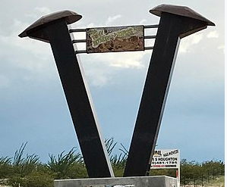
Incorporate Vail AZ (?) Presents Fun Facts About Vail

Slide 2
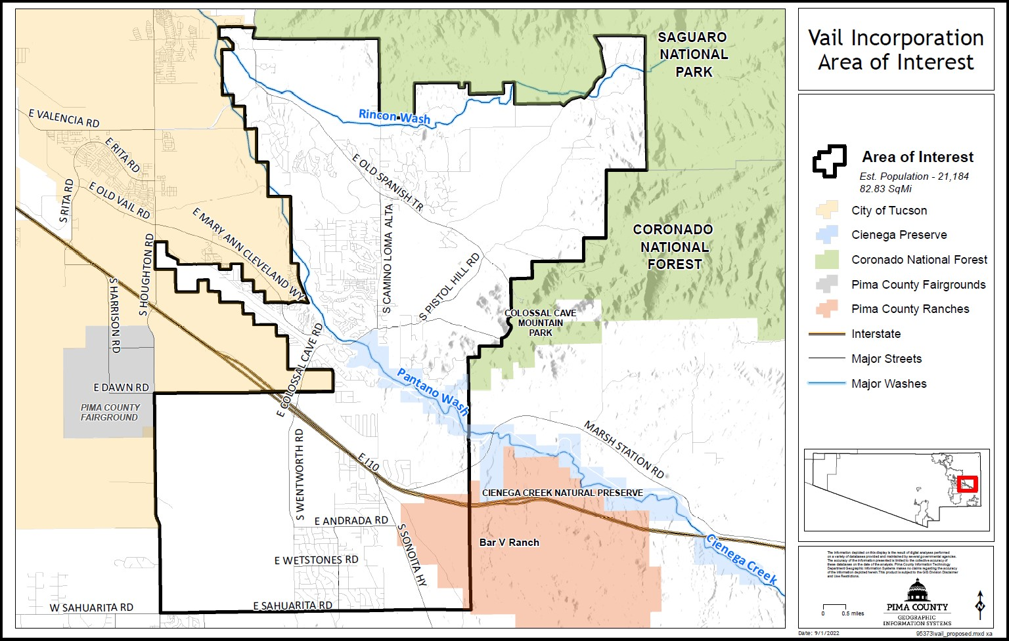
Saguaro National Park East
(Rincon Mountain District)

Slide 3
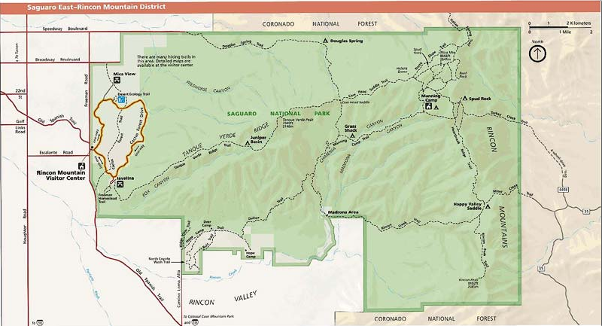
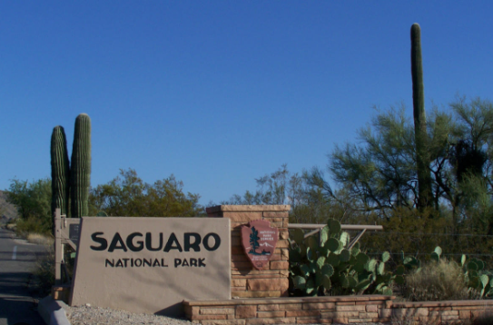
The archeological sites at Saguaro National Park span more than 8,000 years of prehistoric and historic-period occupation. The artifact scatters represent villages, campsites, farmsteads, and stone quarries. Other prehistoric sites include rock art (petroglyphs and pictographs), rock shelters, and bedrock milling sites
Herbert Hoover declared this land a National Monument on March 1st, 1933. Congress officially elevated the area known as Saguaro National Monument to the current designation as a National Park in 1994. Saguaro National Park is comprised of two districts, an east district and a west district, separated by the City of Tucson.

Slide 4
Coronado National Forest
(Santa Catalina District)

Slide 5
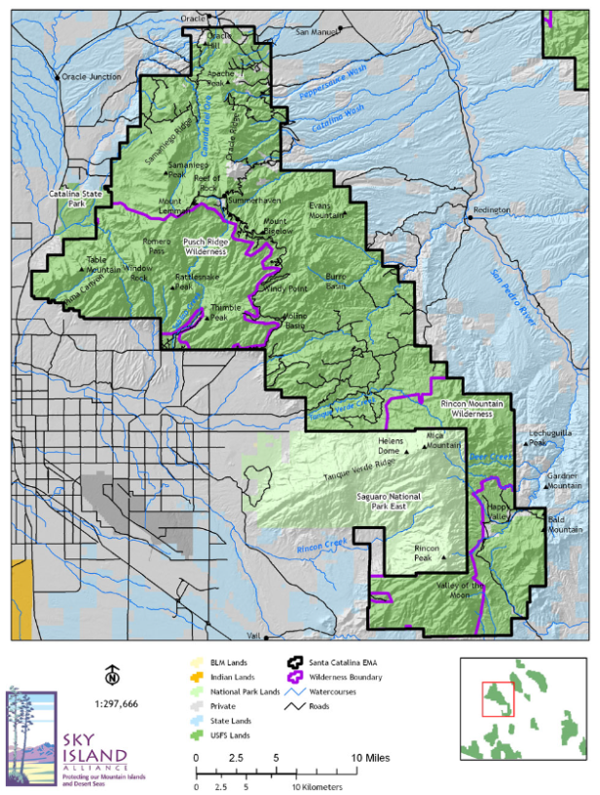
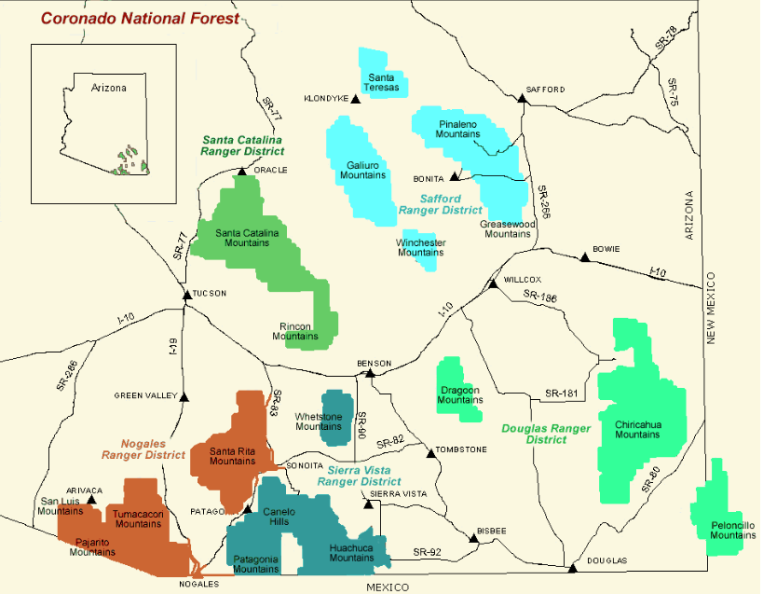
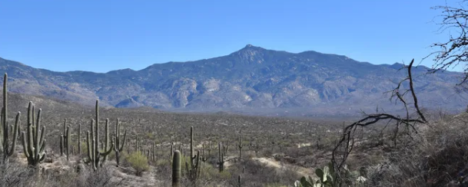
The 1.7 million-acre Coronado National Forest is made up of 15 mountain ranges which rise dramatically from a sea of surrounding desert. Elevations range from 3,000 to 10,720 feet above sea level, supporting vegetation communities as biologically diverse as those encountered on a trip from Mexico to Canada. Views from these mountains are spectacular, and visitors might experience all four seasons during a single day on the Coronado.
The Santa Catalina Ranger District near the city of Tucson comprises the Santa Catalina and Rincon Mountains

Slide 6
Federally Designated
Wilderness Areas
(Rincon and Saguaro)

Slide 7
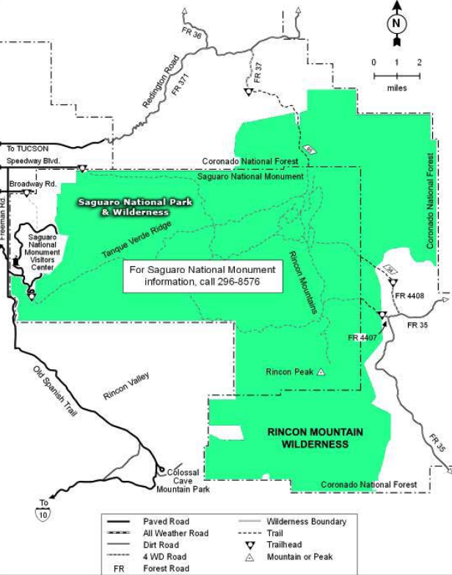
Rincon Mountain Wilderness is a 38,590-acre property in Coronado National Forest that wraps around three sides of Saguaro National Park & Wilderness. Rincon Mountain Wilderness offers rocky ridges rising steeply above deep canyons. Elevations range from about 3,880 feet to 7,325 feet
Saguaro Wilderness is a 57,930-acre property in the Rincon Mountain section of Saguaro National Park. It is bounded on three sides by the Rincon Mountain Wilderness, a 38,590-acre piece of Coronado National Forest.

Slide 8
The Historic Mormon Battalion Trail

Slide 9
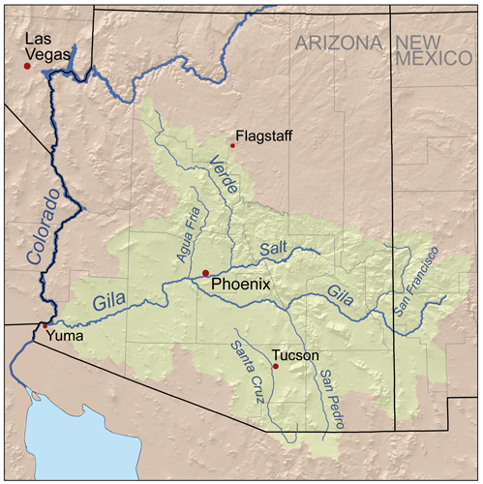
Mormon Battalion Trail - 2000 mile Historic military march of the Mexican-American War from Council Bluffs, Iowa to San Diego, CA. Completed 1846-47 by the Mormon Battalion, America's only religious-based army unit
A study indicated the Battalion left the San Pedro River to turn towards Tucson. Their historic route picks up and generally follows the right of way of Interstate I-10

Slide 10
Historic
U.S. Route 80

Slide 11
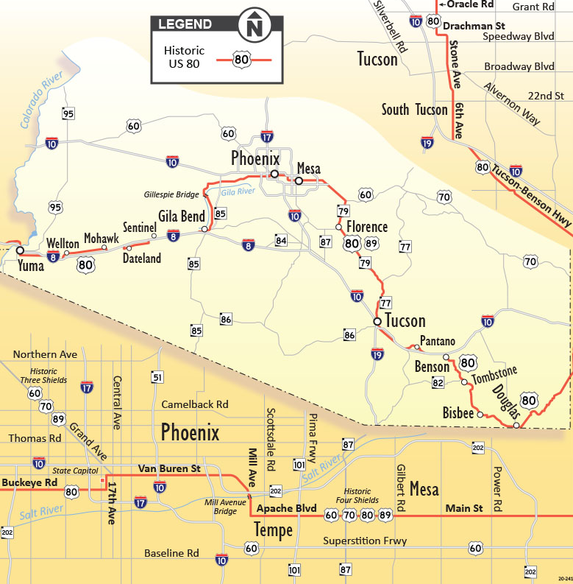
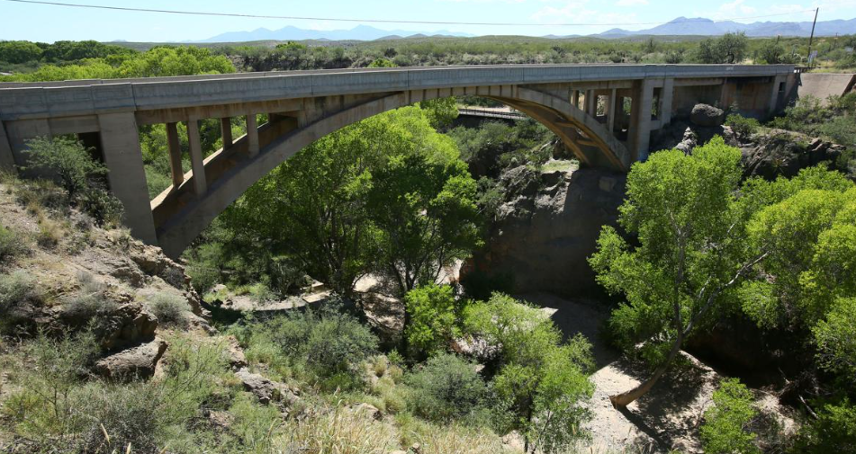
Historic Hwy 80 touches Marsh Station Road and the Cienega Creek Bridge that is listed in the National and State Registers of Historic Places.
The “Broadway of America”, as Hwy 80 was called in some places, came right through downtown Vail.
A small section of the original alignment remains intact between the railroad tracks in Vail

Slide 12
The Arizona Trail

Slide 13
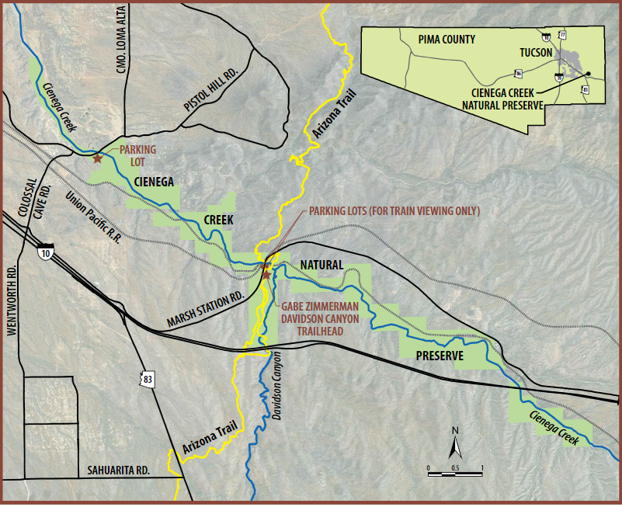
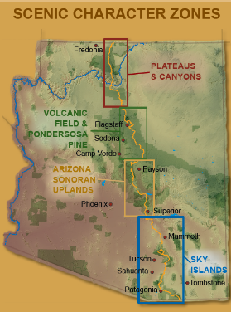
One of 11 national scenic trails in the U.S., the 807-mile Arizona National Scenic Trail (AZT) traverses the state's vast and varied geography—from the mountains near Sierra Vista, along the border of Mexico, to Kanab by the Utah border.

Slide 14
Old Vail Post Office

Slide 15
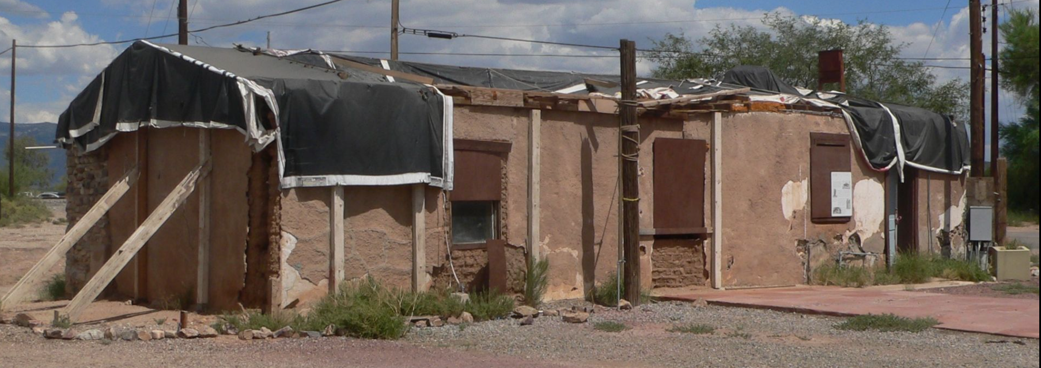
The Old Vail Post Office, built in 1908, is listed on the National Register of Historic Places

Slide 16
The Shrine of Santa Rita in the Desert

Slide 17
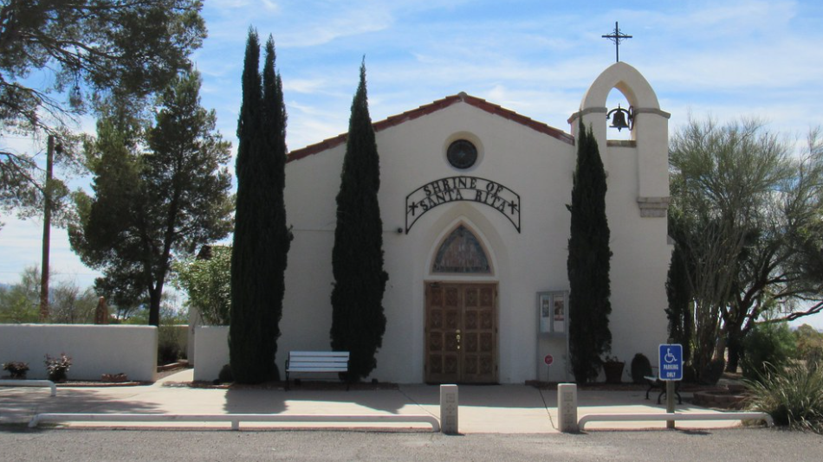
The Shrine of Santa Rita in the Desert is listed on the National Register of Historic Places
The church was built in 1935 in memory of Dr. Jokichi Takamine (1854-1922) by his widow, Caroline Takamine Beach. It is the only Catholic Church in the United States built in memory of a Japanese citizen.

Slide 18
Colossal Cave
Mountain Park

Slide 19
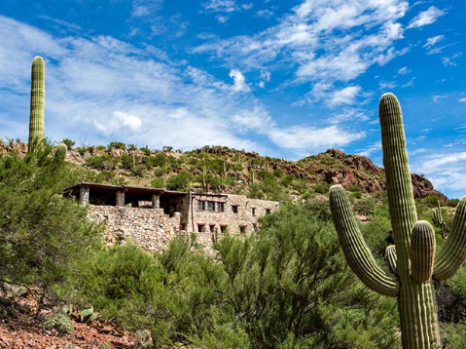
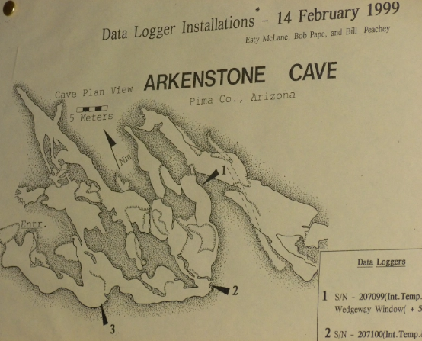
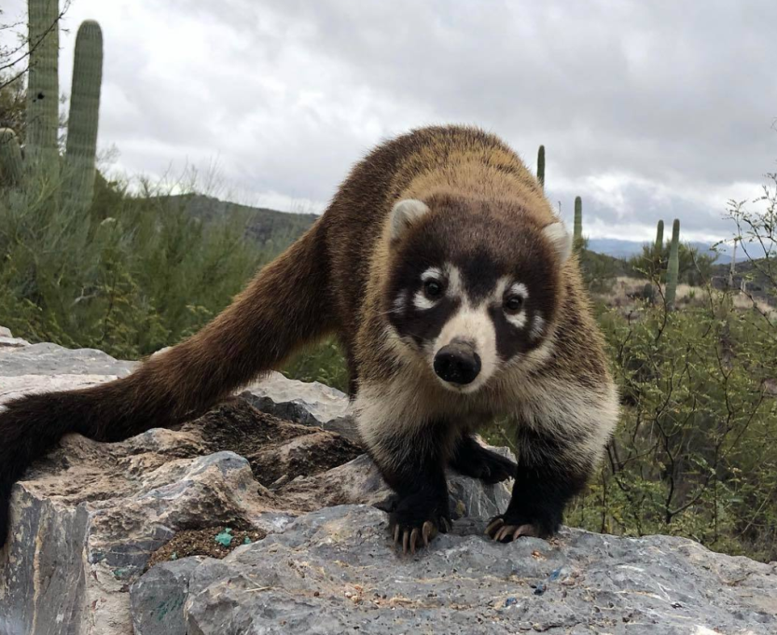
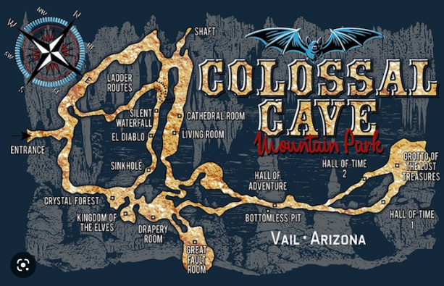
Colossal Cave is a 2,400-acre desert park, on the National Register of Historic Places. It was “rediscovered” in 1879 by Solomon Lick while searching for stray cattle. The Cave became legendary when train robbers used it as a hideout after pulling a job. Colossal Cave is "dry" or "dormant.”
There’s also two living caves!
Arkenstone Cave and La Tetera. These caves are accessible only to scientists and researchers. Arkenstone cave was discovered in the 1960’s, La Tetera in 1996.

Slide 20
Cienega Creek Natural Preserve

Slide 21
The Preserve is significant on a regional basis due to the presence of perennial stream flow and lush riparian vegetation.
The Arizona Trail passes through the Cienega Creek Natural Preserve.

