Slide 1
THE FUNDAMENTAL UNIT OF LIFE
BIOLOGY
CHAPTER-1

Slide 2
What is a cell?
A cell is the structural Functional and biological unit of all living organisms.
Imagine a building. The building is made up of bricks. Similarly, All the living organisms are made up of cells.
For Example:
Tiny Insect, Birds , Elephant, Humans beings

Slide 3
Discovery of cells: -
Cell was first discovered by Robert Hooke in 1665.
He saw a thin slice of cork under his primitive microscope. It resembled like a honey comb like structures.
Thus, he coined a word called ‘CELL’.
Cell Is a Latin word called “Small room”.

Slide 4
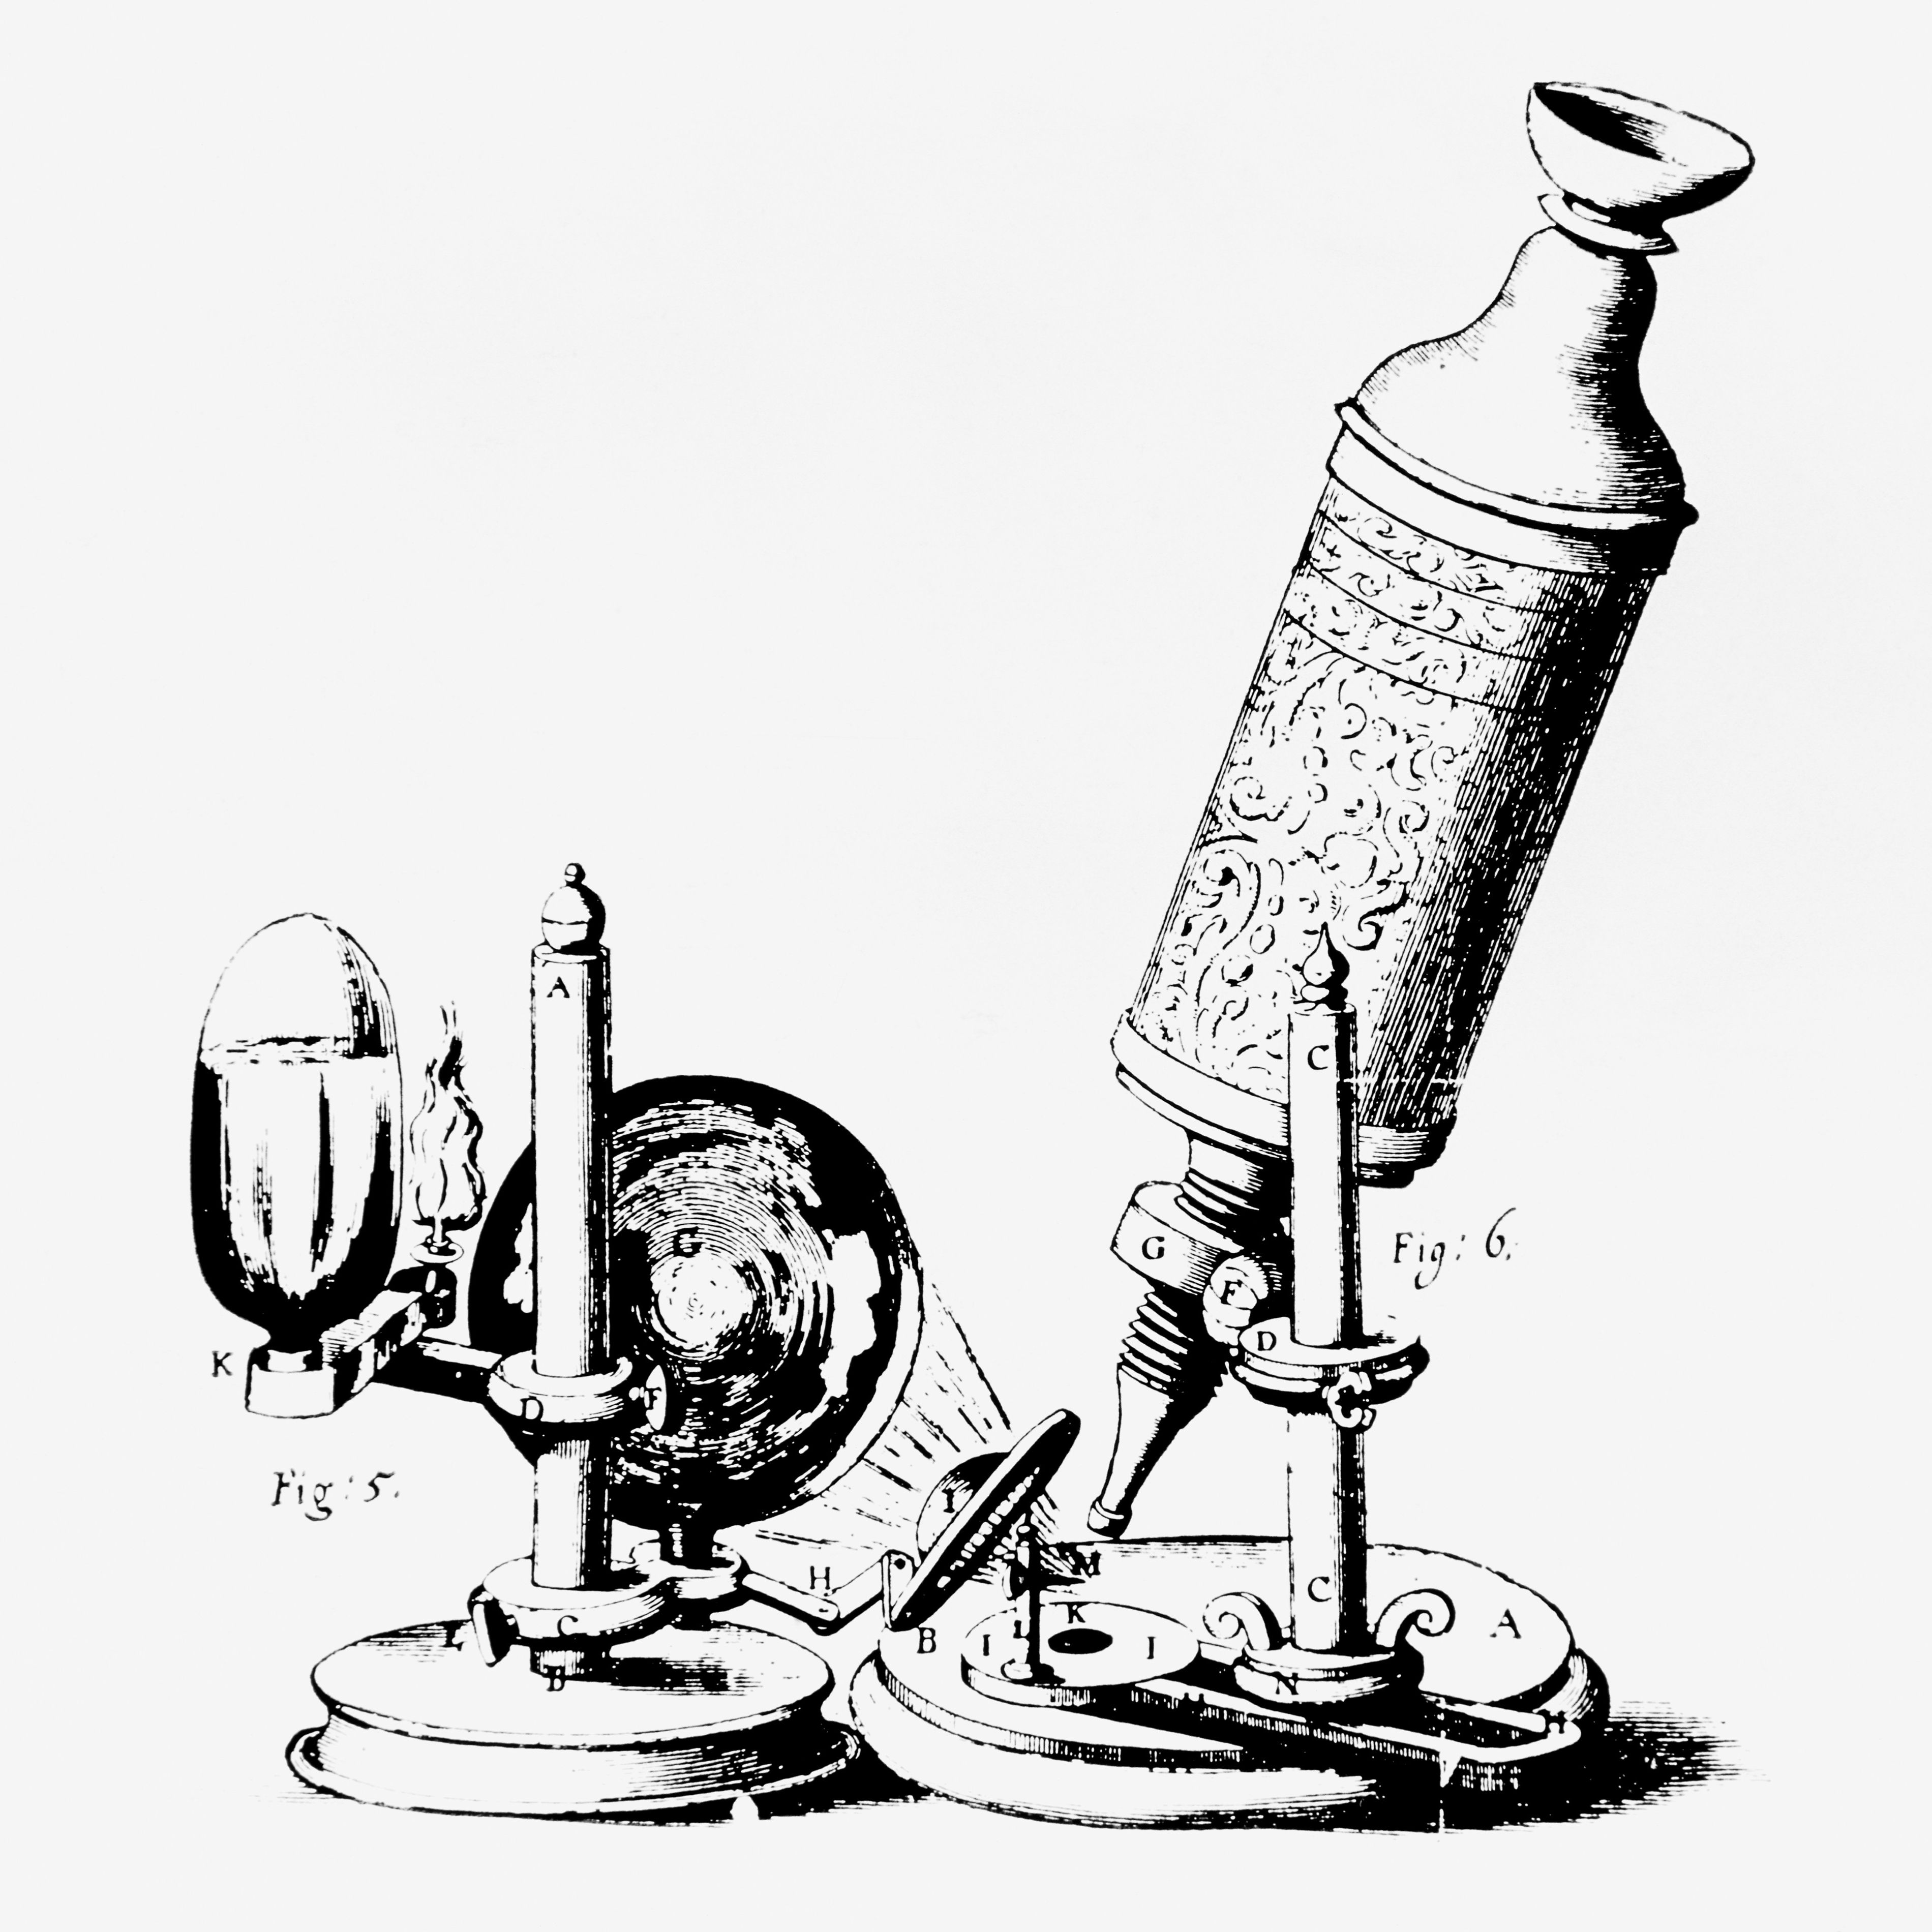
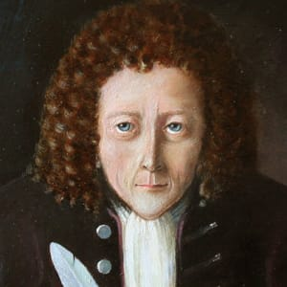
ROBERT HOOKE AND HIS MICROSCOPE

Slide 5
The Evolution of cell theory: -
Robert Hooke (1665) discovered cells.
Leuwenhoek saw a free living cell in a pond (1677)
3. Robert Brown (1833) discovered the nucleus in a cell.
3. Schleiden and Schwan proposed the cell theory In 1838 and 1839 respectively.
4. Virchow expanded the cell theory (1855). he stated that ‘All the cells arise from preexisting cells.’

Slide 6
The Cell Theory: -
Cells are the structural functional and biological unit of life.
All the cells have almost the same chemical composition.
All the organisms are made up of cells
All the cells arise from pre-existing cells.

Slide 7
The Classification of organisms based on number:
Unicellular Organisms – one cell
Multicellular Organisms - more than one.

Slide 8
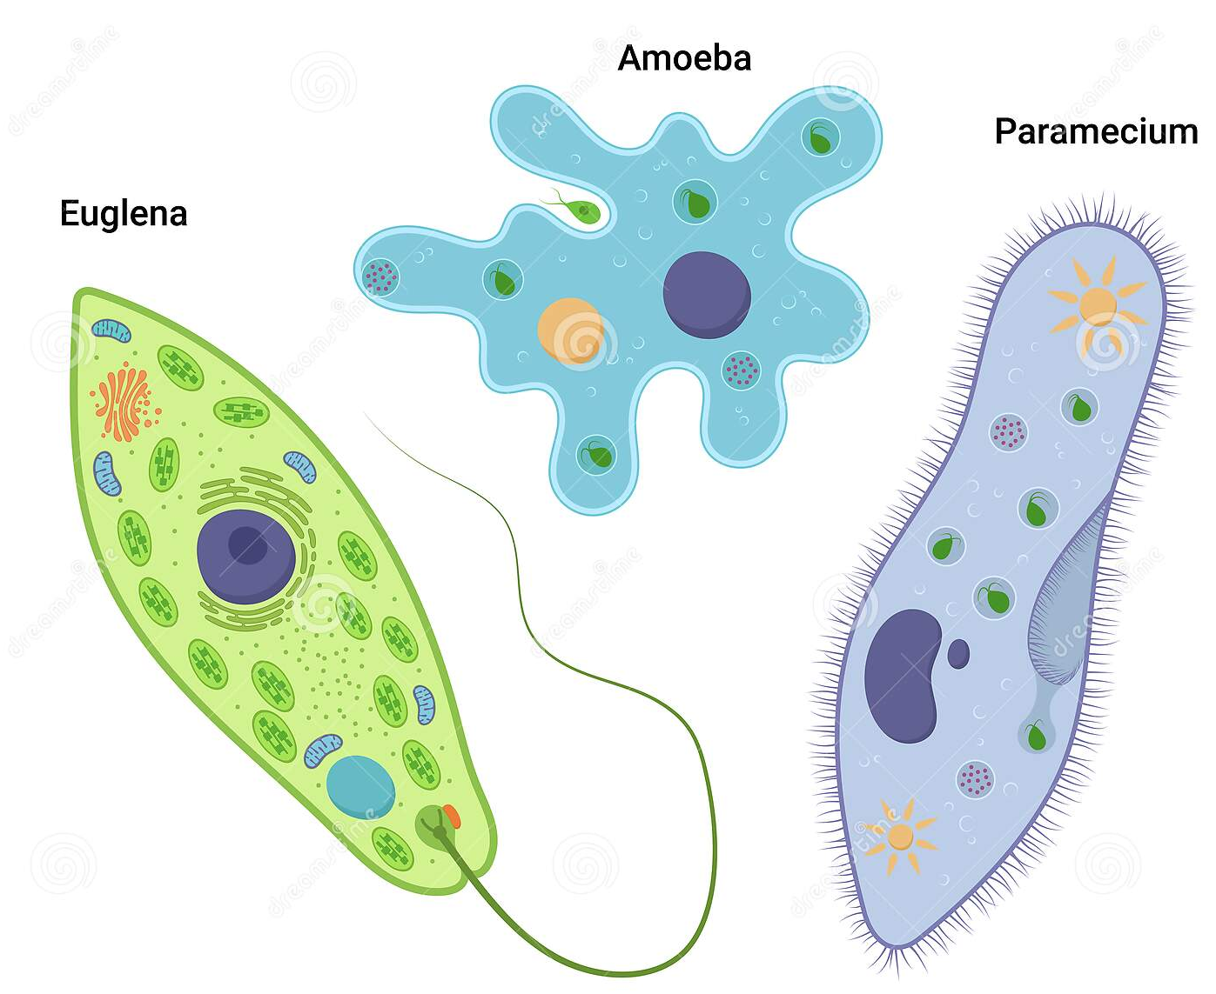
Unicellular Organisms
Single cell perform the basic functions that are the characteristics of the organism.
E.g.- Amoeba (keep changing Its shape)
Chlamydomonas ,Etc.

Slide 9
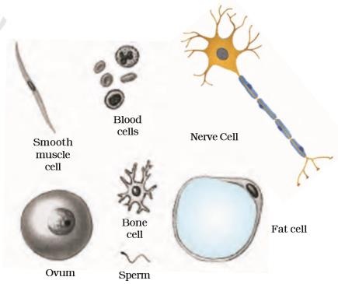
Multicellular Organisms:
Many cells constitute the organism.
Division of labor in multicellular organisms
Some organisms have cells of various kinds

Slide 10
What is a cell made up of?
Cells are made up of components called cell organelles.
A cell is able to live and perform all its function because of these organelles.
All the cells have the same organelles Irrespective of their function and organism they are found In.

Slide 11
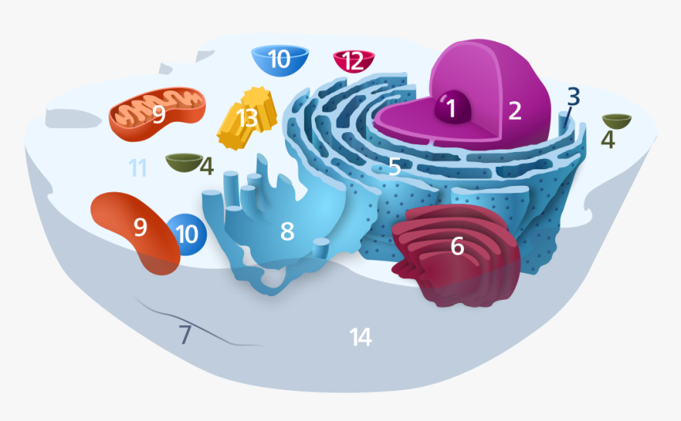
THE CELL ORGANELLES
Nucleolus
Nucleus
Ribosomes
Vesicle
Rough endoplasmic reticulum
Golgi apparatus
Cytoskeleton
Smooth endoplasmic reticulum
Mitochondria
Vacuole
Cytosol
Lysosome
Centrioles with chromosome
Cell membrane

Slide 12
Structure of a onion cell

Slide 13
Structure of a cell
Plasma membrane
Cell wall [only in plant cell]
Nucleus
Cytoplasm
Cell organelles

Slide 14
Plasma Membrane :
Cell membrane (Also known as)
Thin delicate living outer most covering of the cell
Ensures protection of the cell
Selectively permeable membrane.

Slide 15
Why Plasma Membrane is called ‘Selectively Permeable Membrane’?
Let’s see why!

Slide 16
Plasma membrane -- Selectively permeable membrane
Movement of certain substance in and out of cell .

Slide 17
Diffusion:-
Gaseous exchange between cells as well as cell and its external environment.
Movement of gases like O2 or CO2 from region of higher concentration to a region of lower concentration.

Slide 18
Osmosis
Water exchange between cells as well as its external environment.

Slide 19
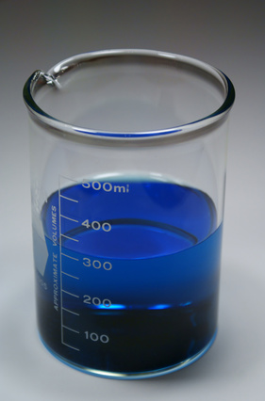
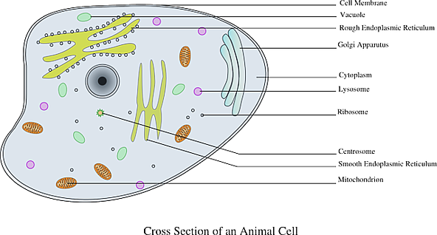
Behavior with different solution – hypotonic solution.
Hypotonic solution:
- Water concentration in the solution Is higher than that inside the cell.
The cell will swell up.

Slide 20
Plasma membrane : structure
Plasma membrane is made up of lipids and proteins.
Structure can be seen under a electron microscope.

Slide 21
What are lipids?
Naturally occurring organic substance insoluble water.
FUNCTIONS:-
Energy storage
Cell membrane construction.
Nanotechnology
-- Dealing with extremely minute things..

Slide 22
Types of lipids:-
Polar – hydrophobia (water hatter).
Non- polar– Hydrophilic (water lover).
Lipids with both hydrophobic and hydrophilic- Amphipathic lipids.
EG. I) Cholesterol
ii) A free fatty acids.

Slide 23
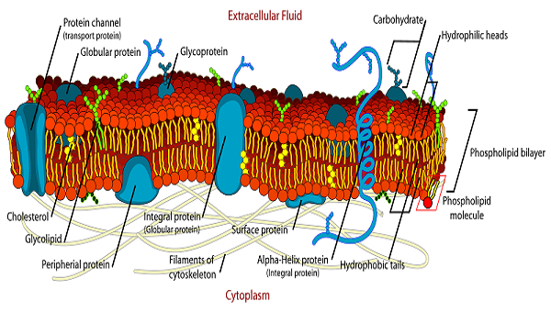
Proteins embedded in continues bilayer of lipids molecules.

Slide 24
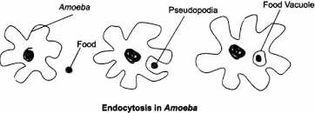
Plasma Membrane : Functions
Protection of the cell
Movement of substance in and out of the cell – gases and water etc.
Flexibility enables cell to engulf food. and other materials from the surroundings.
EG: Endocytosis In Amoeba.

Slide 25
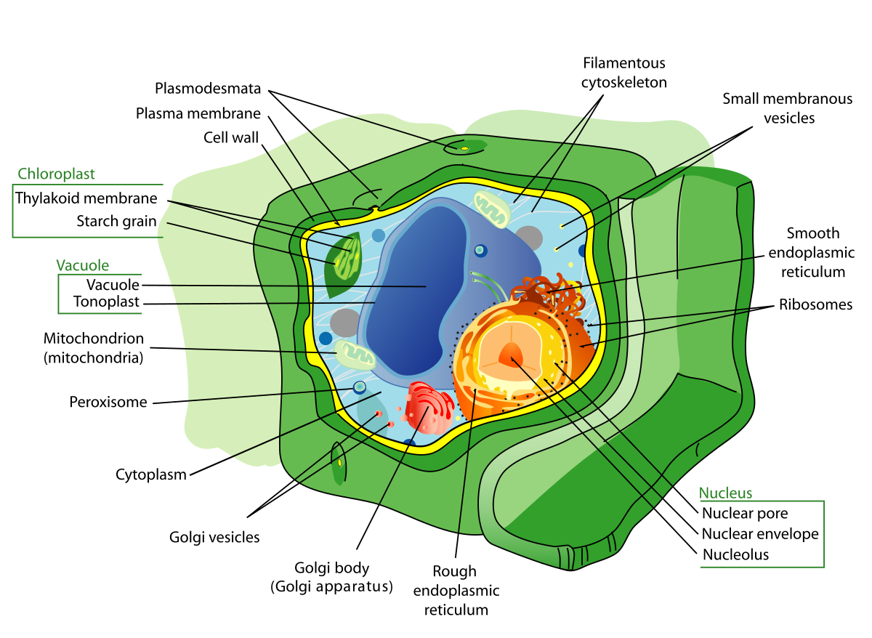
CELL WALL:-
Present only in plant cell.
Rigid non living outer most covering
Present out of the plasma membrane
Composed with cellulose.

Slide 26
Cell wall functions
Provides structural strength to plants.
Prevents busting of cells in hypotonic solution.
Hypotonic – solute Is less.
hypertonic – solute Is more.

Slide 27
Cell wall vs. CELL MEMBRANE:
Cell wall
CELL MEMBRANE
Present only in plant cell
Non living
Permeable
Considerably rigid
Present both in plant and animal cell.
Living
Selectively permeable.
Thin delicate and flexible.

Slide 28
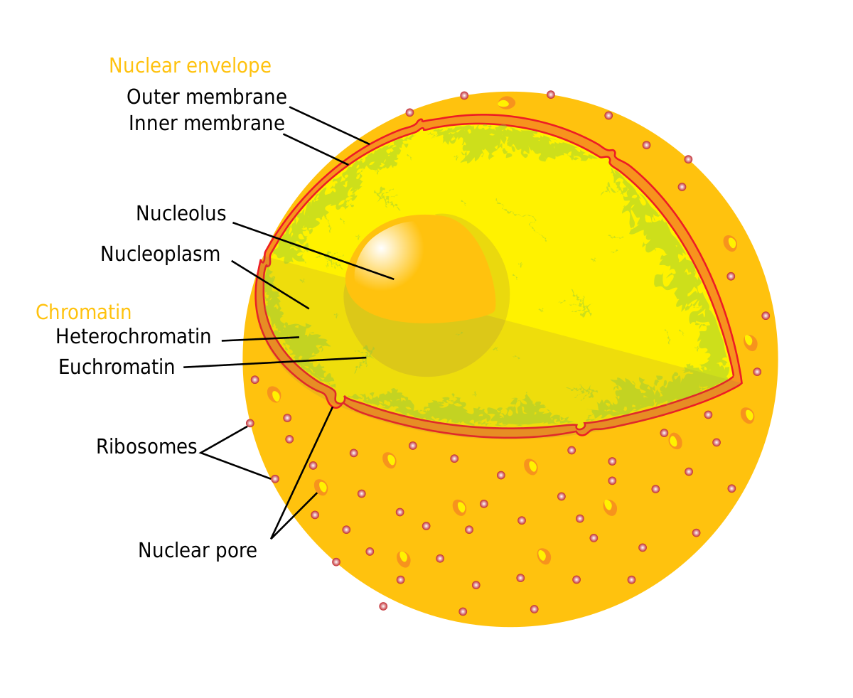
Nucleus
Spherical , oval structure near of the center of the cell.
Present both in plants and animals.

Slide 29
Nucleus Significance
Control structure of the cell.
Helps in movement and reproduction.

Slide 30
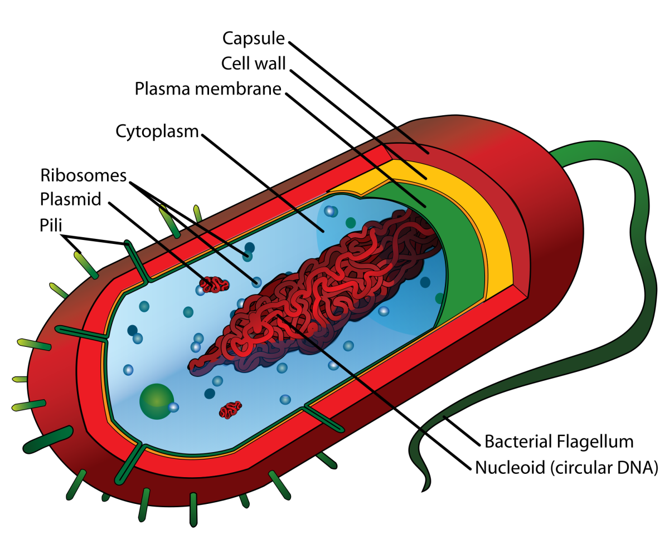
EUKARIYOTIC AND PROKARIYOTIC CELLS

Slide 31
Eukaryotic cell and prokaryotic cells.
Eukaryotic cell
prokaryotic cell
Well defined nuclear membrane
Distinct Nucleus
Cell organelles are present
Region bounded by nuclear membrane contains DNA and Proteins
E.g. Plants and animals
No defined nuclear membrane.
No Distinct Nucleus.
Many Cell organelles are absent.
Undefined region with nucleic acids Is termed as nucleoid
EG. Bacteria and blue green algae

Slide 33
Nucleus structure – eukaryotes

Slide 34
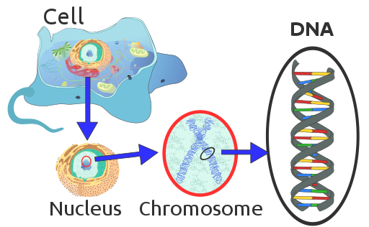
Chromatins
→ chromosomes → (cell division).
Chromosomes contains ‘DNA’ and ‘proteins’.

Slide 35
Nucleus structure – description.
Nucleus membrane:-
Double layer covering of nucleus
Nuclear pore:-
Which allows the transfer of materials through outside.
Nucleoplasm
Fluid enclosed with nuclear membrane .

Slide 36
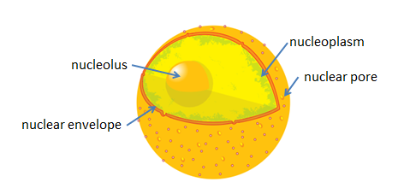
Nucleus structure – description.
Nucleolus:-
Structure embedded in nucleoplasm.
May be one or many in number.
Composed with RNA and proteins.
Ribosomes formation takes place here.

Slide 37
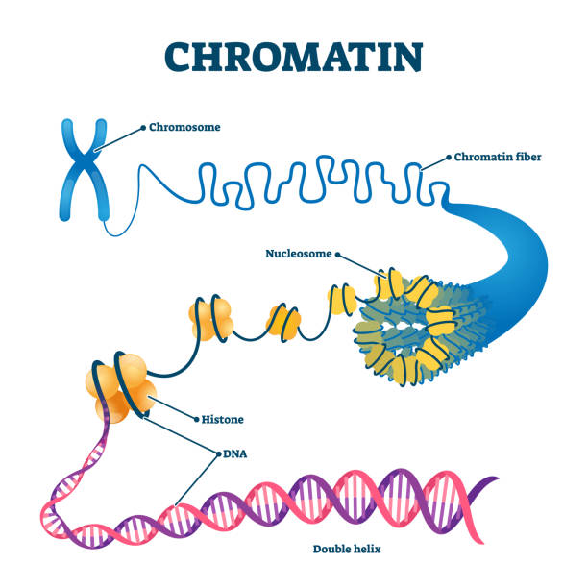
Nucleus structure – description.
Chromatins:-
- Thin thread like structures embedded in cytoplasm.
Contains
DNA and RNA.

Slide 38
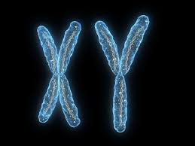
NUCLEAR PROTEINS
Exists during resting stage.
Chromosomes :-
Rod shaped structure
Formed when chromatins come together when the cell about to divide.
Composed with DNA and nuclear proteins.
Information for Inheritance.

Slide 39
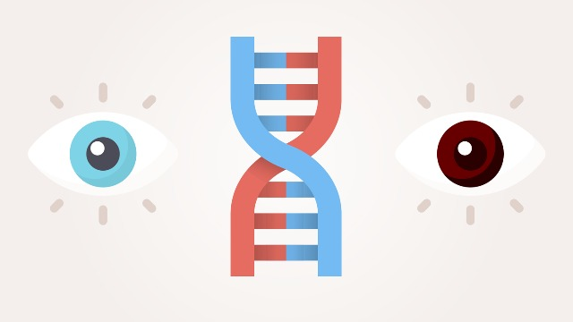
Nucleus Significance:
Control structure of the cell.
Helps in Movement of ribosomes (proteins and RNA) through nuclear pore from nucleolus to cytoplasm.
Cellular reproduction: Chromosomes contained in Nucleus play a crucial role in ‘cell division’.
Genes present inside the chromosomes decide the hereditary characters.

Slide 40
Cytoplasm
Fluid structure inside the cell enclosed by the plasma membrane.
Little viscous (80% water).
Also known as cytosol.
Many cell organelles are embedded in the cytoplasm.

Slide 41
Cytoplasm significance
Contains dissolved nutrients.
Dissolve the waste products
Organelles present in the cytoplasm perform different functions with out which a cell cannot function as a whole.
Controls the shape of the cells to an extend.
Helps in cellular reproduction with the help of cytoplasmic inclusions (non-soluble molecules floating in the cytoplasm.)

Slide 42
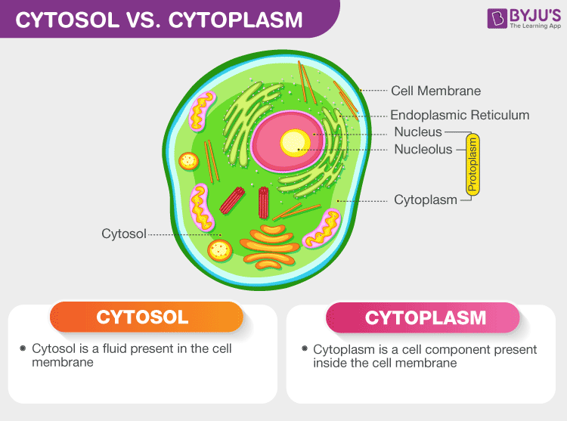

Slide 43
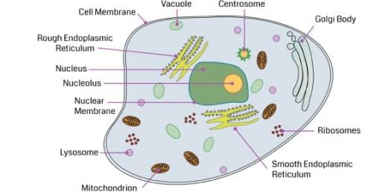
CELL ORGANELLES:
Several cell organelles are suspended in cytoplasm.
Each cell organelle is surrounded by its individual membrane (eukaryote).

Slide 44
CELL ORGANELLES:-
Endoplasmic reticulum
Golgi Apparatus
Lysosome
Mitochondria
Plastids
Vacuoles.

Slide 45
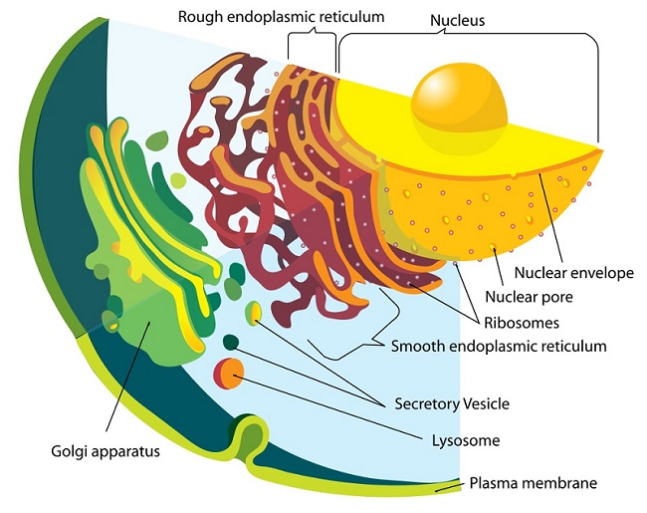
ENDOPLASMIC RETICULUM
ROUGH ENDOPLASMIC RETICULM
Ribosomes attached to its surface.
Proteins manufactured in ribosomes and transferred to other part of ER.
SMOOTH ENDOPLAMIC RETICULM
No ribosomes attached to its surface.
Fat molecules are manufactures here.

Slide 46
ENDOPLASMIC RETICULUM significance
Proteins and lipids are manufactured here are used:
In building the plasma membrane
As enzymes and proteins.
ER acts like a channel to transport materials to different part of the cell.

Slide 47
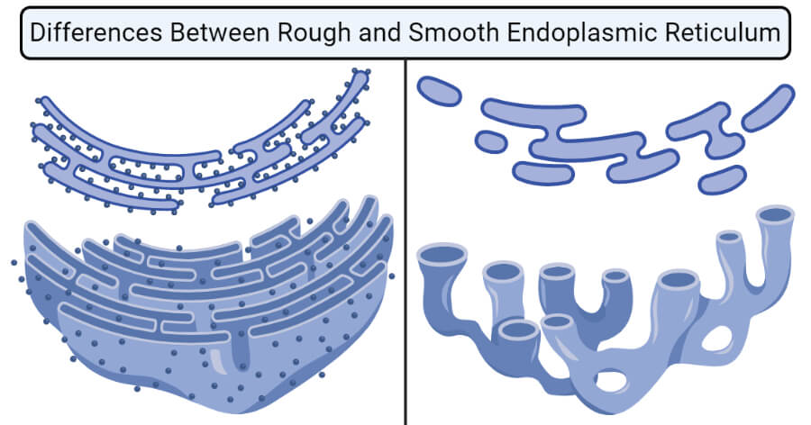

Slide 48
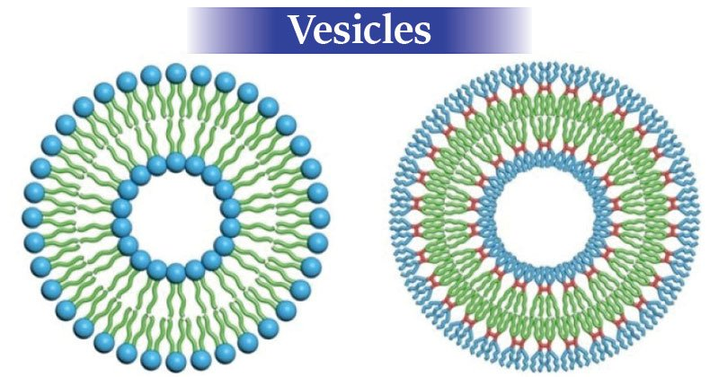
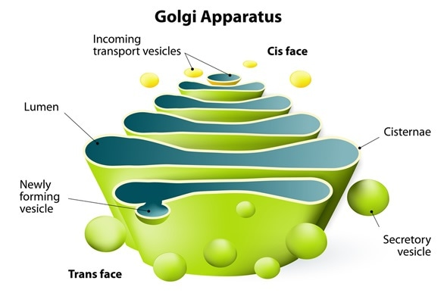
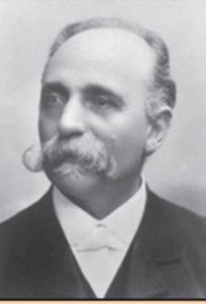
GOLGI APARATUS
Named after Camillo Golgi who first described it.
Network of membrane bound vesicles arranged parallel to each other in sacks called cisterns
Present near nucleus in animal cell.
Freely distributed in plant cell.

Slide 49
GOLGI APARATUS significance
Materials manufactured in ER is disposed
Lipids and proteins from RER and SER to various parts in side the cell through Golgi Apparatus.
Helps in storage of cellular secretions( enzymes, cellulose etc.)

Slide 50
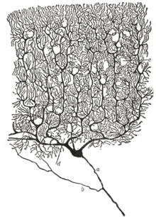
BLACK REACTION:
In 1873 Italy, Camillo Golgi created the black reaction technique, which enabled scientists to stain and view the structure of neurons.
This method uses a weak solution of silver nitrate and is particularly valuable in tracing the processes and most delicate ramifications of cells. He shared the Nobel prize in 1906 with Santiago Ramony Cajal for their work on the structure of the nervous system.

Slide 51
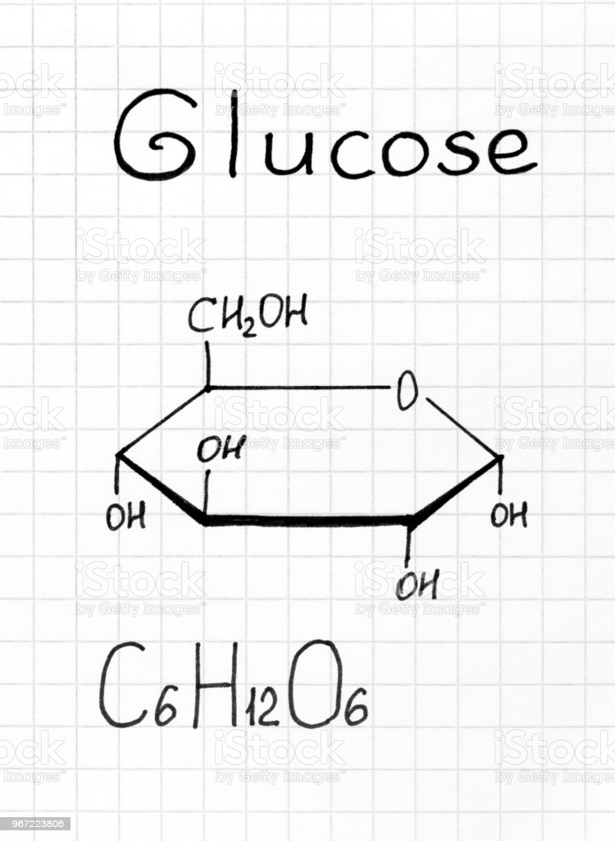
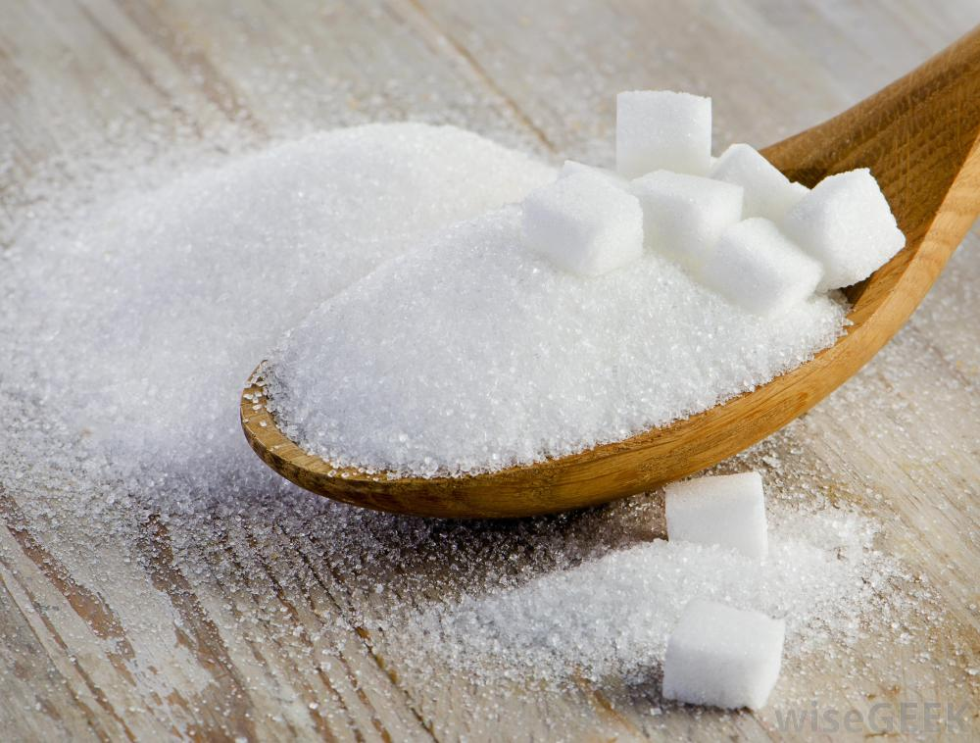
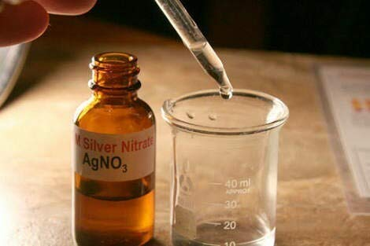
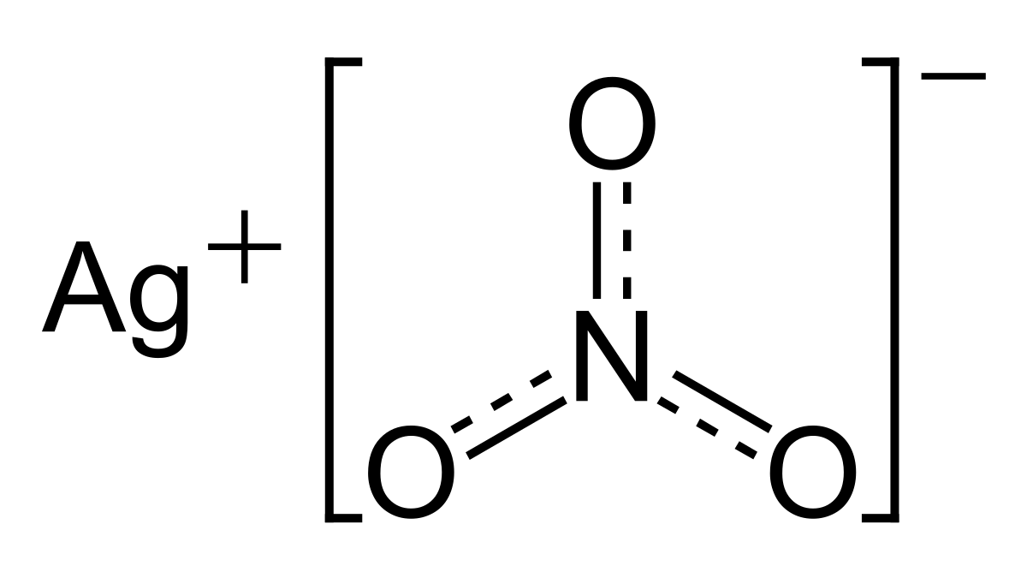
SILVER NITRATE SOLLUTION

Slide 52
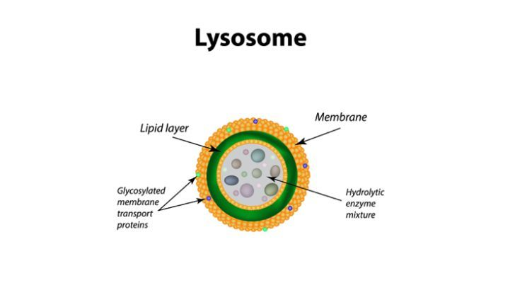
LYSOSOME
Lysosomes are the suicide bags of the cell
Lysosomes are able to do this because they contain powerful digestive enzymes capable of breaking down all organic material.
When the cell gets damaged, lysosomes may burst and the enzymes digest their own cell. Therefore, lysosomes are also known as the ‘suicide bags’ of a cell.

Slide 53
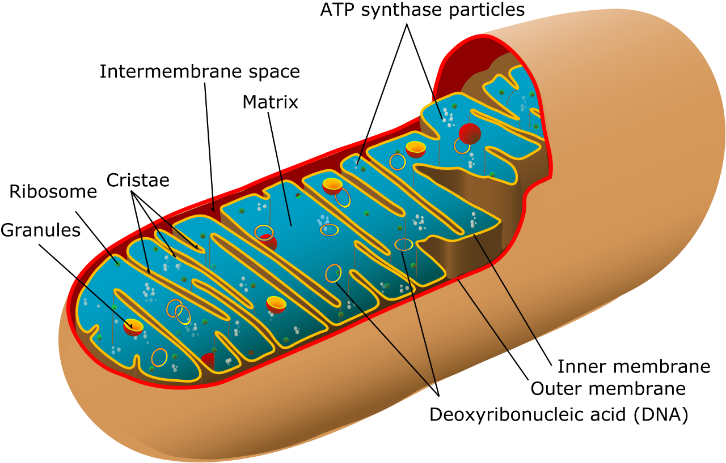
MITOChONDRIA
Mitochondria are known as the powerhouses of the cell.
The energy required for various chemical activities needed for life is released by mitochondria in the form of ATP (Adenosine triphosphate) molecules. ATP is known as the energy currency of the cell. Mitochondria are strange organelles in the sense that they have their own DNA and ribosomes.
Mitochondria and Plastids like Chloroplast have their own DNA and ribosomes because of which they are able to synthesize some of their own proteins and replicate independent of the nucleus.

Slide 54
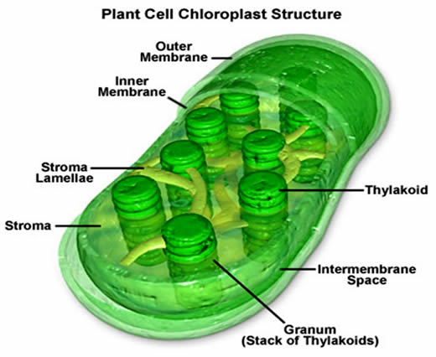
PLASTIDS
Plastids are present only in plant cells
There are two types of plastids – chromoplasts (colored plastids) and leucoplasts (white or colorless plastids).
Chromoplasts containing the pigment chlorophyll are known as chloroplasts.
Chloroplasts are important for photosynthesis in plants

Slide 55
PLASTIDS
Chloroplasts also contain various yellow or orange pigments in addition to chlorophyll.
Leucoplasts are primarily organelles in which materials such as starch, oils and protein granules are stored.

Slide 56
Structure of the chloroplast
Numerus membrane layers are embedded in the material.
Grana / granum.
Membrane Layer.
Contains chlorophyll.
Stroma:
Homogeneous mixture.
Contains photosynthetic enzymes and starch grains.

Slide 57
Stroma importance:
The stroma is essential for this because not only does it contain the enzymes necessary for carbon fixation, it also manages the chloroplast response to cellular stresses and signaling between various organelles. It plays an important role in both the light-dependent and light-independent reactions of photosynthesis.
Stroma, in botany, refers to the colorless fluid surrounding the grana within the chloroplast. Within the stroma are grana, and the sub-organelles or daughter cells, where photosynthesis is commenced before the chemical changes are completed in the stroma. Photosynthesis occurs in two stages.

Slide 58
Significance of plastids:
Helps in photosynthesis.
Storage in plant cell.
Have their own DNA and ribosomes so that they have their own proteins.
[this is same for ‘mitochondria.’]

Slide 59
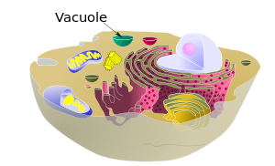
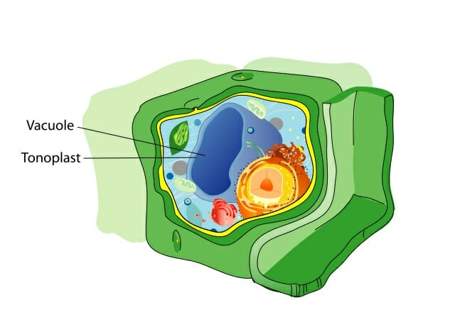
Vacuoles
Solid or Fluid filled membrane bound sacs.
ANIMAL CELL
PLANT CELL

Slide 60
VACUOLES IN ANIMAL and plant CELL
IN ANIMAL CELL
Vacuoles are small in size.
Not all animal cell have vacuole.
IN PLANT CELL
Vacuoles are large in size.
Tonoplast → membrane bound vacuole.

Slide 61
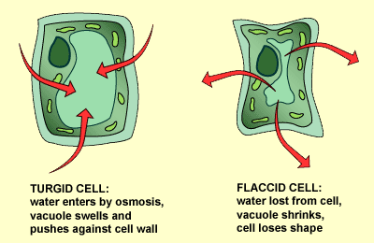
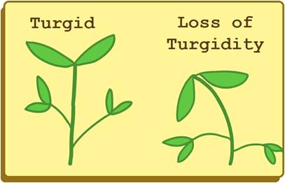

Slide 62
Importance of vacuoles:
The central vacuole of some plant cells may occupy 50-90% of the cell volume.
In some unicellular organisms, specialized vacuoles also play important roles in expelling excess water and some wastes from the cell.
Vacuoles contains amino acids, sugars, various organic acids and some proteins.

Slide 63
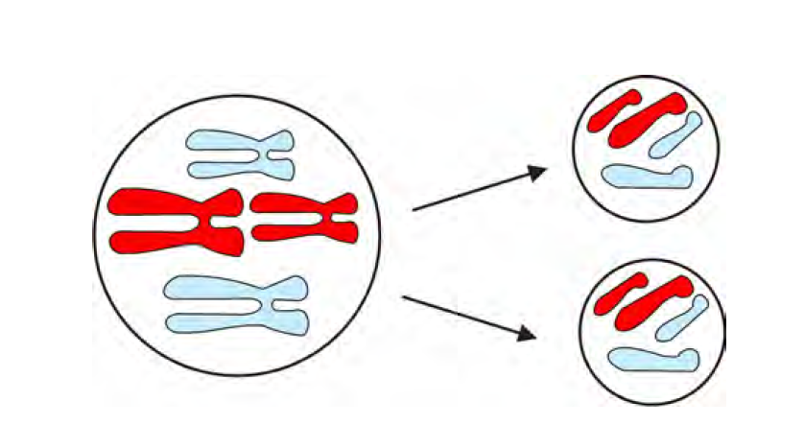
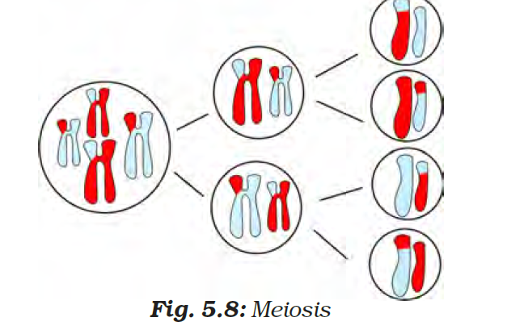
CELL DIVISION
The process by which new cells are made is called cell division.
There are two main types of cell division: mitosis and meiosis.
Specific cells of reproductive organs or tissues in animals and plants divide to form gametes, which after fertilisation give rise to offspring.
They divide by a different process called meiosis which involves two consecutive divisions.
When a cell divides by meiosis it produces four new cells instead of just two.

Slide 64
CELL DIVISION haploid vs. diploid
Haploid is the quality of a cell or organism having a single set of chromosomes.
Organisms that reproduce asexually are haploid.
Sexually reproducing organisms are diploid (having two sets of chromosomes, one from each parent).
In humans, only their egg and sperm cells are haploid.

Slide 65
Mitosis and meiosis
From a diploid parent cell during mitosis , 2 diploid daughter cells are formed .
From a diploid parent cell during meiosis, 4 haploid daughters cells are formed.
Prophase , metaphase , Anaphase and telophase .
Mitosis occur in somatic cells and meiosis occur in sex cells.

Slide 66
Summarizing teaches students how to discern the most important ideas in a text, how to ignore irrelevant information, and how to integrate the central ideas in a meaningful way. Teaching students to summarize improves their memory for what is read. Summarization strategies can be used in almost every content area.

Slide 67
SUMMARY
Cell is the basic structural unit of life.
Each cell is made of various cell organelles that perform special functions
Cell membrane(plasma membrane) contains proteins and lipids. And cell membrane is a living delicate thin membrane.
Cell wall is present outside the cell membrane and it is present only in plant cell. And it is non- living. It is mainly composed with cellulose.
The presence of the cell wall enables the cells of plants, fungi and bacteria to exist in hypotonic media without bursting.

Slide 68
Summary
Nucleus is the control center of the cell . Nucleus contains chromosomes which contains DNA and DNA contains genetic materials
ER serves as a channel between the nucleus and cytoplasm.
There are two types of ER they are i) Rough endoplasmic reticulum and ii) smooth endoplasmic reticulum.

Slide 69
SUMMARY
RER contains ribosomes and manufacture proteins and ribosomes are the site of protein manufacture.
The Golgi apparatus consists of stacks of membrane-bound vesicles that function in the storage, modification and packaging of substances manufactured in the cell.
Most plant cells have large membranous organelles called plastids, which are present only in plant cells . They are of two types – chromoplasts and leucoplasts.

Slide 70
SUMMARY
Chromoplast is the colored plastids and leucoplasts are the colorless plastids.
Chromoplast contains pigment called chlorophyll that is chloroplast.
Leucoplast contains oils, proteins etc.
Vacuoles are those which are present both in plant cell and in animal cell.
In animal cells it is small and more in number and in plant cell it is large and small in number.

Slide 71
QUESTION TIME

Slide 72
Who discovered the cell and when?
Robert Hooke in 1665.
What is hypotonic solution?
Answer: A solution having solute concentration lower than that of the cell sap is called hypotonic solution.
What is hypertonic solution?
Answer: A solution having solute concentration higher than that of the cell sap is called hypertonic solution.
What is endocytosis?
Answer: Endocytosis is the ingestion or engulfment of food and other material by folding of the plasma membrane it as seen in Amoeba.

Slide 73
Name any two structures found in plant cells but not in animal cells.
Answer: Cell wall and chloroplast
Name two structures found in animal cells but not in plant cells.
Answer: Lysosomes and centrioles
Which organelle is the storage sack of solid and liquid materials?
Answer: Vacuoles

Slide 74
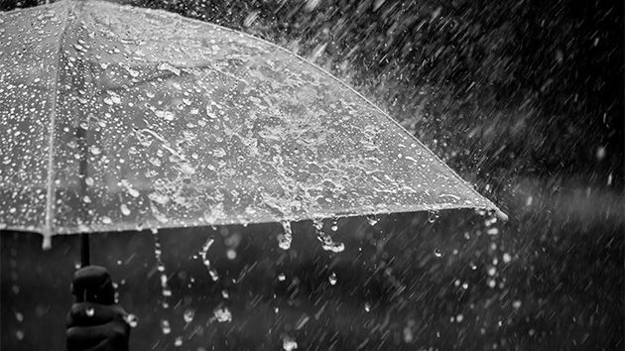
THANK YOU

