Slide 1
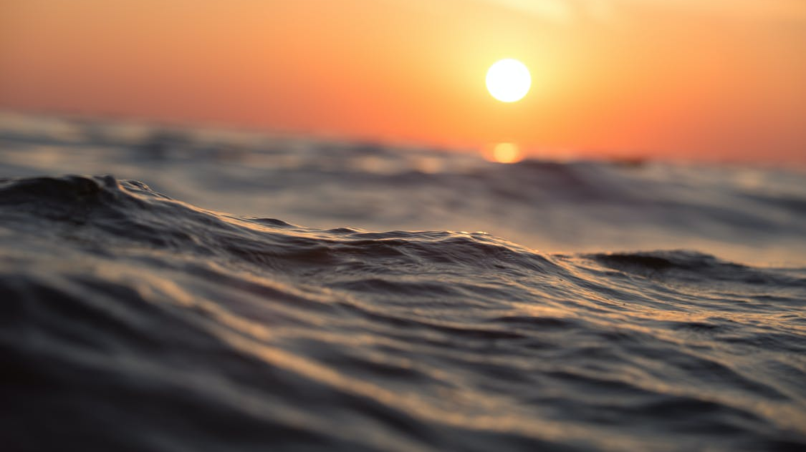
SCOTLAND THE WAVE
4 ROWERS – 1 OCEAN
The world’s toughest row
Welcome to our Partnership Package

Slide 2
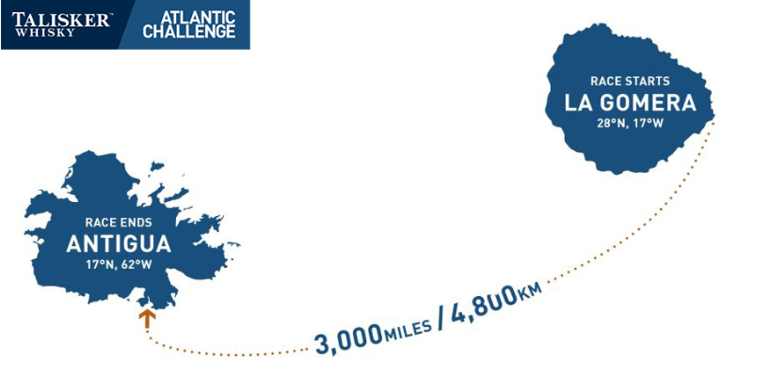
CONTENTS 1 - The Challenge 2 - The Facts 3 - The Rowers 4 - The Charities 5 - Coverage 6 - How to Get Involved

Slide 3
The Challenge In December 2025 we will join approximately 35 other teams who will race 3000 miles across the Atlantic Ocean unaided in what is known as the world's toughest row! Rowing 2 hours on and 2 hours off continuously for up to 60 days. Living off rehydrated foods, salt sores, sleep deprivation, sea sickness, 40ft waves, wild storms and a few visits from whales, sharks and blue marlins are all part of the experience. The ultimate endurance race across the world’s second largest ocean. We are aiming to achieve a world record of being the first Scottish female team of 4 to row any ocean. Join us now and be part of our adventure!

Slide 4
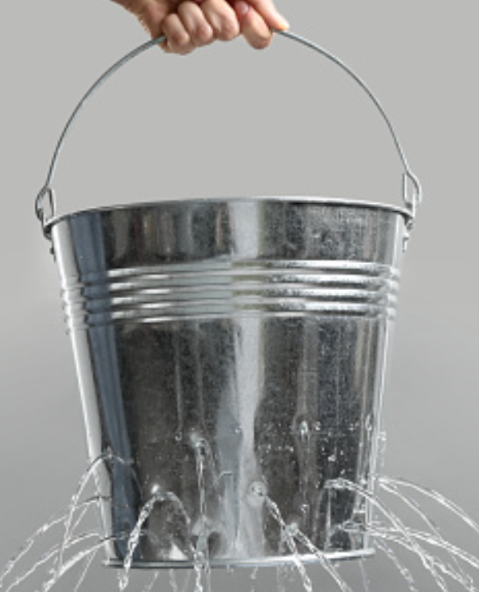
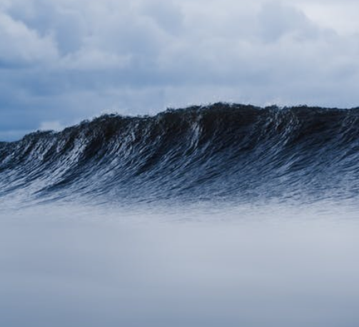
The Facts
More people have climbed Everest than rowed an ocean.
5000+ calories and 10 litres of water will be consumed per person each day.
Row 2 hours, sleep 2 hours 24/7.
Average weight loss of 8kg per person.
Each team will row in excess of 1.5 million stokes.
Each rower will use 800 sheets of toilet paper. There is no loo - just a bucket!
The team will spend 45-65 days at sea.
Up to 20-foot waves and wild storms.

Slide 5
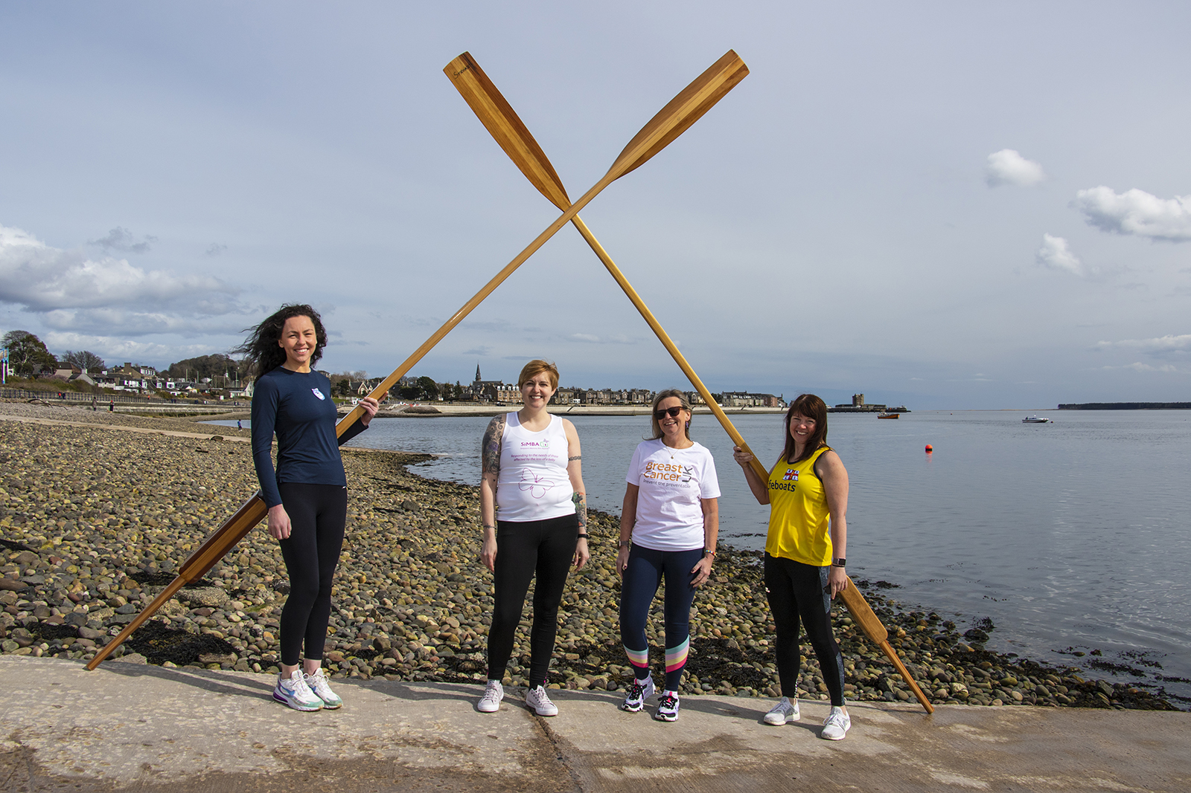
The Rowers We are a team of 4 women from Scotland have chosen to push ourselves physically and mentally to raise both money and awareness for each of our chosen charities, achieve the unachievable and attain a world record along the way! We believe we hold the edge over other competitors as we span 4 decades giving us knowledge and experience along with fresh ideas and youthful enthusiasm.

Slide 6
The Rowers - Andrena
I have always been active in various sports throughout my lifetime, and I am now looking to set myself the ultimate sporting challenge. Working as a Certified Chartered Accountant for the past 9 years I spend most of my free time kayaking, mountaineering and hill walking. When I first heard of the Atlantic Challenge I though this was perfect for me, I have always had a love of the water and when I set myself a target, I give 100% to make it achievable. Fast approaching 40 I decided, with the support of my wife and children, to put together a team of like-minded woman passionate for adventure and willing to give their everything to achieve this dream while raising money for my chosen charity SiMBA.

Slide 7
The Rowers - Fiona
I’m a single mum to three amazing people, I’m a sister, a daughter, a cousin and a friend, a fellow rower in a fantastic coastal rowing club, and a B&B proprietor in beautiful Cromarty on the Black Isle - hosting wonderful travellers from all around the world. These people have inspired me to take on the most amazing challenge I have ever faced, mentally and physically, and I hope to inspire others to do amazing things too. Being the chubby un-sporty kid at school to making some questionable life choices, I have finally got it all together and will complete this row a month or two before my 60th birthday. I will be raising funds on behalf of Breast Cancer UK for my cousin Nicky , my two school friends Susan and Sally, Betty a lovely guest at my B&B and Uncle Peter who have all suffered this preventable disease.

Slide 8
The Rowers – Heather
Over the years I've been lucky enough to travel to many countries, including living in Australia for one year and spending two and a half months volunteering in Rwanda. I have taken part in the likes of sky diving and bungee jumping and enjoy hiking and going camping in my free time. I work for Police Scotland and have been looking to set myself a bigger challenge, as something to work towards. Two of us only tried rowing for the first time three months after signing up to the challenge, so it is definitely pushing us outside our comfort zones. From now until 2025, I will be raising money for the Scottish Charity Air Ambulance, as they go above and beyond to help those in need all over Scotland and rely on public donations to attend trauma incidents and medical emergencies.

Slide 9
The Rowers - Nicky
I am a very ordinary person; I have four amazing daughters, six beautiful grandchildren and a supportive partner. He rows and understands my dream to complete the Atlantic. I have worked for Angus council for over twenty years within Social Work. As a child I struggled at school with dyslexia, so all my energy went into sports where I felt an equal with my peers. This has continued throughout my life. I started rowing in my early twenties, I loved being part of a crew and club. Having a family impacted on rowing, however I have always maintained fitness from hill walking, running, and taking part in the London marathon. I progressed to team events such as Tough Mudder. I cycled Vietnam and completed a tandem parachute jump - I love a challenge. Four years ago, I returned to rowing, this time coastal rowing. I heard of the Atlantic challenge over twenty years ago and decided this is something I had to be a part of. So here I am, the question is not why would you? It’s more like why wouldn’t you? You have one life so chase your dreams.

Slide 10
The Charities Each of the team have chosen a charity that is important to them and hope to raise £60,000 to split equally between these charities. Please visit our JustGiving page for more information (https://gofund.me/ddd65ebe) SiMBA was set up in 2005 to help those affected by the loss of a baby during pregnancy and offers a wide range of services including providing memory boxes, trees of tranquillity, family rooms to say goodbye and support groups to those who need it. Registered Charity Number: SC038243 RNLI Scotland is the charity that saves lives at sea. Powered primarily by kind donations, their search and rescue service has been saving lives for nearly 200 years. Their volunteer lifeboat crews provide a 24-hour rescue services, seasonal lifeguards look after people on busy beaches and Flood Rescue Team helps those affected by flooding. Registered Charity Number: SC037736

Slide 11
The Charities SCAA – Scotland's Charity Air Ambulance responds, on average, to one time-critical emergency call out each day. A patient’s chance of survival and full recovery are greatly increased if they receive the right medical care within the first hour of injury or illness. The fast response of SCAA and its ability to reach Scotland’s most remote and rural areas saves vital minutes when every second really does count. Registered Charity Number: SC041845 BREAST CANCER UK was formed in 2001 with a mission to prevent cancer through education, scientific research, collaboration and policy change. Around 55,000 women and 390 men a year in the UK are diagnosed with breast cancer. Yet over a quarter of these cases could be prevented through lifestyle changes, saving millions of lives, avoiding unnecessary suffering, and reducing the cost to the NHS by over £1.5 billion a year. By raising awareness breast cancer UK can have a significant impact in helping reduce the risk of breast cancer. Registered Charity Number: 7348408

Slide 12
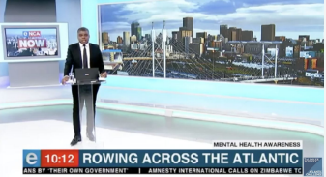
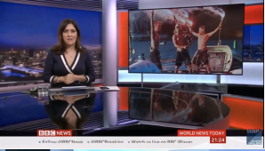
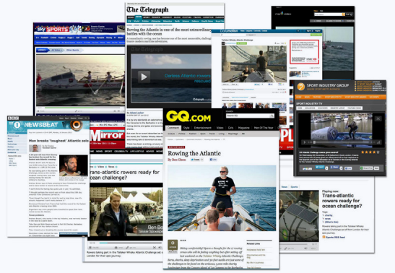
The Coverage -The race has a dedicated media and PR team with extensive international media coverage with royalty free content. -Official film crews are at the start and finish to capture the key visual assets. -Press releases and video news reels are produced for each team to ensure a steady stream of content. -Teams send content from the sea. -The website receives 1.5m page views.

Slide 13
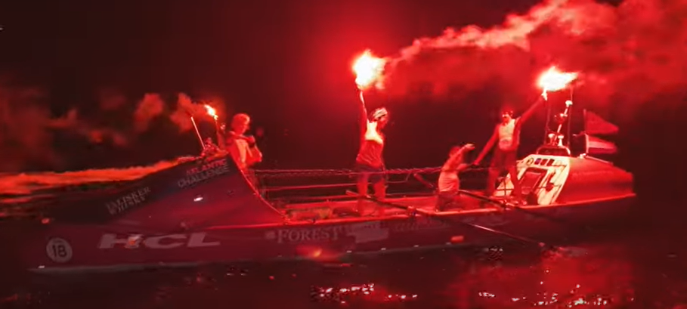
The Coverage – Television & Print
248+ Hours of coverage.
52.6m People reached.
121.5m Audience impressions.
223+ Individual broadcasts.
15.1m Total viewers.
21.6m People reached (print).
11.3m People reached (digital).

Slide 14
The Coverage – Social Media
Facebook – Each year the race reaches close to 20 million people on Facebook with the reach amongst 25-54 age groups being the highest. With Facebook live being hugely popular attracting 500k+ live video views each year. (18,256,873 Total reach).
Follow us @scotlandthewave
Instagram – Proving to be one of the most popular ways for fans to engage with the race. The latest content from the fleet is constantly uploaded by a dedicated content manager on site at the start in La Gomera and finish line in Antigua. (68,649 Total post likes).
Follow us @scotlandthewavet.w.a.c
Twitter – The fastest way to get news from the fleet. The race contents team continually updates the feed with the latest information, videos and photos as they capture or receive from the teams. (3,453 Follower).
Follow us @Scotland The Wave
YouTube – The World's Toughest Row Atlantic Challenge’s official YouTube channel has generated more than 2 million views over 53 countries. Most views come from Western Europe. (2,113,574 Lifetime views).

Slide 15
The Coverage - Documentary Katrina Inkster has 15 years of experience in the TV Industry as a Producer and Director making many documentaries for BBC, Channel 4, Sky and many more. Katrina has successfully secured funding to make a documentary about Scotland The Waves’ journey. A film crew was there for our first meeting as a team, the first time Andrena & Heather set foot in a rowboat as well as during the application process for the race. They will continue to follow us throughout securing sponsorship, fundraising, training an onto our goal of crossing the Atlantic Ocean and arriving in Antigua.

Slide 16
How to get involved Our Partnership Packages Title - £TBC (SOLD) Platinum - £30,000 (One available) Gold - £15,000 (SOLD) Silver - £10,000 (One available) Bronze - £1,500 (Six available available) £250 Club (Unlimited)

Slide 17
How to get involved

Slide 18
How to get involved Platinum - £30,000 (One available)
BRANDING
Large company logo on each side of the boat (see diagram).
Company logo to feature as title sponsors on our website along with a direct link to your webpage.
Large company logo on crews rowing vests used in training, during row and on arrival to Antigua.
Large prominent company logo on all printed and digital promotional material.
Company logo and branding on an oar that will be used in training and during the race.
CORPORATE
ENGAGEMENT
On completion you will receive your signed oar for display in your office.
The team will be available to present the story of their venture at a corporate event of your choosing.
Quarterly newsletters on our preparation for the row.
Display of company material at fundraising/ promotional events.
A day on the boat for 3 employees with the crew.
MEDIA
Company will feature prominently as title sponsor in our online monthly blogs and social media streams (Facebook, Instagram, Twitter).
Rights to use team videos, photos and press releases.
Exposure through official race media content (photos and videos).
Where possible your company will be named in all public and press events/media interviews and documentary as title sponsors.
Signed and framed team photograph on completion of the race.

Slide 19
How to get involved Silver - £10,000 (One available)
BRANDING
Medium company logo on each side of the boat (see diagram).
Company logo to feature as silver partner on our website.
Medium company logo on all printed and digital promotional material.
Medium company logo on crews rowing vests used in training and during the row.
CORPORATE
ENGAGEMENT
The team will be available to present the story of their venture at a corporate event of your choosing.
Quarterly newsletters on our preparation for the row.
Display of company material at fundraising/ promotional events.
MEDIA
Company will feature regularly as silver partners on our social media streams (Facebook, Instagram, Twitter).
Rights to use team videos, photos and press releases.
Exposure through official race media content (photos and videos).
Where possible your company will be named in public and press events/media and documentary interviews as silver partners.

Slide 20
How to get involved Bronze - £1,500 (Six available)
BRANDING
Small company logo on each side of the boat (see diagram).
Company logo to feature as bronze partner on our website.
Small company logo on all printed and digital promotional material.
Small company logo on crews rowing vests used in training and during the row.
CORPORATE
ENGAGEMENT
Quarterly newsletters on our preparation for the row.
Display of company material at fundraising/ promotional events.
MEDIA
Company will feature regularly as bronze partners on our social media streams (Facebook, Instagram, Twitter).
Rights to use team videos, photos and press releases.
Exposure through official race media content (photos and videos).

Slide 21
SCOTLAND THE WAVE
250 CLUB
Join our 250 club now and help us achieve the world’s toughest row!!
By donation £250 individuals and small business can help get us to the start line. You will get your company name/logo or inspirational quote on the boat deck so you can join us on our crossing. We will also give you a social media shout out and 4 free tickets to our annual fundraisers!
GET IN CONTACT PHONE - 07740 26 26 88 EMAIL – ScotlandTheWave@gmail.com

Slide 22
Thank-You We thank you in advance for your interest in partnering with us. WE LOOK FORWARD TO HEARING FROM YOU. For more information follow us on social media: Facebook @scotlandthewave Instagram @scotlandhewavet.w.a.c Twitter @Scotland the wave GET IN CONTACT PHONE - 0044 (0) 7740 26 26 88 EMAIL – ScotlandTheWave@gmail.com

