Slide 1
PAUL
The Life, Letters and Theology of St. Paul

Slide 2
Paul, the Man

Slide 3
St. Paul
Saul of Tarsus, Cilicia, was a young rabbi who participated in the martyrdom of Stephen and headed the severe persecution of the Jerusalem church.
A Diaspora Jew (Ac. 21:39), he had relatives in Jerusalem (Ac. 23:16) and had moved there at an early age to study under Rabban Gamaliel (Ac. 22:3; cf. Ga. 1:14).
As the arch inquisitor for the Sanhedrin, he extradited Christians from far-flung synagogues, bringing them to heresy trials (22:4-5; 26:9-11).

Slide 4
Paul, the man
Saoul
Jewish name
Paullus
Roman name (cognomen)
Roman Citizen from Tarsus
Acts 16:37; 21:39; 22:26-28
Hebraistic Jew
Acts 22:2; Phil. 3:6 (Hebrew speaking)
Tribe of Benjamin
Rom. 11:1; Phil. 3:5
Pharisee
Acts 23:6; 26:5
Disciple of Rabbi Gamaliel
Acts 22:3
Tentmaker Trade
Acts 18:3
Unmarried
1 Cor. 7:7a; 9:5

Slide 5
Saul is Baptized a Christian
He could not have been more shocked than when the answer to his question, “Who are you, Lord,” was a heavenly voice saying, “I am Jesus!” (Ac. 9, 22)
Later, Saul would recount, that he had been chosen as a witness of Jesus to the Gentiles so they might be forgiven and included in God’s holy people (cf. Ac. 26:15-18).
Led into Damascus blind, he was eventually healed and baptized by a reluctant Ananias.
To Ananias, God revealed that Saul would be an instrument of profound suffering as well as outreach to the Gentiles.

Slide 6
The Inquisitor Turned Evangelist
The newly converted Saul visited the synagogues in Damascus, not to serve extradition papers on Christians, but to preach Jesus as the Christ.
Ripples of shock, surprise and suspicion filtered through the whole Jewish community.
Eventually, some of the Jews decided he must be silenced by death, but the Christians secretly slipped Paul over the city wall in a basket, an event Paul would later refer to as a irony to the Roman accolade for soldiers who first made it over the wall.

Slide 7
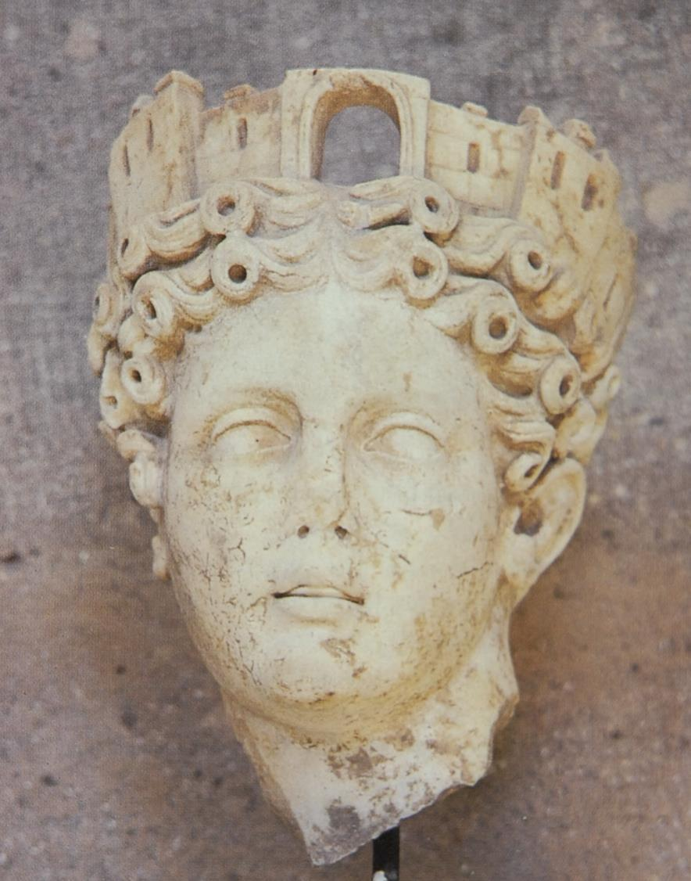
Wall Crown
The corona muralis was a standard adornment of Fortuna, goddess of cities.
Such a crown was bestowed by the emperor on the first soldier who was able to make it safely over the wall into an enemy city.
Paul possibly alludes to this in an irony, when he claimed that he, also, once went “over the wall”—in a basket to escape the clutches of Aretas of Damascus (2 Co. 11:32-33).

Slide 8
Saul in Arabia and Jerusalem
In his Galatian letter, Saul (Paul) adds details that Luke omits.
After his conversion, he immediately went into Arabia, the Nabataen kingdom ruled by Aretas IV (9 BC – AD 40). Presumably this interlude took about three years (Ga. 1:18a).
The trip to Jerusalem that Luke describes in Acts 9 would have been after the time in Arabia. In Jerusalem, Barnabas introduced him to Peter and James (Ga. 1:18b-19).
In Jerusalem, he saw none of the other apostles (Ga. 1:19). The other Christians were reluctant to accept him.
During this stay, Saul debated with Hellenistic Jews who now were so angered they attempted to kill him, but again the Christians secreted him out of the city and sent him home to Tarsus.

Slide 9
Barnabas Brings Saul to Antioch
Barnabas, knowing of Paul’s skill in debating Hellenistic Jews, considered him to be a prime candidate for reaching out to Greeks.
Traveling to Tarsus, Cilicia, he found Paul and brought him to Antioch, Syria.
Here, the believers were first dubbed with the Latin coinage “Christians”, though earlier they were simply known as “followers of the Way” (Ac. 9:2; cf. 19:9, 23; 22:4; 24:14, 22).

Slide 10
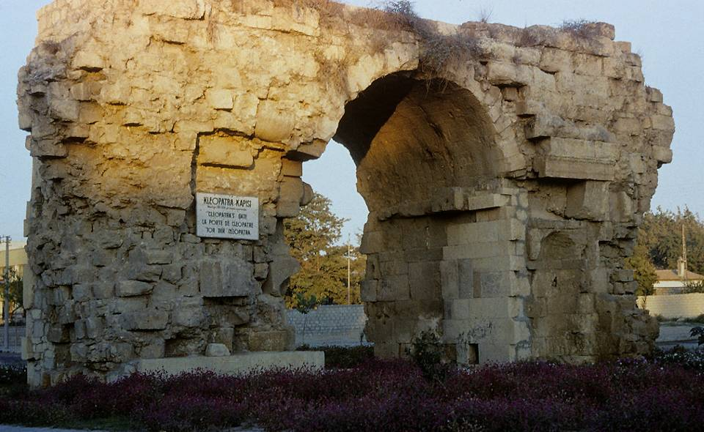
Cleopatra’s gate in Tarsus is the only one of three Roman gates that have survived the centuries in Saul’s home city.

Slide 11
Only Physical Description from Antiquity
“And he (Onesiphorus) saw Paul coming, a man small in size, bald-headed, bandy-legged, well-built [i.e., healthy], with eyebrows meeting, rather long-nosed, full of grace. For sometimes he seemed like a man, and sometimes he had the countenance of an angel.”
Acts of Paul and Thecla (c. AD 160-180)

Slide 12
Discussion:
Paul consistently regards himself as an apostle in his letters. He obviously was not one of the Twelve, so in what sense was he an apostle?
While the answer is entirely speculative, why do you think God may have chosen Paul to fulfill such an important role in the early church?

Slide 13
Paul the Missionary and Martyr

Slide 14
The First Missions Tour

Slide 15
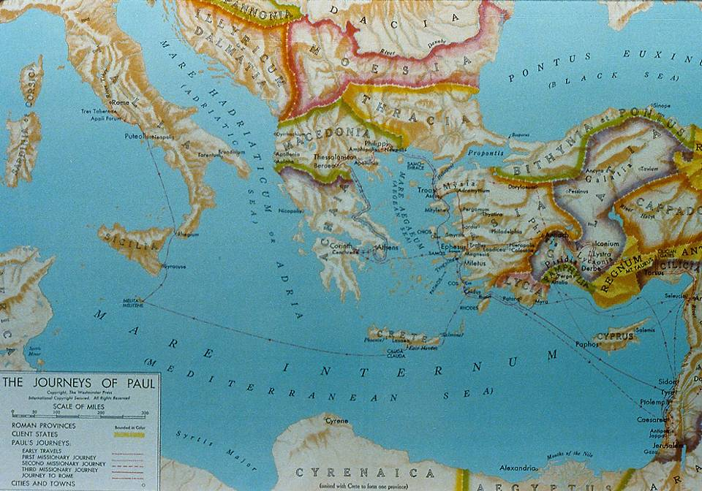
The Roman World and the Gospel

Slide 16
Christians in the Gentile World
There may have been a few scattered Christians in the larger Roman world, presumably Jews, though no formal outreach had been conducted.
That there were Christians in Rome during the reign of Claudius (AD 41-54) is apparent, since the emperor expelled the Jews from the city over rioting connected with the “instigation of Chrestus”. Scholars generally agree that “Chrestus” is a misspelling of “Christus”, the Latin word for Christ, and the demonstrations probably were protests from the Jews against the Christian message.
It would now be Saul and Barnabas who would deliberately reach out to this larger Gentile world with the gospel.

Slide 17
Antioch, the Missionary Church
Antioch, Syria became the first “sending” church for Christian missions.
The leadership of the Antioch church was multi-ethnic and multi-national.
At the direction of the Holy Spirit, the church commissioned its first missionary team of Barnabas, Saul and John Mark.

Slide 18
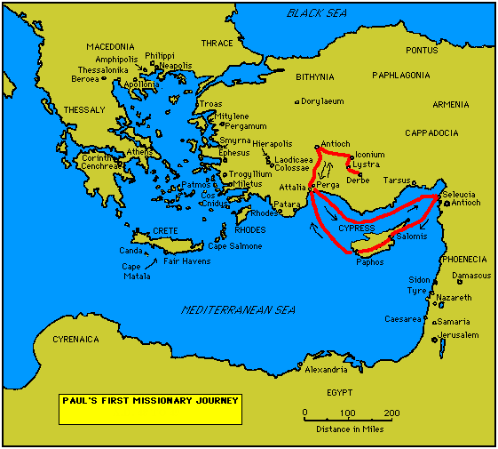
Four Important Churches
Antioch (Pisidia)
Iconium
Lystra
Derbe
Probable recipients of the Galatian Letter

Slide 19
The Jerusalem Council

Slide 20
The Gentile Question
The acceptance of the Christian message by pagans in Asia Minor raised a critical question: Did Gentiles need to become Jews in order to become Christians?
Circumcision was the religious symbol of accepting the Jewish faith, since the uncircumcised were not numbered among God’s people.
A strong party in Jerusalem advocated that circumcision and Torah observance were necessary, and they carried this message to Antioch, Syria.
Paul and his party countered that this badge of Jewish identity was unnecessary, and he and Barnabas were sent to Jerusalem for a decision.
In Jerusalem, they encountered strong opposition from Christian Pharisees (Ac. 15).

Slide 21
Presentation of Cases
In Jerusalem, the apostles and elders listened to both sides. In the end, two voices served to swing the decision to the side of Paul and Barnabas.
Peter recounted the events at the home of Cornelius in Caesarea, emphasizing that God showed his acceptance of Gentiles by giving them the Holy Spirit. Cornelius had not submitted to circumcision. His inclusion in God’s people was on the basis of grace and faith, not religious ritual.
Barnabas and Paul then recounted their Gentile mission and its attendant miracles, clear signs of God’s approval.

Slide 22
The Summary of James
James, the Lord’s brother, then summed up the case, citing the prophet Amos (Am. 9:11-12), whom he quoted from the LXX.
The inclusion of Gentiles in the circle of God’s people had been part of God’s ancient purpose all along.
The restoration of David’s dynasty (and all its attendant promises) had been fulfilled in Jesus.
The whole human race was now privileged to seek salvation in him without requiring the full range of Jewish legalism.
Hence, the Gentile mission of Paul was confirmed.

Slide 23
The Encyclical Letter
James then advised a letter to the new Gentile congregations, urging them to show respect to four particularly sensitive Jewish issues, since they would be living side-by-side with Jews.
Food dedicated to pagan deities: it was common practice in Greco-Roman cities to eat food that had been dedicated at pagan temples.
Incestuous marriages: probably, the prohibition against pornei<a (= unchastity, fornication) is especially directed toward the Gentile practice of marrying close relatives or else mixed marriages between Christians and pagans.
The meat of strangled animals (cf. Lv. 17:13-14)
Eating blood (cf. Lv. 17:10-12).

Slide 24
Sending Letters in Imperial Rome
While there was an imperial postal service (cursus publicus), it was not available for private mail.
Hence, private correspondence necessarily had to be sent by private courier.
The letter from the Jerusalem church was duly composed and commissioned to be carried by Barnabas and Paul, along with two other representatives of the Jerusalem church, Judas and Silvanus (Silas), who would validate the letter by personal testimony.
The four of them then were sent to Antioch, where they delivered the letter to the church.

Slide 25
Discussion:
Consider Paul’s behavior in Acts 15 with respect to the Jerusalem church:
How does he show deference to the leadership there?
How does he present his “case” to the Jerusalem leadership?
What insights are to be gained about how Christians ought to sort out their theological differences?

Slide 26
The Second Missions Tour

Slide 27
A Christian Disagreement (15:36-41)
The 2nd mission tour also began at Antioch, but this time the leaders were Paul and Silas.
Paul and Barnabas disagreed about the usefulness of John Mark, so Barnabas took Mark and went to Cyprus.
Paul chose Silas and traveled throughout the congregations in Syria and Cilicia, traveling overland this time while passing through the Cilician Gates and over the Taurus mountains in order to visit the churches initially established in Galatia.
Silas was an admirable choice: he was a Roman citizen (cf. 16:37) and one of the guarantors of the Jerusalem Council’s letter (15:22).

Slide 28

Five Important New Churches
Philippi
Thessalonica
Beroea
Athens
Corinth
Paul would write letters to three of them

Slide 29
1st Century Travel by Land and by Sea
The Route of Paul’s 2nd Missions Tour (2 Co. 11:23-27)
Jerusalem to Antioch (Ac. 15:30) = 375 miles By land
Antioch to Cilicia (Ac. 15:41) = 140 miles By land
Cilicia to Phrygia & Galatia (Ac. 16:6) = 495 miles By land
Phrygia & Galatia to Troas (Ac. 16:8) = 500 miles By land
Troas to Neapolis (Ac. 16:11) = 140 miles By sea
Neapolis to Philippi (Ac. 16:12) = 15 miles By land
Philippi to Thessalonica (Ac. 17:1) = 85 miles By land
Thessalonica to Berea (Ac. 17:10) = 45 miles By land
Berea to Athens (Ac. 17:15) = 310 miles By sea
Athens to Corinth (Ac. 18:1) = 50 miles By land
Corinth to Ephesus (Ac. 18:18-19) = 250 miles By sea
Ephesus to Caesarea and Antioch (Ac. 18:22) = 620 miles By sea and land

Slide 30
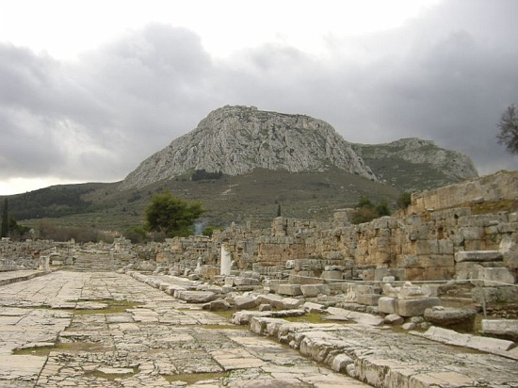
Lechaeum Road of Corinth with the Acrocorinth in the background, the view that would have greeted Paul when he entered the city of Corinth.

Slide 31
PAUL’S THIRTEEN LETTERS
While Luke does not describe the writing of Paul’s letters, a reasonable chronology can be ascertained from internal references in the letters themselves.
2ND TOUR LETTERS
Galatians (date is debated
between 2nd and 3rd tour)
1 Thessalonians
2 Thessalonians
3RD TOUR LETTERS
1 Corinthians
2 Corinthians
Romans
PRISON LETTERS
Colossians
Philemon
Ephesians
Philippians
PASTORAL LETTERS
1 Timothy
Titus
2 Timothy

Slide 32
The Third Missions Tour

Slide 33
Back to Galatia, Greece, Asia Minor and Jerusalem
After a brief stay in Antioch, Syria, Paul once more set out to visit the congregations he had started.
Traveling overland, he visited the churches in Phrygia and Galatia.
He spent two years in Ephesus.
He revisited his churches in Greece.
He traveled back to Asia Minor and then went back to Jerusalem.

Slide 34
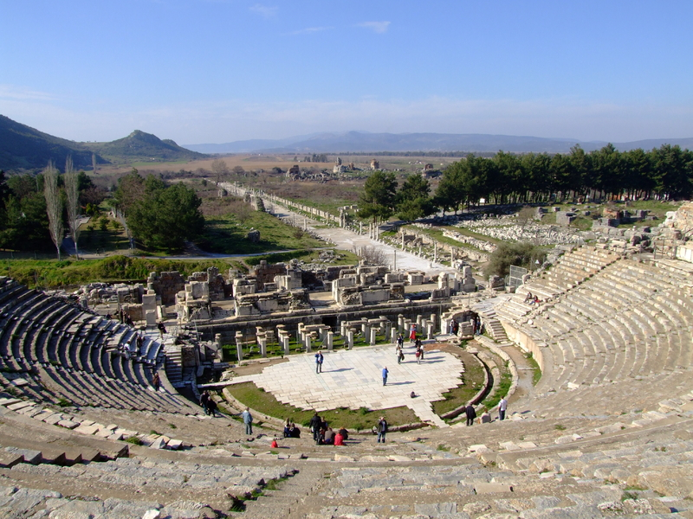
The amphitheater in Ephesus, where Paul was nearly lynched, lies at the end of the Arcadian Way.
While at Ephesus, Paul made a firm decision to revisit Jerusalem after which he hoped to reach further west by going to Rome (Ac. 19:21; cf. Ro. 1:11-13; 15:23-24, 31-32).

Slide 35
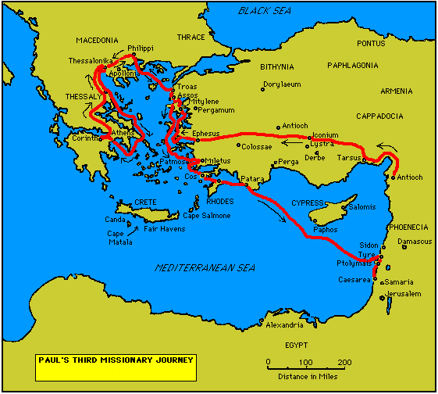
On his 3rd journey, Paul wrote three large letters:
He wrote two letters to the Corinthians and one to the Romans.

Slide 36
In Jerusalem
Upon his arrival in Jerusalem, Paul immediately faced a delicate situation.
After reporting on his missions work, he was apprised that his reputation had preceded him, a distorted picture that he was urging Diaspora Jews to abandon the Torah. This may not have been true, but perception counted nonetheless (Ac. 21:18-25).
Since all the Jewish Christians in Jerusalem were Torah-observant, it was decided that Paul should accompany some brothers to the temple, who, like Paul, were completing a Nazirite vow (Ac. 21:26; cf. 18:18).
This temple ritual, involving the presentation of four offerings (Nu. 6:13-21), hopefully would defuse the nasty rumors.

Slide 37
The Temple Riot
Entry into the temple precincts required purification, since Paul had been traveling among Gentiles.
Such defilement would have prevented Paul from passing beyond the Court of the Nations.
Some Asian Jews saw Paul there and seized him, charging that he not only opposed the Torah but had brought a Greek beyond the barrier.
Paul was dragged from the temple, and had it not been for an alert Roman officer who saw the commotion from the Antonia Fortress, Paul likely would have been summarily lynched.

Slide 38
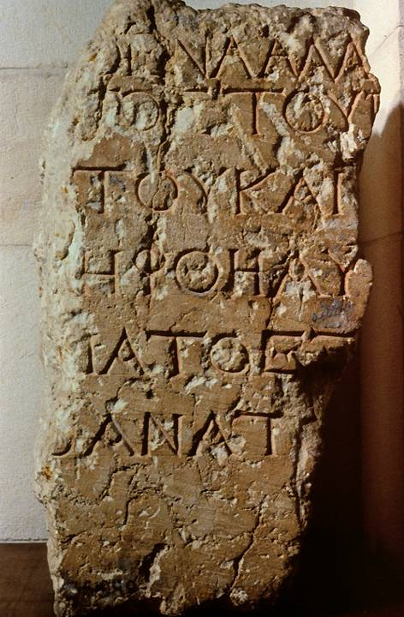
This excavated fragment is one of several of the “keep out” inscriptions surrounding the 2nd temple in the 1st century. The penalty for violation was “death”, and the Greek word “death” can be clearly made out in the final line:
[Q]ANATO[S]
The notices were written in Greek and Latin. This one is in Greek.

Slide 39
Paul’s Arrest
The commanding Roman Tribune immediately entered the temple’s Court of the Nations with soldiers, arresting Paul and shackling him with chains.
As he was being carried inside, Paul spoke to the Tribune in Greek, surprising him, for by this time the officer had assumed Paul to be an Egyptian rebel, a known messianic pretender who had caused trouble previously.
Paul requested that he be allowed to speak to the crowd, and since he claimed to be a Roman Citizen, the Tribune gave his consent.

Slide 40
Paul’s Five Defenses
After his arrest, Paul offered five defenses of himself and his ministry.
To the Jews
To the Sanhedrin
To Felix
To Festus
To Agrippa
This speech was made from the steps of the Antonia Fortress to the Jews in the Court of the Nations (Ac. 22).
This speech was given to the assembled Sanhedrin by order of the Roman Tribune (Ac. 23).
This speech was given to the Roman Procurator, Antonius Felix (Ac. 24).
This speech was given to Festus, the incoming governor who would replace Felix (Ac. 25).
This speech was given to Herod Agrippa II, the provincial king from Caesarea Philippi (Ac. 26).
In the accounts of these five defenses, Luke provides an extended apologetic for the Christian movement, both to Romans and to Jews.

Slide 41
Transferred to Caesarea
Due to a plot against Paul’s life, the Tribune transferred Paul to the Roman provincial government seat in the north.
Under heavily armed guard, Paul was taken by cavalry at night to be arraigned before Felix, the Governor.
The Tribune wrote an accompanying letter to explain the circumstances, and Paul was duly delivered and kept under guard to await his accusers.

Slide 42
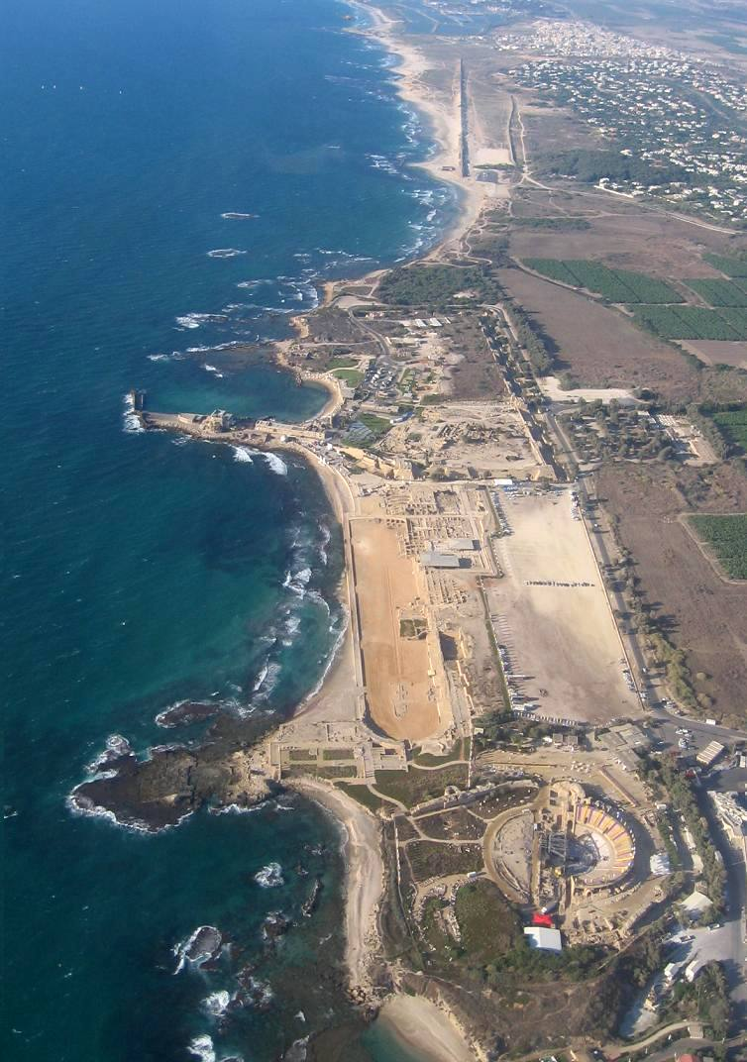
Caesarea Maritima
The city was built by Herod the Great and became the military and civilian capital of the Judean Province. It included:
A palace (where Paul was held temporarily)
Sebastos Harbor, the largest artificial harbor in the ancient world with cement breakwaters poured on the bottom of the seabed.
An amphitheater
A cardo
An aqueduct

Slide 43
The Trip to Rome

Slide 44
A Long Incarceration
In Caesarea, Paul remained incarcerated for two years.
After his incarceration in Caesarea and upon Paul’s appeal to Caesar, which was his right as a Roman citizen, Festus extradited Paul to Rome.
After an arduous trip (including shipwreck), Paul reached Rome, where he was incarcerated an additional two years under house arrest while awaiting his hearing before Caesar Nero.
Luke concludes his history of the early church with Paul awaiting his imperial hearing.

Slide 45
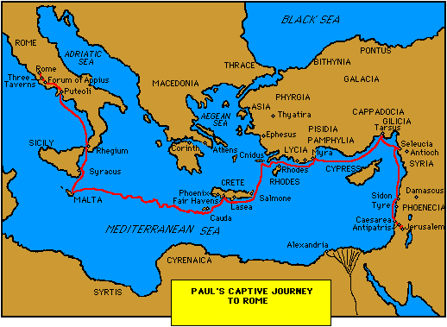

Slide 46
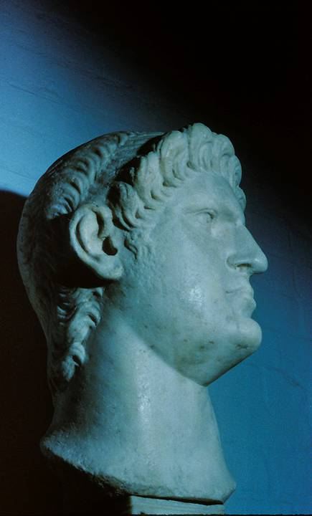
Caesar Nero ruled Rome (AD 54-68), and according to 5th century church tradition, he released Paul after his first imprisonment, after which Paul went to Spain.
Later, Paul is said to have been arrested a second time, and this time Nero had him executed by beheading.
However, there are competing traditions that make the closing years of Paul’s life uncertain.

Slide 47
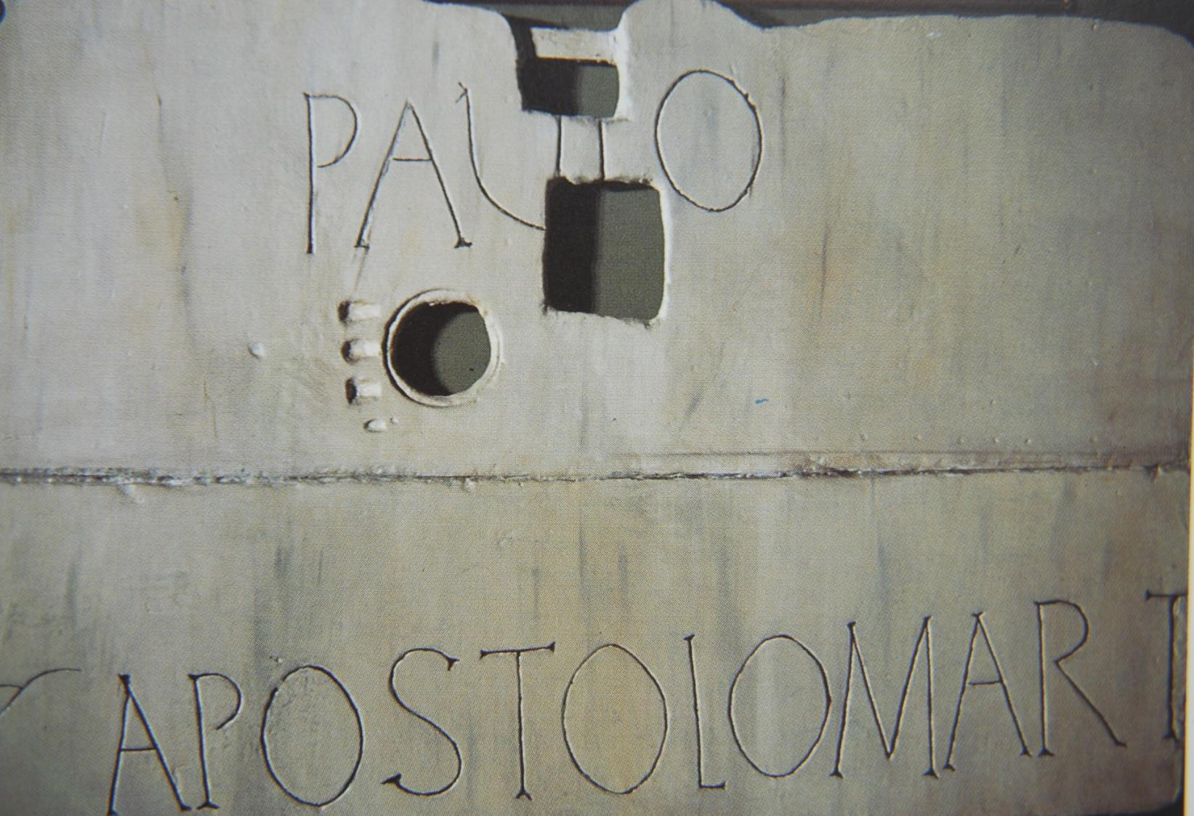
Erected above the traditional site of Paul’s tomb, Church of St. Paul Outside the Walls, Rome.

Slide 48
Discussion:
Consider what we know of Paul from Luke’s history and what we know of him from his letters:
How might our understanding of Paul be different if we had only one or the other of these sources?
Why do you think there is so little information in the NT about the end of Paul’s career?

Slide 49
Paul and His Letters

Slide 50
Sending Letters
Colleagues like Tychicus, Phoebe and Titus, among others, were commissioned by Paul to carry his letters. This accounts for his recommendations (e.g., Col. 4:7-8; Eph. 6:21; Rom. 16:1-2).
Letters typically had internal references to the courier as a confirmation of his/her trustworthiness.
As the writer’s personal representative, the courier would read the letter publicly, explaining any difficult parts and generally sharing news of the sender.

Slide 51
Production of Paul’s Letters
Composition & Inscription
Amanuenses:
  Tertius (Rom. 16:22)
  Sosthenes (1 Cor. 1:1)
  Timothy (2 Cor. 1:1; Phil. 1:1; Col. 1:1; 1 Thess. 1:1; 2 Thess. 1:1; Phlm. 1)
Personal Signature (1 Cor. 16:21; Gal. 6:11; 2 Thess. 3:17)
Delivery & Public Reading
Personal Couriers:
  Phoebe (Rom. 16:1-2)
  Titus (2 Cor. 8:17-18; 12:18)
  Tychicus (Eph. 6:21-22; Col. 4:7-8)
Public Reading (Eph. 6:21-22; Col. 4:16; 1 Thess. 5:27)

Slide 52
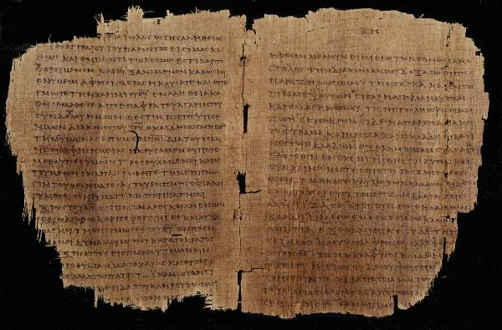
What Paul’s Letters May Have Looked Like p46 (Chester Beatty Papyri Collection, Dublin): Romans 11: 13-22 and Colossians 1: 5-12, c.AD 200

Slide 53
Paul’s Epistolary
Style
THE PAULINE PATTERN
Opening
Paul, an apostle…to the saints…
Thanksgiving
Greeting…grace and peace
(xai<rein changed to xa<rij)
Body
Central concern and communication
Paraenesis
Indicative and imperative moods (you are…so behave in this way)
Closing
Benediction
Letter-writing in the Greco-Roman world followed stylistic conventions.
Handbooks on letter theory were available as guides to differentiate between business letters, official letters, public letters and discursive letters.
Paul’s letters follow to a large degree the conventions of the times, but he also freely adapted those conventions to suit his own purposes.

Slide 54
Reading Another’s Mail
Reading someone else’s mail from the distance of two millennia creates special challenges.
The writer could assume certain shared information not available to a later reader.
Hence, topics could be addressed without a full explanation.
Especially when Paul addresses heresies or enemies of the Christian faith, the modern reader must, so to speak, “read between the lines” to discover the nature of the problem based on the polemics Paul uses.
In some letters, Paul uses critical vocabulary that helps the reader profile the heresy he addresses.

Slide 55
How to Discern an Author’s Goals
What does he include?
What does he leave out?
What does he emphasize?
What events does he link?
What does he clearly state?
What does he imply?

Slide 56
Spiritual Authority
One of the challenges for new Christian communities was the question of spiritual authority.
The earliest Christians had no New Testament, no creeds, no established church structure and no written guidelines.
Citizens in Asia Minor and Greece may never have heard of Jesus Christ until Paul came.
So, where did spiritual authority lie?

Slide 57
The Authority of Paul’s Letters
Paul clearly considered his letters to be authoritative in the churches.
He instructed churches not only to read them but to share them with other congregations (Col. 4:16).
They were a way of extending his presence when he could not be there personally (1 Cor. 5:3-4; 2 Cor. 10:10-11).
His personal signature at the end authenticated the contents of the letters (1 Cor. 16:21; Gal. 6:11; Col. 4:18; 2 Thess. 3:17).
While he distinguishes between what he writes and what Christ said (1 Cor. 7:10, 12), he also claims the authority of Christ and the Spirit (1 Cor. 2:16; 7:40; Gal. 1:1, 8, 11-12).

Slide 58
The Christian Traditions
Paul refers to Christian tradition handed down to him and in turn delivered to his converts (1 Cor. 11:23; 15:1-4).
These “traditions” were to be faithfully kept (1 Cor. 11:2; 2 Thess. 2:15; 3:6).
They were the “deposit of faith” faithfully passed down to successors (2 Tim. 1:13-14; Tit. 1:9).

Slide 59
Dominical Sayings
Obviously, a clear level of authority resided in the sayings of Christ, which in the earliest period were preserved orally.
As yet, the canonical gospels had not been composed (though smaller accounts of Jesus’ life may have been circulating, cf. Lk. 1:1-2).
Paul draws from the sayings of Jesus as an impeccable authority (1 Cor. 7:10-11; 9:14; 11:23-25; 14:37; cf. Ac. 20:35; Rom. 14:14; 1 Thess. 4:15-17).

Slide 60
The Septuagint
The presence of the Hebrew Scriptures “in every city” (Ac. 15:21) assumes the availability of the LXX translation in Greek.
Paul frequently alludes to the Hebrew Scriptures, assuming that his readers will accept their full authority on the basis of the introductory clause, “It is written…” (1 Cor. 1:19, 31; 2:9; 3:19; 4:6; 9:9-10; 10:7, 11; 14:21; 15:45).
To be sure, he does not merely use the OT to interpret Christ, but also, Christ to interpret the OT.
Though Paul is familiar with the Hebrew text, in all but a few cases his citations agree with the Septuagint renderings.

Slide 61
Discussion:
How would Christianity be different without the letters of Paul?
Why do you think Paul used a secretary?
What implications might there be that Phoebe, a woman and the courier of the Roman Letter, would have been the first to read and explain it to the Roman church?

Slide 62
2nd Tour Letters
Galatians
1 Thessalonians
2 Thessalonians

Slide 63
Galatians

Slide 64
The Dating Debate
The Galatian Letter is the most difficult of Paul’s letters to place chronologically.
The issue concerns the fact that the term “Galatia” can be used as an ethic term (pre-dating the Roman administration) or as a provincial term (as reorganized by Caesar Augustus).
Depending upon which “Galatia” Paul has in mind (cf. Ga. 1:2), Paul established these churches on either his 1st missions tour or his 2nd missions tour, and the letter must be dated accordingly.
Nothing in the letter clearly indicates where Paul was when he wrote this letter.

Slide 65
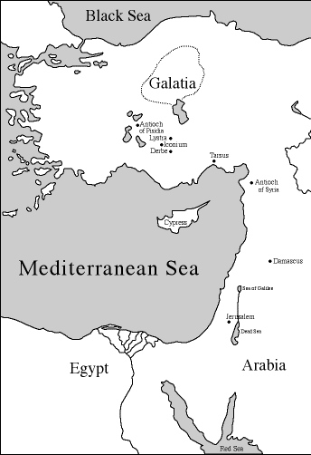
Ethnic Galatia ca. 278-25 BC
Settled by Celtic immigrants
The North Galatian Theory is that Paul visited this area on his 2nd and 3rd Missions Tour (Ac. 16:6; 18:23).
His Galatian Letter was not sent prior to the 3rd tour (cf. Ga.4:13-14).
If this theory is correct, the Galatian Letter may be as late as AD 55.

Slide 66
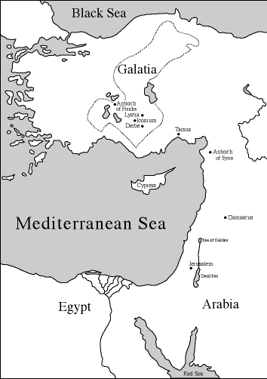
Provincial Galatia ca. 25 BC – 137 AD
Caesar Augustus reorganized this area, extending Galatia as a province well into the south of Asia Minor.
The South Galatian Theory is that the churches were in the south—the ones Paul established on his 1st Missions Tour (cf. Ac. 13:13—14:20).
If this theory is correct, the Galatian Letter may be as early as AD 48.

Slide 67
The Judaizers
The Galatian issue arose when some aggressive teachers urged that it was necessary for Gentiles to live in full conformity to Moses’ law (Gal. 4:17; 5:7-10; 6:12).
Presumably, they were of the same group who came to Antioch, Syria urging that “unless you are circumcised according to the custom taught by Moses, you cannot be saved” (Ac. 15:1, 5).
Of course, circumcision was only the beginning, for it implied the full yoke of the Torah, and for Paul, this was a denial of the gospel of grace (Gal. 5:3-4).

Slide 68
Justification, the Central Issue
There is a clear polarity in the Galatian Letter over how one is justified.
“ …yet we know that a person is justified not by the works of the law but through faith in Jesus Christ. And we have come to believe in Christ Jesus, so that we might be justified by faith in Christ, and not by doing the works of the law, because no one will be justified by the works of the law.” (2:16)
“I do not set aside the grace of God, for if righteousness could be gained through the law, Christ died for nothing.” (2:21)
“Clearly no one is justified before God by the law, because, ‘The righteous will live by faith.’” (3:11)

Slide 69
The Argument
The opening expresses shock that the Galatians had turned back to a distorted form of the gospel (1:1-10).
Paul then defends his apostleship and message (1:11—2:14):
Apparently there had been attempts to discredit him.
His gospel came directly from Christ himself, and he had had limited contact with the Jerusalem church; however, the Jerusalem apostles had confirmed his calling.
Salvation is by faith in Christ Jesus, not by works of the Torah (2:15-21).
Paul addresses the anticipated question of whether the message of grace means the tolerance of sin. Certainly not!
At the same time, believers in Christ must not set aside God’s grace.

Slide 70
Salvation is by believing the message of the cross, not by doing the works of the Torah (3:1-18).
The Galatians themselves had experienced salvation by faith, not works.
Abraham, the original model, was justified by faith, not works.
Those who rely on works for salvation come under the curse of the Torah.
The language of God’s covenant with Abraham concerned the “seed” of Abraham—and that seed was Christ!
Why then was the Torah given (3:19-25)?
So that sin would be clearly defined as sin.
The very purpose of the Torah was to lead us to Christ.

Slide 71
Abraham’s true children are to be defined by faith (3:26—4:31).
Christ gives the full rights of sonship, not to slaves under law but to free persons who belong to Christ.
To go back to the Torah as the means for salvation was no better than returning to paganism.
Hagar & Sarah and Ishmael & Isaac are the paradigms for slavery and freedom—but believers are children of freedom!
Paraenesis and Closing (5:1—6:18):
Therefore, maintain your freedom in Christ!
Live by the Spirit, producing its fruit!
Carry each other’s burdens!
Realize that those who demand circumcision are only doing so to avoid the stigma of the cross of Christ.

Slide 72
1 Thessalonians

Slide 73
Occasion for Writing
When after an indictment before the Thessalonian politarchs Paul was forced to leave Thessalonica abruptly, he left Timothy and Silas behind to stabilize the believers, instructing his companions to join him as soon as possible (Ac. 17:13-15).
Exactly what they shared with Paul when they caught up with him is unknown (Ac. 18:5; 1 Th. 3:1-3a, 6), but judging from 1 Thessalonians, we can reasonably surmise the situation.
When reading someone else’s mail, one can approximate the unknown circumstances by what is expressed in the letter.

Slide 74
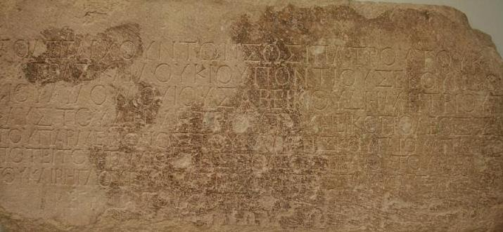
Politarchs were elected governors of Macedonian cities in the Roman era. This inscription excavated from the Vardar Arch of Thessalonica lists six politarchs in the city. (British Museum, London)

Slide 75
The Three Major Themes
Due to the things Paul addresses in 1 Thessalonians, three major issues seem to have been at stake:
From Paul’s defense of his evangelistic ethics, it seems likely that his enemies sought to defame him as an imposter or an opportunist.
From his comforting words regarding persecution, it seems certain that the opposition to the new Christians did not stop when Paul left.
Apparently some Thessalonian Christians had died since Paul had been there, and the remaining Christians were uncertain about what would happen to believers after death.

Slide 76
Date
The date of 1 Thessalonians can be fixed in about AD 50-51.
Presumably, Paul wrote this letter from Corinth after being joined by Timothy and Silas (Ac. 18:1, 5).
This date can be cross-referenced with the tenure of Gallio’s proconsulship in Achaia, since Paul later appeared before him in Corinth (Ac. 18:12).
According to an inscription at Delphi, Lucius Junius Gallio took office probably in July AD 51 (Proconsuls normally took office on July 1st).

Slide 77
The Argument
The opening of the letter stresses that in their conversion the Thessalonians had become imitators of Christ and Paul, both in faith and also in suffering (1:1-10).
If Paul’s enemies attempted to discredit him as a charlatan, he countered by emphasizing his ethics in preaching the gospel (2:1-16).
His mission work was not a failure, and his message did not arise from falsehood or mixed motives. His suffering validated his message.
In the same way, the suffering of the Thessalonians validated their faith as well.

Slide 78
Though Paul was unable to reestablish contact with the church, Timothy ministered in Paul’s stead and reported to him that the Thessalonians’ faith stood strong in spite of persecution (2:17—3:13).
Such perseverance was important for Paul himself, since his reward at the return of Christ was dependent upon their faithfulness.
Several times Paul makes direct references to Christ’s return as the hope of believers (1:10; 2:19; 3:13).
Paraenesis (4:1-12)
As believers, the Thessalonians must remain sexually pure in the midst of a culture that was sexually permissive.
They also must show brotherly love and live reputable lifestyles.

Slide 79
The Return of Christ (4:13—5:11).
Concerning those who had died, the promise for believers was that they would be resurrected at Christ’s return, joined with the living believers, and caught up in the air as a single body to welcome his return.
The timing of this event was yet unknown, comparable to the coming of a burglar. However, as people of light, the believers were always to be confident that whether living or dead when Christ returned, they would be joined to the Lord.
Closing (5:12-28)
In his final remarks, Paul urges the Christian ethic of industrious labor.
The Thessalonians could depend upon God’s faithfulness in preserving them to the end.

Slide 80
2 Thessalonians

Slide 81
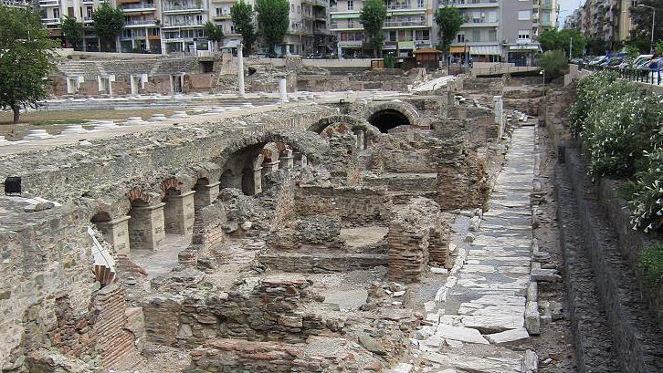
Excavations of 1st century Roman Market at Thessalonica

Slide 82
The Follow-up
Letter
The second Thessalonian letter seems to have been written soon after the first one, for Paul is at pains to correct some misunderstanding.
Hence, Paul wrote this letter from Corinth, too.
In his first letter, Paul had spoken of the “Day of the Lord,” a future day of destruction for those spiritually asleep but a day of salvation for those spiritually awake . Some believers seem to have assumed that the Day of Yahweh had already arrived.
Also, some believers had stopped working, possibly thinking it was now unnecessary in view of the soon return of Christ.
Finally, there is the possibility that someone had forged a letter in Paul’s name.

Slide 83
The Argument
God’s final justice will be evident when Christ returns (1:1-12).
The Thessalonians’ current suffering would be rewarded.
Their persecutors would be punished.
The Day of the Lord has not yet come (2:1-17):
Certain things must happen before that day, including a great apostasy and the unveiling of a malignant enemy called the “man of lawlessness”.
A restraining force (and Paul does not say what it is) now holds back the powers of Satanic chaos.
In view of this coming eschatological trauma, believers must trust in their calling, because God would preserve them.

Slide 84
Closing (3:1-18):
Paul requests prayer both for the spread of the gospel and deliverance from enemies.
He reaffirms his advice in the first letter that the Thessalonians must give themselves to industrious work, just as Paul himself toiled in the cause of the gospel.
Finally, he signed off in his own hand (apparently the letter was drafted by an amanuensis), and his personal signature now would become a validating mark in all his letters.

Slide 85
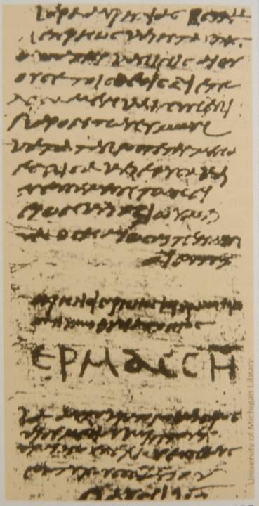
PAUL’S OWN SIGNATURE
With the possibility of a forged letter (2 Th. 2:2), Paul adopted the practice of signing off his letters in his own hand, even though he may have used an amanuensis for the actual writing (2 Th. 3:17).
Like the signature of Hermas to the right (AD 250), Paul’s signature was in large script (cf. Galatians 6:11).
His signature was his authentication of the genuineness of his letter (1 Cor. 16:21).
University of Michigan

Slide 86
Discussion:
What do we learn about Paul as a person in the Galatian letter?
In the Thessalonian letters, Paul seems to envision that he will be alive at the second coming of Jesus. In later letters, this is not so apparent. Do you think Paul may have reconsidered his opinion on this issue as he grew older?

Slide 87
3rd Tour Letters
1 Corinthians
2 Corinthians
Romans

Slide 88
1 Corinthians

Slide 89
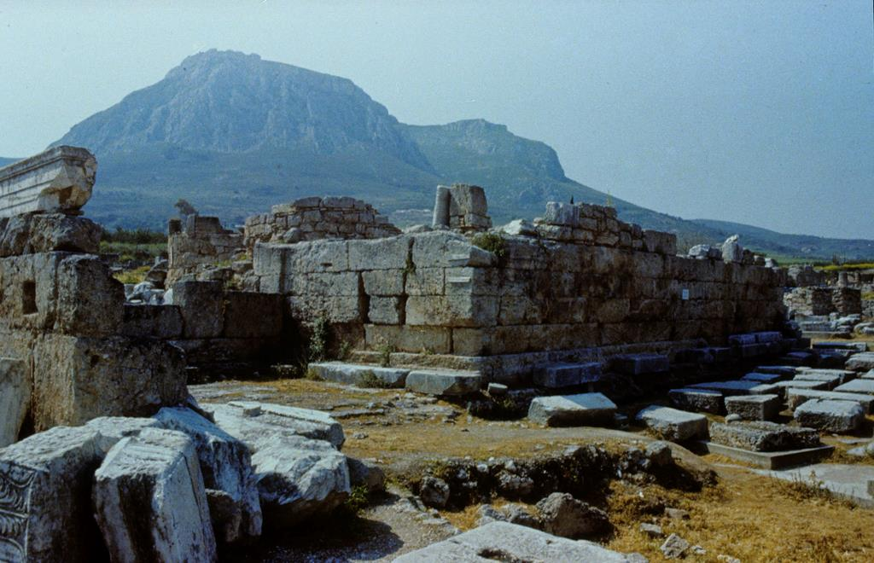
bh?ma (= judgment seat) at Corinth where Paul was arraigned before Gallio, the Proconsul at Corinth in AD 51-52 according to an inscription at Delphi. (Acts 18:12-17)

Slide 90
Circumstances
After spending a year and a half in Corinth (Ac. 18:11), Paul left with Prisca and Aquila (Ac. 18:18), after which he wrote a letter no longer extant (1 Cor. 5:9).
Subsequently, he learned from Chloe’s household that the Christians had split into factions (1 Cor. 1:11-12).
At about the same time, he received a letter from the Corinthians asking advice about certain issues (1 Cor. 7:1), presumably carried by Stephanas, Fortunatus and Achaicus (1 Cor. 16:17).
The writing of 1 Corinthians was Paul’s response to these circumstances.

Slide 91
Where and When Written?
Paul was in Ephesus when he wrote 1 Corinthians (16:8, 19).
Assuming he left Corinth in AD 52, time must be allowed for him to travel to Ephesus, then to Palestine, and finally back to the churches in Galatia and Phrygia before arriving once more at Ephesus (Ac. 18:20-23; 19:1).
His stay in Ephesus was the better part of three years (Ac. 19:8, 10, 22).
Hence, 1 Corinthians should date to about AD 55 or 56.

Slide 92
The Argument
In the first part of the letter, Paul addresses the divisions in the church described to him by representatives from Chloe’s house church (1:1—4:21):
Like secular teachers in Corinth, they were divided over leaders.
Paul, however, was following a different kind of wisdom, not secular wisdom but spiritual—and Christ was not divided!
Paul’s only message was the cross. In fact, to divide over leaders was to live in a worldly, secular way!
Discipline Over Incest (5:1-13):
Corinthian arrogance was evident in that they allowed a man to function in the church even though he was living in incest, something which was illegal even under Roman law!
Paul, therefore, commands disciplinary action.

Slide 93
Another shortfall was litigation between members and their perception that freedom meant license (6:1-20).
Church members were acting more like Corinthians than Christians by suing each other in the secular courts. This must be stopped!
Sexual purity was absolutely mandatory, for sexual sin pollutes the very body of Christ himself.
The rest of the letter consists of Paul’s answers to questions from the Corinthians. The phrase “and now about” introduces his answers (7:1, 25; 8:1; 12:1; 16:1).
One question concerned marriage during a “present crisis” (7), possibly a grain shortage. Paul advised married people to stay married and unmarried people to consider the single life.
Another question concerned food dedicated to pagan deities (8-10). Paul urged both Christian freedom and sensitivity.

Slide 94
There also was a question about public decorum in worship (11:1-16). Paul gives guidance for head coverings in Roman culture.
Abuses of the Lord’s Table were an additional problem (11:17-34).
Paul gives an extensive treatment of the nature of spiritual gifts, especially using the metaphor of the church as the body of Christ. His concern was over two gifts in particular, speaking with tongues and prophecy. Paul addresses the use of these gifts on the underlying principle that if something is not understandable, it cannot be edifying (12-14).
Yet another issue concerned the nature of resurrection against the background of Greek metaphysical dualism (15).
Paul saves until last the final question about the collection of funds for the impoverished Jewish Christians in Jerusalem (16).
He ends the letter by discussing his future travel plans.

Slide 95
2 Corinthians

Slide 96
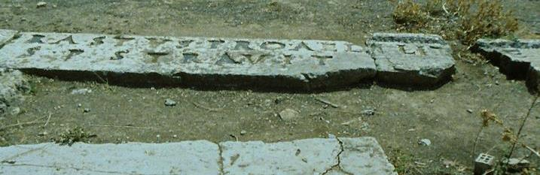
Erastus Inscription
[. . .] ERASTVS PRO AEDILIT[AT]E
S P STRAVIT
“Erastus in return for his aedileship laid [the pavement] at his own expense.”
This inscription from Corinth almost certainly refers to the Erastus mentioned by Paul in Romans 16:23, whom he calls “Erastus, the city’s director of public works…”

Slide 97
Reconstructing Paul’s Contact with the Corinthians
PAUL’S PLANS
Paul’s intent was to spend a winter in Corinth (1 Cor. 16:5-7), but due to the opportunities in Ephesus, he felt compelled to send Timothy for the present interim (1 Cor. 16:8-11; 1 Cor. 4:17).
He later modified his plans and indicated that he would make two shorter visits on his way to and from Macedonia (2 Cor. 1:15-16).
In the end, Paul was unable to follow through on either of these intentions.
The situation in Corinth deteriorated so badly that he felt constrained to make an emergency visit (2 Cor. 12:14; 13:1). His “third visit” requires a “second visit” subsequent to his founding of the church (2 Cor. 13:2a).
The second visit, the “painful” one (2 Cor.2:1), seems to have ended in Paul’s public humiliation (2 Cor. 12:21; 2:5; cf. 7:12; 10:1, 10).

Slide 98
Reconstructing cont.--
AFTERMATH OF THE PAINFUL VISIT
The second visit ended in such irresolution that Paul composed a stinging letter to set things straight (2 Cor. 2:3-4).
By his own admission, he composed this letter in “great distress and anguish of heart”. Presumably it was carried by Titus (2 Cor. 12:18; cf. 7:6-7, 13, 15). This stinging letter also is lost to us.
While Titus visited Corinth as Paul’s personal representative and carried the stinging letter, Paul stayed in Ephesus under great duress, waiting for news (2 Cor. 1:8-9a).
Eventually, so anxious was he that he left Ephesus for the seaport of Troas, probably hoping to intercept Titus’ on his return by sea (2 Cor. 2:12-13).
When Titus was not forthcoming, he crossed the Aegean, hoping to intercept Titus by land (2 Cor. 2:13b; 7:5).

Slide 99
Reconstructing cont.--
TITUS’ ARRIVAL
Titus finally arrived, and Paul was relieved to find that his letter and Titus’ diplomacy had effected a change of heart in the Corinthians (2 Cor. 7:6-11).
The Corinthians had received Titus very positively (2 Cor. 7:13-16).
The man who had publicly opposed Paul was reprimanded by the majority (2 Cor. 2:6).
Due to Titus’ encouraging report, Paul wrote another letter (probably 2 Corinthians 1-9). In it, he shared his own hardships (2 Cor. 1:3-11; 4:7-12, 16-18; 6:4-10). He explained his change in travel plans (2 Cor. 1:12—2:4) and generously urged forgiveness for the one who had opposed him (2 Cor. 2:5-11), announcing that Titus would be coming back (2 Cor. 8:6, 16-19, 22-24).
Because of the complications just described, it is difficult to say where Paul was when he wrote this letter, but likely he still may have been in Ephesus (cf. Ac. 19:10).

Slide 100
The Abrupt Shift in Tone
The change in tone between 2 Corinthians 1-9 and 2 Corinthians10-13 presupposes intermediate events. Either…
…Titus carried chapters 1-9 as a separate letter, one not well-received, causing Paul to write 10-13 as an additional letter.
…or else, Paul received further information between chapters 1-9 and 10-13, which accounts for the shift in tone.

Slide 101
Reconstructing cont.-
TITUS’ SECOND VISIT
Titus’ second visit may not have gone as smoothly as the first one.
2 Corinthians 10-13 reflects yet another change in atmosphere in Corinth.
The optimism and conciliation present in 2 Cor. 1-9 are absent in 2 Cor. 10-13. Possibly Titus had returned with the alarming news of yet another change (2 Cor. 12:18).
Paul now anticipates a third visit to Corinth (2 Cor. 12:14, 20-21; 13:1-2; cf. 10:11). This promise of a third visit he was able to keep (Ac. 20:2-3a; cf. Rom. 15:25-27).
Again, it is difficult to say where Paul was when he wrote, but the two-year stay at Ephesus is the most likely period (Ac. 19:10).

Slide 102
The Argument
The Change in Travel Plans (1:1—2:13):
At the beginning, Paul reviews the dangerous circumstances of his present location in Ephesus and explains why he changed his travel plans. In particular, he is concerned to defend his integrity.
He also speaks of the “tearful letter” he sent via Titus (probably a lost letter).
The New Covenant (2:14—7:4):
Breaking off from his itinerary, Paul now offers an extensive interlude about Christian ministry under the new covenant.
He served as a missionary-apostle, but always as one commissioned by Christ himself.
The glory of new covenant ministry is to reveal Christ unveiled, even though that ministry often involves suffering.

Slide 103
Still, all suffering must be endured in light of the eternal reward.
New covenant ministry concerns reconciliation with God, and the ethics of such ministry must be grounded in true holiness. If this is the nature of Christian ministry, the Corinthians should now become reconciled to Paul.
Travel Plans Resumed (7:5-16):
Paul now picks up where he left off earlier. In the light of covenant ministry, Paul explains why his stinging letter carried by Titus was necessary.
He also explains how relieved he was when he finally intercepted Titus as his colleague was on his way back from Corinth.
The Relief Offering (8-9):
Paul now urges the Corinthians to participate in the relief fund being gathered for the impoverished Christians in Jerusalem.

Slide 104
An Abrupt Change in Tone (10:1—11:15):
Paul now begins to defend his ministry and ethics in highly rhetorical language, using sarcasm and hyperbole.
Especially, he addresses his deep concern over false leaders who distort the gospel.
Suffering in Ministry (11:16—12:10):
The true test of apostolic ministry is suffering, and Paul’s ministry was a ministry of hardship and danger.
Especially, Paul struggled with some personal “thorn”, an unexplained malady which God refused to remove.
The Closing (12:11—13:14):
At the end, Paul pleads for mutual respect, and he promises to visit Corinth a third time. He warns, however, that he may have to exercise discipline, though he hopes this will not be the case.

Slide 105
Discussion:
Paul’s relationship with the Christians in Corinth can only be described as difficult. What can we glean from these two letters about handling difficult relationships between Christians?
On one occasion, Paul suggests that the Corinthians are living more like Corinthians than Christians (1 Co. 3:1). How might Greek cultural factors have influenced the way the Corinthians tried to live out the Christian life?

Slide 106
Romans

Slide 107
The Roman Church
We know Christians were in Rome by AD 64, because Nero blamed the great fire on them (Tacitus, Annals 15:44).
When Paul came to Rome as a prisoner, ca. AD 60-62, a community of Christians was already present (Ac. 28:14b-16).
Paul’s Roman letter was written about AD 58, and he conceded he had wanted to visit “for many years” (Rom. 15:23; cf. 1:8).
A Jewish Christian couple had left Rome under Claudius’ expulsion of Jews in AD 49 (Ac. 18:1-3).
Hence, we assume the Roman church was established some time in the 40s by persons unknown.

Slide 108
When and Why Paul Wrote Romans
The Roman letter was written during Paul’s final stay at Corinth (ca. AD 57-58), when he had completed the collection of funds for Jerusalem (Ac. 20:2-3; Rom. 15:25-26; cf. 1 Cor. 16:1-3; 2 Cor. 8-9).
The letter was carried by Phoebe, a delegate from Cenchreae, the eastern port of Corinth (Rom. 16:23).
Ostensibly, Paul’s letter was an overture to the Roman Christians concerning his long-held desire to do missions work further west (Rom. 15:19-24).
At a deeper level, he seems to have intended an introduction of his own essential understanding of the gospel, especially in light of his ongoing polemics with others (Rom. 2:17; 3:1ff.; 4:1; 11:1; 14:1ff.; 15:7ff.). If the Romans were to support his mission to the west, they needed to know what his message would be.

Slide 109
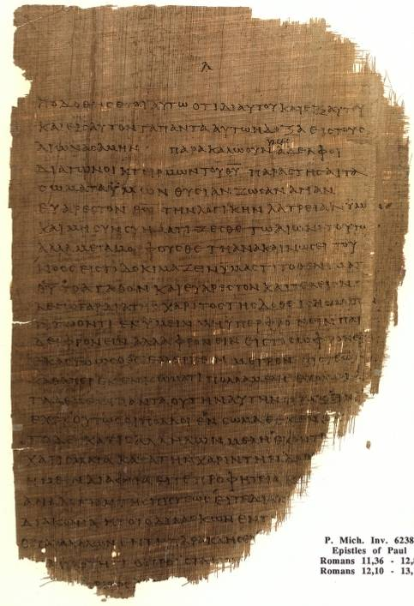
Romans 11:36—12:8
Chester Beatty Papyri
p⁴⁶ (the earliest extant copy of this letter)
University of Michigan
ca. AD 200

Slide 110
The Argument
The Opening (1:1-17):
Paul immediately voices his desire to visit Rome and states his thesis of the gospel upon which the whole letter depends.
The Message Paul Preached (1:18—8:39):
At length, Paul now outlines his understanding of the Christian message, what he calls “the gospel of God’s Son” .
God expresses himself against evil by his divine wrath, but he also is fair. Still, the basic problem of the human race is not ignorance, but outright rebellion. Both Jew and non-Jew are equally culpable and both stand guilty as sinners (1:18—3:31).
The gospel, then, is the message about grace and faith, and the ancient paradigm for faith is Abraham, who was credited with righteousness because he simply believed God’s promise. He is the father of all who believe the good news (4:1-25).

Slide 111
With the word “therefore” in 5:1, Paul now draws out the implications of the gospel: on the basis of grace and faith, and due to God’s love demonstrated in Christ’s sacrificial death, believers now enjoy peace with God through Christ (5:1-11).
As a second Adam, Christ is now the head of a new creation (5:12-21).
Still, divine grace does not mean Christians can sin with impunity. Rather, in this new creation they must live a new life. Formerly, they were slaves to sin; now, they are slaves of righteousness (6).
For Jews, formerly they were married to the Torah; now, they are married to Christ (7:1-6).
To be sure, there still is struggle with sin, so the believer is obliged to depend upon the power of the Spirit to live out God’s laws (7:7-25).
At the same time, the believer is assured of final acceptance, for nothing cannot separate him from God’s redeeming love (8).

Slide 112
God’s Purpose in Salvation-History (9-11):
Here, Paul addresses Israel in God’s eternal plan. He begins with his acute grief over the fact that most Jews have not accepted salvation in Christ, despite the fact that God chose the Israelite nation as the means through which salvation would come (9-10).
Nevertheless, God has not rejected his ancient people, for there yet is a remnant chosen by grace, and the general unbelief of Israel is simply God’s means of allowing non-Jews to be included among God’s chosen people. The “hardening” of God’s ancient people is partial and temporary (11).
Christian Ethics (12:1—15:13):
The true center of worship, then, is spiritual and internal, but it works outwardly in behaviors motivated by love (12-13).
The strong must bear with the failures of the weak (14:1—15:13).

Slide 113
Future Plans (15:14—16:27):
Returning to what he said at the beginning, Paul now explains his travel plans to the west, hoping to go as far as Spain (15:14-33).
He closes with a lengthy list of personal greetings to people he had met in his missionary travels and who now were living in Rome (16).

Slide 114
Discussion:
The Roman Letter is sometimes considered to be Paul’s magnum opus, the most complete explanation and summary of his thought: would you agree? Why or why not?
Romans became the single most important document in the New Testament with respect to the Protestant Reformation. Why do you think this was the case?

Slide 115
Prison Letters
Colossians
Philemon
Ephesians
Philippians

Slide 116
Paul, the Prisoner
In each of four letters, Paul describes himself as a “prisoner” (Col. 4:3, 18; Phlmn. 1:1, 10, 23; Eph. 3:1; 4:1; Phil. 1:7, 13, 17).
In none of them does Paul given details about his situation other than to say that he was “in chains.”
Traditionally, the assumption has been that this imprisonment was in Rome (Ac. 28:16, 30), though it could have been in Caesarea, where Paul also was incarcerated for two years (Ac. 23:23-35; 24:27; 26:29), or even elsewhere (cf. 2 Co. 6:5; 11:23).
It seems that Paul’s circumstances of imprisonment may not have been the same for all four letters inasmuch as the people he mentions as being with him are different (Col. 4:7, 10-14; Phil. 2:19-21, 25-30).

Slide 117
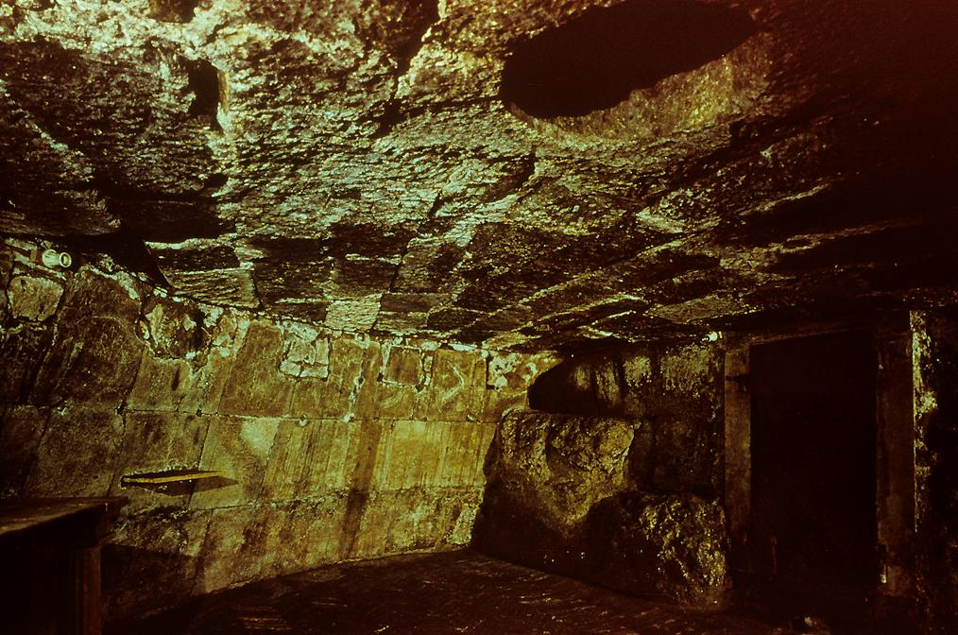
Near the Forum, at the base of the Capitoline Hill, is the dungeon of the Mamertine Prison. This was the state prison of Rome, and Paul may have been incarcerated here at the end of his life. Originally, this 30-foot diameter room could be reached only through the hole visible in its ceiling.

Slide 118
Colossians

Slide 119
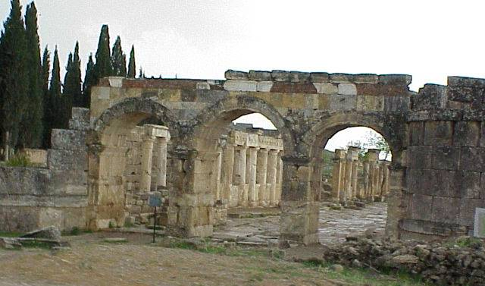
While the ancient ruins of Colossae have been clearly identified, no major excavation has yet been conducted by professional archaeologists. Ruins from the ancient city, however, are still standing.

Slide 120
Date and Circumstances
The traditional view is that Paul wrote Colossians during the earlier part of his detention.
He was imprisoned two years at Caesarea (Ac. 23:23-35; 24:27) and two more years under house arrest in Rome (Ac. 25:9-12; 28:16, 30).
If, as one tradition suggests, Paul was imprisoned twice in Rome with a temporary release between the two imprisonments, then Colossians may have belonged to the earlier imprisonment.
In general, the Colossian letter can be placed in the period of about AD 58-64. The final years of Paul’s life after his arrest in Jerusalem and incarceration in Rome are largely unclear.

Slide 121
The Colossian Heresy
Deciphering the Colossian heresy must be inferred from Paul’s polemics.
It seems obvious that he combats what he considers to be a perversion of the gospel in which the Christian message was being mixed with other religious and philosophical thought (2:8).
Central to this thought was the notion that religious fullness and knowledge were dependent upon mystical experience (2:18).
Further, there seems to have been a strong Jewish component demanding conformity to Jewish celebrations and the Jewish calendar (2:16-17).

Slide 122
The Argument
Fullness in Christ (1:1—2:5):
After emphasizing that there are only two kingdoms, darkness and light, Paul argues that Christ is the sovereign Lord of all creation. He is the pre-existent Agent by whom God created the universe, the visible image of the invisible God, he holds primacy over all things and he has reconciled humans to himself through the cross.
As an apostle-missionary, Paul was a herald of this gospel in all its fullness, commissioned to preach while fully accepting his part in the sufferings of Christ through his apostolic ministry.
The Practical Goal (2:6-23):
The practical end of this message is that believers should live in light of Christ’s lordship.
Whatever the background of the Colossian heresy, either incipient Gnosticism or Jewish mysticism, true fullness was in Christ alone.

Slide 123
As baptized believers, the Colossians had entered a new reality, no longer subject to the weakness of fleshly life nor the condemnation of Mosaic law.
The Colossians must never allow this new reality in Christ to be subverted by worldly philosophies, mysticism and Jewish ritual.
The Christian Alternative (3:1—4:6):
The alternative to mysticism, ritualism and prohibitionism is full devotion to Christ himself, who is the true center of spiritual life.
Believers are part of a new social order, where their old self has died with Christ and a new self has risen with Christ through his resurrection.
This means that new behaviors are in order for family life, working life, and all social relationships.

Slide 124
The Closing (4:7-18):
Though Paul would not be able to visit the Colossians, due to his circumstances, he was sending Tychicus and Onesimus as his representatives.
Mutual greetings close the letter.

Slide 125
Philemon

Slide 126
Occasion for Writing
This, the smallest of Paul’s known letters, addresses the conflict between accepted Greco-Roman custom concerning slavery and the liberating dimensions of the gospel.
It was almost certainly written at about the same time as the Colossian letter, written to Philemon, a member of the Colossian church, and there is a marked overlap of names between the two letters.
The letter concerns the slave, Onesimus, who, while away from home, became a Christian under Paul’s influence, but who legally belonged to this Colossian church member. Paul argues for a new relationship between slave and master.

Slide 127
The Situation
Onesimus clearly is a slave and equally clearly he is coming back to Colossae under question.
Why he was absent longer than anticipated is unknown, and while it often is assumed he was a runaway, this is never stated in the letter (slaves also could be sent by their masters on legitimate trips).
Paul wants reconciliation between Philemon, the owner, and Onesimus, the slave, particularly since Philemon also is the host of a house church in Colossae.

Slide 128
The Argument
Paul appeals to Philemon on the basis of love:
The appeal contains an elegant pun based on Onesimus’ name, which means “useful” or “profitable”: “I appeal to you for my son Profitable. Formerly he was unprofitable, but now he has become profitable” (11).
Paul also uses the repeating metaphor of “bowels”, drawn from the Greco-Roman idea that the bowels were the source of human compassion (7, 12, 20).
The Diplomatic Appeal:
Paul is both gentlemanly and sensitive to Philemon. As an apostle, he could order him, but he appeals on the basis of compassion and love—the new relationship that is presupposed by the gospel.
He asks Philemon to accept Onesimus just as he would accept Paul himself. If anything was owed, Paul would repay it himself.

Slide 129
Ephesians

Slide 130
Theme
More than any other of Paul’s letters, Ephesians addresses the nature and character of the Christian church.
The church was planned by God before the creation of the universe, established through the death and resurrection of Christ, and is being brought to unity and maturity through the ongoing work of the Spirit.
This church is God’s temple (2:21), a counterpart to the Ephesian Temple of Artemis.
Unlike some of his letters, this one does not combat a heresy; rather, it displays the church as combatting the powers of evil in the world while serving as the showpiece of God’s wisdom to the whole universe (3:10-11).

Slide 131
Audience
Ephesians is less personal than Paul’s other letters. Indeed, other than Paul himself, the only other name in the letter is Tychicus (6:21), the same courier as for the Colossian letter (cf. Col. 4:7-9).
One possible reason for this generality may be that the letter was intended for multiple recipients, possibly all of them in Asia and probably only one of them the Ephesians.
This speculation derives from the fact that in some of the earliest manuscripts, the words “in Ephesus” are missing from the introduction (1:1).

Slide 132
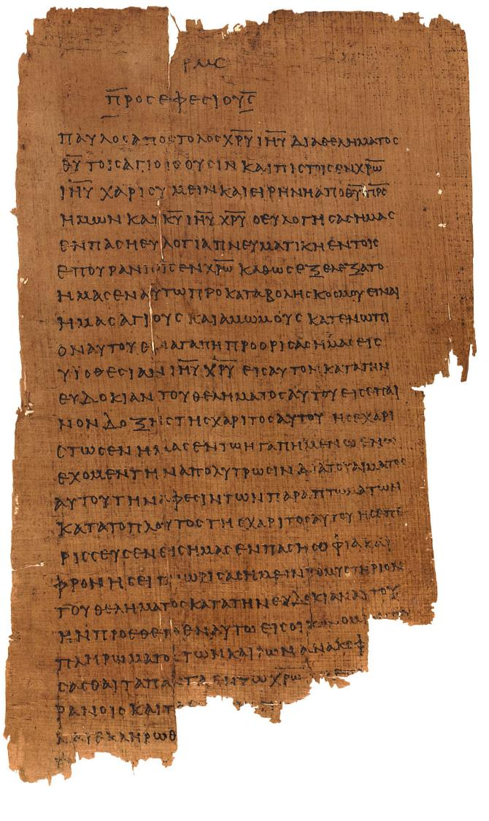
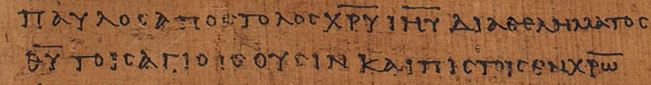
Ephesians 1:1 p46
Chester Beatty Papyri ca. AD 200 earliest copy of the Ephesian letter
(University of Michigan, Hatcher Library)
“Paul, an apostle of Christ Jesus through [the] will of God to the holy ones who are also faithful in Christ…” (1:1)

Slide 133
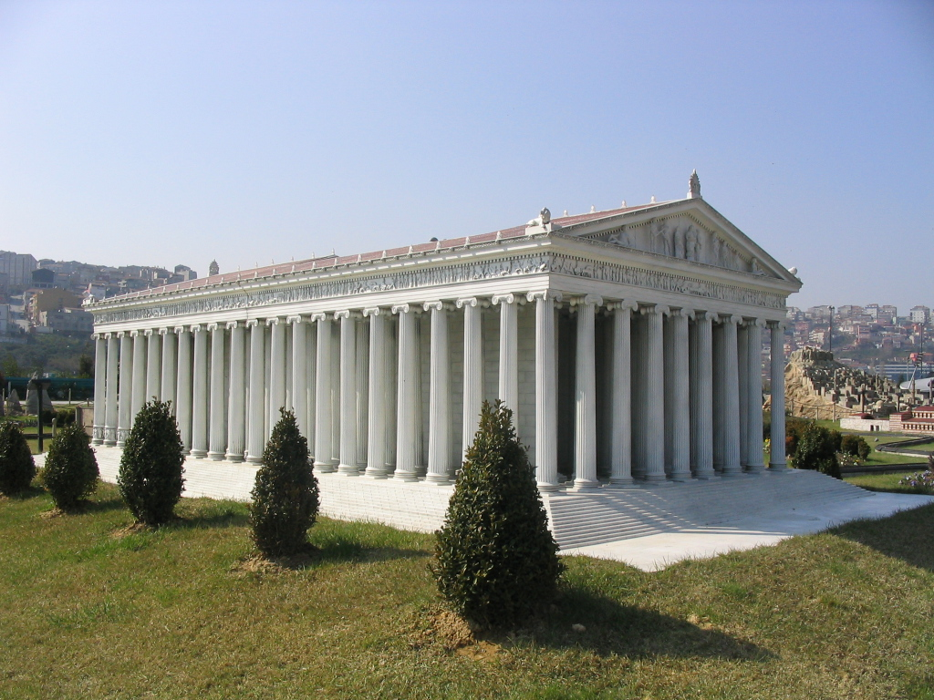
Though only sculptural fragments and foundation stones remain, the Temple of Artemis was named by Antipas of Sidon as one of the seven wonders of the ancient world.
Though destroyed in the late Roman Period, it’s ruins were rediscovered by scholars from the British Museum in 1869.
Model of the Temple of Artemis

Slide 134
The Argument
The church is the climax of God’s eternal purpose (1):
Before the creation of the universe, the Father planned to have a body of people adopted as his children.
He provided redemption and forgiveness through his Son, working everything out according to his sovereign will.
Through the Holy Spirit, he guaranteed the final outcome of this blessing.
The Ephesians themselves were examples of this mystical “body”, over whom is Christ the “head”.
Grace and unity are the enduring qualities of God’s redemptive work (2):
Believers are saved by grace through faith.
Unity between Jews and Gentiles in a single body through the cross has resulted in a holy temple where God lives by his Spirit.

Slide 135
Paul was himself a servant of this gospel (3):
This eternal purpose of God—the “mystery”—was kept hidden for long ages, but now God has made it known.
It was Paul’s privilege and burden to be the bearer of this good news to Gentiles.
His continual prayer was that the Ephesians would be able to fully grasp Christ’s immeasurable love.
The practical implications of this universal gospel aimed toward unity and spiritual maturity (4:1—5:20):
Since God has now united both Jew and Gentile, Christians must live in unity with each other, using the gifts God has given for the spiritual growth of the body.
As God’s children, they must be characterized by moral behavior.

Slide 136
Family life must be follow the lead of Christ as the “husband” of the church, his “bride” (5:21—6:9).
This meant sacrifice and submission between husbands and wives.
It also meant respectful obedience on the part of children.
It meant that Christians who were slaves and Christians who were masters must see themselves as serving Christ, not the expectations of the surrounding culture.
The church faces an intractable and threatening world (6:10-24):
Still, though the church engages in warfare, its warfare is not conducted with physical violence, but rather, spiritual weaponry.
Prayers for Paul as Christ’s ambassador were in order, and peace, love and grace were the enduring virtues of God’s new society, the church.

Slide 137
Philippians

Slide 138
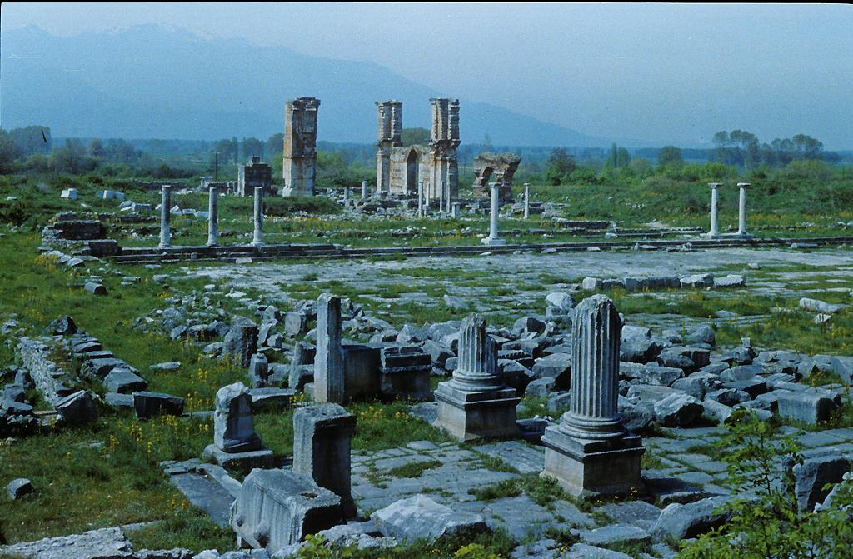
Archaeological remains of ancient Philippi.

Slide 139
Occasion of the Letter
The Philippians had sent a monetary gift to Paul by Epaphroditus, one of their members (2:25-30).
This brother had become seriously ill, an illness that nearly resulted in his death. Paul was sending him back to Philippi as the courier of the letter.
Shortly, Paul also intended to send Timothy to minister to the congregation (2:19-23), and soon he hoped to come himself (2:24).
In the meantime, he was concerned about outside opposition (1:27-30) as well as the influence of Judaizers who might distort the gospel (3:2).
He also was concerned about perfectionists (3:15), materialists (3:18-19) and a dispute between two church members (4:2).

Slide 140
Personal Character of the Letter
Paul’s uses extensive “friendship language” in this letter.
The idea of koinwni<a (= fellowship) is prominent (1:5; 2:1; 3:10; 4:15).
Paul attaches the prefix sun- (= together with) to many words (1:7, 27; 2:2, 17, 18, 25; 3:10, 17, 21; 4:3, 14) which, although not always apparent in the English versions, is quite apparent in the Greek text.
He uses a variety of tender phrases (1:7, 8; 2:18; 4:1, 14).
He uses the first person “I” some 52 times in the Greek text, far more than is typical in his other letters.

Slide 141
The Argument
From his prison cell, Paul expresses joy because of the Philippians’ loyalty (1:1-11):
He frankly admits the real possibility that his imprisonment might end in execution (1:12-30):
He seems torn between his desire to be with Christ after death and the importance of continuing his ministry.
Whatever might happen to him personally, he urges the Philippians to stand firm in Christian solidarity against any opposition.
He urges imitating Christ’s humility (2:1-18):
The ultimate Christian ethic is to think of others, not oneself.
Christ’s humility in the incarnation is the model to follow.
Lives of godliness shine like stars against a black world.

Slide 142
Paul intended to send Timothy and Epaphroditus to Philippi (2:19-30):
Timothy would represent Paul well.
Epaphroditus had endangered his own life in order to minister to Paul in prison.
Now, Paul extends a warning and encouragement (3:1—4:1):
He warns them against Judaizers who distort the gospel. In doing so, he recounts what he gave up in Judaism in order to gain Christ.
He encourages them to press onward toward maturity.
He closes the letter with final exhortations (4:2-23):
First, he seeks to reconcile two women workers who were at odds.

Slide 143
He enumerates the marks of the Christian life.
He saves until last his profound thanks for the Philippians’ financial gifts.

Slide 144
Discussion:
In three of the prison letters (Colossians, Philemon and Ephesians), Paul addresses slaves. How do you think Paul thought of slavery in the context of the Christian message?
In his prison letters, Paul is frank about his suffering for Christ. What is the role of suffering in the Christian life, and what does Paul say about it?

Slide 145
Pastoral Letters
1 Timothy
Titus
2 Timothy

Slide 146
The Context
Inasmuch as details about the closing years of Paul’s life are unclear, finding the context for the pastoral letters is difficult.
1 Timothy and Titus offer little about Paul’s circumstances other than that he anticipated a continuing ministry (1 Ti. 3:14-15; Tit. 3:12).
In 2 Timothy he is clearly imprisoned (2 Ti. 1:8; 2:9), speaks about his “first defense” (2 Ti. 4:16), and anticipates the near certainty of his approaching death (2 Ti. 4:6-7, 18).
Traditionally, it has been assumed that these details can be accounted for by a 1st and 2nd imprisonment in Rome for Paul.

Slide 147
Authorship
While historical-critical scholars have questioned Pauline authorship for several of the letters in the Pauline corpus, the most aggressive doubts have arisen concerning the pastorals.
These doubts largely concern differences in literary style, vocabulary, the more ordered state of the church reflected in the letters, the ambiguity of the latter years of Paul’s life, the address of ideas that seem Gnostic, and the fact that the letters speak of “the faith” as an established orthodoxy.
Conservative scholars remain unconvinced and give Paul full credit as the author.

Slide 148
1 Timothy

Slide 149
Situation
Written to Timothy while he was at Ephesus (1:3), this letter addresses the challenge of heretical teachers, two of whom are named (1 :20), who gave priority to myths and genealogies (1:4, 7).
They taught a theology of abstinence, including celibacy and dietary restrictions (4:3), and they believed they were the recipients of special knowledge (6:20-21).
Obviously, there is a Jewish flavor to this heresy, but the language of “false knowledge” smacks of early Gnostic thought as well.
Given the several mentions of women (2:9-12; 3:11; 5:13, 15), it seems likely that this heresy was strongly promoted by female teachers.

Slide 150
The Argument
The false gospel versus the true (1):
Paul issues a severe warning against false teachers who were distorting the gospel by emphasizing Mosaic legalism while deemphasizing faith.
The true gospel, which was epitomized in divine grace and mercy, had been demonstrated in the conversion of Paul himself.
An order for Christian life, worship and leaders (2-3):
After offering a general comment about prayer, Paul gives an order for decorum in public worship, first for men, then for women.
He then gives an order for the traits that should characterize the lives of leaders, first for elders, then for deacons.
The coming apostasy (4):
The false teachers in Ephesus were merely part of a larger final apostasy, and Timothy must stand firm against it.

Slide 151
Order for Christian relationships (5:1—6:2):
Here, Paul offers an order for the deference of the younger to the older and the church’s treatment of widows who are receiving support from the church.
He also addresses the treatment of church leaders.
Finally, he addresses the relationship of slaves to masters.
Final warnings and a charge (6:3-21):
As a final word against false teachers, he warns against the love of controversy, pride and greed.
His parting charge to Timothy emphasizes true pastoral concern grounded in basic Christian virtue and faith.

Slide 152
Titus

Slide 153
Situation
According to the Titus letter (1:5), Paul had visited Crete, leaving Titus there; the circumstances of this visit are not described by Luke in Acts, however, so it’s provenance can only be conjectured.
Titus was left in Crete to complete the work started by Paul, particularly appointing elders.
He hoped to relieve Titus by sending Artemas and Tychicus to replace him (3:12).
Paul’s primary concern was about false teachers, not only among the Cretans, but also among the Jews in what what he calls “the circumcision group” (1:10, 14-16).
He urges severe measures to silence these false voices (1:11), rebuking them sharply (1:13) while avoiding their controversies (3:9-11).

Slide 154
The Argument
Titus’ task in Crete (1):
Having left Titus to complete the work he had started, Paul instructed him to appoint elders, and he offers a list of character traits for leaders very similar to what one finds in 1 Timothy.
Also as in 1 Timothy, Paul is concerned about false teachers, particularly the circumcision group (1:10).
In various of his letters, Paul gives what has come to be known as a “household code”, that is, instructions for behavior to various groups (2):
As in 1 Timothy, he addresses the relationship between both older and younger believers as well as the behavior of slaves.
In general, he urges the importance of godly lives as believers await the “blessed hope” of the return of Christ.

Slide 155
Living as Christians in the larger community (3):
Because Christians live within the larger culture, they also must demonstrate peaceful obedience to the secular government.
Christian life should be a life of grace, mercy and love, following the example of God himself who generously saved believers by his grace.
Controversies and argumentation that cause division should be avoided.

Slide 156
2 Timothy

Slide 157
The Closing Years of Paul’s Life
Three scenarios are possible concerning the closing years of Paul’s life.
TRADITIONAL
According to Eusebius and Jerome, Paul was released after his two-year house arrest in Rome (AD 62-64).
He continued his missionary work in the west (AD 64-68).
He was arrested a second time (AD 67-68).
During his second incarceration, he wrote all three pastoral letters.
EARLY EXECUTION
The testimony of the early church is that both Peter and Paul were executed under Caesar Nero in AD 64.
Here, Paul was not released after his house arrest, but executed.
2 Timothy, at least, was written during the latter days of his Roman imprisonment.
BANISHMENT
Paul’s hearing in AD 62 ended in banishment to Spain, enabling him to continue his missions work.
Hearing of the great fire in Rome and the persecution of Christians, he returned to be arrested again and executed.
1 Timothy and Titus were composed between his two imprisonments and 2 Timothy after his second arrest.

Slide 158
Circumstances
Clearly, the situation described in 2 Timothy was precarious.
Paul was incarcerated (1:16; 2:9; 4:16), denied the liberty of house arrest he had enjoyed earlier (Ac. 28:16, 30-31) and fully expected to die (4:6).
Still, in spite of his grim circumstances, Paul’s greater concern was for the continuity of his mission. He was grieved by the unfaithfulness of others (1:15; 4:10, 16), distressed because some of his co-workers were no longer available to assist him (4:20), yet hoping to continue his work though delegates (4:10-12), especially Timothy (1:6-8; 4:12).

Slide 159
Purpose
Above all, Paul was concerned about maintaining the purity of the Christian gospel.
Repeatedly, he urges Timothy to “guard” the truth entrusted to him (1:13-14; 2:2, 8-9, 15; 3:14-17; 4:1-2, 5).
God had given Paul insight regarding the future, and he knew well the dangers of a distorted message (2:17-18; 3:6-8, 13; 4:3-4).
Because of opposition, Timothy must be prepared to suffer for the gospel (1:8; 3:12)

Slide 160
The Argument
Paul opens this final letter by urging Timothy toward fidelity to the gospel (1):
He reminds Timothy of his heritage in the Scriptures.
He urges him to guard the pattern of sound teaching he had received.
He continues by encouraging Timothy toward diligence in ministry (2):
He must be ready to endure hardship for the gospel.
He must avoid becoming mired in word battles and empty talk, cluttering his ministry with quarrels and endless arguments.
Faithfulness is the most important ministry goal (3:1—4:5):
A great apostasy was on the horizon, and Timothy could expect it.

Slide 161
Paul’s charge, therefore, was that Timothy should imitate Paul’s integrity in ministry, being willing to suffer but holding tightly to the Holy Word.
As for Paul himself, his death was imminent, but so also was his reward (4:6-22):
Paul hoped for Timothy to be able to visit him, especially before winter, in order to bring extra clothing for warmth as well as his manuscripts of the Scriptures.
He closes by enumerating both his friends and his enemies, but he is certain that whatever the outcome of his imprisonment, he would be safely borne to God’s heavenly kingdom.

Slide 162
Discussion:
Paul’s order for church leaders is rather simple, consisting of “elders” and “deacons”. How does this compare with the various roles one finds in the branches of the Christian church today?

Slide 163
Paul’s Theology

Slide 164
Paul and Jesus

Slide 165
Paul and the Historical Jesus
Since Paul’s letters were composed prior to any of the gospels, he becomes the earliest extant written Christian witness to the historical Jesus.
For Paul, the central aspect of Jesus’ life and ministry are the cross and the resurrection.
Indeed Paul offers only minimal information about Jesus’ earthly life, what he describes as “Christ according to the flesh” (2 Co. 5:16).
Though Paul offers no narratives from Jesus’ life, nor does he describe Jesus’ baptism, miracles or disputes, in bits and pieces he shows that he is familiar with the story of Jesus.

Slide 166
Had Paul ever seen Jesus personally?
Though he was a citizen of Tarsus, he was educated in Jerusalem under Rabbi Gamaliel, where he possibly lived with his sister (Ac. 22:3; 23:16).
The odds are good that he may have been in Jerusalem at the time of Jesus’ death, an event that hardly would pass unnoticed. Still, we don’t know.
Did Paul recount the story of Jesus in his preaching to Gentiles? Luke is silent on the matter, though he describes several of Paul’s sermons and speeches.

Slide 167
Paul and the sayings of Jesus:
What is clear is that Paul was familiar with the teachings of Jesus and quotes from them at various times (1 Co. 7:10-11//Mk. 10:9-12; 1 Co. 9:14//Lk. 10:7; 1 Co. 11:23-25//Mt. 26:22-29//Mk. 14:17-25//Lk. 22:14-23; 1 Th. 4:15-17//Mt. 24:30-31).
He even quotes a saying of Jesus that is not recorded in the canonical gospels (Ac. 20:35).
Altogether, there are some 30 passages in Paul where he alludes to or echoes the teachings of Jesus.

Slide 168
Revelation & Tradition
How, then, did Paul know about the historical Jesus?
He goes to great lengths to stress that his contact with the Jerusalem church was minimal (Ga. 1:11—2:10).
The 15 days he spent with Peter and James must have been enlightening (Ga. 1:18-19), but he still insists that his understanding of the gospel came through direction revelation (Ga. 1:11-12).
At the same time, he concedes that he received by tradition (parado<seij and paralamba<nw) certain aspects of Jesus’ life (1 Co. 11:2; 15:1-7; 2 Th. 2:15).

Slide 169
Paul’s Understanding of Salvation

Slide 170
Paul’s Gospel
At various times, Paul can refer to the gospel personally as “my gospel” (Ro. 2:16; 16:25; 2 Ti. 2:8).
Indeed, the word “gospel” appears far more in Paul’s letters than the remainder of the New Testament.
Central to Paul’s gospel was the cross and resurrection of Jesus, what he says is of “first importance” (1 Co. 15:3; cf. 1 Co. 1:17-18; 2:2).
In the cross and resurrection, Paul sees the supreme act of salvation-history (Ac. 13:26-38).
It was not that Paul was uninterested in the life of Jesus, but rather, that he fully realized that apart from the cross and resurrection, Jesus would be perceived, at best, as only a prophet, not the Son of God who would take away the world’s sins (Ro. 1:4).

Slide 171
Jesus is Christ and Lord!
For Paul, the critical moment was on the Damascus Road, when he asked, “Who are you Lord?” and the heavenly voice said, “I am Jesus!”
The lordship of Christ concerns his exaltation, and the confessional formula for all believers is simply, “Jesus is Lord” (Ro 10:9; 1 Co. 8:6; 12:3; 2 Co. 4:5; Phil. 2:9-11).
For Paul, the title Christ/Messiah functions as a proper name.
Finally, the righteousness of God is imputed to believers by faith.

Slide 172
It is in the gospel that God’s righteous faithfulness is graciously revealed (Ro. 1:16-17; 3:21).
Righteousness is God’s gift to the sinner (Ro. 4:4-5; 5:17; 6:23; Ep. 2:8), and it is mediated through Christ alone (1 Co. 1:30; 2 Co 5:21).
For Paul, righteousness is something God credits or imputes to believers by faith (Ro. 4:4-8, 11b).
The primary realities of salvation, therefore, are grace and faith.
Paul uses the word xa<rij (= grace) more than all other NT writers combined.
Grace is God’s unmerited initiative to provide humans with salvation (Ro. 11:6).

Slide 173
Grace and faith stand in polar opposition to salvation by wages (Ro. 4:4), obedience to law (Ro. 3:28; 4:14; 6:14; Ga. 1:6ff.; 2:19-21; 5:4) or religious works (Ro. 11:6; Ep. 2:9; 2 Ti. 1:9).
Faith is itself the gracious gift of God enabling believers to believe (Phil. 1:29; Ep. 2:8).

Slide 174
Salvation
For Paul, salvation is not only “from” something, but also “toward” something, which is to say, salvation is oriented in two directions.
Because of Christ’s sacrifice, believers have been rescued from the kingdom of darkness (Col. 1:13), freed from the power of sin (Ro. 6:6-7, 14, 18, 20-22) and exempt from divine wrath (Ro. 5:9; 2 Co. 3:15).
At the same time, believers were saved “to do good works” (Ep. 5:10; 1 Ti. 2:10; 5:10; 6:18)—to be ambassadors through whom God makes his appeal to the world (2 Co. 5:18-20), while exhibiting the fruit of the Spirit (Ro. 7:4; Ga. 5:22-23; Ep. 5:8-9; Phil. 1:9-11; Col. 1:10).

Slide 175
Salvation in Two Directions
(Romans 6:13-14)
Believers are saved “from” something, but they also are saved “to” something.
UNDER LAW
sin
condemnation
death
slavery to sin
UNDER GRACE
obedience
righteousness
life
an offering to God
From To
Salvation is not only an escape but also a calling (cf. Eph. 2:10; 2 Ti. 1:9).

Slide 176
Paul uses three verbal tenses to describe salvation: past, present and future.
As a past event, salvation is something that has been completed in the cross of Jesus and appropriated into the lives of believers through faith (Ga. 3:13; 1 Co. 6:11; Ep. 2:5; Ro. 5:1, 10; 8:24).
At the same time, Paul can refer to salvation as a present process, so he can say that believers “are being saved” (1 Co. 1:18; 15:2; 2 Co. 2:15).
Finally, salvation is a future hope, an event in which believers “will be saved” at the end (Ro. 5:9; Phil. 1:28).

Slide 177
SALVATION IN THREE TENSES
Romans 5:1, 9
PAST
“…having been justified through faith…” (5:1a)
(aorist passive participle)
PRESENT
“…we have peace with God through our Lord Jesus Christ…” (5:1b)
(present active indicative)
FUTURE
“…we shall be saved from God’s wrath through him!” (5:9b)
(future passive indicative)

Slide 178
Paul uses powerful metaphors or word pictures drawn from the Jewish and Gentile cultures to describe salvation.
Reconciliation sets the framework of salvation as the repair of a relational breach between humans and God (Ro. 5:1, 11; 2 Co. 5:18; Ep. 4:17-19; Col. 1:21).
Redemption is both a Jewish concept, in which someone is “bought back”, and a Gentile concept, in which slaves are given manumission (Ro. 3:24; 1 Co. 1:30; 6:20; 7:23; Ga. 3:13; 4:5; Ep. 1:7, 13-14; 4:30; Tit. 2:14).

Slide 179
Justification is a forensic term and evokes the picture of acquittal before a judge. It means that even though a guilty sinner, the believer is viewed as righteous because he/she has come into a righteous relationship with God (Ro. 3:24, 26; 4:5; 5:1; Ga. 2:16; 3:8, 24; Tit. 3:7). This acquittal is based upon the death of Jesus so that God’s wrath against sin has been satisfied in the death of his Son (Ro. 5:9; 8:30-34).
Substitution is a sacrificial concept in which the offenses of the worshipper are transferred to the innocent sacrificial animal—life for life. Paul sees both Yom Kippur and Passover rituals underlying the sacrifice of Christ (Ro 3:25; 1 Co. 5:7; 11:23-25; 2 Co. 5:21; Ep. 5:2).

Slide 180
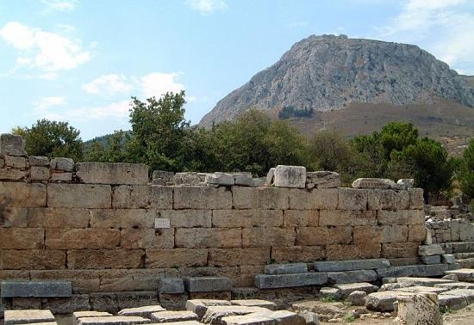
The Corinthian Bema
The idea of acquittal may have loomed large for Paul, since he was arraigned in Corinth before Gallio, the Proconsul in Corinth who took office in AD 51, on the charge of promoting an illegal religion. Gallio threw the case out of court (Ac. 18:14-16).

Slide 181
Adoption was a Roman practice, a legal process by which a person was set free from the authority of his natural father and transferred over to the authority of his adopted father. Old debts were cancelled, and the adopted son now participated in a new family with inheritance rights (Ro. 8:15-17; Ga. 4:3-7; Ep. 1:5).
Sanctification is a Jewish concept in which the idea of “cleanness” meant that one was qualified to approach a holy God. Paul employs two verbal tenses, past tense (what is already done, cf. Ro. 15:16; 1 Co. 1:2; 6:11; Ep. 5:26) and present tense (what is being done, cf. Ro. 6:19, 22; 1 Th. 5:23; 2 Ti. 2:21).

Slide 182
Paul’s Metaphors for Salvation
drawn from
Roman family laws
…to transfer authority to a new family
JUSTIFICATION
drawn from the
Torah laws for buying back
to effect a release or to buy back
SUBSTITUTION
drawn from the
Torah laws for purification
…to make clean, fit to approach God
drawn from the Roman criminal courts
…to be acquitted, to be pardoned by a judge
drawn from the sacrificial system of the temple
…to turn aside God’s wrath against sin
ADOPTION
REDEMPTION
SANCTIFICATION
RECONCILIATION
…repairing the breach between humans and God

Slide 183
Discussion:
Everyone agrees that Paul is a major force for shaping Christianity. A few have argued that he distorted the simple message of Jesus. How would you respond to such an idea?
How does Paul take concepts from the ancient faith of Israel and bring them to bear upon the message of Christ?

Slide 184
Fundamental Structures

Slide 185
Worldview
Paul’s view of the world was essentially the Jewish view of the world based on the Hebrew Scriptures.
Though he was at home in the Greco-Roman world, he was not a Platonist, like his Jewish contemporary Philo.
Neither did he derive his cosmology from the Hellenistic mystery religions.
As a Pharisee (cf. Ac. 23:6; 26:5), he embraced aspects of theology not shared unilaterally by all schools of Jewish thought, such as the existence of angels and the resurrection of the dead, (Ac. 23:6).

Slide 186
Anthropology
Anthropology in the Greco-Roman world was characterized by a dualism of spirit (good) and matter (evil).
Paul, however, takes his anthropology from the Hebrew Scriptures, even though he uses some of the same terms as would be found in Greek metaphysics (e.g., “soul”, “body”, etc.).
Theologians have wrestled with Paul’s anthropology, and usually their conclusions fall into one of three models:
TRICHOTOMY (body, soul and spirit, cf. 1 Th. 5:23)
DICHOTOMY (body and soul, cf. Ro. 8:10; 1 Co. 5:5)
UNITY (heart, mind, body, flesh, spirit, bowels
and soul, each a synecdoche for the whole)

Slide 187
Creation & Re-creation
Paul describes the event of salvation as involving two creations, the old & the new, the old Adam & the second Adam and the present age & the coming age.
The original creation was good (1 Ti. 4:4), but it was marred, and the process of decay and death began (Ro. 8:20). A new creation has begun in Christ (2 Co. 5:17; Ga. 6:15).
Adam, as the head of the old creation, brought universal death into the human race (Ro. 5:12, 14). What Paul calls “the old man” stands in solidarity with the ancient Adam (Ro. 6:6; Ep. 4:22; Col. 3:9). However, death has been abolished in Christ (1 Co. 15:22; Ro. 5:18), and a “new man” has been created (Ep. 4:22-24; Col. 3:10; Ga. 2:20).

Slide 188
The original creation and original Adam belong to the present age, an age whose values are in opposition to God’s will (1 Co. 2:6, 8; 3:18; 2 Co. 4:4;; Ep. 2:1-2). However, there is both a present age and an age to come (Ep. 1:21). Christ has delivered us from the present age (Ga. 1:4), while the old age is “passing away” (1 Co 7:31).

Slide 189
The People of God
Paul asserts that the true “Israel”, the people of God, cannot be defined by ethnic pedigree.
He never denies that ancient Israel was chosen by God as the recipients of adoption, glory, covenant, law, priesthood, promises and the lineage of the Messiah (Ro. 3:1-2; 9:4-5).
However, he goes on to assert that the true “Israel” must be defined by faith (Ro. 2:28-29; 9:6-9; 10:8-13; 11:26; Ga. 3:6-9, 14, 26-29; 6:16).
The corporate imagery he uses of the church—the body of Christ, the temple of God, the bride of Christ, the city community and the household community—are metaphors describing the whole people of faith, including both Jew and Gentile.

Slide 190
BRIDE
BODY
CITY
TEMPLE
CORPORATE METAPHORS FOR THE CHURCH
THE BODY OF CHRIST
(Ro. 12:4-5; 1 Co. 12:12-27; Ep. 2:14-16, 5:29-30; Col. 1:24, 2:19
THE TEMPLE OF GOD
1 Co. 3:10-11, 16-17; 2 Co. 6:16; Ep. 2:20-22
THE BRIDE OF CHRIST
Ep. 5:23-24, 32; 2 Co. 11:2
THE CITY OF GOD
Phil. 3:20
THE HOUSEHOLD OF GOD
Ep. 2:19
HOUSEHOLD

Slide 191
Spheres of Power

Slide 192
Flesh & Spirit
Paul often describes the Christian life in terms of striking tensions or polarities, each side of which exerts a pull upon the believer.
These polarities are very much related to the “already/not yet” tension inherent within the old and new creation.
The believer lives in two worlds, as it were, and each has powerful forces that attract.
The most apparent tension is between the realm of the flesh and the realm of the Spirit.

Slide 193
Spheres of Power
(Ro. 8:5-8)
The Flesh
The sphere of human weakness
Mind controlled by what the flesh desires
Mind of the flesh is death
Hostile to God, refusing to submit to his Torah
Subject to the parasite of sin
The Spirit
The sphere of the Spirit’s power
Mind controlled by what the Spirit desires
Mind of the Spirit is life and peace
Seeks to love God with heart, soul and strength
Enabled to obey God’s
Torah

Slide 194
Before coming to Christ, our sinful passions were aroused, leading to death (Ro. 7:5). The behaviors of the flesh are degenerative (Ga. 5:19-21).
The opposite field of force is the Holy Spirit, which is a working dynamic in the lives of believers, leading them toward maturity and godliness (1 Co. 2:14-15; Ga. 5:22-23; 6:1).
After coming to Christ, believers no longer live “according to the flesh” (Ro. 8:4), even though they live “in the flesh” (Ga. 2:20).
To live “after the flesh” is to live in weakness (Ro. 7:5, 18-20; 8:5-8), but to “walk in the Spirit” is to live in freedom (Ro. 8:5b, 9, 12-14; Ga. 5:16, 25).

Slide 195
Sin & Righteousness
The second polarity consists of the power spheres of sin and righteousness.
Sin is more than a broken rule; it is a broken relationship, the antithesis of faith (Ro. 14:23).
It is transgression against others, but more importantly, it is transgression against Christ himself (Ro. 3:23; 1 Co. 8:12).
Humans were not created sinful, but sin gained ascendancy over all humans by the rebellion of the first human (Ro. 5:12).
Sin is the active agent that dominates weak humans, and they are powerless in themselves to withstand it (Ro. 5:6; 7:8, 11).

Slide 196
Sin brings humans under God’s wrath (Ro. 1:18), first as a judgment within history (Ro. 1:24, 26, 28), and finally, as a judgment at the end of history (Ro. 9:22; Phil. 3:19; 2 Th. 1:5-10).
In the death of Jesus, divine judgment against sin was carried out as a substitutionary judgment for human sin (Ro. 5:8; 2 Co. 5:21; Ga. 2:20; 3:13; Col. 3:3).
God’s righteous saving action in Christ, which is an expression of his divine justice, reaches the helpless and puts them in right relationship with himself (Ro. 1:16-17; 3:25-26; 4:5).
In the end, righteousness is both process (God’s saving action) and result (the gift of righteousness God gives the sinner), giving them right standing with God (Phil. 3:9; Ro. 5:1-2).

Slide 197
Two Verbal Moods in Paul`s Letters Describe both Process and Result
INDICATIVE MOOD
(the fact of what now is)
“I have been crucified with Christ” (Ga. 2:20)!
We died to sin, were baptized into Christ’s death, and the old self was crucified (Ro. 6:2-4, 6).
IMPERATIVE MOOD
(the demand for what should be)
“Walk in the Spirit” (Ga. 5:16)!
We are to count ourselves dead to sin and refuse to let sin reign; we must not offer the parts of our bodies to sin (Ro. 6:11-13)
This is what Christ has done! It is accomplished—finished—in Him alone!
This is what we are called to do by the power of the Spirit.

Slide 198
Law & Grace/Faith
Paul uses the word “law” with more than a single nuance. On the positive side, law is the revelation of God’s will (Ro. 7:12-14, 16; 1 Ti. 1:8). On the downside, law is inadequate to enable righteousness (Ro. 8:3).
Paul defines the two power-spheres of law and grace with the preposition “under” (u[po): a person is either “under” law or “under” grace (Ro. 3:19; 6:14-15; 1 Co. 9:20; Ga. 5:18).
The problem with living “under law” is that it cannot provide empowerment for obedience (Ro. 3:20; Ga. 2:21). It is not that the law is bad, but that the empowerment to fully meet the demands of the law lies elsewhere (Ro. 8:3-4, 7; Ga. 3:21)

Slide 199
To rely on the law or in one’s ability to keep the law as the means for right standing with God is futile, and it leads only to a curse, the penalty for law-breaking (Ga. 3:3, 13).
Christ, on the other hand, has redeemed believers from being under law (Ga. 4:5), so that now they are under grace where empowerment for obedience comes from the Holy Spirit (Ro. 8:2, 5-11; Ga. 5:16-18).

Slide 200
Discussion:
A long-standing discussion among Christians has been about the relationship between faith (what you believe) and works (what you do). What does Paul’s theology have to say about these categories?
For Paul, the cross of Jesus is central. Why do you think he makes this the center?

Slide 201
Eschatology

Slide 202
Resurrection
Paul’s eschatology begins with his affirmation of the resurrection of the dead:
As a Pharisee, resurrection was a central theological tenet for Paul even before becoming a Christian.
As a Christian Pharisee (Ac. 26:5), he continued to uphold this central eschatological expectation of “the hope of Israel” (Ac. 23:6-9; 24:14-15, 21; 26:6-8; 28:20).
The resurrection of Jesus, then, fits perfectly into Paul’s larger theology of resurrection and, while not negating it, certainly reshaped it (Ac. 25:19; 26:22-23).

Slide 203
The Living Christ
When Paul was confronted by the risen Christ on the Damascus Road, this encounter reoriented his eschatological perspective (Ac. 9:3-5; 22:6-8; 26:13-15).
It meant that in some sense the last things had already begun, Christ being the “first-fruits” of the resurrection (1 Co 15:20-23).
It also meant that Christians now live in the transition between two ages, the “present age” and the “age to come” (Ep. 1:21; 2:7; Col. 1:26).
Christ is the “last Adam” (1 Co. 15:45; cf. Ro. 5:14), and the apostles are the “last witnesses” (1 Co. 4:9).

Slide 204
The Blessed Hope
Central to the Christian life, then, is hope, the firm conviction that God will fulfill his promises:
The believer rejoices in hope (Ro. 5:2-5) as he/she patiently awaits this final redemption of the body in resurrection (Ro. 8:23-25) and the promise of heaven and eternal life (Col. 1:5, 27; Tit. 1:2; 3:7).
In the meantime, the Christian “waits” for the Son from heaven (1 Th. 1:9-10; Ga. 5:5).
The consummation of this hope will be the return of Christ at the end of the present age (Tit. 2:13).

Slide 205
The Already-Not Yet Tension
The Christian lives within an inaugurated eschatology, which is to say, he/she participates in both the present and the future.
ALREADY
…we are seated in the heavenly places in Christ Jesus (Ep. 1:3; 2:6)
…our citizenship is in heaven (Phil. 3:20a)
…we have been transferred over into the kingdom of God’s Son (Col. 1:13)
…we have been saved and justified by faith (Ro. 5:1; Ep. 2:5)
NOT YET
…we presently live in an earthly home while awaiting a heavenly home (2 Co. 5:1)
…we await the transformation of our bodies (Phil. 3:20b-21)
…we await being brought safely into Christ’s heavenly kingdom (2 Ti. 4:18)
…we shall be saved in the day of the Lord Jesus (Ro. 5:9b; 10:9; 1 Co. 1:8; 5:5; Ep. 4:30)

Slide 206
Resurrection & Judgment
The two most prominent aspects of the future are the resurrection of the dead and the final judgment of all humans at “the day of the Lord” (1 Th. 5:2).
RESURRECTION
The resurrection of Christ presumes the ultimate resurrection of all the dead (Ro. 8:11; 1 Co. 15:12-23, 51-55; 2 Co. 4:14; 5:1-5; 1 Th. 4:13-17).
JUDGMENT
God will judge all humans (Ro. 2:16; 14:10-12; 1: Co. 1:8; 2 Co. 5:10; Phil. 1:6, 10).
His wrath will be revealed against those rejecting the gospel (Ro. 2:5; 2 Th. 1:7-10).

Slide 207
The Day of the Lord
Paul uses the Old Testament language of the advent of God (1 Th. 5:2; 2 Th. 2:2).
For the prophets, the ”Day of Yahweh” was doomsday, the day of God’s judgment (cf. Am. 5:18-20; Isa. 2:12-21; 13:9-11; Joel 1:15ff.; 2:1ff.; Zep. 1:14-18; Obad. 15; Mal. 4:5).
It included judgment on a blasphemous world and salvation for God’s people.
However, because “the LORD” in the Old Testament is “Christ, the Lord” in the New Testament, Paul also can speak of this as the “Day of Christ” (1 Co. 1:8; 2 Co. 1:14; Phil. 1:6, 10).

Slide 208
The Vocabulary of Christ’s Return
Paul uses three Greek terms more or less interchangeably to describe the second coming of Christ:
parousi<a (parousia = presence, coming, 1 Th. 2:19; 3:13; 4:15; 5:23; 2 Th. 2:1, 8)
a]poka<luyij (apocalypse = revelation, disclosure, 1 Co. 1:7; 2 Th. 1:7)
e]pifa<neia (epiphany = appearing, brightness, visible manifestation, 2 Th. 2:8; 1 Ti. 6:14; 2 Ti. 4:8; Tit. 2:13)

Slide 209
The Precursors
While Paul agrees with the rest of NT writers that the time of Christ’s return is unknown ( 1 Th. 5:2), he also describes several things that will precede it:
The Jews will be received back into divine favor, which he calls “life from the dead” (Ro. 11:11-32).
A great apostasy will occur (1 Ti. 4:1; 2 Ti. 3:1ff.)
The “man of lawlessness” will be revealed, claiming to be divine (2 Th. 2:3). He will be destroyed at the return of Christ (2 Th. 2:8).
Finally, all worldly authorities and powers will be put down (1 Co. 15:24-25).

Slide 210
The End
What Paul calls “the end” refers to the consummation and fulfillment of everything (1 Co. 15:24).
Christ will deliver up the kingdom to the Father after subduing all enemies, including death itself (1 Co. 15:24-28).
Every conscious entity in heaven, earth and the underworld will acknowledge that Jesus Christ is Lord to the Father’s glory (Phil. 2:10).
Believers will be “ever with the Lord” (1 Th. 4:17).

Slide 211
Discussion:
Paul’s description of the return of Israel to faith has been widely discussed. Do you think this refers to what happens within the scope of Christian history or something at the end of history?
Paul’s eschatology is claimed both by premillennialists and amillennialists. What are possible points of favor for each view?

