Slide 1
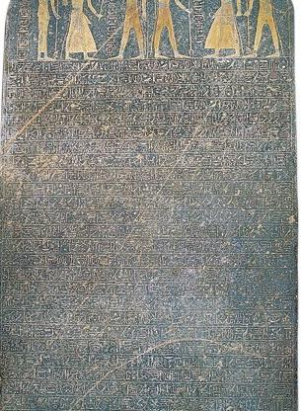
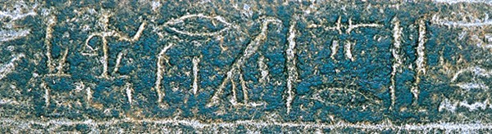
Exodoj
tOmw; hl.,xev4

Slide 2
Introduction

Slide 3
The Title
The Greek term e@codoj (= the way out) becomes the title of the second Torah scroll in the English Bible.
The Hebrew title is tOmw; hl.,xev4 (= And these are the names…)
In the Septuagint, the title is Exodoj Ai]guptou (= Exodus of Egypt)
The Latin Vulgate shortened it to simply Exodus, and from thence we derived the English title.

Slide 4
The Story
The exodus story is the most important narrative in the Hebrew Bible.
It describes how Yahweh chose Moses to be the founder of the nation Israel by leading them out of Egyptian slavery to the edge of Canaan, a land promised centuries earlier to Abraham, Isaac, Jacob, and Jacob’s sons (Ge. 12:7; 13:14-17; 15:7, 18-21; 17:8; 26:3; 28:13-13; 35:12; 48:3-4, 21; 50:24-25).
God also predicted to Abraham that his descendants would be slaves for a long time before they would be able to possess this promised land (Ge. 15:13-16).
The exodus story, then, is the foundation narrative of a new nation, its peculiar worldview and how it was redeemed from the land of Egypt.

Slide 5
The Themes
Liberation
The opening is primarily concerned with the transition from oppression to freedom.
The author of this freedom is Yahweh.
Law
At Sinai, Yahweh announces his will for all aspects of Israel’s public and private life.
For Israel, all law is God’s law.
Covenant
A binding relationship is established between God and Israel.
This covenant envisions both judgment and hope.
Presence
God takes up residence in the midst of Israel in the tabernacle.
The “glory of God” is both an abiding presence and traveling assurance.

Slide 6
Structure
Slavery in Egypt (1)
The Call and Commission of Moses (2-6)
The Ten Plagues (7:1—13:16)
The Exodus (13:17—15:21)
From the Sea to Mt. Sinai (15:22—18:27
At Mt. Sinai (19-40)

Slide 7
From Where and How Does This Story Come?
Like most ancient texts, the Book of Exodus is anonymous.
It belongs to the five books of the Torah (Pentateuch), all of which are anonymous. Traditionally the Torah has been ascribed to Moses so that together the five scrolls are often are called the “Books of Moses.”
However, while the Book of Exodus certainly depicts Moses as writing (cf. Ex. 17:14; 24:4; 34:27-28), various passages in the Torah also suggest a later hand(s):
  Anachronisms (cf. Ge. 14:14//Jg. 18:29; Ge. 12:6; 21:34; 36:31; 47:11; Ex. 13:17; 23:31; Dt. 2:23)
  “To this day” statements (Ge. 22:14; 26;33; 32:32; Dt. 3:11b; 29:28; 34:10-12)

Slide 8
The prevailing opinion for nearly the past century and a half among historical-critical scholars was that various strands of four pre-existing traditions were brought together to create the Pentateuchal literature long after any of the events themselves.
Documentary Hypothesis
Ge. Ex. Lv. Nu. Dt.
Four Primary Sources
J = Yahwist (10th century BC) passages using the name Yahweh
E = Elohist (8th century BC) passages using Elohim
D = Deuteronomic (7th century BC) Book of Deuteronomy
P = Priestly code (6th century BC) cultic materials

Slide 9
Today, however, it is widely recognized that this theory must be reassessed, and it is more common for scholars to suggest a variety of shorter, independent narratives, gradually formed into units and brought together.
Current theory
Ge. Ex. Lv. Nu. Dt.
Three Primary Sources
Deuteronomic (7th century BC) Book of Deuteronomy
Priestly code (6th century BC) cultic materials
Non-priestly materials
If so, then the Book of Exodus would have been compiled both from priestly and non-priestly sources.

Slide 10
Two Important Factors for Conservatives
While the Book of Exodus is formally anonymous, the historicity and authenticity of its narratives and speeches must be maintained.
While there is no necessary reason to oppose oral or written sources underlying Exodus in its final form, conservatives are still committed to the Mosaicity of the book, which is to say, Moses was a real person and the events describing him, what he said, and what he did are true.
Anything less seems to compromise the belief that this work was divinely inspired.

Slide 11
The language of Israel In and Out of Egypt
The precise nature of the language of Jacob’s family in Egypt is unknown.
The upheavals which rearranged the political geography of Syria-Palestine during the transition from Late Bronze Age II to Iron Age I (ca. 1400 to 1200 BC) produced changes in the linguistic map as well.
It is likely that Hebrew emerged as a distinct language during this period, though it used the same alphabet as several other Northwest Semitic languages as well as held a rather large pool of common vocabulary.

Slide 12
Early Semitic Script
Script (the writing style of the alphabet) was common to several languages, just as it is in modern times (i.e., we write in English, but we use Latin letters). Our earliest Semitic inscriptions have peculiarities that predate standardization:
The orientation of a given letter might vary (it could “face” in more than one direction; it could “lean” to either the right or the left).
Some writing was left-to-right, some right-to-left, and some “as the ox plows,” that is, left-to-right, then right-to-left, then left-to-right, etc.
A few early inscriptions are even written vertically in columns!

Slide 13
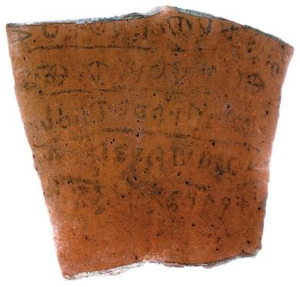
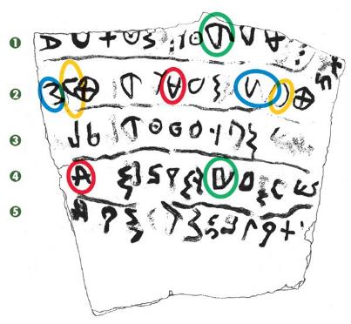
Qeifa Ostracon
Arguably the oldest Hebrew text yet discovered, this inscription features alphabetic letters that are oriented in more than one direction (see the red, blue, gold and green circled letter pairs).

Slide 14
The Developing Alphabet
Though eventually Hebrew became standardized with just 22 consonants, early versions of the alphabet sometimes contained as many as 27 or 28 consonants.
Vowels were not represented, nor would there be any complete system of vowel-pointing for many hundreds of years (ca. 9th century AD).
However, early Hebrew began using certain consonants to signify vowels, first at the end of words and later in the middle of words.
Pronunciation variations occurred even within the clans of Israel, and a local dialect existed in which the sounds “sh” and “s” were not clearly distinguished (cf. Jg. 12:5-6).

Slide 15
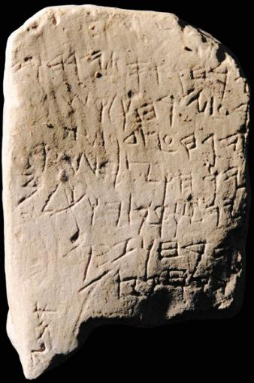
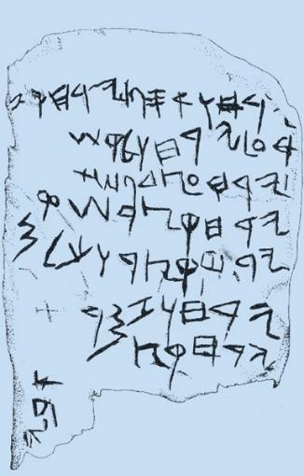
Gezer Calendar
An agricultural calendar from about 1000 BC. The script is ancient Canaanite; the language is Hebrew.

Slide 16
Standardization
By about the mid-11th century BC (the time of Samuel and Saul), several important developments occurred toward the standardization of Hebrew:
The stance of alphabetic letters became stable.
The direction of writing became consistent (right-to-left).
The number of consonants in the Hebrew alphabet was standardized to 22 letters.
The earliest written forms of the Torah, such as, the 10 commandments (Ex. 31:18; 32:16) and Moses’ written accounts (Ex. 24:4; Dt. 31:24), would necessarily have been “modernized” as the Hebrew language developed with respect to vocabulary, grammar and the forms of the letters themselves.

Slide 17
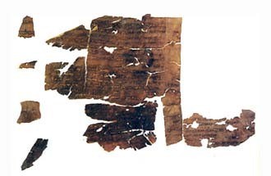
Fragment of the Book of Exodus
Among the Dead Sea Scrolls are the oldest extant copies of the Book of Exodus. 4QExod-Lev, shown here, dates to about 250 BC.

Slide 18
One of the most debated factors regarding the exodus story is the absence of archaeological corroboration.
To date, there is no unequivocal material remains of the Israelites in Egypt or their departure in a mass exodus into the Sinai Peninsula.
Further, there is no surviving textual material outside the Bible that speaks of the exodus.
To be sure, as Egyptologist Kenneth Kitchen (University of Liverpool) has aptly put it, “Absence of evidence is not evidence of absence.”
Still, this “gap” has led to the development of what are called “minimalists” and “maximalists.”
The Archaeological Issue

Slide 19
Minimalists
(the terms “minimalist” and “maximalist” were coined by William Hallo of Yale University)
Minimalists are those scholars who widely doubt the reliability of the biblical record: they doubt or reject all historical statements in the Bible unless corroborated by extra-biblical sources from the ancient Near East.
  Large portions of biblical history, including the exodus narratives, are treated as legend or heroic myth.
  Current major “players” include:
    Philip Davies (University of Sheffield)
    Niels Peter Lemche (University of Copenhagen)
    Thomas Thompson (Marquette University)
    Margaret Steiner (University of Leiden)

Slide 20
Maximalists
Maximalists are those scholars who tend to accept historical statements in the biblical record unless disproved by extra-biblical evidence.
  Current major “players” include:
    William Dever (University of Arizona)
    Kenneth Kitchen (University of Liverpool)
    Alan Millard (University of Liverpool)
    William Hallo (Yale University)
    Kyle McCarter (Johns Hopkins University)
    Andre Lemaire (Sorbonne University)

Slide 21
This debate, in turn, has led to two basic positions in the academy regarding the exodus.
The Israelites were never there…
The account of the exodus is mere folklore and legend.
It was composed centuries after the event, so the account cannot be read as “history”.
The Israelites were there, but we have had unrealistic expectations as to what archaeology can deliver…
The ability to determine ethnicity in the archaeological record is quite limited, so trying to find “Israel” in Egypt is nearly impossible.
The area where the Israelites lived, the northeastern Delta (cf. Ge. 45:10; 47:4, 6, 11; Ex. 8:22; 9:26), has a very high water table (due to the waters of the Nile River), which makes excavation difficult and expensive.
No historical or administrative papyri has survived in this damp environment.

Slide 22
A factor to consider…
The Egyptians were not famous for recording their defeats.
When they experienced military victories, they built monuments to these victories.
When they suffered defeat, they either remained silent or, in some cases, even claimed victory when there was none.
Hence, expecting to find a text describing an Israelite triumph over Pharaoh is highly unlikely.
In this relief of the Battle of Kadesh against the Hittites (1273 BC), the Egyptians suffered near disaster, but in their monuments, Ramesses II claimed to crush the Hittites under his chariot wheels.

Slide 23
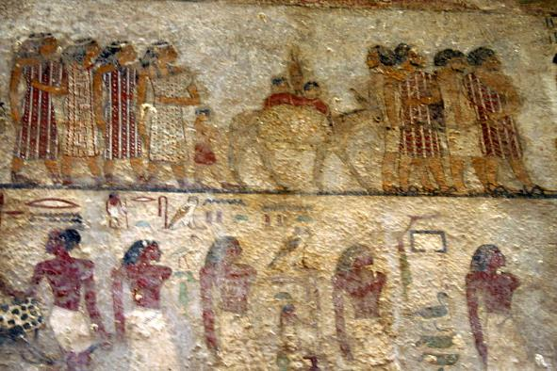
Were there Semites in Egypt?
There certainly is substantial evidence of Semitic peoples like the Israelites migrating to Egypt, usually tempted by better grazing for their livestock or by food in times of drought. This is precisely what is described in Genesis regarding Jacob and his family (cf. Ge. 42-43).
In this 19th century BC mural from a tomb painting in Beni-Hassan (left), colorfully dressed Bedouin Semites, regarded as “foreigners” by the Egyptians, are shown asking permission to enter Egypt.
In addition, several texts, including one from Pharaoh Menerptah (1213-1203 BC), describe Semites entering Egypt, and these texts span some 700 centuries during the 2nd millennium BC.

Slide 24
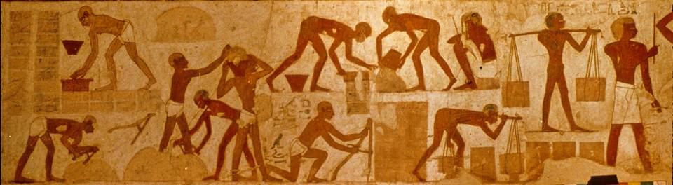
Were Semites reduced to slavery in Egypt?
New Kingdom Egypt is well-known for its military campaigns into Canaan and other places, where many captives were brought to Egypt as slaves, some of which are pictured here making mud bricks in this famous tomb painting from the 15th century BC. The accompanying text identifies them as Canaanites and Nubians.
The Book of Exodus describes just such slavery (Ex. 5:6-18).

Slide 25
Quotas for brick-making…
Egyptian records (preserved on a leather scroll in the Louvre Museum) from the 5th regnal year of Ramesses II describe quotas imposed on the brick-makers.
Sometimes quotas were reached; sometimes not.
One Egyptian officer complained that he was unable to complete his quota, since “…there were no men to make bricks nor straw in the neighborhood.”
This situation sounds very much like what is described in the Book of Exodus.

Slide 26
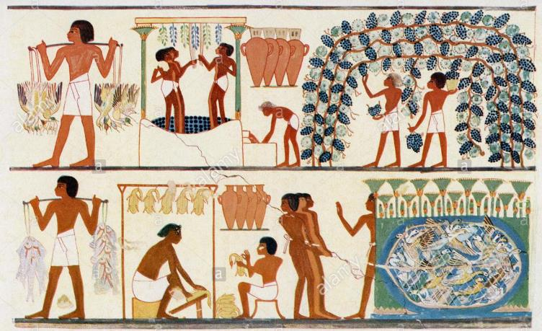
Slaves and agricultural work…
Beside brick-making, the Israelites also were involved in “all kinds of work in the field” (Ex. 1:14).
Slaves appear in Egyptian paintings herding cattle, serving in vineyards, and working in winepresses.
This 19th century copy of a wall painting shows slaves gathering grapes, stomping grapes in a vat, and collecting the juice in jugs for storage.

Slide 27
The importance of toponyms…
The importance of place names is that if a story was concocted centuries after the fact, one would not expect it to contain little-known references to geography. Hence, identifiable places in the exodus story lend credibility to the narratives, suggesting real historical memory.
Ramesses, the “storage city” on which the Israelites worked (Ex. 1:11) and from which they started their trek out of Egypt (Ex. 12:37; Nu. 33:3), is likely the Delta capital built by and named for Ramesses II. There is now wide agreement among scholars that it has been identified.
Pi-Ramesses (city of Ramesses) had a relatively short life-span (ca. 1275-1075 BC), however, and was abandoned. It is unlikely that someone writing a legendary account hundreds of years later would even have known about Pi-Ramesses.

Slide 28
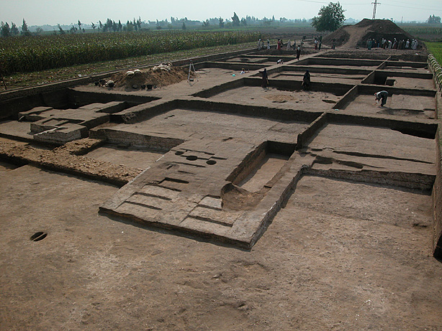
Excavations at Pi-Ramesses are ongoing

Slide 29
Looming large in the discussion exploring the link between Joshua, archaeology and external history is a debate about “when.”
Naturally, the relevance of any archaeological or historical data can change drastically if the dating of the biblical events themselves change.
Two theories dominate the field for the dating of the exodus and the invasion of Canaan, and since they are separated by about two centuries, this skews the applicability of the archaeological data, depending upon which date one prefers.
The Dating Debate

Slide 30
The Traditional Date
The traditional date for the exodus has been calculated by internal factors in the Bible itself.
The critical passage is 1 Kings 6:1, which specifically says that there were 480 years between the exodus and the beginning of work on the 1st temple during Solomon’s reign.
Solomon’s reign can be fixed at 970-930 BC.
If the temple construction began in Solomon’s 4th regnal year (966 BC), then the date of the exodus would be 480 years earlier (1446 BC).

Slide 31
The Unnamed Pharaoh
Alas, none of the biblical materials designates the Pharaoh of the exodus by name.
The title “Pharaoh” is general, much like our modern titles of king, queen, president and prime minister.
Hence, we must coordinate our efforts at dating to the known history of Egypt.

Slide 32
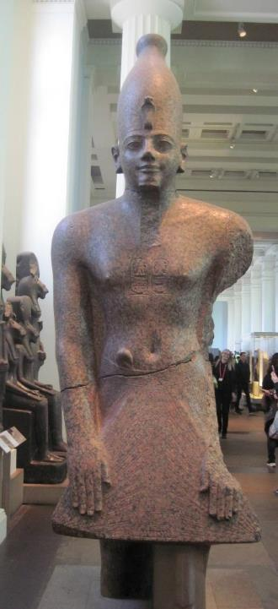
Thutmose III
(ca. 1479-1425 BC)
Possible Pharaoh of the exodus based on an early date
Alternative possibilities are Queen Hatshepsut (co-regent with Thutmose III at the beginning of his reign) and Amenhotep II (co-regent with Thutmose III at the end of his reign)
British Museum

Slide 33
The Late Date
A later date has been calculated for the exodus based on additional and/or external factors.
Objections have been raised against the 1446 BC date and how it is calculated (see Slide #36).
At the same time, many scholars believe that the correlation of the archaeological record with this early date does not fit as well as with a later date in the 13th century.
Ramesses II is the only known Pharaoh to gain notoriety for large scale building projects using conscripted foreigners.
Hence, the exodus has been re-dated by most scholars to about 1250 BC. This date also fits with the Merneptah stela, which puts the Israelites in Canaan by about 1210 BC.

Slide 34
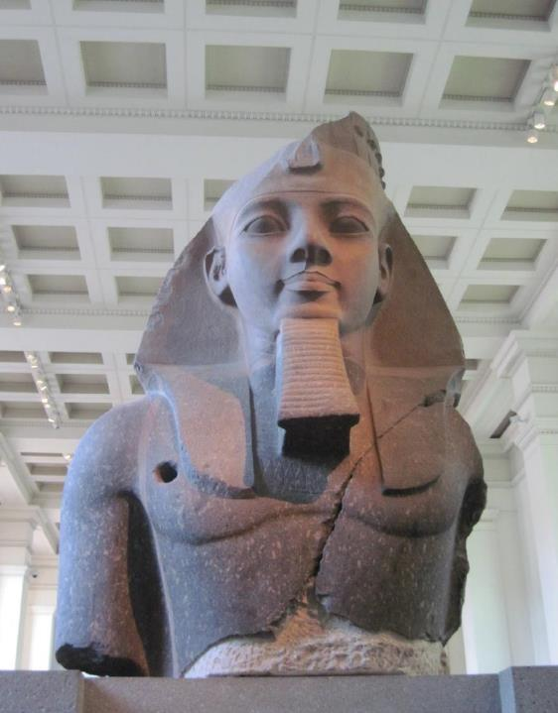
Ramesses II
(ca. 1279-1213 BC)
Possible Pharaoh of the exodus based on the later date
The use of his name in the accounts (Ge. 47:11; Ex. 1`:11; 12:37; Nu. 33:3, 5), even though indirect, suggests this possibility.
British Museum

Slide 35
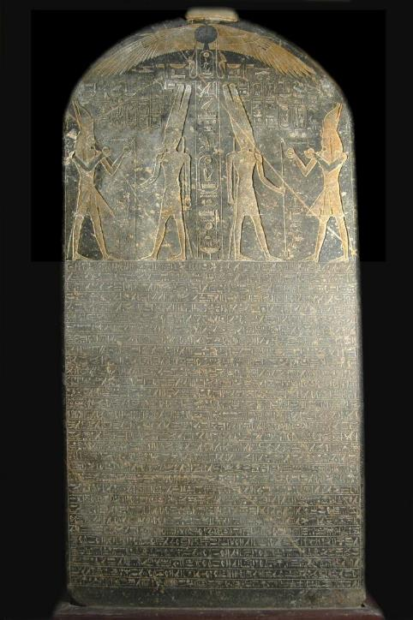
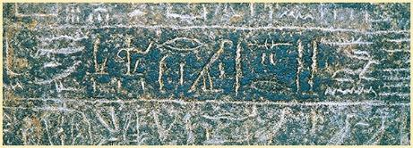
Merneptah Stele
Colloquially known as the “Israel stele,” this monumental inscription excavated in Thebes describes Pharaoh Merneptah’s invasion of Canaan in ca. 1210 BC. In this inscription, he claims to have conquered several Canaanite cities, but also, a people group called “Israel,” apparently a group without a city, in which he inscribed, “Israel is laid waste, its seed is not.” That the Israelites had no city suggests they were recent arrivals.

Slide 36
Objections to the 1446 BC date for the exodus lie along three primary lines.
First, the Old Testament uses many increments of 40 years, and the cumulative figure of 480 years may not be a mathematical one, but rather, a schematic one, approximating 12 generations. If so, then the traditional calculation fails.
Second, the Israelites in bondage are described as building Rameses, the site from where they also set out on the exodus (Ex. 1:11; 12:37). If this is Pi-Rameses, the eastern delta city built by Rameses II, the exodus could not have been in 1446 BC, since Rameses II reigned in 1279-1213 BC.
Third, in the archaeological excavations in Israel, there is a substantial break in the culture at the end of the Late Bronze Age (ca. 1250-1150 BC), a break that would correlate with the emergence of Israel in the land. There is no such break in the 15th century.

Slide 37
The Archaeological Break
It is especially the break in the archaeological sequence that has convinced most scholars that the emergence of Israel must be at the later date.
At the end of the 13th century BC, there was a sharp rise in settlements (farms, hamlets, villages), especially in the territory that belonged to Ephraim and Manasseh (i.e., central Israel).
This sudden rise in population would accord well with the emergence of Israel.
Further, the infrastructure of Canaanite city-states began to break down at the same time, whereas it seems to be intact during the earlier Amarna Period.
Archaeologists date destruction levels at various sites (including Hazor) to the 13th century.

Slide 38
THE AMARNA PERIOD (14th century BC)
A huge cache of letters was discovered in 1887 at Tel el-Amarna, Egypt, and more have been discovered since (382 in all).
Most of them are imperial documents between Canaanite cities and the Egyptian court in the 14th century BC.
They included correspondence from Canaanite cities like Jerusalem, Lachish, Shechem, Gezer, Gaza, Ashkelon, Joppa, Taanach and Hazor, all of them cities that appear in the Book of Joshua.

Slide 39
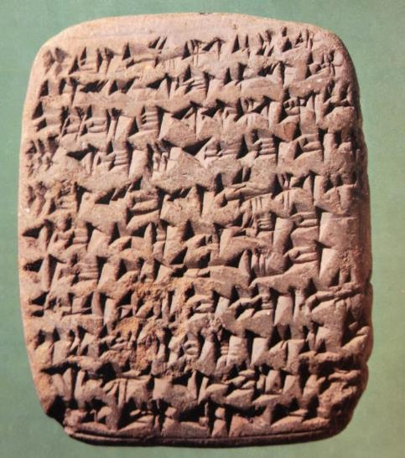
SAMPLE LETTER:
“The war, however, [o]f the Hapiru forces [aga]inst me is extremely severe, and so may the king, my lord, not [ne]glect Sumur lest ever[yon]e be joined to the Hapiru forces. …the w[a]r [agai]nst us is extremely severe, and so may the king not [ne]glect his [ci]ties.”
Amarna Letter EA 68 speaks eloquently of the lack of military preparedness in the Canaanite city of Hebron.

Slide 40
Various of the Amarna letters mention a series of conflicts between Canaanite cities and a group called “the Hapiru”.
The Hapiru sounded a bit like the Israelites—semi-nomadic invaders threatening Canaanite stability.
Some even suggested that there may have been a linguistic link between the name “Hapiru” and the name “Hebrews,” since the names are phonetically similar (though this view is now largely discounted).
Regardless, however one dates the exodus, the Amarna Period must be taken into account.

Slide 41
Implications
If the exodus and invasion of Canaan are placed in the 15th century (early date), the interaction between Moses and Pharaoh must be worked out in the context of Egypt’s rulers Thutmose I, Hatshepsut, and Thutmoses III (the latter who would most likely have been the Pharaoh of the exodus):
Many Christians are uncomfortable with the idea that the Bible uses schematic numbers, preferring instead that all numbers must be treated strictly mathematically.
Since we possess the mummy of Rameses II (Cairo Museum), it seems unlikely that he died in the Red Sea.

Slide 42
Implications Cont.--
If the exodus and invasion of Canaan are placed in the 13th century BC (later date), then the Hapiru in the Amarna Letters of the 14th century cannot be directly linked to the Israelites.
The political relationship between Egypt and Canaan during the Amarna Period would be irrelevant for assessing conditions during Joshua’s invasion.
In either case, the archaeological record figures significantly in the attempt to fix a date.
Currently, most non-evangelical scholars support the later date as do some evangelical scholars. However, other conservative scholars continue to support the early date.

Slide 43
Slavery in Egypt

Slide 44
The Sons of Israel (1:1-7)
The twelve sons of Jacob who descended into Egypt and from which are derived the twelve tribes of Israel are listed by their birth mothers, and the list matches Genesis 35:23-26.
Reuben, Simeon, Levi, Judah, Issachar, Zebulun (sons of Leah)
Benjamin (son of Rachel)
Dan and Naphtali (sons of Bilhah)
Gad and Asher (sons of Zilpah)
Joseph (son of Rachel, already in Egypt)
The total number was 70 people (cf. Ge. 46:27; Dt. 10:22), which are the 66 mentioned in Genesis 46:26 plus Jacob, Joseph, Ephraim and Manasseh. The Dead Sea Scrolls and the LXX list seventy-five, a number reproduced in the New Testament (Ac. 7:14).

Slide 45
THE HYKSOS
To understand the shift between Jacob’s descent into Egypt as a man of means and the reduction of his descendants to slaves, one must know something of Egyptian history.
Semitics began to increase sharply in Egypt during the 12th dynasty (20th century BC), and some Semites rose to levels of official power.
By the 17th century BC, the whole of Egypt had come under the dominion of these foreigners, who relocated the capital in the East Delta and ruled for about a century (called “the Second Intermediate Period”).
Naturally, the Hyksos would be more favorable to other Semites relocating in Egypt, and it is probable that Jacob’s family descended into Egypt during this period.

Slide 46
The Pharaoh who Did Not Know Joseph (1:8-22)
The Hyksos (Asian rulers) were resented as usurpers and eventually expelled from Egypt by Ahmose, who became the first Pharaoh in the 18th dynasty.
In all likelihood, it was the 18th dynasty of native Egyptians who “did not know Joseph” or his family (whereas the previous Asiatic rulers had been favorable).
They were the founders of “The New Kingdom.”
Not trusting aliens after the Hyksos’ Period, the native Egyptian rulers would have been the ones most likely to have enslaved Semites who lived in Egypt.

Slide 47
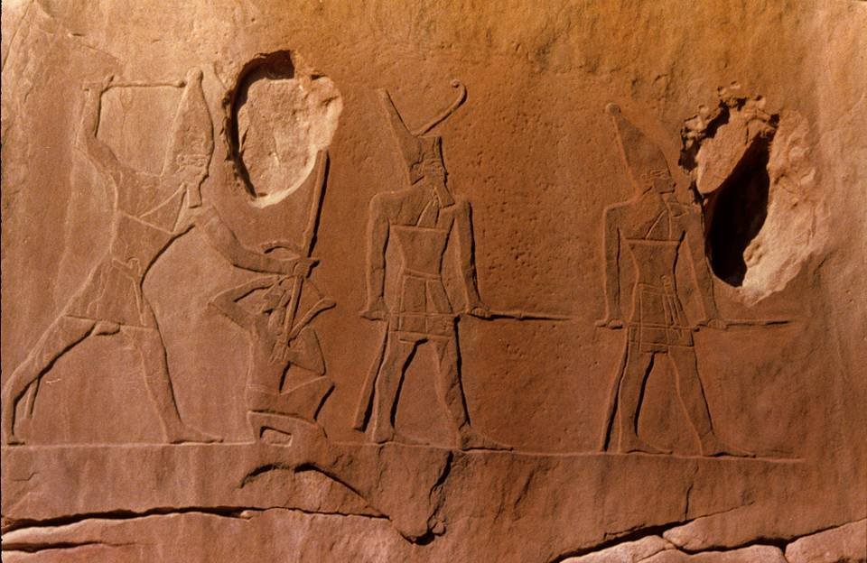
Carved into the face of a high cliff is the depiction of an Egyptian taskmaster striking an Asiatic prisoner.

Slide 48
Moses’ Call and Commission

Slide 49
Birth of Moses (2:1-10)
The birth of Moses under the trying circumstances of slavery and a government policy of infanticide became the initial step toward liberation.
There may well be a deliberate parallelism between the rescue of Noah from the flood waters and the rescue of Moses from the Nile.
  In both stories, the rare word “ark” (hbaTe) is the same.
  In both stories, the threat of the chaotic waters symbolizes overwhelming danger in a fallen world gone astray.
His name “Mosheh” (a pun on the Hebrew verb “to draw out”) anticipates his “drawing out” of the Israelites from Egyptian bondage. It also is an Egyptian root meaning “to give birth,” found in the names of various Pharaohs, such as, Ahmose, Thutmose, Amenmose and Ramose.

Slide 50
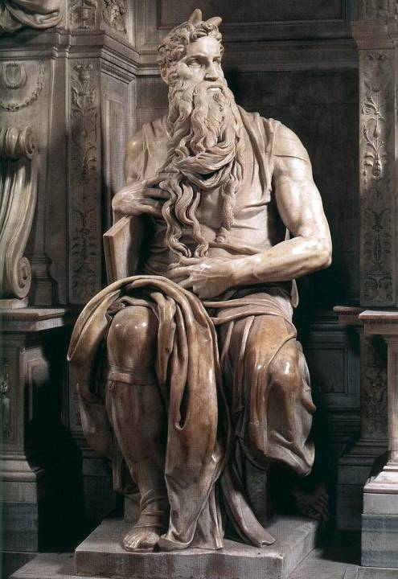
Moses
Born into a Hebrew slave family from the clan of Levi, Moses was saved from extermination by the subterfuge of hiding him in an “ark” in the river.
He subsequently was discovered by an Egyptian princess and reared in the royal court.
Eventually, Moses would become the archetype for the three public offices of Israel, prophet (the immediate voice of God), priest (the cult) and king (the giving of law).
“Moses” by Michelangelo, Church of San Pietro in Vincoli, Rome

Slide 51
Moses’ Exile to Midian (2:11-25)
Moses, raised in Pharaoh’s court, had to flee for his life after killing an Egyptian.
Fleeing to “land of Midian,” the area to the south and east of Palestine, he later married Zipporah, the daughter of a Midianite priest, who was a distant relative (cf. Ge. 25:1-2).
Moses father-in-law is known by three names, Ruel (2:18), Jethro (3:1) and Hobab (Nu. 10:29; Jg. 4:11). These variants may derive from different textual sources or may be simply personal, family and/or clan names.
In the meantime, the oppression of the Israelites in Egypt had grown only worse, and God heard their outcry of misery and remembered his covenant promise to the Patriarchs.

Slide 52
The Call of Moses (3-4)
The divine calling of Moses came at the age of 80 (7:7; cf. Ac. 7:23, 30).
In the desert, he was confronted by Yahweh who appeared to him in a burning bush that was not consumed: God commissioned him to go back to Egypt to lead out the Israelites.
This occurred “beyond the wilderness” at the “mountain of God,” also called Mt. Horeb (especially in Deuteronomy) and Mt. Sinai (especially in Exodus, Leviticus and Numbers)
Here, God declared to Moses his sacred name, Yahweh.

Slide 53
The Mal’ak Yahweh
The “Angel of the LORD” is the same theophany that appeared to Abraham (cf. Ge. 22:11).
A theophany (= God shining, God appearing) bridges the gap between YHWH as invisible Spirit and YHWH as one who reveals himself.
The fire is an expression of divine holiness, since it does not consume the bush (which is neutral) but will consume a human (who is sinful).
DEFINING NORMS:
YHWH cannot be seen by humans (Ex. 19:21; 33:20).
He takes the initiative to reveal himself in temporary self-disclosures as the
Mal’ak Yahweh (Angel of the LORD) and other forms.

Slide 54
The Tetragrammaton
hv!hy4
While the words for “God” (Myhi|x< and lxe) were commonly used in all the languages of the ancient Near East, the name Yahweh (hv!hy4) was unique to Israel (Ex. 3:14; 6:2-3).
The traditional English translation in the OT has been “LORD” (as opposed to yn!d*xE, which is translated as “Lord”.)
The four-lettered name is based on the Hebrew verb “to be,” and the meaning of the imperfect tense in 3:14 is either, “I am who I am” or “I will be who I will be.”

Slide 55
The Commission
From the burning bush, Yahweh commissioned Moses to lead the Israelites out of their bondage and bring them to the mountain of God.
Moses was to lead them to Canaan, a land “flowing with milk and honey,” an idiom for a land of abundance.
Yahweh also promised that before this escape, he would demonstrate his divine power by striking Egypt with judgments.
The Israelites would leave Egypt enriched by gifts from the Egyptians themselves.

Slide 56
The Reluctant Deliverer
Moses’ response to this commission was diffident, at best.
First, he asked, “Who am I (3:11)?
Next, he posed the problem of the Israelites not recognizing his authority or the authority behind him (3:13), to which God responded by revealing his sacred name Yahweh.
He envisioned that the people would not believe him (4:1), to which God showed Moses three convincing signs.
He complained that he was not a good speaker (4:10), to which God promised to enable Moses to speak.
Finally, Moses suggested God send someone else (4:13), to which God promised to send his brother Aaron as a spokesman.

Slide 57
The Three Signs
Several ancient texts describe Egyptian court magicians performing signs that today would be considered trickery.
They are described as changing serpents into staves (Egyptian charmers pressed the nape of the snake’s neck, which threw it into a type of catalepsy and rendered it stiff).
They used a variety of methods to turn their hands bloodless and white.
Using sediment powders, they turned river water into a blood-red color, replicating the annual reddening of the Nile that occurred each June.

Slide 58
Moses’ Rod
The rod is a primary symbol of kingship. Moses’ rod, which first appears in 4:2, is called the staff of God (4:20), Moses’ staff (7:15), and Aaron’s staff (7:10).
It demonstrates the power of Yahweh to be the true Shepherd-King, the ruler of creation and the master of life and death.
Later, it will be used in the confrontation with Egyptian magicians (7).
Still later, it will be used to initiate several plagues (7:20; 8:5, 16; 9:23).
Even later, it will be used to divide the sea (14:16).
Moses will use it to bring water from the rock (17:5-6).
He will raise it to the sky in the battle with Amalek (17:9).
Finally, it would sprout almond blossoms (Nu. 17).

Slide 59
Back to Egypt
Yahweh now instructed Moses to return to Egypt and confront Pharaoh.
Yahweh would harden Pharaoh against the Israelites, and against this hardness, Yahweh would perform wonders to bring Pharaoh to heel.
In confronting Pharaoh, Moses would offer for the first time the prophetic preface, “Thus says Yahweh…” (4:22).
Since Israel was God’s “firstborn son,” and Pharaoh would refuse to release the Israelites, God would kill Pharaoh’s firstborn.

Slide 60


CORPORATE PERSONALITY IN ANCIENT ISRAEL
In Hebrew literature, there is a fluidity between “the one” and “the many,” so that a single person can represent the group and vice versa.
This idea begins with Jacob, renamed Israel, and the names “Jacob” and “Israel” can refer to the man (Ge. 32:28) but also to the nation (Is. 40:27; 41:8, etc.).
In Yahweh’s word to Moses, this idiom of corporate personality is used to describe Israel as God’s “firstborn son” (Ex. 4:22; cf. Ho. 11:1).
In the NT, the idiom can move from the general to the specific (Mt. 2:15).

Slide 61
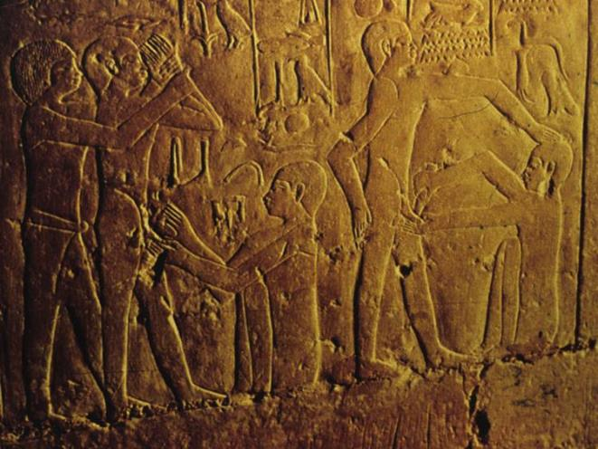
The Circumcision of Gershom
In this enigmatic passage, God threatens to kill either Moses or his first-born son.
The antecedent to the pronoun “him” in 4:24 is “first-born son” in 4:23-24).
This threat to Gershom is linked to God’s threat to bring death to Egypt’s firstborn sons, but Moses has failed to provide the covenant sign of circumcision for his own son.
Perhaps this negligence was due to his Midianite wife, and hence, the operation is performed by Zipporah.
The scenario is a dark foreshadowing of the Passover and the importance of covenant protection.
Circumcision depicted in Egyptian reliefs, ca. 2200 BC

Slide 62
The Divine Contest

Slide 63
The Contest Between Pharaoh and Yahweh
Pharaoh was the god-symbol of Egypt; hence, Moses’ confrontation with Pharaoh was a contest between deities, Yahweh and Pharaoh (and the Egyptian pantheon).
Pharaoh was believed to be the incarnation and Son of Amon-Re (or Horus), the ka (life-force and soul) of Egypt.
He was believed to be descended from the gods in which the queen mother had intercourse with the supreme god Amun or Amon-Re.
At death, the Pharaoh went to the place of the gods, where he continued to exercise his right over life and death.
Hence, when Pharaoh hears Moses say, “Thus says Yahweh…” (5:1) he knows he is being directly challenged by a deity, and the response, “Thus says Pharaoh…” (5:10) uses the same language as a counter claim.

Slide 64
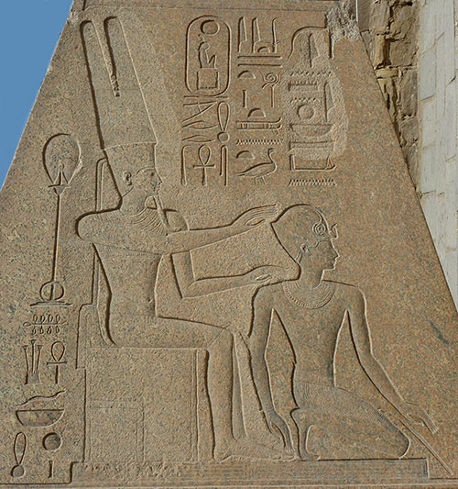
Legitimizing the Pharaoh
The idea that the Pharaoh was a son of Amon-Re was a powerful influence upon the populace to accept his legitimacy.
From the 18th Dynasty, many Pharaohs commissioned art pieces depicting Amon-re fathering them, which in turn served as propaganda proving their right to rule.
Here, Hatshepsut, the queen mother, kneels before Amon-Re.

Slide 65
The Initial Confrontation (5)
Moses initial confrontation with Pharaoh was a request to allow the people a three-day journey into the wilderness so they could offer sacrifice to Yahweh.
The language “lest he fall on us with pestilence” communicates the request in language Pharaoh could understand, a request that presumably he would take in the context of polytheism.
Pharaoh’s response, however, was, “Who is Yahweh?” Yahweh was not a god with whom he was familiar, and he refused their plea.
Instead, Pharaoh increased their hardship, forcing them to find their own straw, a particularly difficult task, since the straw was chaff taken from wheat fields after the wheat was harvested.

Slide 66
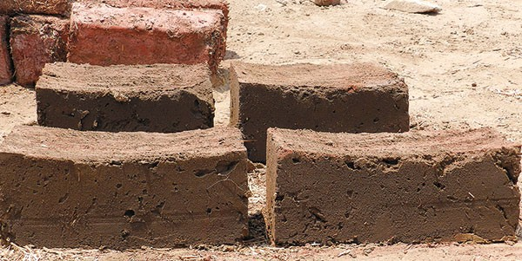
BRICKS AND STRAW
Adding straw to mudbricks strengthens them, enabling them to dry evenly while reducing shrinkage.
In 2013, archaeologists experimented with mudbrick-making under the guidance of a traditional Egyptian brick-maker. In two days, they were able to produce nearly 2000 mudbricks, which is the quota listed by Egyptian overseers in an Egyptian scroll dated to the 5th regnal year of Ramesses II (1275 BC).
Pictured here, the brown mudbricks without straw (foreground) were significantly more fragile and easily broken than the sturdier red bricks with temper (background).

Slide 67
“I Am Yahweh” (6:1-13)
Pharaoh’s question, “Who is Yahweh?” (5:2) and the repeated declaration, “I am Yahweh” (6:2, 6, 7, 8, 29; 7:5, 17; 8:22; 10:2; 12:12; 14:4, 18), is an exchange that defines God’s self-revelation in his mighty acts before both Israel and the Egyptians.
While this God was truly the God of Abraham, Isaac and Jacob (cf. 2:24; 3:6, 15-16; 4:5; 6:3, 8), he was known by them (yet not fully known), and they knew him as El Shaddai (Ge. 17:1; 28:3; 35:11; 43:14; 48:3), not Yahweh (6:3).
Of course, the Book of Genesis employs the name Yahweh many times, so these occasions must be accounted as retrojections, since by the time of compilation, the compiler knew the sacred name Yahweh.

Slide 68
Covenant and Redemption
The two themes of Yahweh’s self-revelation are covenant and redemption.
THE COVENANT GOD
God’s ancient promises to the Patriarchs becomes the basis for his relationship to the Israelites (6:4-5).
His ancient covenant promise concerned the land of Canaan (6:8; cf. Ge. 12:7; 15:7, 13-16, 18-21; 17:8; 26:2-3; 28:13; 35:12; 48:4).
THE REDEEMER
Because of his covenant, God now promises to deliver the Israelites from Egyptian bondage (6:5-8).
The language of redemption means “to buy back,” and Yahweh now promises to redeem Israel with mighty acts of judgment (6:6).

Slide 69
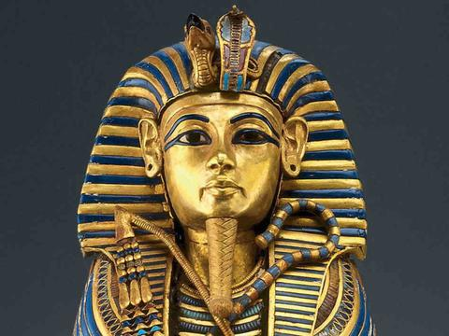
The Serpent Sign (7:8-13)
The serpent (uraeus) was an emblem of Pharaoh’s power during the New Kingdom Period.
On the pharaonic crown were two golden cobras symbolizing the connection between the gods and the Pharaoh and reflecting the king’s royalty and sovereignty over Upper and Lower Egypt.
The confrontation between Moses and Aaron and the court magicians was a direct challenge to Pharaoh’s power and claim to be a son of god.

Slide 70
The Hardening of Pharaoh’s Heart
It is in the context of rival divine claims that one must understand the “hardening” of Pharaoh’s heart (4:21; 7:3, 13; 8:15, 32; 9:12, 34; 10:1, 20, 27; 11:10; 14:4, 8).
The hardening of Pharaoh’s heart was not an infringement on his human freedom, but rather, a blunt answer to the question, “Who is really God?” Yahweh made Pharaoh’s heart “heavy” (dbeKA), cf. 10:1.
In Egyptian mythology, the Pharaoh’s heart was weighed in the balance of truth to determine his afterlife.
If his heart was too heavy, he would be judged a sinner and cast to the goddess Amenit, the Devouress. If his heart was no heavier than a feather, he would be granted eternal life.

Slide 71
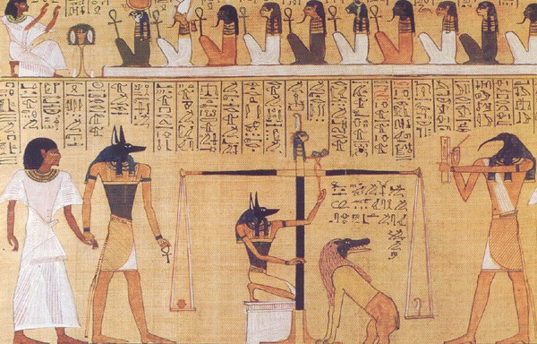
Weighing the Pharaoh’s Heart
In this papyrus from the New Kingdom Period (1550-1090 BC), the balance of truth renders judgment on the dead.
At the left, the jackal-headed Anubis leads the deceased to the balance.
He then weighs the heart of the deceased in the left pan against a feather in the right pan.
Beneath the balance is Amenit, the Devouress, who will eat the heart of the deceased if it outweighs the feather.
At the far right is the recorder.
British Museum, London

Slide 72
The Nine Wonders (7:14—10:29)
Using language like hpAGema (= plague, cf. 9:14), fgan@ (= assault, cf. 11:1), hkan! (= batter, cf. 7:17), tOx (= sign, cf. 7:3), tpeOm (= omen, cf. 7:3), and xl,P, (= wonder, cf. 3:20), Yahweh sent plagues upon Egypt which were attacks upon Egypt’s gods (cf. Nu. 33:3-4).
Pharaoh, of course, was the god-symbol of the state of Egypt.
At stake was which deity had sovereign control, Yahweh or the gods of Egypt.
The Egyptians worshipped gods and goddesses connected with the Nile, frogs, the sky, bulls and cows, the sun, and the realm of the dead.
Egyptian texts described epidemics as coming from the “hand” of the gods, the same language used in 9:3 and 8:15.

Slide 73
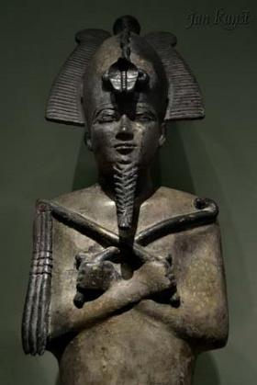
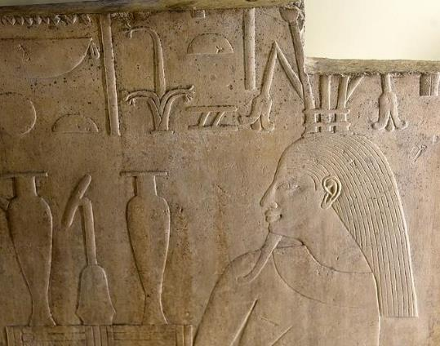
First Plague (7:14-25)
The first calamity consisted of three related events: 1) turning the Nile into blood, 2) infestation of frogs, and 3) infestation of “fasteners,” translated variously as lice, gnats or mosquitos.
This plague likely was directed at Khnum, creator of water and life; Hapi, the Nile god; and Osiris, whose bloodstream was believed to be the Nile.
The various calamities may be ecologically linked: violent storms in the mountains of Ethiopia saturates the Nile with red clay, which then chokes the fish, which in turn are infected with anthrax causing the frogs to leave, after which they die. Lice and flies feed on the dead frogs, infecting the grass that in turn kills cattle and causes boils in humans.
LEFT: Osiris
BELOW: Hapi

Slide 74
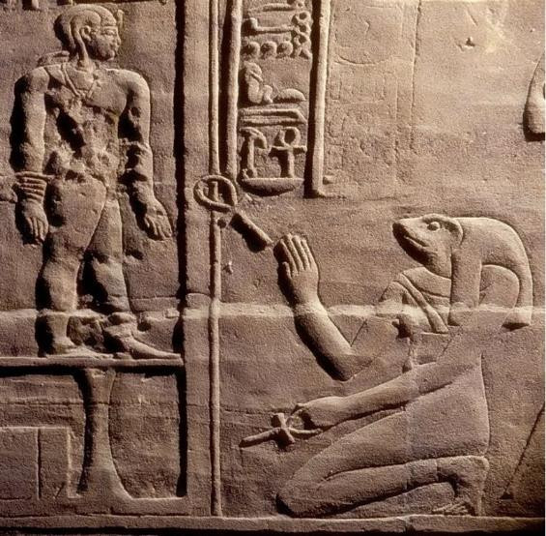
Second Plague (8:1-15)
Heket, the goddess of childbirth, was represented as a frog or a woman with the head of a frog.
She was believed to be the wife of Khnum and the protector of women in childbirth.
She holds an ankh (symbolizing life), and she gives life to the newly created child.

Slide 75

Third Plague (8:16-19)
The infestation of Nke (= “fasteners”) has been variously translated as lice (KJV, RV), gnats (RSV, JPS, NAB, NASB, ESV) or mosquitos (NJB).
Egyptian magicians were able to replicate the first two plagues (7:22; 8:7), but they failed in their efforts to replicate the third (8:18).
Hence, while this plague does not concern an Egyptian deity, it does have a religious aspect.
Here, the Egyptian priests conceded that this plague was caused by the “finger of God,” an expression that would be used centuries later by Christ in exorcising demons (cf. Lk. 11:20).

Slide 76

Fourth Plague (8:20-32)
The precise nature of this plague has been debated in Jewish sources for centuries.
The typical translation is “swarms of insects” or “flies,” since the Hebrew word describing them is b)rfA (= swarm, mixture). However, the Hebrew text does not specify a mixture of what (the KJV puts the word “flies” in italics, indicating it is not in the Hebrew text).
Some rabbis speculated that it might refer to predatory animals, others flying insects.
In the end, the translation “flies” has won the day for most scholars.
Ecologically, bacterium carried by flies could have caused death to livestock and skin infections to humans.

Slide 77
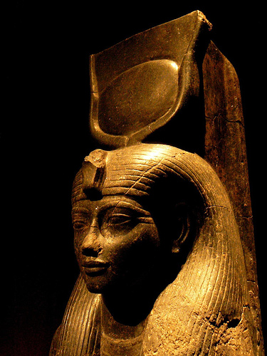
Fifth Plague (9:1-7)
The fifth plague was an affront to Hathor, the mother and sky goddess represented as a cow, and Apis, the symbol of fertility represented as a bull.
Hathor was often depicted, as here, with horns holding a sun disk.
She was believed to be the wife of Horus, the sky god, and symbolically she was the mother of the Pharaohs.

Slide 78
Sixth Plague (9:8-14)
As with the third and fourth plagues, this one has no known parallel with Egyptian deities, but it does have a religious aspect.
The term translated “boils” is the same as used to describe Job’s affliction (Job 2:7), and some scholars have suggested the possibility of smallpox.
Whatever it was, it was severe enough to prevent the court magicians from appearing (9:11).
In effect, it cut off the royal priests from access to their gods and placed them under dire threat of death!
Thus says Yahweh…
…for by now I could have put out my hand and struck you and your people with pestilence, and you would have been cut off from the earth.
Exodus 9:15

Slide 79
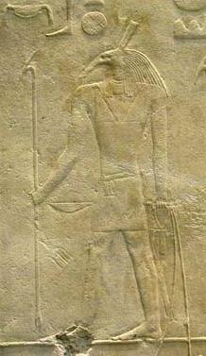
Seventh Plague (9:13-35)
The next three plagues move from the land to the skies.
The god Seth, brother to Osiris, was the god of war, chaos and storm. Usually he was depicted with the head of an animal with pointed snout and tall ears.
That Moses could control the weather, bringing hail to batter the crops of flax and barley, was a direct challenge to the authority of Seth.

Slide 80
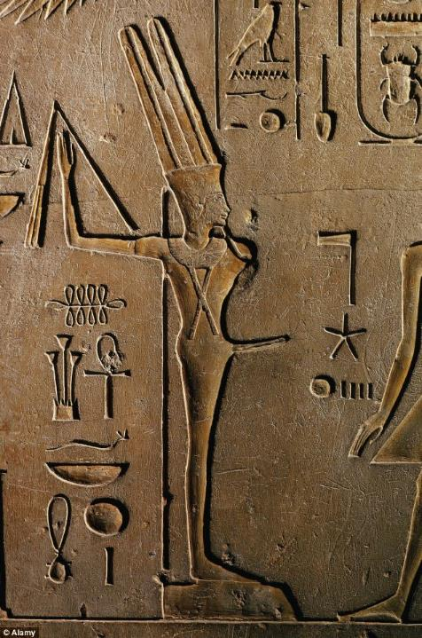
The Eighth Plague (10:1-20)
The god Min, the protector of crops, was most often represented as a human with an erect penis and holding a flail.
The plague of locusts destroyed the trees, fruit, remaining crops, and everything green.
Min was powerless to protect Egypt.
A widely celebrated “Coming Out of Min” occurred at the beginning of the harvest, and in effect, this plague ruined Min’s coming-out party.

Slide 81
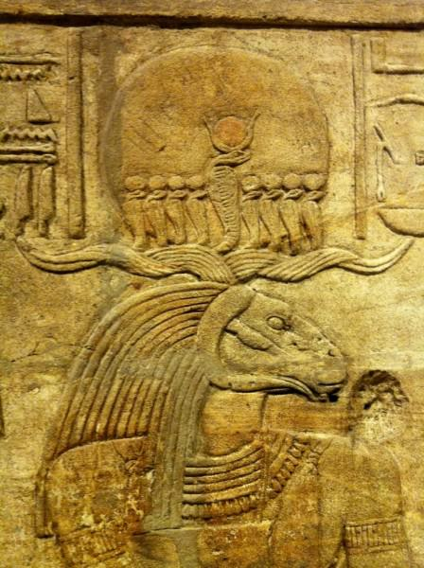
The Ninth Plague (10:21-29)
Amon-Re, the Egyptian sun god
The king of the gods, he was believed to rule in the heavens, earth and underworld.
As here, he is often depicted as a ram with a human body.
The plague of darkness was a direct affront.

Slide 82
Biblical Hyperbole
Like most literature, the Bible uses hyperbole as an accepted rhetorical device. In the narratives of the plagues, this use is evident in phrases like “not one remained,” “all were smitten,” “not a hoof,” “not a house,” etc.
The word “all” (lKo) is used more than 40 times.
Westerners are accustomed to mathematical precision, but these rhetorical expressions must be afforded some flexibility.
For instance, if “all the cattle” were killed in the fifth plague (9:6), how were any left to be killed in the seventh plague (9:22, 25) or the tenth plague (11:5)?

Slide 83
The Passover

Slide 84
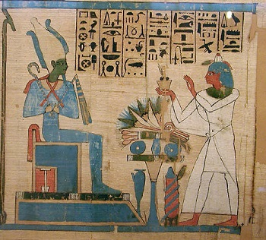
The Final Plague is Announced (11)
The last plague, once again, would be against the patron deity of Pharaoh, the god Osiris.
As the righteous judge and ruler of the land of the dead, he also was the god who granted all life.
He was typically depicted with green skin and holding a crook and a flail.
The threat of death to all the first-born was a direct challenge to Osiris.

Slide 85
The Tenth Plague (12:1-32)
The last plague, the Passover, was the final blow to Egypt, the death of the first-born.
Each Israelite family was instructed to slaughter an unblemished lamb, roasting and eating it with unleavened bread and bitter herbs.
Only those who had the lamb’s blood smeared on their doorposts and lintels were spared. The destroyer would then “pass over” their home (12:13), which is the origin of the word “Passover” (HsaP,).
The “destroyer” (tyHiw;m0aha, 12:23; cf. He. 11:28) was likely the Angel of Yahweh (cf. 2 Sa. 24:16; 2 Kg. 19:35).
Ramesses II is known to have had thirteen sons. His first-born, Amun-her-khepeshef, died as a young man of unknown causes, ca. 1254 BC. The crown passed from Ramesses II to his brothers, eventually landing on Merneptah in 1213 BC.

Slide 86
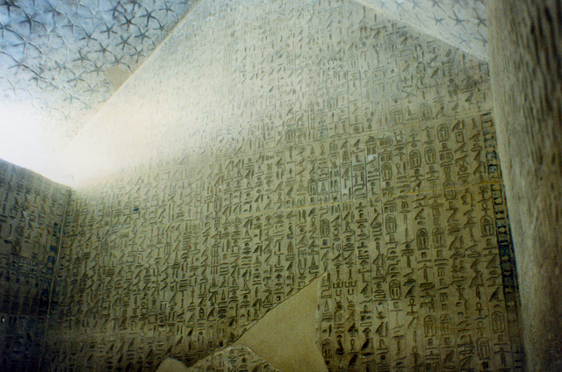
Slaying the First-born
The idea of death to the first-born was a known concept in ancient Egypt. The so-called “Cannibal Hymn” (from ca. 2300 BC) and coffin texts (ca. 2000 BC) describe the judgment of slaying the first-born on a particular night by “Him-whose-name-is-hidden.”
In the biblical story, the One with power over death is revealed to be Yahweh.
Pyramid Texts in Unas' tomb

Slide 87
The Annual Passover Festival
A perpetual Passover ritual was to be held on the 14th of the first month, followed by a full week of the Festival of Mazzot or Unleavened Bread (12:2, 14-20; 13:3-10, cf. Lv. 23:5-8).
However, unlike at the original Passover, the lambs were to be slaughtered at the central sanctuary (cf. Dt. 16:2).
People who were ritually impure were excluded and were to celebrate the Passover a month later (Nu. 9:9-11).
The Passover became the highest symbol of redemption for the Israelites, and in the New Testament, it becomes a central explanation of the death of Jesus (cf. 1 Co. 5:7).

Slide 88
The Expulsion from Egypt (12:33-42)
In consternation over massive deaths, Pharaoh now ordered the Israelites to leave Egypt.
Yahweh had rejected the most powerful kingdom in the world, bringing death to all their first-born sons, while adopting and protecting Israel as his own first-born son.
Just as God had promised (cf. 11:2-30), the Egyptians gave to the Israelites many valuables (12:35-36).
They left with the bones of Joseph (13:19; cf. Ge. 50:24-25), which later would be interred at Shechem in the territory of Manasseh allotted to one of Joseph’s sons (Jos. 24:32).

Slide 89
The Number of the Israelites Fleeing Egypt
The number of Israelites in the exodus has been debated.
The round number given in Ex. 12:37 (which generally agrees with the figures cited in Numbers 1) is about 600,000 men plus women and children, a group in total of perhaps 2 or 2 ½ million people.
Several factors make this large number difficult apart from the fact that the transmission of numbers in written texts is itself difficult, since Arabic numbers were not yet in use.
At the time of the first census, there were 22,273 firstborn males over a month old (Nu. 3:40-43). To account for this relatively small number for a group of 2 million or more, this would mean that each household would need to produce about 27 sons and additional daughters, and each mother would need to bear about 50 children.
Further, the Israelites later would be described as “the fewest of all peoples” (Dt. 7:7), and if they numbered more than 2 million, they would have been by far the largest people group the world had thus far seen.

Slide 90
The Logistical Difficulties
Could 70 people (cf. Ex. 1:5) proliferate into a group of over two million in only four generations (cf. Ge. 15:16)?
Could a group the size of metropolitan Detroit and all their animals break camp and cross a body of water in a single day?
How could a mere two mid-wives handle all the births in such a large group (1:15ff.)?
How could Moses “speak” to such a group of people?
How could sufficient provisions for fodder be found for the livestock of such a large group?
How could issues of sanitation, camping and travel be arranged for such a large group (e.g., Dt. 23:12).
The typical fighting forces described in other ancient Near Eastern texts are not over 20,000 warriors, yet the Israelites are described as “the fewest of all peoples” (Dt. 7:7), and the Canaanites are described as “larger and stronger” (Dt. 7:1).
Why would such a huge force fear the comparatively small 600 Egyptian chariots (Ex. 14:7, 10)?
The Israelites seem to be smaller in number than the Canaanites (cf. Ex. 23:30).

Slide 91
Possible Solutions
If the large numbers are to be retained, then one must accept that there are many unnamed miracles associated with the exodus as well as many features of daily life that are not described.
If one accepts that the Hebrew word Jl,x, (= “thousand” or “military unit”) is taken in the secondary sense of a unit of variable size, as some scholars have suggested, then the total number of Israelites is greatly reduced, though an exact figure cannot be given. The number is likely to be in the proximity of about 20,000, still a large group, but not unreasonable given what we know about population densities in the ancient Near East.

Slide 92
The Mixed Multitude (12:38)
Along with the Israelites, others fled also, which in turn suggests that among the Israelites were non-Israelites.
In later stories, we discover that some of these designated the “mixed multitude” were pejoratively labeled “rabble” (Nu. 11:4), while others were Egyptians (Lv. 24:10).
Several laws in the Torah may be especially directed toward members of this group, including the stipulation that the Passover could be celebrated by a stranger in Israel’s midst so long as he was circumcised (12:43-49), and the oppression of such strangers was forbidden (23:9; cf. Lv. 19:33-34; Dt. 10:19).

Slide 93
Consecration of the Firstborn (13:1, 11-16)
The death of Egypt’s firstborn sons links directly to the laws of the dedication of Israel’s firstborn sons.
After this first Passover, the Israelites would dedicate to Yahweh their firstborn sons as a memory of this event and to demonstrate that they now belonged Yahweh as his people.
The whole nation owed God a life-debt:
  All firstborn animals were to be sacrificed (at an altar not yet built).
  All firstborn males were to be redeemed (cf. Nu. 3:40-48).
  For the tribe of Levi, redemption was not allowed: all Levites were given over to service in the sanctuary (Nu. 3:44-47).
These initial laws concerning the firstborn show that the Israelites were now to become a holy nation of priests and laypersons living around a central sanctuary.

Slide 94
The Exodus

Slide 95
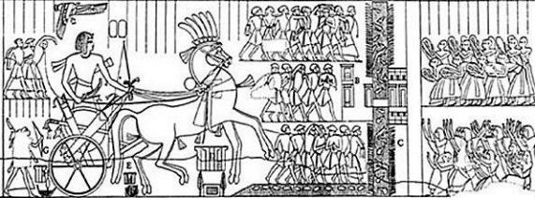
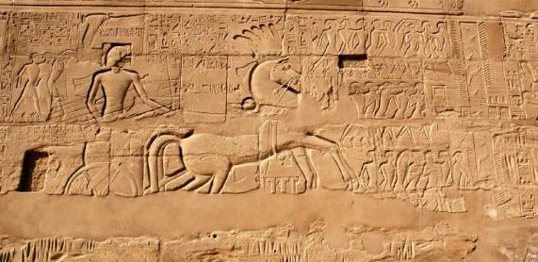
“…not by way of the land of the Philistines…” (Ex. 13:17)
When the Israelites left Egypt, they were instructed by God not to take the coastal road (called the “Way of Horus” by the Egyptians).
This route was heavily defended by a series of Egyptian forts, which are named on this relief of Seti I (1294-1279 BC), father of Ramesses II.
That route, according to Exodus 13:17, would result in war, and the Israelites must avoid it.

Slide 96
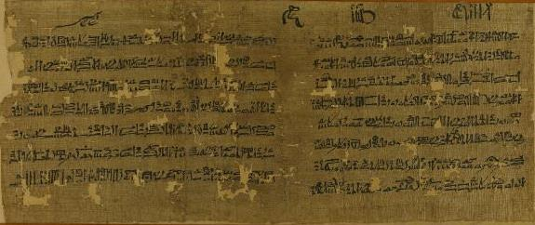
Papyri Anastasi V
That the Egyptians carefully guarded the coastal route between Egypt and Canaan is documented in this late 13th century BC remnant of an Egyptian text.
It indicates no one was allowed to use this route without a permit.
It also describes the escape of two slaves who, to avoid capture, fled into the Sinai desert.

Slide 97
Leaving Egypt (14:1-9)
After heading southeast from Ramesses, the first camp was Succoth, after which the Israelites were told to make a sharp turn back northward (12:37; cf. Nu. 33:5).
They were to camp in front of Pi-hahiroth, between Migdol and the sea facing Baal-zaphon (14:2; cf. Nu. 33:7).
The people marched in battle formation (13:18), and they were led by a pillar of cloud and a pillar of fire, as though Yahweh were their battle standard (13:21).
The pursuing Egyptians caught up with them, and the Israelites were now trapped between the Egyptian army and the sea.

Slide 98
The Yam Suph
The traditional rendering “Red Sea” is an unfortunate mistranslation first appearing in the LXX and followed by later versions for centuries (13:18; 15:4, etc.).
The Hebrew term Yam Suph (JUs-My!) means “Sea of Reeds” and probably refers to the marshy lake district on Egypt’s eastern frontier. It should not be confused with the large body of water between Egypt and Saudi Arabia.
Until the last century, this system of lakes was known as the el-Ballah lakes, and one of these is likely what the biblical writer calls the Yam Suph.
Today, this whole area has been significantly altered by the building of the Suez Canal.

Slide 99
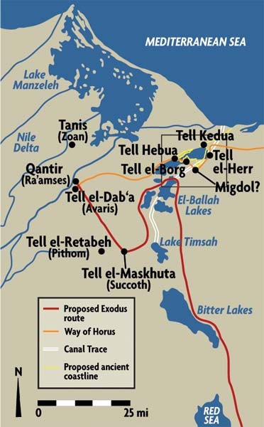
From Ramesses to the Yam Suph
To date, some of these locations have been archaeologically identified, while others have not.
The area was heavily guarded by Egyptian fortresses protecting the route along the seacoast to Canaan, which is why the Israelites did not follow “the way of the Philistines” (13:17).
What looks like aimless wandering was actually a very careful route threaded between these forts.
The term Pi-hahiroth means “mouth of the canal” (several canals spanned the gaps between the lakes).
The best candidates for the Yam Suph are either the northern part of Lake Timseh or one of the El-Ballah lakes.

Slide 100
Crossing the Sea (14:10-31)
Fearful of the Egyptian chariot corps, the Israelites now respond to the first of many crises in which they challenge Moses and express a desire to return to Egypt.
However, Yahweh instructed Moses to lift his rod over the sea, and when he did, the pillar of cloud relocated and became a rearguard.
Moses stretched his rod over the sea, a strong wind blew the sea back, parting it, and the Israelite passed through the sea on dry ground, the Egyptian charioteers following them.
On the other side, Moses once more lifted his rod, and the waters of the sea converged, drowning the Egyptian chariot corps.

Slide 101
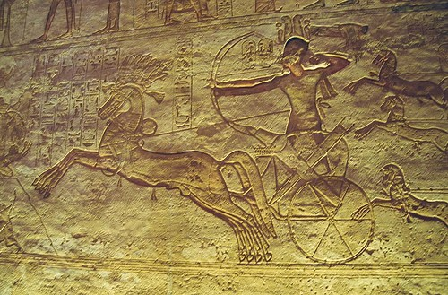
Egyptian Chariotry
Chariotry was first introduced to the Egyptian military during the Hyksos Period.
They gradually developed from a mode of transportation to a formidable implement of war with speed and mobility unmatched by foot soldiers.
Egyptian chariots of the period were generally pulled by two horses.
Wall relief from Abu Simbel of Ramesses II in his chariot at the Battle of Kadesh

Slide 102
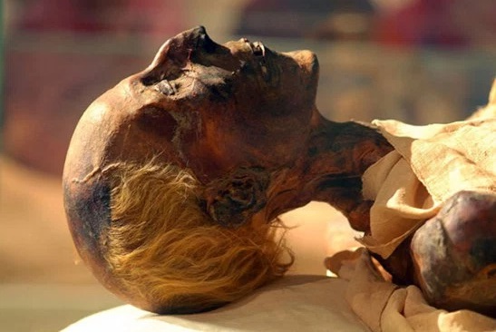
Mummy of Ramesses II
While the identity of the Egyptian Pharaoh of the exodus is debated, the majority opinion remains with Ramesses II, regarded by many historians as the most powerful pharaoh in history.
He was appointed prince regent by his father, Seti I, at the age of 14.
He lived until he was about 90, and his mummy was discovered in 1881.

Slide 103
The Song of the Sea (15:1-21)
This victory hymn, sung by Moses, is arguably one of the oldest parts of the Hebrew Bible (based on archaic Hebrew).
The hymn falls into four parts:
  Doxology, in which Yahweh is described as a “Man of War” (15:1-3)
  Praise to Yahweh’s justice in overthrowing the Egyptians (15:4-12)
  Declaration of Yahweh’s love in establishing Israel as a nation (15:13)
  Triumph of the kingdom of God, anticipating the arrival of the Israelites in Canaan and the eventual building of the temple (15:14-18)
Another version of Miriam’s short song (15:21) was discovered in the Dead Sea Scrolls (4Q365). This version is fragmented (see next slide).

Slide 104
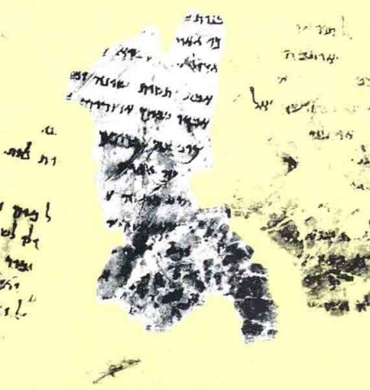
Dead Sea Scrolls Fragmented Version (4Q365)
1 You despised (or, you plundered)…
2 for the triumph of…
3 You are great, a Savior…
4 the hope of the enemy perishes and
he is…
5 they perished in the mighty waters,
the enemy…
6 and he exalted her to their
heights…you gave…
7 wor]king a triumph.

Slide 105
Journey to Sinai

Slide 106
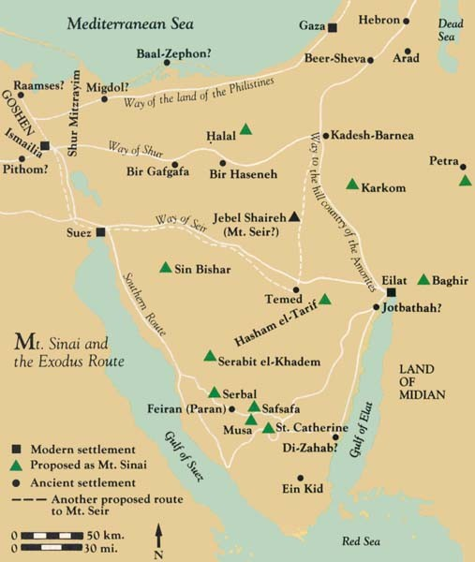
Route of the Exodus
Quite a variety of routes have been proposed over the years by different scholars, some more plausible than others. Any suggested route is directly affected by the ancient routes that follow wadis (water courses) and where one locates Mt. Sinai. All the locations marked in green have been suggested as locations for Mt. Sinai, but the oldest tradition is the one near the tip of the Sinai Peninsula marked as “Musa” near St. Catherine’s monastery.

Slide 107
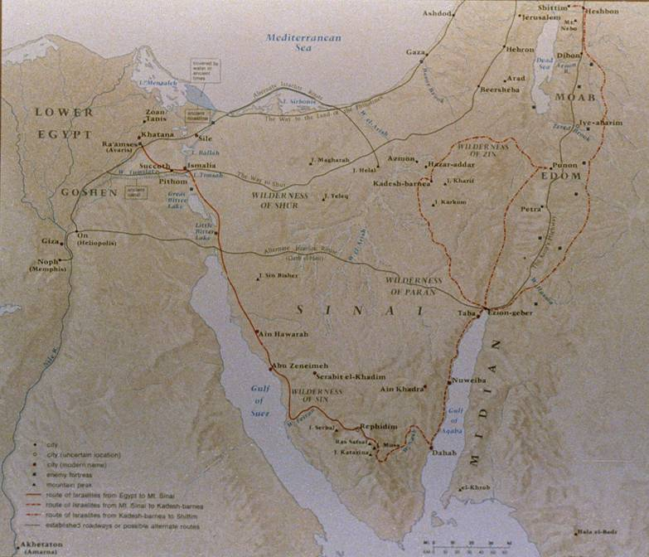
Traditional Route
The traditional route follows the coastline of the Gulf of Suez toward the Sinai mountains.
Ecologically, it has the best water sources and best vegetation with seasonal grasses suitable for sheep and goats.
Also, Egyptian hegemony did not extend into the south central Sinai as with the other routes.

Slide 108
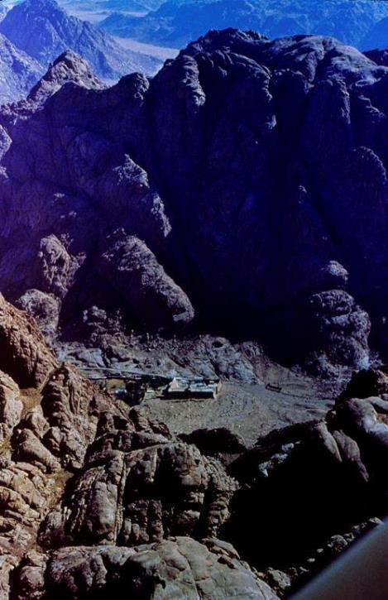
Jebal Musa,
the traditional Mt. Sinai
Though there is no consensus on the location of Mt. Sinai, the site having the oldest tradition is near the bottom of the Sinai peninsula.
St. Catherine’s monastery (Eastern Orthodox), dating from the 4th century AD, lies at the foot of the mountain.
At the “mountain of God” the Israelites would receive the first of what would come to be called “the law of Moses.”

Slide 109
Tests of Faith
The next series of narratives occurred en route to Mt. Sinai: these were tests of faith and parental disciplines (15:25; 16:4 cf. Dt. 8:2-5).
Their initial trek into the Sinai desert led them to the wilderness of Shur (Shur means “wall,” and it probably refers to the buffer zone separating the Egyptians and the area outside Egyptian jurisdiction).
This part of their escape is depicted as a series of crises brought on by thirst, hunger and enemies.
A repeating motif is the Israelite penchant for complaint and murmuring (15:24; 16;2-3, 8; 17:1-7), a motif that will reappear again in Numbers.

Slide 110
The Test at Marah (15:22-26)
The people complained that they were dying of thirst.
They had found water, but the water was undrinkable.
At Yahweh’s instruction, Moses threw a tree into the water, and the water became sweet. (Modern nomads still use vegetable matter to sweeten bitter waters.)
They named the site “Marah” (= “bitter,” cf. Ru. 1:20)
Here, Yahweh promised them that if they were obedient, he would spare them the diseases of Egypt and would be to them a healer. His declaration was, “I am Yahweh-roph’ka” (= “I am the LORD your healer”).

Slide 111
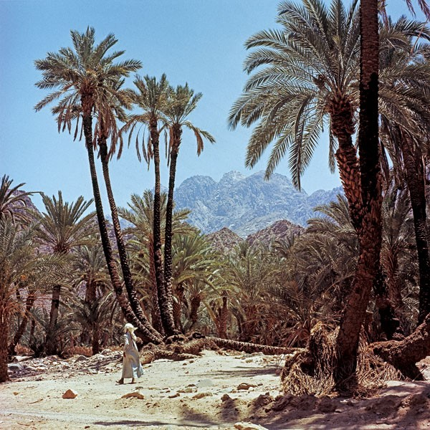
At Elim (15:27)
Elim has been identified with Feiran, the largest oasis in the Sinai desert where nearly three miles of palm-covered shade surrounds pure spring water.
This oasis lies about 60 miles south of the modern town of Suez.
The name means “terebinths” (large trees) or “gods” and was probably a sacred site.

Slide 112
The Test in the Wilderness of Sin (16:1-36)
In the next test, the people complained that they were starving to death.
The place-name “sin” is a transliteration, but it probably has a morphological link with the place-name “Sinai.” (It should not be connected to the word “sin” as transgression, since this is an entirely different word in Hebrew.)
Here, Yahweh provided them with manna and quail [The Hebrew expression xUh NmA (= man-hu’ or manna) is a question, “What is it?”]
Even today, a species of honey dew is known to accrue in the desert, and the Bedouins still call it “mann,” either a species of lichen, a gum resin produced by flowering trees, or a scale produced by insects.
Also, migrating quail, after crossing the sea, even today fall exhausted to the ground in the desert and are easily scavenged.

Slide 113
Origins of the Sabbath
The gift of manna coincides with the beginning of Sabbath observance.
The concept of Sabbath appears first in 16:23, and in order for the people to trust the Giver (and not merely the gift), they were forbidden to collect manna on the 7th day, but were required to observe this as a day of rest.
Essentially, the Sabbath is a basic expression of faith in God’s presence and provision, and later its observance will be required as one of the 10 commandments, where it is linked to God’s rest at the climax of creation (20:11; cf. Ge. 2:1-3).
Failure to observe the Sabbath was an act of treason and punishable by death (cf. Nu. 15:32-36).
The word “Sabbath” derives from the Hebrew verb tbawA (“Shabath” = to stop).

Slide 114
The Test at Rephidim (17:1-7)
The next test once again concerned water, always a crucial factor in desert survival.
Here, the underlying issue in all the tests was the Israelites’ question, “Is Yahweh among us or not?”
The irony, of course, is that by complaining the Israelites were testing Yahweh (17:2, 7) without realizing that he was testing them (cf. Dt. 8:2).
On this occasion, Moses used his rod to strike the rock, thus bringing water.
The place-names Massah (= testing) and Meribah (= quarreling) would live on as examples of unbelief and shame (cf. Dt. 6:16; 9:22; 33:8; Ps. 81:7; 95:8; 106:32).

Slide 115
The Test Against Amalek (17:8-16)
While at Rephidim, the Israelites were attacked by a warlike group called Amalek (descended from Canaanites and Edomites, cf. Ge. 36:12).
While earlier Yahweh is designated as a “Man of War” (15:3), here will be the first occasion of holy war in which the Israelites fight in combat and are successful so long as Moses’ arms, holding the staff of God, are upraised.
Here, the reader also meets for the first time Joshua, who served as the field commander.
The battle with Amalek, along with the command for total extinction, serves as a paradigm for the later wars of Israel against the Canaanites.

Slide 116
The Beginning of Oral and Written Memoirs
The battle against Amalek becomes the first occasion when the outcome was to be written out and recited, presumably using the early alphabet of Hebrew.
A victory monument was erected and given the name ys0in9 hv!hy4 (Yahweh-nissi’ = “The LORD is my banner”), which is to say, my rallying point and the cause for which I fight.
The form of writing was on a scroll (not a codex, as the word “book” might imply in the English versions).
This incident foreshadows the essentials of Israelite leadership: Yahweh, the divine King; Joshua, the Ephraimite field officer; Hur, the prince of Judah, anticipating the kingship of David; and, Aaron, the priests from the line of Levi.

Slide 117
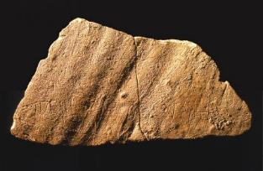
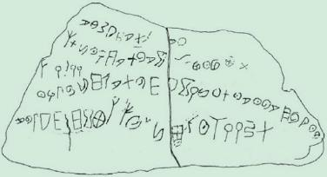
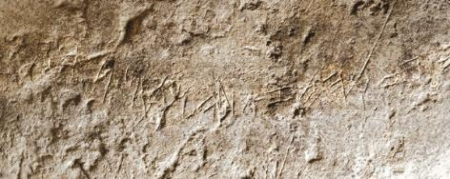
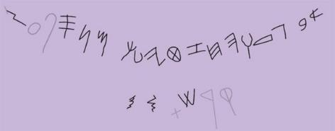
The Early Hebrew Alphabet
Early examples of an alphabet using Phoenician-type script includes the Isbet Sartah Abedecary, which dates to about 1200 BC, and the Tel Zayit Abecedary, which dates to about the late 10th century BC. These are precursors of biblical Hebrew.

Slide 118
The Advice of Jethro (18)
Moses’ father-in-law, along with Moses’ wife and two sons, now met Moses in the desert, and Jethro offered some wise advice on adjudicating civil concerns among the people.
As yet, there was no formal law, as would be the case later, and Moses seemed to be handling disputes on the basis of natural principles of justice. People simply brought their civil concerns to Moses personally.
Upon the advice of Jethro, Moses organized a judiciary, though he himself would still serve as a supreme justice for difficult cases.

Slide 119
The Initial Law Code

Slide 120
The Calling of Israel (19:1-9)
From Rephidim, the Israelites now completed the final leg of their journey to Mt. Sinai, where Moses ascended the slopes to hear the voice of Yahweh.
Here, God announced to him Israel’s calling to be a kingdom of priests and a holy nation, a calling that would stretch into the NT (1 Pe. 2:5, 9).
The redemption of Israel from Egypt was also a calling—it was not only an escape from something, but a commission to be something.
The commission of the nation to be a kingdom of priests set apart for God’s larger purpose theologically connects directly with God’s promise to Abraham that in his seed all nations of the earth will be blessed (cf. Ge. 12:3). Priests, by definition, are mediators, and if the whole nation was to be a priesthood, this immediately implies that they were to be priests to the nations.

Slide 121
The Marking Off of Holy Space (19:10-25)
At Mt. Sinai, Moses was instructed to mark off the space around the mountain into concentric spaces of holiness:
The people were confined to the foot of the mountain outside a barrier (19:17-25).
The elders were allowed part way up (24:9-11).
Only Moses was allowed to enter the cloud of Yahweh’s presence at the top (24:15-18).
These same concentric areas of holiness would be repeated in the tabernacle, and later, the 1st and 2nd temples.
The tabernacle yet to be built would become a kind of portable Mt. Sinai, and the concentric circles of the mountain are replicated in the sanctuary.
Yahweh’s presence on the mountain would be replicated by his presence in the Most Holy Place.

Slide 122
Ritual Purification (19:10, 14-15, 22)
Ritual purification involves washing with water, a symbolic cleansing of those things associated with mortality (natural death and reproduction).
The act of purification makes the people fit for an encounter with God, who is immortal (and not subject to death or reproduction).
As yet, there were no corpses in the community, so only a restriction on sexual relations is described.
Later, these same regulations will be incorporated into the rules governing the sanctuary.
God is a consuming fire, and he must not be approached casually.
A full vision of God will result in death, which is why communications must be mediated.

Slide 123
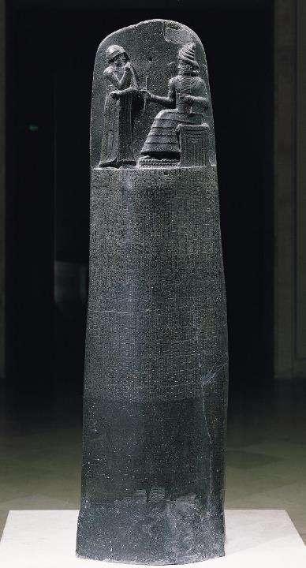
Law in the Ancient Near East
A number of law codes have been discovered from the ancient Near East (Ur-Nammu, Hammurabi, Eshnunna, Lipit-Ishar, etc.).
Most such law codes contain case laws, that is, if “such and such” is the case, then “such and such” is the penalty.
The laws of Moses also contain many such case laws (Ex. 21).
However, the law of Moses also contains apodictic laws, that is, absolute laws (“you shall” and “you shall not”). Such laws are unique in the ancient world, and in Moses’ law they are the more important of the two kinds.
The heart of these apodictic laws are the Ten Commandments.
Louvre, Paris

Slide 124
The Ten Words (20:1-21)
As familiar as is the phrase “the Ten Commandments,” it comes as a surprise that this language is only used later (34:28).
Quite literally, the designation is “the ten words” (Myr9bAD;ha tr@W,fE).
In Greek, the designation is the Decalogue (de<ka lo<gouj).
That the ten words are the core of the law is indicated not only in that it was the first part to be given, but also, because it would be encoded on the tables of stone and deposited in the ark of the covenant.
While the Bible indicates the proper number is ten, it does not enumerate them.
Hence, there are diverse traditions as to how they should be enumerated.
In all, the Ten Words would be given three times, once orally (20:1ff.) and twice in stone tablets (31:18; 34:4, 28).

Slide 125
The Ten Words
Traditions as to how the Ten Words are to be counted.
JEWS ORTHODOX/REFORMED/ANGLICAN LUTHERAN/CATHOLIC
1 20:2
2 20:3-6
3 20:7
4 20:8-11
5 20:12
6 20:13
7 20:14
8 20:15
9 20:16
10 20:17
1 20:2-3
2 20:4-6
3 20:7
4 20:8-11
5 20:12
6 20:13
7 20:14
8 20:15
9 20:16
10 20:17
1 20:2-6
2 20:7
3 20:8-11
4 20:12
5 20:13
6 20:14
7 20:15
8 20:16
9 20:17a
10 20:17b
Israel’s relationship to Yahweh
Israel’s relationship within the community

Slide 126
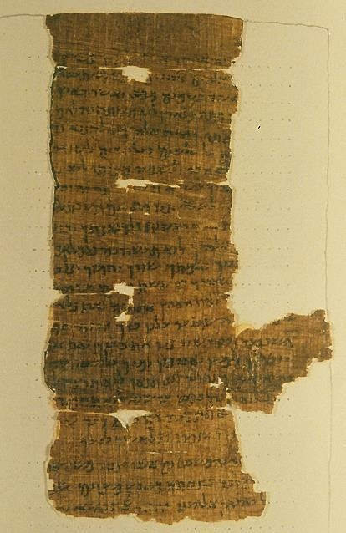
Discovered in 1898, these four fragments comprise a single sheet containing the Ten Commandments and the beginning of the Shema (Dt. 6:4). Dating to the 2nd century BC, the text conflates the versions of the commandments in Ex. 20 and Dt. 5. Since the Ten Commandments were traditionally recited prior to reciting the Shema, it is likely that this text is a liturgical document.
Prior to the discovery of the Dead Sea Scrolls, this was considered to be the oldest extant Hebrew manuscript fragment.
Nash Papyrus containing the Ten Commandments.
Cambridge University Library

Slide 127
Commandments 1-2
The 1st commandment bans polytheism and the worship of foreign gods.
Yahweh has exclusive claim upon Israel.
The essence of the commandment is relational, and the essence of relationship is faithfulness.
“Jealousy,” here, is the appropriate exclusivity of a husband for his wife.
The 2nd commandment bans any image of deity carved in wood or stone.
Yahweh is unlike any created thing, and his mystery is to be preserved.
Virtually all other ancient Near Eastern religions practiced idolatry.
The character of Yahweh is that his mercy is much greater than his capacity for punishment.

Slide 128
The language in 20:5 of “children to the third and fourth generation” as opposed to “thousands” [of generations] is a typical idiom of comparison (repeated in 34:7; cf. Nu. 14:18; Dt. 5:9).
The point is not a mathematical one, but rather, a comparison between the vastness of God’s mercy and the relative brevity of his punishment.
Dt. 24:16 indicates that such a comparative statement should not be taken in an absolute way.
Some interpreters have sought to make this statement a “generational curse,” but this is unlikely to be the meaning, and the idea was directly rebutted by Ezekiel and Jeremiah.
Based on Dt. 24:16, Ezekiel in Babylon challenged the notion of generational curses (Eze. 18).
Jeremiah in Jerusalem did the same (Je. 31:29-30).

Slide 129
Commandments 3-4
The 3rd commandment bans the abuse of God’s sacred name.
Ancient people considered a name to bear the nature or function of the one named.
Primary abuses concerned oath-taking (“As Yahweh lives…”) and prophecy (“Thus says Yahweh…”), both of which were attempts to presume on God’s power.
The 4th commandment concerns respect for divine grace through rest.
The Sabbath was implicit in creation and the sending of manna.
The Sabbath was a day of reflection on the redemption from Egypt.
The word “Sabbath” is derived from the Hebrew verb tbawA (= to stop, cease).

Slide 130
Commandments 5-6
The 5th commandment aims at preserving the family.
While often taken to refer to parents and small children, this law equally concerns adult children and their aged parents (cf. Mk. 7:9-13).
To dishonor one’s parents is to dishonor God himself, the heavenly Father.
The 6th commandment bans murder.
While there are several words in Hebrew for killing, the one used here specifically refers to the private killing of humans.
Specifically, it prohibits private blood revenge, for only the community can take responsibility for capital punishment.

Slide 131
Commandments 7-8
The 7th commandment preserves the sanctity of marriage.
Like murder, adultery was a capital offense.
It represented defiance against God who unites a man and woman in marriage.
As a fundamental act of unfaithfulness, it underlies various other sexual offenses taken up later.
The 8th commandment preserves the sanctity of personal ownership.
Popularly, this law concerns robbery and petty theft, but it also probably includes kidnapping (the Hebrew verb can also have persons as its object, cf. 21:16).
Acts of theft are violations of the person him/herself.

Slide 132
Commandments 9-10
The 9th commandment concerns perjury.
The extension “against one’s neighbor” sets the focus within Israel’s legal system.
Especially in capital cases, perjury could be tantamount to murder (cf. 1 Kg. 21:19).
The 10th commandment concerns inward sin.
The intent was not to address crimes committed, but rather, the root of crime that lies within the self.
No breach of this law could be examined by a human court.
Hence, the chief judge of this law could only be God himself.

Slide 133
The Book of the Covenant (20:22—23:33)
The title “Book of the Covenant” comes from 24:7, at the conclusion and acceptance of the next set of laws.
The use of the term “covenant” is important in that it describes a binding suzerainty relationship between Israel and Yahweh.
The expansion of the principles set forth in the Ten Words would be Israel’s first law code, though many of the laws have parallels in other ancient law codes as well.
In general, the Book of the Covenant presents three basic types of laws:
  …those commanding piety
  …those commanding justice
  …those commanding charity.

Slide 134
The Nature of A.N.E. Covenant
The cultural institution of covenant, widespread throughout the ancient Near East, became the essential basis for the relationship between Yahweh and Israel.
Covenant was a basic social institution within tribal structures and between city-states when there was no international law.
A covenant was a solemn promise made binding by an oath so that each party was obliged to fulfill the terms.
A suzerainty-treaty was a covenant between parties of unequal status—an overlord and a subject. Here, Yahweh was the suzerain (the Great King), and Israel was the vassal (the lesser party).

Slide 135
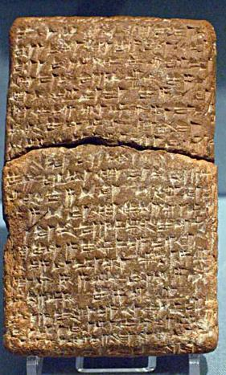

Other well-known covenants are known from the ancient world.
Ancient Near Eastern treaties with striking parallels to the biblical covenant material have been found in ancient Hittite culture (15th century BC) and in the vassal treaties of Esarhaddon II of Assyria (7th century BC).
British Museum, London
University of Pennsylvania

Slide 136
Expansions on the Ten Words
The classical principle for justice in the ancient Near East was the lex talionis (like punishment for like offense, i.e., “eye for eye”). Many of these laws are largely expansions of the Ten Words, though they do not follow the original order. If the Decalogue consists of apodictic laws, the expansions are case examples.
First Word: The exclusive worship of Yahweh meant no recognition of other deities (22:20). Sacrifice to any deity but Yahweh was a capital offense. Here is the first appearance of the word herem (= “banned” or “devoted to destruction”).
Second Word: Fashioning likenesses of God in gold or silver was strictly forbidden, since the mystery of God was to be preserved (20:23).
Third Word: Reverence for Yahweh’s name also meant that the names of other deities were not to be invoked (23:13; 22:28).

Slide 137

Laws About Altars (20:22-26)
Altars were to be constructed of earth (i.e., packed dirt or mudbrick) or unhewn field stones; they were not to be approached with steps.
This altar of unworked stones, discovered in Arad, Judah, fits the requirements.
Later, Joshua will build such an altar (Jos. 3:12; 4:20).

Slide 138
Fourth Word: Sabbatical laws concerned not only the seventh day but the seventh year (23:10-12). Also, attendance at three annual pilgrim festivals was required (The Haggim): 1) Passover/Unleavened Bread, 2) Harvest, and 3) Ingathering (23:14-17). Details would be provided later (34:18-24; cf. Lv. 23; Nu. 28-29; Dt. 16).
Fifth Word: Each person owes his life to his parents, and more remotely, to God. To attack one’s parents is implicitly to attack God (21:15, 17).
Sixth Word: Distinction is made between premeditated murder, manslaughter and negligent homicide, and sanctuaries for those guilty of manslaughter are anticipated (21:12-14, 18-32; cf. Dt. 19:1-13; Jos. 20).
Seventh Word: Distinction is made between adultery and premarital sex (22:16-17), and bestiality is a capital crime (22:19).

Slide 139
Eighth Word: Kidnapping is a capital offense (21:16). Killing an intruder is justifiable (22:2). Negligence and breaches of trust call for restitution (21:33-36; 22:1-15).
Ninth Word: The commandment about false witness includes perjury, defamation of character and bribery (23:1-3, 6-8).
Tenth Word: Inasmuch as the final commandment concerns internal motives, there are no direct expansions. However, it should be remembered that internal motives implicitly lie behind other commandments (i.e., murder, adultery, lying, theft), and the charity laws urge a generosity that is the opposite of covetousness.

Slide 140
Laws About Charity
Charity laws are the obverse of what the 10th Word prohibits. These laws are matters of the heart and often require self-sacrifice.
Charity begins with foreigners, since the Israelites themselves were foreigners in Egypt, and it extends to those who are the most disadvantaged, such as, widows and orphans (22:21-24; 23:9).
It includes the poor, who subsist day-to-day (22:25-27).
It even includes one’s enemies (23:4-5), a commandment underlying the teachings of Jesus (cf. Mt. 5:43-48).

Slide 141

Translation
…your servant was at Ha-saar-Asam (when the following incident occurred). …when your servant had finished (his) reaping and had stored it a few days ago, Hoshayahu ben Shabay came and took your servant’s garment. …all of my companions will vouch for me…(that) I am guiltless of any in[fraction]. [(So) please return] my garment. If the official does not consider it an obligation to return [your servant’s garment, then have] pity upon him [and return] your servant’s [garment] from that motivation. You must not remain silent [when your servant is without his garment].
This 7th century BC ostracon from the Israelite coast refers to the garment which functioned as a cloak by day and a blanket by night (cf. Dt. 24:12-13).

Slide 142
Laws About Slaves
In the ancient Near East, slavery was not based on race, but rather, one’s economic situation (i.e., one could sell himself into slavery to pay a debt, and he could buy himself out of slavery by paying the debt).
These laws recognize such servitude but limit the service to six years. Permanent slavery was not to be imposed on Israelite citizens, though they could opt for permanent slavery by their own free will (21:1-11).
Slaves were granted the right to life (21:20-21) and freedom from injurious treatment (21:26-27).

Slide 143
Laws Concerning the First-born and First-fruits (22:29-30)
The laws concerning firstborn sons and firstborn animals is related to the Passover, when the firstborn sons of Egypt were stricken, both human and beast (4:22-23; 11:5; 12:12, 29).
Of course, the firstborn are not consigned to destruction but are to be redeemed (cf. 13:13; 34:20; Dt. 15:19).
The general law about offering to God the first-fruits of the harvest will eventually be detailed more specifically (22:19a; 23:19; cf. Dt. 26).

Slide 144
Unusual Laws
Several laws do not fall easily into any of the foregoing categories, and they include:
Magicians (22:18), probably referring to freelance wonder-workers operating outside the faith of Yahweh, were sentenced to death (cf. Dt. 18:9-14).
The law about boiling a kid in its mother’s milk likely concerns an insensitivity to animals (23:18-19), and similar concerns are to be found in other laws (e.g., Dt. 22:6-8). This law became the basis for the general prohibition of mixing meat and dairy in Jewish kosher law.
The law about not eating flesh torn by beasts (22:31) likely derives from the fact that it was not properly slaughtered and bled (cf. Dt. 12:16, 23).

Slide 145
Some Comparisons with Hammurabi’s Code
HAMMURABI
If a man is in debt and sells his wife, son, or daughter, or binds them over to service, for three years they shall work in the house of their purchaser of master; in the fourth year they shall be given their freedom. (#117).
If a man destroys the eye of another man, they shall destroy his eye. If he breaks another man's bone, they shall break his bone. If a man knocks out a tooth of a man of his own rank, they shall knock out his tooth (#196-197, 200).
If a man has struck a free woman with child, and has caused her to miscarry, he shall pay ten shekels for her miscarriage (#209).
If a man's ox be a gorer, and has revealed its evil propensity as a gorer, and he has not blunted its horn, or shut up the ox, and then that ox has gored a free man, and caused his death, the owner shall pay half a mina of silver (#251).
MOSES
When you buy a Hebrew slave, he shall serve six years, and in the seventh he shall go free, for nothing (21:2).
But if there is harm, you shall pay life for life, eye for eye, tooth for tooth, hand for hand, foot for foot, burn for burn, wound for wound, stripe for stripe (21:23-25).
When men strive together and hit a pregnant woman, so that her children come out, but there is no harm, the one who hit her shall surely be fined (21:22).
But if the ox has been accustomed to gore in the past, and its owner has been warned but has not kept it in, and it kills a man or woman, the ox shall be stoned, and its owner also shall be put to death (21:29).

Slide 146
Anticipating the Conquest of Canaan (23:20-33)
From the beginning, the deliverance of Israel from Egypt was in order to bring the Israelites into a new land and so fulfill God’s covenant promises to Abraham (6:6-8).
The “Messenger of the Covenant,” probably another example of the Mal’ak Yahweh, would now lead them to the land of Canaan, where they would confront the Canaanite nations in war.
Covenant obedience would result in gradual military victory (“little by little”).
Of central importance was the worship of Yahweh alone and no tolerance of Canaanite religion.

Slide 147

Ba’al Epic
Discovered in Ugarit (Ras Shamra, Syria), this text describes the myth of Ba’al and his role as “Lord of the Earth” (responsible for fertility). The text describes the construction of Ba’al’s palace on Mt.
Zaphon after he defeated Yamm, god of the sea, as well as his return from the underworld after being imprisoned by Mot, god of death.

Slide 148
Canaanite Religion
The religions of the Canaanite nations were fertility cults using imitative magic to induce fertility in the land, livestock and people.
  The deities were both male and female.
  In Canaanite mythology, Ba’al (god of rain, lightning and storm) was killed each fall and imprisoned by Mot (god of death), causing the dry season.
  In the spring, Ashtaroth (goddess of sex and war) rescued Ba’al from the power of Mot, enabling Ba’al and Ashtaroth to mate.
  The mating of the deities was believed to cause fertility in soil, animals and humans.
  To induce the mating of Ba’al and Ashtaroth, humans participated in sacred prostitution at the high places as a form of imitative magic—”on every high hill and under every green tree”.
  Both male and female sacred prostitutes (qedeshim and qedeshot) served the public in Canaanite temples and open air sacred sites on the mountains.

Slide 149
Canaanite Pantheon
Lx (El) trwx (Asherat)
father of the pantheon mother of the gods
Mylx (Elim)
70 gods and goddesses
Symbols and sacred places:
tObcZema (matstsebot = phallic pillars, male symbols)
hrAwex3 (asherah = sacred tree, female symbol)
tOmBA (bamoth = high places)

Slide 150



Ba’al
Ba’al, the Canaanite god of storm, often was depicted with an Egyptian-style crown. He also was believed to ride standing on a bull.

Slide 151


The god El in the form of a bull, symbolizing power and sexual virility.
Image of Ba’al, the Canaanite storm god

Slide 152

tOb’cZema (matstsebot = phallic pillars, male symbols, 23:24)

Slide 153


Goddess figures, probably Asherah or Astarte (ca. 14th or 13th century BC), the two major goddesses of the Canaanite pantheon.
Israel Museum, Jerusalem

Slide 154
The Covenant Ceremony (24)
Formal acceptance of the covenant was conducted in a special ceremony.
The nation’s leaders were invited part way up the mountain, the people remaining below and only Moses ascending to the summit.
First the first time, the terms of the covenant were written down.
An altar representing Yahweh and twelve pillars representing the twelve clans were erected.
  Sacrifices were conducted, and Moses collected the sacrificial blood and dashed it on the altar and the people to bind them to Yahweh in a blood oath.
  The Book of the Covenant was then read aloud, and the people gave their verbal assent to its terms.

Slide 155
The Vision of God
While no mortal is able to survive a full vision of God (cf. 19:21; 33:20), various degrees of partial vision are granted.
These degrees of visibility correspond to the religious hierarchy of the nation:
  The people behold Yahweh from a distance.
  The leaders behold Yahweh from below but closer than the people.
  Moses, at the summit, is granted the closest vision of all, and later, he will be granted an even greater degree of vision, cf. 34:29-36).
This vision draws from the ancient Near Eastern depictions of kingship, where kings sat on elevated seats, their feet resting on a footstool (dais).
  Here, the sky is the ceiling for humans but only the dais for Yahweh, and the whole earth is his footstool (cf. Is. 66:1).
  The fact that the leaders ate and drank in the presence of God, their new King, constitutes a covenant meal, acknowledging his provision and their dependence upon him (cf. 1 Kg. 1:25).

Slide 156

This relief of Xerxes I from Persepolis is a typical depiction of a king seated on an elevated throne with his feet resting upon a footstool:
Tehran Museum, Iran

Slide 157
The Taberncale

Slide 158
Cult and Ritual
Standing alongside law & covenant was cult & ritual, and much of the remainder of Exodus, all of Leviticus and much of Numbers concerns this aspect of Israel’s national life.
Israelite temple practice and Israelite theology are one and the same.
The theology of Israel is expressed in ritual, not merely words, including the structure of the sanctuary, the performance of sacrifice and the observance of purity laws.
Here, the nature of Yahweh himself was revealed in the ancient forms of worship.

Slide 159
Through cult and ritual, the Israelites were called to forsake common life (to separate themselves from the world) in order to live a life of holiness (to separate themselves unto Yahweh).

Slide 160
Religious Background
The Israelites coming out of pagan Egypt now are to become the people of Yahweh alone
Pagan Religion
Pagan religion is based on human needs and desires:
It is polytheistic (many gods, both good and evil)
The actions of the gods are mirrored in the physical world.
Through magic, one can access the divine world and manipulate the gods to do one’s will.
Yahweh Religion
Yahweh religion is based on the nature and character of God himself:
Yahweh is one, and he is holy.
His actions in the world are always in concert with his basic moral attributes, such as, his power, righteousness, faithfulness, love, holy wrath, and wisdom.
Access to God is reconciliation from a condition of estrangement.

Slide 161
The Cult
The term “cult,” when used by scholars, refers to the system of worship through the use of a sanctuary, sancta and rituals.
The Sanctuary:
A place regarded as holy (e.g., a shrine, temple)
The Sancta:
Holy objects (altars, lavers, bowls, etc.)
The Rituals:
System of formalized words and activities referred to individually as “rites.”

Slide 162
The Tabernacle or Sanctuary (25-31)
While Moses was on Mt. Sinai for 40 days and nights (24:18), Yahweh revealed to him the architecture for a moveable worship center.
This sanctuary was to be at the center of the nation surrounded by concentric circles of holiness (Most Holy Place, Holy Place, Courtyard).
The most sacred piece of furniture was the Ark of the Covenant containing the Ten Commandments.
Because the glory of Yahweh that had enveloped Mt. Sinai would later take up residence in the Tabernacle, the Tabernacle was a kind of moveable Mt. Sinai.

Slide 163

The materials in the tabernacle reflect differing levels of holiness.
THREE METALS
Gold
Silver
Bronze
SEVEN FABRICS
Blue wool yarn
Purple wool yarn
Crimson wool yarn
Fine linen
Goat’s hair
Ram skins
Leather
OTHER MATERIALS
Acacia wood
Oil
Spices
Precious stones

Slide 164

From The Tabernacle by Moshe Levine (London, Jerusalem, London, Tel Aviv: Soncino Pres, 1969)
A tabernacle model constructed by Moshe Levine and based on biblical references and interpretations in the Talmud
Whether or not there was a large ramp to the altar, as shown here, is debated. Ex. 20:26 might be taken to suggest such a ramp, but no ramp is described in the biblical text, only in Jewish tradition from the late 2nd temple period.

Slide 165
The Levels of Holiness
The diminishing levels of holiness as one moves from the interior to the exterior is reflected in the classes of individuals who are permitted to officiate between these levels:
The high priest alone can move between the Most Holy Place and the Holy Place.
The large class of priests are permitted to move between the Holy Place and the Outer Court.
The Israelites themselves are permitted to move between the Outer Court and the Encampment, but they can come no closer to the sanctuary than the altar.

Slide 166
History of the Tabernacle
The tabernacle of the congregation was a mobile sanctuary constructed of gilded boards and covered by curtains. It would accompany the Israelites during their-40 year sojourn in the Sinai Peninsula.
Upon their arrival in Canaan, the tabernacle was pitched in Gilgal, near the Jordan River, throughout the period of conquest (Jos. 4).
Near the end of Joshua’s life, it was relocated to Shiloh in the central hill-lands (Jos. 18:1; 19:51; 1 Sa. 1:3, 9; 3:3, 15; Ps. 78:60ff.).
After Shiloh was destroyed, it was relocated to Nob (1 Sa. 21:1ff.), and from there, it was relocated to Gibeon (1 Chr. 16:39; 21:29; 2 Chr. 1:3-6, 13).
After Solomon erected the first temple, the tabernacle was dismantled and stored within the new shrine (1 Kg. 8:4; 2 Chr. 5:5).

Slide 167
Building the Tabernacle (25-31, 35-39)
Instructions for the Tabernacle and its actual construction are separated by the episode of the golden calf. However, it will be appropriate to address both sections together.
While one might expect considerable agreement between these two sections, a close reading will reveal some minor variations.
The construction of the Tabernacle seems to have occurred over several months while the Israelites were encamped at Mt. Sinai, though we are told nothing in particular about the construction process.
The primary craftsman, Bezalel, was filled with the Holy Spirit to carry out the work (31:1-3), and he, along with Oholiab and various other artisans, completed the work (31:4-11).

Slide 168
The Census (25:1-9)
Materials for the Tabernacle came from two sources, voluntary gifts (25:1-2; 35:4-29) and mandatory taxes (38:21-31).
A national census was taken in order to facilitate the mandatory taxation (and it will receive a fuller account in Nu. 1-4).
The half-shekel tax was collected before the construction began (Exodus 38:24-26).
This half-shekel tax was a ransom for the lives of the people so that no plague would be among them due to the census (30:12, 16).

Slide 169
The Danger of Census-taking
The threat of epidemic disease that accompanied census-taking aims at preventing the unwarranted expansion of government over the people (30:12, 16), which implicitly displaces Yahweh as the true King.
Many years later, David would violate this principle by taking an unauthorized census. A plague among the people was the result (2 Sa. 24; 1 Chr. 21).
The Destroyer who killed the first-born in Egypt now killed Israelites (2 Sa. 24:16; 1 Chr. 21:15-16, 27).
Census-taking, by definition, is a means of exercising power over the people by government.
However, it raises the very important question, “To whom do the people belong?”
Here, the census and half-shekel tax toward the tabernacle construction confirmed that the people belonged to Yahweh, who was their true King.

Slide 170
The Measurements
Various efforts have been made to replicate the Tabernacle and its furnishings, but admittedly there are gaps in our knowledge.
The basic measurements are given in cubits, but this measurement is less than precise by modern standards.
The actual length of a cubit varied according to date and region, the Egyptian cubit being a bit longer (about 21” or 53 centimeters) and the Mesopotamian cubit shorter (about 18” or 45 centimeters).
  The Hebrew word hm0Axi (= cubit) is the same root as the word for forearm, i.e., the distance between the elbow and the fingertips.
  The references in 2 Chr. 3:3 to “cubits of the old standard” and in Dt. 3:11 to “the common cubit” suggests that more than one reckoning was in use.

Slide 171

The Ark as a Throne (25:10-22; 37:1-9; cf. 1 Sa. 4:4; Is. 37:16)
Variously called the Ark of the Covenant or the Ark of the Testimony, this rectangular box symbolized Israel’s binding agreement with God and contained the Ten Commandments.
Here, the glory of God rested between/above the cherubim and from this throne he would speak.
That the staves for carrying were on the shorter ends of the box is indicated by it’s later placement in Solomon’s temple, since the ends of the staves could be seen from the adjacent room (2 Chr. 5:9).

Slide 172

Table for the Bread (25:23-30; 37:10-16)
The actual style of this table can only be conjectured.
Here, based both on Scripture and Jewish rabbinical tradition, the table contained an elaborate set of shelving.
Later, it will be specified that the bread was to be laid out in two “piles” or “stacks,” six in each pile or stack (Lv. 24:6, NIV, ESV, NIB).

Slide 173

The Lampstand
(25:31-40; 37:17-24)
The Menorah was the only light in the Tabernacle.
While we can only conjecture its appearance based on the biblical description, we do have a visual representation of the Menorah from the Second Temple Period, since the Romans who destroyed the temple took it to Rome as booty (see next slide).
Fuel for the lamp was olive oil (27:20-21).

Slide 174


Slide 175

Altar of Incense
(30:1-10; 37:25-28)
The altar for burning incense, a substance with strong odor concocted from plant materials (30:34-38), rested in front of the inner curtain (30:6)
An anomaly is the reference in the Letter to the Hebrews that it was placed inside, not outside, the curtain (cf. He. 9:3-5).

Slide 176

The Bronze Altar (27:1-8; 38:1-7)
Also referred to as the Altar of Burnt Offerings, this implement for sacrifice stood outside the sanctuary to the east.
Because it was forbidden that altars be approached on steps, (20:26), it is sometimes conjectured that the altar was approach by a ramp.
The projections at the corners, the “horns,” were smeared with blood in certain rituals (29:12; Lv. 4:18; 16:18).

Slide 177

The largest Israelite four-horned altar so far discovered is this one from Beersheba in southern Judah. While the altar from the Tabernacle has never been discovered (and, of course, it was not made from stone, since it had to be portable), the “horns” on this one gives us some idea of how it may have looked.

Slide 178

The Bronze Basin (30:18-20; 38:8)
Also called the Laver, this implement for washing was placed between the Bronze Altar and the Sanctuary.
Because it was used for washing feet as well as hands, it seems that it may have been relatively small or at least low to the ground.
Later, Solomon would construct a huge basin along with ten other smaller ones (1 Kg. 7:23-37; 2 Chr. 4:2-6).

Slide 179

The Sanctuary
(25:3-9; 26; 35:30—36:38; 38:21-31)
The sanctuary itself was a rectangular structure divided into two rooms demarcated by curtains.
The walls were constructed of vertical boards sheathed with gold.
The two curtains, one covering the innermost room (Holy of Holies) and the other the entrance to the outer room (Holy Place), were embroidered with cherubim.

Slide 180

The Holy of Holies and the Holy Place
The inner room contained only a single piece of furniture, the ark of the covenant.
This inner room was a perfect cube and totally dark.
The outer room was rectangular and contained the menorah, the altar of incense, and the table for holy bread.

Slide 181

The Coverings
(26:1, 7, 14; 36:8, 14, 19)
Three layers of coverings were draped over the sanctuary.
INNER LAYER: linen tapestry embroidered with cherubim
MIDDLE LAYER: goat’s hair fabric
OUTER LAYER: rams’ skins dyed red or tanned and wHaTa (this latter word is various translated as “badger skins” (KJV) or “porpoise” or “seal skins” (RV, JPS, NASB) or “goat skins” (RSV, ESV, NLT) or “durable leather” (NRSV, NET, NIV, NIB, NJB).

Slide 182

The Court
(27:9-19; 38:9-20)
The court surrounding the sanctuary was demarcated by a network of linen hangings suspended from pillars.
From the outside, the people would not be able to see the priests at their work.
Within the court, which was accessible by the people bringing offerings, the bronze altar and laver were placed.

Slide 183

Priestly Vestments
(28; 39)
Garments for the ordinary priests and for the high priest were highly specialized.
Ordinary priests had linen undergarments, tunics, sashes, and turbans.
The high priest had additional accoutrements: bells on his robe, an ephod (with engraved names of the 12 tribes on his shoulders), a breastpiece (with four rows of precious stones along with Urim and Thummim), an elaborate outer robe, and a forehead diadem (engraved with “Holy to Yahweh”).

Slide 184
URIM AND THUMMIM
The curious stones in the High Priest’s breastplate called Urim and Thummim were most likely divining stones used to solicit judgments from God.
They were assigned to the Levites generally (Dt. 33:8) and the High Priest specifically (Ex. 28:30), a representation of the people before God in order to seek judgments in their behalf (Nu. 27:21)..
Details of the use of these stones are not given, but their use may have been a ritual of casting lots calling for a “yes” or “no” answer (1 Sa. 14:41).

Slide 185
Ordination Ritual for Priests
(29; cf. Lv. 8)
Bathing
Clothing
Tunic, Sash, Robe, Ephod, Breastpiece, Turban, Sacred Diadem
Anointing (cf. 30:22-35)
Bull Sin Offering
Imposition of hands
Ram Holocaust
Imposition of hands
Ram for Ordination
Imposition of hands
Blood on right ear lobe, thumb & big toe
Waving of Unleavened Bread
Waving of Ram Breast
Sprinkling with Blood and Oil
Sacred Meal

Slide 186

Anointing
The anointing of the high priest may have been with an implement similar to this horn excavated at Megiddo (northern Israel) from the 15th century BC. This horn of elephant ivory has gold bands and originally was used for perfume. The people of Israel used similar horns for anointing oil. High priests were anointed for office, and kings were anointed to rule.
Anointing with oil symbolized consecration for service. The anointing oil was composed according to a special recipe (cf. Ex. 30:22ff.).

Slide 187
Sabbath and Creation (31:12-19)
The importance of Sabbath observance is evident in the frequency of occasions where it is addressed.
It begins in the exodus (16:23-30), is one of the Ten Commandments (20:8-11), is reiterated on Mt. Sinai to Moses (31:12-17), and is publicly proclaimed to the people again after the golden calf episode (35:1-3).
The Sabbath served as a covenant sign (31:16-17), and Sabbath-breaking was a capital offense (31:14-15; 35:2b).
It reflects upon the creation (20:11; 31:17) and becomes the climax of the instruction about the building of the Tabernacle. As in the creation narrative in Genesis, the building of the sanctuary entails seven divine commands (25:1; 30:11, 17, 22, 34; 31:1; 31:12), culminating with the Sabbath and a blessing (39:43; cf. Ge. 2:3).

Slide 188
The Covenant Broken and Renewed

Slide 189
On the Mountain of God
Moses was on the mountain alone with God when he received the written version of the Ten Commandments and the instructions for the tabernacle (24:12-18; 31:18).
The decalogue was written by God on two tables of stone (24:12; 31:18; 32:16) as the core of the covenant between himself and Israel.
The 40 days and nights is a highly symbolic number, often indicating a period of trial (as in the 40 years in the desert sojourn).

Slide 190

The Two Tables of Stone
In popular depictions, the two tables of stone are round-topped rectangles, a tradition that only goes back to the Middle Ages (earlier, they were depicted with sharp corners).
Often, they are stylized with the first ten letters of the Hebrew alphabet, which in Hebrew signify the numbers 1-10, five on each tablet.
Because they are the core of the law, it is likely that all 10 commandments were duplicated on both tablets, since such treaties in the ancient world were usually composed with two copies, one for each party to the covenant, to be deposited in their respective shrines.
Since Israel was to worship Yahweh alone, both tablets, Yahweh’s copy and Israel’s copy, would be deposited in a single shrine, the Tabernacle.

Slide 191
The Golden Calf Episode (32:1-6)
While Moses was on the mountain of God, the people fell into false worship, constructing a golden calf by which to worship Yahweh.
A calf was considered a pedestal for the god(s) in the ancient Near East, and even though Aaron proclaimed a festival to Yahweh, the golden calf was a violation of the 2nd commandment.
Before Moses descended the mountain, Yahweh told him that the people had already corrupted themselves, and this, in turn, led to a quasi-humorous dispute between the two, where Yahweh calls them “Moses’ people” (lit., “your people,” cf. 32:7) and Moses calls them “Yahweh’s people (lit., “your people,” cf. 32:11).

Slide 192

The Golden Calf
Bull calves were part of the fertility cult of Canaan, but they also were known in Egypt.
This 3” bronze bull was excavated in Hazor, Canaan and dates to the Late Bronze Age (1550-1200 BC), the same general time frame as the exodus from Egypt.
IT WAS ONE THING TO TAKE ISRAEL OUT OF EGYPT, BUT QUITE ANOTHER TO TAKE EGYPT OUT OF THE ISRAELITES!

Slide 193
The Lethal Presence of Yahweh (32:7-10)
The lapse of the people into idolatry and their proximity to the holy mountain posed two threats.
At close proximity, Yahweh is a consuming fire (Dt. 4:23-24; cf. Nu. 11:1-3). Idolatry in his presence is an invitation to destruction.
At greater distance is the threat of plague and death, comparable to what happened in the plagues of Egypt and the Passover (15:26; Nu. 16:46-49).

Slide 194
Moses, the Intercessor (32:11-14)
When Moses interceded, Yahweh relented from destroying the people.
The idea that prophets could intercede in behalf of others so that God seems to reverse his decision is found throughout the Bible, beginning with Abraham’s intercession for Sodom and Gomorrah (Ge. 18:23-33).
On the face of it, such intercession seems to be in tension with the clear statement that God does not repent or change his mind (Nu. 23:19; 1 Sa. 15:29).
The language of divine change is probably rhetorical condescension, which is to say, God knows what he intends to do, but he gives opportunity for humans to become intercessors.

Slide 195
The Broken Covenant (32:15-29)
Moses had interceded for the people before fully realizing what they had done.
His breaking of the two stone tablets symbolized the people breaking the covenant.
In destroying the golden calf, the people were compelled to drink the idol-dust mixed in water, similar to the later law of the ordeal for suspected adultery (cf. Nu. 5:11-31). In effect, Israel had become an adulterous wife, and those who drank it and were guilty were struck with a plague (32:35).
The death penalty carried out by the Levites against the erring ring-leaders confirmed the Levites as the priestly clan, zealous for the service of God.

Slide 196
Moses’ Continued Intercession (32:30-35)
Earlier, Moses had interceded for the people on the mountain without their knowledge. Here, he intercedes for them in full view.
He even offers himself as a substitute for the people.
The reader is introduced to the “Book of God,” a registry of the righteous which will resurface in various later passages extending into the New Testament (Ps 69:28; Da. 7:10; cf. Lk. 10:20; Phil. 4:3; Rv. 3:5; 13:8; 21:27, etc.).

Slide 197


The Command to Leave Sinai (33:1-6)
The Israelites do not actually leave until Nu. 11, but here the entry into Canaan is envisioned.
Yahweh pledges to fulfill his promise to give them the land.
However, at first he does not agree to dwell among them, since their inability to keep covenant would only bring dishonor to him and destruction to them.
The present-day long-distance hiking trail through the Sinai desert, including Mt. Sinai, is 550 km., a 42-day adventure.

Slide 198
Yahweh Outside the Camp (33:7-11)
Usually, those who are unclean are required to be isolated in order not to pass on their contagion to others. Here, however, the whole nation is unclean because of the debacle with the golden calf, and Yahweh himself is now “outside” the camp.
Hence, Moses was compelled withdraw outside the community to go to Yahweh, confronting him in a special tent.
At this special tent, Moses and God would speak to each other with the familiarity of close friends (cf. Dt. 34:10).

Slide 199
Yahweh in the Midst of the Camp (33:12-17)
Earlier, Yahweh said he would not dwell within the community (33:3). At Moses’ intercession, however, Yahweh said he would reenter the community and lead them to Canaan. Implicitly, this would entail the building of the tabernacle.
In his intercession, Moses asked Yahweh to show him his “ways.” Later, a Hebrew poet would make a subtle distinction between Yahweh’s “ways” (a deeper level) and his “acts” (a more superficial level). He made known his “ways” unto Moses, but his “acts” to the Israelites (Ps. 103:7).
The face/presence of Yahweh would now go with them and lead them to the promised land.

Slide 200
The Divine Face
Hence, Yahweh says his “face” will go with the Israelites (33:14), usually translated as “presence” in the English versions.
Later, Moses would say that God brought the entire company out of Egypt by his “face” (Dt. 4:37; cf. Is. 63:9).
The sacred bread in the tabernacle would be, quite literally, the “bread of the face” (Ex. 25:30; 39:36), and the table was the
“table of the face” (Nu. 4:7).
Just as the Mal’ak Yahweh (Angel of the LORD) is the primary recurring theophany, so the Face of Yahweh (MyniPA) is the primary recurring anthropomorphism.
Divine displeasure is expressed when Yahweh’s face is against someone (Ge. 3:8; 4:14, 16; Lv. 10:2; 22:3).
Divine approval is expressed when his face is turned toward someone (Ge. 27:7; Nu. 6:25; Dt. 12:7, 18; 14:23, 26; 15:20, etc.).

Slide 201

The Great Theophany (33:18-23; 34:1-9)
On the mountain, Moses requested to see Yahweh’s glory.
Though Moses was not allowed to see the divine glory in its full essence (Ex. 33:22), he was privileged to see at least a veiled expression (cf. Nu. 12:8).
He also heard a fuller expression of the divine name.
Moses now cut two more tables of stone upon which Yahweh wrote the Ten Words once again.
Mt. Sinai

Slide 202
The Divine Glory (dObKA = “heaviness” or “weight”)
The reader first encounters the kavod of Yahweh in the desert account of the supply of manna and quail (Ex. 16:7, 10-12). Even more impressive is the kavod of Yahweh in the cloud which covered Sinai (Ex. 24:16-17) and in the residence of Yahweh in the Tent of Meeting, where he would speak from between the cherubim (Ex. 25:21-22; 29:42-43; 40:34-35).
The divine glory, the divine name and the divine face are each a synecdoche for the full essence of God’s person.
No one can behold this full essence of God and survive, which is why Moses was shielded in a cleft of the rock (33:20-23).

Slide 203
Mwe
The “Name” synecdoche for personality, character & reputation
(“I know you by name,” 33:12, 17)
In the ancient Near East, one’s name embodied the essence of one’s essential personhood.
  Adam (Ge. 5:2 – Adam’s name is a play on the word dirt)
  Nabal (1 Sa. 25:25 – the word “fool”)
  Elijah (1 Kg. 18:39 – Elijah’s name means “Yahweh is my God”)
  Names in the Book of Ruth (Elimelech, Naomi, Marah, Kilion, Mahlon, Orpah, Ruth)
Yahweh’s “name” is a circumlocution for Yahweh himself, his reputation for compassion and forgiveness.

Slide 204
Translating the Divine Name in the English Old Testament
“God” in the English Bible
Myhi|x< = “God” or “gods” (governed by singular or plural verbs)
Lxe = “ God” or “god”
Mylixe = “gods” (pagan)
“LORD/Lord” in the English Bible
hv!hy4 = “LORD“ (the Tetragrammaton)
NOdxA = “Lord” or “lord” (master, husband)
Yn!d*xE = “my Lord”

Slide 205
Renewal of the Covenant (34:10-28)
Previously, the Israelites had affirmed their covenant with Yahweh in a blood ceremony (24:7-8). Now, because of the golden calf episode and the broken covenant, it needed to be renewed.
The language of covenant-making as well as covenant renewal is consistent throughout, which is to say, covenants are “cut” (traKA), cf. 34:10, 27.
Here, the imperative to drive out the Canaanites is repeated along with the command to destroy their pagan religious implements.
Several key elements in the original covenant are repeated as well, including: the outlawing of idolatry, the observance of the three pilgrim festivals (Passover/Unleavened Bread, Weeks and Booths), the dedication of the first-born, the observance of Sabbath, the offering of first-fruits, and the basis for kosher observance.

Slide 206

The Face of Moses (34:29-35)
A curious anomaly has arisen over the exact meaning of the Hebrew expression which says the “skin of his [Moses’] face was qaran” (Ex. 34:30), the same root as the Hebrew word for “horn.” St. Jerome rendered it in the Latin Vulgate that Moses’ faced was ‘horned.” The LXX, on the other hand, defined the word contextually and rendered it that Moses’ face “shone,” a rendering that is now reflected in most English Bibles, and which seems to have been the opinion of Paul (2 Co. 2:13, 18). Another rabbinical interpretation is that Moses’ skin became deformed or scarred by his exposure to the kavod of Yahweh.
Michelangelo depicted Moses’ face as “horned”.

Slide 207
Erection of the Tabernacle

Slide 208
The Erection of the Tabernacle (40:1-33)
The Book of Exodus closes with the erection of the Tabernacle by Moses.
This event occurred almost one year after the exodus from Egypt (40:2, 17; cf. 12:2-3) and 9-10 months after the Israelites arrived at Mt. Sinai (19:1).
All the furniture and implements constructed by Bezalel and his assistants were now put together for the first time.
The sanctuary and all the other implements were consecrated with anointing oil, along with Aaron and his sons.

Slide 209
The Descent of the Glory Cloud (40:34-38)
The glory that the Israelites has seen in the pillar of cloud (16:6-7, 10) and which had covered the mountain of God (24:16) now filled the sanctuary.
Neither Moses nor the priests were able to enter the sanctuary at this point.
The cloud of glory would now lead the Israelites throughout all their travels toward the land of Canaan.
The tabernacle would serve as a sort of portable Mt. Sinai, going with the Israelites to the promised land.
Later in the Aramaic Targums, the presence of God would be referred to as the Shekinah (= to abide, to settle).

Slide 210
Calendar of the Exodus
PASSOVER: 10th Day of 1st Month, Year 1 (Ex. 12:2-3)
ARRIVAL AT SINAI: Third New Moon, Year 1 (Ex. 19:1-3)
ERECTION OF THE TABERNACLE: 1st Day, 1st Month, Year 2 (Ex. 40:2, 17)
MILITARY CENSUS: 1st Day, 2nd Month, Year 2 (Nu. 1:1, 18)
DEPARTURE FROM SINAI: 20th Day, 2nd Month, Year 2 (Nu 10:11)
DEATH OF MIRIAM: 1st Month, Year 3 (Nu. 20:1)
Stages of the Sojourn (Nu. 33:1-49, 40 years total)
MOSES’ FINAL SPEECH: 1st Day, 11th Month, Year 40 (Dt. 1:3)
ENCAMPMENT AT GILGAL IN CANAAN: 10th Day, 1st Month, Year 41 (Jos. 4:19)

Slide 211
Locations of the Exodus Literature
EGYPT
Ex. 1-12
SINAI
Ex. 19-40
Lv. 1-27
Nu. 1-9
KADESH
Nu. 13-19
MOAB
Nu. 22-36
Dt. 1-34
Ex. 13-18
Nu. 10-12
Travels:
Nu. 20-21

