Slide 1

-----ADAM TO DAVID-----
(Week 2)

Slide 2
The Big Ideas

Slide 3
God as Creator and Father
The people of the ancient world were entirely polytheistic, believing in many gods and goddesses. These deities were characterized by power struggles between each other, while the role of humans was to appease them, sometimes to the extent of human sacrifice. Yahweh, the God of the Hebrew Bible, was distinctly different. He was the one Creator of the universe as well as all humans, and his relationship to humans was that of a Father to his children.

Slide 4
The Uniqueness of Israel’s Faith
Ancient Near East
The deities were personifications of the mysterious forces of nature.
Festivals were pagan reenactments of sacred myths celebrating the never-ending cycles of life.
National histories existed to exalt the kings; defeats were rarely recorded.
Israel
Yahweh was transcendent, known only by his own self-disclosures and his mighty acts.
God himself both anticipated and interpreted the meaning of history. He made promises about the future and kept them.
Success depended upon God’s grace. The failure of God’s people was graphically depicted.

Slide 5
Uniqueness of Genesis 1-11
The primeval history exhibits three horizons that make it distinct.
HISTORICAL
…a record of real people and events
SYMBOLIC
…the use of archetypes to represent primordial truths about people and events
APOLOGETIC
…a corrective to the current Egyptian and Mesopotamian cosmogonies

Slide 6
Possible Genre for Genesis 1-11
Interpreters usually have treated the primeval history according to one or some combination of three genres
HISTORICAL
Objective report about real people and events
MYTHOPOEIC
Traditional account of primordial people and events appealing to cultural ideas and deep, commonly felt emotions
STORY
Pictorial literary account employing symbolism, allusion, poetry, and prose to describe primordial people and events

Slide 7
A QUESTION:
How does the universe exist?
From Nothing
(atheism)
Here, one cannot assume the existence of anything—energy, mass, or motion. Nothing means absolutely nothing.
This position requires an incredible leap of logic.
The Impersonal
(atheism/pantheism)
Here, one must begin with the eternal existence of impersonal matter that evolved into the personal.
It begs the question: can the impersonal give birth to the personal?
The Personal
(theism)
Here, the universe is the creation of a personal God. The universe has meaning that is derived from its Creator.
The personal gives birth to the personal.

Slide 8
AN ANCIENT QUESTION:
How does the universe exist?
In Egypt
The universe was created by Re, who created himself by self-generation.
Other deities were formed by divine sneezing, spitting, or masturbation.
The gods and goddesses were personifications of nature.
Egyptian Cosmology
NUT (= the upper plate, the heavens)
SHU (= air)
ddd ddd
hhhhhhhhhhhhhhhhhhhhhhhhNUN (= primeval waters) hhh
GEB (= the lower plate, the earth)
NAUNET (= chaos)

Slide 9
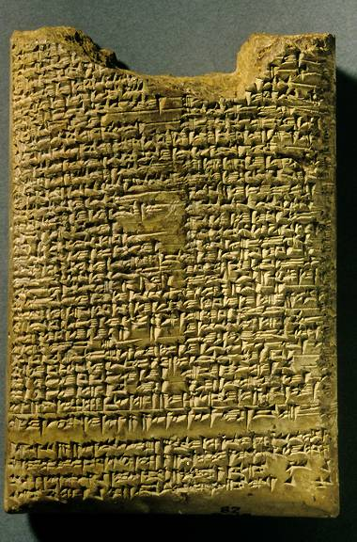
AN ANCIENT QUESTION:
How does the universe exist?
Enuma Elish, Tablet IV
British Museum, London
In Mesopotamia
Creation was the result of a violent primeval conflict.
Marduk (god of order) fought Tiamat (goddess of chaos), defeating the gods of chaos, and splitting Tiamat’s corpse into sky and earth.
Humans were created out of the blood of the slain god Kingu.

Slide 10
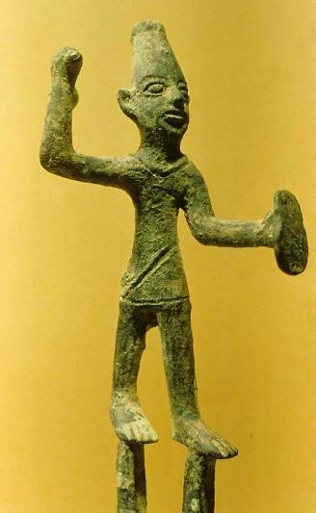
AN ANCIENT QUESTION:
How does the universe exist?
In Canaan
Ugaritic myths focus not so much on origins as on how the universe functions.
The gods are not the greatest power, but rather, magic can be brought to bear upon the gods, other humans, nature, and events.
The primary myth depicts Ba’al (god of rain) and his consort Anath (goddess of fertility) building a palace.
Mot (god of death) slays
Ba’al, taking him to the underworld.
Anath retaliates by killing Mot, whereupon Ba’al rises again to reclaim his palace.
Ba’al
This mythology explains the cycles of the seasons, which could be controlled by magic ritual.

Slide 11
Contrasts Between the Bible and Other Ancient Versions of Creation
The Bible and the Genesis Creation Accounts
Monotheism
God is just and loving
Orderly, good creation
Creation “Ex-Nihilo”
“Greater light” and “lesser light” are created
Humans are the climax of creation
Mesopotamian, Egyptian and Canaanite Mythologies
Polytheism
Gods are whimsical & cruel
Chaotic, imperfect creation
Ordering of existing matter
Sun, moon, and natural phenomena are deities
Humans are an afterthought

Slide 12
The Metaphor of God as Father Derives from God as Creator (Dt. 32:6b)
God as “Father” properly begins with the formation of Israel, his “children” (Ex. 4:22; Dt. 14:1a).
Like a father carries his son, so God carried Israel from Egypt and through the Sinai desert (Dt. 1:31).
Also, as a father disciplines his son, so God disciplined Israel (Dt. 8:5).
As a father has compassion on his son, so God has compassion on the children he created from dust (Ps. 103:13-14).

Slide 13


CORPORATE PERSONALITY IN ANCIENT ISRAEL
In Hebrew literature, there is a fluidity between “the one” and “the many,” so that a single person can represent the group and vice versa.
This idea begins with Jacob, renamed Israel, and the names “Jacob” and “Israel” can refer to the man (Ge. 32:28) but also to the nation (Is. 40:27; 41:8, etc.).
In Yahweh’s word to Moses, this idiom of corporate personality is used to describe Israel as God’s “firstborn son” (Ex. 4:22; cf. Ho. 11:1).
In the NT, the idiom can move from the general to the specific (Mt. 2:15).

Slide 14
Humans as Prodigal Children
Early in the biblical story, the humans whom God created abused their freedom to rebel against him. What sometimes is called “the fall” was not a brief stumble, but a headlong plunge into violence and depravity. Even a watery flood of judgment did not alter the basic problem, and humans expressed their narcissism and self-worship by building a great tower. Their rebellion knew no bounds, and it was prevalent even among the people of Israel, the ones God chose to be his special people. The nation of Israel and its unfaithfulness become a paradigm of all humans in all nations.

Slide 15
The Human Abuse of Freedom
The humans God created were free (Ge. 2:16-17).
The abuse of their freedom (Ge. 3:1ff.) has now spread to every living human, for the story of Adam and Eve is at once the story of every living human since (Ro. 5:12).
Humans were not created as sinners; rather, they became sinners by their abuse of freedom.
No human person is exempt (Ro. 3:23).

Slide 16
God tolerates moral evil…
…to maintain human freedom
…to make possible human personality
…to provide an environment in which to express love, grace and forgiveness
…to make possible moral growth

Slide 17
God tolerates natural evil…
…to provide a stable environment
for the expression of human freedom
…to enable humans to value life and God
…to enable humans to value eternal life
…to give men and women a correct
perspective of their creatureliness

Slide 18
The Two Trees at the Center
The account of the fall describes what it means to be in a broken relationship with God.
At the center of the garden were two trees, the tree of life (the source of life) and the tree of the knowledge of good and evil (the source of death).
While it is traditional to read this description literally, the imagery of the two trees strongly suggests that there is intended symbolism as well.
Hence, physical life and physical death point to a more profound spiritual life and spiritual death.
Pure relationship with God, grounded in innocence and obedience, was replaced with an experiential relationship with good and evil grounded in disobedience and rebellion.

Slide 19
Both the Man and Woman are Culpable
It often is assumed that the woman was alone and vulnerable when the snake approached her (suggesting that the man was less culpable). This assumption is wrong on two counts.
First, she was not alone. The Hebrew expression h0m0Afi (= with her) in 3:6 suggests that the man was there and heard the entire conversation. Not once did he raise his voice in protest.
Second, Paul clearly stated the man’s complicity when he says “sin entered the world through one man” (Ro. 5:12).
Hence, while Eve acted first, she did not act alone!

Slide 20
The Snake
The snake is not further defined in Genesis 3 except as a voice opposing God.
While it has always been assumed that the snake was the guise of Satan, this is not clearly stated until the New Testament (cf. Ro. 16:20; Rv. 12:9; 20:2).
At the same time, the Old Testament uses stock imagery from the ancient Near East describing Satan as a snake-like monster:
  RAHAB (the sea dragon over whom Yahweh triumphed, cf. Job 9:13; 26:12; Ps. 89:9-10; Is. 51:9)
  LEVIATHAN (also the sea dragon image, cf. Job 3:8; 41:1ff. Ps. 74:13-14; 104:25-26; Is. 27:1)
  BEHEMOTH (the beast or monster, cf. Job 40:15-24; see also 2 Baruch 29:4; 2 Esdras 6:49, 52; 1 Enoch 60:7-8)
  TANNIN (the whale, dragon, sea monster, serpent, cf. Job 7:12; Ps. 74:13; Is. 27:1; 51:9)

Slide 21
Shame
Shame is the first expression of disunion with God and others. It was not merely sexual, for the humans hid from God as well as from each other.
As sin matures, disunion with God is not expressed through shame, but pride, first toward others (4:23-24) and finally toward God (11:4).
While the psychological determinants of shame and pride are antithetical, they are expressions of the same basic alienation.
Shame expresses a relationship to sin defensively; pride expresses this relationship offensively.

Slide 22
The Curse and the Promise
The curse upon the snake set it apart from the livestock and wild animals, placing it in an antagonistic relationship to the humans.
The curse upon the man and woman is appropriate to their respective roles:
The man’s work (the ground is cursed with intrusions)
The woman’s work (the womb is cursed with pain)
The relationship between the man and the woman will now be defined by power rather than love (3:16b).
The promise of the crushing of the snake’s head is the earliest messianic hint—the protoevangelium (3:15; cf. Ro. 16:20).

Slide 23
The Flood Prelude
The judgment of the Great Flood should be regarded as the climax of the human fall.
The intermarriage between the “sons of God” and the “daughters of men” suggests the multiplication of perversity (6:1-4).
Two primary interpretive lines have been followed:
  In Jewish tradition, the “sons of God” refer to angelic beings, while the “daughters of men” refer to human women (cf. 1 Enoch 10-16; 2 Baruch 56:12; Jubilees 5:6; 10:1-14; 2 Enoch 7; Josephus, Antiquities 1.3.1). In the Old Testament, the expression bene ha-elohim usually refers to angels (cf. Job 1:6; 2:1; 38:; Ps. 29:1; 89:7; Dt. 32:8, LXX).
  In Protestant tradition, the “sons of God” often refer to the Sethites , the godly family, while the “daughters of men” refer to the Cainites, the ungodly family (Keil & Delitzsch).
IN EITHER CASE, HUMAN DEPRAVITY CONTINUED UNABATED.

Slide 24
The Universal Covenant
After the flood, Yahweh God established a covenant with Noah and his posterity and “all life” (9:8-17):
The mandate originally given to Adam to populate the earth is now repeated (9:1, 7; cf. 1:28), suggesting that in some sense Noah was a second Adam.
Now, the dynamic between human life and animal life undergoes a radical shift. Previously, only vegetable life had been sanctioned for food (cf. 1:29-30; 2:16). Now animals are sanctioned as well (9:2-3) with a restriction on eating blood, the symbol of life, which belongs to God (9:4).
Finally, there is a clear prohibition against murder along with the institution of capital punishment for murderers, since human life is made in the divine image (9:5-6).

Slide 25
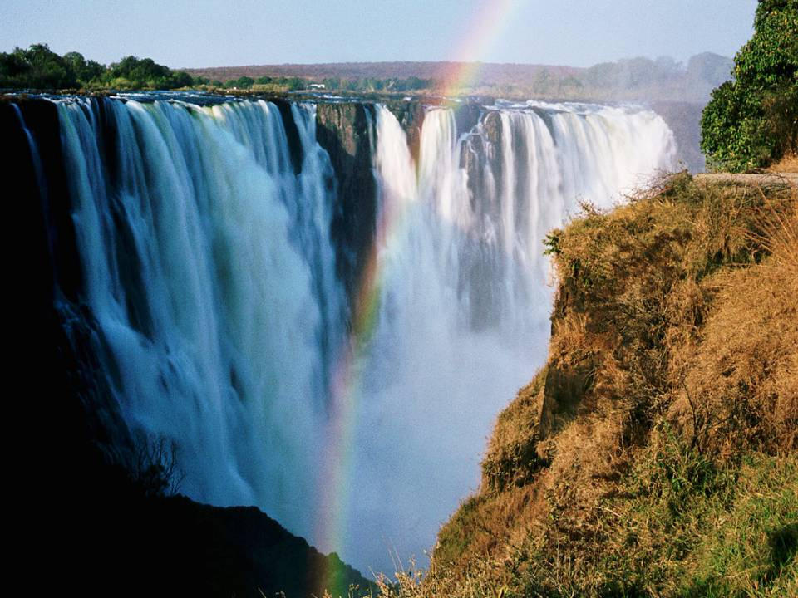
The rainbow is the covenant sign

Slide 26
Babel
As humans migrated eastward (the symbol of alienation from God, cf. 3:24; 4:16), they attempted a joint rebellion against God by building a tower (ziggurat) into heaven.
Later, the Sumerian description of the ziggurat at Babylon would be “the building of a foundation platform of heaven and earth” whose “top reaches to heaven,” language very similar to the language in Genesis.
The very name “Babylon” (Assyrian Bab-ili) meant “gate of God.” The idea of “confusion” (11:9) is a pun with the Hebrew verb llabA (= confuse, mix).
The ziggurat was the ultimate symbol of human achievement; the refusal to be scattered was a direct rebellion against God’s command to fill the earth (11:4; cf. 9:1).

Slide 27
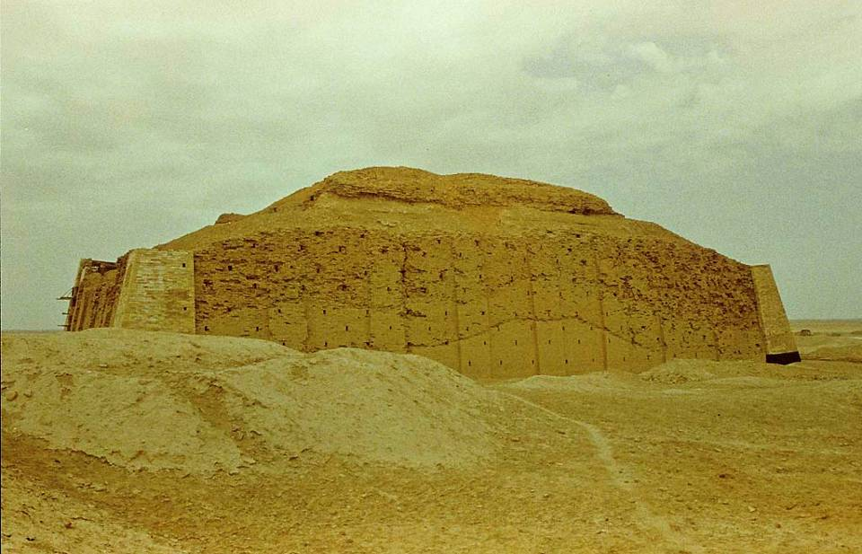
This is the oldest Sumerian ziggurat constructed by King Ur-Nammu of Ur (2112-2095 BC) to celebrate his founding of a new dynasty. It was dedicated to the moon god Nannar.

Slide 28
A World in Need of Salvation
Babel forms the climax of the primeval history, depicting a world deeply alienated from and in rebellion against its Creator.
The progress of human history is arrogant and destructive.
The earth is saturated with discord: husband against wife, son against father, son against son, people against creation, nation against nation, and all against God.
While Mesopotamian versions depict humans rising from obscurity to establish culture and asserting themselves through ingenuity, Genesis depicts humans as tragically fallen from a place of honor and goodness.
It was a twisted world, crying out for salvation.

Slide 29
The Patriarchal Cycle
The final 39 chapters of Genesis are a collection of narratives about the ancestors of the nation Israel.
The emphasis shifts from a universal perspective (the whole human race) to an individual perspective (one man and his family).
The patriarchal cycle serves as a postlude to the primeval cycle and a prelude to the exodus story.
Yahweh’s promise to Abram that in his posterity all the families of the earth would find blessing is the beginning of the divine answer to the desperate human need for salvation.

Slide 30
Human Fallenness Continues in the Israelite Nation (Ex. 15:22-26)
At Marah, the people complained that they were dying of thirst.
They had found water, but the water was undrinkable.
At Yahweh’s instruction, Moses threw a tree into the water, and the water became sweet. (Modern nomads still use vegetable matter to sweeten bitter waters.)
They named the site “Marah” (= “bitter,” cf. Ru. 1:20)
Here, Yahweh promised them that if they were obedient, he would spare them the diseases of Egypt and would be to them a healer. His declaration was, “I am Yahweh-roph’ka” (= “I am the LORD your healer”).

Slide 31
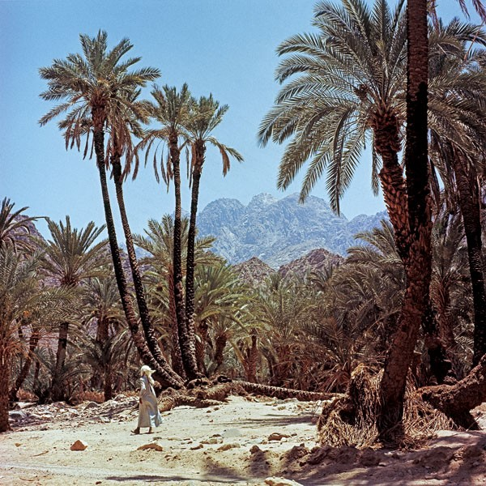
At Elim (15:27)
Elim has been identified with Feiran, the largest oasis in the Sinai desert where nearly three miles of palm-covered shade surrounds pure spring water.
This oasis lies about 60 miles south of the modern town of Suez.
The name means “terebinths” (large trees) or “gods” and was probably a sacred site.

Slide 32
The Test in the Wilderness of Sin (Ex. 16:1-36)
In the next test, the people complained that they were starving to death.
The place-name “sin” is a transliteration, but it probably has a morphological link with the place-name “Sinai.” (It should not be connected to the word “sin” as transgression, since this is an entirely different word in Hebrew.)
Here, Yahweh provided them with manna and quail [The Hebrew expression xUh NmA (= man-hu’ or manna) is a question, “What is it?”]
Even today, a species of honey dew is known to accrue in the desert, and the Bedouins still call it “mann,” either a species of lichen, a gum resin produced by flowering trees, or a scale produced by insects.
Also, migrating quail, after crossing the sea, even today fall exhausted to the ground in the desert and are easily scavenged.

Slide 33
The Test at Rephidim (Ex. 17:1-7)
The next test once again concerned water, always a crucial factor in desert survival.
Here, the underlying issue in all the tests was the Israelites’ question, “Is Yahweh among us or not?”
The irony, of course, is that by complaining the Israelites were testing Yahweh (17:2, 7) without realizing that he was testing them (cf. Dt. 8:2).
On this occasion, Moses used his rod to strike the rock, thus bringing water.
The place-names Massah (= testing) and Meribah (= quarreling) would live on as examples of unbelief and shame (cf. Dt. 6:16; 9:22; 33:8; Ps. 81:7; 95:8; 106:32).

Slide 34
The Golden Calf Episode (Ex. 32:1-6)
While Moses was on the mountain of God, the people fell into false worship, constructing a golden calf by which to worship Yahweh.
A calf was considered a pedestal for the god(s) in the ancient Near East, and even though Aaron proclaimed a festival to Yahweh, the golden calf was a violation of the 2nd commandment.
Before Moses descended the mountain, Yahweh told him that the people had already corrupted themselves, and this, in turn, led to a quasi-humorous dispute between the two, where Yahweh calls them “Moses’ people” (lit., “your people,” cf. 32:7) and Moses calls them “Yahweh’s people” (lit., “your people,” cf. 32:11).

Slide 35
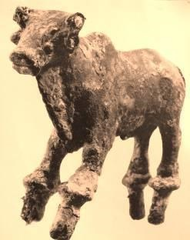
The Golden Calf
Bull calves were part of the fertility cult of Canaan, but they also were known in Egypt.
This 3” bronze bull was excavated in Hazor, Canaan and dates to the Late Bronze Age (1550-1200 BC), the same general time frame as the exodus from Egypt.
IT WAS ONE THING TO TAKE ISRAEL OUT OF EGYPT, BUT QUITE ANOTHER TO TAKE EGYPT OUT OF THE ISRAELITES!

Slide 36
The Broken Covenant (Ex. 32:15-29)
Moses interceded for the people in view of their idolatry.
His breaking of the two stone tablets symbolized the people breaking the covenant.
In destroying the golden calf, the people were compelled to drink the idol-dust mixed in water, similar to the later law of the ordeal for suspected adultery (cf. Nu. 5:11-31). In effect, Israel had become an adulterous wife, and those who drank it and were guilty were struck with a plague (32:35).
The death penalty carried out by the Levites against the erring ring-leaders confirmed the Levites as the priestly clan, zealous for the service of God.

Slide 37
Yahweh Outside the Camp (Ex. 33:7-11)
Usually, those who are unclean are required to be isolated in order not to pass on their contagion to others. Here, however, the whole nation is unclean because of the debacle with the golden calf, and Yahweh himself is now “outside” the camp.
Hence, Moses was compelled withdraw outside the community to go to Yahweh, confronting him in a special tent.
At this special tent, Moses and God would speak to each other with the familiarity of close friends (cf. Dt. 34:10).

Slide 38
Renewal of the Covenant (Ex. 34:10-28)
Previously, the Israelites had affirmed their covenant with Yahweh in a blood ceremony (Ex. 24:7-8). Now, because of the golden calf episode and the broken covenant, it needed to be renewed.
The language of covenant-making as well as covenant renewal is consistent throughout, which is to say, covenants are “cut” (traKA), cf. Ex. 34:10, 27.
Here, the imperative to drive out the Canaanites is repeated along with the command to destroy their pagan religious implements.
Several key elements in the original covenant are repeated as well, including: the outlawing of idolatry, the observance of the three pilgrim festivals (Passover/Unleavened Bread, Weeks, and Booths), the dedication of the first-born, the observance of Sabbath, the offering of first-fruits, and the basis for kosher observance.

Slide 39
The Sacrificial System
(the Immediate Remedy for Sin)
The ritual of sacrifice involved the slaughter and burning of an animal.
To understand this, one must look at the relationship of God to living creatures.
  In the creation account, animal life (6th day) is valued higher than vegetable life (3rd day)—both are “alive”, but one is animate and the other inanimate.
  Animate life has both a created element (body) and an uncreated element (God’s own spirit, the “breath of life”).
Blood is the element of animate life that signifies life from God (Ge. 9:4; Lv. 17:11; Dt. 12:23).
Hence, animate life is a combination of “body” and “blood,” and sacrifice is the death of an animal to purge impurity and to ransom the life of the sinner—in short, to repair the relationship between God and the Israelite.

Slide 40
Concepts of Sin & Impurity
Sin is rebellion against God and associated with death.
It can be deliberate and defiant.
It can be the unconscious result of weakness.
In either case, it results in death (Ge. 2:17; Eze. 18:20; Ro 6:23).
Impurity is the by-product of sin resulting in:
Ethical Impurity: idolatry, bloodshed, sexual sins, etc.
Ritual Impurity: corpse contamination, scale disease, genital discharge—all associated with the forces of life and death.
The primary agent for remedying sin and impurity is blood, since blood “ransoms” the sinner (substitutes for the life of the sinner) and purges impurity (Lv. 17:11; He. 9:22).

Slide 41
Substitutionary Atonement
This act of “atoning” (bringing into unity) involves cleansing from sin and impurity so that the sinner is reconciled to God from whom he has been estranged.
All sin has its origin in the life of the sinner. The life of the sinner is forfeit, since he is now estranged from the sole source of life, who is God.
The removal of sin is possible only by the same means, the payment of this life-debt, through the substitution of one life for another. The symbolic agent of this substitution is blood. One ancient example is Abraham and the sacrifice of Isaac on Mt. Moriah.

Slide 42
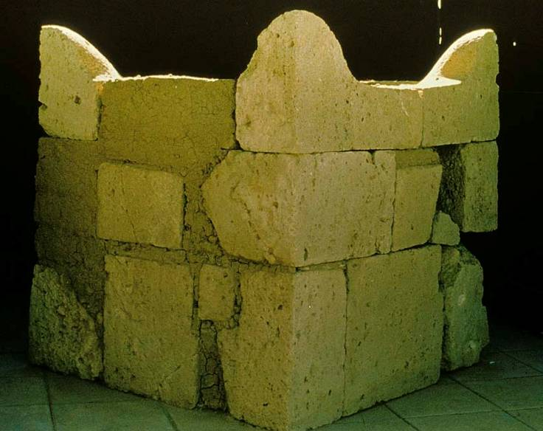
The largest Israelite four-horned altar so far discovered has been this one from Beersheba in southern Judah.
This would be typical of the sacrificial altars built by the Israelites.

Slide 43
The Center
(Lv. 16)
The center of Israel’s atonement system was the annual Day of Atonement, 10th Day of the 7th month, a day of purgation for the whole nation.
It included all the unintentional sins and impurities that individuals may have failed to address through the daily sacrifices.
In also included all the deliberate sins and impurities that the high priest alone was permitted to address.

Slide 44
Yom Kippur
(Lv. 16)
Preparation
Selection of the Bull and two Rams
Selection of Two Goats and the Casting of Lots
Bathing and Vesting of the High Priest
Ritual
Bull Slaughter (purification for the high priest & his family)
Offering of Incense
Sprinkling of Blood
He-Goat Slaughter (purification for the people)
Sprinkling of Blood
Ram Burnt Offering (for the high priest himself)
Ram Burnt Offering (for the people)
Goat for Azazel (chosen by lot)
Imposition of hands
Driving the goat into the desert

Slide 45
Apostasy at Ba’al-Peor (Nu. 25)
Unable to curse the Israelites, the Moabites seduced the Israelites into the Ba’al fertility cult.
As they had done in worshipping the golden calf, the 2nd-generation of Israelites now engaged in pagan worship, and also as had happened at the golden calf incident, immediate executions were enjoined by God (cf. Ex. 32:26-29).
Phineas, Aaron’s son, actually impaled an Israelite man and Midianite woman in the act of sacred sex.

Slide 46
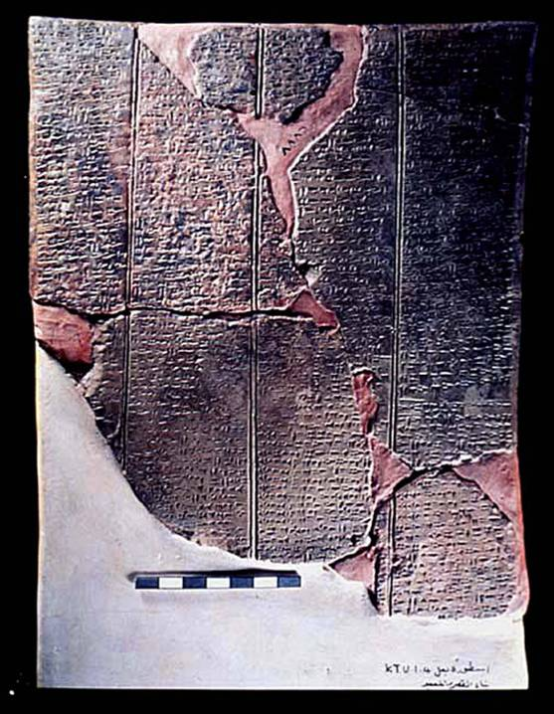
Ba’al Epic
Discovered in Ugarit (Ras Shamra, Syria), this text describes the myth of Ba’al and his role as “Lord of the Earth” (responsible for fertility). The text describes the construction of Ba’al’s palace on Mt.
Zaphon after he defeated Yamm, god of the sea, as well as his return from the underworld after being imprisoned by Mot, god of death.

Slide 47
Canaanite Religion
The religions of the Canaanite nations were fertility cults using imitative magic to induce fertility in the land, livestock and people.
  The deities were both male and female.
  In Canaanite mythology, Ba’al (god of rain, lightning and storm) was “killed” each fall and imprisoned by Mot (god of death), causing the dry season.
  In the spring, Ashtaroth (goddess of sex and war) rescued Ba’al from the power of Mot, enabling Ba’al and Ashtaroth to mate.
  The mating of the deities was believed to cause fertility in soil, animals, and humans.
  To induce the mating of Ba’al and Ashtaroth, humans participated in sacred prostitution at the high places as a form of imitative magic—as the Bible describes it, …”on every high hill and under every green tree.”
  Both male and female sacred prostitutes (qedeshim and qedeshot) served the public in Canaanite temples and open air sacred sites on the mountains.

Slide 48
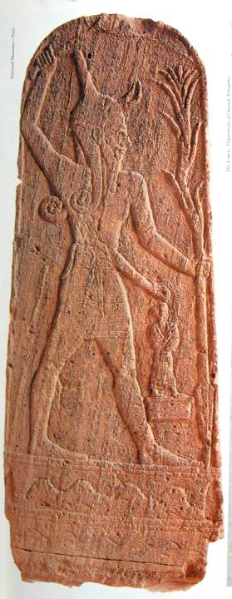
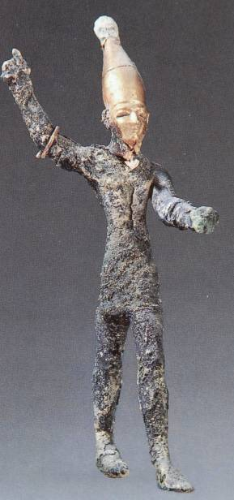
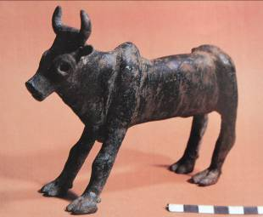
Ba’al
Ba’al, the Canaanite god of storm, often was depicted with an Egyptian-style crown. He also was believed to ride standing on a bull.

Slide 49
1st Generation Failure (Dt. 9:7—10:11)
The failure of the 1st generation began at Horeb itself.
While Moses was on the mountain, the people fell into idolatry by building a golden calf.
Moses shattered the first written edition of the Ten Words when he saw their rebellion.
Repeated rebellions occurred at Taberah (Nu. 11:1-3), Massah (Ex. 17:7), Kibroth-Hattaavah (Ex. 11:4-34), and Kadesh (Nu. 14).
Only the intercession of Moses stood between them and Yahweh’s wrath.

Slide 50
Blessing or Curse (Dt. 11:26-32)
The exhortation and warning.
In the style of ANE suzerainty treaties, two ways lay open to the Israelites.
Obedience would result in blessing.
Rebellion would bring a curse.
Later, these blessings and curses would be recited from the slopes of two central mountains in Canaan, Ebal and Gerizim (cf. 27:9-26; Jos. 8:30-35).

Slide 51
The Election of Israel
God’s solution to the human problem began with one man, Abraham, whom God chose as the ancestor of a chosen people. To this man God promised posterity and land, and most importantly, blessing for the whole human race. He chose the descendants of Jacob, Abraham’s grandson, to be his special people. He redeemed them from slavery in Egypt, gave them his instructions for life, and called them to serve as priests to the nations of the world. This gracious election set apart Israel as an example of wayward children, redeemed by love, and called to serve.

Slide 52
Abram’s Call (Ge. 12:1-3)
In the first biblical episode in Abram’s life, God called him to separate himself from all natural ties (land, people and household).
In return, God promised to give Abram posterity and land and that he would be the means of blessing to the nations.
For both the OT and NT, Abram’s call and promise offers a description of what biblical faith is about: the call to forsake one’s natural home and way of life in order to receive a home and way of life from God’s hand.
As the father of the faithful, Abram’s descendants are now marked off as a people to serve a theological purpose of universal significance.

Slide 53
Israel’s Call (Ex. 19:1-9)
The Israelites, the descendants of Abraham, completed the final leg of their journey to Mt. Sinai, where Moses ascended the slopes to hear the voice of Yahweh.
Here, God announced to him Israel’s calling to be a kingdom of priests and a holy nation, a calling that would stretch into the NT (1 Pe. 2:5, 9).
The redemption of Israel from Egypt was also a calling—it was not only an escape from something, but a commission to be something.
The commission of the nation to be a kingdom of priests set apart for God’s larger purpose is theologically linked with God’s promise to Abraham that in his seed all nations of the earth will be blessed (cf. Ge. 12:3). Priests, by definition, are mediators, and if the whole nation was to be a priesthood, this immediately implies that they were to be priests to the nations.

Slide 54
Election
God’s choice of Israel to serve his purpose to the nations should not be misunderstood as an affirmation of Israel’s righteousness.
Though the whole nation was chosen, there would be multiple examples of Israelites who lapsed into unbelief and defiance against God.
Hence, being “chosen” does not mean being “saved,” a point St. Paul would make many centuries later (Ro. 9:6-7; cf. 9:1-4, 27, 31-33; 10:1).
Still, God chose Israel out of his faithful love and promise to Abraham (Dt. 4:37; 7:6-8; 10:15; 14:2).
Centuries later, Isaiah will describe Israel as God’s servant (Is. 41:8-9; 44:21), the ones elected to serve as witnesses to his grace (Is. 43:10).
Alas, history would demonstrate that Israel was a failed servant (Is. 42:18-25), and in light of this failure, God would send a greater Servant who would not fail as Israel had failed (Is. 42:1-4).

Slide 55
God and Israel
Yahweh chose Israel out of divine love (Dt. 7:7-9; 10:15).
He carried Israel as a father carries his son (Dt. 1:31).
He was near them when they prayed (Dt. 4:7).
During their sojourn in the desert, he blessed and cared for them (Dt. 2:7).
He humbled and tested them so that they might learn that life was about relationship with him, not material things (Dt. 8:2-5).

Slide 56
Israel and God
The Israelites were obliged to watch themselves and not forget God (Dt. 4:9; 8:10-20).
They were to stand in unity with the first generation (Dt. 5:2-3; 4:10-20).
Israel must take to heart God’s sovereign choice and conscientiously keep his covenant (Dt. 4:39-40; 5:32-33).
Especially, they were to remember their past failures and not repeat them (Dt. 9:7; 10:13).
Eventually, Israel would be condemned to exile, because the nation had profaned God’s name among the nations (Eze. 20:8-26; 36:20-23).

Slide 57
The Concept of Covenant
In the absence of international law, humans established and maintained their relationships with each other by covenants, binding agreements confirmed by oaths and attended by reprisals if they failed to keep their covenant promises. God used this well-known institution of covenant to relate to his people, beginning with Abraham, then Moses, and then David. At last, he offered the vision of a new covenant described by Jeremiah and Ezekiel. All these covenants were attended by divine promises: some had conditions that were temporal, and some had features that were to last forever.

Slide 58
The Idea of Covenant
In the ancient Near East, where international law was still a thing of the future, covenants were socially binding agreements enacted between two parties in which one or both made promises under oath to perform certain actions stipulated in advance.
THE VOCABULARY OF COVENANT
tyr9B; tr1KA ( karat berith = to cut a covenant)
fav0bwA (shevu’ah = oath)
fBaw;n9 (nishba’ = swearing)
tOc;m0i (mitswot = obligations)
hkAr!B; (berakah = blessing)
hlAxA (‘ala = curse)

Slide 59
The Five Divine “I wills…” in God’s Covenant with Abram (Ge. 12:1-3)
…make you a great nation
…bless you
…make your name great
…bless those who bless you
…curse those who curse you
THE PROMISE: ...all peoples on earth will be blessed through your seed!

Slide 60
Cutting (Heb. tr1KA) a Covenant
(Ge. 15)
The form of covenant ratification is consonant with covenant practices in the ancient Near East, where the ritual of sealing an oath by cutting an animal in two and passing between the pieces is found in Mesopotamian literature.
Those passing between the animal halves bind themselves to a curse should they violate the covenant.
Here, Yahweh himself passed between the pieces, symbolized by the smoking oven and flaming torch.
An ominous warning anticipates the Egyptian bondage and exodus.

Slide 61
Circumcision
(Ge. 17)
Now Yahweh added a covenant sign, circumcision, when Abram was 99 years old.
A new name for God is introduced, yDawa lxe (= El Shaddai)
God also changed Abram’s and Sarai’s names to Abraham (= father of a crowd) and Sarah (= princess), changes that marked an important transition.
Circumcision was widely practiced in the ANE as a puberty rite, usually in preparation for marriage. Abraham, on the other hand, was to circumcise all males in his family on the 8th day after birth.

Slide 62
The Nature of A.N.E. Covenant
The cultural institution of covenant, widespread throughout the ancient Near East, would ultimately become the essential basis for the relationship between Yahweh and Israel.
Covenant was a basic social institution within tribal structures and between city-states when there was no international law.
A covenant was a solemn promise made binding by an oath so that each party was obliged to fulfill the terms.
A suzerainty-treaty was a covenant between parties of unequal status—an overlord and a subject. Yahweh was the suzerain (the Great King), and Israel was the vassal (the lesser party).

Slide 63
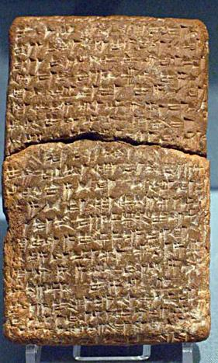
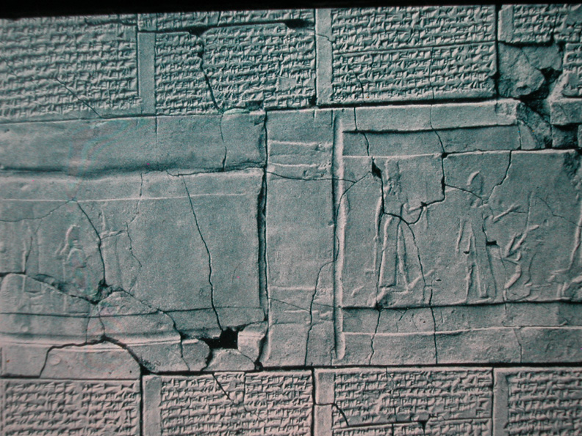
Other similar covenants are known from the ancient world.
Ancient Near Eastern treaties with striking parallels to the biblical covenant material have been found in ancient Hittite culture (15th century BC) and in the vassal treaties of Esarhaddon II of Assyria (7th century BC).
British Museum, London
University of Pennsylvania

Slide 64
TREATY FORM
(Hittite Suzerainty Treaty)
Preamble: “These are the words of the Great King…”
Historical Prologue: Details about the Great King’s benevolence in the past
Stipulations: The respective obligations of the vassal and overlord
Deposit of Document: Written record with copies deposited in the respective temples of the covenant parties
Witnesses: The deities of the respective parties
Blessings and Curses: Implications for obedience or covenant violation

Slide 65
The Covenant Ceremony (Ex. 24)
Formal acceptance of the covenant was conducted in a special ceremony at Mt. Sinai.
The nation’s leaders were invited part way up the mountain, the people remaining below and only Moses ascending to the summit.
First the first time, the terms of the covenant were written down.
An altar representing Yahweh and twelve pillars representing the twelve tribes were erected.
  Sacrifices were conducted, and Moses collected the sacrificial blood and dashed it on the altar and the people to bind them to Yahweh in a blood oath.
  The Book of the Covenant was then read aloud, and the people gave their verbal assent to its terms.

Slide 66
Deuteronomy and the Covenant of Moses this covenant form is very apparent in the structure of Deuteronomy
Preamble (1:1-5): “These are the words…”
Historical Prologue (1:6—4:49): Yahweh’s protection over Israel between Sinai and Moab
General Stipulations (5-11): The basic covenant principles including the Shema and the 10 commandments
Specific Stipulations (12-26): Detailed laws and expectations
Deposit of the Document (27:1-10; 31:9-29): Encoding the covenant law for public reading every seven years
Witnesses (32): The heavens and earth serving as covenant witnesses
Blessings and Curses (27:12-26; 28:1-68): Benefits and reprisals for obedience or disobedience

Slide 67
A COVENANT PEOPLE
THE COVENANT PROMISE OF LAND TO THE PEOPLE OF ISRAEL
Abraham (promissory oath, grant)
Moses (covenant of retributive justice, conditional)
ISRAEL’S SELF-IDENTITY AS A COVENANT PEOPLE:
Israel is an MfA (= a people)
The nations are My9Og (= gentiles, pagans)

Slide 68
The Language of Loyalty
Like the vassal treaties of Esarhaddon, Deuteronomy contains the language of loyal-love that should characterize Israel’s loyalty to Yahweh.
“If you do not love the crown prince designate Ashurbanipal, son of your lord Esarhaddon, king of Assyria, as you do your own lives…” (lines 266ff., ANET, p. 537).
“Love Yahweh your God with all your heart and with all your soul and with all your strength.” (Dt. 6:5).

Slide 69
The Language of Cursing
Both Esarhaddon’s treaties and Deuteronomy contain similar curses for disloyalty.
ESARHADDON
“Just as rain does not fall from a copper sky, so may there come neither rain nor dew upon your fields.”
“May Sin, the luminary of heaven and earth, clothe you in leprosy…”
“May Shamash…take away your eyesight; walk about in darkness!”
“May Adad…put an end [to vegetation] in your land…”
“May Gula…put illness…an unhealing sore in your body…”
“May Nabu…make your descendants disappear from the land.”
DEUTERONOMY
“The sky over your head will be bronze… The LORD will turn the rain of your country into dust and powder.”
“Yahweh will plague you with diseases…”
“Yahweh will afflict you with…blindness and confusion of mind.”
“You will plant a vineyard, but you will not even begin to enjoy its fruit.”
“Yahweh will afflict your knees and legs with…boils that cannot be cured…”
“You will be uprooted from the land you are entering to possess.”

Slide 70
Blessings and Curses (Dt. 27:9-26)
“Today you have become the people of God!”
This announcement presumes Israel’s acceptance of the covenant and their solemn promise to keep it.
While the blessings are not described until later (cf. 28:2-14), twelve curses are specified.

Slide 71
Blessings for Obedience (Dt. 28:1-14)
As observed earlier, blessings and curses were a constituent part of ancient Near Eastern Suzerainty treaties.
The blessings for obedience included both farmers and city-dwellers.
Families, fields, and livestock would be fertile.
Victory over enemies was assured.
As promised, the people of Israel would become Yahweh’s holy nation (cf. 26:18; 27:9).

Slide 72
Curses for Disobedience (Dt. 28:15-68)
After the opening section, which follows the order of the foregoing curses, detailed descriptions of escalating disasters are offered.
The pattern of these curses are consistent with other known vassal treaties from the ancient Near East.
The first section of curses begins with an “if” clause; the following sections have no stated conditions, but they assume covenant violation.
The curses climax with the threat of exile.
There were only two ways open, obedience or rebellion.

Slide 73
A Perpetual Covenant
(Dt. 29:9-29; cf. 5:3)
The covenant community not only was linked to the past but also to the future.
It was for “those who are not here today” (i.e., those yet to be born, cf. Ps. 78:4-6).
Hence, the covenant was to be perpetual and binding, and each new generation must also stand before Yahweh and commit themselves to this covenant.
Idolatry and covenant rebellion would result in all the curses of the covenant, a sign to the nations.

Slide 74
The Role of Faith
Faith is not merely a matter of believing certain facts. It is a relationship of complete trust. This, ultimately, is what God, the Father, desired from his human children. The laws of the Torah—God’s instructions for living—were intended for guiding Israel toward a life of complete trust in Him. Waywardness was not merely a matter of breaking the rules, it was breaking a relationship with one’s Father. While faith and faithfulness were intended to be the hallmarks of God’s people Israel, mostly they failed to live a life of faith, and in the end only a remnant survived.

Slide 75
Abraham, the Man of Faith
Abraham’s faith in God’s promise was “credited to him as righteousness” (15:6), a passage quoted in the NT to show that faith is not a crowning merit but a readiness to trust God’s promises (cf. Ro. 4:3, 19-22; Ga. 3:6; Heb. 11:8-12).
As such, Abraham becomes the prototype for how a life of faith is to be understood.
For both the OT and NT, the life of faith is about the call to forsake one’s natural home and way of life in order to receive a home and way of life from God’s hand.

Slide 76
What Does Yahweh Require? (Dt. 10:12—11:25)
The covenant demands are described in five infinitive verbs that serve as a directory for the admonitions to follow (10:12-13):
Xr2y! (“to fear”) 10:20
j`lah, (“to walk”) 11:22
bhaxA (“to love”) 11:1, 13, 22
dbafA (“to serve”) 10:20
rmawA (“to keep”) 11:1, 8, 22

Slide 77
Circumcision of the Heart (Dt. 10:16)
While outward circumcision was a covenant symbol and compulsory, it did not in itself create a faithful relationship.
What was necessary was a deep and inward commitment, metaphorically described as “circumcision of the heart.”
This metaphor will be used repeatedly, both in the Old and New Testaments (30:6; cf. Je. 6:10; Ro. 2:28-29; Phil. 3:3; Col. 2:11).

Slide 78
The Central Concern (Dt. 4:1-3)
Here, as with the rest of the Book of Deuteronomy, the central concern is for deep covenant commitment and obedience.
The Israelites must offer exclusive allegiance to Yahweh alone.
Fulfillment in life, not to mention possession of the land of Canaan, was conditioned upon covenant faithfulness without deviation.

Slide 79
The Shema (‘Hear!’) (Dt. 6:1-4)
There are several possible translations of the Hebrew phrase in 6:4 (dHAx, hv!hy4 Unhelox$ hvAhy4):
Yahweh our God, Yahweh is one! (NIV)
Yahweh our God is one Yahweh! (RSV)
Yahweh is our God, Yahweh alone! (NAB)
Yahweh is our God, one Yahweh! (NEB)
Yahweh is our God, Yahweh is one! (NASB)
In addition to declaring that Yahweh alone is truly God, the Shema eliminated any tendency toward poly-Yahwehism, the parceling out of Yahweh to various cultic sites, something common enough in the Ba’al worship of the Canaanites.

Slide 80
Love and Obedience (Dt. 6:5-9)
In Deuteronomy, love is profoundly linked with obedience.
If Yahweh occupied the sole focus of Israel’s heart, then his commandments should be the sole focus for living.
This devotion was to be transmitted to succeeding generations so that God’s Torah was the conversation of daily life.
Later, the Israelites took 6:8-9 quite literally as the basis for mezuzahs and phylacteries.

Slide 81
Do Not Forget! (Dt. 6:10-24)
The acquisition of new land and wealth must not be allowed to lead the Israelites away from their devotion to Yahweh.
They would be entering a land with an established religious culture, and they must not allow this culture to subvert their faith in Yahweh alone.
They must not lapse into the mistake at Massah (Ex. 17), where they put demands on Yahweh so that their allegiance to him depended upon him doing what they required.
They must carefully instruct their children in the Torah.

Slide 82
Remember! (Dt. 8:1-20)
Israel’s past was a prime collection of failures.
The 40 years in the “terrible desert” had been a test of their hearts to show that their lives depended not merely upon food but upon God’s word.
Coming prosperity in the land of Canaan would also be a test of their hearts.
If they forgot God as the giver and sustainer of their lives, they, too, would succumb to destruction, just as the Canaanites.

Slide 83
Repentance & Restoration (Dt. 30:1-10)
While future violation could not be foreseen, it was a serious possibility.
In such an eventuality, Israel must know that judgment—even exile—was not Yahweh’s final word.
Even in exile, Israel could count on Yahweh’s faithfulness—and repentance would result in restoration!
It was out of this promise that prophets like Jeremiah and Ezekiel preached about Israel’s recovery from exile. Judgment was not Yahweh’s final word! Here was the germ of the Messianic Hope!

Slide 84
So, Choose Life! (Dt. 30:11-20)
Yahweh’s requirements were not difficult to understand nor impossible to attain.
Two ways lay before them, the path toward life and the road to death.
Heaven and earth served as covenant witnesses to Israel’s choice.
If confession and faith was called for by this ancient covenant (30:14), how much more would confession and faith be appropriate for the new covenant in Christ (cf. Ro. 10:6-8).

Slide 85
Controversial Issues in the Torah and Beyond

Slide 86
Composition of the Torah

Slide 87
How Ancient Books Were Composed
Many of the oldest biblical books have scant information about their composition.
The common scholarly assumption has been that the various accounts were first passed down in the form of oral tradition before they were committed to writing.
At the time of writing, various preexisting sources were brought together into a final form (and there may have been later editing).
Examples of such preexisting sources seem to be cited in various passages of the historical books of the Old Testament.

Slide 88
From Where and How Do the Books of the Torah Come?
Like most ancient texts, the five books of the Torah are formally anonymous.
Traditionally the Torah has been ascribed to Moses so that together the five scrolls are often are called the “Books of Moses.”
Contemporary scholars doubt that the composition of the Torah is quite so simple.

Slide 89
Many Passages in the Torah Suggest a Date Later than Moses
Anachronisms, such as, the naming of northern Dan (Ge. 14:14; cf. Jg. 18:7, 14, 27, 29), presuppose a date later than Moses.
Other anachronisms include “the Canaanites were then in the land” (Ge. 12:6), “the land of the Philistines” (Ge. 21:34; Ex. 13:17; 23:31), and “the land of Rameses” (Ge. 47:11).
A phrase like “To this day…” suggests a date within the later history of Israel (Ge. 22:14; 26:33; 32:32).
Knowledge of the Israelite monarchy presupposes a date later than the 10th century (Ge. 36:31).
Some passages imply a later time, such as, “the Moabites of today” and “the Ammonites of today” (Ge. 19:37-38), the reference to Og’s bed as “still in Rabbah” (Dt. 3:11b), and the reference to the invasion of the Caphtorites (Dt. 2:23).

Slide 90
The description of Moses’ death seems to require a date of documentation later than the event itself (Dt. 34:5ff.).
The observation that since Moses’ death, no prophet like him had arisen in Israel (Dt. 34:10-12).
In particular, a reference to the exile suggests a later date:
“Therefore, Yahweh’s anger burned against this land, so that he brought on it all the curses… Yahweh uprooted them from their land and thrust them into another land, as it is now.” (Dt. 29:27-28).
The Hebrew phrase “as on this day” (or, “as it is now”) suggests a time removed from Moses’ day.

Slide 91
At the same time, Moses is described as committing at least some of the Torah to writing.
The Book of Exodus certainly depicts Moses as writing (cf. Ex. 17:14; 24:4; 34:27-28) as does the Book of Deuteronomy (Dt. 31:9, 19, 22, 24ff.).
A generation after Moses, Joshua is commanded to obey the “book of the law” (Jos. 1:7-8), and he certainly seems familiar with the Deuteronomic code forbidding the use an iron tool to fashion an altar (Jos. 8:31; Dt. 27:5).
At the same time, Joshua also is said to have drawn up decrees and laws which then were recorded in the “book of the law” (Jos. 24:25-26).

Slide 92
The prevailing opinion among historical-critical scholars is that various strands of pre-existing tradition were brought together to create the Pentateuchal literature long after any of the events themselves. An early theory joined Joshua to the Torah so that the Torah dd not end on an unfinished note.
Hexateuch Theory
Natl. History
Ge. Ex. Lv. Nu. Dt. Js.
Jg. Sa. Kg.
Four Primary Sources
J = Yahwist (10th century BC)
E = Elohist (8th century BC
D = Deuteronomic (7th century BC)
P = Priestly code (6th century BC)
The Hexateuch theory links Joshua directly to the Pentateuch in order to bring a conclusion to the promise of land.

Slide 93
The theory of a Hexateuch was relatively short-lived, but the theory of a Tetrateuch has become much more widely accepted in the academy.
Tetrateuch Theory
Deuteronomistic History
Ge. Ex. Lv. Nu.
Dt. Js. Jg. Sa. Kg.
Three Primary Sources
J = Yahwist (10th cent. BC)
E = Elohist (8th cent. BC)
P = Priestly code (6th cent. BC)
Miscellaneous Sources
D = Deuteronomy along with tribal
traditions and various other
histories (the final form was not
reached until the mid-6th
century BC).

Slide 94
Today, it is widely recognized that this theory must also be reassessed, and it is more common for scholars to suggest a variety of shorter, independent narratives, gradually formed into units and brought together to form the Torah.
Current theory
Ge. Ex. Lv. Nu. Dt.
Three Primary Sources
Deuteronomic (7th century BC) Book of Deuteronomy
Priestly code (6th century BC) cultic materials
Non-priestly materials

Slide 95
Two Important Factors for Conservatives
While the books of the Torah are formally anonymous, the historicity and authenticity of its narratives and speeches must be maintained.
While there is no necessary reason to oppose oral or written sources underlying these five books in their final form, conservatives are still committed to the Mosaicity of the material, which is to say, Moses was a real person and the events describing him, what he said, and what he did are true.
Anything less seems to compromise the belief that this work was divinely inspired.

Slide 96
Dating the Torah
ANCIENT ORAL TRADITIONS
ANCIENT WRITTEN TRADITIONS
MOSES
15th Century BC?
13th Century BC?
FINAL FORM
the monarchy or later?

Slide 97
The Creation Story and Modern Science

Slide 98
Basic Perspective
It is axiomatic that the accounts in Genesis were written, not to address modern questions of science and philosophy, but to address ancient questions about God and origins.
Hence, only a limited amount of information may be available with regard to our modern questions.
For the most part, the narratives in Genesis must be viewed against the backdrop of the ancient Near East.

Slide 99
Lingering Scientific Questions
Even though the Genesis record does not address itself to modern questions of science, such questions inevitably arise, and Christians have grappled with them out of necessity. These include:
The age of the earth and/or the universe
The meaning of the Genesis “day”

Slide 100
Age of the Earth/Universe may be related to but is not the same as the theory of evolution
Young Earth Theory (less than 10,000 years)
Requires a flat reading of Scripture (avoids poetic genre)
Requires catastrophism (the flood is responsible for much of the earth’s geological phenomena)
Popular date, 4004 BC (Ussher), though some would extend it
Old Earth Theory (up to 10 billion years)
Requires a poetic reading of Scripture (avoids overt literalism)
Requires uniformitarianism (long epochs are responsible for the geological and anthropological phenomena)
Usually accepts the “Big Bang” theory (astronomy)
OBJECTION: Why would God create the world with the appearance of antiquity if this were not true?
OBJECTION: Usually accepts creation plus natural processes.

Slide 101
The Genesis “Day” related to the question of age is the meaning of the Genesis MOy
If a solar day…
The sun was not created until the 4th day.
If a revelational day…
It took Yahweh seven days to reveal to Moses the creation story.
If each day represents a geologic age…
The geologic periods are not evenly spaced.
If the days are poetic structural devices…
The days are formulaic, not markers of precise time increments.
The argument that in all cases the Hebrew word MOy (= day) must refer to a 24-hour period is invalid, else one would then have to conclude from Ge. 2:4 that God made the universe on a single day.

Slide 102
Cosmic Temple Interpretation
Here, Genesis 1 does not describe material creation at all, but rather, the functional inauguration of God’s residence (i.e., his temple) from which he runs the world.
The Hebrew verb xrAbA (= to create) concerns the assignment of functions, not the material existence of the universe.
The first three days pertain to the functions of time, weather and food.
The second three days pertain to the roles and spheres of the elements in the cosmos.
The evaluation “it was good” refers to functional goodness for the benefit of humans (i.e., everything works as it should).
God’s rest refers to his residence in the cosmic temple from which he takes up his lordship to sustain the world.

Slide 103
Cosmic Temple Cont.--
Implications of the cosmic temple interpretation:
Ancient cosmology was function-oriented; hence, Israel’s cosmology was function-oriented as well.
Genesis 1 concerns teleology (the purpose of the cosmos for human habitation), not material origins. Indeed, Genesis 1 is not about material origins or the age of the universe.
Genesis 1 is not concerned with the mechanism of creation. All scientific explorations of the mechanism of cosmic origins are fully permitted (including evolution).
However, whatever mechanism was involved, whether long or short, God stood behind it at every moment.

Slide 104
Extreme Ages and the Family of Seth
Genesis 5 describes the family of Seth. The extreme ages of the antediluvians raise questions of credibility, usually answered in one of three ways.
The ages are to be taken literally and presuppose that the antediluvian atmosphere was conducive to longevity (young earth creationism)
The idea of long age spans is not unique to Genesis (e.g., the Sumerian King List). Perhaps the “years” are a different time unit than what we normally mean by a year (reductionism).
The names and ages represent clan epochs, where names refer to the clan itself. The age represents the time a clan was prominent (the Hebrew terms “son” and “to be the father of” need not be confined to a single generation).

Slide 105
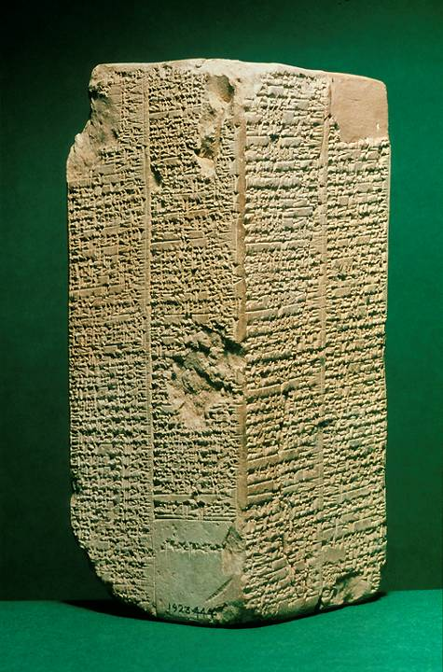
The Sumerian King List
Near the end of the 3rd millennium BC
List of early Mesopotamian kings who lived “until the time of the great flood” as well as after it, the early ones with extremely long life-spans (some reigning as long as “64,800 years”). The purpose was evidently to show that Mesopotamia had always been ruled by a single king.
Ashmolean Museum, Oxford, England

Slide 106
The Factor of 10
The compiler of Genesis seems to structure genealogies in sets of 10, which in turn implies selection rather than an exhaustive list:
4:1, 17-22 5:1-31 11:10-26
Adam Adam Shem
Cain Seth Arphaxad
Enoch Enosh Shelah
Irad Kenan Eber
Mehujael Mahalalel Peleg
Methusael Jared Reu
Lamech Enoch Serug
Jabal Methusaleh Nahor
Jubal Lamech Terah
Tubal-Cain Noah Abraham

Slide 107
The Flood Story: Ancient Perspectives, and Modern Science

Slide 108
Flood Stories
If the Genesis creation account was a corrective to other ancient Near Eastern creation myths, the Genesis flood story was equally a corrective to existing flood myths.
The Genesis flood account has clear resemblances to Sumerian and Babylonian flood stories:
  The gods instruct a hero to build a boat and caulk it with pitch.
  The hero is instructed to take animals with him into the boat.
  The world population is destroyed.
  After the flood, the hero releases birds to see if the waters have receded.
  The boat comes to rest on a mountain.
  After leaving the boat, the hero offers sacrifices, and the gods smell the sweet odor.
These flood stories are older than Genesis.

Slide 109
What is most significant about the Genesis flood story are its dissimilarities from its Mesopotamian counterparts.
Mesopotamian Accounts
The gods are characterized by their cruelty, irritation, and anger.
The gods decide to destroy humans because they are too noisy and over-populated.
The surviving family is spared because of belief in a god who didn’t support the gods’ decision to destroy the world.
Genesis Account
Yahweh God is characterized by moral grief over human sin.
Yahweh God sends the flood as a moral judgment because of wickedness, violence, and perversity.
Noah and his family are spared because he is righteous and obedient.

Slide 110
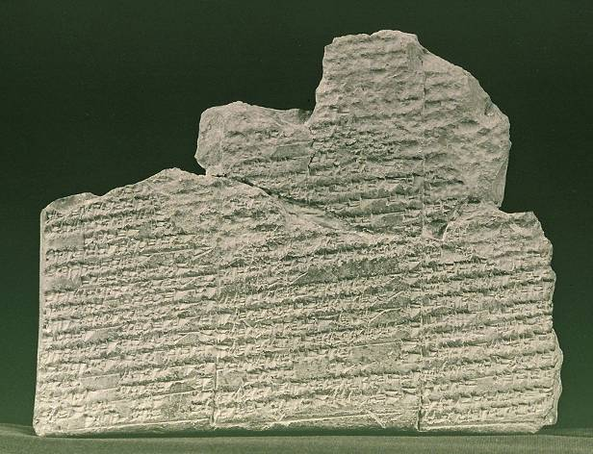
The Earliest Flood Story
18th century BC, excavated in Nippur
The Sumerian deluge tablet, which is incomplete due to the fragmentary nature of the tablet, names the flood hero as Ziusudra. After the flood, Ziusudra was deified as a reward for saving human and animal life on the earth.
University of Pennsylvania Museum

Slide 111
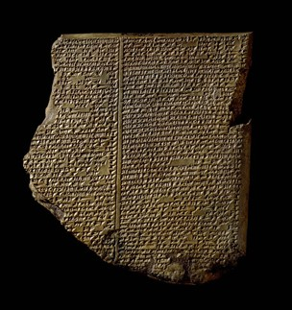
The Gilgamesh Epic from the library of Ashurbanipal, Nineveh, 7th century BC
Tablet 11 of a larger 12 tablet epic describes the flood hero Utnapishtim, who built a boat, survived the flood, released a dove, released a swallow, and then released a raven. He left the boat, offered sacrifices and was granted eternal life.
British Museum, London

Slide 112
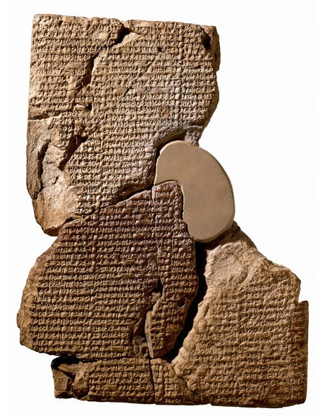
The Atrahasis Epic
17th century, reign of Ammi-Saduqa, Hammurabi’s great-grandson
Atrahasis, the flood hero, builds a boat at the instruction of the god Enki, sealing it wth bitumen. He fills it with animals, shuts the door, and survives the great flood. After Atrahasis embarks and offers a sacrifice, the hungry gods swarm over the offering like flies.
British Museum, London

Slide 113
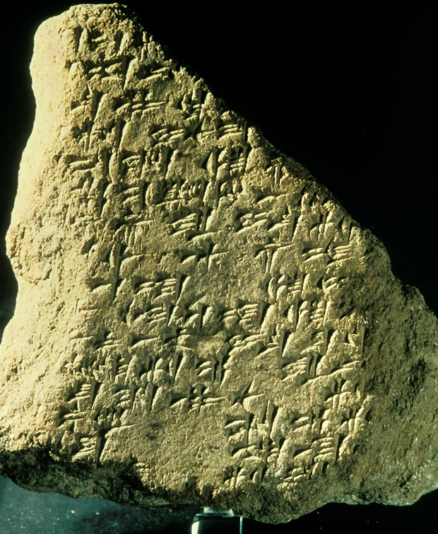
Gilgamesh in Galilee
That the Mesopotamian flood story was known in Canaan, where the Israelites were going, is verified by this fragment of the Gilgamesh Epic found at Megiddo in the 1950s. It dates to the 14th century BC.
Hence, the importance of the biblical corrective is underscored.

Slide 114
The Extent of the Flood
One of the science-related questions concerning the Great Flood is how far did it extend?
Traditionally, most Christians have considered the flood to be global.
  The flood annihilated all humans and land animals except Noah and his cargo.
  The geological phenomena of the earth derive from this global catastrophe (young earth creationism).
However, there are logistical problems with a global flood that are not easily resolved.
  Hence, a more limited flood has been proposed which seeks to do justice to the scientific issues as well as remain faithful to the biblical text.
  The limited flood is more compatible with old earth creationism.

Slide 115
Logistical Problems with a Global Flood
The geological strata as we know it does not fit with a global flood.
Enough water to cover the Himalayas (approximately 6 miles deep from sea level) would require eight times more water than our planet contains.
Ridding the earth of this vast amount of water would have required a miracle every bit as big as providing it.
Neither plant life nor fish life could have survived the extended saline concentrations as ocean and fresh water mixed.
The increase in earth’s mass (by a six mile deep layer of water) would have caused astronomical disturbances now detectable (but there is no evidence).
The task of feeding and caring for representatives of all the species in the world would have been astronomical.
Bernard Ramm, The Christian Approach to Science and Scripture (Eerdmans), pp. 163-168.

Slide 116
The Local Flood Theory
Here, the Genesis flood was more likely a deluge of unparalleled severity in the area of Mesopotamia (but it did not cover the globe).
The language of Genesis is phenomenological, not scientific (i.e., it describes how the flood appeared from a limited vantage point).
The Hebrew word Cr@x@ (= land, earth) need not refer to the globe but to the territory or visible land (e.g., as in Ge. 42:6). The Hebrew word lbeTa (= the whole world) is not used.

Slide 117
Objections to the Local Flood Theory
While the local flood theory alleviates some logistical problems, it leaves unresolved other sorts of problems.
Humans probably lived outside Mesopotamia, and if so, then some people other than Noah and his family must have survived.
New Testament references to the flood seem to presume a global flood (cf. 2 Pe. 2:5; 3:6).
Flood stories have been discovered in virtually all parts of the world (more than 200), and if they have a common origin, the flood must have been beyond Mesopotamia.
A flood sufficient to cover the Ararat mountains (nearly 17,000’) could hardly be contained in the Mesopotamian valley—Mesopotamia is not a water-tight basin.

Slide 118
Four Primary Issues About the Flood Continue to be Debated
The extent of the flood (global or local)
The date of the flood (with substantial evidence that humans crossed the Bering Strait well before 20,000 BC)
Flood geology (catastophism is advocated by the supporters of John Whitcomb & Henry Morris and debunked by Davis Young and other evangelical geologists)
The search for the ark (though several claims have been put forth, the evidence is scanty and highly questionable)
At the end of the day, these issues must be left open with no present resolution.

Slide 119
The Pharaoh and Date of the Exodus

Slide 120
Looming large in the story of the exodus is a scholarly debate about “when.”
Naturally, the relevance of any archaeological or historical data can change drastically if the dating of the biblical events themselves change.
Two theories dominate the field for the dating of the exodus and the invasion of Canaan, and since they are separated by about two centuries, this skews the applicability of the historical and archaeological data, depending upon which date one prefers.
The Dating Debate

Slide 121
The Traditional Date
The traditional date for the exodus has been calculated by internal factors in the Bible itself.
The critical passage is 1 Kings 6:1, which specifically says that there were 480 years between the exodus and the beginning of work on the 1st temple during Solomon’s reign.
Solomon’s reign can be fixed at 970-930 BC.

Slide 122
Doing the Math
If Solomon reigned from 970-930 BC, and construction of the 1st temple began in his 4th regnal year (1 Kg. 6:1), then the construction commencement can be fixed at 966 BC.
If the exodus occurred 480 years earlier, then the exodus can be fixed at 1446 BC.
This date has traditionally been supported by many if not most conservative interpreters.
If the exodus occurred in 1446 BC, then the invasion of Joshua 40 years later occurred in 1406 BC.
Whatever archaeological and historical data is linked to the biblical record must then fit this period.

Slide 123
The Unnamed Pharaoh
Alas, none of the biblical materials designates the Pharaoh of the exodus by name.
The title “Pharaoh” is general, much like our modern titles of king, queen, president, and prime minister.
Hence, we must coordinate our efforts at dating to the known history of Egypt.

Slide 124
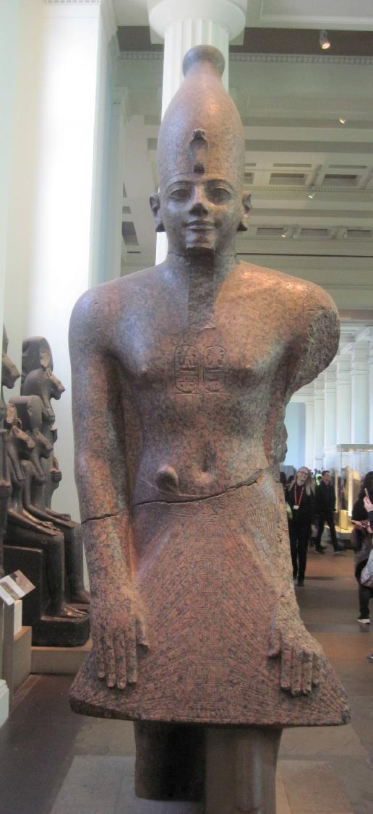
Thutmose III
(ca. 1479-1425 BC)
Possible Pharaoh of the exodus based on the traditional date
Alternative possibilities are Queen Hatshepsut (co-regent with Thutmose III at the beginning of his reign) and Amenhotep II (co-regent with Thutmose III at the end of his reign)
British Museum

Slide 125
The Late Date
A later date has been calculated for the exodus based on additional and/or external factors.
Objections have been raised against the 1446 BC date and how it is calculated.
Many scholars believe that the correlation of the archaeological record with this 15th century date does not fit as well as a 13th century date.
  For instance, Ramesses II of the 13th century is the only known Pharaoh to gain notoriety for large scale building projects using conscripted foreigners.
Hence, the exodus has been re-dated by most scholars to about 1250 BC. This date also fits with the Merneptah stela, which puts the Israelites in Canaan by about 1210 BC.

Slide 126
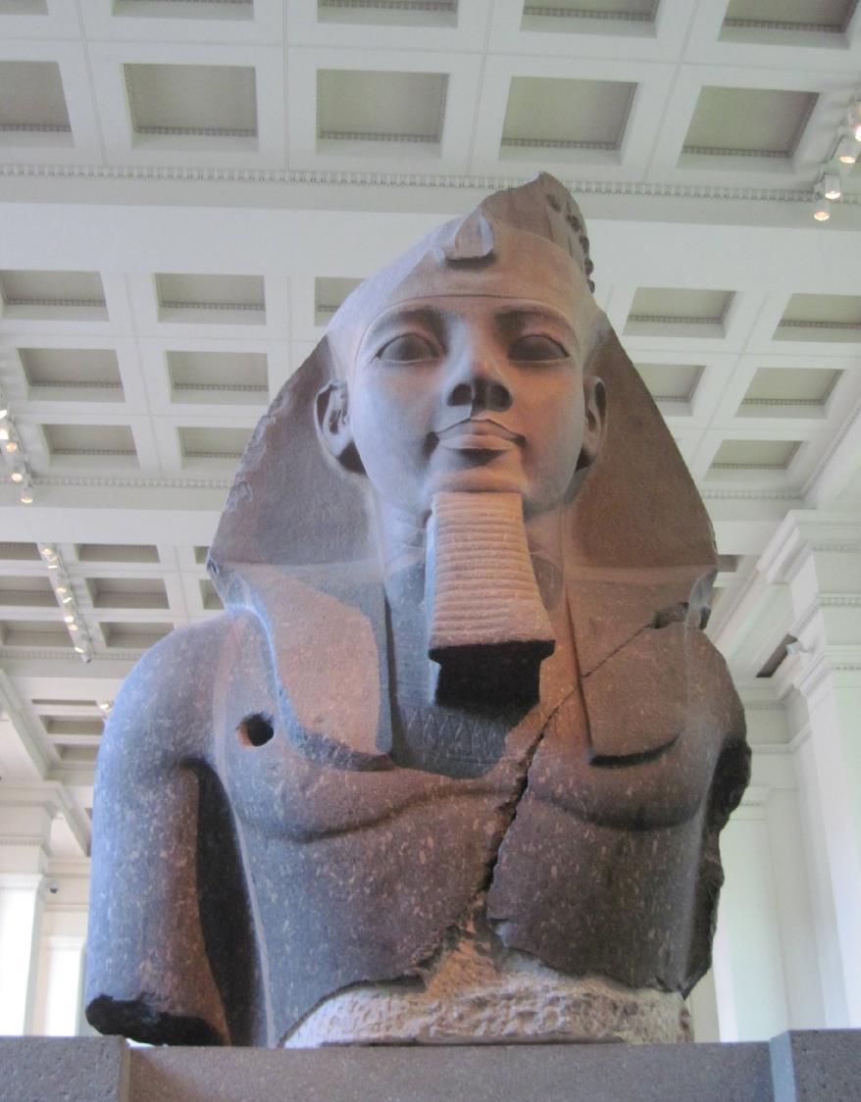
Ramesses II
(ca. 1279-1213 BC)
Possible Pharaoh of the exodus based on the later date
The use of his name in the accounts (Ge. 47:11; Ex. 1`:11; 12:37; Nu. 33:3, 5), even though indirect, suggests this possibility.
British Museum

Slide 127
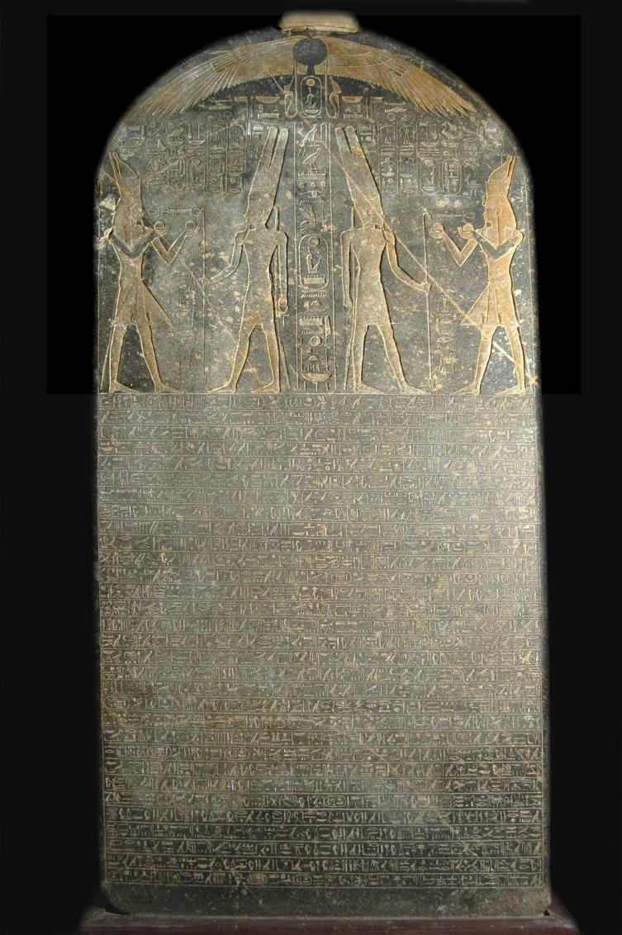
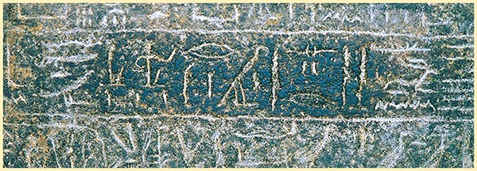
Merneptah Stele
Colloquially known as the “Israel stele,” this monumental inscription excavated in Thebes describes Pharaoh Merneptah’s invasion of Canaan in ca. 1210 BC. In this inscription, he claims to have conquered several Canaanite cities, but also, a people group called “Israel,” apparently a group without a city, in which he inscribed, “Israel is laid waste, its seed is not.” That the Israelites had no city suggests they were recent arrivals.

Slide 128
Objections to the 1446 BC date for the exodus lie along three primary lines.
First, the Old Testament uses many increments of 40 years, and the cumulative figure of 480 years may not be a mathematical one, but rather, a schematic one, approximating 12 generations. If so, then the traditional calculation fails.
Second, the Israelites in bondage are described as building Rameses, the site from where they also set out on the exodus (Ex. 1:11; 12:37). If this is Pi-Rameses, the eastern delta city built by Rameses II, the exodus could not have been in 1446 BC, since Rameses II reigned in 1279-1213 BC.
Third, in the archaeological excavations of Israel, there is a substantial break in the culture at the end of the Late Bronze Age (ca. 1250-1150 BC), a break that would correlate with the emergence of Israel in the land. There is no such break in the 15th century.

Slide 129
The Archaeological Break
It is especially the break in the archaeological sequence that has convinced most scholars that the emergence of Israel must be at the later date.
At the end of the 13th century BC, there was a sharp rise in settlements (farms, hamlets, villages), especially in the territory that belonged to Ephraim and Manasseh (i.e., central Israel).
This sudden rise in population would accord well with the emergence of Israel.
Further, the infrastructure of Canaanite city-states began to break down at the same time, whereas it seems to be intact during the earlier Amarna Period.
Archaeologists date destruction levels at various sites (including Hazor) to the 13th century.

Slide 130
THE AMARNA PERIOD (14th century BC) AND ITS RELEVANCE TO THE DATE OF THE EXODUS
A huge cache of letters was discovered in 1887 at Tel el-Amarna, Egypt, and more have been discovered since (382 in all).
Most of them are imperial documents between Canaanite cities and the Egyptian court in the 14th century BC.
They included correspondence from Canaanite cities like Jerusalem, Lachish, Shechem, Gezer, Gaza, Ashkelon, Joppa, Taanach, and Hazor, all of them cities that appear in the Book of Joshua.
They demonstrate that there was a suzerainty relationship between these city states and the Egyptian Pharaoh.
If the exodus occurred in the 15th century, then the question arises why there is no biblical indication of a relationship between the Canaanite city-states and Egypt during the period of the judges.

Slide 131
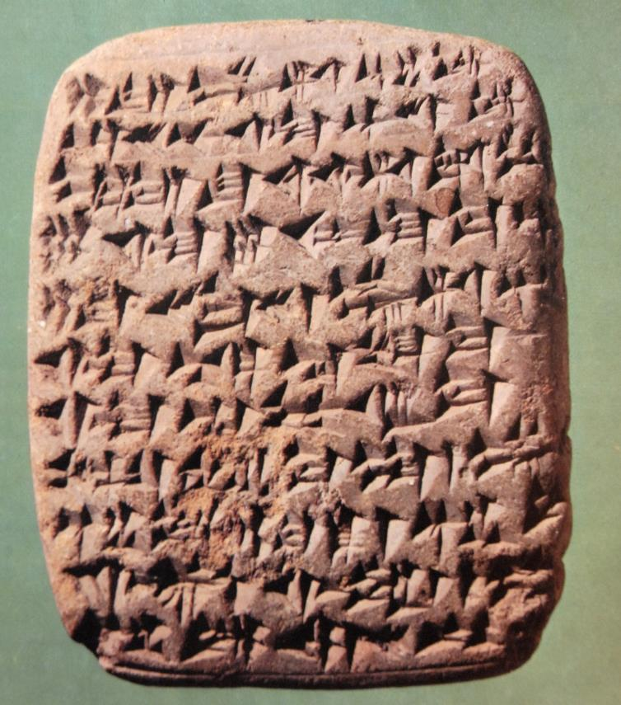
SAMPLE LETTER:
“The war, however, [o]f the Hapiru forces [aga]inst me is extremely severe, and so may the king, my lord, not [ne]glect Sumur lest ever[yon]e be joined to the Hapiru forces. …the w[a]r [agai]nst us is extremely severe, and so may the king not [ne]glect his [ci]ties.”
Amarna Letter EA 68 speaks eloquently of the lack of military preparedness in the Canaanite city of Hebron.

Slide 132
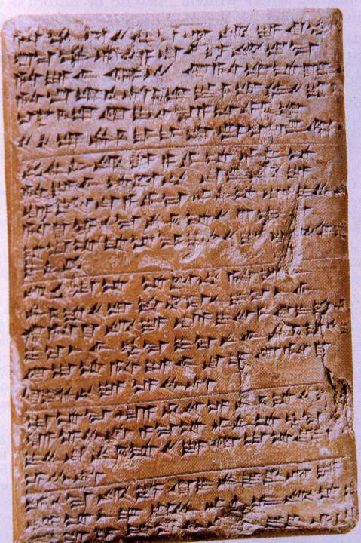
“…message of ‘Abdi-Heba, your servant. Milkilu does not break away from the sons of Lab’ayu and from the sons of Arsawa, as they desire the lands of the king for themselves. …now as for Jerusalem, if this land belongs to the king, why is it not of concern to the king? …Milkilu has written…’let us isolate Jerusalem.’ May the king, my lord, know (that) no garrison of the king is with me. …and so, may the king send 50 men as a garrison to protect the land. The entire land of the king has deserted.”
EA 289 (letter from the governor of Jerusalem to Pharaoh Akhenaten)

Slide 133
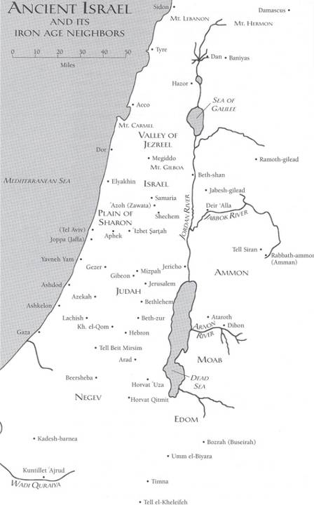
Canaanite cities from which letters were sent to the Pharaoh in Egypt during the Amarna Period.
If one adopts the early date for invasion, Joshua would have entered Canaan in the early Amarna Period or shortly before.
If one adopts the late date for invasion, then Joshua entered Canaan after the Amarna Period, and it is unclear how much of the socio-political structure may have remained intact.

Slide 134
Various of the Amarna letters mention a series of conflicts between Canaanite cities and a group called “the Hapiru.”
The Hapiru sounded a bit like the Israelites—semi-nomadic invaders threatening Canaanite stability.
Some even suggested that there may have been a linguistic link between the name “Hapiru” and the name “Hebrews,” since the names are phonetically similar (though this view is now largely discounted).
Regardless, however one dates the exodus, the Amarna Period must be taken into account.

Slide 135
Implications
If the exodus and invasion of Canaan are placed in the 15th century (early date), the interaction between Moses and Pharaoh must be worked out in the context of Egypt’s rulers Thutmose I, Hatshepsut, and Thutmoses III (the latter who would most likely have been the Pharaoh of the exodus):
Many Christians are uncomfortable with the idea that the Bible uses schematic numbers, preferring instead that all numbers must be treated strictly mathematically.
Since we possess the mummy of Rameses II (Cairo Museum), it seems unlikely that he died in the Red Sea.

Slide 136
Implications Cont.--
If the exodus and invasion of Canaan are placed in the 13th century BC (later date), then the Hapiru in the Amarna Letters of the 14th century cannot be directly linked to the Israelites.
The political relationship between Egypt and Canaan during the Amarna Period would be irrelevant for assessing conditions during Joshua’s invasion.
In either case, the archaeological record figures significantly in the attempt to fix a date.
Currently, most non-evangelical scholars support the later date as do some evangelical scholars. However, other conservative scholars continue to support the early date.

Slide 137
The Lack of Archaeological Evidence for the Exodus

Slide 138
One of the debated factors regarding the exodus story is the absence of archaeological corroboration.
To date, there is no unequivocal material remains of the Israelites in Egypt or their departure in a mass exodus into the Sinai Peninsula.
Further, there is no surviving textual material outside the Bible that speaks of the exodus.
To be sure, as Egyptologist Kenneth Kitchen (University of Liverpool) has aptly put it, “Absence of evidence is not evidence of absence.”
Still, this “gap” has led to the development of what are called “minimalists” and “maximalists.”
The Archaeological Issue

Slide 139
Minimalists
(the terms “minimalist” and “maximalist” were coined by William Hallo of Yale University)
Minimalists are those scholars who widely doubt the reliability of the biblical record: they doubt or reject all historical statements in the Bible unless corroborated by extra-biblical sources from the ancient Near East.
  Large portions of biblical history, including the exodus narratives, are treated as legend or heroic myth.
  Current major “players” include:
    Philip Davies (University of Sheffield)
    Niels Peter Lemche (University of Copenhagen)
    Thomas Thompson (Marquette University)
    Margaret Steiner (University of Leiden)

Slide 140
Maximalists
Maximalists are those scholars who tend to accept historical statements in the biblical record unless disproved by extra-biblical evidence.
  Current major “players” include:
    William Dever (University of Arizona)
    Kenneth Kitchen (University of Liverpool)
    Alan Millard (University of Liverpool)
    William Hallo (Yale University)
    Kyle McCarter (Johns Hopkins University)
    Andre Lemaire (Sorbonne University)

Slide 141
This debate, in turn, has led to two basic positions in the academy regarding the Israelites in Egypt and the exodus.
The Israelites were never there…
The account of the exodus is mere folklore and legend.
It was composed centuries after the event, so the account cannot be read as “history.”
The Israelites were there, but we have had unrealistic expectations as to what archaeology can deliver…
The ability to determine ethnicity in the archaeological record is quite limited, so trying to find “Israel” in Egypt is nearly impossible.
The area where the Israelites lived, the northeastern Delta (cf. Ge. 45:10; 47:4, 6, 11; Ex. 8:22; 9:26), has a very high water table (due to the waters of the Nile River), which makes excavation difficult and expensive.
No historical or administrative papyri, which might have had a bearing on Israel in Egypt, has survived in this damp environment.

Slide 142
Factors to consider…
The Egyptians were not famous for recording their defeats.
When they experienced military victories, they built monuments to these victories.
When they suffered defeat, they either remained silent or, in some cases, claimed victory when there was none.
Hence, expecting to find a text describing an Israelite triumph over Pharaoh is unlikely.
In this relief of the Battle of Kadesh against the Hittites (1273 BC), the Egyptians suffered near disaster, but in their monuments, Ramesses II claimed to crush the Hittites under his chariot wheels.

Slide 143
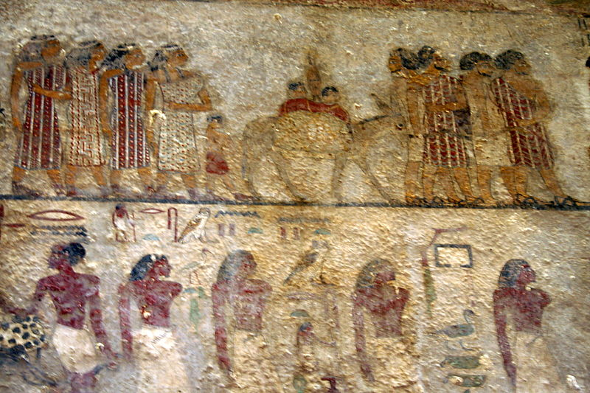
Were there Semites in Egypt?
There certainly is substantial evidence of Semitic peoples like the Israelites migrating to Egypt, usually tempted by better grazing for their livestock or by food in times of drought. This is precisely what is described in Genesis regarding Jacob and his family (cf. Ge. 42-43).
In this 19th century BC mural from a tomb painting in Beni-Hassan (left), colorfully dressed Bedouin Semites, regarded as “foreigners” by the Egyptians, are shown asking permission to enter Egypt.
In addition, several texts, including one from Pharaoh Menerptah (1213-1203 BC), describe Semites entering Egypt, and these texts span some 700 centuries during the 2nd millennium BC.

Slide 144
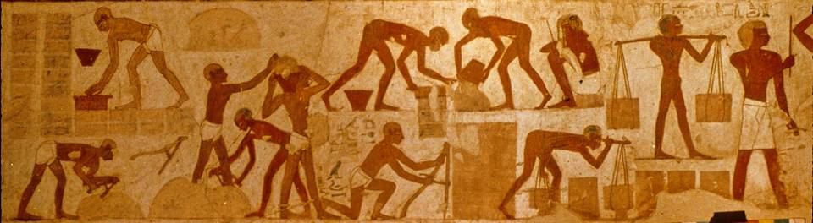
Were Semites reduced to slavery in Egypt?
New Kingdom Egypt is well-known for its military campaigns into Canaan and other places, where many captives were brought to Egypt as slaves, some of which are pictured here making mud bricks in this famous tomb painting from the 15th century BC. The accompanying text identifies them as Canaanites and Nubians. Egyptian supervisors monitor them as they gather mud and water, mix the materials, form mudbricks, carry dried bricks, and measure a wall.
The Book of Exodus describes just such slavery (Ex. 5:6-18).

Slide 145
Quotas for brick-making…
Egyptian records (preserved on a leather scroll in the Louvre Museum) from the 5th regnal year of Ramesses II describe quotas imposed on the brick-makers.
Sometimes quotas were reached; sometimes not.
One Egyptian officer complained that he was unable to complete his quota, since “…there were no men to make bricks nor straw in the neighborhood.”
This situation sounds very much like what is described in the Book of Exodus.

Slide 146
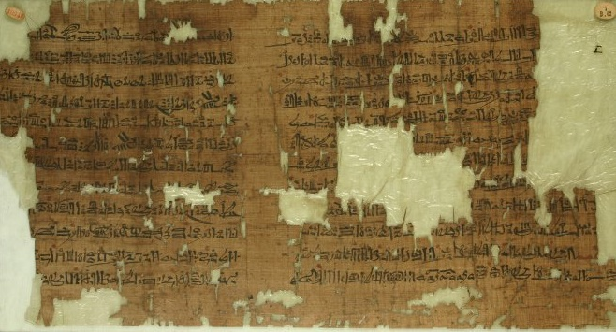
Papyrus Anastasi III
This report from about 1210 BC (in hieratic script) is from an Egyptian officer describing work done in the royal workshops, including quotas set for brickmakers: “Likewise…people are making bricks…they are making their quota of bricks daily.”
British Museum, London

Slide 147
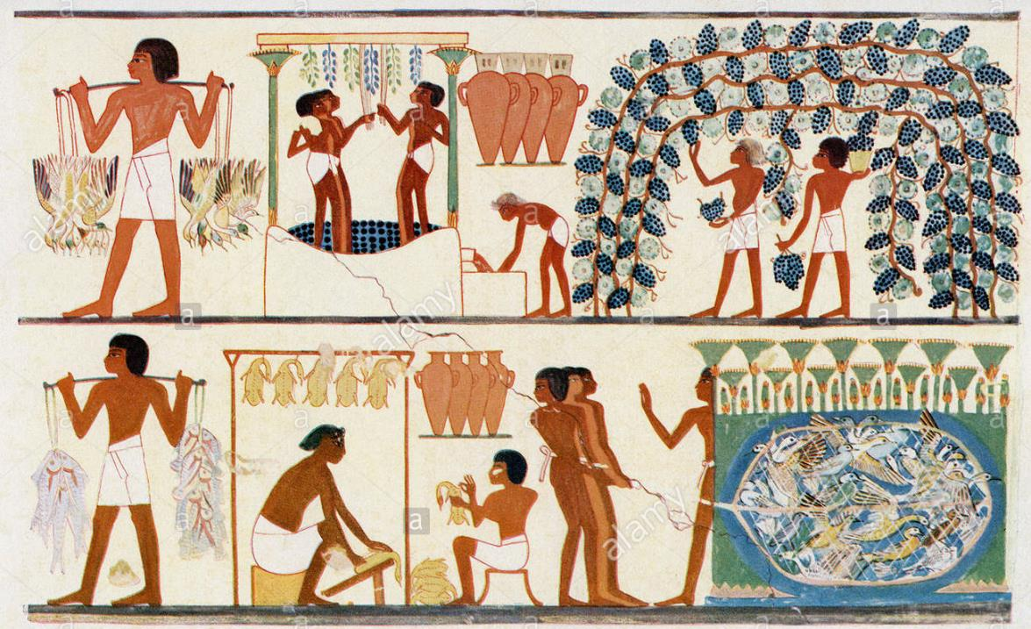
Slaves and agricultural work…
Beside brick-making, the Israelites also were involved in “all kinds of work in the field” (Ex. 1:14).
Slaves appear in Egyptian paintings herding cattle, serving in vineyards, and working in winepresses.
This 19th century copy of a wall painting shows slaves gathering grapes, stomping grapes in a vat, and collecting the juice in jugs for storage.

Slide 148
The importance of toponyms…
The importance of place names is that if a story was concocted centuries after the fact, one would not expect it to contain little-known references to geography. Hence, identifiable places in the exodus story lend credibility to the narratives, suggesting real historical memory.
Ramesses, the “storage city” on which the Israelites worked (Ex. 1:11) and from which they started their trek out of Egypt (Ex. 12:37; Nu. 33:3), is likely the Delta capital built by and named for Ramesses II. There is now wide agreement among scholars that it has been identified.
Pi-Ramesses (city of Ramesses) had a relatively short life-span (ca. 1275-1075 BC), however, and was abandoned. It is unlikely that someone writing a legendary account hundreds of years later would even have known about Pi-Ramesses.

Slide 149
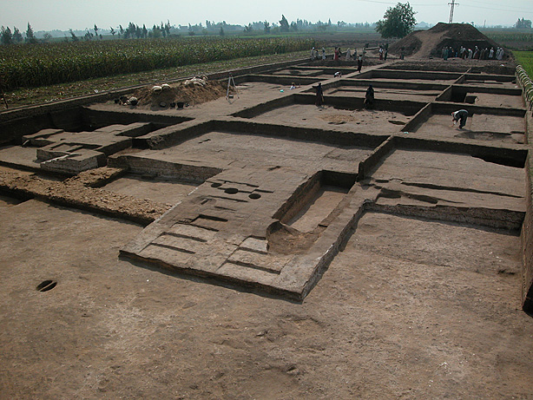
Excavations at Pi-Ramesses are ongoing

Slide 150
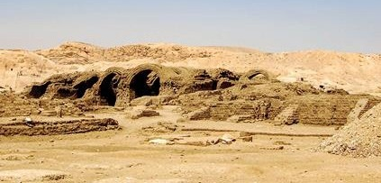
Storage Depots
These mudbrick storage depots stand near the mortuary temple of Ramesses II in Thebes (13th century BC). Such depots provided stored food to guarantee that the temple could keep functioning in the event of the Pharaoh’s death. The “storage cities” of Pithom and Rameses in Ex. 1:11 were likely similar.

Slide 151
The Problem of the Large Census Numbers

Slide 152
The Number of the Israelites Fleeing Egypt
The number of Israelites in the exodus has also been debated.
The round number given in Ex. 12:37 (which generally agrees with the figures cited in Numbers 1) is about 600,000 men plus women and children, a group in total of perhaps 2 or 2 ½ million people.
Several factors make this large number difficult apart from the fact that the transmission of numbers in written texts is itself difficult (since Arabic numbers were not yet in use).
Further, the Israelites later would be described as “the fewest of all peoples” (Dt. 7:7), and if they numbered more than 2 million, they would have been by far the largest people group the world had thus far seen.

Slide 153
The Logistical Difficulties
Known armies of the period averaged only about 5000 or 6000, and the largest known to date was only 20,000.
The total population of Egypt was hardly more than 3 million, and there is no evidence for the depopulation of Egypt.
Could 70 people (cf. Ex. 1:5) proliferate into a group of over two million in only four generations (cf. Ge. 15:16)?
At the time of the first census, there were 22,273 firstborn males over a month old (Nu. 3:40-43). To account for this relatively small number for a group of 2 million or more, this would mean that each household would need to produce about 27 sons and additional daughters, and each mother would need to bear about 50 children.
Could a group the size of metropolitan Detroit and all their animals break camp and cross a body of water in a single day?
How could a mere two mid-wives handle all the births in such a large group (1:15ff.)?
How could Moses “speak” to such a large group of people?

Slide 154
How could sufficient provisions for fodder be found for the livestock of such a large group?
How could issues of sanitation, camping, and travel be arranged for such a large group (e.g., Dt. 23:12).
The typical fighting forces described in other ancient Near Eastern texts are not over 20,000 warriors, yet the Israelites are described as “the fewest of all peoples” (Dt. 7:7), and the Canaanites are described as “larger and stronger” (Dt. 7:1).
Why would such a huge force fear the comparatively small 600 Egyptian chariots (Ex. 14:7, 10)?
The Israelites seem to be smaller in number than the Canaanites (cf. Ex. 23:30).

Slide 155
Possible Solutions
Writing out numbers in Hebrew without Arabic numbers:
M’W0imiH3V1 tOxme wmeHEV1 MypilAxE tw,lw;U Jl,x, tOxme-wwe
fifty hundred five-and thousands three-and thousand hundred six
(read right to left)
If the large numbers are retained, then one must accept that there were many unnamed miracles associated with the exodus as well as many features of daily life that were not described.
Since the Hebrew word for “thousand” (Jl,x,) also doubles for the word “captain,” “clan,” and “military unit,” some have suggested a translation solution that would reduce the total number of Israelites to about 20,000 or so (i.e., 600 clans) rather than 2 ½ million (the traditional estimate).

Slide 156
The Dating of Deuteronomy

Slide 157
The Discovery of the Torah Scroll
During temple repairs, Hilkiah, the high priest during the early reign of Josiah (7th century BC), reported the discovery of a Torah scroll.
The distressed reaction of Josiah when it was read suggests that it may have been the scroll of Deuteronomy with its searing curses for covenant disobedience (2 Kg. 22:11; cf. Dt. 28).
The scroll was then sent to Huldah, the prophetess, and she confirmed that the predicted disaster would surely happen because of covenant unfaithfulness (2 Kg. 22:14-20).

Slide 158
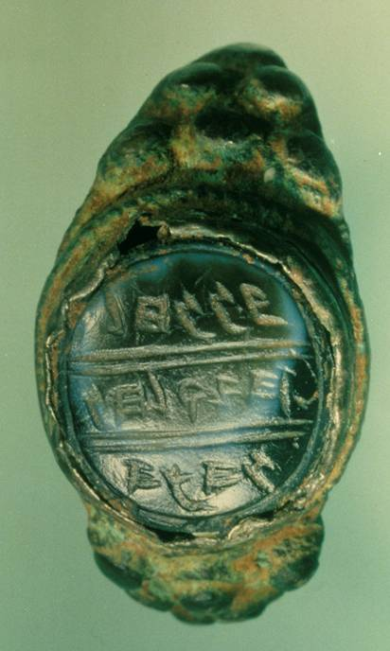
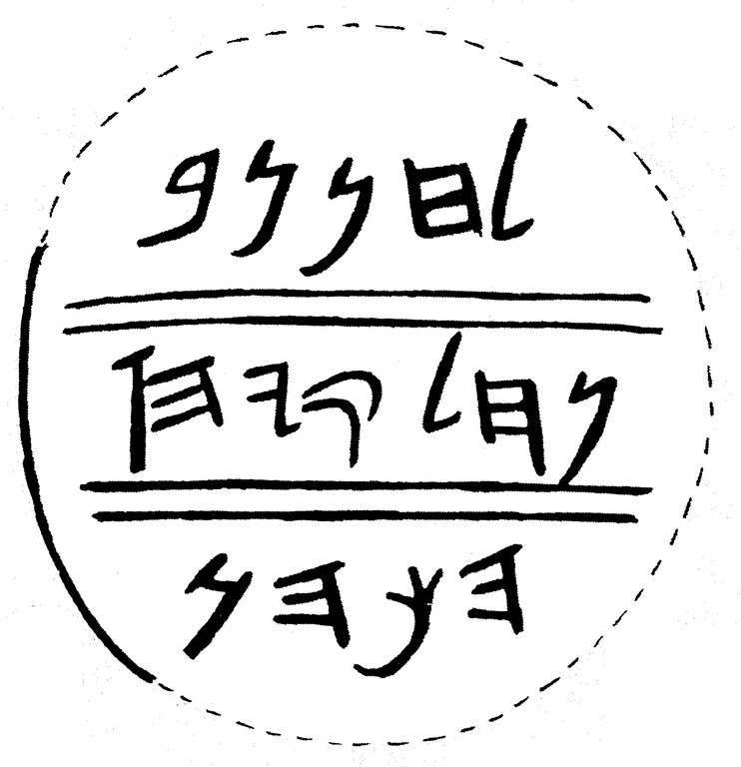
Hilkiah’s name surfaces on a sealing ring
The three-line inscription…
“[belonging] to Hanan, son [of] Hilqiyahu”
…may indicate that this ring belonged to the son of the priest who discovered the Torah scroll.

Slide 159
Historical-Critical Scholarship and the “Discovered” Torah Scroll
Historical-critical scholars have speculated considerably about the discovered Torah scroll.
First, the full Torah (five books) existed on five separate scrolls, so whatever was discovered could not have been the whole Torah, but only one scroll of the Torah at most.
Second, scholars concluded that the so-called “Books of Moses” either were not in their final form from the time of Moses and/or were composed or edited much later than Moses.
The tendency has been to consider this Torah scroll (Deuteronomy) to be a fresh composition, and the account of its “discovery” is thought to be an artifice to gain its acceptance.

Slide 160
Conservative Scholarship
Conservative scholars are doubtful about this theory of late composition and/or editing of the Book of Deuteronomy.
Though allowing for some later revisions and/or additions (e.g., the account of Moses’ death, cf. Dt. 34, etc.), they still give the lion’s share of credit to Moses himself.
Rather than a fresh composition, they suggest that the Torah scroll may have been suppressed during the dark regime of Manasseh. Indeed, the Chronicler’s record indicates that it was known during the reign of Jehoshaphat (cf. 2 Chr. 17:9). Hence, its discovery was not an artifice, but a genuine recovery of something that had been misplaced or lost.

Slide 161
Archaeology and the Problem at Jericho

Slide 162
The Archaeological Issue
In the early 20th century archaeology was embraced as the “proof” of the Bible—a “savior” from the negative conclusions of the literary critics.
Many new discoveries seemed to validate the biblical story of Joshua, such as:
The Hapiru in the Amarna Letters
John Garstang’s excavation of Jericho
Yadin’s excavation of Hazor

Slide 163
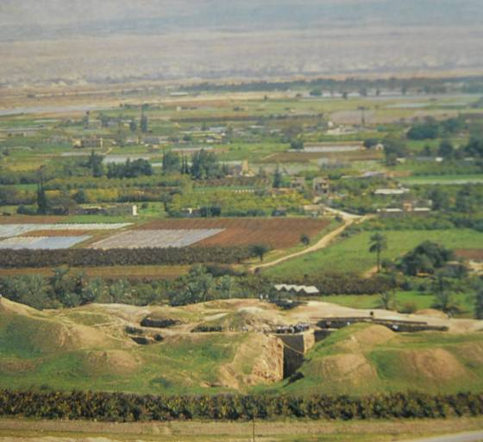
Garstang at Jericho
John Garstang (University of Liverpool) excavated the tel at Jericho, 1930-36.
He discovered a destruction layer which he dated to ca. 1400 BC (corresponding to the early date for Joshua’s invasion).
He also discovered a fallen double wall dating to about the same period.
The Tel at Jericho

Slide 164
A perception developed among some Christians that there was a sort of straightforward relationship between archaeology and the Bible. Archaeology was sometimes called upon to “prove” the Bible. When these early opinions were reversed by other archaeologists, conservative Christians, who had tied their hopes to archaeology, were not prepared for such a reversal.

Slide 165
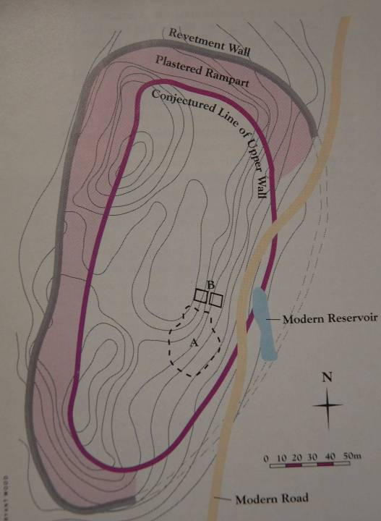
City IV
All scholars agree that City IV at Jericho, a heavily fortified city, was violently destroyed.
It was fortified with a revetment wall, a plastered rampart, and an upper wall of mudbrick.

Slide 166
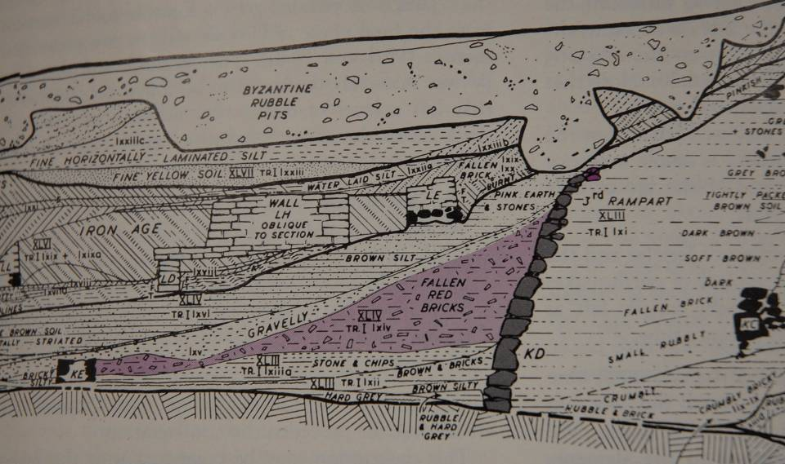
Anatomy of the Jericho Tell the critical stratigraphy at Jericho

Slide 167
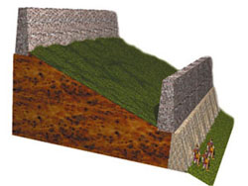
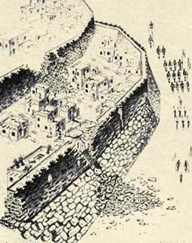
Jericho’s Fortifications
Cross section sketch of Jericho’s double wall fortifications based on Kenyon’s west trench excavation.
How the walls may have collapsed outwardly in sections, leaving Rahab’s house “in the wall” intact.

Slide 168
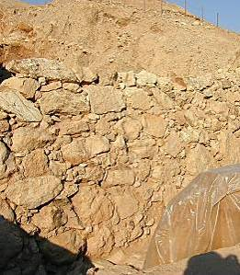
This Jericho revetment wall supported the slope of the tell in the Middle Bronze Age (12’-15’ high).
On top of the revetment wall was a mudbrick parapet wall (6’ thick and 20’-26’ high), which collapsed, leaving brick debris at the base of the revetment wall.

Slide 169
Kenyon’s Revision
When Kathleen Kenyon (British Museum) later excavated at Jericho once more, she also discovered the fallen double wall, but on the basis of an absence of certain pottery types, she dated Jericho’s destruction to ca. 1550 BC (much too early for Joshua).
Today, most archaeologists accept Kenyon’s dating.
Further, since there was no evidence of a later wall, they agree with Kenyon’s conclusions that at the time of Joshua’s invasion, there was no walled city at Jericho to fall down. (Kenyon used the later invasion date, but if her dating of the city’s destruction is accurate, her negative conclusion would apply equally to the early invasion date).

Slide 170
Wood’s Revision of Kenyon’s Revision
More recently, Bryant Wood (University of Toronto) has argued that Kenyon was wrong and Garstang was correct to date the destruction at ca. 1400 BC, but most scholars have not accepted his conclusions.
To complicate matters, the tell at Jericho is severely eroded.
Also problematic is the fact that a modern road has destroyed part of the tel.
Based on this massive erosion, some scholars suggest that there is insufficient data to be precise, and Joshua’s Jericho simply can no longer be found.

Slide 171
Today, even conservative Christian scholars agree that one must be very careful in the use of archaeology as related to the Bible.
The role of archaeology is not “proof” but offers help with context (e.g., ancient culture, historical setting, etc.)
Archaeology should not assume the role of authenticating the Bible as though an external proof were necessary or even possible.
Just as archaeology cannot “prove” the Bible to be true, it is equally important to remember that archaeology cannot “disprove” the Bible, either.

Slide 172
The Emergence of Israel in Canaan

Slide 173
The Emergence of Israel
Given the rather mixed results of literary theories and archaeological reassessments, by the late 20th century modern scholars now struggled to find a model for the emergence of Israel that correlated with all these factors.
The Bible, of course, describes the emergence of Israel through the narratives of the exodus and Joshua’s invasion of the land of Canaan.
Historical-critical scholars were quite willing to adjust or even reject the biblical story in light of their various scientific approaches.

Slide 174
There is a terminus ad quem (i.e., a limiting point in time) for Israel’s appearance in Canaan.
Composed in Egyptian hieroglyphics, this hymn of victory boasts that Pharaoh Merneptah triumphed over Israel (ca. 1210 BC) during a military campaign into Canaan. The stela was installed in Merneptah’s funerary shrine in Thebes and discovered by Sir Flinders Petrie in 1896.
Cairo Museum, Cairo, Egypt

Slide 175
Models for Israel’s Origins
Since there was an identifiable group called “Israel” in Canaan by 1210 BC, but also since there was a lack of clear archaeological evidence of Israel’s exodus from Egypt and a 40-year sojourn in the Sinai Peninsula, four paradigms have been developed by scholars for how Israel emerged as a people in Canaan.
Some of these models were quite incompatible with the Bible’s record.

Slide 176
The Conquest Model
William Albright; G. Ernest Wright
This model, patterned after the Book of Joshua, attempted to preserve the Bible’s story for the most part.
Based on the destruction layers of some Canaanite cities at approximately the “right” time period (Late Bronze Age), it suggested that the Israelites came from the outside and conquered Canaan by a military invasion.
However, the archaeological record worked better for some Canaanite cities than for others, and the evidence yielded mixed results. Hazor was clearly burned, but the excavations at Jericho raised more questions than they answered.

Slide 177
The Immigration Model
Albrecht Alt; Martin Noth
This model proposed that the Israelites came from the outside, possibly Egypt, and first occupied the highlands of Canaan but only gradually extended their control to the plains.
Here, the rise of Israel was not by outright conquest but by a gradually attained superiority over many years.
This model follows the pattern in the Book of Judges while at the same time questioning the conquest narratives in the Book of Joshua.

Slide 178
The Revolt Model
George Mendenhall; Norman Gottwald
This model held that the Israelites were lower class Canaanites who rebelled against their overlords, eventually forming an identifiable group later called “Israel.”
Hence, they did not come from the outside at all, and they certainly did not arrive via any “exodus” from Egypt.
Their emergence was more along the lines of the Marxist theories of a revolt against the bourgeoisie, an internal uprising against Canaanite feudalism.

Slide 179
Gradual Emergence Model
21st Century Consensus among Critical Scholars
By the turn of the millennium, most historical-critical scholars had reached the conclusion that any reconciliation between the Book of Joshua and the archaeological record was impossible.
Hence, some form of gradual emergence must be adopted.
The Israelites were insider Canaanites who gradually developed a separate identity, migrated from the highlands to the lowlands, and eventually gained dominance.
…the external evidence supports almost nothing of the biblical account of a large-scale, concerted Israelite military invasion of Canaan… William Dever (University of Arizona)

Slide 180
Where do we go from here?
In the first place, biblical Christians share the conviction that the Bible is trustworthy and that God’s revelation in Scripture cannot contradict his revelation in the concrete world of experience.
At the same time, they also know that God is sovereign and that truth has time on its side.
While history is very important, even history is not, in itself, the center of faith: the center is the conviction of sin and the acceptance of the gospel. Historical questions must be worked out from that center.
Biblical Christians have long survived as a minority with respect to cultural trends and opinions, but what they must not do is abandon the field.

Slide 181
The issues concerning the Book of Joshua are part of a larger picture.
In our post-modern world, there is a decided trend toward revisionist history.
Much of history is currently being rewritten by deconstructionist literary theorists and political activists. To assume that biblical studies will be exempt from the influences of this trend is naïve.
Postmodernism is the handmaiden of this trend with its rejection of the notion of historical objectivity and its concerted attack upon written texts as untrustworthy.

Slide 182
At the same time, it must be remembered that BOTH archaeology AND the Bible are interpreted sources of information.
ARCHAEOLOGY
Over-confidence in the archaeological enterprise that claims “assured results” often is undermined by further investigation.
Only a fraction of the archaeological sites in Israel have been excavated.
THE BIBLE
Christians also must be careful in their biblical interpretation so that they do not force the Bible to say what it, in fact, does not say.
Some interpreters have reached unwarranted conclusions about what the Bible actually says.

Slide 183
A case in point…
Language must be given enough flexibility so that phrases like “the entire land” (Jos. 11:23) and “all the land” (Jos. 21:43) should be qualified by parallel statements in the biblical text.
“…there are still very large areas of land to be taken over” (Jos. 13:1)
“Judah could not dislodge the Jebusites…” (Jos. 15:63)
“They did not dislodge the Canaanites living in Gezer…” (Jos. 16:10)
“…the Manassites were not able to occupy these towns…” (Jos. 17:12)

Slide 184
Invasion is not the same as occupation. At the very least, the Book of Joshua does not describe a total occupation.
When Christians conclude (wrongly) that it does, they open themselves to criticisms that are unnecessary.
Even the Deuteronomic promise did not include total occupation immediately: “Yahweh your God will drive out those nations…little by little. You will not be allowed to eliminate them all at once…” (Dt. 7:22).
The Book of Joshua describes disabling raids, not territorial occupation. After their various raids in the center, the south, and the north, the Israelites simply returned to their base camp at Gilgal (Jos. 10:15, 43; 14:6).

Slide 185
An interpretive approach is required that takes into consideration all these factors as opposed to a selective approach that singles out and isolates some passages without giving due consideration to others.

Slide 186
The common interpretation of a sweeping conquest with nearly immediate occupation of the whole land is not what the Book of Joshua actually describes. To expect archaeology to demonstrate such a conclusion is deeply flawed!

Slide 187
Joshua’s Long Day

Slide 188
Battle of Gibeon
When a runner from Gibeon pleaded for help, Joshua force-marched the Israelite forces from Gilgal to Gibeon, taking the coalition by surprise.
Yahweh directly intervened with a hail storm (and since the Canaanites worshipped Ba’al, lord of storm, they must have thought their own gods had turned against them).
Isaiah later would call this divine intervention Yahweh’s “strange work” (Is. 28:21).
During the battle, Joshua prayed so that the daylight hours were miraculously extended enabling the Israelite army to continue their pursuit of the Amorite coalition forces.
Both Jews and Christians have always considered this to be a miracle that defied human explanation.

Slide 189
Two Bogus Links
The “Missing Day” story
An urban legend that scientists have uncovered a “missing day” through astronomy and computer research linked directly to Joshua’s long day has persisted since 1936 and still circulates on the Internet.
It is simply not true and has been appropriately debunked by such conservative institutions as Moody Bible Institute and the periodical Christianity Today.
The Book of Jashar
This relatively recent forgery, published in 1829 and said to have been “rediscovered” in England in 1721 claims to be the document cited in the Book of Joshua.
The occultic society of the Rosicrucians published it again in 1953, but scholars have determined it to be an 18th century forgery.

Slide 190
The Moral Problem of War Against the Canaanites

Slide 191
The Moral Problem of War
Canaan was not open, available land to the Israelites. Rather, it was widely populated by various Canaanite groups.
The wars were wars of extermination commanded by Yahweh (Jos. 6:17, 24; 8:24, 29; 10:40; 11:12; Dt. 7:1-2, 16, 24; 13:12-16; 20:16-18).
The Hebrew term MrH (= banned, utterly destroyed) describes the mass killing of the Canaanites.
Such wars have caused considerable distress for modern sensitivities, particularly in light of the message of peace through Christ.
Hence, some modern interpreters reject the Book of Joshua as fundamentally incompatible with Christianity.

Slide 192
“Much about the Book of Joshua is repulsive, starting with ethnic cleansing, the savage dispossession and genocide of native peoples, and the massacre of women and children—all not simply condoned but ordered by God. These features are worse than abhorrent; they are far beyond the pale…”
Robert Coote
New Interpreters Bible (1998)

Slide 193
“This is a case where biblical authority is a dangerous and misleading concept. The aura of biblical authority must not be allowed to mask the utter barbarity of the conduct.” John Collins
Introduction to the Hebrew Bible (2004)
“The God of the Old Testament is arguably the most unpleasant character in all fiction; jealous and proud of it; a petty, unjust, unforgiving control-freak; a vindictive, bloodthirsty ethnic cleanser…
Richard Dawkins
The God Delusion (2006)

Slide 194
Can the wars against the Canaanites be correlated with the calling of Israel to be a blessing to the nations, a kingdom of priests among the nations of the world?

Slide 195
BASIC MORAL ASSUMPTIONS
Conservative interpreters generally work within the parameters of what are considered to be moral constants:
God is always good and compassionate.
The OT is a faithful record of God’s dealings with humans.
The OT describes events that are similar to genocide and/or ethnic cleansing.
Mass killings are evil.
The problem is that these moral constants collide in the wars of Israel against the Canaanites.

Slide 196
DIFFERENT APPROACHES interpreters have offered multiple solutions
The OT Text is Not Faithful
Events Less Violent Than They Seem
The Destruction was Justifiable
Here, it is argued that the destruction of the Canaanites never happened.
The texts were written much later (in the time of Josiah), long after the Canaanites had disappeared.
They were written in the interests of Josiah’s reform movement as a stimulant to remove the remnants of Canaanite religion.
Here, it is argued that the events are not as violent as they appear.
The herem texts are treated as non-lethal, either as a destruction of Canaanite religious paraphernalia or a metaphor for religious fidelity.
What was called for was expulsion, not extermination.
It was a destruction of Canaanite identity, not the Canaanite people.
God’s judgments are righteous, but sometimes they are mysterious and incomprehensible to humans.
The Canaanites were utterly wicked, deserving to be destroyed (Ge. 15:16; Lv. 18:24-25; Dt. 9:4-5; 2 Chr. 28:3.
God was gracious to the Canaanites, giving them many centuries to repent.

Slide 197
The Ethics of Yahweh War
The wars of Israel against the Canaanites were not merely wars of conquest.
As early as Abraham, Yahweh anticipated that these wars would be wars of judgment (Ge. 15:16).
The Canaanites’ immoral lifestyles were so vile that the land would “vomit out its inhabitants” (Lv. 18:24-27).
Such immorality was abhorrent to God himself (Lv. 20:22-23).
Hence, the wars of Joshua were to be waged “on account of the wickedness of these nations” (Dt. 9:5; 18:9, 12).
They were analogous to the plagues of Egypt, where “Yahweh brought judgment upon their gods” (cf. Nu. 33:4b).

Slide 198
“…the sin of the Amorites…”
(Ge. 15:16; Dt. 7:25-26; 12:31; 18:9-12; 20:18)
Idolatry
Child sacrifice
Divination and sorcery
Omens
Witchcraft and spells
Consulting the dead

Slide 199
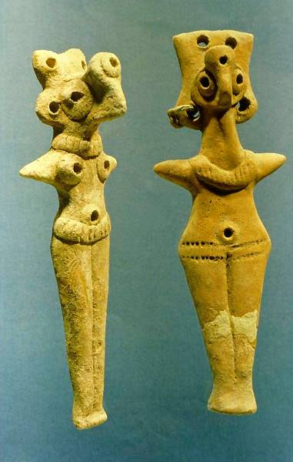
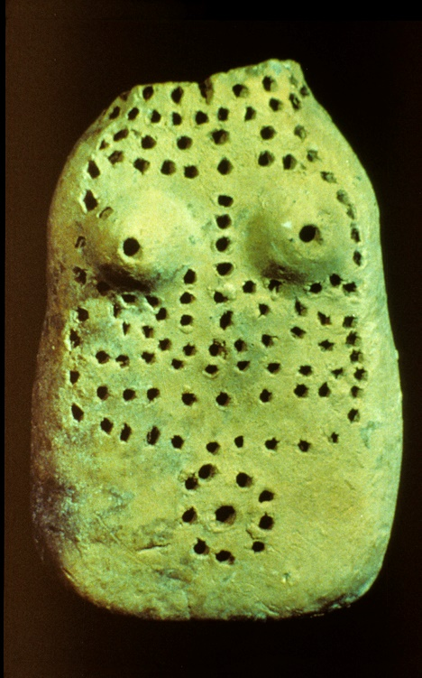
Goddess figures, probably Asherah or Astarte (ca. 14th or 13th century BC), the two major goddesses of the Canaanite pantheon.
Israel Museum, Jerusalem

Slide 200
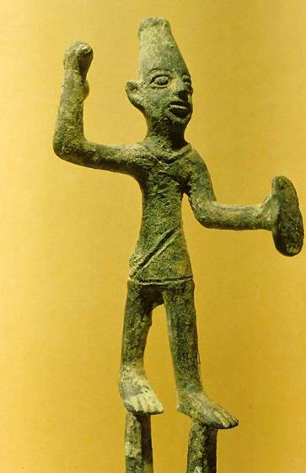
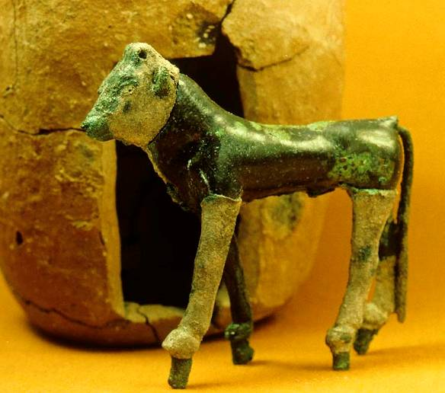
The god El in the form of a bull, symbolizing power and sexual virility.
Image of Ba’al, the Canaanite storm god

Slide 201
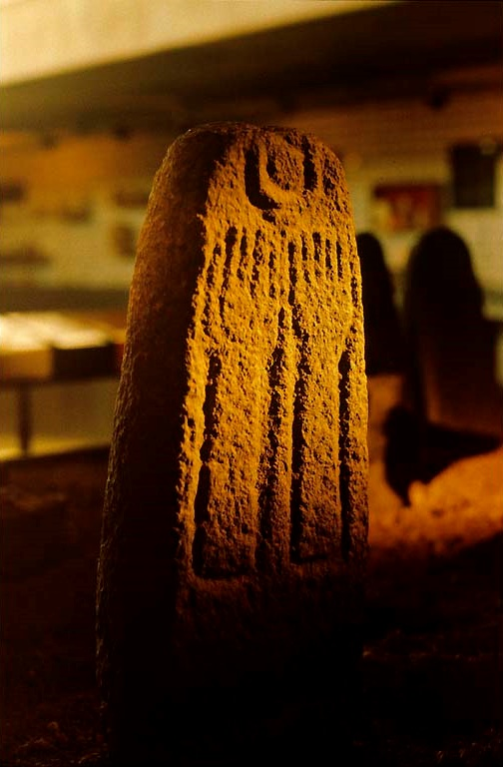
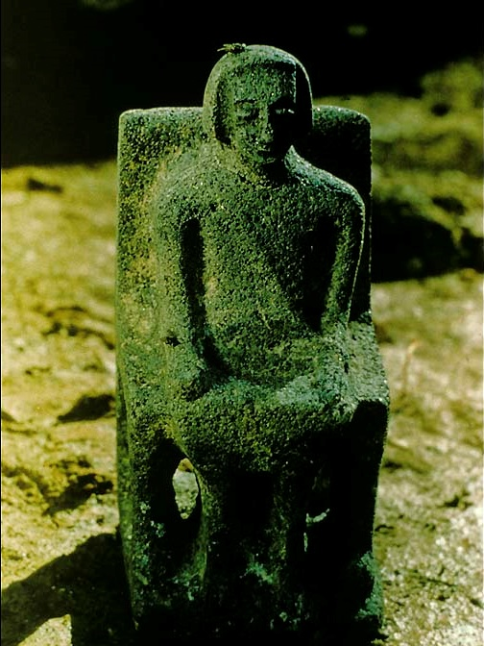
Seated god (probably El) from Hazor.
Lunar deity (Ba’al Hamon) from Hazor.

Slide 202
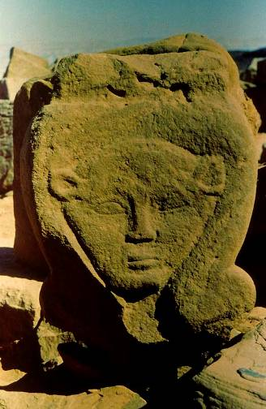
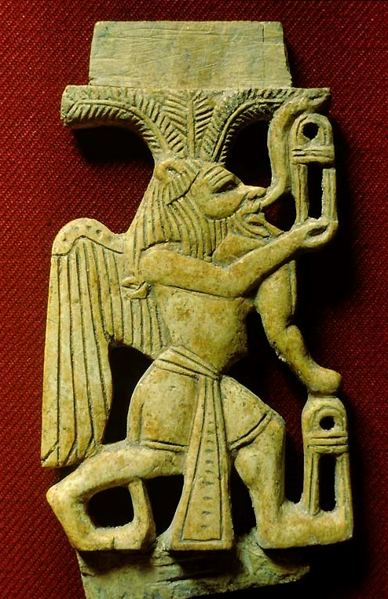
Egyptian deities in Canaan
Because Canaan was under Egyptian hegemony, it is not surprising to find Egyptian deities in Canaan as well.
Hathor, the mother-goddess and queen of the underworld
Bes, the protector of pregnant women and guardian of evil spirits, excavated at Megiddo.

Slide 203
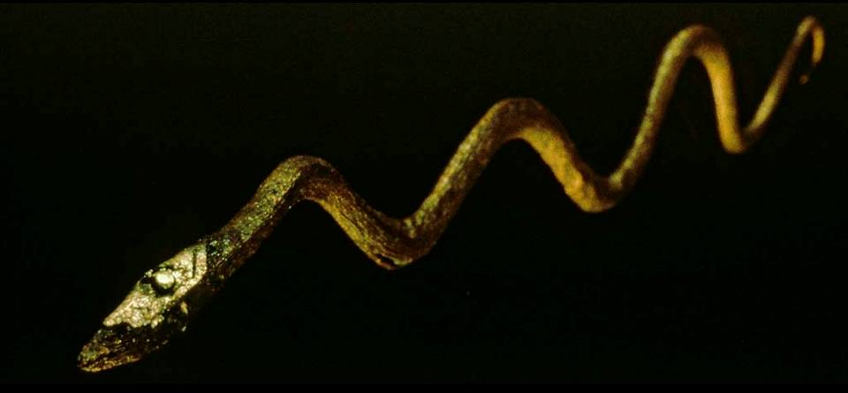
This serpent image (13th-12th century BC), used by the Midianites, recalls the temptations of Eve in Genesis by a serpent.

Slide 204
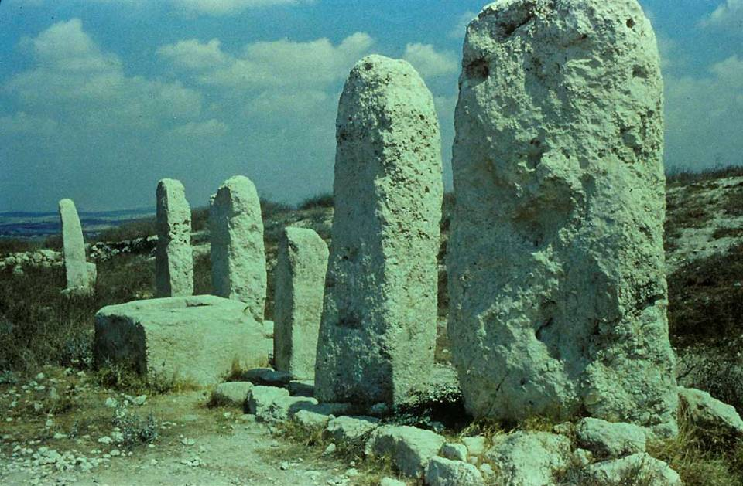
Standing stones (phallic symbols) at the high place at Gezer.

Slide 205
Limitations of the Israelite Invasion
The invasion of Canaan was a one-of-a-kind event.
It cannot be used as justification for other war efforts, however nobly motivated.
The Israelites were not permitted to build an empire.
The real warrior was Yahweh himself, not merely the Israelite soldiers (Jos. 10:14).
For some targets (Jericho specifically), the Israelites were forbidden to take spoils of war, which in turn prevented them from treating the invasion as simply a means of personal gain.
War was not the final goal, but rather, a vision of peace (Jos. 1:13; cf. Dt. 12:8-14; Is. 2:4; Mic. 4:3).

Slide 206
Hence, the real question is…
…not whether Israel had the right to dispossess the Canaanites of their land…
…but rather, whether Yahweh had the divine right to execute judgment.
The invasion of Canaan by the Israelites no more abrogated God’s promise to the nations through Abraham’s seed than the later exile of Israel abrogated God’s promises to Israel as the channel through which the messiah would come.

