Slide 1

CHRISTIANITY
THE FIRST 300 YEARS
A Short History

Slide 2

1 - THE APOSTOLIC PERIOD
Jesus and the Apostles, the Foundation

Slide 3
So then you are…fellow citizens with the saints and members of the household of God, built on the foundation of the apostles and prophets, Christ Jesus himself being the cornerstone…
Ephesians 2:19-20

Slide 4
The new israel
Without equivocation, Jesus clearly based his mission and ministry on the Hebrew Bible (Old Testament).
He said he did not come to abolish the law and the prophets (Mt. 5:17).
He based the authority of his ministry on the Old Testament, frequently using the phrase, “It is written…”
At the same time, he anticipated a New Israel.
He chose 12 apostles to be his emissaries, the ancient number of the 12 tribes (Lk. 6:13-16).
He sent out 70 disciples into Galilee, the ancient number of the Israelites who descended into Egypt (Ex. 1:5).
He began redefining the boundary of Israel, reaching out to non-Jews and delivering a final commission to the nations (Mt. 28:19).

Slide 5
“Go therefore and make disciples of all nations, baptizing them in the name of the Father, and of the Son, and of the Holy Spirit.
Matthew 28:19

Slide 6
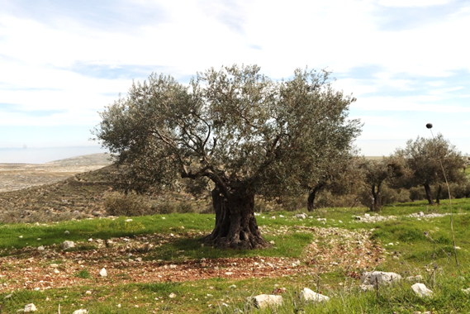
THE WILD OLIVE BRANCHES
St. Paul would use the metaphor of the olive tree to describe the union of Jews and non-Jews in this New Israel (Ro. 11:17-24).
The naturally cultivated olive tree represented ancient Israel.
The wild olive shoot represented the non-Jews, who were grafted into the cultivated tree where they shared the nourishing root.
The cultivated olive tree of ancient Israel

Slide 7
WHO ARE GOD’S children?
Formerly, God’s children had been defined by pedigree, those descended from Abraham and Jacob.
In the New Israel, the children of Abraham are defined by faith in Jesus Christ, regardless of bloodline (Rom. 4:16-17).
If one belongs to Christ, he belongs to Abraham’s “seed” (Gal. 3:26-29).
This combination of Jew and Gentile united by faith in Christ results in what Paul will call “the Israel of God” (Gal. 6:15-16).
Out of the two, God has created “one new man” (Ep. 2:14-22), where the ancient distinctions between Jew and Greek, male and female, slave and free no longer exist (Gal. 3:28).

Slide 8
CROSSING BOUNDARIES
Despite Jesus’ great commission to go to the nations, the earliest Christians were reluctant to cross ethnic barriers.
Those who traveled northward from Jerusalem eagerly shared the story of Jesus—but only with other Jews (Ac. 11:19).
Only through a series of graduated steps did they finally become an international multi-ethnic community.
The first barrier was the equalization of the Hebrew-speaking Christians with the Greek-speaking Christians.
While the church was concerned to minister to the disadvantaged, such as widows, an implicit favoritism was shown toward the Hebrew-speaking contingency (Ac. 6:1).
The apostles appointed seven overseers (the first example of deacons) to ensure equality, and it is to the point that all seven had Greek names, suggesting that they were from the neglected group (Ac. 6:2-6).

Slide 9
THE SAMARITAN MISSION (Ac. 8:4-25)
Stephen’s martyrdom became a watershed for the Jerusalem church, since it forced the Jewish Christians out of their local environment.
Already, the new Christian community had stretched to include proselyte and Hellenistic leaders from within the larger Jewish community.
All this was in Judea, however, where everyone was Torah-observant.
Philip, one of the new deacons, would test the boundaries by preaching about Jesus in Samaria. Samaritans, though Yahweh worshippers, were at odds with Torah-observant Jews, and both claimed to be the true Israel.

Slide 10
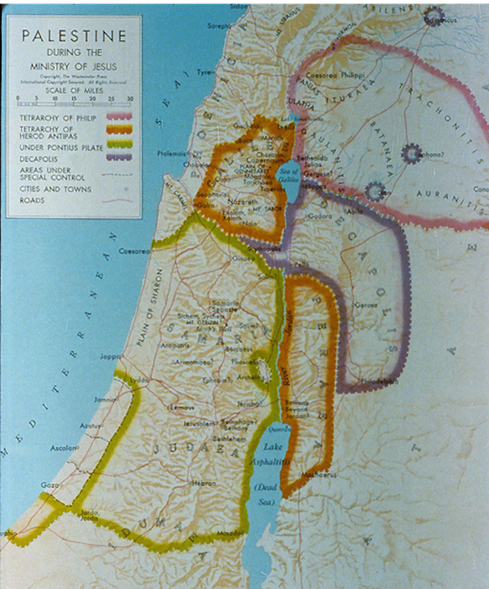
Samaria lay between Galilee and Judea, and due to mutual hostilities, it was generally avoided by Jews traveling north to south or vice versa on the grounds of ritual impurity or outright danger.
Samaritans had their own version of the Pentateuch and had rejected the temple in Jerusalem.
Samaritans did not use the term “messiah,” but they did believe in the Taheeb, a coming Savior and prophet like Moses.

Slide 11
Philip’s Preaching
Philip may have taken as a precedent the fact that Jesus himself had once ministered in Samaria (Jn. 4).
Without hesitation, he preached that Jesus was the Messiah, performing miraculous healings and exorcisms, so that joyful attention was focused on what he said.
Many believed Philip’s word and were baptized.
The news of what was happening in Samaria made it back to Jerusalem, and the apostles felt it necessary to send a delegation to investigate. Peter and John were sent, and they confirmed that this outreach was legitimate.

Slide 12
The New Horizon
The Samaritan episode changed the entire outlook of the Jerusalem church.
Now, not only proselytes and Hellenistic Jews could be included, but also Samaritans.
Peter and John, thoroughly convinced that this new direction had divine sanction, continued to preach the message of Jesus in many Samaritan villages.
The programmatic geographical/ethnic directive of the risen Christ, “You will be my witnesses in Jerusalem, in all Judea and Samaria…” (1:8), had begun to materialize.

Slide 13
DISCUSSION
How difficult is it today to cross uncomfortable boundaries?
It is sometimes said that Sunday morning is the most segregated hour in America. What might contribute to this ongoing tendency?

Slide 14
THE CONVERSION OF A GENTILE GOD-FEARER (Ac. 10:1-48)
Peter’s residence with a tanner, a Jew of a despised trade, became the scene for crossing the next great ethnic barrier.
The story begins with a God-fearer, a Roman centurion in the administrative city of Caesarea about 30 miles north of Joppa, who was instructed by an angel to send for Peter.
The next day, while Peter was on the rooftop of Simon’s house (possibly to escape some of the foul odors), he had a vision of non-kosher animals (Lv. 11) and a heavenly voice that told him to “slay and eat,” with the follow-up that he should not regard anything as unclean that God had cleansed. This scenario was repeated twice.
At the same time, the ambassadors from Caesarea arrived.

Slide 15
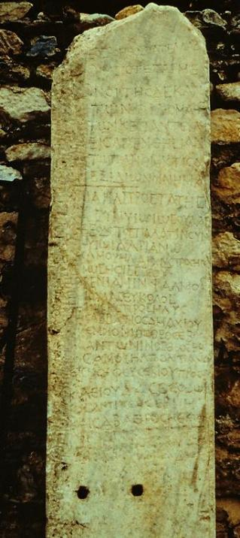
“God-fearers” (Ac. 10:2, 22) This “roster” of God-fearers from Aphrodisias (southwestern Turkey) is one of various references in inscriptions and texts to pious Gentiles who were sympathetic to Jewish religion, even though they had not themselves become proselyte Jews. Hence, they stood somewhere between full Jewishness and paganism. This list names 54 Gentiles who, alongside Jews from the local synagogue, contributed to relief efforts as well as construction of a place for worship. The Gentile part of the register is headed by the words “those who are God-fearers”.

Slide 16
At Cornelius’ Home
Peter took with him half a dozen Christian brothers when he departed for Caesarea (cf. 11:12).
This may have been the first time in his life that Peter had entered a Gentile home—an entry that would immediately have defiled him, a fact that Peter frankly asserted to the whole group when he arrived.
But Peter was quick to acknowledge that God had changed the rules!
Before Peter had finished speaking, the Holy Spirit fell on Cornelius, his family and his gathered friends, a clear confirmation that God had fully accepted them.

Slide 17
THE JERUSALEM CHURCH AFFIRMATION (Ac. 11:1-18)
Earlier, the Jerusalem church had sent investigative representatives to Samaria to investigate Philip’s crossing an ethnic barrier. Now, they thoroughly examined Peter!
In the first place, Peter’s entrance into a Gentile residence sent shock waves through the Jewish Christian community, and the fact that he even ate there suggested he had violated the Torah’s kosher laws.
The Jewish believers were scandalized, and the entire incident threated to divide the community.

Slide 18
Peter’s Explanation
Peter rehearsed his story beginning with the rooftop vision, the angelic message to Cornelius, and the outpouring of the Spirit as had happened at Pentecost.
The six Jews who had accompanied him now were highly important for corroborating Peter’s account.
Peter then recalled the words of John the Baptist, suggesting that what had happened at Pentecost had now happened to Gentiles.
The bold conclusion: “So then, God has even granted the Gentiles repentance unto life!”

Slide 19
THE GREEK CHURCH IN ANTIOCH (Ac. 11:19-30)
If Peter’s trip to Caesarea opened the door to Gentiles, what happened in Antioch only solidified the bold conclusion.
Some of the Christians who now were fleeing persecution in Jerusalem went there, and some of the Cypriot and African Jewish Christians began to tell the story of Jesus to Greeks.
Many Greeks now became believers, and when the Jerusalem church heard about it, they did what they had done before—they sent an investigative and trusted representative, this time Barnabas of Cyprus, who confirmed that all was well!
The Antioch church would become the first sending church for Christian missionaries, and the mission trips of Paul to the larger Roman world occupy the last half of the Book of Acts.

Slide 20
STAGES BETWEEN JEW & GENTILE
Hebraistic Jews (e[brai?oj)
Jews attending a Hebrew-speaking synagogue
Hellenistic Jews (e[llhnisth<j)
Jews attending a Greek-speaking synagogue
Proselytes (prosh<lutoi)
Gentiles who accepted circumcision
Samaritans (Samaritoi)
Yahweh worshippers who rejected the Jerusalem temple
God-fearers (fobou?menoi)
Gentiles attracted to the Jewish view of God (but remaining uncircumcised)
Pagans (e@qnoi)
Worshipers of the Greco-Roman pantheon

Slide 21
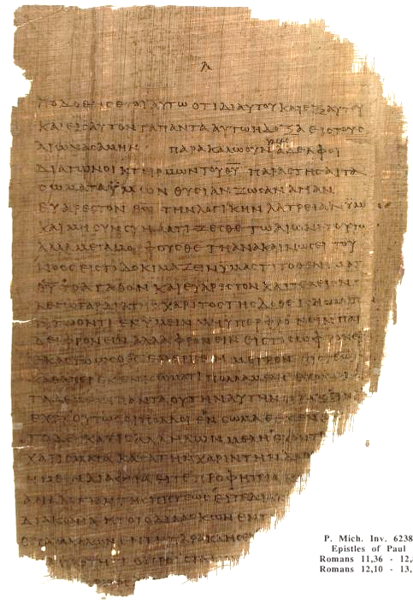
LITERATURE
While Jesus never instructed his followers to write documents, very early they began to do so.
The Jerusalem church composed a letter to the new Gentile churches to resolve an issue concerning Jewish and Gentile relationships (Ac. 15:1, 5, 15-29).
Paul began writing letters in the late 40s to instruct and encourage his new churches.
Eventually, the four gospels were composed before the close of the 1st century.
P46, the earliest copy of the Roman letter containing Romans 11:36—12:8 and dating to ca. AD 200.
University of Michigan

Slide 22
THE CHURCH AND THE CHURCHES
The New Testament uses the word “church” (ekklhsia) in two basic ways.
First, it is used of local congregations in the various towns and cities where Christians gathered (Ac. 13:1; 18:22; 1 Cor. 16:19b, etc.).
Second, it is used of the entire Christian movement (1 Cor. 10:32; 12:28; 15:9; Eph 1:22; 3:21, etc.).
The Church Catholic
This broader reference to the church as the growing world-wide body of Christians eventually gave rise to the term “catholic church” (Greek: kaqolikoj; Latin: catholicus).
The earliest usage of the term “the catholic church” is in St. Ignatius’ letter to the Smyrnaeans (ca. AD 110).

Slide 23
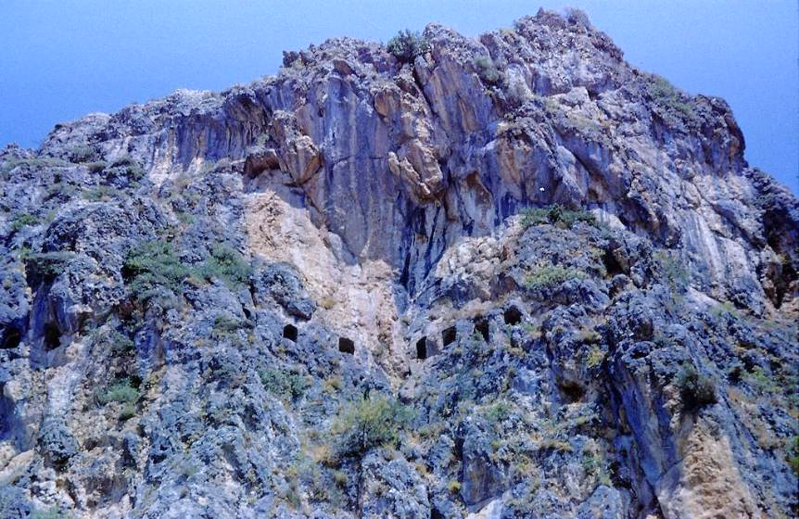
Church at Antioch, Syria (modern Antakya, Turkey)
ancient church in a cave above the city
Peter is believed to have preached here.

Slide 24
DISCUSSION
Why do you think the earliest Christians were so slow in crossing ethnic barriers, especially in light of Jesus’ direct command to go to the nations?
Some Christians (usually Protestant) flinch as the term “catholic church,” larger because they are anti-Catholic. What might you say that could help them?

Slide 25
2 - POST-APOSTOLIC CHRISTIANITY
The Post-Apostolic Period

Slide 26
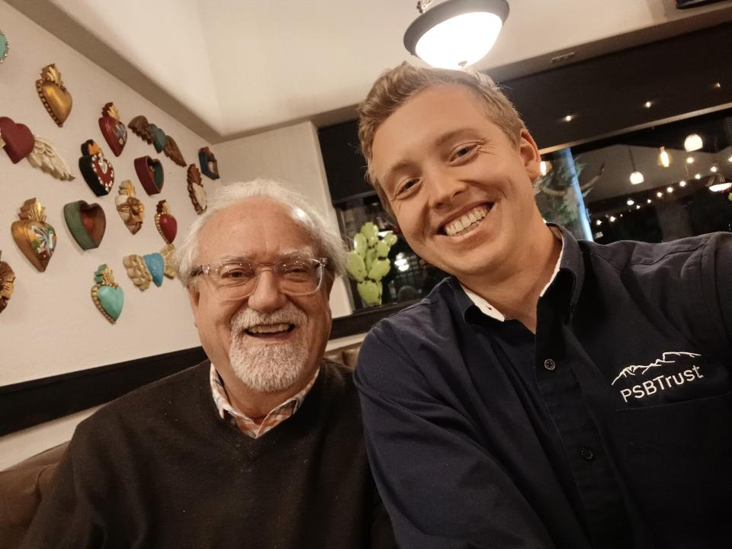

Slide 27
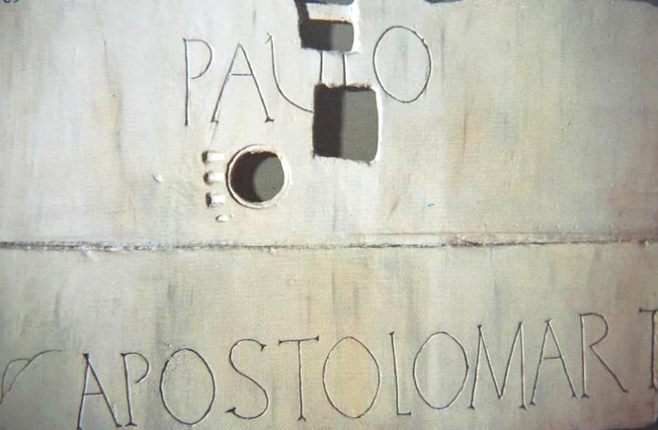
Paul and Peter, the two most important leaders in early Christianity, were both executed in Rome in the mid-60s.
Erected above Paul’s tomb, Church of St. Paul Outside the Walls, Rome
In 2009, the Pope gave permission for the bone fragments in the tomb to be carbon-dated, and indeed they date to the 1st century.

Slide 28
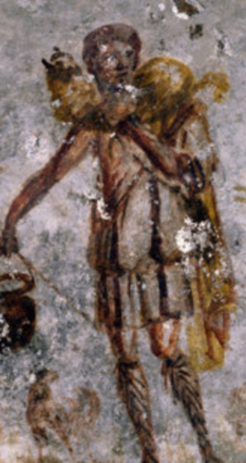
TRANSITION QUESTIONS Apostolic To Post-apostolic
What is the relationship between Judaism & Christianity?
What forms of worship can be used?
What are the authoritative Scriptures?
How should leadership & succession work?
How should we treat opposing religious ideas?
What church administration is necessary?
What is the relationship between Christianity & Rome
Christ, the Good Shepherd, St. Callisto Catacomb, Rome

Slide 29
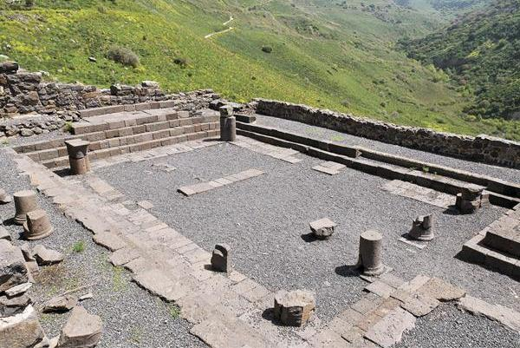
Separation from Judaism
Jesus, the apostles, and the earliest Christians were all Torah-observant Jews.
The temple and the synagogue continued to be revered as sacred space with Christians meeting in the temple (Ac. 2:46; 3:11; 5:12, 21, 42) and Paul visiting synagogues throughout the Roman world (Ac. 13:14; 14:1; 17:1-2, 10, 17; 18:4, 19; 19:8).
When Christian Jews spread out from Jerusalem, they only shared the message of Jesus with other Jews (Ac. 11:19).
James could address Christians and write, “For if a man enters into your synagogue…” (Greek text, Ja. 2:2).
Excavated remains of the Gamla synagogue in northern Galilee

Slide 30
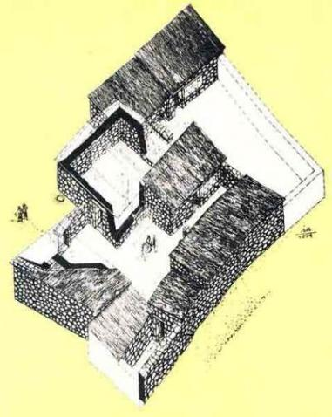
The Tensions begin
Jesus had warned that his followers would be expelled from the synagogues (Jn. 16:1-4).
Stephen was accused of speaking against the temple and the Torah and summarily lynched (Ac. 7:11, 13-14).
Paul was expelled from the synagogues (Ac. 13:50; 18:6-8; 19:8-9).
The anonymous author of Hebrews wrote an entire document dedicated to the thesis that the old system of temple worship was now obsolete (He. 8:13; 10:8-9).
House churches apart from the synagogue began being used for Christian assembly on the Lord’s Day (Ac. 12:12; Ro. 16:5; 1 Co. 16:19; Col. 4:15).
By the end of the 1st century, John began to speak of “those who say they are Jews and are not, but are a synagogue of Satan” (Rv. 2:9; 3:9).
Archaeologist’s sketch of a 1st century house in Capernaum used as a house church. Graffiti on the carefully plastered walls (more than 100 in Greek, Latin, Aramaic, Syriac, and Hebrew) inscribe sayings such as, “Lord Jesus Christ help your servant…” and “Lord have mercy.”

Slide 31
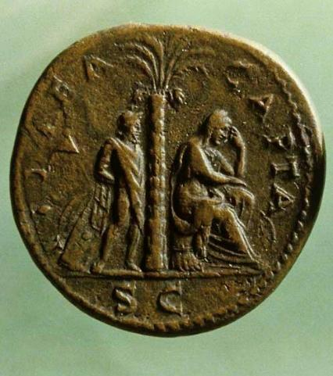
The Jewish revolt
Led by Simon bar-Giora, the Jews in Jerusalem revolted against the Romans in AD 66.
According to the early church historian, Eusebius, the Christians, acting upon Jesus’ warnings in Matthew 24 and Luke 21, did not join in this revolt, but rather, escaped the city and moved to the Transjordan town of Pella for the duration (Church History 3, 5, 3).
There were two significant outcomes: first, it drove a further wedge between the Jews and the Christians, and second, it made clear to the Romans that Christianity was not a subset of Judaism, and therefore, its legal status was questionable, since it was not protected under the umbrella of Judaism.
The inclusion of the birkat ha-minim in synagogue liturgies effectively forced Jewish Christians out of the synagogues.
Thousands of Judaea Capta coins, like this bronze sesterce, were struck in Rome in AD 71 after Jerusalem’s fall. This coin was the largest series minted in Roman history. The bound captive and weeping woman symbolize the disaster.

Slide 32
BIRKAT HA-MINIM (curse upon the heretics)
“For the apostates let there be no hope, and let the arrogant government (i.e., Rome) be speedily uprooted in our days. Let the Nazarenes (i.e., Christians, cf. Acts 24:5) and the heretics be destroyed in a moment, and let them be blotted out of the book of life and not be inscribed together with the righteous. Blessed art thou, O Lord, who humblest the arrogant.”
(from the 18 benedictions, the standard synagogue liturgy of the late 1st century)

Slide 33
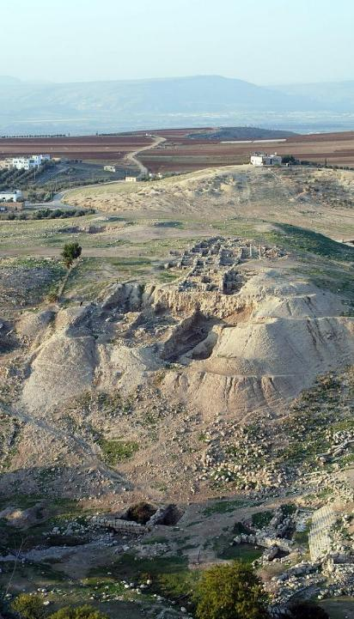
Saturday to sunday
In the apostolic period, Christians already were meeting on “the Lord’s Day,” an idiom for Sunday, the day of Jesus’ resurrection (Ac. 20:7; 1 Co. 16:2; Rv. 1:10).
This did not preclude their attending a synagogue on Saturday.
However, there was no “weekend” in the Roman Empire, and every day, including Sunday, was a work-day. (The Jews had special permission from the Roman Senate to observe the Sabbath, but Christians did not have Sunday free. Hence, any Christian assembly was either early in the morning or late at night, cf. Ac. 20:7-8, 11.)
By the early 2nd century, several early Christian writers recognize the Lord’s Day as a replacement of the Jewish Sabbath.
Remains of Pella in the Transjordan, where Christians escaped during the Jewish Revolt against Rome

Slide 34
THE LORD’S DAY
“Assemble on the Lord’s Day, and break bread and offer the Eucharist…”
Didache 14 (c. AD 95)
“We keep the eighth day [Sunday] with joyfulness, the day also on which Jesus rose again from the dead...”
Epistle of Barnabas (c. AD 100)
“They [Jewish Christians] have given up keeping the Sabbath, and now order their lives by the Lord’s Day instead (the day when life first dawned for us…) …to profess Jesus Christ while continuing to follow Jewish customs is an absurdity…”
Ignatius, Magnesians 9 and 10 (c. AD 135)
“And on the day called Sunday, all who live in cities or in the country gather together to one place, and the memoirs of the apostles or the writings of the prophets are read…”
Justin Martyr, First Apology 67 (c. AD 155)
“On the first day of the week let there be service, and the reading of the holy scriptures, and the oblation [Eucharist], because on the first day of the week [i.e., Sunday] our Lord rose from the place of the dead…”
Didascalia 2 (c. AD 255)

Slide 35
DISCUSSION
What is relationship between Christianity and Judaism today?
Seventh Day Adventists contend that the choice of Sunday for worship by early Christians was a mistake and violates the 4th commandment. How would you respond to this charge?

Slide 36
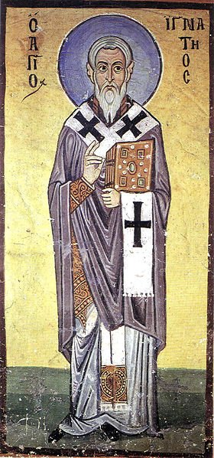
The apostolic fathers
The title “Apostolic Fathers” refers to the writings of those Christian leaders who had known the apostles and were faithful to their teachings.
Though some of these texts are anonymous, at least four writers are directly linked to apostles:
Clement (ordained by Peter according to Tertullian) c. AD 35-99
Ignatius (Bishop of Antioch, a disciple of John) c. AD 35-110
Polycarp (Bishop of Smyrna, a disciple of John) c. AD 69-155
Papias (Bishop of Hierapolis, knew John) c. AD 60-130
These texts, widely circulated among the early Christians, were: Didache, 1 Clement, Seven Letters of Ignatius, Epistle of Polycarp, Martyrdom of Polycarp, Epistle of Barnabas, Epistle to Diognetus, Shepherd of Hermas, and Fragments of Papias.
Fresco of Ignatius, Hosios Loukas Monastery, Greece

Slide 37
The apostolic fathers
DIDACHE (c. AD 95) | 1 CLEMENT (c. AD 96) | 7 LETTERS OF IGNATIUS (c. AD 135)
The Two Ways | Letter to the Corinthians | Wrote letters while being transported to Rome for execution
Instructions for Baptism and Eucharist | Addresses congregational repentance and restoration of unjustly deposed elders | Six letters were to churches; one letter was to Polycarp.
Instructions about itinerant apostles and prophets | Included in some early Bibles (Codex Alexandrinus) | Stresses the value of the Eucharist, replacing the Sabbath with the Lord’s Day, and loyalty to a single bishop in each city.

Slide 38
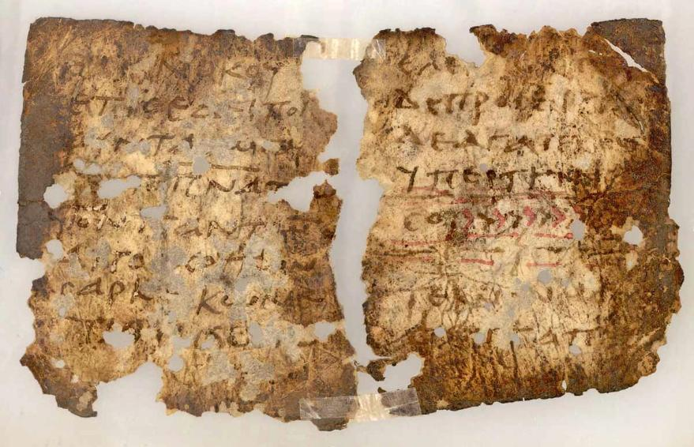
Ancient copy of the Didache, in which appears the baptismal formula “of the Father, and of the Son, and of the Holy Spirit” (range of dating AD 50-120)

Slide 39
Excerpts from the didache
The procedure for baptism is as follows: After repeating all that has been said, immerse in running water “In the name of the Father, and of the Son, and of the Holy Ghost.” If no running water is available, immerse in ordinary water. This should be cold if possible; otherwise, warm. If neither is practicable, then pour water three times on the head “in the name of the Father, and of the Son, and of the Holy Ghost.”
At the Eucharist, offer the eucharistic prayer in this way: Begin with the chalice: “We give thanks to thee, our Father, for the holy Vine of thy servant David, which thou has made known to us through thy servant Jesus. Glory be to thee, world without end.”
Then over the broken bread: “We give thanks to thee, our Father, for the life and knowledge thou has made known to us through thy servant Jesus. Glory be to thee, world without end.”
As regards apostles and prophets… Every apostle who comes to you should be welcomed as the Lord, but he is not to stay more than a day, or two days if it is really necessary. If he stays for three days, he is a false prophet… If he asks for money, he is a false prophet.

Slide 40
DISCUSSION
From time to time, you may notice that in the Book of Common Prayer some phrases are drawn from ancient texts like the Didache. Is this important, and if so, why?

Slide 41
EARLY CHRISTIAN WORSHIP
Christ Jesus did not leave his disciples with a form for Christian worship. Hence, it is not too surprising that for the most part early Christians drew from the pattern of the synagogue with which they were familiar.
Jesus himself had been comfortable in the synagogue (Lk. 4:16-21), so this pattern prevailed.
He also promised that the Holy Spirit would guide his followers, teaching and reminding them of his life and instruction (Jn. 16:13a; 14:26; 15:26; cf. 4:21-24).
Jesus did leave two sacraments (rituals in which the outward form expresses an inward reality): baptism (Mt. 28:19; Mk. 16:16) and Eucharist (Lk. 22:19b; 1 Co. 11:24b).
Both rituals had precedents in Judaism, miqveh immersion as a ritual of purification and a Passover seder meal in memory of the exodus using unleavened bread and wine.
Both rituals were transformed, baptism as an initiation ritual signifying faith in Christ and Eucharist as a weekly memory of Jesus’ death.

Slide 42
The two sacraments
BAPTISM
As a ritual of initiation, baptism is mentioned frequently in the New Testament (Ac. 2:4; 8:12-13, 36-39; 9:18; 10:47-48; 16:14-15, 33; 18:8; 22:16; 19:3-5; 1 Co. 1:13-16; Ro. 6:3-4; Ga. 3:27).
EUCHARIST
Luke’s phrase “breaking bread” (Ac. 2:42, 46; 20:7, 11) probably refers to the celebration of the Lord’s Table as do Paul’s instructions about Communion (1 Co. 10:16-17, 21; 11:17-34).
By the end of the 1st century, instructions for water baptism and the ongoing practice of the Eucharistic meal is attested widely (Didache VII, IX and X; Ignatius, Philadelphians IV; Justin Martyr, 1st Apology LXV-LXVI; Irenaeus, Against Heresies V.ii.2-3, etc.

Slide 43
Worship in the New Testament There are hints about the form of Christian worship in the New Testament:
Described Elements
Eucharist (Ac. 20:7; 1 Co. 11:17-34)
Baptisms (Ac. 2:41, etc.)
Community Prayer (Ac. 4:24; 12:12)
Jewish Prayer Hours (Ac. 3:1)
Free Participation in hymn, instruction, revelation, language/interpretation (1 Co. 14:26) – foreign tongues were restricted to two or, at the most, three occasions per service and forbidden if not translated (1 Co. 14:27-28)
Public Scripture Reading (1 Ti. 4:13; Col. 4:16; 1 Th. 5:17; Rv. 1:3)
Confessions of Faith (Ro. 10:”8-9; 1 Co. 12:3; 15:1-4; 1 Ti. 6:12)
Preaching & Teaching (1 Ti. 5:17, etc.)
Collection of Gifts (Ro. 15:25-27; 1 Co.. 16:1-4; 2 Co. 8-9; Phil. 4:15-19; 1 Ti. 5:17-18)
“Maranatha” (1 Co. 16:22) in Aramaic
“Abba” (Ro. 8:15; Ga. 4:6)
Doxologies (Ro. 16:27; Ga. 1:5; 1 Ti. 1:17; 6:16; 1 Pe. 5:11; Jude 25; Rv. 1:6; 7:12; 19:1)
Psalms, Hymns, Songs (Ep. 5:14, 19; Phil 2:6-11; Col. 3:16; 1 Ti. 1:17; 3:16; 6:15-16; 2 Ti. 2:11-13)
Liturgical Elements
“The Thanksgiving” (1 Co. 14:16)
“The Amen” (1 Co. 14:16; 2 Co. 1:20) in Hebrew

Slide 44
EARLY INSTRUCTIONS FOR CHRISTIAN WORSHIP
“And on the Lord’s own day gather yourselves together and break bread and give thanks, first confessing your transgressions, that your sacrifice may be pure.”
Didache 14 (c. AD 95)
The instruction, “…first confessing your transgressions,” is captured in the Book of Common Prayer in the opening, “Cleanse our hearts by the inspiration of thy Holy Spirit…” It also is reflected in the prayer of confession prior to the Euchartist.

Slide 45
DISCUSSION
Why do you think Jesus did not leave any instructions for Christian worship to his disciples?
What effect might Jesus’ warning have had on the pattern of Christian worship that his disciples would be expelled from the synagogues?
In liturgical churches, the font and the altar are prominent. In many current Protestant churches, the pulpit is most prominent. What symbolic difference does this make?

Slide 46
EARLY EUCHARISTIC PRAYER
“We give you thanks, O our Father, for your holy vine of your son David, which you made known unto us through your Son Jesus; Yours is the glory forever and ever. We give you thanks, O our Father, for the life and knowledge which you made known unto us through your Son Jesus; Yours is the glory forever and ever. As this broken bread was scattered upon the mountains and being gathered together became one, so may your church be gathered together from the ends of the earth into your kingdom; for yours is the glory and the power through Jesus Christ forever and ever’.”
Didache 9 (c. AD 95)

Slide 47
EARLY EUCHARISTIC THANKSGIVING
“We give you thanks, Holy Father, for your holy name, which you have made to tabernacle in our hearts, and for the knowledge and faith and immortality, which you made known unto us through your Son, Jesus; yours is the glory forever and ever. You, Almighty Master, created all things for your name’s sake, and gave food and drink unto men for enjoyment, that they might render thanks to you; but you bestowed upon us spiritual food and drink and eternal life through your Son. Before all things we give you thanks that you are powerful; yours is the glory forever and ever. Remember, Lord, your church to deliver it from all evil and to perfect it in your love; and gather it together from the four winds—even the church which has been sanctified—into your kingdom which you have prepared for it; for yours is the power and the glory forever and ever. May grace come and may this world pass away. Hosanna to the God of David. If any man is holy, let him come; if any man is not, let him repent. Maranatha. Amen!”
Didache 10 (c. AD 95)

Slide 48
EARLY DESCRIPTION OF CHRISTIAN WORSHIP BY AN OUTSIDER
“They were in the habit of meeting on a fixed day before it was light, when they sang an anthem to Christ as God, and bound themselves by a solemn oath not to commit any wicked deed, but to abstain from all fraud, theft and adultery, never to break their word, or deny a trust when called upon to honor it; after which it was their custom to separate, and then meet again to partake of food, but food of an ordinary and innocent kind.”
Pliny, Letters x.96 (c. AD 110)
(Pliny was the Governor of Bithynia, and he was writing to Emperor Trajan about how to treat the Christians)

Slide 49
2nd CENTURY DESCRIPTION OF CHRISTIAN WORSHIP
And on the day called Sunday, all who live in cities or in the country gather together to one place, and the memoirs of the apostles or the writings of the prophets are read, as long as time permits; then, when the reader has ceased, the president verbally instructs and exhorts to the imitation of these good things. Then we all rise together and pray, and, as we before said, when our prayer is ended, bread and wine and water are brought, and the president in like manner offers prayers and thanksgivings, according to his ability, and the people assent, saying, “Amen”; and there is a distribution to each, and a participation of that over which thanks have been given, and to those who are absent a portion is sent by the deacons. And they who are well to do, and willing, give what each thinks fit; and what is collected is deposited with the president, who succors the orphans and widows, and those who, through sickness or any other cause, are in want, and those who are in bonds, and the strangers sojourning among us, and in a word takes care of all who are in need. But Sunday is the day on which we all hold our common assembly, because it is the first day on which God, having wrought a change in darkness and matter, made the world; and Jesus Christ our Savior on the same day rose from the dead. For he was crucified on the day before that of Saturn [i.e., Friday]; and on the day after that of Saturn, which is the day of the Sun [Sunday], having appeared to his apostles and disciples, he taught them these things, which we have submitted to you also for your consideration.
Justin Martyr, 1st Apology 68 (c. AD 155)

Slide 50
DISCUSSION
What stands out to you about these ancient descriptions of Christian worship?
The early prayers for the Eucharist begin with words in the 1st person plural: “We give you thanks…” The Lord’s Prayer also begins with “Our Father…” These plurals immediately imply that they were memorized prayers and offered in unison. Liturgical churches use memorized prayers, and non-liturgical churches often do not. What is the difference?

