Slide 1
MicAH

Slide 2
Micah’s Historical Context (1:1)
A contemporary of Isaiah, Micah’s ministry occurred during the regnal years of Jotham (ascension c. 750), Ahaz (ascension c. 735), and Hezekiah (ascension c. 715).
Unlike Isaiah, however, whose ministry was in Jerusalem, Micah was a rural prophet from the border country of Moresheth-Gath (1:14), a locale with a history of turbulence and political fragility.
  The village name immediately suggests its proximity to the Philistine city of Gath.
  Immediately prior to Micah’s career, Uzziah of Judah had raided the area, rebuilding some of the local towns (2 Chr. 26:6-7), possibly including Moresheth.
  During Micah’s lifetime, the Philistines raided Judah’s occupied cities in the area (2 Chr. 28:18; cf. Is. 9:12).
Later, the Assyrian Tiglath-pileser III attacked Gath in 734 BC for disloyalty, and still later, Hezekiah would war with the Philistines (2 Kg. 18:8).

Slide 3
The Social Background
The halcyon years of Uzziah’s reign, which was largely due to a power vacuum with no serious outside threat, brought an increase in trade and commerce, elevating the wealthy class in Jerusalem with the finery of sophistication and culture (Is. 3:16-23; 5:11-12).
This amassed wealth, however, often came at the expense of the poor, whose fortunes were decided by dishonest magistrates in cahoots with thieves (Is. 1:21-23; 3:13-15; 5:23; 10:1-2).
Dirt farmers were losing their land (Is. 5:8).

Slide 4
The Assyrian Threat
Rising in the east, the Assyrian war machine was on the move, and the kingdoms of Aram and Israel formed a coalition to defend against it, attempting to force Jotham to join them (2 Kg. 15:36-37).
When Jotham died, his son Ahaz was left to deal with the extortion (Is. 7).
Ahaz directly appealed to the Assyrian Tiglath-pileser III, offering himself as an Assyrian vassal (2 Kg. 16:7-10).
This vassalship would last until the death of Tiglath-pileser III, when Hezekiah would withhold tribute and break the Assyrian suzerainty-treaty (2 Kg. 18:7), though later he would be forced to accept vassalship once again (2 Kg. 18:13-16).

Slide 5
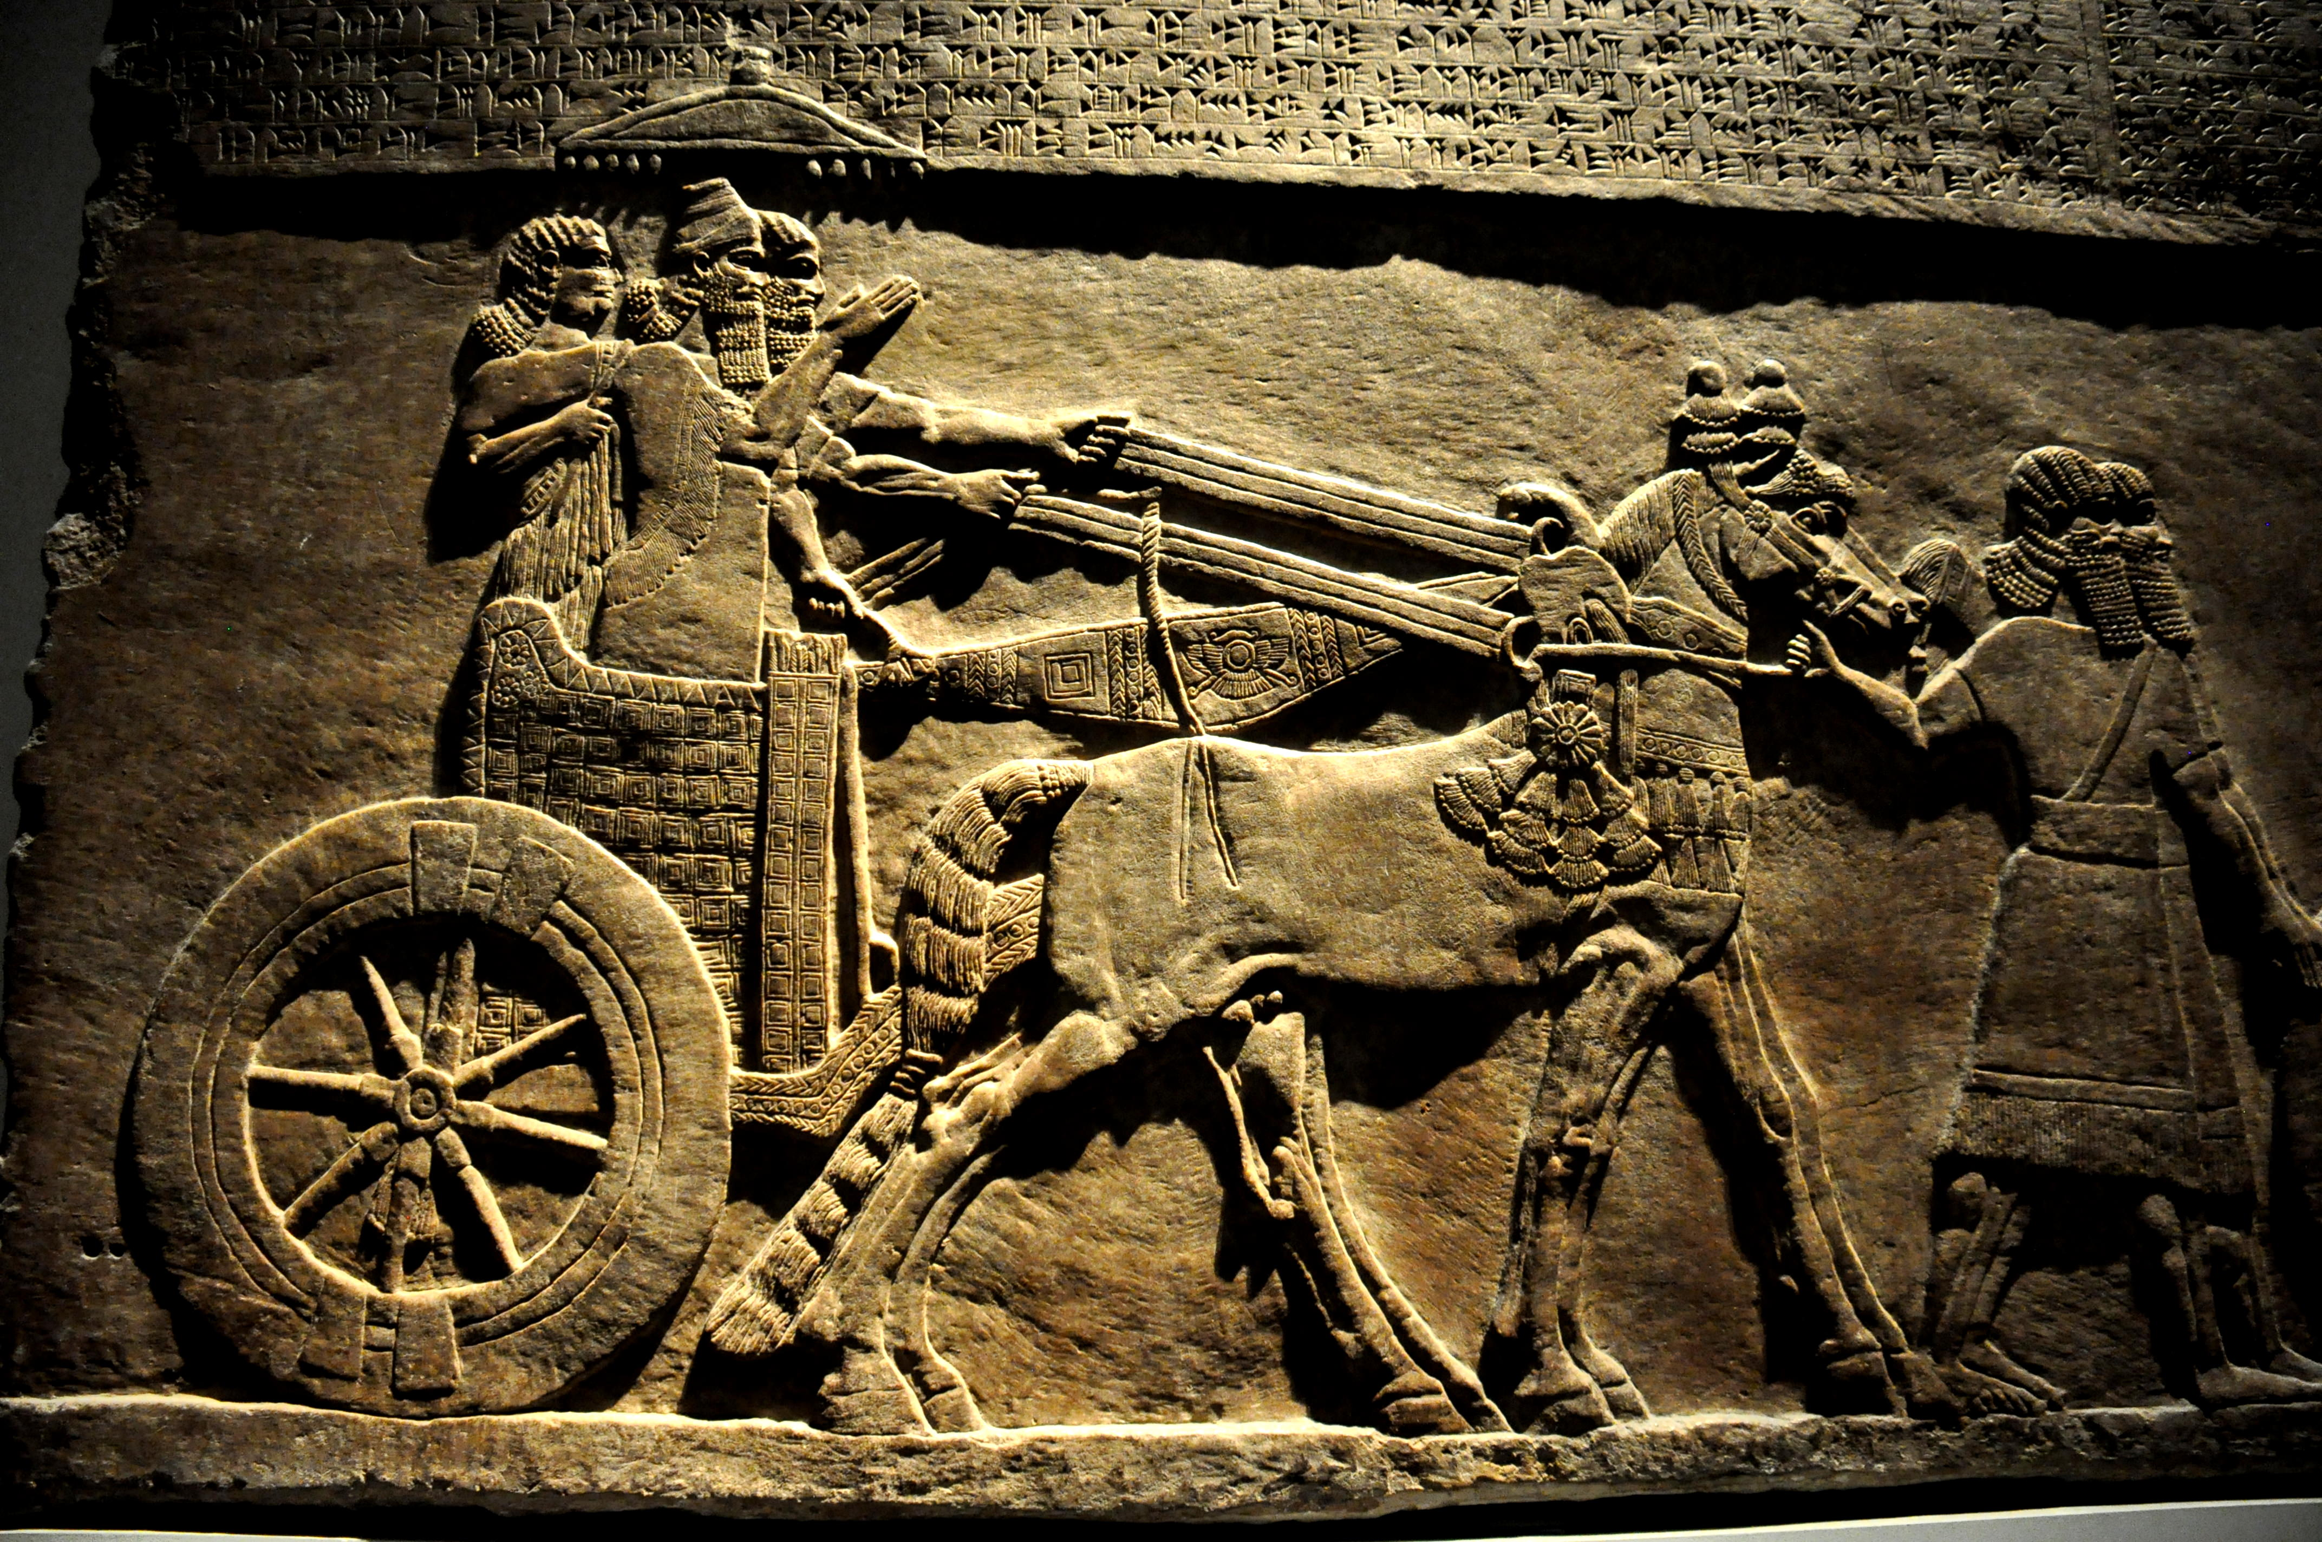
Tiglath-pileser III (744-727 BC)
British Museum, London

Slide 6
Micah, the Man
The book offers little in the way of personal information other than his name, which means, “Who is like Yahweh?”
Like Amos, he distanced himself from the court prophets who supported the status quo (3:5-8; cf. Am. 7:14).
Nothing in the book suggests that any of Judah’s kings ever consulted him as was the case for Isaiah (though many years later, his oracles were certainly known in Jerusalem, cf. Je. 26:18).
Whether or not he was himself a farmer, he certainly championed the property rights of the small farmers who were threatened by the encroachment of the wealthy (2:2; 3:1-3).

Slide 7
Date and Structure
Given the opening (1:1), the date of Micah’s ministry is not in doubt.
His ministry begins prior to the fall of the northern nation Israel and extends for another three decades or so into the period of Hezekiah.
Structurally, the oracles of Micah alternate between doom and hope and are demarcated by the imperative form of the Hebrew verb fmawA (= Listen!) in 1:2, 3:1 and 6:1.
  Oracles Against Israel and Judah (1-2)
  Oracles of Judgment and Restoration (3-5)
  Oracles about Crime, Punishment and Mercy (6-7)

Slide 8
The First Oracle: the Covenant Lawsuit (1-2)
The ancient Near Eastern suzerainty treaty offered a powerful image used by several prophets, the image of the courtroom (Is. 3:13-14; Je. 2:9; Ho. 4:1; Am. 3:13; Mic. 6:1-2; Eze. 20:4).
These indictments, in turn, derived from the ancient suzerainty treaty between Yahweh and Israel, where the heavens and earth stand as witnesses to the covenant terms (Dt. 4:26; 30:19; 31:28; 32:1).
Micah now describes Yahweh as prosecuting a case against the capital cities of the northern and southern nations, Samaria and Jerusalem (1:2-5), and he issues a summons to the whole world to these assizes.
The charge is covenant unfaithfulness, and both capitals have invited the sworn covenantal judgments of Yahweh (cf. Lv. 26:14, 30-33; Dt. 28:15, 42-52, 64-68).

Slide 9
USE OF COURTROOM LANGUAGE IN THE PROPHETS
“Will you judge them?” (Eze. 20:4)
bYR9 (R’iv = lawsuit)
Domestic (civil case)
Suzerainty-Vassal (international)
Covenant (human-divine)
TYPICAL ELEMENTS:
Appeal to witnesses
Interrogation & accusation
Review of past benefits
Warning about disloyalty
Declaration of guilt & punishment
Byr9 (r’iv = lawsuit)
FpawA (shaphat = to settle a case)
tOmcuf3 (‘etsumoth = arguments)
hHAk;v0An9 (niwwakeha = summons)

Slide 10
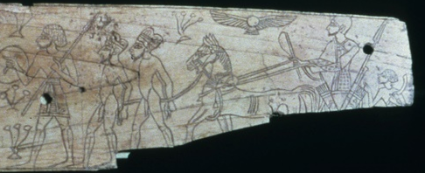
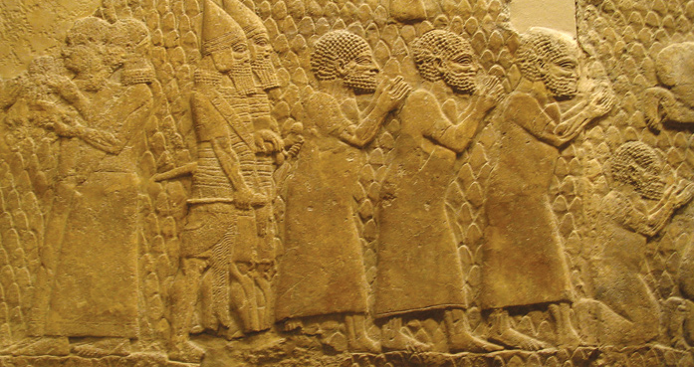
Living Parables (1:6-9)
Several prophets acted out living parables of their messages, and Micah is one of them, parading himself either as a refugee, a potent symbol of the coming exile, a prisoner of war, or someone mourning for the dead.
Prisoners of war being deported by the Assyrians from Ashtaroth.
British Museum, London

Slide 11
Puns (1:10-15)
  Gath (tGa) creates assonance with dgan!, meaning to report or to announce [i.e., disaster].
  Beth Ophrah (hr!p;fa tyBe) means “house of dust”, and its citizens are sentenced to rolling in the dust as an expression of lament.
  Shaphir (rypiwA), meaning “pleasant”, sounds like rpAOw), the war trumpet; the town’s pleasantness would be brutally reversed by a coming invasion.
  Tsaanan (Nn!xEca) creates assonance with the verb hxAc;y!, meaning “to come out”. The citizens will refuse to engage in battle because it will be hopeless.
  Beth Etsel (lcAxe tyBe) sounds similar to the verb lcaxA, meaning “to take away”. The city’s protection would vanish.
  Maroth (tOrmA) sounds like rma, which means “bitter,” and the bitterness of disaster would reach as far as the gates of the city of peace (Jerusalem).
  Lachish (wykilA) sounds like the word wk,r@, which refers to a team of horses [i.e., chariot horses].
  Moresheth (tw,r@Om) sounds like hwAr!Om, meaning “possession”, the very thing the citizens would give up when invaded.
  Aczib (byz9k;xa) sounds like bz!k;xa, meaning “deceitful.”
  Mareshah (hwAr2mA) sounds like wr1y!, meaning “to dispossess.”
Puns, where the sounds of two words are similar, are largely untranslatable. In an oral culture, however, they become powerful rhetorical devices to assist in memory and vivid imagery. Micah has a whole series of them in the latter half of chapter 1.

Slide 12
Exploitation and Deception (2:1-13)
Society had disintegrated at every level:
Powerful landowners aimed to drive out the small farmers through an unjust court system by which they could manipulate foreclosures and evictions (2:1-5).
The prophetic guild supported the status quo and were eager to silence Micah’s denunciations, arguing that his sermons must only be positive, not negative (2:6-11).
Hence, judgment was coming! Still, as was true for all the prophets, judgment was not God’s final word. The final word was hope for a remnant surviving on the far side of judgment (2:12-13).

Slide 13
The Second Oracle (3-5)
The second oracle paralleled the first, and later, it would be recalled in the lifetime of Jeremiah (cf. Je. 26:17-19).
Dirty politics characterized Judah’s leaders, who treated their subjects like carcasses to be butchered (3:1-4).
Prophets, who should have been a voice for justice, were in cahoots with the crooked politicians (3:5-8).
Hence, judgment was surely coming, and the climax of this judgment would be the destruction of the temple on Mt Zion (3:9-12).
Micah, therefore, becomes the first prophet to directly predict the destruction of the 1st temple (3:12).

Slide 14
The Message of Hope (4:1-5)
Earlier, Micah offered a small glimpse of the future on the other side of judgment with a future king (2:13); now he expands on that theme, predicting that Zion, after its destruction, would become the center of worship for the whole world (4:1-5).
Obviously, there is a literary relationship between this passage in Micah and Isaiah 2:2-5, since the larger portion of the two passages are word-for-word in the Hebrew text.
Micah uses the stock phrases “in the last days” and “in that day” to refer to the cessation of war and the universal worship of Yahweh.

Slide 15
Isaiah 2:2-4 (My Translation)
Micah 4:1-3 (My Translation)
(Is. 2:2) In the last days, the mountain of the LORD’s house will be established as the most important of the mountains, being lifted up more than the hills, and all the nations will stream to it.
(Is. 2:3) Many peoples will come and say, “Come, let us go up to the mountain of the LORD to the house of the God of Jacob, so that he will teach us his ways and so that we may walk in his paths.” For the law will go forth from Zion, and the word of the LORD from Jerusalem.
(Is. 2:4) He will judge between the nations and will arbitrate for many peoples; and they will hammer their swords into plowshares and their spears into pruning hooks. Nation will not raise sword against nation, nor will they again learn war.
(Mic. 4:1) In the last days, the mountain of the LORD’s house will be established as the most important of the mountains. It will be lifted up more than the hills, and the peoples will stream on it.
(Mic. 4:2) Many nations will come and say, “Come, let us go up to the mountain of the LORD and to the house of the God of Jacob, so that he will teach us his ways and so that we may walk in his paths.” For the law will go forth from Zion, and the word of the LORD from Jerusalem.
(Mic. 4:3) He will judge between many peoples and will arbitrate for vast nations far away; and they will hammer their swords into plowshares and their spears into pruning hooks. Nation will not raise sword against nation, nor will they again learn war.

Slide 16
The Day of Yahweh in the Prophets
NEAR FUTURE
Judgment by exile on the unfaithful nations of Israel and Judah
Judgments in history on the nations surrounding Israel and Judah
FAR FUTURE
Judgment on a blasphemous world by universal cataclysm
Disintegration of the universe
Salvation of God’s people
Victory of God’s armies
Universal peace

Slide 17
Yahweh’s Glorious Plan (4:6—5:1)
For those who would survive exile, hope remained, since the royal dominion would be restored.
The Hebrew text of 4:8 uses the term “Ophel” or “hill” ( lp,f*), the name of the ancient ridge that David fortified as his capital (2 Sa. 5:9), to describe the place of this restored kingship.
In the meantime, however, there would be a period without a king, since the nation of Judah would be deported to Babylon.
From Babylon, the remnant eventually would be rescued, but first Jerusalem would be put to siege by “many nations”, and her leader would be “struck on the cheek”. This may refer to the invasion of Sennacherib in the period of Hezekiah.

Slide 18
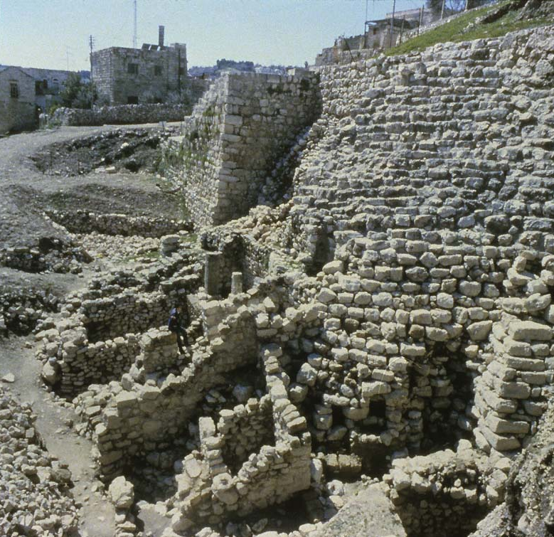
The Stepped Stone Structure
On the east side of the Hill of Ophel (City of David), archaeologists have excavated a stepped stone structure. It appears to date from pre-Davidic Jerusalem, but was reused by both David and Solomon as a high standing buttress upholding a platform for a state building.
Possibly, this structure is the famous “Millo” (= filling) described in 2 Sa. 5:9; 1 Chr. 11:8.

Slide 19
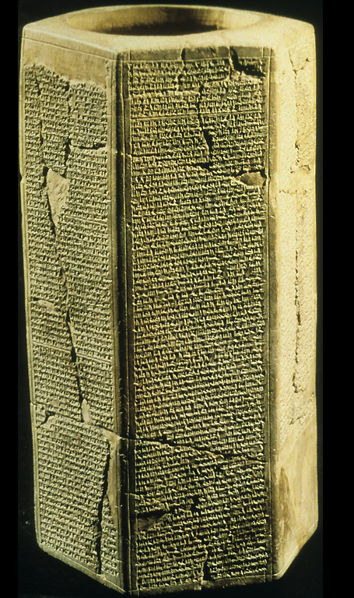
Taylor Prism
Sennacherib’s invasion of Judah is particularly well documented in Assyrian texts, bas-reliefs and excavation.
The Taylor Prism, like the Oriental Institute Prism, details his conquest of 46 of Judah’s walled cities and “countless villages”. He also claimed to deport 200,150 people.
“Hezekiah I made a prisoner in Jerusalem, his royal residence, like a bird in a cage.”
Sennacherib may indeed have “struck the judge of Israel on the cheek” (5:1).
British Museum, London

Slide 20
The Coming King (5:2-5a)
The loss of the house of David, whose kingdom was never to have ended (cf. 2 Sa. 7:13, 16; 22:51b; 23:5a), would be a formidable theological problem for the people of Judah.
Many thought that the kingdom of David had divinely guaranteed longevity, and Micah’s break with this popular ideal was decidedly unpopular (cf. 2:6-7; 3:11b).
However, the divine promise to David’s house would not fail, for a king yet to be born would come, arising from Bethlehem, the ancient village of David.
Between the time of Babylonian exile and the birth of the coming king, the people of Judah would suffer abandonment, waiting like a pregnant woman for the time of delivery.
When this king came, he would tend the flock of Israel like a good shepherd.

Slide 21
The New Kingdom (5:5b-15)
The remainder of Micah’s second oracle describes the prominence of God’s people under the reign of the coming king.
The aggression of Assyria and Babylon (land of Nimrod) would not last indefinitely (5:5b-6).
The remnant would distil among the nations as mysterious as dew (5:7-8).
At last, the many covenant violations would cease, and God would purge from his people all vestiges of false religion (5:10-14).

Slide 22
The Third Oracle: the Covenant Lawsuit Resumes (6-7)
The third oracle returns to the image of the court scene, where Yahweh presses his case against Judah (6:1-2).
The summon to the mountains and hills as ancient witnesses to the covenant are consonant with the heavens and earth, the original witnesses (cf. Dt. 32:1).
Now, God cross-examines his people (6:3). That Israel had broken covenant implied that she was the aggrieved party, but given all that Yahweh had done for Israel since the exodus from Egypt, how could they contend that he had not fulfilled his covenant obligations (6:3-5)?
For too many, it was the external form of the covenant that counted most, but what Yahweh required was the inward character of righteousness (6:6-8)!

Slide 23
THE ESSENCE OF TRUE RELIGION
FPAwmi (mishpat = justice, upholding what is right)
ds,H, (hesed = mercy, loyal love)
fn1cA (tsana’ = to live modestly) implies humility, not so much in terms of self-effacement as by considered attention to others

Slide 24
Crime and Punishment (6:9-16)
Israel’s covenant violations could only result in deserved reprisals:
Judgment would begin with the city, where so much dishonesty and exploitation had been perpetrated.
It would climax with the sword of invasion.
Judah had been infiltrated with the deadly religious syncretism of the Ba’al cult so vigorously pursued by the Omri dynasty in Samaria, and now a judgment within history was at hand.

Slide 25
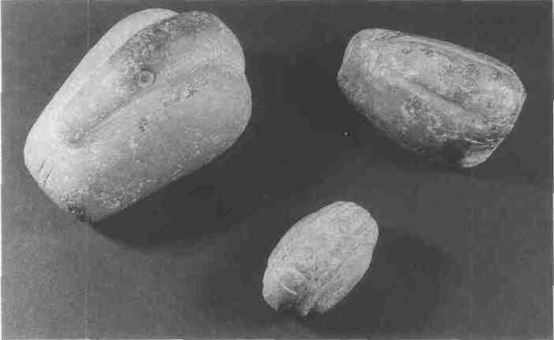
Weights and Measures
Metrology in the ANE, going back as far as 3000 BC or earlier, primarily consisted of standardized lengths (e.g., cubit, etc.), capacities (e.g., ephah, etc.) and weights (e.g., shekel, etc.).
Dishonest merchants would deliberately deceive a buyer by using different weights, one heavy for purchasing, one light for selling (6:11).
Semitic Museum, Harvard University
These stone weights, excavated at Nuzi (1600-1400 BC), represent 20 shekels (smallest), 1 mina and 2 minas (largest). They are marked with incisions to denote their values.

Slide 26
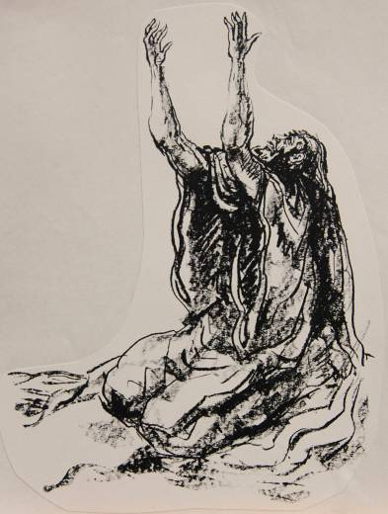
The Anguish of the Prophet
Micah’s moan, “What misery is mine!” expresses his deep grief over the godlessness of his own people. He laments:
Their rapacious greed and corruption.
Their lust for advantage.
Their faithlessness, contempt and disloyalty.

Slide 27
Waiting for Justice (7:7-20)
As did other prophets, Micah determined that he could only wait for God’s justice (7:7; cf. Hab. 2:1, 4b, etc.).
Still, the hope of Israel would rise from the ashes, and the fallen Zion would be rebuilt!
In the end, the nations would make pilgrimage to Jerusalem.
Micah closes with a prayer to Yahweh as the true Shepherd of Israel, whose defining characteristic is not wrath but mercy.

