Slide 1
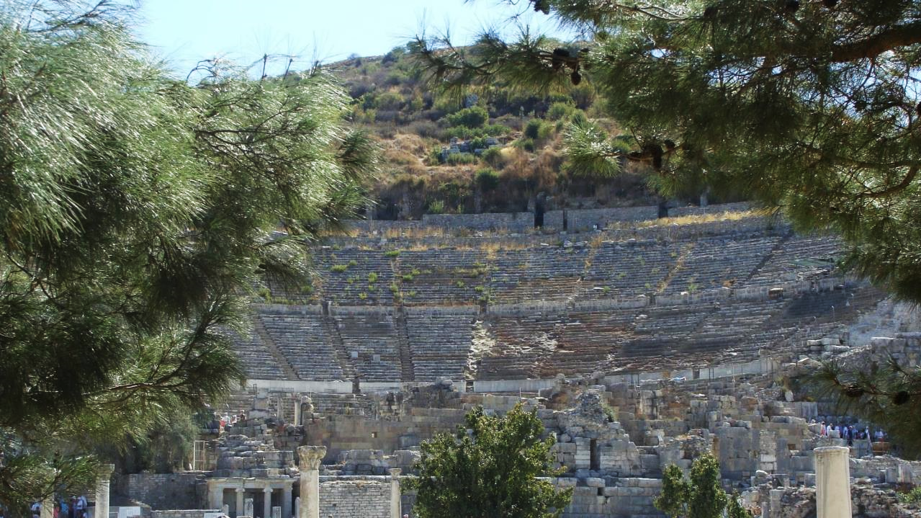
NT ARCHAEOLOGY
NT ARCHAEOLOGY
INTRODUCTION
Lesson 1
Lesson 1
Introduction

Slide 2
Archaeology
The science and art of recovering the material past of humans:
It includes government, religion, animal husbandry, agriculture, cultural interchange, cities and villages, domestic life, writings, and many other areas.
There are two primary aspects of this discipline:
  Discovery and reclamation of ancient remains from surface collecting
  Field excavation followed by analysis, interpretation and publication

Slide 3
The Archaeological Periods
EARLY
BRONZE
MIDDLE
BRONZE
LATE
BRONZE
IRON
1 & 2
PERSIAN
GREEK
ROMAN
3000
3000 BC
2000 BC
1000 BC
4 BC
Abraham
David
Christ
Moses
Jeremiah

Slide 4
NT Archaeology
The period for NT archaeology is much shorter than for the Old Testament, only about a century as opposed to two millennia:
Primarily, it focuses upon three broad categories:
  Life and times of Jesus
  History of the Early Church
  Texts of the New Testament
However, lying just before the birth of Jesus is the long transition from the Old Testament to the New Testament—about four centuries—and many things that one finds in the NT depend upon events and ideas from what is popularly called “the silent years.”
Since NT archaeology is later, sometimes archaeologists reach strata from this period rather quickly, as in, for instance, the village of Bethsaida.

Slide 5
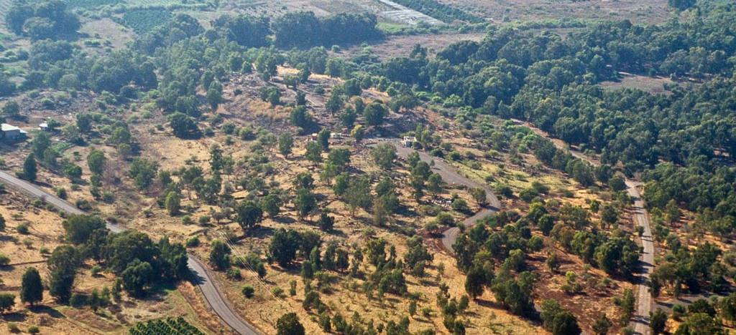
Bethsaida, the home of Peter, Andrew and Phillip, was a small fishing village on the north side of the Galilean Lake. The site has been under excavation for a number of years by Rami Arav (University of Haifa) and Mark Smith (College of Idaho).

Slide 6
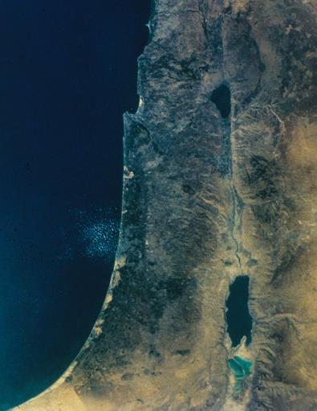
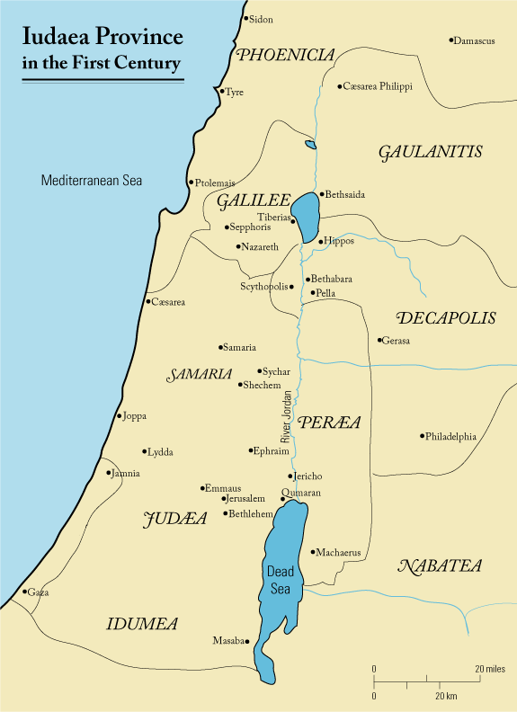
A Bit of Geography
LAKE
Galilee
Transjordan
MEDITERRANEAN SEA
JORDAN RIVER
Coastal Plain
Central Mountains
Shephelah
DEAD SEA
Negev

Slide 7
Intertestamental History
Several important events happened between the Old and New Testaments:
The Jews transitioned from the Persian Empire to the Hellenistic Empire to a period of independence to the Roman Empire.
Greek became the international language of the Mediterranean world.
Greek culture spread widely and became a threat to Jewish culture and faith.
Forums, gymnasiums, amphitheaters, and shrines to the Greco-Roman pantheon became common, even in Syria-Palestina (the Roman name for the Holy Land).
Antiochus IV Epiphanes made a major attempt to obliterate Jewish religion, leading to the Maccabean Revolt (160s BC).
Pompey conquered Palestine for Rome in 63 BC.

Slide 8
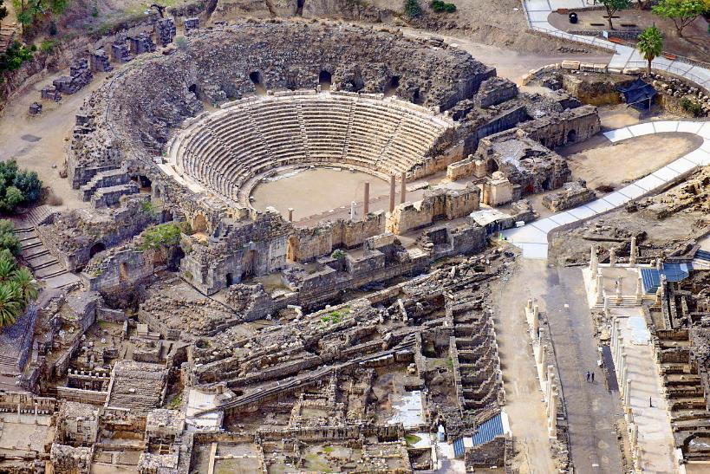
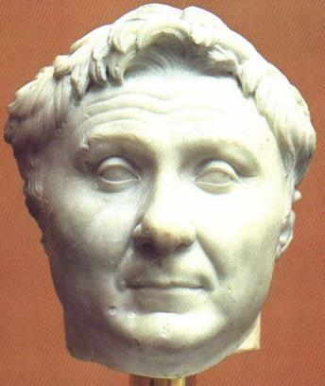
The Roman amphitheater in Beth Shean (north central Israel)
Pompey the Great (106-48 BC) conquered Palestine and Jerusalem for Rome in 63 BC.
Ny Carlsberg Glyptotek
Copenhagen, Denmark

Slide 9
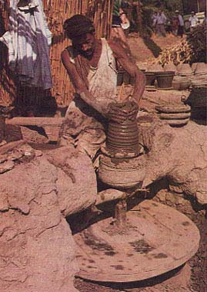
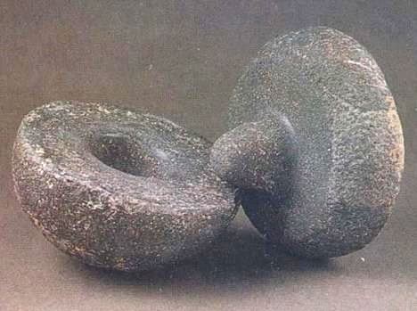
Technological Advances
Many technological advances were made in the period shortly before the birth of Jesus.
The invention of the double wheel (right) for throwing pottery streamlined the entire industry.

Slide 10
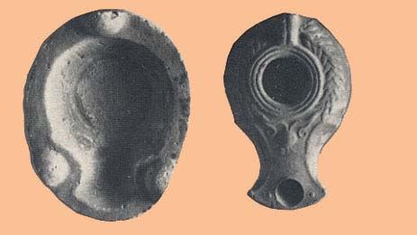
The Bivalve Mold with Keys
Lamps were originally individually crafted by hand. Such lamps were a basic part of every household.
The invention of a mold with keys revolutionized the oil-lamp industry, since only the archetype needed to be crafted, and many pieces could be made from the same archetype.
High quality lamps could be mass produced.
KEYS
Israel Museum, Jerusalem

Slide 11
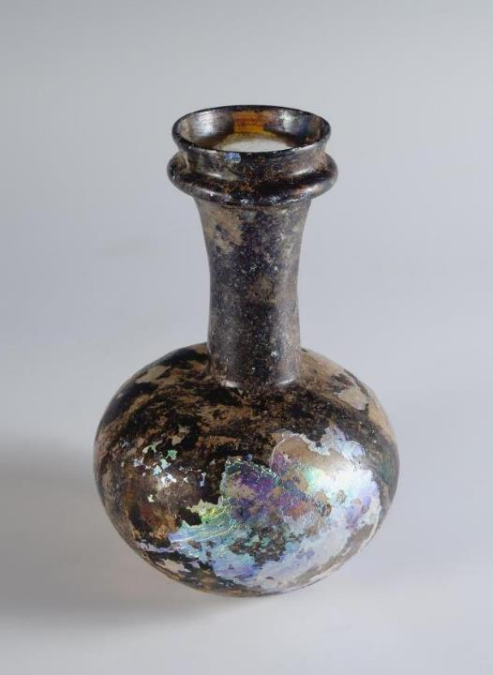
Glass Blowing
Shortly before the time of Jesus (mid-1st century BC), glass blowing was invented, possibly in Jerusalem. Here, melted glass (heated to 1100-1300 degrees F.) could be expanded by blowing into it through a hollow tube. At the left is an example of a 1st century blown glass flask.
They also learned to color glass by adding metallic oxides. Various shades of blue were achieved by adding cobalt and/or copper oxide. A small amount of iron caused glass to turn green, while manganese created yellowish or purple glass.
University of Colorado Museum

Slide 12
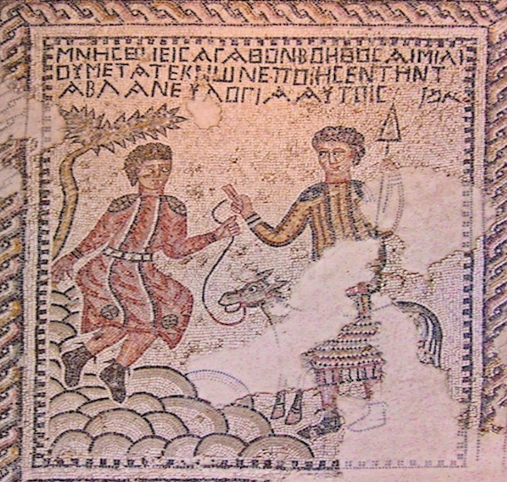
Mosaics
Cut stone cubes (called tesserae) were used to produce highly detailed mosaics with different colors, and from the 2nd century BC and later, mosaic flooring became extremely wide-spread, appearing on many floors of synagogues as well as the homes of the more affluent.
This mosaic from the floor of the synagogue in Sepphoris (about 4 miles from Nazareth) depicts the binding of Isaac on Mt. Moriah (Ge. 22).

Slide 13
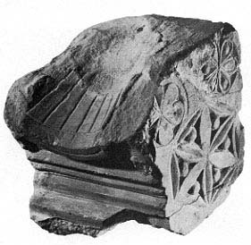
Sundial
Literally hundreds of sundials have been recovered, a number of them from Jerusalem. This one comes from the debris of the Roman destruction of Jerusalem in AD 70 and possibly was used to time the duties of those in temple service.
It still retains half its 12 radial segments, divided by incised lines. These segments on the concave sundial tracked the sun’s movement by marking the progress of the shadow of a gnomon, an upright piece of metal (only the stub remains).
New Testament references to hours of the day, sunrise to sunset, may have been calculated by sundials.
Nahman Avigad
The Jewish Quarter Excavations

Slide 14
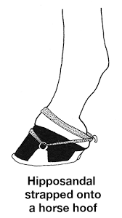
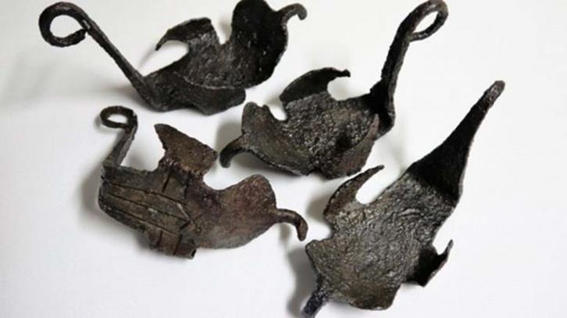
The Horseshoe
The horseshoe or hipposandal (a leather “boot” with a solid bottom, not nailed but attached to the hoof by leather straps)
A rare find: a complete set of hipposandals discovered at Hadrian’s Wall in Great Britain

Slide 15
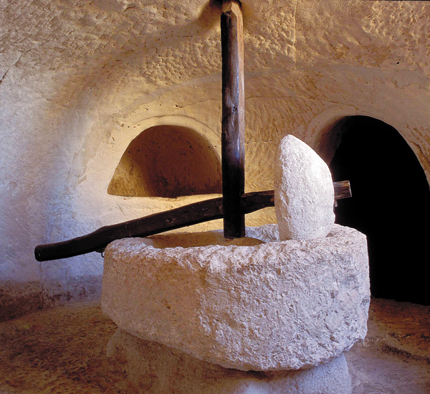
This olive press from the underground “factory” at Maresha was one of 22 known olive oil producers producing some 300 metric tons of olive oil annually.
The stone weights on these crushing basins weighed about 800 lbs. each.

Slide 16
What Archaeology Can & Cannot Do
Archaeology is a discipline in progress; hence material remains are always subject to interpretation and reinterpretation.
Only fragmented remains survive from the past.
Relatively few sites have been excavated.
This means that yesterday’s “proof” might become tomorrow’s Achilles heel.
Hence, Christians should be cautious when using words like “confirm” or “prove” or “authenticate” or “substantiate.”

Slide 17
At the same time, it must be remembered that BOTH archaeology AND the Bible are interpreted sources of information.
ARCHAEOLOGY
Over-confidence in the archaeological enterprise that claims “assured results” sometimes is undermined by further investigation.
Only a fraction of the archaeological sites in Israel have been excavated.
THE BIBLE
Christians also must be careful in their biblical interpretation so that they do not force the Bible to say what, in fact, it does not say.
Some interpreters have reached unwarranted conclusions about what the Bible actually says.

Slide 18
NT ARCHAEOLOGY
NT ARCHAEOLOGY
ARCHITECTURE OF HEROD THE GREAT
Lesson 2
Lesson 1
Introduction

Slide 19
Herod the Great
Jesus may have been alluding to Herod when in a parable he described a nobleman who went to a distant country to have himself appointed king and then returned: Herod did exactly that in 40 BC, when the Roman Senate appointed him king of Judea!
After the Roman civil wars, Herod allied himself with Mark Antony when Octavian and Antony had a falling out.
Following Antony and Cleopatra’s decisive defeat at the Battle of Actium in 31 BC, he then went to Rhodes to pledge his loyalty to Octavian (Augustus Caesar).
His personal life was chaotic, and he logged 10 wives and 15 children, leading to court intrigue and the execution of three of his own sons, one of his wives, and one mother-in-law.
None-the-less, he was an avid builder who reshaped his domain architecturally.

Slide 20
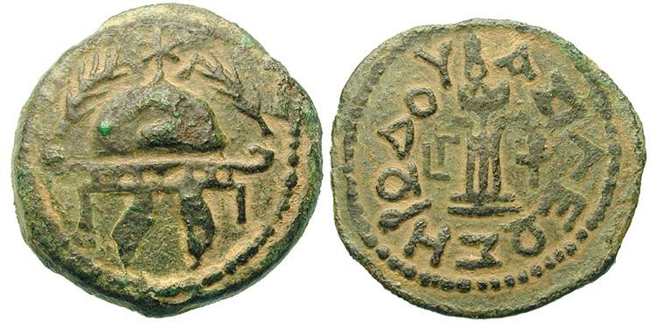
Minted coin of Herod the Great
The obverse shows a helmet with dangling cheek straps. The reverse has inscribed on it BASILEWS HRWDOU (= “of King Herod”).
Herod the Great, famous in the Bible for the slaughter of the innocents, died shortly after the birth of Jesus (Mt. 2:16-20).
The date of his death is usually fixed around 4 BC, and if so, the birth of Jesus was about that year or slightly earlier.
That Jesus was not born in AD 1, as might be supposed, is due to calendar errors made in the 5th and 6th centuries by the monk Dionysius Exiguus, who originated the “BC” and “AD” acronyms.

Slide 21
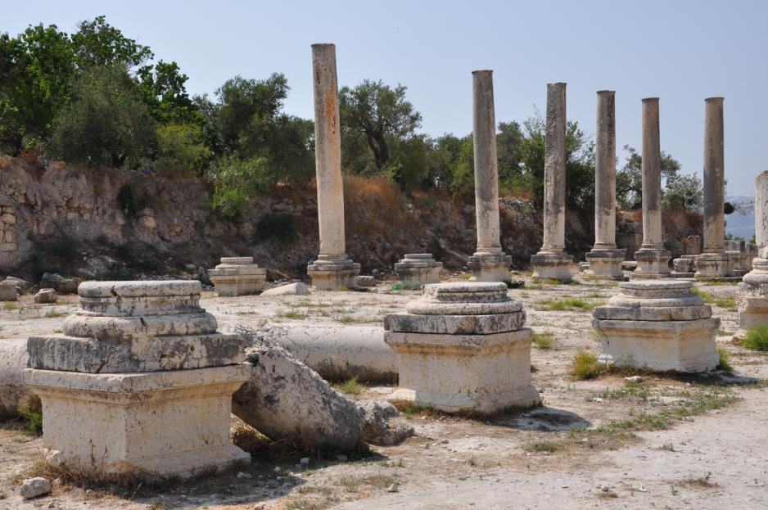
Samaria-Sebaste
Samaria had been the capital of northern Israel in the Old Testament. Herod renamed it Sebaste (the Greek equivalent of the Latin Augustus), rebuilding the city in full Roman style. It included a cardo, a forum, a Roman basilica, a stadium, a temple, and a hippodrome.

Slide 22
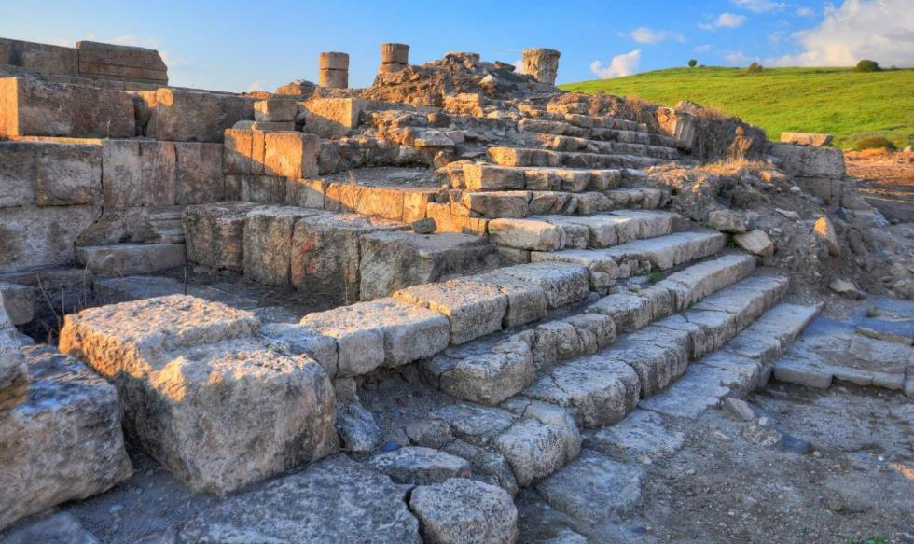
Probable Ruins of Herod’s Temple at Omrit
Herod built three temples in the Holy Land in honor of Augustus Caesar, at Sebaste, Caesarea, and Omrit, near Caesarea Philippi.

Slide 23
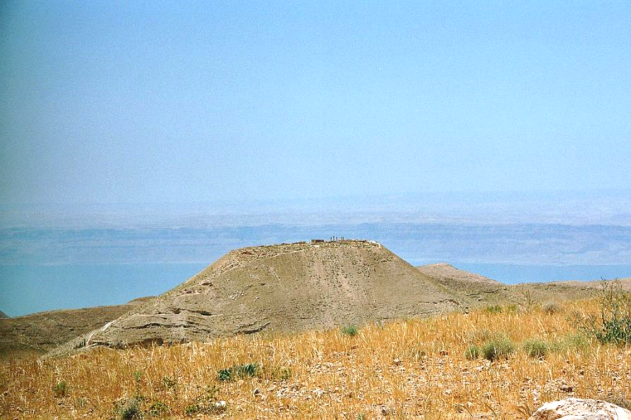
Machaerus
Panoramic view of the ruins of Machaerus with the Dead Sea in the background: the hilltop stands about 1100 meters above the Dead Sea level.
John the Baptist’s execution occurred here in about AD 32, shortly before Passover in that year.

Slide 24
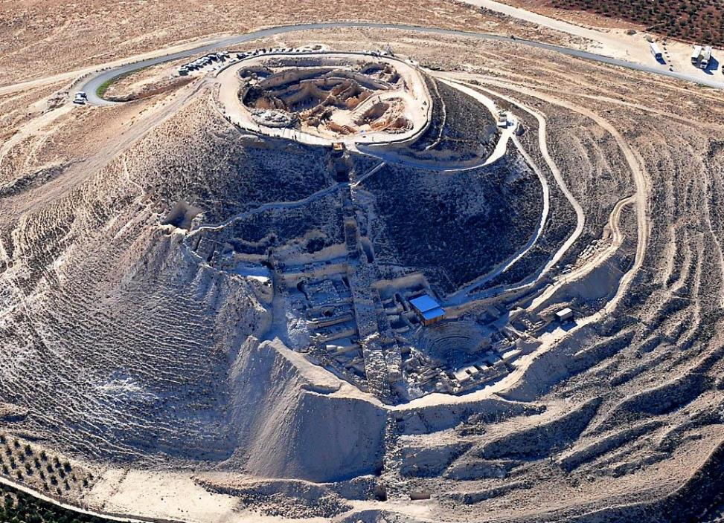
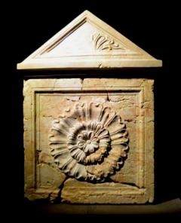
Herodium
The only palace-fortress named after Herod himself, Herodium lies about 3 miles southeast of Bethlehem.
Archaeologists have discovered fragments of a sarcophagus which they believe to have held the body of Herod the Great.

Slide 25
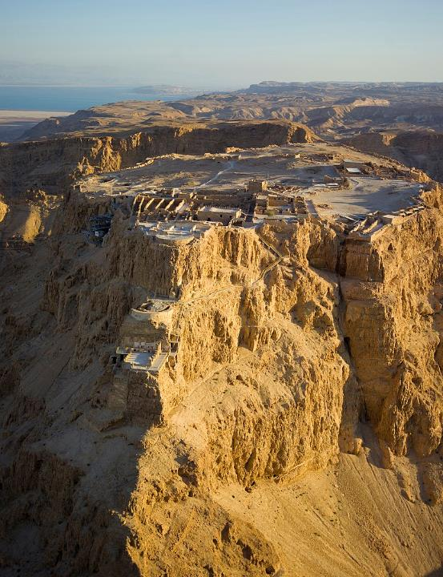
Masada
Following the Maccabean ideal and concluding that Jesus was a failed messiah, the voices of armed rebellion eventually won out among the Palestinian Jews, leading to a revolt against Rome.
In AD 66-73, the Jews expelled the Romans from Palestine, but later succumbed to Vespasian and Titus.
Jerusalem was retaken by the Romans and the temple destroyed in AD 70.
The final resistance force held out at Herod’s fortress on the shores of the Dead Sea at Masada, where 960 rebels committed mass suicide in AD 73.

Slide 26
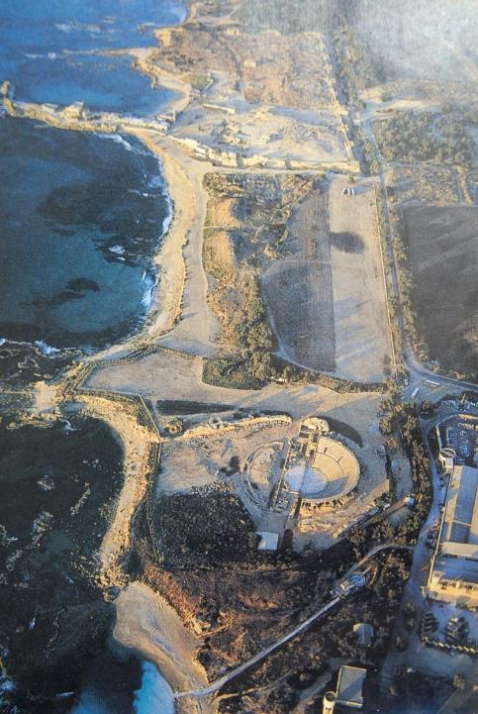
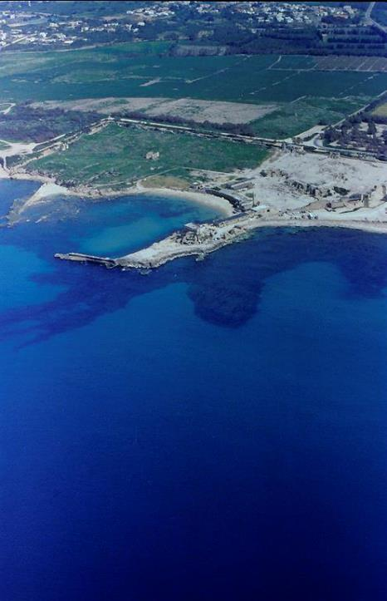
Caesarea Maritima (left) became the seat of Roman government in Palestine. Herod created an artificial harbor, one of the largest ports in the Mediterranean. The dark areas in the water (right) mark the outline of a 200-foot-wide concrete breakwater that Herod’s engineers laid on the seabed.

Slide 27
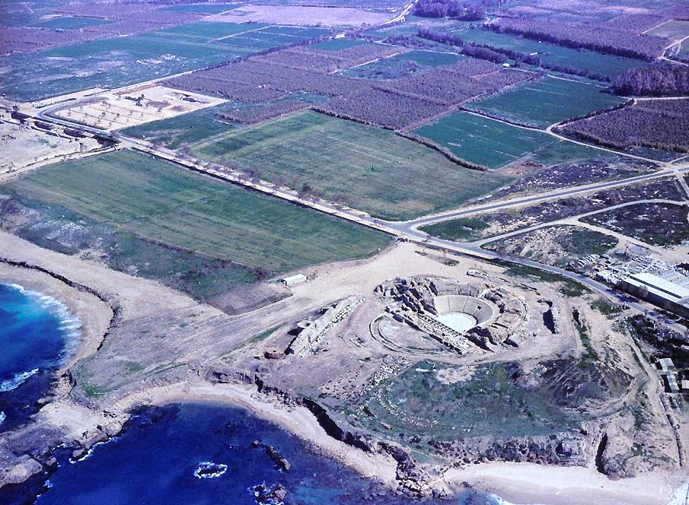
The theater Herod built (bottom right) was situated to allow audiences to savor the sunset over the Mediterranean.

Slide 28
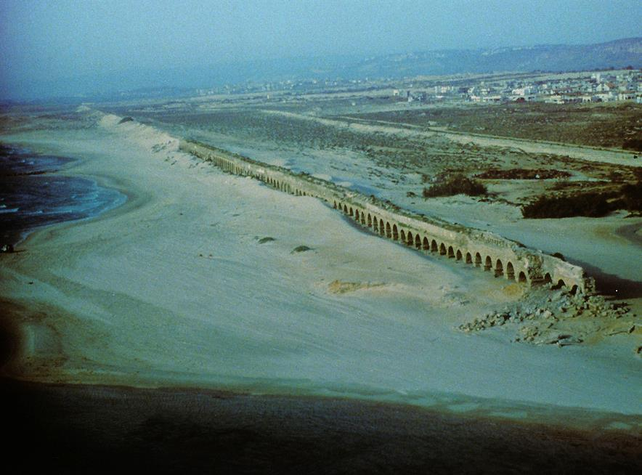
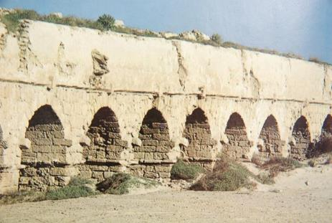
The aqueduct stretches northward to a spring in the Mt. Carmel range, barely visible through the haze.

Slide 29
The Temple Mount
David was the original purchaser of Mt. Zion, where his son Solomon built the 1st Temple (1 Chr. 21:21-26; 22:1; 2 Chr. 3:1; 5:1ff.):
After the Babylonians destroyed this temple in 587-6 BC (2 Kg. 25:8-9), a 2nd Temple was constructed by Zerubbabel after the return of the Jews from exile, and it was completed in 516 BC (Ezr. 6:14-15)
Later still, Herod the Great greatly expanded the Temple Mount, creating much larger temple courtyards, lavishly decorating the 2nd Temple with gold, and making it the largest such edifice in ancient times.
This 2nd Temple would eventually be destroyed in AD 70 by Titus Vespasian and a huge army of some 60,000 troops from the Roman Legions V, X, XII, and XV.

Slide 30
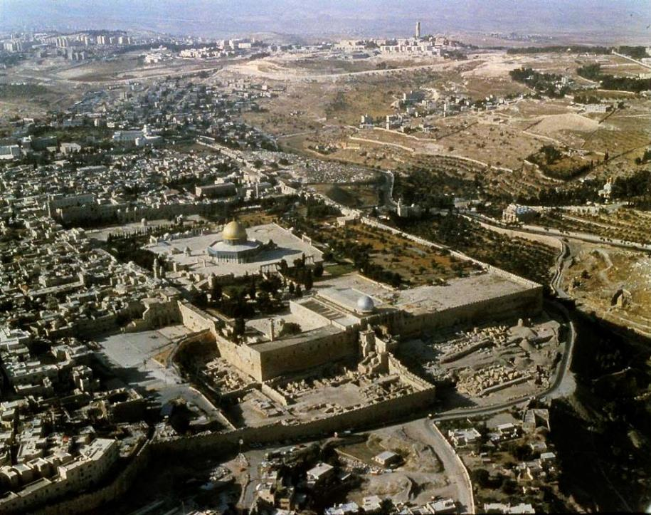
Dramatically preserved, the huge platform of some 36 acres surrounding the 2nd Temple includes the highest man-made elevation in the Holy Land, the retaining walls rising from bedrock some 130’. This “pinnacle of the Temple” was were Satan tempted Jesus to throw himself down (Mt. 4:5-7), and where James, in fact, was thrown down in AD 62.

Slide 31
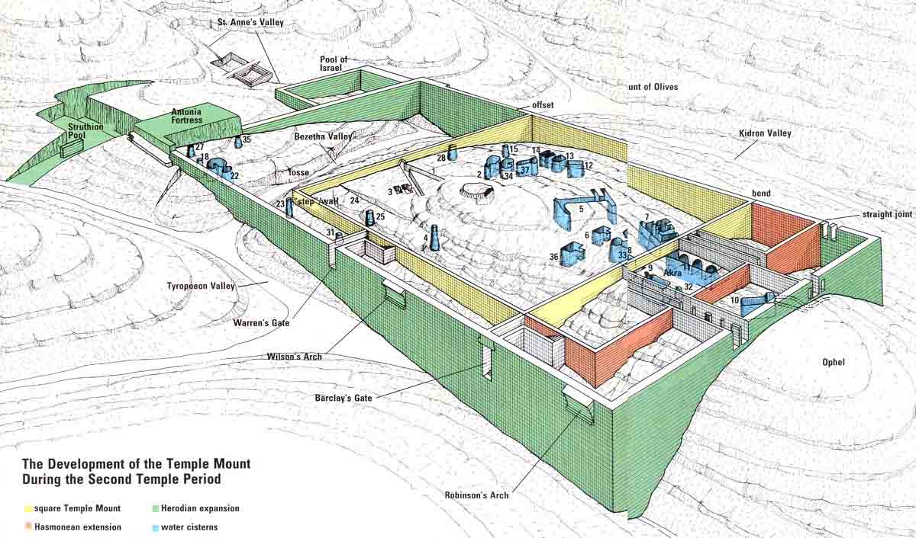

Slide 32
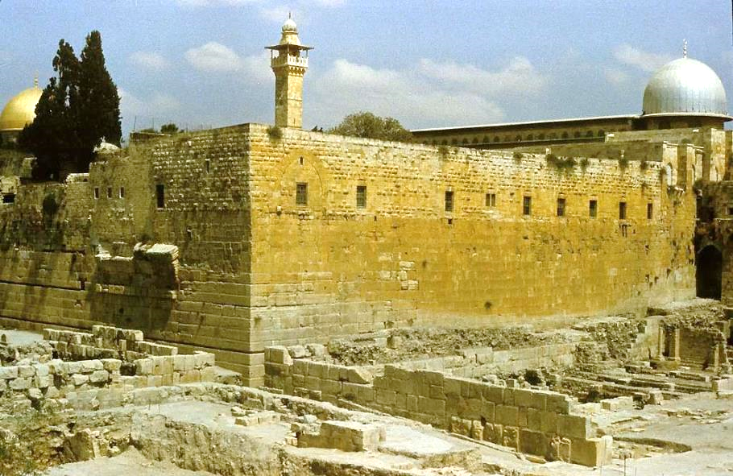
The southwestern corner of the Temple Mount, where excavations began in the late 1960s, shows Herodian ashlars in the lower courses and the projections on the western wall of Robinson’s Arch, which is all that remain of a stately staircase from the 1st century.

Slide 33
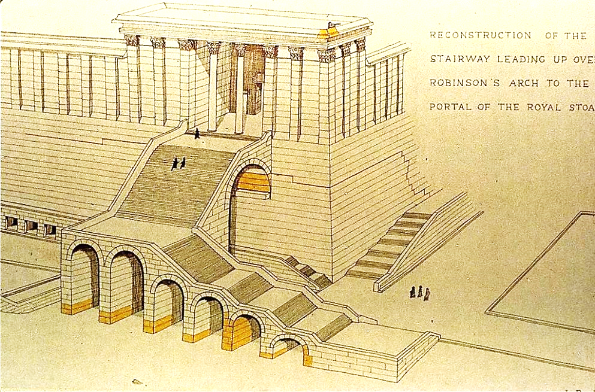
This drawing shows how the stairway that ended in Robinson’s Arch may have looked in the time of Jesus. The colored yellow areas show what remains as well as an inscribed piece of the cornice at the top.

Slide 34
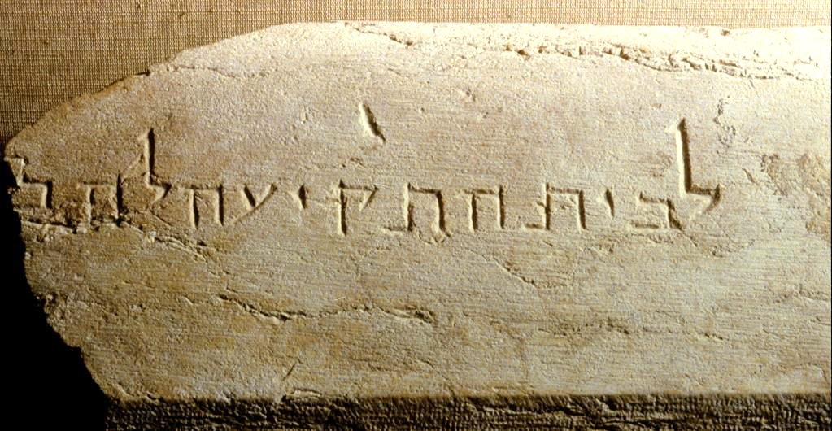
This stone inscribed in Hebrew, “To the place of trumpeting…,” was discovered in the rubble left by the Romans two millennia ago. It marks the place from which a priest would blow the trumpet announcing the beginning and end of the Sabbath.

Slide 35
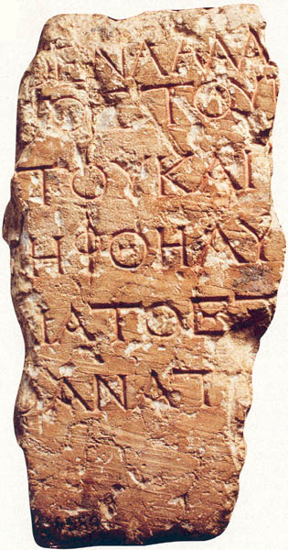
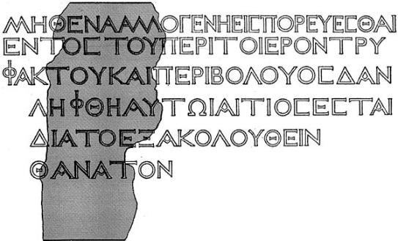
This Greek inscribed placard, discovered in 1935, once warned Gentiles not to enter the inner courts reserved for Jews at the pain of death. The full inscription reads: “No foreigner may enter within the railing and enclosure that surround the Temple. Anyone apprehended shall have himself to blame for his consequent death” (this fuller text is reconstructed from a more complete copy in the Archaeological Museum in Istanbul.
Israel Museum, Jerusalem

Slide 36
NT ARCHAEOLOGY
NT ARCHAEOLOGY
JESUS’ EARLY LIFE
Lesson 3
Lesson 1
Introduction

Slide 37
NT FIGURES CONFIRMED IN EXTERNAL SOURCES
Some 30 New Testament persons have been confirmed by external texts, coins, and inscriptions.
Jesus
John the Baptist
James, Jesus’ Brother
Annas, son of Seth
Caiaphas
Gamaliel
Ananias, son of Nebedaios
Augustus
Tiberius
Claudius
Nero
Herod the Great
Herod Archelaus
Herod Antipas
Herod Philip
Herodias
Salome
Philip the Tetrarch
Herod Agrippa I
Herod Agrippa II
Berenice
Drusilla
Quirinius
Pontius Pilate
Lucius Gallio
Marcus Felix
Porcius Festus
Aretas IV
Unnamed Egyptian
Judas of Galilee

Slide 38
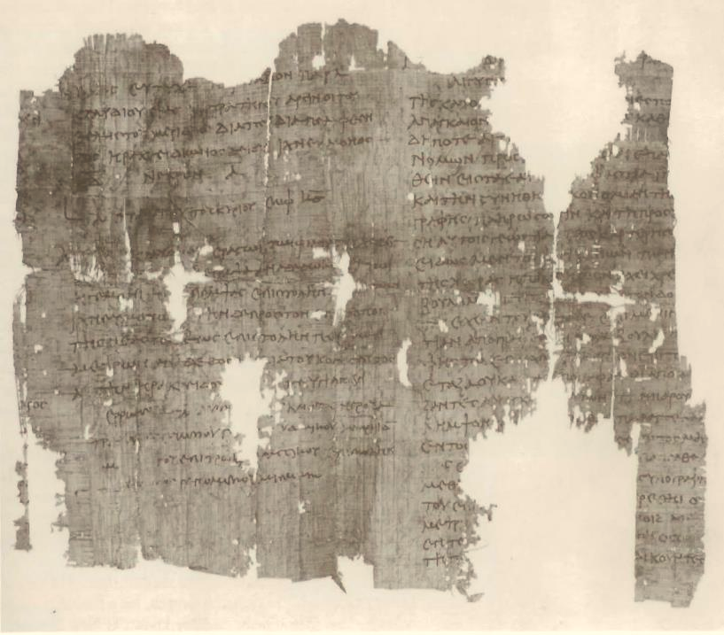
This papyrus census document (Papyrus 904, British Museum) from the administration of Emperor Trajan (AD 104) describes the requirement that everyone was to return to his ancestral home to register, the very same situation described by Luke (Lk. 2:1-4).

Slide 39
The Problem of Quirinius
We know of a Quirinius who conducted a census in AD 6.
This is a decade too late to coordinate with the birth of Jesus before Herod the Great’s death, which we know occurred in 4 BC.
Attempts at resolution:
  Some scholars suggest the word prw<th in Lk. 2:2b should be rendered as “formerly” rather than “first.” If so, the passage would read, “This was the former census that took place while Quirinius was governor of Syria.)
  This rendering opens the possibility that there may have been an earlier tenure of Quirinius (of which we have no record), or else, there may have been two governors with the same name (of which we have no record).
  Finally, some would redate the birth of Jesus to AD 6, setting aside the reference in Matthew concerning Jesus’ birth near the time of Herod’s death.
At present, this issue remains unresolved.

Slide 40
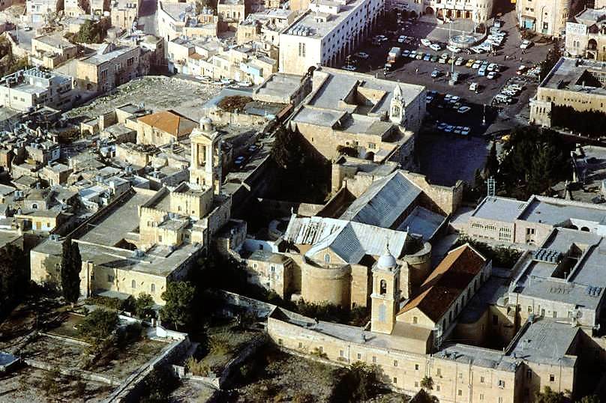
Church of the Nativity, Bethlehem

Slide 41
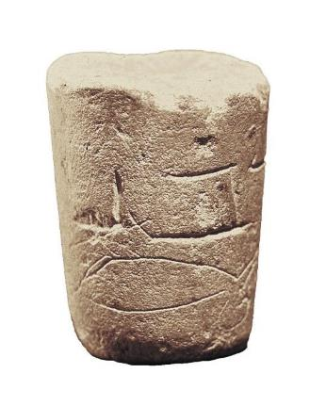
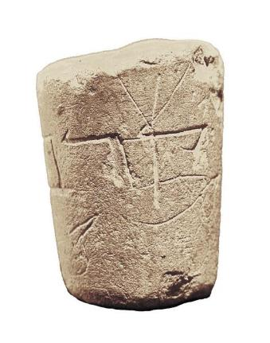

Qorban (= offering) Inscription
This 1st century stone vessel discovered on the Temple Mount features two upside down birds along with the inscription qorban (= offering). Leviticus 12:8 specifies a pair of doves or pigeons as the appropriate sacrifice for the poor at the birth of a first-born son, one bird as a burnt offering and the other as a sin offering.

Slide 42
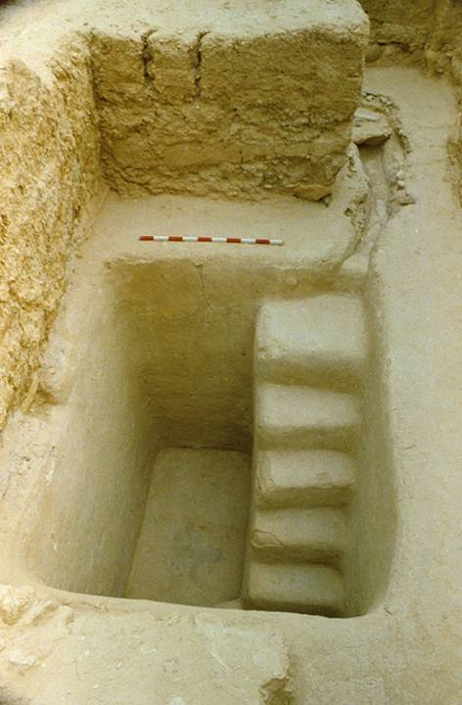
Baptismal Purification of Mary
Leviticus 12 also describes the process for purification after childbirth, and since the ritual impurity for childbirth is of the same kind as for menstruation (Lv. 15:19-23), it also involved a ritual immersion in water. The purification of Mary at the temple was duly accomplished (Lk. 2:22). Presumably, she would have had a ritual immersion in one of the mikva’ot at the temple.
By the 1st century, Jewish purification pools (mikva’ot) were in regular use, and a number of them have been discovered, including this one from near the stairway at the southern wall of the Temple Mount.

Slide 43
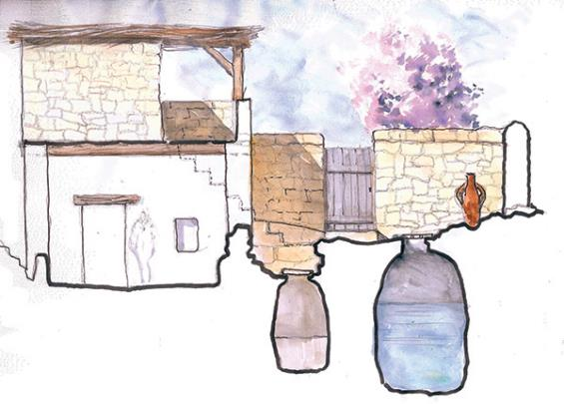
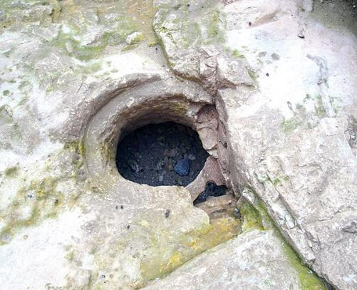
CISTERN In 2006 and 2009, archaeologists discovered two homes in Nazareth dated to the 1st century along with cisterns serving the family. It would be too fanciful to suggest that Jesus grew up in one of these homes. However, they do provide a window into 1st century domestic life in the village of Jesus’ childhood.
One of the cisterns and an archaeological watercolor of the cisterns in relation to the house

Slide 44
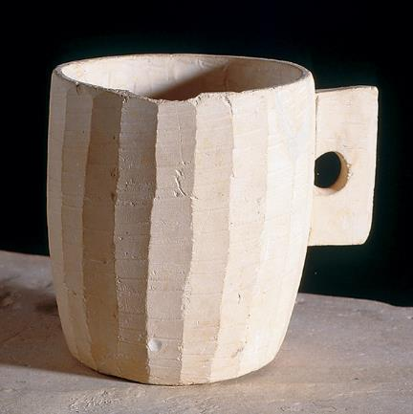
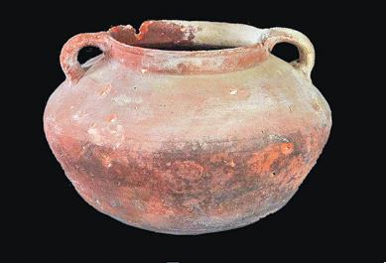
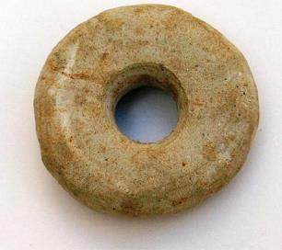
1st Century Jewish Household Items
Everyday dishware, known as Kefar Hananya pottery, was common in the area surrounding Nazareth.
Israel Antiquities Authority
Discovered in one of the two 1st century Nazareth homes, this spindle whorl would have been used to make thread.
Inserted through the hole was a dowel to which was attached plant or wool fibers. Then, the whorl was spun to twist and compress the fibers into thread.
Limestone vessels, like this stone cup, were highly valued because they could be used continually rather than destroyed, unlike pottery vessels that had contracted impurity.
Israel Museum, Jerusalem

Slide 45
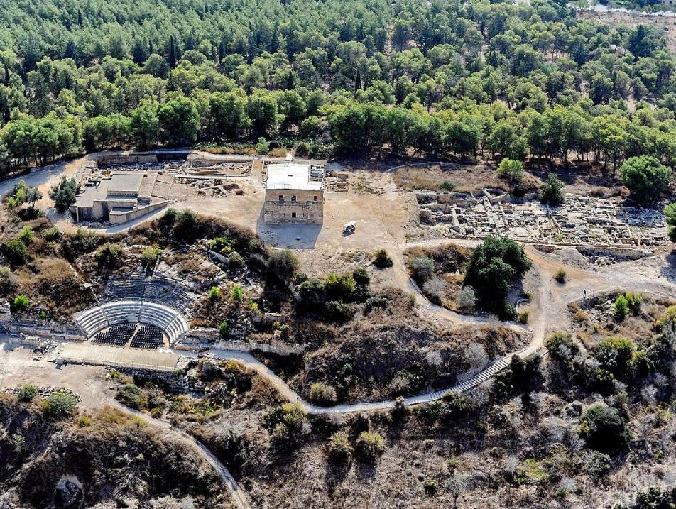
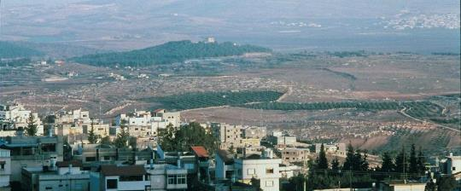
Sepphoris (2013 aerial photo), about 3 miles from Nazareth, was a city of mixed population by the time of Jesus’ childhood. Jesus and Joseph may have labored here as construction workers.

Slide 46
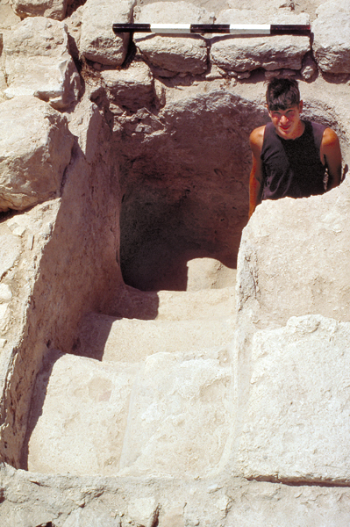
MIKVA’OT
Many Jewish mikva’ot have been uncovered from the 1st century, including this one at Sepphoris.
Such baptismal pools were required to have “living water,” which is to say, running water. They were constructed so that water could be circulated by gravity, and indeed, this feature would later be included in perhaps the earliest description of Christian baptism outside the New Testament (Didache 7), where it specifies a preference for “living water” as well as cold water.

Slide 47
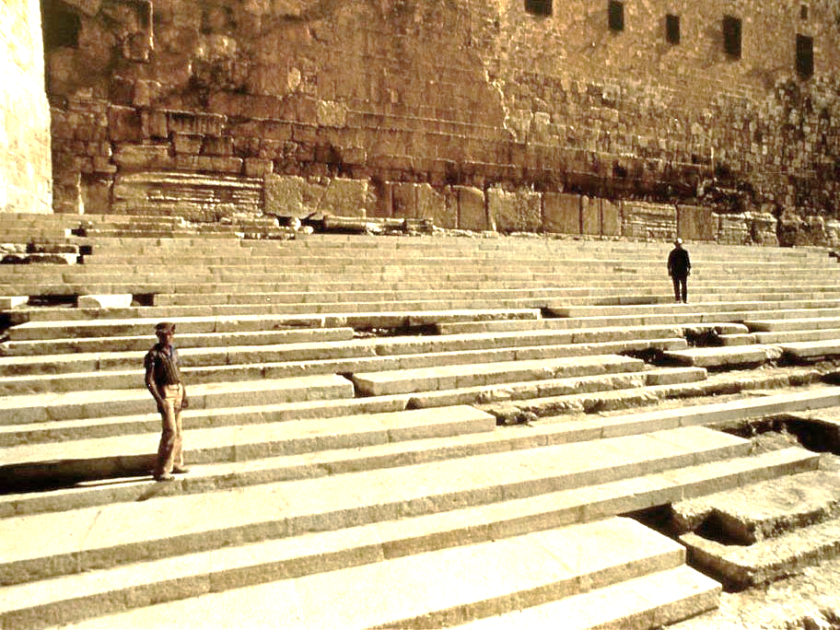
The so-called “Steps of the Rabbis,” according to the Talmud, was where rabbis would engage in theological discussion with Jews attending the Passover.
This may well be where Jesus both asked and answered questions on his first visit to Jerusalem.

Slide 48
The Jewishness of Jesus
Jesus’ basic language seems to have been Aramaic (based on the several Aramaic logia in Mark’s Gospel).
However, it also is possible that he understood Greek, given the proximity of Nazareth to Sepphoris, a city of mixed population (about 3 miles away). He likely also understood Hebrew.
Given what Jesus said about the sacredness of the law of Moses (Mt. 5:18), it seems most probable that he was reared in a Torah-observant family.
As would have been true of most Jewish boys, Jesus was trained in the trade of his father as a carpenter or mason (cf. Mk. 6:3; Mt. 13:55). The term te<ktwn (= one who constructs) could be used of both wood workers or masons, though Justin Martyr (early 2nd century) records that Jesus made “plows and yokes.”

Slide 49
Transliterated Aramaic words of Jesus in Mark:
TRANSLATION TRANSLITERATION PRONUNCIATION
Mk. 3:17
Mk. 5:41
Mk. 7:11
Mk. 7:34
Mk. 14:36
Mk. 15:34
“Sons of Thunder”
“Girl, arise!”
“Offering/sacrifice”
“Be opened!”
“Father…”
“My God, my God, why
have you left me?”
boanhrge<j
taliqa> kou<m
korba<n
e]ffaqa<
a]bba<
e]lwi~ e]lwi~
lama>
sabaxqa<ni
bene-re’am
telitha qum
qorban
effathah
ebbah
elahi elahi
lemah
sevaqtani

Slide 50
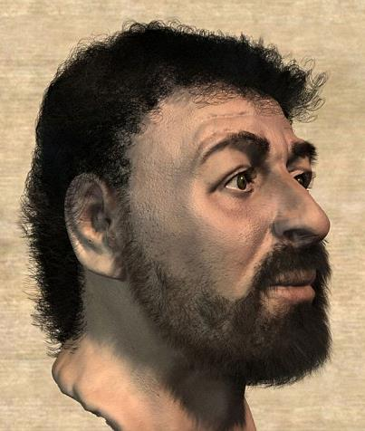
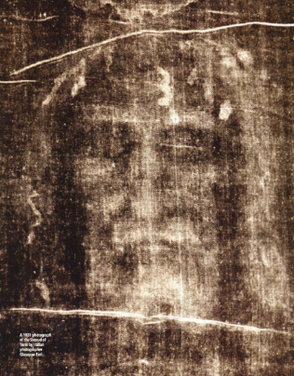
What did Jesus look like?
No one knows, of course, but two images, quite different from each other, have captured the popular imagination
Based on skeletal remains of 1st century Jews, British forensic anthropologists reconstructed a “typical” Jewish face. For more sensationalist reasons, their reconstruction was billed as the “real face of Jesus” (Popular Mechanics, Dec. 2002).
The negative image (here shown as a positive) on the highly controversial Shroud of Turin

Slide 51

Rembrandt was the first artist to use Jewish models, Sephardic Jews in Amsterdam, for his portraits of Jesus.

