Slide 1
TITUS
Letter to a Younger Colleague

Slide 2
INTRODUCTION

Slide 3
A Colleague and Ambassador of Paul
Unlike Timothy, about whom the reader gains some details in the Book of Acts, Titus is known to us only in the letters of Paul.
He first appears in the Galatian letter as a Greek convert who accompanied Paul to Jerusalem to serve as a test case for circumcision (Tit. 1:4; Ga. 2:1-3; Ac. 15:2ff.).
That he was a convert under Paul’s ministry seems clear inasmuch as Paul calls him “my true son in our common faith” (Tit. 1:4).
In the Corinthian correspondence, he served as Paul’s personal representative after Paul had been publicly humiliated during the “painful visit” (2 Co. 2:1), traveling to Corinth to work toward a diplomatic reconciliation (2 Co. 12:18).
This mission was a success (2 Co. 7:6-7, 13-15), and he then was instrumental in collecting funds for the poor in Jerusalem (2 Co. 8:6, 16-23).

Slide 4
When Written
The Book of Acts does not offer anything concerning an evangelistic visit by Paul to Crete, though the Book of Titus itself suggests that Paul was there (1:5).
Those who accept the early church tradition that Paul was released after his hearing before Nero suggest the visit to have been then, prior to a second arrest (Eusebius, Ecclesiastical History ii.22; 1 Clement 5).
If Paul was not released shortly after the end of Acts, then the timing of the letter remains an open question.

Slide 5
Situation
Paul says he left Titus in Crete to correct what was defective in the church as well as to appoint elders in the various Cretan cities (1:5).
The term Paul uses (presbu<teroj = elder) had a long history in the Jewish community, the Sanhedrin, and the Greco-Roman world. It carried a double meaning both as a designation for an older person and also as a title for an office of leadership, the latter of which seems intended here.
Since various teachers were offering versions of Christianity that Paul considered deceptive and misguided (cf. 1:10-11), he was concerned about preserving the apostolic faith without distortion.
Soon, Paul hoped to relieve Titus by sending Artemas and Tychicus, thus enabling Titus to join him in Nicopolis for the winter on the west coast of Greece, when travel would be suspended for the season (3:12).

Slide 6
Roman Crete
The island of Crete, just over 150 miles long (east to west) and ranging from 8-35 miles wide (north to south), lay southeast of the Grecian mainland.
In ancient times, it was the original home of the Philistines, a part of the “sea peoples” who invaded Egypt in the 13th century and settled on the southwest coast of Palestine (Am. 9:7; Je. 47:4).
Rome conquered the island in 67 BC, and it became part of the North African Province of Cyrenaica.
Jews began settling there as early as the 2nd century BC (1 Macc. 15:23), and some Cretan Jews were present at Pentecost (Ac. 2:11).

Slide 7
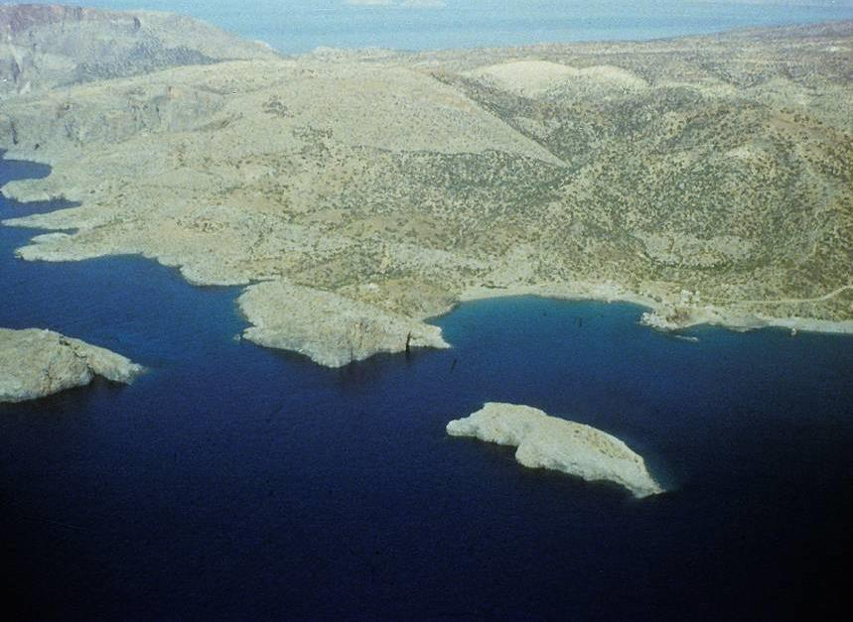
Fair Havens in Crete was where Paul recommended wintering when on his voyage to Rome. (Winter travel generally halted on the Mediterranean due to adverse weather.)

Slide 8
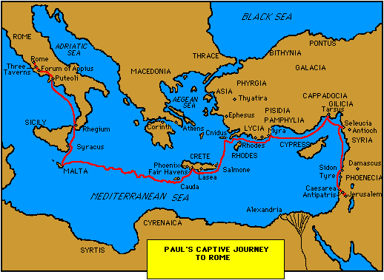

Slide 9
Did Paul Write the Titus Letter?
About 80-90% of contemporary biblical scholars believe that Titus (along with 1 and 2 Timothy), were composed after Paul’s death.
Literary and linguistic analyses in Greek are major reasons for this reassessment (e.g., the pastoral letters use particles, conjunctions, and adverbs differently than the other Pauline letters).
Also, about a quarter of the vocabulary in the pastorals do not appear in Paul’s other letters.
Some Pauline terms, such as righteousness, faith, and law, seem to have a different nuance than in Paul’s other letters.
The development of church structure seems to be later than what can be gleaned from Paul’s other letters.

Slide 10
Against This Modern Conclusion
The early church universally accepted the pastoral letters as genuinely Pauline.
The early church rejected documents attributed to Paul, such as, 3 Corinthians, the Letter to Laodiceans, the Letters of Paul and Seneca, and the Acts of Paul and Thecla, but not the pastoral letters.
Perceived differences in vocabulary, syntax, and word nuances can be put down to Paul’s brilliance and range, and possibly, his use of an amanuensis. (Literary style is invariably affected by subject matter and mood.)
Some details must always remain ambiguous due to lack of clear evidence, and hence, we will rest with the conclusion of the post-apostolic church that Paul wrote the Letter to Titus.

Slide 11
The Spiritual Danger Crete
Everything in the letter suggests that the church in Crete was a new community.
Paul agrees with the conventional assessment that the Cretans were lacking in honesty, morality, and self-discipline (1:11-12, 15-16).
Elders were still to be appointed (1:5, 7).
Opponents to Christianity came from both Jewish and non-Jewish sources (1:10).
Some were peddling Jewish myths (1:14) and fussing about legal observances from the law of Moses (1:9; 3:9-11).
The end result was the upsetting of whole households (1:11).

Slide 12
OPENING (1:1-4)
The opening formula is rather lengthy, and assuming the letter would be read publicly, then the long introduction would serve well to introduce Paul to any present who may not have known him.
As is typical in Greco-Roman letters, the introduction identifies the sender and addressees.
Paul depicts himself as the “slave of God” and an “apostle of Jesus Christ.”
His purpose is pastoral, and the goal is eternal life, divinely planned before history began and announced in the preaching of missionaries like Paul.
By referring to “the elect,” Paul borrows the common Jewish designation for the people of God, where election vocabulary is applied to the nation as a whole ( cf. Dt. 7:6; 10:15; 14:2; Is. 41:8-9, etc.,), but he clearly is transferring this vocabulary over to a Christian community that was not strictly Jewish.

Slide 13
WORDS & EXPRESSIONS FROM THE IMPERIAL CULT
Paul will use several words/phrases from the imperial cult to describe God, Christ, and the Christian message. These are counter-cultural and almost certainly used deliberately.
The title “Savior,” with a long history going back into the Hellenistic Period, was later adopted by the Roman Caesars, where they are depicted as “saviors” or “benefactors” of the world.
Words like epiphaneia (= the appearance of a god), makaria elpis (= blessed hope), philanthropia (love for humanity), and chrestotes (= kindness) were regularly used to describe the imperial Caesars.
Phrases like the “charis (= grace) of Caesar Augustus” were imperial accolades.
Paul uses these same titles/phrases in a Christian sense (1:3; 2:11, 13; 3:4).

Slide 14
ESTABLISHING CHURCH STRUCTURE (1:5-9)
The titles Paul uses for church leaders are presbu<teroj (= elder) and epi<skopoj (= overseer, bishop).
Paul seems to be using these terms more-or-less interchangeably, though by the time of Ignatius (early 2nd century), these terms will gain a hierarchical distinction.
As in 1 Ti. 3:1-7, Paul’s criteria for church leaders focuses on maturity and godly character, though unlike 1 Timothy, Paul offers no instruction about deacons.
Paul had left Titus in Crete to make these appointments, and he assumes his authority to do so as well as the authority of whomever he delegates, in this case Titus (cf. Ac. 14:23).
The very first character qualification is a]ne<gklhtoj (= irreproachable, unimpeachable). Integrity (as opposed to skill sets) was of first importance.

Slide 15
THE CRITERIA
PERSONAL LIFE
Demonstrating Christian character by avoiding vices:
au]qadhj (= self-willed)
o]rgiloj (= quick-tempered)
pa<roinoj (= a drunkard)
plh<kthj (= a bully)
ai]sxrokerdh<j (= greedy)
Characterized by:
filo<cenoj (= hospitable)
fila<gaqoj (= loving the good)
sw<frwn (= prudent, thoughtful)
di<kaioj (= fair, just)
o!sioj (= devout)
e]gkrath<j (= self-controlled)
FAMILY LIFE
Marital fidelity
Children who are believers, self-disciplined, loyal
Critical vocabulary:
kathgori<a a]swti<aj (= not charged with dissipation)
kathgori<a a]nupo<takta (= not charged with rebellion)
THEOLOGICAL LIFE
Deeply committed to the Christian message
Their task is not to be innovative, but faithful “to what has been taught.”
They must pass on the tradition to those following without distortion.
They must defend the tradition against those who oppose it.

Slide 16
Discussion
What would you say is the most important characteristic of a church leader?
Among contemporary Christians, there are three models for church government: episcopal (hierarchy of clergy), oligarchy (body of elders), and congregational (voting by the people).
  What are the biblical underpinnings for each?
  What are the pluses and minuses for each?

Slide 17
THE PROBLEM OF FALSE TEACHERS (1:10-13)
The final phrase in 1:9 about those opposing sound doctrine introduces the next section, the correction of false teachers.
Paul is blunt, if anything, in describing them as insubordinate charlatans, and he especially singles out the circumcision party, apparently Jews who were willing to go against the decision of the apostles while still trying to maintain their standing in the Christian fellowship (cf. Ac. 15).
Paul is crystal clear—these teachers must be stopped.
To buttress his comments, Paul borrows a nasty quotation from the Cretan poet Epimenides of Cnosus (6th century), where the poet says: “Liars ever, men of Crete, nasty brutes that live to eat.” Yet another poet, Callimachus, also said, “Cretans are always liars…” Perhaps Paul intends to rest his case on the ancient Torah prescription that any charge must be established by two witnesses (Dt. 19:15).

Slide 18
JEWISH MYSTICISM (1:14-16)
Paul’s reference to Jewish mysticism is ambiguous.
In the Colossian letter, Paul also addresses Jewish mysticism, where a type of spirituality was being urged that included the worship of angels, visions, and rigorous rules for avoiding impurity (Col. 2:16-23), so the issue in Crete might have been similar.
There, Paul castigated such teaching as false humility and superficial wisdom, mere “human commands.”
Here, this mysticism seems to have included Jewish kosher laws about ritual defilement.
In saying “to the pure, all things are pure” Paul may be alluding to the teaching of Jesus (Mk. 7:15-19). Indeed, legalism imposed by kosher regulations were not the path to true purity but the product of a corrupt conscience and unbelieving mind.
Paul spares no quarter: these interlopers undermined by their behaviors their claim to have the knowledge of God.

Slide 19
THE HOUSEHOLD CODE (2:1-10)
Household codes—ethical lists of domestic relations—were a regular feature among both Jews and Gentiles.
Among Jews, these codes went all the way back to the Torah (cf. Lv. 19).
Among Gentiles, the patria potestas gave the father absolute authority over his family, and the familia regulated household slaves, while the familiaris addressed friends and acquaintances.
It is probable that the household codes in the NT (Ep. 5:21—6:9; Col. 3:18—4:1; 1 Pe. 2:13—3:7) were patterned, at least to some degree, after those in the culture at large, though they were necessarily shaped by Christian concerns.
In his other letters, the household codes address husbands and wives, children and parents, masters and slaves. Here in Titus, the code addresses older people, younger people, and slaves.

Slide 20
THE TITUS HOUSEHOLD CODE
Older Men:
Various Roman writers differentiate between “older” and “younger” at about the mid-40s to 50 years of age (Solon, Hippocrates, Gellius).
Paul here uses the term presbu<thj (= an old man).
He warns against alcohol abuse, which was common in Roman life.
Rather, old men should be characterized by respectability, prudence, and a robust faith, love, and steadfastness.
Older and Younger Women:
Older women are to be reverent, not gossips or slaves to wine.
In particular, they are to be mentors to younger women, training them in the virtues of loving their spouses and children.
Young women should be characterized by prudence and purity, managing their homes while voluntarily submitting to their husbands to avoid any discredit to the Christian message.

Slide 21
Younger Men:
Males younger than 17 were still considered “boys” rather than “men,” since they were not eligible for military conscription.
Young men should be characterized by self-control, and Titus himself was to be a model for them of purity, reverence and healthy speech, again in the interests of the Christian community’s reputation among outsiders.
Slaves:
Almost certainly, some of the converts to Christianity were slaves working in pagan households. As with wives, he urges submission, not because slaves are inferior, but because their willing submission demonstrates the attractiveness of Christianity.
Paul’s advice to both slaves and wives toward voluntary submission (middle-voice verbs) is not so much a comment on their status before God, but rather, their willingness to sacrifice their freedom in the interests of making the Christian message attractive to the outsider. Elsewhere in the NT, the Christian ethic is to recognize the equality of men, women, slaves, and masters.

Slide 22
THE EVANGELISTIC NUANCE
Paul’s emphasis in the household code has been clear from the beginning: it is “so no one will malign the word of God” (2:5b), “so that those who oppose you may be ashamed because they have nothing bad to say about us” (2:8b), and “so that in every way they will make the teaching about God our Savior attractive” (2:10b).
This series of i!na (= so that) clauses sets up Paul’s summary of the Christian message to follow.
The link between the behaviors he urges and what follows is the bedrock fundamental of the “grace of God,” and it is to this grace that Paul now turns.

Slide 23
Discussion
With elements like a household code, the interpreter must decide whether the instructions are timebound or universal or some combination. What elements might be timebound? What might be universal?
Is there still a place among Christians for voluntary submission in the interest of evangelism?

Slide 24
THE EPITOME OF THE GOSPEL (2:11-15)
In all Paul’s letters, grace is God’s free gift of salvation in Jesus Christ given out of his love, mercy, and kindness (e.g., Ro. 2:4; 3:23-24; 5:6-8; Ep. 2:8, etc.)
This grace has appeared for the sake of all humans without distinction (contra extreme Calvinism).
Grace educates (paideu<w = educates) believers in Christian behavior, anticipating the appearance of Christ at the end of the age.
Here is one of the few places in the NT that directly identifies Christ with God (cf. Jn. 1:1, 18; 20:28; Ro. 9:5; He. 1:8).
This salvation by God’s grace is the truth that Christ gave up his own life to buy back (redeem) those who were enslaved to lives of iniquity.
The phrase “a people for himself” comes from the ancient Torah passages about Israel (Ex. 19:5; Dt. 4:10; 7:6; 14:2). Paul expands this OT vocabulary to include the Christian church.

Slide 25
REDEMPTION
Redemption, the act of setting free by buying or buying back, is one of several metaphors Paul uses to describe salvation.
In the Jewish world, the idea of redemption derives from the Torah, where ransom prices were paid for the recovery of persons, animals, and land.
In the Roman world, the idea of redemption was more directly connected with slavery and manumission.

Slide 26
CHRISTIANS IN THE LARGER COMMUNITY (3:1-2)
Christian, of course, live in the larger community of the world, and the opening of Chapter 3 should be considered as an extension of the household code.
Titus must teach the Cretans to be loyal citizens insofar as it was possible.
There is, of course, a tension between the counter-claims of Christ over against Caesar, as expressed in the imperial vocabulary that is transferred over to Christ.
Still, while the Christians’ highest allegiance must be to God, their only true Savior, Cretans are to voluntarily submit (middle voice verb) to the civil authorities (cf. Ro. 13:1-10; 1 Pe. 2:13-17).
As good citizens, the Cretans should be ready to give themselves to any kind of good activity, adopting a disposition of gentleness and consideration of others rather than argumentative antagonism.

Slide 27
BORN AGAIN BY GRACE (3:3-7)
Because of the language of the “washing of regeneration” and “renewal by the Holy Spirit” some scholars have understood this section to be a sort of baptismal catechism.
Certainly, Paul contrasts the old life and the new life, and the demarcation between them was the appearance of God our Savior.
Equally clear, the salvation God provides is not due to any human ability but to God’s mercy and grace.
The language of new birth, of course, goes back to Jesus himself (Jn. 1:12-13; 3:3-8).
The language of “washing“ probably refers to Christian baptism (cf. Ac. 22:16).
An ongoing theological question concerns the relationship between “washing” and “spiritual birth.”

Slide 28
What is the relationship between baptism and spiritual birth? Two basic views:
Baptism Effects New Birth
Jesus made a clear connection between baptism and regeneration (Jn. 3:3-5).
Baptism is the instrument God uses, a means of grace, to make a person “born again.”
Ancient Christians like Cyprian, Origen, and Augustine affirmed it.
Generally, this position is held by Roman Catholics, Eastern Orthodox, Anglo-Catholics, Lutherans, and the Churches of Christ.
Outward Sign Pointing to an Inward Work
Here, baptism is an outward ritual pointing toward an inward reality, but the inward reality of new birth derives from faith, not an external ritual.
Apart from faith, baptism is ineffective, so those who baptize infants must also complete this baptism by confirmation.
Baptism is incumbent on all believers, but it does not in itself effect salvation.
Generally, this position is held by evangelical Protestants.

Slide 29
Discussion
Christians have divided over issues like baptism (infant vs. believer) and regeneration (in the act of baptism or apart from the act of baptism). How serious are these differences and should they divide Christians from each other?
What are other issues that divide Christians, and how should wee handle them?

Slide 30
CLOSING ADMONITION (3:8-11)
In all the pastoral letters, Paul uses the expression “faithful saying” (1 Ti. 1:15-16; 3:1; 4:9-10; 2 Ti. 2:11-13; Tit. 3:8).
In each case, the faithful sayings are about the salvation provided by God.
This language also denotes the passing of apostolic tradition, the unchanging gospel.
Here, the emphasis is on faith as initiation and good works as the consequence of faith, similar to James’ concern that faith must be demonstrated in Christian action (cf. Ja. 2:14-26).
At the same time, believers must not descend to petty arguments about Jewish Halakah (rituals in Jewish tradition), which lead to divisions among Christians.
Faith alone saves, but the faith that saves is not alone.

Slide 31
CONCLUSION (3:12-15)
The letter concludes with a series of personal asides.
Either Artemas (mentioned only here in Paul’s letters) or Tychicus, Paul’s associates, would arrive soon.
Of Zenas the lawyer, we know nothing.
Apollos, of course, is well known from the both Acts and 1 Corinthians.
The final word: Cretans must add good works to their faith.

