Slide 1

The suffering of job Part 7

Slide 2
second CYCLE OF DIALOGUES
15-21

Slide 3
THE SECOND CYCLE
As before, each of Job’s three friends speak in turn, and Job will offer responses.
Previously, the friends sought to defend God; now, they attempt to defend religion, accusing Job of doing away with reverence for God (cf. 15:4).
Though shorter, their rebukes become attacks without reservation.

Slide 4
“Would a wise man answer with empty notions
or fill his belly with the hot east wind?
Would he argue with useless words,
with speeches that have no value?
But you even undermine piety
and hinder devotion to God.
Your own mouth condemns you, not mine;
your own lips testify against you.”
Job 15:2-4, 6

Slide 5
ELIPHAZ SPEAKS (15)
Eliphaz begins by bluntly charging Job with windy emptiness (15:1-3), a threat to religious reverence (15:4).
He says Job’s claims of innocence are nothing more than a cover-up, little more than outright lies (15:5-6).
In charging Job with sinning with his lips, he flatly contradicts what the narrator said earlier, that Job did NOT sin with his lips (cf. 2:10b).

Slide 6
Sarcastic Questions
In a series of barbed sarcastic rhetorical questions, Eliphaz derides Job’s capacity for wisdom:
“Are you the original human, older than the hills?” (15:7)
“Were you privileged to listen in on the divine council, smarter than everyone?” (15:8)
“How is it that you think you know more than we do, since there is a gray-headed man here older than your own father?” (15:9-10)
“Are our gentle and consoling words, inspired by God, not sufficient?” (15:11)
“Why do you allow yourself to get carried away with passionate speeches that end up turning you against God?” (15:12-13)
“Who among humans is pure? The Almighty could not even trust the angels in heaven, much less an abominable and filthy man like you, who gulps injustice like water!” (15:14-16)

Slide 7
Fallen Angels
Eliphaz returns to the idea he expressed earlier (cf. 4:18), that God did not even trust angels, hinting at their fall (15:15).
Unfortunately, the biblical information about fallen angels is fragmented and incomplete.
The two passages cited most often are Isa. 14 and Eze. 28, but in each of these texts the primary figures are human rulers. If there is information in them about angels who fell, it is indirect rather than direct.
Still, Jesus refers to the “devil and his angels” (Mt. 25:41), and St. Paul speaks of hostile “rulers and authorities” in the heavenlies (Ep. 3:10).
In the end, the reader of the Bible must be content with hints about this rebellion rather than direct descriptions.

Slide 8
JOB RESPONDS (16-17)
Nothing new has been added, and Job’s counterpunch that Eliphaz is at least as windy as Job, seems entirely appropriate (16:1-3).
If their positions were reversed, Job could easily do what they are now doing (16:4).
However, he contends that if their positions were reversed, he, at least, would offer words of comfort and encouragement, not this unrelenting barrage of condemnations (16:5)!

Slide 9
Job Is Completely Shattered
By this time, Job is truly at his wit’s end.
It hasn’t help to vent his feelings, but silence doesn’t help either (16:6).
He feels persecuted and the object of God’s anger (16:7-9). His words describe this attack by God and now by his friends, too (16:10-11). A literal rendering of 16:12-14 is vivid and excruciating!
I was at ease and he shattered me;
He grabbed my gullet, and smashed me.
He set me up as his target,
His archers encircled me.
He chopped my kidneys unsparingly,
And split my guts on the ground.
He wounds me with wound upon wound;
He rushed against me like a champion.

Slide 10
Still, Job Refuses to Retaliate Against God
The vivid description of what seemed to be God’s attack is just that -- a description!
Job never resorts to incriminating God (16:15-17).
God has not spoken, and his friends who have spoken have only mocked and betrayed him.
Still, though he feels death is imminent, he remains confident that there is an intercessor in heaven, and ultimately God will vindicate him (16:18-19).
With tear-stained face upward, Job pleads for God, to come to his defense (16:20-21).

Slide 11
DISCUSSION POINTS
Job is confident that there is an intercessor. Why is an intercessor necessary?
How is this idea of an intercessor or mediator developed in the New Testament?
Job longed to face God directly. In the end, we shall all face God directly. What is our hope in this final facing of God at the end of the age?

Slide 12
BILDAD SPEAKS (18)
Bildad embarks on a rambling discourse about the misfortunes that beset the wicked.
Again, this is cause-and-effect theology, except this version is more blunt and less nuanced with its imagery of extinction of light, entrapment, disease, and death (18:5-20).
Such things are bound to happen, so says Bildad, to the arrogant person who does not recognize God (18:21).

Slide 13
JOB RESPONDS (19)
Job moans under the stinging barbs of his friends. They have been unrelenting in crushing him with accusations that they cannot prove (19:1-3).
Even if they had been right, it was none of their business (19:4)!
Still, Job continues to contend for his innocence, and it is God’s place to judge, not theirs (19:5-6).

Slide 14
“Oh, that my words were recorded,
that they were written on a scroll,
that they were inscribed with an iron tool on lead,
or engraved in rock forever.”
Job 19:23-24

Slide 15
Hope and Faith
In desperation, Job turns from his faithless friends to his faith in God.
Somehow deep within him, Job is certain God will vindicate him, and when it happens, he will know it himself.
He even wishes that his claim of innocence could be inscribed on a scroll, embossed on a lead sheet or engraved in stone (19:23-24).
With incredible confidence, Job announces his full expectation that God will speak (19:25-27)!

Slide 16
Job’s Confession of Faith and Hope
:MUqy! rpAfA-lfa NOrHExav4 yHA ylixEG* yTif;day! yn9xEv1
And I know my Redeemer lives, and afterward he will stand upon the earth [lit. “the dust,” a metaphor for the dust of death]!
:H01Olx< hz@H<x, yr9WAB;miU txz*-Upq04n9 yr9Of rHaxav4
And after my skin has been stripped off, so from my flesh I will see God!
rz!-x|v4 Uxr! yn1yfev4 yl.-Hz@H,x, yn9xE rw,xE
Whom I will see for myself, and my eyes will behold [Him], and not a stranger!
:yq9HeB; ytay*l;ki UlKA
How my “heart” [lit., kidney] is spent in my bosom!
(my translation)
Job anticipates his vindication, even if after death!

Slide 17
ZOPHAR SPEAKS (20)
Zophar claims to be personally insulted by Job, and from an inner dialogue with himself, he claims to offer wisdom (20:1-3).
He seems shocked that Job refuses to follow the wisdom of the ages (20:4-5).
Hence, he resorts to crude analogies—that such prideful wickedness ends up like feces, as ephemeral as a dream (20:6-9).
The children of such a man become beggars, while the man himself is destined to an early death (20:10-12).
Zophar seems to have no room for divine mercy, and his generalisms have little to do with Job’s specific circumstance.

Slide 18
JOB RESPONDS (21)
The basic problem with his friends’ theodicy is that it is not true to life.
Wicked people sometimes live long and healthy lives (21:7-13)!
How often do the wicked really experience calamity (21:17-18)?
Who gets to tell God how to run the world (21:22)?
The fates of any two individuals, one healthy and prosperous and the other bereft and poor, are the same—they both die (21:23-26)!

Slide 19
How Can One Understand God’s Justice?
In view of the inequities in the world of experience, Job’s dilemma is how to explain them.
The world seems more characterized by randomness than anything else (see also, Eccl. 9:1-3).
Of course, his friends will continue to cite this or that occasion when some noble has lost everything, but any chance traveler on the road knows that very often the wicked person escapes entirely (21:27-33).
In the end, his friends’ consolations are just so much nonsense (21:34).

Slide 20
What Have We Learned in the Second Dialogue?
Job’s friends continue to press their cause-and-effect theology.
Job, for his part, sees such “wisdom” as deeply flawed and contrary to the broad experience of life.
Their debate often takes the form of sarcastic and rhetorical questions, but they make little progress in solving the problem of how to understand divine justice.
On the positive side, Job tenaciously defends his innocence and voices his full expectation that he will be vindicated by God, even if after death.

Slide 21
DISCUSSION POINTS
What would you say to the modern person who objects that God is unjust because he allows innocent death, unbearable suffering, and evil to go unanswered?
Does the gospel have a bearing on this difficult question?

Slide 22
The suffering of job Part 8

Slide 23
third CYCLE OF DIALOGUES
22-27

Slide 24
THE THIRD CYCLE
In the third cycle, Job’s friends become even more severe with sharp accusations of personal transgression.
To be sure, their accusations are not based on any real knowledge: they only have deduced that Job MUST be a heinous sinner, else he would not be suffering.
In this round, Bildad’s speech is quite short and Zophar does not speak at all (apparently, he has said all he intends to say).
Bildad’s brevity and Zophar’s silence may be a literary device for showing that the discussions are grinding to a halt.

Slide 25
“Can a man be of benefit to God?
Can even a wise man benefit him?
What pleasure would it give the Almighty if you were righteous?
What would he gain if your ways were blameless?
Is not your wickedness great?
Are not your sins endless?”
Job 22:2-3, 5

Slide 26
ELIPHAZ SPEAKS (22)
As predicted, Eliphaz is shocked by Job’s observations that God seems aloof.
Hence, he poses the question as to whether God even needs humans (22:1-3).
He engages in wild speculations:
Maybe Job cheated someone by refusing to return a garment given in pledge (22:6).
Maybe he refused food and water to someone in need (22:7).
Maybe he seized someone else’s property (22:8).
Maybe he neglected widows and orphans (22:9).
Something like this MUST have happened to cause Job’s downfall (22:10-11).

Slide 27
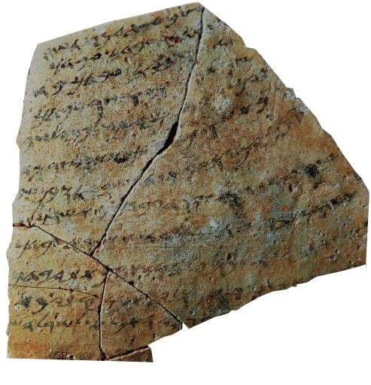
Translation …your servant was at Ha-saar-Asam (when the following incident occurred). …when your servant had finished (his) reaping and had stored it a few days ago, Hoshayahu ben Shabay came and took your servant’s garment. …all of my companions will vouch for me…(that) I am guiltless of any in[fraction]. [(So) please return] my garment. If the official does not consider it an obligation to return [your servant’s garment, then have] pity upon him [and return] your servant’s [garment] from that motivation. You must not remain silent [when your servant is without his garment].
This 7th century BC ostracon from the Israelite coast specifically mentions the dgb, the “garment” which functioned as a cloak by day and a blanket by night (cf. Dt. 24:12-13).

Slide 28
JOB RESPONDS (23-24)
Job responds by once more voicing his bitterness and suffering (23:1-2).
Eliphaz asserted that Job must put things right between himself and God, but Job sees no way to do so, since God seems hidden (23:3).
If he could just lay his case before God, he was confident that God would be fair, and he would be vindicated (23:4-7).
But here was the problem: Job has searched in every direction, but he still has been unable to gain access to God (23:8-9).
Still, despite his frustration over God’s hiddenness, Job instinctively knows that God knows his plight.
Job may not know where to find God, but God surely knows where to find Job, and in this, Job will be satisfied!

Slide 29
“But if I go to the east, he is not there;
if I go to the west, I do not find him.
When he is at work in the north, I do not see him.
when he turns to the south, I catch no glimpse of him.
But he knows the way that I take;
when he has tested me, I will come forth as gold.”
Job 23:8-10

Slide 30
The Nature of Divine Judgment Postponed
Job poses the question of why God has no fixed times for judgment (24:1).
His friends have argued that God dispenses judgment quickly, but Job observes that real life indicates otherwise.
Crimes often go unpunished, and Job offers a list to prove his point (24:2-17).

Slide 31
BILDAD SPEAKS (25)
Bildad now offers his final speech, which is also his shortest.
Here, he contents himself with a series of rhetorical questions about how any lowly human could possibly think he could be justified before God (25:1-4).
Even the celestial bodies seem dim and unworthy, much less a human who is nothing but vermin (25:5-6).

Slide 32
JOB RESPONDS (26-27)
Job addresses Bildad directly.
Bildad has chided Job like a powerless empty-head, while assuming for himself the role of paternalistic counselor and wise man.
Job retorts with dripping sarcasm, and his question, “Whose breath has come out from you?” probably suggests that what Bildad has said has not come from God (26:1-4).

Slide 33
The Majesty of God
Job goes on to eloquently describe God’s majesty, and in doing so, the roles are reversed. Job is now the teacher, and the Bildad listener!
In a flurry of descriptions, Job moves from the underworld to the visible world, both of which are completely dependent on God’s sustaining hand (26:5-14).
It must be born in mind that Job’s descriptions are phenomenological, so no one should attempt to draw from his poetic language some scientific approach to cosmology.

Slide 34
Job’s Powerful Metaphors
The language in Job’s description of God is rich in figures of speech.
God is the sovereign master of Sheol and Abaddon, i.e., the underworld (26:5-6).
The word UhTo (= void, emptiness) seems to be drawn from the creation account (26:7; cf. Ge. 1:1-2).
In hanging the world in the void of the heavens, the Hebrew reads, “He hangs the earth on what?”
He fills the clouds with water like a huge wineskin without it bursting (26:8).
He hides the moon behind clouds and inscribes a map of the seas (26:9-10).
Like a huge roof, he suspends the heavens on “pillars” (26:11).
He shattered the great sea monster, Rahab (26: 9:12-13), bringing order out of chaos.
All these things are but a whisper and the barest hint of his majestic works (2:14)

Slide 35
“As long as I have life within me,
the breath of God in my nostrils,
My lips will not speak wickedness,
and my tongue will utter no deceit.
I will never admit you are in the right;
till I die, I will not deny my integrity.
I will maintain my righteousness and never let go of it;
my conscience will not reproach me as long as I live.”
Job 27:3-6

Slide 36
Job’s Final Words to His Friends
Job’s closing response amounts to a curse of warning upon his friends and their constant recriminations.
He begins with an oath formula, “As God lives…”
The formula “let my enemies be…” is the form for an imprecatory curse, similar to those imprecatory curses in the Psalms.
It is probably hyperbolic, and the “enemy” (27:7) probably refers to his friends.
In this curse, Job is warning that the very things his friends have said about him might very well recoil on their own heads!

Slide 37
What Have We Learned in the Third Dialogue?
Job’s friends have now exhausted their explanations of cause-and-effect justice. Bildad is brief; Zophar has fallen silent.
They have offered no new ideas but have resorted to wild speculations about what they believe to be Job’s “secret” sins.
Job, for his part, continues to maintain his innocence, but he sees no way forward for gaining access to God?
Job’s final words come in the form of a curse: he warns his friends that the seat of the scorner is a dangerous place.

Slide 38
DISCUSSION POINTS
Why is the “seat of the scorner” a dangerous place?

Slide 39
The search for wisdom
28

Slide 40
Chapter 28 as an Interlude
The best solution seems to be that this poem should be read as an interlude by the narrator.
The debate between Job and his friends has reached an impasse.
As such, the interlude demarcates what has gone before from what will follow—the monologues of Job, Elihu, and God.
It addresses a fundamental question: Where is wisdom to be found?
Chapter 28 has aroused considerable scholarly debate.
As a poetic unit, it can stand alone, unconnected to what precedes or follows.
It is not introduced by any identifying clause or speaker.
The content and unruffled style seem very unlike the speeches of either Job or his friends, which have been bombastic, to say the least.

Slide 41
The Ingenuous Search for Precious Metals
Using mining as a metaphor for the task of searching, the poet describes the various ways humans have scoured the earth for silver, gold, iron, and copper (28:1-11).
Yet for all their cleverness, humans have been unable to successfully find wisdom, which is more precious than gold dust (28:12, 20).
Unlike precious metals, wisdom cannot be discovered by scouring land and sea (28:13-14).
It cannot be purchased, like some commodity in the market (28:15).
Its value is far beyond the precious objects that humans desire (28:16-19).

Slide 42
The Elusiveness of Wisdom
Wisdom is hidden from all creatures high and low (28:21-22).
God, alone, knows the true path to wisdom, for only he sees all things from horizon to horizon (28:23-24).
He embodies his wisdom in the ordering of wind, water, rain, and lightning (28:25-27).
Hence, true wisdom must derive from reverence for God himself (28:28; Pro. 1:7; 9:10; Ps. 111:10).
Job has not yet found the answer to his dilemma, but he is certainly following the path of wisdom in yearning for God to speak!

Slide 43
DISCUSSION POINTS
In the New Testament, Peter says, “The Lord is not slow in keeping his promises, as some understand slowness” (2 Pet. 3:9). This is prefaced by a statement that with the Lord a day is as a thousand years, and it is followed by a statement that the Lord is patient…wanting everyone to come to repentance.
How does the Book of Job and the statements of Peter assist us in assessing the progress of time?

Slide 44
The suffering of job Part 9

Slide 45
The monologues
29-41

Slide 46
The Monologues
Offsetting the cycles of speeches between Job and his friends is now a set of monologues.
They are not soliloquies, since Job is not alone. Still, there is no dialogue as before.
Three voices will be heard: Job, Elihu, and God, and they will bring the reader to the denouement of the book.

Slide 47
JOB’S FINAL APPEAL (29-31)
Job commences his final appeal with a yearning for his past life of happiness.
Then, he was deeply conscious of God’s providential care (29:1-6).
He was held in high regard by the larger community (29:7), and all were aware of his continual benevolence to the poor (29:8-17).
Ironically, these are the very things that Eliphaz accused Job of neglecting (cf. 22:5-9), but Job could hardly have reflected on such things had they not been true and publicly acknowledged.

Slide 48
Then and Now
In the aftermath of his fall, everything was now different. Three times (30:1, 9, 16) Job uses the expression hT!fav4 (= “but now”).
Now, he is mocked by brash youngsters whose family character was even lower than dogs (30:1).
His bones ached, he lacked sleep, and he lived in constant pain (29:16-18).
Instead of reward, he had only misery and visceral agony, burning with fever, ostracized, and abandoned by God (29:26-31).

Slide 49
The Language of Cursing
To understand the climax of Job’s final appeal, one must understand the language of cursing.
Curses are a speech-act inviting divine judgment.
Job’s appeal comes in the form of a negative curse in which he disowns the accusations against him and invites God’s judgment if he is guilty.
Such an oath of exoneration had wide precedent in the ancient Near East.
Job’s final words, “The words of Job are ended,” are an affirmation and final signature that throws the burden of proof upon the court, and in this case, upon God (31:35).

Slide 50
The Oaths
Job will utter oaths in several categories defending his integrity:
Innocence of sexual dalliance (31:1-4, 9-12)
Innocence of dishonesty (31:5-8)
Innocence in social obligations (31:13-23, 31-32)
Innocence in the use of wealth (31:24-25)
Innocence of idolatry (31:26-28)
Innocence of vindictiveness (31:29-30)
Innocence of harboring hidden sins (31:33-34)
Innocence of exploiting others (31:38-40a)

Slide 51
The Final Appeal
Earlier, Job wished that his suffering could be recorded on a scroll or inscribed on a lead sheet (19:23-24).
Now, he metaphorically invites a legal document, a record of God’s indictments against his foregoing oaths of innocence (31:35-36).
He would sign it with his own mark and call for God to respond.
The description of the “mark” (the Hebrew t formed like an X in ancient script) is the final letter in the Hebrew alphabet (31:35).
If he had such a document, he would display it prominently (31:36-37)!
“The words of Job are ended.”

Slide 52
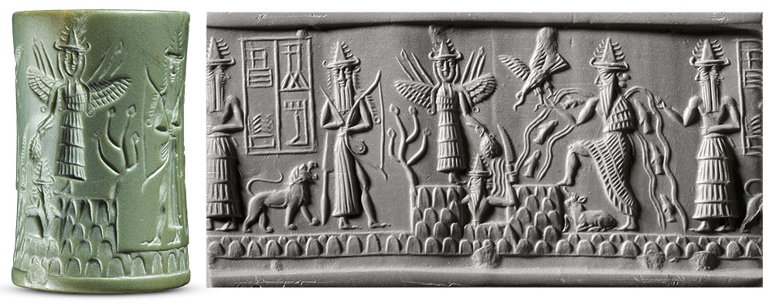
The document that Job said he would carry on his shoulder or wear as a crown might seem odd to the modern reader; however, in his era people wore cylinder seals on cords around their necks (cf. Ge. 38:18, 25).
Cylinder seals were cylindrical shaped stones with engravings to mark ownership.
Appearing in about 3500 BC, they could be rolled into soft clay, leaving a kind of signature.
Morgan Library, New York

Slide 53
DISCUSSION POINTS
What do you make of Job’s curse-language?
Do you think Job goes too far in calling for God to put indictments against him in a legal document?

Slide 54
The SPEECHES OF ELIHU
32-37

Slide 55
The Unexpected Appearance of Elihu
Job has consigned his case to God, praying and hoping that God will speak.
Indeed, God WILL speak, but before he does, a fourth voice is to be heard.
Elihu appears unexpectedly to rebuke both Job and the others. He was not one of the original group of friends, and unlike the others, there is no dialogue between them.
After he speaks, he will disappear altogether.
At the end of the book, God will address Job’s three original friends, but Elihu is left unmentioned, almost as though he hadn’t been there. Is this tacit approval or the ultimate dismissal?

Slide 56
The Role of Elihu
Not a few scholars have speculated that Elihu belongs to a later stage in the book.
For one thing, the story seems quite complete without him.
What he has to say seems theologically and poetically feeble compared to what has gone on before.
While Elihu is notoriously wordy, his contribution is less substantial.
He does allude to the speeches made earlier by Job and the others, so it is to be assumed that he was there and listening though not mentioned.
He will offer a fourth perspective before God adds the divine perspective.

Slide 57
“But Elihu…became very angry with Job for justifying himself rather than God. He was also angry with the three friends, because they had found no way to refute Job, and yet had condemned him.”
Job 32:2-3

Slide 58
ELIHU’S FIRST MONOLOGUE (32-33)
Elihu’s first speech is introduced with a description of his anger both at Job and his three friends (32:1-5).
He begins rather elaborately, commenting on his youth and his elders’ seniority (32:6-10).
He has listened to them, hoping to hear some “wise words,” but rather pompously, he asks whether or not he should remain silent in the face of their inadequate arguments (32:11-16).
All this opening rhetoric seems a bit overstated, which can be summarized as simply, “I’m about to say something important.”

Slide 59
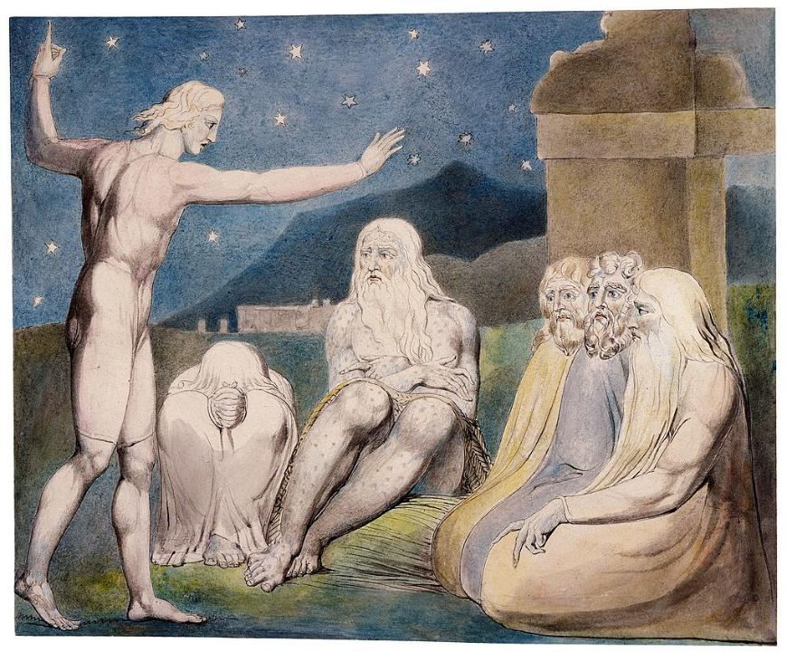
The wrath of Elihu Watercolor by William Blake

Slide 60
The Problem
Job has asked God to speak, but in Elihu’s way of thinking, God speaks, but humans are simply not listening.
Job has admitted to having nightmares (cf. 7:14), and Elihu uses this confession to suggest that God is trying to break through to Job (33:15-16).
Sickness, also, can be a redemptive chastening from God, so Job needs to view his suffering in this way (33:19-22).
In all these subtle ways, God repeatedly reveals himself so that humans can be corrected and redeemed from death (33:29-30).

Slide 61
ELIHU’S SECOND MONOLOGUE (34)
Elihu now solicits help from other listeners to dismantle Job’s defenses (34:1-4).
He repeats the former accusations—that Job is a liar (34:5-6) and a scoffer (34:7-8; cf. 11:3; 15:16, 25-26).
It is inconceivable that God would govern the universe unjustly. As the sovereign Creator, he equally judges kings and nobles, rich and poor, even if his ways are sometimes mysterious (34:16-20).
He sees all (34:21-22), and he is under no obligation to hear individual cases like Job’s, since he is omniscient and already knows all things (34:23-24).

Slide 62
ELIHU’S THIRD MONOLOGUE (35)
Two issues greatly disturbed Elihu’s perceptions of Job’s defense.
One is Job’s claim to be in the right (35:1-2; cf. 34:5; 13:18).
The other concerns the question he put in Job’s mouth earlier, “What is the advantage of being good?”(35:3-4; cf. 34:9)?
Elihu cannot conceive of God being either pleased with creatures who are faithful or grieved by those who are not. God is impassive. So, for God to be impartial means that he must be aloof (35:8).
Finally, God remains silent because people who cry out to him are filled with pride (35:9-12).

Slide 63
ELIHU’S FOURTH MONOLOGUE (36-37)
Elihu’s final speech falls into two sections.
In the first, he addresses the redemptive character of suffering (36:1-21).
In the second, he extols God as the incomparable Teacher (36:22—37:24).
God doesn’t ignore the righteous, but when people find themselves in distressing circumstances, he uses hardships as teaching instruments to lead them to repentance (36:8-10).
Elihu cannot avoid a touch of hubris, however, and adds that his wisdom is wide-ranging and no less than perfect (36:4)! (Being a such a modest man, he couldn’t say more.)

Slide 64
Nothing New Here
This whole line of reasoning seems to mirror much of what has been said earlier by the other three (cf. 18:5-21; 20:1-29), and it is precisely what Job observes is NOT happening in the world (cf. 21:7-18, 29-30; 24:1-12, 21-25).

Slide 65
DISCUSSION POINTS
What parts of Elihu’s speeches might be true?
Where does he fall short?
What do you make of Elihu’s claim that for God to be just he must be impassive?

Slide 66
What Have We Learned from Elihu?
Elihu’s contribution is more ambiguous than that of Job’s other friends.
For the most part, he rises above their petty insults.
His perspective that suffering can be redemptive is surely to be acknowledged.
At the same time, his commitment to the impassivity of God is at least questionable, and this will be demonstrated when God speaks.
In the end, God will say nothing about Elihu, good or bad.
Elihu remains a somewhat shadowy figure in the book. The value of his contribution is muted by his occasional pomposity.

Slide 67
The suffering of job Part 10

Slide 68
The VOICE OF GOD
38-41

Slide 69
“Then the LORD answered Job out of the whirlwind. He said, ‘Who is this that darkens my counsel with words without knowledge? Brace yourself like a man; I will question you, and you shall answer me.’”
Job 38:1-3

Slide 70
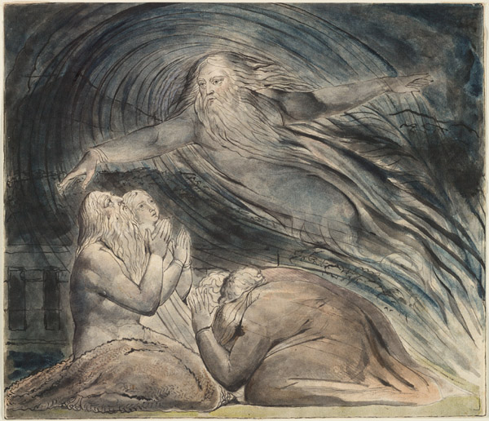
God answers Job from a whirlwind. Watercolor by William Blake

Slide 71
The Voice of God
At long last, Job hears the voice of God for which he has been desperately longing (cf. 9:35; 13:22; 23:3-7; 31:35-37).
As with the other voices in the story, the reader must decide what tone is to be heard in the divine voice.
Sometimes there are clues in language that might swing the reader in one direction or another, but the reader can hardly remain neutral.
God will pose some very pointed questions to Job: the issue is whether these are to be heard as coming from a friend or an enemy.
Those readers who consider Job to be cynical and antagonistic toward God read the divine questions as thrusts aimed at crushing Job in humiliation.
Such an assumption is unnecessary, in my view, and it seems better, especially since God will say that Job had spoken what was right (cf. 42:7b), to view these questions as coming from a friend to a friend.

Slide 72
The Nature of God’s Revelation to Job
In one sense, the divine speeches are surprising.
Job had asked for specific charges (cf. 31:35), or at least, a verdict of exoneration (cf. 13:18; 23:3-7, 10-12).
Neither of these are forthcoming.
Conspicuous by its absence is a list of Job’s offenses causing his downfall or any explanation as to why it all happened.
Rather, God voices a series of questions that invite Job to observe the world, and in doing so, he will implicitly discover God within the world.
This, then, is the central point of the book: Job can find resolution to his suffering without ever knowing the complete back story.

Slide 73
In the end, Job does not see it all; rather, he sees God, and this makes all the difference!
Job had felt abandoned by God.
The divine voice indicated that God was not aloof, and more to the point, Job could experience the presence of God even in the midst of suffering.

Slide 74
THE FIRST SPEECH (38-39)
The opening question, “Who is this darkening counsel in speech without knowledge?” is a wry reference to Elihu’s castigation of Job (cf. 38:1-2; cf. 35:16).
Job is now invited to face God, the very thing he has repeatedly requested (cf. 38:3; cf. 13:22; 31:35).
The divine questions fall into two large blocks, the mysteries of the created world (38:4-38) and the mysteries of the animal kingdom (38:39—39:30).

Slide 75
The Purpose of the Divine Questions
These questions are rhetorical and educational. The intent is not to humiliate Job (contrary to some interpreters), but to reinforce to him that there were huge areas of knowledge that were simply beyond him.
By analogy, Job should see his own suffering in the same light—something he experiences but may not fully understand.
Because God speaks to Job directly, he confers upon him the highest dignity. Job had invited God to call and believed he would answer (cf. 13:22), and now the thing he desperately desired was actually happening!

Slide 76
DISCUSSION POINTS
Job never discovered the back story of his tragedy, but he continued to trust just the same. So, what is the relationship between trust and knowledge?
Hebrews 11:13: “All these people were still living by faith when they died. They did not receive the things promised; they only saw them and welcomed them from a distance.” How might this apply to Job?

Slide 77
Mysteries of the Created World
The initial series of questions concern the origins of the universe.
Though humans were not there to see it, the angels (sons of God) were there, and they watched with admiration, amazement, and spontaneous song (38:1-7).
The origins of the oceans are described by the metaphor of child-birth (38:8-11).
The questioning continues regarding the demarcation of night and day (38:12-13) and the coming of light that brings into sharp relief the profile of the wicked (38:12-15).

Slide 78
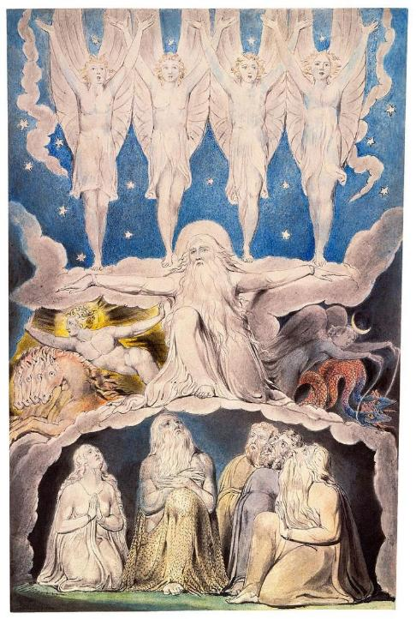
When the morning stars sang together and the sons of God shouted for joy… Watercolor by William Blake

Slide 79
The Subterranean World
God returns to the sea, this time to its subterranean depths.
In Hebrew poetry, the sea is often a symbol of death (e.g., Ps. 69:2, 14; Jonah 2:3).
Here, the sea is linked to the “gates of death,” the entry into the place of the dead (38:17).

Slide 80
Other Places Job had Never Been
Just as Job had never explored such unreachable places in the sea, so he had never explored the expanse of even the visible land (38:18).
He had never been to the horizon, where light and darkness begin and end (38:19-20). We should think of Job’s world-view as phenomenological; neither Job (nor the Bible) is offering any sort of scientific view.
God even uses some gentle sarcasm, “Surely you know,” probably a play on Eliphaz’ jibe (38:21; cf. 15:7).
Job had never seen the origins of snow or hail, “weapons” that God sometimes uses (38:22-23; cf. Ex. 9:22; Jos. 10:11; 1 Sa. 7:10; Eze. 13:13), nor had he seen the sources of lightning or the east wind (38:24).

Slide 81
The Mysteries of Weather and the Heavens
Continuing with more rhetorical questions, God asks whether Job knows about rain in uninhabited places that carve channels for irrigation (38:25-27).
What could he know about the origins of rain, dew, ice, and frost (38:28-30)?
Moving to the heavens (38:31-33; cf. 9:9), there are the mysteries of the constellations. (Pleiades and Orion are well-known, but Mazzaroth and the Bear with Cubs are not, though some have suggested the Bear might refer to Ursa Major).
The movements of cloud, lightning, rain, and flood are totally out of Job’s realm of control (38:34-38).
The “water skins of the skies,” of course, is a metaphor for the heavenly reservoirs of water (38:37).

Slide 82
The Mysteries of the Animal World
In a series of vignettes, God now invites Job to explore the animal world. (The chapter division between 38:38 and 38:39 is unfortunate.)
Could Job conduct a hunt to provide meat for a pride of lions (38:39-40)?
Could he provide for the chicks of the desert raven (38:41)?
What does he know about the birthing patterns of the ibex (39:1-4)?
What about wild asses that freely roam the steppes (39:5-8) or the wild ox (39:9-12), a creature of great strength but impossible to domesticate?

Slide 83
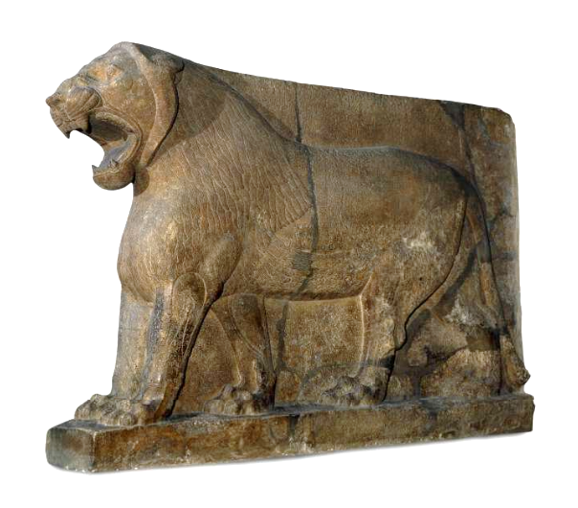
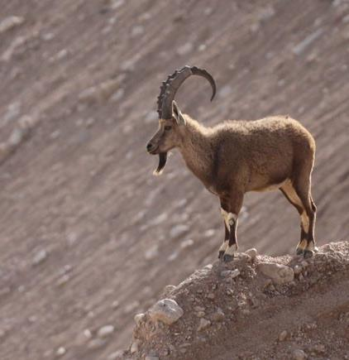
The Asian Lion
The Ibex
British Museum, London

Slide 84
From Questions to Descriptions
Even though some of these descriptions are not in a question format, they still are implicit questions.
Ostriches are comical creatures with feathers useless for flying but running faster than a horse, while leaving their eggs exposed (39:13-18)? (The identity of this creature is a contextual guess, since the Hebrew noun is a hapax legomenon. A stork is another possibility.)
The horse, famous for its courage in battle, is the only domesticated animal in the series (39:19-25). (At this point in history, horses were primarily used for chariotry rather than cavalry.)
The soaring flight of hawks and vultures are equally beyond Job’s ken (39:26-30).

Slide 85
The Divine Challenge (40:1-5)
After this lengthy series of unanswerable rhetorical questions, God now challenges Job to respond (40:1-2).
Once again, there is the language of the law court (40:2; cf. 9:3).
In his final appeal, Job had bluntly said that if God would provide him an audience, he would approach God “like a prince” (cf. 31:35-37).
Now, God has answered, and Job, too, must answer!
Job, suitably chastened, concedes that before God he is very small indeed, and he lapses into awed silence (40:4-5).

Slide 86
Then Job answered the LORD, “I am unworthy—how can I reply to you? I put my hand over my mouth. I spoke once, but I have no answer—twice, but I will say no more.”
Job 40:3-5

Slide 87
DISCUSSION POINTS
If you could meet with God face-to-face and ask a question, what might it be?
Modern people have answered many of the questions God asked Job with respect to geography and animal life. What kind of questions are they yet unable to answer?

Slide 88
The suffering of job Part 11

Slide 89
Then the LORD spoke to Job out of the whirlwind: “Would you discredit my justice? Would you condemn me to justify yourself? Do you have an arm like God’s?”
“Look at Behemoth…”
“Can you pull in Leviathan with a fish hook?”
Job 40:6-9, 15; 41:1

Slide 90
THE SECOND SPEECH (40:6—41:34)
As in the first speech, God confronts Job out of the whirlwind (40:6-7).
The first question concerns moral justice (40:8-9).
Was Job so insistent on his innocence that he would impugn God?
What follows is a challenge for Job to consider how he might govern the moral world if he had the opportunity (40:10-13).
If Job could achieve justice in such a way, only then would God concede that Job was capable of vindicating himself (40:14).
THE POINT, OF COURSE, IS THAT JOB WAS QUITE UNEQUAL TO SUCH A TASK, AND CONSEQUENTLY, HE NEEDED TO RETHINK HIS MINDSET.

Slide 91
Two Additional Awesome Creatures
Both these creatures are prime examples of power and pride.
If Job could wear the robes of God as judge, would he be able to bring them down?
Did he have an “arm” like God or a “hand” like God that could bring to heel these two terrible and incredible creatures called Behemoth and Leviathan (40:9, 14)?

Slide 92
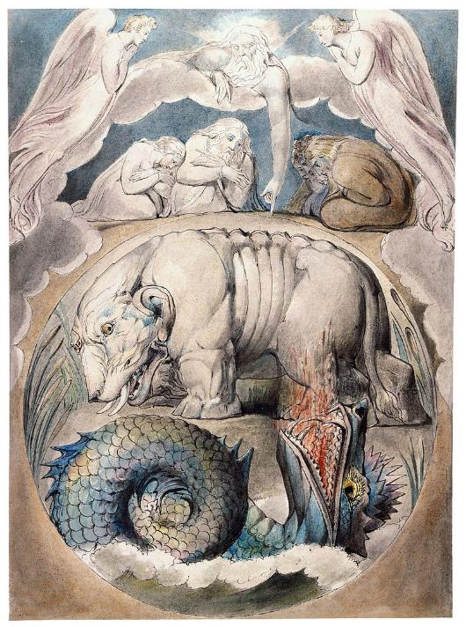
Behemoth and Leviathan Watercolor by William Blake

Slide 93
So, who are these creatures?
In the English Versions, their names are merely transliterated.
The names are proper, since they appear in the Hebrew text without definite articles.
One of them, Leviathan, has been mentioned earlier (3:8), and both names are known from other ancient Near Eastern literature, where they seem to refer to supernatural creatures.
Isaiah depicts Leviathan as the “twisting serpent” and the “dragon from the sea” that God will ultimately slay (Is. 27:1).

Slide 94
Behemoth
Behemoth eats grass (40:15), but he also is called “the first of the works of God,” which is to say, the first created creature (40:19a).
The Hebrew word “behemoth” can be used of beasts in general (12:7; Dt. 32:24; Ps. 8:7; 50:10, etc.), but since this is a proper name, it is not “a beast,” but “Beast.”
In later Jewish writings, Behemoth (a male monster) is depicted as a primeval creature of the land (1 Enoch 60:7-9).

Slide 95
Leviathan
Leviathan seems to live in the water (41:1), yet out of his nostrils comes smoke and fire (41:19-21).
In the ancient Near East, Leviathan is generally described as a sea monster with seven heads: Ugaritic texts describe him as the “twisting serpent” and “the tyrant with seven heads.”
In later Jewish literature, Leviathan (a female monster) is the symbol of chaos from the abyss (1 Enoch 60:7-9).
Here, he is called “the king of the sons of pride” (41:34b).

Slide 96
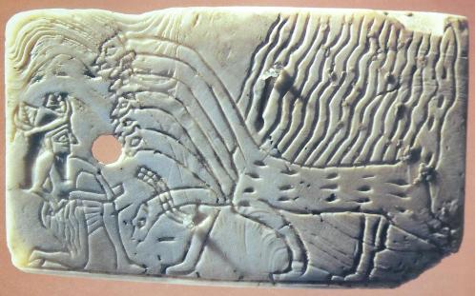
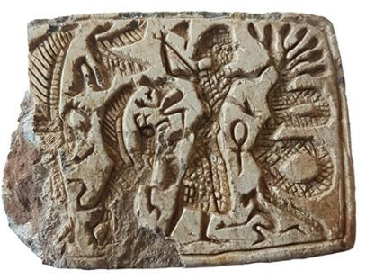
Imagery of Leviathan Various passages, both in the Bible (Isa. 27:1) and other ancient Near Eastern literature, use stock imagery to depict a dragon-like, threatening creature with seven heads.
STOCK NAMES
Leviathan
Rahab
Tannin
Yam
Nahar
Nahash
In this incised Sumerian shell from ca. 2600 BC, a seven-headed monster confronts a god or hero who already has wounded one of its heads.
A stamp seal excavated in 2022 in northern Israel and dating to the 8th century BC depicts a seven-headed serpent held at bay by a hero who with one hand grasps one of its necks while brandishing a spear in his other hand.

Slide 97
Interpreting the Two Monsters
Since the 17th century, Behemoth has traditionally been identified with the hippopotamus, while Leviathan has been thought to be a crocodile.
With the discovery of both ancient Near Eastern texts and artifacts depicting these creatures as mythological, many scholars are doubtful that they represent ordinary animals.
If they are taken to represent spiritual powers, which St. Paul would much later describe as the “stoicheia,” i.e., the rulers, authorities, powers, and dominions (Ep. 1:21; 3:10; 6:12; Col. 2:8, 20), then they are malevolent creatures opposing God, like the beast from the sea and the beast from the land in the Revelation of John (Rv. 13:1, 11).

Slide 98
The Main Point
Regardless of their precise identity, one thing is clear: these creatures, whatever they are, were created by God and live under God’s dominion (40:15, 19; cf. Ps. 104:26; Col. 1:16).
Job would never be able to control them or bring them under submission!

Slide 99
The denouement
42

Slide 100
Job’s Final Response (42:1-6)
After his tour of the unfathomable world, Job now understands all too clearly that as a limited, finite human he could never govern the universe.
God alone can do this.
Humans must be content to leave this governance in the hands of God, who is both all-powerful and all-wise.
Job also realizes that God is transcendent, and as a finite human, it is not his place to unpack the mystery of God.
While Job does not discover the back story of his tragedy, he has discovered something much more satisfying—God himself!

Slide 101
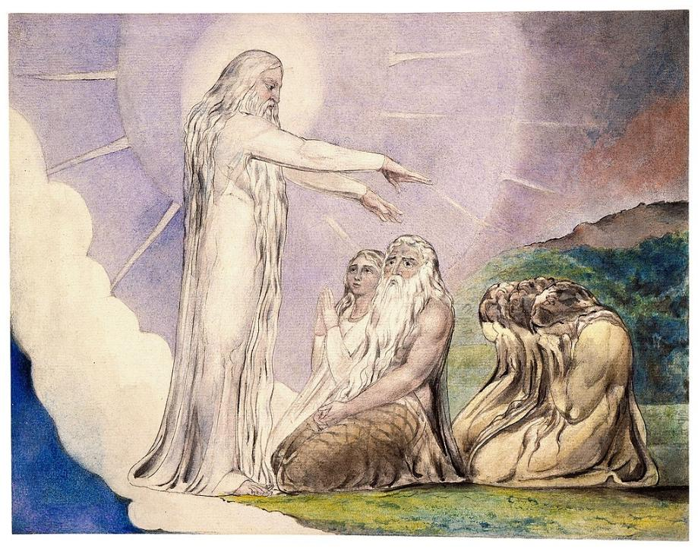
The Vision of Christ: but now my eye seeth Thee. Watercolor by William Blake

Slide 102
Job’s Confession
“I know you are able [to do] everything, and no purpose of yours can be restrained.”
“Therefore, I declared [what] I did not discern, [things] too wonderful for me, which I did not know”
Job 42:1-3

Slide 103
Resolution
Job has now been set free from the narrow confines of his former world-view.
The satan’s slanderous prediction that Job would curse God to his face has been proved absolutely false.
Now, Job is free to speak, for he realizes that his former knowledge of God was only comparable to a dim rumor; now, he has heard from God himself (42:5).
He retracts his former doubtful ruminations and bows in deep reverence while gratefully accepting the comfort brought to him by the voice of God (42:6).

Slide 104
God’s Rebuke of Job’s Friends
In neither of God’s long speeches did he refer to any of the arguments of Job’s friends, but now he does so.
Addressing Eliphaz, presumably the oldest and representing the others, he bluntly assesses their contributions as failures (42:7).
The irony is that all of Job’s friends condemned him, implying that his suffering was a result of God being angry with him, and now, at the end, it is Yahweh who is angry at his friends.
It was not that his friends did not say many things that were true (or for that matter, that Job always said what was correct), but their overall conclusion that sin is immediately punished while righteousness is immediately rewarded was absolutely wrong.

Slide 105
The Final Assessment
Job’s friends had argued that Job brought this tragedy on himself, and this was certainly not the case.
Indeed, Job had spoken what was “right” about God, and whatever else this might mean, it must surely include his unwavering trust in a Redeemer who would someday “stand upon the earth” and right the wrongs of the world (cf. 19:25-27).

Slide 106
The Final Irony
The deepest irony is that God now demanded of Job’s friends that they suffer the ultimate ignominy—going to Job so that he might offer a sacrifice and prayer in their behalf for their folly (42:8-9).
The large size of their sacrifice suggests the enormity of their error.
No mention is made of Elihu. Given his pomposity and verbose exuberance, it may be that he experiences the ultimate dismissal as a theological fly-weight.

Slide 107
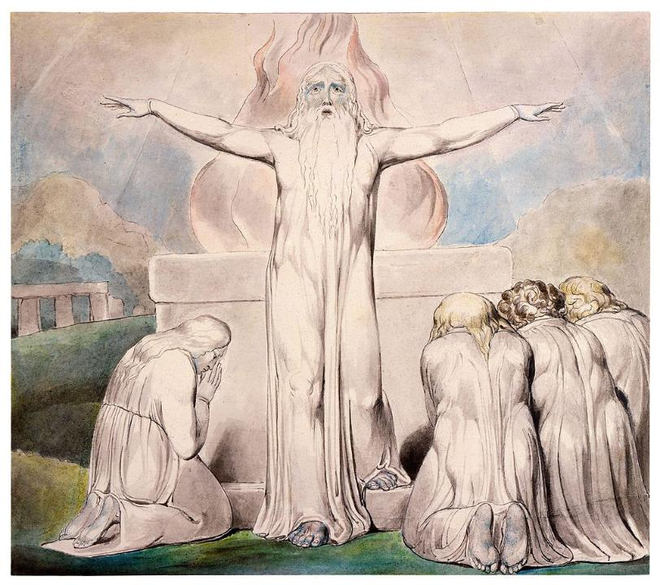
Job sacrifices and prays for his friends. Watercolor by William Blake

Slide 108
Restoration
After his generous prayer, God turned about Job’s ordeal (42:10).
His relatives and acquaintances now came to offer gifts and condolences (42:11).
The numbers of his livestock doubled (42:12; cf. 1:3).
His additional three daughters, Dove, Cinnamon and Mascara Bottle, are singled out because of their beauty (42:13-15).
Job lived out his life to the age of 140, double the normal lifespan (cf. Ps. 90:10).

Slide 109
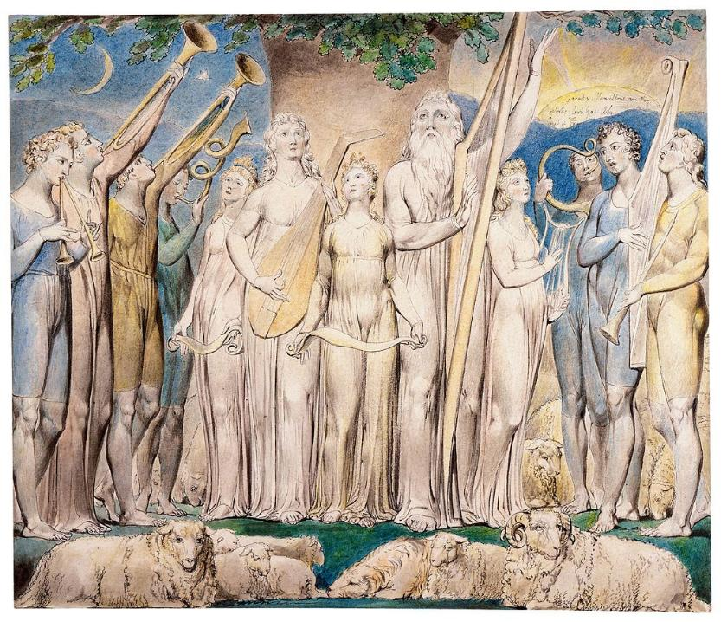
Job restored to prosperity Watercolor by William Blake

Slide 110
The Answers of Jesus to Job
Job’s penetrating questions are timeless, and though Job could not have known it, they would be answered in the incarnation of God’s Son.
Does God understand human suffering (6:2-3)? Jesus was made like his human fellows in every respect; he suffered and was tested to the limit (He. 2:17-18).
Could humans be righteous before an infinitely holy God (9:2, 14-20)? Since they have been justified by faith, they now have peace with God through the Lord Jesus Christ (Ro. 5:1). They are given the gift of righteousness (Ro. 5:15-17).
Is there a mediator who can fully relate to both God and human life (9:32-35)? There is one mediator between God and humans, the man Jesus Christ (1 Ti. 2:5).

Slide 111
Does God somehow perversely enjoy human suffering (10:3-4)? Certainly not! The person of faith may confidently cast all his/her cares upon Jesus, for he cares for them (1 Pe. 5:7).
If a man dies, will he live again (14:14)? Jesus said, “I am the resurrection and the life. He who believes in me will live, even though he dies” (Jn. 11:25).
Would God cover over human sin so that he might enjoy relationship with his creatures (14:16-17)? Humans have been given the opportunity of true fellowship, for the blood of Jesus cleanses them from all sin (1 Jn. 1:7).
Will there be justice in the end (24:1)? When Christ comes, he will bring to light the things now hidden in darkness and will disclose the purposes of the heart. Then each one will receive his commendation from God (1 Co. 4:5).
Why is God silent? Will he ever speak (23:3-9; 30:20)? In these last days, God has spoken to us by his Son (He. 1:2). He is able to sympathize with humans in their weakness, inviting them near to the throne of grace, where they will find mercy in their time of need (He. 4:15-16).

