Slide 1

-----NEW TESTAMENT-----
(Week 3)

Slide 2
The Big Ideas

Slide 3
Jesus as the Messiah

Slide 4
WHO IS JESUS?
This basic question, fundamental to all four gospels, is addressed implicitly in a variety of ways).
Each of them will address it in their openings.
Each of them will implicitly address it in the larger scope of their gospels.
Each of them will address it in the narratives of Jesus’ death and resurrection.

Slide 5
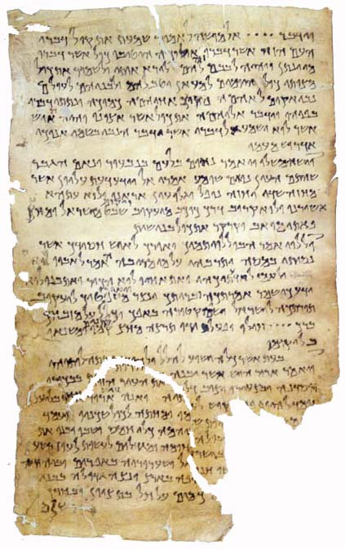
MESSIANIC EXPECATIONS
4Q175 (4QTestimonia)
This leather sheet from the Dead Sea Scrolls brings together four texts, suggesting the Jewish messianic hopes:
The prophet like Moses (Dt. 5:28-29; 18:18-19)
The star of Jacob (Nu. 24:15-17)
The proper high priest (Dt. 33:8-11)
The fourth quotation foretells the rise of three wicked figures, but their messianic relevance is unclear (quoted from the pseudepigraphical Psalms of Joshua, 4Q379, frag. 22)

Slide 6
The “Kingdom of God”
(the rule of God—when God would be King)
Jewish responses to the messianic vision of the prophets were varied:
Memories of the Maccabean success (all sects)
Collaboration with the Roman occupation (Herodians, Sadducees)
Armed resistance to Rome (zealots)
Intensifying devotion to Torah observance (Pharisees)
Withdrawing and waiting for an apocalyptic divine intervention (Essenes, Qumran Community)

Slide 7
Mark’s Prologue (1:1-15)
Mark’s Gospel has a narrative prologue with one unique feature.
It is theologically “loaded,” so that Mark immediately offers to the reader the answer to the basic question, “Who is Jesus?” He is Jesus, the Messiah (1:1).
He is the one who has authority to dispense the Holy Spirit (1:8).
His identity is confirmed by the heavenly voice, “You are my Beloved Son” (1:11).

Slide 8
Matthew’s Genealogy (1:1-17)
Matthew begins with Jesus’ genealogy which he arranged into three symmetrical groups of fourteen generations each (1:17).
The reasoning behind the number fourteen is not immediately clear to modern readers, but if Matthew was using the Jewish technique of gematria (adding together the numerical values of the alphabetical letters), then the number fourteen may be derived from the name David.
There also may be a covenantal motif: God’s initial covenant with Abraham (1st 14), his covenant with David (2nd 14) and his action to fulfill both these ancient covenants in Jesus’ new covenant (3rd 14).

Slide 9
GEMATRIA symbolically expressing an idea through the numerical value of alphabetic letters
דוד(DVD)
(spelled in ancient Hebrew without vowels)
Each alphabetic letter stood for a number prior to the development of Arabic numbers
ד = 4 (4th letter of the Hebrew alphabet)
ו = 6 (6th letter of the Hebrew alphabet)
ד = 4 (4th letter of the Hebrew alphabet)
The combined value of the name David is fourteen

Slide 10
Luke’s Account of the Birth of Jesus (2:1-20)
The birth of Jesus occurred during a trip from Galilee to Joseph’s ancestral home in Judah to register for Roman taxation.
The earliest Christian traditions indicate that Jesus was born in a cave (Protoevangelium of James, 18-19; Justin Martyr’s Dialogue with Trypho, LXXVII).
The angelic message to the Bethlehem shepherds included three highly important titles:
  Σωτηρ (= Savior, a widely used title for the Roman emperor)
  Χριστος (= Messiah, the anointed, the king from David’s family)
  Κυριος (= Lord, the standard LXX rendering of the name Yahweh)

Slide 11
John’s Gospel Features the Logos Theology
The term Λογος (Logos) was widely known:
  For Jews, the Logos was the דבר יהוה (Word of Yahweh) by which God created the universe and spoke to the prophets.
  For Hellenists, the Logos, going back as far as the 6th century BC, was the generative principle of the world, the eternal principle of order in the universe.
Before the creation of the universe, the Logos existed paradoxically both “with” God and “as” God (1:1-4):
  The preposition προς (= with) requires individuality or distinctness, and the verb ην (= was) requires identity or sameness.
  The preposition δια (= through) designates the Logos as God’s Agent of creation, while the preposition εν (= in) designates him as the source of all life.

Slide 12
Jesus as the Father’s Only Son
As the μονογενης (only begotten, one of a kind) of the Father (1:14, 18; 3:16, 18), Jesus is absolutely unique:
  The origin of the messiah was an important credential in Jewish thought (6:42; 7:41-43; 8:21-23), and the “sending” (αποστελλω) of the Son by the Father suggests that his origin was heavenly (3:17, 34; 5:36-37; 6:29, 57; 7:29; 8:42; 10:36; 11:42; 17:3, 8, 18, 21, 23, 25; 20:21).
  The functions of the Son are the functions of God himself, for the two are one (5:19; 10:30, 38). The Son is:
    The judge of all (5:22-23, 27)
    The one who has life “in himself” (5:26; 10:17-18)
    The one who gives eternal life (3:15; 6:53-59; 11:25-26)
    The one who by virtue of his pre-existence and intimate relationship with the Father reveals the glory of God (1:14, 18; 11:4, 40; 13:31-32; 17:5-6, 24)

Slide 13
The “I Am” Sayings
It is unnecessary in highly inflected languages like Koine Greek to use subject pronouns, since they are implied in the conjugation of the verb.
  When such pronouns are included, the construction becomes emphatic.
  Hence, the frequent appearance of the emphatic constructions εγω ειμι (I am) in the Fourth Gospel merit special consideration.
  In a Jewish community that already had suspended verbal pronunciation of the tetragrammaton (i.e., the name Yahweh), the “I Am” sayings are the functional equivalent of saying, “I am Yahweh!”

Slide 14
Constructions with a predicate or an implied predicate:
  “I am the bread of life” (6:35, 51)
  “I am the light of the world” (8:12; 9:5)
  “I am one who testifies for myself” (8:18)
  “I am from above; I am not of this world” (8:23)
  “I am the gate” (10:7, 9)
  “I am the good shepherd” (10:11, 14)
  “I am the resurrection and the life” (11:25)
  “I am the way and the truth and the life” (14:6)
  “I am the true vine” (15:1, 5)
  “I am [the one you are looking at] (6:20)
  “I am [the one you are seeking] (18:5)
Absolute constructions without a predicate:
  “I am. Don’t be afraid” (6:20)
  “If you do not believe that I am, you will die in your sins” (8:24)
  “When you lift up the Son of Man, then you will know that I am…” (8:28)
  “Before Abraham was, I am” (8:58)
  “I am telling you before it happens so that you will believe when it happens that I am” (13:19)
These “I Am” sayings seem intentionally linked to the “I AM” self-revelation of Yahweh to Moses at the burning bush:
אהיה אשר אהיה
(I AM who I AM)
(Ex. 3:14, MT)
εγω ειμι ο Ων
(I am the Being)
(Ex. 3:14, LXX)

Slide 15
The “Messianic Secret”
Because in Mark’s Gospel Jesus consciously silenced those who recognized his messiahship, scholars have come to call this feature the “messianic secret.”
He commanded demons to silence (1:24-25, 34; 3:11-12; 5:6-20).
He enjoined those he healed not to make him known (1:43-44; 5:42-43; 7:35-36; 8:25-26).
He retired from public view as though to conceal himself (1:35-38; 7:24; 9:30-32).
He restricted his disciples from announcing his messiahship (8:30; 9:9)
It was not that Jesus rejected the idea of messiahship, but rather, that his messiahship must not be understood in conventional terms.

Slide 16
Peter’s Great Confession (Mk. 8:27-31)
In response to Jesus’ question, “Who do people say I am?” Peter offered the confession that Jesus was the Messiah, God’s Son.
The warning not to tell anyone is repeated in various ways (8:30; 9:9, 30).
Immediately after Peter’s confession, Jesus began to talk directly about his coming death, an emphasis that would be repeated (9:30-32; 10:33-34, 45).

Slide 17
Matthew (16:20) and Luke (Lk. 9:21) follow Mark in that Jesus urged his disciples not to tell anyone that he was the Messiah (presumably due to the common political vision for the messiah).
After Peter’s messianic confession, the synoptic gospels depicts Jesus as frankly talking about his suffering, rejection, death on the cross and resurrection (Mk. 9:31ff.; Mt. 16:21ff.; Lk. 9:22ff.).
If the disciples were ready to accept him as the Christ, it must be on his own terms, not the popular image.
Some would not die before they had seen God’s kingdom come (16:28), a prediction that has been variously interpreted to refer to:
  His transfiguration (17:1-2; cf. 2 Pe. 1:16-18)
  His post-resurrection appearances after Easter
  His coming in judgment on Jerusalem in AD 70
  The whole complex of events attending his death, resurrection and Pentecost

Slide 18
The Transfiguration (Mk. 9:2ff.; Mt. 17:1ff.; Lk. 9:28ff.)
Shortly after Peter’s confession, the synoptics describe Jesus ascending a mountain to pray, taking with him three of the apostles, Peter, James and John.
  His appearance changed and his clothes became radiant.
  Moses and Elijah, the two most prominent representatives of the law and the prophets, appeared talking to him about his εξοδος (= exodus), a term deliberately paralleling Jesus’ messianic mission with the ancient event of salvation-history.
  While Peter was on the verge of building a memorial to the event, a heavenly voice, similar to the one at Jesus’ baptism, announced, “This is my Son!”

Slide 19
The Climactic Confession (Mk. 15:39)
By placing the centurion’s exclamation “surely this man was the Son of God” at the moment of Jesus’ death, Mark gives it special prominence.
This climactic confession, hinted at throughout the gospel but hidden from a blind world, is the point toward which Mark’s Gospel has been inexorably moving.
Earlier, Peter’s great confession marks the center of the book; here, the Gentile soldier’s confession marks the climax—that the character of Jesus’ messiahship and divine sonship is to be found in the humiliation and loneliness of the cross.

Slide 20
In John’s Gospel, the Raising of Lazarus is the final sign of Jesus’ identity (11:1-44)
A general escalation is apparent in the seven signs in John, moving from the changing of water into wine to the resurrection of Lazarus.
The deliberate delay of Jesus resulted in Lazarus being dead for four days by the time of his arrival (11:1-17).
The expression in 11:39, “He is a fourth [day man],” should be read in light of the Jewish view that after the fourth day the soul would depart so that there was a complete dissolution of life.
The death and resurrection of Lazarus offers a striking parallel with the death and resurrection of Jesus so that the one event anticipates the other.

Slide 21
The Crisis of Unbelief
The “Book of Signs” closes with the reiteration of unbelief in spite of the signs (12:37).
The unbelief of Israel was in itself a fulfillment of prophecy (12:38-41; cf. Is. 53:1; 6:10).
In spite of a minimal level of faith (2:23-25; 6:14-15, 41-42, 60-66; 11:45-46), the result was superficial (12:37).
Some who were said to believe (8:31) later are shown to have inadequate faith, because they would not accept Jesus’ self-claims (8:33-59).
Others secretly believed but were intimidated by the religious authorities (12:42-43; cf. 9:22-23).
Adequate faith was the kind that accepted Jesus’ claim to have been sent by the Father into the world(12:44-46). To accept Jesus was to accept the Father, but to reject him was to reject the Father.
Finally, those who rejected Jesus would face judgment (12:47-50; cf. 5:45-47; Dt. 18:18-19).

Slide 22
Resurrection in the Four Gospels
Matthew
Jesus appears to the women
The report of the guard
Appears to eleven in Galilee
Mark
Jesus appears to the women
(summary of appearances and ascension in the long ending)
Luke
Jesus appears to the women
Appears to Cleopas and his companion
Appears on Easter evening
Leads disciples to Bethany and ascends into heaven
John
Jesus appears to the Magdalene
Appears on Easter evening
Appears to the disciples with Thomas
Appears to seven in Galilee

Slide 23
The First Witnesses
Having marked where Jesus was buried late on Friday evening, the Galilean women waited until the Sabbath was past and returned to the tomb early Sunday morning.
  Finding the tomb empty, they were confronted by two figures who announced to them that Jesus had risen, reminding them that Jesus had predicted this very thing.
  They reported what they had seen and heard to the Eleven, and while their story seemed incredible, Peter, at least, went to investigate and also found the tomb empty.

Slide 24
The Faith of the Beloved Disciple
The Fourth Gospel affirms that the first disciple to come to Easter faith was the Beloved Disciple, who “believed” even before he had seen the risen Christ (Jn. 20:8).
This level of faith—believing without seeing—is what John has been aiming for in his readers (Jn. 20:29).
This earliest example of faith gives the Beloved Disciple a kind of priority, which in turn supports the authenticity of his witness in the Fourth Gospel (Jn. 21:24).

Slide 25
Easter Faith the gospels offer two kinds of testimony
INDIRECT
(the empty tomb)
Women’s testimony
Angels’ announcement
Guards’ report (Matthew)
Investigation by Peter and the beloved
disciple (Luke & John’s Gospel)
DIRECT
(appearances)
To the women
To Mary Magdalene (John’s Gospel)
To two on the Emmaus Road (Luke’s
Gospel)
To the apostles on several occasions

Slide 26
Appearance to Cleopas & Companion
Only Luke tells us the account of Jesus appearing later on Sunday to Cleopas and an unnamed companion on the Emmaus Road a few miles from Jerusalem (Lk. 24:13-32).
  They did not recognize him, but they did discuss with him the events of the past few days.
  In all the sections of the Hebrew Bible—the Torah, the Prophets and the Writings (Psalms)—Jesus explained how his death was a fulfillment of the Scriptures.
  In the end, they finally recognized him by the familiar gesture of the breaking of the bread—and then he disappeared.

Slide 27
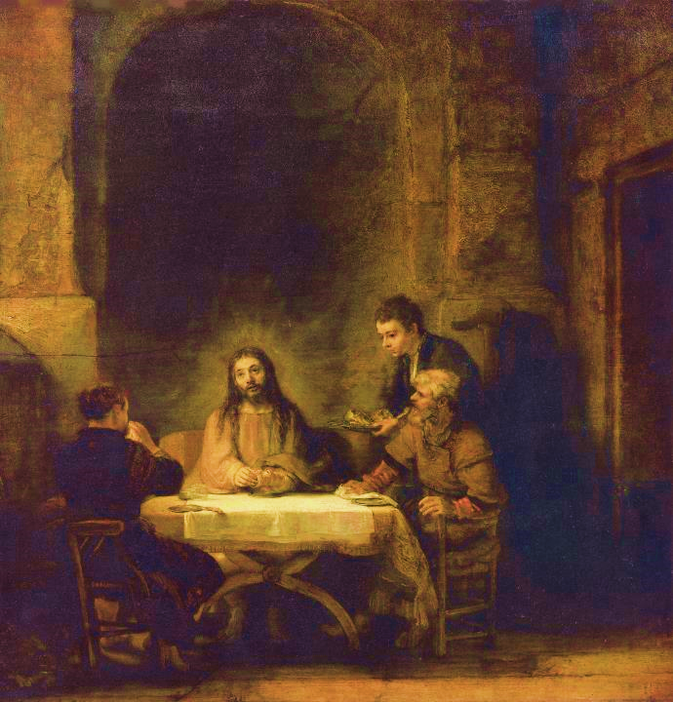
Rembrandt, 1648
The Louvre, Paris

Slide 28
The Appearance to the Eleven
Cleopas and his companion hurried to report their encounter with Jesus to the Eleven (Lk. 24:33ff.).
  That Luke uses the term “the Eleven” presumes both the demise of Judas, the absence of Thomas (cf. Jn. 20:24) and the eventual addition of Matthias (cf. Ac. 1:15-26).
  While Cleopas and his companion were reporting, Jesus suddenly stood among them, inviting them to examine his hands and feet which still bore the marks of crucifixion.
  He ate with them (cf. Ac. 10:41) and then opened their minds to the fulfillment of the Scriptures, commissioning them to preach the gospel to the nations.

Slide 29
“That You May Believe”
The Fourth Gospel really speaks for all the gospels in its closing affirmation of Jesus as the Messiah (Jn. 20:30-31).
In a multitude of ways, each gospel addresses the basic question, “Who is Jesus?”
The narratives of his teaching, his mighty acts, and his death and resurrection all converge in the final conclusion: Jesus is the Christ, the Son of God—and faith in him results in true spiritual life.

Slide 30
Focal Points of the Gospels
Jesus’ Mighty Acts
Jesus’ Passion
Jesus’ Sayings

Slide 31
In Jesus the promise is confirmed,
the covenant is renewed,
the prophecies are fulfilled,
the law is vindicated,
salvation is brought near,
sacred history has reached its climax,
the perfect sacrifice has been offered
and accepted,
the great priest over the household of God has taken his seat at God’s right hand,
the Prophet like Moses has been raised up,
the Son of David reigns,
the kingdom of God has been inaugurated,
the Son of Man has received dominion from the Ancient of Days,
the Servant of the Lord,
having been smitten to death
for his people’s transgression
and borne the sin of many,
has accomplished the divine purpose,
has seen light after the travail of his soul and is now exalted and extolled and made very high.

Slide 32
His Mighty Acts

Slide 33
The Role of Signs (Mk. 8:11-26; Jn. 2:11)
John’s Gospel uses the term “signs” to refer to Jesus miracles. As such, his miracles were events that pointed beyond themselves to Jesus’ identity.
Still, while Jesus’ miracles were widely acclaimed, signs were not to be demanded.
When the Pharisees sought a miraculous sign, Jesus refused.
Jesus regarded “sign-seeking” as entirely inappropriate (Mt. 16:4).

Slide 34
Jesus and Nature (Lk. 8:22-25)
The incident of the stilling of the storm became another occasion for amazement.
  That Jesus had power over the elements of sea and weather were incredible signs pointing to his divinity.
  It caused the disciples to ask the most basic of all questions, and indeed, the question that Luke wants to prompt from all his readers, “Who is this?”

Slide 35
Demons
Jesus was repeatedly confronted by demonized people (Lk. 4:31-36, 41; 8:26-39; 9:37-43).
  He compared his power over demons to God’s power over the Egyptian magicians during the exodus (11:20; cf. Ex 8:19).
  Sometimes demonization was linked to sickness and at other times to insanity, though this is not a necessary connection.

Slide 36
The Language of Demonization
Expressions describing demonization in the Synoptic Gospels are:
δαιμονιζομαι = to be demonized, to be “possessed” by a demon (this is the term preferred by Matthew)
εχω...δαιμονιον/πωευμα ακαθαρτου = to have a demon, to have an unclean spirit
Associated verbs:
εισερχομαι = to enter
εκβαλλω = to drive out
εξερχομαι = to come out

Slide 37
The Issue of Ritual Impurity
Various sorts of contact caused ritual impurity, which meant that one was barred from temple worship. Typically, Jews would have avoided all such contact.
In healing the man with leprosy, instead of ritual uncleanness being transferred to Jesus (cf. Lv. 5:3), the sanctity of Jesus was transferred to the leper (Mk. 1:40-44).
In his robe being touched by the woman with the hemorrhage, the ritual uncleanness of contact with blood was reversed by Jesus’ act of healing (Mk. 5:25-34; cf. Lv. 15:25-27, 31).
In touching the dead girl, Jesus reversed the ritual uncleanness of contact with a corpse by raising her to life (Mk. 5:41; cf. Lv. 19:14; Nu. 19).

Slide 38
The relationship of purity laws to Jesus’ contact with Gentiles
Earlier, the Roman centurion recognized that Jewish contact with a Gentile was unacceptable (Mt. 8:8).
Here, Jesus is approached directly by a Gentile woman in behalf of her demonized daughter (Mt. 15:21ff.).
  Though Jesus conceded that his ministry at this time was restricted to Israel (cf. 10:5-6), he nonetheless responded to the Gentile woman’s desperate plea (15:24).
  This occasion becomes a prelude to the universal commission of Jesus at the climax of Matthew’s Gospel (28:19).
The healing of the Phoenician woman’s daughter is immediately followed by the feeding of the 4000, presumably a large crowd of non-Jews (based on the expression “they praised the God of Israel”, Mt. 15:31b).

Slide 39
Greater Works and Asking the Father “in my name”
Jesus’ command to “ask in my name” rested on the fact of his return to the Father (14:12-14).
Only the one who came from the Father and returned to the Father had the authority to offer immediate access to God (cf. 3:13).
If the apostles were to ask anything, therefore, they must do so through the Son (cf. 15:16b).
Before Jesus returned to the Father, completing his incarnational work, it had not been possible to petition the Father in this way (cf. 16:23-24, 26-28).
The “greater things” probably should be understood in terms of the disciples’ evangelistic mission to the whole world to bear fruit (15:7-8, 16).
  It is hard to imagine “greater works” in terms of Jesus’ miracles.
  Rather, the idea is that the disciples’ mission to the world would be greater in scope than the limitations imposed upon Jesus’ ministry among the Jews.

Slide 40
His Words

Slide 41
Five Pronouncement Stories
Mark consecutively links several conflict stories, each featuring a pronouncement that bears directly upon Jesus’ person and work:
…authority to forgive sins (2:10)
…the call to sinners, not the righteous (2:17)
…the issue of ritual fasting (2:19)
…question about Sabbath observance (2:27-28)
…healing on the Sabbath (3:4)

Slide 42
Forgiving Sins (2:1-12)
In healing the paralytic, Jesus shocked the crowd by offering the man forgiveness of sins.
Here, Jesus is suspected of blasphemy, since God alone can forgive sins (by implication, Jesus takes to himself divine prerogatives).
Jesus’ question, “Which is easier to say…” is double-edged. Physical healing cannot be denied, since it is visible. Forgiveness is “easier” in that it is invisible.

Slide 43
The Sabbath (2:23-28)
The Pharisees interpreted Ex. 34:21 as prohibiting what they saw Jesus’ disciples doing—plucking ears of grain on the Sabbath.
In response, Jesus’ cited 1 Sa. 21:1-6 as an example of suspending Sabbath regulations in the interests of emergency or human need.
The Torah was a gift for human benefit, not a burden to be borne.
Jesus claimed to be lord of the Sabbath, an indirect claim to his divine origin.

Slide 44
Jesus and the Torah
(5:17-48)
Jesus unequivocally declared that he was not abrogating the Torah nor the prophets (5:17-18).
Rather, his mission was to see the Torah and the prophets filled out to their full meaning.
While he stood in continuity with the Torah, at the same time he deepened and expounded the profound implications of the Torah:
  The prohibition against murder must include hatred and anger.
  The commandment against adultery must include motives and thoughts.
  Divorce for any reason was a breaking of God’s ideal for marriage.
  Oaths are not the guarantor of truth, but rather, the intent of the heart.
  Non-retaliation and love for one’s enemies is incumbent upon all who claim to be God’s children.

Slide 45
The Heart of the Sabbath Controversies
The Torah (the written law)
The five books of Moses comprised the Torah (= the instruction).
The Torah was the oldest and most revered part of the Holy Scriptures.
Jesus referred to the Torah by the phrase “it is written” (4:4, 7, 10).
The Halakah (the oral tradition)
Derived from the Hebrew word “to walk,” the Halakah was the so-called Oral Torah believed to be from God but not contained in the written Torah.
Many Sabbath regulations fell into this category.

Slide 46
While Jesus fully supported the Torah, he rejected the rabbinic Halakah as non-binding human tradition.
He defended his disciples’ breaking of Halakah by citing the irregularities of David and the priests (12:3-5; cf. 1 Sa. 21:3-6; Nu. 28:9-10).
He appealed to the prophet Hosea that God desired mercy, not ritual (12:7; cf. Ho. 6:6).
He claimed for himself the distinguished title “Lord of the Sabbath” (12:8).
He declared that is was lawful to “do good” on the Sabbath (12:12).

Slide 47
Matthew’s Use of the Old Testament
Matthew’s Gospel contains over sixty explicit quotations from the Old Testament (usually from the LXX) as well as many more allusions.
A favorite term he uses is πληροω (= fulfill, fill, make full, bring to completion).
His usage, however, suggests much more than simply prediction and verification:
  He does not depend strictly upon a historical-grammatical reading of the texts.
  Rather, he often develops a sensus plenior (= deeper sense meaning) which includes the clarification of enigmatic passages (cf. 22:41-46) and the recapitulation of Old Testament events in the life of Jesus along the lines of typology (cf. 2:17-18).
  Most important, he sees a link between the Israelite nation and Jesus so that Jesus was in every way the “true” Israel, i.e., Jesus fulfilled what Israel was intended to be but never became (cf. 2:15; 3:17; 17:5).

Slide 48
Synoptic Parables
(about a third of Jesus’ recorded teachings)
Popular stories from real life
5 farming 5 fishing 5 village life
Extemporaneous
5 illustrations 5 explanations 5 rebuttals
Subversive
5 revelation to some 5 concealment for the cynical
Striking for a verdict
5 “What do you think?”

Slide 49
The Parables of the Kingdom (Mk. 4) what God’s rule will look like
In several parables, Jesus taught that God’s reign will look very different than what was popularly conceived.
The real enemy is not Rome but Satan (Strong Man).
The kingdom will involve personal choice (Sower)
Recognizing the kingdom is neither automatic nor obvious (the lamp under a meal-tub)
Rather than in an apocalyptic burst, the kingdom will come gradually (the Growing Seed and the Mustard Seed).

Slide 50
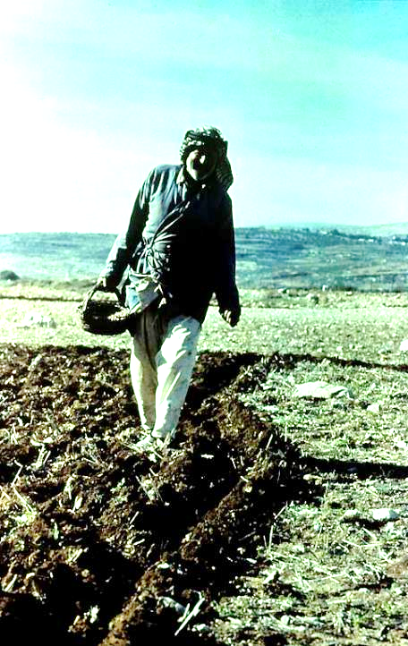
Local Color in the Sower
Sowing by hand means that some seed inevitably falls on rocks, high ground or the path next to the field.
In some regions, sowing actually precedes plowing, an additional reason why seed falls on the different sorts of soil.

Slide 51
Three Parables on Welcoming Sinners
Luke’ especially emphasizes Jesus’ openness to “sinners” (5:29-32; 7:34, 39; 15:1, 7, 10; 18:13; 19:7).
The Lost Sheep
The Lost Coin
The Two Lost Sons
God’s love takes the initiative!
It does not merely wait, but seeks out the sinner.
God rejoices more over sinners who repent than the righteous who think they do not need to do so.
In the ancient Near East, a woman’s headdress was decorated with coins as part of her dowry.
To lose one was a great loss, and the woman would search thoroughly to find it!
This parable is on the father’s love.
The father had two sons, both were lost, but only one was “found.”
Jesus’ critics would have had little trouble seeing themselves as the elder brother.

Slide 52
People Perceived to be “Last” In Jewish Society
  One of Jesus’ famous repeated sayings was, “There are those who are last who will be first, and the first who will be last” (13:30; cf, Mk. 9:35; 10:31; Mt. 20:16). Various lists would later appear in the Jewish Mishnah ranking people from “first” to “last” based on racial purity.
The “First”
Priests and Levites
The Lay Nobility
Scribes
Pharisees
Israelites
Pure ancestry
Those with despised trades
Slaves
Those with slight pedigree blemishes
Proselytes
Bastards, eunuchs, foundlings
The “Last”
Samaritans
Gentiles

Slide 53
The Counter Question
Jesus took the initiative and posed a question for his critics, counter-questioning them about Psalm 110:1.
All agreed that the messiah would be a descendent of David.
There are three figures in view in Psalm 110, Yahweh (LORD), Adonai (my Lord), and David (the author of the Psalm). Jesus seemed to know his opponents would agree that Adonai in Psalm 110:1 referred to the messiah.
If this was so, then how could Adonai, who was David’s Lord (“my” Lord) at the same time be his descendent?
The implications were profound: no one could have been greater than great David except a divine figure. If Adonai was greater than David, he must have been divine!

Slide 54
The Last Great Discourse (Jn. 14—16)
A critical interpretive question concerning this, the longest of the discourses in the Fourth Gospel, is how the apostles are being addressed.
Are they addressed as a unique group, those who had been with Jesus in his earthly ministry, witnesses of his death and resurrection, and serving in a non-repeatable ministry?
Or, are they addressed as the first Christians so that what is said to them is said to all Christians of all times?

Slide 55
Christians differ concerning how to apply the passages about performing “greater works” (14:12-14; 15:7, 16b; 16:23-24).
As a Unique Group
“You have been with me from the beginning” (15:27)
“You will be expelled from the synagogue” (16:1-4)
They would have grief during the days between crucifixion and resurrection (16:17-22)
They would abandon Jesus and be scattered (16:31-32)
As the First Christians
Promise of going to the Father’s house (14:1-3)
The way to the Father is through Jesus (14:6)
The new commandment that they should love each other (15:12; cf. 13:34-35)
Promise of the Paraclete (14:26; 16:7)

Slide 56
His Passion

Slide 57
The Last Meal
All four gospels describe the last meal, but the Synoptics follow a different course than the Fourth Gospel.
Synoptics Only
Disciples prepare the room
Institution of the Eucharist
Teaching on Servanthood
John Only
Washing of feet
New Commandment
Teaching on the Paraclete
Common to Both
Farewell meal
Prediction of Peter’s denial
Departure for Gethsemane

Slide 58
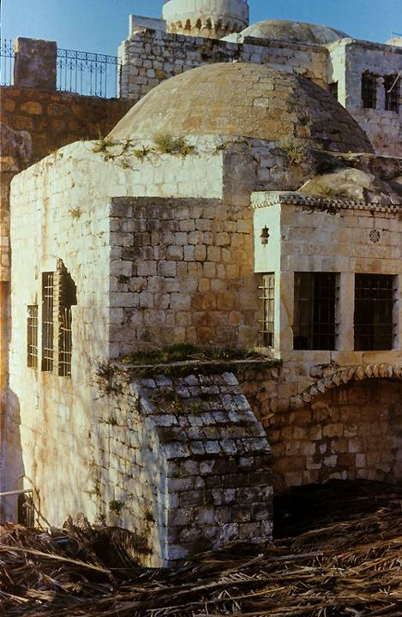
Traditional site of the Last Supper
Though the present structure only dates to the Crusader Period, foundations beneath it may go back as far as the time of Jesus. This is the traditional site of the Last Supper (Mk. 14:13, 15), called the Cenacle (from Jerome’s Latin Vulgate). Its earliest foundation seems to be from either an ancient synagogue or church that may have existed prior to the destruction of the 2nd temple.

Slide 59
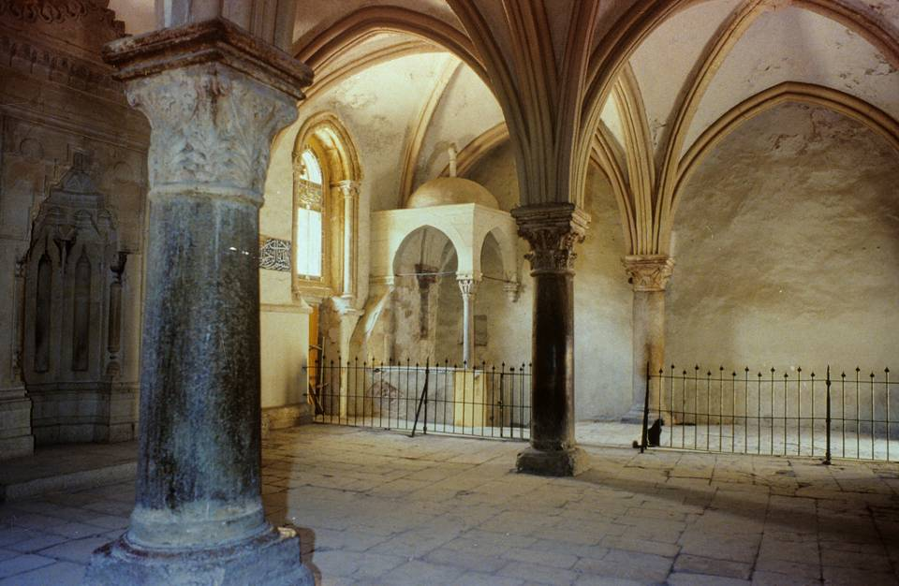
The columns of the structure’s interior go back to an early Byzantine church, while the vaulted ceiling was constructed by the Crusaders.

Slide 60
The Passover Tradition
Stage 1
Blessing and first cup of wine
Preliminary dish
Placement of the meal and mixing of the second cup of wine
Stage 2
Recounting the Passover story
Singing of Psalm 113-114
Drinking the second cup of wine
Stage 3
Blessing of the unleavened bread
Meal
Blessing and drinking the third cup of wine
Stage 4
Singing Psalm 115-118
Blessing and drinking the fourth cup of wine
Clearly, Jesus linked the meaning of his death with the covenant, also echoing the language of the suffering servant (Is. 53:12).

Slide 61
Sacramentalism
The Fourth Gospel does not contain the story of Jesus’ baptism, his great commission commanding baptism, or the Eucharistic words or actions of Jesus at the Last Supper.
  Should such omissions be taken as anti-sacramental (some interpreters take this position)?
  Do other Johannine passages that use the symbolism of water, bread and blood suggest a deeper sacramental meaning (other interpreters take this position)?

Slide 62
Sacramentalism cont.-
While it is true there are no overt references to baptism or Eucharist in the Fourth Gospel, some passages are clearly suggestive:
  The instruction that one must be born of water and Spirit (3:5)
  The metaphorical link between living water and the gift of the Spirit (7:37-39; 19:34)
  The extended discourse of “eating” Christ’s body and “drinking” his blood (6:32-58)
Within Christian communities for whom baptism and Eucharist were normative, it is hard to believe that they would not have seen an intentional sacramental meaning in these passages.

Slide 63
Why does John’s calendar not agree with the Synoptics?
The Synoptics show the last supper as a Passover meal (Mk. 14:12-16//Mt. 26:17-19//Lk. 22:7-13); John put the supper a day earlier (Jn. 13:1; 18:28; 19:14).
This difference is reflected in two traditions: the Eastern Church celebrates Eucharist with leavened bread, while the Western Church celebrates with unleavened bread.
The idea that Jesus had two “last meals” on consecutive evenings does not seem very likely.
Was the meal in the Synoptics a true Passover meal, or was it a private, irregular paschal meal held a day early because Jesus anticipated the coming events of his arrest and execution?
Was more than one liturgical calendar in force so that both the Synoptics and the Fourth Gospel are correct, each following a different Jewish calendar (see Jeremias and Marshal)?

Slide 64
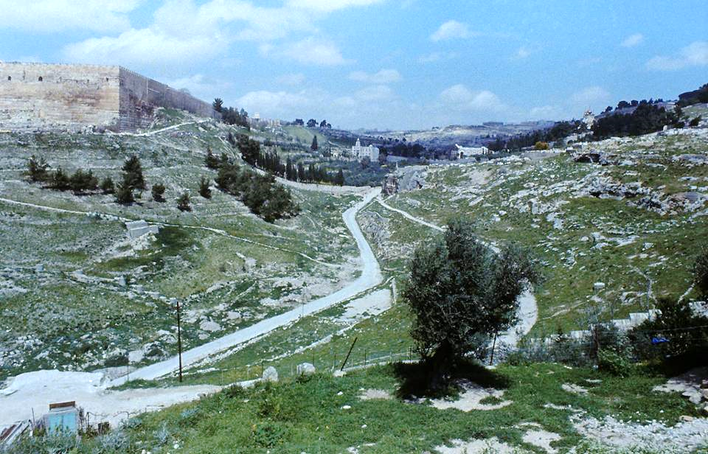
The Kidron Valley facing northward (southeast corner of the temple mount visible on the left; lower slopes of the Mt. of Olives on the right, cf. 18:1).

Slide 65
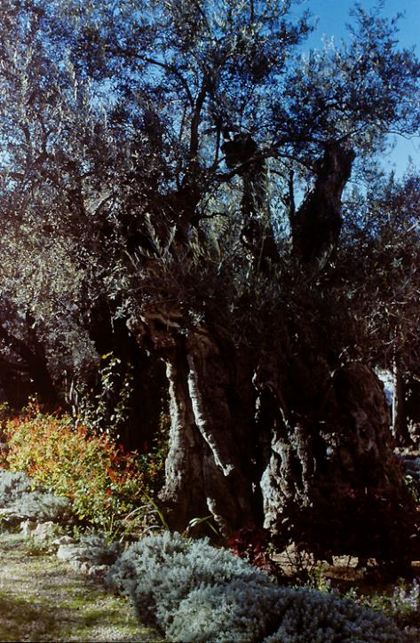
This is the approximate place on the lower slopes of the Mt. of Olives that Jesus resorted with his disciples during Passover week and where he was arrested (18:2ff.)

Slide 66
The Arrest and Trial in the Four Gospels
Matthew
Gethsemane
Judas’ betrayal
Before Caiaphas
Before the Sanhedrin
Peter’s denials
Before Pilate
Death of Judas
Release Barabbas
Soldiers mockery
Mark
Gethsemane
Judas’ betrayal
(High Priest unnamed)
Before the Sanhedrin
Peter’s denials
Before Pilate
Release Barabbas
Soldiers mockery
Luke
Gethsemane
Judas’ betrayal
(High Priest unnamed)
Before the Sanhedrin
Peter’s denials
Before Pilate
Before Herod
Pilate declares Jesus innocent
Release Barabbas
John
Gethsemane
Judas’ betrayal
Before Annas
Before Caiaphas
Peter’s denials
Before Pilate
Pilate declares Jesus innocent
Release Barabbas
Soldiers mockery

Slide 67
The Trial of Jesus Proceeded in Two Stages with Different Indictments
The Jewish Stage
Preliminary examination before Annas (John)
Appearance before Caiaphas (all four gospels)
Condemnation by the full Sanhedrin (Synoptics)
Indictment
Blasphemy
The Roman Stage
First appearance before Pontius Pilate (all four gospels)
Appearance before Herod Antipas (Luke)
Final appearance before Pilate (all four gospels)
Indictment
Treason

Slide 68
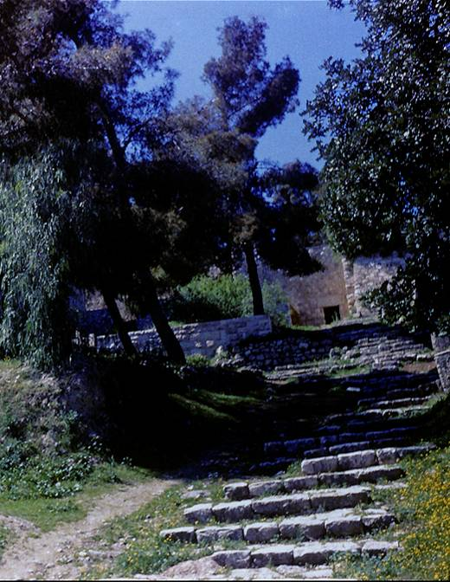
Church of St. Peter in Gallicantu (in galli cantu = “as the cock crowed”, Latin)
These ancient steps, excavated in 1887, date to the 1st century and mark the probable path that Jesus would have walked on his way to the hearing before the Chief Priest and the Sanhedrin.

Slide 69
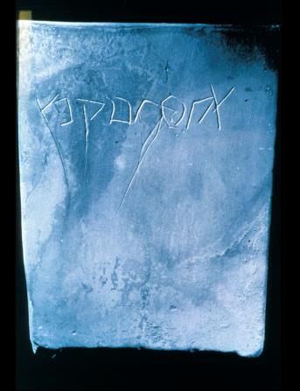
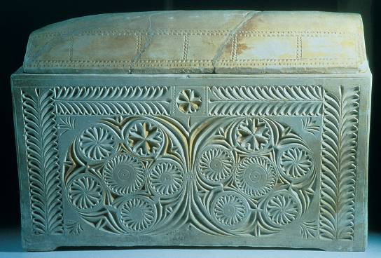
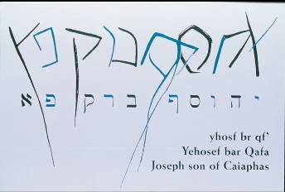
THE CAIAPHAS OSSUARY
In 1990 an ancient tomb chamber was discovered containing several ossuaries (bone boxes for second burial). Among them was an ossuary inscribed with the name “Joseph bar Caiaphas”, almost certainly the same Caiaphas in the gospels whom Josephus calls “Joseph Caiaphas”.

Slide 70
Legal Irregularities
If Jesus’ hearing before the Sanhedrin was a formal trial, there were several breaches in procedure as outlined in the Talmud.
A trial at the high priest’s home was illegal.
A trial at night was illegal.
A trial during a festival was illegal.
A capital crime resulting in a guilty verdict could not be settled in a single session.
Hence, either Jesus’ trial was not a “formal” trial, or else, the Sanhedrin acted out of desperation, throwing out their own judicial procedure.

Slide 71
The Climax in the Jewish Stage
Though a number of witnesses were interviewed, none were able to offer substantial grounds for an execution (26:59-60).
At last, two witnesses recalled Jesus’ words about destroying and rebuilding the temple (26:61).
This was a sustainable capital charge if it could be demonstrated that Jesus intended violence against the temple; however, Jesus’ silence left the charge ambiguous.
Hence, the High Priest put Jesus on oath, and Jesus’ response, in which he identified himself with the heavenly Son of Man (cf. Da. 7:13-14), was taken as blasphemy (26:64-68).

Slide 72
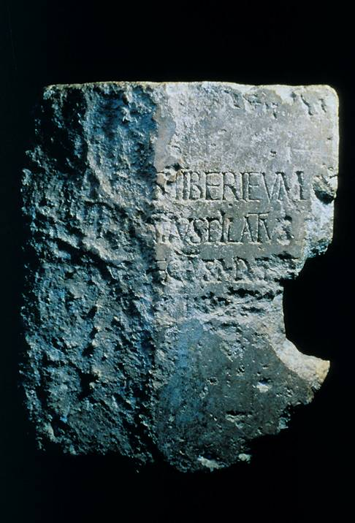
Pilate Inscription
This1st century inscription, naming Pontius Pilate, was discovered in the excavations of 1959-1963 in Caesarea Maritima, the provincial Roman capital of Palestine.
It reads: Pontius Pilate, the Prefect of Judea, has dedicated to the people of Caesarea a temple in honor of Tiberius.
Though the inscription is damaged, the Latin words “Tiberius”, “Pilate” and “Caesarea” can be made out.

Slide 73
The Hearing Before Pilate (27:11-26)
The Roman Governor had the final decision in matters of execution (cf. Jn. 18:31b; 19:10), and this policy is corroborated by Flavius Josephus (Antiquities xviii.1.1).
Pilate seemed to suspect that this issue was more religious than political, which explains his reluctance to give an execution order. Jesus might be a religious eccentric, but he was no threat to Rome, and Pilate knew it.
He even attempted to release Jesus.
Still, the Sanhedrin pressed for an execution and called for the release of Barabbas.
Pilate consented to Jesus’ execution and delivered Jesus over for scourging.

Slide 74
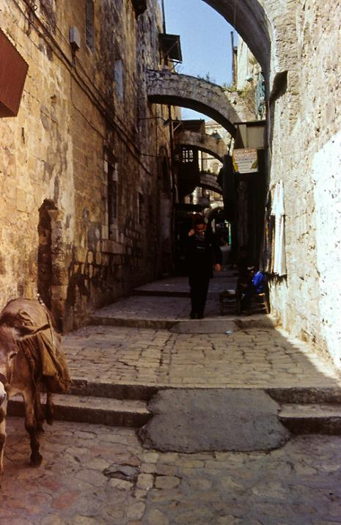
The Via Dolorosa (way of suffering)
This is the traditional route of Jesus’ painful procession to Calvary, though the present street is several feet higher than the ancient street in the 2nd temple period.

Slide 75
Crucifixion & Burial in the Four Gospels
Matthew
Via dolorosa
Crucifixion
Spectators mock
Two thieves
Death
Burial
Guard at the tomb
Women come on Easter
Mark
Via dolorosa
Crucifixion
Spectators mock
Two thieves
Death
Burial
Women come on Easter
Luke
Via dolorosa
Crucifixion
Spectators mock
Two thieves
Death
Burial
Women come on Easter
John
Via dolorosa
Crucifixion
Mary given to the beloved disciple
Two thieves
Death
Jesus is pierced
Burial
Women come on Easter
Peter and beloved disciple at the tomb

Slide 76
Roman Crucifixions
Roman crucifixions generally consisted of three parts:
Scourging (there was no limit to Roman flogging as there was in Judaism, cf. Dt. 25:1-3)
Carrying the patibulum (cross-piece) to the site of execution, usually with the titulus (inscription with charges) hung about the victim’s neck
Nailing (or tying) and lifting: crosses could be T-shaped (crux commissa) or dagger shaped (crux immissa). Also, crosses typically had a sharp projection that fit beneath the pelvis and helped suspend the weight of the body (sedile). Sometimes they also had a foot support (suppedaneum)
Death was by shock or gradual asphyxiation as the lungs collapsed and the victim could no longer raise himself in order to breath. Breaking the legs of the victims would hasten asphyxiation. For more clinical-medical details on crucifixion, see W. Edwards, W. Gabel and F. Hosmer, Journal of the American Medical Association (March 21, 1986), pp 1455-1463.

Slide 77
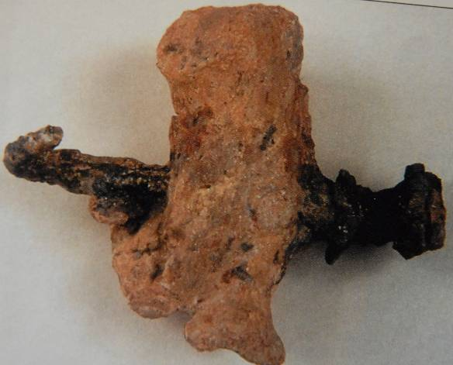
Although thousands of prisoners and slaves were crucified in antiquity, the remains of only one victim so far have been discovered, a Jewish male from about the mid-1st century AD.
Excavated in 1986 in Jerusalem, the remains of this man of about 24-28 years old were found in an ossuary that named him as Yehohanan.
His heel bone was transfixed sideways by a single spike, which had sunk deep into a knot so that the only way to remove the body was to amputate the feet.

Slide 78
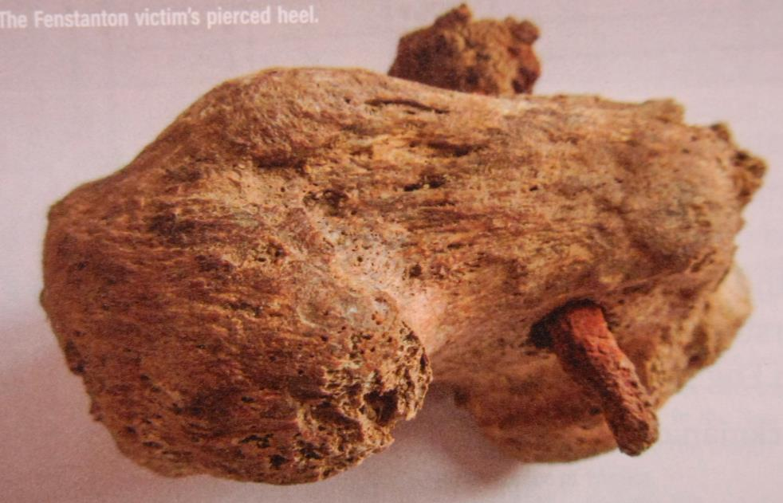
Yet another artefact from crucifixion, this time in Roman Britannia from the 2nd century, shows the spike also driven through the heel both from the side.

Slide 79
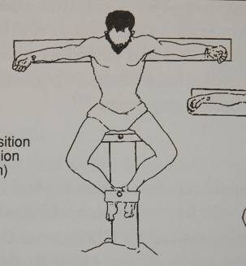
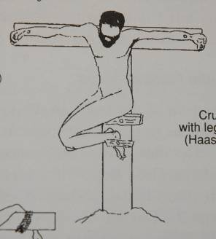
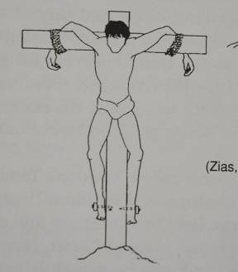
Possible Positions of Crucifixion
Based on the remains of Jehohanan, archaeologists have theorized about his position on the cross, given that his heels were nailed with a single spike
It remains an open question as to whether or not the crucifixion of Jesus may have been similar.

Slide 80
The Seven Sayings from the Cross
Matthew
“My God, my God, why have you forsaken me?”
Mark
“My God, my God, why have you forsaken me?”
Luke
“Father, forgive them, for they do not know what they are doing.”
“Amen, I say to you, today you will be with me in paradise.”
“Father, into your hands I commit my spirit.”
John
“Woman, here is your son.”
“Here is your mother.”
“I am thirsty.”
“It is finished.”

Slide 81
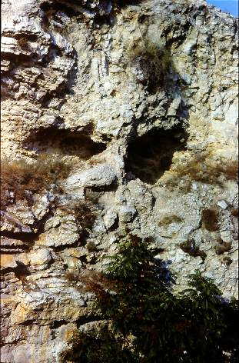
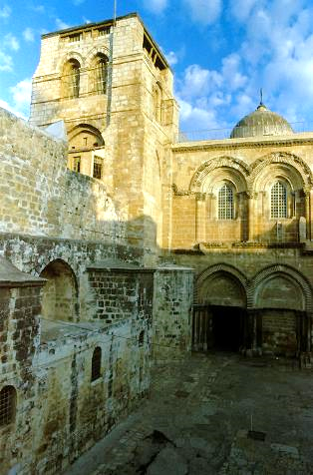
Locating Calvary
The exact site of the crucifixion has been elusive, exacerbated by the destruction of the city in AD 70 and its rebuilding by Trajan in the 2nd century. Two primary sites have been defended (as well as several that are less popular), Gordon’s Calvary and the Church of the Holy Sepulchre. The only clear identity marker in the gospels is that it was outside the city wall (19:20; cf. He. 13:12-13).
Gordon’s Calvary (left) was identified by British General Charles Gordon for mystical reasons. The shape of the hill somewhat resembles a skull.
The Church of the Holy Sepulchre (right) has the best attestation in antiquity (Eusebius and Jerome). In general, the question is still open.

Slide 82
Jesus and Women
Luke has a special emphasis on the openness of Jesus to women, and they would be the first witnesses of his resurrection.
  That he accepted them as his disciples and even allowed them to travel with him was virtually without precedent in a patriarchal society (8:1-3).
  It is no wonder that they were last at the cross and first at the tomb!

Slide 83
The Role of the Women
That the first post-resurrection appearances depend upon the testimony of the women is significant in 1st century Jewish culture in view of women’s restricted roles:
Women did not figure in the count of Jews necessary to form a synagogue.
Barriers of lattice, balconies and galleries separated women from men in public worship.
Women could listen, but not participate in public worship.
They were restricted from reading and studying the Torah, were not expected to recite the Shema, and were not required to attend the pilgrim festivals.
They could not recite the blessing for family meals.
They could not function as disciples of a rabbi.
They could not go into the temple beyond the Court of the Women, and during their menstrual cycle or the period of childbirth, they could not even go into the Court of the Gentiles.

Slide 84
Role of Women cont.--
In legal matters, except under limited conditions, women were not allowed to give testimony.
Women were not entitled to inheritance.
While men could divorce, women could not.
Up until the age of 12 ½, fathers could arrange for their daughters’ betrothal or even sell them as slaves. Any bride price was kept by the father.
Women, slaves and children were lumped together as the three lowest rungs on the social scale.
A woman leaving her home was obliged to keep her face hidden by a double veil, a head-band covering the forehead with bands to the chin, and a hairnet. To be seen in public without a double veil was grounds for divorce.
Social rules forbade a woman from being alone with a man who was not her husband. The proper response to a married woman in public was to avert the eyes. (An inappropriate conversation was grounds for divorce.)

Slide 85
The women who followed Jesus from Galilee to Jerusalem would be last at the cross and first at the tomb.
“They had never known a man like this Man—there never has been such another. A prophet and teacher who never nagged at them, never flattered or coaxed or patronised; who never made arch jokes about them, never treated them as “The women, God help us!” or “The ladies, God bless them!”; who rebuked without condescension; who took their questions and arguments seriously; who never mapped out their sphere for them, never urged them to be feminine or jeered at them for being female; who had no axe to grind and no uneasy male dignity to defend; who took them as he found them and was completely unself-conscious. There is no act, no sermon, no parable in the whole Gospel that borrows its pungency from female perversity; nobody could possibly guess from the words and deeds of Jesus that there was anything “funny” about woman’s nature.”
Dorothy Sayers

Slide 86
The Jewish Restriction is Lifted
Though Matthew clearly shows that Jesus’ public ministry was restricted to Israel (cf. 10:5-6; 15:24), the great commission eliminated this boundary (28:19).
This first gospel, which began as the most Jewish of the gospels and forms the bridge between the Old and the New Testaments, concludes with Jesus sending his disciples as witnesses to all nations of the world!

Slide 87
Luke’s History of the Apostolic Community

Slide 88
PURPOSE
Luke intends to tell the story of Christian origins with particular goals in mind.
As both a theologian and an historian, his primary goal is to show how the good news about Christ became international as a fulfillment of God’s purpose.
The opening language in the gospel about the “[things] having been fully carried out” (Lk. 1:1) was according to God’s “fixed counsel and foreknowledge” (Ac. 2:23).
What Jesus “began to do and teach” is carried on by the apostles as directed by the Holy Spirit (1:1-2).

Slide 89
CONTINUITY
The transition between Judaism and Christianity was neither immediate nor sharp.
Christians continued to use the same basic biblical texts (whether in Hebrew or Greek).
Basic structures seemed to retain their value for the earliest Christians, especially covenant, ethnicity and temple.
  Israel was the heir to the covenants made with the ancestors (3:24-25).
  The earliest Christian community was thoroughly Jewish (6:7; 11:19).
  They continued to use the temple as sacred space, meeting there (2:46; 3:1; 5:12, 20-21, 42a; 21:20-26).
  They continued to attend synagogue worship (6:9ff.; 9:20; 13:14; 14:1; 17:2; 18:4, 19, 26; 19:8).

Slide 90
DISCONTINUITY
Initial continuity notwithstanding, there was discontinuity as well.
Jews who remained opposed to Jesus were regarded as rejecting God’s messiah (3:22-23; 4:8-12; 13:46; 18:6; 28:25-28).
The message to Israel was to repent and be baptized in the name of Jesus Christ, for only in him was there true forgiveness (2:38; 5:30-31).
Such teaching was bound to bring these earliest Christians into sharp conflict with the Sanhedrin and the Temple, who easily cast the followers of Jesus as anti-Torah and anti-temple—and this is precisely what happened (6:11-14; 7:48-53).

Slide 91
Paul’s Gospel

Slide 92
Paul and the Historical Jesus
Since Paul’s letters were composed prior to any of the gospels, he becomes the earliest extant written Christian witness to the historical Jesus.
For Paul, the central aspect of Jesus’ life and ministry are the cross and the resurrection.
Indeed Paul offers only minimal information about Jesus’ earthly life, what he describes as “Christ according to the flesh” (2 Co. 5:16).
Though Paul offers no narratives from Jesus’ life, nor does he describe Jesus’ baptism, miracles or disputes, in bits and pieces he shows that he is familiar with the story of Jesus.

Slide 93
Had Paul ever seen Jesus personally?
Though he was a citizen of Tarsus, he was educated in Jerusalem under Rabbi Gamaliel, where he possibly lived with his sister (Ac. 22:3; 23:16).
The odds are good that he may have been in Jerusalem at the time of Jesus’ death, an event that hardly would pass unnoticed. Still, we don’t know.
Did Paul recount the story of Jesus in his preaching to Gentiles? Luke is silent on the matter, though he describes several of Paul’s sermons and speeches.

Slide 94
Paul and the sayings of Jesus:
What is clear is that Paul was familiar with the teachings of Jesus and quotes from them at various times (1 Co. 7:10-11//Mk. 10:9-12; 1 Co. 9:14//Lk. 10:7; 1 Co. 11:23-25//Mt. 26:22-29//Mk. 14:17-25//Lk. 22:14-23; 1 Th. 4:15-17//Mt. 24:30-31).
He even quotes a saying of Jesus that is not recorded in the canonical gospels (Ac. 20:35).
Altogether, there are some 30 passages in Paul where he alludes to or echoes the teachings of Jesus.

Slide 95
Revelation & Tradition
How, then, did Paul know about the historical Jesus?
He goes to great lengths to stress that his contact with the Jerusalem church was minimal (Ga. 1:11—2:10).
The 15 days he spent with Peter and James must have been enlightening (Ga. 1:18-19), but he still insists that his understanding of the gospel came through direction revelation (Ga. 1:11-12).
At the same time, he concedes that he received by tradition (παραδοσεις and παραλαμβανω) certain aspects of Jesus’ life (1 Co. 11:2; 15:1-7; 2 Th. 2:15).

Slide 96
Paul’s Gospel
At various times, Paul can refer to the gospel personally as “my gospel” (Ro. 2:16; 16:25; 2 Ti. 2:8).
Indeed, the word “gospel” appears far more in Paul’s letters than the remainder of the New Testament.
Central to Paul’s gospel was the cross and resurrection of Jesus, what he says is of “first importance” (1 Co. 15:3; cf. 1 Co. 1:17-18; 2:2).
In the cross and resurrection, Paul sees the supreme act of salvation-history (Ac. 13:26-38).
It was not that Paul was uninterested in the life of Jesus, but rather, that he fully realized that apart from the cross and resurrection, Jesus would be perceived, at best, as only a prophet, not the Son of God who would take away the world’s sins (Ro. 1:4).

Slide 97
Jesus is Christ and Lord!
For Paul, the critical moment was on the Damascus Road, when he asked, “Who are you Lord?” and the heavenly voice said, “I am Jesus!”
The lordship of Christ concerns his exaltation, and the confessional formula for all believers is simply, “Jesus is Lord” (Ro 10:9; 1 Co. 8:6; 12:3; 2 Co. 4:5; Phil. 2:9-11).
Finally, the righteousness of God is imputed to believers by faith.
Righteousness is God’s gift to the sinner (Ro. 4:4-5; 5:17; 6:23; Ep. 2:8), and it is mediated through Christ alone (1 Co. 1:30; 2 Co 5:21).
For Paul, righteousness is something God credits or imputes to believers by faith (Ro. 4:4-8, 11b).

Slide 98
The primary realities of salvation, therefore, are grace and faith.
Paul uses the word χαρις (= grace) more than all other NT writers combined.
Grace is God’s unmerited initiative to provide humans with salvation (Ro. 11:6).
Grace and faith stand in polar opposition to salvation by wages (Ro. 4:4), obedience to law (Ro. 3:28; 4:14; 6:14; Ga. 1:6ff.; 2:19-21; 5:4) or religious works (Ro. 11:6; Ep. 2:9; 2 Ti. 1:9).
Faith is itself the gracious gift of God enabling believers to believe (Phil. 1:29; Ep. 2:8).

Slide 99
Salvation
For Paul, salvation is not only “from” something, but also “toward” something, which is to say, salvation is oriented in two directions.
Because of Christ’s sacrifice, believers have been rescued from the kingdom of darkness (Col. 1:13), freed from the power of sin (Ro. 6:6-7, 14, 18, 20-22) and exempt from divine wrath (Ro. 5:9; 2 Co. 3:15).
At the same time, believers were saved “to do good works” (Ep. 5:10; 1 Ti. 2:10; 5:10; 6:18)—to be ambassadors through whom God makes his appeal to the world (2 Co. 5:18-20), while exhibiting the fruit of the Spirit (Ro. 7:4; Ga. 5:22-23; Ep. 5:8-9; Phil. 1:9-11; Col. 1:10).

Slide 100
Salvation in Two Directions
(Romans 6:13-14)
Believers are saved “from” something, but they also are saved “to” something.
UNDER LAW
sin
condemnation
death
slavery to sin
UNDER GRACE
obedience
righteousness
life
an offering to God
From To
Salvation is not only an escape but also a calling (cf. Eph. 2:10; 2 Ti. 1:9).

Slide 101
SALVATION IN THREE TENSES
Romans 5:1, 9
PAST
“…having been justified through faith…” (5:1a)
(aorist passive participle)
PRESENT
“…we have peace with God through our Lord Jesus Christ…” (5:1b)
(present active indicative)
FUTURE
“…we shall be saved from God’s wrath through him!” (5:9b)
(future passive indicative)

Slide 102
Paul uses powerful metaphors or word pictures drawn from the Jewish and Gentile cultures to describe salvation.
Reconciliation sets the framework of salvation as the repair of a relational breach between humans and God (Ro. 5:1, 11; 2 Co. 5:18; Ep. 4:17-19; Col. 1:21).
Redemption is both a Jewish concept, in which someone is “bought back”, and a Gentile concept, in which slaves are given manumission (Ro. 3:24; 1 Co. 1:30; 6:20; 7:23; Ga. 3:13; 4:5; Ep. 1:7, 13-14; 4:30; Tit. 2:14).

Slide 103
Justification is a forensic term and evokes the picture of acquittal before a judge. It means that even though a guilty sinner, the believer is viewed as righteous because he/she has come into a righteous relationship with God (Ro. 3:24, 26; 4:5; 5:1; Ga. 2:16; 3:8, 24; Tit. 3:7). This acquittal is based upon the death of Jesus so that God’s wrath against sin has been satisfied in the death of his Son (Ro. 5:9; 8:30-34).
Substitution is a sacrificial concept in which the offenses of the worshipper are transferred to the innocent sacrificial animal—life for life. Paul sees both Yom Kippur and Passover rituals underlying the sacrifice of Christ (Ro 3:25; 1 Co. 5:7; 11:23-25; 2 Co. 5:21; Ep. 5:2).

Slide 104
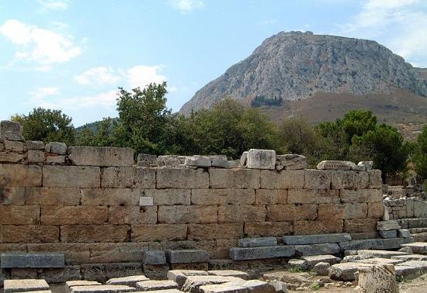
The idea of acquittal may have loomed large for Paul, since he was arraigned in Corinth before Gallio, the Proconsul in Corinth who took office in AD 51, on the charge of promoting an illegal religion. Gallio threw the case out of court (Ac. 18:14-16).
The Corinthian Bema

Slide 105
Adoption was a Roman practice, a legal process by which a person was set free from the authority of his natural father and transferred over to the authority of his adopted father. Old debts were cancelled, and the adopted son now participated in a new family with inheritance rights (Ro. 8:15-17; Ga. 4:3-7; Ep. 1:5).
Sanctification is a Jewish concept in which the idea of “cleanness” meant that one was qualified to approach a holy God. Paul employs two verbal tenses, past tense (what is already done, cf. Ro. 15:16; 1 Co. 1:2; 6:11; Ep. 5:26) and present tense (what is being done, cf. Ro. 6:19, 22; 1 Th. 5:23; 2 Ti. 2:21).

Slide 106
Paul’s Metaphors for Salvation
drawn from
Roman family laws
…to transfer authority to a new family
JUSTIFICATION
drawn from the
Torah laws for buying back
to effect a release or to buy back
SUBSTITUTION
drawn from the
Torah laws for purification
…to make clean, fit to approach God
drawn from the Roman criminal courts
…to be acquitted, to be pardoned by a judge
drawn from the sacrificial system of the temple
…to turn aside God’s wrath against sin
ADOPTION
REDEMPTION
SANCTIFICATION
RECONCILIATION
…repairing the breach between humans and God

Slide 107
The People of God
Paul asserts that the true “Israel”, the people of God, cannot be defined by ethnic pedigree.
He never denies that ancient Israel was chosen by God as the recipients of adoption, glory, covenant, law, priesthood, promises and the lineage of the Messiah (Ro. 3:1-2; 9:4-5).
However, he goes on to assert that the true “Israel” must be defined by faith (Ro. 2:28-29; 9:6-9; 10:8-13; 11:26; Ga. 3:6-9, 14, 26-29; 6:16).
The corporate imagery he uses of the church—the body of Christ, the temple of God, the bride of Christ, the city community and the household community—are metaphors describing the whole people of faith, including both Jew and Gentile.

Slide 108
BRIDE
BODY
CITY
TEMPLE
CORPORATE METAPHORS FOR THE CHURCH
THE BODY OF CHRIST
(Ro. 12:4-5; 1 Co. 12:12-27; Ep. 2:14-16, 5:29-30; Col. 1:24, 2:19
THE TEMPLE OF GOD
1 Co. 3:10-11, 16-17; 2 Co. 6:16; Ep. 2:20-22
THE BRIDE OF CHRIST
Ep. 5:23-24, 32; 2 Co. 11:2
THE CITY OF GOD
Phil. 3:20
THE HOUSEHOLD OF GOD
Ep. 2:19
HOUSEHOLD

Slide 109
Flesh & Spirit
Paul often describes the Christian life in terms of striking tensions or polarities, each side of which exerts a pull upon the believer.
These polarities are very much related to the “already/not yet” tension inherent within the old and new creation.
The believer lives in two worlds, as it were, and each has powerful forces that attract.
The most apparent tension is between the realm of the flesh and the realm of the Spirit.

Slide 110
Spheres of Power
(Ro. 8:5-8)
The Flesh
The sphere of human weakness
Mind controlled by what the flesh desires
Mind of the flesh is death
Hostile to God, refusing to submit to his Torah
Subject to the parasite of sin
The Spirit
The sphere of the Spirit’s power
Mind controlled by what the Spirit desires
Mind of the Spirit is life and peace
Seeks to love God with heart, soul and strength
Enabled to obey God’s
Torah

Slide 111
Sin & Righteousness
The second polarity consists of the power spheres of sin and righteousness.
Sin is more than a broken rule; it is a broken relationship, the antithesis of faith (Ro. 14:23).
It is transgression against others, but more importantly, it is transgression against Christ himself (Ro. 3:23; 1 Co. 8:12).
Sin is the active agent that dominates weak humans, and they are powerless in themselves to withstand it (Ro. 5:6; 7:8, 11).

Slide 112
God’s righteous saving action in Christ, which is an expression of his divine justice, reaches the helpless and puts them in right relationship with himself (Ro. 1:16-17; 3:25-26; 4:5).
In the end, righteousness is both process (God’s saving action) and result (the gift of righteousness God gives the sinner), giving them right standing with God (Phil. 3:9; Ro. 5:1-2).

Slide 113
Two Verbal Moods in Paul`s Letters Describe both Process and Result
INDICATIVE MOOD
(the fact of what now is)
“I have been crucified with Christ” (Ga. 2:20)!
We died to sin, were baptized into Christ’s death, and the old self was crucified (Ro. 6:2-4, 6).
IMPERATIVE MOOD
(the demand for what should be)
“Walk in the Spirit” (Ga. 5:16)!
We are to count ourselves dead to sin and refuse to let sin reign; we must not offer the parts of our bodies to sin (Ro. 6:11-13)
This is what Christ has done! It is accomplished—finished—in Him alone!
This is what we are called to do by the power of the Spirit.

Slide 114
Law & Grace/Faith
Paul uses the word “law” with more than a single nuance. On the positive side, law is the revelation of God’s will (Ro. 7:12-14, 16; 1 Ti. 1:8). On the downside, law is inadequate to enable righteousness (Ro. 8:3).
Paul defines the two power-spheres of law and grace with the preposition “under” (υπο): a person is either “under” law or “under” grace (Ro. 3:19; 6:14-15; 1 Co. 9:20; Ga. 5:18).
The problem with living “under law” is that it cannot provide empowerment for obedience (Ro. 3:20; Ga. 2:21). It is not that the law is bad, but that the empowerment to fully meet the demands of the law lies elsewhere (Ro. 8:3-4, 7; Ga. 3:21).

Slide 115
To rely on the law or in one’s ability to keep the law as the means for right standing with God is futile, and it leads only to a curse, the penalty for law-breaking (Ga. 3:3, 13).
Christ, on the other hand, has redeemed believers from being under law (Ga. 4:5), so that now they are under grace where empowerment for obedience comes from the Holy Spirit (Ro. 8:2, 5-11; Ga. 5:16-18).

Slide 116
Resurrection
Paul’s eschatology begins with his affirmation of the resurrection of the dead:
As a Pharisee, resurrection was a central theological tenet for Paul even before he become a Christian.
The resurrection of Jesus, then, fit perfectly into Paul’s larger theology of resurrection and, while not negating it, certainly reshaped it (Ac. 25:19; 26:22-23).

Slide 117
The Blessed Hope
Central to the Christian life, then, is hope, the firm conviction that God will fulfill his promises:
The believer rejoices in hope (Ro. 5:2-5) as he/she patiently awaits this final redemption of the body in resurrection (Ro. 8:23-25) and the promise of heaven and eternal life (Col. 1:5, 27; Tit. 1:2; 3:7).
In the meantime, the Christian “waits” for the Son from heaven (1 Th. 1:9-10; Ga. 5:5).
The consummation of this hope will be the return of Christ at the end of the present age (Tit. 2:13).

Slide 118
The Already-Not Yet Tension
The Christian lives within an inaugurated eschatology, which is to say, he/she participates in both the present and the future.
ALREADY
…we are seated in the heavenly places in Christ Jesus (Ep. 1:3; 2:6)
…our citizenship is in heaven (Phil. 3:20a)
…we have been transferred over into the kingdom of God’s Son (Col. 1:13)
…we have been saved and justified by faith (Ro. 5:1; Ep. 2:5)
NOT YET
…we presently live in an earthly home while awaiting a heavenly home (2 Co. 5:1)
…we await the transformation of our bodies (Phil. 3:20b-21)
…we await being brought safely into Christ’s heavenly kingdom (2 Ti. 4:18)
…we shall be saved in the day of the Lord Jesus (Ro. 5:9b; 10:9; 1 Co. 1:8; 5:5; Ep. 4:30)

Slide 119
Resurrection & Judgment
The two most prominent aspects of the future are the resurrection of the dead and the final judgment of all humans at “the day of the Lord” (1 Th. 5:2).
RESURRECTION
The resurrection of Christ presumes the ultimate resurrection of all the dead (Ro. 8:11; 1 Co. 15:12-23, 51-55; 2 Co. 4:14; 5:1-5; 1 Th. 4:13-17).
JUDGMENT
God will judge all humans (Ro. 2:16; 14:10-12; 1: Co. 1:8; 2 Co. 5:10; Phil. 1:6, 10).
His wrath will be revealed against those rejecting the gospel (Ro. 2:5; 2 Th. 1:7-10).

Slide 120
The Day of the Lord
Paul uses the Old Testament language of the advent of God (1 Th. 5:2; 2 Th. 2:2).
For the prophets, the ”Day of Yahweh” was doomsday, the day of God’s judgment (cf. Am. 5:18-20; Isa. 2:12-21; 13:9-11; Joel 1:15ff.; 2:1ff.; Zep. 1:14-18; Obad. 15; Mal. 4:5).
However, because “the LORD” in the Old Testament is “Christ, the Lord” in the New Testament, Paul also can speak of this as the “Day of Christ” (1 Co. 1:8; 2 Co. 1:14; Phil. 1:6, 10).

Slide 121
The Vocabulary of Christ’s Return
Paul uses three Greek terms more or less interchangeably to describe the second coming of Christ:
παρουσια (parousia = presence, coming, 1 Th. 2:19; 3:13; 4:15; 5:23; 2 Th. 2:1, 8)
αποκαλυψις (apocalypse = revelation, disclosure, 1 Co. 1:7; 2 Th. 1:7)
επιφανεια (epiphany = appearing, brightness, visible manifestation, 2 Th. 2:8; 1 Ti. 6:14; 2 Ti. 4:8; Tit. 2:13)

Slide 122
The Precursors
While Paul agrees with the rest of NT writers that the time of Christ’s return is unknown ( 1 Th. 5:2), he also describes several things that will precede it:
The Jews will be received back into divine favor, which he calls “life from the dead” (Ro. 11:11-32).
A great apostasy will occur (1 Ti. 4:1; 2 Ti. 3:1ff.)
The “man of lawlessness” will be revealed, claiming to be divine (2 Th. 2:3). He will be destroyed at the return of Christ (2 Th. 2:8).
Finally, all worldly authorities and powers will be put down (1 Co. 15:24-25).

Slide 123
The End
What Paul calls “the end” refers to the consummation and fulfillment of everything (1 Co. 15:24).
Christ will deliver up the kingdom to the Father after subduing all enemies, including death itself (1 Co. 15:24-28).
Every conscious entity in heaven, earth and the underworld will acknowledge that Jesus Christ is Lord to the Father’s glory (Phil. 2:10).
Believers will be “ever with the Lord” (1 Th. 4:17).

Slide 124
Jesus, the Final Yom Kippur

Slide 125
The Priestly Work of the Son (He. 1:3)
The final two of the Opening seven confessions address Jesus’ messianic, priestly work.
As the final great High Priest, he provided purification for sins—what the author later will describe as being “once, for all”—and this is the primary argument of the whole book.
When his priestly work was completed, he indicated the finished character of this work by being seated at the Father’s right hand—not facing the Father, but facing the same way as God is facing.

Slide 126
The Priest of Eternal Salvation (He. 4:14-16)
Previously, the author has described Christ as a merciful and faithful high priest who made atonement for the people’s sins (2:17; cf. 3:1).
Now, he will concentrate upon one particular event in the ancient sacrificial system, Yom Kippur, the day of national atonement, the only day when the high priest was allowed into the Most Holy Place in the immediate presence of Yahweh enthroned over the ark (Lv. 16).
Christ, in his resurrection and ascension, has now entered into the Most Holy Place of heaven before the “throne of grace,” the heavenly counterpart to the mercy seat of the ark.

Slide 127
THE HIGH PRIESTLY ENTRANCE OF CHRIST INTO HEAVEN
The author of Hebrews sees a profound parallel between Yom Kippur and the death, resurrection, and ascension of Jesus.
On Yom Kippur, the High Priest made his once-in-a-year entrance into the Most Holy Place to atone for the nation’s sins (Lv. 16).
On that day, he passed through the inner curtain to intercede for the people.
As a human person, he represented the people to God.
When Jesus had made purification for sins, he sat down on the right hand of God (1:3b; 2:17-18).
He passed through the heavens into heaven’s Most Holy Place (4:14).
As a human person, made like his brothers in every way (2:17), he fully represents their weaknesses, even though he himself was without sin (4:15).

Slide 128
The Two Basic High Priestly Qualifications (He. 5:1-10)
REPRESENTATION
A priest is by definition a representative of the people.
He is obliged to show gentleness and empathy, since he is himself characterized by weakness, offering sacrifice for himself as well as the people.
ORDINATION
The honor of ordination was not self-chosen.
Aaron, the first high priest, was directly appointed by God (cf. Ex. 28:1-4; Lv. 8).
Jesus, in his earthly life, experienced the reality of human horror and the prospect of death.
Jesus, the Great High Priest, also required divine appointment, and this appointment was confirmed by God himself (Ps. 2:7; 110:4).
BOTH BY DIVINE CALL AND HUMAN EXPERIENCE, JESUS IS QUALIFIED!

Slide 129
Melchizedek’s Priesthood (He. 7:1-10)
The author now addresses the primary objection to Jesus’ high priesthood—he was from the Tribe of Judah, not the Tribe of Levi or the family of Aaron.
Was the claim of Jesus’ high priesthood therefore false? Absolutely not! Rather, his priestly order was different, following that of Melchizedek, the ancient priest of Jerusalem to whom Abraham paid tithes.
Of primary importance is that Melchizedek’s priesthood was not based on pedigree, but rather, God’s direct appointment. Jesus’ high priesthood is the same.

Slide 130
A New Priesthood (He. 7:11-25)
Hereditary priesthood presumes an ongoing ritual of atonement for successive generations.
The repetition implies that such ritual is not finally effective.
In declaring his Son as a priest in the office of Melchizedek, God effectively indicated that the law of priesthood in Aaron’s family would be superseded.
This change in priestly order from Aaron’s sons to Melchizedek’s order repealed the requirement that all high priests must come from Aaron’s line.
This is how Jesus was qualified to be a high priest, and because this priesthood was declared to be “forever”, the office had to be filled by someone who would live forever.

Slide 131
The Better Priesthood (He. 7:26-28)
This priesthood of Jesus, God’s Son, truly fits what every human needs!
Unlike the Aaronic priests who die, this high priest has been exalted above the heavens and now sits at the Father’s right hand!
Finally, unlike those priests who must perform their service repeatedly, this high priest offered one sacrifice for everyone forever by becoming BOTH priest and sacrifice!

Slide 132
Once for All! (He. 7:27; 9:12; 10:1-10)
The author’s explanation of Christ’s superior priesthood climaxes in a single word: εφαπαξ (= “once for all”).
In the old system, the priests of Aaron’s line remained standing, offering their sacrifices time after time and implying by their very repetition that such sacrifices were not finally effective. This repetition showed that their work was never finished.
By contrast, Christ finished his sacrificial work once for all and sat down! The fact that he “sat down” meant the sacrificial work was perfectly completed forever!

Slide 133
Controversial Issues

Slide 134
The Synoptic Problem

Slide 135
The Need for Written Records
As early Christians began to die who had known and seen Jesus personally, the need for permanent records became highly important.
It became increasingly apparent that Jesus might not return during the lifetimes of the apostles.
Further, it was important that the authentic story of Jesus be preserved undistorted by those who had known him best.

Slide 136
The Gospel Tradition
c. AD 100
c. AD 95
c. AD 85
c. AD 65
c. AD 50
c. AD 30
WRITTEN STAGE
Deaths of the last apostles
Gospel of John
Gospels of Matthew & Luke
Gospel of Mark
Paul’s letters
Possible existence of small collections of Jesus’ sayings (cf. Lk. 1:1-4)
ORAL STAGE
The living voices of the apostles and other witnesses

Slide 137
The Synoptic Gospels
Matthew Luke Mark
1-28
Common to all three Synoptics
1-24
Common to all three Synoptics
1-16
Common to all three Synoptics
Common to Matthew and Luke
Common to Matthew and Luke
Unique to Mark
Unique to Matthew
Unique to Luke

Slide 138
Literary Relationships
All biblical scholars recognize a literary relationship between the three Synoptic gospels.
They are similar in structure, chronology and content.
Of the 661 verses in Mark, Matthew has parallels for some 600 of them. Luke has parallels for some 300 of them. Matthew reproduces about 90% of Mark, much of it verbatim or with close verbal agreement.
Matthew and Luke also have parallels that are not in Mark.
The most widely accepted theory for these relationships is the so-called Four Source Theory

Slide 139
Four Source Theory
Mark (at the death of Peter)
(c. AD 65?)
Matthew Luke
(c. AD 85?) (c. AD 85?)
Proto-Matthew Proto-Luke
Q?
(sayings)
Quelle = hypothetical source

Slide 140
Interpreting the Olivet Discourse

Slide 141
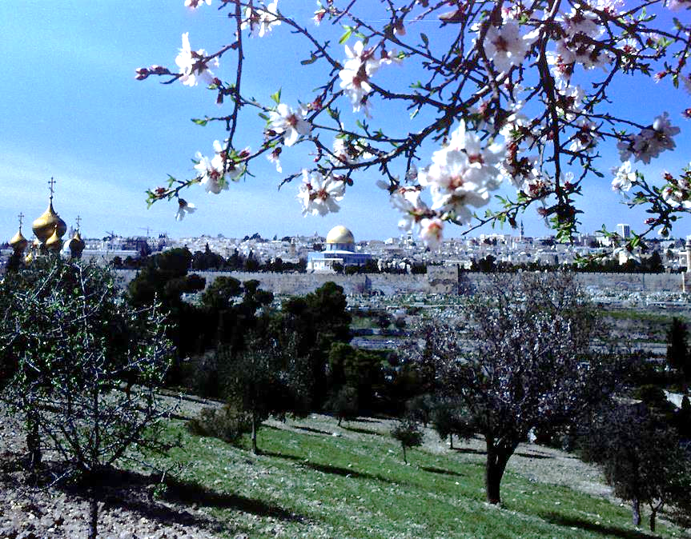
SOMEWHERE NEAR THIS SPOT, JESUS SAID: “Do you see all these things? I tell you the truth, not one stone here will be left on another; every one will be thrown down.” (Mt. 24:1-3).

Slide 142
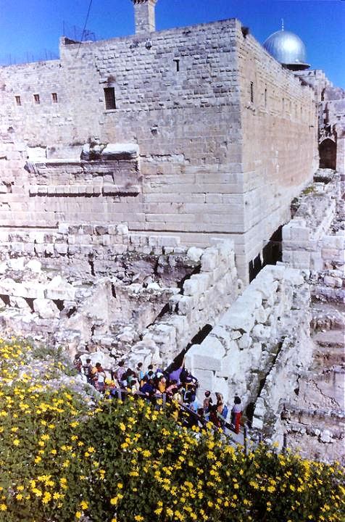
Many of the huge stones tumbled by the Romans from the temple in AD 70 still remain at the southwest corner of the temple mount.

Slide 143
Discourse About the Temple
Jesus’ teaching in this last great discourse addressed:
The destruction of the temple (Mt. 24:1-2)
The “coming” of the Son of Man (Mt. 24:3, 27, 30, 37, 39, 42, 44, 50; cf. 10:23)
  Do all the references to the “coming” refer to Jesus’ 2nd advent at the close of history, or might they refer to his “coming” in judgment on the temple itself?
The “end” (Mt. 24:3, 6, 13-14)
  Does the “end” envision the end of the temple or the end of the age?
While there is little disagreement that Jesus predicted the end of the 2nd temple, there is considerable disagreement about the meaning of the “coming of the Son of Man” and the “end”.

Slide 144
Three Interpretive Positions
Dispensational
The “coming” is Jesus’ second advent at the end of the age.
The “end” is the end of history, the end of the present era.
The “signs” escalate near the end of history.
Preterist
The “coming” is Jesus’ coming in judgment on Jerusalem in AD 70.
The “end” is the end of the 2nd temple.
The “signs” are associated with the 1st Jewish revolt.
Mediating
Both the destruction of the temple and the 2nd advent of Christ are subsumed into the scope of this single prophecy.
The near event becomes a double entendre for the far event.

Slide 145
The Abomination of Desolation
The initial salient point is that the desecration by Antiochus Epiphanes in the 160s BC did not exhaust Daniel’s prediction (Mt. 24:15; cf. Da. 8:13; 9:27; 11:31; 12:11; 1 Maccabees 1:54).
Dispensationalists hold that there must be the erection of a 3rd temple in order for this prediction to be fulfilled.
Preterists hold that the abomination refers to the raising of the imperial eagle in the 2nd temple in AD 70.
Still others hold that the abomination refers to the actions of the eschatological antichrist against the church (cf. 2 Th. 2:4).

Slide 146
A Transition?
Most interpreters agree that there is a transition in this discourse where Jesus moves from talking about the fall of the 2nd temple to his return at the end of the age, usually at Mt. 24:26 or 24:29 or 24:36.
A critical exegetical issue concerns “immediately after the distress of those days” (Mt. 24:29). If this refers to the Jewish wars in the 60s AD (preterists), then the “coming” of Jesus must refer to his judgment on Jerusalem in AD 70.
If, on the other hand, “immediately after” refers to a period of suffering at the end of history (dispensationalists), then the “coming” in 24:30 refers to Christ’s 2nd advent.

Slide 147
This Generation
Another interpretive crux is how one takes “this generation” (24:34).
If “this generation” refers to those living in Jesus’ own time, then the Preterist position must be adopted.
If “this generation” refers to the survival of the Jewish race, i.e., to the generation that is alive when the eschatological crisis starts or to humans in general, then the passage need not be locked into the 1st century.

Slide 148
The Unknown Time
However the interpretive issues of the Olivet Discourse are resolved, the final warning is most pertinent—the time of Christ’s coming is unknown (24:36, 42)!
The parable of the thief emphasizes that Jesus’ disciples always should be ready (24:42-44).
The parable of the traveling master emphasizes that the disciples must all be about their assigned tasks (24:45-51).
The parable of the home-taking emphasizes that the disciples of Jesus must always be watching (25:1-13).
Only the thoroughly arrogant would attempt to figure out what God said they could not know! Hence, speculation should be curbed.

Slide 149
Debated Authorship in the Pauline Corpus

Slide 150
Did Paul Write the Pastoral Letters?
About 80-90% of contemporary biblical scholars believe that 1 and 2 Timothy and Titus were composed after Paul’s death.
Literary and linguistic analyses in Greek are major reasons for this reassessment (e.g., the pastoral letters use particles, conjunctions, and adverbs differently than the other Pauline letters).
Also, about a quarter of the vocabulary in the pastorals do not appear in Paul’s other letters.
Some Pauline terms, such as righteousness, faith, and law, seem to have a different nuance than in Paul’s other letters.
The development of church structure seems to be later than what can be gleaned from Paul’s other letters.
The heresy envisioned seems Gnostic in orientation, and Gnosticism did not reach its full form until after well Paul’s era.

Slide 151
Against This Modern Conclusion
The early church universally accepted the pastoral letters as genuinely Pauline.
The early church rejected documents attributed to Paul, such as, 3 Corinthians, the Letter to Laodiceans, the Letters of Paul and Seneca, and the Acts of Paul and Thecla, but not the pastoral letters.
Perceived differences in vocabulary, syntax, and word nuances can be put down to Paul’s brilliance and range, and possibly, his use of an amanuensis. (Literary style is invariably affected by subject matter and mood.)
Some details must always remain ambiguous due to lack of clear evidence, and hence, we will rest with the conclusion of the post-apostolic church that Paul wrote the Letter to Titus.

Slide 152
THE CASE FOR PAUL’S AUTHORSHIP
Conservative scholars defend Pauline authorship:
Both letters directly claim to be by Paul (1 Ti. 1:1; 2 Ti. 1:1).
The letters are replete with details that make this claim plausible, such as:
  Paul’s former life as a blasphemer (1 Ti. 1:12-14)
  Details about prison life (2 Ti. 1:8; 2:9; 4-6-7, 18)
  Knowledge of Timothy’s family (2 Ti. 1:5; 3:15)
  Various mutual acquaintances (2 Ti. 1:15-16; 2:17; 4:9-14, 19-24)

Slide 153
Reading Paul and Others in the Context of Calvinism & Arminianism

Slide 154
THE DIVINE CHOICE
Paul describes the divine choice in five stages:
Ro. 8:28-29
Ep 1:3-14
2 Th. 2:13-17
ELECTION
CALLING
SALVATION
PERSEVERANCE
GLORIFICATION
Foreknowledge & Predestination
Called according to God’s purpose
Justification
Inseparable from Christ’s love
Glorification
Chosen & predestined to be sons
His will revealed in the word of truth
Redemption and forgiveness through Christ’s blood
The Spirit is a deposit guaranteeing our inheritance
Final redemption of believers who are God’s possession
Chosen from the beginning
Called through the gospel
Sanctification by the Spirit and belief in the truth
Believers must stand firm and hold to the teachings
All will share in the glory of the Lord

Slide 155
Calvinist Arminian Debate
Calvinism
Humans are completely unable to turn to God on their own.
God chose in advance who would be saved based on his sovereign will alone.
Christ died only for those he chose to save; he did not die for everyone.
Those whom God chose will certainly come to faith.
Those whom God chose will certainly persevere in their faith; they cannot fall from grace.
Arminianism
Fallen humans participate in the act of faith.
Election is based on divine foreknowledge of human choice.
Christ died for all, but only believers are forgiven.
Grace begins, continues and completes all good—but it can be refused.
Grace preserves, but humans can fall from grace and reject their salvation.

Slide 156
The Calvinist-Arminian Divide
Tend to Be Calvinist
Reformed
Presbyterian
Baptist
Tend to be Arminian
Methodist
Pentecostal-charismatic
Holiness

Slide 157

Critical Vocabulary (Ro. 8:29; Ep. 1:5, 11)
…to know in advance
προγινωσκω
To foreknow
προοριζω
To predestine
…to decide in advance
εκλεκτος
The elect
…what/who is chosen

Slide 158
What is Clear/What is Interpreted
The language of divine foreknowledge, God’s decision in advance, and his divine choice must be frankly acknowledged. These are the words Paul chose to use.
What still is open to interpretation is the issue of what this foreknowledge/predestination/choice was about: was it about salvation or about service? Was it about individuals or the community?
Calvinists and Arminians both have approached this issue in terms of individual salvation.
There is, of course, the third option that they were both oriented wrongly and that the issue is really about service and the larger community.

Slide 159
From Paul’s language, the long-standing debate continues over divine sovereignty and human freedom.
CALVINISM
ARMINIANISM
A THIRD OPTION
Here, the focus is upon the individual whom God chose.
God acts alone in saving the individual based upon his sovereign choice before the universe began.
The predestination passages are read in the sense “God chose me to be saved.”
Here, the focus is upon the individual who chooses God.
Humans have free will, and they can chose for God or against god.
Even after they have chosen for God, they can later reject him (e.g., the stern warnings in the Book of Hebrews).
Here, the focus is upon the community which God chose.
Before the universe began, God determined that he would have an international, multi-ethnic church
The predestination passages are read in the sense “God chose us as his special community.”

Slide 160
THE THIRD OPTION (Ro. 9:10ff.)
Paul’s fundamental point is that God chose Jacob and his descendants, not Esau and his descendants, as the instrument through which the promise to Abraham would be fulfilled.
In the birth stories of Jacob and Esau, Rebekah was told, “Two nations are in your womb” (Ge. 25:23).
When Malachi spoke of God’s love for Jacob and his rejection of Esau, he was speaking of the nations, NOT the individuals (Mal. 1:2-3).
Therefore, when Paul cites the passage from Malachi, he also speaks of the nation God choose to serve his special purpose. The choice was NOT about individuals, but about nations.
Unfortunately, Protestant discussions about Calvinism and Arminianism—both of which were preoccupied with the salvation or damnation of individuals—largely missed the context of these passages.
The question was not, “Who can be saved?” but rather, “What nation has been chosen as the instrument to fulfill the covenant promise?”

Slide 161
Losing Salvation?
The five solemn warnings in Hebrews (2:1-4; 3:7-19; 5:11—6:12; 10:26-39; 12) raise the question as to whether or not a believer can lose his/her salvation.
Clearly, the author of Hebrews envisions that some who were part of the Christian community could turn back from the Christian faith.
Hence, these solemn warnings become an interpretative crux in the long-standing debate over divine sovereignty and human freedom (i.e., Calvinism and Arminianism).
The larger question is whether or not those who fall away had genuine faith or only pseudo-faith.

Slide 162
Two Answers
The answer of Calvinism is that this was only pseudo-faith, which is to say, it had the appearance of faith but was not genuine.
To allow that true Christians can fall from grace nullifies grace itself and makes salvation a result of human effort.
Perseverance is due to divine sovereignty alone.
The answer of Arminianism is that these passages demonstrate the possibility of apostasy by true Christians.
God’s grace will keep everyone who wants to be kept, but human rejection of divine grace is possible, also.
God is sovereign, but he exercises self-limitation in order to grant humans this freedom.

Slide 163
Views of Israel & the Church

Slide 164
The Meaning of Israel
Paul makes several remarkable statements that beg the question of the meaning of Israel in God’s larger purpose.
Jewishness is essentially inward, not outward (2:28-29).
The true offspring of Abraham, to whom the initial promise was made, are the people of faith from many nations—with or without the Torah (4:16-18).
Both Jew and non-Jew alike are sinners falling short of God’s glory and therefore in need of redemption (3:22b-23).
Those led by the Spirit are God’s sons (8:14-16), which is quite different from saying that those who born in the lineage of Abraham as God’s sons.

Slide 165
Three Views
REPLACEMENT
Replacement theology, which comes from the Reformers, is that Israel has been replaced by the church as the people of God.
All the promises made to ancient Israel are fulfilled in the Christian church.
Promises regarding land, temple, statehood, etc., are spiritualized or allegorized to refer to the Christian church.
DISPENSATIONAL
Dispensational theology, deriving from the thought of John Darby, is that God has two peoples, Israel and the church.
He never confuses them and never mixes them.
The church will be evacuated from the earth, after which God will turn back to the Jews for the final seven years of the age.
A pretribulation rapture is necessary.
EXPANSION
The boundaries of Israel as God’s people have been expanded to include Gentiles who come to faith in Christ.
This was God’s promise to Abraham (Ge. 12:1-3), and it is now fulfilled in what Paul calls “one new man” (Ep. 2:15) in which both Jews and Gentiles, who are the “Israel of faith,” are brought together in one body.

Slide 166
Interpreting Romans 7

Slide 167
Who is the “I” (7:14-25)
UNBELIEVER
Here it is held that Paul descries the state of the unregenerated person “sold as a slave to sin” and a “prisoner of the law of sin.”
NORMAL LIFE OF THE BELIEVER
Here it is held that Paul describes the ordinary Christian based on the verbal tense change (past to present). He “desires to do what is good” and “delights in God’s law.”
SUBSTANDARD LIFE OF THE BELIEVER
Here it is held that Paul describes the regenerated person, but one who serves sin while depending upon the flesh alone.

Slide 168
Speaking with Tongues

Slide 169
Forming Greek Questions
There are different ways to frame a question in NT Greek:
If one uses the word μη, a negative answer is expected.
If one uses the word ου, a positive answer is expected.
The series of rhetorical questions in 12:29-30 all use the μη form, indicating that the expected answer is, “No!”
μη παντες γλωσσαις λαλουσιν; (= “not all speak with
tongues, do they?”)
No gift is to be considered universal, and this include speaking with tongues.

Slide 170
When will tongues cease (1 Co. 13:8)?
The issue concerns the Greek middle voice verb παυσονται.
(In Greek, the middle voice verb describes actions in which the subject performs an action upon himself/itself or in his/its own interests. Unlike the verbs regarding prophecies and knowledge, which are future indicative passive verbs, Paul changes the tense regarding tongues to future middle passive. This, in turn, leaves the meaning, “…tongues, they will cease of themselves…”)
There are two ways of treating this verb leading to quite different theological positions:
#1 – Permitting tongues for the whole period of the church (Here, the middle voice verb is regarded as a stylistic change and should not differ in meaning from the other verbs used. Hence, prophecies, tongues, and knowledge will all continue until the end of the age when the “perfect” comes.
#2 – Tongues would gradually die out in the post-apostolic church (Here, the middle voice verb is regarded as theologically significant, not merely stylistic. While prophecies and knowledge both continue until the end of the age, the gift of tongues would gradually cease to be operative.

Slide 171
Christ’s Descent into Hell

Slide 172
Preaching to Spirits in Prison
In his death, Peter says that Christ preached to the underworld between his death and resurrection (1 Pe. 3:19).
Peter’s later statement (4:6), that the gospel was preached to those who are dead, along with several other NT passages, convinced the ante-Nicene Fathers that after his death on the cross Christ descended into Hades ( cf. Ep. 4:9; Mt. 12:40; Ac. 2:25ff; Ro 10:6-7).
However, there is more than one understanding of what this might mean.

Slide 173
FOUR VIEWS OF CHRIST’S DESCENT INTO HELL
ANNOUNCING VICTORY
Here, Christ announced his triumph, either to the rebels from the time of Noah, or else to the Old Testament faithful, raising them to life in heaven (Ignatius). This came to be referred to as “the harrowing of hell.”
PROCLAIMING THE GOSPEL
Here, Christ preached the gospel in Hades, either to deceased Israelites or to pagans who had been deprived of hearing it before Christ’s incarnation (Justin Martyr, Irenaeus, Tertullian, Calvin).
NOAH’S PREACHING
Here, the spirit of Christ preached through Noah to the ante-diluvian people in the time of Noah (Augustine). The NASB embraces this view and emends the text by adding the word “now” (“those now in prison”).
A GENUINE DEATH
Other interpreters regard this passage in more general terms to stress that Christ truly died, a contradiction to the Docetic view that Christ only seemed to die.
Some versions of the Creed simply say Christ “descended to the dead.”

Slide 174
Interpretive Models for Revelation

Slide 175
The Trend Over the Centuries
Various interpreters have tended to view their own era and circumstances as the primary focus of the book.
However, as the centuries marched onward, the interpretations continued to change in order to accommodate contemporary events, such as, the fall of Rome, the rise of Islam, the wars of Napoleon, the aggression of Germany in World War I and II, the Cold War, the formation of the European Union, and so forth.
All we know from the post-apostolic period is that the early Christians expected the church to see the whole complex of events described in the Revelation.

Slide 176
Idealism
CHRISTIANS vs.
THE WORLD SYSTEM
The seven churches are paradigms for the whole church of all times.
The plagues symbolize universal troubles throughout history.
The beast is the godless state.
The whore is the world system of commerce.
Christus Victor!

Slide 177
Historicism
THE TRUE CHURCH
vs.
FALSE RELIGION
The seven churches are historical.
The seals and trumpets are woes in the world until the Edict of Constantine.
The beast is papal Rome; the beast’s mark is obedience to the papacy.
Babylon is the city of Rome, the seat of the papacy.
The Roman Church is the great whore.
The people of God are Protestants.
Christus Victor!

Slide 178
Preterism
EARY CHURCH vs.
PAGAN ROME
The seven churches are historical.
The plagues are symbols of divine judgment, either on the City of Rome or Jerusalem.
The beast is pagan Rome.
The wounded head is Caesar Nero.
The mark of the beast is the certificate for Caesar worship.
Babylon is Rome.
The whore is Rome.
Christus Victor!

Slide 179
Dispensationalism
The seven churches are symbols of seven ages throughout Christian history.
The plagues will be fulfilled during the 70th week of Daniel, a period to come.
The saints will be righteous Jews still within God’s ancient covenant of Moses.
The beast will be the antichrist to come.
The beast’s mark will be economic domination of the whole world.
Babylon is the European Union.
The conqueror will be Christ’s return.
The 1000 years will fulfill the ancient land promises to the Jews.
THE JEWS vs.
ANTICHRIST AFTER THE RAPTURE OF THE CHURCH

Slide 180
Historic Premillennialism
The seven churches are historical.
The plagues are the woes of Messiah that escalate toward the end of the age.
The beast is the eschatological antichrist foreshadowed by the imperial cult.
Babylon is the anti-God world system.
The whore symbolizes the history of godlessness.
The people of God are Christians.
The conquering rider is Christ’s return.
The 1000 years consummates God’s kingdom.
CHRISTIANS vs.
CAESAR and the ESCHATO-LOGICAL ANTICHRIST

Slide 181
NT Canon

Slide 182
The Fixing of the NT Canon
The New Testament canon was fixed gradually during the early centuries of Christianity.
The earliest canon lists and translated codices are not uniform:
Marcion’s canon (consists of Luke and ten letters of Paul)
Muratorian fragment (omits Hebrews, James and 1 & 2 Peter)
Old Syriac (omits 2 Peter, 2 & 3 John, Jude and Revelation)
Old Latin (omits Hebrews, James and 1 & 2 Peter)
Codex Sinaiticus (includes the Letter of Barnabas and the Shepherd of Hermas)

Slide 183
The Categories of Eusebius
By the 4th century, Eusebius divides the Christians’ writings into three classes (Ecclesiastical History III.25):
Known to be canonical (Four Gospels, Acts, Pauline Letters, Hebrews, 1 John, 1 Peter and Revelation)
Widely accepted though disputed by some (James, Jude, 2 Peter, 2 & 3 John)
Spurious (Acts of Paul, Hermas, Apocalypse of Peter, Barnabas, Didache—and “perhaps” Revelation)

Slide 184
Athanasius’ 39th Easter Letter
The earliest full canon listing of New Testament books as we know them today was made by Athanasius in AD 367.
Contains the full 27 books of the New Testament
Augustine supported this canon list
Jerome’s Vulgate also supported this canon list

Slide 185
Other gospels, acts, or letters were not accepted as canonical
Protoevangelium of James
Infancy Gospel ofThomas
Armenian Infancy Gospel
Gospel of Peter
Gospel of Nicodemas
Gospel of the Ebionites
Gospel of the Hebrews
Gospel ofEve
Gospel of Judas
Pistis Sophia
Gospel of Thomas
Gospel of Philip
Acts of Paul and Thecla
Acts of Peter
Acts of John
Acts of Andrew
Acts ofThomas
Acts of Thaddaeus
Acts of Philip
Acts of Andrew and Matthias
3 Corinthians
Laodecians
Alexandrians
Paul and Seneca
Epistle of the Apostles
Didascalia
Letter of Jesus
Clementine Homilies
Letter of Lentulus
Sunday Letter
Ascension of Isaiah
Apocalypse of Peter
Coptic Apocalypse of Peter
Apocalypse of Paul
Sibylline Oracles

Slide 186
Transition from Apostolic to Post-Apostolic Christianity

Slide 187
THREE MYTHS FROM MY PAST
Christian history is a great wasteland: nothing important happened between the end of the 1st century and the beginning of the 20th.
There is only one right pattern for worship—and our group has it! The NT paradigm for all Christian worship is that of Corinth.
Religious tradition is always bad and to be avoided.

Slide 188
TRANSITIONAL ISSUES
APOSTOLIC TO POST-APOSTOLIC: Jesus left no instructions for these transitional issues.
Is Christianity a subset of Judaism?
Should Christian worship follow the pattern of the synagogue?
What constitutes authoritative Scripture: The Hebrew Bible? The Christian writings from the apostolic period?
How are leaders to be chosen, and what should be their qualifications? What vehicle is appropriate for succession?
How should church life be administered?
What should be the attitude of Christians to Rome?

Slide 189
THE DELAY OF THE PAROUSIA
On the one hand…
Jesus promised to return “soon.”
No one knew the day or hour of his coming.
All the disciples should constantly be watching.
Some thought John bar-Zebedee would not die before the Lord returned.
On the other hand…
Some Christians began to die, including apostles.
Eventually, the first generation of Christians would be gone.
The church was obliged to address the future without any certainty that Christ would return in their lifetimes.

Slide 190
The Churches the Apostles Left Behind
Jerusalem (James)
Asia Minor & Greece (Paul)
Cyprus (Barnabas)
Rome (Paul, Peter and others)
Ephesus (John)
Antioch (Matthew)

Slide 191
ANTIOCH CHURCH, Paradigm in Three Stages
STAGE ONE (ca. AD 40-70)
Period of Barnabas and Paul
STAGE TWO (ca. AD 70-100)
Period of Matthew
STAGE THREE (ca. AD 100-115)
Period of Ignatius

Slide 192
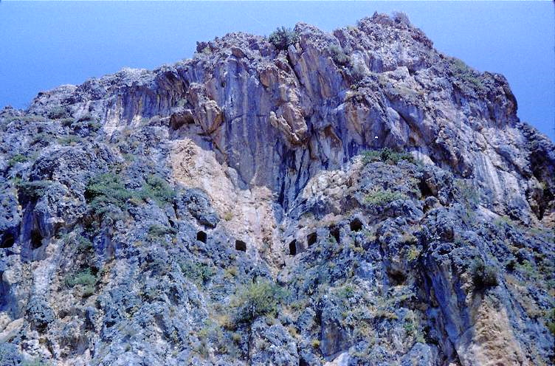
Ancient Church at Antioch, Syria (modern Antakya, Turkey)
Ancient church in a cave above the city

Slide 193
Early Church History

Slide 194
THE MISSIONARY APOSTLES
Early Christian tradition describes the apostles as missionaries
Paul (Asia Minor and Greece)
Peter (Rome)
Andrew (Scythia)
John bar Zebedee (Asia Minor)
Philip (Hierapolis)
Bartholomew (India)
Thomas (India)
Matthew (Persia)
Judas Thaddaeus (Armenia)
Simon the Zealot (Britain)
Matthias (Armenia)
John Mark (Egypt, Rome)
Barnabas (Cyprus)
Luke (Greece)
Lazarus (Cyprus)

Slide 195
EARLY PERSECUTION
FROM THE JEWISH COMMUNITY
Sanhedrin in Jerusalem (Ac. 8:1; 9:1-2)
Jewish communities in Asia Minor and Greece (Ac. 13:50; 14:4-5, 19; 17:5-9, 13; 18:12-17)
Birkat ha-minim (curse upon the heretics after the 1st Jewish Revolt)
FROM THE ROMAN GOVERNMENT
Caesar Nero blamed the great fire in Rome upon the Christians (AD 64)
Christianity, after its alienation from Judaism, became an illegal religion (post-AD 70)
By the time of Domitian (AD 81-96), emperor worship became the primary point of contention

Slide 196
BIRKAT HA-MINIM
(curse upon the heretics)
“For the apostates let there be no hope, and let the arrogant government (i.e., Rome) be speedily uprooted in our days. Let the Nazarenes (i.e., Christians, cf. Acts 24:5) and the heretics be destroyed in a moment, and let them be blotted out of the book of life and not be inscribed together with the righteous. Blessed art thou, O Lord, who humblest the arrogant.”

Slide 197
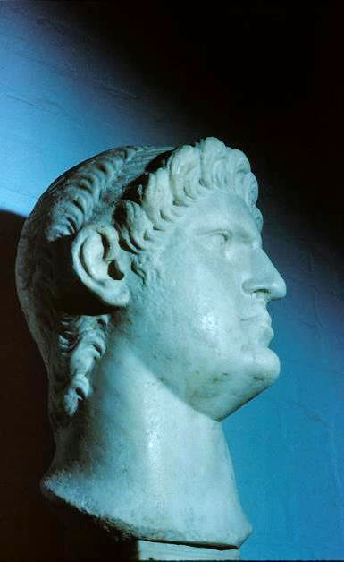
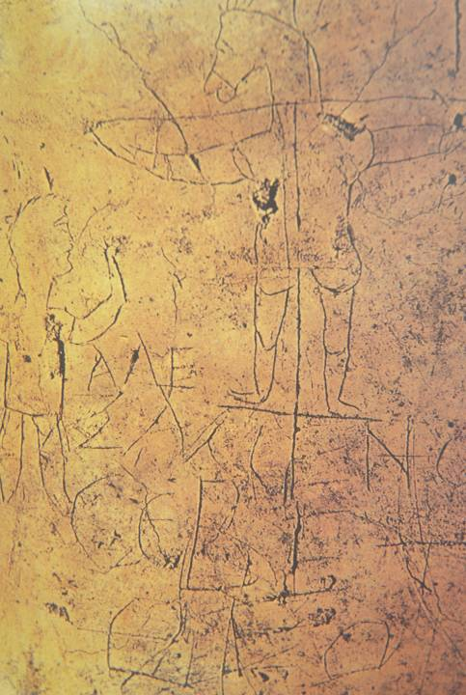
CAESAR NERO
Grafitto mocking Christians,
Palatine Hill, Rome
Alecamenoj sebete qeon
(Alexamenos prays to [his] god)

Slide 198
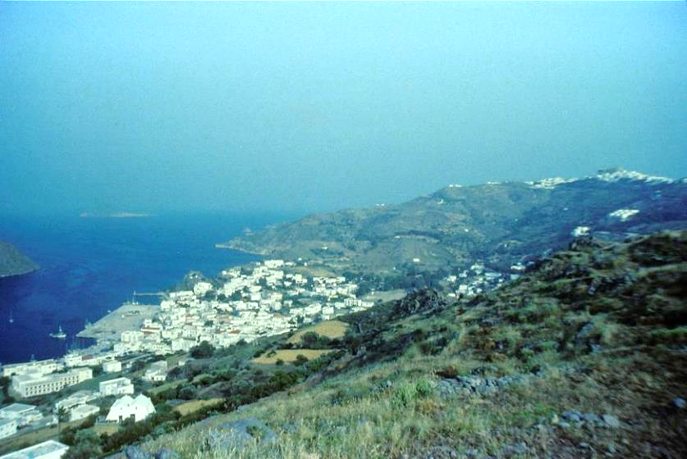
“I, John, your brother and companion in the sufferings and kingdom and patient endurance that are ours in Jesus, was on the island of Patmos because of the word of God and the testimony of Jesus.”

Slide 199
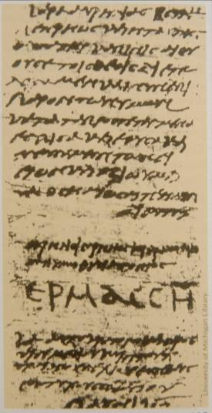
LIBELLUS: certificate proving that one had sacrificed to the Roman gods
Found in Egypt
One of 43, all dated between June 12th and July 14th, AD 250.
Hermas, the recipient, signed his name in large capital letters.
University of Michigan

Slide 200
Roman Accusations Against Christians
Christians were “anti-social”
Christians were “atheists”
Christians were “haters of mankind”
Christians were “cannibals”
Christians promoted “incest”
“The blood of the martyrs is seed…”
Tertullian (early 3rd century)

Slide 201
The Martyrdom of Polycarp, the Disciple of John
…Polycarp was entering into the stadium… And when he came near, the proconsul asked him whether he was Polycarp. On his confessing that he was, [the proconsul] sought to persuade him to deny [Christ]… “Swear by the fortune of Caesar; repent, and say, ‘Away with the Atheists.’” But Polycarp…waving his hand towards them…said, “Away with the Atheists.” Then, the proconsul urged him saying, “Swear, and I will set you free, reproach Christ;” Polycarp declared, “Eighty-six years have I served him, and he never did me any injury: how then can I blaspheme my King and my Savior? ”
Again the proconsul said to him, “I will cause you to be consumed by fire… But Polycarp said, “You threaten me with fire which burns for an hour, and after a little is extinguished, but [you] are ignorant of the fire of the coming judgment…for the ungodly.” …the proconsul was astonished, and sent his herald to proclaim in the midst of the stadium thrice, “Polycarp has confessed that he is a Christian.” …the whole multitude…cried out with uncontrollable fury…immediately gathering together wood and fagots out of the shops and baths.
They did not nail him then, but simply bound him. And he, placing his hands behind him…looked up to heaven, and said, “O Lord God Almighty, the Father of your beloved and blessed Son Jesus Christ…I give you thanks that you have counted me, worthy of this day and this hour, that I should have a part…in the cup of thy Christ…” When he had pronounced the amen…those who were appointed for the purpose kindled the fire.

Slide 202
Worship in the New Testament
Format seems largely to have followed the synagogues.
Described Elements
Eucharist
Baptisms
Community Prayer
Singing
Free Participation (gifts)
Confessions of Faith
Public Scripture Reading
Preaching & Teaching
Collection of Gifts
Liturgical Elements
The “Thanksgiving”
The “Amen”
“Maranatha”
“Abba”
Doxologies
Hymns
“The Lord’s Day”

Slide 203
EARLY DESCRIPTIONS OF CHRISTIAN WORSHIP
“They were in the habit of meeting on a fixed day before it was light, when they sang an anthem to Christ as God, and bound themselves by a solemn oath not to commit any wicked deed, but to abstain from all fraud, theft and adultery, never to break their word, or deny a trust when called upon to honor it; after which it was their custom to separate, and then meet again to partake of food, but food of an ordinary and innocent kind.”
Pliny, Letters x.96
“On the day called Sunday, all who live in the cities or in the country gather together in one place, and the memoirs of the Apostles or the writings of the prophets are read, as long as time permits…”
Justin Martyr (d. 166)

Slide 204
Fixed Order
The fixed order of a codex affected both the Old and New Testaments.
The order of books in the LXX was somewhat different than the ordering of books in the Hebrew tradition.
  For instance, in the LXX the prophetic books are generally placed last, whereas in the Hebrew tradition they fall in the middle section (Nebiim) of the Hebrew Bible.
  Ruth is placed next to Judges in the LXX, but in the Hebrew Bible it belongs to the Megilloth near the end.
Very early, the four gospels gained a fixed order which we retain today: Matthew, Mark, Luke and John.
Paul’s letters in the various early Christian lists have a varied order, though eventually the order became fixed by about the 4th century.
The so-called “general epistles” also had a varied order which eventually became fixed.

Slide 205
NEW TESTAMENT TEXTS
AUTOGRAPHxxxxxxxxxxxxxxxxxxxxxxxxxxxx
1st Century
2nd Century
3rd Century
4th Century
5th Century
EGYPT
COPY
xxxxxxxxxxxxxxxxxxxxxxxxxxxx
ITALY
COPY
xxxxxxxxxxxxxxxxxxxxxxxxxxxx
PALESTINE
COPY
xxxxxxxxxxxxxxxxxxxxxxxxxxxx
COPY
xxxxxxxxxxxxxxxxxxxxxxxxxxxx
COPY
xxxxxxxxxxxxxxxxxxxxxxxxxxxx
COPY
xxxxxxxxxxxxxxxxxxxxxxxxxxxx
COPY
xxxxxxxxxxxxxxxxxxxxxxxxxxxx
COPY E
xxxxxxxxxxxxxxxxxxxxxxxxxxxx
COPY F
xxxxxxxxxxxxxxxxxxxxxxxxxxx
COPY A
xxxxxxxxxxxxxxxxxxxxxxxxxxxx
COPY B
xxxxxxxxxxxxxxxxxxxxxxxxxxx
COPY C
xxxxxxxxxxxxxxxxxxxxxxxxxxxx
COPY D
xxxxxxxxxxxxxxxxxxxxxxxxxxxx
COPY G
xxxxxxxxxxxxxxxxxxxxxxxxxxxx
Slight variations are passed down through subsequent copies as texts are copied and shared.

Slide 206
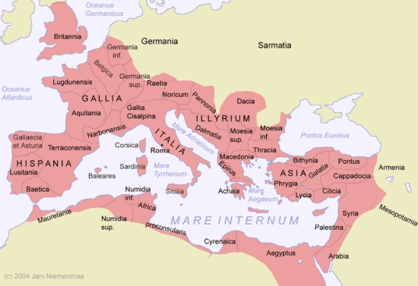
GEOGRAPHICAL TEXTUAL FAMILIES
Western Text
Byzantine Text
Alexandrian Text
Caesarean Text

Slide 207
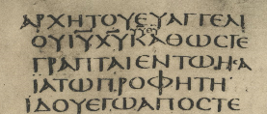
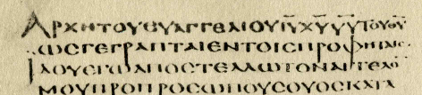
AN EXAMPLE OF A TEXTUAL VARIATION
The problem, of course, is that the passages quoted come from Malachi 3:1 as well as Isaiah 40:3.
Mark1:2
…εν τω Ησαια τω προφητη.
(= “…in Isaiah the prophet.”)
…εν τοις προφηταις.
(= “…in the prophets.”)
__________
___________________
______________
X CODEX SINAITICUS (4th century)
A CODEX ALEXANDRINUS (5th century)
Followed by all modern versions
Followed by the KJV

Slide 208
The Selected Readings
The early churches varied in their choice of selected readings.
Some churches read from Sunday to Sunday until a particular book was finished (and this seemed to have been the general practice).
In other areas (Spain and France), short selections from various parts of Scripture were pieced together.
Some churches used harmonies of the gospels and read them in parallel.
By the 4th century, fixed readings were associated with Advent and Pentecost, and eventually, Lent, Good Friday, Easter, etc.

Slide 209
The Lectionary
In AD 471 (or earlier), a lectionary was produced, the Comes Hieronymi (Lectionary from Jerome), and it became the standard order of readings for the Western Church.
It assigned readings for Advent, Christmas, Lent, and Easter.
The rest of the year was covered by optional texts and could be adjusted by the local bishop or pastor.
Three centuries later, Charlemagne standardized liturgical practices in his domain along with a revision of the lectionary, and this, in turn, meant that everyone in the west was reading the same passages on the same Sundays.

Slide 210
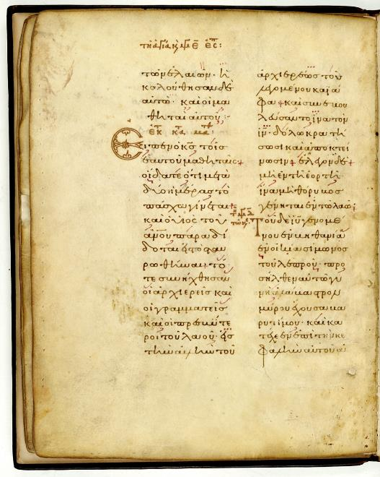
Greek Lectionary of the Gospels
The Readings for Easter Week from the Gospel of Matthew, along with readings for the stations of the cross.
The Greek lectionaries become an important witness to the Greek text of the New Testament.

Slide 211
Early Translations
As early as the 2nd century, the texts of the New Testament began being translated into vernacular languages.
Christian missionaries translated biblical texts into local languages wherever Greek would not serve the needs of the people.
These early translations include:
  Old Latin (predating Jerome’s Latin Vulgate)
  Syriac (Peshitta)
  Coptic
  Armenian
  Georgian
  Ethiopic
  Arabic
  Gothic

Slide 212
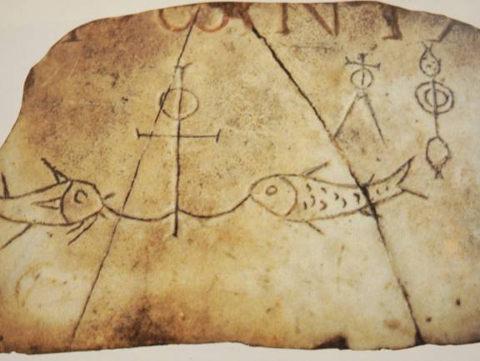
ANCIENT SYMBOLS
ANCHOR
Symbol of hope and steadfastness
CROSS
Symbol of the sacrifice of Jesus
ιχθυς (= fish acronym)
ιησους = Jesus
χριστος = Christ
θεος = God
υιος = Son
σωτηρ = Savior

Slide 213
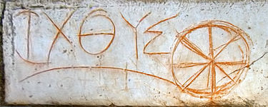
Early circular fish symbol created from Greek Letters IXQUS/ICHTHUS discovered at Ephesus

Slide 214
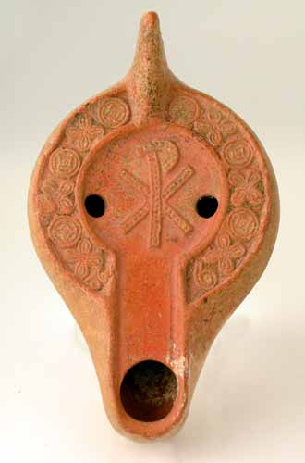
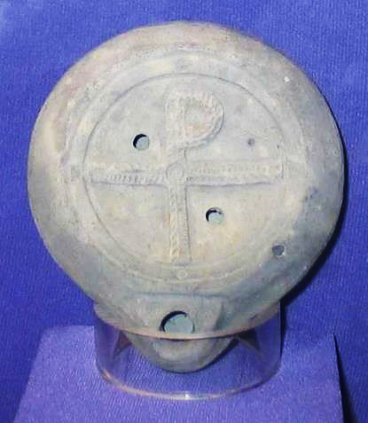
Lamps with Christian Reliefs
Christian oil lamp from the late Roman Period with Chi-Rho
Recovered from Caesarea Maritima, 4th century with Tau-Rho

Slide 215

Staurograms
The earliest depictions of the cross occur in New Testament texts in which the letters tau (τ) and rho (ρ) from the Greek words “cross” (σταυρος) and “crucify” (σταυροω) appear superimposed on each other, looking something like this:
Beginning in NT texts from about AD 200, staurograms are the earliest visual depictions of Christ crucified.

Slide 216
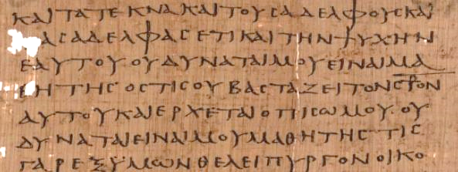
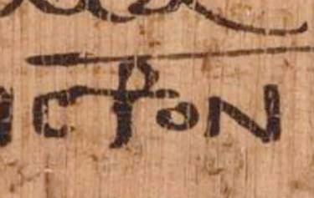
Early text of Luke 14:27 p75 Bodmer Papyri XIV (ca. AD 200-225)
Vatican Library, Rome

Slide 217
DEVELOPMENT OF HIERARCHY
Ignatius’ letters elevating the bishop (AD 115)
Monarchical Bishops (authority over elders and deacons, 2nd century)
Metropolitan Patriarchs (Rome, Constantinople, Alexandria, Antioch, Jerusalem, 3rd century)
Roman Bishop (first among equals, 4th century)
Roman Pope (direct succession from Peter, 5th century)

Slide 218
QUESTION: What is the relationship of the ongoing church to the primitive church?
Is it imitating what the early church did?
Results in a “back to the early church” search, typical of restorationist Protestantism.
Is it following the trajectory that the early church set?
Results in the belief that the church has legitimately recognized and followed the Spirit’s ongoing direction.

Slide 219
Marcionism
Marcion (mid-2nd century) concluded that the God of the OT was different than the God of the NT:
  The God of the OT was vengeful, the author of evil
  The God of the NT was gracious and loving
  Hence, the Hebrew Bible must be rejected as inferior—and any books in the NT that favored the OT must be rejected as well.
    Matthew, Mark, Acts and Hebrews were to be rejected
    1 & 2 Timothy and Titus were to be rejected
    The nativity stories in Luke were to be rejected
Marcion was excommunicated by the church in Rome. He then formed his own churches and clergy which lasted until about the 7th century.

Slide 220
Montanism
Montanus (late 2nd century) emphasized ecstatic revelations by the Holy Spirit:
  His associates, two prophetesses named Prisca and Maximilla, claimed to be direct mouthpieces for the Paraclete by prophecy, tongues, and ecstatic trance.
  Montanus taught that the Age of the Paraclete had arrived—the New Jerusalem soon would descend from heaven to Pepuza, Phrygia.
  Christians should leave their occupations and go to Pepuza to await the return of Christ.
Montanists were excommunicated, but various Montanist groups survived up into the 5th century in Phrygia and Africa.

Slide 221
Novatianists
Novatianists split from the church in Rome in the mid-3rd century after Novatian was defeated in the election for bishop.
  Fostered a rigorist position that anyone who denied the faith under persecution could never be reinstated.
  All major sins after baptism were unforgiveable.
Novatianists were excommunicated by the church in Rome, after which they established a separate church that survived up into the 7th century.

Slide 222
Manichaeans
Mani, a Persian of the 3rd century, claimed to have received the final, universal revelation.
  Reality consisted of two independent, eternal principles:
    Light/God
    Darkness/Matter
  Jesus, along with Zoroaster, Buddha and others, had come so that the “souls of light” could be released from the material prison of the body.
  Manichaeism combined features of Zoroastrianism and Indian thought with Christianity.
  It was similar to Gnosticism and some modern scientologies.
Manichaeism survived into the Middle Ages.

Slide 223
Paul on Passing on Important Truths,
Values and Traditions
ORAL TRADITION
…what I received I passed on to you as of first importance (1 Co. 15:3a; 2 Ti. 1:13)
TRUSTED SUCCESSORS
…the things you have heard me say in the presence of many witnesses entrust to reliable men who will also be qualified to teach others (2 Ti. 2:2)
RITUALS
…For I received from the Lord what I also passed on to you: The Lord Jesus, on the night he was betrayed, took bread… (1 Co. 11:23)
WRITTEN DOCUMENTS
…after this letter has been read to you, see that it is also read in the church of the Laodecians and that you in turn read the letter from Laodecia. (Col.4:16)

Slide 224
Balancing Orthodoxy ορθος = right; δοξα = glory three spheres of authority must be kept in balance to preserve orthodox Christianity
Scripture: Canon of the Old and New Testaments
CHALLENGE: Proper interpretation
Tradition: Rituals, practices and oral transmissions of the church
CHALLENGE: Rigidity
Holy Spirit: Ongoing direct guidance by God
CHALLENGE: Subjectivism

Slide 225
Quod ubique quod semper, quod ab omnibus creditum est
…that which has been believed everywhere, always, by all.
Vincent of Lerins
ca. AD 450

Slide 226
The κηρυγμα (kerygma)
The “proclamation” preached by the apostles and earliest missionaries.
The Rule of Faith
The earliest post-apostolic informal
confessions for baptismal catechisms.
The Apostles’ Creed
The earliest formal creed of the church.

Slide 227
The Apostles’ Creed
We believe in God, the Father Almighty.
And in Jesus Christ, his only Son, our Lord; who was conceived by the Holy Spirit, born of the virgin Mary, suffered under Pontius Pilate, was crucified, dead and buried; he descended into hell; the third day he rose again from the dead; he ascended into heaven and sitteth on the right hand of God, the Father Almighty, from thence he shall come to judge the quick and the dead.
We believe in the Holy Spirit, the holy catholic church, the communion of saints, the forgiveness of sins, the resurrection of the body, and the life everlasting. Amen.

