Slide 1

5 – THE APOSLTES’ CREED
The Earliest Formal Confession

Slide 2
I am astonished that you are so quickly deserting the one who called you by the grace of Christ and are turning to a different gospel… If we or an angel from heaven should preach a gospel other than the one we preached to you, let him be eternally condemned!
Galatians 1:6-8
For if someone comes to you and preaches a Jesus other than the Jesus we preached…you put up with it easily enough… For such men are false apostles, deceitful workmen, masquerading as apostles of Christ.
2 Corinthians 11:4a, 13

Slide 3
EARLY SUMARIES OF FAITH
Within the New Testament itself, various writers like Paul, Peter, John, and Jude addressed distortions of the Christian faith.
  In the face of heresies, they began to offer short summaries of those core beliefs they held to be central (Ac. 8:37; 1 Co. 12:3; 15:1-4; 1 Ti. 3:16).
  As the decades rolled by and the church entered the 2nd century and beyond, Christian leaders became more elaborate in their formulations.
  One of the most important of these summaries was the Rule of Faith, a set of baptismal questions put to candidates when they were baptized. A good example comes to us from Hippolytus in the early 3rd century.
Eventually, the consensus of the orthodox faith was captured in the words of Vincent of Lerins (d. AD 445): quod ubique, quod semper, quod ab omnibus creditum est (= “that which has been believed everywhere, always, by all”).

Slide 4
Baptismal questions
When the person being baptized goes down into the water, he who baptizes him, putting his hand on him, shall say: "Do you believe in God, the Father Almighty?" And the person being baptized shall say: "I believe."
Then holding his hand on his head, he shall baptize him once. And then he shall say: "Do you believe in Christ Jesus, the Son of God, who was born of the Virgin Mary, and was crucified under Pontius Pilate, and was dead and buried, and rose again the third day, alive from the dead, and ascended into heaven, and sat at the right hand of the Father, and will come to judge the living and the dead?" And when he says: "I believe," he is baptized again.
And again he shall say: "Do you believe in the Holy Spirit, in the holy church, and the resurrection of the body?" The person being baptized shall say: "I believe," and then he is baptized a third time.

Slide 5
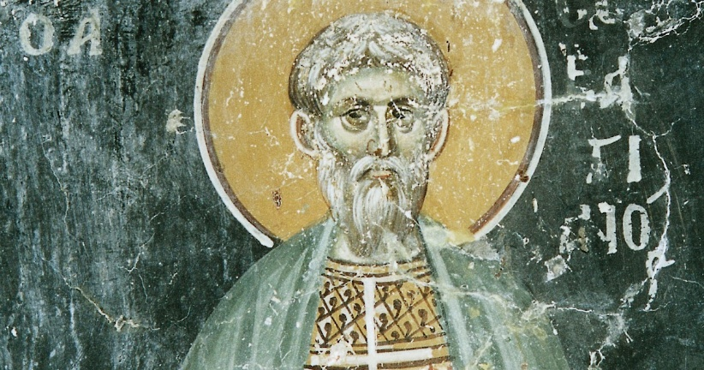
HIPPOLYTUS (ca. 170--ca. 235 ad)
Bishop of Rome, Hippolytus was one of he most important theologians in the 2nd and 3rd centuries. According to ancient sources, he was a disciple of Irenaeus, who was a disciple of Polycarp, who was a disciple of John. He was exiled during the emperorship of Maximus Thrax to Sardinia and likely died in the mines.

Slide 6
Development of the Creed
Various segments of the Apostles Creed can be found in Christian writings as early as the 2nd century in what is called “the Rule of Faith.”
In the earliest period of the church, these early versions functioned as confessions of faith for those who were to be baptized.
It also provided a benchmark for distinguishing the true faith over against heresies and distortions.

Slide 7
DISCUSSION
Many contemporary churches no longer post on their websites any Statement of Faith. Why might this be the current trend?
What similarities (or differences) do you see between Hippolytus’ description of Christian baptism and contemporary baptisms?

Slide 8
The Apostles’ Creed
The term “creed” comes from the Latin “credo,” which means “I believe…” or “I rely upon…”
The Apostles’ Creed is the oldest and most generally accepted creed in Christendom (Roman Catholic, Eastern Orthodox, Anglican, Lutheran, Presbyterian, Methodist, and most evangelical denominations).
Since it is largely a collage of NT Scripture phrases, there is little room for objection.
At the same time, it serves to focus on the core of what Christians have always held central, taking its primary formulations from the Rule of Faith.

Slide 9
The Apostles’ Creed
I believe in God, the Father Almighty, Maker of heaven and earth.
And in Jesus Christ, his only Son, our Lord; who was conceived by the Holy Spirit, born of the virgin Mary, suffered under Pontius Pilate, was crucified, dead and buried; he descended into hell; the third day he rose again from the dead; he ascended into heaven and sitteth on the right hand of God, the Father Almighty, from thence he shall come to judge the quick and the dead.
I believe in the Holy Spirit, the holy catholic church, the communion of saints, the forgiveness of sins, the resurrection of the body, and the life everlasting. Amen.

Slide 10
The Rule ofFaith
HERESY
Creation is by an inferior deity (Gnosticism).
Creation is by a vengeful god who was not the father of the Lord Jesus (Marcionism).
ORTHODOXY
God is the Father Almighty.
He is the Creator of heaven and earth.

Slide 11
Rule ofFaith cont.-
ORTHODOXY
Christ Jesus is the eternal Son of the Most High God.
He came from heaven.
He was born of the Holy Spirit through the virgin Mary.
He took upon himself flesh.
HERESY
Christ Jesus was the son of a lower Aeon in the pleroma (Gnosticism).
He was born naturally (Ebionites).
He was not born at all and was not a real human (Marcion).

Slide 12
Rule ofFaith cont.-
HERESY
Jesus Christ did not truly die (Gnosticism).
He was not truly resurrected (Gnosticism).
Mani, not Jesus, is the final revelation (Manichaeism).
ORTHODOXY
Jesus Christ truly died, was buried, and arose on the third day.
He ascended into heaven to the right hand of the Father.
He will judge the living and the dead.

Slide 13
Rule ofFaith cont.-
ORTHODOXY
The Holy Spirit belongs to the Godhead.
The church is catholic (universal).
The bodies of believers will be resurrected.
HERESY
Mani is the Paraclete (Manichaeism).
Church schisms are to be tolerated (Novatianists).
Matter is evil; therefore, there can be no resurrection of the body (Gnosticism).

Slide 14
The phrases in the creed
Most of the various words and phrases in the Apostles’ Creed are simply drawn directly from the New Testament. Three phrases, however, are theological summaries of New Testament ideas. They are:
“he descended into hell…”
“the holy catholic church…”
“the communion of saints…”

Slide 15
…the Son of Man will be three days and nights in the heart of the earth. (Matthew 12:40)
He was put to death in the body but made alive by the Spirit, through whom also he went and preached to the spirits in prison… (1 Peter 3:18-19)
For this is the reason the gospel was preached even to those who are now dead… (1 Peter 4:6a)
The patriarch David died and was buried… But he was a prophet… Seeing what was ahead, he spoke of the resurrection of Christ, that he was not abandoned to hades (hell), nor did his body see decay. (Acts 2:29-31)

Slide 16
“…he descended into hell…”
This phrase is based upon several passages that seem to describe the interval between Jesus’ death and resurrection.
Christ “preached to the dead” (1 Pe. 3:19; 4:6).
He descended to the “nether regions of the earth” (Ep. 4:9; Mt. 12:40).
He was not “abandoned to hell” (Ac. 2:25ff.)
He was in “the Abyss” prior to resurrection (Ro. 10:6-7).
The ante-Nicene fathers took these passages to mean that Christ descended into Hades, either to proclaim the gospel or to announce his victory over Satan and death. At the very least, the phrase “he descended into hell” means that Christ’s death was real.

Slide 17
FOUR VIEWS OF CHRIST’S DESCENT INTO HELL
ANNOUNCING VICTORY
Here, Christ announced his triumph, either to the rebels from the time of Noah, or else to the Old Testament faithful, raising them to life in heaven (Ignatius). This came to be referred to as “the harrowing of hell.”
PROCLAIMING THE GOSPEL
Here, Christ preached the gospel in Hades, either to deceased Israelites or to pagans who had been deprived of hearing it before Christ’s incarnation (Justin Martyr, Irenaeus, Tertullian).
THE PREACHING OF NOAH
Here, the spirit of Christ preached through Noah to the ante-diluvian people in the time of Noah (Augustine). The NASB embraces this view and emends the text by adding the word “now” (“those now in prison”).
A GENUINE DEATH
Other interpreters regard this passage in more general terms to stress that Christ truly died, a contradiction to the Docetic view that Christ only seemed to die.
Some versions of the Creed simply say Christ “descended to the dead.”

Slide 18
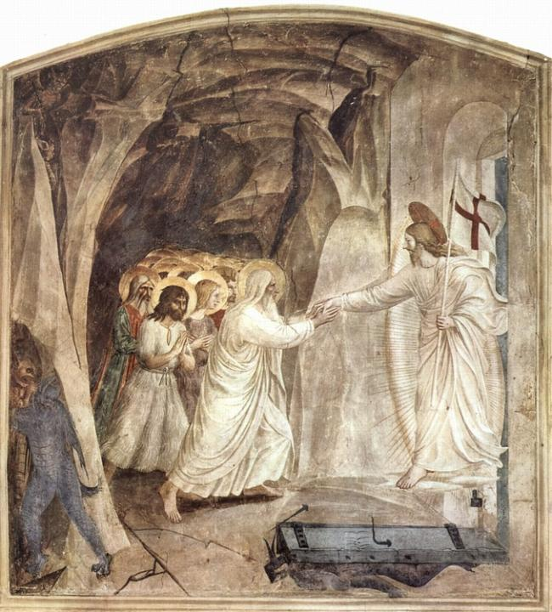
Fresco of “The Harrowing of Hell”
Fra Angelico c. 1441
San Marco, Florence

Slide 19
Upon this rock I will build my church… (Mt. 16:18)
…the Gentiles are fellow heirs, members of the same body... (Ephesians 3:6)
He has made us both one…that he might create in himself one new man…and might reconcile us both to God in one body through the cross… (Ephesians 2:14-16)
…you are fellow-citizens with the saints and members of the household of God, built upon the foundation of the apostles and prophets, Christ Jesus himself being the cornerstone… (Ephesians 2:19-21)
…And he is the head of the body, the church… (Colossians 1:18)

Slide 20
“the catholic church”
The Greek term katholikos in the creed means “through the whole” or “universal.”
This is the concept, especially in Paul’s letters, that God has created a new congregation (church) made up of Christians all over the world.
Referring to the universal church, this word “catholic” had been used by Christians since the early 100s AD to describe the whole church in the whole world.
It also is used to describe the orthodoxy of the church in the face of heresies—the church whose faith is “that which has been believed everywhere, always, and by all.”
The word “catholic” should be distinguished from the expression “Roman Catholic,” which is a later formulation.

Slide 21
…have you not read what was said to you by God: “I am the God of Abraham, the God of Isaac, and the God of Jacob?” He is not the God of the dead, but of the living (Matthew 22:31-32)
…but God…made us alive together with Christ. (Ephesians 2:5)
God will bring with him those who have fallen asleep. Then we who are alive…will be caught up together with them…to meet the Lord… (1 Thessalonians 4:14-17)
And I heard every creature in heaven and on the earth and under the earth and in the sea, and all that is in them, saying, To him who sits on the throne and to the Lamb be blessing and honor and glory and might forever and ever. (Revelation 5:13)

Slide 22
“the communion of saints”
Since all Christians, living or dead, are “in Christ,” all believers belong to a single body, the church.
Those who are living are “alive in Christ” (Ro. 6:11; Ep. 2:4-5); those who are deceased are “dead in Christ” (1 Th. 4:14, 16).
Hence, Christ is Lord of both the dead and the living (Ro. 14:9).
At the end, both the living and dead in Christ will be caught up as a single group to meet the Lord at his return (1 Th. 4:15-17).
Death does not break the bond between believers. They are all part of a larger, eternal spiritual community.

Slide 23
DISCUSSION
Why is the word “catholic” still a very appropriate word, and what does it suggest?
Every Sunday in the liturgy, we pray for “the whole state of Christ’s church.” What is meant when we say this?
Can you see the connection between the language “the communion of saints” and the liturgy which describes Christian worship by saying, “Therefore with Angels and Archangels, and with all the company of heaven, we laud and magnify thy glorious name?”

Slide 24
6 – THE PERSECUTIONS
The Trial and Testimony of the Early Church

Slide 25
Where next?
WHERE WE’VE BEEN
Birth Narratives
Christianity—300 Years
Divine Names
English Bible
Book of Galatians
Intertestament
Isaiah of Jerusalem (1-39)
Book of Jeremiah
Book of Job
New Testament Canon
Book of Revelation
NT Archaeology
Torah Survey
Prologue of John
SUGGESTED SUBJECTS
Book of Exodus
Life of David
Book of Amos
Book of Philippians
Parables of Jesus
OTHER POSSIBILITIES
Christian World View
Book of Ezekiel
Book of Esther
Book of Matthew
Book of 1 Peter

Slide 26
AN ILLEGAL RELIGION
The transition between being a sect of Judaism (in the Roman point of view) and being a separate religion left Christians in “no-man’s land.”
Judaism had been a legal religion since the days of Julius Caesar.
Christianity, if distinct from Judaism, had no legal status.
Rome was generally tolerant of the various religious sects so long as they deified the emperor and participated in ritual sacrifices in his honor. Such practices were not so much a matter of morality but patriotism. Since virtually all the religions were polytheistic, adding one more god to the pantheon was not objectionable.
These issues, however, were precisely the ones Christians could not accept, and in time, this would lead to outlawing Christians and opening the door to persecution.

Slide 27
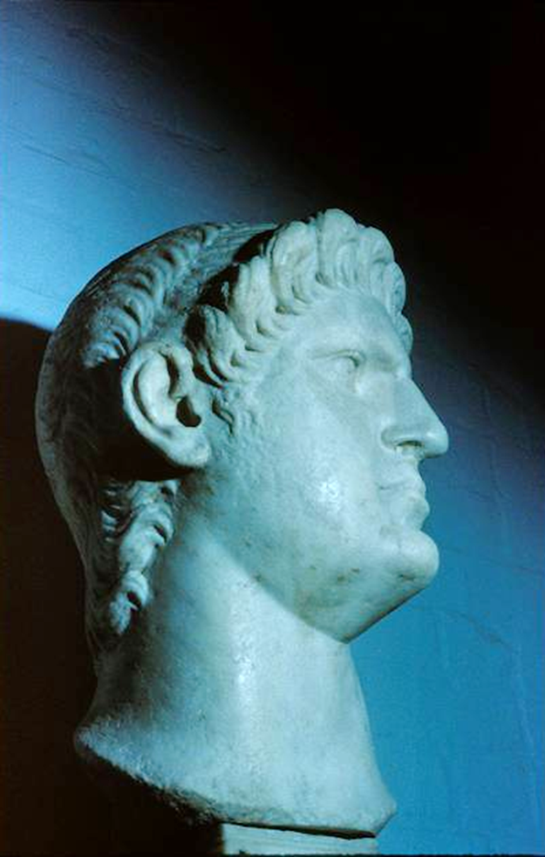
EARLY PERSECUTIONS
FROM WITHIN THE JEWISH COMMUNITY
Sanhedrin in Jerusalem (Ac. 8:1; 9:1-2)
Jewish communities in Asia Minor and Greece (Ac. 13:50; 14:4-5, 19; 17:5-9, 13; 18:12-17)
FROM THE ROMAN GOVERNMENT
Tacitus, the Roman historian, wrote that Caesar Nero blamed the great fire in Rome upon the Christians (AD 64).
The legality of Christianity, after its alienation from Judaism, became ambiguous (post-AD 70).
By the time of Domitian (AD 81-96), emperor worship became the primary point of contention.
CAESAR NERO

Slide 28
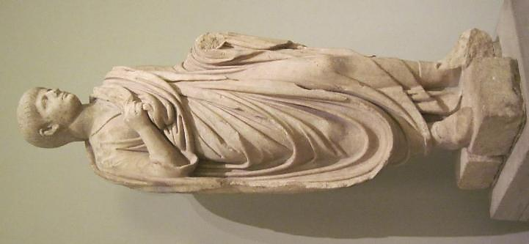
Caesar Nero
This youthful version of Nero (ruled AD 54-68) was produced after he was named successor to Emperor Claudius. According to the Roman historian Tacitus, Nero blamed the great fire in Rome in AD 64 on the Christians. Later Christian historians indicate that Paul was executed by beheading under Nero, probably in AD 64. Probably in AD 65, the other great leader of the Christians, Peter, was also martyred in Rome under Nero, who according to early witnesses was crucified upside down, because he felt unworthy to be crucified in the same manner as his Lord.
Detroit Institute of Arts

Slide 29
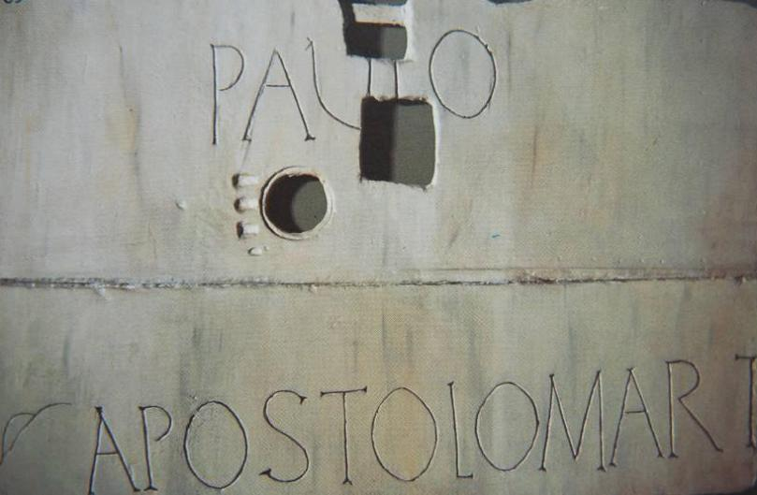
Paul and Peter, the two most important leaders in early Christianity, were both executed in Rome in the early to mid-60s.
Erected above Paul’s tomb, Church of St. Paul Outside the Walls, Rome
In 2009, Pope Benedict XVI gave permission for the bone fragments in the tomb to be carbon-dated, and indeed they date to the 1st century.

Slide 30
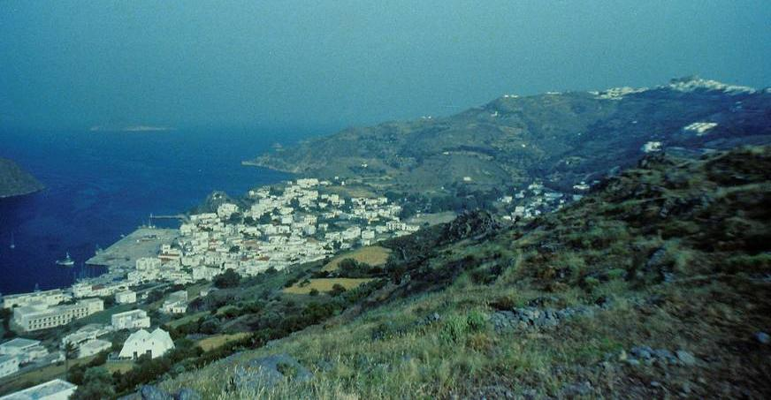
“I, John, your brother and companion in the sufferings and kingdom and patient endurance that are ours in Jesus, was on the island of Patmos because of the word of God and the testimony of Jesus.”
The Island of Patmos, where John was exiled during the reign of Emperor Domitian.

Slide 31
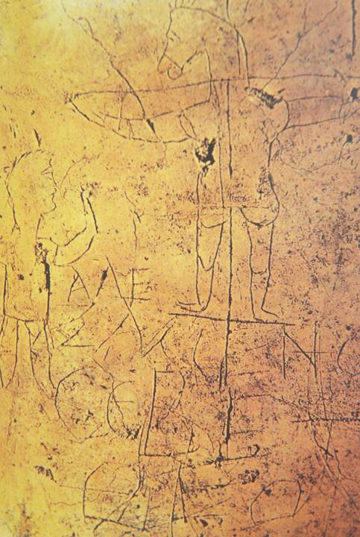
Grafitto mocking Christians,
Palatine Hill, Rome
Alecamenoj sebete qeon
(Alexamenos prays to [his] god)

Slide 32
ST. IGNATIUS EN ROUTE TO ROME
Ignatius, a disciple of John and the Bishop of Antioch, was arrested and condemned to death.
Taken to Rome by a company of 10 soldiers, he wrote seven letters en route to churches as well as to his friend Polycarp.
It was unusual to transport a condemned person to Rome, since most punishments were enacted locally. However, some prisoners were transported to provide a spectacle in the Colosseum, and Ignatius certainly believed this would be the case for him.
Ignatius was martyred in Rome in AD 107 (the traditional year).

Slide 33
What a thrill I shall have from the wild beasts that are ready for me! I hope they will make short work of me. I shall coax them on to eat me up at once and not to hold off, as sometimes happens, through fear. And if they are reluctant, I shall force them to it…. May nothing seen or unseen begrudge me making my way to Jesus Christ. Come fire, cross, battling with wild beasts, wrenching of bones, mangling of limbs, crushing of my whole body, cruel tortures of the devil —only let me get to Jesus Christ!
Ignatius, Letter to the Romans

Slide 34
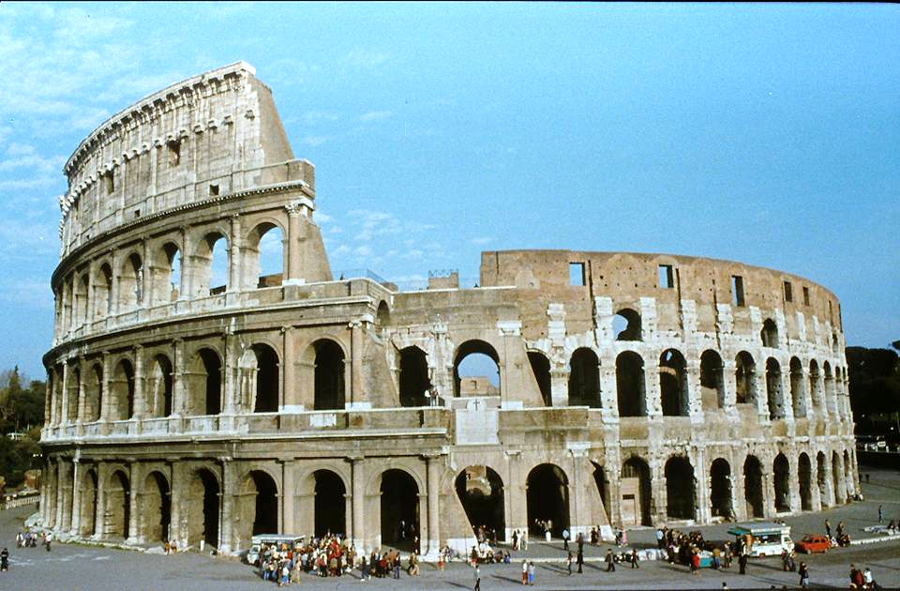
The Colosseum in Rome was completed in AD 80. Ignatius may have been the first Christian martyred here, since he expected to be “thrown to the beasts” when he arrived in Rome.

Slide 35
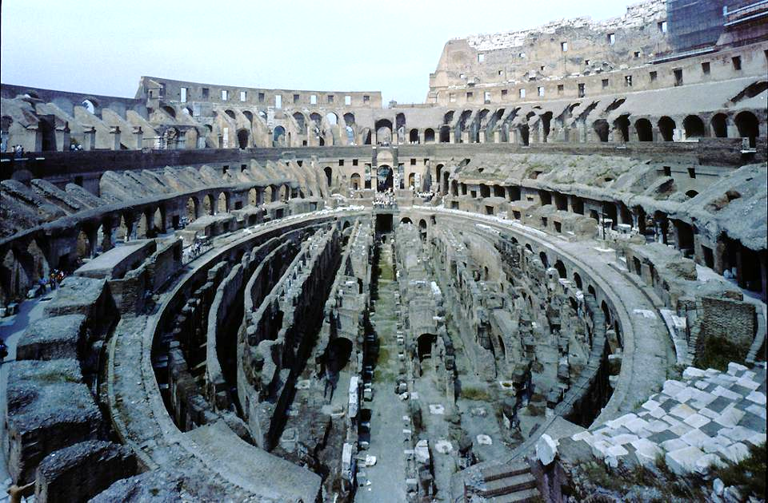
Colosseum Floor, where prisoners and wild animals were kept in preparation for the spectacles in the arena.

Slide 36
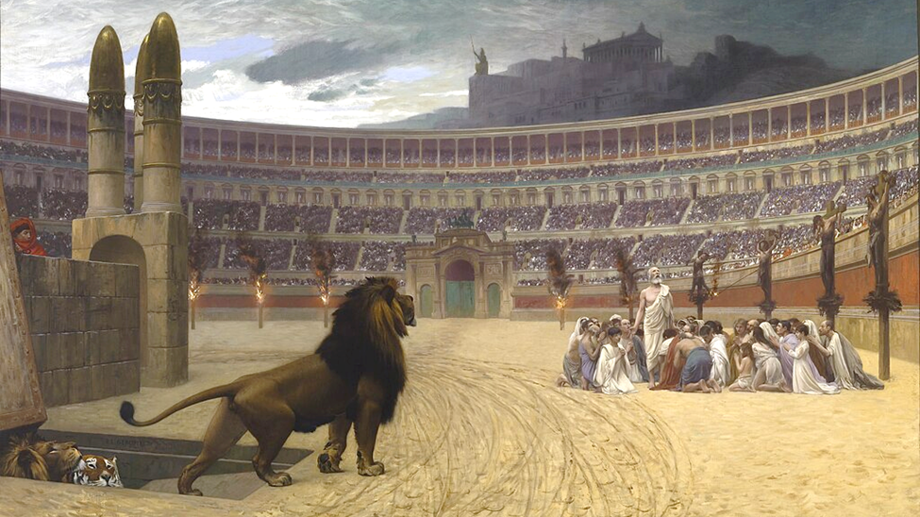
The Christian Martyr’s Last Prayer
By Jean-Léon Gérôme (1883)

Slide 37
Excerpts from the Martyrdom of Polycarp, martyred in Smyrna in AD 155
“…Polycarp entered into the stadium… When he was brought up, there was a great tumult, for they heard that Polycarp had been apprehended.
“…the Proconsul [urged], ‘Swear by the genius of Caesar; repent, and say, Away with the atheists.’ Polycarp…looked upon the whole multitude of lawless heathen…and waved his hand to them; and groaning and looking up to heaven he said, ‘Away with the atheists.’
“They did not nail him, but tied him. …looking up to heaven [he] said, ‘O Lord God Almighty…may I be received in your presence this day…’ When he had offered up the ‘Amen’ and finished his prayer, the firemen lighted the fire.”
Martyrdom of Polycarp 9-15

Slide 38
DISCUSSION
The word for “witness” and the word for “martyr” are homonyms in Greek (martuj). What might be the connection between them?
For centuries, Christians have held up the martyrs as especially deserving of honor. What underlies this recognition?

Slide 39
Accusations Against Christians
Christians were “anti-social”
Christians were “atheists”
Christians were “haters of mankind”
Christians were “cannibals”
Christians promoted “incest”
“The blood of the martyrs is seed…”
Tertullian (early 3rd century)

Slide 40
Pagan Diatribe against Christians…
“Excuse me for expressing my intense feelings so freely, but I think it is deplorable that attacks should be made upon the gods, by a gang, yes I mean a gang, of discredited and proscribed desperadoes. This gang [the Christians] has been gathered from the lowest dregs of the population. They are ignorant men and women—and we all know women are naturally unstable. They are a rabble of impious conspirators. At their night-time meetings, solemn fasts, and barbarous meals, their bond of union is not a sacred rite, but crime. They are a secret tribe that lurks in the darkness and shuts out the light. They are silent in public but chatter in the corners.
These conspirators must be utterly destroyed and cursed!”
From Minucius Felix (d. 250)

Slide 41
SPORADIC PERSECUTION
Emperor Trajan’s policy toward Christians was that they should be punished only if they refused to worship the emperor and the gods, but they were not to be sought out.
According to Irenaeus, there was a mass-slaughter of Christians thrown to wild beasts in Lyon.
In the 2nd century, Justin Martyr wrote that Christians were punished if they did not deny and blaspheme Christ.
Emperor Decius (249-251) initiated the first empire-wide persecution to be enforced by a libellus, a certificate verifying that the recipient had sacrificed to the Roman gods. Failure to do so resulted in arrest, imprisonment, torture, and execution.
Emperor Valerian (253-260) instituted another wave of persecution.

Slide 42
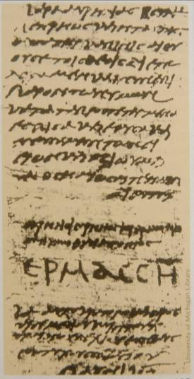
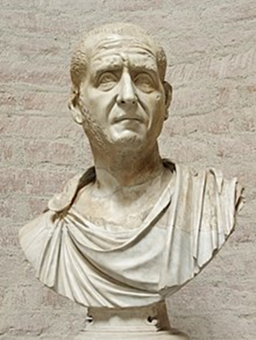
LIBELLUS: certificate proving that one had sacrificed to the Roman gods
Found in Egypt,
one of 43, all dated between June 12th and July 14th, AD 250.
Hermas, the recipient, signed his name in large capital letters.
University of Michigan, Hatcher Library
Emperor Decius

Slide 43
THE GREAT PERSECUTION
Emperor Diocletian began an intensive persecution on February 23, 303.
Churches were destroyed, Scriptures confiscated and burned, and Christians imprisoned and forced to perform sacrifices to the gods.
The emergence of Constantine (306-337) as emperor brought an end to the state persecutions.
The new emperor was originally a pagan. He would be baptized as a Christian just before dying in AD 337. However, in AD 313 he issued the Edict of Milan, which decreed tolerance for the Christian religion.

Slide 44
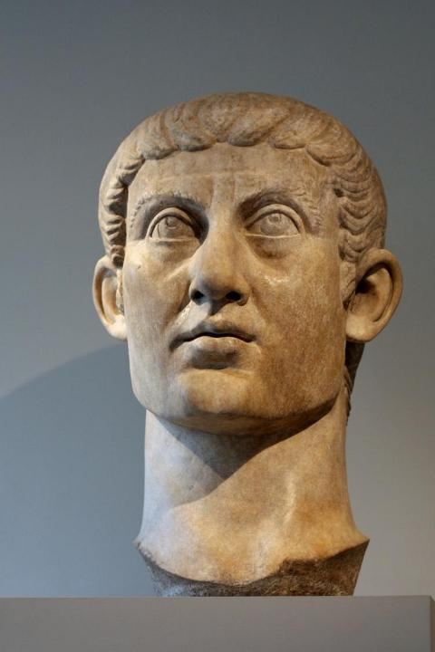
EDICT OF MILAN
Constantine, the Roman Emperor (AD 306-337) who converted to Christianity, played a central role in elevating Christianity in the Roman Empire.
  Though originally a pagan, he began to lean toward Christianity.
  In AD 313 he was influential in the Edict of Milan, which announced tolerance for the Christian religion. This edict effectively ended the persecution of Christians by the state.
  While he clearly seemed to wish all his subjects would become Christians, he did not believe that genuine faith could be imposed.
  Rather, he worked from the viewpoint of toleration, respect, bridge-building, and persuasion.
  Marble bust of Constantine (c. 325-370), Metropolitan Museum of Art, New York

Slide 45
THE DONATIST CONTROVERSY
After each of the major persecutions, the church had to decide what to do with Christians who had succumbed to the demand that they deny Christ, worship Caesar, and/or surrender their Scriptures to the authorities.
Some leaders held that after a period of penance, such persons could be readmitted.
Others considered this blasphemy, and such people could never again be part of the church.
The issue came to a head after the Diocletian persecution, when it became known that the Bishop of Carthage had turned over Christian Scriptures to the Roman soldiers.
  Donatus led the faction demanding that any church recognizing the bishop was a false church, and in the end, claimed that the Donatist churches were the only true church.
  Constantine, the new emperor, became involved, and Augustine provided the definitive theological response to the Donatists, which allowed lapsed Christians to be reconciled to the church. (“The church is not a hotel for saints, but a hospital for sinners.”)

Slide 46
DISCUSSION
The Donatists said that denying the faith under the duress of severe persecution was unpardonable. Is there an unpardonable sin?
The Edict of Milan by Constantine lifted the dark cloud of persecution, and many people afterward became Christians. What might be the pros and cons of such conversions?
What martyrs do you know of in modern times?

Slide 47
THE PERSECUTED CHURCH
According to the World Watch List 2025, more than 380 million Christians suffer high levels of persecution and discrimination for their faith.
Figures for the year 2024:
  4476 murdered
  7679 Christian church/properties attacked
  4744 Christians imprisoned
The most extensive persecution comes from extreme forms of Islam.

Slide 49
THE MARTYRS SCULPTURE AT WESTMINSTER ABBEY
Ten statues located above the Great West Door depict 20th century Christians who surrendered their lives for their Christian faith.
Unveiled in 1998
Figures are from every continent and diverse denominations.
From left to right, they include:
  Maximilian Kolbe (Poland)
  Manche Masemola (South Africa)
  Janani Luwum (Uganda)
  Grand Duchess Elizabeth (Russia)
  Martin Luther King, Jr. (USA)
  Oscar Romero (El Salvador)
  Dietrich Bonhoeffer (Germany)
  Esther John (Pakistan)
  Lucian Tapiedi (Papua New Guinea)
  Wang Zhiming (China)

Slide 50
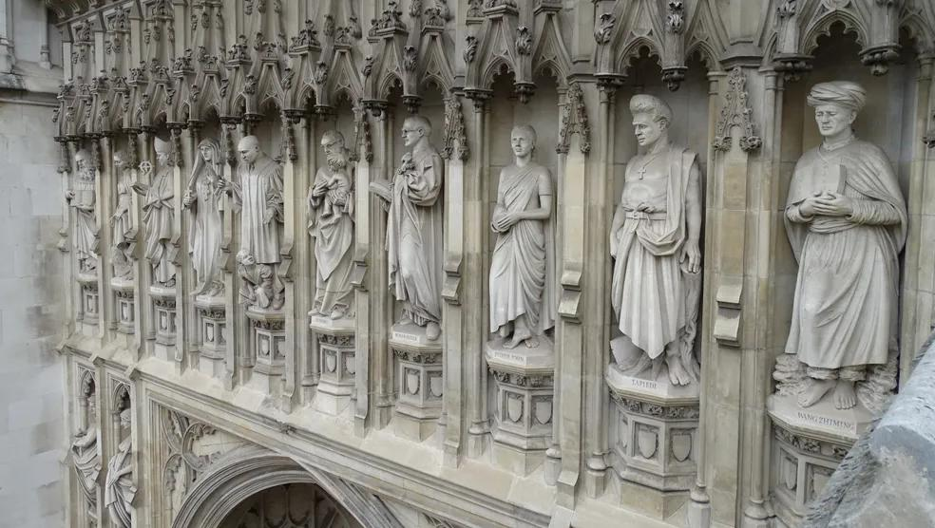

Slide 51
THE NICENE COUNCIL AND BEYOND
Doctrine of the Trinity; the Post-Nicene Fathers

Slide 52
The doctrine of the trinity comes of age
Already, the term “Trinity” had been employed as a description of the Three-in-One God for well over a century, first used by Theophilus of Antioch and Tertullian in the late 2nd century.
Tertullian also had coined the language “three persons, one substance” to express the three-ness and one-ness of the Father, Son, and Holy Spirit.
After rejecting the various early heresies of the Ebionites, the Gnostics, the Marcionites, and the Modalists about the nature of God, the church would now encounter the most serious threat to its understanding of the godhead in the rise of Arianism.
The struggle with Arianism, in turn, would lead to a more nuanced definition of the Trinity expressed in the Nicene Creed.

Slide 53
The arians
In the 4th century, not long after Constantine’s rise, a popular preacher named Arius contended that the Son was not eternal but was the first created Being, hence, a creature less than God.
Arius’ followers took up the chant into the streets, “There was a time when he was not!”
The problem with Arianism, like Modalism, is that it cut directly across plain statements in the New Testament.
  At the beginning of time, the Son (Logos) already was “with” God (Jn. 1:1, 3).
  If only God the Father was eternal and absolute, then the Logos was a sort of intermediate Being, neither fully divine nor fully a creature.
  If the Son was a created Being, how could he have been “before all things” (Col. 1:17) and how could the Father have loved him before the world’s creation (Jn. 17:5, 24)?
  Most important, if the Son was not fully divine, then the Christian church since its inception had been worshipping a creature, which is the essence of idolatry.

Slide 54
The nicene council
The theological dispute also had political implications, so Emperor Constantine called for a council of all the bishops world-wide to convene at Nicaea, Bithynia to resolve the dispute.
According to Athanasius, some 318 bishops attended from all over the Roman Empire (and a few outside it as well). Presbyters and deacons also attended, altogether well over a thousand.
They met from May until the end of July AD 325.
A statement of faith (Creed of Nicaea) was drafted based on the Apostles Creed, and all but two bishops subscribed to its final form. (This creed would later be slightly amended in AD 381, with some expansions concerning the Holy Spirit and the Church, in what we now call the Nicene Creed.)
This council was the first of its kind to attain Christian theological consensus, and subsequent councils would follow, called the first seven ecumenical councils in Christian history.

Slide 55
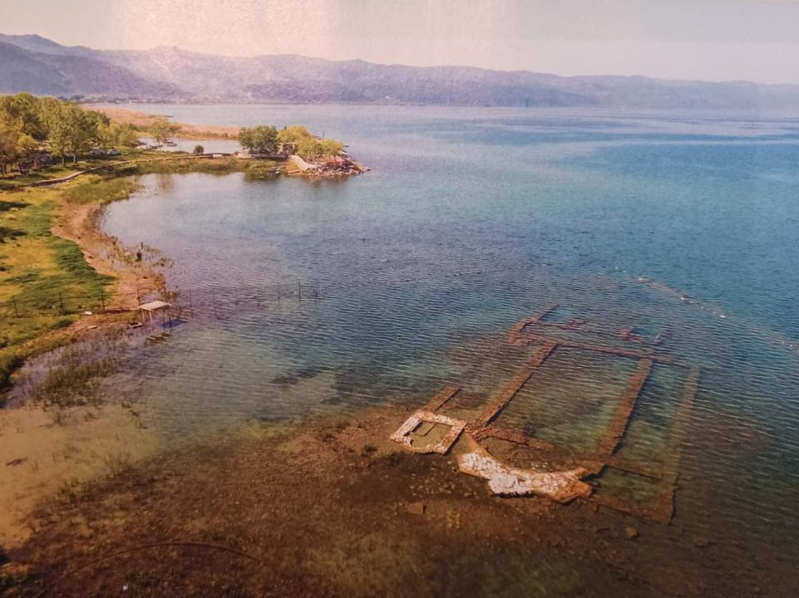
In 2015 near modern Iznik (ancient Nicaea), an early basilica was discovered lying submerged in 6-10’ of water about 165’ offshore. The church is divided into three aisles with an apse on the eastern end. Likely it was built on the site where the Council of Nicaea convened in AD 325.

Slide 56
The Nicene Creed from AD 325 and AD 381
We believe in one God, the Father almighty, maker of all things visible and invisible;
And in one Lord, Jesus Christ, the Son of God, begotten from the Father, only-begotten, that is, from the substance of the Father, God from God, light from light, true God from true God, begotten not made, of one substance with the Father, through Whom all things came into being, things in heaven and things on earth,
Who because of us men and because of our salvation came down,
and became incarnate and became man, and suffered,
and rose again on the third day, and ascended to the heavens,
and will come to judge the living and dead,
And in the Holy Spirit.
But as for those who say, There was when He was not, and, Before being born He was not, and that He came into existence out of nothing, or who assert that the Son of God is of a different hypostasis or substance, or created, or is subject to alteration or change–these the Catholic and apostolic Church anathematizes.
The areas highlighted in yellow were especially directed toward the Arian controversy, both as positive statements regarding Christ Jesus as well as anathemas at the end.

Slide 57
Two Competing Views
ARIANISM
God is a simple “one.”
The Son is less than God. He was the first created Being, hence not fully God.
The Son is inferior to the Father.
The Holy Spirit is impersonal.
TRINITARIANISM
God is a complex “one.”
Jesus is God the Son incarnate. He is the Son eternally, and this is part of his essential nature.
God is one Substance in three Persons.
The Holy Spirit is personal.

Slide 58
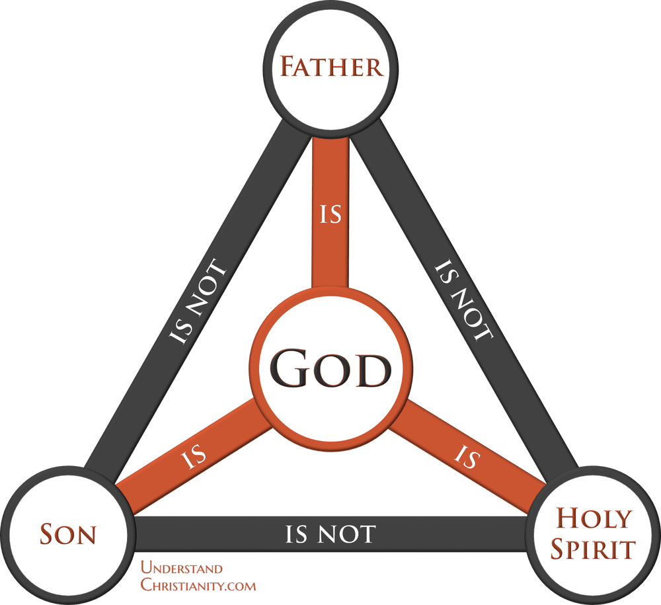
“How much more, then, will the blood of Christ [the Son], who through the eternal Spirit [the Holy Spirit] offered himself unblemished to God [the Father], cleanse our consciences from acts that lead to death so that we may serve the living God?”
He. 9:14
“Father, I want those you have given me to be with me where I am, and to see my glory, the glory you have given me because you loved me before the creation of the world.”
Jn. 17:24

Slide 59
CONSTANTINE and CHRISTIANITY
Constantine was pivotal in transforming Christianity from a persecuted faith to the dominant religion in the empire.
He converted to Christianity in AD 312.
In AD 313 he issued the Edict of Milan, which granted religious tolerance and also mandated the return of confiscated properties to Christians.
He constructed new churches, especially in Bethlehem, Jerusalem, Rome, and Constantinople, and he commissioned the copying of 50 new large format Bibles.
Still, despite favoring Christianity, he also permitted the traditional pagan religions to continue, sometime patronizing them and allowing their images to appear on imperial coinage. This, in turn, raised questions about the authenticity of his conversion.
Was he a genuine Christian or a political mastermind who used Christianity to foster political unity? (The debate continues.)
Many citizens now converted to Christianity, but their motives might well have been social advantage as much as faith (i.e., nominal Christianity).

Slide 60
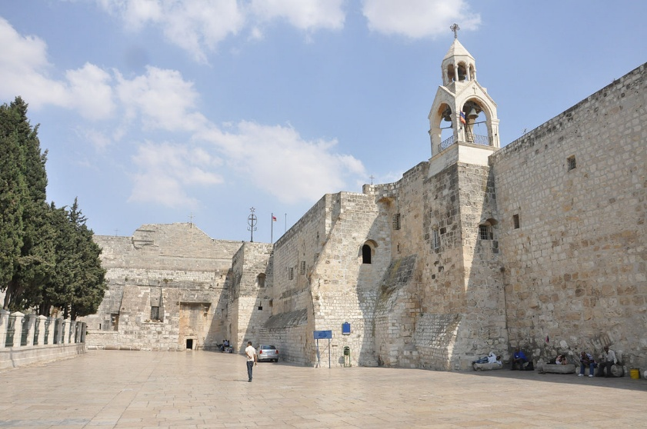
The Church of the Nativity, Bethlehem

Slide 61
The FIRST seven ecumenical councils
Periodically, the emperor called councils in the attempt to reach an orthodox consensus to unite Christendom.
Their decisions were intended to be binding upon the whole church. The word “ecumenical” derives from the Greek word oikoumenikos, meaning “from the whole world.”
The first four of them are generally accepted by Lutherans, Anglicans, and Reformed Churches, though generally Protestants do not hold their decrees in the same regard as do Catholics. For Protestants, any decrees by councils are subordinate to Holy Scripture.
All of the first seven are accepted by the Eastern Orthodox Churches.
The Roman Catholic Church accepts 21 councils altogether, the final being the Second Vatican Council (1962-1965). However, since many of them were only attended by Roman Catholic bishops, they were hardly ecumenical in the plain sense of the word.

Slide 62
1st COUNCIL OF NICAEA
(AD 325)
Affirmed the deity of Christ
Condemned Arianism
Christ is of the same substance as the Father
The date of Easter was fixed
1st COUNCIL OF CONSTANTINOPLE (AD 381)
Clarified the nature of the Holy Spirit
Condemned Arianism
Christ is “begotten of the Father before all time”
COUNCIL OF EPHESUS
(AD 431)
Clarified the nature of Christ’s personhood as a single unified being
Condemned Nestorianism
Proclaimed Mary as the Theotokos (= God-bearer)
Condemned Pelagianism
COUNCIL OF CALCEDON
(AD 451)
Clarified the nature and person of Christ as fully God and fully human with two natures and two wills, human and divine
Condemned the Monophysites
2nd COUNCIL OF CONSTANTINOPLE (AD 553)
Confirmed the conclusions of the first four councils
3rd COUNCIL OF CONSTANTINOPLE (AD 680-681)
Clarified the nature of Christ’s will
Condemned Monothelitism
2nd COUNCIL OF NICAEA
(AD 787)
Established guidelines for veneration of icons
Condemned iconoclasm

Slide 63
THE POST-NICENE FATHERS
The Post-Nicene fathers are those church leaders who came after the Council of Nicaea in AD 325. The most important of them were:
EUSEBIUS
(c. AD 260-340)
Known as the father of church history, he was the first to write a comprehensive history of the early church, Ecclesiastical History, using extensive quotations from primary sources.
ATHANASIUS
(c. 296-373)
The primary proponent of Nicene trinitarianism against the Arians. He was the first to list the 27 NT books as canon. Because of his struggle with several Roman emperors, he was known as “Athanasius Against the World.”
CHRYSOSTOM
(c. AD 347-407)
Archbishop of Constantinople, he was famed because of his excellent skills in elocution and dubbed the “golden-mouthed.” He was banished by the empress Eudoxia and died in exile.
JEROME
(c. AD 345- 420) Translated the Latin Vulgate from the Hebrew Bible and the Greek New Testament. This translation would serve the western church for a full millennium and remains the official Latin Bible for Roman Catholics.
AUGUSTINE
(c. AD 354-430)
Converted in AD 387, he became the Bishop of Hippo, Africa. He is best known for his Confessions (personal memoirs) and The City of God (composed after the sack of Rome by the Visigoths).

Slide 64
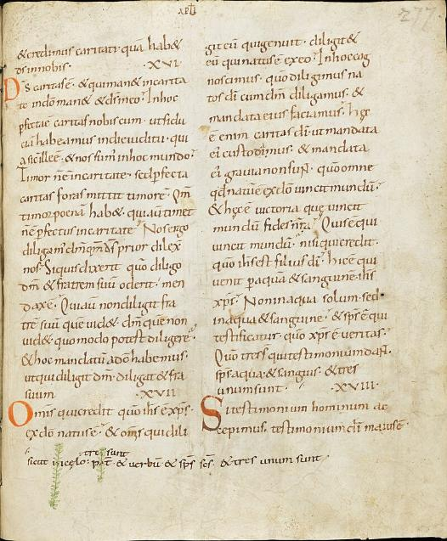
THE LATIN VULGATE
In AD 382, Damasus I, the Bishop of Rome, commissioned a new “common version” (edition vulgate), which would become the standard Bible for the next thousand years in the western church.
St. Jerome labored on this work over many years while living in Bethlehem, completing it in AD 405. (He is buried in the cave beneath the Church of the Nativity.)
The Eastern Church would continue to use the Greek text.

Slide 65
The LATER HERESIES
The later heresies primarily concerned two issues, what does it mean to be human, and what does it mean that Christ was both human and divine?
Pelagianism
Pelagianism emphasized the inherent goodness and autonomy of humans.
  Adam’s fall did not taint the human race, and all humans are born morally neutral.
  God would not have given commandments in the first place if he thought humans were incapable of keeping them.
As such, humans, by their divinely given free will, are capable of achieving moral perfection.
Christology
If Christ is both fully human and fully divine, how does this union work?
  Did Christ have a single will and a single nature, or did he have two wills and two natures?
  Were the divine and human natures in Christ independent of each other?
The Alexandrines were concerned that Christ not be divided into two beings.
The Antiochenes were concerned that in affirming the humanity of Christ, his deity was not diminished.

Slide 66
Pelagius
Born in the British Isles, Pelagius arrived in Rome sometime in about the late 300s.
In Rome, he discovered that a good many Christians were not really living changed lives, so he sought moral change.
In this context, he preached the possibility and urgency of sinlessness and that all humans were born with the sinlessness of the original Adam. (After all, Christ had said, “Be perfect” [Mt. 5:48], so this must mean that it was possible.) Humans had the innate ability to respond to the gospel by their own wills alone.
Pelagius’ views, in turn, raised the question of children being baptized, usually shortly after birth. If they were sinless, why be baptized at all?
Many people began to appeal to Augustine of Hippo to look into this new theology.

Slide 67
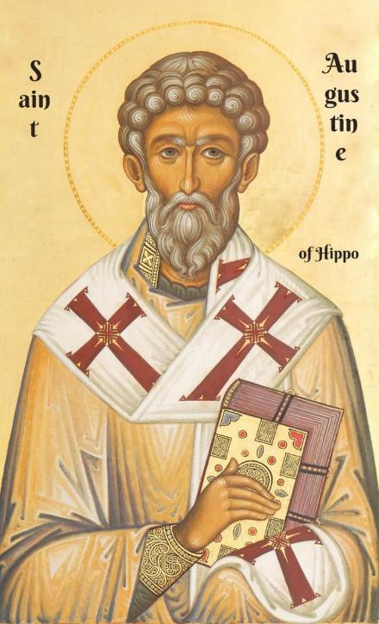
Augustine’s response
If a major concern in Christian baptism was the forgiveness of sins (i.e., Ac. 2:38; 22:16, etc.), in what sense was an infant sinful?
The long-standing theology of the church was that ALL humans were sinful (cf. Ro. 3:23).
Augustine cited St. Paul’s writings that all humans were sinful “in Adam,” and therefore, they all experience death (Ro. 5:12, 18-19; 1 Co. 15:22).
This meant that infants are sinful at birth, not because they had personally committed sin, but because they were tainted with “original sin,” i.e., the sin of Adam.
If an infant dies unbaptized, the guilt of original sin remains. Therefore, Christian parents should have their infants baptized as soon as possible.

Slide 68
Augustine’s four points
The concept of original sin logically implied other derivative theological conclusions.
TOTAL DEPRAVITY
Every facet of human life is disordered: body, mind, emotion, and will.
Far from being born morally neutral, humans are born morally compromised.
Their passions, especially sex, demonstrates their disordered state.
IRRESISTABLE GRACE
The only way humans can respond positively to the gospel is by a divine act that overpowers human depravity.
This divine act enables a person to see the truth and choose the good.
Everything comes by the grace of God, including faith itself.
PREDESTINATION
God chooses to give his grace to some but not to others.
Had Adam not fallen, there would have been only the proper number of humans born to replace the fallen angels.
Due to Adam’s fall, there are excess humans; the number of the elect is very limited.
PERSEVERANCE
If divine grace causes humans to believe, then grace will also enable them to sustain their faith.
Though they might sin on occasion though weakness, such grace-empowered-faith will ultimately be victorious over all doubt and difficulty.

Slide 69
The aftermath
Augustine’s theology, while it clearly rejected Pelagianism, which the church likewise condemned, left a number of unresolved questions with which the church would continue to struggle for centuries right up into the present time.
The Bible indicated that God wants all people to be saved (1 Tim. 2:4 but if so, why did he not give irresistible grace to everyone?
Augustine’s conclusion that a fixed number of persons were destined to be saved cut the nerve of missionary effort.
Could anyone have assurance that he/she was numbered among the elect? Belonging to the visible church was no guarantee, and no one (apart from God) knew who belonged to the invisible church.
Many who read Augustine’s refutation of Pelagianism felt that he had undercut the nature of the Christian life. Monks in France who disagreed with him were dubbed “semi-Pelagians.”

Slide 70
Augustine’s Three Enduring Conclusions
TOWARD DONATISM
The church is a hospital for sinners, not a haven for saints.
Therefore, lapsed Christians are to be readmitted.
TOWARD PELAGIANISM
God is sovereign, and grace is central.
Humans cannot come to God simply by their own human wills.
TOWARD THE FALL OF ROME
Earthly cities rise and fall, but the City of God will endure forever.
Christians belong to the City of God, not the City of Man.

Slide 71
Quotable quotes by st. augustine
"If you believe what you like in the gospels, and reject what you don't like, it is not the gospel you believe, but yourself."
"Faith is to believe what you do not see; the reward of this faith is to see what you believe."
"Hope has two beautiful daughters; their names are Anger and Courage. Anger at the way things are, and Courage to see that they do not remain as they are."
"If God seems slow in responding, it is because He is preparing a better gift. He will not deny us. God withholds what you are not yet ready for. He wants you to have a lively desire for His greatest gifts. All of which is to say, pray always and do not lose heart."
"A Christian is: a mind through which Christ thinks, a heart through which Christ loves, a voice through which Christ speaks, and a hand through which Christ helps."
"To fall in love with God is the greatest romance; to seek him the greatest adventure; to find him, the greatest human achievement."
"There is no saint without a past, no sinner without a future."
"Because God has made us for Himself, our hearts are restless until they rest in Him."
"Learn to dance, so when you get to heaven the angels know what to do with you."

Slide 72
COUNCIL OF CHACEDON (AD 451)
A vigorous debate arose over Christology and the human and divine nature(s) of Christ.
Did he have a single will and a single nature, or did he have two wills and two natures, one human and the other divine?
Some were concerned that Christ not be divided into two beings. Others were concerned that in affirming Christ’s humanity, his deity would not be diminished. The Council of Chalcedon (AD 451) would clarify that Christ was fully God and fully human. The two natures remain distinct though united.

Slide 73
A Simple Way of Understanding Orthodoxy
ONE FAITH
…that which has been believed everywhere, always and by all
TWO TESTAMENTS
Old Testament
New Testament
THREE CREEDS
Apostles’ Creed
Nicene Creed
Chalcedonian Confession
FOUR COUNCILS
Nicaea (AD 325)
The Holy Trinity
Constantinople (AD 381)
Error of Tri-theism
Ephesus (AD 431)
Mary, Theotokos (= the “God- Bearer”)
Chalcedon (AD 451)
Christ, fully human & divine
FIVE CENTURIES

