Slide 1
Hebrews
Letter to those being pressured to turn back to judaism

Slide 2
A Christological System of Worship
The Letter to the Hebrews is a Christological explanation of the worship system of the Aaronic priesthood.
It forms a majestic connection between the old and new covenants.
Worship in the heavenlies had its counterpart in the tabernacle in the desert—but it reached its highest meaning in Christ’s death!
This is the burden of the Book of Hebrews—to explain the fullness of worship and religious faith as it comes to its highest meaning in the death and resurrection of God’s Son, and especially, to prevent believers from lapsing back into any inferior system.

Slide 3
AUTHOR
Probably more than any other book in the NT, the authorship of Hebrews has remained elusive.
Formally, the book is anonymous.
Though many have suggested St. Paul, probably because he knew Timothy (13:23), the Greek style of Hebrews is much more polished than Paul’s known works.
The writer does not number himself among the apostles (2:3).
Still, the work is being quoted as early as the mid-90s (1 Clement 1:3-7; 17:1), so the writer must have lived well before the end of the 1st century.
Other suggestions have been Apollos (so Luther), Luke (so Origen and Calvin) and Silas, Barnabas (so Tertullian) and even Priscilla & Aquila (based on the “we” passages).

Slide 4
Why Paul probably didn’t write Hebrews:
Since the book is formally anonymous, and the traditions about the book mixed, internal evidence must be given more attention.
The Greek in Hebrews is stylistically different than Paul’s—more classical, more polished, and missing Paul’s habitual abrupt changes in sentence structure to a second grammatical structure inconsistent with the first.
As one scholar put it, it would seem strange that Paul would write to the Hebrews in polished Greek when he spent much of his life writing to the Greeks in a style “abounding with rugged and barbarous Hebraisms.”

Slide 5
Eusebius in the 4th century, after exploring the varied traditions in the church, probably sums up the majority opinion about authorship:
“But who wrote the epistle, in truth, God knows”
Ecclesiastical History VI.xxv.14

Slide 6
READERS AND OCCASION
Equally elusive has been the precise circumstances under which the book was written.
That the first readers were a Christian congregation (or part of a congregation) seems clear enough, since the farewell mentions the leaders and all the saints (13:24).
We also know the readers faced persecution (10:23-34; 12:4).
There seems to have been some association between the readers and the Christians in Italy(13:24), and since Hebrews is first quoted by Clement, also from Italy, this connection seems solid.
Were the readers Christians, Jews or both? Certainly the book fits well within a Jewish context, but there is nothing inherently prohibiting it being applicable to Gentiles, also.

Slide 7
DATE
Since the book is quoted by Clement in about AD 95 (1 Clement 17:1; 36:2-5), the book cannot have been later, though theoretically, it could have been any time after the death of Jesus. In the attempt to narrow down the dating possibilities, the relationship of the book of the 1st Jewish Revolt looms large:
Those preferring a date within the Jewish revolt (AD 66-70) focus on the descriptions of persecution and the implied pressure to revert to temple worship. Certainly the book has repeated warnings against turning away from Christ (2:1-4; 3:7—4:13; 5:11—6:12; 10:26-39; 12:1-29).
Those doubtful about such a date point out that the book focuses on the ancient tabernacle, not on the temple itself.

Slide 8
CANONICITY
The acceptance of Hebrews into the NT canon was slower than for most other books, probably due to uncertainty about its author.
It is missing in some early canon lists (Muratorian Fragment, Marcion, and Irenaeus).
In some early collections, it appears among Paul’s letters, though sometimes in a different order (in p46 it falls between Romans and 1 Corinthians; in x and B it falls between 2 Thessalonians and 1 Timothy).
It was largely accepted in the east but questioned in the west; in the Protestant Reformation, Luther placed it alongside James, Jude and Revelation after III John.
Of interest is that in the Roman Catholic Church it was accepted as genuinely Pauline by the Pontifical Biblical Commission (1914).

Slide 9
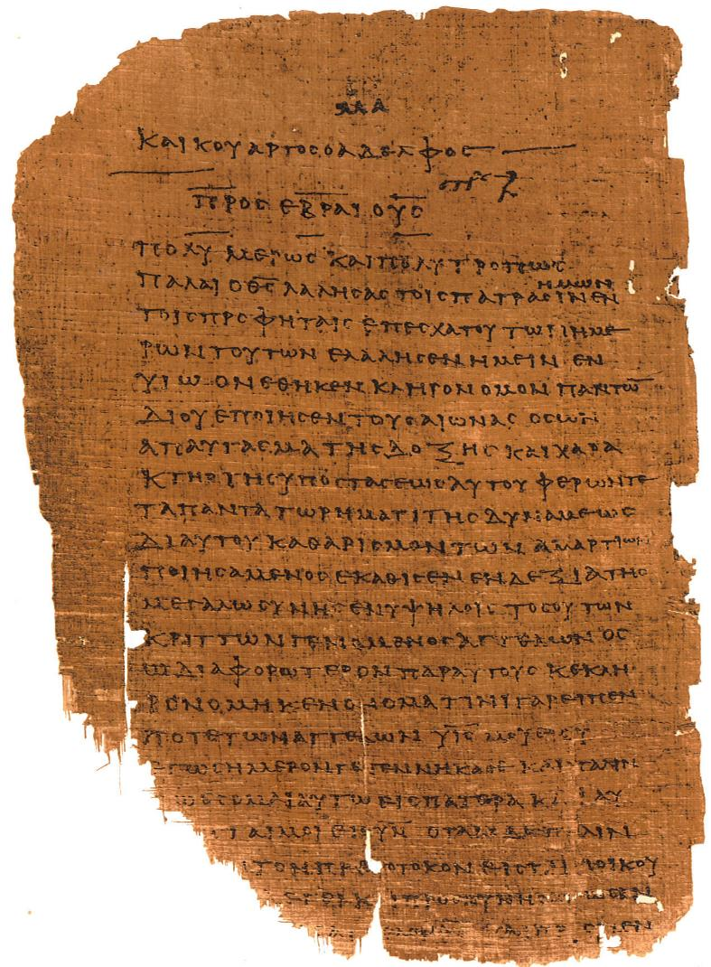
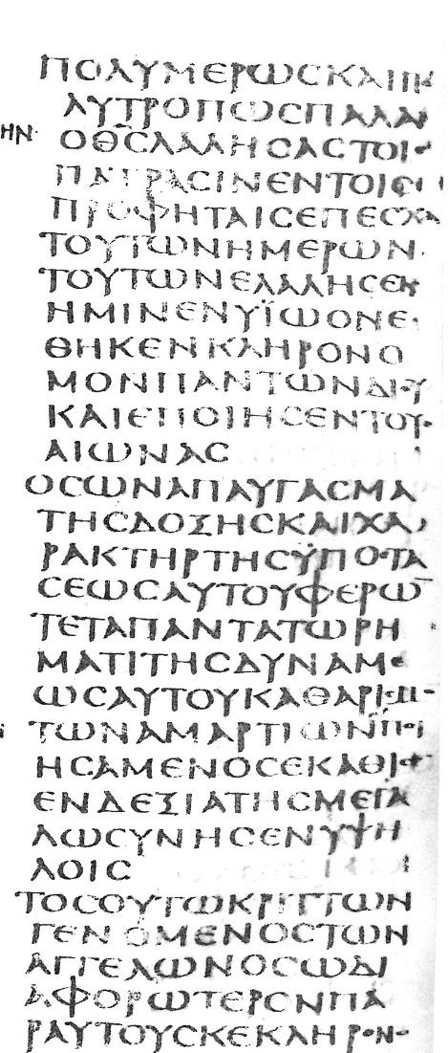
Early Copies
p46
Chester Beatty Papyri
c. AD 200
X
Codex Sinaiticus
4th century
British Library

Slide 10
LITERARY CHARACTER
By all accounts, the Letter to the Hebrews contains some of the most sophisticated Greek in the NT.
The diction and rhetorical style are elevated, and the sentences carefully constructed.
Though there is no epistolary introduction (leading some to argue that the letter reads more like a sermon), there is an epistolary conclusion (13:18-25).
The book is saturated with allusions and quotations from the Hebrew Bible (quoted, however, from the LXX).

Slide 11
ARGUMENT
The letter has the longest sustained argument in the NT about the superiority of Christ over Moses and the ancient patterns of tabernacle worship.
The style of argumentation is a fortiori, which is to say, “if that is true, then how much more is this true”.
In keeping with this rhetoric, the letter frequently uses modifiers, such as, “better” and “superior” (1:4; 7:19, 22; 8:6; 9:23; 10:34; 11:16, 40; 12:24).

Slide 12
The Better Way! krei<ttwn (= superior); dia<foroj (= better)
Christ is “superior” to angels, and his name as Son is “better” than theirs (1:4).
Christianity has a “superior” hope than Judaism (7:19).
The new covenant is “superior” to the old one (7:22; 8:6).
The priesthood of Jesus is “superior” to that of Aaron’s line (8:6).
The promises of the new covenant are “superior” to the old (8:6).
The sacrifices of the new covenant are “superior” to the old (9:23).
The heritage of heaven is “superior” to the temporal world (10:34).
Heaven is a “superior” country to Canaan, the promised land (11:16).
Resurrection life is “superior” to temporal life (11:35).
The fulfillment of the promise in Jesus is “superior” to anything prior (11:40).
The blood of the new covenant, which speaks of forgiveness, offers something “superior” to the blood of Abel, which called for vengeance (12:24).

Slide 13
STRUCTURE
THE SUPERIORITY OF CHRIST
…to the prophets (1:1-3)
…to the angels (1:4-14)
  The 1st solemn warning (2:1-4)
The condescension of Christ (2:5-18)
…to Moses who received the Torah (3:1-6)
  The 2nd solemn warning (3:7-19)
…to Joshua who led them into the land (4:1-13)
…to Aaron and the priestly line (4:14—7:28)
  The 3rd solemn warning (5:11—6:12)
The High Priest of a new covenant (8)
Worship in the earthly sanctuary (9:1-10)
Christ supersedes the old covenant (9:11-28)
The once for all sacrifice of Christ (10:1-18)
EXHORTATION TOWARD STEADFASTNESS
Hold to the hope (10:19-25)
  The 4th solemn warning (10:26-39)
The cloud of witnesses (11)
  The 5th solemn warning (12)
Living as the pilgrim people of God (13)

Slide 14
OPENING (1:1-3)
Unlike most letters, the opening is not epistolary but confessional.
It affirms that God has not been silent, but he has spoken through the prophets.
As important as the prophets were, however, God now has spoken by his Son.
Like John (Jn. 1:1-2, 1 Jn. 1:1-2), the writer identifies Christ Jesus with the Logos (using the verb lale<w).
This “Word” has come “in the last days”, a way of describing the time of fulfillment.

Slide 15
The Seven Confessions
Following this opening, the writer offers seven acclamations about the Son as the full and final revelation of God. He is…
…the heir of all things.
…the agent of all creation.
…the radiance shining forth from God, the true source of all light.
…the very image of the substance of God (the Greek word karakth<r describes a seal impression on coins or seals).
…the one who enables the universe to continue to exist.
…the priest who provides purification for sins.
…the one who, because his saving work is now completed, sits at God’s right hand, the place of all authority.

Slide 16
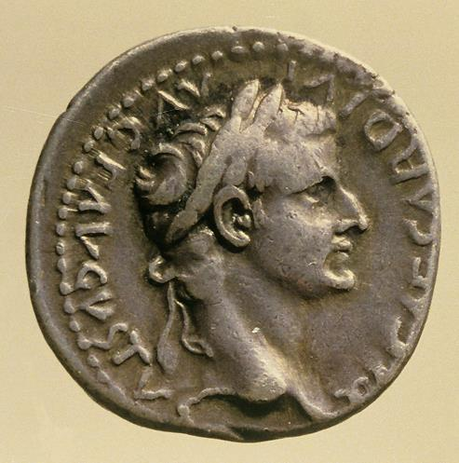
The Son, the karakth<r of God:
If a Roman coin carried the karakth<r of Caesar, Jesus carries the karakth<r of God.
karakth<r is the exact impress.

Slide 17
The Supremacy of the Son
As the Heir of all things, the Son’s authority is his by right.
As the Agent of creation, the Son pre- exists before any created entity.
If God is Light (1 Jn. 1:5), then the Son is the outshining of that light.
As the karakth<r of God, the Son is the very image of the substance of God.
As the One who upholds the universe, the Son is not only its Creator, but its Sustainer.
Hebrews 1:1-3 and the Nicene Creed:
“…God of God, Light of Light, very God of very God, begotten, not made, being of one substance with the Father, by whom all things were made…”

Slide 18
The Priestly Work of the Son
The final two of the seven confessions address Jesus’ messianic, priestly work.
The Son is not only the Creator of all, he is the Savior of all.
As the final great High Priest, he provided purification for sins—what the author later will describe as being “once, for all”—and this is the primary argument of the whole book.
When his priestly work was completed, he indicated the finished character of this work by being seated at the Father’s right hand—not facing the Father, but facing the same way as God is facing.
Because the Son is God’s final Word—his full and final revelation—there is nothing more to be said!

Slide 19
NEGATIONS AND AFFIRMATIONS
Over the next several chapters, the author will take his readers through a series of negations as well as affirmations about Christ.
The same concern underlies each category he addresses. Jesus cannot be reduced to the level of:
  Angels (the ancient mediators of God’s law, cf. Dt. 33:2; Ac. 7:53)
  Moses (the lawgiver)
  Joshua (the victorious military hero)
  Aaron (the head of the high priestly family)
Rather, the Son is higher than all, and any effort to turn back from God’s final revelation in his Son is inferior and misdirected.

Slide 20
SUPERIOR TO ANGELS (1:4—2:18)
In a collage of OT quotations, the writer demonstrates that Jesus cannot be reduced to the level of angels.
God never addressed any angel, “You are my Son”, but he addressed Jesus in this way at both his baptism and his transfiguration (cf. Ps. 2:7; 2 Sa. 7:14; Mt. 3:17; 17:5).
In the Song of Moses (Dt. 32:43, LXX), the angels (lit., ui[oi qeou? = “sons of God”) are summoned to worship the Son.
Angels are temporary servants (Ps. 104:4), but the Son is God eternal (Ps. 45:6-7; 102:10-12).
Yahweh himself even addresses the Son as Lord and seats him at his right hand (Ps. 110:1).

Slide 21
The Royal Son (1:5; Ps. 2:7; 2 Sa. 7:14)
In the Davidic covenant, God announced to David that his son would be God’s Son.
Certainly God never announced such a privilege to angels!
Indeed, it is this affirmation in the original wording of the covenant that lies behind the proclamation in Ps. 2:7: “You are my Son!” something God never said to angels!

Slide 22
The Hebrew Bible and the Septuagint (1:6; Dt. 32:43)
NT writers commonly quote from the LXX as well as the Hebrew Bible (Luke and Paul usually use the LXX, as does the author of Hebrews).
Sometimes, there are differences between the LXX rendering and the Masoretic Text which underlies our English Versions, and this is the case in the quotation of Dt. 32:43:
  The LXX reads: “Rejoice with him, O heavens, and worship him all [you] sons of God; rejoice, O nations, with his people, and give glory to him all [you] angels of God…”
  The MT reads: “Rejoice, O nations, [with] his people…”
Obviously, the LXX has additional phrases not present in the MT, and the author of Hebrews clearly sees these as referring to God’s Agent of salvation and judgment (perhaps also alluding to what is described in Lk. 2:8-14).

Slide 23
The Royal Wedding Psalm (1:7-9; Ps. 45)
Here, the author contrasts what is said of angels as opposed to what is said to the royal son.
The role of angels is to serve as temporary agents of divine commands, and in this role, they are like wind and fire, temporary in nature (Ps. 104:4).
By contrast, the Davidic son in the royal wedding Psalm is addressed as God, and his dominion will endure forever (Ps. 45:6). God has elevated his royal Son above all others!
The ancient language begs the question, “Whom would God address as ‘God’ if not his own Son?”

Slide 24
The Son as the Eternal Lord (1:10-12; Ps. 102:25-27)
In this prayer of an afflicted person pouring out his lament to God, God addresses the sufferer by the title su< ku<rie (= you, Lord). As with the Deuteronomy passage, here the author depends upon the LXX reading, which begins:
kat’ a]rxa>j su< ku<rie th>n gh?n e]qemeli<wsaj… = “At the beginning, you, O Lord, laid the foundation of the earth…”
Such an address naturally begs the question, “Whom would God address as Lord?” and even more to the point, whom would God describe as the Agent of creation, an eternal Being?
Never had such a remarkable thing been said to angels!
To the author of Hebrews, the answer could only be that God was speaking to his Son, whom this ancient sufferer foreshadowed!

Slide 25
The Son as the Regent at God’s Right Hand (1:13-14; Ps. 110:1)
In a final crescendo, the author appeals to the same passage elicited by Jesus in response to the Pharisees (cf. Mt. 22:41-46):
The Psalm begins with “Yahweh says to my Lord…”
Whom would God address as Lord and invite to sit at his right hand as Vice-Regent over all enemies?
Certainly not angels!
At best, angels are servants who do God’s bidding. Angels might stand in God’s presence, but they certainly never sit at his right hand!
Hence, angels exist to serve and minister to God’s people (but the Son is much greater)!

Slide 26
The First Solemn Warning (2:1-4)
Altogether, there will be five solemn warnings in the book.
This first warning begins the a fortiori argument (if that is true, how much more is this true).
If the Torah mediated by angels (Dt. 33:2; cf. Ac. 7:53) was so binding that violations merited death (Ex. 19:12-13), and if Jesus is superior to the angels, then to drift away from this higher word of salvation would be to invite disaster!
God’s word had been declared by his Son, attested by his apostles, and confirmed by signs, miracles and spiritual gifts, all of which pointed to the validity of the gospel message!

Slide 27
The Humanness of Jesus (2:5-8a)
Some might argue that Jesus’ superiority over angels is put in question because of his incarnation, based on the biblical passage that says the “son of man” was made lower than the angels (Ps. 8:4-6).
In addressing this objection, the author quotes the passage at length from the LXX (and as before, the LXX reads differently than the MT):
  MT: “You made him less than God…”
  LXX: “You made him a short while lower than angels…”
Here, the LXX reading is important, because it can be taken to mean that this subordination to angels was, as the author puts it, “for a short while”, suggesting that it was temporary.
The temporary character of this subordination is further underscored by the fact that God’s ultimate purpose was to put everything beneath him.

Slide 28
The Condescension of the Son (2:8b-9)
The primary point, then, is that the condescension of the Son belongs to this present age—for “a little while”. In the future, God’s purpose was that he will be exalted as Lord with nothing outside his lordship!
Everything is not yet subjected to Christ, but this triumph is coming!
Jesus’ condescension to the lowly estate of humans was in order that he might suffer death in behalf of them all.
The glory and lordship God planned for all humans was first realized in Jesus’ exaltation to the right hand of the Father.

Slide 29
Perfection through Suffering (2:10-11a)
By his suffering and victory over death, Christ fulfills God’s purpose that humans should be lord over all creation, thereby bringing “many children” into this new state.
Again, the author urges the highest Christology: the Son “for whom and by whom all things exist” is the same who became a perfect Savior through suffering.
Further, since in his incarnation he condescended to humanness, he fully participates in the human race, so that both the one who makes them holy (Christ) and the ones who are being made holy (believers) are fully identified with each other.

Slide 30
Brothers Together (2:11b-13)
In his humanness, he is able to regard all humans as his “brothers”, demonstrated by two ancient biblical texts:
Ps. 22:22 – Already, based on Jesus’ words from the cross (22:1; Mk. 15:34), the early church had identified the sufferer in Psalm 22 to be the Messiah (22:18; cf. Jn. 19:24). Here, it is to the point that the word for congregation in the LXX is e]kklhsi<a (= church).
Is. 8:17b-18 – In Isaiah’s statement about his two sons, the LXX reads:
I will wait for the Lord…and I will put my trust in him. Behold, I and the children that God gave me.”
The author of Hebrews sees a double entendre: in an ancient sense, it means that Isaiah and his children would take their stand in the believing community, enduring the coming disaster but believing in God’s promise of restoration. In a christological sense, it symbolizes that Jesus and his “children” will wait together for the consummation God has promised at the end of the age. Jesus stands in solidarity
with his “children”, the human race.

Slide 31
Destroying the Destroyer (2:14-18)
The incarnation of Jesus, then, results in the destruction of death itself.
Satan, the great accuser, is depicted as holding the threat of death over all humans.
In the Son’s incarnation and victory over death, he destroyed the destroyer—and this is not to the benefit of angels, but to the benefit of his human “brothers”, the “seed” of Abraham.
Since he serves as their faithful high priest, suffering with them, he is particularly suited to help them when they are tempted.
In describing Jesus as the merciful and faithful high priest, the author now anticipates what will become the major theme of his letter, the priesthood of Christ.

Slide 32
i[la<skomai
The verb the author uses for “make atonement” (NIV) or “make propitiation” (ESV) is part of a word group used in Leviticus in the LXX to describe various sacrifices as well as Yom Kippur, the Day of Atonement (Lv 16).
It’s essential meaning is “to turn aside wrath” (cf. 4:10; Ro. 3:25b; 1 John 2:2).
There has been considerable discussion among scholars over whether this word is best translated as “expiate” (= suggesting divine initiative, so RSV, NAB, NJB) or “propitiate” (= suggesting human activity, so NASB, ESV), but either way, the term refers to a sacrificial action that removes the barrier of sin blocking fellowship between God and humans. Several English Versions simply say “make atonement” (so NRSV, NIV, NET, NIB ).

Slide 33
SUPERIOR TO MOSES (3:1-19)
The third link in the author’s argument moves from prophets and angels to Moses. Moses was faithful as the Lawgiver and Intercessor, but the Son, in an even greater way, is faithful as the Final Apostle and High Priest.
The Son is superior to Moses just as the builder of a house is greater than the house itself: the house is the “house of Israel”, a common OT title for the people of God!
Moses was not the builder, but rather, a faithful servant within the household, a witness of things still to come.
The Son, on the other hand, is joined to the Father as the Builder-Owner, and the difference between a house-servant and a Son who is the Co-owner is enormous!
Ultimately, believers in Christ ARE the house of Israel,

Slide 34
The Second Solemn Warning (3:7-19)
Taken from Ps. 95:7b-11, this warning cites two great rebellions of the Israelites, Rephadim which Moses renamed as Meribah-Massah (Ex. 17:1-7) and Kadesh, which also is linked to the name Meribah (Nu. 20:1-13).
Both times, the Israelites quarreled with God over water, refusing to trust him, and in both cases God gave them water from a rock.
Ultimately, this was the unbelief that resulted in them be shut out of the promised land, disallowed to enter God’s promised rest.
Members of the believing Christian community must take care not to do the same thing, for the rebellion of unbelief ends in disaster!
Daily they must encourage each other to be faithful!

Slide 35
“Today” is for us, too!
The “today” in Psalm 95 has continuing relevance for contemporary people of faith.
The hardening of hearts in unbelief must not be repeated!
If the Israelites quarreled with Moses, their ancient apostle and priest, how much worse would it be if Christians quarreled with and rejected Jesus, the greatest apostle and high priest of all!
If the ancient people were disallowed the land of promise, by implication, contemporary people who refused to believe God’s Word would be disallowed as well!

Slide 36
The Divine Oath
The Standard Oath Formula:
“As Yahweh lives…” (1 Sa. 25:34; Jg. 8:19; 1 Sa. 14:39;1 Kg. 17:1; 2 Kg. 5:20, etc.)
Since Yahweh can swear by no one greater, he swears by himself:
“As I live, says the LORD…” (Nu. 14:21-23, 28; Is. 49:18; Je. 22:24; Eze. 5:11, etc.)
Taking oath to confirm solemn promises was ubiquitous in the ancient Near East, and one finds it frequently in the Hebrew Bible in several forms (Nu. 30:2; Ge. 26:28; 2 Kg. 11:4; Ru. 1:17; etc.)

Slide 37
SUPERIOR TO JOSHUA (4:1-13)
The second solemn warning continues into Chapter 4, but now the focus shifts to Joshua, Moses’ successor.
Theoretically, at least, the promised land was to be a place of rest (Jos. 1:13-15), but the ancient people of Israel found no rest there. (Indeed, the entire history of the nation is fraught with war, failure, rebellion and exile.)
Hence, the writer asserts that the promise of rest still stands open, since it had never been realized.
This good news of rest is now preached in the message of Jesus, and if the ancient community missed it for lack of faith, Christians must not do the same!

Slide 38
The Unfinished Conquest
While the first half of the Book of Joshua details the successful invasion of the Land of Canaan, the remainder of the book is set against the backdrop of an unfinished conquest.
After Joshua’s initial strikes into the center, north and south of Canaan, there still remained very large tracts of land under Canaanite control (Jos. 13:1-5).
The division of the land was with the assumption that the various clans would complete the conquest in their allotted areas (Jos. 13:6-7).

Slide 39
Covenant Failure
The Book of Judges is largely a picture of covenant failure (Ps. 106:34-43).
The Israelites were unable to conquer various Canaanite enclaves, especially in the lowlands where they faced Canaanite chariots (Jg. 1:19-21, 27-36).
Because of this military failure (which was regarded as covenant failure, cf. Jg. 2:20), God announced that the Canaanites would live among the Israelites as “thorns” (Jg. 2:1-5; 2:21-23).
In addition, treaties and intermarriage with Canaanites were a breach of covenant law (Jg. 1:25; 3:5-6; 14:1-3; cf. Dt. 7:3-4; Jos. 23:12-13).
The generation after Joshua was marked by continued covenant failure and religious syncretism (Jg. 2:10-15).

Slide 40
Joshua did not provide the full measure of rest:
Since the promise of rest was not fully realized by the people of Israel under Joshua, the promise remains to be fulfilled:
The “good news” of true rest in Christ parallels the ancient “good news” of rest in Canaan—but the ancients failed due to lack of faith (4:2).
Hence, believers in Christ must be sure they do not fail to claim God’s promise as did the ancient people (4:1, 6)!
That Psalm 95:11 speaks of “my [i.e., God’s] rest” links the promise of rest with God’s Sabbath rest in the creation (cf. Ge. 2:2). The promised rest in the gospel is the privilege of entering God’s rest.

Slide 41
“Today” means “now”:
The author of Hebrews sees great significance in the word “Today” in Psalm 95:7.
If many years after Joshua the poet David can still speak of “Today”, then the promise of rest is not dead (4:7)!
There yet remains this Sabbath rest for God’s people (4:8-10).
Believers must make every effort to confirm their faith by obedience so that they do not miss it (4:11)!

Slide 42
What is this Sabbath Rest?
Critical to this passage is the present middle indicative verb ei]serxo<meqa in 4:3 (i.e., “we are entering”). Interpreters are divided regarding how to take it:
Since as believers “we are entering into [this] rest”, does the present tense suggests that Christians already have reached a state of rest as a present experience in Christ?
  Here, the “rest” is the believer’s security in Christ because of Christ’s finished work on the cross.
Alternatively, is the present tense used to underscore the certainty of the promise of rest (i.e., rest after death in the sense of Rv. 14:13)?
  Here, the “rest” is the “better country” still available to those who believe (cf. 11:10, 16), i.e., heaven.

Slide 43
Completing the Second Warning (4:11-13)
The warning that began in 3:7 now reaches its climax in this affirmation that God’s Word is alive, active and capable of exploring the deep recesses of human inner life.
God’s final Word has been spoken through his Son (1:2), and this same Word penetrates deeply to judge human motives (4:12).
Nothing in the universe can be hidden from God, so readers must take seriously the warning to “make every effort to enter that rest”. If their hearts are hardened in unbelief, they will face God’s stern judgment (4:13).

Slide 44
SUPERIOR TO AARON (4:14—10:18)
At last the writer reaches his primary objective, the priesthood of Christ, and this section will be the largest in the letter.
First, he will focus upon the office of Christ’s priesthood (chapters 5-7).
Then, he will explore the function of Christ’s priesthood (chapter 8-10).

Slide 45
The Office of Christ’s Priesthood (5-7)

Slide 46
The Priest of Eternal Salvation (4:14-16)
Previously, the author has described Christ as a merciful and faithful high priest who made atonement for the people’s sins (2:17; cf. 3:1).
Now, he will concentrate upon one particular event in the ancient sacrificial system, Yom Kippur, the day of national atonement, the only day when the high priest was allowed into the Most Holy Place in the immediate presence of Yahweh enthroned over the ark (Lv. 16).
Christ, in his resurrection and ascension, has now entered into the Most Holy Place of heaven before the “throne of grace”, the heavenly counterpart to the mercy seat of the ark.

Slide 47
Hints of the Heavenly Sanctuary
The idea of a heavenly sanctuary begins with Moses on Mt. Sinai.
When Moses received the plans for the ancient Tabernacle, he was told to construct it “after the pattern” he was shown (Ex. 25:8-9, 40). This, in turn, meant that the earthly sanctuary followed a heavenly architectural pattern.
When David made plans to replicate the Tabernacle in the First Temple, he did so expressly at the direction of the Spirit (1 Chr. 28:12, 19).
Yet later hints of the divine heavenly temple, Yahweh’s enthronement, the smoke of incense, the altar and the ritual of atonement are glimpsed in Isaiah’s call (Is. 6:1-7).
Ezekiel’s vision also depicts the heavenly cherubim (Eze. 1, 10).
Zechariah adds a vision of the heavenly menorah (Zec. 4).

Slide 48
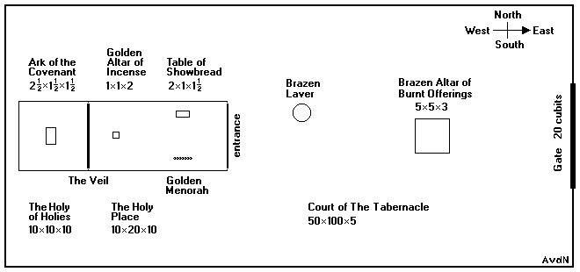
Hence, the earthly pattern of worship in both Tabernacle and Temple follows a heavenly pattern of worship. While the Letter to the Hebrews is likely earlier than the Apocalypse of John, John’s vision of a heavenly worship order is similar to Hebrews.,

Slide 49
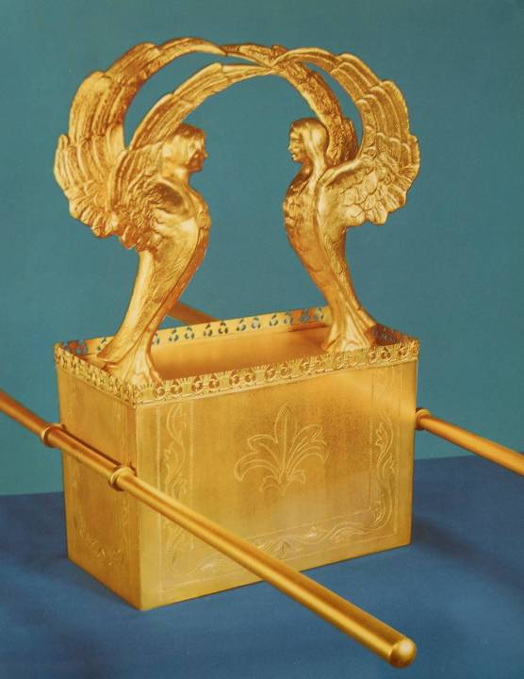
The Ark as a Throne
The ark of the covenant, symbolizing Israel’s binding agreement with God and containing the Ten Commandments, was the very center of the Israelite encampment.
Here the glory of God rested between the cherubim.

Slide 50
THE HIGH PRIESTLY ENTRANCE OF CHRIST INTO HEAVEN
The author of Hebrews sees a profound parallel between Yom Kippur and the death, resurrection, and ascension of Jesus.
On Yom Kippur, the High Priest made his once-in-a-year entrance into the Most Holy Place to atone for the nation’s sins (Lv. 16).
On that day, he passed through the inner curtain to intercede for the people.
As a human person, he represented the people to God.
When Jesus had made purification for sins, he sat down on the right hand of God (1:3b; 2:17-18).
He passed through the heavens into heaven’s Most Holy Place (4:14).
As a human person, made like his brothers in every way (2:17), he fully represents their weaknesses, even though he himself was without sin (4:15).

Slide 51
Drawing Near the Throne of Grace (4:16)
The throne language used here is important, for God’s ancient throne was the lid or mercy-seat of the ark (Ex. 25:22). The typical English rendering of “enthroned between the cherubim” (cf. 1 Sa. 4:4; 2 Sa. 6:2; 2 Kg. 19:15; 1 Chr. 13:6; Ps. 80:1; 99:1; Is. 37:16, etc.) envisions the atonement lid as God’s earthly throne.
Still, as Solomon expressed it, God’s true throne is heavenly (2 Chr. 6:18, 21).
Though the author of Hebrews does not directly mention it yet, his admonition to “draw near to the throne of grace” (4:16) presumes that in Christ it now is possible to draw near God’s throne, a hint that he will later draw attention to more directly (cf. 10:20).
He seems to assume the tearing of the inner curtain (cf. Mt. 27:51; Mk. 15:38; Lk. 23:45).

Slide 52
The Two Basic High Priestly Qualifications (5:1-10)
REPRESENTATION
A priest is by definition a representative of the people.
He is obliged to show gentleness and empathy, since he is himself characterized by weakness, offering sacrifice for himself as well as the people.
ORDINATION
The honor of ordination was not self-chosen.
Aaron, the first high priest, was directly appointed by God (cf. Ex. 28:1-4; Lv. 8).
Jesus, the Great High Priest, also required divine appointment, and this appointment was confirmed by God himself (Ps. 2:7; 110:4).
Jesus, in his earthly life, experienced the reality of human horror and the prospect of death.
BOTH BY DIVINE CALL AND HUMAN EXPERIENCE, JESUS IS QUALIFIED!

Slide 53
The Qualifications of Jesus
Jesus’ qualifications for priesthood are exemplified in his crucible in Gethsemane (where he suffered as a human) and in his perfect obedience (where he dedicated himself to the cross that lay before him).
It is obvious that the author of Hebrews now draws upon the experience of Jesus in Gethsemane, where the Lord recoiled from the horrific reality of what was ahead. Though the author does not quote the wrenching words, “Father if it be possible…” he surely has them in mind (Mt. 26:36-46//Mk. 14:32-42//Lk. 22:39-46).
Jesus suffered as God’s obedient Son, and in this suffering, he served perfectly as the great High Priest in Melchizedek’s order, bringing salvation to all his followers. (The author will take up the meaning of Melchizedek’s priesthood later in Chapter 7).

Slide 54
The Third Solemn Warning (5:11—6:12)
The first readers of the letter are judged to be immature Christians who need to make real progress toward spiritual perception.
It would be especially disastrous for those who had begun a new life in Christ to revert back to something less.
In turning back from Christ, it would be as though they were crucifying him all over again!

Slide 55
Sluggish Disciples
The use of the word nwqro<j (= sluggish) recalls the sleeping disciples who accompanied Jesus to Gethsemane. They slept while he prayed.
Similarly, the readers, though they had been Christians for some time, still needed basic instruction about Christianity’s fundamental truths.
Spiritually, they still were infants, unable to think critically about even elementary concepts.

Slide 56
The Basics
As examples of rudimentary lessons, the author offers a short list:
Repentance from Dead Works: turning away from behaviors leading to spiritual death
Faith in God: believing in the good news
Baptisms: Jewish ceremonial cleansings that anticipated Christian baptism
Laying on of Hands: the practice of the early church symbolizing the gift of the Spirit (cf. Ac. 8:17; 9:12, 17; 19:6)
Resurrection of the Dead: the central Christian hope at Christ’s return
Eternal Judgment: the certainty of God’s final evaluation at the end of the age

Slide 57
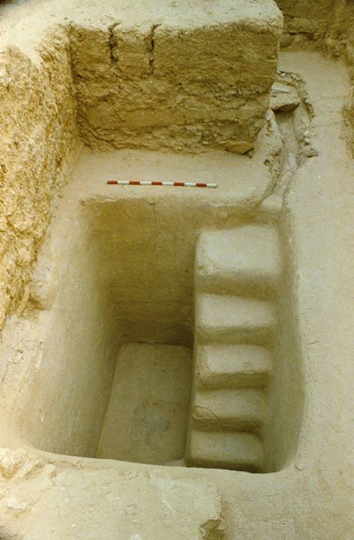
Second temple mikveh (baptismal pool) excavated near the stairway at the southern wall of the temple mount.
It would have been in use during the time of Jesus.

Slide 58
Blessings Now Enjoyed
It would be especially disastrous if those who had begun a new life in Christ reverted back to something less. The general blessings of the new life included:
Enlightenment: they had come to know the true Light of the world
The Heavenly Gift: received God’s gift of his Son
Sharing in the Spirit: participated in benefits brought by the Holy Spirit
Tasting the Goodness of God’s Word: heard and received the early church’s preaching about Jesus
Tasting the Powers of the Coming Age: in the resurrection of Jesus, the power of new age already had begun, even before the old age had expired

Slide 59
The Fruit of Life Demonstrates Faith or Its Absence
While “works” do not in themselves effect salvation, they do demonstrate whether or not one has genuine faith.
To accept the Christian faith but then revert back to something less is to hold Christ in contempt and tantamount to crucifying him again.
The fruit of life is the proof, one way or another: if the fruit is good, it demonstrates genuine faith, but if the fruit is worthless, nothing remains but destruction.

Slide 60
The Debate About Falling from Grace
Since the early centuries of Christianity, a longstanding and acrimonious debate over whether or not genuine believers can fall from grace has attended Christian theology.
The Novatians (3rd Century) believed that some sins (i.e., murder, blasphemy, adultery, idolatry, etc.) were irremediable, while the Donatists (4th century) argued that those who denied Christ in the face of persecution were forever outside the church.
In post-Reformation Calvinism, the doctrine of perseverance expressed the opposite stance, as did the doctrine of eternal security among those in the Anabaptist tradition.
Arminians generally, including Methodists and the descendants of the American Holiness Movement, contend that the human rejection of divine grace is possible.

Slide 61
Without question, the solemn warnings in Hebrews have sharpened this debate.
The warning against “drift” (2:1-3)
Conditional clauses beginning with “if you hold fast” (3:6)
The analogy with ancient Israel’s failure (3:12)
The warning against “falling short” (4:1, 11)
The urgency of “holding firmly” (4:14)
The impossibility of repentance for those who fall away (6:4-6)
The danger of being “cursed” and “burned” (6:8)
The admonition to make one’s hope “sure” (6:11)
Faith and patience as the means of inheriting the promises (6:12)

Slide 62
The warning to those who “keep on sinning” (10:26-27)
The dire threat of damnation to those who “spurn” the Son of God (10:28-31)
The urgent admonition not to “throw away your confidence” (10:35) and the need to persevere (10:36, 39; 12:1, 3)
The challenge not to “miss the grace of God” (12:15-17)
The final warning that if ancient Israel did not escape divine judgment, no more will Christians (12:25)
It is to the point, of course, that these severe warnings are issued to the readers of this letter, those whom he calls “brothers” (3:1, 12; 10:19; 13:22), who have experienced basic Christian initiation (6:4-5).

Slide 63
The Two Positions
CALVINISM
ARMINIANISM
Here, the warnings are explained on the basis of pseudo-faith.
Those who “fall away” never had genuine faith to start with.
It is precisely because they did not have true faith that they fall away.
Here, the warnings indicate the real possibility of apostasy.
Those who “fall away” had genuine Christian faith but renounced it.
God has granted freedom to the point that humans can reject Christ.

Slide 64
Both sides agree that there are some who claim to be Christians but fall away.
What must be left to God:
No psychological certainty can be found on either side, since a person’s assessment of his own faith, or even the Christian community’s assessment of his faith, does not guarantee anything.
Only God can be the judge of genuine Christian faith, since only God knows the heart.
Hence, whether or not those who fall away were ever true Christians becomes academic.
Still, the solemn warnings in Hebrews must stand, since passivity or turning from the Christian faith will certainly end in disaster.

Slide 65
Caution and Hope
The third solemn warning closes with both a caution and a confident hope.
The fruitful life of faith will be blessed by God, while the spiritually barren life, like thistles and thorns, will be burned up (6:7-8).
Still, the author is persuaded that his readers will persevere to salvation (6:9).
God’s justice ensures that they will be rewarded for their faithfulness (6:10).
Therefore, diligence and the imitation of those faithful saints who have gone before is the right path forward.

Slide 66
God’s Promises are Sure (6:13-20)
The end of the third solemn warning urges believers to imitate the people of faith who inherit God’s promises.
God’s promises are sure, because they are established on his own inviolable character.
The unchangeableness of God’s character rests on two unchangeable things:
  His promise of blessing to Abraham (Ge. 12:2-3)
  His oath at the binding of Isaac (Ge. 22:15-18)
Believers, then, have this firm hope in God’s unchanging character which anchors them to Jesus, the Great High Priest, who has entered heaven’s Most Holy Place!

Slide 67
Divine Promises
Divine promises are prominent in the theology of Hebrews.
God has promised “rest” for his people (4:1ff.).
The ancient people could not inherit this promise because of their unbelief (3:19).
It is only through faith and perseverance that God’s people inherit what has been promised (6:12).
God promised/appointed his Son to be an eternal priest after Melchizedek’s order (5:6, 10).
He also promised blessing to Abraham as well as the nations through his son, confirming the promise in the language of oath-taking (Ge. 22:16-18).

Slide 68
Christians are the Heirs of God’s Promises
The emphatic “we” of 6:18b clearly indicates that these ancient promises are for believers in Christ.
Like Lot fleeing from Sodom, we have fled the world in order to cling to God’s promises.
Our hope is like the anchor of a ship, holding it steady during storm and tempest, and the anchor point is Christ himself.
We are anchored to our great High Priest, who already has entered the heavenly sanctuary “behind the veil”, an eternal priest whose priestly work stands forever!

Slide 69
Melchizedek’s Priesthood (7:1-10)
The author now addresses the primary objection to Jesus’ high priesthood—he was from the Tribe of Judah, not the Tribe of Levi or the family of Aaron.
Was the claim of Jesus’ high priesthood therefore false? Absolutely not! Rather, his priestly order was different, following that of Melchizedek, the ancient priest of Jerusalem to whom Abraham paid tithes.
Of primary importance is that Melchizedek’s priesthood was not based on pedigree, but rather, God’s direct appointment. Jesus’ high priesthood is the same.

Slide 70
Unpacking Melchizedek (Ge. 14:17-24)
Salem is directly linked with Mt. Zion in Jerusalem (cf. Ps. 76:2). In the Targums, Ge. 14:18 is glossed as “Jerusalem”.
The name Melchizedek (= my king is righteous) is a typical Canaanite royal name and similar to a later Jerusalem king, Adonizedek (= my lord is righteous, cf. Jos. 10:1).
He was a priest of NoOyl;f, lxe (= God Most High), a divine name commonly linked with Yahweh (cf. Ps. 7:17; 18:13; 21:7; 47:2; 83:18; 91:9; 92:1).
Melchizedek was the priest-king of Salem (= peace), hence, the “king of peace”. In these ancient name-meanings, the author of Hebrews finds great relevance for anticipating Christ, the righteous king of peace, especially in light of Ps. 110:4.
That Abram paid tithes on the spoils of war is not surprising, since tithing was known throughout the ancient Near East.

Slide 71
A Priest with No Genealogy
It is significant that no genealogical records for Melchizedek are given.
The brevity of the Genesis account and the language “without father or mother or genealogy, having neither beginning of days nor end of life” offers no details about his lineage, birth or death, and this absence contrasts sharply with the way priests typically were understood in the Torah, where pedigree was paramount (cf. Nu. 20:25; 25:10).
Hence, Melchizedek’s priesthood did not depend upon lineage, but rather, on direct appointment from God, the same as described in Ps. 110:4.
As such, Christ’s priesthood also does not depend upon genealogy, but it comes by God’s direct appointment!

Slide 72
The Superiority of Christ over Aaron
The superiority of the Melchizedek priesthood over the Aaronic priesthood is apparent in that Abraham, the ancestor of Levi and Aaron, paid tithes to this ancient priest-king Melchizedek!
The priestly family of Levi received tithes from their fellow Israelites.
Melchizedek, by contrast, received tithes from Abraham himself, the father of the whole Israelite nation, long before Levi was even born!
Even more to the point, Melchizedek pronounced blessing over Abraham (Ge. 14:19a), and this blessing suggests that Melchizedek held higher rank than Abraham.

Slide 73
A Priest Forever!
When the Aaronic priests died, their priestly office passed to one of their sons.
Not so with Melchizedek! As far as the record goes, his priestly office still stands, since there is no record of his death nor the transfer of his office.
In this sense, he still “lives” (7:8), and in this sense he is like the Son of God, whose priesthood and priestly office continues forever (7:3b)!

Slide 74
Was Melchizedek a pre-incarnation of Christ?
Because of the language in 7:3, several church fathers concluded that Melchizedek was a pre-incarnation of the Second Person of the Trinity (and sometimes they linked this conclusion to a similar view of the Mal’ak Yahweh).
This conclusion seems unlikely for two reasons:
  The language of 7:3 appears in another ancient Near Eastern document, the Amarna letter from Abd-Khiba of Urusalima (Jerusalem), where the Jerusalem king tells his Egyptian suzerain, “Neither my father nor my mother set me in this place: the mighty arm of the king established me in my father’s house” (Letter 102). Here, clearly, the language does not represent a supernatural figure, but rather, an earthly king whose position did not depend upon pedigree.
  Further, if Melchizedek was already the Son of God, it makes no sense why the author of Hebrews says he is “made like” ( a]fomoio<w = to make like) the Son of God.

Slide 75
A New Priesthood (7:11-25)
Hereditary priesthood presumes an ongoing ritual of atonement for successive generations.
The repetition implies that such ritual is not finally effective.
In declaring his Son as a priest in the office of Melchizedek, God effectively indicated that the law of priesthood in Aaron’s family would be superseded.
This change in priestly order from Aaron’s sons to Melchizedek’s order repealed the requirement that all high priests must come from Aaron’s line.
This is how Jesus was qualified to be a high priest, and because this priesthood was declared to be “forever”, the office had to be filled by someone who would live forever.

Slide 76
The Ordination Ritual for Aaron, His Sons and the Transfer of Office (Lv. 8-9)
Bathing
Clothing
Tunic, Sash, Robe, Ephod, Breastpiece, Turban, Sacred Diadem
Anointing
Bull Sin Offering
Imposition of hands
Ram Holocaust
Imposition of hands
Ram for Ordination
Imposition of hands
Blood on right ear lobe, thumb & big toe
Waving of Unleavened Bread
Waving of Ram Breast
Sprinkling with Blood and Oil
Sacred Meal

Slide 77
The Problem with Hereditary Priesthood
The office of the High Priest was to be hereditary, first given to Aaron and preserved in perpetuity through his sons and their sons (Ex. 29:9, 29; Nu. 20:28; 25:11-13 Dt. 10:6).
Hereditary priesthood, by definition, presupposes the ongoing ritual of atonement for successive generations.
That the ritual is ongoing, in turn, suggests that such priestly service was not completely effective.
It is this ineffectiveness, the author argues, that lies behind the establishment of another priesthood announced in Psalm 110, an eternal one, long after the Aaronic priesthood had been established.
THE DECLARATION OF A NEW PRIEST AFTER MELCHIZEDEK’S ORDER THEREFORE ANTICIPATES THAT THE TORAH LAWS OF PRIESTHOOD WOULD BE SUPERSEDED!

Slide 78
The Change in Priesthood
The change in priesthood from Aaron to Melchizedek repealed the requirement that all High Priests must come from Aaron’s family.
This is how Jesus, descended from the Tribe of Judah, could be qualified as a High Priest, even though he did not come from the family of Aaron.
This priesthood, after Melchizedek’s order, did not depend upon pedigree, but rather, God’s direct appointment.
Most important, since this priesthood was declared to be “forever”, it had to be appointed to someone who would live forever, not one would die and pass on his in office.

Slide 79
A Priest Forever!
The Aaronic order had many priests, all who lived and died ordinary lives.
As such, the office of High Priest could not continue without the laws of heredity.
Jesus, however, lives forever by an “indestructible life”!
His priesthood never needs to be passed on, since the laws of heredity have no provenance for a priest who never dies!
Hence, his priesthood is effective in a way that the Aaronic priesthood could never have been effective, since he lives forever as the perpetual intercessor for his people (cf. Ro. 8:34).
CHRIST, AS THE GREAT HIGH PRIEST AFTER MELCHIZEDEK’S ORDER, IS NEVER UNAVAILABLE, NEVER DISPLACED, AND NEVER OUT OF OFFICE! HE SAVES ABSOLUTELY!

Slide 80
The Better Priesthood (7:26-28)
This priesthood of Jesus, God’s Son, truly fits what every human needs!
Unlike the priests of Eli’s line, who were rejected (cf. 1 Sa. 2:27-36; 3:11-14; 1 Kg. 2:26-27), this high priest is holy, blameless, pure and set part from sinfulness!
Unlike the Aaronic priests who die, this high priest has been exalted above the heavens and now sits at the Father’s right hand!
Finally, unlike those priests who must perform their service repeatedly, this high priest offered one sacrifice for everyone forever by becoming BOTH priest and sacrifice!

Slide 81
Once for All!
7:27 is the first of three occasions when the author of Hebrews uses the key word e]fa<pac (= once for all, cf. 9:12; 10:10).
This word expresses the final effectiveness of Christ’s high priestly service.
It stands in direct contrast to the repetitive sacrifices of the Aaronic priests over the centuries.
The priesthood of Jesus, established by divine oath to his Son, has been made effective forever by his suffering unto death and his indestructible life (7:28; cf. 2:10, 17-18; 7:16, 24-25).

Slide 82
The Function of Christ’s Priesthood (8-10)

Slide 83
High Priest of a New Covenant (8:1-13)
As implied earlier, heaven is the true sanctuary of which the earthly sanctuary of the Tabernacle (or Temple) was only a model of what exists in heaven.
Hence, the entry of Christ into the heavens is the counterpart to the entry of the high priest into the earthly throne-room of Yahweh on the Day of Yom Kippur.
If Yom Kippur belonged to the old covenant, then the entry of Christ into heaven belongs to a new one, the one envisioned by Jeremiah (Je. 31:31-34)—not a covenant of retribution, like the old one, but a covenant of forgiveness.
The very fact that Jeremiah called it “new” implies that the former covenant would become obsolete.

Slide 84
The True Tent (8:1-2)
What earlier was implied (cf. 4:14-16) now becomes explicit: the heavenly sanctuary is the “true tent” (th?j skhnh?j th?j a]lhqinh?j), which in turn means that the earthly sanctuary is only a model of what exists in the heavenlies.
The author here may be reflecting upon the LXX rendering of Nu. 24:5-6, which contrasts the tents of Israel with the tent God built:
  skhnai< sou Israhl (= “your tents, O Israel”), 24:5 LXX
  w[sei> skhnai< a{j e@phcen ku<rioj (= “like the tent which the LORD built”), 24:6 LXX
Christ has passed “through” the heavens (cf. 4:14) into this “true tent”, and now is seated in the exalted position of final authority at God’s right hand.

Slide 85
Priestly Gifts and Sacrifices (8:3-5)
The task of every priest is to offer gifts and sacrifices:
As far as earthly priesthood in the order of Aaron, Christ had nothing to offer, since he was not from Aaron’s family.
However, since the Aaronic priests serve in an earthly sanctuary and since the “true tent” is heavenly, Christ’s priestly ministry is not bound to the restrictions of the earthly tabernacle (and temple).
Even more to the point, the earthly tent itself was only constructed “according to the pattern shown…on the mountain” (cf. Ex. 25:9, 40).
The word “pattern” suggests an actual model or archetype which Moses was able to see while on the mountain of God:
  tyn9b;Ta (MT = pattern, figure, model, image): used for an architectural sketch or model in 2 Kg. 16:10 and for a “graven image” in Dt. 4:16
  tu<poj (LXX = image, statue, figure, pattern)

Slide 86
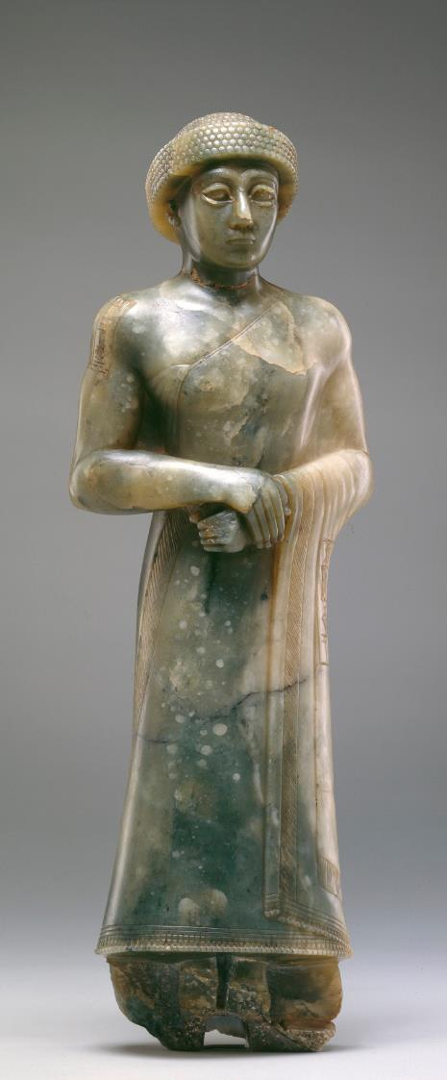
Temple Patterns
The idea of a temple model or pattern was known both within and outside Israel.
As far back as 3000 BC, Gudea of Lagash claimed to see in a dream the very model of a temple, which he later built.
The Jews already had applied the idea of a temple model to Solomon’s Temple, which followed the same floor-plan as the Tabernacle:
“Thou hast given command to build a temple on thy holy mountain, and an altar in the city of thy habitation, a copy of the holy tent which thou didst prepare from the beginning.”
Wisdom 9:8, RSV
Detroit Institute of Arts

Slide 87
A Heavenly, Priestly Ministry (8:6)
If there is indeed a heavenly sanctuary, then there must be a heavenly priestly ministry in that sanctuary (otherwise, what would be the point of having a heavenly sanctuary in the first place?):
The Aaronic priests certainly could not minister in heaven—but the One who passed through the heavens, Jesus the great High Priest, surely could minister there!
His ministry, therefore, is immeasurably superior to any priestly service conducted in the earthly sanctuary!
The covenant that regulates his ministry is therefore superior to the old covenant that regulates Aaron’s ministry—and it is established on better promises!

Slide 88
The Better Promises (8:7-12)
The conditions in this new covenant are not like the conditions in the old one:
The very promise of a new covenant presupposes the ineffectiveness of the old one.
The old covenant was written on stone tablets, but the new one would be written on human hearts.
The old one depended upon 3rd party instruction, either by priest or prophet (a system that frequently failed), but the new one established direct communication with God.
The old covenant was couched in the language of retribution—blessings and curses—but the new one promised the justice of forgiveness without retribution.

Slide 89
THE PROBLEM WITH THE OLD COVENANT
Corporate Retributive Justice
Torah declared that Yahweh inflicted penalty for covenant disobedience upon succeeding generations (Ex. 20:5; 34:7; Nu. 14:18; Dt. 5:9)
This, in turn, gave rise to the popular proverb, “The fathers eat sour grapes, and the children’s teeth are set on edge” (Je. 31:29; cf. Eze. 18:1-2).
Consequently, those who suffered discipline were apt to blame their punishment on their ancestors (cf. Eze. 18:3-32).
Both Jeremiah and Ezekiel rejected this interpretation, declaring that each one would be punished for his own sin (Je. 31:30; Eze. 18:4-29).

Slide 90
The New Covenant
Nevertheless, a New Covenant was coming!
It was to be established with the remnant from both the northern and southern nations (31:31).
Whereas the Mosaic covenant was contained in external codes, the New Covenant would be deeply internalized (31:33-34a).
Whereas the Mosaic covenant was based on obedience-reward and disobedience-punishment—retributive justice—the New Covenant would be grounded in forgiveness (31:34b).
Whereas the Mosaic covenant could end in a divine rejection of Israel for disobedience, the New Covenant was guaranteed forever (31:35-37; 32:40).

Slide 91
The New Covenant Cont.--
Jeremiah
“The time is coming,” declares Yahweh, “when I will make a new covenant…
“It will not be like the covenant I made with their forefathers…
“I will put my law in their minds and write it on their hearts…
“I will forgive their wickedness and will remember their sins no more…
Jeremiah 31:31-34
Ezekiel
“I will make a covenant of peace with them…
“There will be showers of blessing…
“I will establish an everlasting covenant with you. Then…I will make atonement for you for all you have done…
“I will give them an undivided heart and put a new Spirit in them…
Ezekiel 34:25-31; 16:60-63; 11:1-20

Slide 92
The Obsolete Covenant (8:13)
It is to be assumed that the author of Hebrews expected his readers to be familiar with Jesus’ eucharistic words at the last supper:
Jesus directly stated that the new covenant would be established in his death (Mt. 26:28//Mk. 14:24//Lk. 22:20; cf. 1 Co. 11:25).
If the Second Temple was still standing when the Letter to the Hebrews was composed (which is debated), the phrase “what is obsolete and aging will soon disappear” would have been a telling judgment, comparable to Stephen’s prediction about the end of the temple (cf. Ac. 6:14).
The two present passive participles, palaiou<menon (= becoming obsolete) and ghra<skon (= growing old), and the final expression e[ggu>j a]fanismou? (= soon to disappear), are highly suggestive!

Slide 93
Worship in the Earthly Sanctuary (9:1-10)
The daily services in the old sanctuary climaxed every year on the Day of Yom Kippur, when the high priest entered the Most Holy Place on behalf of the whole nation.
This ritual, which had to be reenacted annually, implied that the people’s access to the mercy seat of atonement was limited and not finally effective.

Slide 94
The Pattern of Tabernacle Worship
Worship in the tabernacle (and later, the temple) was essentially liturgical, and this earthly worship was patterned after heavenly worship.
The brief glimpses we have of heavenly worship (Isa. 6; Eze. 1, 10; Rv. 4-5) suggest concentric areas of holiness, the throne of God being central and surrounded by ranks of angels.
Similarly, the ancient tabernacle was composed of concentric areas of holiness as well, the ark as the “throne” of God in the Most Holy Place accessible only to the High Priest once each year on Yom Kippur (Lv. 16:14-17).
The Holy Place was accessible only to priests (Ex. 27:20-21; 30:7-8; Lv. 24:5-9), and the Israelite worshippers could only come as far as the altar (Lv. 1:3, etc.).

Slide 95
The Center
(Lv. 16)
The center of Israel’s atonement system was the annual Day of Atonement, 10th Day of the 7th month, a day of purgation for the whole nation.
It covered all the unintentional sins and impurities that individuals may have failed to address via the five primary sacrifices.
It also included all the deliberate sins and impurities that the high priest alone was permitted to address.

Slide 96
Yom Kippur
(Lv. 16)
Preparation
Selection of the Bull and two Rams
Selection of Two Goats and the Casting of Lots
Bathing and Vesting of the High Priest
Ritual
Bull Slaughter (purification for the high priest & his family)
Offering of Incense
Sprinkling of Blood
He-Goat Slaughter (purification for the people)
Sprinkling of Blood
Ram Burnt Offering (for the high priest himself)
Ram Burnt Offering (for the people)
Goat for Azazel (chosen by lot)
Imposition of hands
Driving the goat into the desert

Slide 97
Restricted Access to God
The fact that the High Priest was only allowed once annually into the Most Holy Place meant that the people’s access to God remained impeded so long as the ritual of the ancient sanctuary was in effect.
Earlier, however, the author of Hebrews already has pointed out that Christians can “approach the throne of grace with confidence” (cf. 4:16), a boldness absolutely prohibited under the old system (Lv. 10: Nu. 16).
This distance between the people and God under the old system, along with the continual repetition of sacrifices and gifts, meant that external rituals were incapable of absolving the worshipper of guilt or cleansing the conscience.

Slide 98
Christ, the High Priest of “Good Things that are Already Here” (9:11-28)
In Christ, the new order for worship already has been inaugurated!
To establish it, Christ did not resort to the old ritual, but entered the Most Holy Place of heaven one time for everyone with his own blood.
Hence, if Moses was the mediator of the old covenant, Christ is the mediator of the new one, which is effective in ways the old one could never be.
In the case of a last will and testament, the death of the testator is necessary to make the will effective; in the same way, Christ’s death put in force the new covenant.

Slide 99
“Good Things To come” vs. “Good Things Already Here” An important textual variant in 9:11 affects the way one understands the passage.
tw?n mello<ntwn a]gaqw?n
tw?n genome<nwn a]gaqw?n
(= the good things already here)
EARLY MANUSCRIPTS: p46 (AD 200), B (AD 300)
ENGLISH VERSIONS: NIV, ESV, NAB, NIB, NLT, RSV, NRSV
(= the good things to come)
EARLY MANUSCRIPTS: x (AD 300), A (AD 400)
ENGLISH VERSIONS: KJV, NASB, NET, NJB
Perhaps the best explanation for this variation is that the earlier text is original (p46, B) but the later text arose as an assimilation to He. 10:1, (x, A) which has the same phrase tw?n genome<nwn a]gaqw?n.

Slide 100
The Final Yom Kippur
Staying with the theme of the heavenly sanctuary, the author now asserts that Christ has entered this “perfect tent”, one NOT made by human hands.
This entry into the heavenly sanctuary was not according to the old pattern with goats’ and bulls’ blood, but rather, Christ brought into the Most Holy Place of heaven his own sacrificial blood—and he did so “once, for all”!
The emphatic term e]fa<pac (= once, for all) stands in direct contrast to the repetitive sacrifices of the sons of Aaron, and unlike theirs, this one purifies even the conscience of the worshipper, securing eternal redemption.

Slide 101
The a fortiori Argument
If the Aaronic rituals for purification, exemplified in Yom Kippur and the red heifer ordinance, were effective outwardly, how much more is the blood of God’s Messiah offered as a perfect sacrifice to God through the Spirit effective for the removal of inward guilt.
The author of Hebrews is consciously Trinitarian here.
The purification of the nation on the day of Yom Kippur is paralleled by the purification of individuals at miscellaneous times by the ashes of a red heifer (Nu 19).
Still, both these ancient ordinances are surpassed by the sacrifice of Christ.

Slide 102
The New Covenant
The new covenant, which Christ mediates, guarantees what the old covenant could not.
The old covenant was characterized by retributive justice of blessings and curses.
The new covenant is characterized by the redeeming act of Christ’s death which sets the guilty party free and ensures the eternal inheritance God has promised to those whom he calls.
Unlike the ancient Israelites who were “not able to enter because of unbelief” (cf. 3:19), those under the new covenant will truly receive what has been promised!

Slide 103
Word with a Double Meaning
The word for covenant, diaqh<kh, was more commonly used in the Greco-Roman world for a last will and testament.
Though his primary focus is on the covenant, the author is not willing to pass up a pertinent analogy with this more common use of the term.
By definition, a last will and testament has no force until the death of its composer, and in the same way, Christ’s death made effective the new covenant.

Slide 104
Symbolic Actions of Blood Application
In 9:18-22 the author introduces several puzzling features with references to “water, scarlet wool and hyssop” as well as the sprinkling of “the scroll”.
In the Exodus account, the only things directly mentioned are the blood dashed against the altar, representing God, the first party of the covenant, and blood dashed over the heads of the people, the second party of the covenant (Ex. 24:4b-8).
In mentioning these other elements, the author of Hebrews speaks about traditions to which we no longer have access (possibly oral traditions).
However, Josephus does mention the sprinkling of blood on the tent and its furnishings and utensils (Antiquities III.205-206).
Such rituals are summarized in the Levitical statement that blood is the agent of atonement (Lv. 17:11) and the conclusion that without blood, there is no forgiveness of sins.

Slide 105
The Blood Ritual in the Heavenlies
If a blood ritual was necessary in the earthly sanctuary (the earthly copy), it follows that a blood ritual was necessary in the heavenly sanctuary (the true tabernacle)—but with better sacrifices!
The “better sacrifice” is not the blood of an animal but the blood of the Messiah.
Here, Christ offered his own blood once (a!pac) and serves as our ongoing intercessor.
His sacrifice is not repetitive, but it is offered at the climax of the ages—for in Christ, the coming age already has begun!

Slide 106
The Completion of the Atonement Ritual
Though the offering of Christ’s blood in the heavenly sanctuary is now complete, the atonement ritual of Yom Kippur has not yet been completed.
One final action remains—the reappearance of the High Priest from within the Most Holy Place to bless the people (cf. Nu. 6:22-27).
Christ, the great High Priest, will not abandon his people to death (even though everyone dies!), but he will appear to them again, just as Aaron once appeared to the congregation waiting outside.
This final appearance of the High Priest, the return of Christ, confirms that sin has been annulled and salvation is final!

Slide 107
Once for All! (10:1-18)
The author’s explanation of Christ’s superior priesthood climaxes in a single word: e]fa<pac (= “once for all”).
In the old system, the priests of Aaron’s line remained standing, offering their sacrifices time after time and implying by their very repetition that such sacrifices were not finally effective. This repetition showed that their work was never finished.
By contrast, Christ finished his sacrificial work once for all and sat down! The fact that he “sat down” meant the sacrificial work was perfectly completed forever!

Slide 108
The Shadow and the True Form
By using the language of “shadow” and “image”, the author asserts that the rituals of the Torah could never be the reality itself, and therefore, the shadow could never produce perfection in the ancient worshipper.
The language of “shadow” and “image” parallels the earlier language of “copy” (8:5) and “true tent” (8:2).
The very repetition of sacrifices from generation to generation, along with the annual Day of Atonement, stood as reminders of sin while demonstrating the impossibility of the full removal of sin.

Slide 109
Christ’s Willing Surrender
In face of the impossibility of sin’s removal by the shadow embodied in the Torah ritual, Christ condescended to the world of humans to sacrifice himself when he came to do the Father’s will.
The Messiah’s own body was infinitely more precious to God than any animal sacrifices could ever be!
The death of Jesus effectively sets aside the entire sacrificial system of the Torah, replacing it with the “once for all” (e]fa<pac) sacrifice of his own body!

Slide 110
The “Body” of the Lord
Once again, a variation occurs between the MT and the version of the LXX used by the author in quoting Psalm 40:6 (which is 39:7 in the LXX):
MT: yl.i tAyr9KA My9n1z4xA (= “you have dug open my ears” or more idiomatically “you have opened my ears”)
LXX: sw?ma de> kathrti<sw moi (= “but you have prepared for me a body”)
This use of the word “body” loomed large for the author, since it describes the gift of one’s body so that it might be offered back to God—which is exactly what Christ did!

Slide 111
The Session of Christ
There were no chairs or seats in either the Tabernacle or Temple (other than the mercy seat in the Most Holy Place). Hence, all priestly service was conducted while standing.
But when Christ “sat down”, his high priestly work was perfectly accomplished forever!
The fact that priests in the Aaronic system never sat implicitly suggested that their priestly work was never done.
Hence, the “session” (or seating) of Christ looms large for the author, for it is a sign of his finished work (cf. 1:3, 13; 8:1; Ps. 110:1).
All that remains is the consummation, when all enemies are subdued.

Slide 112
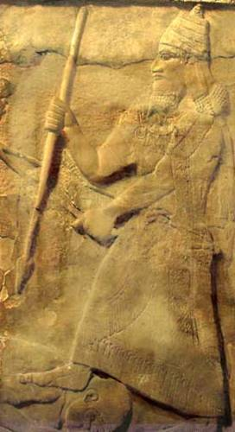
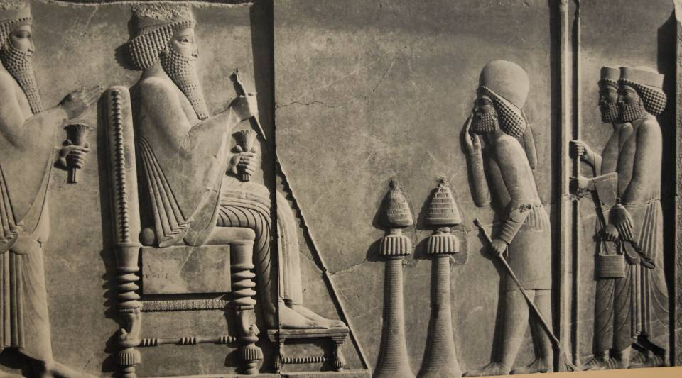
“Under his feet”
The language “a footstool under his feet” derives from the ancient practice of the use of a footstool for a seated king and placing one’s foot on an enemy’s neck after conquest.
2 Chr. 9:18
cf. Jos. 10:24

Slide 113
The Internal Quality of the New Covenant
The new covenant, which the author has referenced previously (cf. 8:8ff.), is deeply internal.
The Torah is now within people’s hearts.
It guarantees forgiveness, not retributive justice.
As such, there no longer is a need for the old system!
The author’s argument here is essentially the same as St. Paul’s majestic assertion, “For what the law could not do…God did!” (Ro. 8:3, NASB).

Slide 114
Call to Perseverance (10:19—13:17)
The word “therefore” (ou?n) presses home that the author is now reaching a climax.
The basic implication is that “since this is true, then let us live appropriately!”
Christians now can confidently enter the Most Holy Place, a closeness to God not possible in the rituals of the tabernacle, and this “new and living way” has been opened up by the sacrifice of the body of Jesus, symbolically the “curtain” in the sanctuary that screened the immediate presence of God (10:19-25).
Jesus is the priest, he is the sacrifice, he is the veil, and he is the mercy seat—all indicating that the old way was finished.

Slide 115
Holding to the Hope (10:19-25)
Because of Christ’s high priestly work, Christians can confidently enter the Most Holy Place, a relationship with God not possible under the Aaronic system (cf. 4:14-16; 6:19-20; 9:11-12, 24-28).
This “new and living way” has been made possible through the sacrificial offering of the body of Jesus, his body torn asunder as the great veil in the temple was torn apart, symbolizing open access to God’s intimate presence (cf. Mt. 27:51//Mk. 15:38; Lk. 23:45).
As internally purified from sin and guilt, epitomized in the ritual of Christian baptism, believers are invited to draw near to God.
Since these realities are now in effect, believers must hold firmly to the hope of God’s promise, which still stands open (cf. 4:1).
They must not neglect the Christian fellowship but should be all the more conscientious as the “day” of Christ’s return draws near.

Slide 116
The Fourth Solemn Warning (10:26-39)
To turn back from Christ would be even more disastrous than rejecting Moses’ law.
Those who rejected Moses’ law were punished, often by death.
Those who reject the Son of God will face an even more dreadful end.
The readers had started well, so they needed to persevere, since God’s promises are sure!

Slide 117
Sinning Deliberately
The sin to which the author here refers is the same aggressive non-faith about which he warned earlier (6:6).
He is not referring to general human weakness, since already he has plainly stated that Christ, as a caring high priest, sympathizes with human temptation and weakness while bearing gently with those going astray (2:17-18; 4:15-16; 5:2, 7-10).
Rather, this is the sin that spurns the Son of God and profanes his blood. The person who commits it has received the truth about Christ but then turns away, giving up the only means of salvation.
Nothing remains except condemnation at the final judgment.

Slide 118
Remembering
The author reminds his readers of their conversion, when they had “received the light” and faced persecution for their faith.
While their distress had not resulted in martyrdom (cf. 12:4), it was severe enough to include the confiscation of personal property and imprisonment.
They had faced this suffering with courage, because they knew that their true home was elsewhere.
Now, they must remain steadfast, for the return of Christ was near (cf. Hab. 2:3-4, LXX).

Slide 119
The Habakkuk Allusion (Hab. 2:3-4)
As usual, the author’s OT allusion is from the LXX, but here it is not a direct quotation.
Habakkuk awaited the fulfillment of a vision for deliverance which, even though it might seem slow in coming, nonetheless would surely come.
  The phrase e]rxo<menoj h!cei (= “coming, it will come”), which appears in both the LXX and the Book of Hebrews, is a Hebraism conveying certainty.
  The double negative in the phrase ou] mh< xronis^ (= “it certainly will not delay”), which appears in the LXX, equally conveys absolute certainty.
The author of Hebrews sees Habakkuk’s reference about a coming deliverance as a reference to the return of Christ (cf. 9:28).
In view of the certainty of Christ’s return, he both urges believers to remain steadfast and boldly affirms that together they will persevere!

Slide 120
The Great Cloud of Witnesses (11)
The past heroes and heroines of faith serve as a strong incentive to persevere!
Repeating themes:
  Faith is the certainty that God will do what he promised.
  The ancients did not receive the fulfillment of the promises within their own lifetimes, but they all understood that these promises reached beyond the land of Canaan and earthly life.
  Their righteous lives in the present were lived in view of the promise yet to come.
If the readers were to remain in continuity with the departed faithful, they must hold firmly to their faith in Jesus Christ, since he was the one for whom the ancients looked by faith!

Slide 121
The Larger Context
It is usually the exception for Christians to read this chapter in its context, but the context is important!
The review of the “great cloud of witnesses” is intended to encourage the readers to “run with perseverance” and “fix their eyes on Jesus” (cf. 12:1-2).
The word “faith”, which appears no less than 24 times in chapter 11, is certainty about the future, and faith is the defining characteristic that underlies the believer’s entire world-view (11:3).
Without faith, no one can please God (11:6).

Slide 122
Awaiting God’s Promises
The ancient people of faith did not receive the finality of God’s promises within their lifetimes.
Though the land of Canaan dominates the theological landscape from Abraham to Moses and beyond, Canaan was at best a prefigurement of the real promised land.
  All the ancients agreed that the ultimate object of their faith was something beyond Canaan and beyond earthly life (11:9-10, 13-16, 26-27).
  That this hope reached beyond the grave was most clearly exemplified in the binding of Isaac, whom Abraham sacrificed while reasoning that God could raise the dead (11:19), and in those who submitted to torture in order to gain a better resurrection (11:35).
The fulfillment of God’s promises would only come as a future perfection by the cross and resurrection of Jesus, a single act that would bring together the entire family of God’s people (11:39-40).

Slide 123
Life in the Present Must be Lived in View of the Promise Yet to be Fulfilled
The ancients demonstrated this life of faith in holy fear (11:7), obedience (11:8), enablement (11:11), radical sacrifice (11:17-19), vision for the future (11:20-22), bravery (11:23), godly choices (11:24-26) and dauntless courage (11:32-35).
They experienced both victory (11:33-35a) and defeat (11:35b-38), but they all had unshakeable faith (11:39)!
God’s messianic promises sustained them, and Christ was the One whom these ancients anticipated by faith (11:9-11, 13-16, 26-28).

Slide 124
The Fifth Solemn Warning (12:1-29)
The ancients who died in faith are the spiritual ancestors of present believers in Christ.
They are a great cloud of witnesses, who cheer the runners on toward the finish line.
Persecution had not yet resulted in martyrdom; indeed, hardship is a form of divine discipline.
The privileged place of Christians is like the difference between Mt. Sinai and Mt. Zion—the difference between the law and the promise. They must not refuse Zion by going back to Sinai!

Slide 125
The Metaphor of the Foot Race
The author assumes his readers’ familiarity with the Greco-Roman games, and like Paul elsewhere, he draws upon the imagery of the foot race.
Like runners in the Greek games (who ran naked), Christians must discard every extraneous encumbrance, fixing their eyes on the goal, which is Jesus.
Christ is the prototype of perseverance, who is both the founder and perfecter of genuine faith.
The ancients who died in faith already have run their race, and they stand at the finish line, cheering on those still running.

Slide 126
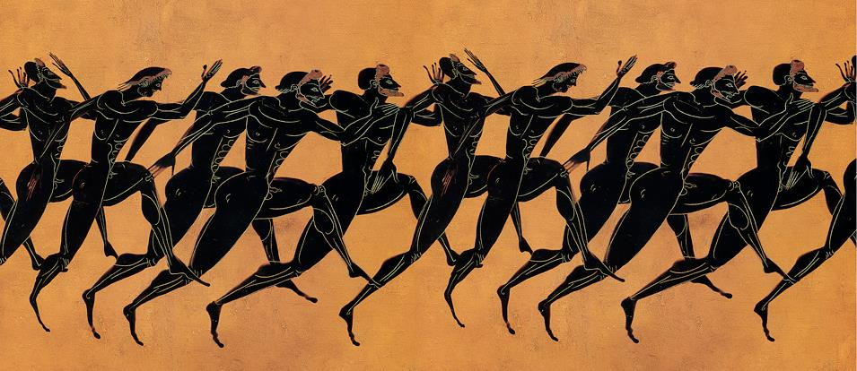
ca. 530 BC
Metropolitan Museum of Art, New York
Ancient races were measured in stadia ( a stadion = 185 yards), ranging from a 1 stadion length, to 2 stadia, and longer, up to a marathon.

Slide 127
The Persecuted Readers
The author is very aware of his readers’ struggle, but he also knows that it has not yet resulted in martyrdoms (though some had faced imprisonment, cf. 13:3).
He encourages them to remember the relationship between discipline and love, citing Proverbs 3:11-12.
Hardship is one means by which God disciplines and trains his people, and a son who receives no discipline is being treated as one unworthy of future honor.
God’s discipline is always “for our good”, so Christians must work toward healing the weak, not crushing them farther (cf. Pro. 4:26; Is. 35:3).

Slide 128
Don’t Fall Short!
In a short series of ethical admonitions, the author leads up the final warning against reverting back.
Believers must strive for peace and holiness.
They must make sure that they do not fall short of God’s grace, but they must live above the worldly vices of bitter attitudes, sexual indulgence, and indifference toward spiritual values, an indifference that prevented Esau from receiving the rightful blessing of the first-born son (cf. Ge. 25:29-34; 27).

Slide 129
Sinai and Zion
Using the two ancient holy mountains as metaphors, the author contrasts the old and new covenants.
SINAI
ZION
Sinai, Moses and the Torah belong together, representing the old system.
In the old system, no one could come near the mountain (cf. Ex. 19:9-24).
Moses himself was terrified by the danger of God’s fiery presence toward sinful people (Dt. 9:18-21).
Fear and distance were the defining characteristics!
Zion, David and the messianic promises belong together, representing the new system.
In the new system, all are invited to come close (cf. 4:14-16; 10:19-22).
Zion and David’s greater Son, whose blood speaks of forgiveness, brings us to the city for which Abraham looked (cf. 11:10)!
Righteousness and joy are now the defining characteristics!

Slide 130
The Climax of the Final Warning
If spiritual Mt. Zion is truly what the author has asserted, then to refuse it would be dangerous folly!
The same God who spoke at Mt. Sinai is now speaking by his Son, opening the way for believers to come to spiritual Zion.
  The present active participle lalou?nta (= “speaking”) is significant, since it recalls the God who in times past had spoken through the prophets, but now he is speaking through his Son (cf. 1:1-2).
Once more, the author employs the a fortiori argument: if those who refused the old covenant were judged by God, those who refuse the new covenant would hardly be exempt!
Heaven and earth will be shaken in the final climax of the age (cf. Hg. 2:6), and only the kingdom of Christ will survive the consuming fire of a holy God (cf. Dt. 4:24).

Slide 131
Living as Pilgrim People (13)
The author’s concluding exhortations consist of practical advice in light of what he already has written.
Love, hospitality, care for those in prison, sexual purity, contentment and trust must be cultivated.
Believers must respect and imitate godly leaders.
They must guard themselves against heresies.
Finally, Jesus’ death “outside the camp” (outside the city gate) calls for Christians to leave the camp of traditional Judaism.
The letter closes with a blessing and prayer.

Slide 132
Charity and Affections
The concluding various pieces of ethical and practical advice, no doubt, were drawn from what the author considered to be pertinent to his readers’ present circumstances.
Altruistic love, hospitality to strangers, and care for those who were mistreated was fundamental to the Christian life.
Sexual purity in marriage, especially in a culture that was highly promiscuous, was essential.
Greed must be rejected and contentment and trust in God embraced (Dt. 31:6; Ps. 118:6-7).

Slide 133
Leaders and Spiritual Life
Christian leaders must be respected and imitated, but while human leaders will pass on, Christ remains constant.
Believers must beware of outlandish teachings, including dietary restrictions.
Instead, their spiritual nurture must come from a spiritual altar unavailable to those who remain attached to the old system.
Most important, believers must be willing to leave the camp of traditional Judaism: just as the carcasses of sin offerings were burned outside the camp after Yom Kippur (Lv. 16:27), so also the body of Jesus was crucified outside Jerusalem’s walls (cf. Jn. 19:20).
Believers should be willing to embrace Jesus’ shame of being “outside the camp”.

Slide 134
The New Worship
If it should be argued that a rejection of the Levitical system meant the worshipper had nothing left to offer God, it should be understood that Christians indeed have a sacrifice to offer.
It is the sacrifice of praise and thanksgiving, the fruit of one’s lips.
It is the offering of spiritual sacrifices of good works.
The letter closes with a prayer of blessing grounded in the sacrificial death of Jesus and the triumph of his resurrection.

