Slide 1
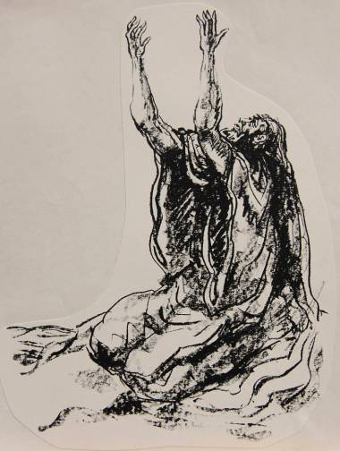
HABAKKUK
Questioning God

Slide 2
introduction

Slide 3
THE ORACLES OF HABAKKUK ARE UNIQUE AMONG THE PROPHETS
Rather than pronouncements of judgement on Israel or the nations, Habakkuk addresses questions of theodicy.
The fundamental question concerns divine justice: is God fair in his treatment of Judah and Jerusalem with respect to the coming disaster?
Like the Book of Job, this book explores the sovereignty of God, not the theoretical extent of his power, but whether or not he administrates his sovereignty consistently and in a just way.

Slide 4
Habakkuk’s questions arise in the context of the prophetic Anticipation of Exile for Jerusalem and judah
8th Century
Only a remnant will return (Is. 1:22).
Zion will be plowed like a field (Mic. 3:12).
7th Century
I will stretch out my hand against Judah and against all who live in Jerusalem… Be silent…for the Day of Yahweh is near. (Zep. 1:4a, 7a)
This whole country…will serve the king of Babylon 70 years (Je. 25:11).
6th Century
I am about to desecrate my sanctuary (Eze. 24:21).

Slide 5
The basic questions
Habakkuk’s fundamental questions follow along two paths:
If God is really in control, why is there so much evil in the world?
If God is really righteous, why does he allow wicked empires to swallow up nations less wicked than themselves?
Though posed more than 2500 years ago, these questions of theodicy are as relevant now as they were then!

Slide 6
Questions
How do modern people frame questions of theodicy?
How does belief in the sovereignty of God sharpen such questions?

Slide 7
Historical context
The one clear historical marker in the book is the reference in 1:6 to the Babylonians: “Behold, I am raising up the Chaldeans…”
The Hebrew term Kasdim refers to the Chaldeans or Babylonians. Since the time of Isaiah, the anticipation of an eventual Babylonian threat had been clearly voiced (Is. 39).
What is unclear is whether Habakkuk anticipated the Babylonian invasion in the distant future or observed them as a present threat.
Many if not most scholars place the book about the time of or slightly earlier than the Battle of Carchemish, where in 605 BC the Babylonians defeated the Egyptians, final remnant of Assyrian support.

Slide 8
DECLINE OF ASSYRIA/RISE OF BABYLON
626-620 BC Defeat at Babylon (Assyrians
driven from Babylon)
614 BC Fall of Ashur (loss of Assyrian
southern capital)
612 BC Fall of Nineveh (loss of Assyrian
northern capital)
609 BC Defeat at Haran (loss of Assyrian
government in exile)
605 BC Battle of Carchemish (loss of last
significant ally, Egypt)

Slide 9
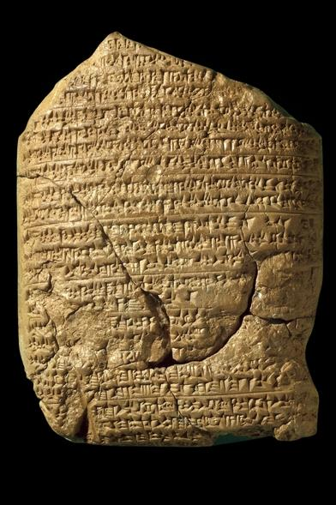
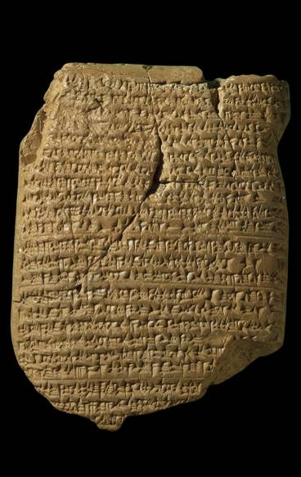
This cuneiform text says that Nebuchadnezzar "crossed the river to go against the Egyptian army which lay in Carchemish. They fought with each other, and the Egyptian army withdrew before him. He accomplished their defeat and beat them to non-existence. As for the rest of the Egyptian army, which had escaped from the defeat so quickly that no weapon had reached them, in the district of Hamath the Babylonian troops overtook and defeated them so that not a single man escaped to his own country."
Babylonian Chronicle 5
British Museum, London

Slide 10
After carchemish
After the Battle of Carchemish, Judah would be forced to change fealty from Egypt to Babylon during the reign of Jehoiakim (2 Kg. 23:34—24:1; 2 Chr. 36:4-6).
If this is indeed the political milieu of Habakkuk’s ministry, then he would have been a contemporary of Jeremiah (cf. Je. 36).
The previous exile of the northern nation Israel and the present looming threat of Babylon to Judah frame Habakkuk’s questions.

Slide 11
The man himself
Nothing particular is known of Habakkuk apart from his name in 1:1.
In the Additions to Daniel in the Apocrypha, there is the intriguing legend about Habakkuk carrying a stew to Daniel when he was in the den of lions (Bel and the Dragon 33-39), but though canonical for Roman Catholics and Eastern Orthodox, most Protestants have been skeptical.
His book begins with language typical of the prophets, “The burden that Habakkuk the Prophet saw…” (1:1).

Slide 12
structure
The book falls into three major parts:
The Dialogue with God
The initial complaint and God’s answer (1:2-11)
The second complaint and God’s answer (1:12—2:5)
Taunt Against Babylon
The five woes against Babylon (2:6-20)
The Divine Theophany
The prophet’s visionary prayer of God’s divine theophanies and judgments in history (3)

Slide 13
The dialogue

Slide 14
The first complaint (1:2-4)
The initial question pertains to what seemed to be divine aloofness with regard to human violence and injustice.
If Yahweh was sovereign, why did he allow anarchy to prevail in the world?
The Torah, God’s instruction for life, seemed to have no effect. Hezekiah had made a valiant effort toward reform (2 Kg. 18:1-8), but after his death, Manasseh plunged headlong back into paganism (2 Kg. 21).
Habakkuk’s implicit question to God was, “Why don’t you do something?”

Slide 15
The first answer (1:5-11)
God’s answer was that he WAS about to do something, something so shocking and terrible that Habakkuk would be hard pressed to even believe it!
He already was putting his plan into action, for he was about to raise up the Babylonians, who would sweep across the ancient Near East in a veritable frenzy or war and annexation.
If the Assyrians had been fearful, the Babylonians would be even more so! Like predators, they would vanquish every opposing force, sending innumerable prisoners of war into exile.

Slide 16
The second complaint (1:12-13)
If anything, Yahweh’s answer made the original complaint more acute.
Yahweh could hardly be faithful to his own covenant promises if he allowed the Babylonians to exterminate the people of Israel; hence, the coming invasion must be a temporary judgment within history.
Even so, this seemed incompatible with Yahweh’s moral character: how could he allow the Babylonians to invade Jerusalem, since they were even more corrupt than the people of Judah?

Slide 17
The Babylonian conquests (1:14-17)
In an extended metaphor, Habakkuk describes the nations like fish in the sea.
The Babylonians would be great “fishers” of men, dropping their military dragnet into the water in order to scoop up nations in order to feed their own political ambitions.
The “net” was Marduk, the Babylonian god of war and chief among the more than 3000 deities in the Babylonian pantheon.
How could Yahweh permit such a pagan “net” to prevail?

Slide 18
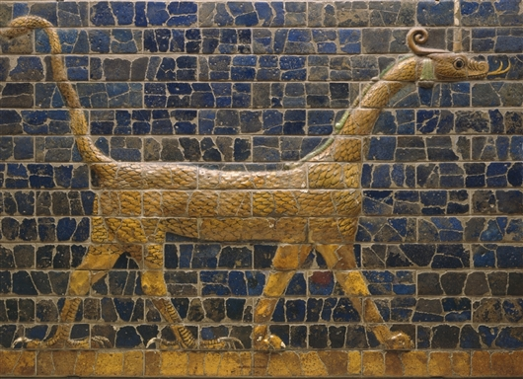
This snake-dragon depiction of the Babylonian god Marduk, originally part of the Ishtar Gate in Babylon and created from terra-cotta glazed and molded bricks, dates to about 604-562 BC. Marduk was the patron god of Babylon.
Detroit Institute of Arts

Slide 19
Waiting on Yahweh (2:1)
Habakkuk resigned himself to wait and see what Yahweh would say.
Like a sentry on duty, he would await God’s answer.
His waiting on God was equally a waiting on the Babylonian doom that was coming.

Slide 20
Questions
While Habakkuk lived in the ancient world with only dim perceptions about the future, how does the coming of Christ affect the way one might answer such questions?
Some modern people (Rob Bell types) wish to eliminate the wrath of God as incompatible with his love. What do you think about such conclusions?
How difficult is it to “wait” upon God?

Slide 21
The second answer (2:2)
Yahweh’s second answer was prefaced by the command to write the answer on tablets, just as Isaiah did (cf. Is. 8:1; 30:8).
The precise type of tablet is unclear, though clay and stone were typical, but here there may be a deliberate echo of the inscription of the Decalogue and its enduring quality (cf. Ex. 34:1).
The text was to be legible (large?) so that anyone reading it could disperse its message.

Slide 22
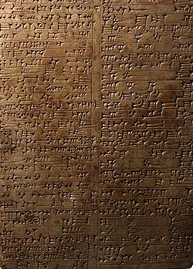
ANCIENT TABLETS
A stone inscription from the 13th century BC during the reign of the Assyrian Tukulti-Ninurta I. The table describes the king’s ancestors, deeds and conquests, and in particular, his restoration of the temple of Ishtar. It concludes with a curse on anyone who would attempt to remove the king’s name from the tablet.
Pierpont Morgan Collection,
New York
One of the cuneiform texts describing Babylonian rations for Jehoiachin and his sons in exile. It was discovered by Robert Koldewey during the German excavation of the Ishtar Gate in the early 1900s.
Pergamon Museum, Berlin

Slide 23
An answer postponed (2:3-4a, 5)
The answer to Habakkuk’s complaint and the resolution to the universal problem of evil in the world would only appear at “the end”, an unknown time in God’s future appointments.
In the meantime, Habakkuk (and all God’s people) must be content to wait.
Though the answer might seem slow in coming, it would surely arrive!
The antecedent of the “he” in 2:4a goes back to the “wicked one” in 1:15, representing Babylon, the empire of power, greed and pride bent on conquest.

Slide 24
the righteous will live by his faith (2:4b)
In the midst of the times between the promise of justice and the fulfillment to come, the righteous person must live by his faith.
The word hn!Umx$ (= faith, faithfulness, fidelity), related to the word “amen”, refers to the inner attitude of faithfulness and continual conscientiousness.
The righteous person must not fall into the way of the pagans; instead, he must remain steadfast in his trust toward God.

Slide 25
Sandwiching literary technique
Hebrew literature features a technique of emphasis in which the focus of a text lies in the middle rather than the beginning or end. This “sandwiching technique” is most familiar in poetic chiastic structures, but one finds it in prose as well.
Here, the emphatic statement “the righteous will live by his faith” (2:4b) falls between the identification of the arrogant power-broker, Babylon (2:4a), and his description as the insatiable conqueror of nations (2:5).
Babylon’s life is inflated, not upright;
But the righteous will live by his faith;
Babylon’s appetite is like hell and the grave; it never has enough.

Slide 26
New Testament quotations
Habakkuk 2:4b is quoted three times in the New Testament.
GALATIANS 3:11
Paul also says that it is precisely by this life of faith that one stands justified before God.
ROMANS 1:17
Paul says that the righteousness of God is revealed both in the beginning and end of faith.
HEBREWS 10:38
Here, the Habakkuk passage is quoted to emphasize the need for patient endurance until the end.

Slide 27
Questions
What do you think it means to say that the righteous person will live by his faith?

Slide 28
TAUNT AGAINST BABYLON

Slide 29
Taunt songs
Poetic taunts appear at various places in the Hebrew Bible (e.g., Ps. 52; Is. 14:3ff., Mic. 2:4; Eze. 28:2ff.; 32:2ff.).
Taunts are direct addresses against an enemy, ridiculing his pretensions and scoffing at his destruction.
Here, the taunt comes in the form of five woes against Babylon.

Slide 30
The five woes (2:6-20)
1st Woe
(2:6-8)
The lands that had been stripped by Babylon are depicted as creditors,
Nevertheless, the day for settling accounts will surely come!
2nd Woe
(2:9-11)
Like a vulture, Babylon had scavenged the nations.
But the very stones and beams of the house built by extortion will cry for vengeance!
3rd Woe
(2:12-14)
Bloodthirsty Babylon would someday disappear like flax in fire!
God will replace Babylon by filling the earth with his divine glory!
4th Woe
(2:15-18)
Just as drunkards descend into debauchery and shame, so Babylon will be drunk on the wrath of Almighty God!
5th Woe
(2:19-20)
The hewn images of Babylon’s idols were lifeless, offering no truth, word, guidance or breath!
But God is in his holy temple!

Slide 31
referencing isaiah
Habakkuk 2:14, while not worded identically to Isaiah 11:9b in the Hebrew text, is very close, so much so that most scholars think it likely that Habakkuk is referencing the great prophet from a century and a half earlier.
ISAIAH 11:9b
“…for the earth shall be full of the knowledge of the LORD as the waters cover the sea.”
ESV
HABAKKUK 2:14
“For the earth will be filled with the knowledge of the glory of the LORD as the waters cover the sea.”
ESV

Slide 32
The divine theophany

Slide 33
A song and a prayer
As in several Psalms, the final section of Habakkuk is structured as a prayer, but presumably a prayer set to music, since the subscript at the end addresses it to the choirmaster with stringed instruments. Hence, perhaps it was used in the 1st temple as a liturgical piece. Also similar to many Psalms, this prayer is punctuated with three “selahs”.
NOyGwi (= shiggaion, cf. Ps. 7) appears in the plural in Habakkuk 3:1. It may be an obscure musical or literary term, and some scholars suggest that it possibly denotes a stirring of the emotions.
HlAs, (= selah), which appears 71 times in the Psalms and 3 times in Habakkuk, is a musical term of unknown intent. It might mean: a) an interlude or pause b) signal to raise the pitch c) an instrumental interlude d) an acrostic indicating a change of voices, or e) a signal for the antiphonal response “forever”.

Slide 34
Intercession (3:2)
Habakkuk’s prayer, after hearing God’s responses and the charge that he must await God’s timing to see justice in the earth, begins with an intercession for the mighty intervention of Yahweh.
He has heard of God’s mighty acts.
Now, he prayers that he might be able to see them.
In particular, even though an evil generation deserves divine wrath, he prays for mercy in the midst of wrath. Would there be mercy for those who lived by faith?

Slide 35
Theophany (3:3-7)
Habakkuk’s prayer was answered by a vision of God’s deliverance of Israel from Egypt, a deliverance in the past, but one that anticipated a deliverance in the future.
This opening line is clearly linked to Dt. 33:
Paran is the desert wasteland between Kadesh-Barnea and Mt. Sinai.
Seir is the hill country of Edom.
Both locations are associated with Mt. Sinai, where Yahweh gave the Torah (Dt. 33:2).
The pyrotechnics of theophany when God descended upon Mt. Sinai (cf. Ex. 19:16-19), often repeated elsewhere (Ps. 18:7-15; 2 Sa. 22:8-16), is now repeated to Habakkuk.

Slide 36
But why did god come in this way (3:8-15)?
Was this merely a display of raw power or something more?
It WAS something more!
Yahweh as the divine warrior (3:9-11; cf. Ex. 15:3) was declaring his judgment upon the nations (3:12) and his deliverance of his people from their bondage (3:13-15)! Pharaoh, the god-symbol of Egyptian power, and all his cohorts were crushed!
This vision of the nations arrayed against Yahweh is the same as in Psalm 2, where they are arrayed against Yahweh and his anointed!
Here, as there, total victory belongs to Yahweh!

Slide 37
The final answer
Will God respond to evil in the world?
Absolutely yes!
He will judge the nations!
Will he allow his very own people to die?
Absolutely not!
In wrath he will remember mercy, just as he did in ancient times (3:13)!

Slide 38
Overwhelmed (3:16)!
At this vision of God’s sovereign majesty, Habakkuk fell in a shuddering heap.
What had once happened to Pharaoh would also happen to Babylon!
What would happen to Babylon would also happen to the power-brokers of the world.
In response, Habakkuk humbly resigned himself to await God’s coming judgment.

Slide 39
Between the times (3:17-19)
Between the promise and the fulfillment, Habakkuk would rejoice in the future God had promised.
Whatever hardships attended the present, whether drought or calamity, he would remain joyful in the salvation God had promised!
Through God’s strength, he would rise above the injustices of the present while living by faith, climbing to the heights of faith with the feet of a deer (cf. Ps. 18:32-33; 2 Sa. 22:33-34).

Slide 40
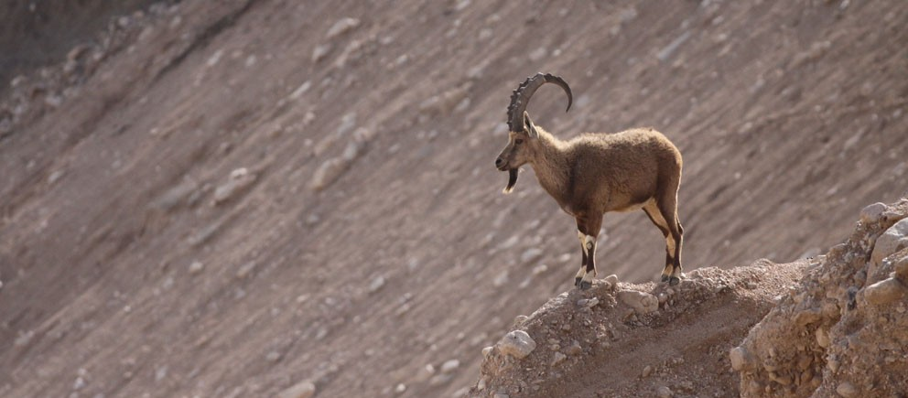
Scholars usually identity the “deer” (hlAY>!xa) in Ha. 3:19 as either the Asian red deer or roe buck, which no longer inhabits Palestine (though some skeletal remains have been discovered); however, a few scholars suggest that it might be the Palestinian ibex (pictured here), which is really a wild goat living in the roughest, steepest terrain it can find.

Slide 41
Questions
Given Habakkuk’s response to his encounter with God, how do you assess those who claim to have had encounters with God and consider them fairly ordinary?
How does God’s answer to Habakkuk speak to the modern person who has questions about the problem of evil?

