Slide 1
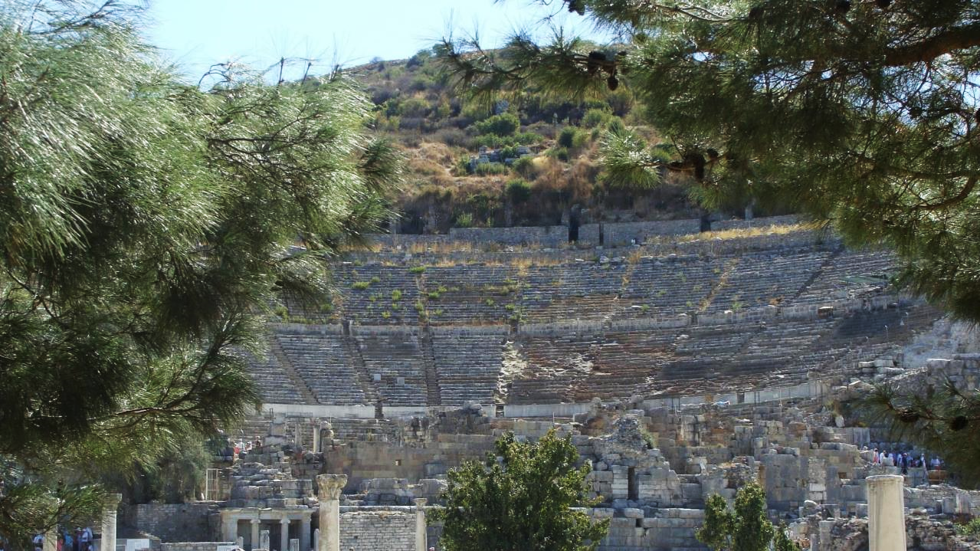
NT ARCHAEOLOGY
NT ARCHAEOLOGY
FROM CORINTH TO EPHESUS
Lesson 11
Lesson 1
Introduction

Slide 2
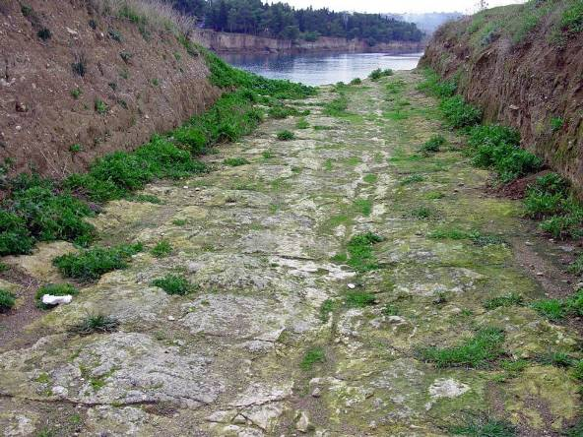
Ongoing excavations of ancient Corinth have been conducted since 1886.
The Diolkos, a paved sledging road between the city’s two harbors, provided a means for transporting cargo between the Saronic Gulf (Aegean Sea) and the Gulf of Corinth (Adriatic Sea).

Slide 3
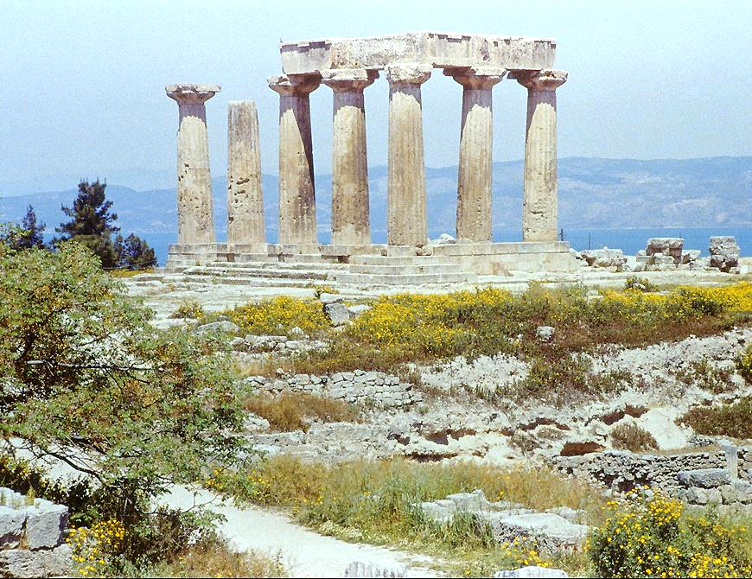
We typically don’t think of Paul’s world as having ruins, but in fact, the Temple of Apollo in Corinth had existed there for about 700 years by the time Paul arrived. The pantheon had a long history in Greece before Paul’s time.

Slide 4
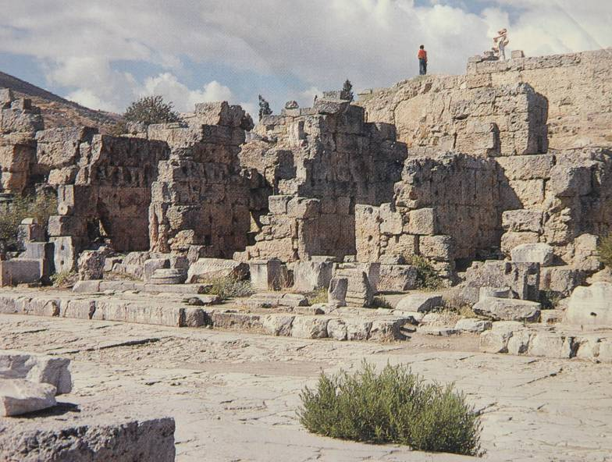
The shops lining the west side of the Lechaion Road in Corinth would be what Paul refers to as the “meat market” (in the older English versions, the “Shambles”).
His counsel to the Corinthians with respect to purchasing food there was, “Eat anything sold in the meat market without raising questions of conscience, for the earth is the Lord’s, and everything in it” (1 Co. 10:25).

Slide 5
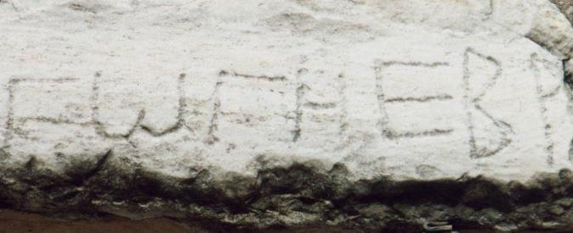
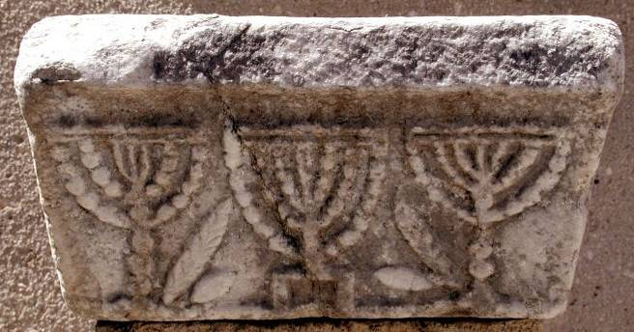
This lintel inscription on the Lechaion Road reads in rough script: “Synagogue of the Hebrews.”
The synagogue at Corinth has yet to be discovered, but two artifacts testify to a Jewish presence, both from a time somewhat later than Paul..
This triple menorah, with its seven-branched candelabras, obviously testifies to a Jewish community.

Slide 6
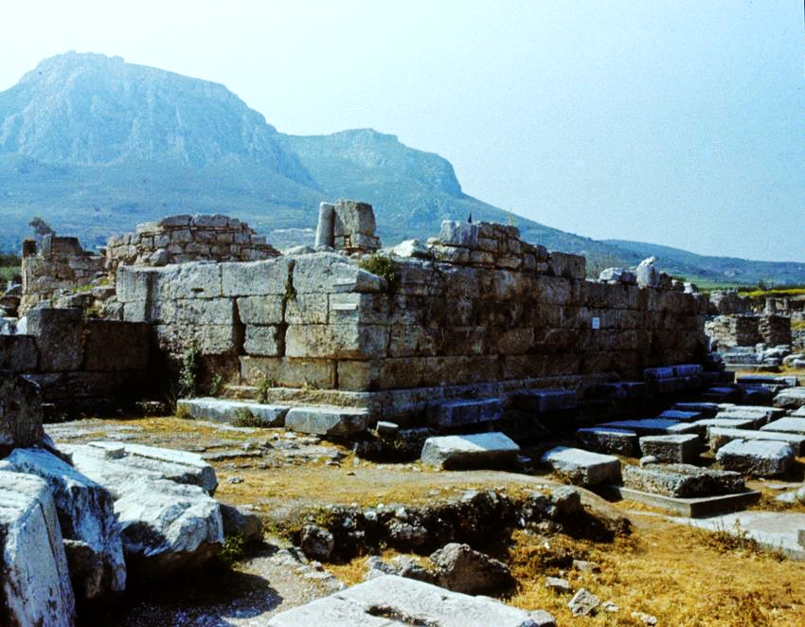
The language of bema was well-known to Paul, who wrote to the Corinthians, “We must all appear before the bema of Christ” (2 Co. 5:10a).
Paul himself appeared before Gallio at this Corinthian bema.

Slide 7
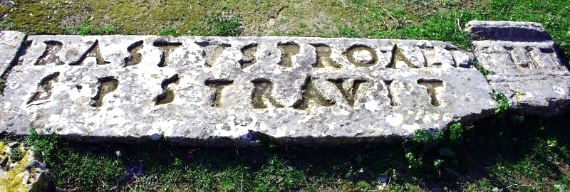
One of Paul’s converts was Erastus, the Aedile of Corinth (= administrator of financial matters concerning streets, markets, games, and public buildings). This pavement in his honor was laid in about AD 50, perhaps before Paul arrived (cf. Ro. 16:13). It reads, “Erastus, in return for his aedileship laid [the pavement] at his own expense.”

Slide 8
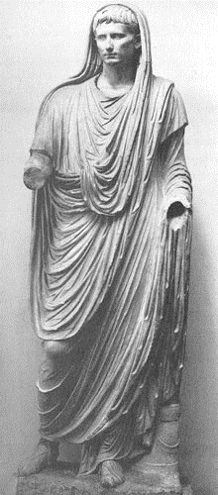
The Tallith
However, the customary posture for men in the Greco-Roman religion was to pray with their head covered, and Paul seems to want Christians to avoid adopting this posture for prayer, probably to show a distinction between Christian prayer and pagan prayer.
Augustus Caesar (left) is depicted in the traditional devotional posture for pagans.
Those familiar with Jewish customs know that the tallith (four cornered cloth covering the head of men in prayer) derives from Nu. 15:38-40, where Moses commanded tassels of blue for the prayer shawl.
It comes as something of a surprise that Paul, an observant Jew, would instruct Corinthian men to pray with an uncovered head (1 Co. 11:4, 7).

Slide 9
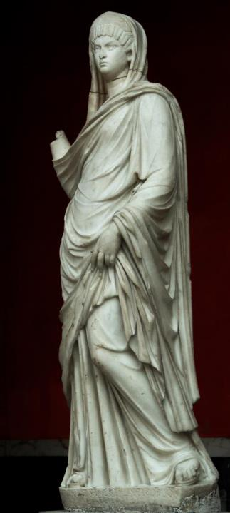
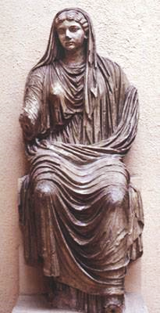
Roman Women with Heads Covered
Paul instructs wives to pray with their heads covered (1 Co. 11:5-6, 13), but for a different reason.
Wives in Roman society who spoke publicly were obliged to wear a veil, a sign of their marriage.
The veil was a symbol of their authority to speak.
Some women were adopting a “liberated” attitude, dispensing with the head covering, and Paul seems to think this sent the wrong signal.
2nd Century depiction of a Roman wife
Livia, wife of Augustus

Slide 10
Talking Points
On occasion Paul or others in the New Testament address issues that might be considered local or time-bound, and the advice about head-coverings is often regarded as such. How does one tell the difference between what is local and time-bound as opposed to what is universal?
Even if some advice is time-bound might it still have relevance for Christians of later generations?

Slide 11
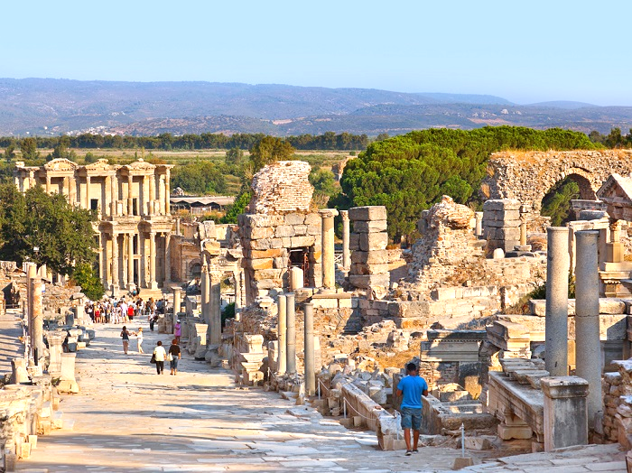
From Corinth, Paul relocated to Ephesus in Asia Minor, where he found great opportunity (Ac. 19:10b; 1 Co. 16:8-9) but also severe danger (2 Co. 1:8-10). He would stay in Ephesus for two years (Ac. 19:10a).

Slide 12
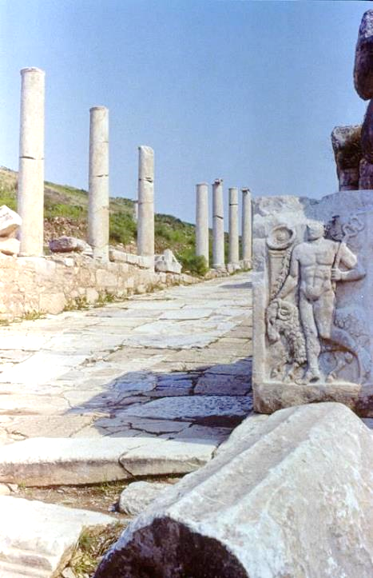
Ephesus featured broad streets paved with marble and lined with columns. Here, the Street of Curetes leads uphill toward the city gates. The stele in the foreground features a relief sculpture of Hermes, the Greek god whom the citizens of Lystra thought had come to earth when Paul healed a crippled man (Ac. 14:12). Hundreds of such ornamental sculptures have been excavated from ancient Ephesus, providing evidence of the elaborate decorations on public buildings that lined the boulevards.

Slide 13
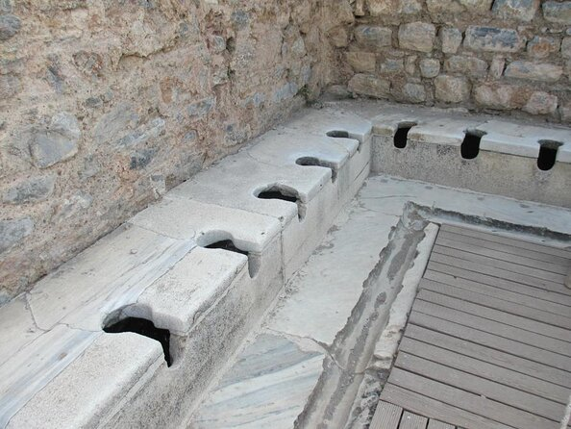
Among the excavations in Ephesus was this 48-seat latrine, some of the finest continuous flush marble toilets in the Roman world. The floor was heated, and clients were sheltered from rain by a wooden roof mounted on columns.

Slide 14
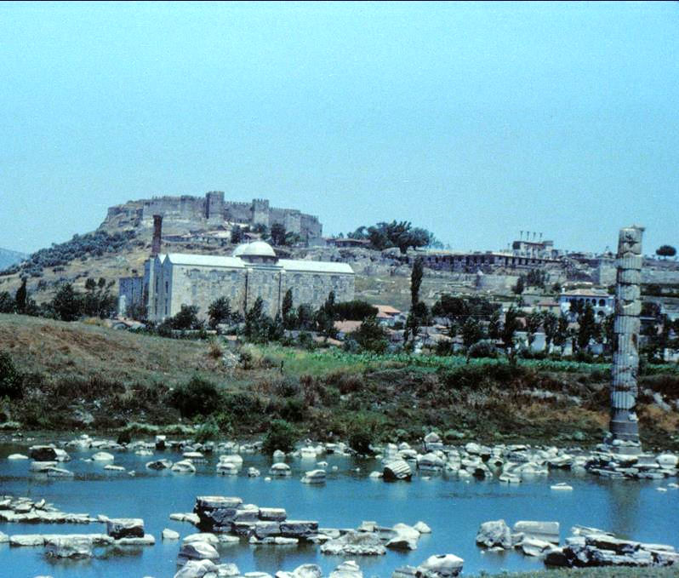
Paul himself does not detail his troubles in Ephesus other than to say bluntly that he “felt the sentence of death” (2 Co. 1:9). Luke, however, tells us that strong opposition came from the silversmiths making amulets in support of the Temple of Artemis (Ac. 19:23ff.). They were frustrated because conversions to Christianity meant a loss of business for them. The foundations of the famous temple remain in a swamp.

Slide 15
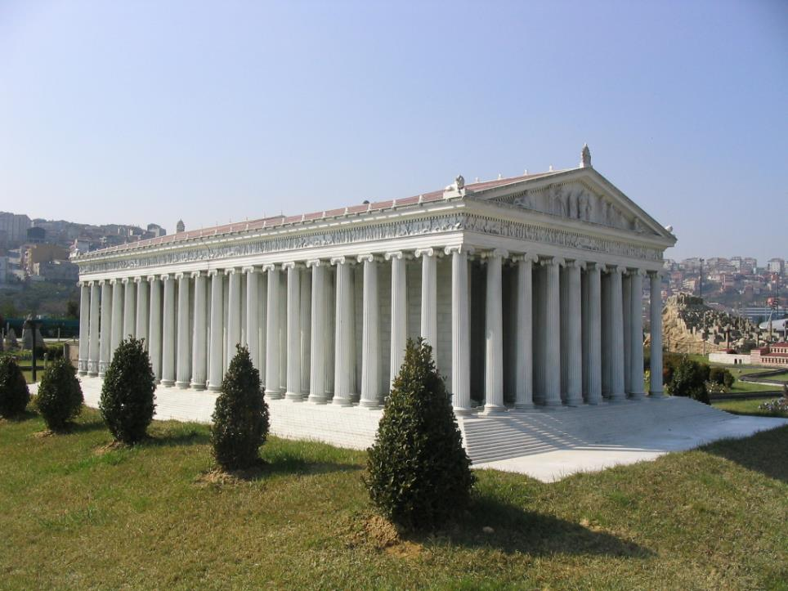
The Temple of Artemis was named by Antipas of Sidon as one of the seven wonders of the ancient world.
Though destroyed in the late Roman Period, it’s ruins were rediscovered by scholars from the British Museum in 1869, though only sculptural fragments and foundations stones remain.
Model of the Temple of Artemis

Slide 16
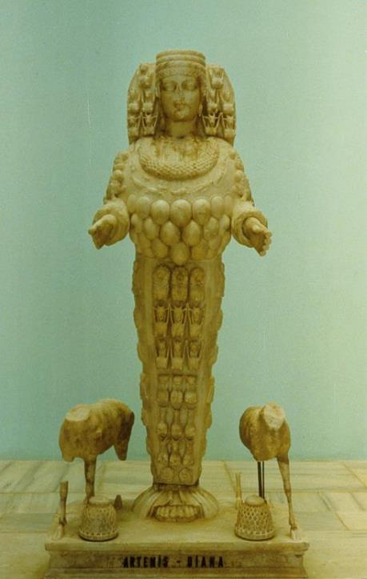
STATUE OF ARTEMIS FROM EPHESUS
Worshipped as the goddess of the hunt and protectress of women in childbirth
Identified with Cybele, the Asian mother-goddess of fertility

Slide 17
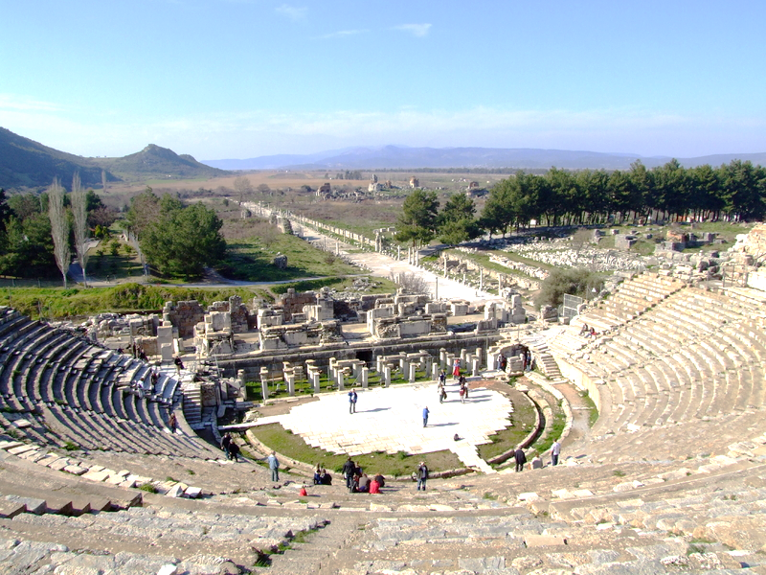
The amphitheater in Ephesus, where Paul was nearly lynched, lies at the end of the Arcadian Way.
At the end of his two years in Ephesus, Paul made a firm decision to revisit Jerusalem after which he hoped to reach further west by going to Rome (Ac. 19:21; cf. Ro. 1:11-13; 15:23-24, 31-32).

Slide 18
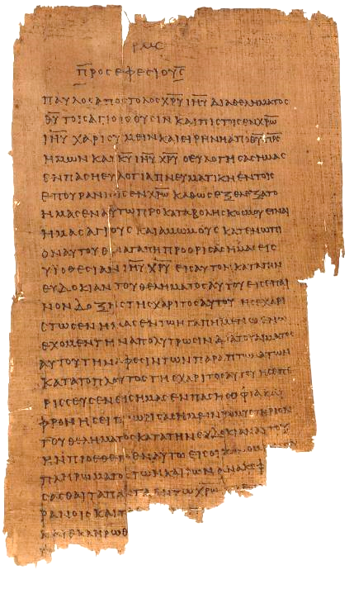
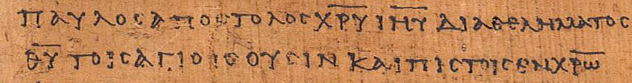
Ephesians 1:1 p46
Chester Beatty Papyri ca. AD 200 earliest copy of the Ephesian letter
“Paul, an apostle of Christ Jesus through [the] will of God to the holy ones who are also faithful in Christ…” (1:1)
(University of Michigan, Hatcher Library)

Slide 19
Talking Points
If the Ephesian letter was intended for multiple congregations would this fact in any way affect its canonicity?

Slide 20
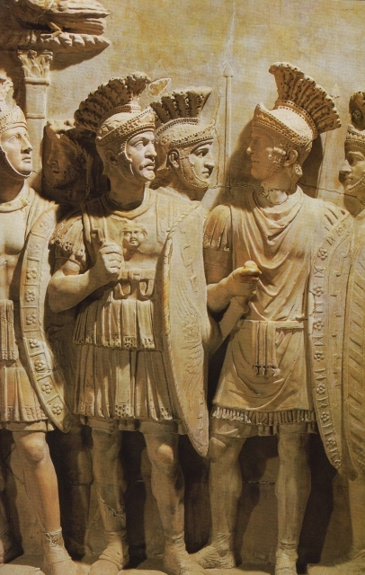
In the Book of Ephesians, Paul uses Roman armor as a metaphor for the Christian’s spiritual gear, what he calls “the full armor of God” (Ep. 6:14-17).
Cingulum (the belt which held the sword and identified the soldier as “on duty”)
Lorica (the breastplate protecting the neck and torso)
Caligae (half-boot necessary for lightness of foot)
Scutum (metal-sheathed body shield)
Galea (helmet, protecting the head)
Gladius (short-sword)
= Truth
= Righteousness
= Gospel
= Faith
= Salvation
= Holy Spirit

Slide 21
NT ARCHAEOLOGY
NT ARCHAEOLOGY
The Remaining History of the 1st Century
Lesson 12
Lesson 1
Introduction

Slide 22
And so we went to Rome.
Acts 28:14b
For I am already being poured out like a drink offering, and the time has come for my departure. I have fought the good fight, I have finished the race, I have kept the faith.
2 Timothy 4:6
I think it is right to refresh your memory as long as I live in the tent of this body, because I know that I will soon put it aside, as our Lord Jesus Christ has made clear to me.
2 Peter 1:13-14

Slide 23
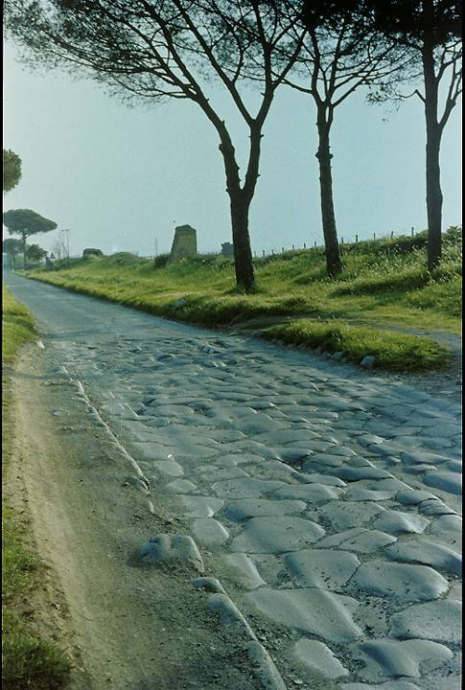
Via Appia
The final leg of Paul’s journey to Rome was on the Via Appia (Ac. 28:14b-16), a well-laid stone pavement from southern Italy to Rome dating to 312 BC. The ruts in this pavement show the wear from generations of chariot travel.

Slide 24
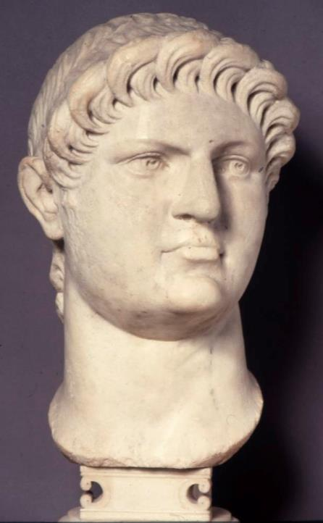
Caesar Nero ruled Rome (AD 54-68), and according early church tradition, he released Paul after his imprisonment, after which Paul went to Spain.
Later, Paul is said to have been arrested a second time, and this time Nero had him executed by beheading.
However, there are competing factors that make the closing years of Paul’s life uncertain.
All ancient sources agree that Paul was martyred, probably between AD 62 and 64 .
British Museum, London

Slide 25
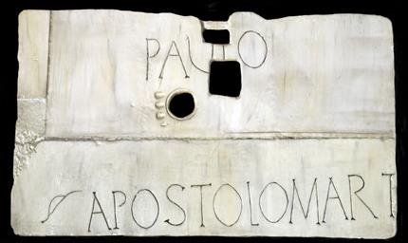
Below the present altar at what is now known as St. Paul Outside-the-Walls church (a basilica built by Constantine in the late 300s AD in Rome along the Ostiense Way) is an ancient marble tombstone marking the traditional burial site of St. Paul.
In 2009, Pope Benedict XVI announced that radiocarbon dating confirmed that the bones in the sarcophagus dated to the 1st or 2nd century.

Slide 26
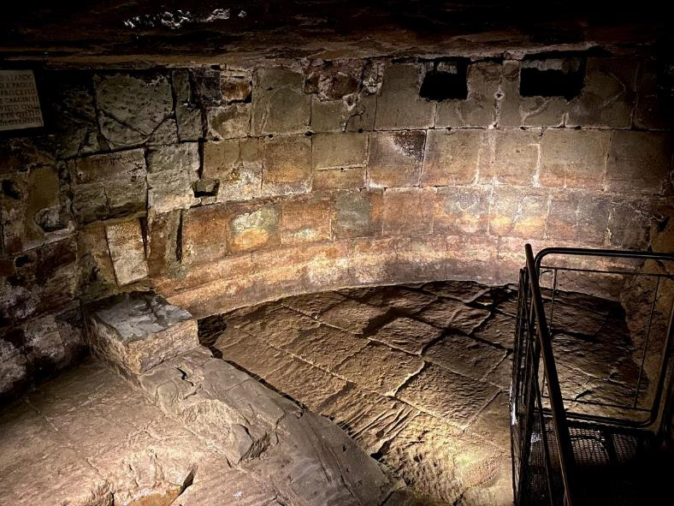
The Mamertine Prison
Tradition asserts that both Peter and Paul were incarcerated in the Mamertine Prison in Rome, the lower part of which dates to centuries before the time of Christ. The Carcer Tullianum was used as a “death’s row,” and a number of historical figures were imprisoned there, including Giugurta, King of Numidia (104 BC) and Vercingetorige, King of the Gauls (46 BC).

Slide 27
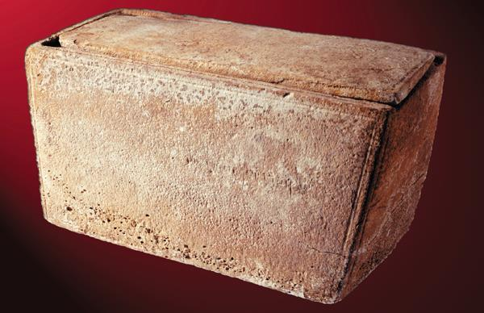
THE CONTROVERSIAL “JAMES OSSUARY”
In 2002, an ossuary was discovered with the inscription “James, son of Joseph, brother of Jesus.” Experts in paleography and the Ministry of National Infrastructures Geological Survey pronounced its authenticity.

Slide 28
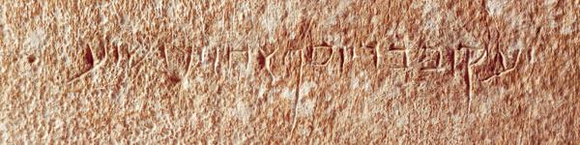
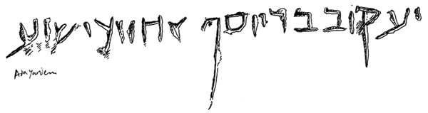
The Inscription
fvwyd yvHx Jsvy rb bvqfy = James, son of Joseph, brother of Jesus =

Slide 29
THE CONTROVERSY
This ossuary was likely to belong to James, the leader of the Jerusalem church, who was martyred in Jerusalem in AD 62.
Subsequently, in 2003, the Israel Antiquities Authority announced that the inscription was a forgery.
Then followed as seven-year forgery trial with the judge eventually throwing it out of court due to insufficient evidence.
Hence, there remains a cloud over this artifact, some scholars supporting its authenticity and others rejecting it.
If authentic, not only is it of intrinsic value, but it would answer an old theological question about the “brothers” of Jesus, whether they were cousins or half brothers (from Mary and Joseph).

Slide 30
Talking Points
What effect did the martyrdom of Stephen, Paul, Peter, and James have on the early Christians?
What did Jesus say about martyrdom?
Are Christians still martyred today?
What is the link between martyrdom and witness?

Slide 31
As he was leaving the temple, one of his disciples said to him, “Look, Teacher! What massive stones! What magnificent buildings!”
“Do you see all these great buildings?” replied Jesus. “Not one stone here will be left on another; every one will be thrown down.”
Mark 13:1-2
“When you see Jerusalem surrounded by armies, you will know that its desolation is near. Then let those who are in the city get out, and let those in the country not enter the city. For this is the time of punishment in fulfillment of all that has been written… Jerusalem will be trampled on by the Gentiles until the times of the Gentiles are fulfilled.”
Luke 21:20-21, 24b

Slide 32
THE 1ST JEWISH REVOLT
In AD 66, the zealots among the Jews led a full-scale rebellion against the Romans, driving them out of Jerusalem and the various Jewish communities.
Christian Jews did not support the revolt, but according to Eusebius, fled to Pella in the Transjordan.
The Romans sent General Vespasian to quell the rebellion, and he marshalled three Legions to begin the attack from the north.
By AD 68, all Jewish territories were once again under Roman control except Jerusalem, but with the death of Caesar Nero that year, Vespasian was forced to return to Rome, where he would become the new Caesar.
His son, Titus, finished the siege of Jerusalem, the city was burned, and the 2nd Temple destroyed.

Slide 33
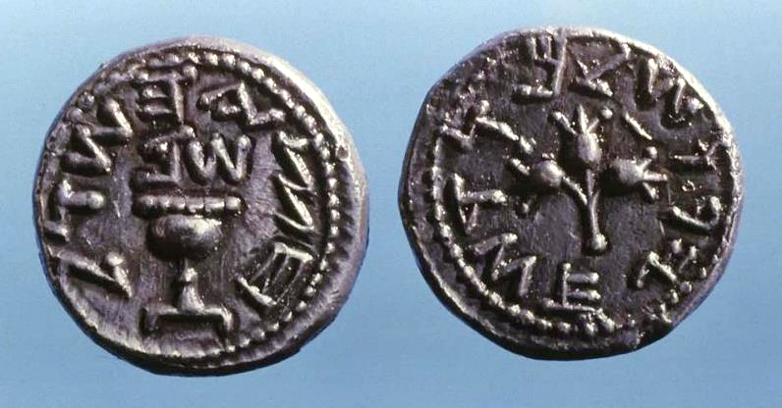
Coins minted very early in the 1st Jewish Revolt, like this half-shekel, featured Jewish symbols and a dating system keyed to the revolt (this one dated to “Year 2”).
On the obverse side is a temple vessel, and on the reverse is a stem with three pomegranates surrounded by the words “Holy Jerusalem.”
Unlike Roman coinage, which used Greek script, these coins used paleo-Hebrew script.

Slide 34
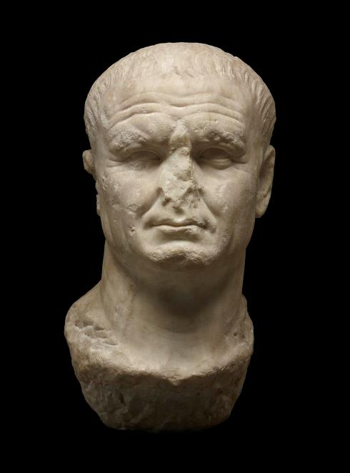
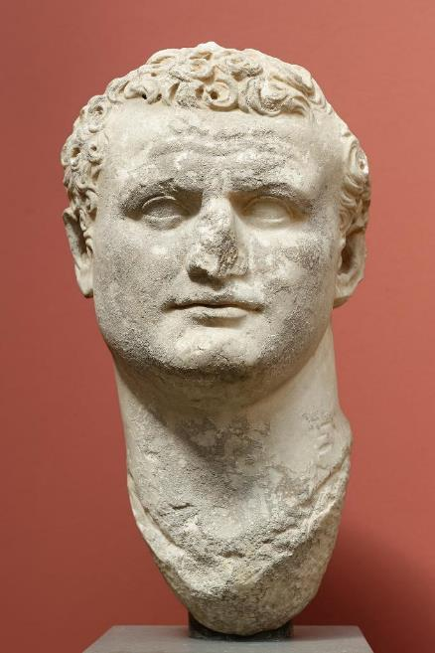
Emperor Vespasian
AD 69-79
British Museum,
London
Vespasian began the siege of Jerusalem in AD 68; Titus destroyed the city in AD 70.
Emperor Titus
AD 79-81
Ny Carlsberg Glyptotek, Copenhagen

Slide 35
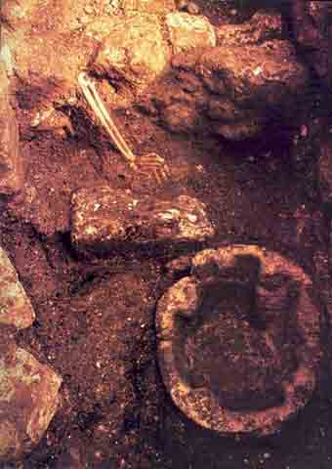
Excavated in January 1970, the skeletal remains of a young woman with arm outstretched was discovered in the kitchen of a 1st century Jerusalem home, a gruesome testimony to the collapse of the city before the Romans. The fire spread so fast, perhaps fed by oil used in kitchens such as this, that the woman could not escape and was buried by fallen debris.

Slide 36
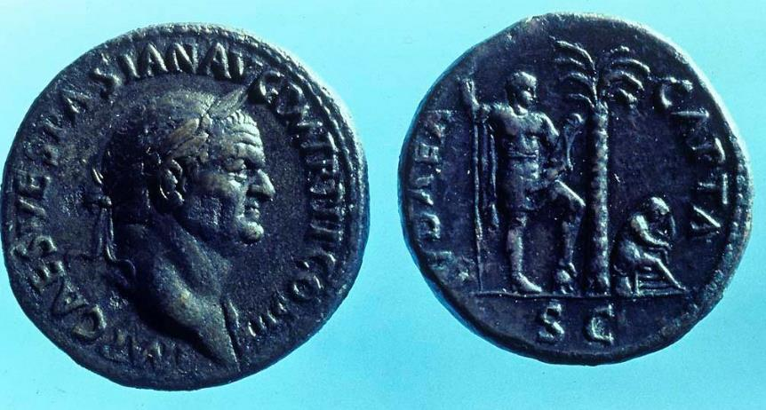
After the fall of Jerusalem (AD 70), the Romans issued a large number of coins to commemorate their victory. This one, minted in AD 71, has the head of Vespasian on the obverse and a mourning female figure representing the defeated Jews on the reverse along with the inscription “Conquered Judea (Judah Capta).”

Slide 37
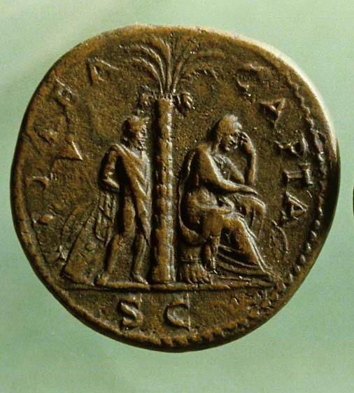
Thousands of Judea Capta coins, like this bronze sesterce, were struck in Rome in AD 71. This type of coin was the largest series minted in Roman history. Note that the figure standing behind the weeping woman is bound with his hands behind him.

Slide 38
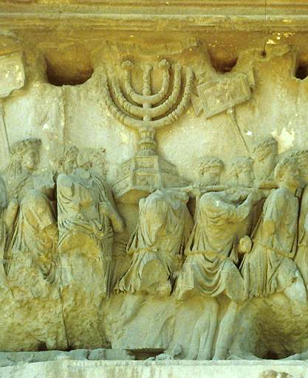
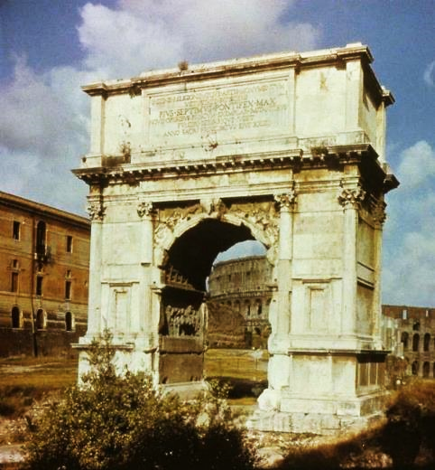
The Arch of Titus was erected in Rome to celebrate Titus’ triumph over Jerusalem. It stands in the Roman Forum near the Colosseum.
The interior detail of the arch offers an ancient relief sculpture of the temple menorah, which the Romans carried off. It has never been found.

Slide 39
Masada
The last vestige of resistance was a group of Jewish freedom fighters who fled to the escarpment called Masada near the Dead Sea.
They managed to hold out until AD 73, when the Romans completed a siege ramp to the top and broke through the defenses.
Upon gaining access to the top, the Romans discovered that the Jewish rebels had committed mass suicide.

Slide 40
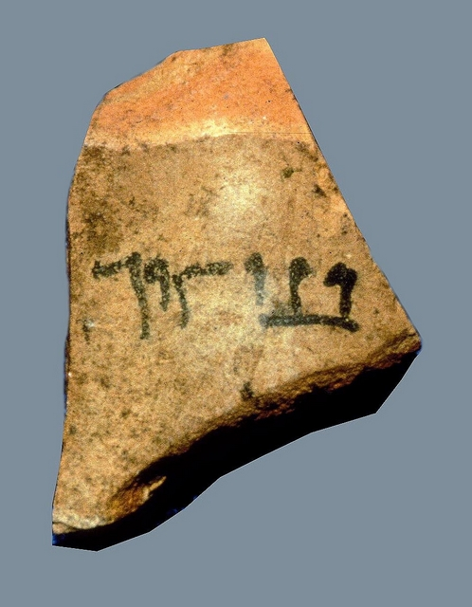
According to Josephus, the zealots chose ten men to kill all the families, then cast lots among themselves for the one to kill the other nine before killing himself. Yagael Yadin’s excavation at Masada uncovered what may be one of the actual lots used in that final, deadly lottery. This shard contains the name Ben Ya’ir, probably the leader of the zealots at Masada, whose full name was
Eleazar ben Ya’ir.

Slide 41
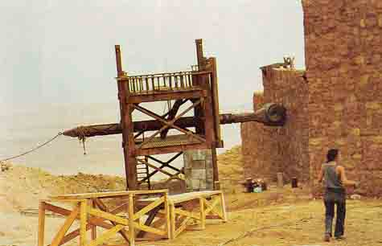
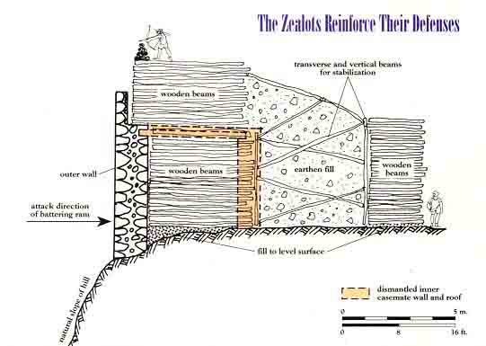
This movie prop (upper left) for the movie Masada, was constructed based on archaeological data, and it probably resembles the Roman battering rams used to hammer at the perimeter wall at the top of the escarpment at Masada.
The diagram (lower left) is a sketch by archaeologists describing the way the zealots reinforced the wall from the inside using wooden beams and slag.

Slide 42
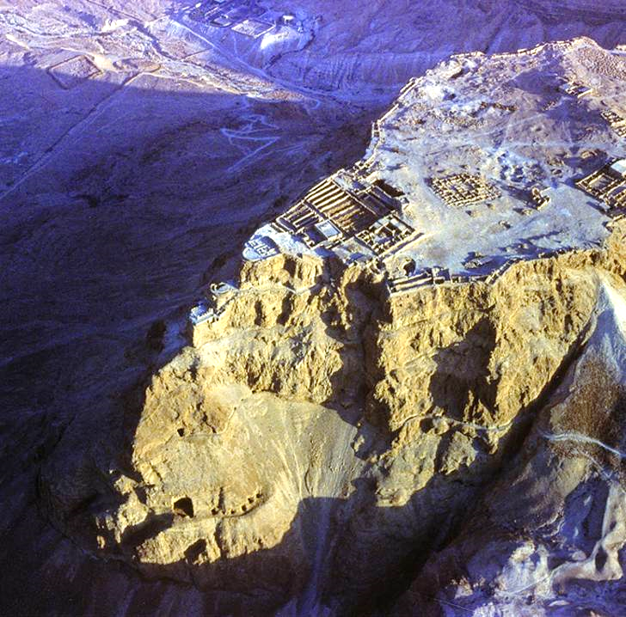
Masada
This 400’ high rocky escarpment near the Dead Sea was the last holdout for Jews in the 1st revolt. Originally constructed by Herod the Great, the nearly impregnable fortress enabled the last of Jewish resistance to hold out against the Romans for three years. When the Romans finally breached the stronghold, the Jewish rebels all had committed suicide.

