Slide 1
CHURCH WEEK
1 & 2 Thessalonians, titus, 1 & 2 Timothy, Hebrews, james, 1 & 2 Peter, jude

Slide 2
THE THREE PILLARS
In Galatians, Paul refers to Peter, James and John as the “pillars” of the Jerusalem church (Ga. 2:9).
In his early days as a new Christian, Paul personally spent time with two of them, Peter and James (Ga. 1:18-19).
Later, Paul, Peter and James (as well as John) would all compose parts of the Christian New Testament.
These early Christian leaders faced huge transition issues as they moved from the old covenant to the new, issues for which Jesus had left them no blueprint—only the assurance that the Holy Spirit would guide them.

Slide 3
TRANSITION ISSUES
PERIOD OF ISRAEL TO THE PERIOD OF THE CHURCH
Relationship between Judaism & Christianity
Forms of worship
Authoritative Scriptures
Leadership & succession
Opposing religious ideas
Church administration
Christianity & its relationship to Rome

Slide 4
ECCLESIASTICAL QUESTIONS
What sort of church structure is appropriate?
What kind of leaders are appropriate?
How are leaders to be chosen, and what should be their qualifications?
What vehicle is appropriate for succession?

Slide 5
THE DELAY OF THE PAROUSIA
On the one hand…
Jesus promised to return “soon”.
No one knew the time of his coming.
All the disciples were to be constantly watching for it.
Some thought John bar-Zebedee would not die before the Lord returned.
On the other hand…
Some Christians began to die, including apostles.
Within the foreseeable future, the first generation of original eye-witnesses would be gone.
Now, the church was obliged to address the future without any certainty that Christ would return in their lifetimes.

Slide 6
LUKE’S HISTORY OF THE EARLY CHURCH
(Acts 1:8)
JERUSALEM
Acts 1-7
JUDEA
Acts 8
SAMARIA
Acts 8
THE ENDS
OF THE EARTH
Acts 9-28

Slide 7
The Apostolic Churches & Their Leaders
Jerusalem (Peter, James, John)
Asia Minor & Greece (Paul and others)
Cyprus (Paul, Barnabas)
Rome (Paul, Peter and others)
Ephesus (Paul, John)
Antioch (Paul, possibly Matthew)

Slide 8
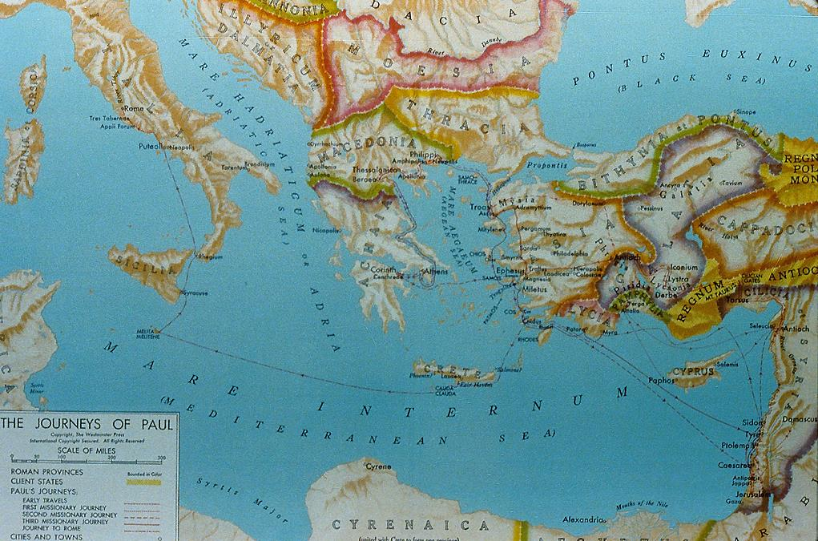
SIGNIFICANT CONGREGATIONS IN THE EARLY CHURCH

Slide 9
Paul and His Letters
1 & 2 thessalonians, titus, 1 & 2 timothy

Slide 10
Paul, the man
Saoul
Jewish name
Paullus
Roman name (cognomen)
Roman Citizen from Tarsus
Acts 16:37; 21:39; 22:26-28
Hebraistic Jew
Acts 22:2; Phil. 3:6 (Hebrew speaking)
Tribe of Benjamin
Rom. 11:1; Phil. 3:5
Pharisee
Acts 23:6; 26:5
Disciple of Rabbi Gamaliel
Acts 22:3
Tentmaker Trade
Acts 18:3
Unmarried
1 Cor. 7:7a; 9:5

Slide 11
Only Physical Description from Antiquity
“And he (Onesiphorus) saw Paul coming, a man small in size, bald-headed, bandy-legged, well-built [i.e., healthy], with eyebrows meeting, rather long-nosed, full of grace. For sometimes he seemed like a man, and sometimes he had the countenance of an angel.”
Acts of Paul and Thecla (c. AD 160-180)

Slide 12
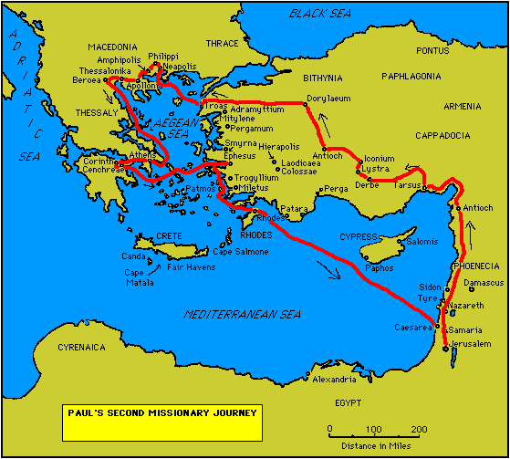
Five Important New Churches
Philippi
Thessalonica
Beroea
Athens
Corinth
Paul would write letters to three of them

Slide 13
1st Century Travel by Land and by Sea
The Route of Paul’s 2nd Missions Tour (2 Co. 11:23-27) – about 3025 miles
Jerusalem to Antioch (Ac. 15:30) = 375 miles (by land)
Antioch to Cilicia (Ac. 15:41) = 140 miles (by land)
Cilicia to Phrygia & Galatia (Ac. 16:6) = 495 miles (by land)
Phrygia & Galatia to Troas (Ac. 16:8) = 500 miles (by land)
Troas to Neapolis (Ac. 16:11) = 140 miles (by sea)
Neapolis to Philippi (Ac. 16:12) = 15 miles (by land)
Philippi to Thessalonica (Ac. 17:1) = 85 miles (by land)
Thessalonica to Berea (Ac. 17:10) = 45 miles (by land)
Berea to Athens (Ac. 17:15) = 310 miles (by sea)
Athens to Corinth (Ac. 18:1) = 50 miles (by land)
Corinth to Ephesus (Ac. 18:18-19) = 250 miles (by sea)
Ephesus to Caesarea and Antioch (Ac. 18:22) = 620 miles (by sea and land)

Slide 14
PAUL’S THIRTEEN LETTERS
While Luke does not describe the writing of Paul’s letters, a reasonable chronology can be deduced from internal references in the letters themselves.
2ND TOUR LETTERS
Galatians (date is debated
between 2nd and 3rd tour)
1 Thessalonians
2 Thessalonians
3RD TOUR LETTERS
1 Corinthians
2 Corinthians
Romans
PRISON LETTERS
Colossians
Philemon
Ephesians
Philippians
PASTORAL LETTERS
1 Timothy
Titus
2 Timothy

Slide 15
Sending Letters
Colleagues like Tychicus, Phoebe and Titus, among others, were commissioned by Paul to carry his letters. This accounts for his recommendations (e.g., Col. 4:7-8; Eph. 6:21; Rom. 16:1-2).
Letters typically had internal references to the courier as a confirmation of his or her trustworthiness.
As the writer’s personal representative, the courier would read the letter publicly, explaining any difficult parts and generally sharing news of the sender (4:7-8).
As the courier, Tychicus would travel to Colossae with Onesimus, who after his conversion could now to be considered “one of you” (4:9).

Slide 16
Production of Paul’s Letters
Composition & Inscription
Amanuenses:
  Tertius (Rom. 16:22)
  Sosthenes (1 Cor. 1:1)
  Timothy (2 Cor. 1:1; Phil. 1:1; Col. 1:1; 1 Thess. 1:1; 2 Thess. 1:1; Phlm. 1)
Personal Signature (1 Cor. 16:21; Gal. 6:11; 2 Thess. 3:17)
Delivery & Public Reading
Personal Couriers:
  Phoebe (Rom. 16:1-2)
  Titus (2 Cor. 8:17-18; 12:18; Col. 4:7-8)
  Tychicus (Eph. 6:21-22)
Public Reading (Eph. 6:21-22; Col. 4:16; 1 Thess. 5:27)

Slide 17
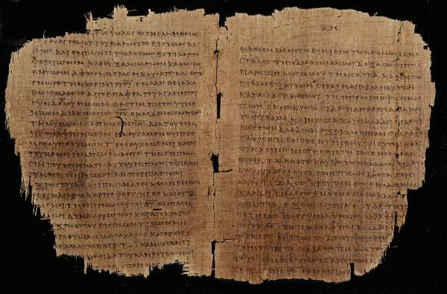
What Paul’s Letters May Have Looked Like p46 (Chester Beatty Papyri Collection, Dublin): Romans 11: 13-22 and Colossians 1: 5-12, c.AD 200

Slide 18
Paul’s Epistolary
Style
THE PAULINE PATTERN
Opening
Paul, an apostle…to the saints…
Thanksgiving
Greeting…grace and peace
(xai<rein changed to xa<rij)
Body
Central concern and communication
Paraenesis
Indicative and imperative moods (you are…so behave in this way)
Closing
Benediction
Letter-writing in the Greco-Roman world followed stylistic conventions.
Handbooks on letter theory were available as guides to differentiate between business letters, official letters, public letters and discursive letters.
Paul’s letters follow to a large degree the conventions of the times, but he also freely adapted those conventions to suit his own purposes.

Slide 19
Reading Another’s Mail
Reading someone else’s mail from the distance of two millennia creates special challenges.
The writer could assume certain shared information not available to a later reader.
Hence, topics could be addressed without a full explanation.
Especially when Paul addresses heresies or enemies of the Christian faith, the modern reader must, so to speak, “read between the lines” to discover the nature of the problem based on the polemics Paul uses.
In some letters, Paul uses critical vocabulary that helps the reader profile the heresy he addresses.

Slide 20
How to Discern an Author’s Goals
What does he include?
What does he leave out?
What does he emphasize?
What events does he link?
What does he clearly state?
What does he imply?

Slide 21
Spiritual Authority
One of the challenges for new Christian communities was the question of spiritual authority.
The earliest Christians had no New Testament, no creeds, no established church structure and no written guidelines.
Citizens in Asia Minor and Greece may never have heard of Jesus Christ until Paul came.
So, where did spiritual authority lie?

Slide 22
The Authority of Paul’s Letters
Paul clearly considered his letters to be authoritative in the churches.
He instructed churches not only to read them but to share them with other congregations (Col. 4:16).
They were a way of extending his presence when he could not be there personally (1 Cor. 5:3-4; 2 Cor. 10:10-11).
His personal signature at the end authenticated the contents of the letters (1 Cor. 16:21; Gal. 6:11; Col. 4:18; 2 Thess. 3:17).
While he distinguishes between what he writes and what Christ said (1 Cor. 7:10, 12), he also claims the authority of Christ and the Spirit (1 Cor. 2:16; 7:40; Gal. 1:1, 8, 11-12).

Slide 23
The Christian Traditions
Paul refers to Christian tradition handed down to him and in turn delivered to his converts (11:23; 15:1-4).
These “traditions” were to be faithfully kept (1 Cor. 11:2; 2 Thess. 2:15; 3:6).
They were the “deposit of faith” faithfully passed down to successors (2 Tim. 1:13-14; Tit. 1:9).

Slide 24
Dominical Sayings
Obviously, a clear level of authority resided in the sayings of Christ, which in the earliest period were preserved orally.
As yet, the canonical gospels had not been composed (though smaller accounts of Jesus’ life may have been circulating, cf. Lk. 1:1-2).
Paul draws from the sayings of Jesus as an impeccable authority (1 Cor. 7:10-11; 9:14; 11:23-25; 14:37; cf. Ac. 20:35; Rom. 14:14; 1 Thess. 4:15-17).

Slide 25
The Septuagint
The presence of the Hebrew Scriptures “in every city” (Ac. 15:21) assumes the availability of the LXX translation in Greek.
Paul frequently alludes to the Hebrew Scriptures, assuming that his readers will accept their full authority on the basis of the introductory clause, “It is written…” (1:19, 31; 2:9; 3:19; 4:6; 9:9-10; 10:7, 11; 14:21; 15:45).
To be sure, he does not use the OT to interpret Christ, but rather, Christ to interpret the OT.
Though Paul is familiar with the Hebrew text, in all but a few cases his citations agree with the Septuagint renderings.

Slide 26
1 Thessalonians

Slide 27
Occasion for Writing
When after an indictment before the Thessalonian politarchs Paul was forced to leave Thessalonica abruptly, he left Timothy and Silas behind to stabilize the believers, instructing his companions to join him as soon as possible (Ac. 17:13-15).
Exactly what they shared with Paul when they caught up with him is unknown (Ac. 18:5; 1 Th. 3:1-3a, 6), but judging from the contents 1 Thessalonians, we can reasonably surmise the situation.
When reading someone else’s mail, one can approximate the unknown circumstances by what is expressed in the letter.

Slide 28
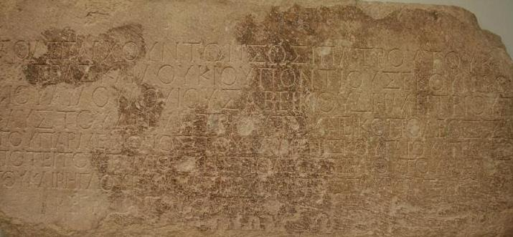
Politarchs were elected governors of Macedonian cities in the Roman era. This inscription excavated from the Vardar Arch of Thessalonica lists six politarchs in the city. (British Museum, London)

Slide 29
The Three Major Themes
Due to the things Paul addresses in 1 Thessalonians, three major issues seem to have been prominent:
From Paul’s defense of his evangelistic ethics, it seems likely that his enemies sought to defame him as an imposter or an opportunist.
From his comforting words regarding persecution, it seems certain that the opposition to the new Christians did not stop when Paul left.
Apparently some Thessalonian Christians had died since Paul had been there, and the remaining Christians were uncertain about what would happen to believers after death.

Slide 30
Date
The date of 1 Thessalonians can be fixed in about AD 50-51.
Presumably, Paul wrote this letter from Corinth after being joined by Timothy and Silas (Ac. 18:1, 5).
This date can be cross-referenced with the tenure of Gallio’s proconsulship in Achaia, since Paul later appeared before him in Corinth (Ac. 18:12).
According to an inscription at Delphi, Lucius Junius Gallio took office probably in July AD 51 (Proconsuls normally took office on July 1st).

Slide 31
The Argument
The opening of the letter stresses that in their conversion the Thessalonians had become imitators of Christ and Paul, both in faith and also in suffering (1:1-10).
If Paul’s enemies attempted to discredit him as a charlatan, he countered by emphasizing his ethics in preaching the gospel (2:1-16).
His mission work was not a failure, and his message did not arise from falsehood or mixed motives. His suffering validated his message.
In the same way, the suffering of the Thessalonians validated their faith.

Slide 32
Though Paul was unable to reestablish contact with the church, Timothy ministered in Paul’s stead and reported to him that the Thessalonians’ faith stood strong in spite of persecution (2:17—3:13).
Such perseverance was important for Paul himself, since his reward at the return of Christ was dependent upon their faithfulness.
Several times Paul makes direct references to Christ’s return as the hope of believers (1:10; 2:19; 3:13).
Paraenesis (4:1-12)
As believers, the Thessalonians must remain sexually pure in the midst of a culture that was sexually permissive.
They also must show brotherly love and live reputable lifestyles.

Slide 33
The Return of Christ (4:13—5:11).
Concerning those who had died, the promise for believers was that they would be resurrected at Christ’s return, joined with the living believers, and caught up in the air as a single body to welcome his return.
The timing of this event was yet unknown, comparable to the coming of a burglar. However, as people of light, the believers were always to be confident that whether living or dead when Christ returned, they would be joined to the Lord.
Closing (5:12-28)
In his final remarks, Paul urges the Christian ethic of industrious labor.
The Thessalonians could depend upon God’s faithfulness in preserving them to the end.

Slide 34
Critical Ideas in 1 Thessalonians

Slide 35
God’s Choice of Us (1:4-5a)
Election is positive: it is God’s action to save, emphasizing that salvation is wholly through God’s initiative and never by human merit.
Election passages are invariably in a plural form (i.e., God chose “us” or “you all” as opposed to God chose “me”). Individuals whom God calls are summoned to be part of God’s people.
The evidence of God’s choice is their response to the gospel. It is a combination of:
  The power of the preached word
  The inward work of the Holy Spirit
  The profound conviction that the message was true

Slide 36
The Framework for God’s Choice
The Calvinist-Arminian Framework
Here, the question concerns the individual—why does God choose some and not others?
The Calvinist answer is the inscrutable character of God’s sovereignty to save some while passing over others (cf. Ro. 9:11-15).
The Arminian answer is God’s intent that those who believe should live a life of service (cf. Ep. 2:10).
The Abrahamic Covenant Framework
Here, the question concerns the group—who belongs to the covenant people of God (Dt. 7:7; 10:15; 14:2)?
The Jews tended to reserve such status for themselves alone, excluding Gentiles (cf. 1 Th. 2:14-16; Ac. 15:1-2; Ga. 2:4-5).
Paul urged that God’s covenant promise was for those who believed in Christ, regardless of ethnicity (Ro. 4:16-18; Ga. 3:29; cf. Ge. 12:3).

Slide 37
When Our Lord Comes (3:13)
Paul describes Christ returning “with all his saints” (lit., holy ones):
While ostensibly this might refer to Christian believers, here it is more likely that he refers to the angels who will attend Christ’s second advent (cf. Mt. 13:41; 25:31; Mk. 8:38; 2 Th. 1:7).
Because Paul does not differentiate between Christ coming “for” his saints and “with” his saints, the dispensational attempt to divide Christ’s return into two phases separated by a span of years is doubtful.

Slide 38
Dispensational View (1830s and later)
Christ’s Return
(in two phases)
PAROUSIA APOCALYPSE/
EPIPHANY
“for” his saints “with” his saints
GREAT TRIBULATION
(God deals with Israel)
CHURCH AGE

Slide 39
Classical View
(early church fathers and Reformers)
CHRIST’S RETURN
Parousia
Apocalypse
Epiphany
GREAT TRIBULATION
CHURCH AGE

Slide 40
Caught Up to Meet the Lord (4:17)
The Greek verb a]rpa<zw (= to be snatched up) was translated in the Latin Vulgate as rapio, which is the origin of the coinage “rapture.”
The verb a]pa<nthsij (= the act of meeting someone) is a technical term for the civic custom of welcoming important visitors to a city or the triumphant entry of a new ruler into the capital (cf. Mt. 25:6; Ac. 28:15).
It describes believers rising in the air to welcome Christ and escort him back to the earth.

Slide 41
Dispensational View (1830s and later)
Christ’s Return
(in two phases)
APANTESIS???
GREAT TRIBULATION
(God deals with Israel???)
CHURCH AGE
A fundamental problem with the dispensational view is the actual Greek vocabulary in 1 Th. 4:17, which seems to refer to Christ’s coming to the earth, not his coming in mid-air with a return to the heavenlies.

Slide 42
Classical View
(early church fathers and Reformers)
Christ’s Return
APANTESIS!
GREAT TRIBULATION
CHURCH AGE

Slide 43
2 Thessalonians

Slide 44
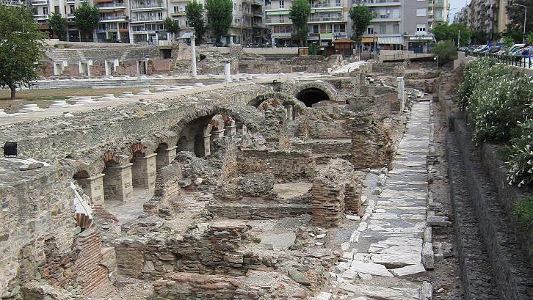
1st century Roman Market at Thessalonica

Slide 45
The Follow-up Letter
The second Thessalonian letter seems to have been written soon after the first one, for Paul is at pains to correct some misunderstanding.
Hence, Paul wrote this letter from Corinth, too.
In his first letter, Paul had spoken of the “Day of the Lord,” a future day of destruction for those spiritually asleep but a day of salvation for those spiritually awake . Some believers seem to have assumed that the Day of Yahweh had already arrived.
Also, some believers had stopped working, possibly thinking it was now unnecessary in view of the soon return of Christ.
Finally, there is the possibility that someone had forged a letter in Paul’s name.

Slide 46
The Argument
God’s final justice will be evident when Christ returns (1:1-12).
The Thessalonians’ current suffering would be rewarded.
Their persecutors would be punished.
The Day of the Lord has not yet come (2:1-17):
Certain things must happen before that day, including a great apostasy and the unveiling of a malignant enemy called the “man of lawlessness”.
A restraining force (and Paul does not say what it is) now holds back the powers of Satanic chaos.

Slide 47
In view of this coming eschatological trauma, believers must trust in their calling, because God would preserve them.
Closing (3:1-18):
Paul requests prayer both for the spread of the gospel and deliverance from enemies.
He reaffirms his advice in the first letter that the Thessalonians must give themselves to industrious work, just as Paul himself toiled in the cause of the gospel.
Finally, he signed off in his own hand (apparently the letter was drafted by an amanuensis), and his personal signature now would become a validating mark in all his letters.

Slide 48
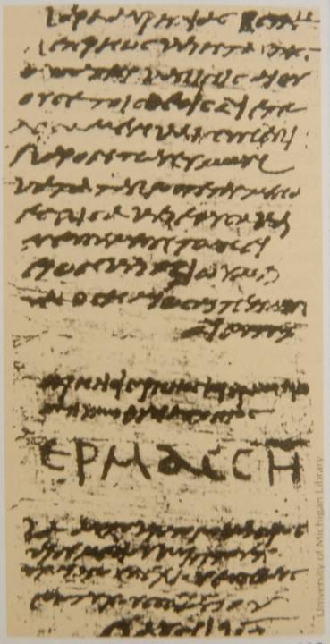
PAUL’S OWN SIGNATURE
With the possibility of a forged letter (2:2), Paul adopted the practice of signing off his letters in his own hand, even though he may have used an amanuensis for the actual writing (3:17).
Like the signature of Hermas to the right (AD 250), Paul’s signature was in large script (cf. Galatians 6:11).
His signature was his authentication of the genuineness of his letter.
University of Michigan

Slide 49
Critical Ideas in 2 Thessalonians

Slide 50
Prerequisites for the Day of the Lord (2:3)
Paul clearly says that some things must happen before the Day of the Lord.
First, there will be a great apostasy or rebellion.
Also, the man of lawlessness will be revealed.
To these may be added some predicted historical events from the teaching of Christ:
  The martyrdom of Peter (Jn. 21:1-19)
  The destruction of Jerusalem (Mt. 24:2; Mk. 13:2; Lk. 21:6)
  The woes of Messiah (Mt. 24:15-31; Mk. 13:14-27; Lk. 21:10-28)
Significantly, Paul does not say the rapture of the church will occur before the Day of the Lord.

Slide 51
The Great Rebellion
Three primary passages describe a time of great distress before the end of the age:
2 Th. 2:3
Here, the rebellion is described as an apostasy linked to a figure called the “man of lawlessness.”
2 Ti. 3:1-5 Here, the period is described as a moral and social disintegration that will characterize “the last days.”
2 Pe. 2:1-3 Here, the rebellion is linked to purveyors of destructive heresies that bring disrepute on the gospel.
Various solutions have been suggested for identifying this rebellion:
a) modernism, b) pseudo-Christianity, c) apostasy within the visible church, or d) rebellion by an unbelieving world.

Slide 52
Who is this Man of Lawlessness?
Since Paul’s language here stands alone in the Bible, interpreters have tried to find possible parallels in other passages:
The Abomination
Here, 2 Th. 2:4 is linked to Mt. 24:15; Mk. 13:14; Da. 9:27, all of which use temple imagery. The Man of Lawlessness is believed to desecrate the temple (The second temple? A third temple?).
The Beast
Here, 2 Th. 2:4 is linked to Rv. 13:5-8, where the beast from the sea blasphemes God and attacks God’s people as he is empowered by Satan, the great Red Dragon (Nero? Eschatological antichrist?).
The Antichrist
Here, 2 Th. 2:4 is linked to 1 Jn. 2:22; 4:3; 2 Jn. 7, where a figure opposing Jesus Christ is envisioned who denies both God the Father and Christ Jesus, the son.

Slide 53
What is the Temple? (2:4b)
Figurative Interpretations:
The Church? In keeping with Paul’s other uses of the term “temple” (1 Co. 3:16-17; 2 Co. 16:16; Ep. 2:21, etc.), the Man of Lawlessness is believed by some to arise within visible Christianity.
Metaphor for God’s Honor? Here, the temple is interpreted as a symbolic description of the man of lawlessness arrogating to himself divine honor.
Literal Interpretations:
A Jewish Temple? Here, either the second temple or the building of a third Jewish temple is envisioned, complete with animal sacrifices according to Mosaic law.
An Unidentified Structure? Here, the temple is interpreted as some material building, such as, a religious shrine or the Chapel of the United Nations or some other such edifice erected for worship.

Slide 54
The Restraining Force (2:5-6)
Paul alludes to this restraining force as something he already explained when he was in Thessalonica. Unfortunately for modern readers, he does not review that teaching here.
Paul uses both neuter (to> kate<xon = the “one restraining,” 2:6) and masculine (o[ kate<xwn = “he who is restraining,” 2:7) pronouns for this restrainer (the NIV rendering obscures this feature). This seems to suggest both impersonal and personal dimensions.
Whatever is this restraining force, Paul clearly envisions it as already in place at the time he was writing.

Slide 55
What is the Restraining Force?
The Force of Order? In keeping with Paul’s references to civil government as ordained by God to restrain evil (Ro. 13:1-5), here it is interpreted to refer to the principle of law itself, both in its governmental (neuter) and personal form (rulers).
The Holy Spirit? Since Jesus used both neuter and masculine pronouns for the Holy Spirit, here the restrainer is interpreted to mean the residence of the Holy Spirit within the church, i.e., when the church is raptured, chaos will reign.

Slide 56
Pastoral Letters

Slide 57
The Pastoral Letters: Context
Inasmuch as details about the closing years of Paul’s life are unclear, finding the context for the pastoral letters is difficult.
1 Timothy and Titus offer little about Paul’s circumstances other than that he anticipated a continuing ministry (1 Ti. 3:14-15; Tit. 3:12).
In 2 Timothy he is clearly imprisoned (2 Ti. 1:8; 2:9), speaks about his “first defense” (2 Ti. 4:16) and anticipates the near certainty of his approaching death (2 Ti. 4:6-7, 18).
Traditionally, it has been assumed that these details can be accounted for by a 1st and 2nd imprisonment for Paul.

Slide 58
Authorship
While historical-critical scholars have questioned Pauline authorship for several of the letters in the Pauline corpus, the most aggressive doubts have arisen concerning the pastorals.
These doubts largely concern differences in literary style, vocabulary, the more ordered state of the church reflected in the letters, the ambiguity of the latter years of Paul’s life, the address of ideas that seem Gnostic and the fact that the letters speak of “the faith” as an established orthodoxy.
Conservative scholars remain unconvinced and give Paul full credit as the author.

Slide 59
1 Timothy

Slide 60
Situation
Written to Timothy while he was at Ephesus (1:3), this letter addresses the challenge of heretical teachers, two of whom are named (1 :20), who gave priority to myths and genealogies (1:4, 7).
They taught a theology of abstinence, including celibacy and dietary restrictions (4:3), and they believed they were the recipients of special knowledge (6:20-21).
Obviously, there is a Jewish flavor to this heresy, but the language of “false knowledge” smacks of early Gnostic thought as well.
Given the several mentions of women (2:9-12; 3:11; 5:13, 15), it seems likely that this heresy was strongly promoted by women teachers.

Slide 61
The Argument
The false gospel versus the true (1):
Paul issues a severe warning against false teachers who were distorting the gospel by emphasizing Mosaic legalism while deemphasizing faith.
The true gospel, which was epitomized in divine grace and mercy, had been demonstrated in the conversion of Paul himself.
An order for Christian life, worship and leaders (2-3):
After offering a general comment about prayer, Paul gives an order for decorum in public worship, first for men, then for women.
He then gives an order for the traits that should characterize the lives of leaders, first for elders, then for deacons.

Slide 62
The coming apostasy (4):
The false teachers in Ephesus were merely part of the larger final apostasy, and Timothy must stand firm against it.
Order for Christian relationships (5:1—6:2):
Here, Paul offers an order for the deference of the younger to the older and the church’s treatment of widows who are receiving support from the church.
He also addresses the treatment of church leaders.
Finally, he addresses the relationship of slaves to masters.
Final warnings and a charge (6:3-21):
As a final word against false teachers, he warns against the love of controversy, pride and greed.
His parting charge to Timothy emphasizes true pastoral concern grounded in basic Christian virtue and faith.

Slide 63
Critical Ideas in 1 Timothy

Slide 64
Did Paul teach that women were inferior to men and that they must be silent?
1 Ti. 2:11-15 is by far the most controversial in the NT with regard to women in the church. What is often not recognized are the huge translation issues in the passage:
How should one translate the word gunh< (wife? woman?)
How to translate h[suxi<% manqane<tw (learn in silence? learn quietly?)
To whom is the woman to be in full submission, the church, her husband or men in general?
Is the phrase ou]k e]pitre<pw to be translated absolutely, “I do not permit…” or periphrastically, “I am not [i.e., at this time] permitting…”
What is the meaning of au]qentei?n, “to have authority over” or “to dominate”?

Slide 65
The passage also is beset with huge interpretive problems:
Why does Paul say that Adam was created first? Is this a statement about rank or a statement correcting a popular Ephesian myth that advocated the woman was created first?
Does Paul’s statement that the woman was deceived imply that she was not to be trusted or the refutation of an Ephesian myth advocating that the woman was the source of all wisdom?
How is the woman “saved” through childbearing? The Greek text is complex, stating, “She shall be saved through childbearing if they remain in faith”. (Virtually all translations “play with” the Greek text.)

Slide 66
Three Approaches
Full Restriction
Here, the passage is taken as absolute prohibition.
Women can listen but not speak.
They can have no leadership role in the church.
Complementarian
Here, the woman is allowed to learn quietly without disruption.
She can teach other women, but cannot function in a role where she would be in authority over men.
Egalitarian
Here, the woman is granted full life in the church.
The passage is read, not as a binding restriction for all time, but as a correction of incipient Gnostic ideas in Ephesus.

Slide 67
A Correction of Gnostic Ideas?
Gnosticism
“The spirit-filled woman came to him and spoke with him, saying, “Arise, Adam.” And when he saw her, he said, ‘You are the one who has given me life.’” The Hypostasis of the Archons 2.89
Paul’s Correction
“For Adam was formed first, then Eve.”
Gnosticism
“But let us not tell Adam because he is not from among us, but let us bring a sleep upon him, and let us teach him in his sleep as if she [Eve] came into being from his rib…” On the Origin of the World 2.5.116
Paul’s Correction
“And Adam was not the one deceived; it was the woman who was deceived and became a sinner.”

Slide 68
Titus

Slide 69
Situation
According to the Titus letter (1:5), Paul had visited Crete, leaving Titus there; the circumstances of this visit are not described by Luke in Acts, however, so it’s provenance can only be conjectured.
Titus was left in Crete to complete the work started by Paul, particularly appointing elders.
He hoped to relieve Titus by sending Artemas and Tychicus to replace him (3:12).
Paul’s primary concern was about false teachers, not only among the Cretans, but also among the Jews in what what he calls “the circumcision group” (1:10, 14-16).
He urges severe measures to silence these false voices (1:11), rebuking them sharply (1:13) while avoiding their controversies (3:9-11).

Slide 70
The Argument
Titus’ task in Crete (1):
Having left Titus to complete the work he had started, Paul instructed him to appoint elders, and he offers a list of character traits very similar to what one finds in 1 Timothy.
Also as in 1 Timothy, Paul is concerned about false teachers, particularly the circumcision group (1:10).
In various of his letters, Paul gives what has come to be known as a “household code”, that is, instructions for behavior to various groups (2):

Slide 71
As in 1 Timothy, he addresses the relationship between both older and younger believers as well as the behavior of slaves.
In general, he urges the importance of godly lives as believers await the “blessed hope” of the return of Christ.
Living as Christians in the larger community (3):
Because Christians live within the larger culture, they also must demonstrate peaceful obedience to the secular government.
Christian life should be a life of grace, mercy and love, following the example of God himself who generously saved believers by his grace.
Controversies and argumentation that cause division should be avoided.

Slide 72
Critical Ideas in Titus

Slide 73
Paul and Slavery (Tit. 2:9-10)
Given what Paul taught elsewhere about the equality of persons in Christ (cf. Ga. 3:28; Col. 3:11), why does he perpetuate the system of slavery by requiring submission to masters?
In the first place, when Paul speaks of submission, he uses a middle voice form, which implies a voluntary action on the part of a free subject.
He urges submission, not because slaves are inferior, but in the interests of evangelism—to make the Christian message as attractive as possible.
While the Christian ethic advocates equality, it also advocates that Christians may sometimes need to surrender their rights in the interests of the gospel (cf. 1 Co. 9).

Slide 74
2 Timothy

Slide 75
The Closing Years of Paul’s Life
Three scenarios are possible concerning the closing years of Paul’s life.
TRADITIONAL
According to Eusebius and Jerome, Paul was released after his two-year house arrest in Rome (AD 62-64).
He continued his missionary work in the west (AD 64-68).
He was arrested a second time (AD 67-68).
During his second incarceration, he wrote all three pastoral letters.
EARLY EXECUTION
The alternative testimony of the early church is that both Peter and Paul were executed under Caesar Nero in AD 64.
Here, Paul was not released after his house arrest, but executed.
2 Timothy, at least, was written during the latter days of his Roman imprisonment.
BANISHMENT
Paul’s hearing in AD 62 ended in banishment to Spain, enabling him to continue his missions work.
Hearing of the great fire in Rome and the persecution of Christians, he returned only to be arrested again and this time executed.
1 Timothy and Titus were composed between his two imprisonments and 2 Timothy after his second arrest.

Slide 76
Circumstances
Clearly, the situation described in 2 Timothy was precarious.
Paul was incarcerated (1:16; 2:9; 4:16), denied the liberty of house arrest he had enjoyed earlier (Ac. 28:16, 30-31) and fully expecting to die (4:6).
Still, in spite of his grim circumstances, Paul’s greater concern was for the continuity of his mission. He was grieved by the unfaithfulness of others (1:15; 4:10, 16), distressed because some of his co-workers were no longer available to assist him (4:20), yet hoping to continue his work though delegates (4:10-12), especially Timothy (1:6-8; 4:12).

Slide 77
Purpose
Above all, Paul was concerned about maintaining the purity of the Christian gospel.
Repeatedly, he urges Timothy to “guard” the truth entrusted to him (1:13-14; 2:2, 8-9, 15; 3:14-17; 4:1-2, 5).
God had given Paul insight regarding the future, and he knew well the dangers of a distorted message (2:17-18; 3:6-8, 13; 4:3-4).
Because of opposition, Timothy must be prepared to suffer for the gospel (1:8; 3:12)

Slide 78
The Argument
Paul opens this final letter by urging Timothy toward fidelity to the gospel (1):
He reminds Timothy of his heritage in the Scriptures.
He urges him to guard the pattern of sound teaching he had received.
He continues by encouraging Timothy toward diligence in ministry (2):
He must be ready to endure hardship for the gospel.
He must avoid becoming mired in word battles and empty talk, cluttering his ministry with quarrels and endless arguments.

Slide 79
Faithfulness is the most important ministry goal (3:1—4:5):
A great apostasy was on the horizon, and Timothy could expect it.
Paul’s charge, therefore, was that Timothy should imitate Paul’s integrity in ministry, being willing to suffer but holding tightly to the Holy Scriptures.
As for Paul himself, his death was imminent, but so also was his reward (4:6-22):
Paul hoped for Timothy to be able to visit him, especially before winter, in order to bring extra clothing for warmth as well as his manuscripts of the Scriptures.
He closes by enumerating both his friends and his enemies, but he is certain that whatever the outcome of his imprisonment, he would be safely borne to God’s heavenly kingdom.

Slide 80
James & Jude
The brothers of jesus

Slide 81
Jesus’ Family
Joseph and Mary
Joseph disappeared from the biblical record after the birth and infancy narratives in Matthew and Luke (presumably deceased)
Mary appeared occasionally during Jesus’ public ministry, watched him die, and gathered with the others at Pentecost; she was likely a source for Luke’s Gospel.
Half-Brothers and Sisters
James, Joses, Judas and Simon (Mk. 6:3). They attended the wedding in Cana (Jn. 2:12).
Nothing is known of his sisters.
Jesus made a post-resurrection appearance to James, who later became the leader of the Jerusalem church (1 Co. 15:7; Ac. 12:17; 15:13ff.; 21:18; Ga. 1:19; 2:9, 12).
The brothers were present at Pentecost (Ac. 1:14).
They were married (1 Co. 9:5).
Judas’ grandchildren appeared before Emperor Domitian and continued as church leaders until the time of Emperor Trajan (Eusebius, Ecclesiastical History 3.19-20).

Slide 82
Three Theories About Jesus’ “Brothers”
Helvidius
Jesus’ “brothers” were children of Mary and Joseph after the birth of Jesus, hence younger.
Epiphanius
Jesus’ “brothers” were children of Joseph by a previous marriage, hence older.
Jerome
Jesus’ “brothers” were cousins, children of Mary’s sister and Clopas, ages unknown.
PROTESTANT
ORTHODOX
CATHOLIC

Slide 83
Assessing the Theories
Evangelicals generally agree that the Epiphanian and Hieronymian theories are largely driven by the attempt to protect the doctrine of Mary’s perpetual virginity.
The most natural way of reading the biblical evidence is that the brothers of Jesus were half-brothers born to Mary and Joseph.
If the James ossuary is authentic, it strongly supports this understanding.
Here, we shall assume that this approach is correct.

Slide 84
James, the Brother of Jesus
What we know from the Bible…
At first he was not a believer (Jn. 7:5).
After his resurrection, Christ appeared to him personally (1 Co. 15:7).
He emerged as the leader of the Jerusalem church (Ac. 12:17; 15:13ff.; Ga. 1:19, 2:9, 12; 21:18).
What we know from other sources…
Eusebius confirms that James was a Nazirite who frequented the temple.
His intercession for his own people was so regular that “his knees became hard like those of a camel”.
The scribes and Pharisees threw him from the temple mount after which he was clubbed & stoned to death.
While dying, he prayed for his enemies’ forgiveness.

Slide 85
The James Ossuary contains the striking Aramaic inscription: “James, son of Joseph, brother of Jesus”
Discovered in a private collection in 2002, the ossuary was judged to be authentic by Andre Lemaire (internationally recognized epigrapher from the Sorbonne, Paris).
It was publicly exhibited at the Royal Ontario Museum in Toronto, Canada as authentic.
In 2003 it was charged to be a forgery by experts from the Israel Antiquities Authority and subsequently seized.
Experts debated the artifact, and the owner was involved in a seven-year forgery trial in the Israeli courts, where he was acquitted.
The tide is again turning, and many experts are now prepared to accept the ossuary as authentic.

Slide 86
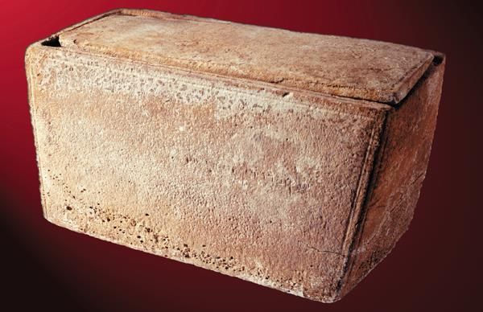
The “James Ossuary”

Slide 87
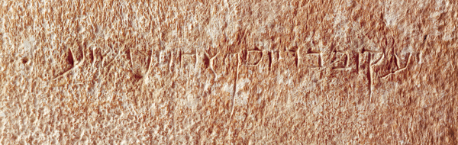
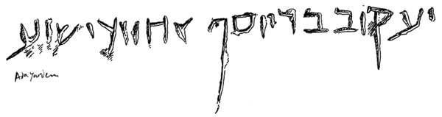
The Inscription
James, son of Joseph, brother of Jesus = fvwyd yvHx Jsvy rb bvqfy

Slide 88
Letter of James

Slide 89
Was “James” the brother of Jesus the author of the Letter of James?
Whoever wrote James, he was well enough known to simply describe himself as “James”, which in turn suggests James, the brother of Jesus, as the most likely candidate. He had sufficient authority, recognition and longevity.
As a leader in the Jewish church, it makes sense that he still calls the church a “synagogue” (2:2).
There are various Hebraisms in the letter that suggest it was written by a Jew, not a Greek.
The language in the Letter of James has striking vocabulary affinities with James’ speeches in Acts.
Many of the sayings in James parallel sayings of Jesus in Matthew’s gospel, the most Jewish of the gospels, though they seem to be from the oral tradition of the church.
While certainty is not possible, James the brother of the Lord seems the best candidate.

Slide 90
The First Readers
James addresses his letter to “the twelve tribes in the Diaspora” (1:1).
Ostensibly, this address suggests he is writing to Jewish Christians.
Some interpreters have suggested a wider scope because of similar statements by Peter and Paul about an “Israel of faith” that include everyone believing in Christ, whether Jew or Gentile.
However, the use of the term “synagogue” (2:2) for Christian meetings points to a more Jewish constituency.
The absence of vice lists, common in Paul’s letters to Gentiles, also leans more toward identifying his readers as Jewish.

Slide 91
Date
If James the brother of the Lord is accepted as the author, then the letter must date before James’ martyrdom in AD 62.
If so, it is one of the earlier documents in the New Testament, perhaps even the earliest.
However, there is no clear historical evidence, either internal or external, to fix any firm date.

Slide 92
Style and Structure
The style is paraenetic (moral advice).
Nearly half the verbs in the letter are in the imperative mood.
There is little in the way of formal doctrine, and Christ is only directly mentioned briefly (1:1; 2:1).
Still, echoes of the teachings of Jesus figure prominently in the letter.
The closest parallels in the Bible are in books of Hebrew wisdom literature, especially Proverbs.

Slide 93
An Ethical Scrapbook?
The letter is composed of groups of sayings without obvious connectives (similar to Proverbs).
Sometimes, catchwords link sayings (e.g., “steadfastness”, “lacking” and “asking”).
Major themes appear in the first chapter and are developed later:
  Enduring trials
  Rich and poor
  The tongue
  True wisdom
  Prayer of faith

Slide 94
Links to Jesus’ Teachings a considerable amount of James’ moral advice seems to be based on the teachings of Jesus, especially the Sermon on the Mount
Joy in trials (1:2; Mt. 5:10-12)
Maturity (1:4; Mt. 5:48)
Asking God (1:5; Mt. 7:7)
Faith (1:6; Mt. 21:21)
Anger (1:20; Mt. 5:22)
Doing, not just hearing (1:22; Mt. 7:24-27)
The poor (2:5; Mt. 5:3)
Loving one’s neighbor (2:8; Mt. 22:39)
The law (2:10; Mt. 5:19)
Having mercy (2:13; Mt. 5:7)
Doing God’s will (2:14; Mt. 7:21)
Teachers (3:1; Mt. 23:8-12)
Hasty speech (3:2-10; Mt. 12:36-37)
Fruit (3:12; Mt. 7:16-18)
Peacemaking (3:18; Mt. 5:9)
Friendship with the world (4:4; Mt. 6:24; Jn. 15:18-19)
The humble (4:10; Mt. 23:12; Lk. 14:11)
Judging others (4:11-12; Mt. 7:1)
Coming judgment (5:9; Mt. 24:33)
Justice (5:2-3; Mt. 6:19-21)
Prophets (5:10; Mt. 5:12)
Oaths (5:12; Mt. 5:34-37)

Slide 95
Conceptual Links to Hebrew Wisdom
God does not tempt (1:13; Sirach 15:11-12)
Be quick to listen, slow to speak (1:19a; Sirach 5:11)
Be slow to anger (2:6: Pro. 14:21)
The poor should be cared for (2:6; Pro. 14:21)
Words are destructive (3:6; Pro. 16:27; Sirach 28:11-12)
The tongue is dangerous (3:9-12; Sirach 28:13-26)
God opposes the proud (2:6; Pro. 14:21)
Tomorrow is beyond human control (4:13-14; Pro. 27:1)
Oaths do not enhance truth (5:12; Sirach 23:9-11)
Offense calls for restoration (5:20; Pro. 10:12)

Slide 96
Quotations
While most links are conceptual, a few times there are direct or near direct quotations:
“The Lord resists the proud; but he gives grace to the humble.” (Pro. 3:34, LXX)
“This is why the Scripture says: ‘God opposes the proud but gives grace to the humble.’” (Ja. 4:6b)
“Be quick to hear, and be deliberate in answering.” (Sirach 5:11)
“Everyone should be quick to listen, slow to speak…” (Ja. 1:19)

Slide 97
Argument
James opens his letter with a theology of suffering (1:1-18).
To Christians who face trials of many kinds, he prays for wisdom so that suffering may be perceived and used in the right way.
He offers blessing to the one who “stays under” during suffering (u[pome<nw = perseveres, stays under).
Next, he urges his readers to be active in their faith, not merely listeners (1:19—3:12).

Slide 98
Active faith entails not only removing things like human anger and immorality, but also, controlling speech and practicing charity.
Especially, it means avoiding favoritism because of social class. The “royal law” is what Jesus himself indicated—loving one’s neighbor as oneself.
Hence, faith and deeds must complement each other. The issue is not whether a person with real faith also has works, but whether a person who “says” he has faith can make such a claim without works.
Finally, guarding one’s speech becomes the ultimate test of genuine godliness.
There are two kinds of wisdom—that from above and that from below (3:13—5:6).
Wisdom from above is peaceable, leading to humility.
Wisdom from below leads to strife, arrogance and exploitation.

Slide 99
Despite injustice in the world, believers must patiently await Christ’s return.
Christ’s return is always imminent!
In the meantime, believers are to endure suffering.
Even in times of sickness, they are to submit their sicknesses to God in faith.

Slide 100
Critical Ideas in James

Slide 101
Was Paul Opposed to James?
Especially since the Reformation, some have pitted James against Paul as though their respective theologies of faith and works were in conflict.
“You see that a person is justified by what he does and not by faith alone”. James 2:24
“We…know that a man is not justified by observing the law, but by faith [alone] in Jesus Christ.” Galatians 2:15-16

Slide 102
CONTEXT IS CRITICAL!
Only by ignoring context can James and Paul be interpreted as opposed!
The context of James’ statement is toward the person who claims to have faith and says that good works are unnecessary.
James uses the word “justify” with the nuance of vindication or demonstration.
For James, “works” refer to good deeds.
James was combating pseudo-faith.
The context of Paul’s statement is toward the person who says that the works of the law are necessary in order to merit salvation.
Paul uses the word “justify” with the nuance of acquittal before a judge.
For Paul, “works” refer to rituals of Mosaic law.
Paul was combating legalism.

Slide 103
The Debate About Anointing one other NT passage also describes anointing with oil (Mk. 6:13)
Anointing was used widely as an ancient medicine (Lv. 14:18, 29; Is. 1:6; Je. 8:22; Lk. 10:34), usually using the word a]lei<fw (= to smear, anoint).
Anointing also was used as a symbol of God’s presence (for kings and priests), usually using the word xri<w (= to smear, anoint).
James uses the first of these two verbs, a]lei<fw, leading some to interpret that he intends oil for its medicinal value. Others argue that James intends anointing only as a symbol for divine healing.

Slide 104
Differences in Understanding
Evangelicals
…are more apt to follow the idea that anointing is medicinal, and therefore, they offer prayer but also seek medical help.
Pentecostals
…usually urge the symbolic use of oil representing God’s divine power to heal miraculously apart from medical help.
R. Catholics
…since the Council of Trent (16th century), anointing is a sacrament administered by a priest to those expected to die.

Slide 105
Sickness and Sin (5:15-16)
Sometimes sickness is linked to sin (Jn. 5:14; Ac. 12:21-23; 1 Co. 11:27-30), but according to Jesus, this is not necessarily so (Jn. 9:1-3).
James says “if he has sinned”, not “since he has sinned”.
Jesus treated most sick people as victims, not criminals.
Nevertheless, if there is reason to believe that a particular sickness was related to sin, the sick person will be forgiven through prayer.

Slide 106
Letter of Jude

Slide 107
An Insider’s Letter
Audience
(1, 3, 17, 20)
Those “called”
Those “beloved”
The Threat
Some who “slipped in” (4)
Participants in Christian love feasts (12)
Self-interested shepherds (12b)
Arrogant fault-finders (16)
Divisive (19)
Doubtful in their loyalty to the orthodox faith (3)
Sexually permissive (4)
Rebellious (8)

Slide 108
Author
Judas, brother of James:
Candidates:
  Half-brother of Jesus (Mt. 13:55; Mk. 6:3)
  Judas Thaddaeus, the Apostle (Mt. 10:3; Lk. 6:16; Ac. 1:13)
  Judas Barsabbas (Ac. 15:22, 27, 32)
  Obviously not Judas Iscariot
Since the writer seems to distinguish himself from “the apostles of our Lord” (17), he is unlikely to be Judas Thaddaeus the Apostle.

Slide 109
Judas, the Brother of Jesus
Several factors suggest that he is in the family of Jesus.
Typically in Jewish culture, one identifies oneself by one’s father, so in cases where a brother is mentioned, one should assume that the brother was well-known.
James, the leader of the Jerusalem church, fits this description (Ga.1:19; 2:9).
He seems to prefer the Hebrew text rather than the Septuagint, which suggests he is not from the Diaspora.
If so, this small letter could be one of the earliest documents in the New Testament.

Slide 110
Readers
Unfortunately, there are no direct clues as to the first readers.
However, the writer assumes their familiarity not only with the apostles and their teachings, but also, with Jewish literature outside the New Testament.
Hence, if the audience was not completely Jewish (and the heresy seems easily compatible with a Gentile culture), there must have been a significant Jewish component.

Slide 111
The Infiltrators
What is clearly in view is some type of antinomianism and libertinism.
They rejected the sovereign lordship of Christ (4, 8).
They claimed authority by dreams (8) and natural instinct (19).
They turned grace into license for sexual promiscuity (4, 6-8).
They flouted church authority (8, 10).
They bragged about their own superiority (16).

Slide 112
Relationship to 2 Peter
Similarities with portions of 2 Peter are striking.
2 Peter
2:1-3
2:5
2:4, 6
2:10-11
2:12
2:15, 13
2:17
2:18
3:2
3:3
Subjects
False teachers who were predicted
Ancient judgments on the ungodly
Judgments on angels and Sodom
Flouting authority and celestial beings
Living by instinct like brute beasts
Joining fellowship but following Balaam
Empty sources whose destiny is darkness
Braggarts following their own desires
Recalling words of apostles & prophets
Scoffers in the last days
Jude
4
5
6-7
8-9
10
11-12a
12b-13
16
17
18

Slide 113
Striking Parallelisms
Such striking parallels and in the same order can hardly be coincidental. Three options can be considered:
2 Peter is later and borrows from Jude.
Jude is later and borrows from 2 Peter.
Both letters borrow from some common but unknown source.
In the absence of any known independent source, most scholars, based on literary style, hold Jude to be the earlier of the two letters.

Slide 114
Canon
As is well known, Eusebius (early 4th century) listed Jude among the disputed letters (accepted by most but not by all).
It is unclear how widely spread were some of the smaller documents in the earliest periods.
Jude appears in the Muratorian Fragment (the earliest existing canon list, late 2nd century), but it is missing in other lists.
The fact that Jude contains references to non-canonical Jewish writings may have created doubts.
By the late 4th century, it was universally accepted.

Slide 115
Argument
Jude’s essential concern is that there are threats to “the faith once delivered to the church”.
By using analogs of past divine judgments, Jude warns against the threat of heresy.
Moving from analog to denunciation, Jude condemns false shepherds who prey upon the flock while offering nothing in return.
The apostles themselves predicted that such deceivers would come.
As a final appeal, Jude urges believers to fight for their faith.

Slide 116
Critical Ideas in Jude

Slide 117
Non-Canonical Texts
Why did Jude quote from non-canonical Jewish literature?
Jude, of course, does not stand alone; Paul quoted from Greek literature and made allusions to non-canonical Jewish texts.
There is no clear indication that Jude considered these works to be Scripture, but he seems to have considered them relevant.
Apparently, Jude and others employed textual material they considered valid, whether canonical or not.

Slide 118
Letters from the Big Fisherman
The letters of peter

Slide 119
In the Jerusalem Church
Peter figures prominently in the Gospels as the most outspoken disciple of Jesus and in Acts 1-12 as the primary leader in the earliest period of the Jerusalem church.
A fisherman from Bethsaida, Galilee and later Capernaum, he demonstrated brashness, human weakness, deep loyalty and repentance.
In the history of the earliest Christians, Peter is at the forefront, the “Rock” upon which the church was built and the one to whom Jesus gave the “keys to the kingdom”.
After that, there is only one direct reference to Peter in the Book of Acts—in the narrative about the Jerusalem council on circumcision (Ac. 15).

Slide 120
In Antioch
Paul describes a critical confrontation between Peter and himself at Antioch, Syria (Ga. 2:1ff.).
Though Peter had been instrumental in opening the gospel to non-Jews at Caesarea, at Antioch he retreated into sectarianism.
Paul charged Peter that he was not “acting in line with the truth of the gospel”.

Slide 121
Hints of Later Ministry
Information about Peter’s later ministry is scant.
He “went to another place” (Ac. 12:17).
He traveled throughout various Christian churches, taking his wife with him (1 Co. 9:5).
Presumably he preached in Corinth (1 Co. 1:12; 3:22)
Later tradition says he traveled through Pontus, Galatia, Bithynia, Cappadocia and Asia (the provinces to which 1 Peter is addressed).

Slide 122
Peter’s Martyrdom
Jesus predicted Peter’s martyrdom (Jn. 21:18-19).
Christian tradition says this happened in Rome during the reign of Nero, probably in AD 64 or 65.
The reference to “Babylon” in 1 Peter (5:13) may be a cryptic reference to Rome.

Slide 123
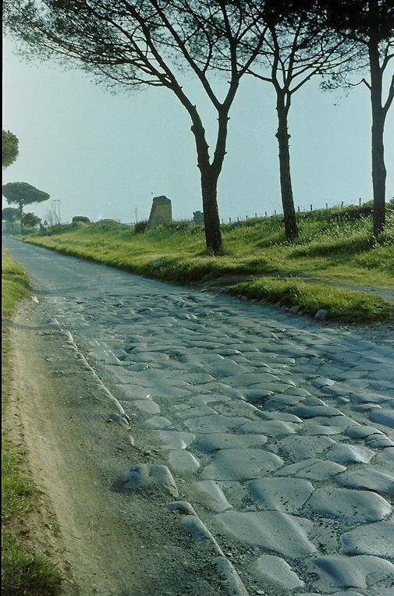
This well-laid Roman pavement shows the final stretch of the Via Appia leading to Rome.
It was already well-worn before Peter’s arrival, and the ruts are from ancient chariot traffic.

Slide 124
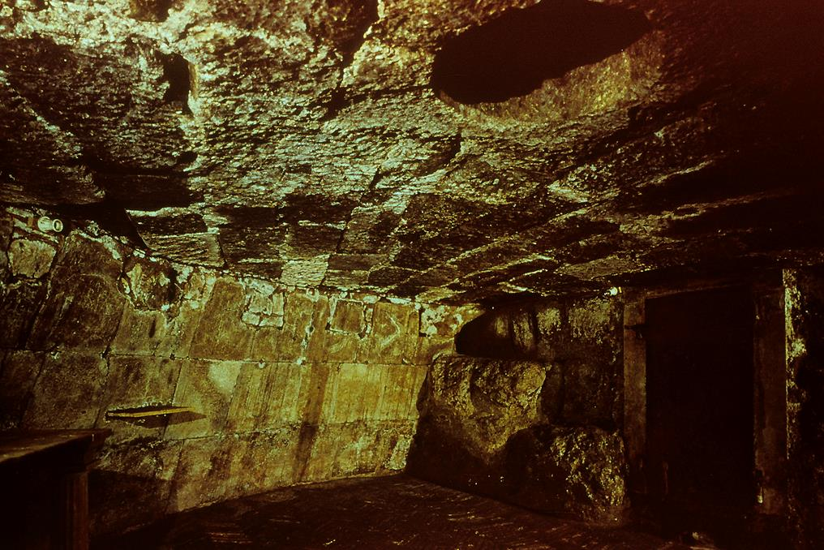
The dungeon of the Mamertine Prison in Rome where, if Peter was arrested by Nero, he likely spent time.
According to early Christian tradition, Peter used the spring that welled up through the lower floor to baptize his jailers.

Slide 125
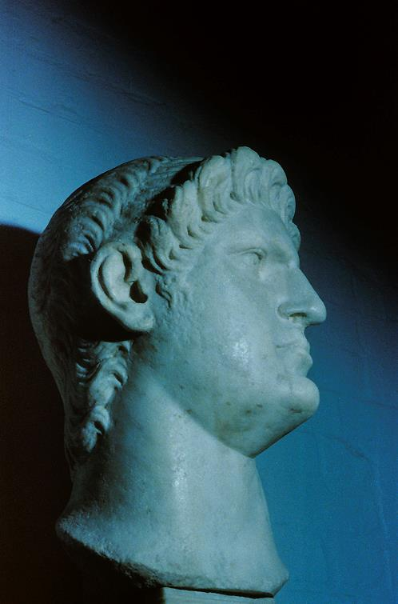
Bust of Caesar Nero under whom, according to early Christian tradition, both Peter and Paul were martyred, Peter by crucifixion and Paul by beheading.

Slide 126
1 Peter

Slide 127
Readers
The initial readers of 1 Peter were Christians on or near the coast of the Black Sea, the northeast extremity of the Roman world (1:1).
Peter calls them the Diaspora, a term usually used to describe the Jewish community scattered through the Roman world.
However, the internal character of the letters suggests that the readers were largely non-Jewish converts living outside Palestine (cf. 1:8, 14; 2:10; 4:3, 15), and the term “Diaspora” seems to be used as a metaphor.

Slide 128
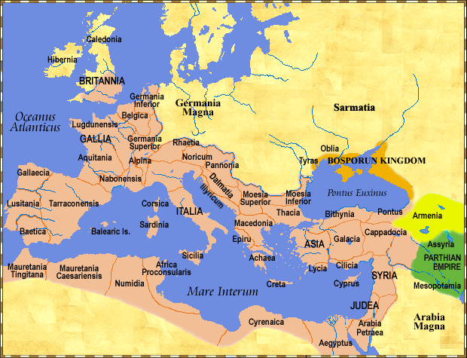
Readers of
1 Peter
The 1st Century Roman World

Slide 129
Literary Character
Scholars agree that 1 Peter is written in excellent, polished Greek with extensive vocabulary and a number of hapax legomena.
While such literary character might seem strange from a Galilean fisherman, it is less strange if the literary character of the letter derived from Silas, the ananuensis (cf. 5:12).
While the book has the appearance of a standard letter, it has a clear break in 4:11 with a doxology and an “amen”, which has led some scholars to suggest it may have been two compositions brought together at a later date.

Slide 130
Place of Composition
Peter says that he wrote this work from “Babylon”: “She, the one co-chosen with you in Babylon…greets you” (5:13).
The use of the feminine pronoun, as in 2 John, probably refers to a Christian community.
There are three candidates for Babylon in the 1st century:
  Babylon in Egypt (a military fort)
  Babylon in Mesopotamia (head of the ancient empire of Nebuchadnezzar)
  Babylon as a cryptic name for Rome (cf. 2 Esdras 3:1, 28; Baruch 11:1; 67:7; Sibylline Oracles 5:143, 157; Rv. 17:6, 9, 18; 18:2; 19:2)

Slide 131
Argument
The Christian life is lived out in an alien world (1:1—2:10).
While the heavenly future is bright with hope, the present world is rife with suffering (1:3-9).
The prophets and even angels focused on the sufferings of Christ (1:10-12).
In the midst of such opposing forces, the Christian is called to live a life of holiness, love and spiritual maturation (1:13—2:3).
Believers are God’s chosen people, a spiritual house, a holy priesthood and the living stones in a spiritual temple (2:4-12).

Slide 132
As the new people of God, Christians must behave appropriately in all structures of society, even though the prevailing culture stands against them (2:11—3:7). This includes:
Respect for the civil authorities (2:13-17)
Submission to superiors (2:18-25)
Mutually appropriate behavior between spouses (3:1-7)
When opposition arises, Christians must make sure it is undeserved (3:8—4:19).
In God’s eyes, it is praiseworthy to suffer for what is right, just as Christ also suffered unjustly (3:8—4:1).
Certainly believers must not fall into sinful behaviors, but must live a life full of Christian grace (4:2-11).

Slide 133
Suffering in a unjust world is only to be expected (4:12-19).
Just as righteous life in an alien culture is important, so also is appropriate behavior within the Christian community (5:1-11).
Christian leaders must serve selflessly out of godly motives (5:1-4).
The young must give deference to those who are older (5:5-7).
All Christians must be on guard again the devil (5:8-9).
Finally, they must remember that suffering is temporary (5:10-11).

Slide 134
Critical Ideas in 1 Peter

Slide 135
How is/was the gospel preached to “the dead”?
Peter’s language in 3:19 and 4:6 has occasioned much discussion from ancient times.
Some Early Church Fathers
The reference to “spirits in prison” (3:19) was linked to “the dead” (4:6) to suggest that between his death and resurrection, Christ preached the gospel in the underworld.
This, along with Mt. 12:40; Ac. 2:27; Ep 4:9, is the origin of the phrase in the Apostles’ Creed that Christ “descended into hell”.
Augustine and Others
Others suggested that this preaching was through the Spirit of Christ in Noah to those who now are dead (but were still living when the gospel was preached to them).
The NASB adds the word “now” to 3:19, even though it is absent in the Greek text, to reinforce this interpretation.

Slide 136
2 Peter

Slide 137
A Controversial Letter
From ancient times, 2 Peter has been surrounded by controversy.
It had relatively late circulation among the post-apostolic churches (unknown to most until about AD 200).
Much of the content mirrors what is in Jude.
Like Jude, it contains references to non-canonical Jewish literature (the Pseudepigrapha).
In modern times, some historical-critical scholars have dismissed it as a secondary document not written by Peter and not worthy of the canon.

Slide 138
Authorship
At first glance, 2 Peter seems authentic.
It claims to have been written by Peter.
It alludes to Jesus’ prediction that Peter would become a martyr (1:14; cf. Jn. 21:18-19).
It recalls the transfiguration, an event experienced by only three of the disciples, one of whom was Peter (1:16-18; Mt. 17:1ff.//Mk. 9:2ff.//Lk. 9:28ff.).
It alludes to the Book of 1 Peter (3:1).
It describes Paul as a “dear brother” (3:15; cf. Ac. 15:22; Ga. 1:18; 2:9).

Slide 139
External Objections
Given these marks of authenticity, why then is there doubt?
In the early church, 2 Peter belongs to half a dozen books that were disputed, even though they eventually were accepted as canonical.
Not until the time of Origen (3rd century) is 2 Peter directly referenced by any of the early Christian leaders, and even then, Origen acknowledges the work as disputed.
At least one early Christian writer, Didymas, bluntly said the work was spurious (4th century).
One early translation of the New Testament, the Syriac Peshitta (5th century), did not include it.

Slide 140
Internal Objections
Scholars have long recognized several internal factors that beg questions.
The Greek in 2 Peter is quite unlike that of 1 Peter.
The writer seems to speak of the “apostles” as a group of which he was not a part (3:2).
The time lapse between the deaths of “the fathers” (a reference to the apostles?) and the return of Christ sounds odd at this early period (3:4).
The writer references Paul’s letters as already collected and recognized as Scripture (3:16), which, given Peter’s death in AD 64 or 65, seems very early.
Why would someone of the stature of Peter draw so heavily from the Letter of Jude?

Slide 141
Diverse Answers
PETER
The work is credited to Peter outright, and various defenses are marshaled to answer the objections.
CRITICAL SCHOLARS
The work was composed by an unknown 2nd century Christian who used the name “Peter” as a pseudonym.
COMPENDIUM
The work is a compendium of Peter’s teachings compiled by an unknown disciple and used to confront a circumstance after Peter’s death (cf. 1:15).

Slide 142
Setting, Readers, Date
These questions remain open:
Based on 3:1, it is possible that both 1 and 2 Peter were written to the same group(s), and if so, then the recipients would have been those Christians living in the provinces near the south shore of the Black Sea (cf. 1 Pe. 1:1).
If the letter was composed during Peter’s lifetime, it must be prior to AD 64 or 65, when Peter was martyred.
If composed by a disciple of Peter using genuine material from Peter, it could be dated any time in the last half of the 1st century, more or less.

Slide 143
Argument
Peter opens his second letter urging the values and virtues of the Christian faith (1):
As participants in immortality, the Christian lifestyle should reflect the qualities of Christ himself (1:1-11).
The Christian tradition rests upon a double foundation, the eyewitnesses who personally knew and saw Jesus and the inspired testimony of the prophets (1:12-21).
False voices from the past match false voices in the present (2):

Slide 144
Following the same analogs of judgment in Jude, Peter warns of the certainty of judgment to come (2:1-16).
Believers must recognize the dangerous moral shortfall of such false teachers in order to avoid deception (2:17-22).
In this second letter, Peter warns that the final days of the age will be marked by skepticism (3):
The delay of the Parousia and judgment, however, is not due to slowness on God’s part, but rather, that his means of reckoning time is not the same as it is for humans. Delay is a form of divine mercy (3:1-9).
The day of judgment will surely come, but in the meantime, as citizens of another world, believers must live exemplary lives (3:10-17).

Slide 145
Critical Ideas in 2 Peter

Slide 146
Jewish Apocalyptic
The writer is obviously familiar with Jewish apocalyptic writings (non-canonical).
The earlier reference to angels who sinned and are confined in Tartarus is detailed in various pseudepigraphical writings as an interpretation of Ge. 6:1-2.
The slandering of celestial beings is described in the lost ending of the Assumption of Moses.
The idea of the world being destroyed by fire is not found in the Old Testament, but it is well-attested in the Pseudepigrapha (Life of Adam and Eve, 49:3; Sibylline Oracles III.54, 544, 690; 2 Baruch 27:10; 70:8).
Like Jude, Peter seems to have regarded this literature as relevant, even if not canonical.

Slide 147
A Translation Issue
2 Pe. 3:12a is capable of alternative translations, both of which are grammatically possible:
“as you eagerly wait” (so RV, KJV, ASV, JB, NEB, Phillips, Weymouth, Williams, footnotes in NIV and RSV)
“as you speed its coming” (so RSV, NIV, NASB, ESV, NAB,TEV).
While the issue cannot be resolved by Greek grammar alone, theologically it seems difficult to accept that the time of Christ’s return, which “the Father has set by his own authority” (Ac. 1:7), can be affected by humans one way or another. Hence, “wait eagerly” is probably to be preferred.

Slide 148
Hebrews
Letter to those being pressured to turn back to judaism

Slide 149
AUTHOR
Probably more than any other book in the NT, the authorship of Hebrews has remained elusive.
Formally, the book is anonymous.
Though many have suggested St. Paul, probably because he knew Timothy (13:23), the Greek style of Hebrews is much more polished than Paul’s known works.
He does not number himself among the apostles (2:3).
Still, the work is being quoted by the mid-90s (1 Clement 1:3-7; 17:1), so the writer must have lived well before the end of the 1st century.
Other suggestions have been Apollos (so Luther), Luke (so Calvin) and Silas, Barnabas and Priscilla & Aquila.

Slide 150
READERS AND OCCASION
Equally elusive has been the precise circumstances under which the book was written.
That they were a Christian congregation (or part of a congregation) seems clear enough, since the farewell mentions the leaders and all the saints (13:24).
The traditional view is that the letter was addressed to Jewish Christians in danger of lapsing back into temple worship, quite possibly under pressure during the 1st Jewish revolt (AD 66-70).
Certainly the book has repeated warnings against turning away from Christ (2:1-4; 3:7—4:13; 5:11—6:12; 10:26-39; 12:1-29).
We also know they faced persecution (10:23-34; 12:4).

Slide 151
ARGUMENT
The letter has the longest sustained argument in the NT about the superiority of Christ over Moses and the ancient patterns of tabernacle worship.
The style of argumentation is a fortiori, which is to say, “if that is true, then how much more is this true”.
In keeping with this rhetoric, the letter frequently uses modifiers, such as, “better” and “superior” (1:4; 7:19, 22; 8:6; 9:23; 10:34; 11:16, 40; 12:24).

Slide 152
STRUCTURE
THE SUPERIORITY OF CHRIST
…to the prophets (1:1-3)
…to the angels (1:4-14)
  The 1st solemn warning (2:1-4)
The condescension of Christ (2:5-18)
…to Moses who received the Torah (3:1-6)
  The 2nd solemn warning (3:7-19)
…to Joshua who led them into the land (4:1-13)
…to Aaron and the priestly line (4:14—7:28)
  The 3rd solemn warning (5:11—6:12)
The High Priest of a new covenant (8)
Worship in the earthly sanctuary (9:1-10)
Christ supersedes the old covenant (9:11-28)
The once for all sacrifice of Christ (10:1-18)
EXHORTATION TOWARD STEADFASTNESS
Hold to the hope (10:19-25)
  The 4th solemn warning (10:26-39)
The cloud of witnesses (11)
  The 5th solemn warning (12)
Living as the pilgrim people of God (13)

Slide 153
OPENING (1:1-3)
Unlike most letters, the opening is not epistolary but confessional.
It affirms that God has not been silent, but he has spoken through the prophets.
As important as the prophets were, however, God now has spoken by his Son.
Like John (Jn. 1:1-2, 1 Jn. 1:1-2), the writer identifies Christ Jesus with the Logos (using the verb lale<w).
This “Word” has come “in the last days”, a way of describing the time of fulfillment.

Slide 154
The Seven Confessions
Following this opening, the writer offers seven acclamations about the Son as the full and final revelation of God. He is…
…the heir of all things.
…the agent of all creation.
…the radiance shining forth from God, the true source of all light.
…the very image of the substance of God (the Greek word karakth<r describes a seal impression on coins or seals).
…the one who enables the universe to continue to exist.
…the priest who provides purification for sins.
…the one who because his saving work is now completed sits at God’s right hand, the place of all authority.

Slide 155
SUPERIOR TO ANGELS (1:4—2:18)
In a collage of OT quotations, the writer demonstrates that Jesus cannot be reduced to the level of angels.
God never addressed any angel, “You are my Son”, but he did so at Jesus’ baptism and the transfiguration (cf. 2 Sa. 7:14).
In the Song of Moses (Dt. 32:43 LXX), the angels are summoned to worship the Son.
Angels are temporary servants (Ps. 104:4), but the Son is God eternal (Ps. 45:6-7; 102:10-12).
Yahweh even addresses the Son as Lord and seats him at his right hand (Ps. 110:1).

Slide 156
The First Solemn Warning (2:1-4)
Altogether, there will be five solemn warnings in the book.
This first warning begins the a fortiori argument (if that is true, how much more is this true).
If the Torah mediated by angels (Dt. 33:2) was so binding that violations merited death (Ex. 19:12-13), and if Jesus is superior to the angels, then to drift away from this higher word of salvation would be to court disaster!

Slide 157
Condescension of the Son
Some might argue that Jesus’ superiority is undermined because of his incarnation.
However, the condescension of the Son belongs to this present age, but in the future, he will be exalted as Lord.
  His condescension to the lowly estate of humans was in order that he might suffer death in behalf of them all.
  By his suffering and victory over death, he fulfills God’s purpose that a human should be lord over all creation, thereby bringing “many children” into this new state.
In the Son’s victory over death, he destroyed the destroyer—and this is not to the benefit of angels, but to the benefit of his human “brothers”, since he serves as their faithful high priest, suffering with them and helping them when they are tempted.

Slide 158
SUPERIOR TO MOSES (3:1-19)
Moses was faithful as the Lawgiver and Intercessor, but the Son is faithful as the Final Apostle and High Priest.
The Son is superior to Moses just as the builder of a house is greater than the house itself.
Moses was not the builder, but rather, a faithful servant within the household.
The Son, on the other hand, is joined to the Father as the Builder-Owner.
The difference between a house servant and a Son who is the Co-owner is enormous!

Slide 159
The Second Solemn Warning (3:7-19)
Taken from Ps. 95:7b-11, this warning cites two great rebellions of the Israelites, Rephadim (Ex. 17:1-7) and Meribah-Massah (Nu. 20:1-13).
Both times, the Israelites quarreled with God, refusing to trust him, which ultimately resulted in them be shut out of the promised land.
Members of the believing Christian community must take care not to do the same thing, for the rebellion of unbelief is disastrous!

Slide 160
SUPERIOR TO JOSHUA (4:1-13)
The second solemn warning continues into Chapter 4, but now the focus will shift toward Joshua, Moses’ successor.
Theoretically, at least, the promised land was to be a place of rest, but the ancient people of Israel found no rest there. (Indeed, the entire history of the nation is fraught with war, failure, rebellion and exile.)
Hence, the writer asserts that the promise of rest still stands open, since it had never been realized.
This good news of rest is now preached in the message of Jesus, and if the ancient community missed it for lack of faith, Christians must not do the same!

Slide 161
SUPERIOR TO AARON (4:14—10:18)
At last the writer reaches his primary objective, the priesthood of Christ, and this section will be the largest in the letter.
First, he will focus upon the office of Christ’s priesthood (chapters 5-7).
Then, he will explore the function of Christ’s priesthood (chapter 8-10).

Slide 162
The Office of Christ’s Priesthood (5-7)

Slide 163
The Priest of Eternal Salvation (4:14-16)
Previously, the author has described Christ as a merciful and faithful high priest who made atonement for the people’s sins.
Now, he will concentrate upon one particular event in the ancient sacrificial system, Yom Kippur, the day of national atonement, the only day when the high priest was allowed into the Most Holy Place in the immediate presence of Yahweh enthroned over the ark (Lv. 16).
Christ, in his resurrection and ascension, has now entered into the Most Holy Place of heaven before the “throne of grace”, the heavenly counterpart to the mercy seat of the ark.

Slide 164
The Basic Priestly Qualifications (5:1-10)
ORDINATION
The honor of ordination was not self-chosen.
Aaron, the first high priest, was directly appointed by God (cf. Ex. 28:1-4; Lv. 8).
Hence, to claim Jesus as the Great High Priest also required divine appointment, and this appointment was confirmed by God himself (Ps. 110:4).
REPRESENTATION
A priest is by definition a representative of the people.
He is obliged to show gentleness and empathy, since he is himself characterized by weakness.
In Jesus’ earthly life, he experienced the reality of human horror and the prospect of death.
BOTH BY DIVINE CALL AND HUMAN EXPERIENCE, JESUS IS QUALIFIED!

Slide 165
The Third Solemn Warning (5:11—6:12)
The first readers of the letter are judged to be immature Christians who need to make real progress toward spiritual perception.
It would be especially disastrous for those who had begun a new life in Christ to revert back to something less.
In turning back from Christ, it would be as though they were crucifying him all over again!

Slide 166
God’s Promises are Sure (6:13-20)
The end of the third solemn warning urges believers to imitate the people of faith who inherit God’s promises.
God’s promises are sure, because they are established on his own inviolable character.
The unchangeableness of God’s character rests on two unchangeable things:
  His promise of blessing to Abraham (Ge. 12:2-3)
  His oath at the binding of Isaac (Ge. 22:15-18)
Believers, then, have this firm hope in God’s unchanging character, which anchors them to Jesus, the Great High Priest who has entered heaven’s Most Holy Place!

Slide 167
Melchizedek’s Priesthood (7:1-10)
The author now addresses the primary objection to Jesus’ high priesthood—he was from the Tribe of Judah, not the Tribe of Levi or the family of Aaron.
Was the claim of Jesus’ high priesthood therefore false? Absolutely not! Rather, his priestly order was different, following that of Melchizedek, the ancient priest of Jerusalem to whom Abraham paid tithes.
Of primary importance is that Melchizedek’s priesthood was not based on pedigree, but rather, God’s direct appointment. Jesus’ high priesthood is the same.

Slide 168
A New Priesthood (7:11-25)
Hereditary priesthood presumes an ongoing ritual of atonement for successive generations.
Repetition implies that such ritual is not finally effective.
In declaring his Son as a priest in the office of Melchizedek, God effectively indicated that the law of priesthood in the Torah would be superseded.
This change in priestly order from Aaron’s sons to Melchizedek’s order repealed the requirement that all high priests must come from Aaron’s line.
This is how Jesus was qualified to be a high priest, and because it was declared “forever”, the office had to be filled by someone who would live forever.

Slide 169
The Better Priesthood (7:26-28)
This priesthood of Jesus, God’s Son, truly fits what every human needs!
Unlike the priests of Eli’s line, who were rejected, this high priest is holy, blameless, pure and set part from sinfulness!
Unlike the Aaronic priests who die, this high priest has been exalted above the heavens and now sits at the Father’s right hand!
Finally, unlike those priests who must perform their service repeatedly, this high priest offered one sacrifice for everyone forever by becoming BOTH priest and sacrifice!

Slide 170
The Function of Christ’s Priesthood (8-10)

Slide 171
High Priest of a New Covenant (8:1-13)
As implied earlier, heaven is the true sanctuary of which the earthly sanctuary was only a model of what exists in heaven.
Hence, the entry of Christ into the heavens is the counterpart to the entry of the high priest into the earthly throne-room of Yahweh on the Day of Yom Kippur.
If Yom Kippur belonged to the old covenant, then the entry of Christ into heaven belongs to a new one, the one envisioned by Jeremiah (Je. 31:31-34)—not a covenant of retribution, like the old one, but a covenant of forgiveness.
The very fact that Jeremiah called it “new” implies that the former covenant would become obsolete.

Slide 172
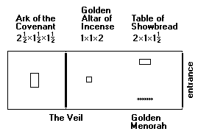
Worship in the Earthly Sanctuary (9:1-10)
The daily services in the old sanctuary climaxed every year on the Day of Yom Kippur, when the high priest entered the Most Holy Place in behalf of the whole nation.
This ritual, which had to be reenacted annually, implied that the people’s access to the mercy seat of atonement was limited and not finally effective.

Slide 173
Christ, the High Priest of “Good Things that are Already Here” (9:11-28)
In Christ, the new order for worship already has been inaugurated!
To establish it, Christ did not resort to the old ritual, but entered the Most Holy Place of heaven one time for everyone with his own blood.
Hence, if Moses was the mediator of the old covenant, Christ is the mediator of the new one, which is effective in ways the old one could never be.
In the case of a last will and testament, the death of the testator is necessary to make the will effective; in the same way, Christ’s death put in force the new covenant.

Slide 174
Once for All! (10:1-18)
The author’s explanation of Christ’s superior priesthood climaxes in a single word: e]fa<pac (= “once for all”).
In the old system, the priests of Aaron’s line stood and offered their sacrifices time after time, implying by their very repetition that they were not finally effective and showing that their work was never finished.
By contrast, Christ finished his sacrificial work once for all and sat down! The fact that he “sat down” meant the sacrificial work was perfectly completed forever!

Slide 175
Call to Perseverance (10:19—13:17)
The word “therefore” (ou?n) presses home that the author is now reaching a climax.
The basic implication is that “since this is true, then let us live appropriately!”
Christians now can confidently enter the Most Holy Place, a closeness to God not possible in the rituals of the tabernacle, and this “new and living way” has been opened up by the sacrifice of the body of Jesus, symbolically the “curtain” in the sanctuary that screened the immediate presence of God (10:19-25).
Jesus is the priest, he is the sacrifice, he is the veil, he is the mercy seat—all indicating that the old way was finished.

Slide 176
The Fourth Solemn Warning (10:26-39)
To turn back from Christ would be even more disastrous than rejecting Moses’ law.
Those who rejected Moses’ law were punished, often by death.
Those who reject the Son of God will face an even more dreadful end.
The readers had started well, so they needed to persevere, since God’s promises are sure!

Slide 177
The Great Cloud of Witnesses (11)
The heroes and heroines of faith from the past serve as strong incentive to persevere!
Repeating themes:
  Faith is the certainty that God will do what he promised.
  The ancients did not receive the fulfillment of the promises within their own lifetimes, but they all understood that these promises reached beyond the land of Canaan and earthly life.
  Their righteous lives in the present were lived in view of the promise yet to come.
If the readers were to remain in continuity with the past, they must hold firmly to their faith in Jesus Christ, since he was the one for whom the ancients looked by faith!

Slide 178
The Fifth Solemn Warning (12:1-29)
The ancients who died in faith are the spiritual ancestors of present believers in Christ.
They are a great cloud of witnesses, who cheer the runners on toward the finish line.
Persecution had not yet resulted in martyrdom; indeed, hardship is a form of divine discipline.
The privileged place of Christians is like the difference between Mt. Sinai and Mt. Zion—the difference between the law and the promise. They must not refuse Zion by going back to Sinai!

Slide 179
Living as Pilgrim People (13)
The author’s concluding exhortations consist of practical advice in light of what he already has written.
Love, hospitality, care for those in prison, sexual purity, contentment and trust must be cultivated.
Believers must respect and imitate godly leaders.
They must guard themselves against heresies.
Finally, Jesus’ death “outside the camp” (outside the city gate) calls for Christians to leave the camp, also.
The letter closes with a blessing and prayer.

Slide 180
Critical Ideas in Hebrews

Slide 181
Losing Salvation?
The five solemn warnings in Hebrews raises the question as to whether or not a believer can lose his/her salvation.
Clearly, the author of Hebrews envisions that some who were part of the Christian community could turn back from the Christian faith.
Hence, these solemn warnings become an interpretative crux in the long-standing debate over divine sovereignty and human freedom (i.e., Calvinism and Arminianism).
The larger question is whether or not those who fall away had genuine faith or only pseudo-faith.

Slide 182
Two Answers
The answer of Calvinism is that this was only pseudo-faith, which is to say, it had the appearance of faith but was not genuine.
To allow that true Christians can fall from grace nullifies grace itself and makes salvation a result of human effort.
Salvation is due to divine sovereignty alone.
The answer of Arminianism is that these passages demonstrate the possibility of apostasy by true Christians.
God’s grace will keep everyone who wants to be kept, but human rejection of divine grace is possible, also.
God is sovereign, but he exercises self-limitation in order to grant humans this freedom.

