Slide 1

THE CHRISTIAN CHURCH
Its peoples, theologies, and practices
A Short History
PART 2: From the Reformation to the 21st Century

Slide 2
Index (2-4)
The Reformation (5)
Fundamental themes in the Reformation (6-7)
The Precursors: Hus, Wyclif (8)
Luther (9-16)
The Spread of Luther’s Ideas (17)
Hallmarks of the Reformation (18)
Protestant and Roman Catholic Differences (19)
The Question of Authority: relationship between the Bible and Church Tradition (20)
The Question of Canon (21-23)
The Question of Eucharist (24-25)
Luther and Erasmus (26)
Luther and Zwingli (27-28)
The Anabaptists and Radical Reformers (29-30)
The Catholic Counter-Reformation (31)
The Question of Worship (32)
The English Reformation (33-34)
The Book of Common Prayer (35-38)
John Calvin (39-41)
Theologies of the Reformers (42)
The Calvinist-Arminian Debate (43-47)
Early Protestant Traditions by Region (48)
Three Branches of Christendom (49)
Wars of Religion (50-51)
Reformation Translations of the English Bible (52)
William Tyndale (53-60)
Tyndale’s Immediate Heritage (61-67)
King James Version (68-74)
The Enlightenment (75)
The Enlightenment (76-78)
Key Enlightenment Thinkers (80)
Enlightenment and Revolution (81-82)
The French Revolution (83)
Enlightenment Influence on Christian Thought (84)
Christianity in the New World (85)
The Puritans (86-89)
The Anglicans (90)
The Baptists (91)
The Methodists (92-93)
The Roman Catholics (94)

Slide 3
The Quakers (95)
The Deeper-Life Movements (96)
Lutheran Pietism (97-101)
1st Great Awakening (102-103)
2nd Great Awakening (104-105)
The American Holiness Movement (106-109)
Christians and Abolition (110)
The Slave-Trade (111)
William Wilberforce (112)
Frederick Douglass (113)
The Civil War and Abraham Lincoln (114-115)
The Development of Modern Missions (116)
The Mission Movement (117)
Roman Catholic Mission to Latin America (118-119)
Moravian Mission to Native Americans (120)
Carey, Moffat, Judson, Livingstone, Taylor, Carmichael (121-127)
American Stepchildren (128)
Restorationism (129-131)
Seventh Day Adventists (132-133)
The Mormons (134-136)
The Jehovah’s Witnesses (137-138)
Christian Science (139-140)
Perfection and Holiness (141)
The Perfectionist Movement (142-143)
The Continuing Holiness Movement (144-147)
Revivalists and Revivalism (148)
The New Revivalists (149)
Finney, Moody, Sunday, Fuller, Graham (150-155)
The Jesus Movement (156-157)
Rise of Eschatology (158-162)
Classical Protestant Liberalism (163)
Friedrich Schleiermacher (164)
Leading Thinkers (165)
Assumptions and Theology (166)
Higher Biblical Criticism (167)
Search for the Historical Jesus (168-171)
The Pentecostal-Charismatic Movement (172)
Pentecostalism (173-177)

Slide 4
The Divine Healing Movement (178)
The New Issue (179)
The Prosperity Gospel Movement (180)
Charismatic Christianity (181)
The Fundamentalist-Modernist Controversy (182)
The Fundamentals (183-184)
The Scopes Monkey Trial (185-186)
The Debate Over Inerrancy (187)
Evangelical Distinctives (188)
The Confessing Church (189)
The Christian Resistance Movement (190)
Niemöller, Bonhoeffer, and Barth (191-193)
The Ecumenical Movement (194)
The Goal (195)
The Missionary Conferences (196-197)
The World Council of Churches (198)
The World Wars (199-202)
Vatican II (203)
The Aim (204)
Roman Catholicism Since the Reformation (205)
Outcomes of Vatican II (206)
Eastern Orthodoxy in the Modern World (207-209)
Liberation Theology (210-211)
Oscar Romero (212)
Desmond Tutu (213)
Martin Luther King, Jr. (214)
Martyrs in the Modern World (215)
The Persecuted Church (216-217)
Modern Martyrs, Westminster Abbey Statues (218-219)
Women in the Church (220-223)
The Parachurch Movement (224-225)
InterVarsity Christian Fellowship (226)
Samaritan’s Purse (227)
Youth With A Mission (228)
The Church Growth Movement (229-230)
Seeker-Sensitive Churches (231)
The Southern Shift (232-234)
Developments in Left-Wing Protestantism (235)
Denominational Distress (236)
Where Do We Draw the Line? (237-242)

Slide 5

THE REFORMATION
The Birth of Protestantism

Slide 6
The IMPORTANCE OF THE REFORMATION
The Protestant Reformation remains one of the most important events shaping western European history and the modern world.
It broke the religious monopoly of the Roman Catholic Church, and it sparked profound political, social, and cultural shifts in Europe.
The late Medieval World had been deeply religious, but its approach to religion was corporate and less individual. The Reformation championed individual faith, but it also laid the groundwork for religious freedom, individualism, and democratic, nation-state sovereignty.

Slide 7
Two Religious Concerns
The Evangelical Concern
Here, the concern is the gospel. There is only one gospel, and anyone who advances any other gospel or “another Jesus” (2 Co. 11:4) is under a curse (Ga. 1:8-9).
The Catholic Concern
Here, the concern is the unity of the church. There is only one church, and all who are baptized into Christ are part of that same body (1 Co. 12:12-13).
Ideally, these two concerns should be in concert. In the Reformation, they came into significant tension.

Slide 8
Reformers Before the Reformation
John Wycliffe (1330-1384)
Wycliffe criticized prevalent views of church authority
The true church is the congregation of those chosen by God
The basic law of the church is the Bible, not the word of the pope
The church was full of wealth and corruption
The Bible should be translated into the common language of the people
Jan Hus (1372-1415)
The church is the elect company of those chosen by Christ
Christ, not the pope, is the true head of the church
Christ, alone, can forgive sins
The pope should not be venerated
Any church where clergy could use offerings to pay for prostitutes must be corrupt

Slide 9
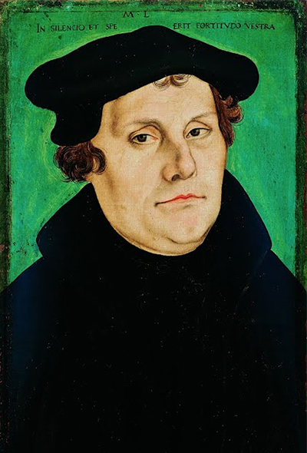
Luther at age 46 by Lucas Cranach the elder (Uffizi Gallery)

Slide 10
Martin Luther 1483-1546
Studied law at the University of Erfurt
Joined the Augustinian monks to fulfill a vow
Ordained a priest, 1507
Taught at the University of Wittenberg
Doctor of Theology, 1512
Posted his 95 Theses on the eve of All Souls Day, 1517
LUTHER’S EXEGETICAL DISCOVERY
The reigning theology of the day was that the “righteousness of God” referred to God’s active condemnation of sinful humans.
Luther’s discovery in Romans 1:17 was that the “righteousness of God” did not refer to God’s holy condemnation of sinners, but rather, his gift of righteousness conferred upon sinners by faith.

Slide 11
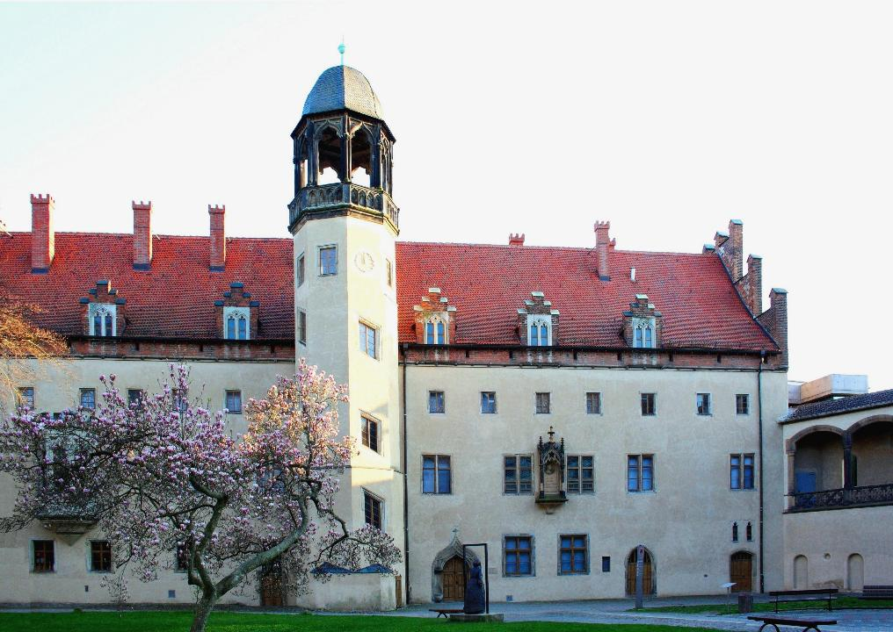
Lutherhause Wittenberg University Built in 1504, this was the home of Martin Luther for most of his adult life. He was living here when he composed the 95 Theses.

Slide 12
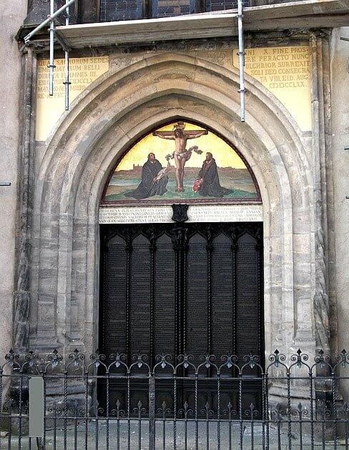
Door to the Wittenberg Church the 95 Theses are engraved on the door

Slide 13
Indulgences and the 95 Theses
THE PROBLEM WITH INDULGENCES
The church taught that it held a “treasury of merits,” that is, excess merit from Christ, the martyrs, and deceased saints which was accessible to living Christians of lesser spiritual status.
These surplus merits were dispensed as indulgences—a means of forgiving temporal punishment for sins (i.e., purgatory).
Indulgences were able to be purchased.
With the construction of St. Peter’s basilica in Rome, the sale of indulgences became a primary means for raising funds.
THE 95 THESES (a “thesis” is a statement presented for debate)
The 95 Theses were directly aimed at the sale of indulgences, and especially, they were a reaction against the salesman, John Tetzel, who marketed indulgences to Luther’s parishioners.
Tetzel’s jingle was, “As soon as the coin in the coffer rings, the soul from purgatory springs.”
For Luther, the sale of indulgences undermined the gospel, which declared that forgiveness was available on the basis of grace and faith alone.

Slide 14
Samples of Luther’s 95 Theses
#32 Those who believe that they can be certain of their salvation because they have indulgence letters will be eternally damned, together with their teachers.
#51 Christians are to be taught that the pope would and should wish to give of his own money, even though he had to sell the basilica of St. Peter, to many of those from whom certain hawkers of indulgences cajole money.
#52 It is vain to trust in salvation by indulgence letters, even though the indulgence commissary, or even the pope, were to offer his soul as security.
#86 Again, “Why does not the pope, whose wealth is today greater than the wealth of the richest Crassus, build this one basilica of St. Peter with his own money rather than with the money of poor believers?''

Slide 15
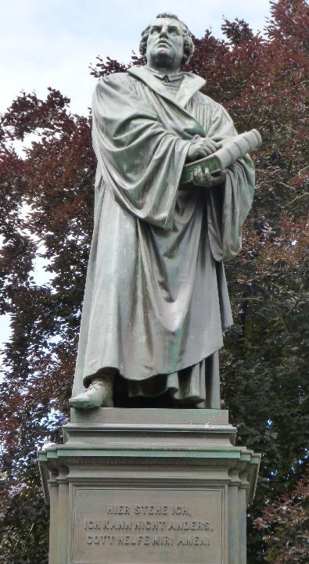
DIET OF WORMS In 1521, Luther appeared at the Diet of Worms, where he was called upon to recant his views. He refused to recant; the council then condemned him as a “notorious heretic.”
“Your Imperial Majesty and your Lordships demand a simple answer. Here it is, plain and unvarnished. Unless I am convicted of error by the testimony of Scripture or by manifest reasoning, I stand convicted by the Scriptures to which I have appealed, and my conscience is taken captive by God’s Word. I cannot and will not recant anything. For to act against our conscience is neither safe for us, nor open to us.
On this I take my stand. I can do no other. God help me. Amen.”
Martin Luther
Luther’s statue in Worms, Germany

Slide 16
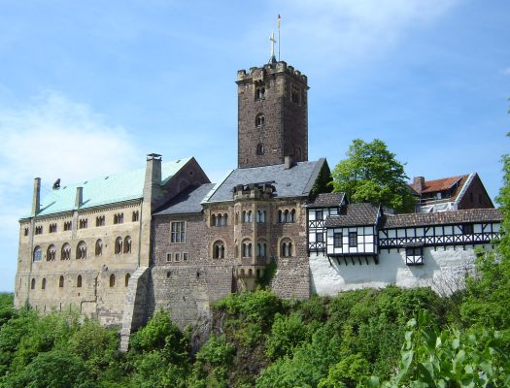
Wartburg Castle The Wartburg Castle is where fake kidnappers secretly took Luther on May 4, 1521 in order to protect his life. Here, he worked on his translation of the New Testament from Greek to German before eventually returning to Wittenberg.

Slide 17
The spread of luther’s ideas
Luther’s ideas became widely and quickly known through…
…the printing press (his 95 Theses were translated from Latin into German, and then became available in other languages as well).
…his use of the German every day vernacular (as opposed to Latin) made his ideas accessible to a broad swath of the German population.
…a network of students who traveled to Wittenberg and returned home, carrying his message with them, plus he had local political elites as supporters as well.
…numerous short, inexpensive pamphlets addressing contemporary issues and church doctrines.

Slide 18
Hallmarks of the Reformation
Sola Gratia (grace alone)
What is the sufficient agent in salvation?
Sola Fides (faith alone)
What is the sufficient human response for salvation?
Solus Christus (Christ alone)
Who is the sufficient source of salvation?
Sola Scriptura (Scripture alone)
What is the sufficient authority for the Christian life?
The ticklish part of the four Reformation hallmarks concerns the word “alone,” which is inferred but is not directly present in the Bible as such.

Slide 19
Protestant/Roman Catholic Differences in several theological categories, Roman Catholics were “both/and” while Protestants were “either/or”
Salvation & Mediation
Christ/Mary (Who is the source of divine grace?)
Faith/Works (Upon what basis does God save us?)
Divine Grace/Human Initiative (What is the effective agent for salvation?)
Christ/Saints (To whom can Christians effectively pray for help?)
Spiritual authority
Christ/Church (Who has the authority to confirm salvation?)
Scripture/Tradition (What is the final court of appeal for Christian belief?)

Slide 20
AUTHORITY The Interplay between Scripture & Tradition
Eastern Orthodoxy
DOUBLE SOURCE
Holy Tradition Holy Written Scripture
Roman Catholicism
DOUBLE SOURCE
Infallible Christian Tradition Inspired Scripture
Protestant Reformers
SINGLE, FINAL SOURCE
Holy Scripture Alone (sola Scriptura)
Christian Tradition

Slide 21
The Question of the OT Canon
While the NT canon was fixed by the 4th century, the OT canon remained more ambiguous.
The canon of the Jews was the collection of 24 books in the Hebrew Bible in three smaller collections fixed before the time of Christ: the Torah (law), Nebiim (prophets), and Kethubim (writings).
However, when the Septuagint was translated in the 3rd century BC, it included both the books of the Hebrew Bible as well as the Apocrypha.
Since the Greek Septuagint came to be the Bible used by most early non-Hebrew speaking Christians, it was common to read the Apocrypha as well.
No official decision had been made concerning the Apocrypha, but the books were included in the Latin Vulgate, though Jerome considered them to be second status. Some church fathers did not accept the Apocrypha as Scripture (Athanasius, Origin, Cyril of Jerusalem, etc.), while others did.

Slide 22
Luther and the Canon
Luther’s relationship to the Apocrypha was complex.
While he included these books in his translation of the German Bible, he relocated them after the OT and called them “Apocrypha” (= doubtful authenticity), which is to say, books that are “useful and good to read” but not equal to the Holy Scriptures.
He also considered Hebrews, James, Jude, and Revelation in the NT to be “disputed books,” which he also placed separately at the end of the New Testament, similar to the disputed works in the categories of Eusebius and others in the Ante-Nicene church.
He particularly did not care for James, since he believed it flatly contradicted Paul regarding faith and works (cf. Ga. 2:16; Ja. 2:24).

Slide 23
The Ongoing Canonical Issue
Luther’s challenge to the Apocryphal books led to two responses:
Roman Catholics: In 1546, the Council of Trent officially declared the Apocrypha to be divinely inspired Scripture, and further, that any who did not accept them as such were to be excommunicated.
Protestants: In early Reformation Bibles (including the KJV), the Apocrypha was included between the OT and NT, just as Luther had done. However, by the early 1800s, there was a concerted effort to eliminate them altogether, and they were no longer printed.
Today, most Protestants are unfamiliar with the Apocrypha except for Lutherans and Anglicans, both of which continue to read it.

Slide 24
The Question of Eucharist
Luther rejected the Roman Catholic doctrine of transubstantiation (i.e., that the bread and wine are miraculously transformed into the literal body and blood of Christ).
Instead, he described the presence of Christ as “in, with, and under” the eucharistic elements of bread and wine.
He also believed that the Eucharist was a means of grace by which Christ’s body and blood are truly received and experienced.
Other Reformers, especially Ulrich Zwingli in Switzerland, urged that the communion service was only a memorial of Christ’s sacrifice.

Slide 25
Four Remaining Positions
The diverging views of the Lord’s Table resulted in four major positions:
TRANSUBSTANTIATION
CONSUBSTANTIATION
DERIVED FROM CALVIN
DERIVED FROM ZWINGLI
Roman Catholic
As a sacrament, it conveys grace to all who receive it.
The bread and wine are transformed into the literal body and blood of Christ.
It is essential to salvation.
Lutheran
There is a sacramental union of the bread and wine with the body and blood of Christ.
As when an iron rod is put into the fire, both are distinct but united in heat.
Real Presence
Christ is spiritually present in the Eucharist (but not physically present).
The Holy Spirit works so that those who in faith receive it can receive the body and blood of Christ.
Memorial
The ritual is only a memorial. There is no special physical or spiritual presence of Christ.
The memory of the Lord’s supper is a reminder of his power to overcome sin and death.

Slide 26
LUTHER AND ERASMUS
Erasmus anticipated many of Luther’s ideas. Both decried the corruption and worldliness of the church. Luther used Erasmus’ Greek New Testament for his own translation. However:
Erasmus emphasized human responsibility and God’s grace through good deeds (“On the Freedom of the Will”), while Luther contended that salvation was the result of divine grace alone (“On the Bondage of the Will”).
Erasmus sought a middle path and reconciliation with the Roman Catholic Church, preferring intellectual discourse. Luther confronted the church directly, refusing to compromise on anything and willing to break with the church altogether.

Slide 27
LUTHER AND ZWINGLI
Luther never had a mild disagreement with anyone. An obvious example is his response to Ulrich Zwingli at the Marburg Colloquy of 1529, a potential joining of the German and Swiss Reformation movements.
After agreeing on 14 of 15 theological articles, their agreement broke down on only one, the meaning of the phrase, “This is my body.” Zwingli interpreted it metaphorically, Luther literally.
Luther castigated Zwingli, refusing to recognize him as a genuine Christian, and when he died two years later, while serving as a military chaplain, Luther remarked that Zwingli died in “sin and blasphemy.”
The German and Swiss branches of the Reformation remained disunited, a lasting split within the broader Reformation movement.

Slide 28
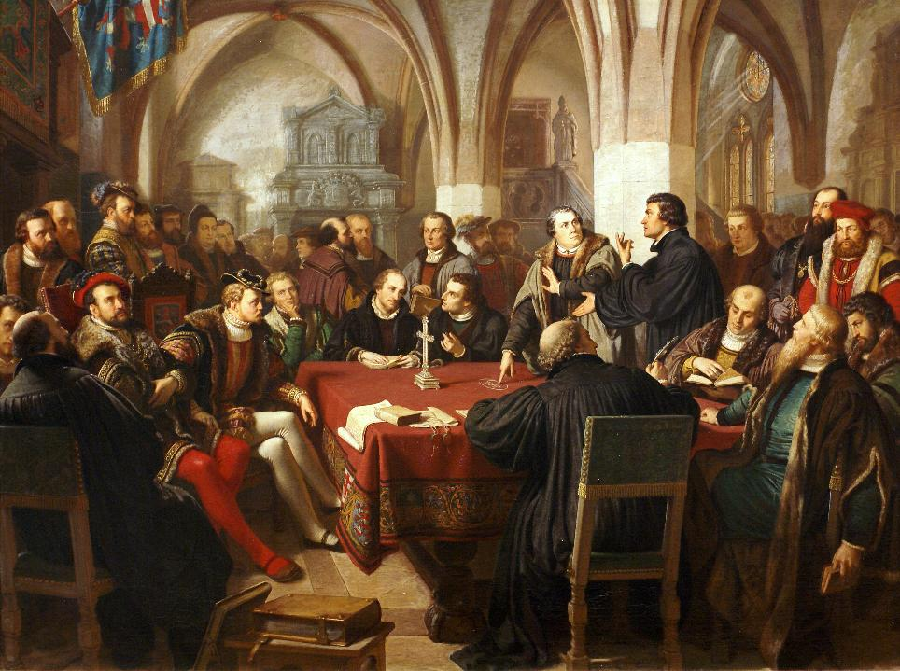
1867 Oil Painting by Christian Karl August Noack depicting the Marburg Colloquy.
Luther points to the Greek word εστιν (= “is”), while Zwingli points upward. “Is” means literal; upward means symbolic.

Slide 29
The ANABAPTISTS (Rebaptisers)
A number of groups in the Reformation Period did not think Luther and the other major reformers went far enough:
In particular, they objected to infant baptism, insisting that since faith was connected to baptism, it could only be performed for those who were old enough to intellectually affirm the Christian faith.
All those who had been baptized previously, but as infants, even Lutherans, were required to be rebaptized.
They issued a confession of faith in 1527 outlining their basic beliefs (Schleitheim Confession).
Major groups descended from Anabaptists are the Amish, the Hutterites, and the Mennonites. Later, the various Baptist groups, also, were influenced by Anabaptist theology.

Slide 30
The radical reformation
Both in Germany and in Switzerland, even more change was urged by some.
In Germany, a former priest, Thomas Muntzer, preached revolt and assembled a peasant army to eliminate the privileges of the nobility and redistribute wealth to all. (His peasant army was crushed.)
They were adamantly opposed to both the Roman Catholic Church and to Lutheranism.
Some, the Illuminists, claimed that the Holy Spirit spoke directly to believers through revelations, and they believed in the eminent end of the world. They are some of the ancestors of modern Pentecostals and Charismatics.

Slide 31
CATHOLIC COUNTER-rEFORMATION
To a significant degree (but not entirely), the Catholic counter-reformation was a response to the Protestant movement, but also a period of resurgence epitomized in the Council of Trent (mid-16th century).
It included documents condemning corruption, the rise of new spiritual orders (i.e., the Spanish mystics, etc.), and a renewed mission effort to reach out to those parts of the world colonized by Catholics and also to reconvert areas like England and Sweden who once were Catholic but had been lost to the Protestant Reformation.
It defended doctrinal positions concerning the seven sacraments and pious practices that were attacked by the Reformers.
It reaffirmed as proper Scripture the Vulgate (including the deuterocanonical books).

Slide 32
The Question of Worship
The Protestant Reformation brought shifts in Christian worship. These shifts included differences between:
LUTHERAN & ANGLICAN
REFORMED & ANABAPTIST
High Church
Using the vernacular in worship services (and a vernacular translation of the Bible)
Retaining the long-standing ritual, tradition, and heritage of early Christianity.
The use of vestments for the clergy along with structured liturgy.
Low Church
Using the vernacular in worship services (and a vernacular translation of the Bible)
More focus on Scripture and less on ritual and liturgy
Reduction of sacraments to two (baptism and communion)
Emphasis on congregational singing with the creation of new hymns
Moving away from the traditional Service of the Word and Service of the Eucharist (the sermon replaced the Eucharist as the high point; the pulpit, not the altar, was the architectural center)
Rejection of religious images (and the destruction of Christian art)

Slide 33
The English reformation
The Reformation in England took an entirely different form than the one in Europe.
Like the other Reformation movements in Germany and Switzerland, the Church of England broke from the authority of the Pope and the Roman Catholic Church in Rome.
However, this break-away was driven by King Henry VIII’s desire to annul his marriage (which the Pope would not grant).
In 1534, Parliament passed the Act of Supremacy, which made the king of England the head of the Church of England.
Monasteries were dissolved, and under Edward VI, the Church of England introduced the Book of Common Prayer formulated by Thomas Cranmer.

Slide 34

The English Reformation took a decided back-step with the elevation of Mary I to the throne, who was a devout Catholic.
Dubbed “Bloody Mary” for her aggressive persecution of Protestants, she implemented harsh measures, including imprisonments and executions.
Hugh Latimer and Nicholas Ridley, and later, Thomas Cranmer, were burned at the stake in Oxford, earning them the title “the Oxford martyrs.”
When Elizabeth I took the throne in 1558 after Mary’s short reign and death, she established a “middle way,” granting tolerance to both Protestant and Catholic Christians. This “middle way” (via media) has generally characterized the Church of England ever since.
Under her reign Protestantism was established as the official religion of England.
X marks the spot on Broad Street, Oxford where Latimer and Ridley were burned at the stake on October 16, 1555

Slide 35
Communal Liturgy and the Book of Common Prayer
In England, spirituality in the Anglican Church was closely associated with the Book of Common Prayer.
The BCP sought a balance between the contemplative life of monastic prayer and the vocal liturgy of communal prayer.
It continued the basic monastic pattern of the Eucharist and the Daily Office, but as the principal form of public worship.
While the full form of the Eucharist among Roman Catholics could only be recited in Latin (thus removing it from the people), and while the Eucharist was celebrated less frequently by Lutherans and the Reformed Church, the Anglican Church retained the monastic character of the service but made it available to the people in their own language.

Slide 36
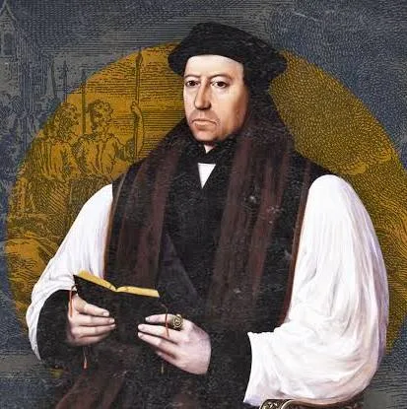
The Book of Common Prayer
The Book of Common Prayer was largely the work of Thomas Cranmer, Archbishop of Canterbury, under the reigns of Henry VIII and Edward VI.
Cranmer’s love for the Bible as the living Word of God led him to believe that if “his countrymen could be induced to read the word of God, or, if illiterate, to hear it read, it would in course of time make its way into their hearts.”
When Mary ascended to the throne in 1553, she returned England to Roman Catholicism. Thomas Cranmer was burned at the stake on March 21, 1556 for his reforming work. The BCP survived, nonetheless.

Slide 37
The Book of Common Prayer
The BCP was not simply a translation from Latin, for it was consciously Protestant, reducing the veneration of the saints and eliminating the concepts of transubstantiation and salvation by merit.
It borrowed from Luther’s Litany and Miles Coverdale’s translation of the New Testament.
It retained the character of medieval worship but abandoned its theology.
The Book of Common Prayer was directly tied to the English Reformation.
It sought to replace the various pre-existing rites in Latin with a single volume in the common English tongue.
First produced in 1549, then revised in 1552 and thereafter, it remains the primary service book for the Church of England.

Slide 38
The Spirituality of the BCP
The BCP sought to cultivate in public and private worship a reflective spirit of prayer, following Jeremy Taylor’s advice, “I would rather your prayer be often than long.”
In prayers composed for everyday occasions of life, the BCP sought to cultivate a habitual sense of the presence of God.
The creative, poetic use of language in beauty, cadence, and rhythm enhanced piety and prayer for both literate and illiterate people so that they became active participates, not merely observers, in the service of worship.
Cranmer had great confidence in ordinary people that they would understand and appreciate this depth in worship.

Slide 39
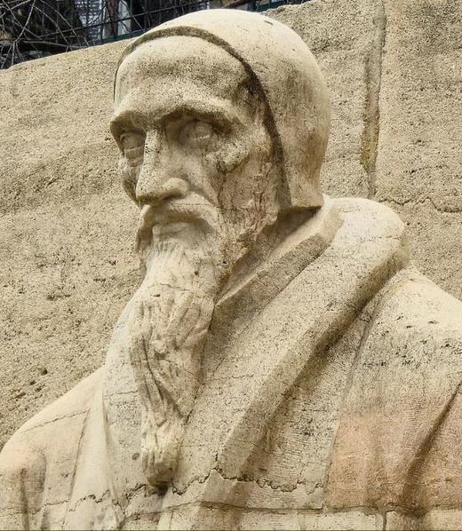
JOHN Calvin
Calvin (1509-1564), a prominent French theologian, was a 2nd generation Reformer best known for his theological system emphasizing divine sovereignty over against human freedom.
His work, Institutes of the Christian Religion, was arguably the most thorough treatment of Reformation doctrines.
He played a central role in establishing and reforming the church in Geneva, Switzerland.
John Calvin, Reformation Monument, Geneva, Switzerland

Slide 40
JOHN Calvin’s geneva
Calvin arrived in Geneva in 1536 and, after a period of exile (he was initially exiled due to conflict with the city council but invited back in 1541), he became the city’s spiritual leader until his death in 1564.
He profoundly shaped the city’s religious and social life as a major center for Reformation thought.
Geneva became a refuge for Protestants fleeing persecution in other European countries as well as a center for the spread of Reformed ideas throughout Europe and beyond.
In 1559, Calvin established the Geneva Academy for training ministers and scholars.

Slide 41
Life in calvin’s geneva
Calvin’s Geneva was known for its rigorous and austere religious life.
Swearing, gambling, fornication, and dancing were all banned.
Church attendance was compulsory and unexcused absence penalized.
A body called The Consistory was responsible for enforcing moral discipline, which evolved into a type of inquisition for violators of the moral laws.
A pronounced emphasis on hard work and clean living would eventually be epitomized in Puritanism, impacting the British Isles, the Netherlands, and the New World.
Calvin removed all religious symbols, forbade choirs, required that all music must be performed in unison without instrumental accompaniment, and allowed no hymns unless the lyrics were taken from the Bible.

Slide 42
systematic theologIES of the reformers No single voice spoke for all branches of the Reformation; while there was wide agreement, there were also differences.
Luther
He emphasized the primacy of divine grace and faith in salvation.
The key tenets were grace alone, faith alone, scripture alone, and Christ alone.
Every believer is a priest before God and has direct access to God.
Melancthon
He is best known for his systematic presentation of Lutheran theology.
Unlike Luther’s “bondage of the will,” however, he acknowledged a limited human free will.
Humans can accept or reject God’s offer of salvation.
Calvin
He emphasized the absolute sovereignty of God.
God chose in advance who would be saved and who would be damned.
Humans can contribute nothing to salvation, but God is the sole mover (monergism).
Hooker
He is often regarded as the originator of the Anglican via media (middle way).
He argued that salvation was possible for Roman Catholics.
He also contended that the Puritans went too far in demoting the clergy.

Slide 43
Divine sovereignty and human freedom
A long and contentious debate going as far back as Judaism, and later, Christianity concerns the relationship between God’s sovereign power and human’s limited freedom.
In Judaism, the Pharisees believed in fate, while the Sadducees did not; the community at Qumran, also, believed in predestination.
In early Christianity the issue came up between Pelagius and Augustine in the late 4th and early 5th century, when Augustine outlined the basic concepts of what later would flower into a debate within Protestantism.
In Protestantism, it is known as the Calvinist-Aminian Debate.

Slide 44
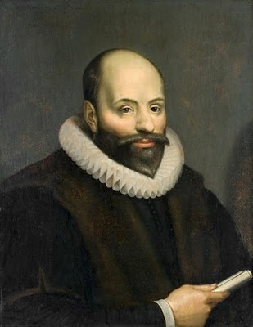
THE REMONSTRANCE
Jacob Aminius, a Dutch scholar (1560-1609), developed an alternative approach to Calvinism that affirmed human free will.
After his death in 1609, his followers produced a doctrinal statement in 1610 called The Remonstrance in which they advanced five articles or correction to the doctrine of predestination:
Conditional Election
Unlimited Atonement
Total Depravity
Prevenient Grace and Resistible Grace
Conditional Preservation of the Saints

Slide 45
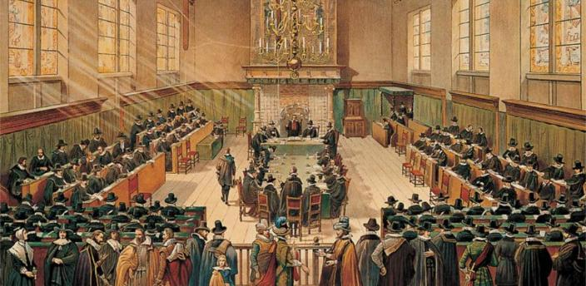
THE SYNOD OF DORT
At the Synod of Dort in 1618-19, traditional Calvinists of the Dutch Reformed Church examined Arminius’ theology and issued a rejoinder.
This rejoinder concluded that Arminius’ views were heretical and affirmed what has come to be known as the five points of Calvinism:
Total Depravity
Unconditional Election
Limited Atonement
Irresistible Grace
Perseverance of the Saints

Slide 46
Calvinist-Arminian Differences
Calvinism
Humans are completely unable to turn to God on their own.
God chose in advance who would be saved and who would be damned based on his sovereign will alone.
Christ died only for those he chose to save; he did not die for everyone.
Those whom God chose will certainly come to faith.
Those whom God chose will certainly persevere in their faith; they cannot fall from grace.
Arminianism
Fallen humans participate in the act of faith by their free will.
Election is based on divine foreknowledge of human choice, and humans can freely choose.
Christ died for all, but only believers are forgiven.
Grace begins, continues, and ends all good—but it can be refused.
Grace preserves, but humans can fall from grace and renounce their salvation.

Slide 47
The Calvinist-Arminian Divide
Tend to Be Calvinist
Reformed
Presbyterian
Congregationalists
Some Anglicans
Puritans
Baptists (particular)
Tend to be Arminian
Methodist
Baptists (general)
Nazarenes
Wesleyans
Holiness
Pentecostal-Charismatic

Slide 48
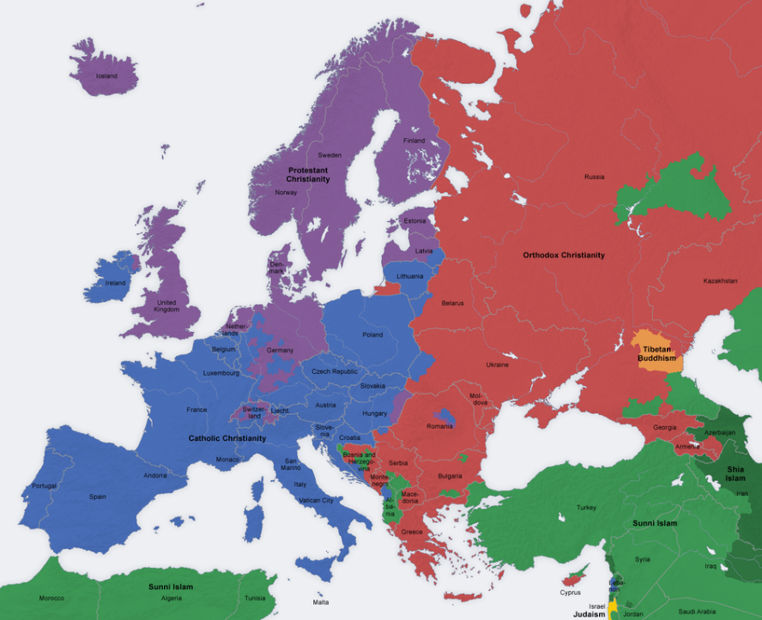
Lutheran
Northern Germany, Denmark, Norway, Sweden
Reformed
Netherlands, France, Switzerland, Scotland
Anabaptist
Germany, Switzerland, Scandinavia, Lowlands
Anglican
England, Wales
PROTESTANT
CATHOLIC
ORTHODOX
MUSLIM

Slide 49
Ancient Church
Three Primary Branches of Christianity
Medieval Church
AD 1054
Eastern
Orthodoxy
Roman Catholicism
16th CENTURY
Protestantism
(multiple branches)
Roman Catholicism

Slide 50
The wars of religion
It must be remembered that in the Reformation and post-Reformation periods, there continued to be a strong link between religion and the state.
Because both Catholics and Reformers were wedded to state support of their respective churches, both felt justified in violence toward the other.
The results were a series religious wars, some lasting many years, and for the most part, no one won—everyone lost.
Only the radicals started “free churches,” which would eventually give rise to the US Constitution which left church identity and preference to individual states, not to the federal government.

Slide 51
MAJOR CHRISTIAN CONFLICTS
Schmalkaldic Wars
1546-1547
Between Catholics and Protestants over the territories of the Holy Roman Empire.
In the end, the Lutherans were recognized as a legitimate entity in the Peace of Augsburg (1555).
French Civil Wars
1562-1598
Between Catholics and Huguenots (French Protestants).
The Edict of Nantes (1598) granted religious toleration (though it was revoked in 1685, forcing many Huguenots to flee France).
30 Years War
1618-1648
Between Catholics and Protestants within the Holy Roman Empire.
It evolved into a broader power struggle involving most major European powers, ending with the Peace of Westphalia.
English Civil War
1642-1646
Between King Charles I and Parliament.
Religion was a major cause (though not the only one), since Charles was pro-Catholic and various Protestant factions were opposed and fearful.
THE RISE OF DENOMINATIONS WAS AN ALTERNATIVE TO CHRISTIANS KILLING EACH OTHER OUTRIGHT .

Slide 52
BIBLE TRANSLATION
Reformation Translations of the English Bible

Slide 53

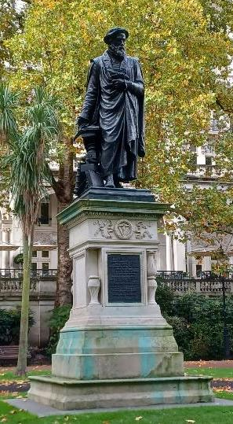
William Tyndale (1494-1536)
Tyndale was educated at Oxford and Cambridge Universities.
At Magdalen Hall, Oxford, he studied Greek and was exposed to the Greek edition of the New Testament produced by Erasmus.
His comparison of the Greek New Testament with what was commonly understood by both priests and laypersons convinced him that there was widespread ignorance of what the Bible actually said.
Statue of William Tyndale along the south side of the Thames, London

Slide 54
“If God spare my life, ere many years pass, I will cause a boy that driveth the plough shall know more of the Scriptures than thou dost.”
William Tyndale’s words to an
English cleric

Slide 55
Failure at English Support
Tyndale turned to Cuthbert Tunstall, the Bishop of London, hoping to gain a sympathetic ear to his vision and legal authority to proceed.
Tunstall refused support.
As an alternative, Tyndale discovered some London merchants who already were smuggling Luther’s writings into England.
Thus was born in Tyndale’s mind the possibility of doing the translation work abroad and smuggling the translations back into England.

Slide 56
Opposition
As Tyndale’s work became known, strong opponents arose, including:
King Henry VIII of England
Cardinal Woolsey, who issued a warrant for Tyndale’s arrest
Sir Thomas More, who wrote against Tyndale, claiming that his translation work was full of errors and heresy
English bishops sought to buy up Tyndale’s smuggled versions and destroy them, but the money they paid was secretly funneled back to Tyndale enabling him to continue his work.

Slide 57
Learning Hebrew
Hebrew scholars had been almost non-existent in England, but in Europe, Tyndale began learning the Hebrew language in order to translate the Old Testament.
While on the run from authorities, Tyndale translated the Pentateuch, which was completed by 1530.
He experienced a huge setback when the ship on which he was passenger sank off the coast of the Netherlands, and he lost his manuscripts and his money.

Slide 58
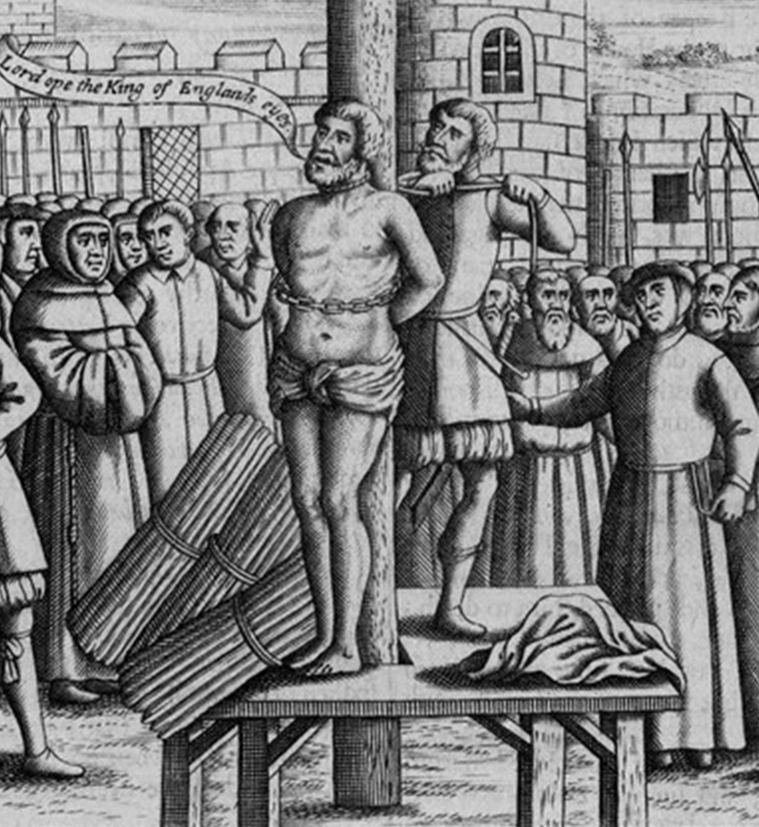
Betrayal
In the end, Tyndale was betrayed to the authorities by Henry Phillips, a young man employed by English authorities as a spy.
In 1534, Tyndale was apprehended in Antwerp.
After eighteen months in a dungeon, he was brought to trial in October 1536, where he was condemned as a heretic.
He died by strangling and burning at the stake.
His last words, according to witnesses, was, “Lord, open the King of England’s eyes!”

Slide 59
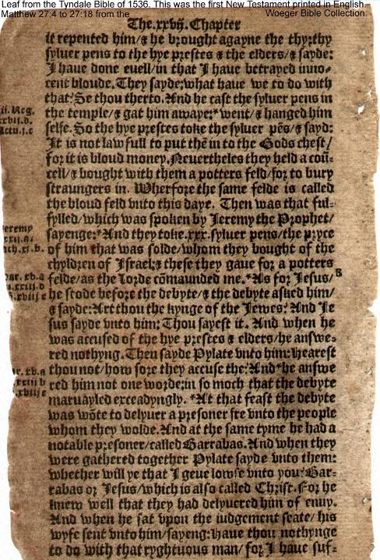
William Tyndale
1536 Version
Matt. 27:4-18
Chapter divisions
No verse divisions
Some 90% of his words would later pass into the King James Version of the Bible. Until the mid-20th century, every English version was, more or less, a revision of Tyndale’s translation.

Slide 60
Though I speake with the tonges of men and angels and yet had no love, I were even as soundynge brass: and as a tynklynge Cymball. And though I coulde prophesy and vngerstode all secretes and all knowledge; yee if I had all faith so that I coulde move mountains oute of there place and yet had no love I were nothynge.
William Tyndale
1 Corinthians 13:1-2

Slide 61
Tyndale’s Immediate Heritage
Though his arrest and execution prevented Tyndale from completing his translation of the Old Testament, two of his assistants continued the work.
Miles Coverdale used the Latin Vulgate and Luther’s German translation, among other sources, to complete the unfinished work on the Old Testament in 1535 while Tyndale still was in prison.
John Rogers, using Tyndale’s work, produced an English translation in 1537 under the pen-name of Thomas Matthew. (The pseudonym was important, since Tyndale had been declared a heretic.)
Both these translations received royal licenses!

Slide 62
The Great Bible
Now that English Bible translation was not inherently illegal, the demand for an English Bible in the churches was immediate.
Coverdale was commissioned to produce such a Bible, which he completed in 1538.
This Bible, known as the Great Bible, was for the most part a revision of the work of William Tyndale (though this was not widely known).
By 1540, the Great Bible was appointed to be used in all the English parish churches. Tyndale’s dying prayer had been answered!
There was such fever for reading the Bible in English that sometimes people would interrupt church services in order to do so! (A royal edict stopped this practice.)

Slide 63
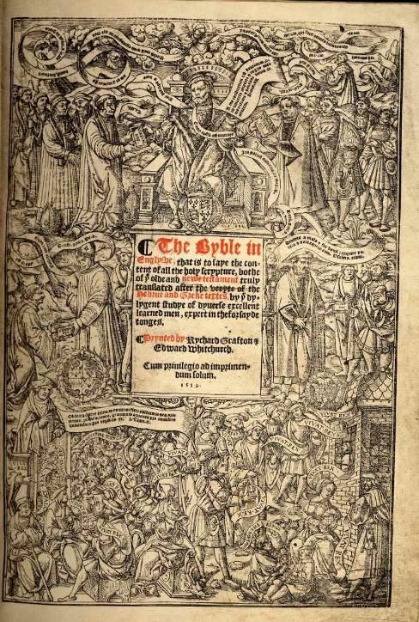
Title Page
The Great Bible
1539 Edition
Authorized to be distributed to all parish churches in England for public reading
“The Byble in Englyshe, that is to saye the content of all the holy scrypture, bothe of the olde and newe testament truly translated after the veryte of the Hebrue and Greke textes by the dylygent studye of dyverse excellent learned men, expert in the forsade tonges.”

Slide 64
Mary and Elizabeth
With the ascension of Mary, who favored the Roman Catholic Church, Bible translation temporarily came to a halt in England (though it continued on the continent).
Translators, if caught, were executed for their pains if they could not escape England.
Many English Bibles were taken from the parish churches and burned.
When Elizabeth succeeded Mary, the pendulum swung back toward a more favorable disposition toward the English Bible, and Elizabeth reissued her father’s order for every parish church to have its own copy.

Slide 65
The Geneva Bible
During Mary’s reign, English Bible translation continued to be carried out in Geneva, Switzerland.
This effort produced a revision of the Great Bible, especially those parts not translated earlier from Hebrew by William Tyndale.
It also included extensive theological annotations favoring Calvinism, which in turn contributed greatly to the developing theology of the Puritans and the Scottish Presbyterians.
The Geneva Bible was widely popular and quickly became the Bible of most Protestants.

Slide 66
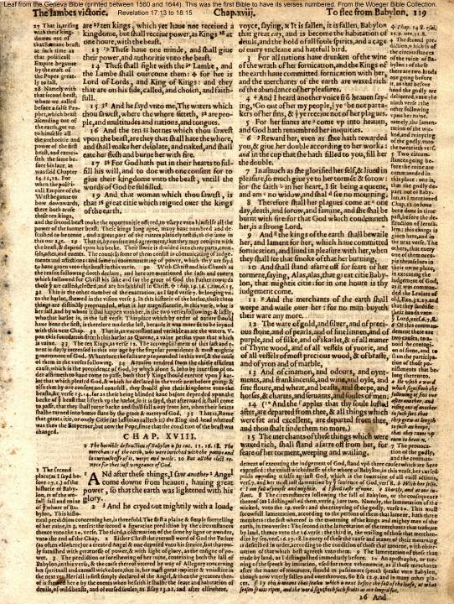
Geneva Bible
1560 Edition
Revelation 17:13—18:15
Chapter Divisions
Verse Divisions
Annotated copiously with interpretive comments in different typeface from Scripture
Clearly identifies the Papacy as Babylon the Great (Rome)

Slide 67
The Bishop’s Bible
Though it was the best English translation to date, the annotations in the Geneva Bible were offensive to non-Calvinists in general and James I in particular.
Hence, a revision of the Great Bible was begun by the English bishops and other qualified scholars who checked it against the original Greek and Hebrew.
Completed in 1568, this Bishops’ Bible was now ordered for the parish churches without any “bitter or controversial” annotations.

Slide 68
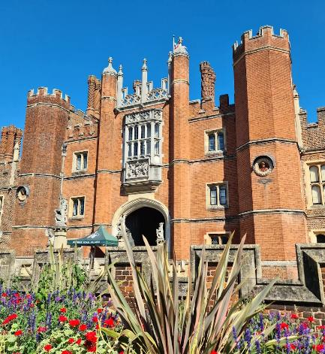
James VI Becomes James I
After ruling as the King of Scotland for 37 years, James became the King of England and head of the Church of England upon the death of Elizabeth.
Early in his reign, he convened a conference at Hampton Court to review church matters.
At this conference, the suggestion was made by John Reynolds that a new English translation of the Bible might be appropriate.
This pleased James immensely, since he disliked the Geneva Bible due to its annotations, some hinting that where the king and the Bible were in conflict, Christians must obey the Bible, not the king.
Hampton Court

Slide 69
Translation by Committee
Earlier English translations of the Bible had been largely due to individual efforts.
The new translation would be by a group of scholars, 47 in all, from Oxford and Cambridge universities, divided into six panels.
Three panels for the Old Testament
Two panels for the New Testament
One panel for the Apocrypha
The starting text would be the Bishop’s Bible, which then was to be compared for accuracy with the available Hebrew and Greek manuscripts in the original language.
The work of each panel was then reviewed by a committee of twelve scholars, two from each panel.

Slide 70
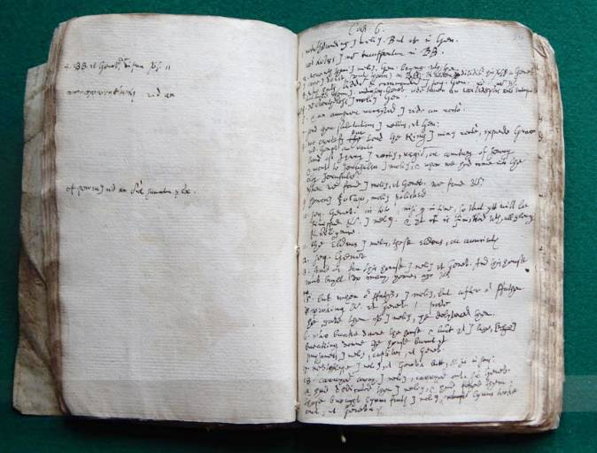
Recently discovered in the archives of Cambridge University, these personal notes are from Samuel Ward, one of the 47 translators of the KJV. It concerns his translation of the Apocryphal Books of Esdras and Wisdom.

Slide 71
Format of the Translation
With the goal of creating a non-partisan Bible, the translators agreed to:
Dispense with theological notation
Include the traditional chapter and verse divisions and compose new chapter headings
The translators frankly conceded that their work would not be perfect, pointing out that all Bible translation is a history of revision and correction, thus paving the way for future revisions.
They also acknowledged that variant readings in the original languages were problematic.
Work on the King James Bible began in 1604 and was completed and published in 1611.

Slide 72
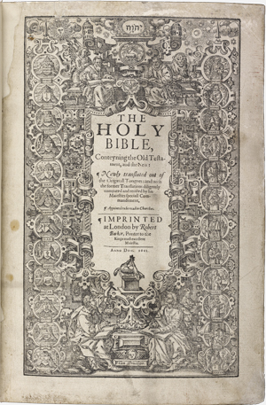
The title page of the first edition of the King James Bible reads, "THE HOLY BIBLE, Conteyning the Old Testament, and the New: Newly translated out of the Originall Tongues : and with the former Translations diligently compared and revised by his Majesties speciall Comandement" and was printed in London in 1611 by “Robert Barker, Printer to the Kings most excellent Majestie”.

Slide 73
Typos
As with any publication, printers’ errors of various sorts were only gradually weeded out. Some of the more notorious have been:
1631 Edition: In the 7th of the 10 Commandments, the printer inadvertently omitted the word “not” in the commandment on adultery.
1795 Edition: The printer inadvertently set the type as “killed” instead of “filled” for Mark 7:27. (“Let the children first be killed…”)
In one Edition, Psalm 119:161 reads: “Printers have persecuted me without a cause” (instead of “princes”).

Slide 74
Revisions and Improvements
Revisions of the KJV began as early as 1616, a mere five years after its initial publication.
Most early revisions concerned spelling changes and punctuation improvements.
Throughout the 17th Century, the Puritans were working to remove the Apocrypha (but this was not official until 1885).
By the early 1800s, paragraphing was added.
By 1851, dates were added, based on the chronology of Bishop James Ussher (who dated creation to 4004 BC).
Family registries were regularly printed in the prefacing pages (e.g., family births, deaths and marriages, etc.).
In 1899 a publisher began printing the words of Jesus in red letters.

Slide 75
THE ENLIGHTENMENT
Revolution in Science, Philosophy, and Government

Slide 76
THE ENLIGHTENMENT
The Enlightenment (alternatively called the Age of Reason) was a shift in Western thought during the 17th and 18th centuries with a focus on reason, logic, empirical observation, and scientific inquiry.
Strong emphases were on the importance of individual rights, liberty, and progress.
The old bastions of authority—especially the church and the divine right of kings—was swallowed up by democratic ideas about government, society, and religion.
Enlightenment thinkers sometimes challenged established religious doctrines, political institutions, and social hierarchies resulting in a more secular and democratic approach to life.

Slide 77
THE enlightenment and science
The progress of science was deeply intertwined with the Enlightenment.
Building on the astronomical discoveries of Copernicus (heliocentric universe), Kepler (laws of planetary motion), Galileo (satellite observation) and Isaac Newton (laws of motion and gravitation), the advance of scientific method based on observation, experimentation, and rational analysis became an important tool for understanding the world.
This drive to better understand the natural world led to continual new discoveries in physics, chemistry, astronomy, and natural history.

Slide 78
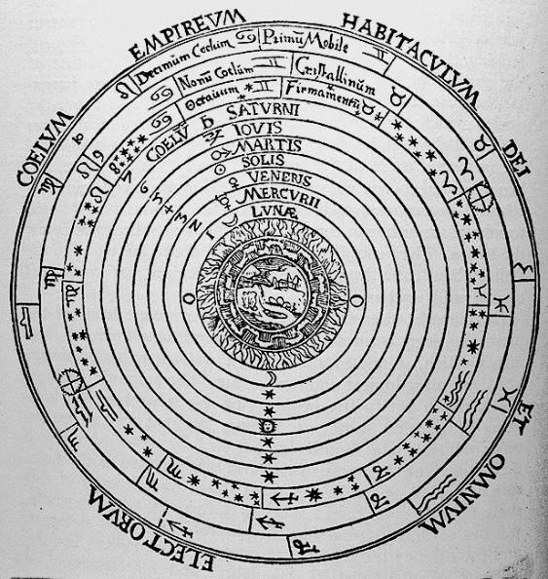
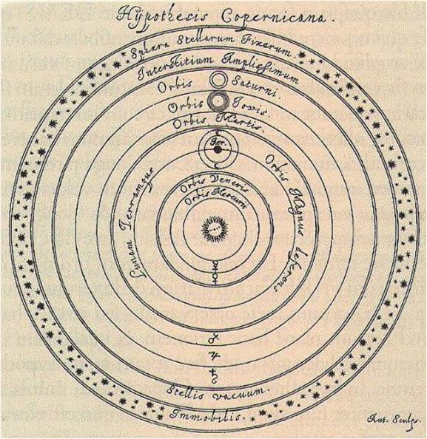
Ptolemaic Model of the Universe (Geocentric, ca. AD 150)
Copernicus’ Model of the Universe (Heliocentric, AD 1543)

Slide 79
CHRISTIANITY and THE scienceS
While it is true that sometimes religious authorities, such as the pope, censured scientists like Galileo and Copernicus, the early leaders of the scientific revolution were by and large Christians attempting to better understand God and the world he had made.
They believed that the “Book of Nature” ran parallel to the “Book of Scripture,” not against it, since both had the same author, God.
To be sure, there were tensions between scientists and theologians, but not necessarily between science and the Bible.
Science and the Bible need not be enemies so long as each respects their unique limitations.

Slide 80
ENLIGHTENMENT THINKERS
John Locke
Locke (English) is considered the founder of modern liberalism.
He is best known for his concept of natural rights, especially life, liberty, and property, as well as his theory of social contract and government.
He argued that experience is the primary source of all knowledge (tabula rasa).
Voltaire
Voltaire (French) advocated for reason, freedom of thought, and religious tolerance.
He believed in the power of reason to improve society and challenged traditional authority, especially religion and politics.
He urged individual human rights and freedom of speech.
Immanuel Kant
Kant (German) argued that knowledge is only a construct in the human mind, not reality itself.
In what he called the Categorical Imperative, he urged that one’s moral actions should be based only on what could be considered universal law.
One should act out of a sense of duty to it.

Slide 81
ENLIGHTENMENT AND REVOLUTION
Enlightenment concepts, especially the ideas of liberty and equality, were directly linked to the American and French Revolutions.
In the New World, the Enlightenment critique of an absolute monarchy and the divine right of kings in voices like Jefferson, Paine, Henry, and Franklin, incited revolts against British rule. The Americans were successful in their revolt, establishing a stable federal republic that continues to endure.
However, rationalists began turning their guns on the Bible and theology, and Deism, with its emphasis on reason and natural law, created distance between traditional Christianity and modern thought.
The Deists valued the moral emphasis of the Bible, especially the idea of freedom, but rejected the classical faith of the church.

Slide 82
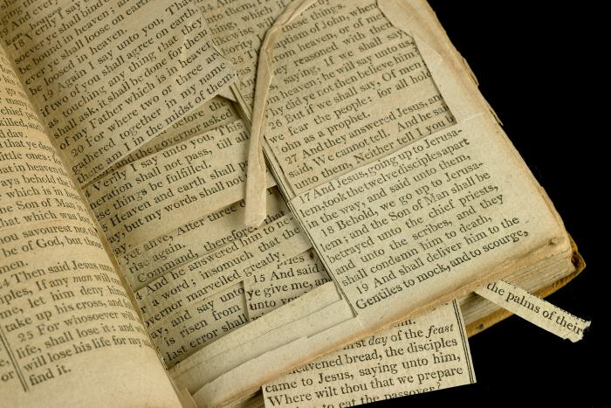
Thomas Jefferson, for instance, edited the New Testament, using a razor to remove all references to miracles and supernatural events.
He glued the parts of which he approved into “The Life and Morals of Jesus of Nazareth,” the so-called Jefferson Bible.

Slide 83
THE FRENCH revolution
The Roman Catholic Church found itself on the wrong side of history, allying itself with the elitism of the entrenched aristocracy while ignoring the plight of the French peasants.
Enlightenment ideas of liberty, equality, and fraternity fueled the overthrow of the French monarchy as well as the church and the establishment of a republic under a newly formed National Assembly.
This included the dechristianization of France (Voltaire’s rubric “Stamp Out the Infamous Thing”)
However, it devolved into the Reign of Terror, including widespread executions of perceived enemies of the revolution. Following the Reign of Terror, Napoleon Bonaparte rose to power ending the revolutionary period.

Slide 84
effect of the enlightenment on Christianity
Enlightenment ideas challenged the religious assumptions of the church in the Medieval Period.
When Galileo popularized the heliocentric theories of Copernicus and was formally condemned by the Roman Church, the stage was set for a continuing tension between science and theology, and it is fair to say that much of the blame must rest on the Christian churches themselves.
In America, central Enlightenment ideals, such as, the inalienable rights of life, liberty, and the pursuit of happiness, were enshrined as gifts of “nature’s God.” This was not traditional Christian theology, but it was “Christian friendly,” and it wasn’t atheism, either.
In France, by contrast, the revolution led to the dechristianization of the whole nation from its Roman Catholic roots. The Christian calendar was replaced with one reckoned from the date of the Revolution, and Christian holidays were replaced by festivals of Liberty and Reason.

Slide 85
CHRISTIANITY IN THE NEW WORLD
Puritans, Anglicans, Baptists, Methodists, Catholics, and Quakers

Slide 86
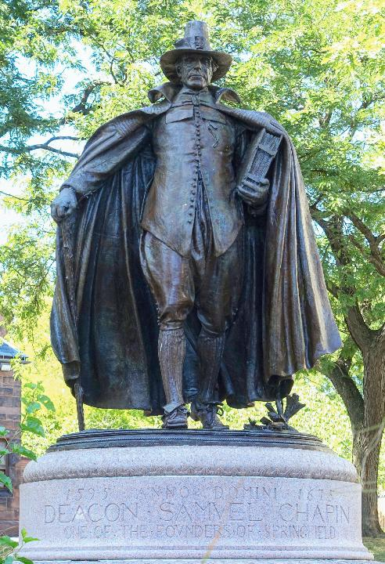
THE PURITANs
Migrating to North America in the 17th Century, the Puritans, dissenters from the Anglican Church, sought to establish a society based on strict religious law.
They were staunch Calvinists, so their churches were plain and unadorned.
Only Puritan men who were church members could own land.
They emphasized the values of hard work, self-reliance, and a strong moral code.
They were concentrated in the northern colonies, like Massachusetts and Connecticut.
1887 statue of a Puritan, Springfield, Massachusetts

Slide 87
Puritan Spirituality
The name “Puritan” derives from those Christians within the English Reformation who deemed that the English church had not gone far enough in shedding the trappings of medieval Roman Catholicism.
Hence, they sought to further “purify” the church, society, and themselves.
At first, they worked within the Church of England, but by the time of James I, some began to separate entirely.
In America, the most famous of the “Separatists” were the pilgrims who, after a sojourn in Holland, established Plymouth Colony in 1620.

Slide 88
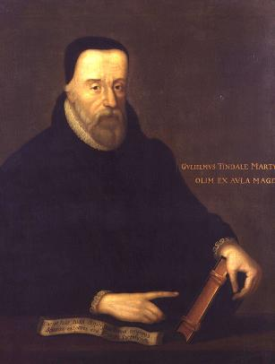
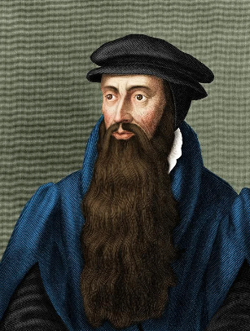
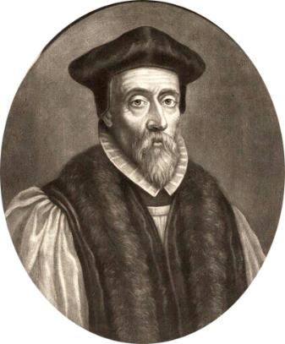
Leading Lights
From William Tyndale (1494-1536), they adopted an intense commitment to Scripture and an emphasis on the concept of covenant.
From John Knox (d. 1572), they absorbed a dedication to thorough reform in church and state.
From John Hooper (d. 1555), they received a firm conviction that Scripture should regulate both church life and personal behavior.

Slide 89
Core Convictions
Personal salvation is entirely from God (it is the gift of God’s grace through faith)
The Bible (Geneva Bible) is the indispensable guide to life (the Anglican Church held that Christians should not do what the Bible prohibited; the Puritans held that Christians should do only what the Bible commanded); hence, they emphasized:
Sabbath-keeping
Family worship & devotions
Personal acts of mercy to the sick and dying
The church should reflect the express teaching of Scripture (they felt that Anglican church structure missed the point with its hierarchy of bishops)
Society should be one unified whole (a single, coordinated set of authorities should govern life in society, and this value was imposed on those living in southeastern Massachusetts)

Slide 90
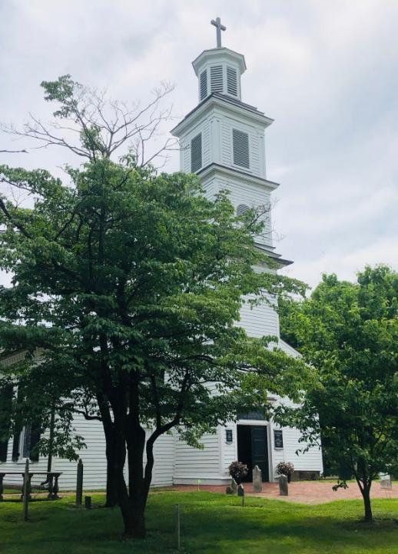
THE ANGLICANs
Whereas Puritans were primarily in the northern colonies in America, Anglicans were more common in the southern colonies, where Anglicanism was the established church often supported by the state.
The first Anglican service in North American was held in 1579.
Anglican parishes began appearing in the middle and northern colonies as well, but not with state support.
A major challenges were the absence of a bishop and the shortage of clergy, since its denominational ties were still in England.
Unlike the Puritans, Anglicans tended to distrust the sudden, strong, public expressions of religious emotion—weeping, shrieking, and trembling—that was characteristic in some evangelical revivals.
St. John’s Church, Richmond, VA, where Patrick Henry gave his “give me liberty or give me death” speech.

Slide 91
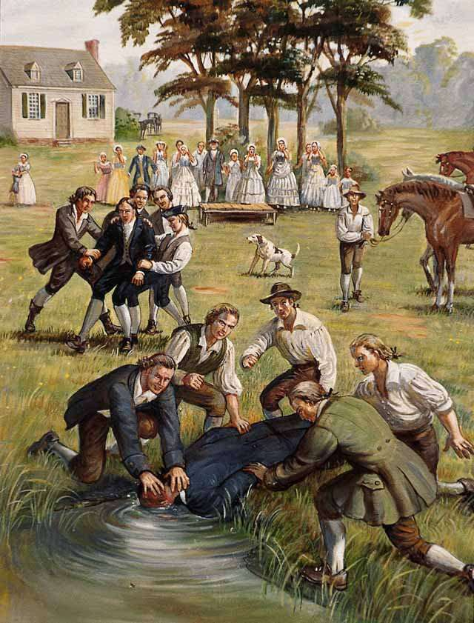
THE BAPTISTs
The dunking of Baptist Pastor David Barrow and his brother in 1778 (Library of Congress). Baptists suffered considerable persecution by members of other churches who disagreed with them.
The first Baptist church in the New World goes back to the 17th century in Providence, Rhode Island, established by Roger Williams (who was banished from the Massachusetts Bay Colony by the Puritans).
English Baptists migrated to America due to persecution and discrimination, and they were especially prominent in the middle colonies.
They would play a significant role in advocating for religious freedom and the separation of church and state.
The Great Awakening (1730s and 1740s) brought about a surge of conversions and growth to the Baptist churches.

Slide 92
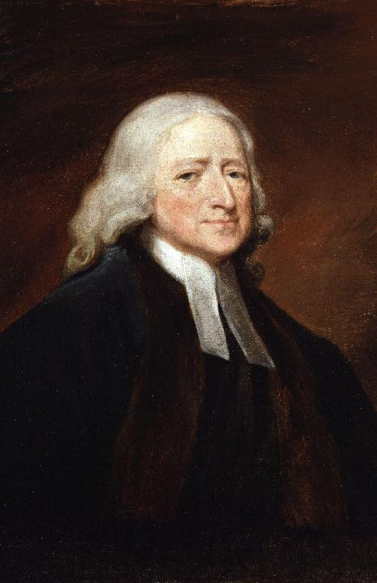
THE METHODISTs
In 1738, the Anglicans John and Charles Wesley, after experiencing a transforming religious experience under the influence of Moravian missionaries, began preaching a message of new birth and sanctification.
They began small group societies in England that soon spread to America.
Loyal to John Wesley’s Anglican leadership, they agreed that they would not administer the sacraments, but would receive them at the local Anglican parishes.
However, the American Revolution (which Wesley was against), persuaded him that changes were necessary, and soon, he began ordaining pastors who could administer the sacraments in America, which in turn led to an independent church, the Methodist Episcopal Church.
1802 portrait of John Wesley by George Romney, National Portrait Gallery, London

Slide 93
CIRCUIT-RIDING ARMINIANS
Following Wesley, who was almost certainly the most ardent Arminian theologian in England, Wesley’s theology of “prevenient grace” (= grace that precedes any human response to salvation) was the theological underpinning of his belief that anyone can be saved by faith in Christ.
This theology led to the horse-preachers, itinerant clergy assigned to travel in specific geographic areas to minister to settlers and organize congregations.
Most prominent from 1784-1830, these circuit-riders spread Methodism in the western, sparsely populated fringes of the colonies and beyond, and by the late 1800s, Methodists would become the largest Protestant denomination in America.

Slide 94
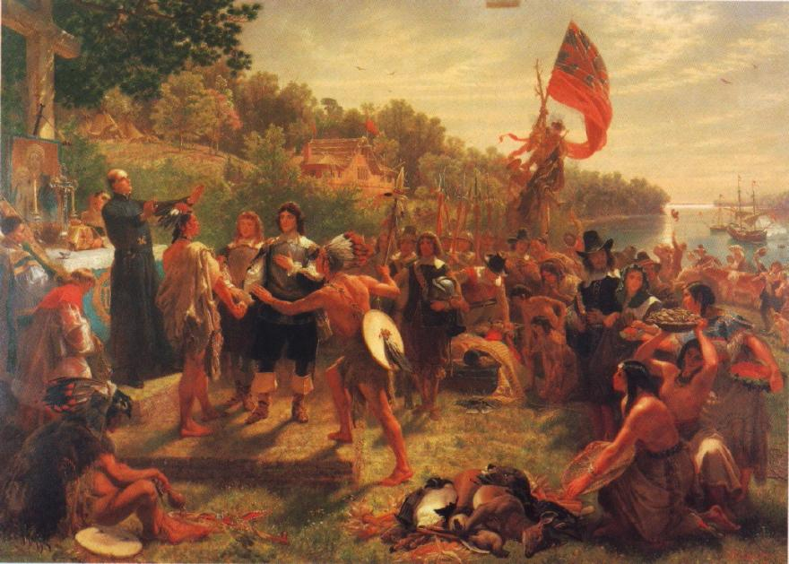
ROMAN CATHOLICS
Though Roman Catholics suffered persecution from Protestants in some of the American colonies (prohibiting mass, restricted voting rights, banned schools), Maryland, which was founded by Catholics, and Rhode Island were notable places of religious freedom.
In this painting by Emmanuel Leutze, Jesuit missionary Andrew White and colonists meet with native Americans in St. Mary’s City, Maryland, the site of Maryland’s first colonial settlement in 1634.

Slide 95
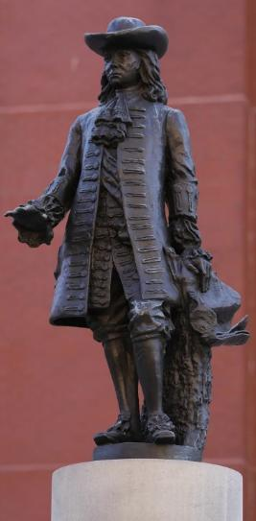
THE quakers (Society Of Friends)
Like other groups, the Quakers migrated to America to escape religious persecution.
They established communities in West Jersey, Rhode Island, and Pennsylvania based on principles of religious freedom, pacifism, abolition of slavery, and social equality.
William Penn in Pennsylvania offered religious toleration, and this colony became a haven for Quakers, especially after the Puritans in Massachusetts subjected them to beatings, imprisonment, and even execution.
Statue of William Penn

Slide 96
THE DEEPER-LIFE MOVEMENTS
Pietism, the 1st Great Awakening, and the 2nd Great Awakening

Slide 97
Lutheran pietism
In the late 17th century, an emphasis on individual devotion, renewal, and living a holy Christian life developed in Germany, but its influence reached far beyond the Lutheran church, spreading to Switzerland, Scandinavia, the Baltics, and beyond, including America.
Philipp Spener (1635-1705), the father of German pietism, had come to the conclusion that the true Christian life was being sacrificed to a zeal for theological orthodoxy and bitter attacks upon the heterodox.
He championed “little churches within the church,” what in modern times we might call small group Bible study and prayer.
The term “evangelical” was widely used by pietists, both Lutheran and otherwise, to describe this deeper-life movement.

Slide 98
Pietist Spirituality
Pietism emphasized the practicalities of the Christian life more than the formal structures of theology or church order. Pietists were…
…people of the heart
…deeply concerned with the Bible, its standards and goals
…oriented toward perfection and holy living
…dedicated to spreading the gospel and providing aid to the needy
…opposed to what they regarded as cold formalism and sterility in the established churches

Slide 99
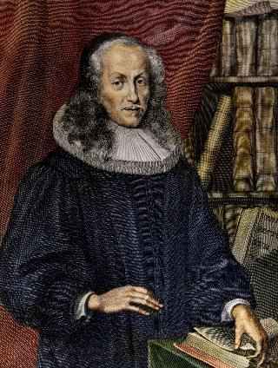
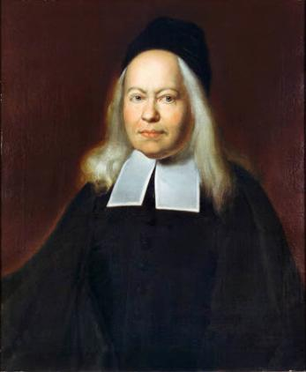
Leading Lights in German Lutheran Pietism
Philipp Spener (1635-1705) began the practice of Wednesday and Sunday meetings for prayer and discussion of the previous week’s sermon.
August Francke (1663-1727) opened his own home as a school for poor children, established a center for translating the Bible into foreign languages, and founded a medical clinic.

Slide 100
Core Convictions
The Bible must be the chief means for reforming anything.
All Christians, as believing “priests,” should be active in the work of ministry.
Christianity must be more than just doctrine; it must also be a reality in practice.
Christians, out of charity, should restrain themselves in religious controversies.
Ministers should be trained in piety and devotion, not just theology and academics.
Ministers should preach understandable sermons that edify, not technical discourses in which few people were interested.

Slide 101
Pietism’s Wide Influence…
…it inspired the Moravians (Zinzendorf, leader in the Moravian Church, was Spener’s godson and Francke’s pupil)
…shaped the thought of John Wesley and the early Methodists through contact with the Moravians
…influenced the Brethren movement in America
…helped to shape many missionary societies in England, Norway, Denmark, and Sweden

Slide 102
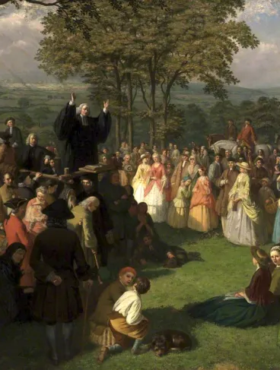
The 1st great awakening
Between the 1730s and 1740s, a widespread religious revival in the American colonies was characterized by emotional preaching, conversions, and a renewed emphasis on personal faith.
Led by figures like George Whitefield and Jonathan Edwards, this revivalist movement attracted a wide range of people from diverse social classes.
The emphasis on individual experience resulted in divisions within established denominations, but also contributed to a shared national identity.
George Whitefield preaching in Bolton, 1750 (Bolton Library & Museum)

Slide 103
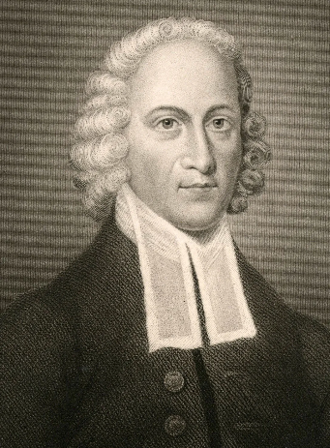
Jonathan Edwards 1703-1758
Jonathan Edwards, in reflecting on this revival, offered five biblical marks of genuine spiritual renewal:
It exalts Jesus Christ
It attacks the powers of darkness
It exalts Holy Scripture
It lifts up sound doctrine
It promotes love toward God and others
He also warned against the dangers of extremism, especially after a parishioner believed he heard a persistent voice telling him to cut his own throat—which he did! These dangers include:
Spiritual pride
Counterfeit religion
The devil, failing to lull the church to sleep, will seek to drive it to excess.

Slide 104
The 2nd great awakening
From 1800 until 1840, yet another period of revivalism emerged. It was marked, as was the 1st Great Awakening, by fervent preaching, outdoor camp meetings, emotional fervor, and an emphasis on personal conversion.
Meetings were characterized by dancing, shouting, and other emotional expressions. The Cane Ridge camp meeting in Kentucky, for instance, garnered an estimated 20,000 attendees.
One major difference was that the theology in the 2nd Great Wakening shifted from Calvinism to Arminianism, emphasizing free will and individual responsibility.
Also, the 2nd Great Awakening saw the emergence of new denominations including the Methodists, Baptists, Disciples of Christ, and the African Methodist Episcopal Church.

Slide 105
The social impact
The 2nd Great Awakening impacted American culture in significant ways with several important social reform movements, including.
The abolitionist movement against slavery
The temperance movement against alcoholic beverages
Education reform
The attempt to improve living conditions for the poor and marginalized
The role of women, who were welcomed as missionaries and preachers

Slide 106
The Origins of the American Holiness Movement
Emerging from the 2nd Great Awakening was the American Holiness Movement, which sought to propagate John Wesley’s teaching about Christian perfection and entire sanctification:
Wesley had emphasized that the path from sin to salvation led from willful rebellion to perfect love for God and other people.
Holiness preachers developed the thought that “full salvation” involved two crises, conversion (justification) and liberation from the flaws in one’s moral nature (sanctification).
To remain in this state of perfection called for constant self-renunciation, careful observance of God’s holiness laws, and a constant reliance on God’s forgiving grace in the atonement.

Slide 107
The American Holiness Movement eventually led to splits in Methodism and the development of parachurch organizations for the promotion of holiness:
Wesleyan Methodists seceded in 1843
Free Methodists seceded in 1860
National Camp Meeting Association for the Promotion of Holiness formed in 1867
Church of God (Anderson, IN) organized in 1880
Church of the Nazarene (1908)
United Missionary Church (Mennonite origin)
Brethren in Christ (German Pietist and Mennonite origin)
Evangelical Friends Alliance (Quaker origin)
Salvation Army
Christian and Missionary Alliance

Slide 108
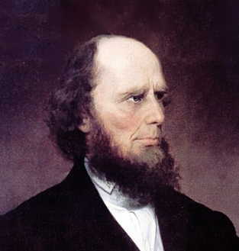
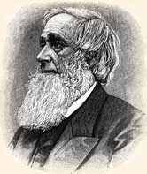
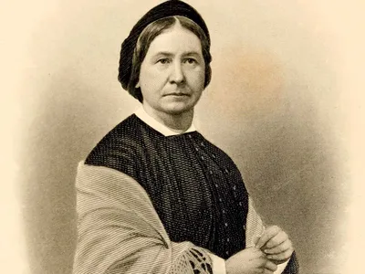
Leading Lights
Charles Finney (1792-1875), a major leader in the Second Great Awakening, was involved in the abolition movement. He was a revivalist who focused on “backsliding Christians.”
Asa Mahan (1799-1889) was also involved in the anti-slavery movement. He preached widely in America and England as an advocate of New Light theology (Perfectionism)
Phoebe Palmer (1807-1874) began an interdenominational prayer meeting movement that inspired gatherings around the United States. She was an ardent supporter of temperance and a founding director of the first inner city mission in the USA in New York City.

Slide 109
Generally speaking, holiness theology advocates two distinct works of grace, justification (salvation) and sanctification (perfection).
While the various holiness groups were united in their view of salvation by grace through faith, they differed on the nature of sanctification:
Some viewed sanctification as a process to which believers should progressively yield.
Others viewed sanctification as an instantaneous, crisis experience in which the human tendency to sin was eradicated completely and immediately.
All holiness groups created lists of forbidden behaviors which were deemed incompatible with a holy life. Typical taboos included:
Fashionable dress, jewelry
Smoking, drinking, card-playing
Secular entertainment (athletics, theatres, television, circuses)
The holiness movement became the immediately ancestor of the Pentecostal movement.

Slide 110
CHRISTIANS AND ABOLITION
Ending the Slave-Trade

Slide 111
The SLAVE TRADE
Slaves and slave-trading goes back to very ancient times. However, beginning with the Muslims in Africa, and later, the European empire-builders, the capture and sale of Africans blotted the social landscape of both England and America.
From the 16th to the 19th centuries, an estimated 12 million Africans were forcibly transported to the Americas.
It would be Christians who would decry this atrocity and take steps to end it.
Officially, the slave trade ended in Denmark in 1803, England in 1807, and the United States in 1808, but banning the slave trade did not end slavery itself, which continued for several decades.
Hence, the abolition movement concerned, not merely the banning of the slave-trade, but the abolishing of slavery itself.

Slide 112
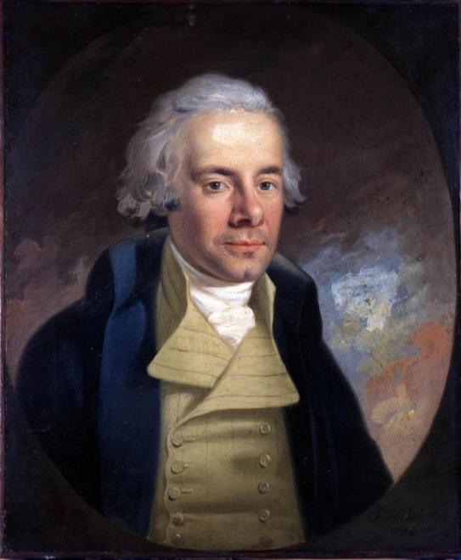
Key abolition figures in England included William Wilberforce, Granville Sharp, and Thomas Clarkston.
As an evangelical Christian, the issue of slavery was deeply moral and religious for Wilberforce.
He sought guidance from John Newton, the former slave-trader turned Christian, who penned the famous hymn “Amazing Grace.”
Wilberforce became the leading British abolitionist, campaigning tirelessly against the slave-trade until it was abolished in 1807.
William Wilberforce
1759-1883

Slide 113
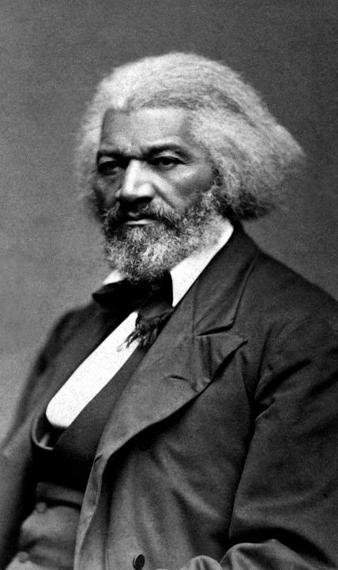
Key abolition figures in the United States included Frederick Douglas and Harriet Tubman.
A former slave, Douglass became a national leader in the abolition movement.
He taught himself to read and write.
At the age of 13, he discovered, through the preaching of a Methodist pastor and an African-American friend, that God could be his friend and that, in his own words, he could “cast his care upon God.”
In his abolition speeches, he distinguished between the “Christianity of Christ” and the “Christianity of America.”
He would become the first African-American nominated for the vice presidency of the USA.
Frederick Douglass
1818-1895

Slide 114
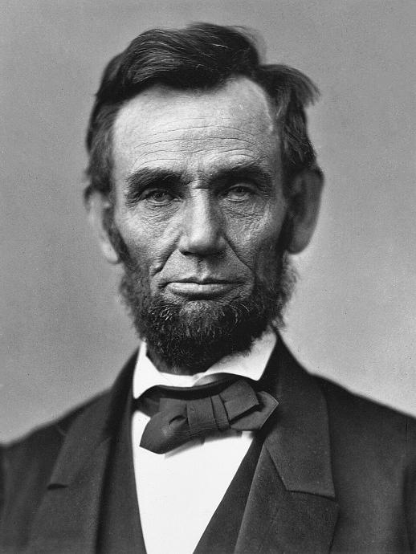
The American Civil War
While there was no single cause leading to the American Civil War, the issue of slavery was most certainly one of them.
From April 12, 1861 to May 26, 1865, the northern states battled the southern states, which had seceded from the union.
On January 1, 1863, President Abraham Lincoln issued the Emancipation Proclamation, declaring all enslaved people to be free.

Slide 115
“Both [North and South] read the same Bible and pray to the same God, and each invokes His aid against the other. It may seem strange that any men should dare to ask a just God's assistance in wringing their bread from the sweat of other men's faces, but let us judge not, that we be not judged. The prayers of both could not be answered. That of neither has been answered fully. The Almighty has His own purposes. ‘Woe unto the world because of offenses; for it must needs be that offenses come, but woe to that man by whom the offense cometh.’ If we shall suppose that American slavery is one of those offenses which, in the providence of God, must needs come, but which, having continued through His appointed time, He now wills to remove, and that He gives to both North and South this terrible war as the woe due to those by whom the offense came, shall we discern therein any departure from those divine attributes which the believers in a living God always ascribe to Him?
…With malice toward none with charity for all with firmness in the right as God gives us to see the right let us strive on to finish the work we are in to bind up the nation's wounds, to care for him who shall have borne the battle and for his widow and his orphan ~ to do all which may achieve and cherish a just and lasting peace among ourselves and with all nations.”
From Lincoln’s, 2nd Inaugural Address
March 4, 1865

Slide 116
DEVELOPMENT OF MODERN MISSIONS
Outreaches in Latin America, America, Africa, China, and India

Slide 117
The mission movement
Since the beginning, Christians have affirmed their commission by Christ to spread the Christian faith throughout the world.
Barnabas and Paul were the first Christian missionaries with a sponsoring church (Antioch).
The apostles of Christ became missionaries in the various parts of the Roman world.
Gregory I (6th century) sent Augustine and some 40 monks on a mission to England, reaching the southern coast in AD 597, and within a year, some 10,000 subjects along with the Saxon king had received Christian baptism.
However, it is fair to say that missionary work in the post-Reformation Period often coincided with colonial expansion.

Slide 118
The Roman Catholic mission to latin america
The Spanish and Portuguese efforts to colonize Central and South America were directly linked to the mission work of the Jesuits, Franciscans, and other orders.
In the 17th century and later, the Jesuits established multiple missions in Argentina, Bolivia, Brazil, Peru, and Paraguay.
The Franciscans and other Catholic orders established multiple missions in Mexico, Florida, Central America, and the Caribbean Islands.
In California, Father Junipero Serra established some 21 mission outposts along the California coast, connecting them by the El Camino Real road.

Slide 119
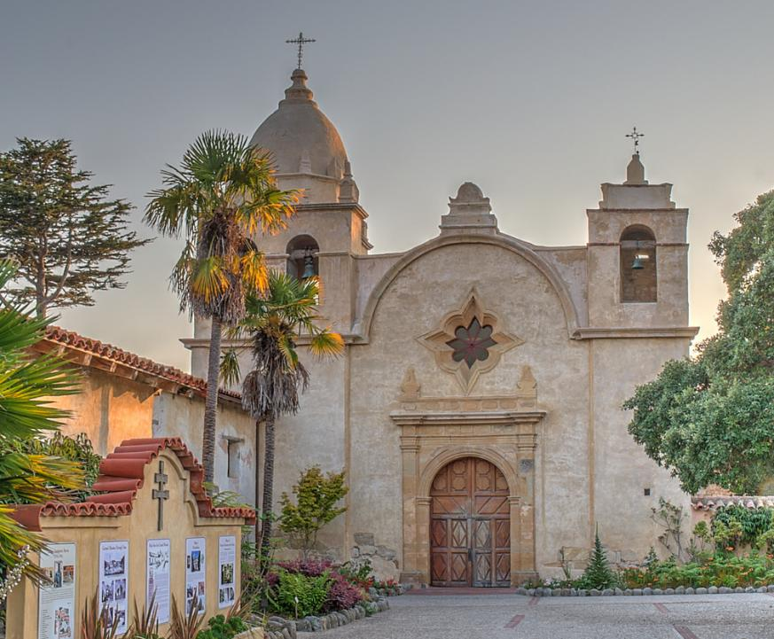
Mission San Carlos Borromeo del Rio Carmelo, constructed in 1797, is one of the most authentically restored mission churches headed by Father Serra from 1770-1784.

Slide 120
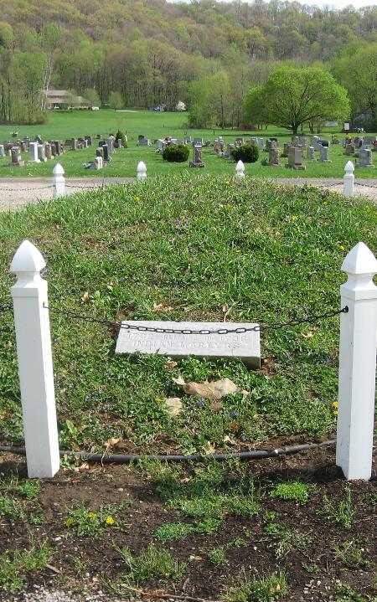
Moravian mission to native americans
With roots as far back as Jan Hus in 15th century, the Moravians arrived in America in the mid-1730s. Their initial focus was on converting Native Americans.
They established settlements in New York and Pennsylvania as centers for missionary work, learning the languages of the Cherokee, Delaware, Mohican, and other tribes.
One of their mission outposts was in Gnadenhutten, Ohio, where in the time of the Revolutionary War, 96 pacificist Christian Indians were massacred in 1782 by a U. S. militia from Pennsylvania.
Mass graves of Native American Christians at Gnadenhutten

Slide 121
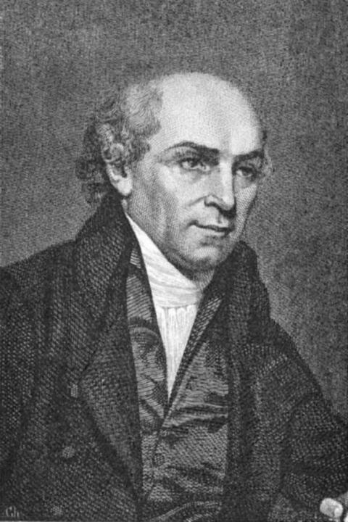
William carey in india
Credited as the father of modern missions, William Carey (1761-1834) was a pioneering English Baptist missionary to India from 1793 to his death in 1834.
He engaged in Bible translation, education, and social reform, such as, working toward eliminating widow burning, infanticide, and caste distinctions.
He founded the Serampore University, the first degree-awarding university in India.
One of his famous maxims was, “Expect great things from God; attempt great things for God.”

Slide 122
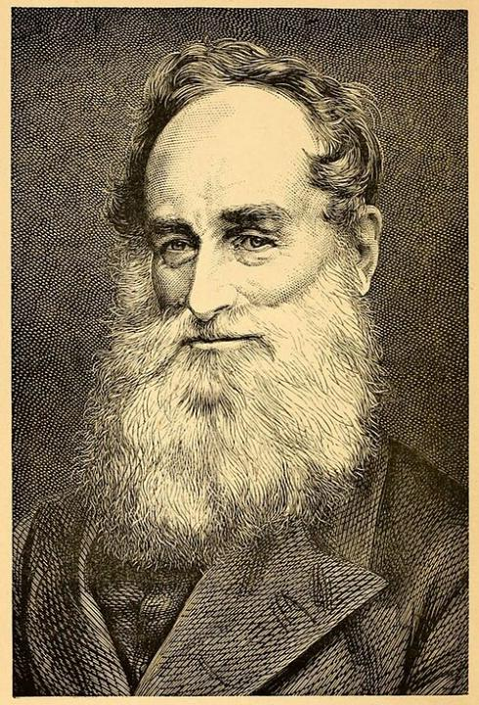
Robert moffat in africa
Robert Moffat (1795-1883) of the Methodist Episcopal Church went to Africa in 1817 at the age of 21, spending the next 52 years there as a missionary.
One of his famous converts was Jager Afrikaner, a notorious bandit and cattle rustler who had terrorized the native tribal people.
He translated the complete Bible into Bechuanas, which he completed in 1857.

Slide 123
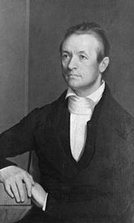
Adoniram Judson in burma
Adoniram Judson (1788-1850), a Congregationalist turned Baptist, was the first American missionary sent to foreign soil.
He was instrumental in establishing America’s first organized missionary society, the American Board of Commissioners for Foreign Missions.
He was married on February 5, 1812, ordained the next day in Salem, and set sail for the east on the 19th with his new wife.
Though he already knew Greek and Hebrew, he learned the Burmese language with difficulty, completing his translation of the Bible into Burmese in 1823.
It took 12 years to make his first 18 converts.

Slide 124
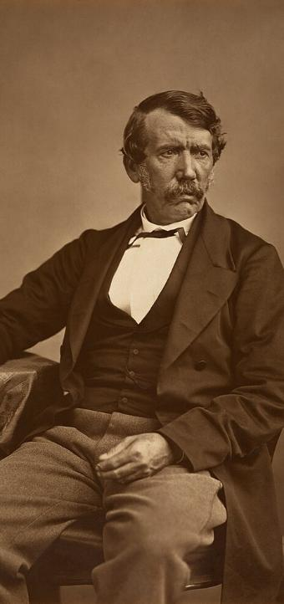
David Livingston in africa
David Livingstone (1813-1873), a Scottish physician serving the London Missionary Society, sought to end the East African Arab-Swahili slave trade.
Under the influence of Charles Finney, he had shifted from Calvinism to Arminianism.
Under the influence of Robert Moffat, he went to Africa, where he explored the south and central regions (he named Victoria Falls after Queen Victoria).
In all his travels, he made only a single convert, an African chief named Sechele of Botswana.

Slide 125
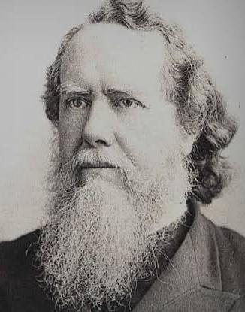
Hudson taylor in china
Hudson Taylor (1832-1905), a Baptist, founded the China Inland Mission focused on reaching into the interior of China.
His vision was not only to plant churches and evangelize, but also to train Chinese leaders who could function as an indigenous church.
He translated the Bible into the Ningbo dialect.
He adopted wearing native Chinese clothing, something very rare among missionaries.
The CIM saw some 20,000 converts.

Slide 126
Quotable quotes by Hudson taylor
“The Great Commission is not an option to be considered; it is a command to be obeyed.”
“God isn’t looking for people of great faith, but for individuals ready to follow him.”
“God’s work done in God’s way will never lack God’s supply.”
“When I cannot read, when I cannot think, when I cannot even pray, I can trust.”
“All God’s giants have been weak men who did great things for God, because they reckoned on God being with them.”

Slide 127
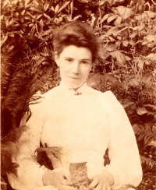
Amy Carmichael in india
The Irish Amy Carmichael (1857-1951) of the Keswick Movement focused on protecting children from exploitation and abuse.
After a short service in Japan and Ceylon, she arrived in south India in 1895, where she remained until her death.
In addition to her outreach to Indian women, she made it her mission to rescue Indian children who were dedicated to the gods by their parents, and the Dohnavur Fellowship, which continues to this day, was established to this end.

Slide 128
AMERICAN STEPCHILDREN
Restorationism, Mormonism, the Jehovah’s Witnesses, Christian Science

Slide 129
restorationism
Sometimes known as Christian primitivism, restorationism was a broad movement asserting that the pure form of Christianity had been corrupted and needed to be restored.
Some restorationist models functioned more closely to the larger framework of historic Christianity:
Here, they sought to return to early Christian practices and beliefs.
Others focused on church structure, ethics, and/or a direct experience of the Holy Spirit.
Still other groups made major departures from classical Christian theology and were pejoratively labeled as cults.

Slide 130
The stone-campbell movement
Merging in 1832 with a handshake between Barton Stone (of Kentucky) and Thomas and Alexander Campbell (of Western Pennsylvania), two similar movements united in their desire to return to 1st century Christianity.
They agreed that creeds kept Christians divided.
They abandoned denominational labels, using instead only biblical names.
Today, they are divided into three primary groups:
Churches of Christ
Christian Church (Disciples of Christ)
Christian Church/Church of Christ

Slide 131
Stone-campbell restorationism
This restoration movement is characterized by several key ideas:
There should only be one church, and Christianity should not be divided.
Since creeds divide, the basis for Christian fellowship should be the Bible alone.
Since church traditions divide, Christians should find common ground following the practices of the apostolic church in the NT.
Since names divide, only biblical names should be used (as opposed, for instance, to Methodism, Lutheranism, etc.)
A common theme: No creed but Christ, no book but the Bible, no law but love, no name but the divine.

Slide 132
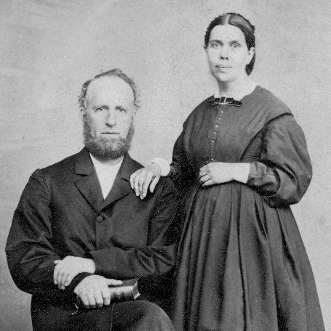
The Seventh-day adventists
Under the leadership of Baptist William Miller, the Seventh-Day Adventist movement emerged from the Second Great Awakening when Miller predicted the return of Christ to be on October 22, 1844, based on calculations from the Book of Daniel.
When this did not occur, some of Miller’s followers, especially Ellen G. White, reinterpreted the prophecy to mean that Christ had entered the heavenly sanctuary to begin an “investigative judgment,” but this was not his return to the earth.
The Seventh-Day Adventist Church was formally organized in 1863.
James and Ellen G. White

Slide 133
Seventh-day adventists
Key ideas of the Seventh-Day Adventists are:
Sabbath observance must be on Saturday, not Sunday (thus fulfilling the Sabbath requirement in the Ten Commandments). More severely, some Adventists regard Sunday observance as accepting the mark of the beast.
The imminent return of Christ to the earth.
The Bible is the ultimate authority.
God has a tangible form.
Some Adventists accept the doctrine of the Trinity, and some do not.
The return of Christ will be post-tribulational and premillennial, but the millennial kingdom will be in heaven, not on earth.

Slide 134
The mormons
Started by Joseph Smith in western New York in the 1820s and 1830s, the Latter Day Saints movement was an attempt to discover the “true” doctrine of God.
In multiple visions and angelic visitations, Smith claimed to have been instructed to re-establish the “true Christian church” (and he also was informed that all the existing Christian churches were wrong).
In 1830 he published the Book of Mormon, which he claimed to have translated from ancient writings on golden plates.
Beginning in 600 BC, the Book of Mormon chronicles a prophet named Lehi who sailed to America, where he found native Americans who had been visited by Jesus Christ hundreds of years prior to his birth in Bethlehem.

Slide 135
Mormon Profile
Mormons have some continuity with historic Christianity but considerable discontinuity.
They accept both the Bible and the Book of Mormon as equally inspired.
For many years, they practiced polygamy (polygamy officially ended in 1890 after congress threatened to remove the church’s legal status).
Several branches evolved after Smith’s death, the largest being the Church of Jesus Christ of Latterday Saints, who followed Brigham Young, the new prophet, to the Utah Territory.
Mormons reject the doctrine of the Trinity (they believe the Father, Son, and Holy Spirit are three distinct Beings), and they believe in other deities as well, such as, a Heavenly Mother, who is married to God the Father.

Slide 136

The Salt Lake City temple, salt lake city, Utah Begun in 1853 and completed in 1893
Mormon President Snow claimed to have been visited by Jesus Christ himself within this temple in 1898.
It continues to be used for celestial marriage ceremonies (i.e., a marriage not merely for life but for eternity)
Key decisions are reached within its precincts by Mormon hierarchy (the President and the Twelve Apostles).

Slide 137

The Jehovah’s witnesses
Following the teachings of Charles Taze Russell in the 1870s, this group emerged from the Adventist movement, later adopting the name “Jehovah’s Witnesses” in 1931.
“The Watchtower” publication, distributed world-wide, heralds the movement’s theological concepts.
The Jehovah’s Witnesses have produced their own translation of the Bible, “The New World Translation,” which uses the name Jehovah for Yahweh some 6,979 times in the OT and 237 times in the NT.
They have made major predictions about Christ’s return for 1878, 1881, 1914, 1918, 1925, and the most recent, for Armageddon in 1975.
Charles Taze Russell

Slide 138
Jehovah’s witnesses’ Profile
Key concepts of the Jehovah’s Witnesses include:
They reject the doctrine of the Trinity, regarding Jesus as less than fully God (similar to Arianism), as well as the doctrine of the immortality of the soul and hell.
They refuse military service, blood transfusions, taking oaths in a court of law, and saluting the flag.
They reject Christmas, Easter, birthdays, and other holidays as pagan.
The only solution to the present problems in the world will be Armageddon, when the present world will be destroyed.
Members who leave are shunned, even by their own family members.
Only 144,000 individuals will go to heaven to rule with Christ (and this number is already complete); other Jehovah’s Witnesses will enjoy a paradise on earth.

Slide 139
Christian science
After a healing experience in 1866, Mary Baker Eddy established the Christian-Science movement.
Many of ideas were derived from Phineas Quimby, a folk-healer and mesmerist, especially the idea that disease was primarily a mental state.
After her researches into the Bible as well as exploring various philosophical and spiritual concepts, she published her findings in Science and Health with Key to the Scriptures (1875). This became the foundational text for the movement.
She established the “First Church of Christ, Scientist” as the mother church, where it continues to serve as the administrative headquarters worldwide.
She claimed to have healed people suffering from tuberculosis, diphtheria, cancer, blindness, deafness, and dumbness. She also clamed to have healed a crippled person.

Slide 140

Christian science profile
God is all good and all spiritual; the physical world is a manifestation of error or illusion.
Illness is a mental aberration that can be conquered through prayer and a deeper understanding of God’s spiritual reality.
The real culprit in sickness is “Malicious Animal Magnetism” (M.A.M.), which is to say, giving into evil thoughts.
While Christian Scientists are allowed to seek medical assistance for certain physical needs (dentistry, broken limbs, etc.), in general they believe that medical treatments are unnecessary if one is properly attuned to God’s spiritual power.

Slide 141
PERFECTION and HOLINESS
Perfectionism and the American Holiness Movement

Slide 142
The perfectionist movement
John Wesley’s teaching on Christian perfection emphasized the transformative power of God’s grace.
He held that Christians could experience a state of being completely cleansed from sin and filled with love for God.
This was not flawless behavior, but rather, a heart focused on loving God and one’s neighbor along with freedom from the compulsion to sin.
This, according to Wesley, was the process of being made holy or sanctified, and as such, becoming more like Christ.
However, unlike the Reformers, who taught that entire sanctification would only come after death, Wesley argued that it could occur within the lifetime of the Christian.

Slide 143
OBERLIN PERFECTIONISM
Closely associated with Charles Finney and Asa Mahan, Oberlin Perfection theology originated at Oberlin College in the 1840s, where both Mahan and Finney taught.
The central belief was that Christians could attain a state of complete freedom from sin through spiritual growth and divine grace.
Oberlin perfectionism was also linked to various reform movements, especially the abolition of slavery and the prohibition movement.
Since it was possible for individuals to achieve perfection, it was equally possible for society to be perfected, which in turn motivated advocates of perfectionist theology toward social reform.

Slide 144
The continuing holiness movement
The American Holiness Movement, initially prominent among Methodists, also took Wesley’s teachings beyond what Wesley himself had said, advocating that sinless perfection was possible in this life.
Such entire sanctification could occur as a second work of grace (subsequent to salvation), which in turn would empower Christians to live a life entirely free from sin.
Entire sanctification was often believed to happen in a crisis spiritual experience, usually deeply emotional, and by the late 1800s, such an experience had several monikers, such as, baptism by fire, the second blessing, entire sanctification, the second work of grace, and the baptism with the Holy Ghost.

Slide 145
MAJOR HOLINESS DENOMINATIONS
Free Methodist Church
Emerging in 1860, free Methodists sought to return to core principles of Methodism after being expelled from the Methodist-Episcopal Church.
They strongly opposed slavery
They gave women freedom to serve in ministry.
Wesleyan Church
Originally formed in 1843 after a split in the Methodist-Episcopal Church
The Wesleyans took a strong stand against slavery.
They hosted the first women’s rights convention in 1848.
Eventually, they merged with the Pilgrim Holiness Church in 1968.
Church of God
Organized in 1880 while emphasizing Christian unity and holiness.
They distanced themselves from formal denominations and creeds.
Anderson, Indiana became the movement’s headquarters, the home of Warner Press and Anderson University.
Church of the Nazarene
Formally organized in 1908 through the merger of several smaller holiness denominations, the Nazarene Church is now the largest Wesleyan-holiness denomination.
Traditionally, Nazarene’s were strongly Arminian and strong supporters of entire sanctification.

Slide 146
holiness IDEALS
The idea of instant perfection in a crisis experience was not embraced by everyone within the American Holiness Movement. Some continued to follow the older model of progressive sanctification.
However, even among those who contended for a more progressive sanctification, there developed substantial lists of forbidden behaviors if one was to lead a holy life. These included prohibitions against:
Smoking, drinking, dancing, card-playing, theatres, sports, and worldly amusements in general.
Also frowned upon were fashionable dress (no jewelry, no make-up, long hair for women, short hair for men); clothing should be simple and modest.
Forbidden behaviors were seen as leading to intemperance which compromised spiritual purity.
Today, many of these taboos have been softened or lifted altogether.

Slide 147
Since the holiness movement advocated that any individual Christian could attain moral perfection in the present life by a “second blessing,” it raised the question as to whether or not the wider Christian fellowship should be divided into the “haves” and the “have nots.”
THE FOCUS QUESTIONS:
Can a Christian be truly “perfected” so that all moral flaws are removed in this life?
Can spirituality be defined by self-abasement and other-worldly asceticism based on stereotyped behavioral codes and emotive experience?

Slide 148
REVIVALISTS and REVIVALISM
Revivalists, Divine Healing, and the Jesus’ Movement

Slide 149
The NEW revivalists
The phenomena of the 1st Great Awakening saw various preachers who served as stimulants toward spiritual advancement, such as, Jonathan Edwards, George Whitefield, and John Wesley.
Near the end of the 2nd Great Awakening, however, a significant shift occurred, particularly in the ministry of Charles Finney.
Here, the stimulant for a deeper experience of God focused on men and women making a radical decision of Christ as opposed to an ongoing process of discipleship.

Slide 150
Charles grandison finney
Ordained in 1824, near the end of the 2nd Great Awakening, Finney conducted a series of lectures on revival that became a kind of handbook for the revivalist movement.
He held that revivals were not necessarily sovereign acts of God, but could be initiated by believers if they followed the proper methods. He urged, “ A revival is not a miracle, not dependent on as miracle, in any sense. It is purely philosophical result of the right use of the constituted means.”
His preaching featured the “altar call,” a fervent invitation at the close of a service for people to come forward for prayer.
He is regarded as the father of modern revivalism.

Slide 151

d. l. moody
Moody was an American evangelist, working first with Union troops in the Civil War through the YMCA and later devoting his life to revivalism in America, the British Isles, as well as internationally.
He worked closely with Ira Sankey, a singer, and conducted hundreds of evangelistic meetings
His “Wordless Book,” a teaching tool for illiterates consisting of three colors (black, red, and white representing sin, the blood of Christ, and righteousness) is still used. Gold, for heaven, was eventually added.
One of his famous quotes was, “Faith makes all things possible…love makes all things easy.”
Moody Bible Institute is his most well-known legacy.

Slide 152

Billy sunday
Sunday, a highly successful evangelist and former baseball player in the late 19th and early 20th centuries, he became a leading figure in the revival movement, known for his dynamic preaching style and strong opposition to alcohol and other social ills.
After playing for the Chicago Whitestockings and Pittsburgh Pirates, he had a conversion experience in 1886 and left baseball to become an evangelist, eventually serving for the YMCA.
His preaching style was energetic, theatrical, and often featured pronounced physical gestures and emotional appeals.

Slide 153

Charles fuller
An American Baptist, Charles Fuller came under the influence of R. A. Torrey at BIOLA.
He was one of the first to use radio extensively, regularly broadcasting and eventually forming his own broadcasting company, “The Old Fashioned Revival Hour” that aired 1937-1968 and by 1942 attracted a listening audience of over 10 million world-wide.
Like Moody with Ira Sankey, Fuller’s broadcast featured music, where the “Old Fashioned Revival Hour Choir” and quartet were accompanied by organist George Broadbent and pianist Rudy Atwood.
His remaining institutional legacy is Fuller Theological Seminary, Pasadena, California.

Slide 154

Oral roberts
Ordained in the Pentecostal Holiness Church (1936), Oral Roberts is considered one of the forerunners of the charismatic movement.
A characteristic of his preaching was “seed faith,” and his ministry brought the ideas of physical healing and American Pentecostalism to millions via televangelism.
His abundant life teachings laid the foundation for what is later known as the “Prosperity Gospel,” the belief that it is God’s will to bring physical well-being and financial blessing to his children based on a positive confession.
His most well-known legacy is Oral Roberts University, Tulsa, Oklahoma.

Slide 155

Billy graham
Ordained as a Southern Baptist, William Franklin Graham’s evangelistic career spanned six decades in the last half of the 20th century and beyond.
By the early 1950s, he was filling stadiums around the world, preaching live sermons and hosting annual “crusades” from 1947-2005.
He insisted on racial integration in all his meetings and preached jointly with Dr. Martin Luther King, Jr. in New York City (1957).
He also encouraged unity between Roman Catholics and Protestants.
More than 3 million people accepted Christ as their personal Savior under his ministry.

Slide 156
The jesus movement
The so-called “Jesus Movement” (late 1960s through the mid-1970s) was a counter-cultural revival among young people, many of them former hippies, who embraced evangelical Christianity.
Their services featured informal worship, contemporary music, open air concerts, beach baptisms, and a focus on love and peace.
Adherents introduced knew musical styles, approaches to evangelism, and church structures.
Key figures included Chuck Smith and Doug Pederson.
Key organizations included the Calvary Chapels and the Vineyard Movement.
Important events included Explo ‘72, sponsored by Campus Crusade for Christ.

Slide 157


Slide 158
RISE OF ESCHATOLOGY
Millennial Theories; Rapture Theories

Slide 159
The resurgence of millennarianisM
Since the time of St. Augustine, the default eschatology had been Amillennialism (the belief that the visions of John in the Revelation were largely symbolic references to the church). Two challenges to this consensus arose:
Postmillennialism: Developing out of the optimism in post-Reformation Europe, this view expected the church to successfully convert the larger world resulting in a lengthy golden Christian era during which evil would be reduced to negligible proportions. Afterward, Christ would return.
Premillennialism: Here, the golden age would follow Christ’s return, not precede it. The kingdom of God cannot be consummated by human effort apart from the return of the Lord. Hence, the church must always be on the watch for the second coming of Christ.

Slide 160
Two types of millenarianism
In one sense, premillennialism was a return to the eschatology of the post-apostolic church (chilism):
Historic Premillennialism: The older view, going back before the developments of St. Augustine, was that the church would face the anti-Christ and the great tribulation before Christ returned (post-tribulationism).
Dispensational Premillennialism: John Darby of England (19th century) developed the idea that God had two distinct peoples, Israel and the church. The church must be evacuated from the world before the great tribulation (pre-tribulationism) so that God can turn back to his natural people, Israel. This view crossed the Atlantic, was incorporated into the Scofield Reference Bible notes, and became popular among Baptists and Pentecostals. In more recent times, it gave birth to the “Left Behind” series of books and movies.

Slide 161

THE LATE GREAT PLANET EARTH
Published in 1970, this book became the largest non-fiction seller of any kind for a full decade (28 million copies; 54 languages).
It was the single most influential book contributing to the popularity of Dispensationalism.
It attempted to prove by Scripture that Christ would return soon, probably in 1988 (i.e., 40 years, one generation from the foundation of the State of Israel).

Slide 162
Theology of dispensationalism
While primarily an American theology, dispensationalism has been carried by missionaries to all parts of the world, where it is embraced by many evangelicals today. It features…
…the idea that the Jews rejected Christ’s offer of the kingdom, so they now must await the rapture of the church before God will turn back to them.
…Christ’s return will be in two stages, the rapture (where the church is evacuated to heaven) and his coming in glory (where Christ returns to the earth after a 7-year tribulation period).
Key representatives of dispensationalism include C. I. Scofield, Hal Lindsey, Dallas Theological Seminary, and Moody Bible Institute.

Slide 163
CLASSICAL PROTESTANT LIBERALISM
The Development of Modern Theology among Mainline Churches

Slide 164
FRIEDRICH SCHLEIERMACHER
The so-called “father” of Protestant liberalism, Schleiermacher proposed that Christianity should adapt to its cultural milieu:
His seminal work, On Religion: Speeches to its Cultured Despisers (1799), argued that true religion is not a cognitive matter of human reason (the Deists) nor an ethical matter of the will (Kant), but rather, it is intuitive and must accommodate itself to the spirit of the age.
Doctrine should originate from the human religious-consciousness, not objective truth derived from biblical propositions.
Redemption consisted in Jesus sharing his God-consciousness with his disciples, who in turn, shared it with succeeding generations.

Slide 165
LEADING THINKERS
A. von HARNACK
God reveals himself through historical processes.
He advocated the historical-critical method independent of metaphysics.
He sought to extract the “timeless kernal” of essential Christianity from the “husk” of biblical and church history.
A. RITSCHL
Faith comes not from facts but value judgments.
The essence of religion is “the fatherhood of God and the brotherhood of man.”
The Bible should be approached through historical criticism, not metaphysics.
J. WELHAUSEN
One of the originators of the documentary hypothesis (JEDP theory of Pentateuchal sources).
As such, the Torah was not written by Moses but was the result of oral traditions that evolved over time.
RAUSCHENBUSCH
Father of the Social Gospel movement.
He rejected substitutionary atonement and the inerrancy of the Bible.
The task of the church is social, loving everyone equally as a subject of service.

Slide 166
ASSUMPTIONS:
Religious belief based on authority alone must be rejected in view of reason and experience.
God is immanent in the world and history. He is to be found in the whole of life, not just in the Bible.
The Bible is a work by writers limited by their own times and culture; it is not infallible, and it does not possess absolute authority.
THEOLOGY:
To find God, one must look inward, not merely upward.
Humans are basically good, not sinful or alienated from a loving God.
Jesus was the perfect example of moral life, and his social-ethical life is the model to follow.
Salvation is overcoming our perceived alienation from God by Jesus’ example.
The fatherhood of God and the brotherhood of man is the essence of Christianity.

Slide 167
HIGHER BIBLICAL CRITICISM
Using the historical-critical methodology of literary, historical, and archaeological disciplines, higher biblical criticism seeks to interpret the texts of the Bible in light of the social and historical circumstances in which they were written rather than accepting them as divinely inspired and inerrant words from God.
Especially, higher critics focus on origins, authorship, pre-existing sources, and historical context to understand the world behind the text.
This often results in challenging traditional views of authorship and dating with many, if not most, texts considered to be produced by multiple authors or editors.

Slide 168
QUEST for the historical jesus
The texts of the Gospels are treated as constructed theologies of Jesus, but not necessarily the Jesus as he truly lived.
It is assumed that the gospels are theological propaganda expressing what some Christians came to believe about Jesus.
Various scholars have attempted to penetrate the gospel texts to find the historical Jesus lying behind these texts, offering different portraits of who he really was, such as, a peasant cynic, an apocalyptic visionary, a radical Jewish rabbi, and so forth.
There has been a “First Quest” (18th and 19th Centuries), a “Second Quest” (beginning in the 1950s), and a “Third Quest” after the discovery of the Dead Sea Scrolls and the Nag Hammadi texts (Gnostic).
This search extends to the modern Jesus Seminar (founded 1985), where some 200 scholars met to decide what Jesus actually said. They produced The Five Gospels in which the sayings of Jesus in the four canonical gospels as well as the Gnostic Gospel of Thomas were evaluated and rated in red (Jesus said this), pink (Jesus might have said this), gray (Jesus probably didn’t say this), and black (Jesus certainly never said this).

Slide 169

Albert Schweitzer (1906)
Schweitzer critiqued the then current spate of historical Jesus studies (1st Quest), because they ended up making Jesus sound like a German rationalist. However, in emphasizing the Jewishness of Jesus, he reached his own rather unorthodox view.
In the knowledge that He is the coming Son of Man [Jesus] lays hold of the wheel of the world to set it moving on that last revolution which is to bring all ordinary history to a close. It refuses to turn, and He throws Himself on it. Then it does turn; and crushes Him. Instead of bringing in the eschatological conditions, He has destroyed them. The wheel rolls onward, and the mangled body of the one immeasurably great Man, who was strong enough to think of Himself as the spiritual ruler of mankind and to bend history to his purpose, is hanging upon it still. That is His victory and His reign.
It would be another half century before a “second quest” would begin on much narrower terms.

Slide 170
THEOLOGICAL OUTCOMES
In response to the centuries-old theology of the church, Classical Protestant Liberalism challenged:
The infallibility of the Bible
The idea of direct revelation from God
The idea of original sin and human depravity
The virgin birth of Jesus
The miracles of Jesus
Salvation by the atoning death of Jesus
The bodily resurrection of Jesus
The expectation that Christ will return at the end of the age
The belief that Jesus is the only way to God

Slide 171

Summary description of protestant liberalism by H. Richard niebuhr
“A God without wrath brought men without sin into a kingdom without judgment through the ministrations of a Christ without a cross.”

Slide 172
PENTECOSTAL-CHARISMATIC MOVEMENT
The Origins of Pentecostalism; the Development of Charismatic Christianity

Slide 173
Pentecostalism
Pentecostalism began at the start of the 20th century as a merging of holiness theology, African-American worship styles, and an emphasis on speaking with tongues.
The “second blessing” of the holiness movement came to be called the “baptism with the Holy Ghost,” and this in turn led to the question of whether some specific religious experience marked such a baptism.
The conclusion of the Pentecostals was that this sign was the phenomenon of speaking with tongues.
In addition, the Pentecostals emphasized instantaneous bodily healing, prophecy, miracles, the interpretation of tongues, and words of knowledge—spiritual gifts that they believed the larger Christian church had neglected or ignored.

Slide 174



Leading Lights
The Apostolic Faith Mission, 312 Azuza Street, Los Angeles, CA, where William Seymour presided over the Pentecostal revival in 1906. Because his services were reported by the Los Angeles Times, news of this revival gained world-wide attention.
Charles Fox Parham (1873-1929), a former Methodist, developed the theology that speaking with tongues was the “initial sign” of the Baptism with the Holy Ghost. This experience, he taught, should be normative for all Christians.
William Seymour (1870-1922), son of freed slaves from Louisiana, established the Azuza Street Mission in Los Angeles, CA.

Slide 175
The Four-Square Gospel
Pentecostals tended to emphasize four cardinal doctrines, which came to be called the “four-square gospel.” They were:
Instant salvation (as a crisis experience)
The baptism with the Holy Ghost (marked by the initial sign of other tongues)
Divine, instantaneous healing (usually administered by anointing and laying on of hands)
The second coming of Christ (Pentecostals taught that the restoration of the baptism with the Spirit and the sign of other tongues were an indication that the church age was near its end; this was the “latter rain” (KJV) predicted by Joel, cf. Jl. 2:23; cf. Ho. 6:3; Zec. 10:1).

Slide 176
Pentecostals emphasize that speaking with tongues is the sign of endowment with “power from on high.”
THE PENTECOSTAL THEOLOGY OF THE BAPTISM IN THE HOLY SPIRIT IMMEDIATELY RAISED QUESTIONS:
Does speaking with tongues elevate the recipient to a level higher than that of other spiritual gifts? (Pentecostals said, “Yes!”)
Are Christians who do not speak with tongues “living below their privilege?” (Again, the Pentecostal answer was, “Yes!”
Should Christians seek to speak in tongues? (And again, “Yes!”)
THIS WAY OF PUTTING THINGS LEFT ALL OTHER CHRISTIANS IN A “CLASS B” CATEGORY, SOMETHING THEY DIDN’T ESPECIALLY APPRECIATE.

Slide 177
PENTECOSTAL DENOMINATIONS
Because the Pentecostals urged other Christians to “come out” of their “spiritually dead” denominations, rather quickly, the Pentecostals formed their own new denominations. Most prominent were:
The Assemblies of God (Springfield, MO)
Church of God in Christ (Memphis, TN) – largest African-American Pentecostal denomination
The Church of God (Cleveland, TN)
International Church of the Foursquare Gospel (Los Angeles, CA)
United Pentecostal Church International (St. Louis, MO) – non-Trinitarian

Slide 178

The divine healing movement
Within the larger framework of Pentecostalism there developed charismatic figures who claimed the gift of divinely healing others.
Though the movement’s roots were earlier then Pentecostalism, it was the Pentecostals who embraced it as part of the gospel alongside spiritual salvation.
The central theology was that divine, instantaneous healing was in Christ’s atonement on the cross (Isa. 53:5) and available to all.
Just as it was everyone’s right to be saved, it was everyone’s right to be healed.

Slide 179
The New Issue
In 1914-16, a new theological issue arose among the Pentecostals concerning Christian baptism and the Godhead.
Some leaders rejected the Trinitarian formula for baptism (Mt. 28:19), requiring all baptisms to be done using the shorter formula “in Jesus’ name” (Ac. 2:38).
Any who had been baptized otherwise were required to be rebaptized.
The baptismal issue was related to a rejection of the doctrine of the Trinity.
This new view, “the Oneness of God,” was similar to Sabellianism in the 3rd Century. There was only one person in the Godhead who manifested himself temporarily as Father (in creation), Son (in redemption), Holy Spirit (in regeneration).
Both African-American and White Pentecostals formed new denominations around these central ideas.
An additional theology was that one must be baptized in the Spirit to be saved, which in turn meant that anyone who did not speak in tongues would be lost.
Today, Pentecostals are split: about 75% are Trinitarian; about 25% reject the doctrine of the Trinity.

Slide 180

The PROSPERITY GOSPEL movement
Related to but not the same as the divine healing movement, the prosperity gospel movement holds that God desires his people to receive financial, not just physical, blessings in this life.
By positive confession (a so-called rhema word) these blessings will become reality, since declarations have creative power and obligate God to respond.
Seed-faith giving is urged, which involves giving money to God (or a ministry) as a “seed” in expectation of a bountiful financial return.
Kenneth Hagin

Slide 181
Charismatic Christianity
The Charismatic Christians developed about half a century after the birth of Pentecostalism.
Like the Pentecostals, the charismatics emphasized the baptism in the Spirit as indicated by tongues-speaking.
Unlike the Pentecostals, they did not call for Christians to leave their own denominations. Charismatics were to be found among:
Roman Catholics (Duquesne University; Notre Dame University)
Lutherans (Larry Christenson, San Pedro, California)
Episcopalians (Father Dennis Bennet, Van Nuys, California)
Charismatic emphases include:
Speaking with tongues as a personal prayer language
Frequent exorcisms, where the primary human dilemma is demonization
Many charismatics have now formed their own non-denominational congregations.

Slide 182
FUNDAMENTALIST-MODERNIST CONTROVERSY
The Battle Over the Traditional Theology of the Church

Slide 183
The growing tension in america
While the tenets of Protestant Classical Liberalism was largely developed in European universities, especially Germany, it did not take long for the ideas to cross the Atlantic.
One by one, major divinity schools accepted the new higher-critical viewpoints (Harvard, Yale, Princeton, etc.), which in turn disseminated the new ideas to local congregations through their seminary graduates.
This, in turn, set up a reaction to combat the new ideas, since they undercut some of the major theologies of the classical Christian church.
Between 1910 and 1915, the “Fundamentals,” a series of tractates intended to defend traditional Christian theology, were composed by some 64 conservative scholars and mailed free of charge to Christian workers across the English-speaking world.

Slide 184
The Fundamentals
The “Fundamentals” reacted strongly against the rise of Classical Protestant Liberalism in general and the German school of higher criticism in particular. Especially, the five following areas were emphasized, all of which had been challenged by the modern point of view:
Inspiration and inerrancy of the Bible
Virgin birth of Christ
Substitutionary atonement for sin
Bodily resurrection of Jesus
Personal return of Christ at the end of the age

Slide 185

The SCOPES “MONKEY TRIAL”
In Tennessee, a state law that forbade the teaching of human evolution in public schools was deliberately put to the test in what was dubbed “The Trial of the Century” (July 10-21, 1925).
John Scopes, a high school teacher, was accused of violating this law, and the trial was deliberately staged to attract national attention.
William Jennings Bryan (three-time presidential candidate and former Secretary of State) sought to defend the Bible. Clarence Darrow, famous trial lawyer, defended Scopes.
Darrow and Bryan

Slide 186
The aftermath
The Scopes trial brought to national attention many of the tensions between secularism and fundamentalism, science vs. religion, and modernism vs. tradition, tensions that continue to the present day.
Darrow thoroughly embarrassed Bryan in a battery of Bible questions regarding the length of creation, Eve being created from Adam’s rib, Jonah and the whale, Noah’s ark, and so forth, forcing Bryan into a series of contradictions and limitations. Bryan died five days after the trial.
Though Scopes was convicted and fined $100, fundamentalism lost in national opinion. Bryan won the case, but Darrow and the ALCU won the war.
Playrights Jerome Lawrence and Robert Lee offered a fictionalized version of the trial in Inherit the Wind, which lampooned fundamentalists and became commonly viewed in high schools across America.

Slide 187
The DEBATE OVER INERRANCY
The decades long debate over whether the Bible is without error in all aspects, including history and science, came to the forefront in the late 1970s.
In 1978, more than 200 evangelical leaders convened in Chicago as the International Council on Biblical Inerrancy.
The “Chicago Statement” became the definitive defense of the inerrancy of the original manuscripts of the Bible in a series of “We affirm” and “We deny” statements.
Major signatories included Robert Preus (Lutheran), James Montgomery Boice (Reformed), Kenneth Kantzer (editor Christianity Today), J. I. Packer (Anglican), Francis Schaeffer (Presbyterian), R. C. Sproul (Reformed), and John MacArthur (Baptist).

Slide 188
Evangelical distinctions
CLOSED FUNDAMENTALISM
This response to modernism calls for separation not only from non-Christians but also from other Christians who disagree.
Bob Jones, Sr. (deceased) and Bob Jones University (still functional) are typical representatives.
OPEN FUNDAMENTALISM
While strongly opposed to modernism, this range of thinkers remains open to fellowship with other Christians despite differences.
Jerry Falwell (deceased) and Liberty University (still functional) are typical representatives.
MAINSTREAM EVANGELICALISM
Evangelicals are more open to cooperation between denominations and a broader cultural engagement.
Billy Graham (deceased) and Gordon-Conwell Serminary (still functional) are typical representatives.
THE EVANGELICAL LEFT
Some evangelicals are open to embracing higher criticism and accepting its conclusions while not surrendering the classical faith of the church.
Fuller Theological Seminary is a typical representative.

Slide 189
THE CONFESSING CHURCH
The Resistance Church During the Nazi Regime

Slide 190
The CONFESSING CHURCH
The Confessing Church was a German Protestant resistance movement against the Nazis, organized by Martin Niemöller and Dietrich Bonhoeffer.
It strongly opposed the pro-Nazi German Lutherans, who incorporated Nazi ideology and antisemitism into the church.
In the 1934 Barmen Declaration, drafted by Karl Barth, they rejected Nazi theology and reaffirmed that Jesus, not Hitler, was the head of the church.
This resistance led to persecution in which many pastors and members were arrested, sent to concentration camps, and executed.
The sad fact is that the Confessing Church was a minority movement. Most German Christians either embraced Nazi ideology or looked the other way.

Slide 191

Karl barth 1886-1968
Barth, a Swiss Reformed theologian, became disillusioned with Protestant liberalism.
He gained world-wide acclaim with the publication of his commentary of Romans.
He composed the Barmen Declaration of the Confessing Church opposing the Nazis.
His Church Dogmatics remains one of the most important theological works in the 20th century.

Slide 192

Martin Niemöller 1892-1984
Niemöller, a Lutheran pastor, directly opposed the Nazi regime during the late 1930s.
He was sent to concentration camps in Sachsenhausen and Dachau, 1938-1945, and narrowly escaping execution.
After the war, he traveled worldwide, condemning the Nazi cause and educating people about human rights.
He is known for his explication of the “sin of silence.”

Slide 193

Dietrich Bonhoeffer 1906-1945
Bonhoeffer, a Luther scholar and pastor, became an anti-Nazi dissident and key founding member of the Confessing Church.
He was arrested in April 1943, imprisoned at Tegel Prison, and later, Flossenbürg Concentration Camp.
He was executed by hanging by direct order of Adolf Hitler on April 9, 1945
His book Discipleship, which is an explication of Jesus’ Sermon on the Mount, is widely regarded as a modern classic.

Slide 194
THE ECUMENICAL MOVEMENT
The Attempt to Unite Christendom

Slide 195
The GOAL
Primarily sponsored by mainline Protestant churches, the ecumenical movement was a worldwide initiative from difference denominations to foster understanding, cooperation, and unity.
It was rooted in the prayer of Christ that the unity of believers would be a witness to the world (Jn. 17:20-23).
It involved shared worship services, joint mission efforts, and shared resources.
Some conservative evangelical churches did not participate, since they perceived the mainline churches as succumbing to Protestant Liberalism.

Slide 196

1910 Edinburgh missionary conference
Held June 14-23, 1910, this was the formal beginning of the modern Protestant Christian ecumenical movement.
Initially, no Eastern Orthodox or Roman Catholic organizations were invited.
The theme was “The Evangelization of the World in This Generation. “
The 100-Year anniversary (2010) conference included Roman Catholics and Orthodox representatives in a common call to mission.

Slide 197
Three additional 2010 missionary conferences
In commemoration of the 1910 conference, three other major conferences were held in 2010 as a gathering of global mission leaders.
Global Mission Consultation (Tokyo) – May 11-14
Third International Congress of the Lausanne Movement (Cape Town) – October 16-25
Boston Theological Institute (Boston) – November 4-7
The goal was to discern a vision for Christian mission in the 21st century, including emphases on human flourishing, reconciliation, faith in the future, and religious liberty.

Slide 198
The world council of churches
Established in 1948, the World Council of Churches (WCC) is a worldwide Christian inter-church organization founded to promote ecumenism.
It is a world-wide fellowship of 352 global, regional, and national churches seeking unity, common witness, and Christian service. Common ground is faith in Jesus Christ, belief in the inspiration of the Bible, baptism in the Triune formula, and acceptance of the Nicene Creed.
Members include Eastern Orthodox, Anglican, Mennonite, Methodist, Baptist, Reformed, Presbyterian, Moravian, and some Pentecostal churches, among others.
The Roman Catholic Church is not a full member, but it does send delegates who have observer status.
Their 11th Assembly convened August 31—September 9, 2022 in Karlsruhe, Germany under the theme, “Christ’s love moves the world to reconciliation and unity.”

Slide 199
THE WORLD WARS
Western Christianity is Substantially Affected by World War I and II

Slide 200
CHRISTIAN vs. CHRISTIAN
Prior to the World Wars, there was wide-spread Christian optimism that the kingdom of Christ was rapidly advancing through science, medicine, missionary activity, and Protestant politics.
A major Christian periodical called the Christian Oracle changed its name to the Christian Century because “…the coming century is to witness greater triumphs in Christianity than any previous century has every witnessed.”
This optimism found cogent expression in Protestant Liberalism and Postmillennialism.
With the two World Wars, in which ostensibly Christian nations were massacring each other in the killing fields of Europe, this optimism was crushed.
Centuries-old beliefs and attitudes crumbled, and in their wake was left an increasingly secular world with little need for religion.

Slide 201
C. S. L ewis
All those who have the courage to do so and are physically sound, are going off to be shot: those who survive are the moral and physical weeds — a fact which does not promise favorably for the next generation.

Slide 202
NATIONALISM vs. GLOBALISM
With the side-lining of Christianity, hope for the future was now sought in other, non-religious ideologies.
Nationalism is the loyalty to one’s nation over against other nations.
Today, nationalists have gained control in Hungary, Austria, and Italy.
They are seeking control in France, Germany, and the USA.
Globalism is the administration of political strategy and economics on a global rather than a national scale based on the ideology of a New World Order.
National interests are subordinated to global ones.
The United Nations and the European Union were largely created to oppose the nationalism resident in Nazism and Communism.
Globalists tend toward democratic socialism and actively oppose colonialism.
Christian Nationalism, especially in the USA, assumes that the politics of one’s political party are the policies of God.

Slide 203
VATICAN II
The Roman Catholic Church Catches Up to the 20th Century

Slide 204

AIM of the 21st Ecumenical council of the Roman catholic church
Vatican II, convened in 1962-1965 by Pope John XXIII, aimed to update the Catholic Church’s self-understanding and its relationship to the modern world.
It opened dialogue with other Christians, other religions, and a broader engagement with the modern world.
It continues to shape the Catholic Church today.

Slide 205
Roman Catholicism Since the Reformation
EARLY COUNTER MEASURES
Counter Reformation (16th century)
Founding of Jesuits by Ignatius of Loyola (1540)
Roman Inquisition to suppress Lutheranism (1542)
Council of Trent and canonization of the Apocrypha (1545-1563)
Index of Prohibited Books (books risking damnation if read: all major Protestant works, including Protestant translations of the Bible—a ban maintained until 1959)
LATER DEVELOPMENTS
National Assembly in France eliminated papal control of French churches
Publication of the Syllabus of Errors which all Catholics must reject: included separation of church & state, freedom of religion, public schools, freedom of the press (1864)
Loss of Papal States (1870)
Declaration of the Pope’s infallibility when speaking ex cathedra (1870)
Declaration of Mary’s Immaculate Conception (i.e., she was born without sin, 1854)
Declaration of the Assumption of Mary into heaven (1950)

Slide 206
OUTCOMES OF VATICAN II
ADDRESSING THE PAST
A call to rejuvenate its own faith rather than set forth a new list of condemnations
Mutual excommunications of 1054 AD between Roman Catholicism and Eastern Orthodoxy were lifted.
The demand that all churches return to Rome was rescinded.
The mass could now be conducted in the vernacular.
Protestants and Anglicans were now both recognized as “separated brethren,” i.e., as Christians.
ADDRESSING THE FUTURE
The church was now defined as the people of God (as opposed to the hierarchy of clergy).
The reading of Scripture was encouraged for lay persons.
The Council expressed hope for the unity of all Christians.
The church now permitted the historical-critical study of the Bible.
In essence, Vatican II “took down the fortress” and cautiously opened the church to the rest of the world.

Slide 207
EASTERN ORTHODOXY IN THE MODERN WORLD
The Autocephalous Churches

Slide 208
The EASTERN ORTHODOX CHURCH
The eastern church has been the branch of Christianity least affected by the currents of the modern world.
It does not have, nor has it every had, a single individual heading up the church.
It is made up of 14 autocephalous bodies, which is to say, each branch chooses their own leaders and manages their own internal affairs. However, the Ecumenical Patriarch of Constantinople is considered the first among equals.
Each body, also, maintains full communion with the others.
The autocephalous bodies include the four ancient Patriarchates (Constantinople, Alexandria, Antioch, and Jerusalem) plus more recently formed national churches (Russia, Serbia, Romania, Bulgaria, Georgia, Cyprus, Greece, Poland, Albania, and the Czech and Slovak Republics).

Slide 209
KEY BELIEFS AND PRACTICES
Developing in the eastern regions of what once was the Roman Empire, a formal break between the eastern and western churches occurred in 1054 AD. Characteristics include:
Living Tradition as the repository of truth (Scripture is part of this living tradition)
Theosis, the process of becoming more like Christ through participation in the divine life
Icons, sacred two-dimensional images as windows into the divine realm
Nicene Creed without the filioque clause of the western church
Leading Lights are the desert fathers (Anthony, Pachomius, others)

Slide 210
LIBERATION THEOLOGY
Defining the Gospel in Social Terms

Slide 211
LIBERATION THEOLOGY
Liberation Theology is a theological approach to the gospel emphasizing the liberation of the oppressed.
The term originated among Latin American Catholic theologians in the 1960s, but it encompasses a variety of similar approaches throughout the world..
At a socio-economic level, it emphasizes social concern for those marginalized by class, ethnicity, and gender.
It interprets the gospel through the lens of the poor and vulnerable.
Sometimes, its advocates also blend their theological conclusions with the Marxist ideologies about class struggle and its critique of capitalism.
The broader movement included not only Latin American social reform and labor rights, but also apartheid in South Africa, the civil rights movement in the United States, and the theological freedom of women in most western countries.

Slide 212

OSCAR ROMERO
Romero’s theological vision is captured in his famous saying, “Gloria Dei, vivens pauper” (= The glory of God is the poor who lives).
As an archbishop in the Roman Catholic Church in El Salvador, he was an advocate for the rights of the poor, while denouncing violence, torture, and the Salvadorian military regime.
He was assassinated while celebrating mass on March 24, 1980.

Slide 213

dESMOND TUTU
A South African Anglican Bishop, Desmond Tutu is known for his work as an anti-apartheid and human rights activist in Johannesburg and Cape Town.
He interwove his Christian faith with his African heritage, adopting the philosophy of the Ubuntu, “I am because we are.”
He was honored with the Nobel Peace Prize in 1984 for his role as a unifying figure in the non-violent campaign to end apartheid in South Africa.

Slide 214

MARTIN LUTHER KING JR.
As an American Baptist, Martin Luther King Jr. was a civil rights activist leading the civil rights movement in the United States until his assassination on April 4,1968.
He advocated non-violent resistance and civil disobedience to Jim Crow laws and other legalized forms of discrimination.
He was posthumously awarded the presidential medal of freedom (1977) and the Congressional Gold Medal (2003).

Slide 215
MARTYRS IN THE MODERN WORLD
Violent Attacks Upon Christians

Slide 216
THE PERSECUTED CHURCH
According to the World Watch List 2025, more than 380 million Christians suffer high levels of persecution and discrimination for their faith.
Figures for the year 2024:
4476 murdered
7679 Christian church/properties attacked
4744 Christians imprisoned
The most extensive persecution comes from extreme forms of Islam.

Slide 218
THE MARTYRS SCULPTURE AT WESTMINSTER ABBEY
Ten statues located above the Great West Door depict 20th century Christians who surrendered their lives for their Christian faith.
Unveiled in 1998
Figures are from every continent and diverse denominations.
From left to right, they include:
Maximilian Kolbe (Poland)
Manche Masemola (South Africa)
Janani Luwum (Uganda)
Grand Duchess Elizabeth (Russia)
Martin Luther King, Jr. (USA)
Oscar Romero (El Salvador)
Dietrich Bonhoeffer (Germany)
Esther John (Pakistan)
Lucian Tapiedi (Papua New Guinea)
Wang Zhiming (China)

Slide 219


Slide 220
WOMEN IN THE CHURCH
The Battle Over Female Clergy

Slide 221
THE ROLE OF WOMEN IN CHURCH LIFE
In the long history of the church, women generally have had roles subordinate to men.
There were exceptions, of course, especially in the Celtic Church, where women could become priests and bishops (5th and 6th centuries and later). St. Brigid, for instance, headed a double-monastery at Kildare, holding authority over both men and women.
However, such leadership positions were exceptions in the larger Christian church, and it was not until the 17th through 19th centuries that some denominations began to ordain women, first Methodists and Pentecostals, and later among other denominations.
Currently, women can be ordained in: United Methodist, Church of England, Presbyterian USA, United Church of Christ, Episcopal, Disciples of Christ, Moravian, Assemblies of God, and the Salvation Army denominations, among others.
They are specifically excluded in Roman Catholic, Eastern Orthodox, Lutheran (Missouri Synod), and Southern Baptist denominations.

Slide 222
THE ARGUMENTS
Complementarian
Jesus appointed 12 apostles, all male. He had women disciples, but their role was complementary.
Paul restricted women from leadership positions (1 Co. 14:34-35; 1 Ti. 2:11-12).
There are no female pastors or elders in the New Testament.
Hence, while Jesus elevated the place of women as true disciples, he did not elevate them to become church leaders. Their role is complementary.
Egalitarian
The old distinctions between male and female have been abolished in Christ (Ga. 3:28).
The restrictive passages in Paul’s letters are real, but they are local and temporary, not universal.
In the New Testament, women fill leadership roles as missionaries, teachers, prophets, deacons, letter couriers, and house-church hosts.
Hence, they are full and equal members of the body of Christ.

Slide 223



NOTABLE WOMEN IN MINISTRY
“A life not lived for others is not a life.”
“In this life we cannot do great things. We can only do small things with great love.”
“Loneliness and the feeling of being unwanted is the most terrible poverty.”
Lucy Thurston
One of the first missionaries to Hawaii
Moved to the islands to help build churches and schools in Kailua-Kona (1820)
Mother Teresa
Founder of Missionaries of Charity in India to serve the poorest of the poor
Catherine Booth
Co-founder of the Salvation Army (1865)
Advocated for the right of women to preach the gospel.

Slide 224
THE PARACHURCH MOVEMENT
Interdenominational Cooperation

Slide 225
INTERDENOMINATIONAL COOPERATION
The Christian parachurch movement operates independently of any denomination but works alongside denominations and churches.
The key word is “para” (= alongside), not “over,” not “instead of.”
These groups focus on specialized ministries, such as, evangelism, missions, discipleship, campus outreach, social services, and media.
They include such organizations as InterVarsity Christian Fellowship, CRU (Campus Crusade for Christ), the Navigators, YWAM (Youth with a Mission, international missions), Samaritan’s Purse (disaster relief), and Fellowship of Christian Athletes.
The interdenominational aspect of the Billy Graham Association is the original model, and many have signed the “Trail West Agreement” (1971) and the “Chicago Agreement” (2010), pledging mutual respect and cooperation.

Slide 226
INTERVARSITY CHRISTIAN FELLOWSHIP
Founded in 1941 by Stacey Woods, InterVarsity is an evangelical ministry active on nearly 800 college campuses across the USA.
Using the inductive method, InterVarsity staff conducts Bible studies on college campuses across the USA, but it also participates in the global student ministry network, the International Fellowship of Evangelical Students (IFES).
Besides its traditional, orthodox theological statement, any staff must affirm orthodox views of sexuality that are shared by most evangelical denominations.
InterVarsity has multiple chapters focusing on international students, nursing students, graduate students, athletes, artists, and various ethnic minorities.

Slide 227


SAMARITAN’S PURSE
Headed by Franklin Graham, son of Billy Graham, Samaritan’s Purse is an international relief organization providing both physical and spiritual aid to people in need around the world who are affected by poverty, disease, war, famine, and other disasters.
Operating in over 100 countries, they deploy medical professionals along with equipment, food, water, shelter, and medical care in areas affected by conflict or natural disasters.
They also have programs for feeding children, supporting the persecuted church, and assisting military veterans.

Slide 228


YOUTH WITH A MISSION
Founded by Loren Cunningham, YWAM is a global discipleship and mission organization operating through evangelism, training, and mercy ministries.
As a decentralized network, it connects individuals and groups who are based on the core beliefs of the Bible as God’s Word and the inspiration of the Holy Spirit.
Its educational arm is the University of the Nations (unaccredited) with campuses in more than 100 countries.
Their core slogan is “to know God and make him known.”

Slide 229
THE CHURCH GROWTH MOVEMENT
Contemporary Ways to Increase Outreach

Slide 230

USING SOCIOLOGY AS A GROWTH TOOL
The CG movement began in India with the writings of Donald McGavran in the 1930s and 40s, who used social research methods to discover how to grow churches.
This approach became influential in North America and elsewhere in the 1950s to 1980s.
Essentially, this approach identifies consumer needs and desires while finding techniques to meet them in order to draw in attendees, including direct mailings, free giveaways, good parking, friendly greeters, gourmet coffee (which can be consumed during the worship service), contemporary music, and excellent signage.
Based on the “all things to all men” approach (cf. 1Co. 9:19-23), it taps into the youth culture’s rejection of most things traditional to create a church atmosphere that is pop, hip, and up-to-date.
Donald McGavran, son of missionaries to India, later professor at Fuller Theological Seminary

Slide 231
SEEKER-SENSITIVE CHURCHES
An outgrowth of the CG movement is the seeker-sensitive model of church life that structures its programs to be appealing and non-intimidating to non-Christians, i.e., friendly to seekers exploring their faith.
Modern entertainment, casual dress, and a focus on meeting people’s psychological needs becomes the means to attract visitors, and hopefully, lead them into a deeper Christian faith.
Exclusively Protestant, primary examples include the Willow Creek Community Church and the Saddleback Valley Community Church, both founded on research into why people don’t attend church.
One can “belong” without necessary being a “believer.” Seeker-sensitive churches are designed for outsiders, who find traditional churches boring.

Slide 232
THE SOUTHERN SHIFT
The Center of Christianity Moves to the Southern Hemisphere

Slide 233

Latin, African, and Asian Christianity
While for most of its history, the Christian church has been concentrated in the northern hemisphere, primarily Europe and the Middle East, today the center of Christianity has shifted southward to Africa, Latin America, and Asia.
In 1800, 90% of Christians lived in Europe and North America; by 1990 60% lived in Africa, South America, Asia, and the Pacific, and that proportion has increased every year since.
This shift has occurred primarily within Catholic, Anglican, and Pentecostal-Charismatic subgroups.
While the larger part of Christian wealth and resources still remain in the northern hemisphere, the southern hemisphere has the greatest numbers.
Pope Francis of Argentina (held the papal office 2013-2025), archbishop of Buenos Aires prior to becoming the Roman Catholic Pope

Slide 234
Pentecostalism, a global phenomenon
Though only about a century old, Pentecostalism of has drawn millions of adherents drawn from the Roman Catholic Church in Latin America.
Speaking in tongues, faith healing, and prophesying are central emphases.
Music drawn from the surrounding culture is embraced in these churches.
Prosperity theology is also a huge drawing factor, especially in Africa following decolonization in Zimbabwe, South Africa, Ghana, Nigeria, Angola, Zambia, and Uganda.

Slide 235
DEVELOPMENTS IN LEFT WING PROTESTANTISM
Redefining the Moral Character of the Church

Slide 236

DENOMINATIONAL DISTRESS
Under intense pressure from the LGBTQ community, a number of Protestant main-line churches have welcomed LGBTQ behavior as morally acceptable.
Taking their lead from the sociological conclusion that sexual orientation is genetically ordered, they view these behaviors as morally acceptable and offer apologetics against the long-standing reading of biblical texts indicating they are perversions and serious sins.
Denominations that have embraced this ideology or else split over it, include:
The Episcopal Church
The Presbyterian Church USA
The Evangelical Lutheran Church of America
United Church of Christ
United Methodist Church
Gene Robinson is widely known as the first openly gay priest to be nominated as a bishop in the Episcopal Church USA (2003).
Many Episcopalians withdrew and founded their own separate Anglican denominations, aligning themselves with bishops outside the Episcopal Church in America.

Slide 237
WHERE DO WE DRAW THE LINE?
Assessing How We Recognize the Authentic Christian Church

Slide 238
THREE MYTHS FROM MY PAST
Christian history is a great wasteland: nothing important happened between the end of the 1st century and the beginning of the 20th.
There is only one right pattern for worship—and we have it! The New Testament paradigm for all Christian worship is that of Corinth.
Religious tradition is always bad and to be avoided.

Slide 239
Two Concerns
The Evangelical Concern
Here, the concern is the gospel. There is only one gospel, and anyone who advances any other gospel or “another Jesus” (2 Co. 11:4) is under a curse (Ga. 1:8-9).
The Catholic Concern
Here, the concern is the unity of the church. There is only one church, and all who are baptized into Christ are part of that same body (1 Co. 12:12-13). The prayer of Jesus on the night before his death was that his followers would be one (Jn. 17:20-23).
Ideally, these two concerns should be in concert. In the Great Schism (11th century) and the Protestant Reformation (16th century), they came into significant tension.

Slide 240
CENTRAL AND SECONDARY ISSUES
The visible church is composed of the variegated denominations in Christianity’s three large branches. The invisible church is the one seen by God alone, who only can read the human heart. Here, then, are the questions we must ask:
Want constitutes a true church?
Can a candlestick be removed?
What theological issues become deal-breakers?
What moral issues become deal-breakers?
What belongs in the center?
What should be left in the periphery?

Slide 241
One Way of Understanding Orthodoxy
ONE FAITH
…that which has been believed everywhere, always, and by all
TWO TESTAMENTS
Old Testament
New Testament
THREE CREEDS
Apostles’ Creed
Nicene Creed
Chalcedonian Confession
FOUR COUNCILS
Nicaea (AD 325)
The Holy Trinity
Constantinople (AD 381)
Error of Tri-theism
Ephesus (AD 431)
Mary as Theotokos
Chalcedon (AD 451)
Christ, fully human & fully divine
FIVE CENTURIES
The first 500 years

Slide 242
Worth Remembering
We are saved by faith, not impeccable theology.
We are saved by Jesus Christ, and him alone.
He, alone, is the Judge of all.

