Slide 1
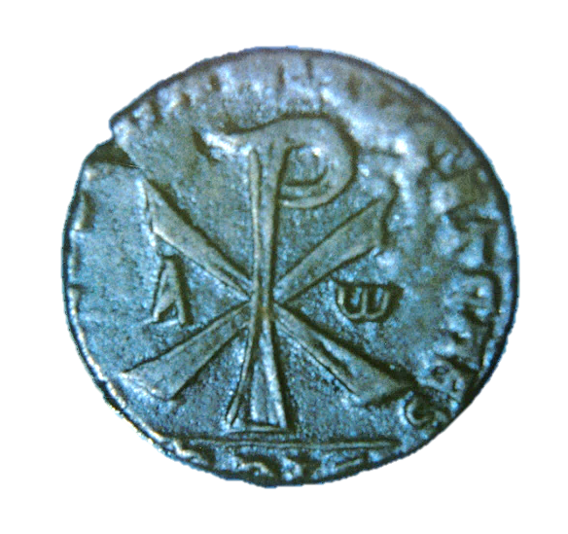
1 & 2 TIMOTHY
LETTERS TO A YOUNGER COLEAGUE

Slide 2
PAUL’S THIRTEEN LETTERS
While Luke does not describe the writing of Paul’s letters, a reasonable chronology can be ascertained from internal references in the letters themselves.
2ND TOUR LETTERS
Galatians (date is debated
between 2nd and 3rd tour)
1 Thessalonians
2 Thessalonians
3RD TOUR LETTERS
1 Corinthians
2 Corinthians
Romans
PRISON LETTERS
Colossians
Philemon
Ephesians
Philippians
PASTORAL LETTERS
1 Timothy
Titus
2 Timothy

Slide 3
THE HISTORICAL-CRITICAL QUESTION ABOUT AUTHORSHIP
Many scholars deny these two letters to Paul:
The vocabulary and literary style seem somewhat different than in his known letters (one needs to be able to access these features in Greek, of course, and they may not be apparent to the English reader).
The church context seems more organized (and therefore later) than what might be expected in the early 60s AD. The writer speaks of “the faith” in more of a static, doctrinal sense, suggesting later development.
The heresy envisioned seems Gnostic in orientation, and Gnosticism did not reach its full form until after well Paul’s era.

Slide 4
THE CASE FOR PAUL’S AUTHORSHIP
Conservative scholars defend Pauline authorship:
Both letters directly claim to be by Paul (1 Ti. 1:1; 2 Ti. 1:1).
The letters are replete with details that make this claim plausible, such as:
  Paul’s former life as a blasphemer (1 Ti. 1:12-14)
  Details about prison life (2 Ti. 1:8; 2:9; 4-6-7, 18)
  Knowledge of Timothy’s family (2 Ti. 1:5; 3:15)
  Various mutual acquaintances (2 Ti. 1:15-16; 2:17; 4:9-14, 19-24)
Differences in literary style might be attributed to an amanuensis.

Slide 5
THE CLOSING PERIOD OF PAUL’S LIFE
Our knowledge about the closing period is Paul’s life is fragmentary, at best.
The Book of Acts closes with Paul under house arrest in Rome (Ac. 28:16, 30-31).
If we are to take Paul’s prison correspondence as having been written during this imprisonment (which is also debated), than further information is available:
  Paul considered his hearing before Nero to be a matter of life and death (Phil. 1:20; 2:17), though he had hopes for release (Phil 1:25; 2:24).
  If Paul was released, a tradition recorded by Eusebius in the 5th century, then he may have been able to fulfill his desire to preach in Spain (Ro. 15:23-25). Still, Eusebius says, “Report has it…”, which is less than confident.

Slide 6
One tradition suggests that Paul was exiled by the emperor (1 Clement 5), and if so, his exile may have been to the west.
Another tradition says that he was released but arrested a second time.
The earliest tradition associates Paul’s martyrdom in Rome with the Neronian persecution of Christians following the great fire in AD 64.
Hence, we do not have a clear picture of the closing years of Paul’s life.
A default conclusion (by no means certain) is that Paul wrote 1 & 2 Timothy during a second imprisonment, and certainly he was incarcerated and anticipating death when he wrote 2 Timothy (1:8; 2:9; 4:6-7, 18).
However, there is none of this sentiment about impending death in 1 Timothy, but rather, an anticipation of a continuing ministry (1 Ti. 3:14-15; cf. Tit. 3:12).

Slide 7
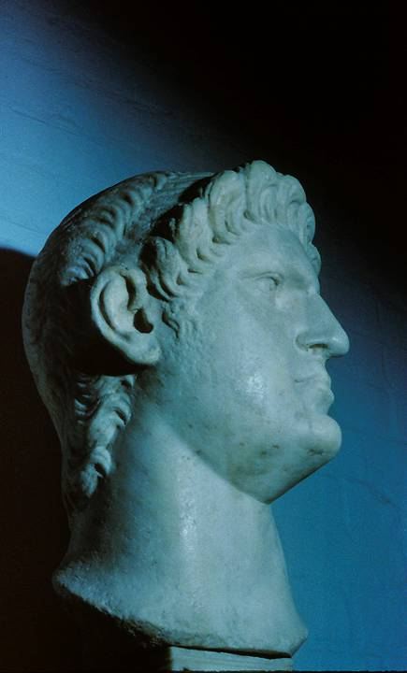
Caesar Nero ruled Rome (AD 54-68), and according to 5th century church tradition, he released Paul after his first imprisonment, after which Paul went to Spain.
Later, Paul is said to have been arrested a second time, and this time Nero had him executed by beheading.
However, there are competing traditions that leave the closing years of Paul’s life uncertain.

Slide 8
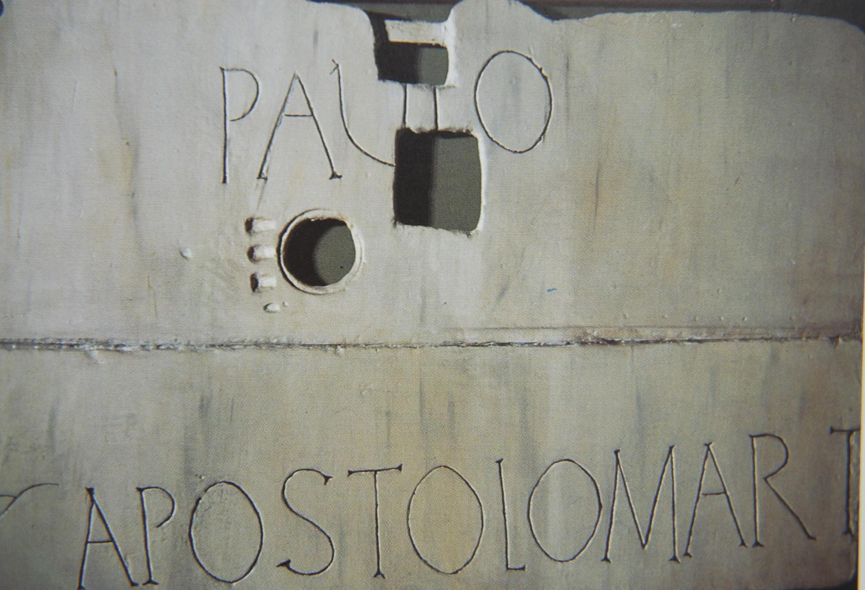
Erected above the traditional site of Paul’s tomb, Church of St. Paul Outside the Walls, Rome.

Slide 9
TIMOTHY
Paul addressed Timothy as “my true son in the Lord,” which suggests that he became a Christian directly under Paul’s ministry (1 Co. 4:17; 1 Ti. 1:2).
Timothy had a Greek father and a Jewish mother (Ac. 16:1). Due to his Jewish heritage, Paul required circumcision (Ac. 16:2-3).
He served as Paul’s understudy in missionary work (Phil. 2:22), ordained presumably at Lystra (1 Ti. 4:14; cf. 1:18).
His spiritual heritage dated back to his mother and grandmother (2 Ti. 1:5; 3:15).
Paul came to trust him more and more, both as an advance representative (Ac. 19:22) and as one who could represent Paul in his absence (Ac. 17:14-15; cf. 1 Th. 3:1-2, 6).

Slide 10
I have no one else like him, who takes a genuine interest in your welfare. For everyone looks out for his own interests, not those of Jesus Christ. But you know that Timothy has proved himself…
Philippians 2:20-22

Slide 11
1 TIMOTHY

Slide 12
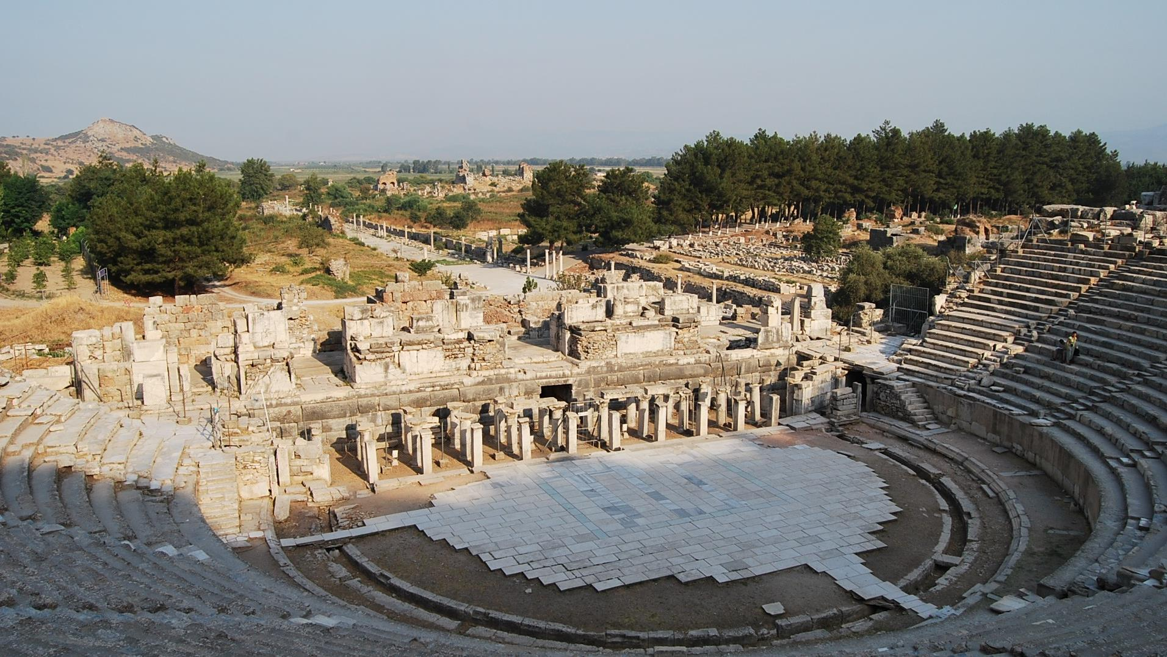
The amphitheater in Ephesus, where Paul was nearly lynched, lies at the end of the Arcadian Way.

Slide 13
THE SITUATION
Paul wrote concerning a situation in Ephesus (1:3), where he addressed a significant challenge to the faith.
Teachers were giving priority to myths and genealogies, apparently based on the Torah (1:4, 7).
They taught a theology of abstinence, including celibacy and dietary restrictions (4:3), asserting that they were the possessors of special knowledge 6:20-21).
Debate and friction were the inevitable result (6:3-5).
Two ringleaders are named, Hymenaeus and Alexander (1:20).

Slide 14
THE JEWISH-GNOSTIC THEOSOPHY
Paul’s mention of dietary laws and asceticism suggests that the heresy at Ephesus was Jewish in orientation.
At the same time, it seems apparent that this was not traditional Judaism, and the language of “falsely called knowledge” smacks of something akin to Gnosticism (6:20).
To be sure, Gnostic thought was not fully developed until about a century later, but forms of incipient Gnosticism may also lie behind Colossians and 1 John, and the Gnostic-like emphasis on asceticism may well derive from the Greek philosophical notion that material things were intrinsically evil.

Slide 15
MATRIARCHAL THEOLOGY
Several passages in the letter concern women teachers, and perhaps the heresy also was sympathetic to the Ephesian cult of Artemis, the patron goddess of the city.
The city was widely known for its glorification of the mother goddess figure, from who it was believed all life originated.
A virulent strain of aggressive feminism (2:11-12) augmented by ostentatious dress (2:9-10) and malicious talk (3:11; 5:13), what Paul labels “old women’s tales” (4:7), had already led some astray in following Satan (5:15).

Slide 16
THE ARGUMENT OF 1 TIMOTHY
The false gospel versus the true (1):
Paul issues a severe warning against false teachers who were distorting the gospel by emphasizing Mosaic legalism while deemphasizing faith.
The true gospel, which was epitomized in divine grace and mercy, had been demonstrated in the conversion of Paul himself.
An order for Christian life, worship and leaders (2-3):
After offering a general comment about prayer, Paul gives an order for decorum in public worship, first for men, then for women.
He then gives an order for the traits that should characterize the lives of leaders, first for elders, then for deacons.

Slide 17
The coming apostasy (4):
The false teachers in Ephesus were merely part of a larger final apostasy, and Timothy must stand firm against it.
Order for Christian relationships (5:1—6:2):
Here, Paul offers an order for the deference of the younger to the older and the church’s treatment of widows who are receiving support from the church.
He also addresses the treatment of church leaders.
Finally, he addresses the relationship of slaves to masters.
Final warnings and a charge (6:3-21):
As a final word against false teachers, he warns against the love of controversy, pride and greed.
His parting charge to Timothy emphasizes true pastoral concern grounded in basic Christian virtue and faith.

Slide 18
THE OPENNG (1:1-2)
The opening in Greco-Roman correspondences typically included the name of the sender, the recipient and a salutation of blessing.
As is typical in his letters, Paul identifies himself as an apostle of Christ.
Timothy he regards as a “true son,” probably a reference to Timothy’s loyalty in contrast to those who had deserted him (cf. 2 Ti. 1:15; 4:16).

Slide 19
THE DANGER OF A FALSE GOSPEL (1:3-11)
1 Timothy is one of several NT letters with Ephesus as its church context (see also, John, 1, 2 & 3 John, Ephesians, and Revelation):
False teachers in Ephesus were supplanting faith and integrity by urging the importance of myths and genealogies, possibly of the sort Paul also mentions to Titus (Tit. 1`:13-14; 3:9).
They seemed to rely on obscure interpretations of the Torah.
Later, Paul will point out that this distortion included a virulent strain of aggressive feminism (2:9-12) with a lot of “godless chatter” and “so-called knowledge” (5:13; 6:20-21).

Slide 20
PAUL AND THE TORAH
Paul was a Torah-observant Jew, holding the law in high value as an indication of God’s righteous demand (1:8-10; cf. Ro. 7:12, 14a) while bringing to humans a consciousness of sin (cf. Ro. 3:19-20, 31; 5:20a; 7:7, 13).
Several Torah laws demonstrate that they are for the lawless and godless:
  Those who batter their parents (cf. Ex. 21:15; Dt. 27:16)
  Murderers (cf. Ex. 20:13; 21:12-14; Lv. 24:17-22; Nu. 35:16-21, 30-34; Dt. 5:17)
  Sexual deviants (cf. Ex. 20:14; Lv. 18; Dt. 5:18; 22:13-30)
  Liars and perjurers (cf. Ex. 20:16; 23:1-3; Lv. 5:1; Dt. 5:20)
Paul’s use of the term a]senokoi<thj (= male-bedder) is the same as in 1 Co. 6:9.

Slide 21
a]senokoi<thj
The translation of this term for same-sex union as “homosexual” has been questioned by the pro-gay community, suggesting that the word refers not to homosexual union in general, but only to exploitative homosexual union between men and boys.
This reinterpretation belongs to a much broader effort over the past several decades to neutralize a number of biblical passages that prohibit outright or describe in morally reprehensible ways the practice of same-sex union.
The word is a compound, made up of arsen (= a male) and koite (= bed). Literally, it means “male-bedder.” The attempt to lessen its general meaning fails on linguistic grounds. In Paul’s world, it indicated an active homosexual partner (in 1 Co. 6:9, Paul also uses the term malakos, which refers to a passive partner).

Slide 22
THE PROFILE OF THE EPHESIAN HERESY
In antiquity, old women were famous for religious storytelling, and in Ephesus, female religious figures kept alive the ancient myths, which Paul does not hesitate to describe as “following Satan” (5:15).
Here, it included the demand for dietary restrictions (probably related to Jewish kosher food laws) and a devaluation of marriage (4:3), possibly on the grounds of a misplaced asceticism.
Those advocating such things did so merely to increase their personal wealth while using their self-elevated positions to that end (3:3b; 6:5b-10, 17-19).

Slide 23
THE TRUE GOSPEL (2:12-17)
The true gospel, to which the law conformed, had been demonstrated in the conversion and life of Paul.
Though out of ignorance Paul himself had committed some of the sins which the law condemned (1:13-14), God’s mercy was bestowed upon him, the very worst of sinners (1:15).
Paul never forgot his life as a persecutor of Christians (cf. Ac. 7:58; 8:3; 9:1-2; 22:4-5; 26:9-11; 1 Co. 15:9; Ga. 1:13; Ep. 3:8a).

Slide 24
THE CHARACTER TRAITS OF THE DEITY
In a beautiful doxology, Paul lists four profound character traits of God drawn from the Hebrew Scriptures.
King of Ages: He is the Lord over history, sovereign over the ages and not bound by time.
Incorruptible: The nuance of the word aphtharto is that God is imperishable. Unlike created matter, God is immortal.
Invisible: God is spirit by his very nature, hence, invisible to the human eye. In a culture steeped in idolatry, this was truly unique.
Only True God: While elsewhere Paul’s acknowledges that in the Greco-Roman world there were many gods and many lords (1 Co. 8:6), for Christians there was only one God who was truly God.

Slide 25
THE WAR AGAINST FALSEHOOD (1:18-20)
Paul charges Timothy, based on his ordination to Christian service, to maintain his faith and integrity in the war against false ideas.
The heretics he names are unknown to us unless Alexander might possibly be the Ephesian antagonist mentioned elsewhere (cf. Ac. 19:33-34; 2 Ti. 4:14-15).
Both of them Paul says he has “handed over to Satan.”

Slide 26
ORDINATION TO CHRISTIAN SERVICE
The consecration of religious officials begins in the Old Testament with the priests of Israel (Ex. 29; Lv. 8).
While the earliest Christians did not replicate the Israelite tradition of distinctive garments and anointing oil, they did retain the practice of imposing hands on the candidate (Nu. 8:10; 27:18-23; Ac. 13:1-3; 14:26).
Timothy’s consecration to Christian service was accompanied by prophecies and the imposition of hands by the elders and by Paul himself (1 Ti. 1:18; 4:14; 2 Ti. 1:6).
These passages provide the basis on which later church ordination practices developed.

Slide 27
CONSIGNMENT TO SATAN
The language of “handing over to Satan” suggests that normally Satan has only limited access to the believer, who is protected by the Holy Spirit (cf. Jn. 14:30; 1 Jn. 5:18b).
This act of consignment to Satan seems to have been taken by the whole community (cf. 1 Co. 5:4-5).
It probably meant that the one under discipline would be stripped of the spiritual protection afforded to believers so that he/she would become vulnerable to the diabolical agent whose goal is to destroy all he can. Satan, then, would be able to physically attack the person.
The goal is remedial, that in the end the person might be saved (1 Co. 5:5b), or in this case, that the offenders might learn not to blaspheme.

Slide 28
ORDER FOR CHRISTIAN LIFE AND WORSHIP (2:1-15)
Paul now shifts his attention to the way Christians ought to express themselves in speech and in worship.
In the first place, their primary responsibility is to pray for all people, both the governors of the state whose statutes and decisions affect God’s people, as well as everyone else, since God desires all people to be saved (2:1-4).
The Christian message is that the way to God is through a single mediator, Jesus Christ, whose atoning death bought the lives of sinners as a witness to God’s eternal purpose (2:5-6; cf. Ro. 5:6; Ga. 4:4; He. 9:26).
Paul had been commissioned as a missionary to spread this faith.

Slide 29
The Order for Men (2:8)
Since God’s purpose is made clear in the ransoming death of Christ, the order for men is to pray out of a life of holiness.
Worshippers should renounce arguments and anger when approaching God in prayer.
The lifting of hands in prayer is an ancient prayer posture (cf. 1 Kg. 8:22; Ps. 28:2, etc.).

Slide 30
The Order for Women (2:9-15)
The order for women is longer. Typically, this order has been read as a universal code for female decorum and applied generally to women as a list of restrictions:
Restrictions on hair arrangements, jewelry, clothing, etc.
Restrictions on participation in church life.
Such a reading may miss the local context out of which Paul was writing and warrants a closer look.

Slide 31
A 1ST CENTURY CONTEXTUAL READING
The present passage arises out of the context of heretical teaching and female teachers with an aggressive feminist bent.
Their demeanor and dress was brash and ostentatious, so Paul calls upon them to dress themselves with good deeds, not flashy clothes.
Further, he calls for these women to become submissive learners instead of teachers. They are in no position to teach, because they do not understand the gospel—and they are certainly in no position to domineer over men or defy the creation accounts as narrated in the Torah.
Later, Paul will call to silence women leaders given to malicious talk (3:11; 5:13) as well as those spreading godless myths and old wives’ tales (4:7).

Slide 32
POPULAR EPHESIAN MYTHOLOGY
A popular mythology in the ancient world was that woman was the author of man rather than vice versa.
This is clearly evident in the Gnostic teaching that Eve was the source of divine revelation in the Garden of Eden, the first one who dared to taste of the tree of knowledge.
Similarly, the foremost deities in Ephesus were maternal, so a worldview of dominant feminism was widely held in Ephesian culture.
Paul’s correctives are clear: these women should not be teaching or peddling their myths concerning female dominance. The notion that woman was the author of man or the brilliant and daring channel of special revelation is a fallacy and flies in the face of the Genesis record.

Slide 33
IF PAUL HAS THIS MATRIARCHAL BACKGROUND IN MIND, THEN HIS STATEMENTS MAY BE READ AS CORRECTIVES
GNOSTIC IDEAS
The Hypostasis of the Archons, 2.89
“The spirit-filled woman came to him and spoke with him, saying, ‘Arise, Adam.’ And when he saw her, he said, ‘You are the one who has given me life.’”
On the Origin of the World, 2.5.116
“But let us not tell Adam because he is not from among us, but let us bring a sleep upon him, and let us teach him in his sleep as if she [Eve] came into being from his rib…”
ST. PAUL
1 Timothy 2:13
“For Adam was formed first, then Eve.”
1 Timothy 2:14
“And Adam was not the one deceived; it was the woman who was deceived and became a sinner.”
The Gnostic texts are much later than Paul, so he cannot be interacting with them directly. However, ideas must begin somewhere, and it is possible that these ideas were current in Paul’s day, even if not in written texts.

Slide 34
SAVED THROUGH CHILD-BEARING
Paul’s final statement has been difficult for all interpreters, both in terms of its grammar as well as its meaning.
A literal rendering of the Greek text is: “She will be saved through child-bearing if they continue in faith and love and holiness with self- control.” The immediate question is who is “she” and who are “they?”
Some versions translate the singular 3rd person pronoun “she” by the plural English noun “women” (so NASB, NIV, NIB, NLT), taking the singular pronoun as a collective for all women.
Most versions leave the 3rd person singular pronoun “she” as it is, allowing the reader to wrestle with the intended meaning.

Slide 35
INTERPRETIVE OPTIONS
HIERARCHICAL
Here, a woman will be saved if she obeys the restriction to stay out of leadership and stays home to have children.
MARY
Here, the “she” refers to the mother of Christ, and Mary herself will be saved through her divine Son.
MOTHERS
Here, Christian women will survive the trauma of child-birth.
EVE
Here, harking back to the first messianic promise in Ge. 3:15, Eve would be saved, because in giving birth, she began the chain of procreation culminating in the birth of Christ.
If the “she” refers to Eve, then the “they” in the passage refers to Eve’s children, i.e., the human race. They testify to the salvation brought about through Eve’s child-bearing in which the seed of the woman would bruise the serpent’s head.

Slide 36
THE ORDER FOR OVERSEERS AND DEACONS (3:1-16)
One of the distinctive features of 1 Timothy and Titus is the formal attention they devote to ordained offices in the church.
Early on, titles like “elders” or “overseers” or “shepherds” seem to be used more or less interchangeably (Ac. 20:17, 28; 1 Pe. 5:1-2).
The title “deacon” is mentioned as well (Phil. 1:1), and apparently it could include women as well as men (cf. Ro. 16:1).
Here one encounters formal orders for each, though the descriptions are largely in terms of character qualifications rather than functions.

Slide 37
POST-APOSTOLIC DEVELOPMENT
Since elders are mentioned first (Phil. 1:1; 1 Ti. 3:1, 8), most interpreters have understood deacons to be subordinate to elders.
By the 2nd century (Letters of Ignatius), a hierarchy had developed with the Office of the Bishop elevated so that there was a single bishop in a given community, under him were the elders of the local congregations, and under them were the deacons.
How this hierarchy developed is unclear, and it is equally unclear whether it was in place as early as the time of Paul, though most scholars think it developed later than Paul.

Slide 38
Order for Overseers (3:1-7)
Paul begins the order with a phrase that implies quoted or traditional material, “Here is a trustworthy saying…” (1 Ti. 1:15; 3:1; 4:9; 2 Ti. 2:11; Tit. 3:8).
The most important prerequisite is reputable Christian character, and other qualities follow in kind.
The phrase “husband of one wife” might be directed against polygamy or bigamy, since such was commonly practiced in the Greco-Roman world, but most likely Paul wants to stress the broader issue of marital fidelity.

Slide 39
As in all Paul’s lists, he intends them to be suggestive, not exhaustive.
Nephalios (sober, temperate in the use of wife)
Sophron (prudent, thoughtful)
Kosmios (respectable, honorable)
Philoximos (hospitable)
Didaktikos (skilled in teaching)
Me paroinos (not addicted to wine)
Me plektes (not a bully)
Apieikes (gentle, kind)
Aphilargyros (not loving money)
Expectations
…a stable family life with obedient children, assuming a parallel between homelife and church life.
…not a recent convert, since rapid promotion often results in pride
…reputable among outsiders

Slide 40
Order for Deacons (3:8-10, 12-13)
The order for Deacons also begins with a series of character delineations.
In addition…
…holding the faith with a clear conscience
…adequately examined
…devoted to one wife
…maintaining a stable family life.
…serving well in assigned tasks
Semnos (dignified, serious)
Me dilogos (not insincere)
Me oino pollo prosechontas (not addicted to much wine)
Me aischrokerdos (not fond of dishonest gain)

Slide 41
THE MYSTERY OF FAITH
The expression “the mystery of faith” is especially Pauline.
While there were mystery religions in the Greco-Roman world, Paul’s use of this term is quite different.
He emphasizes the present revelation and manifestation of the gospel, not some sort of mysteriousness or mysticism.
It is the gospel that once was hidden in past ages but now has been made known to the saints (Col. 1:26).

Slide 42
Order for Deaconesses (3:11)
The order for women deacons begins with the formula hosautos (= in the same way), an introductory formula indicating that a corollary order is in view. Hence, there is the possibility of translating gynaikas as “deaconesses” as opposed to “wives” (so NIVmg, NIBmg, NRSVmg, NLT mg).
There is no qualifier, such as, “their” wives in the Greek text, though a number of English translations add this qualifier.
There remains some linguistic ambiguity.
One deaconess is known by name from the NT, Phoebe of Cenchreae (Ro. 16:1).
Semnos (dignified, serious)
Me diabolos (not slanderous)
Nephalios (sober, temperate in the use of wine)
Pistos (trustworthy, dependable)

Slide 43
Appropriate Conduct in the Household of God (3:14-16)
The various orders for church leaders were intended to guide Timothy until Paul could come to Ephesus himself.
Given travel conditions in the ancient world, not to mention other factors in the life of the churches, the possibility of delay was a perennial threat.
Still, the church is the community of living believers sharing a common faith, metaphorically a “household.”
Like a new temple, this community is the “pillar and foundation” of the truth, the custodian of the gospel.

Slide 44
A CHRISTIAN HYMN
While the early Christians did not compose formal creeds, such as would later be developed by the church, they did compose hymns that focused on the central tenets of the faith.
These “hymns” (we don’t know that they were set to music, though some scholars suggest as much) provided summaries of central Christian beliefs (cf. Phil. 2:5-11; Col. 1:15-20; Rv. 4:8b, 11; 5:9-10).
Such “hymns” were a first step toward the later creeds of the early church.
1 Ti. 3:16, which is set out in rhythm and antithetical couplets (i.e., flesh and spirit, angels and nations, the world and glory), treats two world orders, the divine and human, showing how Christ has brought both spheres together in his incarnation.

Slide 45
A Textual Issue
Older English translation read, “God was manifest in the flesh…” Based on earlier texts, most modern versions read, “Who/he/which was manifest in the flesh…” This textual variation likely arose from the confusion of letters between the standard abbreviation for God (QS) and the relative pronoun “who” (OS).
Later Greek manuscripts have the word “God” (so KJV, NKJV).
The earliest Greek manuscripts have the pronoun “who” (followed by virtually all modern versions other than the NKJV).

Slide 46
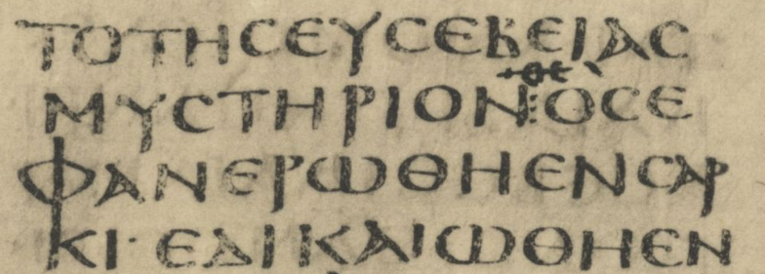
Confusion of letters
1 Timothy 3:16
!Oj e]fanerw<qh e]n sarki<… (= “…who was manifested in flesh…”)
qj (abbreviation for qeo<j) e]fanerw<qh e]n sarki<… (“…God was manifested in flesh…”
A corrector has written in QS over the original text OS.
X CODEX SINAITICUS (4th century)

Slide 47
PREPARING FOR THE COMING APOSTASY (4:1-16)
Paul seems to view the problem at Ephesus as the vanguard of the last great apostasy.
It seems clear that Paul anticipated a general departure from the Christian faith (2 Ti. 3:1-9, 13; 2 Th. 2:3, 10-12).
Further, Paul and other NT writers considered themselves to be in the last times already (Ro. 13:11-12; 16:20; 1 Co. 7:31bb; Phil. 4:5; Ac. 2:16-17; He. 1:1-2; Ja. 5:8-9; 1 Pe. 4:7; 1 Jn. 2:8, 18a).
Part of this heresy would include forced celibacy and rigorous dietary laws, restrictions that flew in the face of God’s created order.

Slide 48
A Good Minister (4:6-10)
By contrast, Paul urges Timothy to set his priorities on the faith and teachings of the church.
Here, Paul seems to have in mind a defined set of Christian teachings, probably similar to what was expressed in 3:16.
At the same time, Timothy must avoid becoming embroiled in mythologies and esoteric stories, but rather, focusing on godliness.
Such godliness is the trustworthy tradition handed down by the church.

Slide 49
Pastoral Duties (4:11-16)
Timothy’s primary responsibility was to teach these central Christians truths, demonstrating the validity of the Christian life by example.
The public reading of Scripture presupposes a pattern for early Christian worship following the synagogue, where one passage from the Torah and one from the Prophets was publicly read in each service (cf. 1 Th. 5:27; Col. 4:16).
His gift of recognized leadership should be cultivated as well, especially his capacity for teaching.

Slide 50
A DESCRIPTION OF EARLY CHRISTIAN WORSHIP BY AN INSIDER
“On the day called Sunday there is a gathering together in the same place of all who live in a given city or rural district. The memoirs of the apostles or the writings of the prophets are read, as long as time permits. Then when the reader ceases, the president in a discourse admonishes and urges the imitation of these good things. Next we all rise together and send up prayers.
When we cease from our prayer, bread is presented and wine and water. The president in the same manner sends up prayers and thanksgivings, according to his ability, and the people sing out their assent, saying the “Amen.” A distribution and participation of the elements for which thanks have been given is made to each person, and to those who are not present they are sent by the deacons.”
Justin Martyr, First Apology (ca. 155)

Slide 51
A DESCRIPTION OF EARLY CHRISTIAN WORSHIP BY AN OUTSIDER
“They were in the habit of meeting on a fixed day before it was light, when they sang an anthem to Christ as God, and bound themselves by a solemn oath not to commit any wicked deed, but to abstain from all fraud, theft and adultery, never to break their word, or deny a trust when called upon to honor it; after which it was their custom to separate, and then meet again to partake of food, but food of an ordinary and innocent kind.”
Pliny, Letters x.96 (ca. 112)

Slide 52
A DESCRIPTION OF EARLY CHRISTIAN BAPTISM
“And concerning baptism, baptize this way: Having first said all these things, baptize into the name of the Father, and of the Son, and of the Holy Spirit, in living water. But if you have no living water, baptize into other water; and if you cannot do so in cold water, do so in warm. But if you have neither, pour out water three times upon the head into the name of Father and Son and Holy Spirit. But before the baptism let the baptizer fast, and the baptized, and whoever else can; but you shall order the baptized to fast one or two days before.”
Didache 7 (ca. 110)

Slide 53
A DESCRIPTION OF EARLY CHRISTIAN EUCHARIST
.
“Now concerning the Eucharist, give thanks this way. First, concerning the cup: We thank you, our Father, for the holy vine of David your servant, whom you made known to us through Jesus your Servant; to you be the glory forever.”
“And concerning the broken bread: We thank you, our Father, for the life and knowledge which you made known to us through Jesus your Servant; to you be the glory forever. Even as this broken bread was scattered over the hills, and was gathered together and became one, so let your Church be gathered together from the ends of the earth into your kingdom; for yours is the glory and the power through Jesus Christ forever.”
Didache 9 (ca. 110)

Slide 54
ORDER FOR CHRISTIAN RELATIONSHIPS (5:1—6:2)
While Paul offers instructions for several kinds of relationships, his initial one is on the basis of age (5:1-2).
An older man should be treated with deference as if he were one’s father, while younger men should be treated as equals.
Older women should be treated as mothers, and younger women should be treated as sisters.

Slide 55
THE PROBLEM CONCERNING WIDOWS
Widows were particularly vulnerable in ancient societies, which were usually patriarchal.
They could not simply enter the work force except under very restricted conditions, and depending on their age, they might not be in a position to remarry.
In the OT, widows were often categorized with orphans or other disadvantaged groups, and this concern carries over into the NT (Ac. 6:1-6; 9:39; Ja. 1:27).

Slide 56
The Order of Widows (5:3-10, 16)
The language of 5:9 implies that by the time of this letter there was an official order of widows supported by the church.
Paul does not consider it to be the church’s responsibility to care for all widows in every case; hence, he outlines certain qualifications, probably aimed at weeding out troublemakers.
In order to receive assistance, a widow must be truly deprived and without other resources.
She must be in her sixties, she must have been faithful to her husband, and she must have a proven record of good deeds, hospitality, and servanthood.

Slide 57
Younger Widows (5:11-15)
Many scholars suggest, on the basis of the language of the broken “pledge” (5:12), that widows on support had to take a vow of celibacy.
While the word in the Greek test is “faith” (pi<stij), most translators takes this to mean a pledge (so ASV, NAB, NASB, NET,NIB, NIV, NJB, NLT, NRSV, RSV).
If they were younger (less than sixty), they might renege on this pledge if/when the opportunity arose for remarriage.
Even worse, the risk seemed high that younger widows might become involved in disruptive behaviors, and given that the church already was experiencing such behaviors on the part of some women (cf. 2:11-14), Paul’s concern seems justified.

Slide 58
Binding Principles and Local Applications
In Paul’s instructions about widows, there is an interplay between the principles of the Torah and the their application in a local situation. Indeed, this interplay is evident in several of Paul’s letters, where the interpreter should distinguish between the two.
The Torah and the prophets in the Hebrew Bible clearly indicate that care for the disadvantaged is to be deeply affirmed as a binding moral principle.
Paul’s application of this principle is local and dependent upon a limited culture condition and church situation.
Some of these applications might very well need to be changed for other settings, but the mandate for benevolence holds true in all cases.

Slide 59
Treatment of Leaders (5:17-18)
Paul uses the same term as he used earlier for elder men, but here the nuance is undoubtably referring to church leadership.
“Double honor,” or increased honor (which probably refers to monetary compensation), is due to those who serve in preaching and teaching (Dt. 24:15; 25:4; cf. 1 Co 9:4, 7-14).
Such instruction, of course, needs to be balanced with Paul’s previous statements against greed (3:3b, 8b).

Slide 60
Charges Against Leaders (5:19-21)
If a church leader was accused of wrongdoing, the accusation must be supported by independent witnesses (cf. Nu. 35:30; Dt. 17:6; 19:15).
If the charge was sustained, the perpetrator was to be publicly chastised as a warning to others.
If the Ephesian church was beset with a chain of rumor and gossip (cf. 3:11; 5:13), these measures seem appropriate.
In all cases, church discipline must be conducted in fairness.

Slide 61
Reinstatement (5:22)
Fallen leaders bring reproach on the whole church, and the violation of their calling stands as an offense in the sight of all heaven.
Hence, reinstatement should be treated with caution.
Paul’s charge against hastily laying on hands, in context, may refer to the reinstatement of fallen leaders.
Those who reinstate such a leader might very well be tainted with his sin.

Slide 62
A Personal Word (5:23)
Parenthetically, Paul offers a word to Timothy directly, since apparently his younger colleague suffered from dyspepsia.
Perhaps Timothy had foregone the consumption of wine in an effort to remain pure or to avoid addiction.
In any case, Paul instructs him to drink wine in moderation, since it was commonly believed to have medicinal qualities.
All wine in the ancient world was intoxicating; the notion that the biblical words for wine are referring only to grape juice cannot be sustained.

Slide 63
A Word Toward Commissioning Leaders (5:24-25)
Assuming Paul is still continuing his instructions about church leaders, his final remarks concern sin and judgment.
Some men’s sins are obvious and can be immediately recognized, thus removing them from candidacy for leadership.
Others have secret sins that may never be known until the final judgment, so avoiding hasty ordination offers opportunity for them to prove themselves (cf. 3:10).
By the same token, some good deeds are obvious, while others might not be well-known.

Slide 64
Slaves and Masters (6:1-2)
The last group Paul addresses are slaves in the Christian community.
We know that by the 2nd century, Christianity was slandered as a religion that disrupted society by appealing to women, slaves, and young people. Perhaps this sort of slander was being bandied about in Paul’s era as well.
Paul urges slaves to give full respect to their masters so that they do not impugn the reputation of the church. If both are believers, they must not use their brotherhood as an excuse for disrespect.

Slide 65
Paul’s Ethic Concerning Slavery
Paul’s approach to slavery creates some amount of tension.
He can say that in Christ there is neither slave nor free, but all believers are equal (Ga. 3:28; Col. 3:11).
On the other hand, he also requires slaves to be respectful and obedient (Col. 3:22; Ep. 6:5-7), and familiarity must not breed contempt (1 Ti. 6:2).
All slaves are free in Christ, while all masters are slaves to Christ (1 Co. 7:22
Slaves are to remain content in their station, though if they can gain manumission, they should do so (1 Co. 7:21). Indeed, Paul implicitly suggests manumission as the appropriate Christian response (Phlm. 15-16, 21).
Still, he is willing to make temporary concessions when necessary so that the message of Christ is unhindered (1 Co. 9:12-23).

Slide 66
FINAL WARNING AGAINST FALSE TEACHERS (6:3-10)
Purveyors of false doctrine were in fundamental disagreement with the teachings of Christ as well as the church, which together are the norm for sound theology.
Paul considered Jesus’ words, preserved at this point in the oral tradition of the church, to be finally authoritative.
In Ephesus, Timothy faced a group of instructors who were motivated by pride, prone to quarrel, and willing to use the Christian faith as a means for acquiring wealth.

Slide 67
The Vice of Greed (6:6-10)
In the ancient world, teachers and philosophers were customarily paid for their services.
Paul certainly affirms that the worker deserves his wages, but he also agrees with Christ that leaders must “be on their guard against all kinds of greed” (cf. Lk. 12:15).
The necessities of food and clothing are enough, and the temptations of wealth lead to many destructive behaviors.

Slide 68
Summary of Paul’s Warnings Against False Teaching
In repeated warnings, Paul develops a profile of the problem of false teachers and apostasy in Ephesus.
Initial warning and charge to silence false teachers (1:3-10).
Order of silence for the women who were propagators of this false teaching (2:11-14).
Description of the church as the pillar and ground of truth against falsehood (3:14-15).
Warning against a coming apostasy, of which the present heresy is a prelude (4:1-5).
Warning against the church supporting of women who go “from house to house” spreading falsehood (5:12-13, 15).
Warning against heresy (6:3-10).
Final word against false knowledge (6:20-21).

Slide 69
FINAL PASTORAL CHARGE (6:11-21)
The contrasting goals between the true Christian pastor and the false one are clear.
Timothy must pursue the deep Christian values, fighting for genuine faith and godly ideals (6:11-12).
This confession of faith, similar to Jesus’ testimony before Pontius Pilate, attended Timothy’s response to the gospel, here probably referring to the occasion of his baptism (6:13).
He is to discharge his ministerial duties in a blameless manner until the return of Christ, and Paul adds a doxology to his charge (6:14-16).

Slide 70
Doxologies—short formulae praising God—are found throughout the Bible.
They appear frequently in the Psalms (Ps. 41:13; 68:35; 72:18-19; 106:48) as well as at the end of songs (1 Chr. 16:36).
Paul and other NT Writers follow in kind, usually ending the doxology with “Amen” (Ro 11:36; 16:27; Gal. 1:5; Ep. 3:20-21; Phil. 4:20; 2 Ti. 4:18; 1 Pe. 4:11).
THE DOXOLOGY IN 1 TIMOTHY 6:15-16
Here, Paul affirms God as sovereign over the universe.
Only God has immortality.
In his purest essence, God cannot be seen (cf. Ex. 33:20).
Honor and dominion are rightfully his.
The closing “Amen,” a transliteration of the Hebrew root word for truth, adds a weighty pronouncement.

Slide 71
The Closing (6:17-21)
Paul signs off with a warning against self-sufficiency.
Christian wealth should be counted in good deeds, which will be rewarded by God, for this is the life that truly matters (cf. Mt. 6:19-21; Lk. 18:22).
Timothy, for his part, must guard the faith, a warning that will be repeated in 2 Timothy 1:13-14.
The theologizing of the false teachers is false knowledge, leading to distortion of the pure Christian faith.
The plural form of the final pronoun “you” suggests that this letter was to be shared with the congregation.

Slide 72
2 TIMOTHY

Slide 73
THE CRITICAL QUESTIONS
The same controversial questions about authorship that surrounds 1 Timothy also surrounds 2 Timothy.
It is at least fair to say that the vocabulary and style of 2 Timothy is considerably closer to that of the undisputed letters by Paul.
Certainly the post-apostolic church embraced it as genuinely Pauline while rejecting other documents as pseudepigrapha associated with Paul’s name (3 Corinthians, Letter to the Laodiceans, Letters of Paul and Seneca, Acts of Paul and Thecla).

Slide 74
THE CLOSING EVENTS OF PAUL’S LIFE
Luke tells us that Paul spent at least four years in incarceration, two in Caesarea Palestine (Ac. 23:23-24, 31-35; 24:22-27) and two more under house arrest in Rome (Ac. 28:16, 30-31).
In the Philippian Letter, written during incarceration, Paul was hopeful for a release and the opportunity to minister in Macedonia (Phil. 1:26; 2:24).
However, he also envisioned the possibility of a mission to the west in Spain (Ro. 15:23-24, 28-29).

Slide 75
Three Scenarios for the End of Paul’s Life
RELEASE
Based on references by Eusebius and Jerome, Paul’s appeal to Caesar ended with his release, and he was able to continue missionary activities either east (Macedonia) or west (Spain).
2 Timothy was written after a second arrest, resulting in martyrdom in AD 67-68.
EXECUTION
Later Christian writers testify that both Paul and Peter perished in Rome at about the same time (ca. AD 64-65).
Here, Paul was not released, but executed.
His hope of going to Spain was unfulfilled.
Paul may or may not have written the pastoral letters, but if so, we do not know whether from Caesarea or Rome.
BANISHMENT
This scenario is more speculative, since it does not have early church tradition to support it.
After Paul’s appeal to Caesar, he was banished to Spain, a relatively mild punishment that would have enabled him to resume missionary work.
Upon hearing about the great fire in Rome, he returned, was again arrested, and executed (ca. AD 64-65).

Slide 76
Tentative Chronology of Paul’s Christian Life
Events Roman History
Conversion 33? 14-37 Caesar Tiberius
Relief mission to
Jerusalem 35?
Cilicia & Syria 35-46 37-41 Caesar Caligula
2nd Jerusalem visit 46 41-54 Caesar Claudius
1st Mission Tour 47-48
Galatian Letter 48?
Jerusalem Council 49 49 Jews expelled from Rome
2nd Mission Tour 49-52
1&2 Thessalonians 50
Corinth 50-52 51-52 Gallio, Achaia Proconsul
3rd Jerusalem visit 52 52-59 Felix, Judaea Proconsul
3rd Mission Tour 52-57
Events Roman History
Ephesus 52-55 54-68 Caesar Nero
Macedonia & Achaia 55-57
1&2 Corinthians 55-56
Roman Letter 57
4th Jerusalem visit 57
Caesarean
Imprisonment 57-59 59-62 Festus, Judaea Procurator
Voyage to Rome 59-60
House Arrest, Rome 60-62
Ephesians, Philippians,
Colossians, Philemon 60-62?
Trip to Spain? 62-64? 64 Great Fire in Rome
Titus, 1&2 Timothy ?
Paul’s Execution 65?

Slide 77
PAUL’S CIRCUMSTANCES
Paul’s situation at the time of writing was precarious.
He was incarcerated but did not have the liberty of house arrest, which had been afforded him at the close of the Book of Acts (1:15; 2:9; 4:16).
Far from being hopeful for a release, he fully expected his life to end (4:6).
Hence, his greatest concern was for the continuity of his mission.
He expressed distress over the unfaithfulness of others (1:15; 4:10, 16) as well as the fact that some of his co-workers were no longer available to help him (4:20)

Slide 78
TIMOTHY AS PAUL’S DELEGATE
Though incarcerated at the time of writing, Paul sought to continue his gospel work through delegates (4:10-12), especially Timothy (1:6-8; 4:1-2).
Above all, he was concerned about maintaining the purity of the Christian message. What would happen to the gospel after his death?
Hence, he repeatedly charges Timothy to “guard” the gospel (1:13-14; cf. 2:2, 8-9, 15; 3:14-17; 4:1-2, 5).
Several times Paul warns against false teachers, and he names four (1:15; 2:17).

Slide 79
OPENING (1:1-7)
The opening of the letter is typically Pauline, where he identified himself as the sender and Timothy as the recipient.
Paul clearly identifies himself with his Jewish ancestors, acknowledging a continuity between their faith and his, a continuity that was equally true of Timothy.
Paul writes to stimulate Timothy to fulfill his call to ministry, and he reminds Timothy of his ordination to service. In his previous letter, he described the council of elders who laid their hands on Timothy to commission him (1 Ti. 4:14), but here, Paul also shows that he was part of that group.

Slide 80
GRACE AND SUFFERING (1:8-14)
Paul minces no words: the call to ministry is a call to suffering.
It was dangerous to be associated with a well-known figure like Paul who had become a target for the Roman government, so Timothy must be prepared to take the risk.
Still, such suffering was ultimately in the interests of the gospel, and Timothy’s service to the gospel was a holy calling, a constituent part of God’s eternal purpose from the beginning.
In the end, this gospel was the abolition of death, the central message which Paul preached.

Slide 81
The Language of Tradition and Stewardship
2 Timothy 1:13-14 is the first of several passages in this letter that describe the importance of tradition.
1:13-14 – Here, Paul speaks of “the deposit,” which seems to refer to what the Lord had committed to Paul and the early Christian leaders (cf. 1 Ti. 6:20).
2:1-2 – Paul also speaks of the passing of tradition from those who had gone before to those who would come later.
3:14-17 – Finally, Paul speaks of the sacred writings, which is the basis for teaching, reproof, correction, and training.

Slide 82
THE DESERTERS AND THE FAITHFUL (2:15-18)
Paul’s concern for the preservation and continuity of the gospel was all the more acute, since some of those whom he had trusted had turned away from him.
Hence, Paul prays for mercy for his faithful followers, in particular Onesiphorus, whom Paul originally met in Ephesus and who had searched in the prison cells until he found Paul. That Paul speaks of the “house” of Onesiphorus rather than him personally might imply that he was deceased.
The prayer for Onesiphorus that he might find mercy in the day of judgment has become, in the Roman Church and the Orthodox Church, one of the scriptural bases for intercession for the dead (cf. 2 Mac. 12:43-45). Protestants have been generally doubtful.

Slide 83
THE PASSING OF TRADITION (2:1-2)
Paul now counsels Timothy about passing on the apostolic tradition to the next generation. The language he uses is particularly suited to the passing on of tradition:
parati<qhmi (2:2)…to entrust something to some one
u[potu<pwsij (1:13)…a standard
paraqh<kh (1:12, 14)…a deposit or trust
The chain of transmission moves from Christ to Paul (1:1, 11), to Timothy (1:6, 13-14), to reliable representatives (2:2), to those coming after (2:2).

Slide 84
DILIGENCE IN MINISTRY (2:3-7)
Paul’s charge contains three striking metaphors:
Soldiers under discipline (Paul would have had ample opportunity to observe soldiers during his four years of incarceration)
Athletes following the rules of competition (Paul would have been in Corinth during the Isthmian Games in AD 51)
Hardworking farmers (central to many of the places Paul had visited)

Slide 85
PAUL’S GOSPEL (2:8-10)
The message of Jesus revolves around two primary foci, his messiahship through the family of David and his resurrection from the dead.
Paul had endured imprisonment because of this gospel, but the message of Christ could not be chained!
Paul considers the Christian community to be the “elect” of God, the term that in past generations was used for Israel as the chosen people of God. As is usual, Paul has in mind the corporate body of Christians rather than individuals.

Slide 86
AN EARLY HYMN (2:11-13)
At various times in his letters, Paul quotes short poetic stanzas that many scholars deem to be early Christians hymns (e.g., Ep. 5:14; Phil. 2:6-11; 1 Ti. 1:17; 3:16; 6:15-16).
In earliest Christianity, probably following the pattern of synagogue worship, vocal music was preferred (with some church fathers showing a decided negativity toward musical instrumentation).
Here, it belongs to the group of “trustworthy sayings” in Paul’s other pastoral letters (1 Ti. 1:15; 3:1; 4:9; Tit. 3:8).

Slide 87
CONFRONTING HETERODOXY (2:14-26)
In his concern for the purity of the gospel, Paul bluntly warned Timothy that he would face misleading distortions of the Christian faith.
The first line of defense was to continually keep the true gospel before the people, warning them against hair-splitting theologies that deteriorate into quarrels (2:14-15).
Two kinds of teachers would come, those “approved/tested” and those mired in word battles and empty talk that only lead to spiritual disease 92:16-17).
Already, some false teachers had been advocating that the resurrection was already in the past, probably by spiritualizing it in some way.

Slide 88
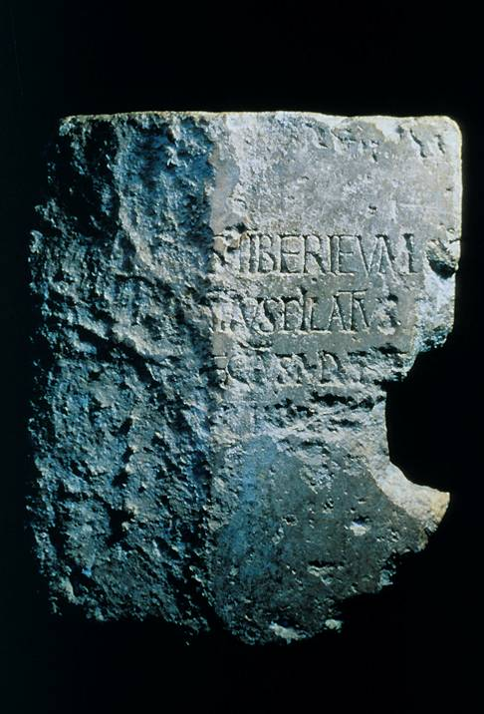
The Seal of God
In speaking of a foundation seal, Paul intends ownership, security, and authentication.
Architects often engraved foundations stones (or cornerstones) to mark dedications, ownership, and authenticity.
The 1st century engraved Pilate Stone, discovered in 1961, is one such stone with an inscription dedicating a building in Caesarea to Tiberius Caesar by his subordinate Pontius Pilate.

Slide 89
God’s Seal (2:19)
In spite of false teachers, the foundation God has established for his church remains steadfast, and it has a double seal:
First, there is the invisible seal that God alone knows: God knows who belongs to him (cf. Nu. 16:5)!
Second, there is the public seal of the righteous lives of those who follow Christ. Heretics, by contrast, abandon a clear conscience (cf. 1 Ti. 1:19-20).

Slide 90
The Metaphor Of Household Utensils (2:20-21)
Using the metaphor of household utensils, Paul explains why the visible church has within its constituency people with false ideas:
Some utensils have honorable uses and some dishonorable; similarly, the visible church is composed of people of varying qualities.
False teachers like Hymenaeus and Philetus performed a function, even if disgraceful (cf. 1 Co. 11:19).
For his part, Timothy must avoid the traps of youth passions and quarrels; rather, he must practice the virtues of righteousness, faith, love, peace, and patience.

Slide 91
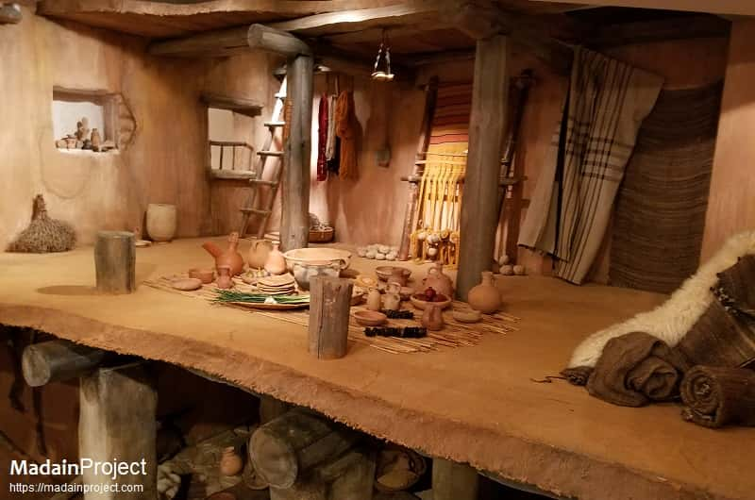
Reconstruction of an Israelite Four-Room House with various household utensils
Semitic Museum, Harvard University

Slide 92
THE COMING APOSTASY (3:1-9)
The heresy of Hymenaeus and Philetus was symptomatic of a much larger threat to the church.
The final days of the age would be marked by great distress and apostasy, an anticipation of great evil that other NT writers predicted as well (cf. 2 Pe. 3:2-3; Jude 17-19; Ac. 20:30-31; 2 Th. 2:3, 9-12; 1 Ti. 4:1; 1 Jn. 2:18-19).
Paul describes this rebellion with an extended series of biting words and phrases.

Slide 93
THE LAST DAYS
In Israel’s 8th Century prophets, the expression be'aher'it hayyamim (= at the end of days) is used to describe the blessings and judgments of Yahweh upon his people and the world in the eschatological future (cf. Ho. 3:5; Mic. 4:1ff.//Is. 2:2ff.).
This same vocabulary was employed by later prophets (Je. 23:20; 30:24; 48:47; 49:39; Eze. 38:16; Da. 10:14), and in time, the whole messianic ideal came to be connected in the Jewish mind with the “last days.”
In the NT, the last days have already been inaugurated with the coming of Jesus, the Messiah, but this was a fulfillment without a consummation.
Hence, the NT also envisions the return of Christ as the consummation, and it is to this that Paul refers.

Slide 94
JANNES AND JAMBRES
In his early rabbinic training, Paul would have become familiar with Jewish oral tradition. The names Jannes and Jambres (Grecianized forms of Johana and Mambres) refer to the Egyptian magicians who opposed Moses.
These names are not found in the Hebrew Bible or Josephus (though they do appear in “The Damascus Document” among the Qumran scrolls).
However, they are found in some later documents of Jewish tradition, and particularly, in the work called “Jannes and Jambres.”

Slide 95
PERSECUTION FOR THE GOSPEL (3:10-13)
Paul’s ministry had been attended by persecution, especially in the cities of south Galatia (Ac. 13:50-51; 14:4-7, 19-20; cf. 2 Co. 11:24-28). Nevertheless, he lived out his life with integrity.
Paul seems to suggest that persecution was inevitable, given the collision of the culture at large with Christian values and beliefs.
It was to be expected that evil teachers and charlatans would grow steadily worse.

Slide 96
FAITHFUL TO SCRIPTURE (3:14-17)
If the future was fraught with theological dangers, Timothy must remain dedicated to the faith passed down to him.
The authenticity of the Christian tradition is validated not only by its truth, but also, by the godly character of those from whom it came.
Timothy had been well-schooled in the sacred writings, which is to say the Hebrew Bible, and since he grew up Lystra, this likely means the LXX.

Slide 97
THE GOD-BREATHED SCRIPTURES
The verb theopneustos (= God-breathed) emphasizes that the Scriptures came at God’s initiative rather than through human creativity.
This need not mean dictation (though some have argued for it), for the personalities and varied writing styles of the human authors are clearly displayed in the original languages.
At the same time, this text affirms that God vouches for the integrity and truthfulness of the Scriptures, and by implication, it rejects any tendency toward Marcionism (Marcion, a theologian in the 2nd century, rejected the Hebrew Bible).

Slide 98
FAITHFUL IN MINISTRY (4:1-5)
Faithfulness to the Scriptures stands alongside faithfulness in calling and ministry.
Paul’s charge to Timothy is especially sober with its reference to the great judgment at Christ’s return.
The charge proceeds with five exhortations: to preach the Word, to discharge his duties even at a moment’s notice, to reprove, to rebuke, and to exhort, backing up his words with careful teaching.
In the stressful days ahead, sound teaching would be replaced by platitudes, novelties and counterfeits.

Slide 99
PAUL ANTICIPATES HIS DEATH (4:6-8)
Though Paul had faced death before (Ac. 14:19; Phil 1:20), this time he clearly felt the end of his life was near.
Using the metaphor of a sacrificial drink offering (Ex. 29:40; Nu. 28:7; cf. Phil. 2:17) and comparing his life to an athletic contest, Paul voiced his belief that the marathon was almost over.
The wreath of victory, to be awarded on “that day” (the day of Christ’s return), was in sight.

Slide 100

Wreath of Victory
Paul uses the imagery of the victory wreath from the Olympic games to symbolize the rewards of Christians (1 Co. 9:25; Phil. 4:1; 1 Th. 2:19-20; 2 Ti. 4:8).

Slide 101
REMARKS CONCERNING FRIENDS (4:9-13)
In his final remarks, Paul requests Timothy to come, bringing Paul’s cloak, plus the scrolls and parchments.
All except Luke had now left, some, like Demas, abandoning Paul to his fate, and others on legitimate business for the kingdom of God.
Though once Paul had bristled at working with John Mark (Ac. 15:36-41), now he wished for Mark’s company and assistance.

Slide 102
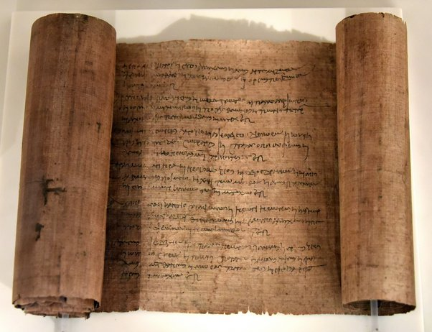
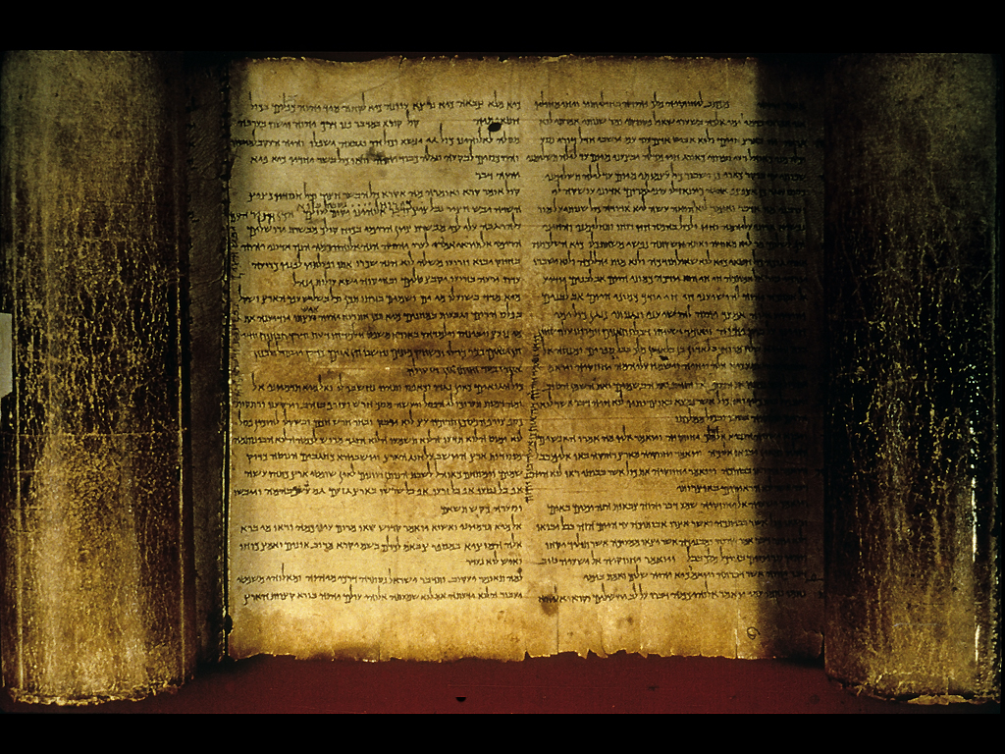
Scrolls and Parchments
While Paul does not describes these documents directly, they most likely were portions of the Hebrew Scriptures, some on papyrus scrolls and others on parchment
Papyrus scrolls, made from a sort of “paper” created from pressed papyrus reeds, was the least expensive and least durable writing surface.
Isaiah scroll on parchment made from animal skins (from the Dead Sea Scrolls)

Slide 103
REMARKS CONCERNING AN ENEMY (4:14-15)
Besides his remarks concerning friends, Paul warned Timothy about an old enemy.
Alexander was a rather popular name, so while it is possible, it is not necessary to link this reference to the Alexander at Ephesus (Ac. 19:33) or the heretic mentioned in 1 Ti. 1:20.
In any case, Paul knew this man was a danger to the Christian community, and his day of retribution would surely come!

Slide 104
THE PROGRESS OF PAUL’S TRIAL (4:16-18)
Our knowledge of the closing events of Paul’s life are unclear: was he imprisoned, released, and imprisoned again, or was he executed shortly after the end of the Book of Acts?
The language of “first defense” in 4:16a is critical. Either this refers to his first trial (after which he was released, i.e., “delivered from the lion’s mouth”), or else it refers to the preliminary investigation when he first arrived in Rome.
Scholars line up on both sides of this issue.

Slide 105
THE WITNESS OF THE POST-APOSTOLIC CHURCH
1 Clement to Corinth 5:6 (ca. AD 96)
‘After he had been seven times in chains, had been driven into exile, had been stoned, and had preached in the east and in the west… having taught righteousness to the whole world and having reached the farthest limits of the west.’
Eusebius (ca. early 4th Century)
‘After defending himself the Apostle [Paul] was again set on the ministry of preaching…coming a second time to the same city [he] suffered martyrdom under Nero. During this imprisonment he wrote the second Epistle to Timothy’ (Eccl. Hist. 2.22.2).
…in his [Nero’s] time Paul was beheaded in Rome itself… (Eccl. Hist. 2.25.5).

Slide 106
Caesar Nero ruled Rome (AD 54-68), and according to 1st and 5th century church tradition, he released Paul after his first imprisonment, after which Paul went to Spain.
Later, Paul is said to have been arrested a second time, and this time Nero had him executed by beheading.
Some contemporary scholars doubt this scenario, because it is presumed to be built out of data in the pastoral letters, which they deny to Paul.

Slide 107
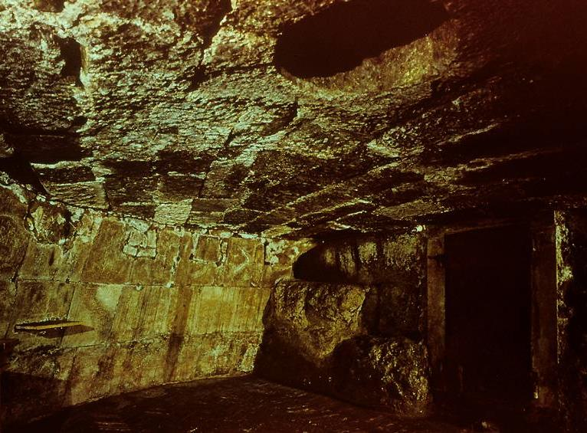
The Mamertine Prison, the state dungeon in Rome, where Paul was believed to be incarcerated after his second arrest and until his second hearing before Nero.

Slide 108

Erected above the traditional site of Paul’s tomb, Church of St. Paul Outside the Walls, Rome.

Slide 109
FINAL REMARKS (4:19-22)
Paul’s final words are greetings to friends.
Among them were Prisca and Aquila, the household of Onesiphorus, Erastus at Corinth, and Trophimus at Miletus.
Arriving before winter was important on two counts: the shipping season on the Adriatic would be halted due to winter storms, and if Timothy could bring Paul’s coat, it would helpful to have it before the temperature turned colder.
Paul closes with mutual greetings from friends in Rome, one of which was Linus, a leader that in early Christian tradition became the first bishop of Rome (ca. 2nd Century, Irenaeus, Against Heresies 3.3.3).

Slide 110
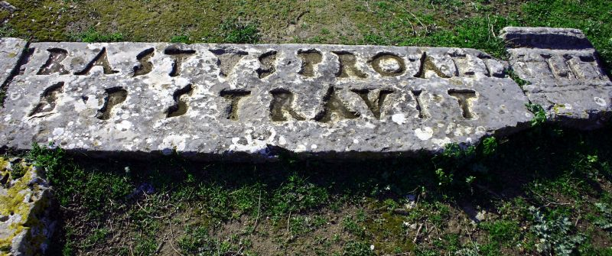
One of Paul’s converts in Corinth was Erastus, the Aedile of the city (= administrator of financial matters concerning streets, markets, games and public buildings). This pavement in his honor, discovered in the archaeological excavations of ancient Corinth, was laid in about AD 50, perhaps before Paul arrived (cf. Ro. 16:13). It reads, “Erastus, in return for his aedileship laid [the pavement] at his own expense.”

