Slide 1

THE CHRISTIAN CHURCH 3
Its peoples, theologies, and practices
A Short History
PART 1: From the Apostles to the Renaissance

Slide 2
The LATER HERESIES The later heresies primarily concerned two issues, what does it mean to be human, and what does it mean that Christ was both human and divine?
Pelagianism
Pelagianism emphasized the inherent goodness and autonomy of humans.
Adam’s fall did not taint the human race, and all humans are born morally neutral.
God would not have given commandments in the first place if he thought humans were incapable of keeping them.
As such, humans, by their divinely given free will, are capable of achieving moral perfection.
Christology
If Christ is both fully human and fully divine, how does this union work?
Did Christ have a single will or a single nature, or did he have two wills and two natures?
Were the divine and human natures in Christ independent of each other?
The Alexandrines were concerned that Christ not be divided into two beings.
The Antiochenes were concerned that in affirming the humanity of Christ, his deity was not diminished.

Slide 3
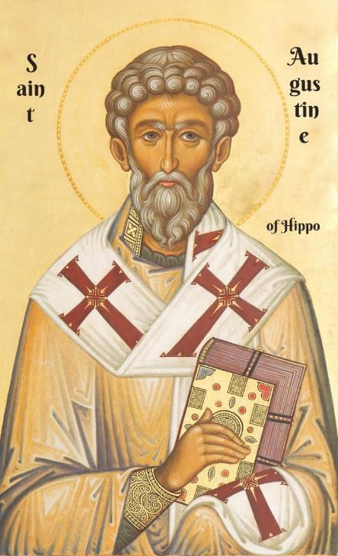
Pelagius and augustine
Born in the British Isles, Pelagius arrived in Rome sometime in about the late 300s.
In Rome, he discovered that a good many Christians were not really living changed lives, so he sought moral change.
In this context, he preached the possibility and urgency of sinlessness and that all humans were born with the sinlessness of the original Adam. (After all, Christ had said, “Be perfect” [Mt. 5:48], so this must mean that it was possible.) Humans could respond to the gospel by their own wills alone.
Children by this time were usually baptized shortly after birth, but if they were sinless, why be baptized at all?
Many people began to appeal to Augustine to look into this new theology.

Slide 4
Augustine’s response
If a major concern in Christian baptism was the forgiveness of sins (i.e., Ac. 2:38; 22:16, etc.), in what sense was an infant sinful?
The long-standing theology of the church was that ALL humans were sinful (Ro. 3:23).
Augustine cited St. Paul’s writings that all humans were sinful “in Adam,” and therefore, they all experience death (Ro. 5:12, 18-19; 1 Co. 15:22).
This meant that infants are sinful at birth, not because they had personally committed sin, but because they were tainted with “original sin,” i.e., the sin of Adam.
If an infant dies unbaptized, the guilt of original sin remains. Therefore, Christian parents should have their infants baptized as soon as possible.

Slide 5
Augustine’s four points
The concept of original sin logically implied other derivative theological conclusions.
TOTAL DEPRAVITY
Every facet of human life is disordered, body, mind, emotion, and will.
Far from being born morally neutral, humans are born morally compromised.
Their passions, especially sex, demonstrates their disordered state.
IRRESISTABLE GRACE
The only way humans can respond positively to the gospel is by a divine act that overpowers human depravity.
This divine act enables a person to see the truth and choose the good.
Everything comes by the grace of God, including faith itself.
PREDESTINATION
God chooses to give his grace to some but not to others.
Had Adam not fallen, there would have been only the proper number of humans born to replace the fallen angels.
Due to Adam’s fall, there are excess humans; the number of the elect is very limited.
PERSEVERANCE
If divine grace causes humans to believe, then grace will also enable them to sustain their faith.
Though they might sin on occasion though weakness, such grace-empowered-faith will ultimately be victorious over all doubt and difficulty.

Slide 6
The aftermath
Augustine’s theology, while it clearly rejected Pelagianism, which the church likewise condemned, left a number of unresolved questions with which the church continued to struggle.
The Bible indicated that God wants all people to be saved, but if so, why did he not give irresistible grace to everyone?
Augustine’s conclusion that a fixed number of persons were destined to be saved cut the nerve of missionary effort.
Could anyone have assurance that he/she was numbered among the elect? Belonging to the visible church was no guarantee, and no one knew who belonged to the invisible church.
Many who first read Augustine’s refutation of Pelagianism felt that he had uncut the nature of the Christian life. Monks in France who disagreed with him were dubbed “semi-Pelagians.”

Slide 7
Augustine’s Three Enduring Conclusions
TOWARD DONATISM
The church is a hospital for sinners, not a haven for saints.
TOWARD PELAGIANISM
God is sovereign, and grace is central.
TOWARD THE FALL OF ROME
Earthly cities rise and fall, but the City of God will endure forever.

Slide 8
Augustine’s Long-Range Influence
THE STATE RESPONSE
The state can legitimately use force in a “just war.”
However, war is a last resort, and it still is required that one must love one’s enemies.
In dividing the church, the Donatists had disturbed the internal peace of the empire in North Africa, so it was appropriate for Constantine to interfere.
OFFICIAL ACTIONS
Does the validity of a church action (i.e., ordination, baptism, Eucharist, etc.) depend upon the holiness of the person performing it?
Since the true celebrant is Christ Jesus, not the clergy, official church actions are valid regardless of whether the human minister is without flaw.
CONCERNING REBAPTISM
When those baptized by the Donatists wanted to reenter the larger church, did they need rebaptism?
There is both a visible and an invisible church, but only God can discern who belongs to the invisible church.
Rebaptism is not necessary, regardless of the theological purity of the one conducting the baptism.

Slide 9
Quotable quotes by st. augustine
"If you believe what you like in the gospels, and reject what you don't like, it is not the gospel you believe, but yourself."
"Faith is to believe what you do not see; the reward of this faith is to see what you believe."
"Hope has two beautiful daughters; their names are Anger and Courage. Anger at the way things are, and Courage to see that they do not remain as they are."
"If God seems slow in responding, it is because He is preparing a better gift. He will not deny us. God withholds what you are not yet ready for. He wants you to have a lively desire for His greatest gifts. All of which is to say, pray always and do not lose heart."
"A Christian is: a mind through which Christ thinks, a heart through which Christ loves, a voice through which Christ speaks, and a hand through which Christ helps."
"To fall in love with God is the greatest romance; to seek him the greatest adventure; to find him, the greatest human achievement."
"There is no saint without a past, no sinner without a future."
"Because God has made us for Himself, our hearts are restless until they rest in Him."
"Learn to dance, so when you get to heaven the angels know what to do with you."

Slide 10
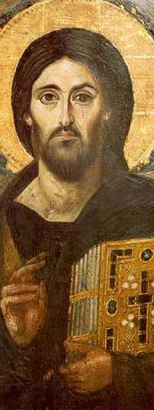
Christological controversies
In the late 4th and early 5th centuries shortly after Augustine’s death, the church became embroiled in a dispute over the nature of Christ.
The church agreed that Christ was truly human and truly divine.
It also was convinced that Christ was only one being, not two.
ANTIOCH
The humanity of Christ must be safe-guarded, else his divinity will swallow up his humanity.
Disjunctive Christologies tend to disjoin Christ’s divinity and humanity.
ALEXANDRIA
Christ is only one person, and he cannot be divided into two beings, one divine and the other human.
Unitive Christologies insist on the unity of the human and divine.
Christ Pantokrator, 6th century, St. Catherine’s Monastery, Sinai
New York Metropolitan Museum of Art

Slide 11
Attempted solutions
Apollinaris
The eternal Word took the place of the rational soul (or mind).
Jesus had a human body like any other human body.
However, instead of a human mind, he had the Word, the eternal Son.
The problem is that the seat of sin is the human mind, and if Christ did not have a human mind, then he could not redeem the human mind.
Nestorius
Mary should be called the “Mother of Christ,” not the “Mother of God.”
The issue was not about Mary herself, but rather, about Jesus.
In Christ there were two natures and two persons, one human and one divine.
The problem is that there is not a true union between the two, and as such, no incarnation.
Eutyches
Christ was one person and one nature.
His divinity eclipsed his humanity.
Some suggest he even held that the body of Jesus was of a heavenly substance, hence, not quite human at all.
Monophysitism is the belief that there is only one nature, the divine nature, in Christ.
The problem is that the humanity of Christ disappears.

Slide 12
Council of chalcedon
“We all teach harmoniously [that Christ is] the same perfect in godhead, the same perfect in manhood, truly God and truly man, the same of a reasonable soul and body; homoousios (= one substance) with the Father in godhead, and the same homoousios with us in manhood ... acknowledged in two natures without confusion, without change, without division, without separation.”
In AD 451, the 4th Ecumenical Council, attended by 520 bishops, convened in Chalcedon, Bithynia near Constantinople to address the issue of the nature of Christ.
Here, they produced a definition of faith, seeking to find a middle ground between the Antioch and Alexandria extremes.
In sum, they affirmed that Christ had two natures, human and divine, but in a single person.
They rejected the Antiochene theory of two persons in Christ.
They rejected the Alexandrine theory of one nature in Christ.

Slide 13
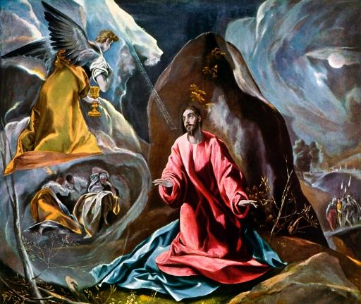
one will or two?
In the 7th century, a further debate erupted when some proposed that Christ had two natures but only one will (Monothelitism).
His human will was fused with the divine will.
The problem with this theology is that it conflicts with Jesus’ own words in Gethsemane, when he prayed, “Not my will, but yours be done.”
Monothelitism was condemned in the 6th Ecumenical Council.
The Agony in the Garden, by El Greco (ca. 1590)
Toledo Museum of Art Toledo, Ohio

Slide 14
EARLY DEVELOPMENT OF HIERARCHY
By the early 2nd century, the concept of a single bishop or overseer had become the norm.
The titles overseer/bishop (e]pi<skopoj), elder/presbyter (presbu<teroj), and pastor-shepherd (poimh<n) seem to be more-or-less interchangeable in the NT.
In Ignatius’ letters, however, the bishop is elevated (ca. AD 115): When Ignatius composed his seven letters in the early 2nd century, he urged the congregations to “follow the bishop…as you would the apostles” and “reverence the deacons.”
He distinguishes between bishops, presbyters, and deacons.
For Ignatius, the monarchical bishop in each city is the bulwark against false teaching.

Slide 15
METROPOLITAN BISHOPS
As Christianity expanded, larger concentrations of Christians emerged in urban centers. The bishops in these cities came to be recognized as having primacy in their province.
The early cities included Rome, Constantinople, Alexandria, Carthage, Antioch, and Jerusalem (3rd century)
The Council of Nicaea in AD 325 codified this as canon law.
These provincial areas were called “sees” (from the Latin “sedes” meaning “seat,” or the seat of the bishop and his area).

Slide 16
FIRST AMONG EQUALS
The Latin term primus inter pares (= first among equals) was an honorary title for one who is formally equal to the others but is accorded unofficial respect (similar to seniority).
By the 5th century, the church had organized five patriarchates, with apostles named as the traditional founders:
Rome (founded by Peter and Paul)
Constantinople (founded by Andrew)
Alexandria (founded by Mark)
Antioch (founded by Peter)
Jerusalem (founded by James)
It was agreed that the bishop of Rome was the first among equals.

Slide 17
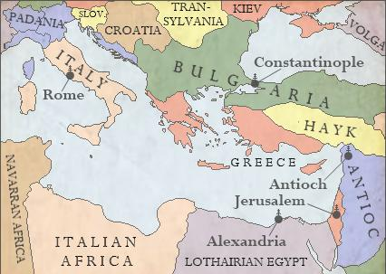
The five early Christian patriarchates
Rome
Constantinople
Alexandria
Antioch
Jerusalem

Slide 18
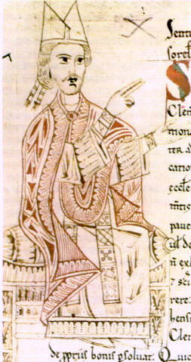
THE SUPREME PONTIFF
In AD 382, the bishop in Rome took the title Pontifex Maximus (i.e., supreme pontiff).
The Latin title papa or “pope” (an affectionate word for father) was used since the early 3rd century to refer to the Metropolitan Bishops.
By the end of the 4th century, this title began to be used as more than an affectionate veneration and began to express greater authority of the Bishop of Rome over the church.
By the 11th century, Pope Gregory VII (in office 1073-1085) prescribed that this title “pope” should be limited to the Bishop of Rome.
Gregory VII from an 11th century manuscript

Slide 19
Early Christian art
Early Christian art began with the enhancement of Scriptural texts and eventually expanded to include a wide range of expressions:
Manuscript Illumination (staurograms, nomina sacra, christograms)
Symbols (cross, alphabetic symbols, fish, lamps, graffiti)
Gestures (sign of the cross, bowing)
Coins (minted after Christianity became legal in the 4th century)
Frescoes (paintings of biblical scenes in wet plaster)
Mosaics (often on the floors of churches)
Sculpture (depicting various biblical persons and themes)

Slide 20

Staurograms
The earliest depictions of the cross occur in New Testament texts in which the letters tau (t) and rho (r) from the Greek words “cross” (stauroj) and “crucify” (staurow) appear superimposed on each other, looking something like this:
Beginning in NT texts from about AD 200, staurograms are the earliest visual depictions of Christ crucified.

Slide 21
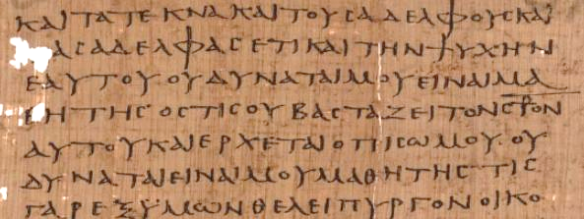
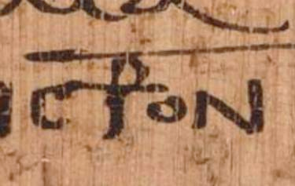
Early text of Luke 14:27 p75 Bodmer Papyri XIV (ca. AD 200-225)
Vatican Library, Rome

Slide 22
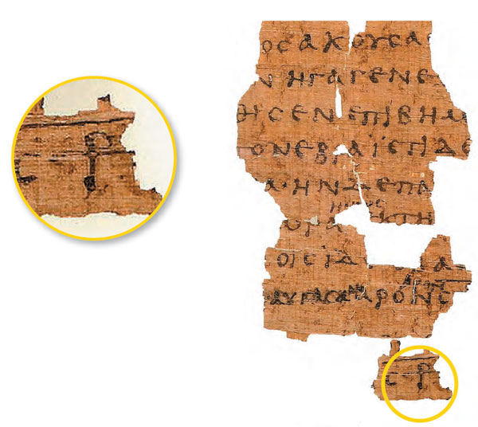
Early Text of John 19:13ff. p66 Bodmer Papyri II (ca. AD 200) Staurograms appears in John 19:6, 15, 16, 18, 19, 25, 31. The superimposed letters look like a human figure hanging on a cross.

Slide 23

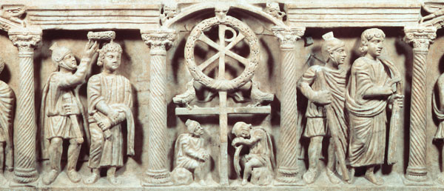
Christograms
Other early similar literary combinations include the chi-rho, looking something like this:
Ca. AD 340
These are the first two letters in the Greek name “Christ” superimposed over each other.

Slide 24
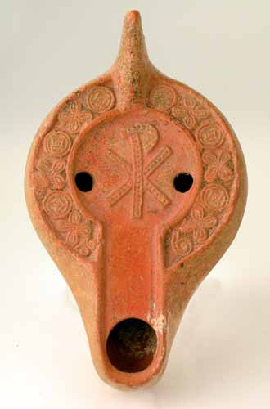
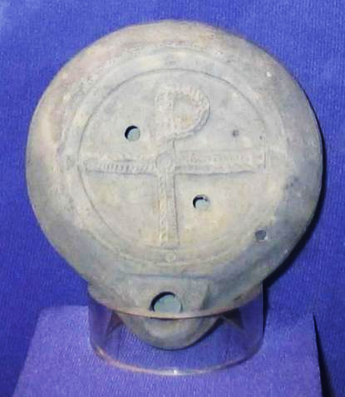
Lamps with Christian Reliefs
Christian oil lamp from the late Roman Period with Chi-Rho
Recovered from Caesarea Maritima, 4th century with Tau-Rho

Slide 25
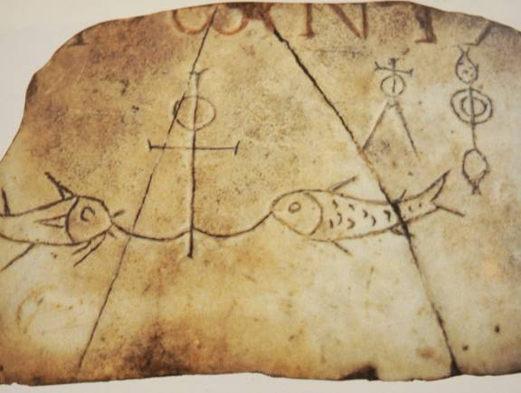
THREE SYMBOLS
ANCHOR
Symbol of hope and steadfastness
CROSS
Symbol of the sacrifice of Jesus
i]xquj (= fish acronym)
i]hsouj = Jesus
xristoj = Christ
qeoj = God
u[ioj = Son
swthr = Savior

Slide 26
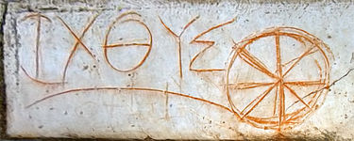
Early circular fish symbol created from Greek Letters IXQUS/ICHTHUS discovered at Ephesus

Slide 27
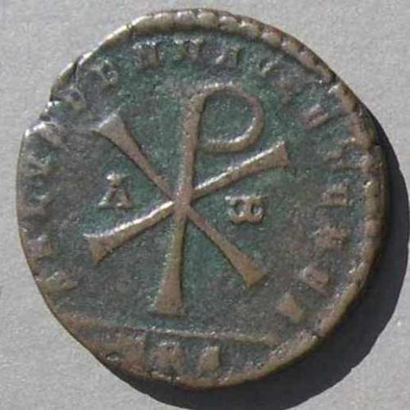
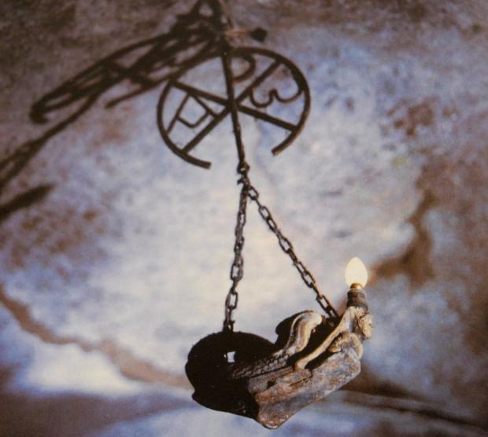
Early Christian chi-rho Symbols with alpha and Omega
After the legalization of Christianity, the earliest Christian coinage featured the chi-rho symbol, like this one minted in AD 350-353.

Slide 28
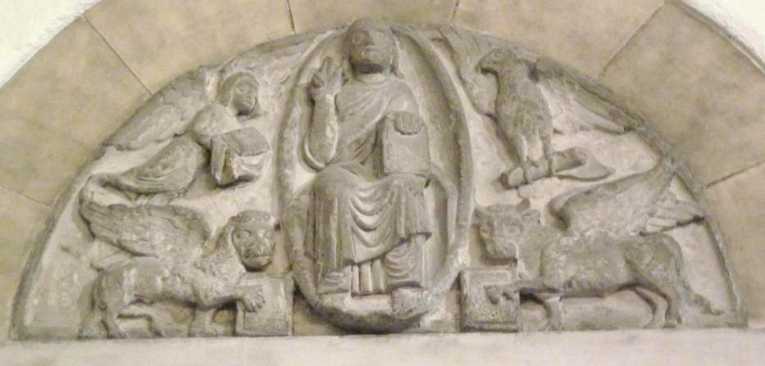
Detroit Institute of Arts
ANCIENT CHRISTIAN SYMBOLS OF THE FOUR GOSPELS Early Christians, beginning at least as far back as St. Jerome, began to associate the four creatures in Ezekiel and Revelation as representing the four canonical gospels, with the winged human symbolizing Matthew, the winged lion symbolizing Mark, the winged ox symbolizing Luke and the eagle symbolizing John. The majestic figure of Christ, enthroned as the ruler of the world, is usually depicted along with these four witnesses to his incarnation, kingship, sacrifice, and heavenly character. These symbols were common motifs in church portals, apses, and other locations.

Slide 29
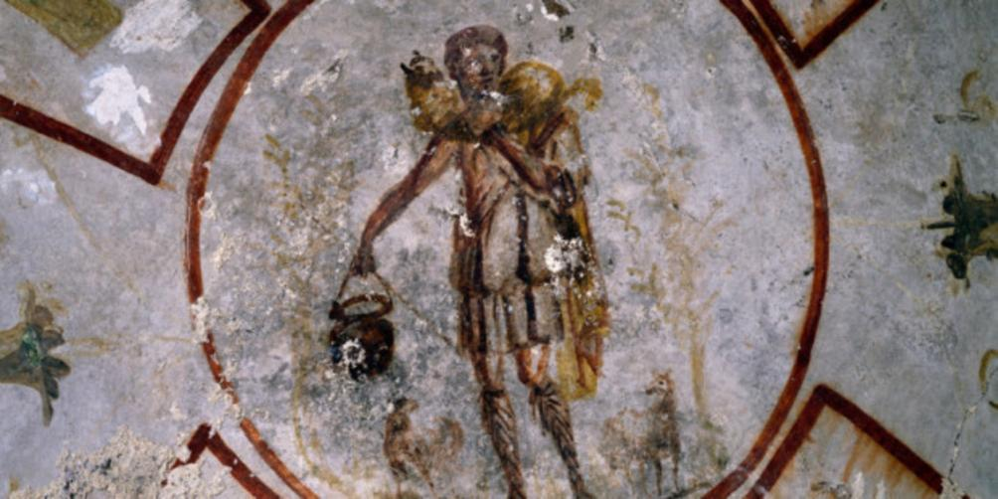
Christ, the Good Shepherd, carries a lamb on his shoulders. Painted frescoe on the walls of the St. Callisto catacomb in Rome (mid-3rd century).

Slide 30
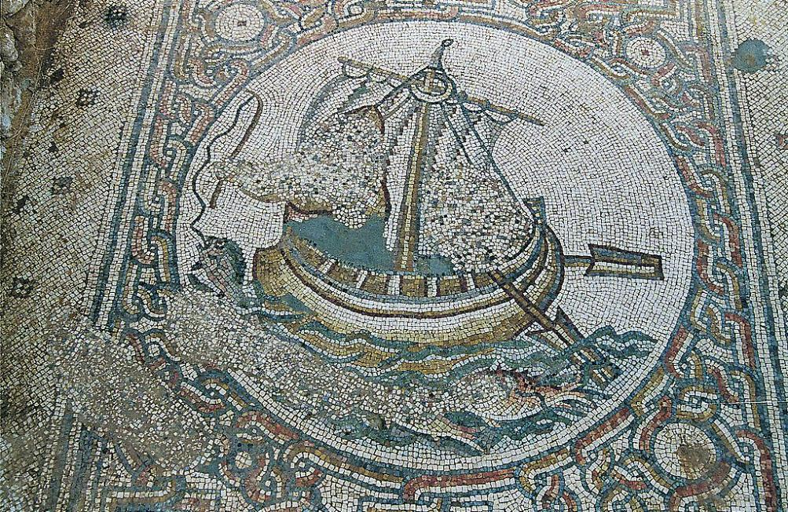
Floor mosaic in the 6th century church at Horvat Beit Loya in central Israel. Although the figures have been defaced (by Muslim edict), they probably depicted Jesus and his disciples.

Slide 31
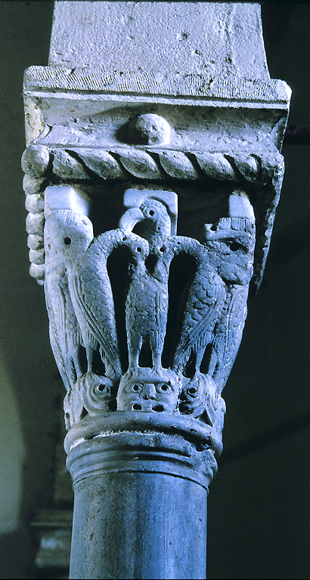
Carved pelicans with folded wings circle this column capital from the Upper Room in Jerusalem. On each of the four sides, a central pelican allows two of its young to feed on its own blood. This theme echoes an ancient belief, recorded in Pliny the Elder’s first-century AD Natural History, that parent pelicans would feed their young with their own blood in time of need, even to the point of sacrificing their own lives. In Christian tradition this legend became a symbol for Christ’s sacrifice of his life on the cross, the giving of his blood in the Eucharist (the sacrament of Communion). The pelican was an appropriate symbol for decoration of the traditional Upper Room, where Jesus is recorded to have instituted the Eucharist the night before his death, saying of the cup he shared with his disciples, “This is my blood of the covenant, which is poured out for many” (Mark 14:24).

Slide 32
Sign of the Cross
The gesture known as “crossing” oneself dates back to early Christianity.
In the Apostolic Tradition, a 3rd century treatise about Christian life and liturgy, it advises using the ritual at baptism and fixed times of prayer.
Tertullian wrote (ca. 200), “We Christians wear out our foreheads with the sign of the cross.”
The actual motion is disputed. In the western church, the crossing element is from left to right, while in the eastern church it is right to left.)

Slide 33
Early Christian architecture
Prior to the Edit of Milan, when Christianity still was an illegal religion, most Christians, with few exceptions, assembled in house churches out of the necessity to assemble undetected.
When Christians no longer were under threat of persecution for practicing their faith, they began constructing formal meeting places.
Early on, some early Christians seem to have adopted a synagogue style of structure.
In time, they developed architectural patterns that were suitable for Christian worship, including a platform for readers and speakers, an altar for the Eucharist, and a baptistery.
Congregants stood for the service.

Slide 34
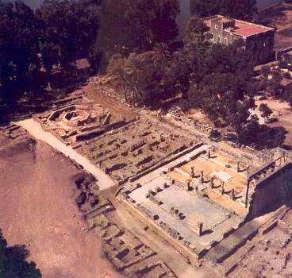
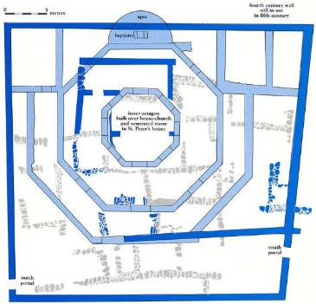
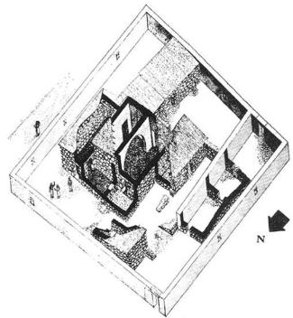
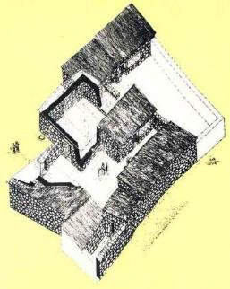
A
B
Three superimposed structures, a 5th century octagonal church (A), a 4th century dwelling repurposed into a chapel (B), and a 1st century house (C), may mark the home of Simon Peter in Capernaum. Italian archaeologists are convinced the earliest structure is Peter’s home, and the circumstantial evidence is supportive with Christian graffiti in Greek, Syriac, Aramaic, Hebrew, and Latin, saying things like, “Lord Jesus Christ help your servant,” “Christ have mercy,” and symbols of the cross.
C

Slide 35
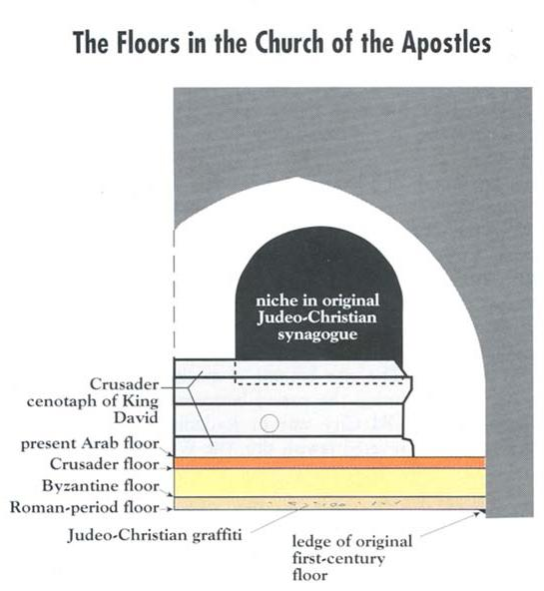
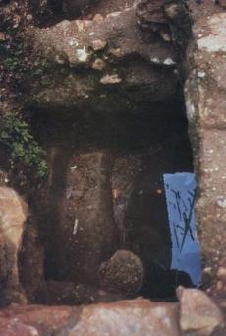
In layers beneath a current structure in Jerusalem, archaeologists have discovered what seems to have been a 1st century Jewish-Christian synagogue. According to Eusebius, not long after the fall of Jerusalem, Christians returned from Pella to Jerusalem to construct a church. A coin dating to AD 67 was discovered under a deep layer of destruction debris. That this structure was a Judeo-Christian synagogue is evidenced by the Christian graffiti, such as, “O Jesus, that I may live.” A ritual bath (mikveh) suitable for baptisms was also discovered.

Slide 36
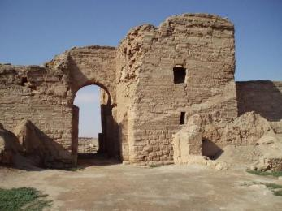
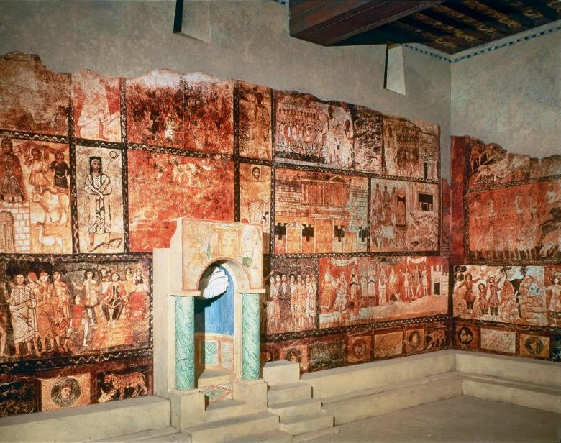
One of the earliest Christian church structures was discovered at Duro-Europas, Syria, dating to the mid-200s AD.
It was apparently a home that was converted to a church.
It featured a baptistery with frescoes, possibly the oldest examples of Christian paintings.
The archaeological site was presumably destroyed by ISIL during the Syrian Civil War, but fortunately, photographs and some artifacts remain as well as the baptistery frescoes, now housed at Yale University.

Slide 37
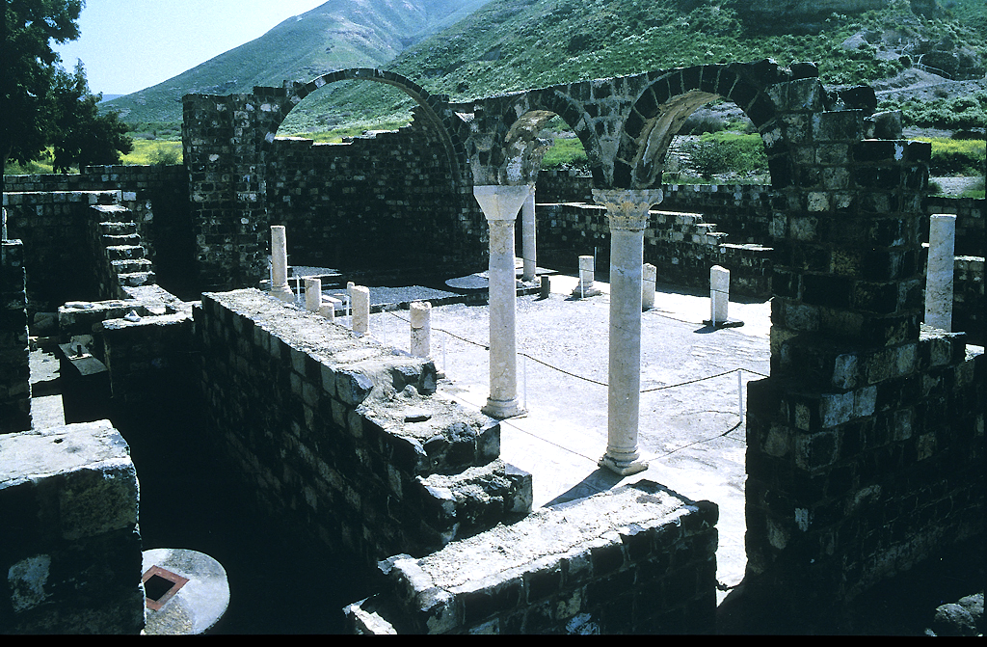
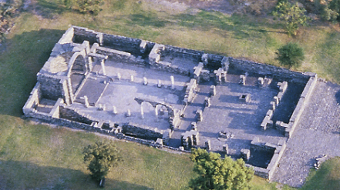
This style of Christian architecture followed the pattern of the standard Roman public building, called a “basilica.” It featured a double colonnade, which divided the floor space into three sections, a large center nave with two narrower side aisles. This church at Kursi (the site of the swine miracle) is typical, built in the late 5th century.

Slide 38
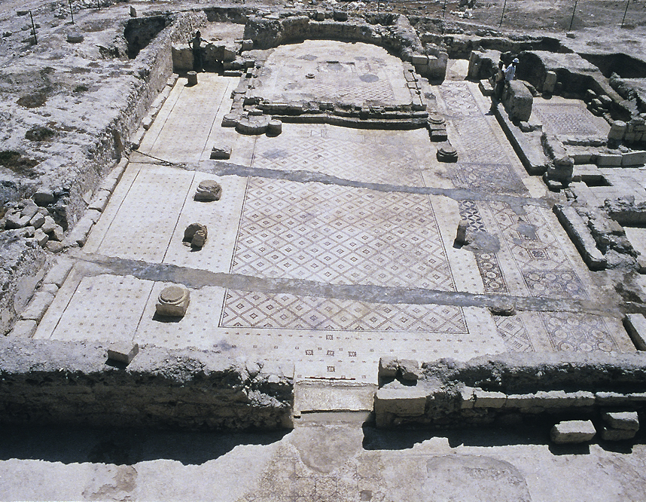
Discovered accidentally in 1986, this basilica church (ca. late 5th century) in the Jordan Valley north of Jericho features the stereotypical basilica style. Here, all the floor surfaces are covered with geometric mosaics. The platform area is raised and reached by three steps.
In the upper left, the cylindrical base was used for the pulpit.
A bowl for baptismal water was also found.

Slide 39
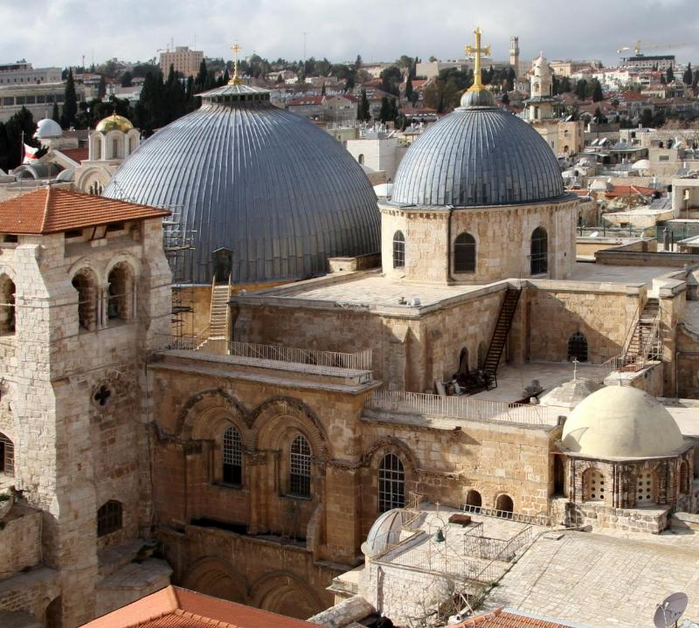
The Church of the Holy Sepulcher in Jerusalem marks the traditional site where Jesus was crucified and buried.
Built at the order of Constantine and dedicated in AD 336, it is considered by many to be the holiest site in Christendom.
After various destructive episodes, it has been reconstructed several times over the centuries.
Today, it is the seat of the Greek Orthodox Patriarchate of Jerusalem, but control of the church has been shared by several denominations over the past century and a half.

Slide 40
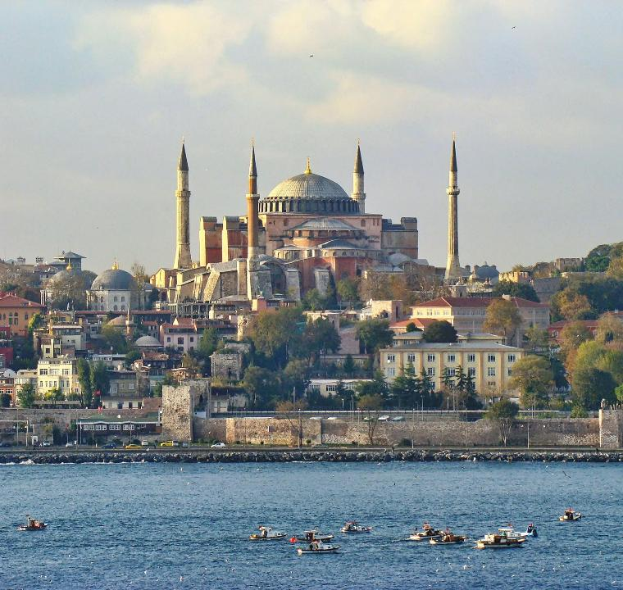
The Hagia Sophia (Holy Wisdom) church in Constantinople (now Istanbul) ranks as one of the most elaborate ancient churches.
First built in AD 360, then rebuilt after two burnings (AD 415 and 537), it still stands overlooking the Bosporus.
Straddling two continents, Europe and Asia, it served Christians for many centuries, though most recently Muslims have converted it to a mosque.

Slide 41
Continuing development of Christian worship
As the decades and centuries rolled by, it is not surprising that there were developments in the forms of Christian worship.
Moving from the Apostolic Period through the Ante-Nicene Period and on into the Post-Nicene Period, several things are observable:
Public reading of Scripture remained a central feature.
The Eucharist continued to be the climax of Sunday worship.
Immersion baptisms were gradually replaced by pouring baptisms, and most baptisms were now for infants rather than adults.
The worships services through the year came to be organized around two central Christ events: his resurrection and his birth.
The weekly service consisted of two parts, the service of the Word and the service of the Eucharist.
Standard prayers, benedictions, and confessions of faith became the norm.
Music followed the pattern of the synagogues, that is, singing without instruments.
Christians often assembled each day for morning prayer (lauds) and evening prayer (vespers).

Slide 42
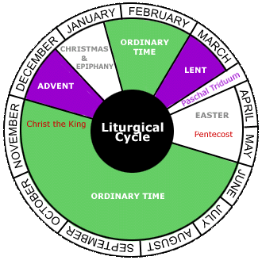
The Christian year
Similar to the Jewish Year, Christians organized their year around prominent Christ events.
Churches observed Easter (the Lord’s Passover) on the Sunday after the Jewish Passover had ended, and the 50 days between Easter and Pentecost were marked. Hence, Easter and Pentecost have movable dates.
By the 4th century, a preparation period prior to Easter (Lent) was observed as a period of penitence and discipline (usually by fasting).
Later in the 4th century, Advent (four weeks prior to Christmas), Christmas (Dec. 25), and Epiphany (Jan. 6) were fixed to complete the annual cycle.

Slide 43
The Sunday service
The classical period in the development of Christian worship occurred in the 4th-6th centuries.
The time of assembly was cockcrow.
In continuity with the past, the Sunday worship service fell into two parts, the Service of the Word (with the public reading of Scripture in Greek followed by translation and then the sermon) and the Service of Communion (with penitential prayers, consecration of the elements, and the celebration of the Eucharist).
The Creed was recited in unison.
Hymns as well as antiphons were sung with accompanying prayers. Vocal music was preferred over instrumental music (and the church fathers showed a decided negativity toward musical instruments, since they were typical of the pagan theater).
The liturgy contained fixed elements, such as, the sursum corda, “Lift up your hearts (leader)” followed by “We lift them up to the Lord” (people), the trisagion or sancta, “Holy, holy, holy, God of power and might, heaven and earth are full of your glory,” and the Gloria Patri, “glory to the Father and to the Son and to the Holy Spirit.” By the 6th century, the Agnes Dei was also a fixed element, “Lamb of God, who takes away the sins of the world, have mercy upon us.”
Plainsong, which is to say, music without strict meter and no accompaniment, was the dominant form.
Based upon the writings of Egeria (AD 380s) and other ancient sources

Slide 44
Development of Roman Christianity
Provincial seats in the government became episcopal seats in the church.
By the 4th century, the church in Rome began to speak of its “primacy” because it claimed to have been founded by Peter and Paul.
Leo, Bishop of Rome (AD 440-461), appropriated the title pontifex maximus (= high priest), the title once used by Roman Emperors as the head of the state religion.
Only Celtic Christianity, now forced into Wales, could claim clear continuity in the West back to the days of the Roman Empire.
Gregory I (consecrated as Bishop of Rome in AD 590) claimed universal jurisdiction over Christianity (and thereby contended with the Patriarch of Constantinople’s claim as the Ecumenical Patriarch).

Slide 45
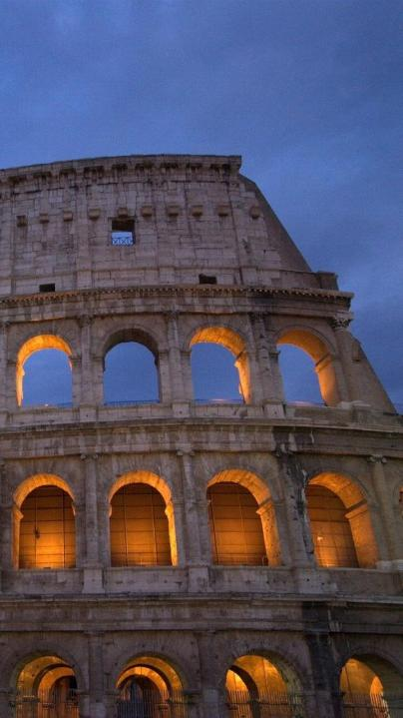
TRANSITION OF ROME
The decline and fall of the western Roman Empire was a complicated process over time involving economic instability, military defeats, disease, internal corruption, and external barbarian invasions. It culminated in AD 476 with the sacking of Rome by the Germanic Odoacer.
The fall of the eastern Roman Empire would not occur until 1453 when it fell to the Ottoman Turks.
Rome’s central political control was lost, and the empire was unable to enforce its rule.
Its vast Mediterranean territories were divided among several successors.
While scholars still debate the fundamental causes of this fall, it clearly involved the Christian church, which by now had become the official religion of the empire.
Western Rome was now preserved and replaced by something new: western Christendom, a synthesis of Roman, Christian, and Germanic culture (primarily the Franks, beginning with Clovis).

Slide 46
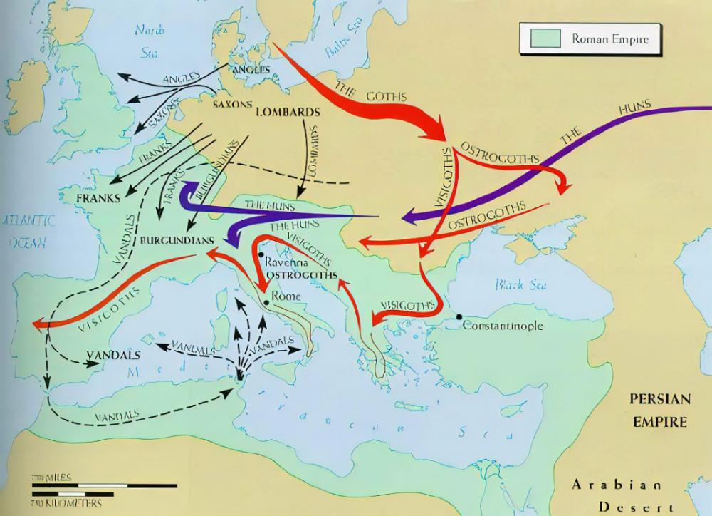
The various invasions of the empire by barbarians from the outside.

Slide 47
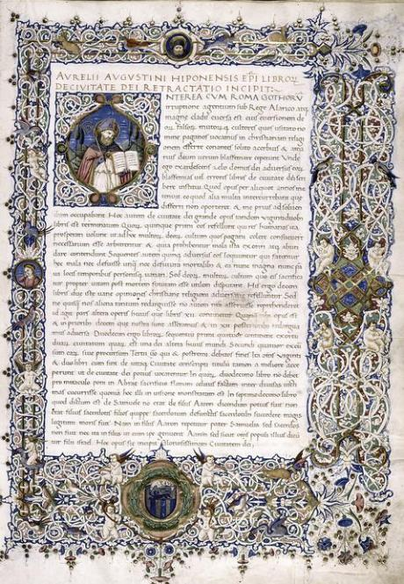
THE CITY OF GOD
In the midst of the turmoil of Rome’s decline, Augustine wrote his epic work The City of God, published in AD 426.
His work was written in defense of Christianity, due to allegations that Christianity was at fault for Rome’s fall.
He argued that even if the earthly rule of the empire was imperiled, the focus of the Christian church was heavenly, not earthly, spiritual rather than political.
The City of Man is not the City of God, and it will be the City of God that will ultimately triumph!
This work would become a cornerstone of Western thought with ramifications reaching all the way to Vatican II.
City of God manuscript, ca. 1470

Slide 48

THE MEDIEVAL CHURCH
A Millennium of Development, Diversity, and Discord

Slide 49
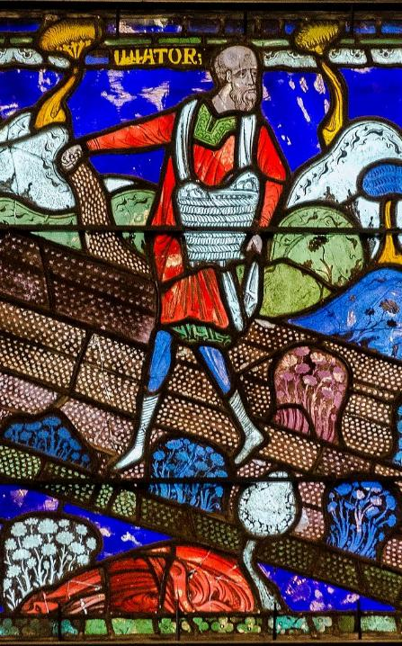
THE MEDIEVAL PERIOD
The Medieval Period, called the Middle Ages, lasted about a millennium from the 5th through the 15th centuries.
It lies between the periods of classical antiquity (8th century BC and 5th century AD) and the modern period (15th century and later).
The Medieval Period is usually divided into:
Early Middle Ages (5th-10th centuries)
High Middle Ages (11th-14th centuries)
Late Middle Ages (14th-15th centuries)
Medieval stain glass panel from Canterbury Cathedral, ca. 1175-1180 depicting the Parable of the Sower
Christ, the Good Shepherd, St. Callisto Catacomb, Rome

Slide 50
Asceticism
The Edict of Milan in AD 313 (which legalized Christianity) largely brought an end to the highest level of spirituality defined by martyrdom.
Asceticism, drawing from the ethos of martyrdom, became a sort of “living” martyrdom—a renunciation of the material world.
Deprivation of food (fasting), marriage, possessions, and social life were urged as the highest level of spiritual commitment.
Such earthly pleasures were replaced by a life of reading and meditation, memorizing scripture, prayer, and good works.

Slide 51
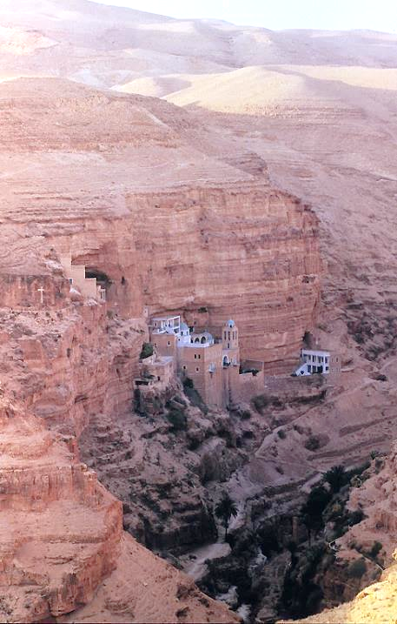
St. George’s monastery, located between Jerusalem and Jericho along the Wadi Qelt, was one of more than 60 monasteries built in the Judean desert east of Jerusalem (4th – 7th centuries).

Slide 52
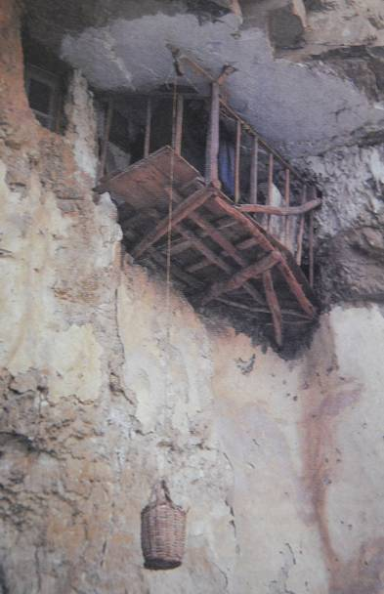
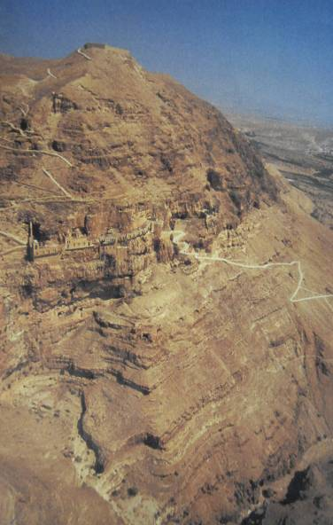
Believed to be the site of Jesus’ temptations, the monastery of Douka was established in AD 340.
Isolated monks would pull up food and necessary items in a basket

Slide 53
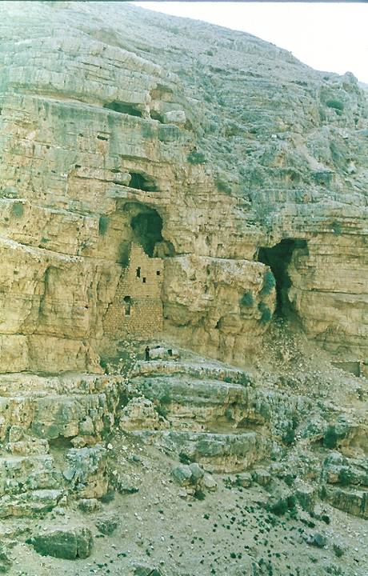
Mar Saba hermitage, where St. Johannes Hesychastes lived from AD 491-559. The hermitage consisted of a one-room cell 13 feet long and less than 9 feet wide. The cell was reached by a path cut along the natural ledge of the cliff face. The roof of the cell, reached by a ladder, was where St. Johannes went to pray at the seven times of the daily office.

Slide 54
Asceticism raises the question of how forms of deprivation affect spiritual life.
FOCUS QUESTION: Do disciplines like fasting enhance spirituality, and if so, how?
Fasting in the Old Testament was associated with personal piety, public devotion, grief over disaster, mourning, and repentance.
John the Baptist required his disciples to fast but Jesus did not, though he seems to imply that after the ascension they would (Mt. 9:14-17; Mk. 2:18-22; Lk. 5:33-39).
Later NT manuscripts (followed by the KJV) sometimes coupled fasting with prayer (e.g., Mt. 17:21; Mk. 9:29; 1 Co. 7:5), but these references are absent in the earliest manuscripts.

Slide 55
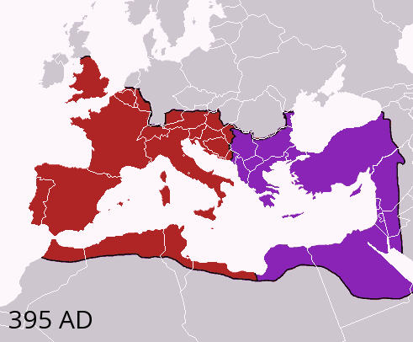
In AD 330, Constantine had moved the capital of the empire from Rome to “New Rome” (Constantinople/ Byzantium). Western Christianity became increasingly centralized under the Roman Bishop. Eastern Christianity developed autonomously.
Constantinople
Rome

Slide 56
THE ELEVATION OF THE POPE
Although much about the early bishops in Rome is historically ambiguous, scholars agree:
The Bishops in Rome were generally selected through election by the clergy and local people with emperors presiding over the elections.
In the early Middle Ages, it is doubtful that most Christians assumed that the Pope in Rome was the spiritual head of the entire Christian Church, regardless of his claims, but gradually, popes like Gregory I and those following slowly increased their authority in the West.
The eventual claim of the Roman Bishop as the leader of the whole Christian Church began to drive a wedge between the western and eastern churches, since the Byzantine emperors claimed authority over both church and state.

Slide 57
Eastern Orthodoxy
Between the 3rd and 8th centuries, the Eastern Church continued to develop under the organization of the patriarchates. Called autocephalous churches (self-governing), each was headed by a patriarch.
Original Five Patriarchies
Rome
Constantinople
Alexandria
Antioch
Jerusalem
Four of the original five jurisdictions (called episcopal sees) were in the East.
The first seven ecumenical councils were all held in the East.
Orthodox missionaries spread Christianity to the Bulgarians, Serbs, Russians, and others toward the north.

Slide 58
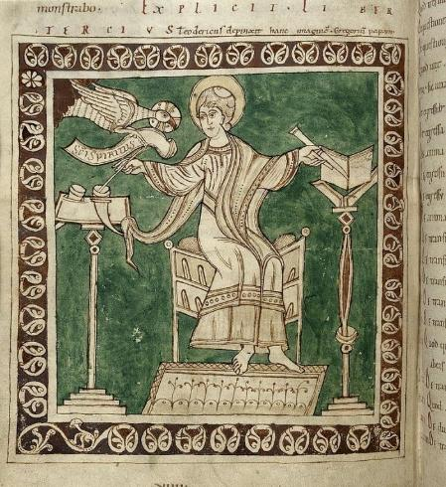
GREGORY I (ca. 540-604)
Gregory I is honored, along with Augustine, Jerome, and Ambrose, as one of the four Great Latin Church Fathers.
As the Bishop of Rome, he initiated a large-scale mission outreach in northern Europe, especially to the Anglo-Saxons via Ireland and Wales through Augustine (not Augustine of North Africa).
He is well known for his prolific writings, which were far beyond those of his predecessors.
He revised Christian worship so that throughout the Middle Ages he was known as the “Father of Christian Worship.”
He had deep respect for the monastic life, especially the vow of poverty, and he was famous for his charitable relief to the poor.
Miniature of Gregory I in a 12th century copy of his Dialogues

Slide 59
The contrast between Gregory and some contemporary expectations for pastors could hardly be greater. He cared deeply about planting churches, training pastors, and spreading the gospel.
GREGORY’S EMPHASES:
Christ-likeness
Godly character
Integrity in public and in private
True piety flowing from the work of the Holy Spirit
SOME CONTEMPORARY PASTORAL EXPECTATIONS:
Extroversion
Magnetic charisma
Management skills
Enthusiasm

Slide 60
St. Patrick
Excerpts from Patrick’s Breastplate Prayer
I bind unto myself today The strong Name of the Trinity, By invocation of the same The Three in One and One in Three.
I bind this day to me forever By power of faith, Christ’s incarnation; His baptism in the Jordan river, His death on Cross for my salvation; His bursting from the spicèd tomb, His riding up the heav’nly way, His coming at the day of doom I bind unto myself today.
Christ be with me, Christ within me, Christ behind me, Christ before me, Christ beside me, Christ to win me, Christ to comfort and restore me. Christ beneath me, Christ above me, Christ in quiet, Christ in danger, Christ in hearts of all that love me, Christ in mouth of friend and stranger.
I bind unto myself the Name, The strong Name of the Trinity, By invocation of the same, The Three in One and One in Three. By Whom all nature hath creation, Eternal Father, Spirit, Word: Praise to the Lord of my salvation, Salvation is of Christ the Lord.
Recognized as the “Apostle to Ireland,” Patrick had been captured by Irish pirates when 16 years old and taken as a slave to Ireland.
After escaping and returning to his family in Britain, he became a priest and eventually a bishop.
From there, he returned to Ireland as a missionary, and in his own writings, he claimed to have “baptized thousands.”

Slide 61
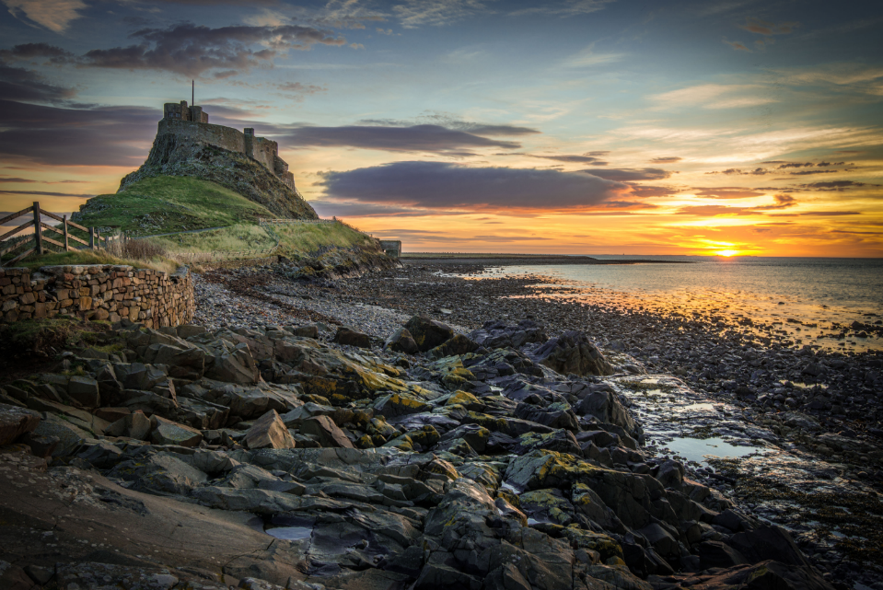
Irish missionaries established a monastery on Holy Island, Lindesfarne, Northumbria, in northern England.

Slide 62
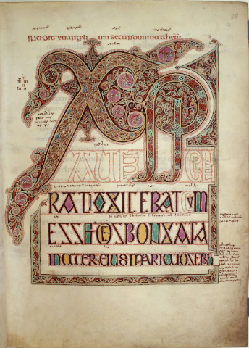
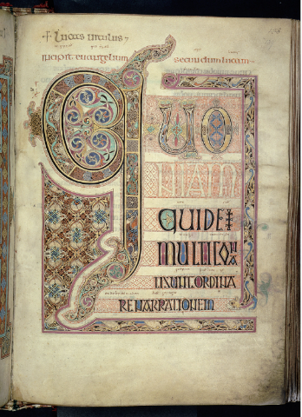
The Lindesfarne Gospels
Beginning of the Gospel of Matthew with a stylized Chi Rho
Beginning of the Gospel of Luke
Produced in honor of Cuthbert, the Bishop of Lindesfarne, the manuscript of the Lindesfarne Gospels took approximately 10 years to produce, a masterpiece of medieval book painting. In it, an Anglo-Saxon interlinear translation was offered between the lines of the Latin Vulgate.

Slide 63
Why Gregory I is to be considered a watershed between the Ancient Church and the Medieval Church in Western Christendom
Some Emphases of Gregory I (6th century):
Elevation of saints (beginning initially as a way of honoring those who endured during persecution, it evolved into a central feature of Western Christianity. The saints served as intercessors and models of piety.)
Importance of relics (either parts of the bodies of saints or clothing they wore or objects they used were venerated and believed to be mediums of divine power)
Value of asceticism (he was the first monastic to become the Bishop of Rome, and he urged this practice in his sermons, equating ascetism with martyrdom)
Purgatory (he advocated that there must be a cleansing fire after death to purify the Christian from minor faults that might remain)

Slide 64
MONKS AND MONASTERIES
While monastic communities began in the late 3rd century and had become an established institution by the 4th century, rules were developed to align all the monastic groups into more consistent expressions of Christianity.
Those choosing the monastic life were not part-time Christians; they had an “all or nothing” mindset leading them to renounce all creature comforts in order to devote themselves unreservedly to prayer, social service to the community, teaching, and spreading the Christian faith.
Monastic life was not restricted to males; many female Christians also chose this ascetic life.
John Cassian (ca. 360-430) set out the rules for monastic life that would last for centuries.
One of the most famous monastics was St. Benedict (ca. 480-543), who created a monastic rule of order as the standard for all monastics with vows of life-long commitment, obedience, poverty, and chastity.

Slide 65
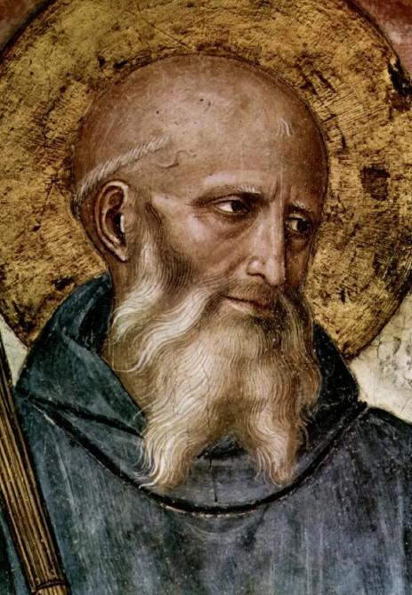
Prayer of St. Benedict
Gracious and holy Father,
grant us the intellect to understand you,
reason to discern you, diligence to seek you,
wisdom to find you, a spirit to know you,
a heart to meditate upon you.
May our ears hear you, may our eyes behold you,
and may our tongues proclaim you.
Give us grace that our way of life may be pleasing to you,
that we may have the patience to wait for you
and the perseverance to look for you.
Grant us a perfect end—your holy presence,
a blessed resurrection and life everlasting.
We ask this though Jesus Christ our Lord.
Amen

Slide 66
Excerpts of the sayings of the desert fathers
"A hermit said, 'Take care to be silent. Empty your mind. Attend to your meditation in the fear of God, whether you are resting or at work. If you do this, you will not fear the attacks of the demons.'"
Abba Moses, "Sit in thy cell and thy cell will teach thee all."
"Somebody asked Anthony, 'What shall I do in order to please God?' He replied, 'Do what I tell you, which is this: wherever you go, keep God in mind; whatever you do, follow the example of Holy Scripture; wherever you are, stay there and do not move away in a hurry. If you keep to these guide-lines, you will be saved.'"
Abbot Pastor, "If someone does evil to you, you should do good to him, so that by your good work you may drive out his malice."
An Elder, "A man who keeps death before his eyes will at all times overcome his cowardliness."
Macarius said, "This is the truth, if a monk regards contempt as praise, poverty as riches, and hunger as a feast, he will never die."
"It happened that as Abba Arsenius was sitting in his cell that he was harassed by demons. His servants, on their return, stood outside his cell and heard him praying to God in these words, 'O God, do not leave me. I have done nothing good in your sight, but according to your goodness, let me now make a beginning of good.'"
Abba Anthony said, 'Whoever hammers a lump of iron, first decides what he is going to make of it, a scythe, a sword, or an axe. Even so we ought to make up our minds what kind of virtue we want to forge or we labor in vain.'"
He also said, "Obedience with abstinence gives men power over wild beasts."

Slide 67
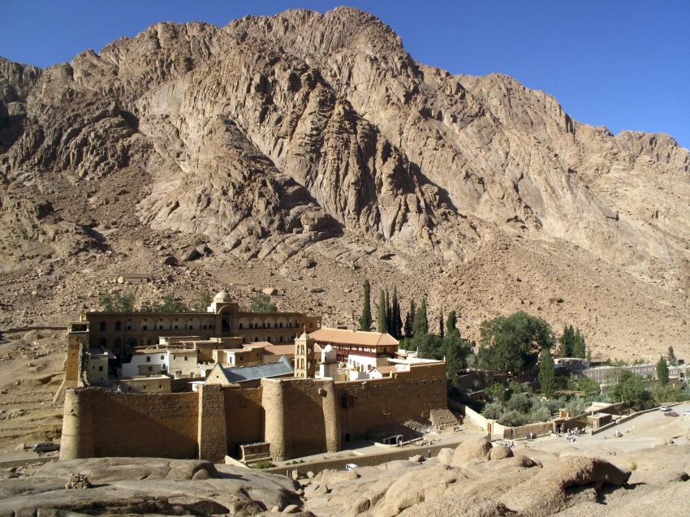
One of the oldest monasteries was St. Catherine’s, built between AD 548 and 565 at the foot of Jebel Musa in the Sinai Peninsula (believed to be Mt. Sinai). This monastery still survives, and in 2002 it became a UNESCO World Heritage Site. Its library held (and holds) many rare and unique works, the most famous being Codex Sinaiticus, the oldest complete Bible in the world (now in the British Library).

Slide 68
The rise of islam
In the 7th century, a new religion arose from the teachings of an Arabian leader named Muhammad (AD 570-632).
He married, and until he was about age 40, he lived as a prosperous trader.
Profoundly dissatisfied with the polytheism and superstition in his native Mecca, he became convinced that there was only one God, Allah.
In AD 610 he claimed to have had divine revelations.
He called his new faith Islam (= submission) and claimed prophethood, urging that his fellow Meccans believe in one sovereign god only, resurrection, and final judgment, and that they must live in charity to the poor and orphans among them.

Slide 69
The new religion expands
The expansion of Muhammad’s religion began in a series of desert battles in which by AD 630 the cities of Medina and Mecca came under his control.
Though he died in AD 632, his followers continued the Muslim expansion through war, eventually spreading beyond the borders of Arabia and encroaching into Christian territory.
AD 636 – Muslims conquered the Byzantine army and occupied Antioch, Damascus, and Jerusalem.
AD 637 – They routed the Persian army and marched into the Persian capital.
AD 646 – They conquered Egypt and began to sweep across North Africa.
AD 651 – The entire Persian Empire was brought under Islamic rule.
AD 711 – They crossed from north Africa into Europe at Gibraltar, took over most of Spain, and were not turned back until AD 732, when Charles Martel of the Franks defeated them at Tours about 150 miles from Paris.
Hence, within a century, the Islamic Empire now stretched over Arabia, Mesopotamia, Persia, North Africa, the Anatolian Plateau, and Spain.

Slide 70
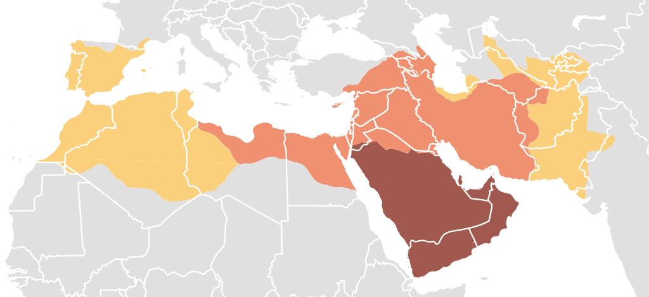
The Spread of Islam 7th and 8th centuries
DURING MUHAMMAD’S IMMEDIATE SUCCESSORS
A CENTURY AFTER MUHAMMAD’S VISIONS
DURING MUHAMMAD’S LIFETIME

Slide 71
Christianity’s struggle with islam
Christians lost most of the eastern Roman/Byzantine Empire.
Both sides engaged in religious war, though with a difference:
For Muslims, jihad is directly advocated in the Quran and had been practiced by Muhammad and his followers from Islam’s inception.
For Christians, crusade came into Christian thought only after a thousand years of its existence and was resisted by many clergy when first proposed.
The Crusades were military expeditions with the objective of retaking Jerusalem and rescuing it from Muslim rule.

Slide 72
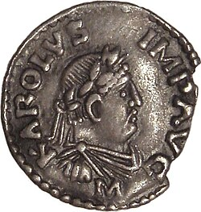
Charlemagne and the holy roman empire
On Christmas Day, AD 800, Charlemagne was crowned Emperor of the Romans by Pope Leo III.
As the first emperor in the West for more than three centuries, he had been king of the Franks since AD 768.
He expanded his rule over the larger portion of Europe, spreading Christianity in those areas he annexed (sometimes by force). His wars with the Saxons lasted nearly 30 years.
Following him, there would be a series of emperors that would last into the early 19th century.
Denarius of Charlemagne, minted ca. 812-814.

Slide 73

Charlemagne’s Empire His position as emperor in the West immediately brought him into conflict with the Eastern Roman Empire in Constantinople. He became ill in AD 813 and spent his final months praying, fasting, and studying the Gospels before his death in January AD 814.

Slide 74
Charlemagne and christianity
Charlemagne was active in church affairs, holding 23 synods to address church administration, education of the clergy, and the proper forms for liturgy.
Christianity was a central unifying factor in his realm, and in turn, he worked to produce unity in the church.
He required monasteries to follow the Rule of St. Benedict.
He believed it essential for his subjects to recite the Lord’s Prayer and the Apostles’ Creed.
He condemned the worship of images and relics (for which John Calvin later would view him as a forerunner of the Reformation).

Slide 75

The crusades
In AD 1095, despite the schism between East and West, the Byzantines requested aid in stemming the Muslim invasion.
Pope Urban II announced the first armed pilgrimage to Jerusalem in support of Alexios 1 Komnenos, the Byzantine Emperor.
Volunteers came from all over Europe.
Many crusades occurred between 1095 and 1291, some official, some unofficial, but in all there were eight major Crusader expeditions.
Theologically, the crusades were justified on the basis of Augustine’s just war theory.
To a significant degree, the crusades became an excuse for Christian warlords to kill Muslims and Jews in the name of Christ. The aftermath is still with us!

Slide 76
FIVE IMPORTANT medieval theologians
ANSELM
(1033-1109)
“I believe so that I may understand”
Became the Archbishop of Canterbury in England
Set out the satisfaction model for substitutionary atonement
ABELARD
(1070-1142)
“Jesus died as a demonstration of God’s love”
He is best known for developing the moral concept of atonement, i.e., the cross was a demonstration of divine love (as opposed to Anselm’s satisfaction model).
BERNARD
(1090-1153)
“Why and How God is to be Loved”
Rather than the rational approach to God, Bernard preferred a personal, experiential friendship with Christ.
Set out the concept of imputed righteousness.
FRANCIS
(1182-1226)
Franciscan Movement
Founded the Franciscan order emphasizing a life of poverty.
By degrees, he took to assisting lepers and leper colonies.
AQUINAS
(1225-1274)
“Summa Theologica”
Perhaps the greatest theologian of the Medieval Church, he emphasized the doctrine of natural law and human reason.
He attempted to synthesize Aristotle and Christian theology.

Slide 77
Lord, make me an instrument of your peace: where there is hatred, let me sow love; where there is injury, pardon; where there is doubt, faith; where there is despair, hope; where there is darkness, light; where there is sadness, joy. O divine Master, grant that I may not so much seek to be consoled as to console, to be understood as to understand, to be loved as to love. For it is in giving that we receive, it is in pardoning that we are pardoned, and it is in dying that we are born to eternal life.
THE PRAYER OF ST. FRANCIS
Attributed to St. Francis

Slide 78
Medieval life
The liturgy of the medieval Christian West (ca. 600–1500) provided the means around which life in Western Europe was structured for nearly a thousand years.
It was rooted in Christian antiquity: in the early central liturgical structures of baptism, confirmation, and Eucharist, the private and public observance of daily prayer, and the development of a liturgical year.
The long medieval period that followed saw a broadening elaboration and expansion of the liturgical life of Christians in many different directions.
By the year 1200, theologians had defined seven of the Church’s liturgical rites as primary sacraments: baptism, confirmation, Eucharist, penance, ordination, extreme unction, and matrimony.
The Christian year centered around the festivals of Easter, Pentecost, Christmas, and Epiphany, augmented by an elaborate calendar of commemorations and feasts of saints.
Gregorian chant became the dominant form of Christian music.

Slide 79
The Christian liturgy was intertwined with the development of art and architecture, law and commerce, and political/socio-economic developments that would take Christian society and religion from the twilight of late antiquity to the dawn of early modernity.

Slide 80
VENERATION OF ICONS
In Judaism, there is a long history of the use of symbols, like the lulav, the menorah, and the ark of the covenant. Christians followed in kind.
As early as Irenaeus (2nd century) Christians were employing art imagery in both two-dimensional and three-dimensional forms.
The veneration of this art (i.e., showing honor and respect) was widely practiced (though Clement of Alexandria says that this was “educational” and would be indecipherable to outsiders).
The eastern church held at least two councils in order to determine the proper use of icons in 754 and 787.
The Iconoclasts, who opposed the veneration of icons, argued that it violated the prohibition against images in the 10 Commandments.
The defenders insisted on their importance for expression and worship.
The Byzantine Emperor, Leo III, banned religious images; the Bishop in Rome supported them.

Slide 81
The east-west divide
Cultural, political, and linguistic differences fueled the increasing distance between the East and the West.
Two fundamental issues were involved:
The claim of the Bishop of Rome to be the spiritual sovereign over all Christendom. For the East, all the bishops are the successors of Peter, not just the Bishop of Rome. The Roman bishop might be the first among equals, but he is not infallible and does not have absolute authority.
The theological implications of adding a clause to the Nicene Creed, the famous filioque clause (“…and from the Son”), the idea that the Holy Spirit proceeds from both the Father and the Son. Originally, it simply read “from the Father.”
While a final break between the two would not occur formally until AD 1054, the schism between the Greek East and the Latin West occurred gradually over an extended period that was intensified by cultural and linguistic differences.

Slide 82
The Great Schism
The formal division of the Christian church came in 1054 when the Bishop in Rome (West) and the Patriarch in Constantinople (East) each mutually excommunicated the other.
The mutual excommunications were not rescinded until 1965, though the schism between east and west remains.
Ancient Church
Medieval Church
AD 1054
Roman Eastern
Catholicism Orthodoxy

Slide 83

The Norman conquest
In the 11th century, England was invaded and occupied by an army from Europe composed of thousands of Norman, Breton, Flemish, and French troops led by the Duke of Normandy (a.k.a., William the Conqueror).
With the defeat of Harold at the decisive Battle of Hastings, October 14, 1066, rulership in England now passed to William.
The old English aristocracy ended, their properties seized by the new conqueror and dealt out to his supporters as earldoms.
English control over the church now passed to the new regime.
Harold’s death (Bayeux Tapestry)

Slide 84
THE HIGH MIDDLE AGES
Education: Generally consisted of memorization of authorities, i.e., the Bible, the church fathers, the traditions, etc.
Rise of Universities: An emphasis on Artes Liberales (liberal arts, i.e., the arts that liberate). The earliest include Bologna (c. AD 1088), Paris (c. AD 1150), Oxford (c. AD 1167), and all had close ties with the church. The curriculum was primarily:
Trivium: grammar, rhetoric, logic
Quadrivium: arithmetic, astronomy, music, geometry
Studia Humanitatis: poetry, history, moral philosophy
Rise of Scholasticism: Intellectual movement using rigorous logic and the attempt to reconcile Christian faith with reason. Key aspects include:
Emphasizing methodology over doctrine, examining authoritative texts, looking as opposing views, and resolving them.
Attempting to “think God’s thoughts after him” by making theology rational.
Major Figures: Peter Abelard, Peter Lombard, Thomas Aquinas (whose Summa Theologica is considered the pinnacle of the movement.

Slide 85
The cathedral churches
Cathedral churches were an important feature of Medieval life., and they developed out of the French style in the 12th century.
This Gothic architecture spread to all of Western Europe, continuing to evolve until well into the 16th century.
Such cathedrals emphasized high, vertical walls and huge windows for light. Their high walls were supported by external braces called flying buttresses.
Prominent among these huge churches were the cathedrals at: Chartres (near Paris), Cologne (Germany), Notre Dame (Paris), York Minster (England), Seville (Spain), Milan (Italy), Westminster Abbey (England), and Reims (France).

Slide 86



Cathedral Style Church (cruciform)
Chartres Cathedral (1194-1220)

Slide 87

Seville Cathedral

Slide 88

Exeter Cathedral in southwest England, completed in ca. 1400, has the longest uninterrupted medieval stone vaulted ceiling in the world.

Slide 89

The black death
The pandemic known as “The Black Death” was a devastating plague that ravaged Europe between 1347 and 1351.
An estimated 25-30 million people died.
Originating in China and Inner Asia, it entered Europe through the trade routes and spread by infected rodents and fleas.
Hardest hit were the towns and monastic communities, where people lived in close proximity.

Slide 90
The late medieval church
The late-medieval church was the single largest and most diverse institution in Europe, the largest landholder.
At the top was the papacy, supervising archbishops and bishops throughout Europe.
These, in turn, supervised thousands of priest and parishes, along with numerous orders of monks, nuns, and friars.
Over the centuries, the church had amassed significant wealth along with political power.
For the layperson, there was no salvation outside the church; hence, its sacraments and rituals were the necessary link between God and humans.
The very worst event in a person’s life was to be excommunicated—separated from the sacraments.

Slide 91
The great papal schism
The Great Schism (1378) was triggered by a contentious papal election.
Due to political factionalism and unsafe conditions, for nearly 70 years, the papacy had been resident in Avignon, France, but Gregory XI succeeded in bringing it back to Rome.
After his death in 1378, six of the twenty-two cardinals were still in Avignon; against them, the Romans feared the election of a French pope and the removal of the papacy back to Avignon.
In the turmoil, Urban VI, an Italian who had served in Avignon, was elected as the new pope, but abusive resistance to the cardinals gave doubts to the legitimacy of this election, and they subsequently rejected Urban and then selected Clement VII.
The result was two rival popes, one in Rome and one in Avignon. France and Scotland backed Clement, while England and Germany backed Urban. Neither was able to dislodge the other, and neither was willing to relinquish the papal claim.
The Papal Schism did not end until resolved by the Council of Constance in 1417.

