Slide 1
Nahum

Slide 2
Historical Background
The history of Assyrian decline lies behind the little work of Nahum.
Assyria reached the height of its imperial power under Ashurbanipal (668-631 BC), but his reign was followed by a series of weak leaders who suffered crippling defeats from the Babylonians.
When the Assyrian refugee government was backed up in northwest Mesopotamia, and the Egyptians, Assyrian’s allies, were marching northward for support, Josiah, the king of Judah, interposed his army, confronting Pharaoh-Neco II at Megiddo in 609 BC.
Though Josiah died in this confrontation, he stalled the Egyptian advance just long enough to leave the Assyrians unaided.

Slide 3
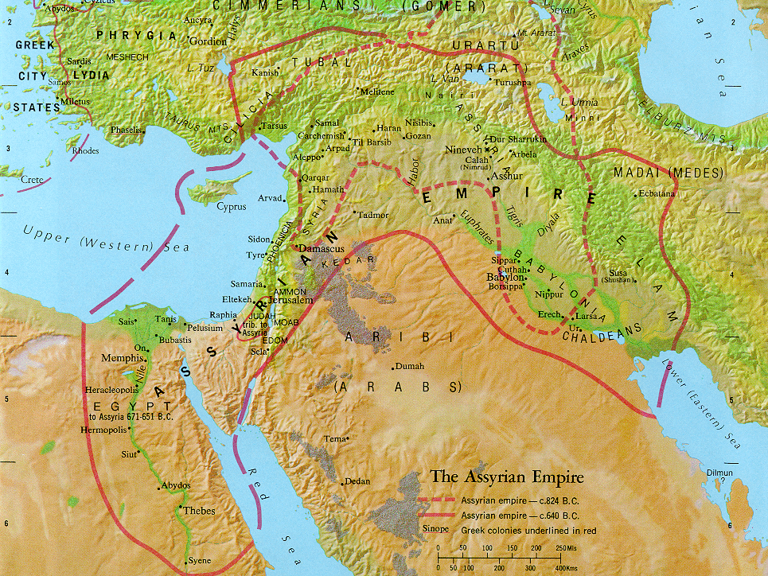
Carchemish
Nineveh
Haran
Asshur
Babylon
Judah
Egypt

Slide 4
DECLINE OF ASSYRIA/RISE OF BABYLON
626-620 BC Defeat at Babylon (Assyrians
driven from Babylon)
614 BC Fall of Ashur (loss of
southern capital)
612 BC Fall of Nineveh (loss of
northern capital)
609 BC Defeat at Haran (loss of
government in exile)
605 BC Battle of Carchemish (loss of last
significant ally, Egypt)

Slide 5
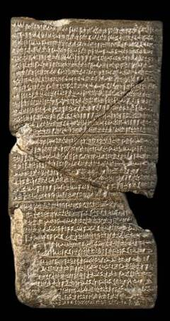
The fall of Assyria was predicted by the prophet Nahum.
The attack upon Nineveh by the Medes and Babylonians, which was successfully conducted in 614 BC, left Assyria’s northern capital in shambles (Na. 2:3-13).
This tablet from the Babylonian Chronicle describes the fall of Nineveh and the collapse of the Assyrian Empire.
British Museum, London

Slide 6
Structure
The structure of the book falls into three sections roughly corresponding to the chapter divisions.
1 - Opening psalm extolls the warlike Yahweh who comes to judge his enemies. (Verses 1:2-9 follow a partial acrostic pattern for the letters x through n, though 1:2b is misplaced.)
2 – The siege and sack of Nineveh
3 – Woe oracle on Nineveh, comparing it to the earlier fall of Thebes (since Thebes was sacked by Ashurbanipal in 663 BC, Nahum must be dated after this known historical event)

Slide 7
Yahweh, the Man of War (1:2—2:2)
Nahum depicts God descending on the world in the awe-inspiring form of theophany—a warrior who executes judgment on his enemies.
As in the theophany at Mt. Sinai, Yahweh is “slow to anger…but not leaving the guilty unpunished” (1:3; cf. Ex. 34:6-7).
The language of theophany shows the world in recoil before the wrath of God, who comes like a desert sirocco, drying up water courses, withering the plateaus and sweeping away the mountains.
Still, his basic relationship toward those who trust him is to provide refuge (1:7).
Judgment is reserved for unbelievers, but for the faithful, there is “good news on the mountains” (1:15; cf. Is. 52:7).

Slide 8
The Fall of Nineveh (2:2-13)
Nahum’s vivid description of the storming and capture of Nineveh contains powerful poetic lines.
The Assyrian chariots would race through the streets to shore up the city’s defenses, but it would be too little, too late.
The Babylonian attackers would dam the river in order to send a hurtling flood of water toward the city, and Nineveh would be left in a pool of receding water, while the enemy looted the town.
Once the home of royal game preserves, where lions were kept for the royal hunts, Nineveh and her royal sport would now be devastated. The empire that once was itself a preying lion would become the victim of the hunt.

Slide 9
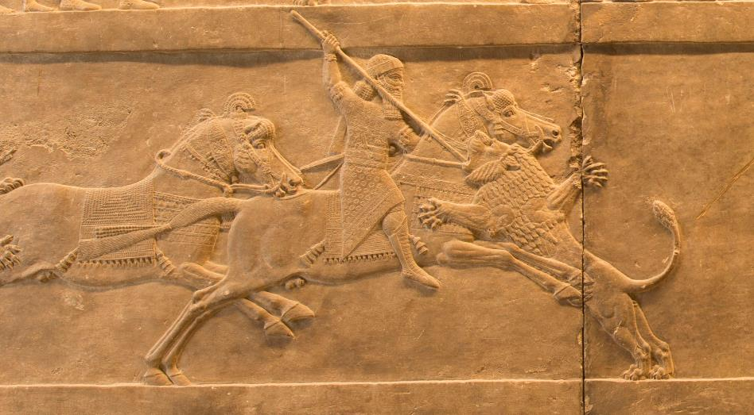
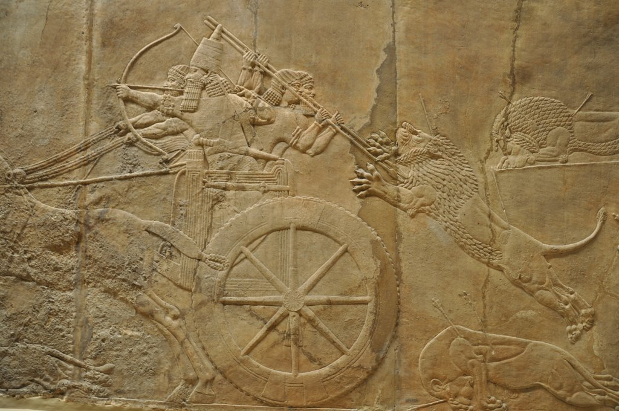
The Royal Assyrian Lion Hunt the symbol of Assyrian dominance over the Mesopotamian world
British Museum, London

Slide 10
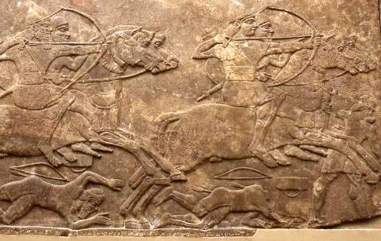
Nineveh, the City of Blood (3)
ASSYRIAN TERRORS (3:1-7)
Nineveh’s wealth had been built upon the blood of its victims.
Like the metaphor of the great whore in the Book of Revelation, Assyria was an international whore destined to be exposed in public disgrace and reduced to ruins.
British Museum, London

Slide 11
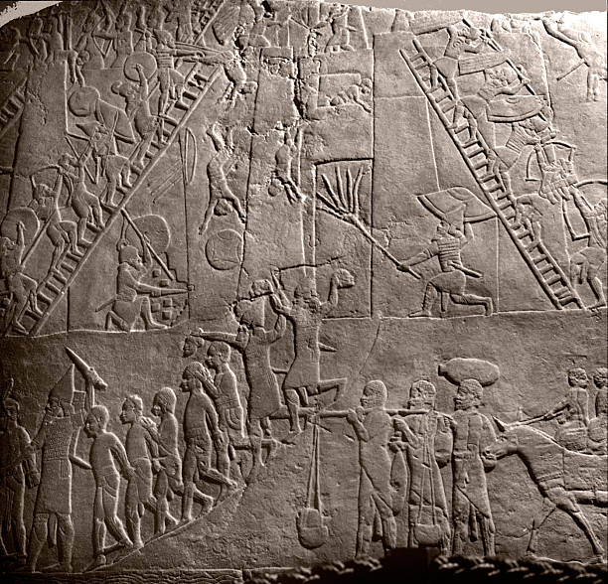
Bas-relief of the attack on Thebes from the palace of Ashurbanipal in Nineveh
THE FALL OF THEBES (3:8-19)
Nineveh’s fall is compared to Ashurbanipal’s destruction of Thebes in 663 BC.
As the Assyrians did to Thebes, so Babylon would do to Assyria.
The Assyrian armies might be multiplied like locusts, but before the Babylonians, they would be like cold-blooded creatures clinging to the walls on a cold day.

Slide 12
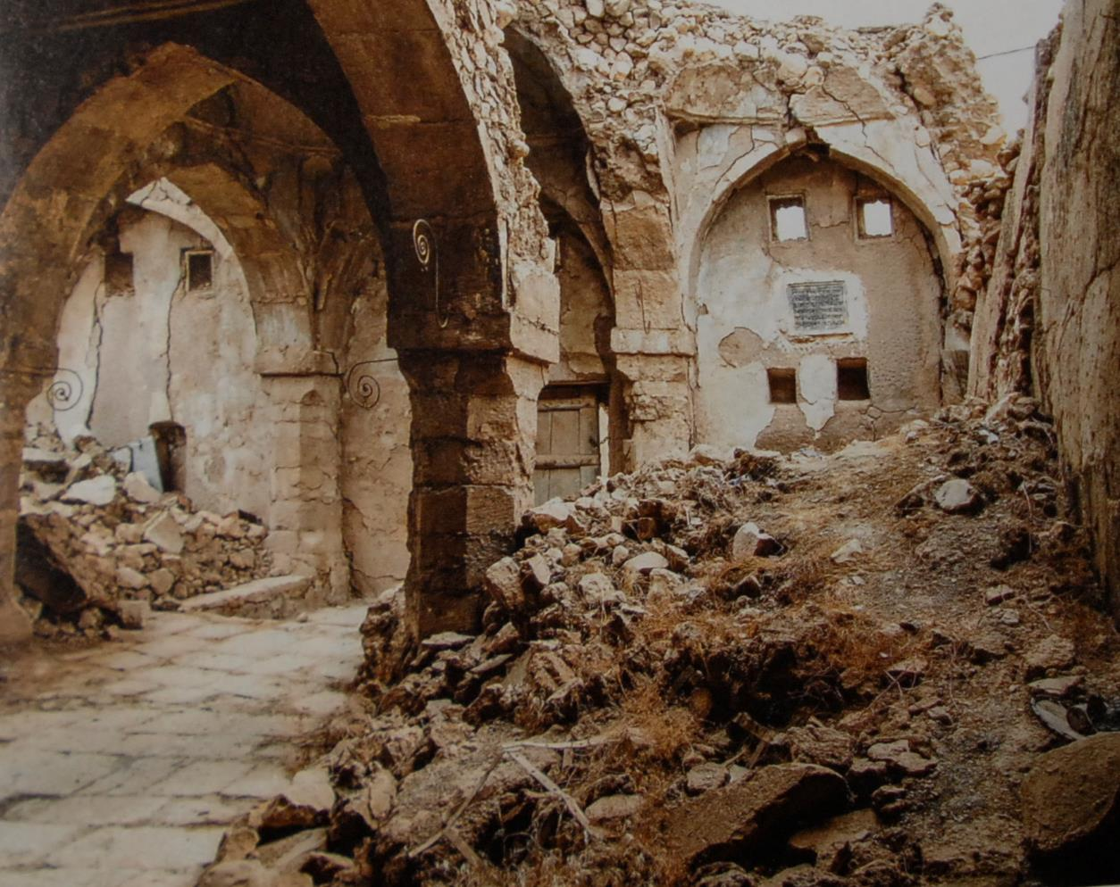
Located in al-Qosh, some 30 miles northeast of Mosul, Iraq, this synagogue, now damaged by war, is believed to house the tomb of Nahum. The shrine was once a site for pilgrimage, but in a war-torn area it now is slowly being reduced to rubble, though recent steps have been taken to stop the deterioration (as of 2017).
POSSIBLE BURIAL SITE OF NAHUM

