Slide 1
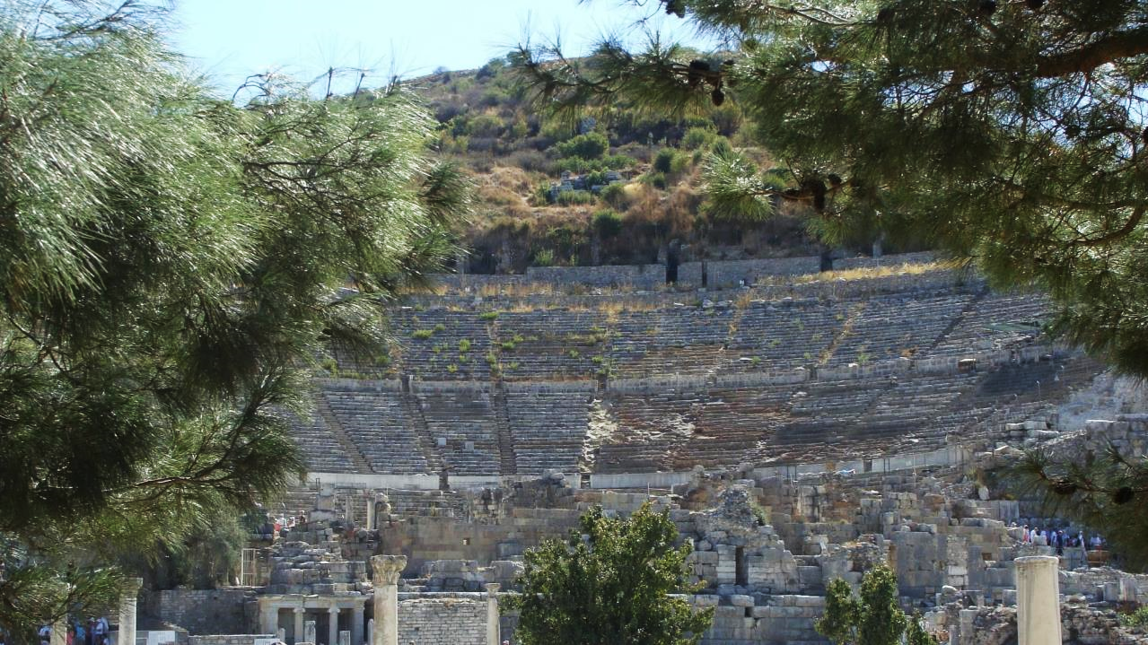
NT ARCHAEOLOGY
NT ARCHAEOLOGY
JESUS IN GALILEE
Lesson 4
Lesson 1
Introduction

Slide 2
Leaving Nazareth, Jesus went and lived in Capernaum, which was by the lake in the area of Zebulun and Naphtali—to fulfill what was said through the prophet Isaiah:
  “The land of Zebulun and land of Naphtali, the way to the sea, along the Jordan, Galilee of the Gentiles—the people living in darkness have seen a great light; on those living in the land of the shadow of death a light has dawned.”
Matthew 4:13-16
As Jesus walked beside the Sea of Galilee, he saw Simon and his brother Andrew casting a net into the lake, for they were fishermen. “Come, follow me,” Jesus said, “and I will make you fishers of men.” At once they left their nets and followed him.
Mark 1:16-18

Slide 3
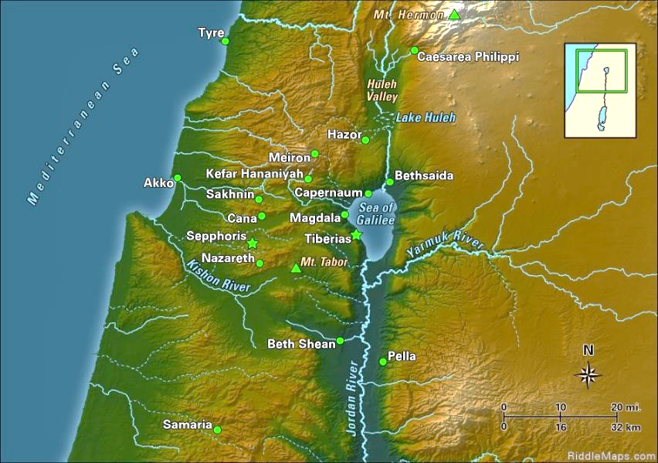
Galilee
What Isaiah called “the Galilee of the Gentiles” is the original homeland of the Israelite tribes of Asher, Naphtali, Zebulun and Issachar, some of the very ones that Isaiah predicted would be honored in the future when the Messiah came (Isa. 9:1; Mt. 4:14-16).

Slide 4
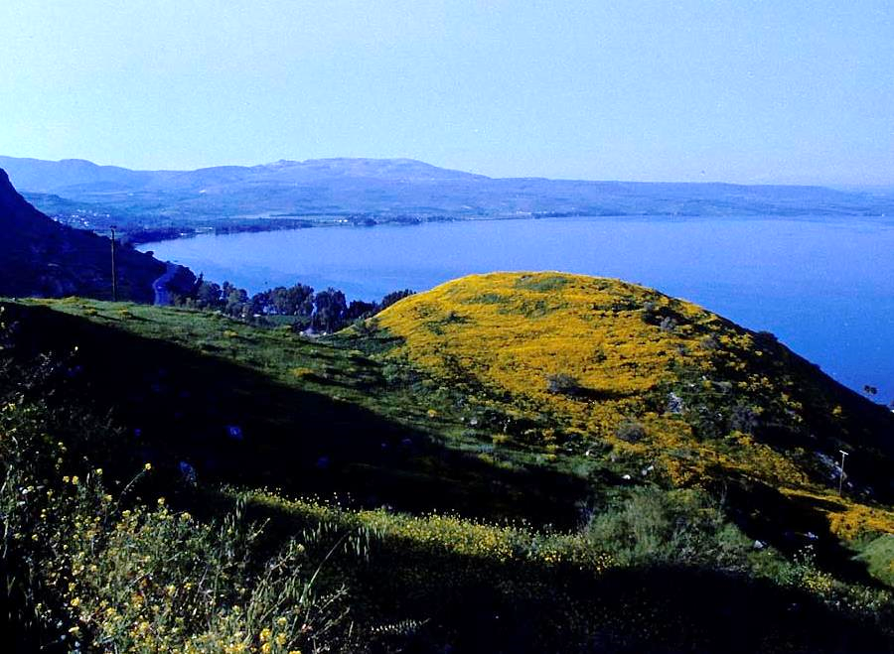
The most prominent geographical feature of Galilee is surely the lake, some 5 miles across (east to west) and 9 miles long (north to south). Lying about 700’ below sea level, it is fed from the north by the Jordan River, which then exits from the southern tip of the lake.

Slide 5
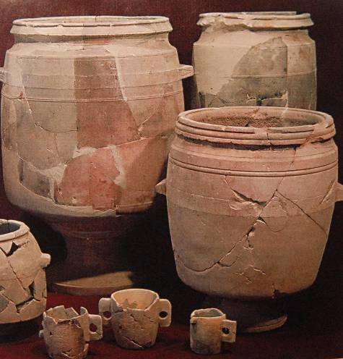
At a Wedding in Cana
At a home-taking (second stage of a Jewish marriage) in Cana, Jesus turned the water in six large water jars into wine (Jn. 2:1-11)
These objects from a 1st century Jewish home in Jerusalem include stone jars of the sort described at the home in Cana. Stone jars, though more expensive, were valued because they could be cleansed and reused without violating kosher law, whereas vessels of pottery, once defiled, could not be reused but had to be destroyed.

Slide 6
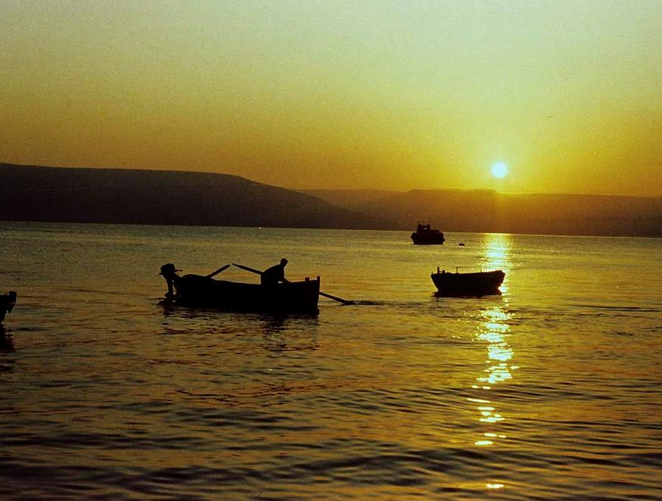
The “sea” of Galilee has been used for fishing all during its long history, and several of Jesus’ disciples were fishermen (Mk. 1:16-20). Much fishing is done at night, and some 25 species of fish are found in the lake. During the 1st century, Galilean cured fish were exported all the way to Rome.

Slide 7
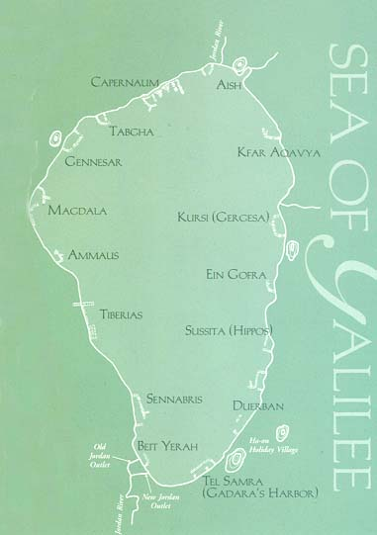
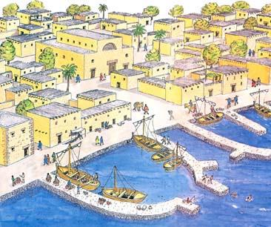
Some 15 man-made harbors dotted the shores of the Sea of Galilee (known in Hebrew as Kinneret). Each harbor consisted of two basic elements, a short pier jutting straight into the water, and a long curved stone breakwater, which protected moored boats from the sometimes violent storms to which the lake is subject.
Drawn by archaeologist Leen Ritmeyer, this representation of the Capernaum port (with the synagogue in the upper left) shows the piers and breakwater typical in the time of Jesus.

Slide 8
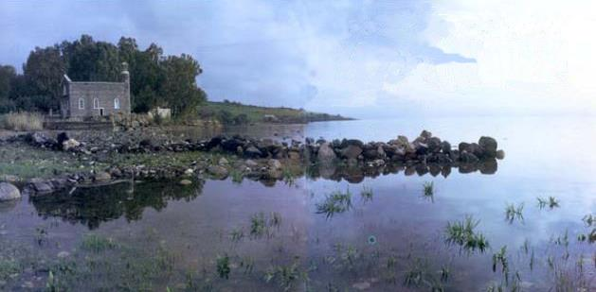
At Tabgha, where Peter and Andrew once fished, a line of basalt boulders juts into the waters of the lake. Commemorating the site is a small stone church where, according to tradition, Jesus first called Peter, Andrew, James and John: “Follow me and I will make you fishers of men” (Mk. 1:17).

Slide 9
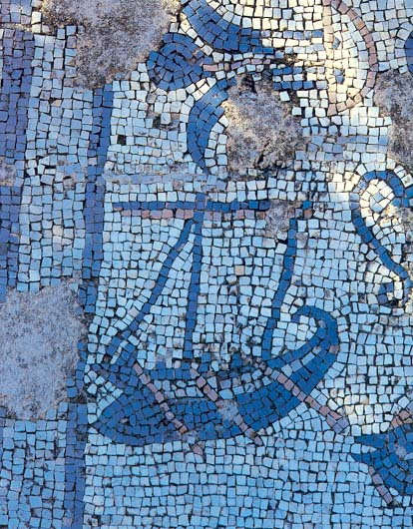
Magdala Mosaic
Discovered in the excavations of a 1st century home in Magdala, one of the lakeside fishing villages and the home of Mary, one of Jesus’ women disciples, this floor mosaic of a fishing boat shows a mast for sailing and oars for rowing. The Greek name of Magdala was Tarichea, a name meaning “the place where fish are salted.”

Slide 10
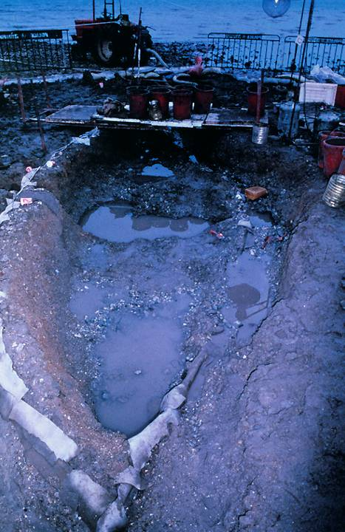
Galilee Boat
In 1986, during a low water level in the Sea of Galilee, an ancient boat was discovered and excavated under the direction of Dr. Rami Arav of the University of Haifa. This is the first ancient boat of its kind to be recovered, and it was dated to the 1st century, based on pottery and coins found inside it. Though there is no indication that Jesus or his disciples ever used it, it has popularly become known as “the Jesus boat,” since it would have been very much like the ones used by fishermen in Galilee in Jesus’ day.
View taken at the beginning of the excavation.

Slide 11
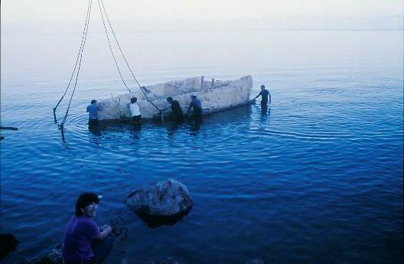
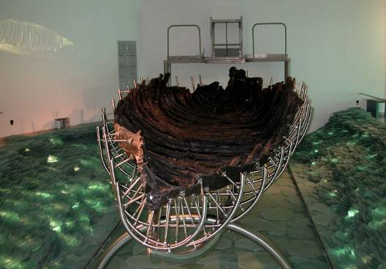
After its excavation, the ancient boat was swathed in polyurethane to preserve it and floated across part of the Sea of Galilee to a site where it could be safely housed and treated for preservation.
The boat was submerged in a chemical bath for several years to fill all the wooden cellular structures with wax (polyethylene glycol) in order to continue its preservation. Now it is on display at a special center at Ginosaur.

Slide 12
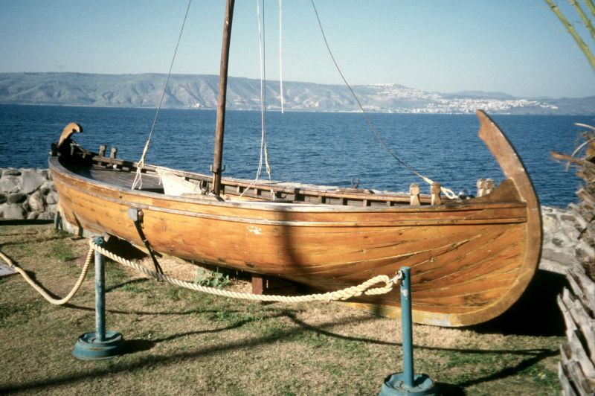
Full-size model of the so-called “Jesus Boat”

Slide 13
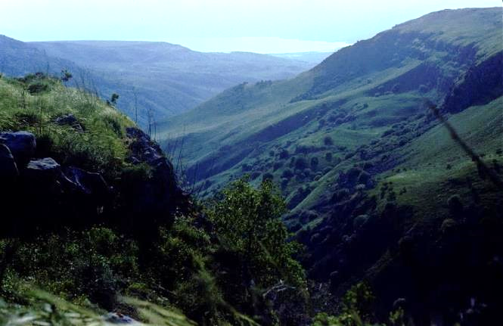
Villages in Galilee
Much of Jesus’ public ministry was conducted in villages and the surrounding countryside.
Some of the terrain surrounding the lake, especially to the north and east, was fairly rugged with steep slopes and deep ravines.
Other areas on the western side of the lake were rolling hills.
The dozens of villages scattered over this area were for the most part relatively small.
Nahal Dalioth is a deep ravine in the Golan Heights to the east of the lake. Barely visible in the distance is the lake itself. Into such hills Jesus went by himself to pray (Mt. 14:23; Lk. 6:12).

Slide 14
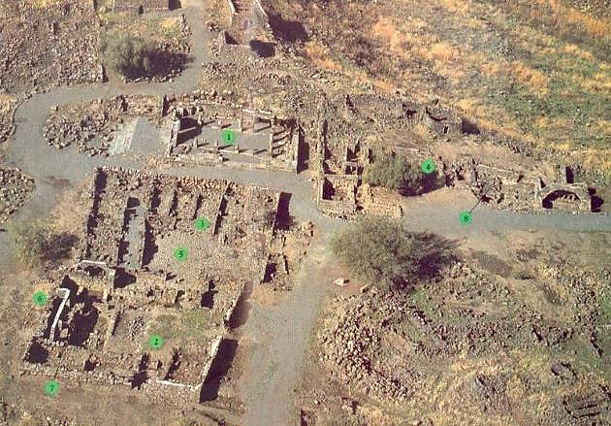
Aerial View of Chorazin Excavations
(1) synagogue,
(2, 3) domestic complexes
(4) public building
(5) cobblestone courtyard
(6) arched wall
(7) basalt stone wall
(8) Mikveh

Slide 15
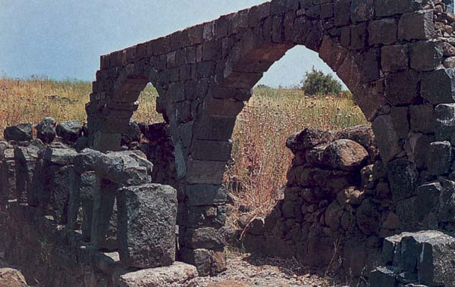
Arched stone wall at Chorazin, constructed from black basalt volcanic rock
Basalt rock is brittle, so beams of basalt cannot be successfully quarried at great lengths.

Slide 16
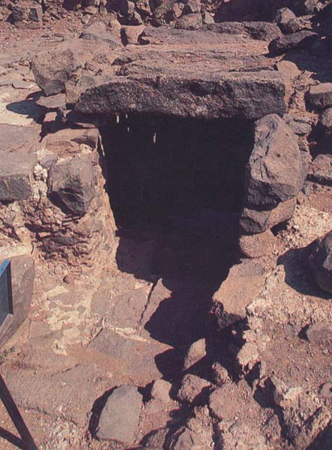
The entrance to the mikveh at Chorazin featured seven descending steps. Not visible in this photo is a large adjacent cistern with storage for “living” water.

Slide 17
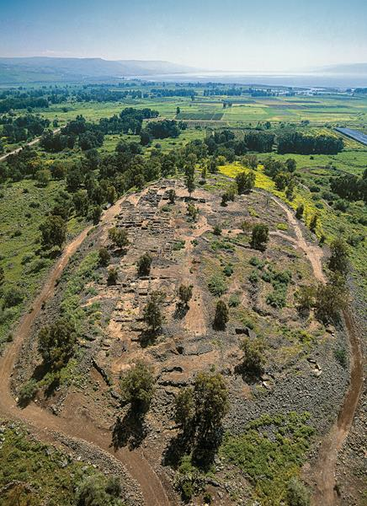
The site at et-Tell has been accepted “officially” as Bethsaida by the Israel Antiquities Authority with posted signs for tourism. However, in the past few years, another site, el-Araj, has gained attention that competes with the official site. Hence, we are now in the “battle of the archeologists” with regard to which is the real Bethsaida.

Slide 18
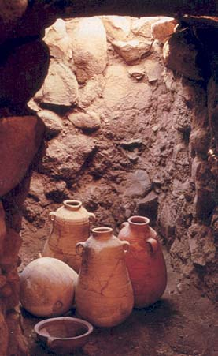
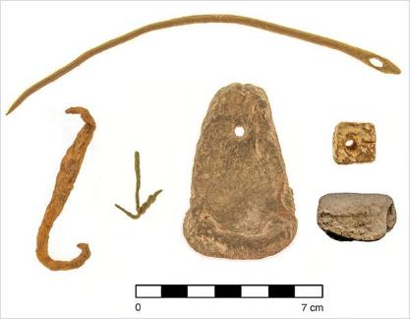
The site at et-Tell produced what amounts to a wine cellar, with four large wine jars (left).
Also was the discovery of a variety of fishing implements, including these hooks and sinkers (below).

Slide 19
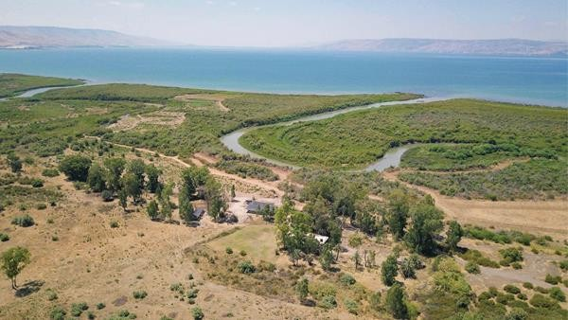
The rival site at el-Araj also revealed a variety of fishing implements as well as the remnants of a 5th century Byzantine Church, which suggests these ancient Christians had identified Bethsaida with this site. (Churches were typically built on sacred sites, such as, the hometown of Peter, Andrew, and Philip.)

Slide 20
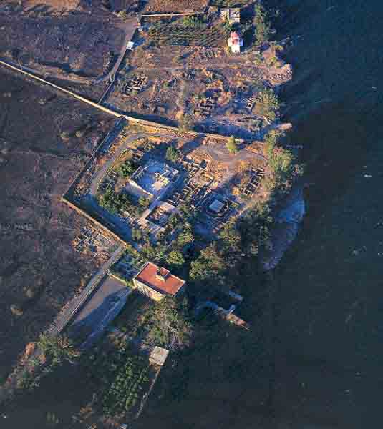
Excavations at Capernaum, which became the center of Jesus’ ministry in Galilee (Mt. 4:13), have been ongoing for many years, and various installations from the time of Jesus have been discovered. As you can see in this aerial photo, the excavation site is immediately on the edge of the lake.

Slide 21
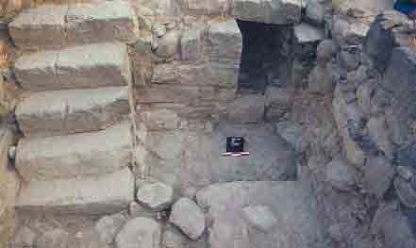
This stone stairway, which once led to a roof in Capernaum, recalls the narrative where, because of the crowds, some friends of a paralytic carried him to the roof, where they lowered the man immediately in front of Jesus (Mk. 2:1-5).
Archaeologists uncovered this staircase in a domestic dwelling, indicating that it had a second story. Roofs in Capernaum, unlike those with the basalt slabs in other villages, had wooden beams covered with straw and earth.

Slide 22
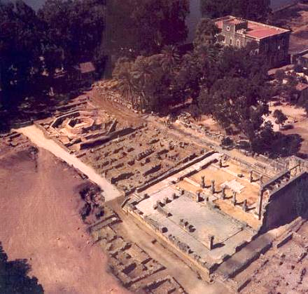
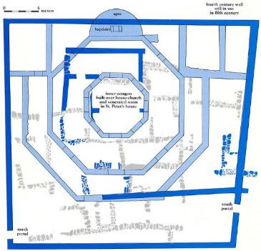
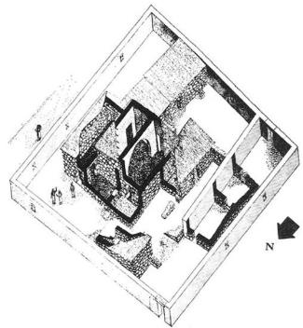
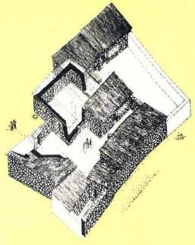
Three superimposed structures, a 5th century octagonal church, a 4th century dwelling repurposed into a chapel, and a 1st century house may mark the home of Simon Peter in Capernaum. Italian archaeologists are convinced the earliest structure is Peter’s home, and the circumstantial evidence is supportive.

Slide 23
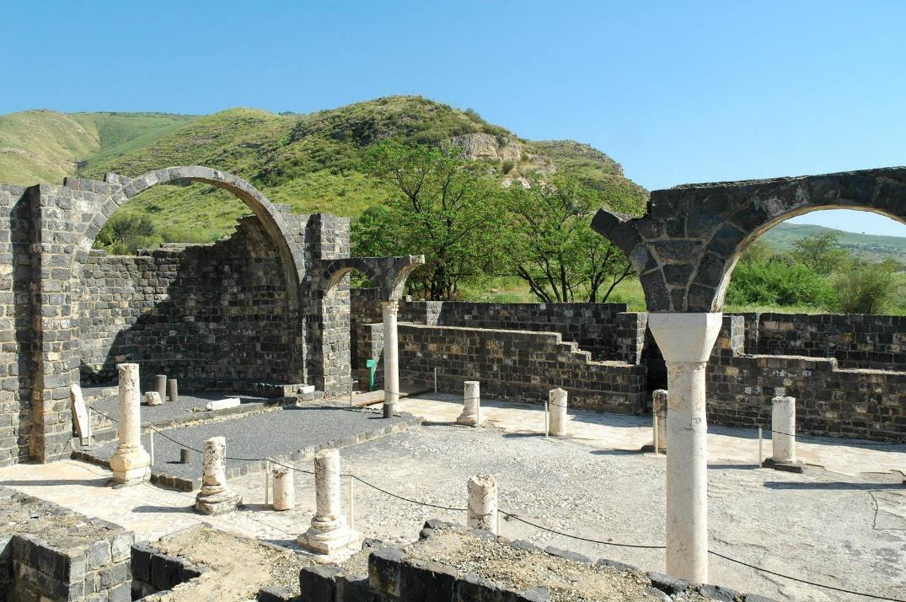
Ruins of a 5th century Byzantine church at Kursi on the east side of the lake, the site of the swine miracle and one of the few places Jesus visited that was largely Gentile in population.

Slide 24
NT ARCHAEOLOGY
NT ARCHAEOLOGY
JESUS IN THE SYNAGOGUES
Lesson 5
Lesson 1
Introduction

Slide 25
The Synagogues
Synagogues (= “assemblies”) were local places for Jewish prayer and worship.
Their origin is obscure, and there are no references to them in the Old Testament.
They seem to have developed among the Diaspora Jews, the earliest example discovered to date being in Egypt during the reign of Ptolemy III Euergetes (246-221 BC).
According to the Talmud, there were 80 synagogues in Jerusalem alone prior to AD 70.
Several synagogues have been excavated in the villages of Galilee.
ALL FOUR CANONICAL GOSPELS SITUATE JESUS’ MINISTRY WITHIN THE SYNAGOGUES.

Slide 26
So he [Jesus] traveled throughout Galilee, preaching in their synagogues…
Mark 1:39a (cf. Mt. 4:23)
When the Sabbath came, he began to teach in the synagogue, and many who heard him were amazed.
Mark 6:2
“I have spoken publicly to the world. I always taught in the synagogues…where all the Jewish people assemble together. I have said nothing in secret.”
John 18:20

Slide 27
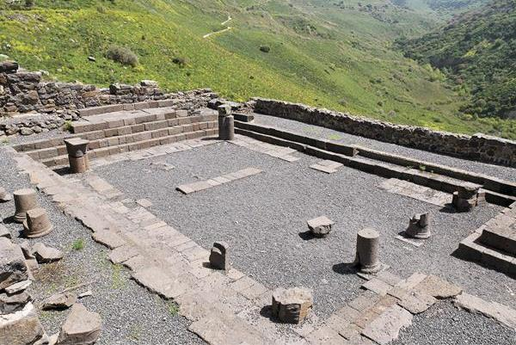
The excavated remains of the synagogue in Gamla show the basic layout with stepped benches on four sides of the assembly hall and columns supporting a clerestory ceiling.

Slide 28
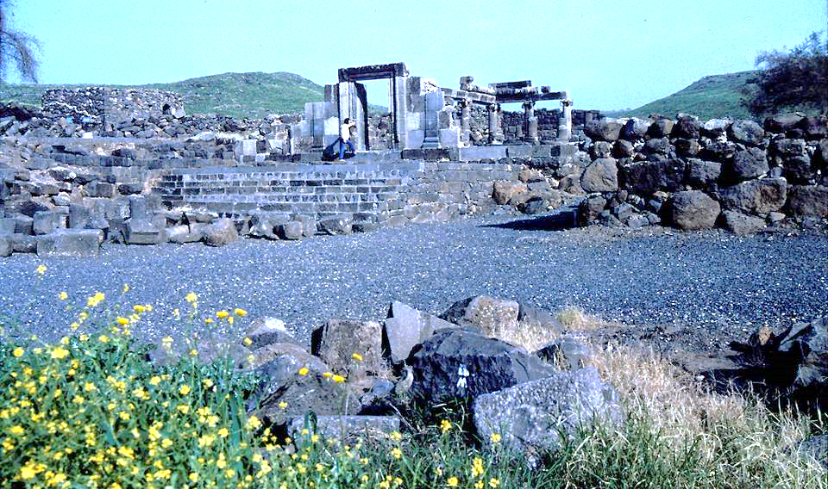
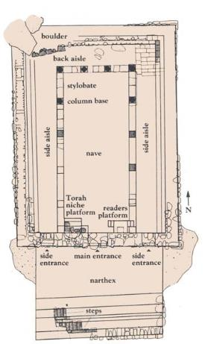
The remains of this synagogue in Chorazin, Galilee, under excavation since 1980, show the reconstructed portals allowing entrance on the south side facing Jerusalem. The synagogue measured approximately 83’ x 58’.
Chorazin synagogue floor plan

Slide 29
The teachers of the law and the Pharisees sit in Moses’ seat. So you must obey them and do everything they tell you. But do not do what they do, for they do not practice what they preach.
Matthew 23:2-4

Slide 30
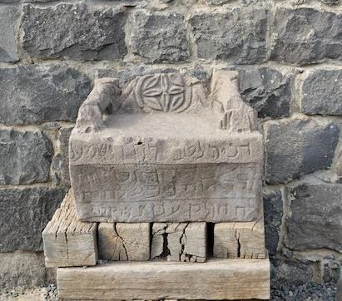
In 1926, archaeologists discovered a decorated basalt stone seat in the Chorazin synagogue with a dedicatory inscription in Aramaic.
Many scholars believe it may have served as the place where a rabbi would sit to expound scripture, what Jesus called “Moses seat” (Mt. 23:2).

Slide 31
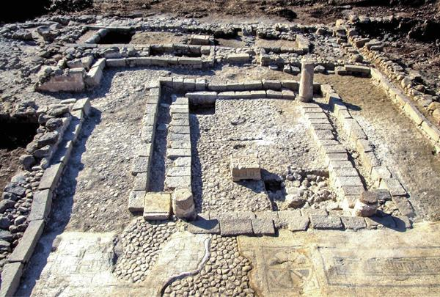
Archaeologists have uncovered two synagogues at Magdala, and these are the remains of one of them. Notice the floor mosaics (near the bottom).

Slide 32
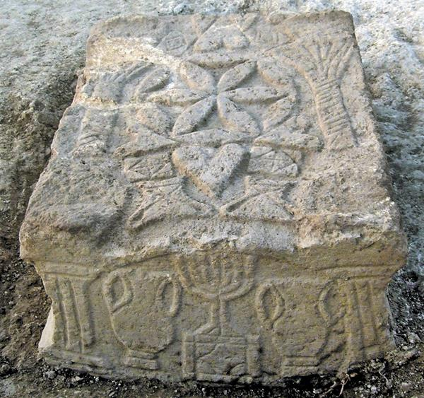
The Magdala Stone
The purpose of this highly decorated stone in one of the Magdala synagogues is a bit of a mystery. Was this a “table” from which the Torah scrolls were read, as suggested by some scholars, or was its purpose altogether different? At present the question remains wide open.

Slide 33
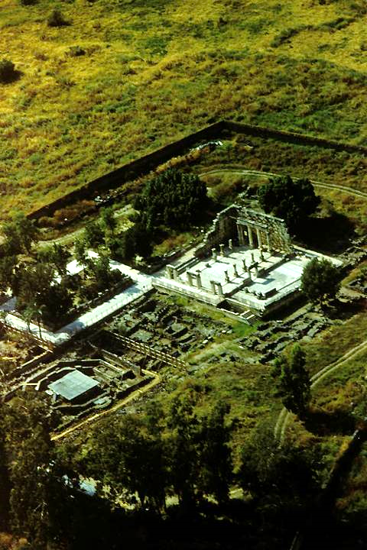
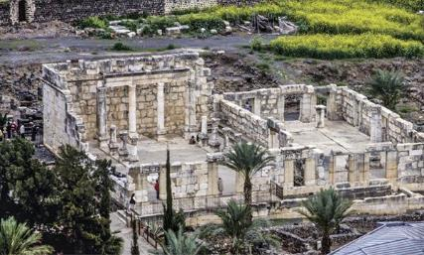
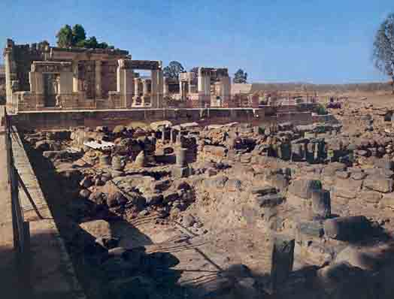
Excavations at Capernaum include a partially-restored synagogue (4th century) built over the more ancient synagogue which was there in the time of Jesus. It was customary for a new synagogue to be built over the remains of the older one. The older one has been dated by pottery and coins.
The black basalt stone in the foreground belongs to residences in Capernaum. Though not fully excavated, the ancient synagogue from the 1st century was built from the same stone and on nearly the same plan as the 4th century synagogue above it.

Slide 34
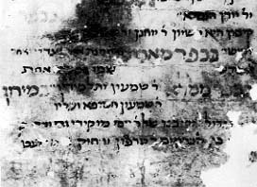
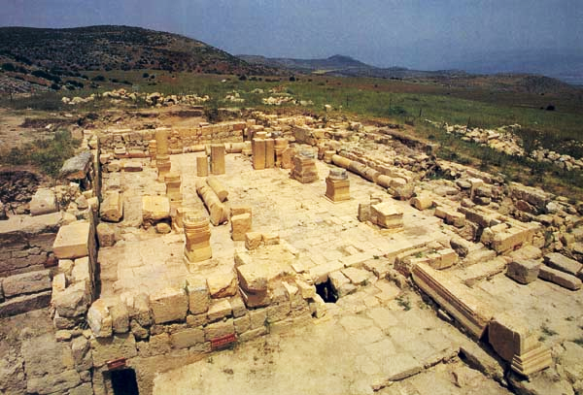
According to the gospels, Jesus visited many synagogues, mostly unnamed. While there is no way to know whether or not Jesus ever visited the one at Meroth in northern Galilee, it’s architecture is similar to the other known synagogues from the 2nd Temple Period.
Unlike most discoveries, this one was not made by an archaeological survey. Rather, it was discovered through an ancient text housed in the Cambridge University Library.

Slide 35
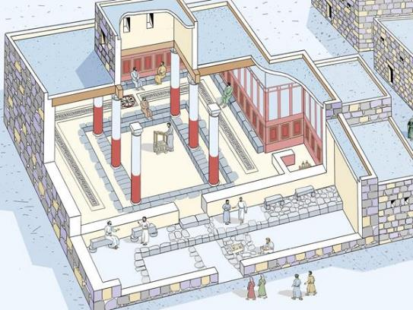
Jesus in Debate
Not only did Jesus teach and preach in the synagogues, the gospels often depict him in debates and discussions, especially with the Pharisees, whose provenance was the synagogues.
Debate about healing the man with the shriveled hand (Mk. 3:1ff.; Lk. 6:6ff.)
Back and forth discussion on the bread of life (Jn. 6:59)
Debate between Jesus and a synagogue official over healing on the Sabbath (Lk. 13:10-17)
The quadrilateral shape of the assembly hall with benches opposing each other lent itself to discussion and debate. This reconstruction of the Magdala synagogue illustrates the setting for such debates.
Such discussion and debate seems to have been normative.

Slide 36
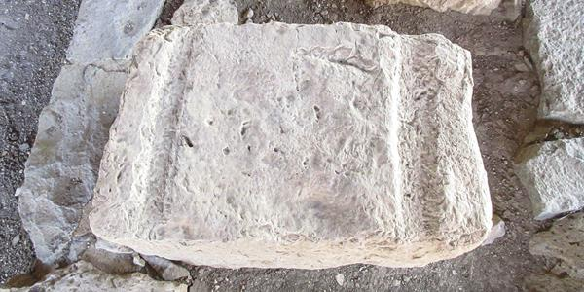
One of two limestone blocks with grooves discovered in one of the Magdala synagogues. The grooved stones may have been used as reading surfaces for the scrolls, and the grooves may have held wooden dowels used as rollers on either end of the scroll.

Slide 37
The Ancient Synagogue Service (according to the Mishnah)
The ancient synagogue service consisted of two primary activities, prayer and the study of Scripture. The order of the service was highly structured:
Opening benedictions (call to “bless” the Lord)
Recitation of the Shema (Deut. 6:4-9; 11:13-21; Num. 15:37-41)
Prayer (from the lectern)
The Eighteen Benedictions (from before the Torah ark) to which the congregation responded, “Amen.”
Public reading of the Torah
Public reading of the Prophets
Sermon (exposition of Scripture)
Concluding benediction

Slide 38
Rejection At Nazareth (Lk. 4:14-30)
Jesus left the desert of temptation “in the power of the Spirit” and began teaching in the Galilean countryside.
  At Nazareth, his home town, he attended the synagogue service on the Sabbath and was selected to read from the scroll of Isaiah.
  He unrolled the scroll until he found the passage at 61:1-2, which he read, stopping in the middle of the sentence (omitting the saying about judgment).
  As the congregation sat expectantly awaiting his comments, he said simply, “Today this Scripture is fulfilled in your hearing.”
  Amazement was followed by incredulity, rejection, and a charge of blasphemy with the threat of death, but Jesus simply walked away unharmed.

Slide 39
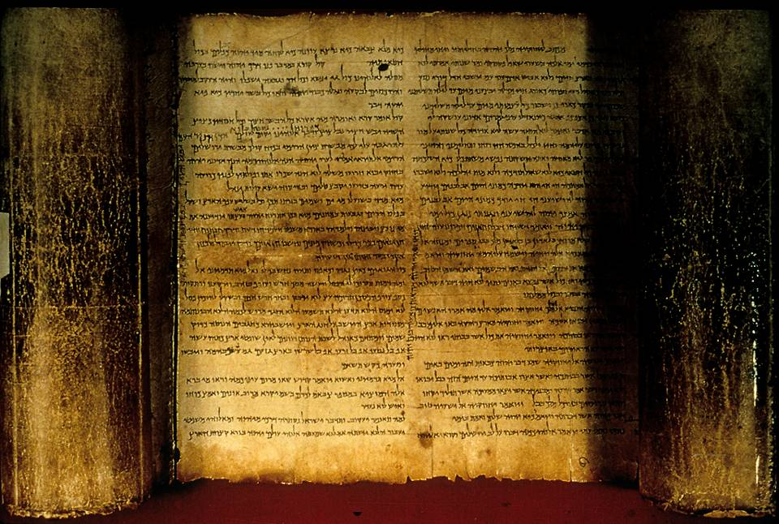
The Isaiah Scroll (Dead Sea Scrolls, 1QIsaª)
Jesus likely read from a scroll similar to this one in the synagogue at Nazareth (Lk. 4:16-20).

Slide 40
A little exercise in consonantal text…
Consonantal text is a text of consonants without vowels:
In English, for example, it might be “BRD,” which yields a host of possibilities.
bared
bard
braid
brad
beard
bread
breed
bred
bird
bride
bored
board
broad
brood
In reading an ancient Hebrew text without vowels, the reader must vocalize the text based on context and tradition.

Slide 41
Standard Hebrew square text without vowel points (written right to left without word spacing or vowels)
YtxhvhyHwmNfyylfhvhyyndxHvr
Myvnfrwbl
With word spacing
Ytx hvhy Hwm Nfy ylf hvhy yndx Hvr
Myvnf rwbl
With vowels
Ytixo hv!hy4 HwamA Nfay1 ylAfA hv!hy4 yn!dox3 HaUr
Myvin!f3 rwebal;

Slide 42
English consonantal text without vowels or word spacing (written right to left)
tmdtnnshdrlhtscbmnpsdgdrlhtftrpsht
rphttsgndtdghcrp
English consonantal text without vowels or word spacing (written left to right)
thsprtfthlrdgdspnmbcsthlrdhsnntdmt
prchgdtdngstthpr

Slide 43
English consonantal text with word spacing but no vowels (written left to right)
Th sprt f th lrd gd s pn m bcs th lrd hs nntd m t
prch gd tdngs t th pr
English consonantal text with word spacing and vowel subscripts (written left to right)
Th_{e} sp_{i}r_{i}t _{o}f th_{e} l_{o}rd g_{o}d _{i}s _{u}p_{o}n m_{e} b_{e}c_{au}s_{e} th_{e} l_{o}rd h_{a}s _{a}nn_{oi}t_{e}d m_{e} t_{o} pr_{ea}ch g_{oo}d t_{i}d_{i}ngs t_{o} th_{e} p_{oo}r

Slide 44
NT ARCHAEOLOGY
NT ARCHAEOLOGY
FROM GALILEE TO JERUSALEM
Lesson 6
Lesson 1
Introduction

Slide 45
Jesus’ Visits to Jerusalem
While much of Jesus’ public ministry was in Galilee to the north, at various times he traveled to Jerusalem, a trip of about 75 miles. John’s Gospel, especially, documents these trips southward.
Passover on three occasions (Jn. 2:23; 6:4; 12:1, 12)
An unknown festival, possibly Pentecost (Jn. 5:1)
Booths (Jn. 7:2, 8-10)
Hanukkah (Jn. 10:22-23) – called “Dedication” in the gospels
Two narratives in Jerusalem feature the large pools of Siloam and Bethesda.

Slide 46
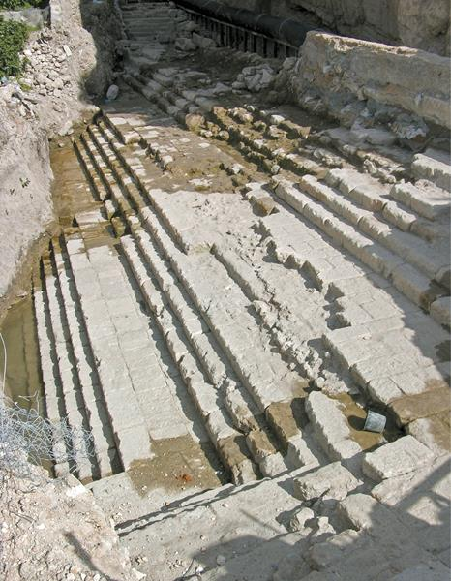
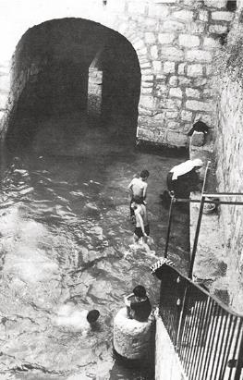
In 2004, the actual pool of Siloam was discovered during a city sewer repair, and archaeologists were quickly brought in to excavate it. They uncovered the large, slightly trapezoid shaped pool (225’ long) with 15 steps in three segments of five steps each with broad landings between the segments.
The stepped segments accommodated varying water levels in the pool, depending upon the season.
Four coins were embedded in plaster, all dated a few years prior to the time of Jesus
This south end of Hezekiah’s tunnel was thought by many to be the Siloam Pool, but actually, it was constructed by the Byzantine Empress Eudocia in the 5th century.

Slide 47
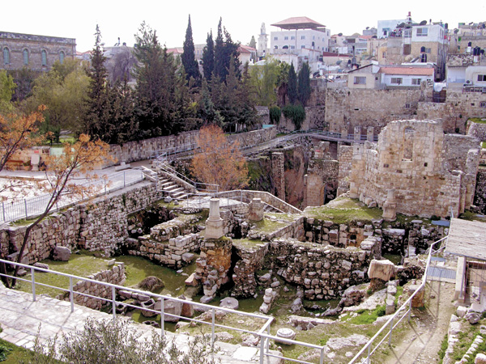
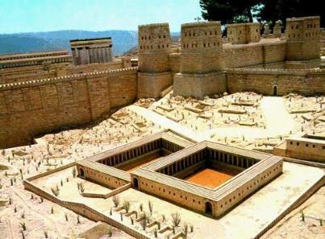
The remains of the Pool of Bethesda, which actually was two connected pools, a northern and southern pool, is obscured in a jumble of ruins. The southern basin (center) is barely visible.
Here, Jesus healed an invalid (Jn. 5:1-15).
A model of the double pool was constructed by a French architect based on archaeological data.

Slide 48
The Travelogue
Luke 9:51 marks a special transition in the Third Gospel. From 9:51 until 19:44, Luke will depict Jesus as “on his way” to Jerusalem, his final trip. Luke’s travel language reinforces this motif:
  “…as they were walking along the road” (9:57)
  “…he sent them ahead of him to every town and place where he was about to go” (10:1)
  “As Jesus and his disciples were on their way…” (10:38)
  “…Jesus made his way toward Jerusalem” (13:22)
  “Large crowds were traveling with Jesus…” (14:25)
  “Now on his way to Jerusalem…” (17:11)
  “Jesus said, ‘We are going up to Jerusalem…” (18:31)
  “He went on ahead, going up to Jerusalem” (19:28)
  “As he approached Jerusalem…” (19:41)

Slide 49
As the time approached for him to be taken up to heaven, Jesus resolutely set out for Jerusalem.
Luke 9:51
“We are going up to Jerusalem, and the Son of Man will be betrayed to the chief priests and the teachers of the law. They will condemn him to death and will turn him over to the Gentiles to be mocked and flogged and crucified. On the third day he will be raised to life.”
Matthew 20:18-19

Slide 50
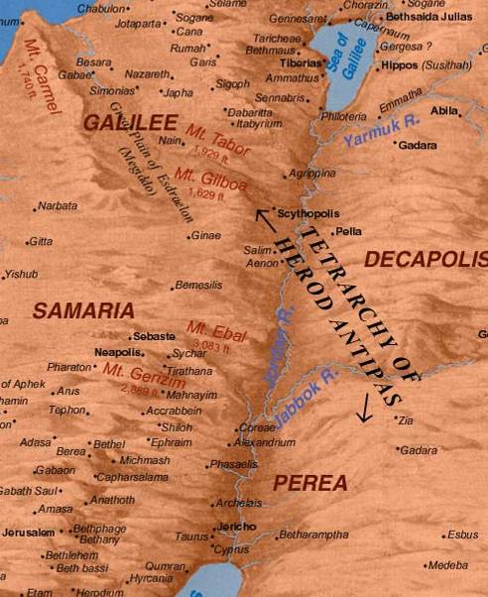
Travel between Judea and Galilee followed one of two routes. The more usual route was to ford the Jordan at Jericho, travel up the eastern side of the river, and ford again near the southern end of the Sea of Galilee. The less traveled route was more direct, through Samaria, but due to hostile relations between Jews and Samaritans (as well as the risk of ritual impurity), it was rarely used.

Slide 51
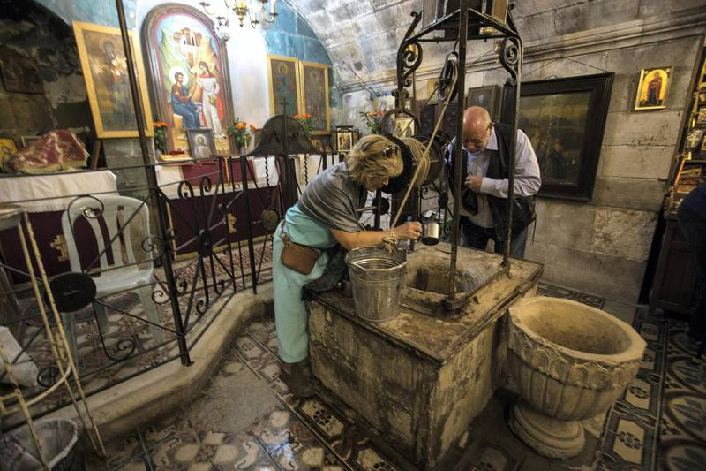
Christians on pilgrimage visit Jacob’s Well at Sychar on the outskirts of the Palestinian city of Nablus (Jn. 4:6).
Constructed into bedrock, this well is traditionally the site where Jesus engaged in conversation with the Samaritan woman. The tradition goes back to the 330s AD based on the writings of pilgrims who visited it then. It is currently maintained by the Greek Orthodox Church.

Slide 52
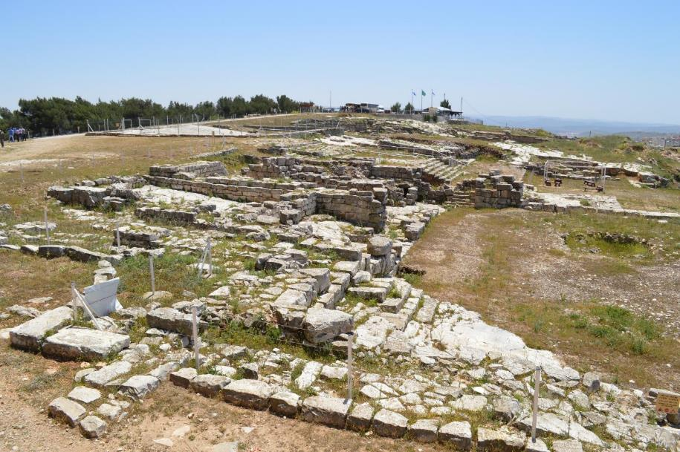
These ruins once belonged to the 2nd Samaritan Temple on Mt. Gerizim. Excavations began in 1982 and have continued uninterrupted ever since.
The first phase of the temple on Mt. Gerizim was erected in the 5th century BC. In the 2nd century BC, a larger edifice was constructed, but John Hyrcanus of Jerusalem, razed it to the ground in the late 2nd century BC. Hostilities continued into the time of Jesus.

Slide 53
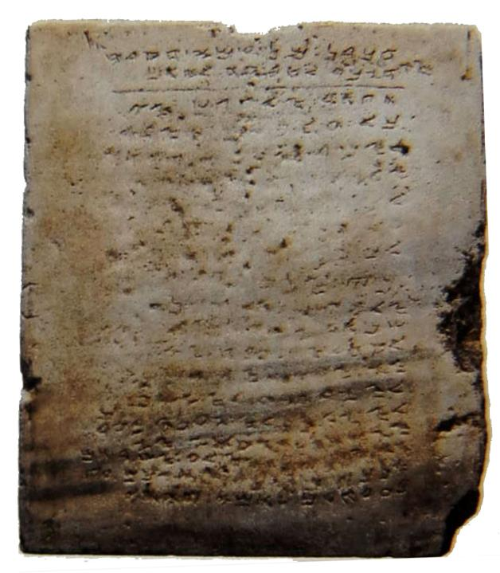

Mt. Gerizim
This Samaritan stone tablet inscription at the right (dated AD 300-500) displays 9 of the 10 commandments, omitting the commandment about taking Yahweh’s name in vain, but including a charge to build a temple on Mt. Gerizim.
The Abisha scroll of the Samaritan Pentateuch at the left specifies Mt. Gerizim as the site where the temple was to be constructed (Dt. 12).

Slide 54

In 14 BC, Herod built a winter palace at Jericho with luxurious amenities, courtyards, sunken gardens, and swimming pools, not to mention orchards and farms for dates, honey, spices, and perfumes.
Here, the temperature would be warm in the winter, and it was only a day’s ride to Jerusalem.

Slide 55

The remains of this bath from Herod’s Jericho palace gives some idea of the opulence of the place.
The palace was near the road from Jericho to Jerusalem, the last leg of Jesus’ journey from Galilee.

Slide 56

On his final day’s walk from Jericho to Jerusalem, Jesus would pass over this lonely stretch of road through the wilderness of Judea.
This section of Roman road is still preserved as it winds up through the hills just south of the Wadi Qelt.
His ministry had begun here with his 40 days in the desert, and he now passes the same area on his way to his death.

Slide 57

The Golden Gate as it is today was built by the Muslims near the end of the 7th century. It was blocked up in 1541, and the exterior face dates from the 16th century. Beneath this gate, however, is an older gate through which Jesus likely entered the city.

Slide 58



Coinage
The “widow’s mite” (Lk. 21:2), the smallest denomination in Roman coinage, was worth about six minutes of the average daily wage.
The question about the imperial tax was designed to put Jesus in a “lose/lose” situation. Jesus’ response implied that if the image of Caesar is in the coin, the image of God is in all humans—and they must give to God what belongs to him.
The Tyrian shekel, minted in Tyre, was required by the 2nd Temple priests when Jews paid their annual Temple Tax, possibly because the shekels were consistently pure (90% silver), much more so than any other coinage. The Tyrian shekel was also likely the type of coin used to pay off Judas for Jesus’ betrayal (Mt. 26:15).

Slide 59

The large courtyard surrounding the temple was the one place where anyone, even a foreigner, could come to pray. However, it had been taken over by a system that made it virtually impossible to use as a place of worship. Here, Jesus not only drove out the money-changers, he also healed the blind and lame who came to him there (Mt. 23:12-15), quoting from Isaiah that his house should be called a house of prayer for foreigners (Is. 56:6-7).

Slide 60

This photo of the traditional Garden of Gethsemane is on the lower slope of the Mt. of Olives, the area to which Jesus and the disciples went after the last supper (Jn., 18:1). Today, Franciscan monks tend the site, and while the olive trees growing here are very old, they are probably not the same trees as were there when Jesus prayed. (Conceivably, they might have grown from the same root system.)

Slide 61

One of the ongoing problems with traditional sites linked to Jesus’ life and ministry is that even though they are very old, it is an open question as to whether they are old enough.
This surface of bedrock in this church certainly goes back to the 1st century, but the tradition that it is the “Rock of Agony” where Jesus prayed on the night of his arrest is less certain. We know that a church in the 4th century was erected on this site based on tradition, and the present church was erected in the 20th century on the same site for the same reason.
After Christianity became legal through the Edict of Constantine (313), and Christian public shrines were first being established, the eagerness with which such sites were accepted as authentic leaves room for doubt.

Slide 62

Luke says that after his arrest in Gethsemane, Jesus was taken to the high priest’s home (Lk. 22:54), where he was tried and condemned. This site was marked fairly early in Christian tradition (4th century), and a 1st century section of stairway leading to this area and may well be the path by which Jesus was led before his accusers.

Slide 63


Next to the Church of St. Peter Gallicantu, archaeologists have discovered deep chambers hewn from bedrock that date to the 1st century.
Some have suggested that Jesus may have been imprisoned here by Caiaphas, largely based on the fact that some 14 Byzantine crosses were discovered here, suggesting that some early Christians may have revered this as a holy site connected to Jesus’ trial.

Slide 64


Traditional Site of the Last Supper
Though the present structure only dates to the Crusader Period, foundations beneath it may go back as far as the time of Jesus. This is the traditional site of the Last Supper (Mk. 14:13-15), called the Cenacle (from Jerome’s Latin Vulgate). Its earliest foundation seems to be from either an ancient synagogue or a church that may have existed prior to the destruction of the 2nd temple.

