Slide 1
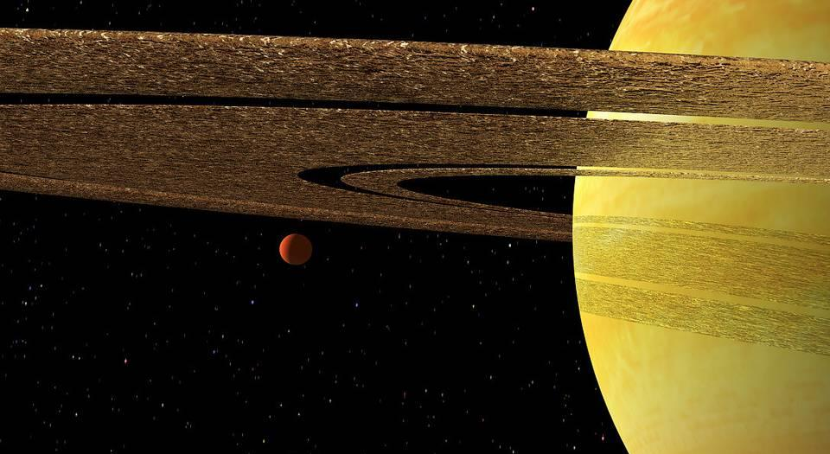
tywixr2B;
In the beginning…
The Book of Genesis
Creation (Part 1)

Slide 2
The Books of Moses
The first five books of the Bible are called the Books of Moses:
In the Hebrew Bible, they are called Torah, which means, “instruction.”
In the Septuagint (LXX), the Greek translation of the Hebrew Bible, they are called the Pentateuch, which means, “five books.”
The first of these books is Genesis (a title that comes from the LXX). In Hebrew tradition it is titled by the first word, which is tywixr2B; (Bereshith), meaning “in the beginning.”

Slide 3
Author
Formally, the Book of Genesis is anonymous (i.e., it does not name its author)
Traditionally, Moses is credited with compiling the Torah.
  Even if Moses did so, however, he was not a personal witness to the events, since they occurred long before his lifetime.
  It generally is conceded that the narratives were compiled from pre-existing traditions (either oral or written).
  Furthermore, there is evidence of later hands than Moses (Ge. 14:14//Jg. 18:29; 36:31ff., etc.), so the final form of the book was likely not reached until a later period.

Slide 4
Scope
Primeval History
Creation (1-2)
Human Rebellion (3-5)
Great Flood (6-9)
Nations (10-11)
Patriarchal History
Abraham (12-25)
Isaac (25-26)
Jacob 27-36)
Joseph (37-50)

Slide 5
Uniqueness of Genesis 1-11
The primeval history exhibits three horizons that make it distinct.
HISTORICAL
…a record of real people and events
SYMBOLIC
…the use of archetypes to represent primordial truths about people and events
APOLOGETIC
…a corrective to the then-current Egyptian and Mesopotamian cosmogonies
The Israelites who first heard these stories would be coming out of Egyptian culture and moving northeasterly to Canaan and closer to Mesopotamian culture.

Slide 6
In the beginning, God [Elohim] created the heavens and the earth.
Genesis 1:1
“I believe in one God the Father Almighty, Maker of heaven and earth.”
Apostles Creed
Nicene Creed
God as the Creator is the very first confession in the ancient faith of the Christian church.

Slide 7
Creation in Genesis
Genesis contains two complementary creation accounts
1:1—2:4a
Consistently uses the Hebrew name Elohim to designate God
Moves from formlessness to form, emptiness to habitation
Gives equal attention to celestial bodies, animal and plant life, and human life
2:4b-25
Consistently uses the Hebrew name Yahweh Elohim to designate God
Focuses on the humans themselves
While the rest of the universe is briefly mentioned, the first humans are the central feature

Slide 8
The Poetic Character of the Creation Story
The universally recognized central feature of Hebrew poetry is parallelism, and the creation story features a marked parallel structure.
The use of poetry to describe the origin of the universe is common in other biblical reflections on the creation (Ps. 33:6-9; 65:5-7; 102:25-26; 104:1-25; Pro. 3:19-20; 8:22-31; Is. 44:24; 45:12; Je. 51:15-16).
Poetic accounts should not be read in the same way as simple narrative descriptions. Rather, they have a high degree of metaphorical language.

Slide 9
The Poetic Structure of the First Account
And God said…
let there be…
and it was so…
it was good…
evening and morning…
ANNOUNCEMENT
COMMAND
REPORT
EVALUATION
CONTEXT

Slide 10
Parallelism in the First Account
(ABC//A’B’C’)
Forming
Filling
THE THREE PRIMARY DOMAINS
1st Day (celestial)
Light and dark
2nd Day (sublunary)
Sky and water
3rd Day (terrestrial)
Earth and seas culminating in the production of vegetation and its seed
INHABITANTS OF THE THREE DOMAINS
4th Day
Sun, moon and stars
5th Day
Birds and fish
6th Day
Livestock, game, and creeping things culminating in humanity and its seed

Slide 11
Discussion
The earliest creeds of the Christian church, the Apostles’ Creed and the Nicene Creed, begin with the creation. Why is this the first point in expressing Christian faith?
Many modern people attempt to find answers to modern scientific questions in the Genesis story of creation. If we seek answers to questions from a text that it does not purport to answer, what are the risks?

Slide 12
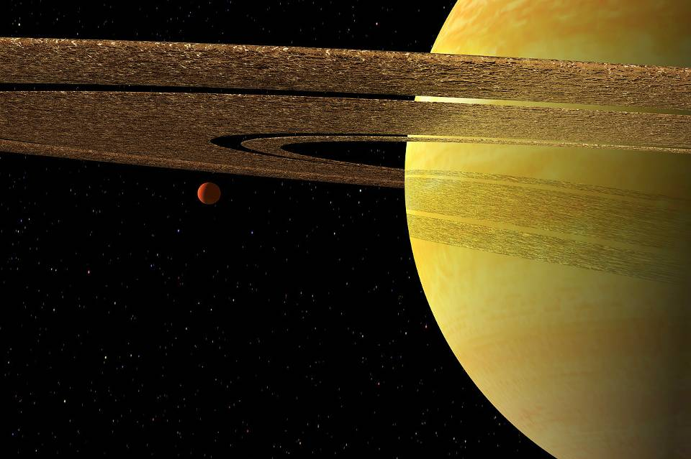
The Universal Reference Point
I …and nothing
I …and it, or
I …and Thou
EITHER…

Slide 13
THE FIRST CREATION ACCOUNT ANSWERS A UNIVERSAL QUESTION:
How does the universe exist?
From Nothing
(atheism)
Here, one cannot assume the existence of anything—energy, mass or motion. Nothing means absolutely nothing.
This position requires an incredible leap of logic.
From the Impersonal
(atheism/pantheism)
Here, one must begin with the eternal existence of impersonal matter that evolved into the personal.
It begs the question: can the impersonal give birth to the personal?
From the Personal
(theism)
Here, the universe is the creation of a personal God. The universe has meaning that is derived from its Creator.
The personal gives birth to the personal.

Slide 14
tywixr2B;
In the beginning…
The Book of Genesis
Creation (Part 2)

Slide 15
Then God said, “Let us make man (‘adam) in our image, in our likeness...” So God created man (‘adam) in his own image, in the image of God he created them; male and female he created them.
Genesis 1:26-27
And the LORD God formed man (‘adam) from the dust of the ground and breathed into his nostrils the breath of life, and man became a living being.
Genesis 2:7
When God created man (‘adam), he made him in the likeness of God. He created them male and female; at the time they were created, he blessed them and called them “man” (‘adam).
Genesis. 5:1-2
“Remember that you are dust, and to dust you shall return.”

Slide 16
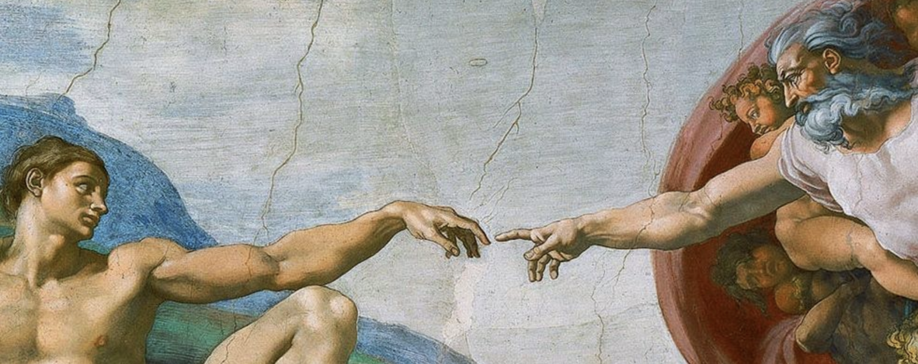
Michelangelo’s fresco of Adam’s creation, Sistine Chapel, Vatican City (1508-1512)

Slide 17
Poetic Character in the Primeval Names
The poetic story line…
…to the Soil-Creature and his wife, Life, were born Acquire and Vapor. When Vapor was murdered by Acquire, Acquire was banished to the land of homelessness. Later, Soil-Creature and Life had another child, named Granted.
MdAxA (Adam = soil creature)
hV0!Ha (Eve = life)
Ny9q1 (Cain = acquire, forger)
Lb,h, (Abel = vapor)
dOn (Nod = homelessness)
Twe (Seth = granted)

Slide 18
The Language of Humanness
MdAxA (‘adam)
Derived from the word hmAdAx# (= soil)
Can refer to the first human either generically (i.e., “the human”) or by
proper name (i.e., “Adam”)
Can refer to the human race collectively (1:26)
Can refer to the first man and first woman collectively (5:2)

Slide 19
Imago Dei
As the crowning event in creation, God created humans in the divine image. Primarily this refers to:
Communal life (“Let us make man…in our image” -- the life of a human is not fully expressed as an individual but in communion with another)
Authority and stewardship (“Let them rule” -- humans are superintendents over the created order)
THE UNIQUENESS OF HUMANS IN GOD’S IMAGE:
Personal Creative Transcendent Moral
Intentional Self-aware Relational

Slide 20
The Second Creation Account Focuses on what it means to be human
While vegetable life is depicted as wholly created, animate life is depicted as a composite of a created element and an uncreated element (2:7).
The sod, soil (created element)
The divine breath (uncreated element)
Only in this way does the human become a “living being,” and death is the separation of these two entities (cf. Job 34:14-15; Eccl. 12:7; Ps. 146:4; Ja. 2:26).
As a living being, humans were created free. However, they could only remain free by the power of obedient choices in response to God’s directives.

Slide 21
Humans, Gender & Marriage
2:4b-25
The man and the woman were brought together by God, who, like the father of the bride, brought the woman to the man (2:22-23). The four “musts” of marital union define marriage:
Independence (leaving)
Psychological and physical independence from parents (the “man” shall leave, which is counter-cultural in the ancient Near East)
Permanence (cleaving)
The bond is intended to be permanent; their first priority is now each other.
Union (the two shall be one flesh)
“One flesh” suggests a coming together on all levels so that each is fulfilled in the other. Marriage is heterosexual, the union of partners distinct from each other.
Intimacy (they were naked and unashamed)
“Nakedness” implies openness, both sexually and spiritually, without exploitation.

Slide 22
Discussion
Given what the Bible offers as the origin of humans, what might this narrative tell you about yourself as a human person?
What parts of the biblical story about human origins seem most difficult to accept by modern people?

Slide 23
AN ANCIENT QUESTION:
How does the universe exist?
Egyptian Cosmology
In Egypt
The universe was created by Re, who created himself by self-generation.
Other deities were formed by divine sneezing, spitting or masturbation.
The gods and goddesses were personifications of nature.
NUT (= the upper plate, the heavens)
SHU (= air)
ddd ddd
hhhhhhhhhhhhhhhhhhhhhhhhNUN (= primeval waters) hhh
GEB (= the lower plate, the earth)
NAUNET (= chaos)

Slide 24
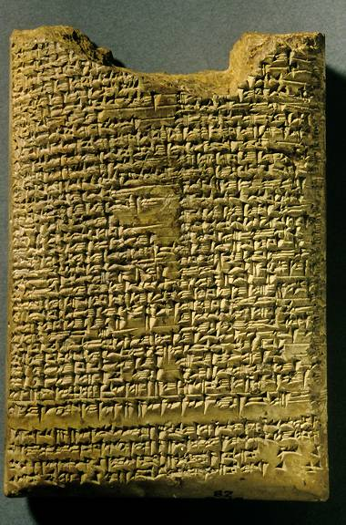
AN ANCIENT QUESTION:
How does the universe exist?
Enuma Elish, Tablet IV
British Museum, London
In Mesopotamia
Creation was the result of a violent primeval conflict.
Marduk (god of order) fought Tiamat (goddess of chaos), defeating the gods of chaos, and splitting Tiamat’s corpse into sky and earth.
Humans were created out of the blood of the slain god Kingu.

Slide 25
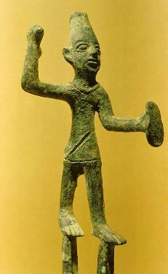
AN ANCIENT QUESTION:
How does the universe exist?
In Canaan
Ugaritic myths focus not so much on origins as on how the universe operates.
The gods are not the greatest power, but rather, magic can be brought to bear upon the gods, other humans, nature and events.
The primary myth depicts Ba’al (god of rain) and his consort Anath (goddess of fertility) building a palace.
Mot (god of death) slays
Ba’al, taking him to the underworld.
Anath retaliates by killing Mot, whereupon Ba’al rises again to reclaim his palace.
Ba’al
This mythology explains the cycles of the seasons, which could be controlled by magic ritual.

Slide 26
The Genesis Account: as an apologia in view of the existing ancient Near Eastern cosmogonies
The Genesis creation account of origins:
Yahweh alone is the Creator (and he has no consort)
The celestial bodies are neither gods nor goddesses; rather, they are simply things that God made
The creation of humans was not an afterthought—it was the climax of all creation.

Slide 27
Discussion
How might the creation story have been perceived by non-Israelites in the ancient world?
What might be the effects of accepting a universe with an unguided origin as opposed to a universe created by a personal God?

Slide 28
tywixr2B;
In the beginning…
The Book of Genesis
Fall, Flood, and Dispersion

Slide 29
Now the serpent was more crafty than any of the wild animals the LORD God had made. He said to the woman, “Did God really say, ‘You must not eat from any tree in the garden?’”
“You will not surely die,” the serpent said… “For God knows that when you eat of it your eyes will be opened, and you will be like God, knowing good and evil.”
Genesis 3:1, 4-5

Slide 30
The Two Trees at the Center
The account of the fall describes what it means to be in a broken relationship with God.
At the center of the garden were two trees, the tree of life (the source of life) and the tree of the knowledge of good and evil (the source of death).
Hence, physical life and physical death point to a more profound spiritual life and spiritual death.
Pure relationship with God, grounded in innocence and obedience, was replaced with an experiential relationship with good and evil grounded in disobedience and rebellion.

Slide 31
The Snake
The snake is not further defined in Genesis 3 except as a voice opposing God.
While it has always been assumed that the snake was the guise of Satan, this is not clearly stated until the New Testament (cf. Ro. 16:20; Rv. 12:9; 20:2).
At the same time, the Old Testament uses stock imagery from the ancient Near East describing Satan as a snake-like monster:
  RAHAB (the sea dragon over whom Yahweh triumphed, cf. Job 9:13; 26:12; Ps. 89:9-10; Is. 51:9)
  LEVIATHAN (also the sea dragon image, cf. Job 3:8; 41:1ff. Ps. 74:13-14; 104:25-26; Is. 27:1)
  BEHEMOTH (the beast or monster, cf. Job 40:15-24; see also 2 Baruch 29:4; 2 Esdras 6:49, 52; 1 Enoch 60:7-8)
  TANNIN (dragon, sea monster, serpent, cf. Job 7:12; Ps. 74:13; Is. 27:1; 51:9)

Slide 32
Shame
Shame is the first expression of disunion with God and others. It was not merely sexual, for the humans hid from God as well as from each other.
As sin matures, disunion with God is not expressed through shame, but pride, first toward others (4:23-24) and finally toward God (11:4).
While the psychological determinants of shame and pride are antithetical, they are expressions of the same basic alienation.
Shame expresses a relationship to sin defensively; pride expresses this relationship offensively.

Slide 33
The Curse and the Promise
The curse upon the snake set it apart from the livestock and wild animals, placing it in an antagonistic relationship to the humans.
The curse upon the man and woman is appropriate to their respective roles:
The man’s work (the ground is cursed with intrusions)
The woman’s work (the womb is cursed with pain)
The relationship between the man and the woman will now be defined by power rather than love (3:16b).
The promise of the crushing of the snake’s head is the earliest messianic hint—the protoevangelium (3:15; cf. Ro. 16:20).

Slide 34
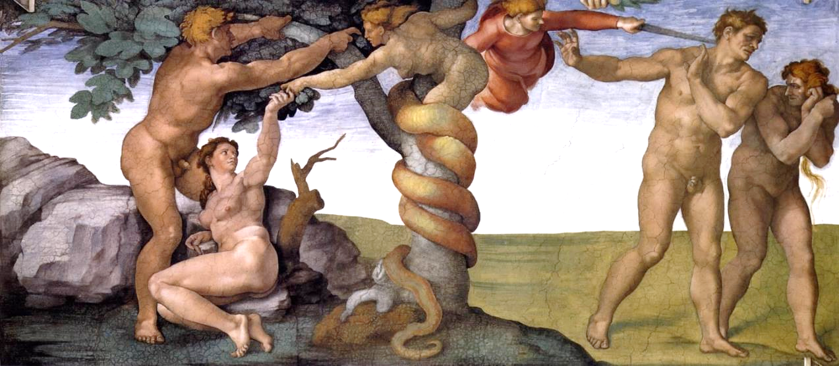
Michelangelo’s fresco in the Sistine Chapel in Vatican City depicts the fall and expulsion of Adam and Eve from the garden.

Slide 35
The Aftermath
The disobedience of the first humans created never-ending ripples of rebellion.
Resentment against God (4:1-7)
Fratricide (4:8-12)
Exploitation by power, the strong over the weak, the male over the female (4:23-24)
“East of Eden” becomes a symbol for human alienation from God (3:24; 4:16; 11:2).
While there is human progress in the arts and technology, human depravity mars this progress (4:17-22).
The birth of Seth offers hope for the future as some men began to seek after God (4:25-26).

Slide 36
Discussion
What does the story of the fall tell us about humans and their relationship with God?
What does it tell us about the nature of temptation?
How would you define sin?

Slide 37
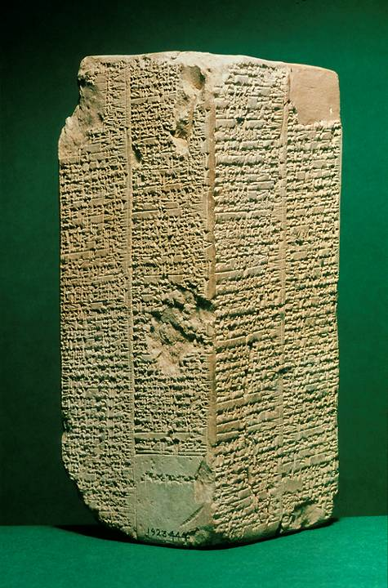
The Sumerian King List
Near the end of the 3rd millennium BC
List of early Mesopotamian kings who lived “until the time of the great flood” as well as after it, the early ones with extremely long life-spans (some reigning as long as “64,800 years”). The purpose was evidently to show that Mesopotamia had always been ruled by a single king.
Ashmolean Museum, Oxford, England

Slide 38
Flood Stories
There was a vivid collective memory in the ancient Near East of a massive, destructive flood. If the Genesis creation account was a corrective to other ancient Near Eastern creation myths, the Genesis flood story was equally a corrective to existing flood stories.
The Genesis flood account has clear resemblances to Sumerian and Babylonian flood stories:
  The gods instruct a hero to build a boat and caulk it with pitch.
  He is instructed to take animals with him into the boat.
  The world population is destroyed.
  After the flood, the hero releases birds to see if the waters have receded.
  The boat comes to rest on a mountain.
  After leaving the boat, the hero offers sacrifices, and the gods smell the sweet odor.
These flood stories are older than Genesis.

Slide 39
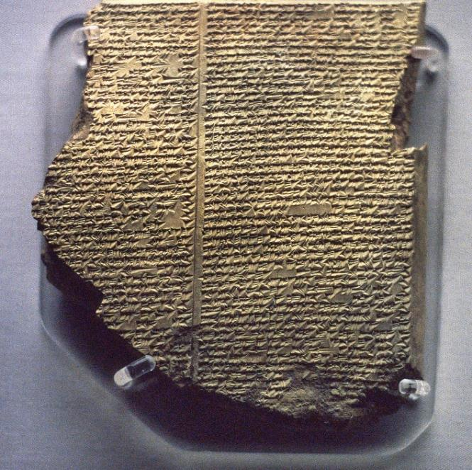
The Gilgamesh Epic from the library of Ashurbanipal
Tablet 11 of a larger 12 tablet epic describes the flood hero Utnapishtim, who built a boat, survived the flood, released a dove, released a swallow, and then released a raven. He emerged from the boat, offered sacrifices and was granted eternal life.
British Museum, London

Slide 40
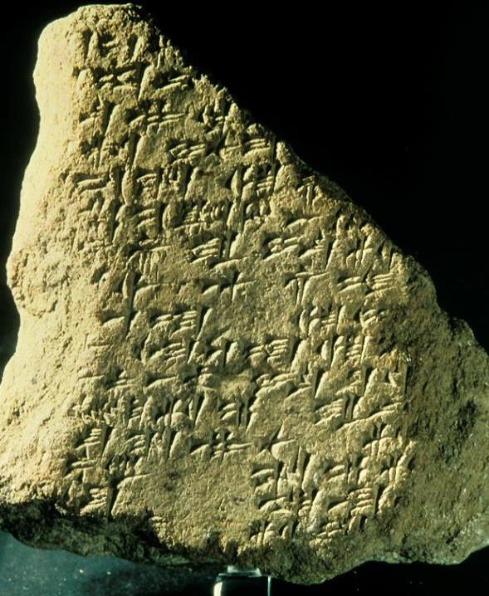
Gilgamesh in Galilee
That the Mesopotamian flood story was known in Canaan, where the Israelites were going, is verified by this fragment of the Gilgamesh Epic found at Megiddo in the 1950s. It dates to the 14th century BC.
Hence, the importance of the biblical corrective is underscored.

Slide 41
What is most significant about the Genesis flood story are its dissimilarities from its Mesopotamian counterparts.
Mesopotamian Accounts
The gods are characterized by their cruelty, irritation and anger.
The gods decide to destroy humans because they are too noisy and over-populated.
The surviving family is spared because of belief in a god who didn’t support the decision to destroy the world.
Genesis Account
Yahweh God is characterized by moral grief over human sin.
Yahweh God sends the flood as a moral judgment because of wickedness, violence and perversity.
Noah and his family are spared because he is righteous and obedient.

Slide 42
Four Primary Issues About the Flood Continue to be Debated
The extent of the flood (universal or local)
The date of the flood (with substantial evidence that humans crossed the Bering Strait well before 20,000 BC)
Flood geology (catastrophism is advocated by proponents of flood geology and debunked by other geologists)
The search for the ark (though several claims have been put forth, the evidence is scanty and highly questionable)
At the end of the day, these issues must be left open with no present resolution.

Slide 43
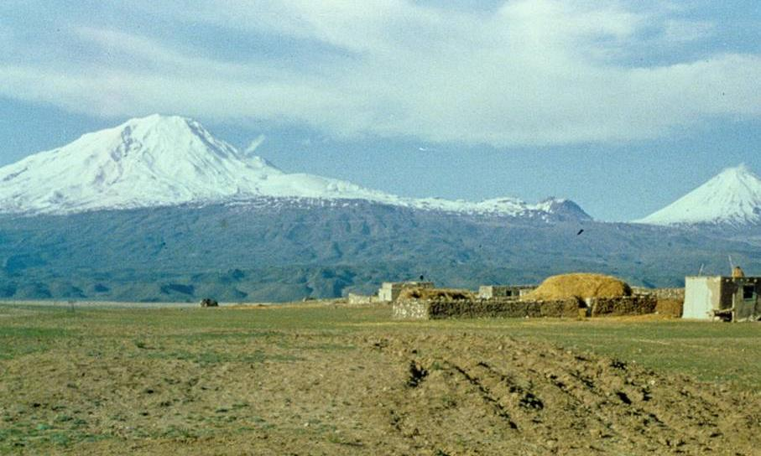
Mt. Ararat in easternmost Turkey, where the ark came to rest, rises to 16,690’, where it dominates the surrounding plain. It is the highest mountain in the Taurus Range.

Slide 44
The Universal Covenant
After the flood, Yahweh God established a covenant with Noah and his posterity and “all life” (9:8-17):
The mandate originally given to Adam to populate the earth is now repeated (9:1, 7; cf. 1:28), suggesting that in some sense Noah was a second “Adam.”
Now, the dynamic between human life and animal life undergoes a radical shift. Previously, only vegetable life had been sanctioned for food (cf. 1:29-30; 2:16). Now animals are sanctioned as well (9:2-3) with a restriction on eating blood, the symbol of life, which belongs to God (9:4).
Finally, there is a clear prohibition against murder along with the institution of capital punishment for murderers, since human life is made in the divine image (9:5-6).

Slide 45
Discussion
Some Christians have struggled with unanswered questions concerning the ancient flood stories arising from science, biology, and history. How far should we go in attempting to resolve such issues?
Can you see why the Genesis account was important to the Israelites coming out of Egypt and traveling to Canaan, which was more heavily influenced by Mesopotamian stories?
What does the flood story tell us about God?

Slide 46
Babel
As humans migrated eastward (the symbol of alienation from God, cf. 3:24; 4:16), they attempted a joint rebellion against God by building a tower (ziggurat) into heaven.
Later, the Sumerian description of the ziggurat at Babylon would be “the building of a foundation platform of heaven and earth” whose “top reaches to heaven.”
The very name “Babylon” (Assyrian Bab-ili) meant “gate of God.” The idea of “confusion” (11:9) is a pun with the Hebrew verb llabA (= confuse, mix).
The ziggurat was the ultimate symbol of human achievement, and the refusal to be scattered was a direct rebellion against God’s command to fill the earth (11:4; cf. 9:1).

Slide 47
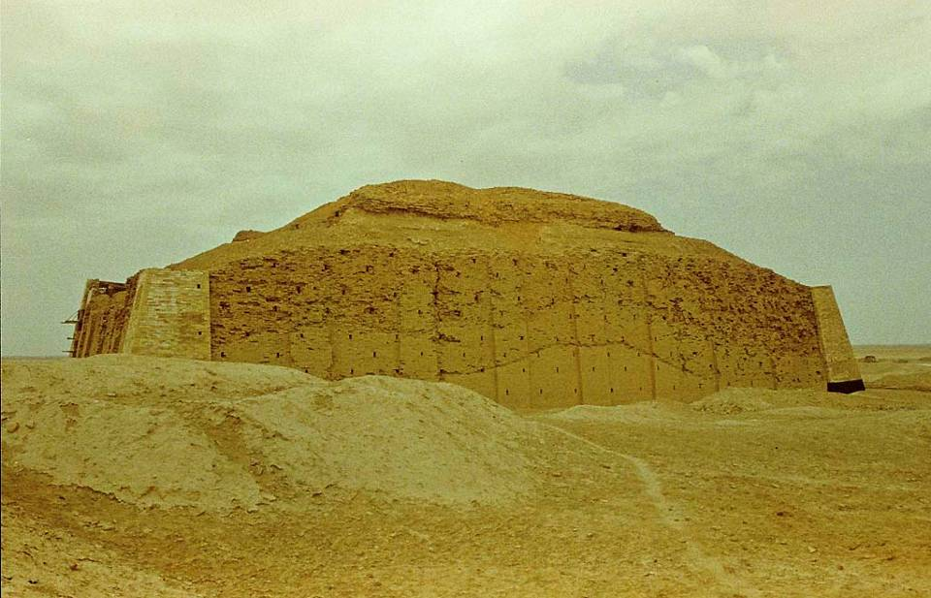
This is the lowest tier of the oldest Sumerian ziggurat constructed by King Ur-Nammu of Ur (2112-2095 BC) to celebrate his founding of a new dynasty. It was dedicated to the moon god Nannar. Ur was the birthplace of Abraham.

Slide 48
A World in Need of Salvation
Babel forms the climax of the primeval history, depicting a world deeply alienated from and in rebellion against its Creator.
The progress of human history is arrogant and destructive.
The earth is saturated with discord: husband against wife, son against father, son against son, people against creation, nation against nation, and all against God.
While Mesopotamian versions depict humans rising from obscurity to establish culture and asserting themselves through ingenuity, Genesis depicts humans as tragically fallen from a place of honor and goodness.
It was a twisted world, crying out for salvation.

Slide 49
tywixr2B;
In the beginning…
The Book of Genesis
(The Patriarchs)

Slide 50
The Patriarchal Cycle
The final 39 chapters of Genesis are a collection of narratives about the ancestors of the nation Israel. Here, we move from the prehistoric to the historic period, from primeval history to patriarchal history.
The emphasis shifts from a universal perspective (the whole human race) to an individual perspective (one man and his family).
The patriarchal cycle serves as a postlude to the primeval cycle and a prelude to the exodus story.
Yahweh’s promise to Abram that in his posterity all the families of the earth would find blessing is the beginning of the divine answer to the desperate human need for salvation.

Slide 51
Ages of Antiquity in Genesis
Palestine Egypt Mesopotamia
Early Bronze Age
EB I (3200-2800)
EB II (2800-2600)
EB III (2600-2350)
EB IV (2350-2200)
Middle Bronze Age
MB I (2200-2000)
MB II (2000-1550)
(Abraham)
Early Dynastic Period
(2920-2575)
Old Kingdom
(2575-2134)
1st Intermediate Period
(2134-2040)
Middle Kingdom
(2040-1640)
Early Dynastic Period
(2700-2400)
Akkad, Ur III
(2400-2000)
Old Babylonian/Old
Assyrian (2000-1600)

Slide 52
The LORD had said to Abram, “Leave your country, your people and your father’s house and go to the land I will show you.
  “I will make you into a great nation and I will bless you;
  I will make our name great, and you will be a blessing.
  I will bless those who bless you, and whoever curses you I will curse;
  and all people on earth will be blessed through you.”
Ge. 12:1-3

Slide 53
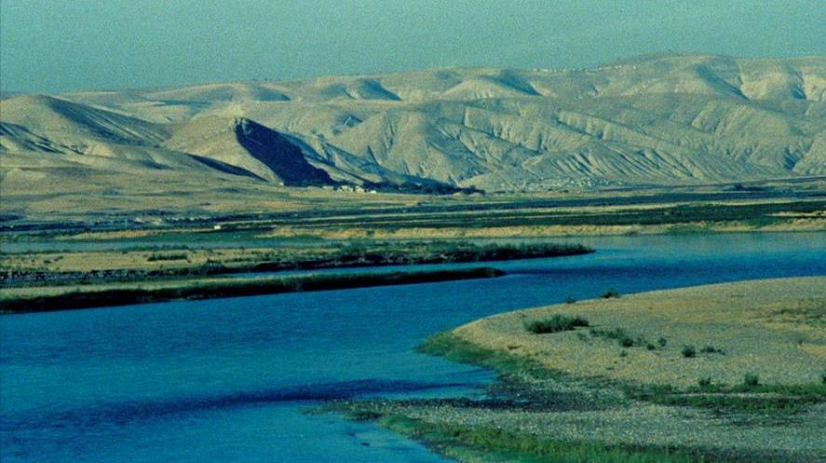
The mighty Euphrates River, 1780 miles long, was the major commercial artery in ancient Mesopotamia.

Slide 54
Abram’s Call (12:1-3)
In the first biblical episode in Abram’s life, God called him to separate himself from all natural ties (land, people and household).
In return, God promised to give Abram posterity and land and that he would be the means of blessing to the nations.
As the father of the faithful, Abram’s descendants were now marked off as a people to serve a theological purpose of universal significance.
For both the OT and NT, Abram’s call and promise offers a description of what biblical faith is about: the call to forsake one’s natural home and way of life in order to receive a home and way of life from God’s hand.

Slide 55
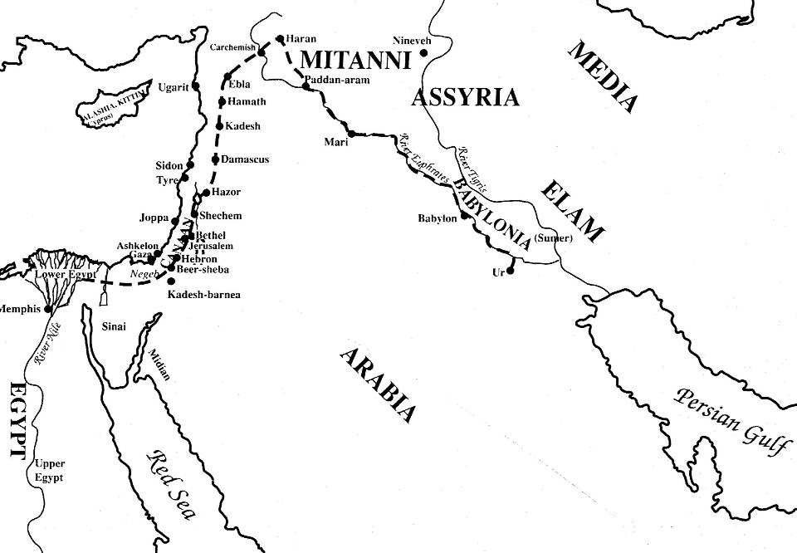
Abraham’s Journeys

Slide 56
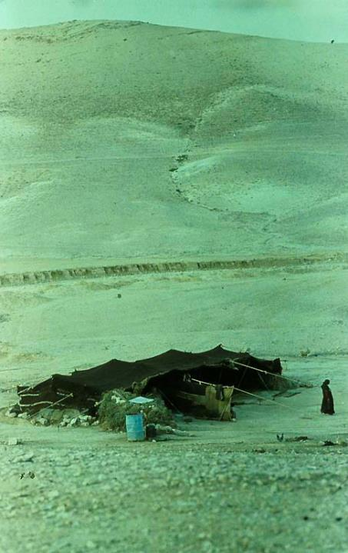
Tents and Altars
As a semi-nomad, Abram lived in tents (a sign of temporary residency).
However, he also built altars (a sign of permanency). The places where he built altars (Shechem, Bethel, Hebron, Moriah) would become sacred sites in the later history of Israel.
Bedouin tents and the semi-nomadic lifestyle have not changed greatly in the last four millennia.

Slide 57
Cutting (Heb. tr1KA) a Covenant
The form of covenant ratification is consonant with covenant practices in the ancient Near East, where the ritual of sealing an oath by cutting an animal in two and passing between the pieces is found in Mesopotamian literature.
Those passing between the animal halves bind themselves to a curse should they violate the covenant.
Here, Yahweh himself passed between the pieces, symbolized by the smoking oven and flaming torch.
An ominous warning anticipates the Egyptian bondage and exodus.
Now Yahweh added a covenant sign, circumcision, when Abram was 99 years old.

Slide 58
The Akedah (Binding)
(22)
Though the promise of a son through Sarah was fulfilled, the God who earlier had called Abraham to give up his past now called upon him to give up his future.
For the reader, this baffling instruction by Yahweh is “a test”; hence, the reader has a psychological advantage over Abraham.
Later, the Old Testament will identify Moriah as the same as Mt. Zion (cf. 2 Chr. 3:1), the site of the 1st temple. The sacrifice of Isaac serves as the prototype for the whole sacrificial system of substitutionary atonement.

Slide 59
Discussion
In the New Testament, St. Paul says that Abraham is the “father of all who believe” (Ro. 4:11b), and later, “the father of us all” (Ro. 4:16-17). What was there about Abraham that qualified him for this prestigious description?
God tested Abraham when he called him to go to the land of Moriah to sacrifice Isaac. Do you think God still tests his people?

Slide 60
Then God said to Jacob, “Go up to Bethel and settle there, and build an altar to God, who appeared to you when you were fleeing from your brother Esau.”
And God said to him, “I am El-Shaddai; be fruitful and increase in number. A nation and a community of nations will come from you, and kings will come from your body. The land I gave to Abraham and Isaac I also give to you, and I will give this land to your descendants after you.”
Ge. 35:1, 11-12

Slide 61
The Isaac and Jacob Stories (25-36)
Abraham’s son through Sarah and grandson through Isaac and Rebekah become the family line through which the covenant promises pass.
The fact that the covenant promises were made to Abraham and his “seed” meant that it was an enduring covenant for succeeding generations.
Isaac, Abraham’s son, had two sons, but the promises did not pass through Esau, the oldest (as would have been customary in the ancient Near East), but through Jacob, the younger.
Jacob, in turn, had twelve sons, and the patriarchal promises passed to all twelve as the tribal heads of the nation of Israel.
God reaffirmed the covenant promises to both Isaac and Jacob.

Slide 62
The Children of Jacob
Along with his daughters, Laban gave to Jacob his daughter’s maids, Zilpah and Bilhah.
In the cases of both Abraham and Isaac, the covenant promises passed to one son only. With Jacob, however, who had 12 sons, the covenant promises passed to all the sons without distinction.
Leah’s Sons
Reuben (1st)
Simeon (2nd)
Levi (3rd)
Judah (4th)
Issachar (9th)
Zebulun (10th)
(Dinah)
Rachel’s Sons
Joseph (11th)
Benjamin (12th)
Zilpah’s Sons
Gad (7th)
Asher (8th)
Bilhah’s Sons
Dan (5th)
Naphtali (6th)

Slide 63
Struggling with God
At the Jabbok in the Transjordan, Jacob sent his family over the ford but stayed by himself where he wrestled with a theophany of Yahweh.
His whole life he had struggled against Yahweh and others in order to achieve his birthright and blessing.
Now, he would receive it as a gift, but he would be wounded in the process.
In his blessing, where he confronted God face-to-face, his name was changed from Jacob (= heel-grabber) to Israel (= he struggles with God).
This incident becomes a paradigm for the history of the nation: struggle, suffering and victory.

Slide 64
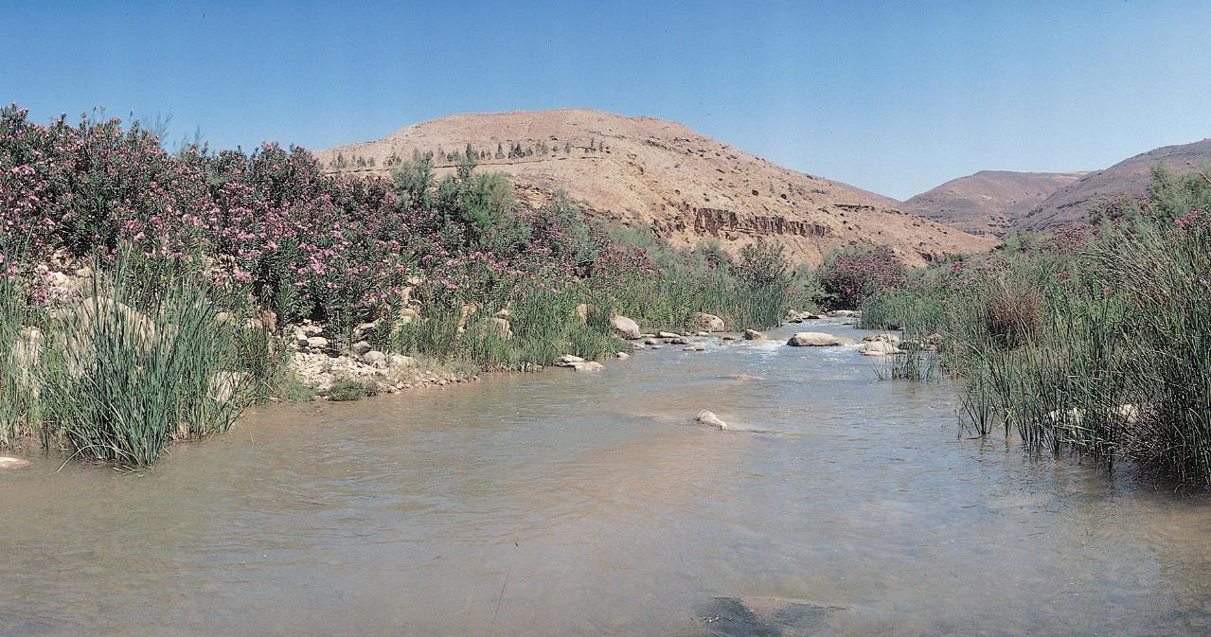
Fords of the Jabbok

Slide 65
The Joseph Stories
The Joseph stories detail how the descendants of Abraham came to migrate to Egypt.
Though Joseph’s brothers were evil-intentioned toward him, selling him to slave-traders, God’s sovereign purposes were supreme.
In Egypt, Joseph rose to become vizier of Egypt through whom God saved the lives of his whole family.
Genesis concludes with the family of Jacob settled in Egypt, which in turn prepares for the most important redemptive event in the Old Testament—the exodus.

Slide 66
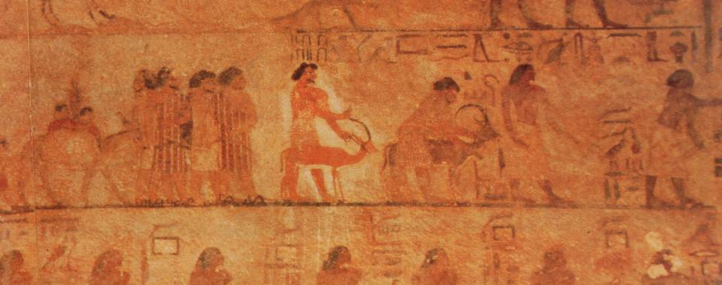
Sons of Israel Seek Grain in Egypt
The Beni Hasan mural (19th century BC) depicts Semitics entering Egypt to trade or negotiate. The presence of Asiatics in Egypt increased during the Hyksos Period (17th and 16th centuries BC), the probable time of the migration of Jacob’s family.

Slide 67
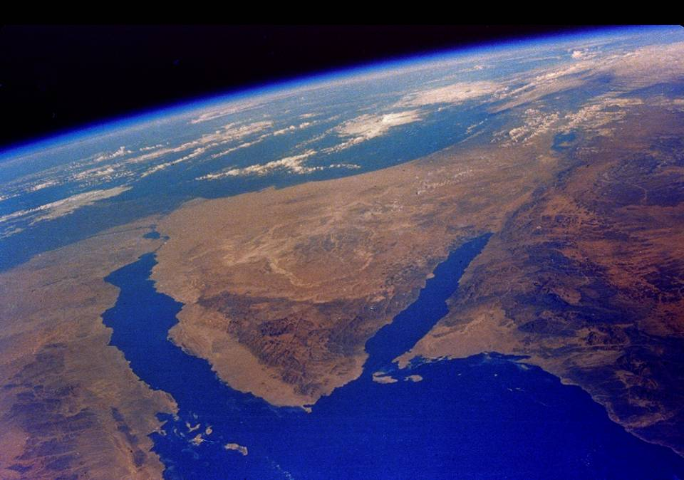
Egypt, the Sinai Peninsula, and Canaan

Slide 68
The Character of Salvation-History
Joseph’s explanation (47:4-8a), which is repeated later (50:18-21), becomes the paradox upon which the narratives of Genesis are built (and, indeed, much of the history in the Hebrew Bible).
  You meant it for evil!
  God intended it for good!

Slide 69
The Book of Genesis
serves as a prolegomena to the history of Israel, a history
that will occupy the remainder of the Hebrew Bible.

Slide 70
Discussion
In most ancient stories, the heroes triumph through personal ingenuity and strength. How are the biblical stories of the patriarchs different?
Why is the Book of Genesis so important, first for the faith of Israel, and second for the faith of Christians?

Slide 71
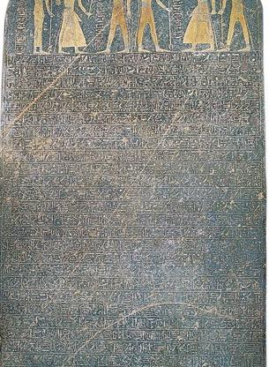
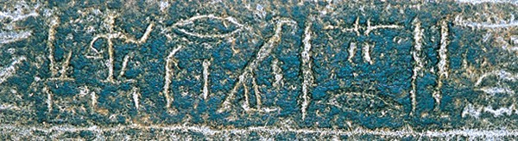
Out of Egypt
Exodoj
tOmw; hl.,xev4

Slide 72
Then Joseph said to his brothers, “I am about to die. But God will surely come to your aid and take you up out of this land to the land he promised on oath to Abraham, Isaac, and Jacob.”
Ge. 50:24

Slide 73
The Story
The exodus story is the most important narrative in the Hebrew Bible.
It describes how Yahweh chose Moses to be the founder of the nation Israel by leading them out of Egyptian slavery to the edge of Canaan, a land promised centuries earlier to Abraham, Isaac, Jacob, and Jacob’s sons (Ge. 12:7; 13:14-17; 15:7, 18-21; 17:8; 26:3; 28:13-13; 35:12; 48:3-4, 21; 50:24-25).
Earlier, God had predicted to Abraham that his descendants would be slaves for a long time before they would be able to possess this promised land (Ge. 15:13-16).
The exodus story, then, is the foundation narrative of a new nation, its peculiar worldview, and how it was redeemed from the land of Egypt.

Slide 74
The Themes of the Book of Exodus
Liberation
The opening is primarily concerned with the transition from oppression to freedom.
The author of this freedom is Yahweh.
Law
At Sinai, Yahweh announces his will for all aspects of Israel’s public and private life.
For Israel, all law is God’s law.
Covenant
A binding relationship is established between God and Israel.
This covenant envisions both judgment and hope.
Presence
God takes up residence in the midst of Israel in the tabernacle.
The “glory of God” is both an abiding presence and traveling assurance.

Slide 75
In the four hundred and eightieth year after the Israelites came out of Egypt, in the fourth year of Solomon’s reign over Israel, during the month of Ziv, the second month, Solomon began to build the temple of Yahweh.
1 Kings. 6:1
The year of David’s death and Solomon’s ascension to the throne is often calculated as 970 BC. Hence, Solomon’s fourth regnal year would then be 966 BC. Based on this, the common calculation of the year of the exodus from Egypt would be 1446 BC.
Alternatively, the figure “480” may be a programmatic number indicating 12 generations, a generation commonly calculated at 40 years (but amounting to much less than 480 actual years).

Slide 76
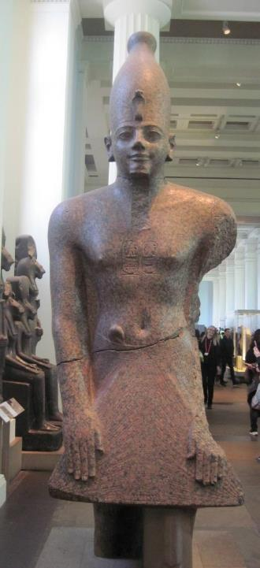
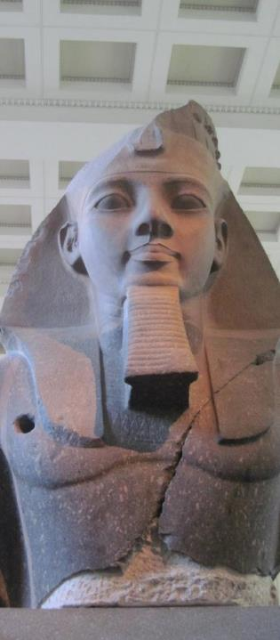
Thutmose III
(ca. 1479-1425 BC)
Possible Pharaoh of the exodus based on an early date (1 Kg. 6:1)
Alternative possibilities are Queen Hatshepsut (co-regent with Thutmose III at the beginning of his reign) and Amenhotep II (co-regent with Thutmose III at the end of his reign)
Ramesses II
(ca. 1279-1213 BC)
Possible Pharaoh of the exodus based on a later date
The use of his name in the accounts (Ge. 47:11; Ex. 1:11; 12:37; Nu. 33:3, 5), even though indirect, suggests this possibility as do archaeological factors.
Most scholars follow the later date.

Slide 77
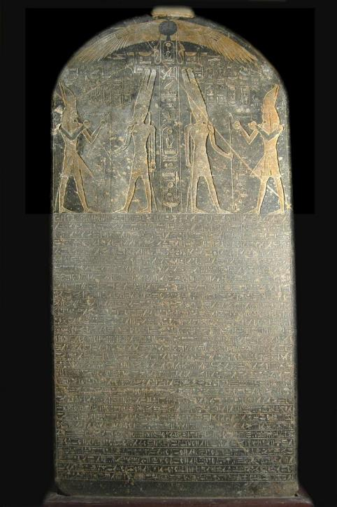
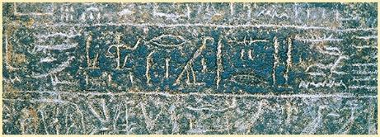
Merneptah Stele
Colloquially known as the “Israel stele,” this monumental inscription excavated in Thebes describes Pharaoh Merneptah’s invasion of Canaan in ca. 1210 BC. In this inscription, he claims to have conquered several Canaanite cities, but also, a people group called “Israel,” apparently a group without a city, in which he inscribed, “Israel is laid waste, its seed is not.” That the Israelites had no city suggests they were recent arrivals.

Slide 78
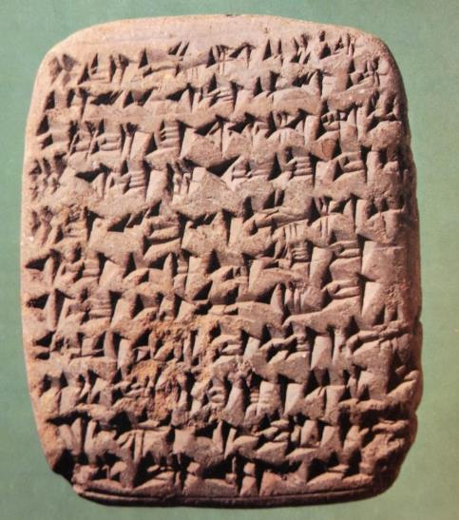
THE AMARNA PERIOD (14th century BC)
A huge cache of letters was discovered in 1887 at Tel el-Amarna, Egypt, and more have been discovered since (382 in all).
Most of them are imperial documents between Canaanite cities and the Egyptian court in the 14th century BC, and the Canaanite cities were in a suzerainty relationship with Pharaoh Akenaten.
The documents included correspondence from Canaanite cities like Jerusalem, Lachish, Shechem, Gezer, Gaza, Ashkelon, Joppa, Taanach and Hazor, all of which appear in the Book of Joshua.
Together, these letters suggest that the Israelites had not yet arrived.
Amarna Letter EA 68 speaks eloquently of the lack of military preparedness in the Canaanite city of Hebron.

Slide 79
THE HYKSOS
To understand the shift between Jacob’s descent into Egypt as a man of means and the reduction of his descendants to slaves, one must know something of Egyptian history.
Semitics began to increase sharply in Egypt during the 12th dynasty (20th century BC), and some Semites rose to levels of official power.
By the 17th century BC, the whole of Egypt had come under the dominion of these foreigners, who relocated the capital in the East Delta and ruled for about a century (called “the Second Intermediate Period”).
Naturally, the Hyksos would be more favorable to other Semites relocating in Egypt, and it is probable that Jacob’s family descended into Egypt during this period.

Slide 80
The Israelites groaned in their slavery and cried out, and their cry for help because of their slavery went up to God. God heard their groaning and he remembered his covenant with Abraham, with Isaac, and with Jacob.
Ex. 2:23-24

Slide 81
The Pharaoh who Did Not Know Joseph (1:8)
The Hyksos (Asian rulers) were resented as usurpers and eventually expelled from Egypt by Ahmose, who became the first Pharaoh in the 18th dynasty.
In all likelihood, it was the 18th dynasty of native Egyptians who “did not know Joseph” or his family (whereas the previous Asiatic rulers had been favorable).
They were the founders of “The New Kingdom.”
Not trusting aliens after the Hyksos’ Period, the native Egyptian rulers would have been the ones most likely to have enslaved Semites who lived in Egypt.

Slide 82
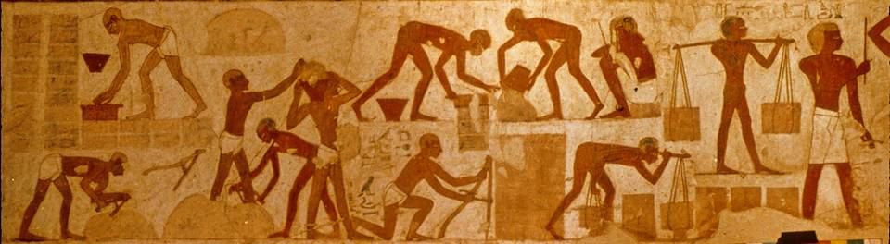
Semites reduced to slavery in Egypt
New Kingdom Egypt is well-known for its military campaigns into Canaan and other places, where many captives were brought to Egypt as slaves, some of which are pictured here making mud bricks in this famous tomb painting from the 15th century BC. The accompanying text identifies them as Canaanites and Nubians.
The Book of Exodus describes just such slavery (Ex. 5:6-18).

Slide 83
Discussion
What do you remember best from famous movies about the exodus, such as, “The Ten Commandments” and “Prince of Egypt”?
Do such artistic retellings of the story help or hurt the biblical story?

Slide 84
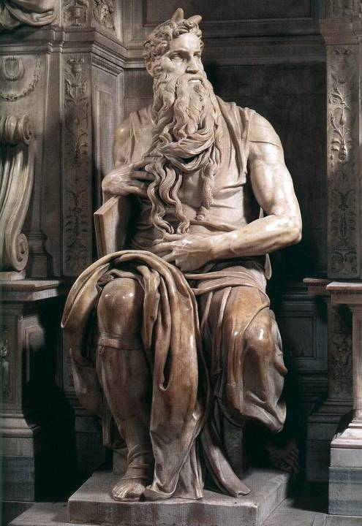
Moses
Born into a Hebrew slave family from the clan of Levi, Moses was saved from extermination by the subterfuge of hiding him in an “ark” in the river.
He subsequently was discovered by an Egyptian princess and reared in the royal court.
The Hebrew name Moshe means “to draw out,” recalling the circumstances of his protection by the Egyptian princess. In Egyptian, the name means “to give birth to,” and the root is found in the names of various Egyptian Pharaohs, such as, Ahmose, Thutmose, Amenmose, and Ramose.
“Moses” by Michelangelo, Church of San Pietro in Vincoli, Rome

Slide 85
Moses’ Exile to Midian (2:11-25)
Moses, raised in Pharaoh’s court, had to flee for his life after killing an Egyptian slave-master.
Escaping to “land of Midian,” the area to the south and east of Palestine, he later married Zipporah, the daughter of a Midianite priest, who was a distant relative (cf. Ge. 25:1-2).
In the meantime, the oppression of the Israelites in Egypt had grown only worse, and God heard their outcry of misery and remembered his covenant promise to the Patriarchs.
In the desert, Moses was confronted by Yahweh who appeared to him in a burning bush that was not consumed: God commissioned him to go back to Egypt to lead out the Israelites.
Here, God declared to Moses his sacred name, Yahweh.

Slide 86
The Reluctant Deliverer
Moses’ response to this commission was diffident, at best.
First, he asked, “Who am I (3:11)?
Next, he posed the problem of the Israelites not recognizing his authority or the authority behind him (3:13), to which God responded by revealing his sacred name Yahweh.
He envisioned that the people would not believe him (4:1), to which God showed Moses three convincing signs.
He complained that he was not a good speaker (4:10), to which God promised to enable Moses to speak.
Finally, Moses suggested God send someone else (4:13), to which God promised to send his brother Aaron as a spokesman.

Slide 87
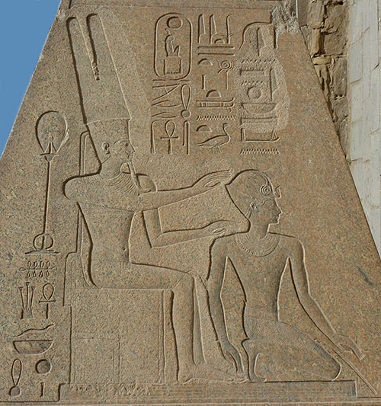
Legitimizing the Pharaoh
The idea that the Pharaoh was a son of the god Amon-Re was a powerful influence upon the populace to accept his legitimacy.
From the 18th Dynasty, many Pharaohs commissioned art pieces depicting Amon-re fathering them, which in turn served as propaganda proving their right to rule.
Here, Hatshepsut, the queen mother, kneels before Amon-Re.

Slide 88
The Nine Wonders (7:14—10:29)
Using language like hpAGema (= plague, cf. 9:14), fgan@ (= assault, cf. 11:1), hkan! (= batter, cf. 7:17), tOx (= sign, cf. 7:3), tpeOm (= omen, cf. 7:3), and xl,P, (= wonder, cf. 3:20), Yahweh sent plagues upon Egypt which were attacks upon Egypt’s gods (cf. Nu. 33:3-4).
Pharaoh was the god-symbol of the state of Egypt.
At stake was which deity had sovereign control, Yahweh or Pharaoh and the gods of Egypt.
The Egyptians worshipped gods and goddesses connected with the Nile, frogs, the sky, bulls and cows, the sun, and the realm of the dead.
Egyptian texts described epidemics as coming from the “hand” of the gods, the same language used in 9:3 and 8:15.

Slide 89
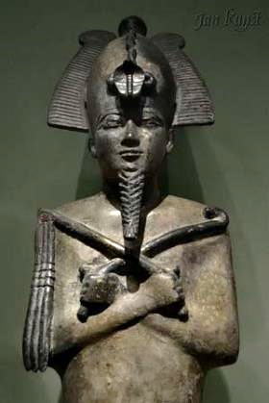
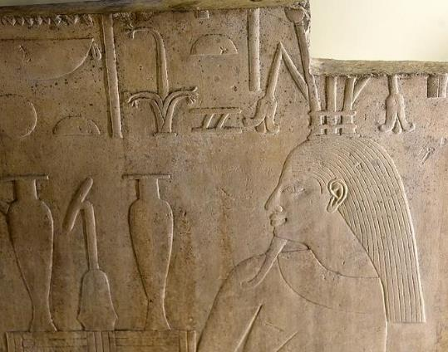
First Plague (7:14-25)
The first calamity consisted of three related events: 1) turning the Nile into blood, 2) infestation of frogs, and 3) infestation of “fasteners,” translated variously as lice, gnats or mosquitos.
This plague likely was directed at Khnum, creator of water and life; Hapi, the Nile god; and Osiris, whose bloodstream was believed to be the Nile.
The various calamities may be ecologically linked: violent storms in the mountains of Ethiopia saturate the Nile with red clay, which then chokes the fish, which in turn are infected with anthrax causing the frogs to leave, after which they die. Lice and flies feed on the dead frogs, infecting the grass that in turn kills cattle and causes boils in humans.
LEFT: Osiris
BELOW: Hapi

Slide 90
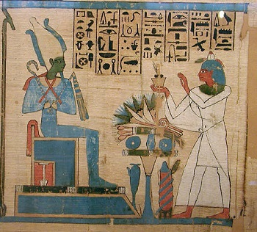
The Final Plague is Announced (11)
The last plague, once again, would be against the patron deity of Pharaoh, the god Osiris.
As the righteous judge and ruler of the land of the dead, he also was the god who granted all life.
He was typically depicted with green skin and holding a crook and a flail.
The threat of death to all the first-born was a direct challenge to Osiris.

Slide 91
The Tenth Plague (12:1-32)
The last plague, the Passover, was the final blow to Egypt, the death of the first-born.
Each Israelite family was instructed to slaughter an unblemished lamb, roasting and eating it with unleavened bread and bitter herbs.
Only those who had the lamb’s blood smeared on their doorposts and lintels were spared. The destroyer would then “pass over” their home (12:13), which is the origin of the word “Passover” (HsaP,).
The “destroyer” (tyHiw;m0aha, 12:23; cf. He. 11:28) was likely the Angel of Yahweh (cf. 2 Sa. 24:16; 2 Kg. 19:35).
Ramesses II is known to have had thirteen sons. His first-born, Amun-her-khepeshef, died as a young man of unknown causes, ca. 1254 BC. The crown passed from Ramesses II to his brothers, eventually landing on Merneptah in 1213 BC.

Slide 92
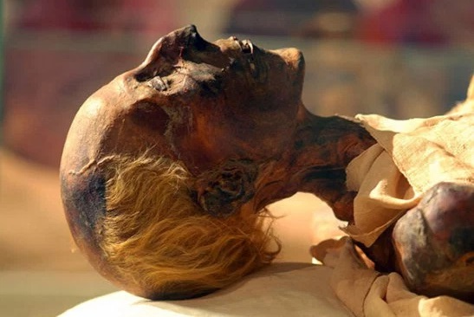
Mummy of Ramesses II
While the identity of the Egyptian Pharaoh of the exodus is debated, the majority opinion remains with Ramesses II, regarded by many historians as the most powerful pharaoh in history.
He was appointed prince regent by his father, Seti I, at the age of 14.
He lived until he was about 90, and his mummy was discovered in 1881.

Slide 93
On the day after the Passover, the people of Israel went out triumphantly in the sight of all the Egyptians, while the Egyptians were burying their firstborn, whom Yahweh had struck down among them. On their gods also Yahweh executed judgments.
Nu. 33:3b-4
Christ, our Passover lamb, has been sacrificed.
1 Cor. 5:7b

Slide 94
Discussion
One of the words used in the Book of Exodus to describe the miracles of the plagues is the word “sign?” What is a “sign?”
How is the exodus story preserved in Jewish culture even today?
What is your favorite part of the exodus story?

Slide 95
The Covenant at Sinai
Exodoj
tOmw; hl.,xev4

Slide 96
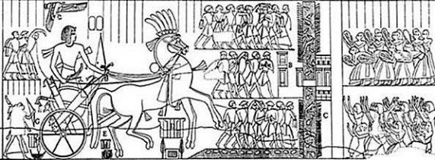
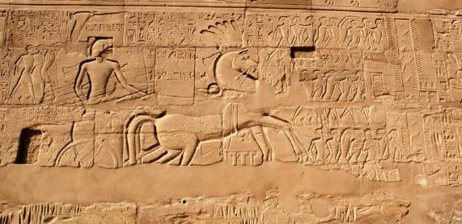
“…not by way of the land of the Philistines…” (Ex. 13:17)
When the Israelites left Egypt, they were instructed by God not to take the coastal road (called the “Way of Horus” by the Egyptians).
This route was heavily defended by a series of Egyptian forts, which are named on this relief of Seti I (1294-1279 BC), father of Ramesses II.
That route, according to Exodus 13:17, would result in war, and the Israelites must avoid it.
Hence, the Israelites miraculously crossed a body of water and headed southward into the Sinai Peninsula.

Slide 97
The Yam Suph
The traditional rendering “Red Sea” is an unfortunate mistranslation first appearing in the LXX and followed by later versions for centuries (13:18; 15:4, etc.).
The Hebrew term Yam Suph (JUs-My!) means “Sea of Reeds” and probably refers to the marshy lake district on Egypt’s eastern frontier. It should not be confused with the large body of water between Egypt and Saudi Arabia.
Until the last century, this system of lakes was known as the el-Ballah lakes, and one of these is likely what the biblical writer calls the Yam Suph.
Today, this whole area has been significantly altered by the building of the Suez Canal.

Slide 98
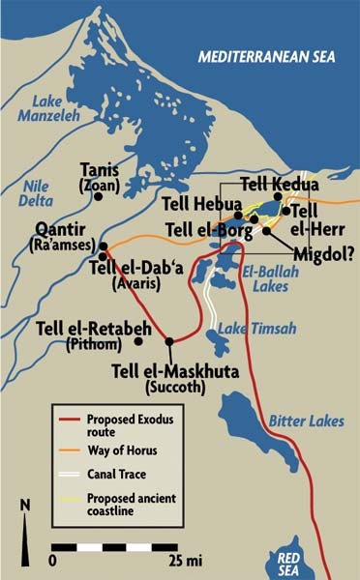
From Ramesses to the Yam Suph
To date, some of these locations have been archaeologically identified, while others have not.
The area was heavily guarded by Egyptian fortresses protecting the route along the seacoast to Canaan, which is why the Israelites did not follow “the way of the Philistines” (13:17).
What looks like aimless wandering was actually a very careful route threaded between these forts.
The term Pi-hahiroth means “mouth of the canal” (several canals spanned the gaps between the lakes).
The best candidates for the Yam Suph are either the northern part of Lake Timseh or one of the El-Ballah lakes.

Slide 99
Crossing the Sea (14:10-31)
Fearful of the Egyptian chariot corps, the Israelites now respond to the first of many crises in which they challenge Moses and express a desire to return to Egypt.
However, Yahweh instructed Moses to lift his rod over the sea, and when he did, the pillar of cloud relocated and became a rearguard.
Moses stretched his rod over the sea, a strong wind blew the sea back, parting it, and the Israelite passed through the sea on dry ground, the Egyptian charioteers following them.
On the other side, Moses once more lifted his rod, and the waters of the sea converged, drowning the Egyptian chariot corps.

Slide 100
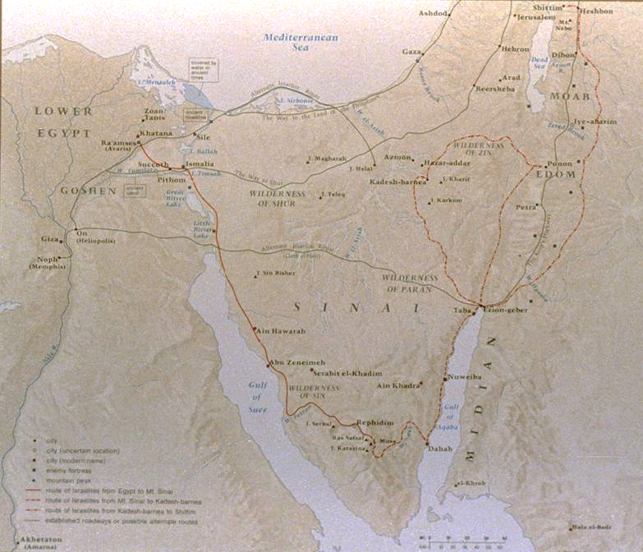
Traditional Route
The traditional route follows the coastline of the Gulf of Suez toward the Sinai mountains.
Ecologically, it has the best water sources and best vegetation with seasonal grasses suitable for sheep and goats.
Also, Egyptian hegemony did not extend into south-central Sinai as with the other routes.

Slide 101
At Sinai
Moses led the Israelites through the desert to Mt. Sinai, where earlier God had revealed himself in the burning bush.
Here, Yahweh would enter into a covenant with the nation, the heart of which would be the Ten Commandments.
Yahweh commissioned the nation to be a kingdom of priests (19:3-6), a calling that was theologically linked to the ancient promise to Abraham that through his seed all the nations would find blessing (cf. Ge. 12:1-3).
If the whole nation was to be a priesthood, this immediately suggests that they were to be mediators and models to the nations of the world.
The rescue of the Israelites from Egypt was not only an escape, but also a calling.

Slide 102
“Now therefore, if you will obey my voice and keep my covenant, you shall be my treasured possession among all peoples, for all the earth is mine; and you shall be to me a kingdom of priests and a holy nation.”
Ex. 19:5-6a

Slide 103
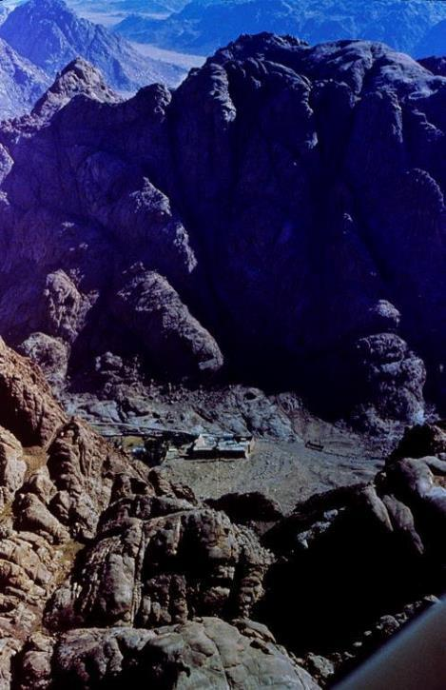
Jebal Musa,
the traditional Mt. Sinai
Though there is no consensus on the location of Mt. Sinai, the site having the oldest tradition is near the bottom of the Sinai peninsula.
St. Catherine’s monastery (Eastern Orthodox), dating from the 4th century AD, lies at the foot of the mountain.
At the “mountain of God” the Israelites would receive the first of what would come to be called “the law of Moses.”

Slide 104
Discussion
It sometimes is suggested that if people saw more miracles, they would more easily come to faith. Do you think this was true for ancient Israel? How did Jesus respond to the desire to see more miracles?
If Israel’s rescue from Egypt was both an escape and a calling, how is this similar for Christians?

Slide 105
The Nature of A.N.E. Covenant
The cultural institution of covenant, widespread throughout the ancient Near East, became the essential basis for the relationship between Yahweh and Israel.
Covenant was a basic social institution within tribal structures and between city-states when there was no international law.
A covenant was a solemn promise made binding by an oath so that each party was obliged to fulfill the terms.
A suzerainty-treaty was a covenant between parties of unequal status—an overlord and a subject. Here, Yahweh was the suzerain (the Great King), and Israel was the vassal (the lesser party).

Slide 106
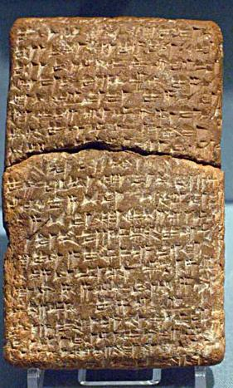
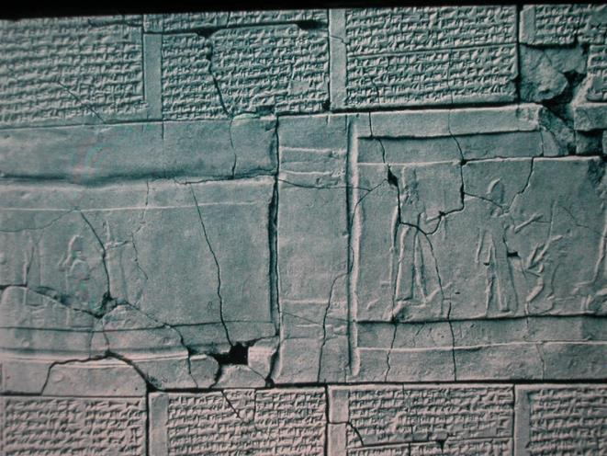
Other such covenants are known from the ancient world.
Ancient Near Eastern treaties with striking parallels to the biblical covenant material have been found in ancient Hittite culture (15th century BC) and in the vassal treaties of Esarhaddon II of Assyria (7th century BC).
British Museum, London
University of Pennsylvania

Slide 107
The Marking off of Holy Space (19:10-25)
At Mt. Sinai, Moses was instructed to mark off the space around the mountain into graduated spaces of holiness:
The people were confined to the foot of the mountain outside a barrier (19:17-25).
The elders were allowed part way up (24:9-11).
Only Moses was allowed to enter the cloud of Yahweh’s presence at the top (24:15-18).
These same concentric areas of holiness would be repeated in the tabernacle, and later, the 1st and 2nd temples.
The tabernacle yet to be built would become a kind of portable Mt. Sinai, and the concentric circles of the mountain would be replicated in the sanctuary.
Yahweh’s presence on the mountain would be replicated by his presence in the Most Holy Place.

Slide 108
The Ten Words (20:1-21)
Quite literally, the designation is “the ten words” (Myr9bAD;ha tr@W,fE), cf. 34:28.
In Greek, the designation is the Decalogue (de<ka lo<gouj).
That the ten words are the core of the law is indicated not only in that they were the first to be given, but also, because they would be encoded on the tables of stone and deposited in the ark of the covenant.
The first nine address overt acts; the last one addresses internal desire.
While the Bible indicates the proper number is ten, it does not enumerate them.
Hence, there are diverse traditions as to how they should be enumerated.
The Anglican/Reformed/Orthodox numbering is different than the Lutheran/Roman Catholic numbering.
In all, the Ten Words would be given three times, once orally (20:1ff.) and twice in stone tablets (31:18; 34:4, 28).

Slide 109
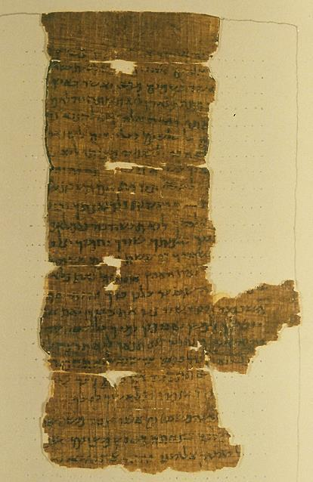
Discovered in 1898, these four fragments comprise a single sheet containing the Ten Commandments and the beginning of the Shema (Dt. 6:4). Dating to the 2nd century BC, the text conflates the versions of the commandments in Ex. 20 and Dt. 5. Since the Ten Commandments were traditionally recited prior to reciting the Shema, it is likely that this text is a liturgical document.
Prior to the discovery of the Dead Sea Scrolls, this was considered to be the oldest extant Hebrew manuscript fragment.
Nash Papyrus containing the Ten Commandments.
Cambridge University Library

Slide 110
Discussion
Why do you think God used the ancient cultural institution of covenant to establish his relationship with the Israelites?
How is the holy space surrounding Mt. Sinai similar to the holy spaces within Christian cathedral-style architecture?
Christians differ in their approaches to holy space and holy time. How do liturgical churches observe both holy space and holy time?
Others argue that since we, the people, are now the new temple of God through the gift of the Holy Spirit, holy space and holy time is irrelevant. What do you think?

Slide 111
“God spoke all these words…”
Ex. 20:1

Slide 112
Commandments 1-2
The 1st commandment bans polytheism and the worship of foreign gods.
Yahweh has exclusive claim upon Israel.
The essence of the commandment is relational, and the essence of relationship is faithfulness.
Divine “jealousy” is like the appropriate exclusivity of a husband for his wife.
The 2nd commandment bans any image of deity carved in wood or stone.
Yahweh is unlike any created thing, and his mystery is to be preserved.
Virtually all other ancient Near Eastern religions practiced idolatry.
The character of Yahweh is that his mercy is much greater than his capacity for punishment.

Slide 113
Commandments 3-4
The 3rd commandment bans the abuse of God’s sacred name.
Ancient people considered a name to bear the nature or function of the one named.
Primary abuses concerned oath-taking (“As Yahweh lives…”) and prophecy (“Thus says Yahweh…”), both of which were attempts to presume on God’s power.
The 4th commandment concerns respect for divine grace through rest.
The Sabbath was implicit in creation and the sending of manna.
The Sabbath was a day of reflection on the redemption from Egypt.
The word “Sabbath” is derived from the Hebrew verb tbawA (= to stop, cease).

Slide 114
Commandments 5-6
The 5th commandment aims at preserving the family.
While often taken to refer to parents and small children, this law equally concerns adult children and their aged parents (cf. Mk. 7:9-13).
To dishonor one’s parents is to dishonor God himself, the heavenly Father.
The 6th commandment bans murder.
While there are several words in Hebrew for killing, the one used here specifically refers to the private killing of humans.
It prohibits private blood revenge, for only the community can take responsibility for capital punishment.

Slide 115
Commandments 7-8
The 7th commandment preserves the sanctity of marriage.
Like murder, adultery was a capital offense.
It represented defiance against God who unites a man and woman in marriage.
As a fundamental act of unfaithfulness, it underlies various other sexual offenses taken up later.
The 8th commandment preserves the sanctity of personal ownership.
Popularly, this law concerns robbery and petty theft, but it also probably includes kidnapping (the Hebrew verb can also have persons as its object, cf. 21:16).
Acts of theft are violations of the person him/herself.

Slide 116
Commandments 9-10
The 9th commandment concerns perjury.
The extension “against one’s neighbor” sets the focus within Israel’s legal system.
Especially in capital cases, perjury could be tantamount to murder (cf. 1 Kg. 21:19).
The 10th commandment concerns inward sin.
The intent was not to address crimes committed, but rather, the root of crime that lies within the self.
No breach of this law could be examined by a human court.
Hence, the chief judge of this law could only be God himself.

Slide 117
Discussion
How do the Ten Commandments compare to modern law codes? What are similarities and differences?
How did Christ “raise the bar” for understanding the Ten Commandments (i.e., Mt. 5:21ff.)?

Slide 118
“Then he [Moses] took the Book of the Covenant and read it in the hearing of the people. And they said, ‘All that Yahweh has spoken we will do…’”
Ex. 24:7

Slide 119
The Book of the Covenant (20:22—23:33)
The Book of the Covenant is the oldest codification of Hebrew law. It is self-contained and addresses the problems of Bronze Age agrarian society.
The laws in the Book of the Covenant are corollaries to the Ten Commandments.
They contain three basic kinds of law:
  Those commanding piety
  Those commanding justice
  Those commanding charity
Some laws are quite similar to laws in other ancient Near Eastern law codes.

Slide 120
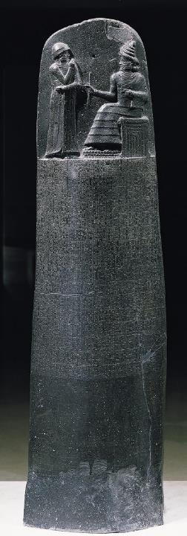
Hammurabi’s Code
HAMMURABI (case laws)
If a man destroys the eye of another man, they shall destroy his eye. If he breaks another man's bone, they shall break his bone. If a man knocks out a tooth of a man of his own rank, they shall knock out his tooth (#196-197, 200).
If a man's ox be a gorer, and has revealed its evil propensity as a gorer, and he has not blunted its horn, or shut up the ox, and then that ox has gored a free man, and caused his death, the owner shall pay half a mina of silver (#251).
Hammurabi’s Code, like most ancient Near Eastern law codes, is made up of case laws, that is, if “such and such” is the case, then “such and such” is the penalty.
The laws of Moses also contain many such case laws (Ex. 21).
However, the law of Moses also contains apodictic laws, that is, absolute laws (“you shall” and “you shall not”).
Such laws are unique in the ancient world, and in Moses’ law they are the more important of the two kinds.
The heart of these apodictic laws are the Ten Commandments.
MOSES (case laws)
But if there is harm, you shall pay life for life, eye for eye, tooth for tooth, hand for hand, foot for foot, burn for burn, wound for wound, stripe for stripe (21:23-25).
But if the ox has been accustomed to gore in the past, and its owner has been warned but has not kept it in, and it kills a man or woman, the ox shall be stoned, and its owner also shall be put to death (21:29).
Louvre, Paris

Slide 121
The Covenant Ceremony (24)
Formal acceptance of the covenant was conducted in a special ceremony.
The nation’s leaders were invited part way up the mountain, the people remaining below and only Moses ascending to the summit.
First the first time, the terms of the covenant were written down.
An altar representing Yahweh and twelve pillars representing the twelve clans were erected.
  Sacrifices were conducted, and Moses collected the sacrificial blood and dashed it on the altar and over the heads of the people, binding them to Yahweh in a blood oath.
  The Book of the Covenant was then read aloud, and the people gave their verbal assent to its terms.
Moses then ascended Mt. Sinai where he remained for forty days and received the Ten Commandments written on stone tablets (cf. 31:18).

Slide 122
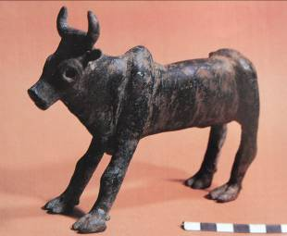
The Broken Covenant
During the lengthy stay of Moses atop Mt. Sinai, the people resorted to idolatry by making a golden calf (32).
The calf was a potent symbol of the god Ba’al, a form of pagan worship known in Egypt and universally practiced in Canaan.
Moses was so angry that he smashed the stone tables, symbolizing the breaking of the covenant (32:19).
This, in turn, meant that he had to go back up the mountain to obtain another set of the stone tablets (34:1).
This time when Moses descended, his face was changed (34:29-33).
Discovered by Ofer Broshi, an officer in the Israeli army, at an ancient “high place” in the territory of Manasseh, the golden calf may have been similar.

Slide 123
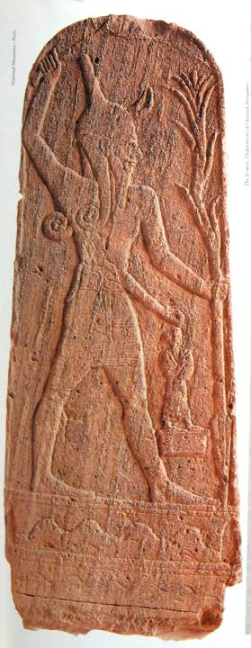
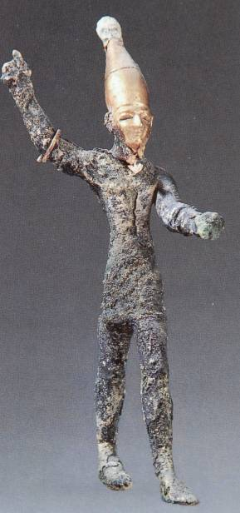
Ba’al
Ba’al, the Canaanite god of storm, often was depicted with an Egyptian-style crown. He also was believed to ride standing on a bull.

Slide 124
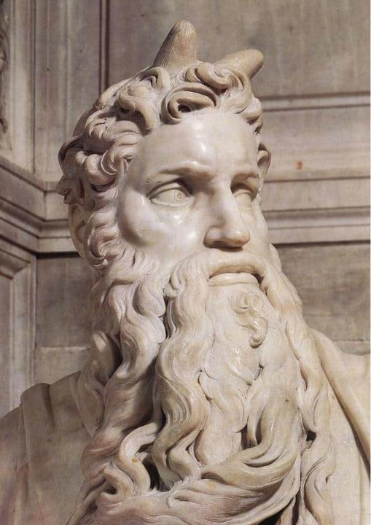
The Hebrew word in Ex. 34:29 describing the skin of Moses’ face is Nrq (= horn). Hence, St. Jerome in the Latin Vulgate rendered it as “horned,” which is why medieval depictions of Moses show him with horns. Modern translators follow the LXX rather than the Hebrew text, and so does Paul in 2 Corinthians, where the LXX describes Moses’ face as dedo<castai (= glorified or radiant).
MICHELANGELO’S MOSES WITH HORNS

Slide 125
Moses’ Vision of God (33:12-23)
While on the holy mountain, Moses asked to see God’s glory. No mortal is able to survive a full vision of God (cf. 19:21; 33:20), but various degrees of partial vision are granted.
These degrees of visibility correspond to the religious hierarchy of the nation:
  The people beheld Yahweh from a distance.
  The leaders beheld Yahweh from below but closer than the people.
  Moses, at the summit, was granted the closest vision of all, and here, he would be granted an even greater degree of vision (34:29-36).
Moses’ intimate vision of God is now replicated in the New Testament people of God who have been blessed with the Holy Spirit in a new covenant, written not on tables of stone but in their hearts (2 Co. 3:3, 12, 15-18).

Slide 126
And you show that you are a letter from Christ delivered by us, written not with ink but with the Spirit of the living God, not on tablets of stone but on tablets of human hearts.
…And we all, with unveiled faces, beholding the glory of the Lord, are being transformed into the same image from one degree of glory to another. For this comes from the Lord who is the Spirit. 2 Corinthians 3:3, 18

Slide 127
Discussion
Is there anything in Christianity comparable to the blood covenant described between Yahweh and the people of Israel?
We typically think of idolatry as primitive and unrelated to life in the modern world. However, do you think there are modern forms of idolatry, and if so, what might they be?

Slide 128
The Tabernacle
Exodoj
tOmw; hl.,xev4

Slide 129
Yahweh said to Moses, “Tell the Israelites to bring me an offering…from each man whose heart prompts him to give. Then have them make a sanctuary for me, and I will dwell among them. Make this tabernacle and all its furnishings exactly like the pattern I will show you.”
Ex. 25:1, 8-9

Slide 130
The Tabernacle or Sanctuary (25-31, 35-40)
While Moses was on Mt. Sinai for 40 days and nights (24:18), Yahweh revealed to him the architecture for a moveable worship center.
This sanctuary was to be at the center of the nation surrounded by concentric circles of holiness (Most Holy Place, Holy Place, Courtyard).
It was to be built precisely after the pattern shown to Moses on the holy mountain.
The glory of Yahweh that had enveloped Mt. Sinai later would take up residence within the Tabernacle, and the Tabernacle was a kind of moveable Mt. Sinai (cf. Ps. 68:17).

Slide 131
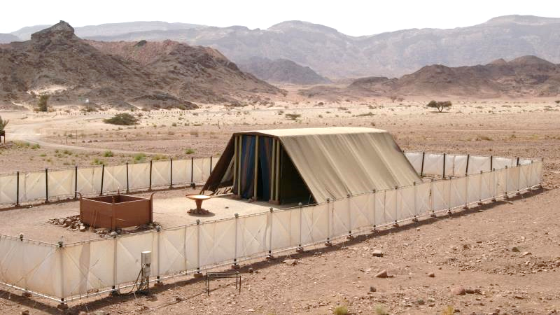
Model of the tabernacle in Timnah Park, Israel

Slide 132
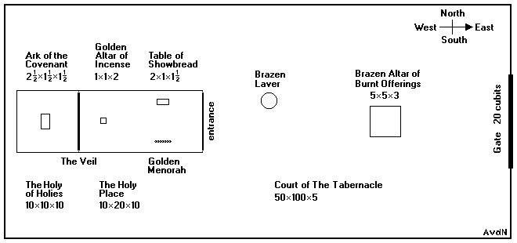
The materials in the tabernacle reflect differing levels of holiness.
THREE METALS
Gold
Silver
Bronze
SEVEN FABRICS
Blue wool yarn
Purple wool yarn
Crimson wool yarn
Fine linen
Goat’s hair
Ram skins
Leather
OTHER MATERIALS
Acacia wood
Oil
Spices
Precious stones

Slide 133
The Levels of Holiness
The diminishing levels of holiness as one moves from the interior to the exterior is reflected in the classes of individuals who are permitted to officiate between these levels:
The high priest alone can move between the Most Holy Place and the Holy Place.
The large class of priests are permitted to move between the Holy Place and the Outer Court.
The Israelites themselves are permitted to move between the Outer Court and the Encampment, but they can come no closer to the sanctuary than the altar.

Slide 134
Building the Tabernacle (25-31, 35-39)
Instructions for the Tabernacle and its actual construction are separated by the episode of the golden calf.
The construction of the Tabernacle seems to have occurred over several months while the Israelites were encamped at Mt. Sinai, though we are told nothing in particular about the construction process.
The primary craftsman, Bezalel, was filled with the Holy Spirit to carry out the work (31:1-3), and he, along with Oholiab and various other artisans, completed the work (31:4-11).
This will be the first reference in the Bible to spiritual gifts, something St. Paul will enlarge on in his letters.

Slide 135
The Measurements
Various efforts have been made to replicate the Tabernacle and its furnishings, but admittedly there are gaps in our knowledge.
The basic measurements are given in cubits, but this measurement is less than precise by modern standards.
The actual length of a cubit varied according to date and region, the Egyptian cubit being a bit longer (about 21” or 53 centimeters) and the Mesopotamian cubit shorter (about 18” or 45 centimeters).
  The Hebrew word hm0Axi (= cubit) is the same root as the word for forearm, i.e., the distance between the elbow and the fingertips.
  The reference in 2 Chr. 3:3 to “cubits of the old standard” suggests that more than one reckoning was in use.

Slide 136
Discussion
The ideas of holy time and holy space have been greatly diminished in contemporary Christianity. How does the ancient tabernacle speak to this reduction?
Moses was instructed to build the tabernacle precisely according to the pattern he saw on Mt. Sinai. Do you think there is a tabernacle or temple in the heavenlies?

Slide 137
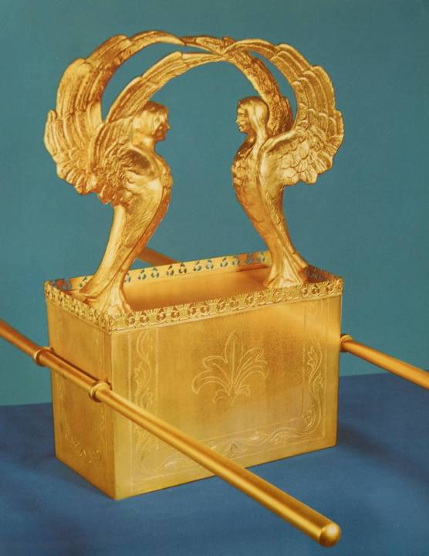
The Ark as a Throne (25:10-22; 37:1-9; cf. Is. 37:16)
Variously called the Ark of the Covenant or the Ark of the Testimony, this rectangular box symbolized Israel’s binding agreement with God and contained the Ten Commandments.
Here, the glory of God rested between/above the cherubim, and from this throne he would speak.
That the staves for carrying were on the shorter ends of the box is indicated by it’s later placement in Solomon’s temple, since the ends of the staves could be seen from the adjacent room (2 Chr. 5:9).

Slide 138
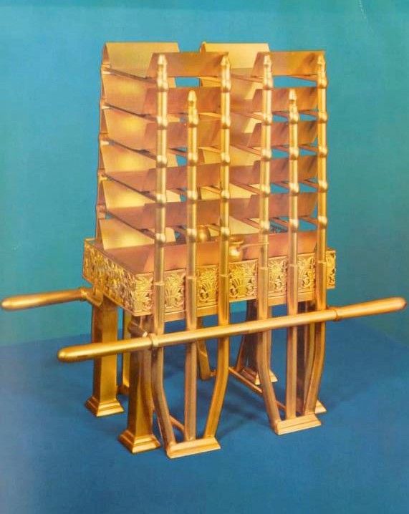
Table for the Bread (25:23-30; 37:10-16)
The actual style of this table can only be conjectured.
Based both on Scripture and Jewish rabbinical tradition, the table contained an elaborate set of shelving.
Later, it will be specified that the bread was to be laid out in two “piles” or “stacks,” six in each pile or stack (Lv. 24:6, NIV, ESV, NIB).

Slide 139
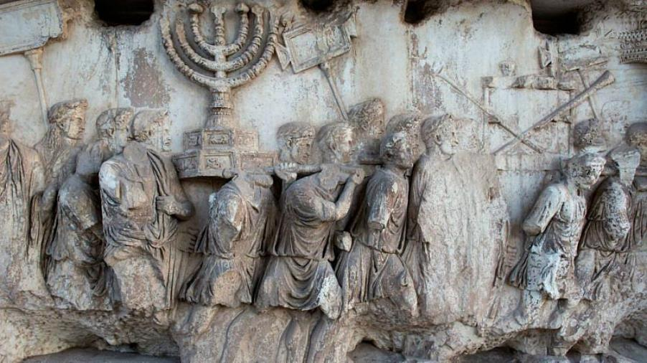
The Lampstand
(25:31-40; 37:17-24)
The Menorah was the only light in the Tabernacle.
While we can only conjecture its appearance based on the biblical description, we do have a visual representation of the Menorah from the 2nd Temple Period, since the Romans who destroyed the temple took it to Rome as a spoil of war.
From the Arch of Titus, Rome

Slide 140
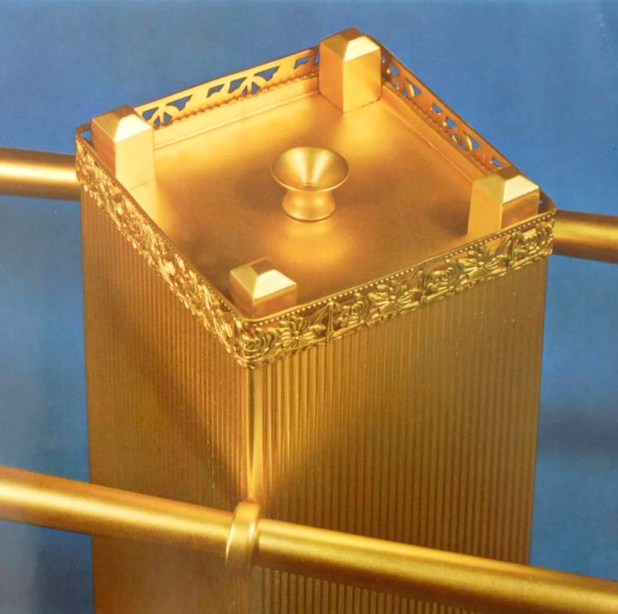
Altar of Incense
(30:1-10; 37:25-28)
The altar for burning incense, a substance with strong odor concocted from plant materials (30:34-38), rested in front of the inner curtain (30:6)
An anomaly is the reference in the Letter to the Hebrews that it was placed inside, not outside, the curtain (cf. He. 9:3-5).

Slide 141

The largest Israelite four-horned altar so far discovered is this one from Beersheba in southern Judah. While the altar from the Tabernacle has never been discovered (and, of course, it was not made from stone, since it had to be portable), the “horns” on this one gives us some idea of how it may have looked.

Slide 142

The Bronze Basin (30:18-20; 38:8)
Also called the Laver, this implement for washing was placed between the Bronze Altar and the Sanctuary.
Because it was used for washing feet as well as hands, it may have been relatively small or at least set low to the ground.
Later, Solomon would construct a huge basin along with ten other smaller ones (1 Kg. 7:23-37; 2 Chr. 4:2-6).

Slide 143

The Coverings
(26:1, 7, 14; 36:8, 14, 19)
Three layers of coverings were draped over the sanctuary.
INNER LAYER: linen tapestry embroidered with cherubim
MIDDLE LAYER: goat’s hair fabric
OUTER LAYER: rams’ skins dyed red or tanned and wHaTa (this latter word is various translated as “badger skins” (KJV) or “porpoise” or “seal skins” (RV, JPS, NASB) or “goat skins” (RSV, ESV, NLT) or “durable leather” (NRSV, NET, NIV, NIB, NJB).

Slide 144

Priestly Vestments
(28; 39)
Garments for the ordinary priests and for the high priest were highly specialized.
Ordinary priests had linen undergarments, tunics, sashes, and turbans.
The high priest had additional accoutrements: bells on his robe, an ephod (with engraved names of the 12 tribes on his shoulders), a breastpiece (with four rows of precious stones along with Urim and Thummim), an elaborate outer robe, and a forehead diadem (engraved with “Holy to Yahweh”).

Slide 145

Anointing
The anointing of the high priest may have been with an implement similar to this horn excavated at Megiddo (northern Israel) from the 15th century BC. This horn of elephant ivory has gold bands and originally was used for perfume. The people of Israel used similar horns for anointing oil. High priests were anointed for office, and later, kings were anointed to rule.
Anointing with oil symbolized consecration for service. The anointing oil was composed according to a special recipe (cf. Ex. 30:22ff.).

Slide 146
The Erection of the Tabernacle (40:1-33)
The Book of Exodus closes with the erection of the Tabernacle by Moses.
This event occurred almost one year after the exodus from Egypt (40:2, 17; cf. 12:2-3) and 9-10 months after the Israelites arrived at Mt. Sinai (19:1).
All the furniture and implements constructed by Bezalel and his assistants were now put together for the first time.
The sanctuary and all the other implements were consecrated with anointing oil, along with Aaron and his sons.

Slide 147
The Descent of the Glory Cloud (40:34-38)
The glory that the Israelites had seen in the pillar of cloud (16:6-7, 10) and which had covered the mountain of God (24:16) now filled the sanctuary.
Neither Moses nor the priests were able to enter the sanctuary at this point.
The cloud of glory would now lead the Israelites throughout all their travels toward the land of Canaan.
Later in the Aramaic Targums, the presence of God would be referred to as the Shekinah (= to abide, to settle).

Slide 148
Discussion
Bezalel was filled with the Holy Spirit to enable him to oversee the building of the tabernacle and its furnishings. How would you define a spiritual gift, and what might be its relationship to one’s natural abilities?
What elements from the tabernacle have passed over into the concepts and practice of Christian worship?

Slide 149

Leviticus and Numbers
The Sacrificial System

Slide 150
Locations of the Exodus Literature
EGYPT
Ex. 1-12
SINAI
Ex. 19-40
Lv. 1-27
Nu. 1-9
KADESH
Nu. 13-19
MOAB
Nu. 22-36
Dt. 1-34
Travels:
Ex. 13-18
Nu. 10-12
Nu. 20-21

Slide 151
The Structure of Leviticus
Sacrifice and Reconciliation
(1-15)
Laws regarding the primary sacrifices
Order for priesthood
Distinction between the holy and the profane
Yom Kippur (Day of Atonement)
(16)
National day of atonement for Israel
The only day annually when the high priest could enter the Most Holy Place of the tabernacle
Ethics, Morality & Holiness
(17-27)
Holiness code
Redemption laws about vows and offerings

Slide 152
Cult and Ritual
Standing alongside law & covenant was cult & ritual, and much of the remainder of Exodus, all of Leviticus and much of Numbers concerns this aspect of Israel’s national life.
Israelite temple practice and Israelite theology are one and the same.
The theology of Israel is expressed in ritual, not merely words, including the structure of the sanctuary, the performance of sacrifice and the observance of purity laws.
Here, the nature of Yahweh himself was revealed in the ancient forms of worship.

Slide 153
The Sanctuary:
A place regarded as holy (e.g., a
shrine, tabernacle, temple)
The Sancta:
Holy objects (altars, lavers, bowls,
etc.)
The Rituals:
System of formalized words and
activities referred to individually as
“rites.”
The Cult
The term “cult,” when used by scholars, refers to the system of worship through the use of a sanctuary, sancta and rituals.

Slide 154
Through cult and ritual, the Israelites were called to forsake common life (to separate themselves from the world) in order to live a life of holiness (to separate themselves unto Yahweh).

Slide 155
Religious Background
Coming out of pagan Egypt Israel was to become the people of Yahweh alone
Pagan Religion
Pagan religion is based on human needs and desires:
It is polytheistic (many gods, both good and evil)
The actions of the gods are mirrored in the physical world.
Through magic, one can access the divine world and manipulate the gods to do one’s will.
Yahweh Religion
Yahweh religion is based on the nature and character of God himself:
Yahweh is one, and he is holy.
His actions in the world are always in concert with his basic moral attributes, such as, his power, righteousness, faithfulness, love, holy wrath, and wisdom.
Access to God is reconciliation from a condition of estrangement.

Slide 156

Offerings in the Ancient Near East
Offerings were of three kinds:
Ritual killing
Cereal offerings
Libations
Bas-relief of Ashurbanipal pouring a libation over the heads of four dead lions

Slide 157
For the life of a creature is in the blood, and I have given it to you to make atonement for yourselves on the altar; it is the blood that makes atonement for one’s life.
Lv. 17:11

Slide 158
The Sacrificial Elements
The ritual of sacrifice involved the slaughter and burning of an animal.
To understand this, one must look at the relationship of God to living creatures.
  In the creation account, animal life (6th day) is valued higher than vegetable life (3rd day)—both are “alive,” but one is animate and the other inanimate.
  Animate life has both a created element (body) and an uncreated element (God’s own spirit, the “breath of life”).
Blood is the element of animate life that signifies life from God (Ge. 9:4; Lv. 17:11; Dt. 12:23).
Hence, animate life is a combination of “body” and “blood,” and sacrifice is the death of an animal to purge impurity and to ransom the life of the sinner—in short, to repair the relationship between God and the Israelite.

Slide 159
Substitutionary Atonement
This act of “atoning” (bringing into unity) involves cleansing from sin and impurity so that the sinner is reconciled to God from whom he has been estranged.
All sin has its origin in the life of the sinner. The life of the sinner is forfeit, since he is now estranged from the sole source of life, who is God.
The removal of sin is possible only by the same means, the payment of this life-debt, through the substitution of one life for another. The symbolic agent of this substitution is blood. One ancient example is Abraham and the sacrifice of Isaac on Mt. Moriah.

Slide 160
Discussion
How do the ideas of ritual extend beyond the ancient people of Israel into the New Testament church?
What is the value of ritual?
How do the ancient ideas of “body” and “blood” set the foundation for the Christian Eucharist?
How does the principle of substitutionary atonement relate to the death of Jesus?

Slide 161
Daily Offerings
(dymiTA = “continual”)
At Sunrise & Sunset (Ex. 29:38-41):
dymiTA = “continual”
1-year old lamb
Burnt offering
To open and close the daily service of the sanctuary
Performed in conjunction with an adjunct cereal offering and an adjunct drink offering
High Priest and his successors (Lv. 6:19-23):
Independent cereal offering
To be burnt entirely, half in the morning and half in the evening

Slide 162
Sacrificial Animals
Three primary distinctions determine whether or not an animal is fit for sacrifice
Pure/Impure
Animals that the Israelites were allowed to eat were “pure.”
Animals forbidden for eating were “impure.”
Domestic/Non-domestic
Domestic animals are livestock but also included some birds.
Non-domestic animals are wild animals or “game.”
Non-Defective/ Defective
Non-defective animals are unblemished.
Defective animals are blemished in some way (disease, injury).
In some cases, age or gender could also be a factor.

Slide 163
Sacrificial Procedure
While there are some differences in the various sacrifices, there also are some generally common features:
The Rituals Performed by the Laity
Presentation of the offering (“to bring near”)
Imposition of hands (identifying the animal as one’s own)
Slaughter by the offerer:
  Holy offerings are slaughtered east of the altar
  Most holy offerings are slaughtered north of the altar—closer to the Sanctuary
The Rituals Performed by the Priests
Ritual of blood (performed in one of three ways)
  Dashing the blood against the altar
  Daubing the blood upon the altar
  Sprinkling the blood
Burning (either whole or partial)
Rites of disposal (blood, body or ashes)

Slide 164
The Five Primary Sacrifices (Leviticus 1-7)
Relational Sacrifices (voluntary)
hlAfo ‘olah (= holocaust, burnt offering)
  Homage, thanksgiving, appeasement
hHAn4mi minhah (= cereal, flour)
  Reverence, gratitude, homage, allegiance
MymilAw; shelamim (= well-being, free-will)
  Well-being, peace, restoration of fellowship
Expiatory Sacrifices (mandatory)
tXF0AHa hatt’at (= sin, purification)
  Personal forgiveness
MwAxA ‘asham (= sacrilege)
  Breach of faith, sacrilege

Slide 165
The Ordination Ritual
(Lv. 8-9)
Bathing
Clothing
Tunic, Sash, Robe, Ephod, Breastpiece, Turban, Sacred Diadem
Anointing
Bull Sin Offering
Imposition of hands
Ram Holocaust
Imposition of hands
Ram for Ordination
Imposition of hands
Blood on right ear lobe, thumb & big toe
Waving of Unleavened Bread
Waving of Ram Breast
Sprinkling with Blood and Oil
Sacred Meal

Slide 166
Judgement on Aaron’s Sons
(10)
The sacred character of the priestly rituals was reinforced by the divine execution of Aaron’s sons, Nadab and Abihu, when they offered unauthorized fire to Yahweh.
Distinction between the holy and the profane was absolutely required.
The precision of the rituals was to be absolutely observed.

Slide 167
The Center
(Lv. 16)
The center of Israel’s atonement system was the annual Day of Atonement, 10th Day of the 7th month, a day of purgation for the whole nation.
It included all the unintentional sins and impurities that individuals may have failed to address via the five sacrifices.
In also included all the deliberate sins and impurities that the high priest alone was permitted to address.

Slide 168
Yom Kippur
(Lv. 16)
Preparation
Selection of the Bull and two Rams
Selection of Two Goats and the Casting of Lots
Bathing and Vesting of the High Priest
Bull Slaughter (purification for the high priest & his family)
Offering of Incense
Sprinkling of Blood
He-Goat Slaughter (purification for the people)
Sprinkling of Blood
Ram Burnt Offering (for the high priest himself)
Ram Burnt Offering (for the people)
Goat for Azazel (chosen by lot)
Imposition of hands
Driving the goat into the desert

Slide 169
Discussion
How does the sacrificial system in the Old Testament sharpen our ideas about sin?
Can you understand why St. Paul would say, “I would not have known what sin was, except through the law?” (Ro. 7:7)
What role does purity play in the life of a modern Christian, and how do the ancient laws of purity help shape our understanding?
The central argument of the NT Book of Hebrews is that Christ’s death is the final Yom Kippur: In what way does the ancient annual ritual prepare us for the sacrifice of Christ?

Slide 170
Leviticus and Numbers
Ethics, Morality, and Holiness

Slide 171
Be holy because I, Yahweh your God, am holy.
Lv. 19:2 (cf. 11:44-45; 19:20:7-8, 26; 21:8, 15b; 22:32. etc.)
But just as he who called you is holy, so be holy in all you do; for it is written, “Be holy, because I am holy.”
1 Pe. 1:15-16

Slide 172
What Is Holiness?
The Hebrew word wdq refers to what is separated and set apart.
God essential character is holy, meaning that he is set apart from the created world as well as from human depravity.
The Israelites, if they are to be God’s people and have fellowship with him as a holy God, must themselves become separated and set apart from the surrounding culture.
Yahweh chose them to be his people, but this choice called for obedience on their part.

Slide 173
Christians and the Holiness Code
The concept of holiness is carried over into the moral framework of life in Christ.
Jesus echoes the holiness code: “You must be perfect as your Father in heaven is perfect” (Mt. 5:48).
Both Peter and Paul quote the ancient command for holiness, applying it to Christians (1 Pet. 1:13-16; 2 Tim. 2:21).
Indeed, the very word “saints,” which is used to describe the body of Christians, literally means “the holy ones” (cf. 1 Cor. 1:2).

Slide 174
Discussion
Does the Old Testament idea of God’s people as a holy community have relevance for the Christian community in the New Testament, and if so, how?

Slide 175
There is a Difference Between Sin and Impurity
Sin is rebellion against God and associated with death.
It can be deliberate and defiant.
It can be the unconscious result of weakness.
In either case, it results in death (Ge. 2:17; Eze. 18:20; Ro 6:23).
Impurity is the by-product of sin resulting in:
Ethical Impurity: idolatry, bloodshed, sexual sins, etc.
Ritual Impurity: corpse contamination, scale disease, genital discharge—all associated with the forces of life and death.
The primary agent for remedying sin and impurity is blood, since blood “ransoms” the sinner (substitutes for the life of the sinner) and purges impurity (Lv. 17:11; He. 9:22).

Slide 176
Purity & Impurity
(Lv. 11-15)
The basic premise behind the purity laws is that God is holy, and therefore, his people must prepare themselves to enter his presence.
Diet (11)
Childbirth (12)
Infectious diseases and mildew (13-14)
Bodily discharge (15)

Slide 177
Ritual Purification
These regulations, which began at Sinai (cf. Ex. 19:10, 14) would be incorporated into the rules governing the sanctuary.
God is a consuming fire, and he must not be approached casually.
A full vision of God will result in death, which is why communications must be mediated.
Ritual purification involves washing with water, a symbolic cleansing of those things associated with mortality (natural death and reproduction).
The act of purification makes the people fit for an encounter with God, who is immortal (and not subject to death or reproduction).
These laws restricted from the sanctuary those ritually unclean through food (11), childbirth (12), infectious disease or contamination (13-14).

Slide 178
The Impurity System
Persons and objects can contract impurity in one of two ways
Firsthand (from an internal source)
Genital discharge
Scale disease contamination
Secondhand (from an external source)
Ritual contamination
Carcass contamination
Corpse contamination
Significantly, ritual impurity does not in itself include any punishments for becoming impure unless a person brings his/her impurity into contact with the sanctuary. Rather, impurity temporarily restricts the person or object from coming into contact with the sacred (Lv. 22:3).

Slide 179
Purification
Purification of Objects
Some objects can be purified by ablution and waiting until evening (wood, cloth, hide).
Some objects require more vigorous ablutions and waiting until evening (gold, silver, bronze, copper)
Some objects cannot be purified but must be destroyed (earthenware, carcasses, moldy cloth)
For more serious purification, burning is sometimes required.
Purification of Persons (consists of two primary elements)
Waiting a period of either one or seven days
Ablutions (ritual washing with water)

Slide 180

There is a link between the water ablutions in the Torah and Christian baptism.
The requirement for water purification eventually was satisfied among the Jews in a ritual bath (mikveh), and by the time of Jesus, these were common throughout Judea and Galilee.
John the Baptist called for baptism for the forgiveness of sins (Mk. 1:4).
Jesus instructed his disciples to go into the whole world, baptizing converts (Mt. 28:19).
Christians, however, only performed baptism once as an initiation ritual directed toward the forgiveness of sins.
Mikveh discovered in Sepphoris, Galilee from the time of Jesus; such installations were required to have “living water”

Slide 181
And concerning baptism, baptize this way: Having first said all these things, baptize into the name of the Father, and of the Son, and of the Holy Spirit, in living water. But if you have no living water, baptize into other water; and if you cannot do so in cold water, do so in warm. But if you have neither, pour out water three times upon the head into the name of Father and Son and Holy Spirit. But before the baptism let the baptizer fast, and the baptized, and whoever else can; but you shall order the baptized to fast one or two days before.
Didache 7 (ca. AD 100)

Slide 182
Discussion
How did Jesus agree and/or disagree with the way his contemporaries defined defilement and practiced holiness?
What did the writer in the Book of Hebrews mean when he wrote, “Without holiness no one will see the Lord?” (He. 12:14b)

Slide 183
Love your neighbor as yourself. I am Yahweh.
Lv. 19:18b
Love the Lord your God with all your heart and with all your soul and with all your mind. This is the first and greatest commandment. And the second is like it: Love your neighbor as yourself. All the Law and the Prophets hang on these two commandments.
Mt. 22:37-40

Slide 184
Loving One’s Neighbor as Oneself
Usually, the verb bhaxA (= to love) takes a direct object (such as Jacob loved Rachel, cf. Ge. 29:18).
In the Levitical command, however, the verb has an indirect object with the preposition “to,” i.e., “you shall do love to your neighbor.”
This is a relatively rare construction, and it indicates that “love” involves action that is beneficial or helpful.
This commandment does not tell the listener to feel something, but rather, to do something.

Slide 185

Law in the Ancient Near East
A number of law codes have been discovered from the ancient Near East (Ur-Nammu, Hammurabi, Eshnunna, Lipit-Ishar, etc.).
Most such law codes contain case laws, that is, if “such and such” is the case, then “such and such” is the penalty.
The laws of Moses also contain many such case laws (e.g., Ex. 21; Lv. 20).
However, the law of Moses also contains apodictic laws, that is, absolute laws (“you shall” and “you shall not”). Such laws are unique in the ancient world, and in Moses’ law they are the more important of the two kinds.
The heart of these apodictic laws are the 10 Commandments.
Code of Hammurabi, Louvre, Paris

Slide 186
hbAfeOt0
To’evah (= what is detestable, abominable, morally repugnant)
Used 112 times in the Hebrew Bible.
Carries both a cultic application and a general moral application.
Some have argued that this word applies only in a cultic sense (i.e., as in the gay apologetic), but this is clearly overstated (cf. Dt. 25:13-16; Pro. 6:16-19, etc.). Behavior that is to’evah is morally repugnant to God, and what is repugnant to God can hardly be indifferent for humans.

Slide 187
The Liturgical Calendar sacred time as well as sacred space was part of Israelite ritual
Annually
Passover (23:5)
Unleavened Bread (23:6-8)
First-fruits (23:9-14)
Weeks (23:15-22)
Trumpets (23:23-25)
Yom Kippur (23:26-32)
Booths (23:33-43)
--------------------------------
Purim would be added after the pogrom in Est. 9:29-32.
Weekly, Monthly & Periodic
Weekly Sabbath (23:3)
New Moons (not described until Nu. 28:11-15)
Sabbatical Year (25:1-7)
Jubilee (25:8-55)

Slide 188
Jewish Months
Nisan
Iyyar
Sivan
Tammuz
Ab
Elul
Tishri
Marchesvan
Chislev
Tebeth
Shebat
Adar
English Months
Mar-Apr
Apr-May
May-Jun
Jun-July
July-Aug
Aug-Sept
Sept-Oct
Oct-Nov
Nov-Dec
Dec-Jan
Jan-Feb
Feb-Mar
Seasons
Flax harvest
Spring rains
Barley Harvest
Dry season starts
Early figs ripen
Grape harvest
Early olives
Summer wheat
Dates
Summer figs
First rains
Late olives
Winter figs
Plowing
Sowing
Rain and snow
Almond blossom
Citrus fruit
Festivals
Passover
Unleavened Bread
First fruits
Weeks (Pentecost)
Trumpets
Atonement (Yom Kippur)
Booths (Succoth)

Slide 189
Blessings for Obedience (26:1-13)
Blessings and curses were a constituent part of ancient Near Eastern Suzerainty treaties.
The blessings for obedience included protection from enemies and prosperity for families, fields, and livestock.
As promised, the people of Israel would become Yahweh’s holy nation.

Slide 190
Curses for Disobedience (26:14-45)
Detailed descriptions of escalating disasters are described.
The pattern of these curses are consistent with other known vassal treaties from the ancient Near East.
The curses begins with a series of “if” clauses, calling attention to hostility toward Yahweh.
The curses climax with the threat of exile (26:33).
However, even after the most severe reprisals, if there was true contrition and repentance, the horrors of the curses could be reversed (26:40-.45).

Slide 191
Categories of Law and Christian Life
The laws of the Torah fall into three broad categories: moral, cultic, and civil.
MORAL
Moral laws, like the 10 Commandments, are upheld in the New Testament as obligatory for Christians, though they all coalesce in the commandment to love one’s neighbor (Ro. 13:8-10).
CULTIC
Cultic laws, relating to the sanctuary and the sacrificial system, are fulfilled in Christ, the great High Priest and perfect sacrifice one-for-all (Heb. 10:12-14). They are now obsolete (Heb. 8:13).
CIVIL
Civil laws, affecting the Israelite nation in its land under a theocratic government, are to a large degree irrelevant for Christians in the modern world.

Slide 192
Discussion
Does the idea of doing love “to” one’s neighbor as oneself help you to understand this commandment?
Do ideas of sacred time and sacred space carry over into the Christian church, and if so, how?
When St. Paul said, “Christ is the end of the law so that there may be righteousness for everyone who believes” (Ro. 10:4), what do you think he meant?

Slide 193
Leviticus and Numbers
rBad4miB; “in the desert”

Slide 194

After a year of encampment at Mt. Sinai, the people of Israel now were to begin their journey onward to the land of Canaan. The route they took should only have occupied a couple of weeks, at most, but it would, in fact, be yet another 39 years before they reached the border of Canaan.

Slide 195
The Military Census Figures (1, 26)
The traditional numbering of about 600,000 fighting men (implying 2 million or more total population) raises logistical questions, both internal and external.
Moses’ testimony was that the Israelites were “the fewest of all peoples” (Dt. 7:7); indeed, two mid-wives seem to have served the whole population (Ex. 1).
At the time of the census, there were 22,273 firstborn males over a month old (3:39-43). To account for this relatively small number for a group of 2 million, this would mean that each household would need to produce 27 sons and additional daughters, and each mother would need to bear about 50 children.

Slide 196
One Possible Solution
Writing out numbers in Hebrew without Arabic numbers:
M’W0imiH3V1 tOxme wmeHEV1 MypilAxE tw,lw;U Jl,x, tOxme-wwe
fifty hundred five-and thousands three-and thousand hundred six
(read right to left)
If the large numbers are retained, then one must accept that there were many unnamed miracles associated with the exodus as well as many features of daily life that were not described.
Since the Hebrew word for “thousand” (Jl,x,) also doubles for the word “captain” , “clan,” and “military unit,” some have suggested a translation solution that would reduce the total number of Israelites to about 20,000 or so (i.e., 600 clans) rather than 2 ½ million (the traditional estimate).

Slide 197
Nazirites
The Nazirite vow was a special commitment to Yahweh for a designated period of time (Nu. 6). During the time of the vow, a Nazirite:
Could not cut his hair.
Could not drink wine.
Could not come into contact with the dead, even a family member.
Nazirite vows were normally for a specified period, but they could be for life as well.
The Nazirites were the “monks” and “nuns” of ancient Israel.
Several biblical figures were life-Nazirites, including:
Samson
Samuel
John the Baptist
The most notable example of a temporary Nazirite vow was the one taken by St. Paul on his third mission tour (Ac. 18:18; 21:23-26).

Slide 198



The Silver Amulet
Discovered in 1980 in a tomb dating to the end of the Judean monarchy, this 1” long roll of silver foil, when unrolled, revealed an inscription of the ancient priestly blessing in Nu. 6:
“May Yahweh bless you and watch over you. May Yahweh make his face shine upon you and grant you peace.”
The revival of Yahweh worship under Josiah may provide a context for this amulet’s creation.
The priestly blessing invokes God’s protection on the people, and it is probably one of the oldest poems in Scripture.
This benediction is echoed in various Psalms, most clearly in Pss. 67:1 and 121.
Israel Museum, Jerusalem

Slide 199
Final Events Before Leaving Sinai
(7:1—10:10)
Events from Exodus 40 until the beginning of Numbers (and including Nu. 1-9) occupied just one month (Ex. 40:1; Nu. 1:1).
At last, the tabernacle set-up was complete (7:1), and offerings for the altar were brought by each tribal leader.
The menorah for the tabernacle was now lit.
The Levites were consecrated for service.
The second Passover since leaving Egypt was celebrated.
Silver trumpets were constructed for mustering the camp and coordinating tribal movements while on the march.

Slide 200

While there is no way of knowing if the elements in the 2nd temple were precisely the same as in the 1st temple or tabernacle, this depiction of the two silver trumpets from the Arch of Titus provides visual clues of what was carried off as war spoils by the Romans in AD 70.

Slide 201
Rebellion At Kadesh (13-14)
The Israelites finally arrived at their destination, the southern border of Canaan.
Here, twelve spies were sent northward into the land.
The negative report of ten spies, who said that the land of Canaan was filled with strongly fortified cities (not to mention giants), resulted in a full rebellion against Yahweh’s command to invade.
As a judgment, God condemned everyone 20 years and older to die in the desert; only the second generation would be allowed to enter the land 39 years later.
Ever after, the rebellion at Kadesh would be held up as the consummate act of unbelief (Nu. 32:6-13; Dt. 1:20-40; Ps. 95:10; 106:24-27; 1 Co. 10:1-4; He. 3:12-19).

Slide 202

Oasis of Kadesh Barnea with the ruins of Ain el-Qudeirat

Slide 203
Excavating Canaanite Hazor
Hazor, at approximately 200 acres, is the largest excavated site of a Canaanite city.
Trial soundings were made in 1928 (John Garstang).
More extensive excavations were conducted 1955-58 (Yigael Yadin).
Excavations were resumed (1968) and renewed again (1990) under the directorship of Amnon Ben-Tor. They have been ongoing since that time.

Slide 204

Aerial view of the tell at Hazor: both the “upper city” (left center) and the “lower city” (center) have yielded magnificent material finds from the Late Bronze Age Canaanite occupation.

Slide 205

Topological map of Hazor’s upper city (areas in blue represent the Late Bronze Age stratum)

Slide 206

Hazor has been under continual excavation for many years. The year 2024 was the 35th season at Hazor.

Slide 207

Hazor excavation at the beginning of the 2004 season.

Slide 208

Diagram of the city gate structure going back to the Middle Bronze Age

Slide 209

Stratum 1-B, temple area, Late Bronze Age

Slide 210
Discussion
What was the aftermath of the negative report of the spies?
In light of what happened at Kadesh, consider the following quote from C. S. Lewis:
“There are two kinds of people: those who say to God, ‘Thy will be done,’ and those to whom God says, ‘All right then, have it your way.’”
What does Lewis mean?

Slide 211
The Final Travel Narrative (20-21)
While very little is told concerning the long 39 years of sojourn, a few incidents are recorded:
Death of Miriam (20:1)
Moses’ disobedience at Meribah in striking the rock when he should only have spoken to it (20:2-13; cf. 1 Co. 10:4), an action that would restrict him from entering Canaan (cf. Dt. 3:23-27; 4:21; 32:48-52)
Detour around Edom (20:14-21)
Death of Aaron (20:22-29)
Conquest of Arad (21:1-3)
The bronze snake (21:4-9; cf. 2 Kg. 18:4b)
The journey to Moab (21:10-20)
Conquest of Sihon and Og (21:21-35)

Slide 212


The Transjordan
LAND OF
OG
Two Transjordan nations were invaded, the lands of Sihon and Og.
All the towns and citizens were committed to Mr,H, (i.e., extermination).
These territories were divided between 2 ½ tribes (Reuben, Gad and Transjordan Manasseh).
LAND OF
SIHON
The Louvre, Paris
The famous Stele of Mesha later names “the men of Gad,” an Israelite clan, as having “always dwelt” in the Moabite territory

Slide 213

The Balaam Stories
In the Plains of Moab, the Israelites again encamped for a lengthy period as they had done at Sinai and Kadesh.
Here, the Israelites would have their first encounter with a pagan Mesopotamian prophet, who was hired by the Moabite king to curse them.
Balaam, the pagan prophet, would be remembered by later writers as the epitome of false spirituality (Dt. 23:4-5; 2 Pe. 2:15-16; Jude 11; Rv. 2:14).
A reference to “Balaam, son of Beor” was discovered at Deir Alla (biblical Succoth) in the transjordan in 1967 (probably from the mid-8th century BC). It appears on a plastered wall.

Slide 214
Hired for Cursing (22:1-35)
The Israelite victory over Sihon and Og frightened the Moabite king Balak, so he sent for Balaam and hired him to curse the Israelites.
However, Balaam was trapped between the desires of the Moabite king and a direct word from God to stay home.
Balaam attempted to curse Israel four times, but each time, he could only pronounce blessing.
In his final blessing over Israel, Balaam envisioned the future, when a coming Israelite champion would conquer Moab and Edom. This champion would be David (2 Sa. 8:2, 13-14), but embedded within it is a foreshadowing of Christ, which even David recognized (Ps. 72).

Slide 215
Apostasy at Ba’al-Peor (25)
Unable to curse the Israelites, the Moabites now seduced the Israelites into the Ba’al fertility cult.
As they had done in worshipping the golden calf, the 2nd-generation of Israelites engaged in pagan worship, and also as had happened at the golden calf, immediate executions were enjoined by God (cf. Ex. 32:26-29).
Phineas, Aaron’s son, actually impaled both an Israelite man and Midianite woman in the act of sacred sex.

Slide 216
Canaanite Religion
The religions of the Canaanite nations were fertility cults using imitative magic to induce fertility in the land, livestock and people.
  The deities were both male and female.
  In Canaanite mythology, Ba’al (god of rain, lightning and storm) was killed each fall and imprisoned by Mot (god of death), causing the dry season.
  In the spring, Ashtaroth (goddess of sex and war) rescued Ba’al from the power of Mot, enabling Ba’al and Ashtaroth to mate.
  The mating of the deities was believed to cause fertility in soil, animals and humans.
  To induce the mating of Ba’al and Ashtaroth, humans participated in sacred prostitution at the high places as a form of imitative magic—”on every high hill and under every green tree”.
  Both male and female sacred prostitutes (qedeshim and qedeshot) served the public in Canaanite temples and open air sacred sites on the mountains.

Slide 217

Ba’al Epic
Discovered in Ugarit (Ras Shamra, Syria), this text describes the myth of Ba’al and his role as “Lord of the Earth” (responsible for fertility). The text describes the construction of Ba’al’s palace on Mt.
Zaphon after he defeated Yamm, god of the sea, as well as his return from the underworld after being imprisoned by Mot, god of death.

Slide 218

Gershonites
Levitical Cities
Forty-eight cities were designated for the branches of the levitical clan (cf. Jos. 21).
Merarites
Kohathites
Aaronite
Priests

Slide 219
Ancient Justice
Especially among semi-nomads, who did not have the same civic structure as city-states, justice was maintained by the family.
The “avenger” or “redeemer” (lxeg*) was a near relative who maintained the rights of family members (Nu. 35:16-21; Dt. 19:11-13).
  Such justice must be “life for life,” a law preventing unlimited vengeance (Ex. 21:23; Dt. 19:21).
At the same time, a distinction was made between premeditated murder and involuntary manslaughter (Ex. 21:13; Nu. 35:22-25; Dt. 19:4-6).

Slide 220
Asylum Cities
For cases of manslaughter, six cities were designated as “cities of refuge” to which one guilty of involuntary manslaughter might go for safety (cf. Jos. 20:1-9).
Golan
Ramoth Gilead
Kedesh
Shechem
Bezer
Hebron

Slide 221
Discussion
Why do you think the Israelites were so susceptible to temptation regarding Canaanite religion?

Slide 222

DEUTERONOMY
Myr9bAD4ha hl,.xe “these are the words”

Slide 223
The Second Law
The Greek word deuteronomion (17:18) provides the title to this book in the English Bible.
This “second law” or “repetition” is an appropriate title, since the book describes the rehearsal of the Mosaic law—a covenant record “in addition to the covenant he [God] had made with them [the Israelites] at Horeb” (29:1).
The Hebrew title, “These are the words…,” is taken from the first line in the book.

Slide 224
TREATY FORM
(Hittite Suzerainty Treaty)
Preamble: “These are the words of the Great King…”
Historical Prologue: Details about the Great King’s benevolence in the past
Stipulations: The respective obligations of the vassal and overlord
Deposit of Document: Written record with copies deposited in the respective temples of the covenant parties
Witnesses: The deities of the respective parties
Blessings and Curses: Implications for obedience or covenant violation

Slide 225
The Covenant of Moses this covenant form is very apparent in the structure of Deuteronomy
Preamble (1:1-5): “These are the words…”
Historical Prologue (1:6—4:49): Yahweh’s protection over Israel between Sinai and Moab
General Stipulations (5-11): The basic covenant principles including the Shema and the 10 commandments
Specific Stipulations (12-26): Detailed laws and expectations
Deposit of the Document (27:1-10; 31:9-29): Encoding the covenant law for public reading every seven years
Witnesses (32): The heavens and earth serving as covenant witnesses
Blessings and Curses (27:12-26; 28:1-68): Benefits and reprisals for obedience or disobedience

Slide 226

Language of Loyalty
Like the vassal treaties of Esarhaddon, Deuteronomy contains the language of loyal-love that should characterize Israel’s loyalty to Yahweh.
“If you do not love the crown prince designate Ashurbanipal, son of your lord Esarhaddon, king of Assyria, as you do your own lives… (lines 266ff., ANET, p. 537).
“Love Yahweh your God with all your heart and with all your soul and with all your strength.” (Dt. 6:5)
University of Pennsylvania

Slide 227
Remember the Day (4:10ff.)
In calling the 2nd generation to “remember the day you stood at Horeb,” Moses addressed them as though they were actually there 40 years earlier—which many if not most of them were not.
This form of address made vivid the corporate solidarity of the people with their ancestors who had now died.
Though invisible, Yahweh was still “near” them (4:7).

Slide 228
Discussion
Does the divine call for loyal love to the Israelites have its counterpart for Christians today?
Do you find it surprising that Yahweh would not allow Moses entrance into the Promised Land, even though he asked for the privilege?
God called upon the Israelites to “remember the day…” Are there similar calls for Christians?

Slide 229
The Shema (‘Hear!’) (6:1-4)
There are several possible translations of the Hebrew phrase in 6:4 (dHAx, hv!hy4 Unhelox$ hvAhy4):
Yahweh our God, Yahweh is one! (NIV)
Yahweh our God is one Yahweh! (RSV)
Yahweh is our God, Yahweh alone! (NAB)
Yahweh is our God, one Yahweh! (NEB)
Yahweh is our God, Yahweh is one! (NASB)
In addition to declaring that Yahweh alone is truly God, the Shema eliminated any tendency toward poly-Yahwehism, the parceling out of Yahweh to various cultic sites, something common enough in the Ba’al worship of the Canaanite culture.

Slide 230
Love and Obedience (6:5-9)
In Deuteronomy, love is profoundly linked with obedience.
If Yahweh occupied the sole focus of Israel’s heart, then his commandments should be the sole focus for living.
This devotion was to be transmitted to succeeding generations so that God’s Torah was the conversation of daily life.
Later, the Israelites took 6:8-9 quite literally as the basis for mezuzahs and phylacteries.

Slide 231


While scholars are unsure when the idea of phylacteries began being taken literally, they certainly were so used by the time of Jesus (cf. Mt. 23:5). The above phylactery comes from the Qumran community (ca. 1st century BC).
The above mezuzah was fixed to the gate of the Old City in Jerusalem.
Traditional phylacteries contain four passages of Scripture: Ex. 13:1-10; Ex. 13:11-16; Dt. 6:4-9; Dt. 11:13-21). Traditional mezuzahs contain Dt. 6:4-9 and 11:13-21 and were marked with the name Shaddai (Almighty).

Slide 232
The Moral Problem of War
Canaan was not open, available land to the Israelites. Rather, it was widely populated by various Canaanite groups.
The wars were wars of extermination commanded by Yahweh (6:17, 24; 8:24, 29; 10:40; 11:12; Dt. 7:1-2, 16, 24; 13:12-16; 20:16-18).
Such wars have caused considerable distress for modern sensitivities, particularly in light of the message of peace through Christ.

Slide 233
BASIC MORAL ASSUMPTIONS
Christian interpreters must work within the parameters of what are considered to be moral constants:
God is always good and compassionate.
God holds accountable the peoples of the earth.
The OT is a faithful record of God’s dealings with humans.
Mass killings are evil.
The problem is that these moral constants collide in the wars of Israel against the Canaanites.

Slide 234
DIFFERENT APPROACHES interpreters have offered multiple solutions
The OT Text is Not Faithful
Events Were Less Violent Than They Seem
The Destruction was Justifiable
Here, it is argued that the destruction of the Canaanites never happened.
The texts were written much later (in the time of Josiah), long after the Canaanites had disappeared.
They were written in the interests of Josiah’s reform movement as a stimulant to remove the remnants of Canaanite religion.
Here, it is argued that the events are not as violent as they appear.
The herem texts are treated as non-lethal, either as a destruction of Canaanite religious paraphernalia or a metaphor for religious fidelity.
What was demanded was expulsion, not extermination.
It was a destruction of Canaanite culture, not the Canaanite people.
God’s judgments are righteous, but sometimes they are mysterious and incomprehensible to humans.
God was gracious to the Canaanites, giving them many centuries to repent.
The Canaanites were utterly wicked, deserving to be destroyed (Ge. 15:16; Lv. 18:24-25; Dt. 9:4-5; 2 Chr. 28:3).

Slide 235
The Ethics of Yahweh War
The wars of Israel against the Canaanites were not merely wars of conquest.
As early as Abraham, Yahweh anticipated that these wars would be wars of judgment (Ge. 15:16).
The Canaanites’ immoral lifestyles were so vile that the land would “vomit out its inhabitants” (Lv. 18:24-27).
Such immorality was abhorrent to God himself (Lv. 20:22-23).
Hence, the wars of Joshua were to be waged “on account of the wickedness of these nations” (Dt. 9:5; 18:9, 12).
They were analogous to the plagues of Egypt, where “Yahweh brought judgment upon their gods” (cf. Nu. 33:4b).

Slide 236
“…the sins of the Amorites…”
(Ge. 15:16; Dt. 7:25-26; 12:31; 18:9-12; 20:18)
Idolatry and fertility religion
Child sacrifice
Divination and sorcery
Omens
Witchcraft and spells
Consulting the dead

Slide 237
Hence, the real question is…
…not whether Israel had the right to dispossess the Canaanites of their land…
…but rather, whether Yahweh had the divine right to execute judgment.
The invasion of Canaan by the Israelites no more abrogated God’s promise to the nations through Abraham’s seed than the later exile of Israel abrogated God’s promises to Israel as the channel through which the messiah would come.

Slide 238

The modern city of Nablus in the Shechem Pass between Mt. Ebal (left, 3077’) and Mt. Gerizim (right, 2849’).

Slide 239
The Ceremony on Mt. Ebal (27:1-8)
Two mountains flank the Shechem Pass in central Israel, and the Israelites were to arrange the tribes on the facing slopes to recite the blessings and curses. Upon Mt. Ebal, the Israelites were to set up an altar with a memorial Torah written on it.
The precise extent of what was to be written on the plastered surface is not entirely clear (i.e., the ten commandments or some longer version of the Torah?).
The eventual construction of this altar is described in the Book of Joshua (cf. Jos. 8:30-35).
In 1980, archaeologist Adam Zertal discovered a fieldstone installation on the top of Mt Ebal, dating it to ca. 1200 BC. He argues that it may be the very altar built by Joshua.

Slide 240

Arial view from the southeast of the stone installation.

Slide 241
Blessings for Obedience (28:1-14)
As observed earlier, blessings and curses were a constituent part of ancient Near Eastern Suzerainty treaties.
The blessings for obedience included both farmers and city-dwellers.
Families, fields and livestock would be fertile.
Victory over enemies was assured.
As promised, the people of Israel would become Yahweh’s holy nation (cf. 26:18; 27:9).

Slide 242
Curses for Disobedience (28:15-68)
After the opening section, which follows the order of the foregoing curses, detailed descriptions of escalating disasters are offered.
The pattern of these curses are consistent with other known vassal treaties from the ancient Near East.
The first section of curses begins with an “if” clause; the following sections have no stated conditions, but they assume covenant violation.
The curses climax with the threat of exile.
There were only two ways open, obedience or rebellion.

Slide 243
The Language of Cursing
Both Esarhaddon’s treaties and Deuteronomy contain similar curses for disloyalty.
ESARHADDON
“Just as rain does not fall from a copper sky, so may there come neither rain nor dew upon your fields.”
“May Sin, the luminary of heaven and earth, clothe you in leprosy…”
“May Shamash…take away your eyesight; walk about in darkness!”
“May Adad…put an end [to vegetation] in your land…”
“May Gula…put illness…an unhealing sore in your body…”
“May Nabu…make your descendants disappear from the land.”
DEUTERONOMY
“The sky over your head will be bronze… The LORD will turn the rain of your country into dust and powder.”
“Yahweh will plague you with diseases…”
“Yahweh will afflict you with…blindness and confusion of mind.”
“You will plant a vineyard, but you will not even begin to enjoy its fruit.”
“Yahweh will afflict your knees and legs with…boils that cannot be cured…”
“You will be uprooted from the land you are entering to possess.”

Slide 244
DEUTERONOMY
Glimpses into the Future

Slide 245
The Central Shrine (12)
The idea of centralization is closely linked with the idea of Yahweh being the one true God.
At a central sanctuary, tithes were to be brought (cf. 14:22-29), first-born sons dedicated (cf. 15:19-23) and the three great pilgrim festivals celebrated (cf. 16:16-17).
The Canaanite religious pattern of multiple worship centers must give place to a permanent, central sanctuary, the only place sacrifice could be conducted.
The site for this sanctuary is left unnamed and would not be chosen until the conquest of Canaan was complete. (This anticipated state of rest was not achieved until the time of David.)

Slide 246

The Later Debate
While the traditional Torah contains no indication of the site for the central shrine, the Samaritan Pentateuch specifically commanded a sanctuary on Mt. Gerizim. Hence, the debate in the second temple period.

Slide 247



Mt. Gerizim
Mt. Zion

Slide 248
Discussion
By what authority did David choose Mt. Zion as the site for the temple (cf. 1 Chr. 21:18--22:1; Ps. 68:16-17; 78:67-69)?
When the kingdom divided in the reign of Rehoboam, what were the implications with respect to Solomon’s temple (1 Kg. 12:26-33)?
How did Jesus address the theological debate about the location of the temple when he spoke to the Samaritan woman (Jn. 4)?

Slide 249
The King (17:14-20)
The idea of Israelite kingship is as old as God’s promises to Abraham (Ge. 17:6, 16).
Though attempted during the period of the judges (cf. Jg. 9), kingship was not successfully instituted before the time of Samuel (cf. 1 Sa. 8-10).
The primary criterion for Israel’s kings was not popularity but divine approval.
Kings were restricted from building a large chariot corps, a large harem or a large treasury, which were the usual hallmarks of royal power in the ancient Near East.
The king must wholeheartedly follow the Torah, regularly reading it to refresh his memory as to its requirements.

Slide 250
The Law of Divine Approval
Israel’s initial kings all were chosen by Yahweh:
Saul (1 Sa. 9:15-17)
David (1 Sa. 16:1, 10-13)
Sons of David (2 Sa. 7:12-16), including Solomon (2 Chr. 28:5-7)
The kingdom of Judah would remain faithful to David’s sons for the duration of its national life.
The northern kingdom’s monarchs were chosen by popular acclaim:
Jeroboam I was called by the assembly and crowned (1 Kg. 12:20).
All northern kings thereafter were either chosen by dynastic succession or emerged as rulers from military coup d’etats.

Slide 251
Solomon’s Dissolution
Solomon would be the first Israelite king to flagrantly violate the Deuteronomic law of kingship (cf. Dt. 17:16-17; 7:3-4).
His accumulation of horses and chariots was a direct violation of the covenant (1 Kg. 9:22; 10:25-26, 28-29).
His royal coffers swelled with gold and silver, another violation (1 Kg. 9:11, 28; 10:14-15, 21-22, 25, 27).
He married a large harem of foreign and domestic wives, still another violation (1 Kg. 11:1-3).
He practiced pagan worship, building shrines to various foreign deities (11:4-8).

Slide 252
Discussion
Why do you think God restricted Israel’s kings from the emblems of royal power (a chariot corps, a large treasury, a large harem, etc.)?

Slide 253
The Prophet (18:14-22)
Because prophets were widely known in the ancient Near East (cf. 13), the legitimacy of prophets succeeding Moses was to be assessed.
The essential quality was that the true prophet must speak the word of Yahweh (i.e., the emphasis was not on magic or ecstasy, but “the Word”).
The litmus test for true prophecy was fidelity to the covenant and accuracy of prediction.

Slide 254
False Prophets (13)
The phenomenon of prophets was widespread in the ancient world, and prophetic texts are known from Mari, Ugarit, Hamath and other cities as far back as the 2nd millennium BC.
Hence, not every prophet spoke for Yahweh, and not every claim to prophethood was genuine.
Prophets must be assessed, and that assessment must evaluate the compatibility of their message with the Torah.
False voices became a test for Israel’s faithfulness, and even family ties were not enough to excuse heresy.

Slide 255
UNIQUENESS OF ISRAEL’S PROPHETS
Prophetic revelations typically were given as sermons, not visionary ecstasies.
The content was primary, not the psychic state of mind (the standard formula = “The word of Yahweh came to ________”
The tests of legitimate prophecy were:
    Fidelity to the Torah, not signs and wonders (Dt. 13:1-11)
    Accuracy of prediction (Dt. 18:20-22; 1 Kg. 22:28)
    Privileged inclusion in Yahweh’s heavenly council in order to speak his word (Je. 23:16-18, 21-22, 25-32; Eze. 13:2-7, 17)
Israel’s prophets consciously distinguished themselves from the non-cognitive ancient Near Eastern style (Am. 7:14; Is. 28:7-10; Je. 23:9-40; Eze. 13:1-13).

Slide 256
The Messianic Prophet
The language “a prophet like Moses” came to be understood in messianic terms (18:18; 34:10-12).
This is why many centuries later the delegation from the temple asked John the Baptist if he was “the prophet” (cf. Jn. 1:21).
Peter announced to his fellow Israelites that in Jesus this ideal had been fulfilled (Ac. 3:22-23).

Slide 257
The Discovery of the Torah Scroll
During temple repairs ordered by King Josiah, Hilkiah, the high priest, reported the discovery of a Torah scroll.
The distressed reaction of Josiah when it was read suggests that it may have been the scroll of Deuteronomy with its searing curses for covenant disobedience (2 Kg. 22:11; cf. Dt. 28).
The scroll was then sent to Huldah, the prophetess, and she confirmed that the predicted disaster due to covenant unfaithfulness would surely happen (2 Kg. 22:14-20).

Slide 258


Hilkiah’s name surfaces on a sealing ring
The three-line inscription…
“[belonging] to Hanan, son [of] Hilqiyahu”
…may indicate that this ring belonged to the son of the priest who discovered the Torah scroll.

Slide 259
Discussion
Are any of the laws regarding OT prophets applicable to NT church leaders?
Is prophecy in the New Testament essentially the same as prophecy in the Old Testament?

Slide 260
Humanitarian Laws
(22:1-4, 6-8)
Animals
Straying animals should be cared for until the owner was found.
Fallen animals should be assisted.
Bird Nests
Certain birds were kosher, but it was forbidden to take a mother bird along with the eggs or hatched young.
Parapets
Since rooftops were usable parts of the house, parapets were important as safety devices to prevent an accidental fall.

Slide 261

Rooftops
Iron-age Israelites typically lived in homes not greatly different than modern farming homes in Israel.
Outside stairways gave access to a flat roof, which served as extra living quarters. Mud walls on the roof offered shade from the sun as well as breeze for comfort. Notice the parapets with air circulation holes.

Slide 262
The Song of Moses
(31:30—32:6)
This song was intended to be a teaching instrument for the nation.
Various elements in the song parallel the elements of a covenant lawsuit.
The initial accusation is short but potent (32:5-6).
Later accusations will be offered in more detail.

Slide 263
USE OF COURTROOM LANGUAGE
The discovery of A.N.E. vassal treaties included the discovery of the covenant lawsuit.
The form holds true:
Arraignment (Dt. 31:30)
Appeal to witnesses (Dt. 32:1)
Past benefits reviewed (Dt. 32:7-14)
Indictments given (Dt. 32:5-6, 15-18)
Judgment declared (Dt. 32:19-25)
Here, however, the song contains an element not typically found in a covenant lawsuit—a vision of hope for the future (32:36, 39, 43).

Slide 264
The Blessing of Moses (33:1-29)
The death blessing derives from the patriarchs—a prophetic announcement given shortly before death.
It begins with a description of God on Mt. Sinai with the heavenly hosts (33:1-2) and follows with an affirmation of Yahweh’s love for Israel (33:3-4).
Then follows an address to each of the tribes (the Simeon tribe is missing, but both Ephraim and Manasseh as well as Levi are included).
Clearly prophetic, some of the blessings reflect later developments (e.g., the migration of Dan, disappearance of Simeon).

Slide 265
The Death of Moses (34:1-12)
Earlier, Yahweh had told Moses that the time of his death had arrived (cf. 32:48-52).
As instructed, Moses climbed Mt. Nebo (Pisgah) and from its summit he surveyed the land of Canaan.
Here Moses died.
An ancient pseudepigraphical text called The Assumption of Moses (cited in Jude 9) recounts that when Michael, the archangel, was sent to bury Moses, Satan claimed the corpse, arguing that Moses was a murderer (cf. Ex. 2:11-12). Michael did not retaliate in his own authority but deferred to God.
Joshua now assumed leadership of the people.

Slide 266

The view of Canaan from the top of Mt. Nebo.

Slide 267
Jesus, Paul, and the Torah

Slide 268

SOMEWHERE NEAR THIS SPOT, JESUS SAID: “Do you see all these things? Amen I tell you, not one stone here will be left on another; every one will be thrown down.” (Mt. 24:1-3).

Slide 269

These excavated stones from the wall of the 2nd Temple were knocked down onto the 1st century street by Roman battering rams in AD 70.
They form a vivid historical verification of Jesus’ words, “…not one stone will be left on another…”

Slide 270
Two Paths into the Future without temple, land or Jewish sovereignty
Jesus
Prediction: the temple will be destroyed!
The body of Christians become the temple of the Holy Spirit.
Worship and good deeds become the daily sacrifice.
Every believer is a priest before God.
Atonement for sin has been completed once, for all, on the cross.
Judaism
The reality: the temple WAS destroyed!
The synagogue succeeds the temple.
Daily prayer replaces the daily sacrifice.
The rabbis inherit the authority of the priests.
Altar of atonement is replaced by the family table.

Slide 271
The Loss of the Temple Raised Basic Questions About the Torah
The earliest Christians fully accepted the canon of Hebrew Scriptures.
Still, they had to grapple with how the Torah was to be understood.
It would be Jesus’ teachings about the Torah, and later the teachings of St. Paul, that would guide them into the future—a path for affirming the Torah without following the path of traditional Judaism.

Slide 272
Jesus and the Torah
Jesus himself was thoroughly Jewish and thoroughly Torah-observant:
He attended the required festivals in Jerusalem.
He instructed lepers he healed to go to a priest for examination and offer sacrifice (Lk. 5:13-14; Lv. 13-14).
He attended the synagogue services “as was his custom.”
He upheld the Hebrew canon of Scripture, often referencing it by the introductory clause, “It is written…”
He urged obedience to the commandments (Mt. 19:17).

Slide 273
Fulfilment!
Unlike other rabbis, Jesus did not teach by citing previous authorities: he was entirely comfortable offering his own judgments about the Torah so that, as was said of him, “He taught with authority, not as the scribes” (Mk. 1:22).
He also spoke of the Torah as something that would be “fulfilled.”
This language immediately suggested that the Torah was not an end in itself.

Slide 274
Jesus’ Use of the Torah
(Mt. 5:17-48)
Jesus unequivocally declared that he was not abrogating the Torah nor the prophets (5:17-18).
Rather, his mission was to see the Torah and the prophets filled out to their full meaning.
While he stood in continuity with the Torah, at the same time he deepened and expounded the profound implications of the Torah:
  The prohibition against murder must include hatred and anger.
  The commandment against adultery must include motives and thoughts.
  Oaths are not the guarantor of truth, but rather, the intent of the heart.
  Non-retaliation and love for one’s enemies is incumbent upon all who claim to be God’s children.

Slide 275
While Jesus fully supported the Torah, he rejected the rabbinic Halakah as non-binding human tradition.
He defended his disciples’ breaking of Halakah by citing the irregularities of David and the priests (12:3-5; cf. 1 Sa. 21:3-6; Nu. 28:9-10).
He appealed to the prophet Hosea that God desired mercy, not ritual (12:7; cf. Ho. 6:6).
He claimed for himself the distinguished title “Lord of the Sabbath” (12:8).
He declared that is was lawful to “do good” on the Sabbath (12:12).

Slide 276
The Heart of the Sabbath Controversies
The Torah (the written law)
The five books of Moses comprised the Torah (= the instruction).
The Torah was the oldest and most revered part of the Holy Scriptures.
Jesus referred to the Torah by the phrase “it is written” (4:4, 7, 10).
The Halakah (the oral tradition)
Derived from the Hebrew word “to walk,” the Halakah was the so-called oral Torah believed to be from God but not contained in the written Torah.
Sabbath regulations generally fell into this category.

Slide 277
Discussion
Ancient prophets like Jeremiah and Ezekiel spoke of a future time when God would write the Torah “in the hearts and minds” of his people. How did Jesus’ approach to the Torah exemplify this ideal?
Given that the temple would be destroyed, how were early Christians to understand issues like sacrifice?
Is there a new temple?

Slide 278

Paul, a Hebrew of Hebrews
Paul was reared as a Torah-observant Jew in Tarsus, Cilicia.
He belonged to the sect of the Pharisees.
He went to Jerusalem to study under the famous Rabbi Gamaliel.
He became the grand inquisitor of Jewish Christians.
Cleopatra’s gate in Paul’s home city of Tarsus, a place that he called “no ordinary city” (Ac. 21:39).

Slide 279
THE CONVERSION OF PAUL (Ac. 9:1-31)
As a young rabbi, he participated in the martyrdom of Stephen and headed the severe persecution of the Jerusalem church.
With extradition letters from the high priest in hand, he was on his way to Damascus, Syria to arrest other Jewish Christians when he was struck to the ground amidst a blinding light and a heavenly voice.
Led blind into Damascus to a residence on Straight Street, he was eventually healed and baptized by a reluctant Ananias in the home of a Christian named Judas.
Paul’s conversion radically changed his world-view.
He claimed that by special revelation from God, his new understanding of the Torah would guide the Christian movement forward (Ga. 1:11-12).

Slide 280

Straight Street
The “Street Called Straight” is the Roman street (Decumanus Maximus) which runs from east to west in the old city of Damascus, Syria.
During the Greek period in Damascus, the city was re-designed by Hippodamus, who gave the city a grid structure. The longest of these streets, 1,500 meters in length across the city, was called Straight Street.
It still is there today, one of the oldest streets in the world.

Slide 281
Paul, the Torah-observant Christian
Paul continued to live a Torah-observant life after becoming a Christian.
He practice circumcision for Jewish Christians (Ac. 16:3), though he was very firm that for non-Jewish Christians this was unnecessary (Ac. 15:1-2; 1 Co. 7:18; Ro. 4:11; Ga. 2:3-5; 5:2; 6:12-15).
He even took a Nazirite vow and completed it in the Jerusalem temple (Ac. 21:23-24; cf. Nu. 6:1-21).

Slide 282
Paul and the Torah
As a Christian leader, Paul remained positive toward the Torah.
It was “holy, righteous, and good” (Ro. 7:12).
It was the “embodiment of truth and knowledge” (Ro. 2:20).
It was “spiritual” (Ro. 7:14a).
He upheld the Ten Commandments, though he also affirmed, following Jesus’ interpretation, that they were fulfilled in the great commandment to love one’s neighbor as oneself (Ro. 13:9-10; Gal. 5:14).

Slide 283
The Role of the Torah
Paul would differ significantly from his Pharisaic fellows about the purpose of the Torah.
The common view was that the Torah was an end in itself, and Torah-observance was tantamount to salvation.
Paul, on the other hand, said the purpose of the Torah was to define sin (Ro. 3:20b; 5:13; 7:7, 13).
It was a temporary slave-custodian to bring us to Christ (Ga. 3:24-25).

Slide 284
For what the law could not do…God did…by sending his own Son in the likeness of sinful men to be a sin offering.
Rom. 8:3

Slide 285
What the Torah Could Not Do
Despite his positive view of the Torah, Paul also knew that the Torah was unable to provide spiritual life (Ga. 3:21).
Sin was deeply embedded in humans, which prevented their obedience to the Torah, and there were no exceptions: both Jew and non-Jew alike fell far short of God’s requirements (Ro. 3:23).
But what the Torah was unable to do, God had accomplished in the sacrificial death of his Son and the gift of the Holy Spirit (Ro. 8:3-4).

Slide 286
Discussion
While Paul was Torah-observant and continued to appeal to the law in his Christian writings, he also said that “Christ is the end of the law” (Ro. 10:4). In what sense does he mean “Christ is the end of the law?”
There have been both ancient and modern Christians who have suggested that we do away with the Old Testament (and the Torah). How would you respond to such a suggestion?

