Slide 1

-----ADAM TO DAVID-----
(Week 1)

Slide 2
Ancient Biblical Texts and Writing

Slide 3
THE HEBREW BIBLE (Old Testament)
Three Collections
hrvt Myxybn Mybvtk
(Torah) (Nebiim) (Kethubim)
Genesis Former Prophets Psalms
Exodus Joshua Proverbs
Leviticus Judges Job
Numbers Samuel Megilloth (five rolls)
Deuteronomy Kings Song of Songs
Latter Prophets Ruth
Isaiah Lamentations
Jeremiah Esther
Ezekiel Ecclesiastes
The Twelve Daniel
Ezra-Nehemiah
Chronicles
ADAM TO DAVID
These 24 books are the same as the 39 in the English Old Testament.

Slide 4
The Text of the Hebrew Bible
Our primary text of the Old Testament is the Leningrad Codex.
Known as the Masoretic Text (after the Jewish family of scribes called the Masoretes in the Middle Ages), this text dates to 1008-1009 AD.
Most earlier Hebrew Texts were buried reverently after they were well-worn, and subsequent copies were then made.
The Dead Sea Scrolls are a millennium older, but they are fragmented. They are helpful but not complete.
Hence, the Masoretic Text is the starting place for all Old Testament translation.

Slide 5
Supplements to the Masoretic Text
Several important supplements to the Masoretic Text assist in the task of Bible translation. These include:
Dead Sea Scrolls (fragmented texts from Qumran dating to before the time of Jesus, ca. 200 BC)
Septuagint (translation of the Hebrew Bible into Greek from about 250 BC)
Targums (Aramaic paraphrases and translations of the Hebrew Bible for the synagogue from about the time of Jesus)

Slide 6
TEXTS and TRANSLATIONS (NRSV notes)
5 HEBREW/ARAMAIC 5 TRANSLATIONS
Dead Sea Scrolls (Q Ms)
Aramaic(Tg) Latin (Vg)
Syriac (Syr) Pointed Hebrew (MT)
Septuagint (LXX) Theodotion (Gk)* Unpointed Hebrew (Heb)
2nd Century Birth 9th Century
BC of Christ AD
*Theodotion was a Jewish convert to Christianity near the close of the 2nd century. He did not offer a new version of the LXX, but he did revise an existing Greek version following the Hebrew and Aramaic texts.

Slide 7
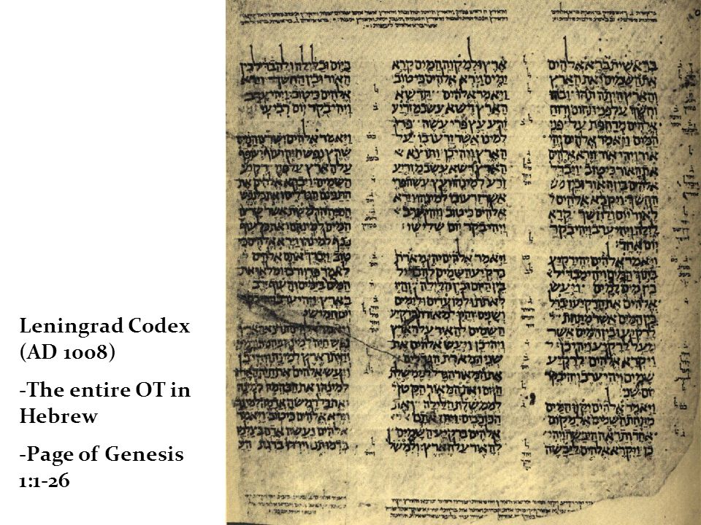
Leningrad Codex (AD 1008)
Entire OT in Hebrew
Page 1 of Genesis (1:1-26)
National Library of Russia
(St. Petersburg)

Slide 8
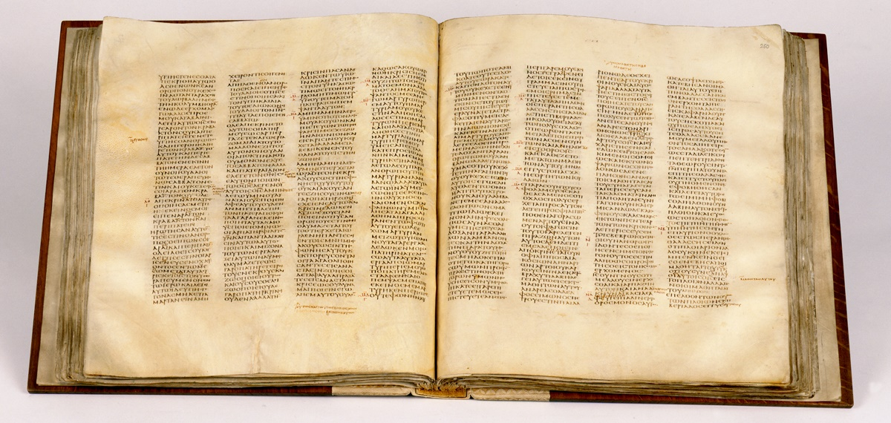
Codex Sinaiticus, 4th century Septuagint and New Testament
(British Library, London)

Slide 9
Ancient Writing
The question of authorship and composition of ancient texts must be linked to forms of ancient writing that are far older than the texts and translations that we now have.
The books of the Torah were necessarily composed using the language base and writing techniques available at the time.
If such writing techniques eventually became obsolete or changed, such changes would require updating the biblical material.

Slide 10
Abraham’s Family
In his move from Ur in southeast Mesopotamia to Canaan in the west (Gen. 12), Abraham moved from an East Semitic language base to a Northwest Semitic language base.
When Joseph was sold as a slave into Egypt, he necessarily learned the Egyptian language (Gen. 39).
Later, when his brothers came to Egypt seeking grain, they supposed that the vizier (who was really their brother Joseph) could not understand their language, since Joseph communicated to them via a translator (Gen. 42:23).

Slide 11
The Language of Israel In and Out of Egypt
Hence, the precise nature of the language of Jacob’s family in Egypt is unknown.
The upheavals which rearranged the political geography of Syria-Palestine during the transition from Late Bronze Age II to Iron Age I (ca. 1400 to 1200 BC) produced changes in the linguistic map as well.
It is likely that Hebrew emerged as a distinct language during this period, though it used the same alphabet as several other Northwest Semitic languages as well as held a rather large pool of common vocabulary.

Slide 12
The Emergence of Bible Hebrew
Biblical Hebrew emerged out of a mix of ancient Near Eastern Semitic Languages with close links to Ugaritic, Phoenician, Moabitish, and Edomitish.
The alphabets were consonantal and essentially the same, and there were many words common to all these languages.
It was naturally an oral language before it was a written language.
Occasionally, “loan words” from other languages are to be found in the biblical text (e.g., Aramaic).

Slide 13
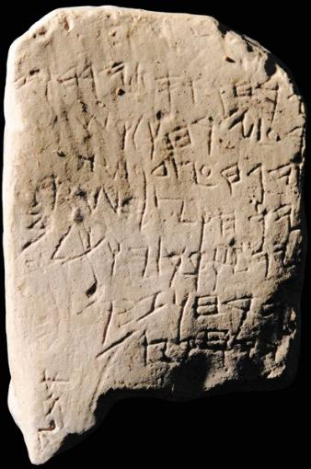
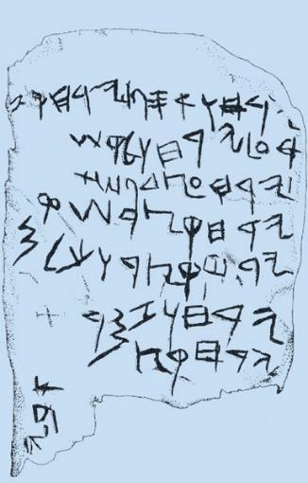
Gezer Calendar
An agricultural calendar from about 1000 BC. The script is ancient Canaanite; the language is Hebrew.

Slide 14
Standardization
By about the mid-11th century BC (the time of Samuel and Saul), several important developments occurred resulting in the standardization of Hebrew.
The stance of alphabetic letters became stable.
The direction of writing became consistent (right-to-left).
The number of consonants in the Hebrew alphabet was standardized to 22 letters.
The earliest written forms of the Torah, such as, the 10 commandments (Ex. 31:18; 32:16) and Moses’ written accounts (e.g., Ex. 24:4; Dt. 31:24), would necessarily have been “modernized” as the Hebrew language developed with respect to vocabulary, grammar, and the forms of the letters themselves.

Slide 15
The Form of Hebrew Writing
The typical form of Hebrew writing became the scroll, long sheets of parchment (leather) stitched together and attached to a spindle for rolling up.
Usually, writing would be on only one side of the parchment surface.
The codex form (book form bound on one edge) would not be developed until the Christian era.
The reader was obliged to provide things like the division of words, vowels, punctuation, and paragraphing. There were no chapter or verse divisions.

Slide 16
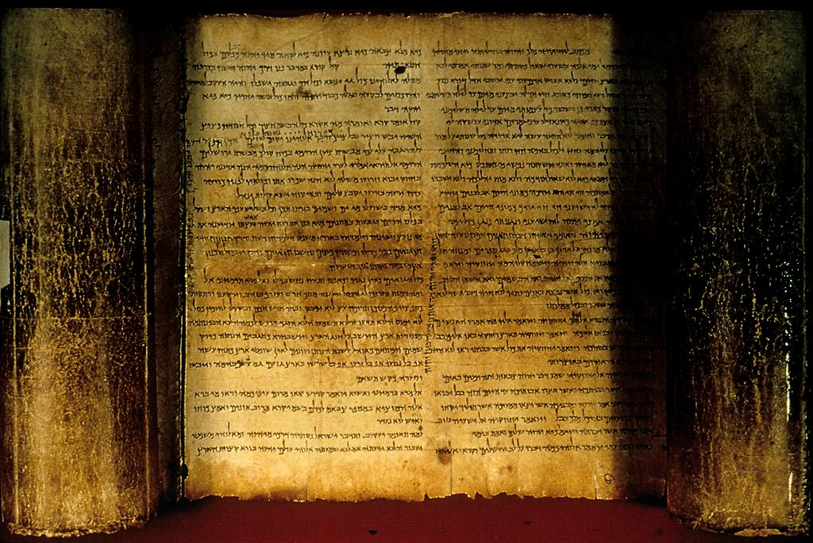
The Isaiah Scroll (Dead Sea Scrolls, 1QIsaª)

Slide 17
Interpreting Old Testament Literature

Slide 18
All Human Language is Culturally Conditioned and Idiomatic, including Hebrew
…dx*m; dbeKA MhAr!b;xa = “Abraham was very heavy…” (i.e., Abraham [was] very rich…)
…Ob UHl;w;Ti-lxa dy!v4 = “And do not send a hand in him…” (i.e., And do not lay a hand on him…)
…NxcZ*ha MOlw;-tx,v4 hxer4 xn! j`le = “Please go see about the peace of the flock…” (i.e., Please go see about the well-being of the flock…)
…OTw;xi hU!Ha-tx, Md!xAhA fd1y! = “The man knew Eve, his wife…” (i.e., The man had conjugal relations with Eve, his wife…)

Slide 19
Reading an Ancient Text
When we read an ancient text written in another language and from another culture, we must translate the culture as well as the language in order to properly understand it.
Otherwise, we will allow our own culture to subtly bend or twist the material to fit our own context.
We often find that to understand an ancient culture, we must be familiar with the literature of that culture, not only the literature in the Bible, but also the literature outside it.

Slide 20
The Reader as Interpreter
As a reader of the Bible, several things are important to bear in mind:
When we read a translation, we depend upon the translator to faithfully convey what is intended by the original writer(s).
The historical and cultural setting of the ancient Near East affects the way we understand words and ideas.
Each genre of literature also carries unique features characteristic of that genre.
Before we attempt to discern what a biblical passage means to us, we must first determine what it meant to its first readers.

Slide 21
Genre
Four primary genres (literary styles) of literature make up the biblical texts from Adam to David.
Narrative
Law
Poetry
Wisdom
Each genre has unique features that should be recognized and understood for proper interpretation.

Slide 22
Historical Narrative

Slide 23
The Bible’s Stories
There are more narratives in the Bible than any other type of genre. Large sections of the following books are narratives.
Genesis, Exodus, Numbers, Deuteronomy
Joshua, Judges, Ruth
1 & 2 Samuel, 1 & 2 Kings, 1 & 2 Chronicles

Slide 24
What Stories Do
Stories were not intended just to give disinterested facts. Rather, they were written to help God’s people who would read them later.
They reflect upon God’s expectations.
They explain how God’s people were blessed for trusting in Him and how they were disciplined when they disobeyed.
They shout warnings to God’s people about behaviors to avoid.

Slide 25
The Macro Story (meta-narrative)
In one sense, the Bible is a single story. It tells the “big picture” about God and his people.
…how God made the world, yet humans turned against him
…how God chose one man and his family to be the means for bringing humans back to Himself
…how even though he saved Israel from slavery in Egypt, God’s people failed to be faithful to Him
…how their failure led them back into slavery, this time to Assyria and Babylon
…how God determined to do for them what they could not do for themselves—save them in spite of their faithlessness

Slide 26
The Unfinished Macro Story
The Bible’s “big story” comes to us in two parts.
The first part (which we call the “Old Testament”) ends on an unfinished note.
God promised to send his Servant to suffer in behalf of the people’s sins, but by the end of the Old Testament, this Servant had not yet appeared.
God also promised to send a righteous King from David’s family to rule the whole world in peace. This promise, also, had not materialized by the end of the Old Testament.

Slide 27
Micro Stories
The “Big Story” is made up of dozens of “little stories.”
The “little stories” are largely about people—men and women whose lives are important because they contribute to the “big story.”
Sometimes there are even stories within stories—two stories intertwined that both underscore a great truth.

Slide 28
Five Common Components in a Story
Narrator
Plot
Dialogue
Characters
Scene

Slide 29
The Narrator
The narrator usually is not personally mentioned, but he does offer a point of view.
His choice of materials shape the overall character and purpose in the story.
The way the narrator tells the story illustrates his theological concerns.

Slide 30
The Plot
The plot is the skeleton upon which the muscles of the story are stretched.
The plot often shows the rise and fall of dramatic tension by setting up conflict and resolving it.
Sometimes there are subplots within stories that complicate the larger plot.

Slide 31
The Characters
Most stories have main characters as well as secondary characters.
In biblical stories, the main interest is NOT in the physical appearance of the people involved but their inward quality of character—what drives them—what makes them do what they do!
Sometimes those inward qualities are positive, and sometimes they are negative. Sometimes characters develop.

Slide 32
The Scene
Stories often are like stage plays with different acts or “scenes.”
These scenes usually are familiar to the listeners, and they draw the listeners into the story.
Sometimes the scenes change throughout the story, helping the listener to follow the sequence of the narrative.

Slide 33
The Dialogue
Dialogue or speeches help the listener understand the main characters and the plot of the story.
Conversations give clues about the internal values of the main characters.
Sometimes the conversations consist of direct statements, and sometimes they raise important questions.

Slide 34
Law

Slide 35
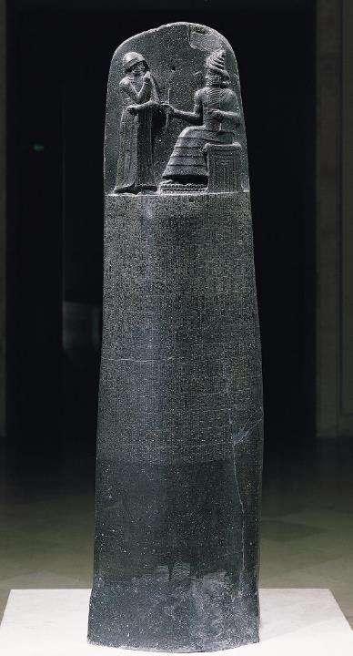
Law in the Ancient Near East
A number of law codes have been discovered from the ancient Near East (Ur-Nammu, Hammurabi, Eshnunna, Lipit-Ishar, etc.).
Most such law codes contain case laws, that is, if “such and such” is the case, then “such and such” is the penalty.
The laws of Moses also contain many such case laws (e.g., Ex. 21).
However, the law of Moses also contains apodictic laws, that is, absolute laws (“you shall” and “you shall not”). Such laws are unique in the ancient world, and in Moses’ law they are the more important of the two kinds.
The heart of these apodictic laws are the 10 Commandments.
Code of Hammurabi, Louvre, Paris

Slide 36
Some Case Law Comparisons between Moses’ Law and Hammurabi’s Code
HAMMURABI
If a man is in debt and sells his wife, son, or daughter, or binds them over to service, for three years they shall work in the house of their purchaser or master; in the fourth year they shall be given their freedom. (#117).
If a man destroys the eye of another man, they shall destroy his eye. If he breaks another man's bone, they shall break his bone. If a man knocks out a tooth of a man of his own rank, they shall knock out his tooth (#196-197, 200).
If a man has struck a free woman with child, and has caused her to miscarry, he shall pay ten shekels for her miscarriage (#209).
If a man's ox be a gorer, and has revealed its evil propensity as a gorer, and he has not blunted its horn, or shut up the ox, and then that ox has gored a free man, and caused his death, the owner shall pay half a mina of silver (#251).
MOSES
When you buy a Hebrew slave, he shall serve six years, and in the seventh he shall go free, for nothing (21:2).
But if there is harm, you shall pay life for life, eye for eye, tooth for tooth, hand for hand, foot for foot, burn for burn, wound for wound, stripe for stripe (21:23-25).
When men strive together and hit a pregnant woman, so that her children come out, but there is no harm, the one who hit her shall surely be fined (21:22).
But if the ox has been accustomed to gore in the past, and its owner has been warned but has not kept it in, and it kills a man or woman, the ox shall be stoned, and its owner also shall be put to death (21:29).

Slide 37
Examples of Apodictic Law: Commandments 7 & 8
“You shall not commit adultery.”
Like murder, adultery was a capital offense.
It represented defiance against God who unites a man and woman in marriage.
As a fundamental act of unfaithfulness, it underlies various other sexual offenses taken up later.
“You shall not steal.”
Popularly, this law concerns robbery and petty theft, but it also probably includes kidnapping (the Hebrew verb can also have persons as its object, cf. 21:16).
Acts of theft are violations of the person him/herself.

Slide 38
Poetry

Slide 39
Hebrew Poetry
Poetry is literature written in meter. General characteristics of Hebrew poetry include:
Rhythm (accented language)
Meter (patterns of verse)
Rhyme (repetitive elements)
Lyrical style (expression of deep personal feelings and emotion)
Metaphorical language (words become symbols of other entities)

Slide 40
Some features of Hebrew poetry are nearly impossible to reproduce in a second language.
Insofar as poetical structures depend upon phonetic devices, such as, puns, assonance, rhyme, alliteration, onomatopoeia, and the like, a second language is incapable of reproducing such elements when they are present in the first language.
However, because Hebrew poetry emphasizes the “rhyming” or relationship of ideas (as opposed merely to the rhyming of sounds), such elements are capable of being understood in a second language.
This “rhyming” of ideas is called parallelism, and it is the most distinctive feature of biblical Hebrew poetry. Several types are observable.

Slide 41
Synonymous or Congruent Parallelism (symmetrical)
(A₁, A₂ // A₁, A₂, etc.)
Come let us sing for joy to Yahweh;
Let us shout aloud to the Rock of our salvation.
Psalm 95:1
God presides in the great assembly;
He gives judgment among the “gods.”
Psalm 82:1

Slide 42
Antithetic Parallelism (Assymetrical)
(A₁, A₂// -A₁, -A₂, etc.)
For Yahweh watches over the way of the righteous,
But the way of the wicked will perish.
Psalm 1:6
They provoked Yahweh to anger by their wicked deeds,
and a plague broke out among them.
But Phinehas stood up and intervened,
and the plague was checked.
Psalm 106:29-30

Slide 43
Staircase Parallelism (the sentence is started, then interrupted, then started again)
(A_{b}A)
When the waters saw you, God,
The waters saw you and writhed;
Psalm 77:16
The seas have lifted up, O LORD,
the seas have lifted up their voice;
the seas have lifted up their pounding waves.
Psalm 93:3

Slide 44
Chiasm (inverted)
(ABA, ABBA, ABCBA, ABCDEDCBA, etc.)
Yahweh’s right hand has done mighty things!
Yahweh’s right hand is lifted high;
Yahweh’s right hand has done mighty things!
Psalm 118:15b-16
His mischief returns upon his own head,
and on his own pate his violence descends.
Psalm 7:16 (RSV)
(some translations either miss or ignore the chiasmus in the Hebrew text, e.g. NIV)

Slide 45
Acrostics (successive lines begin with the letters of the alphabet in order) x b g d h v z H F y k l m n s f p c q r w t
Psalm 111
bbAle-lkAB; Hv!hy4 hd@Ox
:hdAfev4 Myr9wy4 dOsB;
hv!hy4 yWef3ma MylidoG;
Mh,ycep;H,-lkAl; Mywiv0rD;
Olf#PA rdAhAv4-dOh
dfalA td@m,fo Otq!d4civ4
vytAxol;p;nil; hWAfA rk,ze
Etc.
I will extol Yahweh with all my heart
In the council of the upright and in the assembly.
Great are the works of Yahweh,
They are pondered by all who delight in them.
Glorious and majestic are his deeds,
And his righteousness endures forever.
He has caused his wonders to be remembered;

Slide 46
Wisdom

Slide 47
Persons of Wisdom
Wisdom in the ancient Near East was a long and respected tradition, and individuals with wisdom formed a special class (cf. Ex. 7:11; Dt. 1:13; Est. 1:13-14; Job 15:17-18; 34:2; Pro. 1:5-6; Je. 8:8-9; 10:7; Ob. 8).
MkAHA (= the wise man or wise woman)
hmAk;HA (= wisdom, technical skill, aptitude, good sense)
hn!yBi (= insight, understanding)
Wise men were an essential part of the royal court, standing as personal advisors to the king (cf. Je. 50:35; 51:57).

Slide 48
Wisdom in the Ancient Near East
Wisdom for the ancients was practical, not strictly intellectual or spiritual. It was a combination of intelligence, shrewdness, good sense, sound judgment, and moral understanding. It was:
The ability to understand one’s surroundings
Being able to foresee the reactions of one’s fellows
Applying one’s own resources at critical points
The wise man in the ANE studied, observed and meditated.

Slide 49
ANE Wisdom Literature
Hebrew Wisdom Literature was a genre common to other ancient Near Eastern peoples:
Examples of Mesopotamian Wisdom:
  “The Instructions of Shuruppak son of Ubaratutu” (ca. 2600 BC)
  “I Will Praise the Lord of Wisdom” (ca. 1700 BC)
  “Instruction of Ahikar” (ca. 500 BC)
Examples of Egyptian Wisdom:
  “Wisdom of Amenemope” (13th century BC)

Slide 50
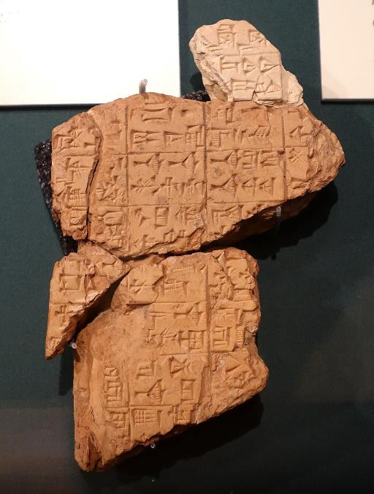
Samples of Wisdom from Shurrupak
“You should not pick a quarrel; it will disgrace you.”
“You should not dally with a married woman; it will bring slander.”
“Do not live with an arrogant man; he will make you like a slave girl.”
“A loving heart maintains a family, but a hateful one destroys it.”
Oriental Institute, University of Chicago

Slide 51
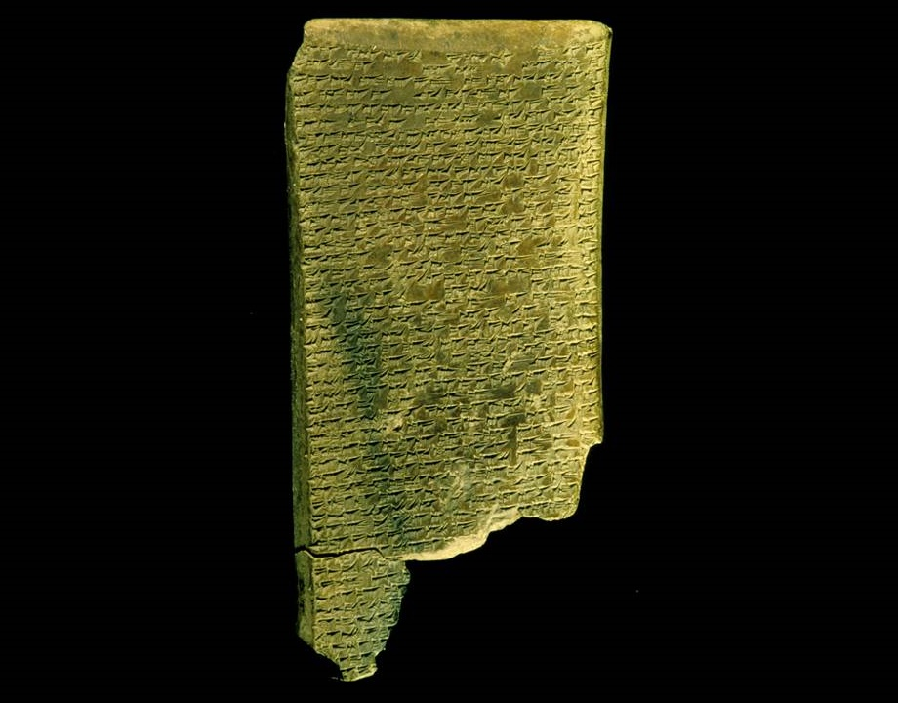
The sufferer complains that his situation is like that of someone who has behaved impiously or irreligiously, whereas he has lived as a model of piety and reverence. This leads him to wonder if this way of life is really the behavior the gods want, and he contemplates, in Job-like fashion, the incomprehensibility of the divine will.
There follows an extended account of the sufferer's various physical afflictions.
BABYLONIAN JOB TABLET
“I Will Praise the Lord of Wisdom”
Describes the plight of an innocent sufferer
British Museum, London

Slide 52
Two Basic Types biblical wisdom literature falls generally into two categories
Practical
The object of practical wisdom was to live a happy, successful, moral life.
This type of wisdom is most clearly expressed in the Proverbs, often in short antithetical statements.
Speculative
Speculative wisdom addresses more philosophical aspects of life—human suffering and the meaning of life.
This type of wisdom is most clearly expressed in Job and Ecclesiastes.

Slide 53
Hebrew Wisdom Literature is found in two primary collections:
HEBREW BIBLE
Job
Proverbs
Ecclesiastes
Song of Songs
APOCRYPHA
Sirach
Wisdom of Solomon
Of these books, only Job falls into the Adam to David section of the Old Testament.

Slide 54
The Fount of Wisdom
While wisdom was acquired through observation and reflection, the Hebrew Bible clearly marks Yahweh himself as the ultimate source of wisdom.
True wisdom begins with the awe of God (Job 28:28; Ps. 111:10; Pro. 1:7; 9:10; Ecc. 12:13).
Wisdom is personified as the pre-existent companion of God at the creation—a hypostatic expression of God himself (Pro. 8:22-31).

Slide 55
The Key Characters from Adam to David

Slide 56
Adam, the Prototype Failed Human
As the original human, Adam was the ancestor of all who followed him. In disobeying God, Adam was estranged from his true home. His descendants followed in kind, living lives of desperation, oppression, and violence. Adam became the prototype for humans in rebellion, alienated from God and alienated from each other.

Slide 57
Imago Dei
God created humans in the divine image. Primarily this refers to:
Communal life (“Let us make man…in our image” -- the life of a human is not fully expressed as an individual but also in communion with another)
Authority and stewardship (“Let them rule” -- humans are superintendents over the created order)
THE UNIQUENESS OF HUMANS IN GOD’S IMAGE:
Personal Creative Transcendent Moral
Intentional Self-aware Relational

Slide 58
The Biblical Language of Humanness
MdAxA (adam)
Derived from the word hmAdAx# (= soil)
Can refer to the first human either generically (i.e., “the
human”) or by proper name (i.e., “Adam”)
Can refer to the human race collectively (1:26)
Can refer to the first man and first woman collectively (5:2)

Slide 59
Humans & Gender
1:1—2:4a
MdAxA (adam) = generic word for “human” or “humankind” (it is not gender specific)
It does not function as a proper name in Ge. 1:26-27a, since it has the Hebrew definite article.
The use of plural pronouns implies that the appropriate translation is “humankind.”
The gender specific terms rkAz! (= male) and hbAq2n4. (= female) are linked to the divine image, implying that both maleness and femaleness are reflections of God’s personhood.

Slide 60
The Creation of Humankind
While vegetable life is depicted as wholly created, animate life is depicted as a composite of a created element and an uncreated element (2:7).
The sod, soil (created element)
The divine breath (uncreated element)
Only in this way does the human become a “living being,” and death is the separation of these two entities (cf. Job 34:14-15; Eccl. 12:7; Ps. 146:4; Ja. 2:26).

Slide 61
Poetic Character in the Primeval Family Names
The poetic story line…
…to the Soil-Creature and his wife, Life, were born Acquire and Vapor. When Vapor was murdered by Acquire, Acquire was banished to the land of homelessness. Later, Soil-Creature and Life had another child, named Granted.
MdAxA (Adam = soil creature)
hV0!Ha (Eve = life)
Ny9q1 (Cain = acquire, forger)
Lb,h, (Abel = vapor)
dOn (Nod = homelessness)
Twe (Seth = granted)

Slide 62
Work and Responsibility
Eden is the setting for human life to be lived in harmony with God.
  The garden was good for food (2:9), though at this early period humans were not meat-eaters (cf. 9:3).
  The human was placed in the garden to “work” it (2:15); hence, work was NOT part of the curse, but endemic to humans made in the divine image.
  Dominion over the earth and its living creatures implied responsibility (1:28).
  The naming of the animals also pointed toward human responsibility (2:19-20).
  The most important responsibility of all was obedience to the divine prohibition (2:9b, 16-17).

Slide 63
The Aftermath
The disobedience of the first humans created never-ending ripples of rebellion.
Resentment against God (4:1-7)
Fratricide (4:8-12)
Exploitation by power, the strong over the weak, the male over the female (4:23-24)
“East of Eden” becomes a symbol for human alienation from God (3:24; 4:16; 11:2).
While there is human progress in the arts and technology, human depravity mars this progress (4:17-22).
The birth of Seth offers the first ray of hope for the future as some within this family line began to seek after God (4:25-26).

Slide 64
Abraham, the Prototype for Faith and Faithfulness
Abraham was called by God to leave his home and go to a land that God would show him. He became the model for true faith and faithfulness, which is God’s call to forsake one’s natural home and way of life in order to receive a home and way of life from God’s hand. The greatest thing Abraham ever did was to believe in God’s promise.

Slide 65
Historical Background
With Abram, the reader moves into a more defined historical era, the Middle Bronze Age (2000-1550 BC).
As pastoral nomads, the patriarchs herded sheep, goats, and cattle in the half-desert regions of the Fertile Crescent.
Initially, Abram lived with his family in Ur of the Chaldeans (i.e., lower Mesopotamia), an important pagan city in antiquity with a known history dating back into the Early Bronze Age.

Slide 66
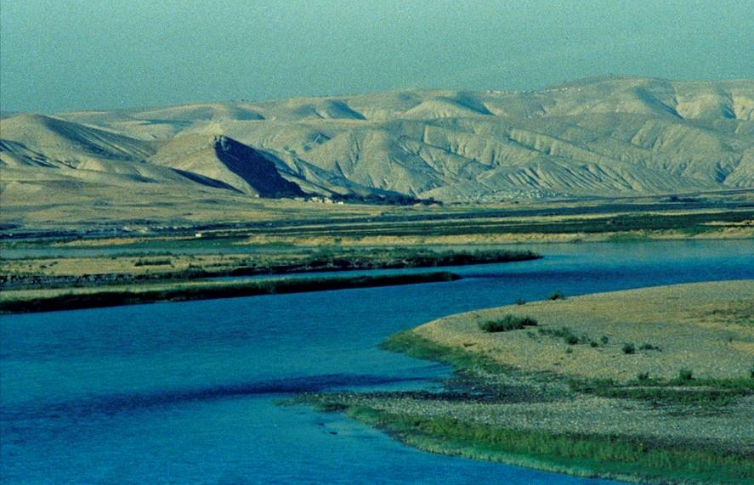
The mighty Euphrates River, 1780 miles long, was the major commercial artery in ancient Mesopotamia along which Abram traveled.

Slide 67
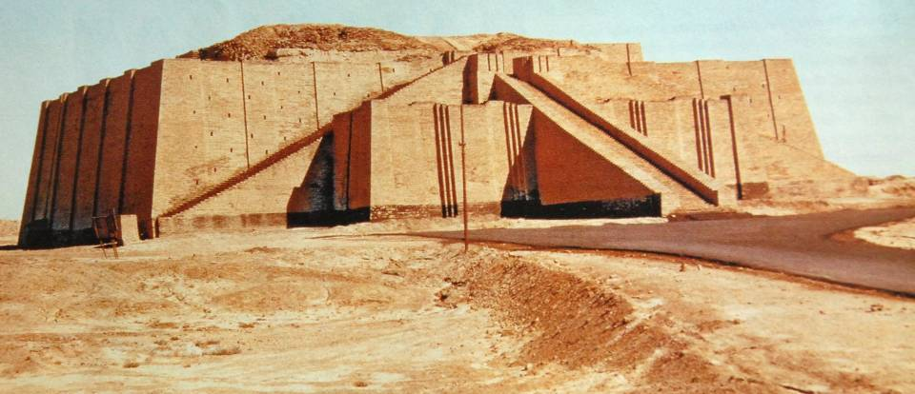
The ziggurat at Ur, the earliest of its kind, dates to the neo-Sumerian period (2112-2000 BC). Originally a three-tiered stepped platform that rose to a height of 100’, only the first and second stages remain.

Slide 68
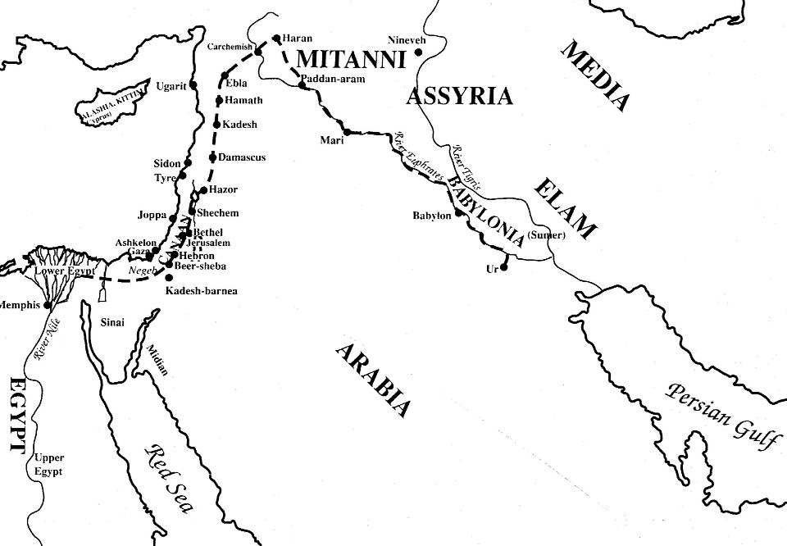
Abraham’s Journeys

Slide 69
Theophanies
…Yahweh appeared to Abram…so he built an altar there… (12:7)
A “theophany” (= God shining, God appearing) bridges the gap between YHWH as invisible Spirit and YHWH as One who reveals himself.
DEFINING NORMS:
YHWH cannot be seen by humans (Ex. 19:21; 33:20).
He takes the initiative to reveal himself in temporary self
-disclosures as the Mal’ak Yahweh (Angel of the LORD) and
other forms.

Slide 70
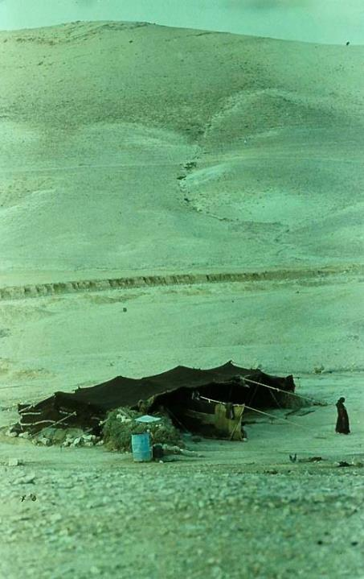
Tents and Altars
As a semi-nomad, Abram lived in tents (a sign of temporary residency).
However, he also built altars (a sign of permanency). The places where he built altars (Shechem, Bethel, Hebron, Moriah) became sacred sites in the later history of Israel.
Bedouin tents and the semi-nomadic lifestyle have not changed greatly in the last four millennia.

Slide 71
Threats to God’s Promise of Offspring much of Genesis details the recurring threats to Yahweh’s promise of offsring to Abram
Sarah’s sterility
Sarah’s addition to Pharaoh’s harem
Abram’s survival in the uncivilized hill-lands
Abram’s attempt at slave adoption
Birth of Ishmael, the slave son
Sarah’s advancing age
Sarah’s addition to Abimelech’s harem
Sacrifice of Isaac
Rebekah’s sterility
Abram’s additional sons
Abimelech’s intent to add Rebekah to his harem
Jacob and the ANE law of primogeniture
The vengeance of Esau
Selling of Joseph
Judah’s lack of an heir
Joseph’s life threatened in Egypt
Survival of Jacob’s family

Slide 72
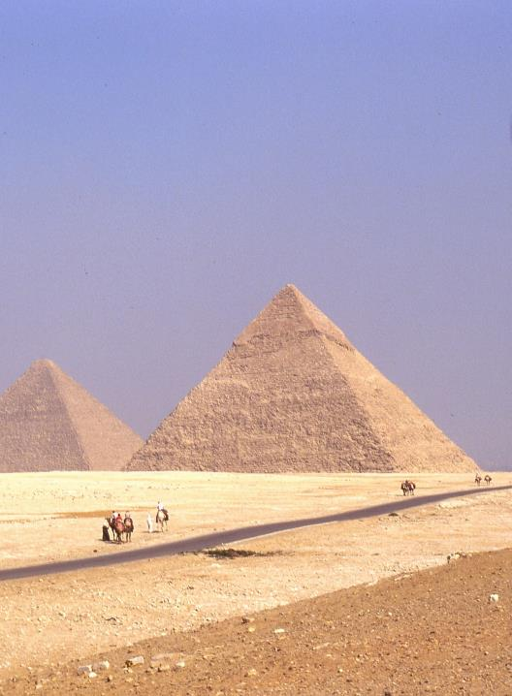
Abram in Egypt
(12:10-20)
Journeying through the Sinai, Abram was driven to Egypt by drought.
He passed his wife off as his half-sister, a half truth (11:27-29; cf. 20:12), and in doing so risked that she would be taken into Pharaoh’s harem.

Slide 73
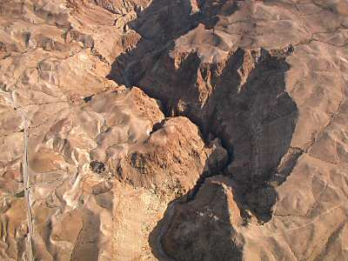
Abram and Lot Separate
(13:1-18)
The issue at hand was either to trust Yahweh’s promise or to trust to the security of the land’s fertility.
Lot “raised his eyes” toward Sodom (13:10), while Abram “raised his eyes” only to Yahweh’s promise (13:14).
Lot’s direction is the product of human choice; Abram’s is God’s choice.
The Nahal Darga is the largest wadi in the northern Judean desert (27miles long and up to 650’ deep). This was the land Abram accepted.

Slide 74
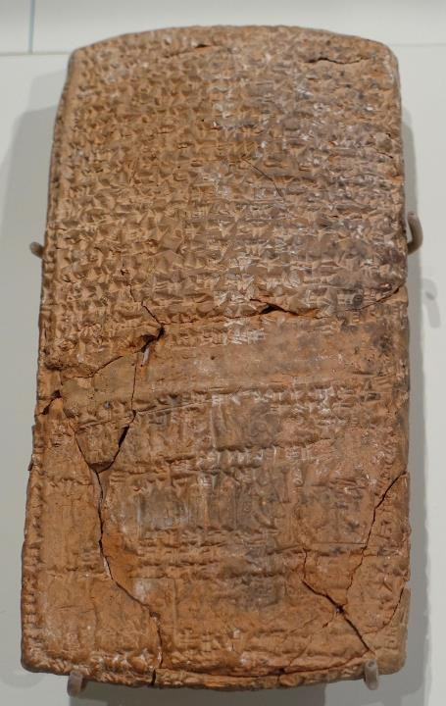
Slave Adoption
Some 6,500 tablets, like this legal dispute over property, have been excavated from Nuzi, an ancient Hurrian town east of the Tigris River (mid-2nd millennium BC). The archive demonstrates common social, economic, and legal traits with the patriarchal narratives.
Hurrian family law codes stipulated two kinds of heirs, direct and indirect. Haran, where Abram lived for a time, was a Hurrian city.
Indirect heirs were adopted in order to ensure proper burial in the absence of a direct heir.
Indirect heirs, however, must give place to a true son born later.
Here, God promised Abram a direct heir.

Slide 75
Hagar’s Pregnancy (16)
God’s promise that Abram’s heir would come from “his own body” leaves unresolved the question of the mother, since Sarai was barren.
The adoption of a slave wife’s son as an heir is also known from the Nuzi texts as well as the Code of Hammurabi.
Like the attempt to adopt the trusted slave Eliezer as an heir, the union of Abram and Hagar was also a threat to God’s promise, in spite of Abram’s best intentions.

Slide 76
Clarification & Obligation
The mother of the promised heir was now specified to be Sarah, and the sheer impossibility of such a son for a 100-year old man and a 90-year old woman becomes an added test of faith.
The name of the promised son, Isaac (= he laughs), is linked with several incidents involving laughter (17:17; 18:12-15; 21:6).
Abraham is now given two commands as obligations:
To be moral and upright
To circumcise every male in his household
These commands will later emerge as the two primary categories of Israelite law: ethical law and cultic law. The essence of the Israelite way of life is internal to the covenant.

Slide 77
The Promise is Fulfilled at Last
(21)
The suspense building from chapter 12 finds resolution in the birth of Isaac, named “he laughs.”
The expulsion of Hagar because 17-year old Ishmael mocked Isaac—which St. Paul later interpreted as a form of persecution (Ga. 4:29)—resulted in the reaffirmation of divine grace to Ishmael.
Ishmael was then married into his own native culture (and he became the ancestor of an Arabic clan, cf. 25:12-18, which Islamic tradition claims as their link to Abraham)
Abraham’s covenant with Abimelech ratified his status as a legal resident. Beersheba (= well of the oath) signified that in both posterity and land God had fulfilled his promises.

Slide 78
The Akedah (the Binding)
(22)
The God who earlier had called Abraham to give up his past now called upon him to give up his future.
For the reader, this baffling instruction by Yahweh is “a test;” hence, the reader has a psychological advantage over Abraham.
Later, the Old Testament will identify Moriah as the same as Mt. Zion (cf. 2 Chr. 3:1), the site of the 1st temple. The sacrifice of Isaac serves as the prototype for the whole sacrificial system of substitutionary atonement.
The name “Yahweh-Yireh” (= Yahweh will see) is used idiomatically to mean Yahweh will provide.

Slide 79
NT Reflections on Abraham’s Faith
In the New Testament, the offering of Isaac foreshadows the sacrifice of Christ on the cross.
The language “your son, your only Son” (22:2), rendered in the LXX as “your beloved son,” anticipates Christ as God’s beloved Son.
The early church fathers saw a parallel between Isaac carrying the wood and Christ carrying the cross.
Abraham believed that God could raise Isaac from the dead, even though he would be sacrificed (He. 11:17-19).
In reconfirming the promises (22:15-18), God took oath upon himself, an act that the writer of Hebrews calls the two unchangeable things, God’s promise and God’s oath (He. 6:16-18).

Slide 80
Joseph, the Model for Forgiveness
Disowned by his brothers and sold by them to slave-traders, Joseph still maintained a life of faithfulness to God. In time, God blessed Joseph and elevated him in Egypt. Eventually, he would have the opportunity to avenge himself of his brothers’ treachery, but instead, Joseph chose the high road of forgiveness.

Slide 81
Joseph’s Dreams
(37)
The promise that had been confirmed to only one male offspring in earlier generations now was confirmed to Jacob’s entire family line of 12 sons.
The meaning of the word describing Joseph’s coat is unknown. The idea that it was a “coat of many colors” is an interpretive translation from the LXX and the Latin Vulgate.
The tribal name “Ishmaelites” to whom Joseph was sold is seemingly interchangeable with “Midianites” (cf. Jg. 8:22-24).

Slide 82
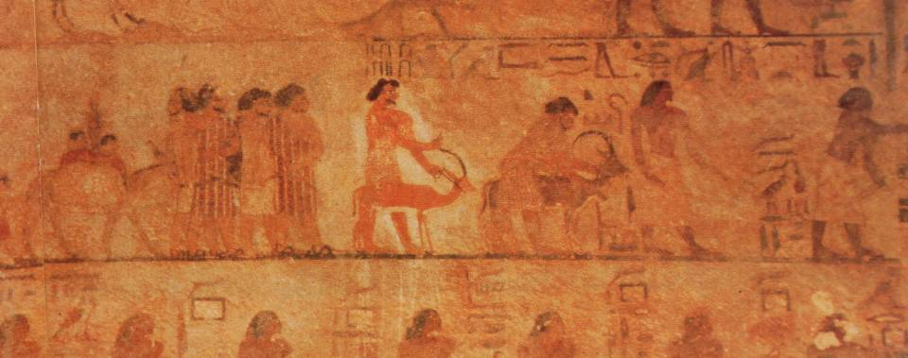
The Sons of Israel Seek Grain in Egypt
The Beni Hasan mural (19th century BC) depicts Semitics entering Egypt to trade or negotiate. The presence of Asiatics in Egypt increased during the Hyksos Period (17th and 16th centuries BC), the probable time of the migration of Jacob’s family.

Slide 83
Joseph Meets His Brothers
(42)
Many years later, when Joseph’s brothers came to Egypt to buy grain, they bowed low to the ground before Joseph, fulfilling Joseph’s childhood dreams (42:6; cf. 37:7, 9).
Joseph’s lack of facial hair, his Egyptian dress and status, his age, and the fact that he took oath “as Pharaoh lives” (implying the divinity of Pharaoh) made him unrecognizable to them.
The secret return of their money and the requirement that they bring back their youngest brother (Benjamin) was Joseph’s stratagem to keep them tied to Egypt.

Slide 84
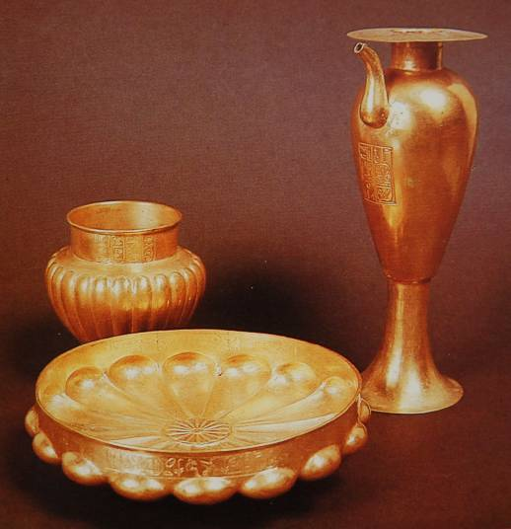
The Goblet in Benjamin’s Grain Sack
Golden tableware from the royal tombs at Tanis (21st Dynasty).
Though the cup that features so prominently in the Joseph stories was silver, it may have resembled these.

Slide 85
Joseph’s Clever Ruse
(44)
Joseph carefully engineered his scheme so as to once more put his brothers in as nearly the same position as they had been so many years before when they had sold him to the Ishmaelites.
The question, of course, was whether they would respond now like they did then.
The most convenient solution would be to deny any connection with the theft of the cup and leave Benjamin to face the consequences.
It was precisely this potential escape route that Joseph wished to create in order to test them.

Slide 86
The Brother’s Response
(45)
That the brothers refused to abandon Benjamin, and particularly, that Judah offered himself for slavery in his brother’s stead demonstrated not only his willingness to save his younger brother, but also his willingness to expiate his own crime in selling Joseph (cf. 37:26-27).
With this, Joseph knew his brothers had changed. They had passed his test!
Hence, Joseph now revealed his identity, urging that “you sold me” but “God sent me.”

Slide 87
The Character of Salvation-History
Joseph’s explanation (47:4-8a), which is repeated later (50:18-21), becomes the paradox upon which the narratives of Genesis are built (and, indeed, much of the history in the Hebrew Bible).
  You meant it for evil!
  God intended it for good!

Slide 88
Moses, the First Pastor and Lawgiver
Born in slavery, Moses was called by God to lead the Israelites from Egypt to Mt. Sinai, where they would become God’s holy people. For forty years, he served as their pastoral leader, mediating God’s instructions for life and leading them to the borders of the land God had promised to Abraham and his descendants.

Slide 89
The Call of Moses (Ex. 3-4)
The divine calling of Moses came at the age of 80 (7:7; cf. Ac. 7:23, 30).
In the desert, he was confronted by Yahweh who appeared to him in a burning bush that was not consumed: God commissioned him to go back to Egypt to lead out the Israelites.
This occurred “beyond the wilderness” at the “mountain of God,” also called Mt. Horeb (especially in Deuteronomy) and Mt. Sinai (especially in Exodus, Leviticus and Numbers).
Here, God declared to Moses his sacred name, Yahweh.

Slide 90
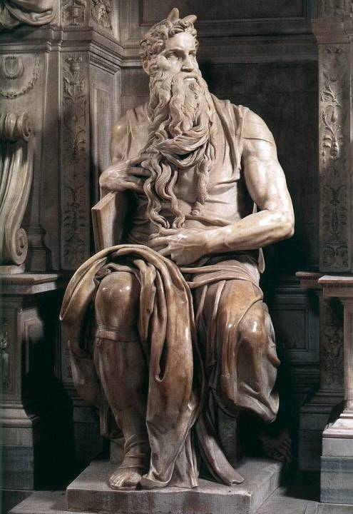
Moses
Born into a Hebrew slave family from the clan of Levi, Moses was saved from extermination by the subterfuge of hiding him in an “ark” in the river.
He subsequently was discovered by an Egyptian princess and reared in the royal court.
Eventually, Moses would become the archetype for the three public offices of Israel, prophet (the immediate voice of God), priest (the cult) and king (the giving of law).
“Moses” by Michelangelo, Church of San Pietro in Vincoli, Rome

Slide 91
The Commission
From the burning bush, Yahweh commissioned Moses to lead the Israelites out of their bondage and bring them to the mountain of God.
Moses was to lead them to Canaan, a land “flowing with milk and honey,” an idiom for a land of abundance.
Yahweh also promised that before this escape, he would demonstrate his divine power by striking Egypt with judgments.

Slide 92
The Reluctant Deliverer
Moses’ response to this commission was diffident, at best.
First, he asked, “Who am I (3:11)?”
Next, he posed the problem of the Israelites not recognizing his authority or the authority behind him (3:13), to which God responded by revealing his sacred name Yahweh.
He envisioned that the people would not believe him (4:1), to which God showed Moses three convincing signs.
He complained that he was not a good speaker (4:10), to which God promised to enable Moses to speak.
Finally, Moses suggested that God send someone else (4:13), to which God promised to send his brother Aaron as a spokesman.

Slide 93
Back to Egypt
Yahweh now instructed Moses to return to Egypt and confront Pharaoh.
Yahweh would harden Pharaoh against the Israelites, and against this hardness, Yahweh would perform wonders to bring Pharaoh to heel.
In confronting Pharaoh, Moses would offer for the first time the prophetic preface, “Thus says Yahweh…” (4:22).
Since Israel was God’s “firstborn son,” and Pharaoh would refuse to release the Israelites, God would kill Pharaoh’s firstborn.

Slide 94
The Contest Between Pharaoh and Yahweh
Pharaoh was the god-symbol of Egypt; hence, Moses’ confrontation with Pharaoh was a contest between deities, Yahweh and Pharaoh (and the Egyptian pantheon).
Pharaoh was believed to be the incarnation and Son of Amon-Re (or Horus), the ka (life-force and soul) of Egypt.
He was believed to be descended from the gods in which the queen mother had intercourse with the supreme god Amun or Amon-Re.
At death, the Pharaoh went to the place of the gods, where he continued to exercise his right over life and death.
Hence, when Pharaoh hears Moses say, “Thus says Yahweh…” (5:1) he knows he is being directly challenged by a deity, and the response, “Thus says Pharaoh…” (5:10) uses the same language as a counter-claim.

Slide 95
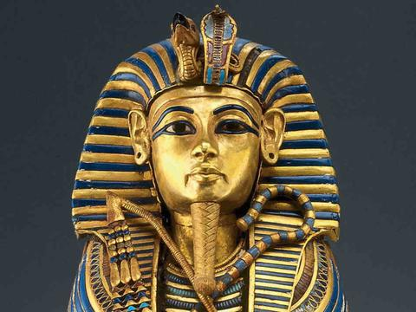
The Serpent Sign (7:8-13)
The serpent (uraeus) was an emblem of Pharaoh’s power during the New Kingdom Period.
On the pharaonic crown were two golden cobras symbolizing the connection between the gods and the Pharaoh and reflecting the king’s royalty and sovereignty over Upper and Lower Egypt.
The confrontation between Moses and Aaron and the court magicians was a direct challenge to Pharaoh’s power and claim to be a son of god.

Slide 96
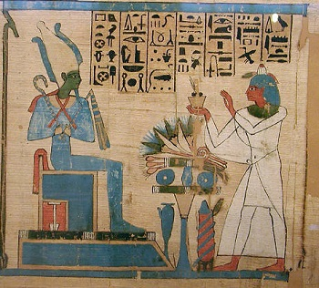
The Final Plague is Announced (11)
The last of the 10 plagues would be against the patron deity of Pharaoh, the god Osiris.
As the righteous judge and ruler of the land of the dead, he also was the god who granted all life.
He was typically depicted with green skin and holding a crook and a flail.
The threat of death to all the first-born in Egypt was a direct challenge to Osiris.

Slide 97
The Tenth Plague (12:1-32)
The Passover was the final blow to Egypt, the death of the first-born.
Each Israelite family was instructed to slaughter an unblemished lamb, roasting and eating it with unleavened bread and bitter herbs.
Only those who had the lamb’s blood smeared on their doorposts and lintels were spared. The destroyer would then “pass over” their home (12:13), which is the origin of the word “Passover” (HsaP,).
The “destroyer” (tyHiw;m0aha, 12:23; cf. He. 11:28) was likely the Angel of Yahweh (cf. 2 Sa. 24:16; 2 Kg. 19:35).
Ramesses II is known to have had thirteen sons. His first-born, Amun-her-khepeshef, died as a young man of unknown causes, ca. 1254 BC. The crown passed from Ramesses II to his brothers, eventually landing on Merneptah in 1213 BC.

Slide 98
The Expulsion from Egypt (Ex. 12:33-42)
In consternation over massive deaths, Pharaoh now ordered the Israelites to leave Egypt.
Yahweh had rejected the most powerful kingdom in the world, bringing death to all their first-born sons, while adopting and protecting Israel as his own first-born son.
They left with the bones of Joseph (13:19; cf. Ge. 50:24-25), which later would be interred at Shechem in the territory of Manasseh, the land area allotted to one of Joseph’s sons (Jos. 24:32).

Slide 99
Crossing the Sea (Ex. 14:10-31)
Fearful of the Egyptian chariot corps, the Israelites now respond to the first of many crises in which they challenge Moses and express a desire to return to Egypt.
However, Yahweh instructed Moses to lift his rod over the sea, and when he did, the pillar of cloud relocated and became a rearguard.
Moses stretched his rod over the sea, a strong wind blew the sea back, parting it, and the Israelite passed through the sea on dry ground, the Egyptian charioteers following them.
On the other side, Moses once more lifted his rod, and the waters of the sea converged, drowning the Egyptian chariot corps.

Slide 100
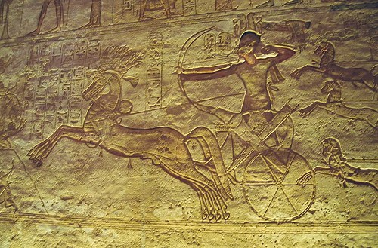
Egyptian Chariotry
Chariotry was first introduced to the Egyptian military during the Hyksos Period.
They gradually developed from a mode of transportation to a formidable implement of war with speed and mobility unmatched by foot soldiers.
Egyptian chariots of the period were generally pulled by two horses.
Wall relief from Abu Simbel of Ramesses II in his chariot at the Battle of Kadesh

Slide 101
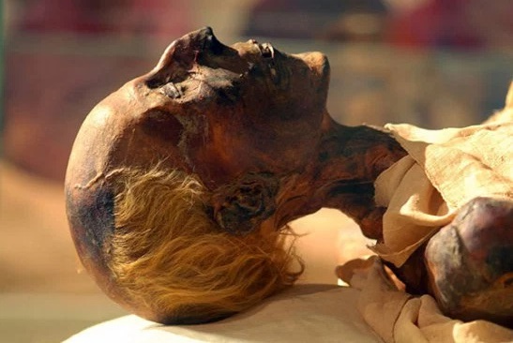
Mummy of Ramesses II
While the identity of the Egyptian Pharaoh of the exodus is debated, the majority opinion remains with Ramesses II, regarded by many historians as the most powerful pharaoh in history.
He was appointed prince regent by his father, Seti I, at the age of 14.
He lived until he was about 90, and his mummy was discovered in 1881.
Cairo Museum

Slide 102
The Song of the Sea (Ex. 15:1-21)
This victory hymn, sung by Moses, is arguably one of the oldest parts of the Hebrew Bible (based on archaic Hebrew).
The hymn falls into four parts:
  Doxology, in which Yahweh is described as a “Man of War” (15:1-3)
  Praise to Yahweh’s justice for overthrowing the Egyptians (15:4-12)
  Declaration of Yahweh’s love in establishing Israel as a nation (15:13)
  Triumph of the kingdom of God, anticipating the arrival of the Israelites in Canaan, and the eventual building of the temple (15:14-18)

Slide 103
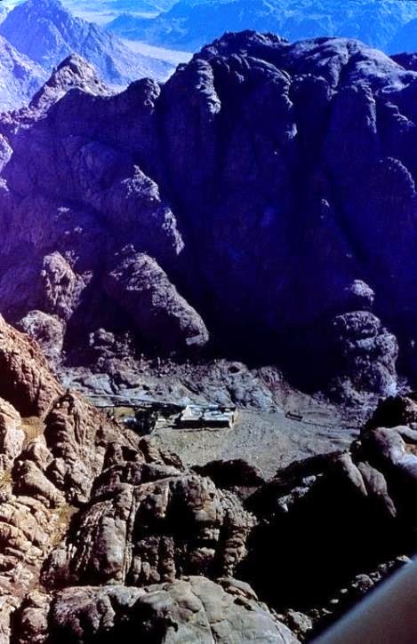
Jebal Musa,
the traditional Mt. Sinai
Though there is no consensus on the location of Mt. Sinai, the site having the oldest tradition is near the bottom of the Sinai peninsula.
St. Catherine’s monastery (Eastern Orthodox), dating from the 4th century AD, lies at the foot of the mountain.
At the “mountain of God” the Israelites would receive the first of what would come to be called “the law of Moses.”

Slide 104
The Calling of Israel (Ex. 19:1-9)
From Rephidim, the Israelites now completed the final leg of their journey to Mt. Sinai, where Moses ascended the slopes to hear the voice of Yahweh.
Here, God announced to him Israel’s calling to be a kingdom of priests and a holy nation, a calling that would stretch into the NT (1 Pe. 2:5, 9).
The redemption of Israel from Egypt was also a calling—it was not only an escape from something, but a commission to be something.
The commission of the nation to be a kingdom of priests set apart for God’s larger purpose theologically connects directly with God’s promise to Abraham that in his seed all nations of the earth will be blessed (cf. Ge. 12:3). Priests, by definition, are mediators, and if the whole nation was to be a priesthood, this immediately implies that they were to be priests to the nations.

Slide 105
Yahweh in the Midst of the Camp (Ex. 33:12-17)
Earlier, because of their rebellion, Yahweh said he would not dwell within the community (33:3). At Moses’ intercession, however, Yahweh said he would reenter the community and lead them to Canaan. Implicitly, this would entail the building of the tabernacle.
In his intercession, Moses asked Yahweh to show him his “ways.” Later, a Hebrew poet would make a subtle distinction between Yahweh’s “ways” (a deeper level) and his “acts” (a more superficial level). He made known his “ways” unto Moses, but his “acts” to the Israelites (Ps. 103:7).
The face/presence of Yahweh would now go with them and lead them to the promised land.

Slide 106
The Divine Face
Hence, Yahweh says his “face” will go with the Israelites (33:14), usually translated as “presence” in the English versions.
Later, Moses would say that God brought the entire company out of Egypt by his “face” (Dt. 4:37; cf. Is. 63:9).
The sacred bread in the tabernacle would be, quite literally, the “bread of the face” (Ex. 25:30; 39:36), and the table was the
“table of the face” (Nu. 4:7).
Just as the Mal’ak Yahweh (Angel of the LORD) is the primary recurring theophany, so the Face of Yahweh (MyniPA) is the primary recurring anthropomorphism.
Divine displeasure is expressed when Yahweh’s face is against someone (Ge. 3:8; 4:14, 16; Lv. 10:2; 22:3).
Divine approval is expressed when his face is turned toward someone (Ge. 27:7; Nu. 6:25; Dt. 12:7, 18; 14:23, 26; 15:20, etc.).

Slide 107
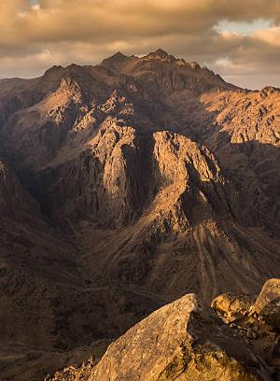
The Great Theophany (Ex. 33:18-23; 34:1-9)
On the mountain, Moses requested to see Yahweh’s glory.
Though Moses was not allowed to see the divine glory in its full essence (Ex. 33:22), he was privileged to see at least a veiled expression (cf. Nu. 12:8).
He also heard a fuller expression of the divine name.
Moses now cut two more tables of stone upon which Yahweh wrote the Ten Words once again.
Mt. Sinai

Slide 108
The Divine Glory (dObKA = “heaviness” or “weight”)
The reader first encounters the kavod of Yahweh in the desert account of the supply of manna and quail (Ex. 16:7, 10-12). Even more impressive is the kavod of Yahweh in the cloud that covered Mt. Sinai (Ex. 24:16-17) and in the residence of Yahweh in the Tent of Meeting, where he would speak from between the cherubim (Ex. 25:21-22; 29:42-43; 40:34-35).
The divine glory, the divine name, and the divine face are each a synecdoche for the full essence of God’s person.
No one can behold this full essence of God and survive, which is why Moses was shielded in a cleft of the rock (33:20-23).

Slide 109
Sinai to Kadesh
(Nu. 10:11—12:16)
Leaving Mt. Sinai, the Israelites traveled northward in battle order to the southern border of Canaan.
Along the way, they were punished for their complaints against Moses because of hardship and boring food.
  At Taberah, they are treated more gently, since the fire of judgment was only at the edge of the camp.
  At Kibroth-hattaavah, they craved meat and were sent quail, but also suffered a plague.
When Miriam (with Aaron’s support) criticized Moses for his Ethiopian wife, behind their criticism was a deeper issue of resentment against Moses’ spiritual authority. Yahweh disciplined Miriam with leprosy.

Slide 110
Rebellion At Kadesh (13-14)
The Israelites finally arrived at their destination, the southern border of Canaan.
Here, twelve spies were sent northward into the land.
The negative report of ten spies resulted in a full rebellion against Yahweh’s command to invade.
As a judgment, God condemned everyone 20 years and older to die in the desert; only the second generation would be allowed to enter the land 39 years later.
Ever after, the rebellion at Kadesh would be held up as the consummate act of unbelief (Nu. 32:6-13; Dt. 1:20-40; Ps. 95:10; 106:24-27; 1 Co. 10:1-4; He. 3:12-19).

Slide 111
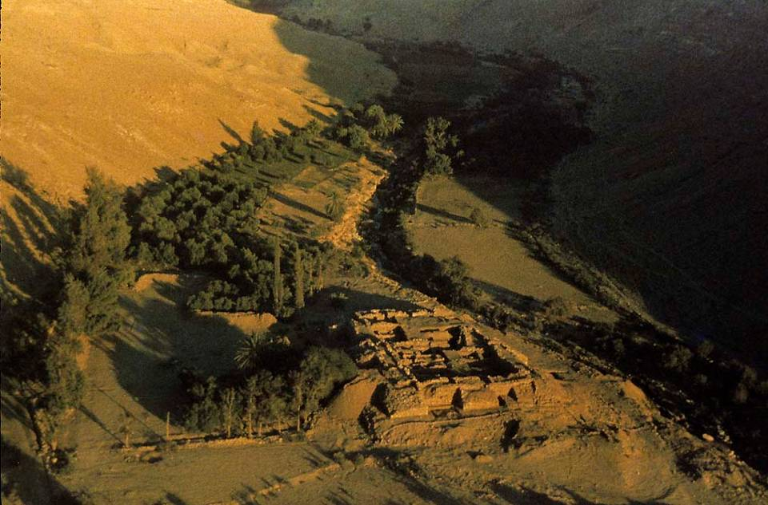
Oasis of Kadesh Barnea with the ruins of Ain el-Qudeirat

Slide 112
Sojourn of 39 Years
Gradually, the older fighting units began to die off.
After the Israelites took up their journey from Sinai, they circled around the southern tip of the Dead Sea and traveled northward through the transjordan.
They passed through the land of Moab and Edom.
They conquered the transjordan territories of Gilead and Bashan, allotting this area to Reuben, Gad, and half the clan of Manasseh.

Slide 113
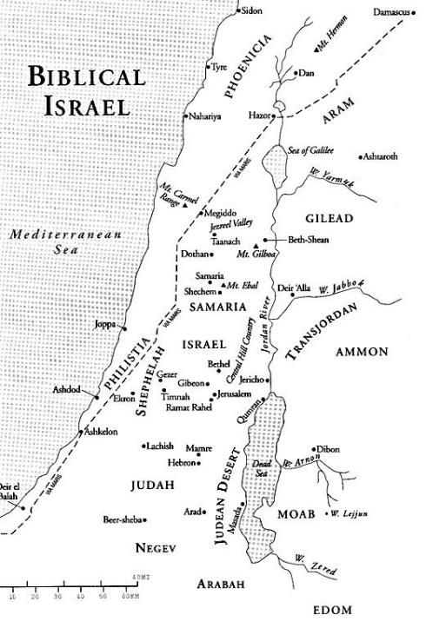
The Transjordan
LAND OF
OG
Two Transjordan nations were invaded, the lands of Sihon and Og.
All the towns and citizens were committed to Mr,H, (i.e., extermination).
These territories were divided between 2 ½ tribes (Reuben, Gad and Transjordan Manasseh).
LAND OF
SIHON

Slide 114
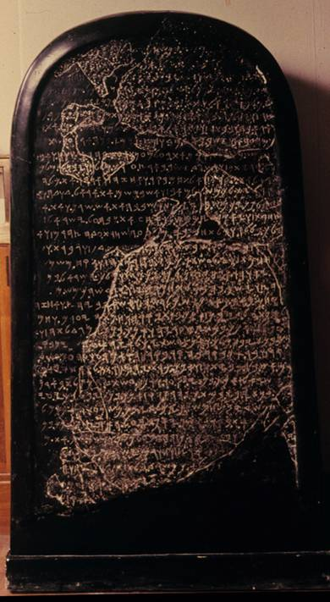
THE MOABITE STONE
The famous Stele of Mesha later names “the men of Gad,” an Israelite clan, as having “always dwelt” in the Moabite territory.
The Louvre, Paris

Slide 115
The Messianic Prophet
The language “a prophet like Moses” came to be understood in messianic terms (Dt. 18:18).
This is why many centuries later the delegation from the temple would ask John the Baptist if he was “the prophet” (cf. Jn. 1:21).
It is why after the feeding of the 5000 the people began to ask whether or not Jesus was “that prophet” (Jn. 14:6).
Peter would announce to his fellow Israelites that in Jesus this ideal had been fulfilled (Ac. 3:22-23).

Slide 116
The Succession of Joshua (Dt. 31:1-8)
At 120 years old, Moses now prepared for the transition of leadership.
Joshua had long been Moses’ designated successor (1:38; 3:28; cf. Nu. 27:18-23).
Moses assured the people that God would not abandon them. He would go before them to assure their victory in Canaan.

Slide 117
The Death of Moses (Dt. 34:1-12)
Earlier, Yahweh had told Moses that the time of his death had arrived (cf. 32:48-52).
As instructed, Moses climbed Mt. Nebo (Pisgah) and from its summit he surveyed the land of Canaan.
Here Moses died.
An ancient pseudepigraphical text called The Assumption of Moses (cited in Jude 9) recounts that when Michael, the archangel, was sent to bury Moses, Satan claimed the corpse, arguing that Moses was a murderer (cf. Ex. 2:11-12). Michael did not retaliate in his own authority but deferred to God.
Joshua now assumed leadership of the people.

Slide 118
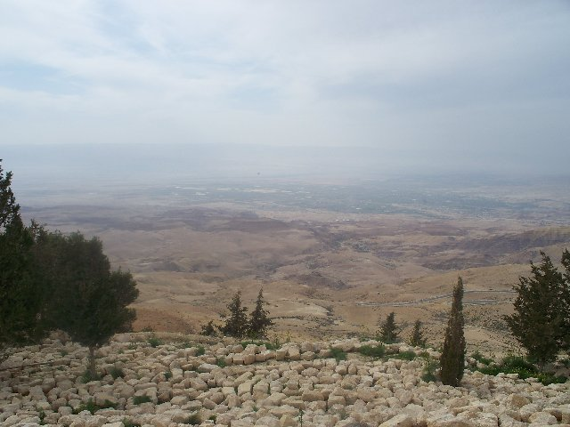
The view of Canaan from the top of Mt. Nebo.

Slide 119
Joshua, the Faithful Successor
Transitions in leadership in the ancient world were often violent, but the transition from Moses to Joshua was a striking exception. The Spirit of Yahweh that was with Moses came to rest upon Joshua, enabling him to successfully lead the Israelites into the land of Canaan. Under his leadership, the Israelites remained faithful until he died.

Slide 120
Joshua ben Nun
The Bible does not inform us of Joshua’s age when the exodus occurred, though the Bible says he served Moses “from his youth” (Ex. 33:11; Nu. 11:28).
We first meet him as Moses’ field commander in the war with Amalek (Ex. 17).
He also served as Moses’ aide when Moses ascended Mt.Sinai (Ex. 24:13; 32:17).
He entered Canaan as one of the original 12 spies sent in at Kadesh Barnea, and he returned with a positive report (Nu. 13:30; 14:6-9).
Yahweh chose him as Moses’ successor and filled him with the Holy Spirit, at which time he was installed by the imposition of Moses’ hands (Nu. 27:15-23).
When Moses gave his final speech to the Israelites before his death, Joshua stood at his side (Dt. 31:7, 14; 32:44).

Slide 121
Joshua cont.--
His given name faweOh (= Hosea) means “salvation,” though Moses amended it slightly to fawuOhy4 (= Yehoshua), which means “Yahweh saves.” It is the Hebrew form of the name Jesus.
As Moses’ successor, Joshua fulfilled two primary functions: he was Israel’s military commander and he oversaw the allotment of Canaanite lands to the Israelite tribes.
As an Ephraimite (one of the Joseph tribes), Joshua took his own inheritance within the larger territory of Ephraim (Jos. 20:49-50).
The Book of Joshua opens with Yahweh’s reconfirmation of Joshua as Moses’ successor, assuring him that just as he had been with Moses, so now he would be with him (Jos. 1:1-9).

Slide 122
The Jordan and the Red Sea
”Yahweh your God did to the Jordan just what he had done to the Red Sea” (Jos. 4:23)
The Red Sea
Escape from Egypt
1st generation
Moses elevated in the eyes of Israel as their leader
Ceremonial purity required
The sea was divided
The people crossed on dry ground
10th day of the 1st month
The Jordan
Invasion of Canaan
2nd generation
Joshua elevated in the eyes of Israel as their leader
Ceremonial purity required
Water flow was stopped
The people crossed on dry ground
10th day of the 1st month

Slide 123
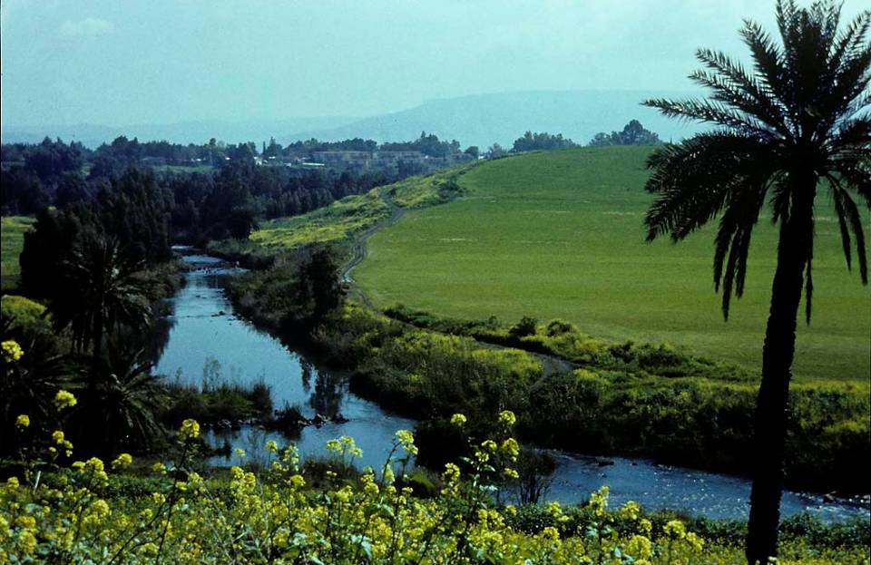
The Jordan River divides the Cisjordan (west) from the Transjordan (east).

Slide 124
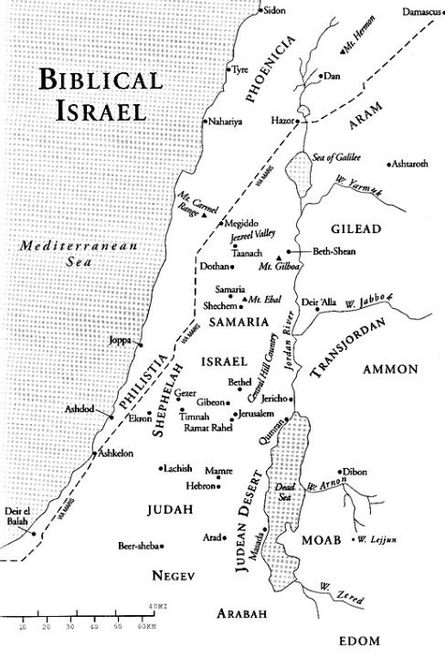
Crossing the Jordan
From Rameses, Egypt to the Plains of Moab in the Transjordan, the Israelites had been constantly moving and camping for 40 years.
Now, they would establish a base camp at Gilgal, and the army would conduct crippling military strikes throughout Canaan, but always returning to the base camp at Gilgal (4:19; 9:6; 10:15, 43; 14:6).
Gilgal, the
base camp

Slide 125
Covenant Renewal on Mt. Ebal
Near the time of his death, Moses had given instructions for building a plaster-coated altar where the words of the Torah could be recorded (Dt. 27:1-8).
This altar was to be built after the Jordan had been crossed.
It was to be set up on Mt. Ebal, one of two mountains that guarded the pass at Shechem.
The altar was to be constructed from undressed fieldstones.
Here, the Israelites were to offer burnt offerings and inscribe the words of the Torah on the plastered stones.
Here, they were to recite the blessings and curses of the covenant (Dt. 27:12ff.)

Slide 126

Mt. Ebal

Slide 127
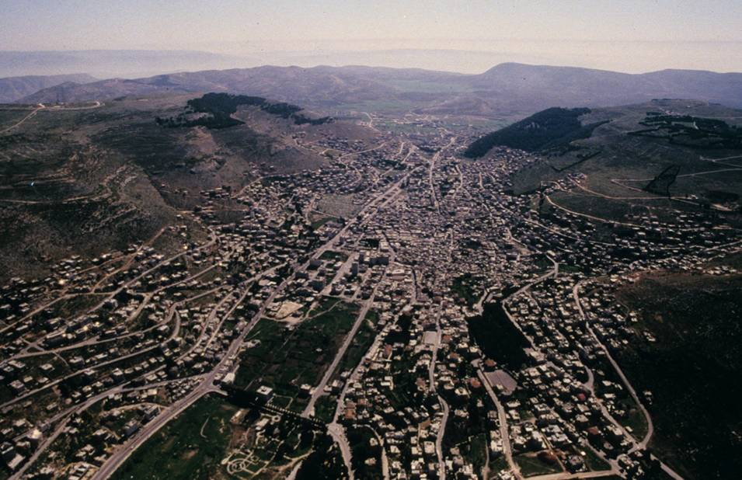
The modern city of Nablus in the Shechem Pass between Mt. Ebal (left) and Mt. Gerizim (right).

Slide 128
The Blessing & Cursing Ceremony
As Moses had instructed, Joshua staged the people on the slopes of the two mountains.
Israelites and aliens alike were divided so that six tribes stood on the slope of Mt. Ebal (3,077’) and six on the slope of Mt. Gerizim (2,849’).
In the valley between the two mountains stood the priests and the ark of the covenant.
Before them, Joshua had the Levites read the covenant blessings and curses (cf. Dt. 27-28), to which the people shouted “Amen.”

Slide 129
The Altar on Mt. Ebal
In 1980, archaeologist Adam Zertal discovered a fieldstone installation on the top of Mt. Ebal, dating it to ca. 1200 BC.
The presence of burned cow, sheep, and goat bones and the absence domestic pottery or other types of bones used in food consumption suggest that this was a ritual site.
Walls of unhewn fieldstones laid in a square directly on bedrock and filled with layers of stone, earth, and ashes points to this installation as being an altar.
Though not accepted by all, Zertal concluded that this could be the very altar that Joshua built on Mt. Ebal.

Slide 130
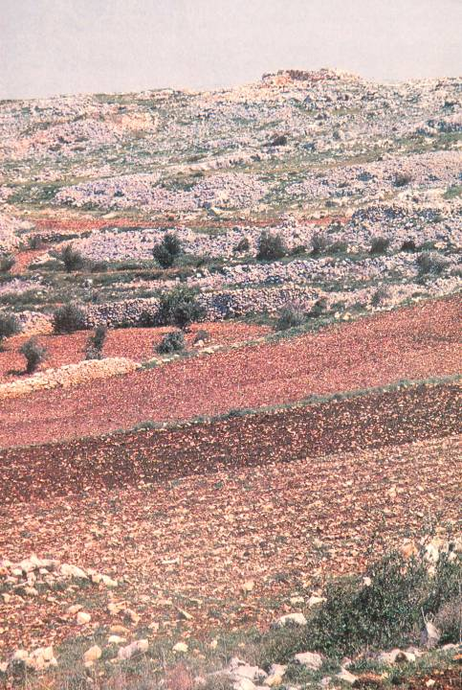
Looking up the slope of Mt. Ebal, the stone installation is visible at the top. The surrounding terrain is covered with piles of stones created by farmers clearing land to be cultivated.
The Israelites would have stood on the slope below the altar, where they would have had a clear view of the ritual performed on it.

Slide 131
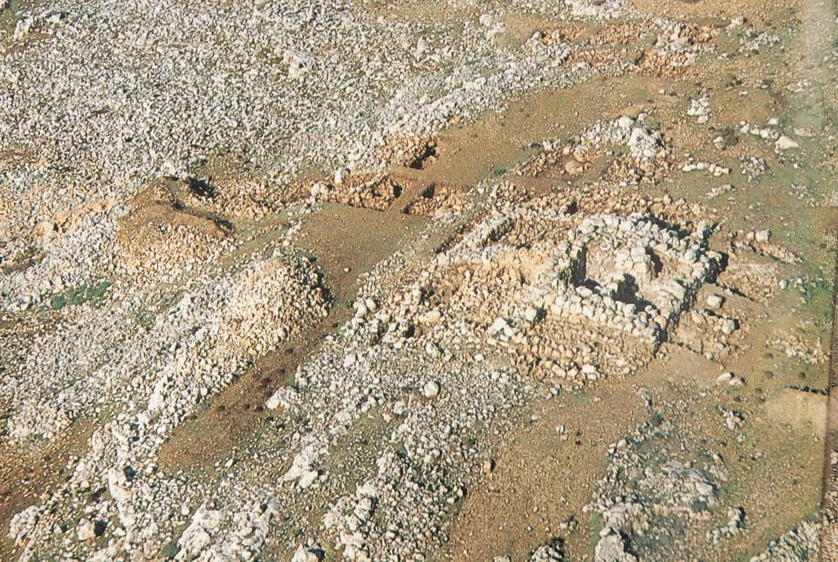
Arial view from the southeast of the stone installation.

Slide 132
The Return to Gilgal
“All these kings and their lands Joshua conquered in one campaign, because Yahweh, the God of Israel, fought for Israel.”
“Then Joshua returned with all Israel to the camp at Gilgal.”
10:42-43
It is important to recognize that the Book of Joshua does NOT describe immediate occupation, but rather, crippling strikes and then a return to the base camp.

Slide 133
The Northern Campaign
(Jos. 11:1-15)
The strikes in the north would take on a different aspect than those of the south.
The conflicts in the south were largely in mountainous terrain, and the Canaanite armies were infantry.
The conflicts in the north would be in the lowlands between mountain ranges, and the Israelites would now face a chariot corps.
The recognized superior city in the north was Hazor (prominent in the Amarna texts as well as various other ANE texts). The Book of Joshua lists Hazor as “head of all those [northern] kingdoms” (11:10).

Slide 134
Hazor, the head of all the northern city states (11:10)

Slide 135
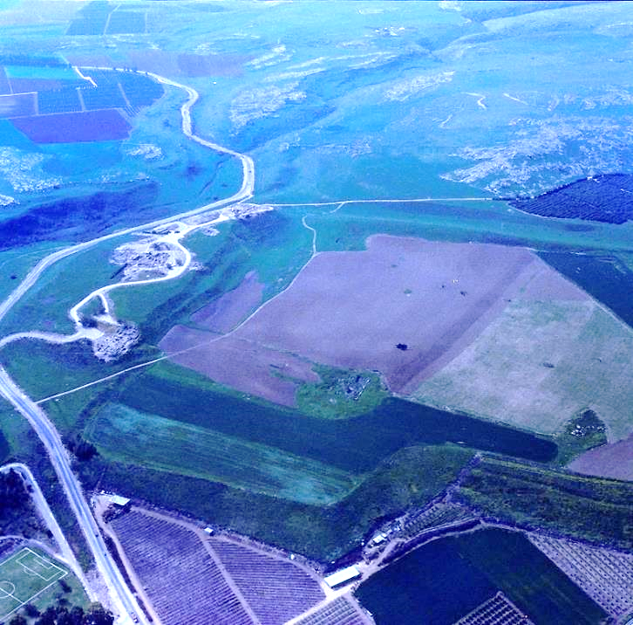
Aerial view of the tell at Hazor: both the “upper city” (left center) and the “lower city” (center) have yielded magnificent material finds from the Late Bronze Age Canaanite occupation.

Slide 136
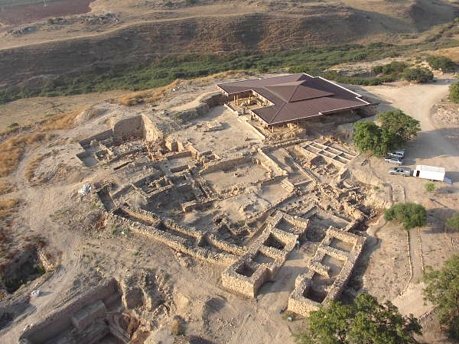
Hazor excavation at the beginning of the 2004 season.

Slide 137
The Unfinished Conquest
(Jos. 13:1-7)
The remainder of the Book of Joshua is set against the backdrop of an unfinished conquest.
After Joshua’s initial strikes into the center, north, and south of Canaan, there still remained very large tracts of land under Canaanite control (13:1-5).
The division of the land was with the assumption that the various clans would complete the conquest in their allotted areas (13:6-7).

Slide 138
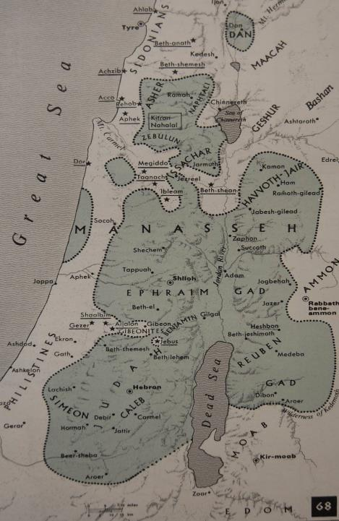
Transjordan Tribes (territories allotted by Moses)
Transjordan ½ Manasseh (Bashan Heights)
Gad (plateau of Gilead)
Reuben (from the Arnon Gorge to Heshbon)
Areas of Israelite control
Areas of Canaanite control

Slide 139
The Tribe of Judah
Judah was allotted the central hill-lands in the south.
Jebus (Jerusalem) was still occupied by Canaanites
Caleb was allotted Hebron, a major city in the south.
Othniel and Acsah were allotted springs in the Negev
Areas of Israelite control
Areas of Canaanite control

Slide 140
Joseph Tribes
Cisjordan ½ Manasseh
Ephraim
Areas of Israelite control
Areas of Canaanite control

Slide 141
Remaining Tribes
Asher
Naphtali
Zebulun
Issachar
Danites (migrated north)
Benjamin
Simeon (soon absorbed into Judah)
Areas of Israelite control
Areas of Canaanite control

Slide 142
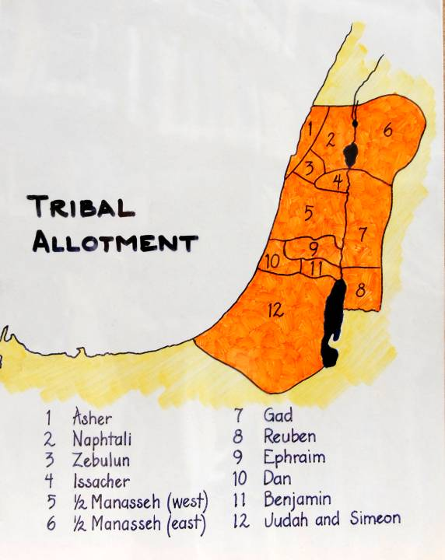
TRIBAL ALLOTMENTS AS THEY WERE INTENDED
Dan (10), of course, migrated to the north
Simeon (12) was eventually absorbed into Judah
Reuben (8) eventually disappeared (or was absorbed into Gad)

Slide 143
Joshua’s Charge
(Jos. 23)
Joshua’s charge to the tribes to complete the conquest was couched in the language of Deuteronomy.
His final warning was that Yahweh’s faithfulness to himself meant both blessing for obedience or retribution for covenant violation (23:14-16)!
“Be strong!”
“Be careful to obey”
“Book of the Torah of Moses”
“Not turning aside”
“Not serving other gods”
“Holding fast to Yahweh”
“Yahweh will drive out the nations”
“One will rout a thousand”
“Be careful to love Yahweh”
“These nations will become traps”
“Until you perish from the land”

Slide 144
Joshua’s Death
(Jos. 24:28-31)
The covenant renewal was Joshua’s final duty.
After sending the clans homeward, Joshua died at the age of 110.
No divine appointment was made for his successor as had happened at the death of Moses.
Hence, the Book of Judges opens with the question, “Who will be first to go up and fight for us?”

Slide 145
Samuel, the Model for Faithful Prophethood
Samuel, the last of the judges, also served as a true prophet-leader. Though only a boy when called by God, he faithfully spoke the Word of God to the Israelite nation, providing spiritual leadership in a world of many threats, both external and internal. He became the pivotal figure in helping the nation make the transition to a monarchy.

Slide 146
Samuel: Judge, Prophet & Priest
Samuel is the first major character in the Book of 1 Samuel.
He often is called “the last judge and the first prophet” (cf. Ac. 3:24; 13:20), though this designation should be qualified in that there were others called prophets before him (cf. Ge. 20:7; Jg. 6:8; cf. 1 Sa. 2:27).
In continuity with the Book of Judges, Samuel “judged” Israel his whole life (cf. 1 Sa. 7:6, 15-17; 12:11).
Further, he was widely recognized by all Israel as a true prophet (1 Sa. 3:20-21; 9:18-19).
Finally, Samuel was a Kohathite priest (1 Sa. 2:18; Lv. 6:10;16:2-5; 1 Chr. 6:22-27).

Slide 147
WHAT IS A PROPHET?
Xybin! (nabi’ = prophet)
Medium of direct communication between God and humans
KEY TEXTS:
Ge. 20:7 Dt. 13:1-5
Ex. 7:1 Dt. 18:20-22
Nu. 12:1-8

Slide 148
PROPHETS IN THE
ANCIENT NEAR EAST
Widespread phenomenon (Canaan, Syria, Anatolia, Mesopotamia and Egypt)
Balaam ben Beor, a biblical example
    Agreed to prophesy for a “fee” (Nu. 22:7, 16)
    Resorted to sorcery (Nu. 24:1)
Prophets of Ba’al, other examples
    Raving and self-mutilation (1 Kg. 18:29)
ANE prophecies often took the form of transcendental ecstasy
    Fits or violent trances
    Leaping, wild dancing
    Contortions, constriction of muscles
    Unintelligible utterances

Slide 149
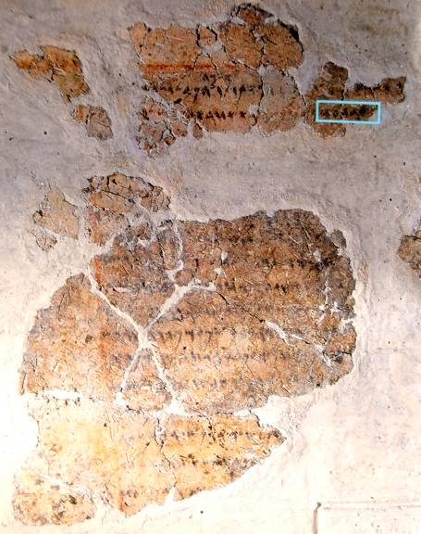
Balaam Inscription
A reference to “Balaam, son of Beor” was discovered at Deir Alla (biblical Succoth) in the transjordan in 1967 (probably from the mid-8th century BC). It appears on a plastered wall and reads in part:
“Inscription of [Ba]laam [son of Beo]r, the man who was a seer of the gods. Lo, the gods came to him at night and [spoke to] him.
“…And the Mighties [Shaddayin, plural of Shadday] have fixed a date, and they said to Sha[ma]sh [the sun]: Sew shut the skies with your cloud! There, let there be darkness and no shining…”

Slide 150
UNIQUENESS OF ISRAEL’S PROPHETS
Prophetic revelations typically were given as sermons, not visionary ecstasies
The content was primary, not the psychic state of mind (the standard formula = “The word of Yahweh came to ________” (1 Sa. 3:21)
The tests of legitimate prophecy were:
    Fidelity to the Torah, not signs and wonders (Dt. 13:1-11)
    Accuracy of prediction (Dt. 18:20-22; 1 Kg. 22:28)
    Privileged inclusion in Yahweh’s heavenly council in order to speak his word (Je. 23:16-18, 21-22, 25-32; Eze. 13:2-7, 17)
Israel’s prophets consciously distinguished themselves from the non-cognitive ancient Near Eastern style of prophecy (Am. 7:14; Is. 28:7-10; Je. 23:9-40; Eze. 13:1-13)

Slide 151
The Birth of Samuel (1 Sa. 1-2)
Samuel was born into a Kohathite levitical family in Ephraim (1 Sa. 1:1; 1 Chr. 6:33-35).
Hannah, his mother, vowed to Yahweh that if he would provide her a son, she would give him up to lifetime service as a Nazirite (1:11).
When the child was born, she named him Samuel, a name that means “His name is El.” The name also is a pun on the verb sa’al (= request, dedicate). Ironically, the same pun will later be behind Saul’s name, implying that the real leader of Israel was not Saul, the first king, but Samuel.
In her song of praise, Hannah exalted God as the one who rescues not only the barren woman, but the poor, the oppressed, and the righteous (2:1-10).

Slide 152
Nazirites
The Nazirite vow was a special commitment to Yahweh for a designated period of time (Nu. 6). During the time of the vow, a Nazirite…
…could not cut his hair
…could not drink wine
…could not come into contact with the dead, even a family member.
Nazirite vows were normally for a specified period, but they could be for life as well.
Several biblical figures were life-Nazirites, including:
Samson
Samuel
John the Baptist
The most notable example of a temporary Nazirite vow was the one taken by St. Paul on his third missions tour (Ac. 18:18; 21:23-26).

Slide 153
The Priesthood of Eli
The transition from a tribal league to a kingdom begins with the priesthood of Eli.
The Period of the Judges was characterized by a tribal confederacy with no kingship (Jg. 17:6; 18:1; 19:1; 21:25).
The sanctuary, still a moveable tent, was pitched at Shiloh.
Because of the abusive behaviors of Eli’s sons, a “man of God” delivered to Eli an oracle of judgment on his priestly family (2:27-36).
This oracle signaled a change in high priesthood from Eli’s family.

Slide 154
Samuel’s First Oracle (1 Sa. 3)
Though Samuel already was in line for priestly service, due to his Kohathite pedigree (2:18), his role as a prophet began with a special calling.
While sleeping in the Tabernacle (presumably the Holy Place), the boy Samuel was awakened by a mysterious voice calling his name.
After determining that the voice was not Eli’s, Samuel then was confronted by Yahweh, who was present in the Most Holy Place on the inside of the inner curtain.
Yahweh reaffirmed his prediction of judgment against the priestly family of Eli.

Slide 155
The Disaster at Shiloh (1 Sa. 4)
In a conflict with the Philistines, the sons of Eli took the ark into battle as an instrument of war.
The sacred ark was captured, the sons of Eli were killed in direct fulfillment to Yahweh’s predicted word, and Eli himself died when he heard the report.
The wife of Phinehas, who was in child labor, also succumbed. Her dying words named the newborn Ichabod (= “No Glory”), a potent symbol of the disaster.

Slide 156
The Request for a King (1 Sa. 8)
The monarchy was first anticipated in the Torah (Ge. 17:6; Dt. 17:14-20).
Even Hannah, Samuel’s mother, seems to have anticipated an eventual kingship (1 Sa. 2:10b).
Samuel himself was a faithful leader, but though he led the Israelites against the Philistine threat, his sons were corrupt (1 Sa. 8:1-3).
In this circumstance—and while under severe threat from the Philistines and the Ammonites—the Israelites asked Samuel for a king (1 Sa. 8:4-5; 12:12).

Slide 157
The End of the Tribal League
The Tribal League came to its end due to a national crisis.
The Philistines gained control of the Negev, the entire Plain of Jezreel, and were encroaching into the central mountains.
They captured the ark of God when they destroyed Shiloh (1 Sa. 4).
They monopolized Israel’s metal industry (1 Sa. 13:19-22).
They placed garrisons at key border locations (1 Sa. 10:5; 13:3).
The Ammonites, from the Transjordan, were mobilizing on Israel’s eastern border (1 Sa. 12:12).

Slide 158
THE THREATS
    The Philistine Threat
    The Ammonite Threat

Slide 159
Samuel Orchestrates a Monarchy (1 Sa. 8-9)
Samuel was reluctant, but Yahweh instructed him to give the people what they desired—but he warned them in advance about the negative aspects of kingship (1 Sa. 8:6-22).
Samuel’s warnings were squarely on target.
Saul, the first king, would eventually leave off his primary task of responding to the Philistine threat by using the army to chase David, whom he feared would replace him.
Samuel showed honor to Saul at a dinner, preparing him for what was to come.

Slide 160
The Kingly Messiah (1 Sa. 10)
With the anointing of Saul, a new royal vocabulary began which would endure into the New Testament.
The kings of Israel would now be called “messiah,” the Lord’s “anointed”.
While priests also were anointed, it would be the king (and soon the Davidic king), who would epitomize the concept of a ruler empowered by the Spirit.
This vocabulary is anticipated in Hannah’s song (2:10a), and it would extend into Israel’s hope for a future after exile.

Slide 161
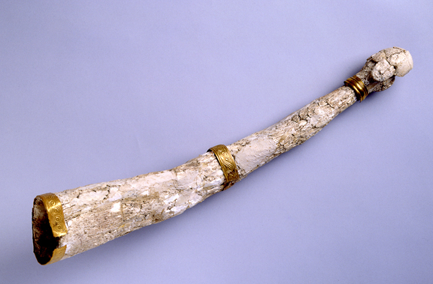
Saul’s Anointing (10:1)
The anointing of Saul by Samuel may have been with an implement similar to this horn excavated at Megiddo (northern Israel) from the 15th century BC. This horn of elephant ivory has gold bands and originally was used for perfume. The people of Israel, of course, used similar horns for anointing oil. High priests were anointed for office, and kings were anointed to rule.
Anointing with oil symbolized consecration for service. The anointing oil was composed according to a special recipe (cf. Ex. 30:22ff.).

Slide 162
Samuel’s Farewell (1 Sa. 12)
Having reached old age, Samuel now offered his final words to Israel.
His ministry had been characterized by clear ethical standards.
He reminded them of the various judges whom God raised up to deliver them from their surrounding enemies (and he included himself in that number).
He performed a sign of thunder and rain in the dry season (probably August) to verify that their desire to have a king was inappropriate.
He closed with a warning against pagan religion.

Slide 163
David, the Great King
Though Yahweh was the Great King of Israel, David, the man after God’s own heart, became God’s royal representative, in effect, a “son” of God. He rose to power during a dark period of internal instability and formidable threats from surrounding enemies, forming the weak clans of Israel into a united kingdom where God was the true center.

Slide 164
Yahweh Rejects Saul (1 Sa. 15)
All war in the ancient Near East was religious.
Patron deities were viewed as combatants in mutual conflict.
For Israel, a war effort began with a priestly pronouncement ritual (Dt. 20:2-4), sacrifices, and prayer for divine guidance (1 Sa. 7:9; Jg. 20:18).
The inhabitants within the cities of Canaan proper were to be annihilated without exception (Dt. 10:16-17).
Already, Saul had transgressed when he usurped Samuel’s priestly role (13:9-10).
In the war with Amalek, he now spared the life of Agag, the king, along with the best of the animals (15:8-9).
This disobedience resulted in irrevocable rejection by God.

Slide 165
The Rise of David (1 Sa. 16)
At the same time that God rejected Saul, he also instructed Samuel to secretly anoint a new king.
The new candidate was as yet only a shepherd boy from Judah, David, the youngest son of Jesse.
This secret anointing was dangerous, since it would be perceived by Saul as treason (cf. 16:2).
In the meantime, David was taken into Saul’s service as a musician and an armor-bearer.

Slide 166
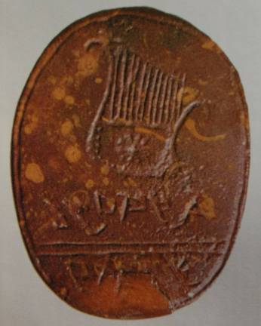
David, Musician and Poet
A lyre depicted on a jasper seal excavated in Jerusalem (7th century BC) may show us what David’s lyre looked like.
73 Psalms are titled in Hebrew “to David” (meaning either “by David” or “in honor of David”).
Unquestionably, the most famous is Psalm 23.
David’s influence in music and poetry must have been tremendous, and when he died, he was called, “Israel’s Singer of Songs” (2 Sa. 23:1).

Slide 167
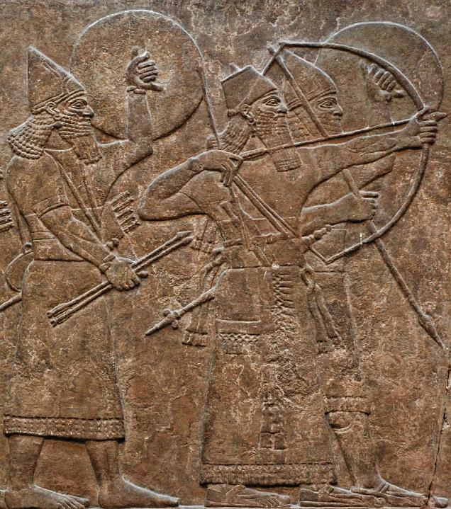
David, the Armor-bearer
Armor-bearers were important so that the king could have the use of both hands.
Here, depicted on the palace walls of Kalhu, Assyrian King Ashurnasirpal stands with his armor-bearers.
British Museum, London

Slide 168
David and Goliath (1 Sa. 17)
There is some variation in the way Goliath of Gath is described, but he was doubtless a formidable foe!
The Masoretic Text puts him at about 10’ tall (6 cubits and a span), but the LXX puts him at a more modest 7’ tall (four cubits and a span). Still, Palestinian skeletal remains from approximately the same period gives plausibility to the Hebrew text.
David’s victory over Goliath with only a sling and stone propelled him to national prominence.
The later statement that Goliath was killed by an Elhanan (2 Sa. 21:19) is probably a copyist’s error (cf. 1 Chr. 20:5).

Slide 169
Psalm 151
The LXX contains an extra Psalm, which also is found among the Qumran Scrolls (11QPsª).
1 I was small among my brothers, and youngest in my father’s house: I tended my father’s sheep.
2 My hands formed a musical instrument, and my fingers tuned a psaltery.
3 And who shall tell my Lord? the Lord himself, he himself hears.
4 He sent forth his angel, and took me from my father’s sheep, and he anointed me with the oil of his anointing.
5 My brothers were handsome and tall; but the Lord did not take pleasure in them.
6 I went forth to meet the Philistine; and he cursed me by his idols.
7 But I drew his own sword, and beheaded him, and removed reproach from the children of Israel.

Slide 170
Saul’s Fear of David (1 Sa. 19)
From his jealousy over Goliath’s defeat to his rising suspicion that David might be the one to replace him, Saul grew increasingly murderous with repeated attempts on David’s life:
Twice with a javelin
On the battlefront
In securing a dowry
Again with a javelin
At David’s home
By three battalions
By personal pursuit
These murderous attempts were all either privately executed or disguised and known only to a few insiders.

Slide 171
David as an Outlaw (1 Sa. 21-27)
David had little choice but to flee.
For the next several years, he would hide as an outlaw in the deserts, ravines, and caves of Judah and along the shores of the Dead Sea.
Around him gathered various dissidents who formed a guerilla band that continued to defend the Israelite towns from enemies, though unofficially (1 Sa. 23, 25).
Saul, meanwhile, took the Israelite army away from their primary task of defending against the encroaching Philistines and began a nationwide search for David.

Slide 172
David and the 400
Striking Against
the Philistines
Dodging Saul
Serving as
a protection
force for
Judean farmers

Slide 173
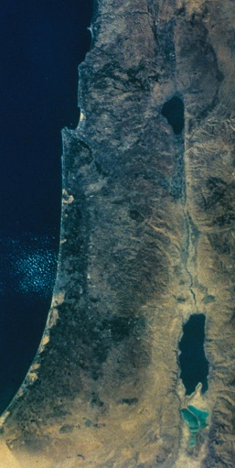
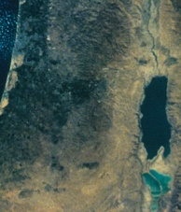
DAVID’S OUTLAW PERIOD
Satellite Photo
Ramah
Gibeah
Nob
Gath
Bethlehem
Adullam
Keilah
En Gedi
Ziph
Maon
Moab
Ziklag

Slide 174
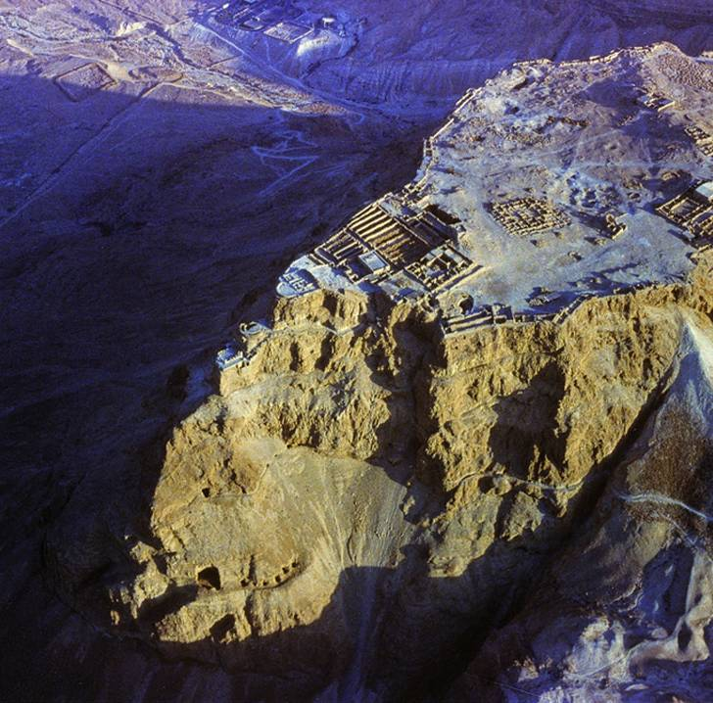
Masada
This 400’ high escarpment near the Dead Sea may have been one of David’s hideouts. The word matsada (= stronghold) is used several times in the Hebrew text to describe David’s hideouts.

Slide 175
Outlaw Psalms
Several Psalms specifically are identified with David’s outlaw period.
Psalm 59 (when Saul attempted to have David killed, cf. 1 Sa. 19:8-17)
Psalm 56 (when David was seized in Gath, cf. 1 Sa. 21:10-15)
Psalm 34 (when David feigned insanity before Abimelech, cf. 1 Sa. 21:10-15)
Psalm 142 (when David was in the cave, cf. 1 Sa. 22:1)
Psalm 52 (when Doeg the Edomite betrayed David,1 Sa. 22:6-23)
Psalm 54 (when the Ziphites betrayed David, 1 Sa. 23:14-25)
Psalm 57 (when David hid from Saul in the cave, cf. 1 Sa. 24)
Psalm 63 (when David was in the desert of Judah, cf. 1 Sa. 24:1-2)
Psalm 60 (when David fought the Edomites after an invasion, cf. 2 Sa. 8:3-6; 10:15-19)
Psalm 18 (when David was delivered from Saul and all his enemies, cf. 1 Sa. 19:1ff.; 24:1ff.; 26:1ff.; 2 Sa. 5:17ff; 8:1ff.; 10:1ff.; 15:1—18:33; 21:15ff.)

Slide 176
Political Instability at the close of 1 Samuel
At the death of Saul, the political circumstances of Israel were especially precarious.
They still faced a Philistine technological advantage, iron against bronze, chariots against infantry.
They faced a Philistine strategic advantage: the Philistines controlled the coastal plain and the Plain of Megiddo; already they had infiltrated into the central mountains.
Israel lacked a procedure for the transition of leadership (the judges had not been dynastic, while kings in the ANE often assumed a dynastic succession. Saul’s son was no exception.)
David’s anointing by Samuel was ineffective, since it was secret.

Slide 177
David’s anointing by Samuel was offset by…
Limited Recognition (a private anointing)
His Outlaw Career (public suspicion)
His Philistine Vassalship (further suspicion)
Loyalists to Saul’s Family

Slide 178
David Moves to Hebron (2 Sa. 2:1-4a)
After seeking Yahweh’s will, David relocated from Ziklag, the border city, to Hebron in the Judean highlands. This marks the end of David’s outlaw career.
Here, the southerners in Judah anointed him as their new king.
In the north, however, Eshba’al (nicknamed Ish-bosheth), Saul’s surviving son, was crowned king.
Such a circumstance could only result in civil war, and for the next 7 ½ years, the two families would struggle for political supremacy.

Slide 179
DAVID AND THE PHILISTINES
David’s move to Hebron—and even his being crowned king by the people of Judah—may not have immediately alarmed the Philistines.
They likely still considered David one of their own.
The fact that David would now become a hostile rival to the house of Saul would further assure the Philistine lords that David continued to serve as their vassal, carrying out their war against Israel.

Slide 180
THE NORTH-SOUTH DIVIDE
Clearly, already there was a north-south divide between the tribes long before the kingdom would actually split upon the death of Solomon.
Shechem, the ancient covenant site where the tribes confirmed the covenant on the slopes of Mt. Ebal, and Mt. Gerizim and where Joshua renewed the covenant, was in the north.
The eventual establishment of a capital in the south, where previously there had been no capital, may have been resented by northerners.
The later construction of the temple in Judah would exacerbate this divide, since earlier, the old tabernacle was movable and spent a considerable time farther north.

Slide 181
The Defection (2 Sa. 3:12-21)
When Abner, the leader of Esh-Baal’s army, defected to David’s side, the tide of war shifted abruptly.
David only required that his first wife, Michal, be returned to him (though as Saul’s daughter, Michal’s return to David would have been politically expedient as well).
Abner now worked behind the scenes with leading northern families to bring all the tribes under David’s kingship.
He met with David at Hebron, one of the sanctuary cities in Judah (cf. Jos.20), to close the negotiations.

Slide 182
David, King Over United Israel (2 Sa. 5:1-5)
All the tribes now approached David and elevated him to king over the entire nation (2 Sa. 4-5).
David’s immediate task was to consolidate the kingdom, which was:
  …torn by the insane obsessions of Saul
  …exhausted from the seven years of civil war
  …threatened by Canaanite enclaves and the Philistines
  …recovering from the shock of Shiloh’s destruction
  …still in shock over Saul’s butchery of the priests at Nob
Samuel was long since dead, and no one of similar spiritual status had risen to replace him.

Slide 183
POLITICAL NEEDS
National security
Centralized government
Trustworthy administration
David responds faithfully to Israel’s deepest needs!
RELIGIOUS NEEDS
Restoration of a center for worship
Restoration of liturgy and the priesthood

Slide 184
The Conquest of Jebus (2 Sa. 5:6-16)
Long a Canaanite stronghold in the heartland of Judah, Jebus (Jerusalem) remained free of Israelite control.
David immediately turned his attention to this city, conquering it by the tsinnor (a word frequently translated as “water shaft,” though other alternatives have been suggested, such as, “grappling hooks”).
With the conquest of Jebus, David made his newly acquired city his capital, calling it the City of David.

Slide 185
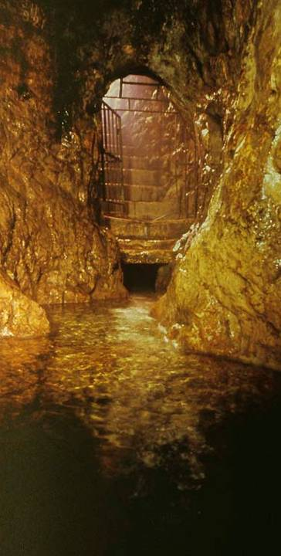
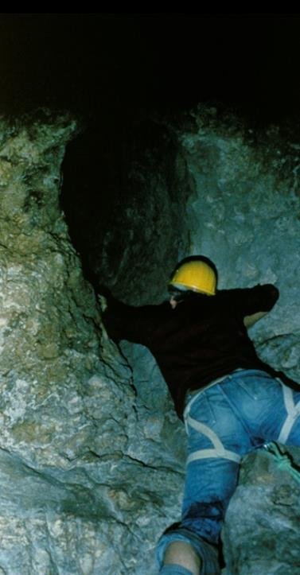
The Gihon Spring (left) and Warren’s Shaft (right) is one possibility for David’s entrance into Jebus.
More recently, some archaeologists have questioned whether or not Warren’s Shaft could be the tsinnor, so the debate continues.

Slide 186
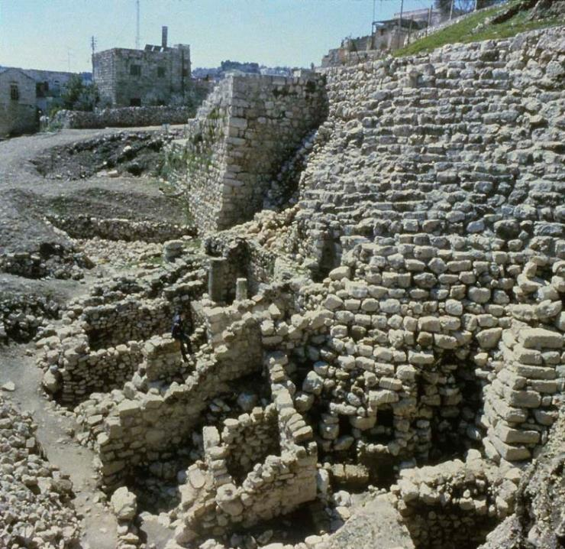
The Stepped Stone Structure
On the east side of the Hill of Ophel (City of David), archaeologists have excavated a stepped stone structure. It appears to date from pre-Davidic Jerusalem, but was reused by both David and Solomon as a high standing buttress upholding a platform for a state building.
Possibly, this structure is the famous “Millo” (= filling) described in 2 Sa. 5:9; 1 Chr. 11:8.

Slide 187
End of the Philistine Threat (2 Sa. 5:17-25)
With all the tribes now firmly behind David and the conquest of Jebus complete, the Philistines clearly understood that he was no longer to be considered their vassal.
After Saul’s death, they had occupied many Israelite cites (1 Sa. 31:7).
Now, they mobilized to attack, but David, under direction from Yahweh, defeated them soundly and burned their gods (cf. 1 Chr. 14:12).
Then, he defeated them again by Yahweh’s help.
The Philistines never again would be a major threat to Israel.

Slide 188
The Ark Comes to Jerusalem (2 Sa. 6)
The heart of Israel’s national consciousness was their ancient faith, and the symbol of this faith was the Ark of the Covenant.
David now arranged for the ark to be brought to his new capital, where he pitched a special tent for it, an action he had confirmed by a solemn oath before Yahweh (Ps. 132:2-5).
No explanation is given as to why he did not return it to the tabernacle, but presumably by this time he already was contemplating plans for a permanent temple.

Slide 189
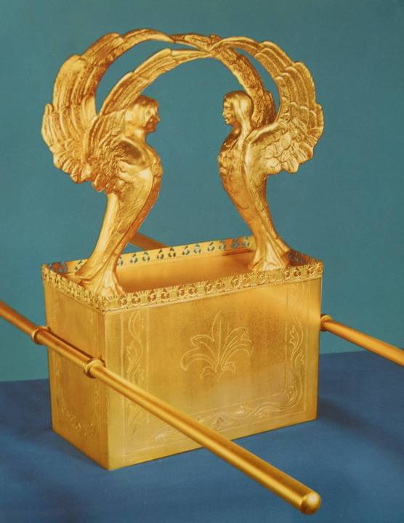
The Ark as a Throne
The ark of the covenant, symbolizing Israel’s binding agreement with God and containing the Ten Commandments, was the very center of the Israelite nation.
Here the glory of God rested between two cherubim constructed over the lid, a “seat” or throne for Yahweh, Israel’s true king.

Slide 190
The Decision to Build a Temple (2 Sa. 7:1-3)
A change as fundamental as the building of a Temple to replace the ancient Tent of Meeting comes almost as a surprise.
It was anticipated in the Torah, a place Yahweh would choose after the nation had achieved rest from its Canaanite enemies (Dt. 12:10).
From the time of Joshua, Israel had lived in continual war with the Canaanites (cf. Jos. 13:1-5; Jg. 2:1-3, 10-15, 20-23).
Now, with David’s defeat of the Philistines, the heartland of Canaan was Israel’s.
Tents are movable; buildings are permanent. The building of a temple heralded permanency in the land of Canaan. David had completed what Joshua had begun.

Slide 191
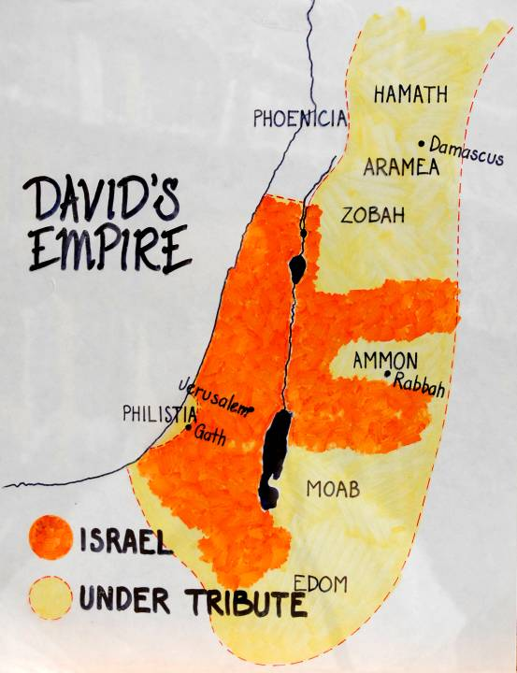
The Heartland of David’s Israel and his Tributaries

Slide 192
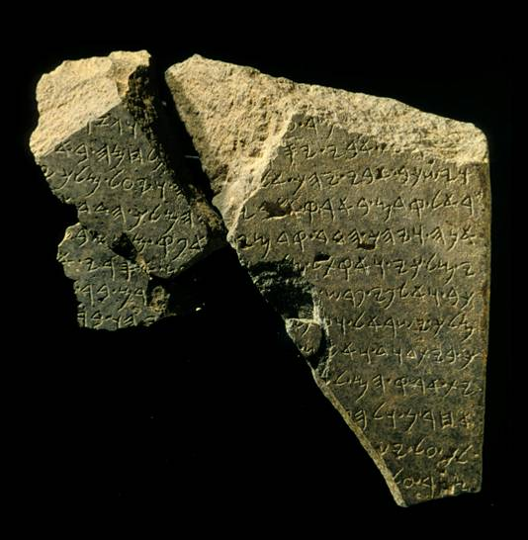
The Historical “House of David”
While some scholars have been skeptical about the historical credibility of David’s dynasty and mini-empire, the discovery of an inscription at Tel Dan containing the phrase “house of David” has provided external verification.

Slide 193

YHWH
The king is a god
Pagan kings are considered divine
ANCIENT NEAR EAST
God is the King
The Davidic Son is Yahweh’s Son
ISRAEL

