Slide 1
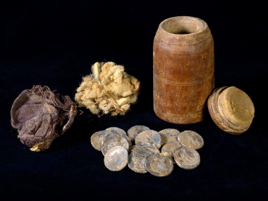
THE INTERTESTAMENTAL PERIOD
6 The Institutions, the Sects, and the Hope of Israel

Slide 2
2nd Temple Judaism
The Judaism that developed during the Intertestamental Period was diverse.
There was a gradual shift in the balance between temple and Torah so that the Torah carried more and more weight in Jewish life and religion.
No doubt, this was augmented by the heavy-handed leadership of John Hyrcanus and others as well as by the eventual appointment of High Priests by Herod the Great and Roman governors.
It also was augmented by the development of the synagogues, local centers for Torah teaching (though not for sacrifice).

Slide 3
The Temple Services
Despite the development of the synagogue, the temple continued as a spiritual center.
While there was dissatisfaction over the appointment of High Priests by Herod, the daily temple rituals and annual festivals, which were centered in the temple, continued to hold high value.
Only the Essenes and Qumran Community maintained that the temple was altogether corrupt and to be rejected outright.

Slide 4
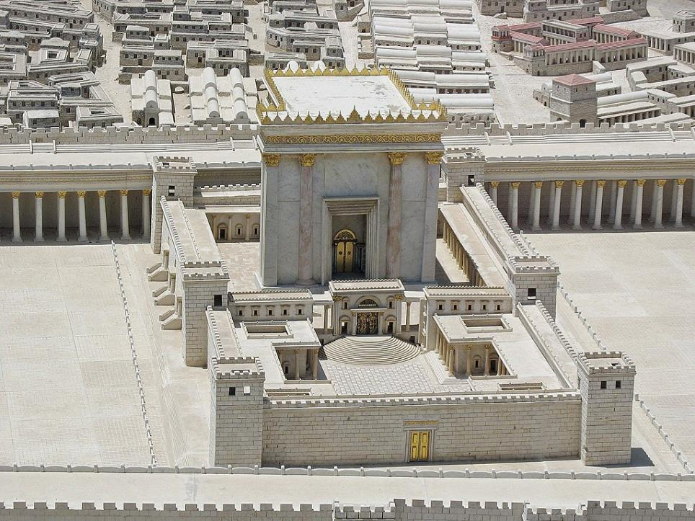
.
Model of Herod’s Temple based on Josephus and archaeological excavation

Slide 5
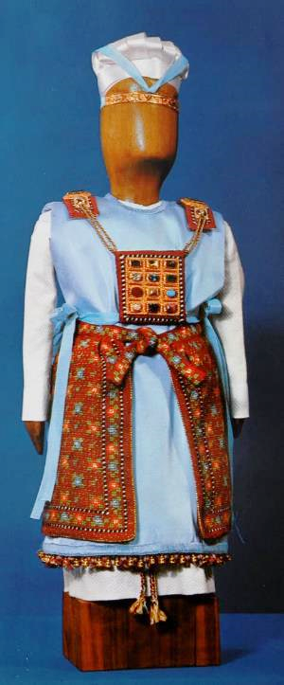
Priestly Vestments (Ex. 28; 39)
Garments for the high priest were highly specialized, and these were kept by Herod and had to be requested before use.
In addition to turbans, linen undergarments, tunics, and sashes, which were common to all the priests, the high priest had additional accoutrements:
Bells on his robe
An ephod (with precious stones and engraved names of the 12 tribes on his shoulders)
A breastpiece (with four rows of precious stones along with Urim and Thummim)
An elaborate outer robe
A forehead diadem (engraved with “Holy to Yahweh”).

Slide 6
Discussion Points
What sorts of things eventually were carried over into the Christian church from the Jewish 2nd Temple?
Was there some sort of mandate for this carry-over, and if not, what was the rationale for doing so?
How have different Christian groups responded to such questions?

Slide 7
The Synagogues
The origin of synagogues is obscure, but our earliest historical reference to them is in the Intertestamental Period.
In Jewish communities throughout the Roman world, they served as places for the study of Scripture and prayer.
Synagogues in the Diaspora generally read from the Septuagint, while synagogues in Judea or Galilee generally read from Hebrew or Aramaic.
Geographically, the synagogues were set so that the building itself and the Torah cabinet in it were oriented toward Jerusalem.
The Samaritans, also, built synagogues, oriented toward Mt. Gerizim.

Slide 8
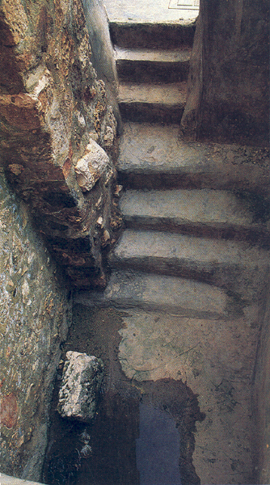
This “laver of living water” (miqveh) was uncovered in Jerusalem just south of the Temple Mount.
The Jewish miqvot were the predecessor of Christian baptism.

Slide 9
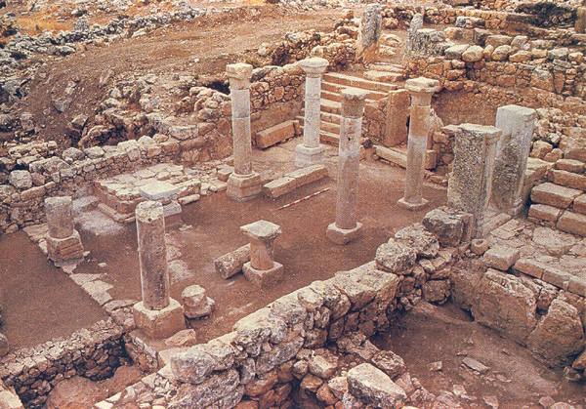
In the Khirbet Shema synagogue in northern Galilee, the raised platform, where the Torah cabinet was placed, was oriented southward toward Jerusalem.

Slide 10
Discussion Points
What sorts of things eventually were carried over into the Christian church from the synagogues?
According to one ancient reference, Jews believed that if as many as ten people assembled, the divine presence was with them. Did Jesus say anything similar?

Slide 11
The Sanhedrin
Our knowledge of the Sanhedrin comes from scattered references to the institution in Josephus, other Jewish writings, the New Testament, and the Mishnah.
There were two classes, the Great Sanhedrin composed of 70 members plus the High Priest (Jerusalem) and lesser sanhedrins composed of 23 members (in various local towns).
In 57 BC, Roman administrators appointed five sanhedrins over five provinces in Israel, each assigned to serve as a judiciary (cf. Mk. 13:9; Mt. 10:17, where the word translated “councils” is the Greek sune<dria). The Great Sanhedrin in Jerusalem functioned as a supreme court.
Largely, the Sanhedrins were an extension of Roman administration.

Slide 12
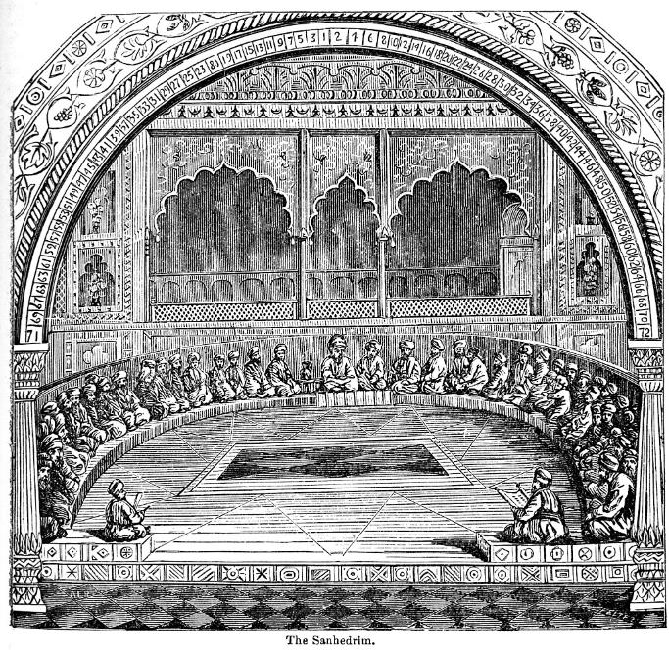
Drawing of the Sanhedrin from an 1883 encyclopedia
(note the arched top, with the numbers 1-72, even numbers on the left and odd numbers on the right, which include the 70 Sanhedrin members, the High Priest, and his scribe)

Slide 13
Legal Irregularities
If Jesus’ hearing before the Sanhedrin was a formal trial, there were several breaches in procedure as outlined in the Mishnah and Talmud (if these are to be taken as accurately representing the 1st century).
A trial at the high priest’s home was illegal.
A trial at night was illegal.
A trial during a festival, such as Passover, was illegal.
A capital crime resulting in a guilty verdict could not be settled in a single session.
Hence, either Jesus’ trial was not a “formal” trial, or else, the Sanhedrin acted out of desperation, throwing out their own judicial procedure.

Slide 14
The Sects
Josephus mentions three primary sects among the Jews, the Pharisees, the Sadducees, and the Essenes (Wars 2.8.2-14; 13.5.9; Antiquities 18.1.2-6).
Other sects are known as well, such as, the Zealots (Mt. 10:4; Mk. 3:18; Lk. 6:15; Ac. 1:13) and the Herodians (Mt. 22:16; Mk. 3:6; 12:13).
These groups had much in common, but they also had diverse theological perspectives.
They functioned more like religious clubs, each promoting its own vision of religious life.
Most Jews, while deeply religious, did not belong to any one sect.

Slide 15
The Hope of Israel
Virtually all Jews maintained a fervent hope in the ancient promises of the restoration of Israel.
During the monarchy, the term Messiah (= the anointed one) came to be a common reference to the Israelite king (cf. 1 Sa. 12:3, 5; 16:6; 24:6, 10; 26:9, 11, 16, 23; 2 Sa. 1:14, 16).
The prophets held forth the hope that despite the exile and the difficult history following it, there would be a restoration by a divinely sent champion, a true Messiah.
The sects differed, however, in what this Messiah would be and do, and different models were embraced—Moses, Elijah, David, and Judas Maccabeus.

Slide 16
The Post-Exilic Vision
The rebuilding of the 2nd Temple was an important event anticipating the fulfillment of Yahweh’s messianic promises.
The glory of God which abandoned the 1st temple would now return to the 2nd temple (Hg. 2:7-9).
Jehoiachin, Yahweh’s rejected signet ring (cf. Je. 22:24-30), would now be replaced by Zerubbabel, his grandson (Hg. 2:23), so that David’s line could continue.
Through Zerubbabel, the prophecy of the coming Branch from Jesse’s stump remained intact (Zec. 3:8; 6:11-13; cf. Is. 4:2; 11:1; Je. 23:5; 33:15).
Yahweh would indeed return to his temple (Mal. 3:1), but before he did, his advent would be preceded by Elijah the prophet (Mal. 4:5-6).

Slide 17
Thy Kingdom Come
1st Century AD responses to the messianic vision of the prophets was varied:
The Herodians and Sadducees deemed collaboration with the Roman occupation a temporary, but necessary, expedient.
The Pharisees urged intensifying devotion to the Torah as the way to usher in God’s kingdom.
The Essenes and the Qumran Community withdrew into the desert to await an apocalyptic divine intervention.
Zealots urged that only immediate armed resistance to Rome was acceptable.
All sects still embraced the memories of the Maccabean success.

Slide 18
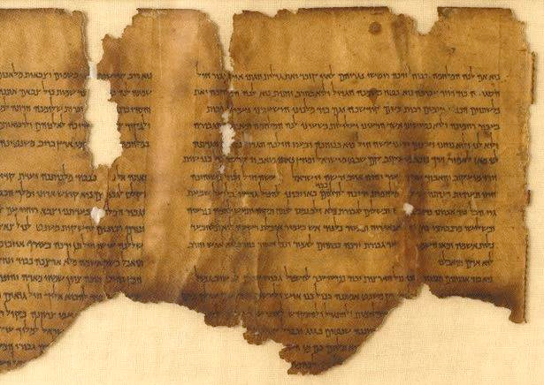
The “War Scroll” (1QM) describes the anticipated 40-year conflict between the Sons of Light and the Sons of Darkness, detailing war preparations, armaments, the carnage to be inflicted, and the final victory of the Sons of Light.
Israel Museum, Jerusalem

Slide 19
Some of the language in the New Testament has precedent in the Qumran Scrolls
The terms “Son of God” (4Q246) and “Son of the Most High” refer to the coming Messiah figure, titles that were not typical within Judaism at large (cf. Lk. 1:32-35).
Even more striking, scroll 4Q521 anticipates that the coming Messiah will open blind eyes, heal the sick, raise the dead, and preach good news to the poor (cf. Lk. 7:22).
Scroll 4Q521 also describes significant features linked to the coming One:
  He will rule heaven and earth.
  The dead will be resurrected.

Slide 20
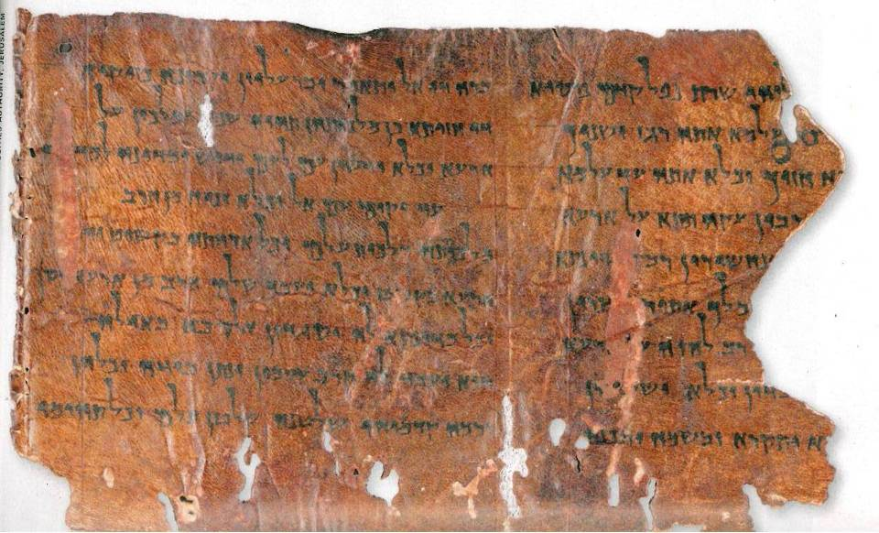
“He shall be hailed the Son of God, and they shall call him Son of the Most High.”

Slide 21
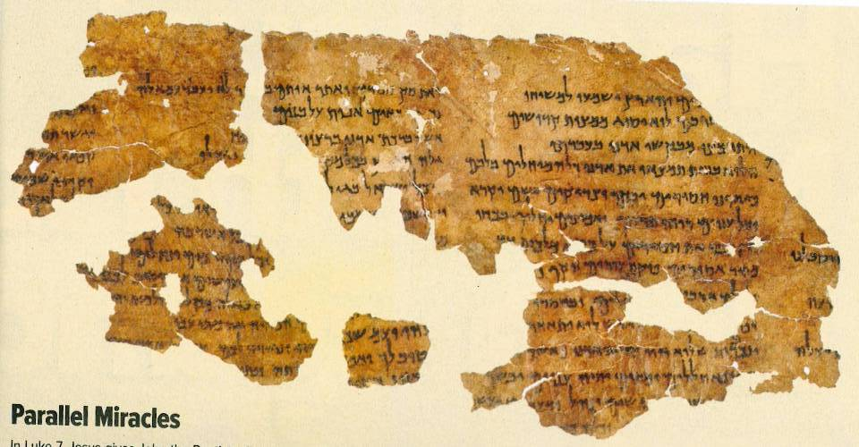
4Q521
Two features stand out in this segment: 1) it speaks of a messianic figure who will rule heaven and earth, and 2) it describes the resurrection of the dead expected to occur during the time of this Messiah.

Slide 22
Discussion Points
What do you make of the disciples’ question to Jesus, “Lord, are you at this time going to restore the kingdom to Israel?” (Acts 1:6)
Consider Zechariah’s song, which we recite from the BCP:
“He has raised up a horn of salvation for us in the house of his servant David.
(as he said through his holy prophets of long ago),
salvation from our enemies and from the hand of all who hate us—
to show mercy to our fathers and to remember his holy covenant…” (Lk. 1.69-72)
How do Zechariah’s words reflect the hope of Israel?

Slide 23
THE INTERTESTAMENTAL PERIOD
7 Pharisees, Scribes, Sadducees, Essenes,
Zealots & Herodians

Slide 24
Class Structure
Class structure in the Hellenistic and Roman Empires consisted of a small ruling class, a huge peasant class, and very little in between. Upward mobility was very difficult, downward mobility always a threat. Smaller subdivisions include:
Ruler (the emperor)
Governors (1-2%)
Retainers (5%, Pharisees and scribes fit here.)
Merchants (market relationship to the elites)
Priests (Sadducees fit here)
Peasants (the am ha’aretz, the “people of the land,” most of which were farmers)
Artisans (3-5%)
Unclean (diseased, people with despised trades)
Expendables (people on the fringe)

Slide 25
Discussion Points
Where would Jesus have fit into the class structures of Jewish society?
How about his various disciples, such as, Matthew the tax collector, Peter and Andrew as fishermen, and Simon the Zealot?
How did class structure become part of the background in Jesus’ parables?

Slide 26
The Major Jewish Sects described by Flavius Josephus
Pharisees
Retainer-class separatists
Lay theologians
Upheld both oral and written Torah
Closely allied with scribes (copyists)
Linked with the synagogues
Essenes
Ascetics with a high value on apocalyptic literature
Held that the priesthood was fully corrupt and saw themselves as the true Israel in exile
Qumran was possibly Essene
Sadducees
Upper-class, mostly priests
Upheld the supremacy of the written Torah
Primary influence in the Sanhedrin and Second Temple
Rejected resurrection & angels
Zealots
Patriotic freedom-fighters
Upheld Maccabean idealism
Opposition to Rome was an expression of zeal for the Torah
Central to the 1st and 2nd Jewish Revolts

Slide 27
The Pharisees
While the origin of the Pharisees is somewhat obscure, they seem to have arisen not long after the Maccabean Revolt.
In particular, the Pharisees emerged in distinction from the Sadducees.
They upheld the belief that there were two types of Torah given by Moses: the Written Torah and the Oral Torah.
They believed in fate, the resurrection of the dead, angels, and the spirit world (Ac.23:8).
They were noted for their punctilious observance of purity laws, for prayer three times each day, and for fasting twice each week.

Slide 28
Josephus’ Descriptions
At this time here were three sects among the Jews, who had different opinions concerning Jewish actions. The one was called the sect of the Pharisees, another the sect of the Sadducees, and the other the sect of the Essenes. Now for the Pharisees, they say that some actions, but not all, are the work of Fate, and some of them are in our own power, and that they are liable to fate, but are not caused by fate. But the sect of the Essenes affirm that fate governs all things, and that nothing befalls men but what is according to determination. And for the Sadducees, they take away all fate, and say there is no such thing, and that the events of human affairs are not at its disposal, but they suppose that all our actions are in our own power…
Wars 13.5
Now the Pharisees live simply and despise delicacies in diet, and they follow the conduct of reason, and what that prescribes as good to them they do… They also pay respect to such as are in years, nor are they so bold as to contradict them… They also believe that souls have immortal vigor in them, and that under the earth there will be rewards or punishments according as they have lived virtuously or viciously in this life… they are able to greatly persuade the body of the people; and whatsoever they do about divine worship, prayers and sacrifices, they perform them according to their direction, insomuch that the cities gave great attestations to them on account of their entire virtuous conduct, both in the actions of their lives and their discourse also.
Antiquities 18:1

Slide 29
“The teachers of the law and the Pharisees sit in Moses’ seat. So you must obey them and do everything they tell you. But do not do what they do, for they do not practice what they preach. They tie up heavy loads and put them on men’s shoulders, but they themselves are not willing to lift a finger to move them.
Everything they do is done for men to see: They make their phylacteries wide and the tassels of their prayer shawls long; they love the place of honor at banquets and the most important seats in the synagogues; they love to be greeted in the marketplaces and to have men call them ‘Rabbi.’”
Matthew 23:2-7

Slide 30
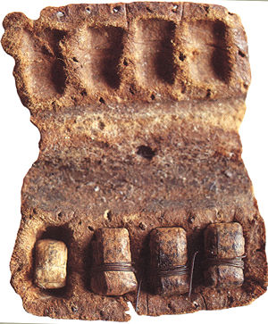

While scholars are unsure when the idea of phylacteries began being taken literally (cf. Dt. 6:8), they certainly were so used by the time of Jesus (cf. Mt. 23:5). The above phylactery comes from the Qumran community (ca. 1st century BC).
The traditional Jewish prayer shawl has four knotted tassels (tzitzits) interwoven with blue thread, as commanded by Moses (Nu. 15:38-40; Dt. 22:12). The color blue-violet (tekhelet) came from the gland of the murex snail and was rare and expensive; hence, tassels were passed down to succeeding generations. Tassels were often markers of social status.

Slide 31
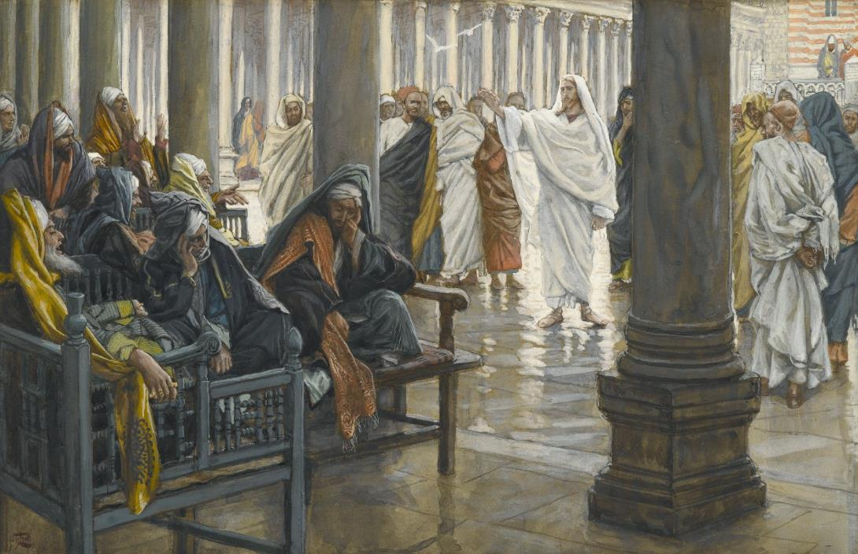
“Woe to you, Scribes and Pharisees” by James Tissot (1836-1902)
Brooklyn Museum

Slide 32
Discussion Points
From the New Testament, what were some of the postives about Pharisees. What were some of the negatives?
Jesus sharply criticized the Pharisees’ manner of wearing tassels as something “done for others to see.” Is there anything comparable in modern Christian practice?
Did Jesus have anything to say about the Oral Torah?
Luke points out that some of the early Christians were Pharisees (Ac. 15:5), and Paul, also, claimed to be a second-generation Pharisee (Ac. 23:6). What points of agreement or disagreement might arise if trying to blend Pharisaic and Christian thought?

Slide 33
The Scribes
Initially, ancient writing was the province of royal courts and primarily used for record keeping. King David was the first to began using a scribe as a member of his administration (2 Sa. 8:16; 1 Chr. 24:6).
Ezra became the prototype scribe for succeeding generations, a scholar and expert in the Torah (Ezr. 7:6, 10).
Because scribes were so directly involved in copying and interpreting the texts of Scripture, they were a natural ally of the Pharisees.
In addition to their expertise in the Torah, scribes could draft legal documents, such as, marriage contracts, mortgages, sales of land, etc.

Slide 34
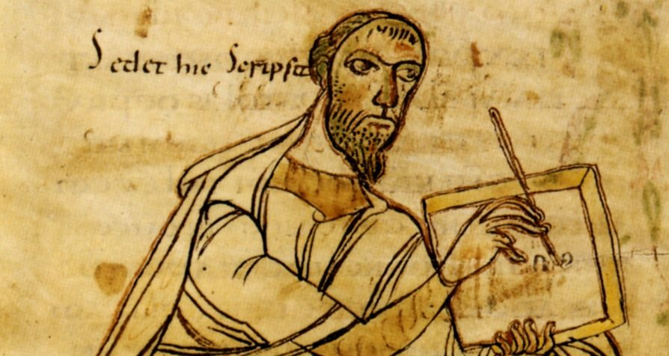
Scribe with stylus and tablet

Slide 35
The Sadducees
Whereas the Pharisees were linked with the synagogue, the Sadducees were linked with the 2nd Temple.
As wealthy members of the upper class, they maintained the temple as well as oversaw some state affairs, collected taxes, and participated in the Sanhedrin.
In contrast to the Pharisees, they held as binding only the written Torah (and rejected the authority of the Oral Torah).
They believed in absolute free will (not fate) but rejected the idea of the afterlife, resurrection, angels, and the spirit world.

Slide 36
The Essenes
Essenes rejected the priesthood of the 2nd Temple as corrupt and irredeemable.
While some lived in the cities, many withdrew to communes in the desert to await the apocalyptic end of the age.
They are the one group described by Josephus that is not found in the New Testament.
Most scholars believe Qumran was an Essene community.
One Dead Sea Scrolls document (4QMMT) has an exact verbal parallel with the writings of Paul, when it speaks of the “works of the law” that would be “reckoned as righteousness.” Paul, of course, says just the opposite (Ro. 3:20, 28; Ga. 2:16; 3:2, 5, 10).

Slide 37
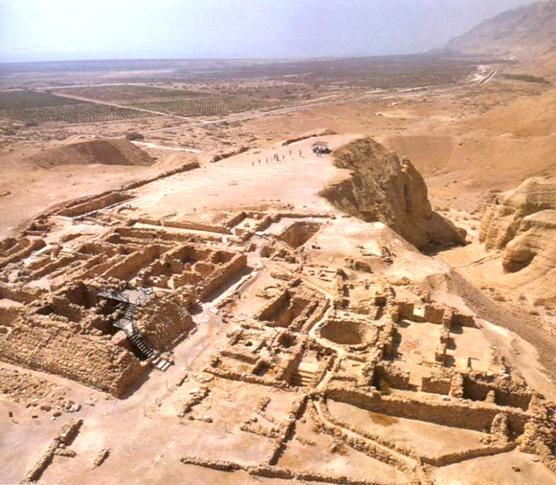
Qumran, the community that preserved the Dead Sea Scrolls, was likely Essene.

Slide 38
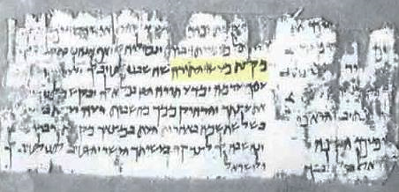
e@rgwn no<mou (= “the works of the law”)
Ro. 3:20, 28; Ga. 2:16; 3:2, 5, 10
Currently, the only extant 1st century Jewish document outside Paul that uses the expression “the works of the law” is a fragment from Qumran (4QMMT, 4Q394-399). In the Qumran Community, the “works of the Law” were a means of “reckoning righteousness.”
“Now we have written to you some of the works of the Law… And it will be reckoned to you as righteousness…”
Altogether, 22 precepts are listed, including:
Food laws
Purity laws
Intermarriage laws
Bans on Gentile offerings

Slide 39
The Zealots
Zealots were freedom-fighters, rebels against Roman administration and occupation.
The prototype zealot was Judas the Galilean (cf. Ac. 5:37), who raided the armory in Sepphoris in 4 BC (about four miles from Nazareth).
  In Roman reprisals, Sepphoris was burned to the ground, its inhabitants sold into slavery, and some 2000 rebels crucified.
In 6 AD, another rebel named Judas (Judas was a popular name, probably going back to the hero Judas Maccabeus), led a resistance movement due to the census by Quirinius.
The zealot slogan was “no king but God.”
Simon, one of Jesus’ disciples, was a zealot (Mt. 10:4; Mk. 3:18; Lk. 6:15).

Slide 40
The Presence of Rome Gave Rise to Revolutionaries of Jewish Nationalism
1st Century BC: Brigandy put down by Herod
40s BC: Execution of Hezekiah
4 BC: Roman eagle pulled from temple gate (perpetrators executed)
Revolt suppressed by Archelaus
Revolt by Judas the Galilean (perpetrators
crucified, cf. Ac. 5:37)
AD 26-36: Mass protest over Roman standards
Resistance to Pilate’s use of temple funds to
build an aqueduct
Galileans executed in the temple (cf. Lk. 13:1)
Capture and release of Barabbas (cf. Mt. 27)
Protest against votive shields
AD mid-40s: Execution of Tholomaeus
Execution of Theudas (cf. Ac. 5:36)
Execution of Judas and Simon
AD ? Execution of an Egyptian Jew (cf. Ac. 21:38)
c.AD 50: Passover riot (20,000 Jews killed)
AD 52-60: Crucifixion of the Lestai
AD 60s: Execution of the Sicarii
AD 60-62: Execution of unnamed messianic imposter
AD 66-70: 1st Jewish Revolt (resulting in the destruction of the temple)
Flavius Josephus

Slide 41
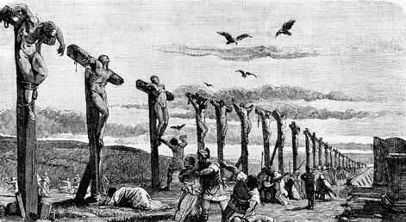
Depiction of mass crucifixions of rebels.

Slide 42
The Herodians
This group, mentioned alongside the Pharisees (Mk. 3:6; 12:13; Mt. 22:16), is largely unknown except for the references in the New Testament.
They are not mentioned by Josephus, at least by name.
Apparently, they were supporters of the Herod family.
Some have suggested that they may have been Essenes, but this is unclear.

Slide 43
Discussion Points
How do you think the mass crucifixions after Judas of Galilee’s attempted take over of Sepphoris may have affected Jesus as a child?

Slide 44
THE INTERTESTAMENTAL PERIOD
8 The Texts

Slide 45
The Concept of Canon
The word “canon” derives from a Greek word (kanw<n) meaning “rule” or “measuring stick.”
The canon of Scripture refers to those writings considered inspired and authoritative.
With the rise of synagogues as places for study, the prominence of the Hebrew Bible increased as well. The Jews became “people of the book.”
Those books considered canonical for the Hebrew Bible fall into three primary collections, the Torah (Law), Nebiim (prophets), and Kethubim (writings).
These collections were recognized well before the Christian era, and they comprise what Christians call the Old Testament.

Slide 46
Prologue to Sirach (ca. 132 BC)
Whereas many and great things have been delivered unto us by the law and the prophets, and by others that have followed their steps... my grandfather Jesus [Joshua], when he had much given himself to the reading of the law, and the prophets, and other books of our fathers, and had gotten therein good judgment, was drawn on also himself to write something pertaining to learning and wisdom… …but the law itself, and the prophets, and the rest of the books, have no small difference, when they are spoken in their own language.
King James Version

Slide 47
Christ Jesus (early 1st Century AD)
Therefore this generation will be held responsible for the blood of all the prophets…from the blood of Abel (Genesis 4) to the blood of Zechariah (2 Chronicles 24:20-21)… [Genesis and 2 Chronicles are the first and final books of the Hebrew Bible.]
Luke 11:50-51
He [Jesus] said to them, “This is what I told you while I was still with you: Everything must be fulfilled that is written about me in the Law of Moses, the Prophets and the Psalms.” [Psalms is the first book in the final section of the Hebrew Bible.)
Luke 24:44

Slide 48
Josephus (late 1st century AD)
For we have not an innumerable multitude of books among us, disagreeing from and contradicting one another, [as the Greeks have,] but only twenty-two books, which contain the records of all the past times; which are justly believed to be divine; and of them five belong to Moses, which contain his laws and the traditions of the origin of mankind till his death. …the prophets, who were after Moses, wrote down what was done in their times in thirteen books. The remaining four books contain hymns to God, and precepts for the conduct of human life. …no one has been so bold as either to add anything to them, to take anything from them, or to make any change in them.
Against Apion 1:8

Slide 49
THE HEBREW BIBLE (Old Testament)
Three Collections (24 books total)
hrvt Myxybn Mybvtk
(Torah = Law) (Nebiim = Prophets) (Kethubim = Writings)
Genesis Former Prophets Psalms
Exodus Joshua Proverbs
Leviticus Judges Job
Numbers Samuel* Megilloth (five rolls)*
Deuteronomy Kings* Song of Songs
Latter Prophets Ruth
Isaiah Lamentations
Jeremiah Esther
Ezekiel Ecclesiastes
The Twelve* Daniel
Ezra-Nehemiah*
Chronicles*
Passover
Weeks
9th of Ab
Purim
Succoth
These 24 books are the same as the 39 in the English Old Testament.
* Originally appearing in single scrolls

Slide 50
Discussion Points
How important is the idea of canon for Christians today?
What would you say to those who suggest a reevaluation of the canon, deleting some books and adding others?

Slide 51
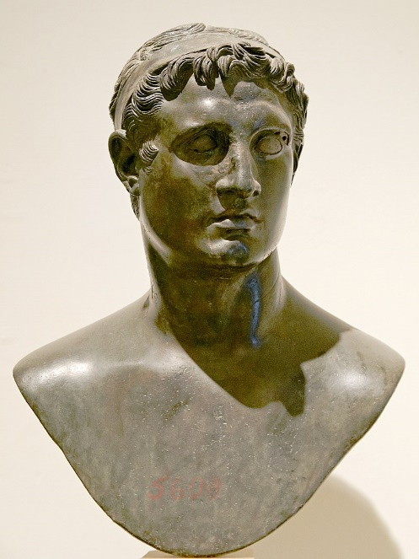
Ptolemy II Philadelphus (285-246 BC) brought to fruition the dream of his father to build a Great Library of all the most important literary works of the ancient world.
This collection would include the Hebrew Bible translated into Greek, what we now call the Septuagint.

Slide 52
The Septuagint (LXX)
During the Hellenistic Period, Jewish scholars in Alexandria began translating the Hebrew Bible into Greek, ca. 250 BC (Letter of Aristeas).
This translation included all three sections of the Hebrew Bible (Torah, Prophets, Writings) as well as the Apocrypha.
Although the Letter of Aristeas, which describes the details of this translation effort, is fraught with legendary accretions, the fact remains that the translation was completed.
The Septuagint would become the Bible of Diaspora Jews in the Greek-speaking world, and later, of Christians in the Roman world.
Today, the LXX remains an important witness to the text of the Old Testament.

Slide 53
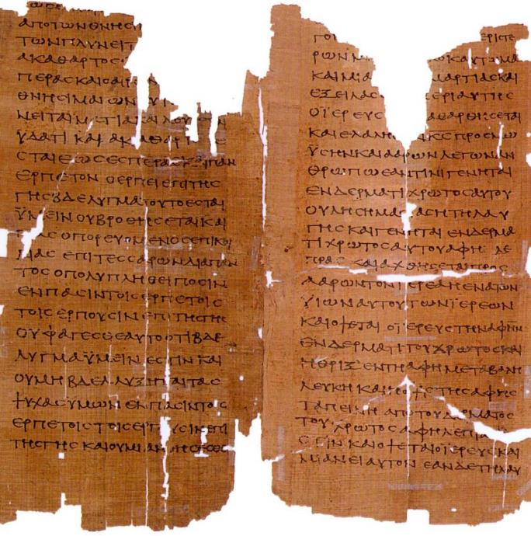
MS2649
From the LXX, Pages from Leviticus, late 2nd century AD, the oldest manuscript of this part of the Bible
(the Schoyen Collection)

Slide 54
The Apocrypha
Jewish authors composed a number of additional works about Jewish history, legends, wisdom, and expansions to canonical books (notably Daniel and Esther).
Some are historical, some fictional, and some theological.
Though never considered canonical by the Jews, they were included in the LXX, and subsequently, were read by early Christians in the Greek-speaking world. St. Jerome included them in the Latin Vulgate.
In the Protestant Reformation, they were rejected as canonical (but translated and read in the churches). They were included in the KJV for the first century of its printing.
At the Roman Catholic Council of Trent (1545-1563), they were officially recognized as canonical. They are also canonical in Eastern Orthodoxy.

Slide 55
The Apocryphal Books
1 Esdras
2 Esdras
Tobit
Judith
Prayer of Azariah
Song of the Three Young Men
Susanna
Bel and the Dragon
Additions to Esther
Prayer of Manasseh
Letter of Jeremiah
Baruch
Sirach (Ecclesiasticus)
Wisdom of Solomon
1 Maccabees
2 Maccabees
3 Maccabees
4 Maccabees
Psalm 151
In keeping with other Protestants, Anglicans do not recognize the Apocrypha as canonical. However, following St. Jerome, they approve of them for “examples of life and instructions of manners.” It only restricts their use for the establishment of Christian doctrine.
39 Articles, Article VI

Slide 56
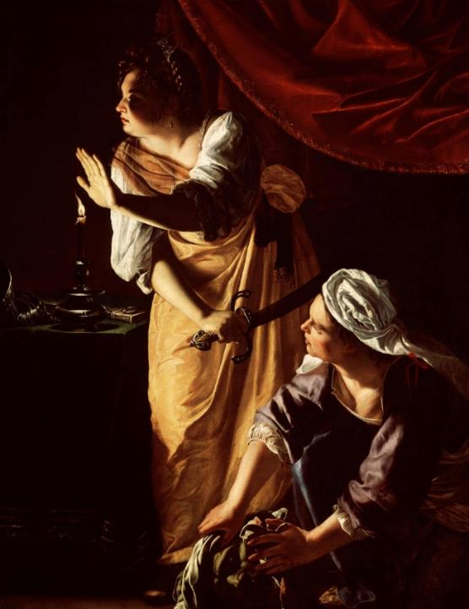
The story of Judith, as one example, is written against the background of a siege upon the Israelite city Bethulia.
To rescue her people, Judith, a beautiful widow, prayed for God’s help and boldly walked into the enemy camp with her maid.
Holofernes, the enemy general, attempted to seduce her, but when he was drunk, Judith took his sword and hacked off his head, putting it in a bag and taking it with her back into the city, where it was exposed on the city wall.
Judith and Her Maidservant with the Head of Holofernes by Artemisia Gentilechi (1593-1643), Detroit Institute of Arts

Slide 57
Some NT Allusions to the Apocrypha
For by the greatness and beauty of the creatures proportionably the Maker of them is seen (Wisdom 5:5)
But miserable are they, and in dead things is their hope, who called them gods, which are the works of men’s hands, gold and silver, to show art in, and resemblances of beasts, or a stone good for nothing… (Wisdom 5:10).
Be quick to hear, and be deliberate in answering (Sirach 5:11)
…what may be known about God is plain to them, because God has made it plain to them (Ro. 1:19).
Although they claimed to be wise, they became fools and exchanged the glory of the immortal God for images made to look like mortal man and birds and animals and reptiles (Ro. 1:22-23).
Everyone should be quick to listen, slow to speak… (Ja. 1:19)

Slide 58
Discussion Points
In what ways might the LXX be helpful for modern translators of the Hebrew Bible?
How has Anglicanism pursued a via media (middle way) with regard to the Apocrypha?

Slide 59
The Pseudepigrapha
The Pseudepigrapha consists of texts allegedly written by great Jewish heroes of the past, such as, Adam, Enoch, Abraham, etc.
The style of writing is often apocalyptic with visions of heaven, hell, and the invisible war in the spiritual world that would climax in the triumph of God and his people.
Some of the imagery of the heavenlies and the underworld that one finds in the New Testament has roots in this literature.
There are several allusions to these works in the New Testament, and the Book of Jude quotes one of them directly (1 Enoch 1:9).

Slide 60
The Pseudepigraphical Books
(following are some of the more important works)
“And behold! He comes with ten thousands of holy ones to execute judgment upon all, and to destroy the ungodly.”
1 Enoch 1:9
“Enoch, the seventh from Adam, prophesied about these men: ‘See, the Lord is coming with ten thousands of his holy ones to judge everyone and to convict the ungodly…’”
Jude 14-15
1, 2 and 3 Enoch
2, 3 and 4 Baruch
Jubilees
Apocalypse of Abraham
Apocalypse of Adam
Apocalypse of Daniel
Apocalypse of Elijah
Apocryphon of Ezekiel
Greek Apocalypse of Ezra
Martyrdom of Isaiah
Jannes and Jambres
Testament of Job
Joseph and Asenath
Jubilees
Testament of Moses
History of the Recabites
Apocalypse of Sedrach
Sibylline Oracles
Odes of Solomon
Psalms of Solomon
Testament of Solomon
Testaments of the Three Patriarchs
Testaments of the Twelve Patriarchs
Apocalypse of Zephaniah

Slide 61
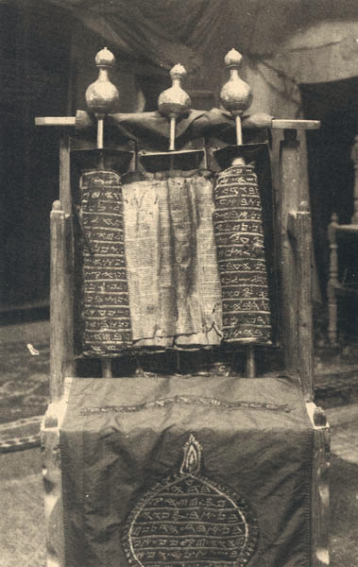

The Samaritan Pentateuch (the Abisha scroll), seen here in an early 20th century photo, seems to contain a text that dates back to between the 3rd century BC to the 1st century AD.
In about 2000 places, it agrees with the LXX over against the MT, showing that there were alternative recensions of the Hebrew Bible.
In particular, it clearly specifies in the Decalogue (Ex. 20:17) that the temple was to be built on Mt. Gerizim, and Samaritans considered the temple of Solomon in Jerusalem to be a serious mistake.

Slide 62
The Targums
After Aramaic became the lingua franca of Jews in Palestine, Targums (translations into Aramaic from Hebrew) began to appear near the end of the Intertestamental Period.
While most scholars believe that Jesus spoke Aramaic, the dual reading of the Torah in the synagogue service using Hebrew and Aramaic side-by-side was not yet authorized (not until the time of the Talmud).
The words of Jesus on the cross as preserved by Mark’s Gospel, however, may be a quotation from a Targum, since they are in Aramaic (Mk. 15:34; cf. Ps. 22:1).

Slide 63
Discussion Points
What do you make of the fact that New Testament authors alluded to and sometimes quoted from works in the Pseudepigrapha?

Slide 64
THE INTERTESTAMENTAL PERIOD
9 Qumran and the Dead Sea Scrolls

Slide 65
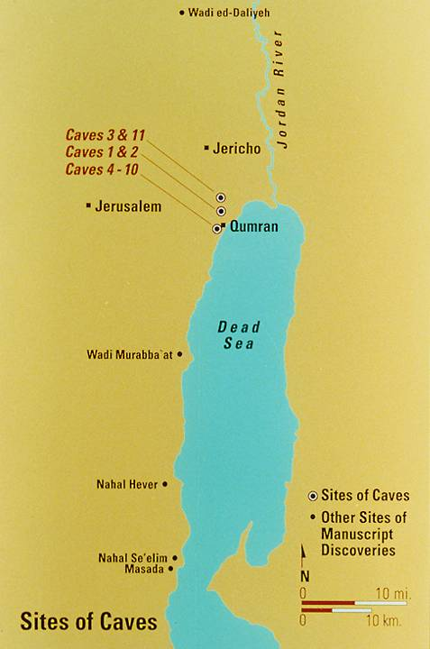
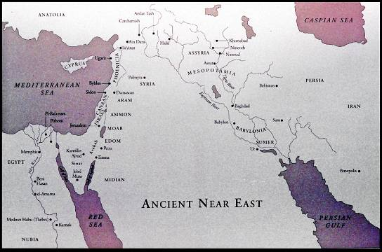
11 Caves of DSS

Slide 66
Qumran
While the precise details of the community’s origins are obscure, Qumran likely began during the period of John Hyrcanus or earlier when there was significant disruption in the priesthood following the Maccabean Revolt.
What is clear is that its members profoundly disapproved of the Jerusalem priesthood and the administration of the 2nd Temple.
The best candidate among Jewish sects is that they were Essenes, though this is debated. The 1st century Pliny the Elder describes such a group as living on the west side of the Dead Sea.
They withdrew into the desert in order to await the climax of the age in a great war between the “sons of light” and the “sons of darkness.”

Slide 67
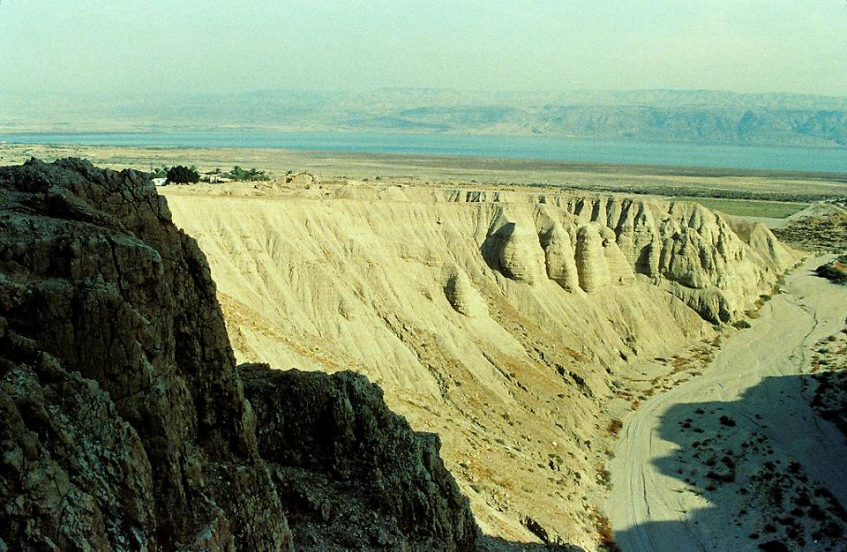
Qumran settlement (upper left) looking eastward toward the Dead Sea.

Slide 68
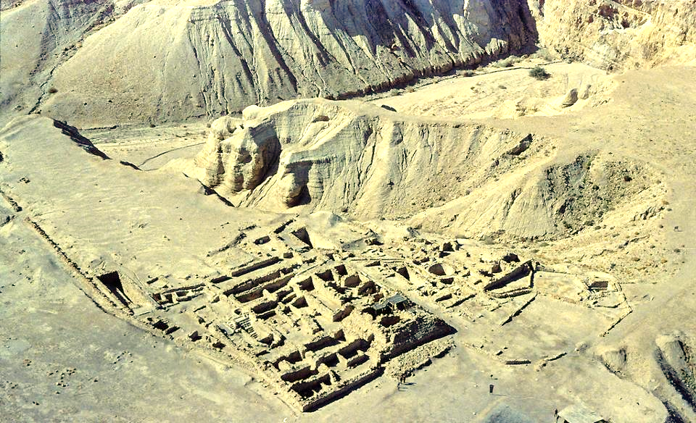
An aerial view of the Qumran terrace from the northeast shows the ruins of Khirbet Qumran after excavation, an area approximately 240 feet east to west and 325 feet north to south.

Slide 69
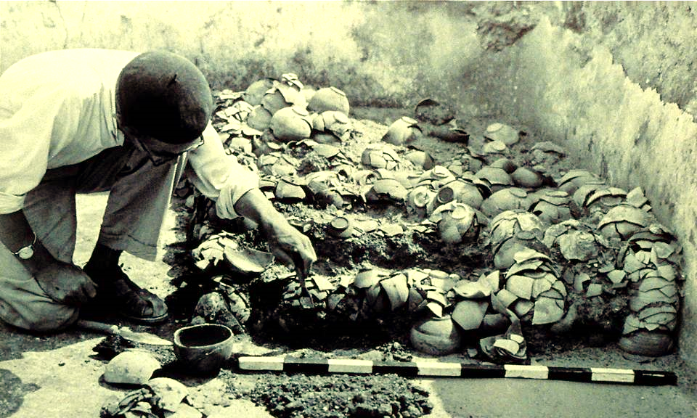
This photo from the excavation of Khirbet Qumran shows Père de Vaux cleaning vessels found in the room that he identified as the pantry. Included were 708 bowls, 210 plates, 75 beakers, 38 dishes, and 21 small jars.

Slide 70
The Scrolls
This desert community wrote their own texts between 200 BC – AD 68, and in the face of Roman reprisals over the 1st Jewish Revolt, hid them in caves surrounding Qumran.
They were discovered by Bedouin shepherd boys in the late 1940s.
The texts, more than 900 in thousands of fragments, were committed to a small team of international scholars for translation and publication.
The full range of DSS texts only became generally available in the 1990s.
The texts fall into four broad categories: Hebrew Bible (portions of all books except Esther); Apocrypha (Sirach, Tobit, and the Letter of Jeremiah); Pseudepigrapha; Sectarian.

Slide 71
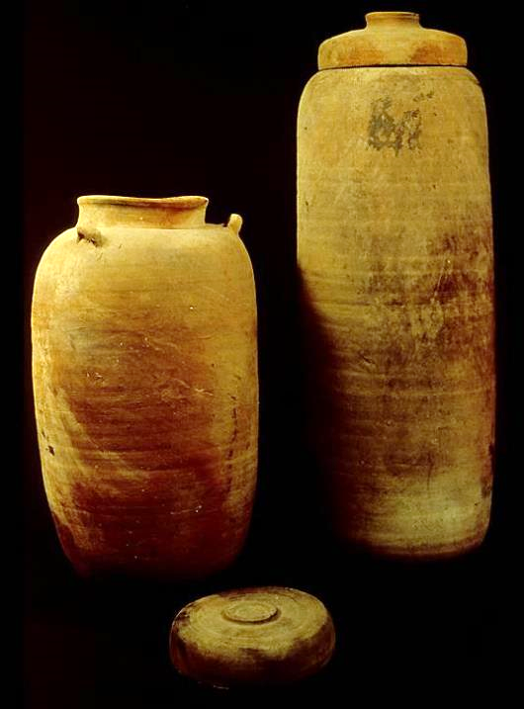
The scrolls found in Cave 1 had been carefully preserved in pottery vessels like the ones shown here on the left. The unusual shape of this vessel suggests that it might have been made specifically for storing scrolls.
Other examples of this type of jar were recovered during the following years from more than two dozen other caves in the vicinity. Later excavation of the building ruins at Khirbet Qumran yielded the same type of pottery and a potter’s kiln.
Carbon-14 testing of the linen wrappings around the scrolls confirmed that the scrolls dated from the Second Temple period.

Slide 72
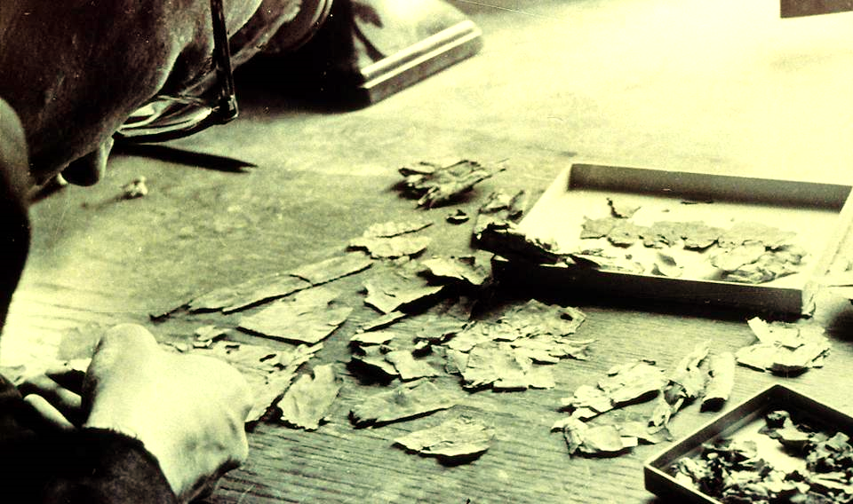
The research team was faced with the task of sorting the flood of fragments. Here are fragments from Cave 4—more than 15,000 of them, some as small as a thumbnail—from more than 500 documents. The scroll fragments are here being separated and sorted prior to being placed between sheets of glass.

Slide 73
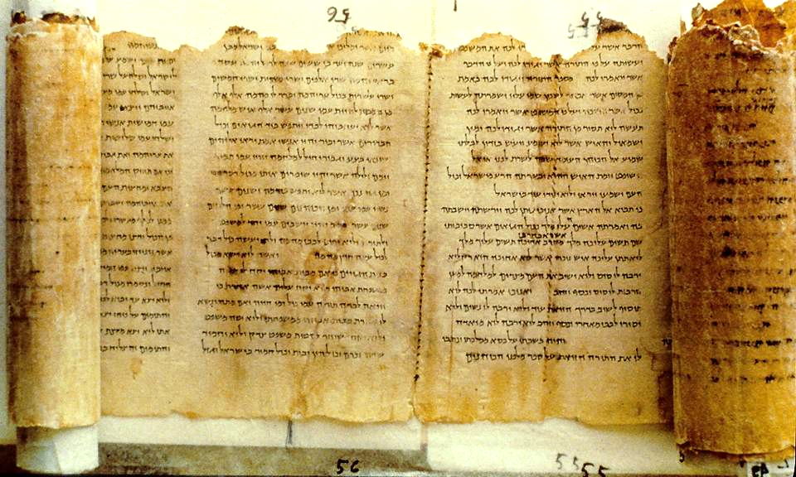
The longest of the DSS (27’ unrolled) describes an idealized perfect temple for the future Jerusalem, a huge edifice nearly the size of ancient Jerusalem itself.

Slide 74
Life at Qumran
Daily life at Qumran was spartan.
They held common property and common meals.
They observed a different liturgical calendar than the Jews in Jerusalem (based on a solar rather than a lunar calendar).
The Sabbath and purity laws in general were rigorously regulated.
The graveyard at Qumran held mostly males.
Qumran was destroyed by the Roman army in AD 68. It lay largely untouched until its discovery in the late 1940s.

Slide 75
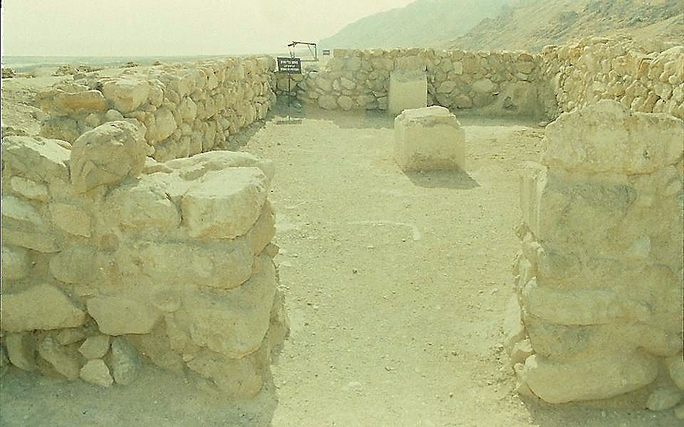
The caves were near Khirbet Qumran (an ancient ruin with some remnants visible above ground). This room was filled with stacks of basic pottery eating vessels. More than a thousand crude bowls, dishes, small jars and jugs were found, enough to serve a sizable gathering.

Slide 76
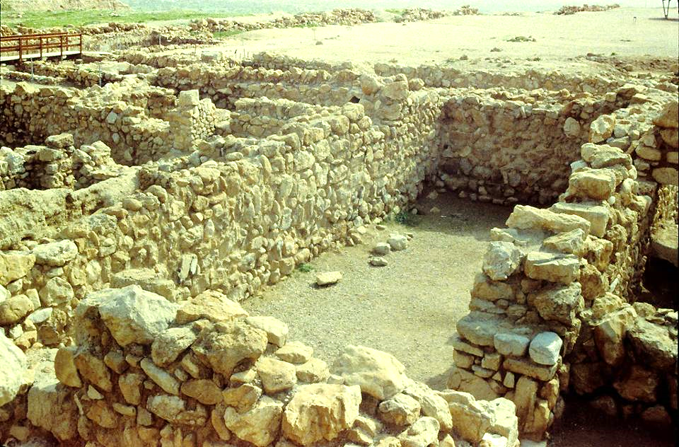
This long, rectangular room contained remains of three plastered mudbrick tables, a low bench, and two inkwells. Another inkwell was found nearby.

Slide 77
Discussion Points
So far as we know, Jesus never encountered this group, or for that matter, Essenes in general. Why might this have been the case?
Some have speculated that perhaps John the Baptist had contact with Qumran, since he grew up in the desert. What do you think about this idea?
Have there been Christians groups, like the Jews at Qumran, that believed they were at the end of the age?

Slide 78
The Biblical Texts
The DSS pushed back our Hebrew text for much of the Old Testament about 1000 years.
The basic text we use for translating the Old Testament dates to AD 1008.
The scrolls, containing some 170 biblical texts, offer us a much older text.
While most of the scroll texts are fragmented, some are relatively complete.
One important discovery was that the scrolls demonstrate the stability of the ancient text, since the DSS texts and the Masoretic text largely agree.
In some cases, the DSS texts resolve problems which had remained as puzzles for translators.

Slide 79
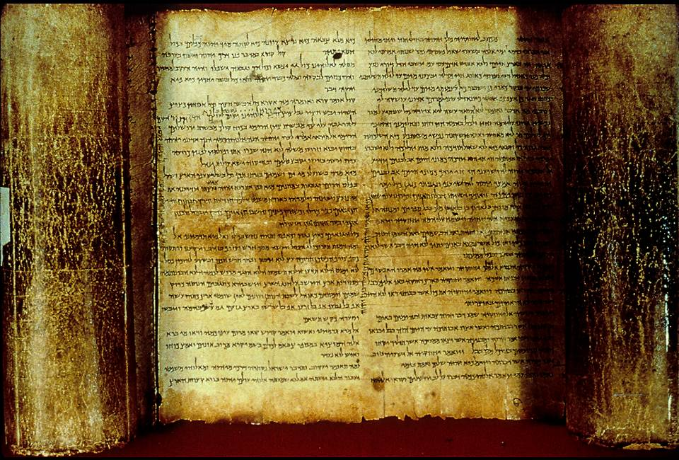
The Isaiah Scroll from Cave 1 contains all 66 chapters of Isaiah.

Slide 80
An Textual Example
Masoretic Text
“Jehoiachin was eight years old when he began to reign… (2 Chr. 36:9, KJV, ERV, NASB, RSV)
“Jehoiachin was eighteen years old when he became king… (2 Kg. 24:8)
DSS
“Jehoiachin was eighteen years old when he began to reign…” (2 Chr. 36:9, NIV, ESV, NAB, NET, NJB)
The Masoretic Text of 2 Chronicles 36:9 (which reads “eight”) stands in tension with 2 Kings 24:8 (which reads “eighteen”), but the DSS suggest that the MT had a transmission problem with the numbers in the age of Jehoiachin.

Slide 81
Another Example
In the Dead Sea Scrolls’ version of 1 Samuel, between chapters 10 and 11, there appears an additional paragraph in the 4QSamª scroll (lines 6-9) which assists in our understanding of the Ammonite threat to Israel.
“…Now Snake, king of the Ammonites, was severely oppressing the Gadites and the Reubenites. He put out [the] right eye of each of them and struck terror and dread over Israel. There [was] no man remaining within the children of Israel east of the Jordan [to] whom Snake, king of the Ammonites, did not put out each right eye, except seven thousand men [who] fled from before the Ammonites and came to Jabesh Gilead.” (My translation)
This paragraph provides important background to the story and directly leads into 1 Samuel 11.

Slide 82
The Scrolls and the New Testament
While there have been various attempts to link the DSS with the New Testament, the scholarly consensus is that there is no unambiguous connection.
No text of the NT nor any person in the NT appears in any of the scrolls
No NT writer references any of the sectarian works in the scrolls.
Still, it is fair to say that there are some elements which the Qumran Community and the early Christians had in common:
  Both believed that the stream of divine revelation had been revived.
  Both produced interpretations of the OT that related to their own times.
  Both anticipated a messianic leader at the end of the age.

Slide 83
Discussion Points
Christians believe the books of the Bible are divinely inspired. How does the fact that we have no original manuscripts from biblical authors but depend upon ancient copies affect our understanding of inspiration?
Why is the ongoing work of Bible translation important?
At Mariners Church, we use both early English translations for public reading (KJV and Coverdale) and later English translations for study (RSV, ESV, NIV). What are the advantages and disadvantages of using multiple versions?

Slide 84
THE INTERTESTAMENTAL PERIOD
10 In the Fulness of Time

Slide 85
“But when the time had fully come, God sent his Son, born of a woman, born under law…
Galatians 4:4

Slide 86
Messianic Consciousness
The messianic hope was shaped in the context of exile and restoration.
There had been ancient hints about a Coming One (cf. Ge. 3:15; 12:3; 49:10; Nu. 24:17; Dt. 18:18).
Still, between Moses and David there was virtually nothing.
During the monarchy, however, the term “messiah” (= the anointed one) came to be a common reference to the Israelite king (cf. 1 Sa. 12:3, 5; 16:6; 24:6, 10; 26:9, 11, 16, 23; 2 Sa. 1:14, 16, etc.)
Consistently, the prophets envisioned a future after exile linked to a son of David (Is. 9:1-7; 16:4b-5; 32:1; 33:17; Am. 9:11-12; Hos. 3:4-5; Je. 23:5-8; 30:8-9; 33:14-16; Eze. 34:23-31; 37:24-28; Ps. 2:6-9; 78:67-72; 89:19-37; 132:11-18).

Slide 87
The Link with David
In that day I will restore David’s fallen tent… (Am. 9:11)
Afterward, the Israelites will seek…David their king. (Ho. 3:5)
In love a throne will be established; in faithfulness a man will sit on it—one from the house of David… (Is. 16:5)
I will raise up to David a righteous branch, a King who will reign wisely… (Je. 23:5)
I will place over them one shepherd, my servant David… (Eze. 34:23)

Slide 88
The Spiritual Character
There was a spiritual character to this future hope that was not always fully appreciated within the Jewish community.
Afterward, the Israelites will…come trembling to Yahweh and to his blessings… (Ho. 3:5b)
I will heal their waywardness and love them freely… (Ho. 14:4)
Those who are left in Zion…will be called holy… (Is. 4:3)
And a highway will be there; it will be called the Way of Holiness. The unclean will not journey on it…only the redeemed will walk there. (Is. 35:8-9)
But I will leave within you the meek and humble, who trust in the name of the LORD. The remnant of Israel will do no wrong; they will speak no lies… (Zep. 3:12-13)
I will give them a heart to know me, that I am Yahweh. They will be my people, and I will be their God, for they will return to me with all their heart. (Je. 24:7)
I will cleanse them from all the sin they have committed against me and will forgive all their sins… (Je. 33:8)
I will sprinkle clean water upon you, and you will be clean… (Eze. 36:25)

Slide 89
The Repeating Phrase
“They will be my people, and I will be their God!”
Jeremiah 32:38
(cf. Is. 51:16a; Je. 24:7; 31:1, 33; Eze. 11:20; 14:11; 37:23, 27; Zec. 8:8)

Slide 90
The Defining Symbols of Self-Identity
KINGSHIP
LAND
TEMPLE
COVENANT

Slide 91
A History of Failure
The long history of Israel in the Old Testament, despite some very bright points of light, was largely a history of failure.
The northern nation suffered exile first, then the southern nation, both as divine judgments for covenant failure.
The Jews who returned from exile, even though they rebuilt the temple, did not see the fulfillment of the glowing promises of the prophets.
The Intertestamental Period was filled with pagan oppression, especially from the Greeks and the Romans.
The two disastrous Jewish revolts, in the 60s AD and the 130s AD, would be the result of centuries of frustration.

Slide 92
Discussion Points
If you had lived in the ancient Jewish context of exile and the Intertestamental Period, how would you have regarded the promises of the prophets?
Based on the spiritual character of what the prophets envisioned, how would Jesus offer an alternative pathway for the future?
How did the Jesus address the enduring national Jewish symbols?
  KING
  TEMPLE
  LAND
  COVENANT

Slide 93
“Behold my servant, whom I uphold, my chosen in whom my soul delights; I have put my Spirit upon him; he will bring forth justice to the nations. …a bruised reed he will not break, and a faintly burning wick he will not quench; he will faithfully bring forth justice. He will not grow faint or be discouraged till he has established justice in the earth…”
Isaiah 42:1-4

Slide 94
The Ebed-Yahweh (hvhy dbf)
In the prophetic hope for restoration, several oracles in the Book of Isaiah use new language to describe the Coming One, the language of Yahweh’s Servant.
In a preliminary sense, this “servant” was a collective metaphor for the whole nation, which had terribly failed in its mission (Is. 41:8-10; 42:18-22, 25).
Nevertheless, Yahweh intended to blot out Israel’s transgressions and redeem her (Is. 43:1-7, 14-21, 25; 44:22-23).
The most remarkable aspect of this promise was that the coming Servant of Yahweh would be an individual commissioned as God’s special representative (Is. 49:5).

Slide 95
“And now the LORD says, he who formed me from the womb to be his servant, to bring Jacob back to him… he says, ‘It is too light a thing that you should be my servant to raise up the tribes of Jacob and to bring back the preserved of Israel; I will make you as a light for the nations, that my salvation may reach to the end of the earth.’”
Isaiah 49:5-6

Slide 96
The Mission of Yahweh’s Servant
This coming Servant of the Lord not only would bring Israel back to God, he would redeem the nations as well (Is. 49:6).
Though collectively the Israelite nation had failed as God’s servant, the coming individual Servant would never falter (Is. 42:1-7).
In contrast to Israel, the stubborn and disobedient servant, the coming Servant would be obedient even to vicarious suffering and death (Is. 50:4-9; 52:13—53:12).
Though the coming Servant is never titled “the Messiah,” his mission would bring about the fulfillment of God’s promises to David (Is. 54:1-8; 55:3-5).

Slide 97
The Songs of the Servant
Beginning in Isaiah 42:1, the reader encounters the first of what has come to be called the four Servant Songs, poetic declarations about Yahweh’s special purpose for his servant.
Mission
42:1-4
Justice to the nations
Endowed with the Spirit
Gracious to the weak
Determined to succeed
Call
49:1-6
Chosen before birth
Hidden in God’s purpose
Destined for glory
A light for the nations
Submission
50:4-9
Completely faithful
Willing to suffer
Determined to endure
Vindicated at last by Yahweh
Humiliation
52:13—53:12
Despised and rejected
Suffers innocently & vicariously
Bears the sin of many
Victorious!

Slide 98
The Post-Exilic Vision
The post-exilic prophets spurred the people to complete the building of the 2nd Temple, since it was the first step toward God’s promises for the future.
The glory of God, which had filled the Tabernacle and Solomon’s temple, would fill this new temple.
A Good Shepherd, a King from David’s family, would bring peace.
The nations would be joined to the Jews to worship God as one nation.
Before that climax, God would send a special messenger, Elijah the prophet.
In the meantime, the Spirit of prophecy had been quenched and would not be active again until the time of the Messiah.

Slide 99
“Why have you rejected us forever, O God?
…pick you way through these everlasting ruins, all this destruction the enemy has brought on the sanctuary. Your foes roared in the place where you met with us… They smashed all the carved paneling… They burned your sanctuary to the ground… They burned every place where God was worshipped in the land. We are given no miraculous signs; no prophets are left, and none of us knows how long this will be.
Psalm 74:1-9

Slide 100
The Maccabean Ideal
While there were competing ideas about the messiah among the Jews at the end of the Intertestamental Period, one thing everyone seemed to agree on:
The Coming One would a national hero, much as had been Judas Maccabeus.
The expectation of a Maccabean-like warrior was never far from the messianic ideal.

Slide 101
Waiting for the Comfort of Israel
In birth narratives of Jesus, there is a prominent theme of restoration hope.
Zechariah’s song celebrates the coming deliverance “from the hand of all who hate us” (Lk. 1:71-74).
Mary’s song echoes these same sentiments, the downfall of pagan rulers and God’s help for Israel (Lk. 1:51-55).
It is not surprising, therefore, to hear Simeon, the old man in the temple, described as one “waiting for the consolation of Israel” (Lk. 2:25).

Slide 102
…a man sent from God whose name was John…
When the Baptist came preaching in the desert of Judea that “the kingdom of God is near,” no one doubted what he was talking about.
Small wonder that everyone went out to the Jordan River to hear him.
John’s consistent witness was that the Coming One would soon appear—and he soon would baptize with the Spirit and the fire of judgment.
His message was to repent and be baptized in preparation for the One coming.

Slide 103
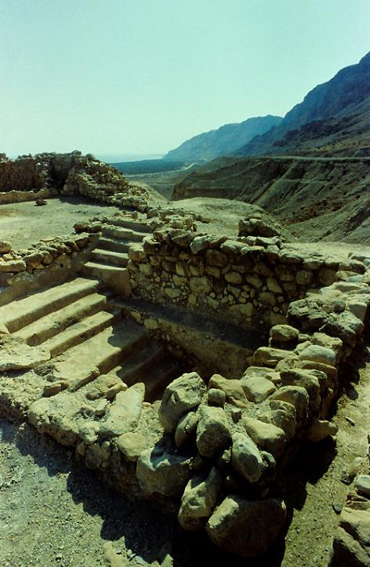
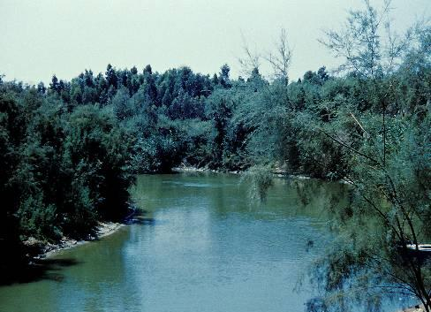
The site of John’s baptisms in the Jordan River was only about eight miles northeast of Qumran. Was John ever at Qumran? Possibly, but there is no evidence one way or another.
Baptismal pool (miqveh) at Qumran

Slide 104
Into this world and set of expectations, Jesus of Nazareth was born.

Slide 105
Discussion Points
Why were some Jews disillusioned with Jesus?
Why were others convinced that he was the Messiah?
Given this background, can you see the relevance of Jesus’ question, “Who do people say that I am” (Mt. 16:13)?

