Slide 1
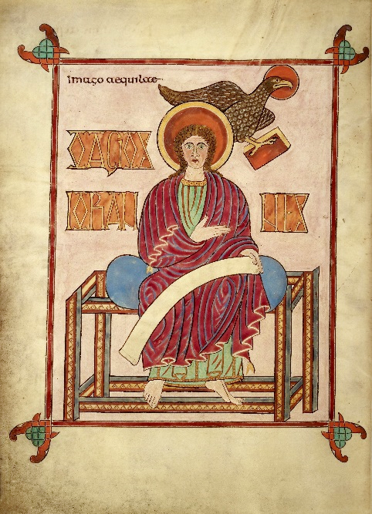
THE PROLOGUE TO JOHN’S GOSPEL: Part 1
John 1:1-9
Carpet page for the Gospel of John from the Lindisfarne Gospels, 8th century, Holy Island, England, now in the British Library

Slide 2
^{1st Quarter 2025}
Suggestions Incoming
Book of Job (x3)
Isaiah (x2)
Book of Amos
Early Christian History
Esther, Judith, or Women in the Bible
Apostles Creed
Bible Characters
Other Possibilities
Life of Samuel or David
Book of Ezekiel
Book of Matthew
English Bible
OT Names for God
Texts & Readers in Early Christianity
Other

Slide 3
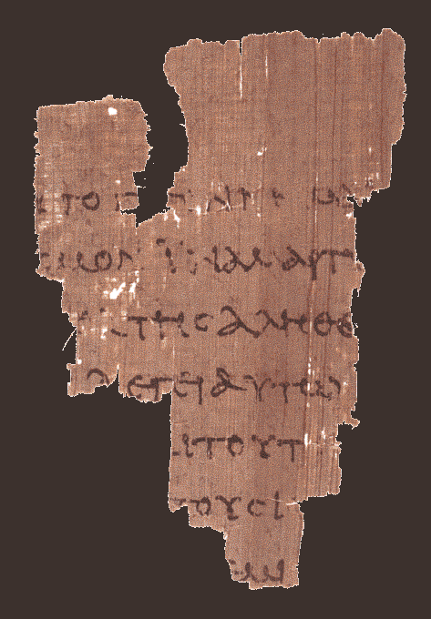
TOU]TO G[E]GENNHM[AI
e]gw> eij tou?]to g[e]ge<nnh[mai kai>
“…I for this have been born and…”
EIC TON KOC]MON INA MART[URHCW
ei]j to>n ko<s]mon i!na mart[urh<sw
“…into the wor]ld that I might wit[ness…”
EK] THC ALHQE[IAC
pa?j o[ w}n e]k] th?j a]lhqe[i<j a]kou<ei mou
“…everyone who being] of the tru[th hears of me.”
L]EGEI AUGW [---
th?j fwnh?j. l]e<gei au]t&? [o[ Pila?toj ti<
“…the voice. S]ays to him, [Pilate: ‘What…”
KA]I TOUT[O
e]stin a]lh<qia; ka]i> tou?t[o ei]pw>n pa<lin
“…is truth? An]d thi[s having said again…”
T]OUC I[OUDAIOUC
e]ch?lqen pro>j t]ou>j ]I[oudiai<ouj
“…he went out t]o the J[ews…”
OUD]EM[IAN
e]gw> ou]d]em[i<an eu[ri<skw e]n au]t& ai]ti<an
“…I n]o[ find in him crime…”
p52
verso side (back) 18:37-38
ca. AD 125

Slide 4
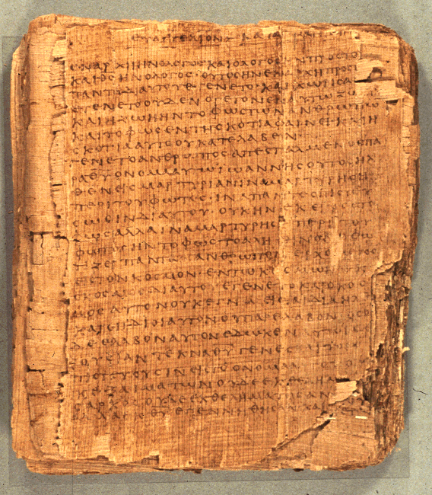
p66
(Bodmer Papyrus II)
75 leaves and 39 fragments
6.4 inches x 5.6 inches
14-25 lines per page
Words for “God”, “Jesus”, “Lord” and “Christ” are always abbreviated

Slide 5
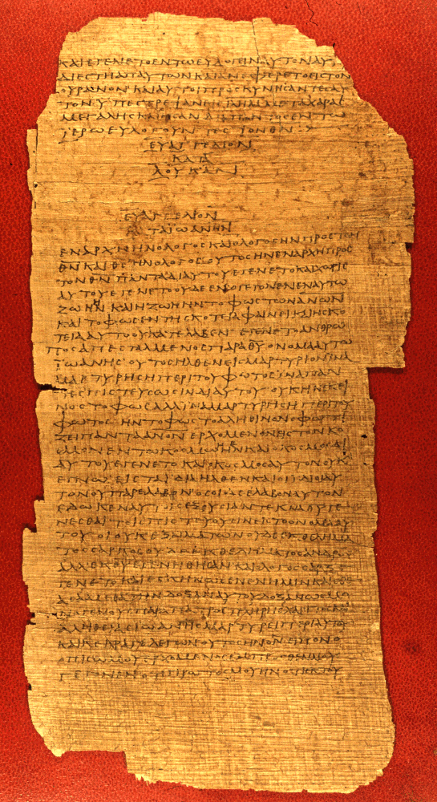
p75
Bodmer Papyrus XIV
51 surviving leaves
10.2 x 5.1 inches per leaf
38-45 lines per page

Slide 6
John’s Gospel begins differently than the Synoptics.
Mark begins the story of Jesus with the preaching of John the Baptist.
Matthew and Luke begin the story of Jesus with the birth narratives.
Matthew traces Jesus’ genealogy back to David, Israel’s greatest king, and Abraham, the ancestor of the nation.
Luke traces Jesus’ genealogy back to Adam, the ancestor of all humans.
John begins with a theological hymn of the incarnation, and the prologue to his gospel climaxes with the identification of Jesus as “God the only [Son]…” (1:18).

Slide 7
In the beginning was the Word. And the Word was with God, and the Word was God. The same was in the beginning with God.
John 1:1-2

Slide 8
The Theological Prologue (1:1-18)
This opening of the book is a hymn of incarnation.
The prologue describes a cyclical pattern of the Word, who comes from God and dwells incarnate as a human. He will then return to the Father.
In particular, the Prologue underscores the pre-existence of the Logos with the Father before the creation of the universe.

Slide 9
The Prologue resonates with themes that permeate the Fourth Gospel
fw?j (= light)
3:19-21; 8:12; 9:5; 12:35-36, 46
zwh< (=life)
3:14-16, 36; 5:24, 26; 6:33, 40, 47-48, 68; 10:10, 27-28; 11:25; 17:2-3
a]lh<qeia (= truth)
3:21; 4:23-24; 8:31-32; 14:6; 17:17; 18:37
e@rxomai (= coming [into the world])
3:19, 31; 4:24; 5:43; 6:14; 7:27-29; 8:14, 42; 11:27; 12:13; 15:22; 16:28; 18:37
ui[o<j (= Son)
1:34, 49; 3:16-18, 35; 5:19, 23, 26; 6:40; 10:34-36; 11:27; 19:7; 20:31
The one key word in the prologue that is not found later in the Fourth Gospel is lo<goj (= Logos).
The Fourth Gospel reserves this word to describe the Son as pre-existent with the Father before he came into the world.
After Jesus is born and begins his ministry, the Fourth Gospel shifts the vocabulary to ui[oj (= Son).

Slide 10
Jesus acts and speaks as the incarnate expression of God’s speech.
As word gives body to thought, so Jesus gives visible expression to the invisible power and presence of God.
At the conclusion of the book, John clearly states his overall purpose:
    “Jesus did many other miraculous signs... But these are written that you may believe that Jesus is the Christ, the Son of God, and that by believing you may have life in his name” (20:30-31).
The basic question lying behind all the gospels is, “Who is Jesus?” John is clear in his answer: Jesus is the Messiah, God’s Son.
The Prologue is John’s first treatment of this theme.

Slide 11
The Pre-existent Word
There is a deliberate parallelism in the opening:
In the beginning God… (Ge. 1:1)
In the beginning was the Logos. (Jn. 1:1)
When the universe began, the Logos was already there. This is clearly expressed later as well:
  The Son possessed divine glory with the Father before the universe existed (cf. 17:5).
  The Son was loved by the Father before the universe was created (cf. Jn. 17:24).

Slide 12
And now, Father, glorify me in your presence with the glory I had with you before the world began.
John 17:5
Father, I want those you have given me to be with me where I am, and to see my glory, the glory you have given me because you loved me before the creation of the world.
John 17:24

Slide 13
TALKING POINTS
John’s prologue is very different than the birth stories in Matthew and Luke. Why do you think John takes this very different direction in describing the origins of Jesus?
How have these descriptions about Jesus in the Fourth Gospel contributed to the Christian teaching about the Trinity?
Why do you think John used the word “Logos” to speak of Christ Jesus before his birth in Bethlehem?

Slide 14
The Meaning of the Logos
The term Lo<goj (Logos) was widely known in both the Jewish and Greek worlds:
  For Jews, the Logos was the hv!hy4-rbaD4 (Word of Yahweh) by which God created the universe and spoke to the prophets.
  For Greeks, the Logos, going back as far as the 6th century BC, was the generative principle of the world, the eternal principle of order in the universe.
Before the creation of the universe, the Logos existed paradoxically both “with” God and “as” God (1:1-4):
  The preposition pro>j (with) requires individuality or distinctness, and the verb h#n (was) requires identity or sameness.
  The preposition di>a (through) designates the Logos as God’s Agent of creation, while the preposition e]n (in) designates him as the source of all life.

Slide 15
Creation of the Universe
The pre-existent Logos was the divine agent of creation (1:3).
  All things were made “through” (di>a with genitive) the Logos.
  Nothing that exists came into being apart from the agency of the Logos.
Life in the universe was an expression of the self-existent life belonging to the Logos (1:4a).
  The Logos was the life breathed into Adam (Ge. 2:7).
  The Son has “life in himself,” which is to say, it is not derived life as would be true for created beings (cf. 5:26).
The Light is a double entendre (1:4b-5).
  It is light as the first creative act (Ge. 1:3).
  It is the light that expels moral darkness through the incarnation.
  It is the light that is misunderstood but cannot be quenched (katalamba<nw = to “comprehend” or to “overcome”).

Slide 16
Double Meanings and Translation
John frequently uses the technique of double entendre in his gospel, which is to say, words that have double meanings.
A few examples:
  Depending on context, the word fwj (= light) can mean physical light, moral light, or intellectual light.
  By contrast, skotia (= darkness) can mean physical darkness, moral darkness, or intellectual darkness.
  In 1:5, he uses the verb katalambanw, which can mean “to comprehend, understand” or “to master, overcome.”
Plays on words, such as double meanings, are difficult if not impossible to recapture in a second language. Hence, translators of the Bible are obliged to use one meaning or the other, or else, add an explanatory footnote to the text.

Slide 17
John, the First Witness
John belongs to the larger theme of witnesses (1:6-7; 3:26; 5:33, 35-36a).
  He is clearly subordinated to Jesus (1:8; cf. 1:15, 30; 3:30).
  This subordination probably speaks to those disciples of John who did not follow Jesus (cf. 3:22-26; Ac. 18:25; 19:3) and who survived into the Christian era (Recognitions of Clement I.54, 60).
The preaching of John was the unimpeachable testimony that the true light was coming into the world (1:9).

Slide 18
The vocabulary in the Fourth Gospel demonstrates the importance of these themes:
  marturi<a (= a witness, a testimony)
  (occurs 14 times; only 4 times in the Synoptics)
  marturei?n (= to witness, to testify)
  (occurs 35 times; only 2 times in the Synoptics)
  kri<sij (= judgment)
  (occurs 11 times; 6 times in Luke; 6 times in Matthew)
  kri<nein (= to judge)
  (occurs 19 times; 4 times in Luke; 12 times in Matthew)
  a]lh<qeia (= truth)
  (occurs 25 times; only 7 times in the Synoptics)
  a]lhqh<j (= true)
  (occurs 14 times; 1 time in Mark; 1 time in Matthew)
  a]lhqino<j (= true, dependable)
  (occurs 9 times in John; 1 time in Luke)
The concept of “witness” in John’s Gospel is linked to a comprehensive theme concerning the “trial” of truth. The witnesses in the gospel testify to the authenticity of Jesus as the Messiah, God’s Son.

Slide 19
TALKING POINTS
Why do you think the Fourth Gospel spends so much energy on the complex question about Jesus’ identity?
How has this reflection in the Fourth Gospel affected the way that Christians have understood Jesus?
Is this issue still important today?

Slide 20
THE PROLOGUE TO JOHN’S GOSPEL: Part 2
John 1:10-18
Carpet page for the Gospel of John from the Lindisfarne Gospels, 8th century, Holy Island, England, now in the British Library

Slide 21
THE LOGOS COMING INTO THE WORLD
The final phrase in 1:9 is that the true Light was coming into the world.
First, this Light gives light to all humans, and it is the moral quality of light that is especially in view.
  Jesus would later claim to be the Light of the world (8:12; 9:5).
  He would also say that humans loved darkness instead of light (3:19).
Second, he was coming into the world he had created, now participating in that world, though he was not recognized by it (1:10).
Third, his own people by and large rejected him (1:11).

Slide 22
THE “WORLD” IN JOHN’S GOSPEL
The Greek word kosmoj (= world) can mean the whole universe, the earth, or the world of humans, In John’s writings, it usually refers to the world of people, especially the alien culture opposing Jesus.
Used 9 times in Matthew
Used 3 times in Mark
Used 3 times in Luke
Used 78 times in John
John uses the word “world” more than any other gospel.
Especially, it is used to describe the world of people.
On the one hand, Jesus loved the people of the world and came to save them (1:29; 3:16).
On the other, the world as a whole did not know him and was continually against him (14:17; 15:18; 17:14-16, 25; 18:36).

Slide 23
JESUS AND “THE JEWS”
Matthew (5 times)
Mark (7 times)
Luke (5 times)
John (71 times)
]]]Ioudai?oj
= “the Jews”
Jesus came as a Jew among Jews (i.e., he came to “his own.”) However, in John’s Gospel there is a special category called “the Jews.”
This could hardly refer to all Jews, since Jesus himself, not to mention his disciples, were Jews (hence, the phrase is not anti-Semitic, as some have charged).
Rather, the designation “the Jews” refers especially to the Jewish leaders who opposed Jesus and rejected him as the messiah.

Slide 24
THOSE WHO RECEIVED HIM AND BELIEVED IN HIS NAME
To those who received him and believed, Jesus gives the right to be become children of God.
They experience a new birth (Jn. 3:3, 5) through a spiritual action of God that can be performed by God alone.
It is not at all the same as a natural procreation.
Of course, there would be those who would not believe in him, and we find variations between unbelief and true faith throughout John’s Gospel.

Slide 25
Groups who did not believe in Jesus
The world (1:10; 3:19; 7:7; 14:17; 15:18; 16:20)
The Jews (the Fourth Gospel uses the term “the Jews” some 71 times in the Greek text as opposed to only a few times in the Synoptics)
Some disciples of John the Baptist (who survived into the Christian era)
Groups who claimed to believe in Jesus
Those who claimed faith but refused to publicly acknowledge Jesus (3:1-2; 12:42-43)
Those whose faith rested primarily in miraculous signs (2:23-25; 6:41-42, 60-66; 11:45-46)
Those whose faith was fully genuine (6:67-69; 11:25-27; 16:29-31; 17:6-10, 20; 20:24-31)
Jesus seemed to take a reserved view of those whose faith rested primarily on miracles (2:18, 23-25; 7:3-6; 8:31, 33-59; 11:45-46). Rather, genuine faith must include accepting the exclusive claims of his Christhood, not merely admitting to his works of power (20:24-31).

Slide 26
TALKING POINTS
Is the world still an alien culture, and if so, how should we then live?
Do you think the categories of faith implicit within John’s Gospel are still relevant to people today, both those who claim to believe and those who do not?

Slide 27
THE LOGOS THEOLOGY
The heart of the Logos theology is the incarnation in which the Word was made flesh (1:14).
  The verb e]ge<neto (became) describes not merely a dwelling christology (i.e., that the Logos took a body), but that the Logos fully participated in human life—he was truly and fully human.
  The unusual verb e]skh<nwsen (tented, lived in a tent, camped), especially when linked to seeing his do<ca (glory), deliberately recalls the glory of God dwelling in the Tent of Meeting: the Logos incarnate was nothing less than God living in the midst of his people in the form of a human being.

Slide 28
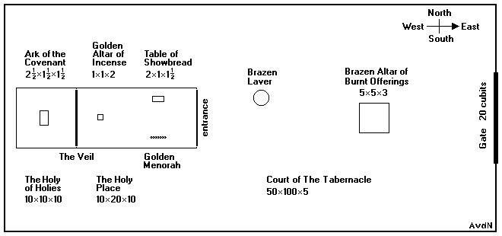
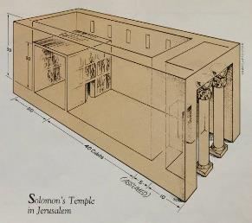
Exodus describes the divine glory entering the Tabernacle (Ex. 40:34-35).
A QUESTION BEGGED: The divine glory is seen by Ezekiel in Babylon with the deported exiles, NOT in the Jerusalem temple. This immediately raises the question: “How can this be?” (1:1, 28b; cf. 3:22-23).
1 Kings and 2 Chronicles describe the divine glory entering Solomon’s temple (1 Kg. 8:10-11; 2 Chr. 5:13-14).
Ezekiel describes the divine glory abandoning Solomon’s temple (Eze. 1:1, 28; 10:4, 18-19; 11:22-24).
Both Ezekiel (43:1-5) and Haggai (2:6-9) predicted that the divine glory would return, but this did not happen for those who completed the 2nd Temple in 516 BC.

Slide 29
THE RETURN OF THE DIVINE GLORY
“We have seen his glory…”
John sees the fulfillment of this promise in the incarnation of the Son of God and his coming into the world. Jesus is the New Tabernacle and New Temple.

Slide 30
THE PRIMACY OF THE SON
The testimony of John the Baptist is paradoxical: “he comes after me” but “he was before me.”
Though Jesus was born six months after John (Lk. 1:36), with respect to his deity as the Logos he still was there before John’s birth.
This directly refers to the preexistence of the Son before the incarnation.
Similarly, Jesus will later say to the Jewish leaders, “Before Abraham was, I am” (8:58).

Slide 31
THE FULNESS OF HIS GRACE
The contrast between law and grace:
The Torah of Moses inaugurated the era of law. John does not denigrate the law, but he sees it as a precursor of Christ:
  Jesus is the one about whom Moses and prophets wrote (1:45).
  The problem was that while the law detailed God’s moral requirements, no one fully kept the law (7:19).
The fulness of grace and truth came through Jesus Christ in his incarnation, a demonstration of the grace that the law, in itself, could not provide.
So, in Christ Jesus, there is blessing after blessing of grace.

Slide 32
The name “Jesus Christ” is withheld until the climax of the prologue
The implicit questions:
Who was with God yet was God?
Through whom did God create the universe?
Who is the true light?
Who was rejected by most but received by the few?
Who gives authority to be called “God’s children”?
Who became flesh and displayed God’s glory?
Who is the one and only Son who came from the Father?
The explicit answer (1:17-18):
Jesus Christ…
…the one who is in the bosom of the Father
…the one who makes the Father known

Slide 33
GOD, THE ONLY SON
No one has ever seen God, but God the only [Son], who is in the bosom of the Father, has made him known (1:18).

Slide 34
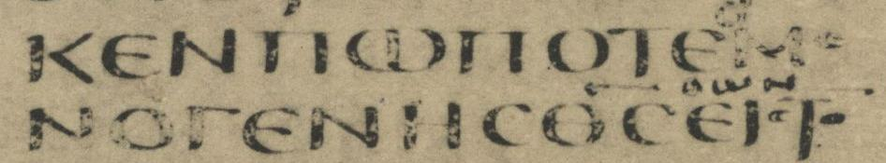
Codex Sinaiticus (x) from ca. AD 300
There are textual variations in Jn. 1:18, ranging between “God the only [Son]” (all modern versions) and “the only begotten Son” (KJV). The earliest reading is “God the only [Son].”
“God the one and only [Son]” (NIV, AB)
“the only One, himself God” (NET)
“the only Son, God” (NAB)
“the only One, who is the same as God” (TEV)

Slide 35
“I am trying here to prevent anyone saying the really foolish thing that people often say about Him: ‘I’m ready to accept Jesus as a great moral teacher, but I don’t accept his claim to be God.’ This is the one thing we must not say. A man who was merely a man and said the sort of things Jesus said would not be a great moral teacher. He would be either a lunatic—on a level with the man who says he is a poached egg—or else he would be the Devil of Hell. You must make your choice. Either this man was, and is, the Son of God: or else a madman or something worse. You can shut Him up for a fool, you can spit at Him and kill Him as a demon; or you can fall at His feet and call Him Lord and God. But let us not come with any patronizing nonsense about His being a great human teacher. He has not left that open to us. He did not intend to.”
C. S. Lewis

Slide 36
TALKING POINTS
Consider C. S. Lewis’s three options for identifying Jesus, liar, lunatic, or Lord. Are there any other options?
If Jesus is the “new” temple or “new” tabernacle, what does that say about the 2nd Temple in Jerusalem?
Several times (1:14, 16, 17) John uses the word “grace.” How should we understand this important word?
Twice, John couples the word “grace” with “truth” (1:14, 17). Why do these two words belong together?

