Slide 1

-----NEW TESTAMENT-----
(Week 2)

Slide 2
From Old to New Testament

Slide 3
Israel Under Foreign Domination
Babylon (597 BC – 539 BC)
Persia (539 BC – 331 BC)
Greece (331 BC – 167 BC)
Rome (63 BC – AD 70)
Brief Independence (167 BC – 63 BC)
By the time of Jesus’ birth, the Jews still considered the exile to be “not yet over” (cf. Lk. 2:25).

Slide 4
Judah’s War of Independence
During the Hellenistic (Greek) Period, a concerted effort was made by the Syrian Hellenists to exterminate Jewish religion.
In the mid-160s BC, Antiochus IV Epiphanes attempted to force Greek culture upon the Jews, desecrating the temple and forbidding kosher laws.
An incensed priest and his family revolted, winning Jewish independence for about a century.
The temple’s cleansing is celebrated by the Feast of Hanukkah (= “Feast of Dedication” in John 10:22).

Slide 5
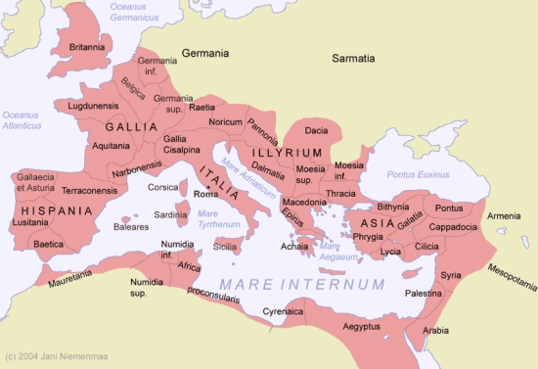
Caesar’s Empire (Rome)

Slide 6
The Apocalyptic Shift
Close of the OT
The
“Silent Years”
UNFULFILLED
EXPECTATIONS
APOCALYPTIC
LITERATURE
EXILE
RETURN
DISILLUSIONMENT
Rise of Hope
Ancient politics = the kingdom of God

Slide 7
Primary Institutions
The primary institutions emerging in Jewry from the Intertestamental Period were:
The 2nd temple (built by Zerubbabel but refurbished and enlarged by Herod the Great)
The Great Sanhedrin (the 70 elders)
The synagogue (local places for worship among Diaspora Jews as well as in the Palestinian villages of Jewish population)
The Samaritans (a separate sect of Yahweh worshippers, who built a temple on Mt. Gerizim in central Israel.

Slide 8
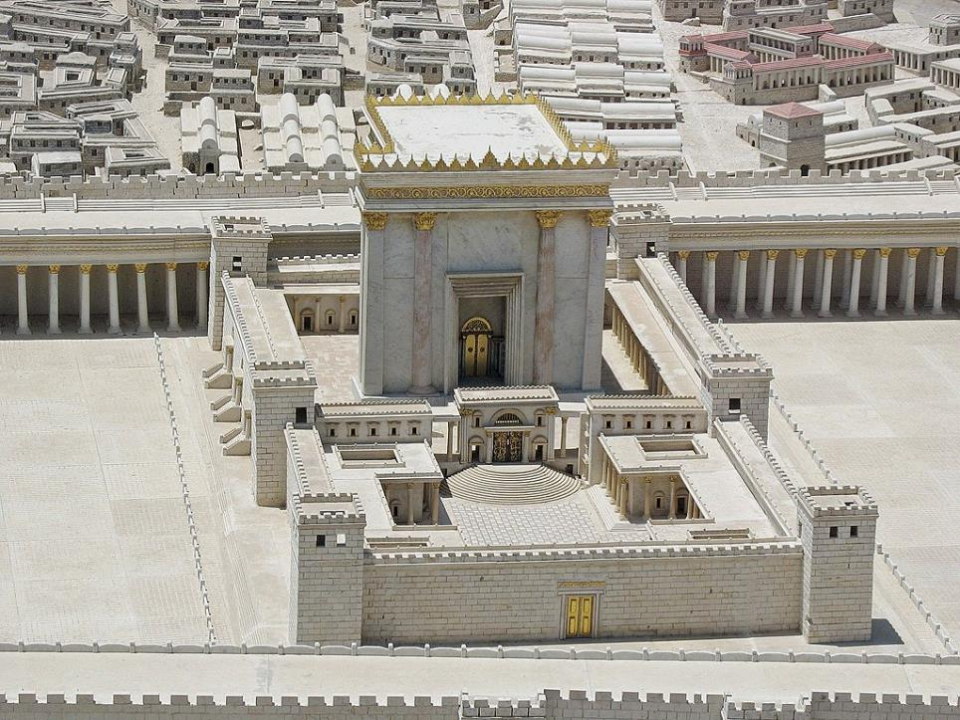
.
Model of Herod’s Temple based on Josephus and archaeological excavation

Slide 9
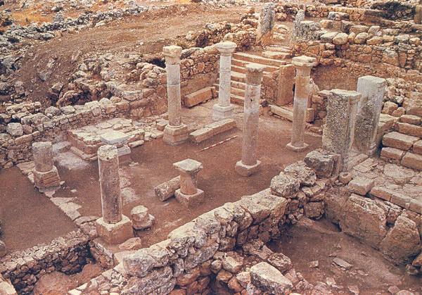
In the Khirbet Shema synagogue in northern Galilee, the raised platform, where the Torah cabinet was placed, was oriented southward toward Jerusalem.

Slide 10
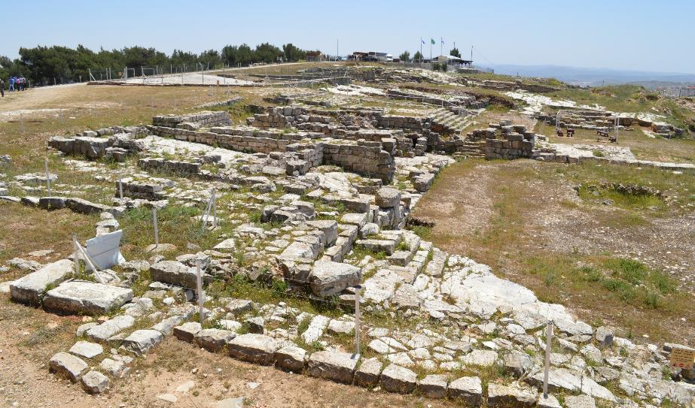
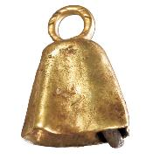
These ruins once belonged to the 2nd Samaritan Temple on Mt. Gerizim. Excavations began in 1982 and have continued uninterrupted ever since.
The first phase of the temple on Mt. Gerizim was erected in the 5th century BC. In the 2nd century BC, a larger edifice was constructed, but John Hyrcanus of Jerusalem, razed it to the ground in the late 2nd century BC. Hostilities continued into the time of Jesus.
Archaeological excavations at Mt. Gerizim have not yet uncovered remains of the 1st temple, but inscriptions in Aramaic as well as a bell of gold (appropriate for a priest, cf. Ex. 28:33-35) testify to its presence.

Slide 11
The Pharisees
While the origin of the Pharisees is somewhat obscure, they seem to have arisen not long after the Maccabean Revolt.
In particular, the Pharisees emerged in distinction from the Sadducees.
They upheld the belief that there were two types of Torah given by Moses: the Written Torah and the Oral Torah.
They believed in fate, the resurrection of the dead, angels, and the spirit world (Ac.23:8).
They were noted for their punctilious observance of purity laws, prayer three times each day, and fasting twice each week.

Slide 12
The Scribes
Initially, ancient writing was the province of royal courts and primarily used for record keeping. King David was the first Israelite king to began using a scribe as a member of his administration (2 Sa. 8:16; 1 Chr. 24:6).
Ezra became the prototype scribe for succeeding generations, a scholar and expert in the Torah (Ezr. 7:6, 10).
Because scribes were so directly involved in copying and interpreting the texts of Scripture, they were a natural ally of the Pharisees.
In addition to their expertise in the Torah, scribes could draft legal documents, such as, marriage contracts, mortgages, sales of land, etc.

Slide 13
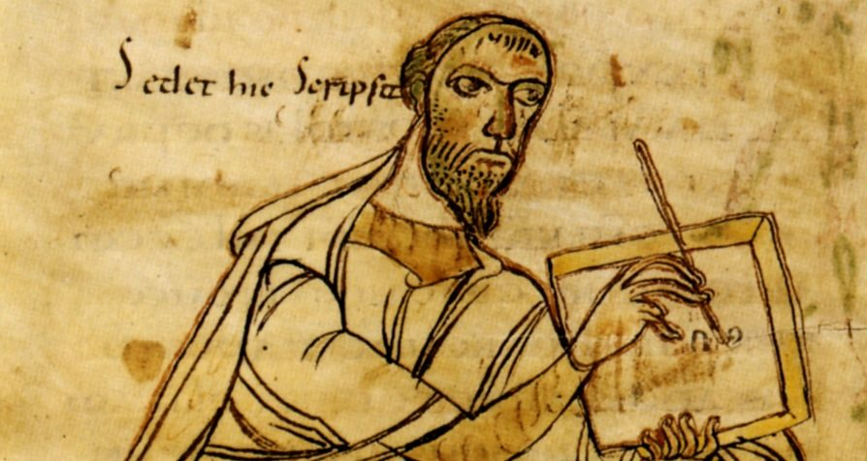
Scribe with stylus and tablet

Slide 14
The Sadducees
Whereas the Pharisees were linked with the synagogue, the Sadducees were linked with the 2nd Temple.
As wealthy members of the upper class, they maintained the temple as well as oversaw some state affairs, collected taxes, and participated in the Sanhedrin.
In contrast to the Pharisees, they held as binding only the written Torah (and rejected the authority of the Oral Torah).
They believed in absolute free will (not fate) but rejected the idea of the afterlife, resurrection, angels, and the spirit world.

Slide 15
The Essenes
Essenes rejected the priesthood of the 2nd Temple as corrupt and irredeemable.
While some lived in the cities, many withdrew to communes in the desert to await the apocalyptic end of the age.
They are the one group described by Josephus but not found in the New Testament.
Most scholars believe Qumran was an Essene community.
One Dead Sea Scrolls document (4QMMT) has an exact verbal parallel with the writings of Paul, when it speaks of the “works of the law” that would be “reckoned as righteousness.” Paul, of course, says just the opposite (Ro. 3:20, 28; Ga. 2:16; 3:2, 5, 10).

Slide 16
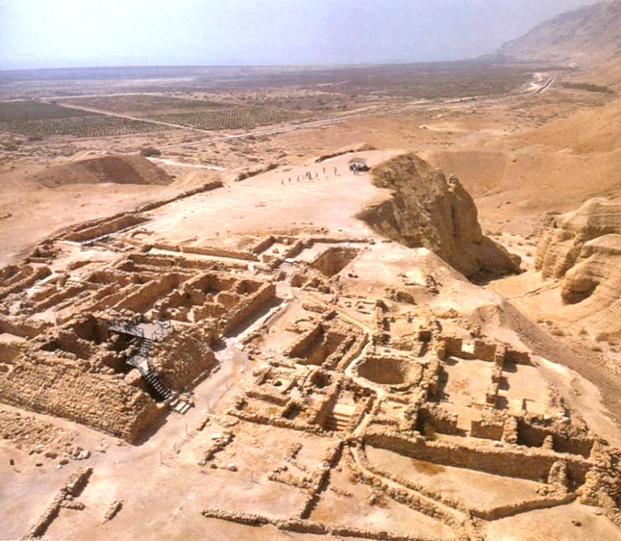
Qumran, the community that preserved the Dead Sea Scrolls, was likely Essene.

Slide 17
The Zealots
Zealots were freedom-fighters, rebels against Roman administration and occupation.
The prototype zealot was Judas the Galilean (cf. Ac. 5:37), who raided the armory in Sepphoris in 4 BC (about four miles from Nazareth).
  In Roman reprisals, Sepphoris was burned to the ground, its inhabitants sold into slavery, and some 2000 rebels crucified.
In 6 AD, another rebel named Judas (Judas was a popular name, probably going back to the hero Judas Maccabeus) led a resistance movement due to the census by Quirinius.
The zealot slogan was “no king but God.”
Simon, one of Jesus’ disciples, was a zealot (Mt. 10:4; Mk. 3:18; Lk. 6:15).

Slide 18
The Presence of Rome Gave Rise to Revolutionaries of Jewish Nationalism
1st Century BC: Brigandy put down by Herod
40s BC: Execution of Hezekiah
4 BC: Roman eagle pulled from temple gate (perpetrators executed)
Revolt suppressed by Archelaus
Revolt by Judas the Galilean (perpetrators
crucified, cf. Ac. 5:37)
6 AD: Another Judas led a resistance movement against the census by Quirinius
AD 26-36: Mass protest over Roman standards
Resistance to Pilate’s use of temple funds to
build an aqueduct
Galileans executed in the temple (cf. Lk. 13:1)
Capture and release of Barabbas (cf. Mt. 27)
Protest against votive shields
AD mid-40s: Execution of Tholomaeus
Execution of Theudas (cf. Ac. 5:36)
Execution of Judas and Simon
AD ? Execution of an Egyptian Jew (cf. Ac. 21:38)
c.AD 50: Passover riot (20,000 Jews killed)
AD 52-60: Crucifixion of the Lestai
AD 60s: Execution of the Sicarii
AD 60-62: Execution of unnamed messianic imposter
AD 66-70: 1st Jewish Revolt (resulting in the destruction of the temple)
Flavius Josephus

Slide 19
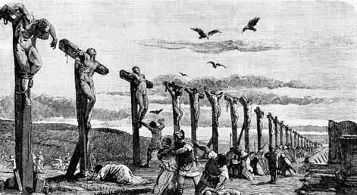
Depiction of mass crucifixions of rebels.

Slide 20
The Herodians
This group, mentioned alongside the Pharisees (Mk. 3:6; 12:13; Mt. 22:16), is largely unknown except for the references in the New Testament.
They are not mentioned by Josephus.
Apparently, they were supporters of the Herod family.
Some have suggested that they may have been Essenes, but this is unclear.

Slide 21
Thy Kingdom Come
1st Century AD responses to the messianic vision of the prophets was varied:
The Herodians and Sadducees deemed collaboration with the Roman occupation a temporary, but necessary, expedient.
The Pharisees urged intensifying devotion to the Torah as the way to usher in God’s kingdom.
The Essenes and the Qumran Community withdrew into the desert to await an apocalyptic divine intervention.
Zealots urged that only immediate armed resistance to Rome was acceptable.
All sects still embraced the memories of the Maccabean success.

Slide 22
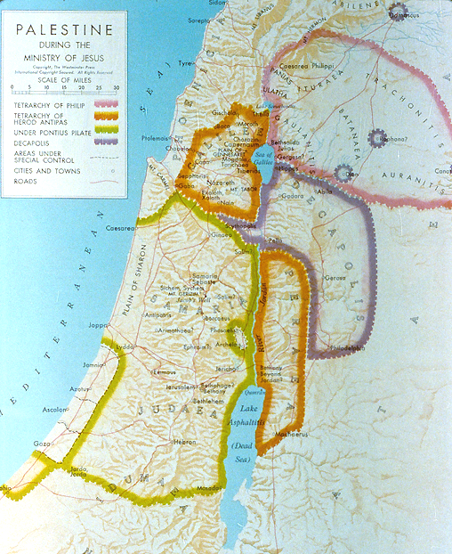
Herodian Palestine
After the death of Herod the Great, his sons were appointed rulers after his death, dividing up the land. By the time of Jesus’ ministry, however, Judea/Samaria had passed into the jurisdiction of a Roman governor.

Slide 23
New Testament Texts

Slide 24
Jewish Texts and Traditions
By Jesus’ time, the following Jewish texts and traditions had become commonly recognized and commonly used.
The Hebrew Bible as a tri-partite collection (Torah, Prophets and Writings)
The Septuagint (Greek translation of the Hebrew Bible)
The Apocrypha (additional books)
The Pseudepigrapha (apocalyptic books)
The Oral Torah (the tradition of the elders handed down orally, cf. Mk. 7:3)
The Targums (Aramaic oral versions of the Hebrew Bible)

Slide 25
The New Testament
The books that Christians call the New Testament were written within the last half of the 1st century AD.
The term “testament” is derived from the word “covenant” (Latin).
The Hebrew Bible came to be called the “Old Testament” by Christians.
The terms “Old Testament” and “New Testament” were in Christian use by the 2nd century AD.

Slide 26
The New Testament (four genres)
Gospels Letters Apocalypse
Matthew Romans Hebrews Revelation
Mark 1 & 2 Corinthians James
Luke Galatians 1 & 2 Peter
John Ephesians 1, 2 & 3 John
Philippians Jude
Acts Colossians
Acts 1 & 2 Thessalonians
1 & 2 Timothy
Titus
Philemon
All branches of Christianity (Catholic, Orthodox & Protestant) agree on the extent of the NT canon.

Slide 27
EARLY GREEK TEXTS of the NT
Papyri (written on papyrus sheets)
The earliest papyri date to the early 200s AD.
p46 (Paul’s letters, ca. AD 200)
p66 (gospels, ca. AD 200)
p74 (Acts, general letters, ca. 7th century)
Uncials (written in all upper case letters)
א (Sinaiticus, ca. 4th century)
B (Vaticanus, ca. 4th century)
A (Alexandrinus, ca. 5th century)
Minuscules (written in cursive)
Earliest minuscules date to the 9th century AD
Versions (translations)
Old Latin (2nd) Peshitta (4th)
Coptic (3rd) Armenian (5th)
Vulgate (4th) Georgian (5th)
Gothic (4th) Ethiopic (6th)
Lectionaries (for public readings)
Church Fathers (writings)
Beginning in the 2nd century

Slide 28
The Papyri of the New Testament
All extant texts of the New Testament were written on papyrus sheets and bound in a codex.
Papyrus was an inexpensive “paper” made from crushed reed stems, and the process of writing is what John calls “papyrus and ink” (2 Jn. 12) or “ink and reed” (3 Jn. 13).
Early Christian texts, unlike traditional Jewish texts which were written on scrolls, were bound in a codex (indeed, Christians are credited with popularizing, perhaps even inventing, the codex form).
Unlike a bundle of scrolls, the codex, by necessity, necessitates a fixed order, and this fixed order was applied to both the LXX and the Christian texts.

Slide 29
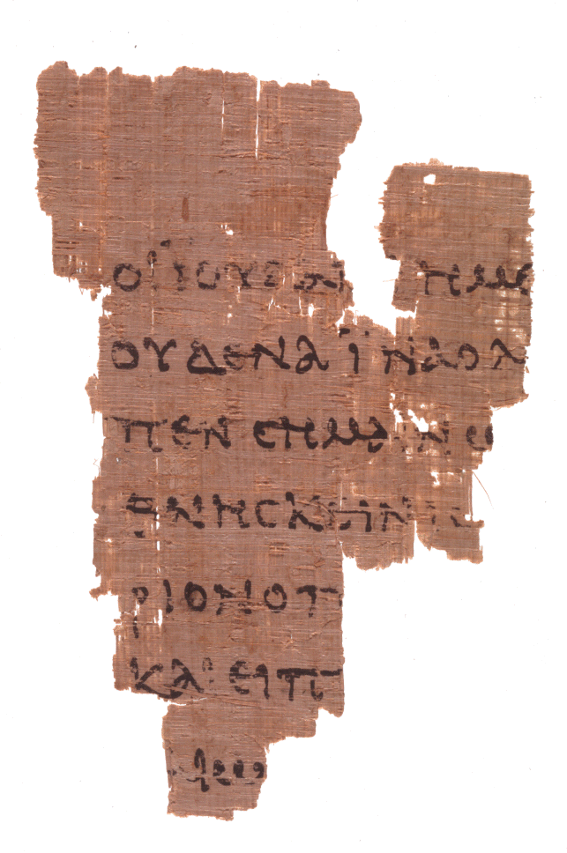
P52
John Rylands Fragment
Earliest fragment of any part of the New Testament
c. AD 125
John 18:31-33
University of Manchester, England

Slide 30
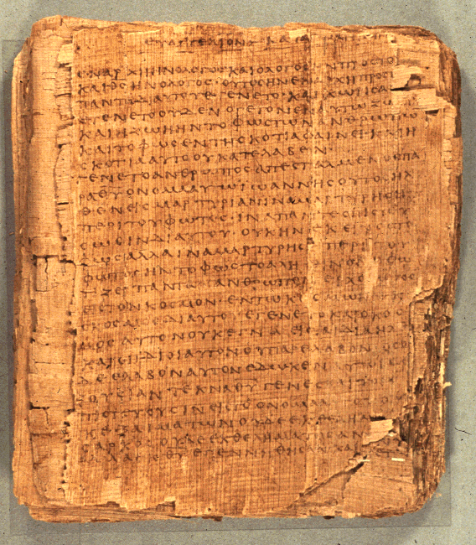
p66
(Bodmer Papyrus II)
75 leaves and 39 fragments
6.4 inches x 5.6 inches
14-25 lines per page
ca. AD 200
Words for “God,” “Jesus,” “Lord,” and “Christ” are abbreviated
Contains the Gospel of John
Bodmer Library of World Literature, Geneva

Slide 31
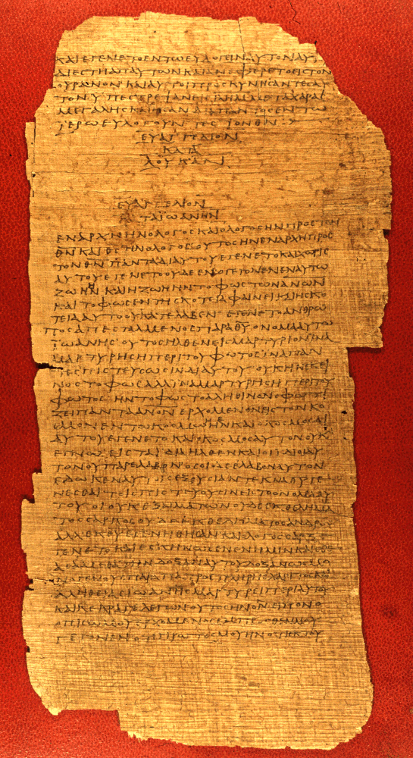
p75
Bodmer Papyrus XIV
51 surviving leaves
10.2 x 5.1 inches per leaf
38-45 lines per page
This page shows the end of Luke and the beginning of John
Vatican Library, Rome

Slide 32
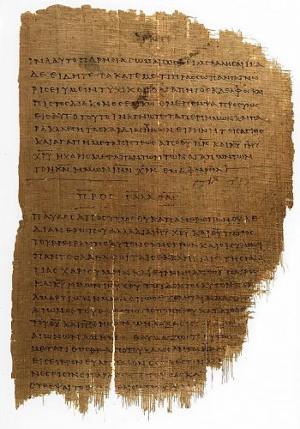
P46
Chester Beatty Papyrus
86 leaves (slightly mutilated) containing some of Paul’s letters
11 x 6.5 inches per leaf
ca. AD 200
First line in the Galatian Letter of St. Paul
University of Michigan, Ann Arbor

Slide 33
Not all writings from the apostolic era survived
Luke mentions very early accounts of the life of Jesus, none of which have survived (Lk. 1:1-2).
An early correspondence of Paul to the Corinthians, which he references, has not survived (1 Co. 5:9).
Paul’s letter to the Laodiceans has not survived, unless, as some think, it was a circular letter and may be preserved as the canonical Ephesians (Col. 4:16).

Slide 34
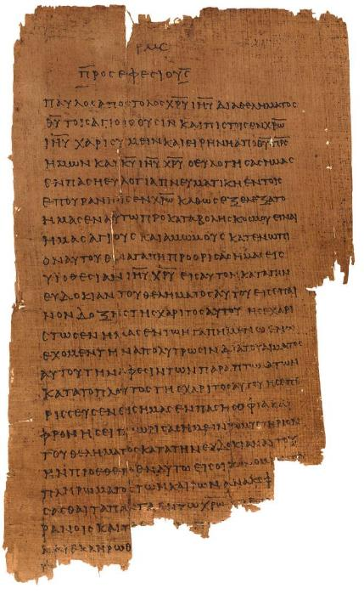
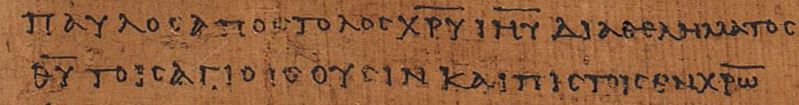
Ephesians 1:1 p46
Chester Beatty Papyri ca. AD 200 earliest copy of the Ephesian letter
“Paul, an apostle of Christ Jesus through [the] will of God to the holy ones who are also faithful in Christ…” (1:1)
(University of Michigan, Hatcher Library)

Slide 35
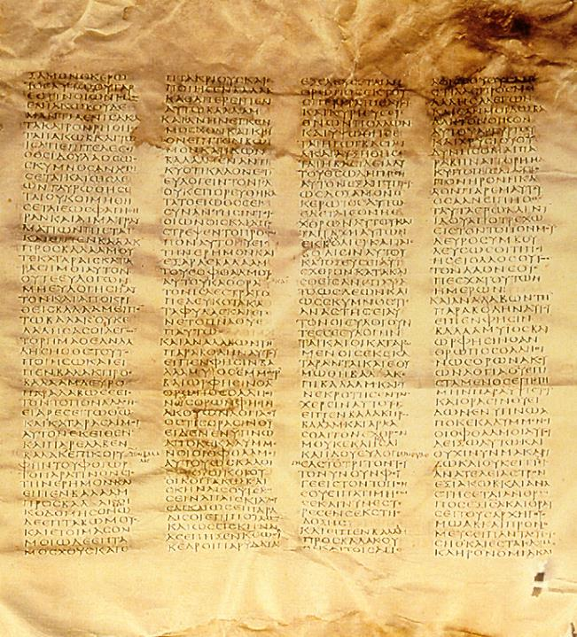
א
Codex Sinaiticus
4th century
Complete New Testament and most of the Old Testament (LXX)
Leaves 14” x 15”
48 lines per column
British Library, London

Slide 36
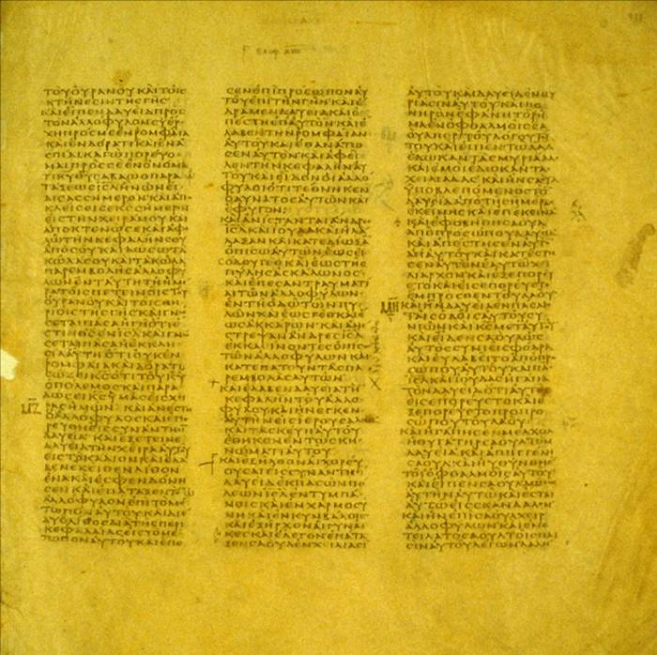
B
Codex Vaticanus
4th century
617 leaves
Originally a full Bible (LXX)
10.8” x 10.8” per leaf
40 to 44 lines per column
Vatican Library, Rome

Slide 37
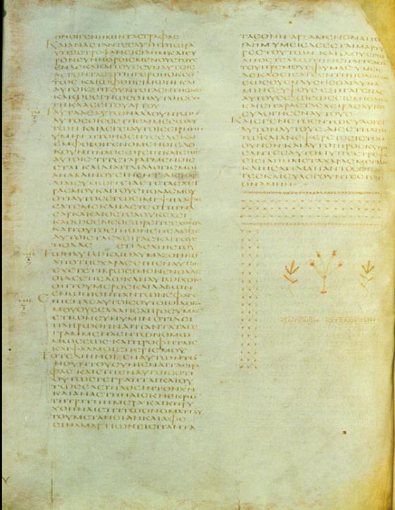
A
Codex Alexandrinus
5th century
Full Bible
773 leaves
12.6” x 10.4” per leaf
46 to 52 lines per column
British Library, London

Slide 38
Because it was in Greek, the LXX would become the “Bible” of the earliest Christians.
Few people outside Palestine would have been conversant in Biblical Hebrew.
Hence, the writers of the New Testament, when quoting from the Old Testament, frequently do so from the LXX.
Paul quotes from both the LXX as well as the Hebrew Bible (but, of course, he writes in Greek).
Luke and the author of Hebrews quote exclusively from the LXX.

Slide 39
The Writings of the New Testament
As the apostles and those close to them began to compose Christian texts, they naturally did so in Greek.
Paul typically used an amanuensis, like Tertius, Sosthenes or Timothy (Ro. 16:22; 1 Co. 1:1; 2 Co. 1:1; Phil. 1:1; Col. 1:1; 1 Th. 1:1; 2 Th. 1:1; Phlm 1), though he made it a practice to sign off with his own signature (1 Co. 16:21; Ga. 6:11; 2 th. 3:17).
We know considerably less about the process of writing lying behind the four Gospels, but early Christian testimony (Papias) indicates that Mark, at least, was a collector of the personal memories about Jesus by Simon Peter.

Slide 40
Early Translations
As early as the 2nd century, the texts of the New Testament began being translated into vernacular languages.
Christian missionaries translated biblical texts into local languages wherever Greek would not serve the needs of the people.
These early translations include:
  Old Latin (predating Jerome’s Latin Vulgate)
  Syriac (Peshitta)
  Coptic
  Armenian
  Georgian
  Ethiopic
  Arabic
  Gothic

Slide 41
The Public Reading of Scripture
In a society where the ownership of texts was economically prohibitive, the familiarity of Christians with the Bible depended upon hearing them read publicly.
In the synagogue tradition, two Scripture readings were appointed for each service, one from the Torah and one from the Prophets, and these were arranged in a three-year cycle. (Jesus gave the “Prophets” reading in his hometown of Nazareth, cf. Lk. 4:16ff.).
These readings, in turn, became the “text” for the sermons of the rabbis.
Christians followed this same pattern (1 Ti. 4:13). Indeed, some suggest that the nuance of this passage is, “…give attention to the selected reading of the day…”

Slide 42
An Early Christian Description
“On the day called Sunday, all who live in the cities or in the country gather together in one place, and the memoirs of the Apostles or the writings of the prophets are read, as long as time permits…”
Justin Martyr (d. 166)

Slide 43
The Selected Readings
The early churches varied in their choice of selected readings.
Some churches read from Sunday to Sunday until a particular book was finished (and this seemed to have been the general practice).
In other areas (Spain and France), short selections from various parts of Scripture were pieced together.
Some churches used harmonies of the gospels and read them in parallel.
By the 4th century, fixed readings were associated with Advent and Pentecost, and eventually, Lent, Good Friday, Easter, etc.

Slide 44
The Lectionary
In AD 471 (or earlier), a lectionary was produced, the Comes Hieronymi (Lectionary from Jerome), and it became the standard order of readings for the Western Church.
It assigned readings for Advent, Christmas, Lent, and Easter.
The rest of the year was covered by optional texts and could be adjusted by the local bishop or pastor.
Three centuries later, Charlemagne standardized liturgical practices in his domain along with a revision of the lectionary, and this, in turn, meant that everyone in the west was reading the same passages on the same Sundays.

Slide 45
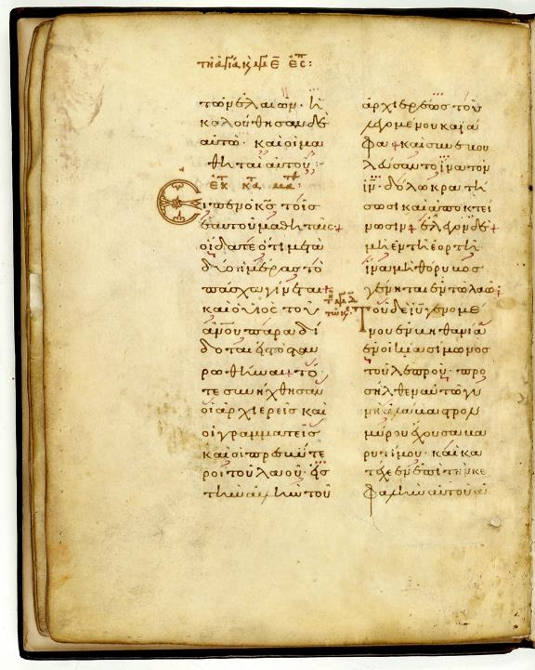
Greek Lectionary of the Gospels
The Readings for Easter Week from the Gospel of Matthew, along with readings for the stations of the cross.
The Greek lectionaries become an important witness to the Greek text of the New Testament.

Slide 46

Staurograms
The earliest depictions of the cross occur in New Testament texts in which the letters tau (τ) and rho (ρ) from the Greek words “cross” (σταυρος) and “crucify” (σταυροω) appear superimposed on each other, looking something like this:
Beginning in NT texts from about AD 200, staurograms are the earliest visual depictions of Christ crucified.

Slide 47
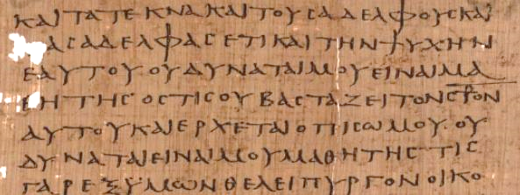
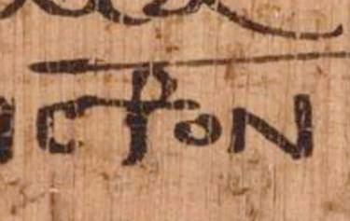
Early text of Luke 14:27 p75 Bodmer Papyri XIV (ca. AD 200-225)
Vatican Library, Rome

Slide 48
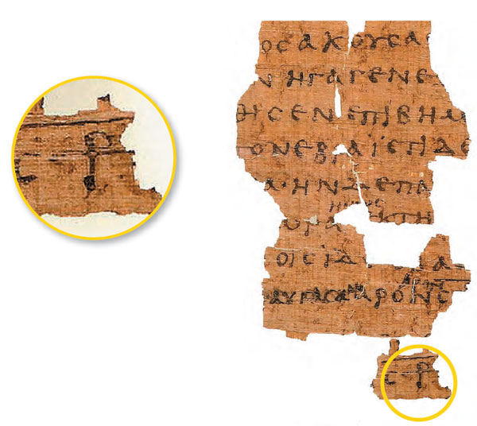
Early Text of John 19:13ff. p66
Bodmer Papyri II
(ca. AD 200)
Staurograms appears in John 19:6, 15, 16, 18, 19, 25, 31.
The superimposed letters look like a human figure hanging on a cross.

Slide 49
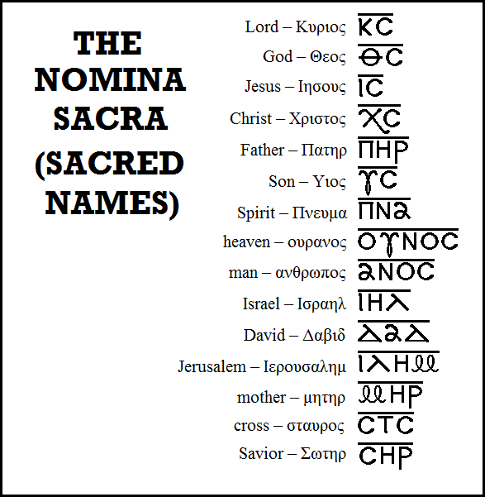
Typical Nomina Sacra found in early New Testament manuscripts.
All these abbreviations are found in Greek manuscripts of the 3rd century and earlier except “mother,” which begins to appear in the 4th century.
Bruce Metzger,
Princeton University

Slide 50
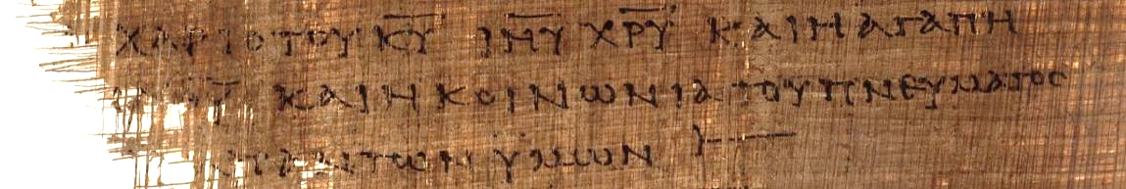
2 Corinthians 13:13 (p46)
“[The] grace of the Lord Jesus Christ and the love of [God] and the fellowship of the Holy Spirit [be] with you all.”
Here, the sacred names “Lord,” “Jesus,” and “Christ” have all been abbreviated with a line drawn over them.
ΚΥΡΙΟΥ = ΚΥ = Lord
ΙΗΣΟΥ = ΙΗΥ = Jesus
ΧΡΙΣΤΟΥ = ΧΡΥ = Christ

Slide 51
AUTOGRAPHxxxxxxxxxxxxxxxxxxxxxxxxxxxx
1st Century
2nd Century
3rd Century
4th Century
5th Century
EGYPT
COPY
xxxxxxxxxxxxxxxxxxxxxxxxxxxx
ITALY
COPY
xxxxxxxxxxxxxxxxxxxxxxxxxxxx
PALESTINE
COPY
xxxxxxxxxxxxxxxxxxxxxxxxxxxx
COPY
xxxxxxxxxxxxxxxxxxxxxxxxxxxx
COPY
xxxxxxxxxxxxxxxxxxxxxxxxxxxx
COPY
xxxxxxxxxxxxxxxxxxxxxxxxxxxx
COPY
xxxxxxxxxxxxxxxxxxxxxxxxxxxx
COPY E
xxxxxxxxxxxxxxxxxxxxxxxxxxxx
COPY F
xxxxxxxxxxxxxxxxxxxxxxxxxxx
COPY A
xxxxxxxxxxxxxxxxxxxxxxxxxxxx
COPY B
xxxxxxxxxxxxxxxxxxxxxxxxxxx
COPY C
xxxxxxxxxxxxxxxxxxxxxxxxxxxx
COPY D
xxxxxxxxxxxxxxxxxxxxxxxxxxxx
COPY G
xxxxxxxxxxxxxxxxxxxxxxxxxxxx
Slight variations get passed down through subsequent copies as texts are copied and shared.

Slide 52
GEOGRAPHICAL TEXTUAL FAMILIES
Western Text
Byzantine Text
Alexandrian Text
Caesarean Text

Slide 53
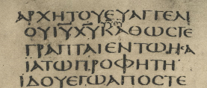
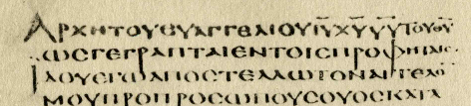
AN EXAMPLE OF A TEXTUAL VARIATION
The problem, of course, is that the passages quoted come from Malachi 3:1 as well as Isaiah 40:3.
Mark1:2
…εν τω ‘Ησαια τω προφητη.
(= “…in Isaiah the prophet.”)
…εν τοις προφηταις.
(= “…in the prophets.”)
__________
___________________
_________________
א CODEX SINAITICUS (4th century)
A CODEX ALEXANDRINUS (5th century)
Followed by all modern versions
Followed by the KJV

Slide 54
Key Characters & Writers

Slide 55
Christ Jesus

Slide 56
“I am trying here to prevent anyone saying the really foolish thing that people often say about Him: ‘I’m ready to accept Jesus as a great moral teacher, but I don’t accept his claim to be God.’ This is the one thing we must not say. A man who was merely a man and said the sort of things Jesus said would not be a great moral teacher. He would be either a lunatic—on a level with the man who says he is a poached egg—or else he would be the Devil of Hell. You must make your choice. Either this man was, and is, the Son of God: or else a madman or something worse. You can shut Him up for a fool, you can spit at Him and kill Him as a demon; or you can fall at His feet and call Him Lord and God. But let us not come with any patronizing nonsense about His being a great human teacher. He has not left that open to us. He did not intend to.”
C. S. Lewis

Slide 57

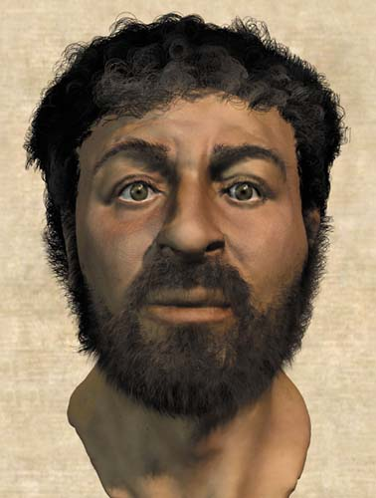
What did Jesus look like?
No one knows, of course, but two images, quite different from each other, have captured the popular imagination
The negative image (here shown as a positive) on the highly controversial Shroud of Turin
Based on skeletal remains of 1st century Jews, British forensic anthropologists reconstructed a “typical” Jewish face. For more sensationalist reasons, their reconstruction was billed as the “real face of Jesus” (National Geographic, Dec. 2002).

Slide 58
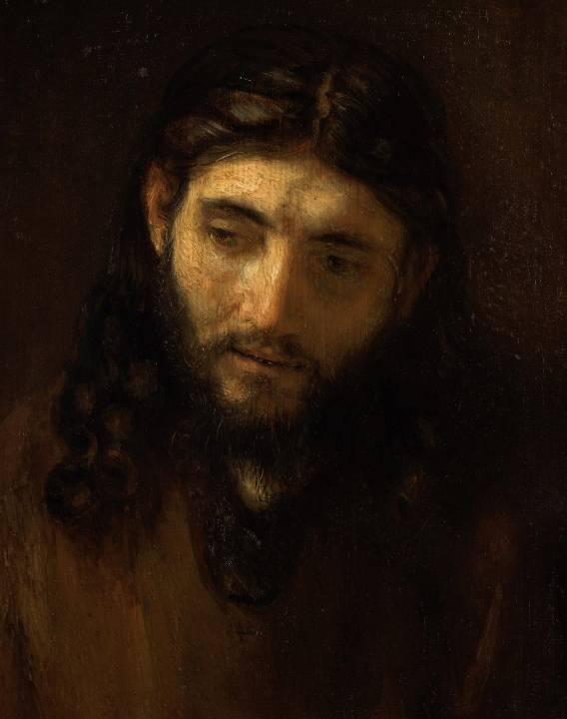
Rembrandt was the first artist to use Jewish models, Sephardic Jews in Amsterdam, for his portraits of Jesus.

Slide 59
The Name Ιησους (Jesus)
Common Jewish 1st century name
Greek form of the Old Testament name Joshua:
  Iesous (Greek)
  Yeshua (Aramaic)
  Yehoshua (Hebrew)
Combines the short form of the name Yahweh (Yah) with the hiphil verb hoshi’a (= to save)

Slide 60
The Names of Jesus
To understand how the early church conceived of Jesus, one should consider the names he used of himself and the ones his disciples used of him.
The Prophet like Moses
The prediction of a coming prophet like Moses fueled Jewish expectations for the future (Dt. 18:18-19; 34:10-12) . Hence, there were questions about “the prophet” (Jn. 1:21; 6:14; 7:40) and the proclamation that Jesus was “the prophet” (Ac. 3:22-26).
The Servant of Yahweh
Isaiah’s described Yahweh’s Servant, called, anointed with the Spirit, completely obedient, and destined for suffering and exaltation (Is. 42:104; 49:1-6; 50:4-9; 52:13—53:12; cf. Ac. 3:26; 4:27; 8:26-35).
The Great High Priest
The Letter to the Hebrews especially exalts Jesus as the true High Priest whose priestly work was “one-for-all” (2:17; 7:23-28; 9:9-14; 10:11-14).

Slide 61
The Son of David
The prophets predicted that a descendant of David would reign as God’s vice-regent (Am. 9:11-12; Je. 23:5-6; 33:14-26; Eze. 34:22-24). This hope was why Jesus was called the Son of David (Mt. 9:27; 12:22-23; 15:22; 20:30-31; 21:9, 15; 22: 42, etc.). The early church made this connection repeatedly (Mt. 1:1; Ro. 1:3; 2 Ti. 2:8; Rv. 22:16).
The Messiah (Hebrew); the Christ (Greek) = “the Anointed”
While the title “the anointed” was used for Israelite kings, the idea developed that an ultimate Messiah would come (Da. 9:25; Lk. 3:15). Jesus’ avoided this title (Mt. 16:20; Mk. 1:24-25, 34, 44; 3:12; 5:43; 7:36; 8:26, 29-30), probably because the popular conception was that the Messiah would be a military hero like Joshua or Judas Maccabaeus. Jesus’ messiahship would be defined by his death, and it was only at his trial that he openly acknowledge that he was the Christ (Mt. 26:62-64.

Slide 62
The Son of Man
Based on the Old Testament phrase “son of Adam,” the term “son of man” was used to refer to a human being (Eze. 2:1, etc.) as well as to a heavenly being who establishes God’s rule on the earth (Da. 7:13-14). Jesus, alone, used this phrase to refer to himself in various ways: as one who forgives sins (Lk. 5:24), as the lord over the Sabbath (Lk. 6:5), as one who seeks out the lost (Lk. 19:10), as one who suffers and gives his life as a ransom (Lk. 9:22; Mt. 20:18; Jn 12:34), as one glorified by the Father (Jn. 19:31) who is the judge of all (Jn. 5:27). As the Son of Man he came from heaven (Jn. 3:13) and returned to heaven (Jn. 6:62).
The Savior
The Hebrew word yeshu’ah (= salvation) corresponds to the Greek word soteria. Jesus is the Savor because he saves people from their sins (Mt. 1:21; Lk. 2:11; Jn. 4:42). The name was counter-cultural inasmuch as it was a title used of Caesar, who was acclaimed as the “benefactor/savior of the world.”

Slide 63
The Lord
The formula “Jesus is Lord” is the most basic Christian confession (Ro. 10:9; 1 Co. 12:3; 2 Co. 4:5; Phil. 2:11). It is the translation of Yahweh in the LXX and is so-used in the New Testament when quoting passages about Yahweh from the Old Testament. Like “savior,” it is counter-cultural, since this title also was used of the Caesar (i.e., “Caesar is lord”).
The Son of God
More than any other designation, Jesus as the Son of God describes the special relationship between God, the Father, and Jesus Christ, his Son. The confession of Simon Peter that Jesus was “the Christ, the Son of the living God” (Mt. 16:16) speaks of Jesus’ heavenly origin and deity. In John, the term “only Son” is used to mean “one of a kind” (Jn. 1:14, 18; 3:16, 18, etc.). In the letters, the title describes Jesus as uniquely God’s Son (Ro. 8:3), the one existing before all creation (Col. 1:13-17) whom God sent into the world (Ga. 4:4). The Son is the exact representation of God’s being (He. 1:3).

Slide 64
The Jewishness of Jesus
Jesus’ basic language seems to have been Aramaic (based on the several Aramaic logia in Mark’s Gospel, cf. 5:41; 7:34; 15:34).
However, it also is likely that he understood Greek, given the proximity of Sepphoris, a Greco-Roman city, to Nazareth (about 4 miles). He almost certainly understood Hebrew.
As would have been true of most Jewish boys, Jesus was trained in the trade of his father as a carpenter or mason (cf. Mk. 6:3; Mt. 13:55). The term τεκτων (= one who constructs) could be used of both wood workers or masons, though Justin Martyr (early 2nd century) records that Jesus made “plows and yokes,” cf. Dialogue with Trypho 88.8.

Slide 65
Transliterated Aramaic words of Jesus in Mark:
TRANSLATION TRANSLITERATION PRONUNCIATION
Mk. 3:17
Mk. 5:41
Mk. 7:11
Mk. 7:34
Mk. 14:36
Mk. 15:34
“Sons of Thunder”
“Girl, arise!”
“Offering/sacrifice”
“Be opened!”
“Father…”
“My God, my God, why
have you left me?”
βοανηργες
Ταλιθα κουμ
κορβαν
εφφαθα
αββα
Ελοι ελοι λαμα
σαβαχθανι
bene-re’am
telitha qum
qorban
effatha
ebbah
elahi elahi
lemah
sevaqtani

Slide 66
JESUS AND THE STORY OF ISRAEL
The gospels show a link between the Israelite nation and Jesus so that Jesus was in every way the “true Israel,” i.e., Jesus fulfilled what Israel was intended to be but never became (cf. 2:15; 3:17; 17:5).
This parallel is based on two titles for Israel in the Old Testament, that Israel was God’s “son” and that Israel was God’s “servant.”
  As God’s “son,” Israel was redeemed from Egypt (Ex. 4:22-23; Ho. 11:1).
  As God’s “servant,” Israel was chosen to represent him to the world (Is. 41:8-10; cf. Ge. 12:3; Ex. 19:3-6).
As both a “son” and a “servant,” Israel failed terribly. As a “son,” Israel was a prodigal (Is. 1:2-4). As a “servant,” Israel was a failure (Is. 42:18-19).
Jesus, both as God’s “Son” and God’s “Servant,” would relive the story of Israel as the truly obedient son and the perfect servant in every way.

Slide 67
The story of Israel is fulfilled in the story of Jesus…
…Jesus, called out of Egypt (Mt. 2:14-15; Ho. 11:1)
…Jesus passed through the waters and was tempted in the desert (Mt. 3:16—4:2; Dt. 8:3; 6:13)
…Jesus, the anointed Servant of Yahweh (Mt. 3:17; Is. 42:1)
…Jesus, the prophet like Moses, teaching law from a mountaintop (Mt. 5-7; Dt. 18:18)
…Jesus, the Shepherd of Israel struck down (Mt. 26:31; Zec. 13:7)
…Jesus, betrayed by Israel’s leaders (Mt. 26:55-56; Eze. 13:6-12)
…Jesus, the Servant of Yahweh given over to suffering and death (Mt. 26:53-56; Is. 53)

Slide 68
…Jesus, the one who suffered exile on the cross (Mt. 27:46; Ps. 22:1; La. 3:1-20)
…Jesus, risen from the dead, is the triumph of God over the world’s kingdoms (Mt. 26:63-64; Da. 7:13-14, 27)
…Jesus, the epitome of vindication and restoration (Mt. 27:51-53; 28:5-7; Is. 26:19; Eze. 37:1-4)
…Jesus, the one at God’s right hand who receives full authority over all (Mt. 28:18; Ps. 110:1)
All that Moses and the prophets have said is fulfilled in Jesus! (Mt. 5:17-18; Lk. 24:27, 44)

Slide 69
Matthew

Slide 70
It is unknown whether or not the gospels originally circulated with titles.
The language “according to Matthew” seems more likely to be wording that someone other than Matthew would choose.
Does such language mean “written by Matthew” or does it mean “according to [the teaching of] Matthew”?
If Matthew used Mark’s Gospel as a basic source, it seems unusual that he would follow Mark’s account of his call instead of writing it first-hand.
Hence, historical-critical scholars sometimes doubt that Matthew the apostle wrote the gospel that bears his name.
Against this opinion, it is the unanimous tradition of the early church that Matthew, the apostle, wrote it.

Slide 71
Assuming that Matthew the Apostle is the author…
His Greek name Matthaios is a transliteration of the Aramaic matta’y deriving from the noun mattan (= gift).
Both Mark and Luke, in parallel accounts, give his name as Levi bar Alphaeus (Mk. 2:14; Lk. 5:27, 29).
Perhaps, “Matthew” was his Christian nickname while “Levi” was his given name.
He held the position of a local official responsible for customs on commercial traffic transported through Capernaum on the Damascus-Palestine road (9:9; 10:3).
He probably was not well-liked by his fellow Jews, because he would have been perceived as a collaborator.
Presumably, he was reasonably well-to-do, since he staged a large dinner party for Jesus (Lk. 5:29).
He was chosen by Jesus as one of the Twelve.

Slide 72
The structure of Matthew’s Gospel is a combination of the alternating narrative/discourse pattern plus the internal literary markers “when Jesus had finished these sayings” (7:28; 11:1; 13:53; 19:1; 26:1).
Birth narratives (1-2)
John the Baptist narratives (3)
Temptation narratives (4)
Sermon on the Mount (5-7)
Galilean Ministry (8-9)
Mission of the Twelve (10)
Conflict narratives (11-12)
Parables of the Kingdom (13)
More ministry in Galilee (14-15)
The turning point (16-17)
Sermon on offense, discipleship & forgiveness (18)
Ministry in Judea and Perea (19-22)
Sermon on the Fall of the Temple (23-25)
Passion narratives (26-27)
Resurrection narratives (28)

Slide 73
Mark

Slide 74
The Need for Written Records
As early Christians began to die who had known and seen Jesus personally, the need for a permanent record became highly important.
It became increasingly apparent that Jesus might not return during the lifetimes of the apostles.
Further, it was important that the authentic story of Jesus be preserved undistorted by those who had known him best.

Slide 75
The early Christian leader Papias (early 2nd century) tells us that Mark wrote down the testimony of Simon Peter.
Peter’s Gospel (Mark)
Mark…wrote down accurately…whatsoever he remembered [that Peter said] of the things said or done by Christ.
…he was careful of one thing, not to omit any of the things which he had heard, and not to state them falsely.
Eusebius, Ecclesiastical History III.39.15.

Slide 76
Special Emphases in Mark’s Gospel
Based on the testimony of Simon Peter, Mark portrays a busy Christ.
A favorite word is ευθυς (= immediately).
A special feature is that Jesus’ messianic identity must be kept a secret by the disciples until after his passion.
Though emphasizing Jesus’ humanity, Mark continually points beyond his humanness to his divine sonship.

Slide 77
Ευθυς (immediately)
Mark’s use of the word ευθυς is striking when compared to the other gospels:
Matthew (5 times)
Mark (41 times)
Luke (1 time)
John (3 times)
Notice how frequently Mark uses this word in just the first chapter (1:10, 12, 18, 20, 21, 23, 28, 29, 30, 42, 43).
Mark seems to wish his readers to see Jesus as busy and able to respond to any situation without hesitation.

Slide 78
Luke

Slide 79
LUKE
Our earliest postapostolic source (Irenaeus, c. AD 180) identifies Luke as the author of Luke-Acts as does the title of the gospel in the earliest extant manuscript (c. AD 200).
Λουκας apparently was himself a Greek, a physician by profession and the fellow-worker of Paul (Col. 4:14; 2 Ti. 4:11; Phlmn 24).
He seems to have accompanied Paul during those missionary narratives written in the first person plural (the “we” sections of Acts), beginning in 16:10 (cf. 20:6; 21:1; 27:1).
In the earliest canon list, the Muratorian Fragment (late 2nd century), the “Third Gospel” is listed to be Luke.
Together with the Book of Acts, Luke wrote approximately 28% of the NT, slightly more than Paul at 25%.

Slide 80
LUKE, HISTORIAN AND THEOLOGIAN
Loukas was a 2nd generation Christian.
  Though not an eyewitness of the life of Jesus, he researched carefully through the eyes of others who were eyewitnesses (Lk. 1:2-3).
  As a historian, he sought to compose “an orderly account” of the life of Jesus (Lk. 1:1).
  His prologues are similar to the genre of ancient prefaces to literary works intended to be read by the public.
  As a Christian theologian, he wrote to convince others about the truth of the claims of Jesus.
  Later, he composed a history of the early Christian community from Pentecost up until the Roman imprisonment of St. Paul

Slide 81
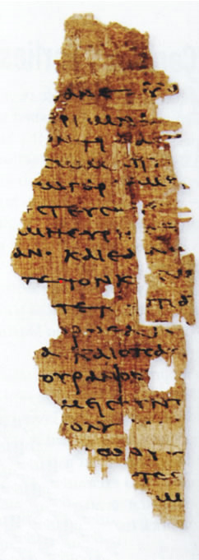
Sayings of Jesus text
Among the half million or so texts in the Oxyrhynchus Papyri, a fragment of a “sayings of Jesus” text was recently discovered. Based on paleography, scholars have assigned it to the early 2nd century. It has some parallels to Luke 12:13-21. Theoretically, it could belong to the collections Luke mentions at the beginning of his gospel (Lk. 1:1-2).

Slide 82
ON WRITING HISTORY
Several important features are apparent in Luke’s work as a historian:
  He provides an historical framework for his account, linking the story of Jesus with known world figures like Herod the Great (Lk. 1:5), Augustus Caesar (Lk. 2:1), Quirinius (Lk. 2:2), Tiberias Caesar, Pontius Pilate, Herod Antipas, Herod Philip and Lysanias (Lk. 3:1-2).
  He also provides a Jewish context during the high priesthoods of Annas and Caiaphas (Lk. 3:2).
  His concern for accurate historicity shows a remarkable knowledge of Roman culture, practices and legal procedures.

Slide 83
LINGUISTIC PRECISION
Luke begins his gospel by stating that he was concerned to write an orderly account (Lk. 1:3).
In Acts, his precision in accurately describing various government structures and provincial titles for officials follows in kind. He accurately describes:
  Sergius Paulus as a Proconsul (ανθυπατος, 13:7)
  Philippi as a Roman colony (κολωνια) governed by civil magistrates (στρατηγοις, 16:12, 20)
  Politarchs (πολιταρχας) as the city leaders in Thessalonica (17:6, 8)
  Asiarchs (ασιαρχων) in Ephesus (19:31)
  The ruler of Malta as the “First Citizen” (πρωτω, 28:7)
He could have used more general titles, but he uses those titles that are precisely specific in the Roman world.

Slide 84
AN APOLOGIA
A number of scholars have observed an apologetic motif in both his gospel and Acts, an attempt to depict Christianity as harmless to the Roman Empire.
  Caesar Nero blamed the great fire in Rome in AD 64 on Christians, and after the destruction of Jerusalem in AD 70, Christianity became an illegal religion.
  Luke’s dedication of his two works to his patron Theophilus (1:3) tends in this direction as does his repeated emphasis that Jesus was pronounced innocent by the Romans (Lk. 23:4, 13-16, 22, 47), while Paul was deemed by Roman officials to be innocent, even though he was under arrest (Ac. 26:32).

Slide 85
MURATORIAN FRAGMENT
The earliest extant listing of books in the New Testament (ca. AD 170)
“…at these, however, he was present and so he set them down. The third book of the gospel: according to Luke…”
The opening of this document has suffered mutilation; hence, the existing first line probably refers to Mark. Matthew, presumably, is the first book in the list, since Luke is referred to as the “third book”.

Slide 86
DATING
The dates of Luke and Acts can only be approximated.
  Luke must be earlier than Acts (cf. 1:1).
  Since Acts does not describe the fall of Jerusalem, some put both works as early as the mid-60s.
  The more conventional dating, however, is related to the fact that Luke is believed to have drawn on Mark’s Gospel, which likely dates to about AD 64 or 65. Hence, suggested dates in the 70s or 80s is not uncommon.
  Whenever it is dated, Luke clearly claims to have composed it within the living memory of those who knew Jesus personally (1:2), people who then served as guarantors for the accuracy of his record.

Slide 87
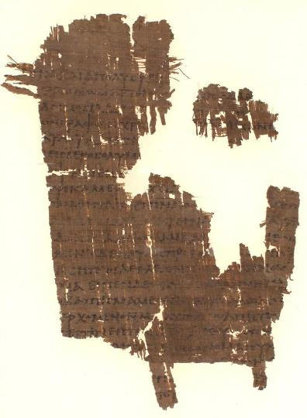
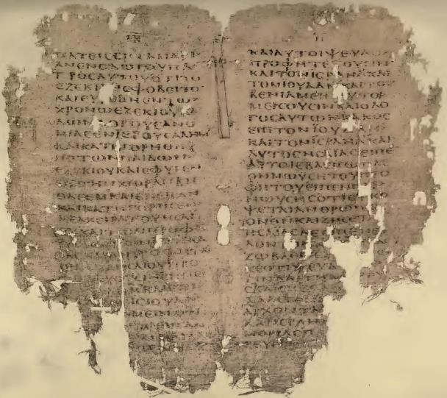
TEXT
Two early manuscripts from Acts
Hatcher Library, University of Michigan
Pierpont Morgan Library, New York, New York
p38 (left)
Acts 18:27—19:6, 12-16
ca. AD 300
076 (right)
Acts 2:11-22
5th/6th century AD

Slide 88
John

Slide 89
It is a peculiarity of the Fourth Gospel that while it describes its author as “the beloved disciple,” at no time does it give this disciple’s name.
As an unnamed companion of Andrew, he was initially a follower of John the Baptist (1:35-40).
His appearances in the gospel narratives are almost all in the vicinity of Jerusalem:
  At the last supper (13:23-26)
  At the trial of Jesus (18:15-16)
  At the cross (19:25-27, 35)
  At the empty tomb (20:2-9)
The only exception is his presence at the post-resurrection appearance of Jesus in Galilee, where he is one of the two unnamed disciples (21:2, 7, 20-24).

Slide 90
Only a few clues can be drawn from his brief appearances in the gospel:
He was not Andrew (13:23-26), Simon Peter (13:23-26; 18:15) or Judas Iscariot (13:23-26).
He was personally acquainted with the high priest and some of his staff (18:15-16).
He owned a home, possibly in Jerusalem (19:26-27).
  If so, he may not have traveled with Jesus during the Galilean campaign.
  This would account for the fact that his appearances in the Fourth Gospel are generally in the vicinity of Jerusalem.
  It also accounts for the homeowner in whose home the last supper was held and the fact that it was customary for the homeowner to sit beside any honored guest (Mk. 14:14-15).
He is unlikely to have been Thomas, Nathanael, James or John bar Zebedee (21:2-3).
  This unlikelihood is based on the fact that the circumlocution “the disciple Jesus loved” is used throughout the closing pericope (2:7, 20-24).
  The reader would naturally suppose that “the beloved disciple” is one of the two unnamed disciples mentioned in 21:2.

Slide 91
The testimony of Papias as he reflected on an earlier period of his life (ca. AD 80) cites several disciples he interviewed:
“…I inquired about the words of the elders – what Andrew or Peter said, or Philip, or Thomas, or James, or John, or Matthew, or any other of the Lord’s disciples, and whatever Aristeon and the elder John, the Lord’s disciples, were saying…”
Eusebius, Ecclesiastical History, 3.39.3-4
These disciples are cited in the order in which they appear in the Fourth Gospel (1:40, 41, 43; 11:16; 21:2), and Matthew is added.
Two disciples are mentioned that do not appear by name in the gospel narratives, Aristeon and John the Elder.

Slide 92
Hence, there seem to be two “Johns” among the disciples of Jesus, John bar Zebedee and John the Elder.
The two NT letters 2 John and 3 John are directly cited as being from “the elder”.
The author of 1 John does not use either a name or a title, but he considered himself to be one of the eyewitnesses (1 Jn. 1:1-3).
The reference to the Fourth Gospel in the earliest list of New Testament books, the Muratorian Canon (ca. AD 170), names the author simply as “John.”
  It may be significant that the Muratorian Canon lists “John” as a “disciple” but Andrew as an “apostle.”
  This might suggest that the author of the Fourth Gospel was not one of the “Twelve,” even though he was an eyewitness and disciple of Jesus.
Irenaeus (AD 180) speaks of “John, the disciple of the Lord” as the author of the Fourth Gospel (Against Heresies, 3.1.1; cf. 2.22.5; 3.3.4).
  While he mentions “John” at various times in his writings, Irenaeus never calls him “bar Zebedee”—only “John, the disciple of the Lord.”
  He does, however, imply that the author of the Fourth Gospel was an apostle (Against Heresies, 3.21.3; 3.11.9), though for Irenaeus, the title “apostle” was not limited to the Twelve (Against Heresies, 3.14.12; 2:21.1)

Slide 93
Polycrates (AD 190-195) also speaks of “John, who leaned back on the Lord’s breast, who was a priest, wearing the priestly frontlet, both witness and teacher” (Eusebius, Ecclesiastical History, 5.24.3).
  If the author of the Fourth Gospel was indeed a priest, this explains how he was acquainted with the high priest and was able to admit Peter to the high priest’s courtyard (Jn. 18:15-16).
  It is not impossible that he was the same “John” who, along with Alexander, was part of the priestly company described in Acts 4:6.
  If so, then this “John” certainly was not John bar Zebedee.
Later church fathers more directly identified the author of the Fourth Gospel with John bar Zebedee (Tertullian, Clement of Alexandria, Origen, etc.).
Modern theories for the identity of the author are more tenuous:
  Lazarus (based on the statement that Jesus “loved” him, cf. Jn. 11:3, 5)
  Matthias (based on Ac. 1:23-26)
  John Mark (based on the name “John” and that he may be the unnamed disciple who owned a home in Jerusalem)
  Thomas (based on Jesus’ invitation to Thomas to touch his side and the fact that the Beloved Disciple saw Jesus pierced, Jn. 20:25; cf. 19:34-35).
  Mary Magdalene (based on Gnostic texts)
  The community of the Beloved Disciple (disciples of the Beloved Disciple)

Slide 94
About the Author
The Fourth Gospel and the Johannine Letters form a distinct group.
The theology, vocabulary and style are strikingly similar.
The second and third letters specify the sender as “the Elder” (ο πρεσβυτερος), and the united testimony of the early church is that this elder was “John”, either “John the Elder” named by Papias (early 2nd century) or “John the Disciple” named by Irenaeus (mid-2nd century).
Later church fathers assumed that this John was John bar-Zebedee, though scholars still debate his identity, since he is unnamed in either the Fourth Gospel or the letters.

Slide 95
An Eyewitness
The Fourth Gospel directly claims to have been composed by an eyewitness called “the beloved disciple” (1:14; 20:30-31; 21:24-25; cf. 19:35):
  This eyewitness appears as an anonymous figure in the Gospel’s narrative, usually described as “the disciple Jesus loved” (13:23; 19:26; 20:2; 21:7, 20).
  The range of nuance for the verb γραφειν (= to write) may include dictation to a scribe (cf. 19:19).
The author claims eyewitness status: “we have seen,” “we have looked upon,” “we have handled,” and “we have heard” (1 Jn. 1:1-3; cf. 4:14). This language is:
…the “we” of authoritative testimony (i.e., the “we” stands for “I”)

Slide 96
The appearances of the Beloved Disciple in the Fourth Gospel
1:35-40 As an unnamed companion of Andrew (as a witness “from the baptism of John”, cf. Ac. 1:21-22)*
13:23-26 At the last supper, seated immediately next to Jesus
18:15-16 At the trial of Jesus
19:25-27, 35 At the cross, the only male disciple present
20:2-9 At the empty tomb, where he was the first to come to faith in the risen Lord
21:2, 7, 20-24 At the post-resurrection appearance of Jesus in Galilee
* Ancient historians typically referred to themselves in the third person within their narratives (e.g., Thucydides, Xenophon, Polybius, Julius Caesar, Josephus)

Slide 97
Paul

Slide 98
St. Paul
Saul of Tarsus, Cilicia, was a young rabbi who participated in the martyrdom of Stephen and headed the severe persecution of the Jerusalem church.
A Diaspora Jew (Ac. 21:39), he had relatives in Jerusalem (Ac. 23:16) and had moved there at an early age to study under Rabbi Gamaliel (Ac. 22:3; cf. Ga. 1:14).
As the arch inquisitor for the Sanhedrin, he extradited Christians from far-flung synagogues, bringing them to heresy trials (22:4-5; 26:9-11).

Slide 99
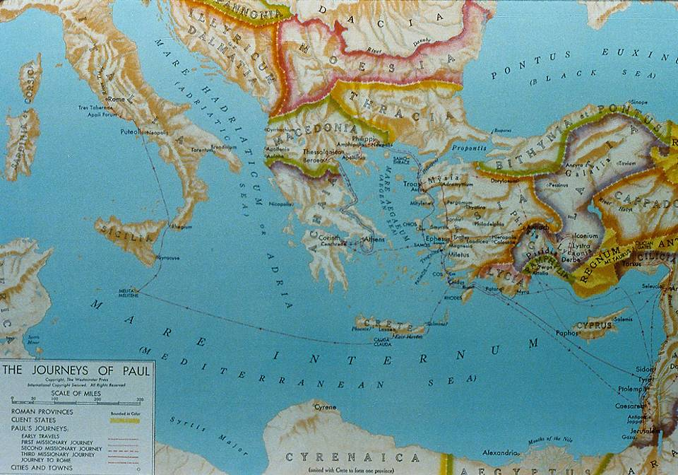
The Roman World

Slide 100
Paul, the man
Saoul
Jewish name
Paullus
Roman name (cognomen)
Roman Citizen from Tarsus
Acts 16:37; 21:39; 22:26-28
Hebraistic Jew
Acts 22:2; Phil. 3:6 (Hebrew speaking)
Tribe of Benjamin
Rom. 11:1; Phil. 3:5
Pharisee
Acts 23:6; 26:5
Disciple of Rabbi Gamaliel
Acts 22:3
Tentmaker Trade
Acts 18:3
Unmarried
1 Cor. 7:7a; 9:5

Slide 101
Saul is Baptized a Christian
He could not have been more shocked than when the answer to his question, “Who are you, Lord,” was a heavenly voice saying, “I am Jesus!” (Ac. 9, 22)
Later, Saul would recount that he had been chosen as a witness of Jesus to the Gentiles so they might be forgiven and included in God’s holy people (cf. Ac. 26:15-18).
Led into Damascus blind, he was eventually healed and baptized by a reluctant Ananias.
To Ananias, God revealed that Saul would be an instrument of profound suffering as well as outreach to the Gentiles.

Slide 102
The Inquisitor Turned Evangelist
The newly converted Saul visited the synagogues in Damascus, not to serve extradition papers on Christians, but to preach Jesus as the Christ.
Ripples of shock, surprise and suspicion filtered through the whole Jewish community.
Eventually, some of the Jews decided he must be silenced by death, but the Christians secretly slipped Paul over the city wall in a basket, an event Paul would later refer to as a irony to the Roman accolade for soldiers who first made it over the wall.

Slide 103
Saul in Arabia and Jerusalem
In his Galatian letter, Saul (Paul) adds details that Luke omits.
After his conversion, he immediately went into Arabia, the Nabataen kingdom ruled by Aretas IV (9 BC – AD 40). Presumably this interlude took about three years (Ga. 1:18a).
The trip to Jerusalem that Luke describes in Acts 9:26 would have been after the time in Arabia. In Jerusalem, Barnabas introduced him to Peter and James (Ga. 1:18b-19).
In Jerusalem, he saw none of the other apostles (Ga. 1:19). The other Christians were reluctant to accept him.
During this stay, Saul debated with Hellenistic Jews who now were so angered they attempted to kill him, but again the Christians secreted him out of the city and sent him home to Tarsus.

Slide 104
Barnabas Brings Saul to Antioch
Barnabas, knowing of Paul’s skill in debating Hellenistic Jews, considered him to be a prime candidate for reaching out to Greeks.
Traveling to Tarsus, Cilicia, he found Paul and brought him to Antioch, Syria.
Here, the believers were first dubbed with the Latin coinage “Christians,” though earlier they were simply known as “followers of the Way” (Ac. 9:2; cf. 19:9, 23; 22:4; 24:14, 22).

Slide 105
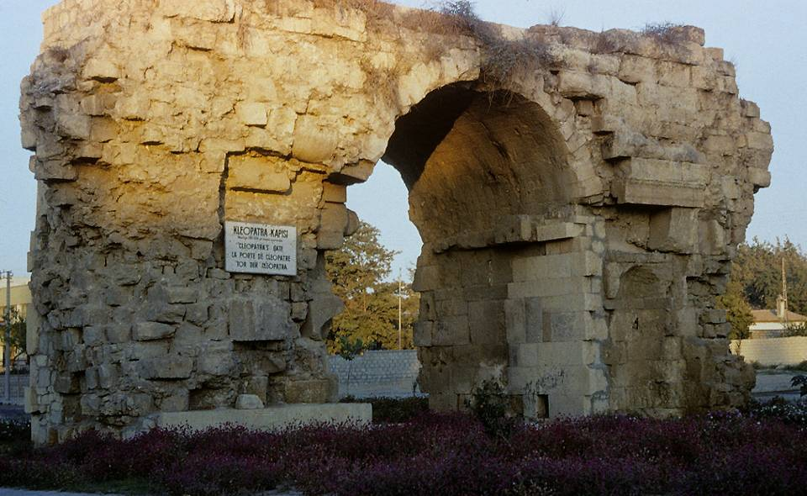
Cleopatra’s gate in Tarsus is the only one of three Roman gates that have survived the centuries in Saul’s home city.

Slide 106
Only Physical Description from Antiquity
“And he (Onesiphorus) saw Paul coming, a man small in size, bald-headed, bandy-legged, well-built [i.e., healthy], with eyebrows meeting, rather long-nosed, full of grace. For sometimes he seemed like a man, and sometimes he had the countenance of an angel.”
Acts of Paul and Thecla (c. AD 160-180)

Slide 107
Chronology of Paul’s Christian Life
Events Roman History
Conversion 33? 14-37 Caesar Tiberius
Relief mission to
Jerusalem 35?
In Cilicia & Syria 35-46 37-41 Caesar Caligula
2nd Jerusalem visit 46 41-54 Caesar Claudius
1st Mission Tour 47-48
Galatian Letter 48?
Jerusalem Council 49 49 Jews expelled from Rome
2nd Mission Tour 49-52
1&2 Thessalonians 50
In Corinth 50-52 51-52 Gallio, Achaia Proconsul
3rd Jerusalem visit 52 52-59 Felix, Judaea Proconsul
3rd Mission Tour 52-57
Events Roman History
In Ephesus 52-55 54-68 Caesar Nero
In Macedonia & Achaia 55-57
1&2 Corinthians 55-56
Roman Letter 57
4th Jerusalem visit 57
Caesarea
Imprisonment 57-59 59-62 Festus, Judaea Procurator
Voyage to Rome 59-60
House Arrest, Rome 60-62
Ephesians, Philippians,
Colossians, Philemon 60-62?
Trip to Spain? 62-64 64 Great Fire in Rome
Titus, 1&2 Timothy ?
Paul’s Execution 65?

Slide 108
1st Century Travel by Land and by Sea
The Route of Paul’s 2nd Missions Tour (2 Co. 11:23-27)
Jerusalem to Antioch (Ac. 15:30) = 375 miles By land
Antioch to Cilicia (Ac. 15:41) = 140 miles By land
Cilicia to Phrygia & Galatia (Ac. 16:6) = 495 miles By land
Phrygia & Galatia to Troas (Ac. 16:8) = 500 miles By land
Troas to Neapolis (Ac. 16:11) = 140 miles By sea
Neapolis to Philippi (Ac. 16:12) = 15 miles By land
Philippi to Thessalonica (Ac. 17:1) = 85 miles By land
Thessalonica to Berea (Ac. 17:10) = 45 miles By land
Berea to Athens (Ac. 17:15) = 310 miles By sea
Athens to Corinth (Ac. 18:1) = 50 miles By land
Corinth to Ephesus (Ac. 18:18-19) = 250 miles By sea
Ephesus to Caesarea and Antioch (Ac. 18:22) = 620 miles By sea and land

Slide 109
PAUL’S THIRTEEN LETTERS
While Luke does not describe the writing of Paul’s letters, a reasonable chronology can be ascertained from internal references in the letters themselves.
2ND TOUR LETTERS
Galatians (date is debated between 2nd and 3rd tour)
1 Thessalonians
2 Thessalonians
3RD TOUR LETTERS
1 Corinthians
2 Corinthians
Romans
PRISON LETTERS
Colossians
Philemon
Ephesians
Philippians
PASTORAL LETTERS
1 Timothy
2 Timothy
Titus

Slide 110
Paul’s Letters
Paul clearly considered his letters to be authoritative in the churches.
He instructed churches not only to read them but to share them with other congregations (Col. 4:16).
They were a way of extending his presence when he could not be there personally (1 Cor. 5:3-4; 2 Cor. 10:10-11).
His personal signature at the end authenticated the contents of the letters (1 Cor. 16:21; Gal. 6:11; Col. 4:18; 2 Thess. 3:17).

Slide 111
Peter

Slide 112
THE FOUR NAMES
The NT uses four names for Peter:
Symeon (Simeon): his Hebrew name (Ac. 15:14; 2 Pe. 1:1)
Simon: Greek form of his Hebrew name
Kephas: Aramaic nickname meaning “rock” (Jn. 1:42)
Peter: Greek form for Kephas
His father’s name was John, hence the Aramaic extension Simon bar-John (Mt. 16:17).
Inasmuch as Galilee was a bilingual setting, it would not be unusual for him (and his brother, Andrew) to have Grecianized names.

Slide 113
PETER’S EARLY LIFE
His original home was in Bethsaida, Galilee, a village on the north shore of the lake (Jn. 1:44):
At some point, he moved his family to Capernaum (Mk. 1:21, 29).
He was married (Mk. 1:30; cf. 1 Co. 9:5).
He and his brother Andrew operated a fishing concern along with James and John (Mk. 1:16, 29).
While there is no physical description of him, he may have been exceptionally strong (Jn. 21:6-11).

Slide 114
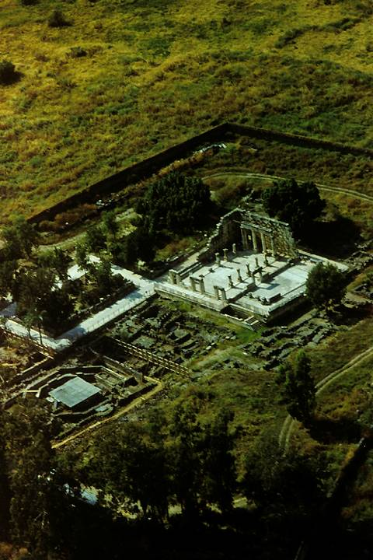
Excavations at Capernaum include a partially-restored synagogue, probably built over the more ancient synagogue which was there in the time of Jesus.
Directly in front of the synagogue and beneath the ancient remains of a church, archaeologists have discovered a domestic structure from the 1st century, and many believe this to have been the home of Simon Peter, where one room was incorporated into a house church.
Graffiti on the carefully plastered walls (more than 100 in Greek, Latin, Aramaic, Syriac and Hebrew) inscribe sayings such as, “Lord Jesus Christ help your servant…” and “Lord have mercy”.

Slide 115
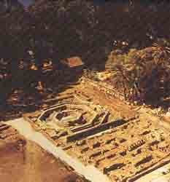
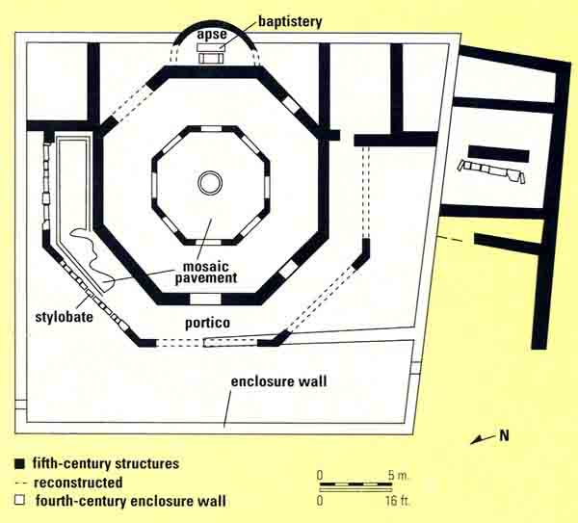
Floor plan of the 5th century octagonal church
Before Constantine’s Edict of Toleration, Christians necessarily had to meet in secret, usually in house churches. However, after Christianity became legal, they began to build churches like this one, often over the ruins of the original church.

Slide 116
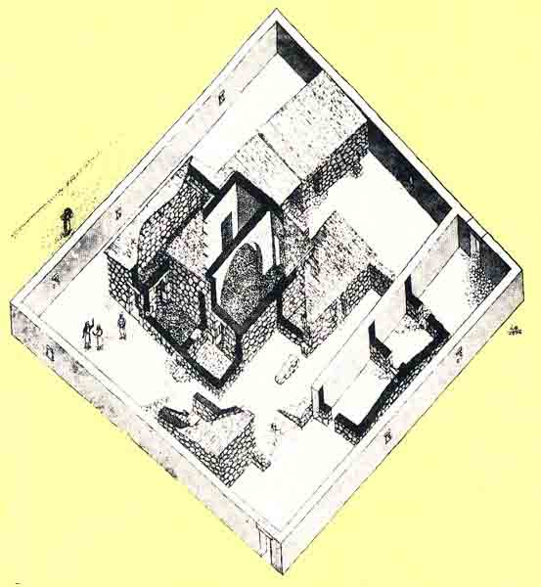
According to the excavators, this house church is from the 4th century, the ruins of which lay beneath the octagonal church. This structure, in turn, was a renovation of a 1st century house. Entrances were added and an arch constructed over the center of the room supporting a two-story high masonry roof.

Slide 117
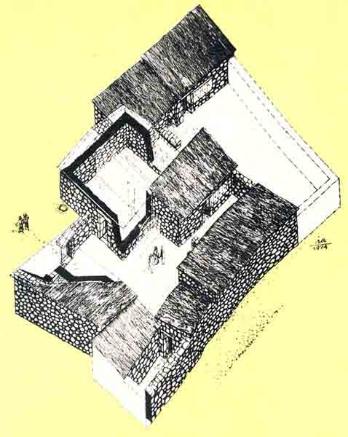
This is an artist’s depiction of the original 1st century house beneath the 4th century church. Here early pilgrims gathered and left Christian graffiti on the plastered walls. The center court served as the “kitchen”, and the largest room was used as a central hall and meetingplace.
Various graffiti mark this as Christian, such as, “Christ” and “Lord”

Slide 118
DISCIPLE OF JOHN; DISCIPLE OF JESUS
Peter was initially a follower of John the Baptist (Jn. 1:40-42).
Jesus gave Peter his nickname Kephas.
In Galilee, Jesus called Peter to be his disciple, and from that time on, he followed Jesus (Mk. 10:38).
He is always named first among the Twelve Apostles.

Slide 119
PETER’S INITIATIVE AND COURAGE
At critical moments, Peter demonstrated his brash courage and deep loyalty to Jesus:
He volunteered to walk on water to Jesus (Mt. 14:28).
He made the great confession that Jesus was the Messiah, to which Jesus responded that Peter was a rock.
When other disciples were deserting Jesus, Peter stood his ground (Jn 6:66-69).

Slide 120
HIS CAPACITY FOR MISUNDERSTANDING AND BLUNDER
Despite his courage, Peter often spoke out of turn (Mk. 9:5-6):
Jesus severely rebuked him when he objected to the prediction of the cross (Mk. 8:31-33).
He attempted to defend Jesus with violence (Jn. 18:10-11).
On the night of Jesus’ arrest, he denied his Lord, a narrative that appears in all four gospels.

Slide 121
HIS LEADERSHIP ROLE
Peter’s leadership among the apostles is evident in several ways:
Jesus singled him out to be told of the resurrection (Mk. 16:7).
Jesus made a special appearance to Peter on Easter morning (1 Co. 15:5).
Peter served as spokesman for the body of the apostles at Pentecost and afterwards (Ac. 2:14; 3:12).
He was the instrument by which God opened the opportunity for Gentiles to belong to God’s people (Ac. 10).

Slide 122
PETER’S LATER MINISTRY
Before his ascension, Jesus indicated that Peter would die as a martyr (Jn. 21:15-22).
After the council in Jerusalem regarding circumcision (Ac. 15), the later ministry of Peter is not well-attested.
That he went “to another place” (Ac. 12:17) indicates that he left Jerusalem:
  He went to Antioch Syria (Ga. 2:11).
  He traveled throughout the early Christian churches with his wife (1 Co. 9:5).
  Ancient Christian tradition says he was martyred in Rome by crucifixion, probably in AD 64 under Caesar Nero.

Slide 123
James

Slide 124
Jesus’ Family
Joseph and Mary
Joseph disappeared from the biblical record after the birth and infancy narratives in Matthew and Luke (presumably deceased)
Mary appeared occasionally during Jesus’ public ministry, watched him die, and gathered with the others at Pentecost; she was likely a source for Luke’s Gospel.
Half-Brothers and Sisters
James, Joses, Judas and Simon (Mk. 6:3). They attended the wedding in Cana (Jn. 2:12).
Nothing is known of his sisters.
Jesus made a post-resurrection appearance to James, who later became the leader of the Jerusalem church (1 Co. 15:7; Ac. 12:17; 15:13ff.; 21:18; Ga. 1:19; 2:9, 12).
The brothers were present at Pentecost (Ac. 1:14).
They were married (1 Co. 9:5).
Judas’ grandchildren appeared before Emperor Domitian and continued as church leaders until the time of Emperor Trajan (Eusebius, Ecclesiastical History 3.19-20).

Slide 125
Three Theories About Jesus’ “Brothers”
Helvidius
Jesus’ “brothers” were children of Mary and Joseph after the birth of Jesus, hence younger.
Epiphanius
Jesus’ “brothers” were children of Joseph by a previous marriage, hence older.
Jerome
Jesus’ “brothers” were cousins, children of Mary’s sister and Clopas, ages unknown.
PROTESTANT
ORTHODOX
CATHOLIC

Slide 126
Assessing the Theories
Evangelicals generally agree that the Epiphanian and Hieronymian theories are largely driven by the attempt to protect the doctrine of Mary’s perpetual virginity.
The most natural way of reading the biblical evidence is that the brothers of Jesus were half-brothers born to Mary and Joseph.
If the James ossuary is authentic, it strongly supports this understanding.
Here, we shall assume that this approach is correct.

Slide 127
James, the Brother of Jesus
What we know from the Bible…
At first he was not a believer (Jn. 7:5).
After his resurrection, Christ appeared to him personally (1 Co. 15:7).
He emerged as the leader of the Jerusalem church (Ac. 12:17; 15:13ff.; Ga. 1:19, 2:9, 12; 21:18).
What we know from other sources…
Eusebius confirms that James was a Nazirite who frequented the temple.
His intercession for his own people was so regular that “his knees became hard like those of a camel.”
The scribes and Pharisees threw him from the temple mount after which he was clubbed & stoned to death.
While dying, he prayed for his enemies’ forgiveness.

Slide 128
The James Ossuary contains the striking Aramaic inscription: “James, son of Joseph, brother of Jesus”
Discovered in a private collection in 2002, the ossuary was judged to be authentic by Andre Lemaire (internationally recognized epigrapher from the Sorbonne, Paris).
It was publicly exhibited at the Royal Ontario Museum in Toronto, Canada as authentic.
In 2003 it was charged to be a forgery by experts from the Israel Antiquities Authority and subsequently seized.
Experts are still debating this artifact, and the owner is currently involved in a forgery trial in the Israeli courts; however, the tide is turning yet again, since the presiding judge has suggested that charges be dropped for lack of evidence (Jan. 2009).

Slide 129
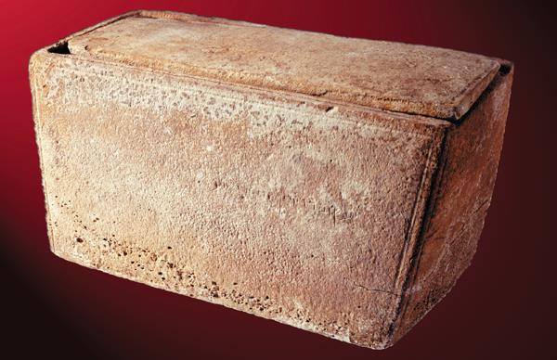
The “James Ossuary”

Slide 130
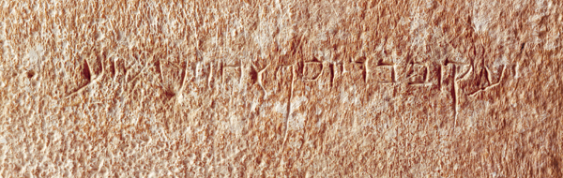
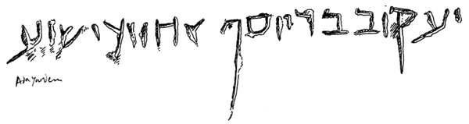
The Inscription
James, son of Joseph, brother of Jesus = ישוע אחווצ יוסף יעקוב בר

Slide 131
If the James ossuary is authentic…
…it strengthens the view that James was the younger half-brother of Jesus, the son of Joseph and Mary.
…it still could permit the theory that the “brothers” of Jesus were children of Joseph by an earlier marriage.
…it makes the “cousin” theory nearly impossible.

Slide 132
Was this “James” the author of the Letter of James?
Whoever wrote James, he was well enough known to simply describe himself as “James,” which in turn suggests James, the brother of Jesus, as the most likely candidate. He had sufficient authority, recognition and longevity.
As a leader in the Jewish church, it makes sense that he still calls the church a “synagogue” (2:2).
There are various Hebraisms in the letter that suggest it was written by a Jew, not a Greek.
The language in the Letter of James has striking vocabulary affinities with James’ speeches in Acts.
Many of the sayings in James parallel sayings of Jesus in Matthew’s gospel, though they seem to be from the oral tradition of the church.
While certainty is not possible, James the brother of the Lord seems the best candidate.

Slide 133
Date
If James the brother of the Lord is accepted as the author, then the letter must date before James’ martyrdom in AD 62.
If so, it is one of the earlier documents in the New Testament, perhaps even the earliest.
However, there is no clear historical evidence, either internal or external, to fix any firm date.

Slide 134
Literary Genres

Slide 135
Gospel Narrative

Slide 136
The Literary Genre of Gospel
So far as we know, the kind of literature we call “gospel” did not exist prior to the composition of Mark.
So long as the stories of Jesus circulated in the early Christian communities as oral traditions, presumably they did so as individual units.
A gospel, however, presupposes a narrative structure, linking the stories of Jesus into a larger composition.
The writer had to determine how he would organize the material, whether geographically, chronologically or thematically, as well as determine what stories to tell.

Slide 137
Gospels are not Biographies
The focus of the four gospels is upon the public ministry and passion of Jesus, not his entire life.
They offer only very brief accounts of Jesus’ birth and growing up years (and Mark offers nothing at all along these lines).
However, all four gospels have “bookends,” beginning with the ministry of John the Baptist and climaxing with the death of Jesus (cf. Ac. 1:21-22).

Slide 138
The Gospels as “Testimony”
The first and most important feature of this testimony is that the gospels all were composed within the living memory of the events they recount (i.e., 30-60 years).
  Eyewitness participants in the events of the gospel narratives moved among the Palestinian Christian communities and beyond for several decades, and their memories were at the disposal of those who sought information.
  These living witnesses, the most important being the apostles themselves, served as guarantors for the accuracy of the traditions about Jesus, both before and after their codification in the four gospels.

Slide 139
Four Gospels, One Story
While the four gospels are not identical, they tell a single, unified story—the story of Jesus’ ministry and passion.
The four gospels are not diaries, however, but selective accounts.
Not all the gospels tell the same stories, nor do they tell all the stories that could have been told (Jn. 21:25).
Hence, each of the four gospels, to greater or lesser degrees, must be read as a portrait of Jesus, and like any portrait, there will be differences of emphasis.

Slide 140
Mark’s Narrative Structure
Mark, as the earliest gospel, combines geography, chronology and themes in setting forth the narratives about Jesus.
Geographically, the direction moves from Galilee toward Jerusalem.
Chronologically, Mark begins with the ministry of John, progresses through the public ministry of Jesus, and climaxes with Jesus’ crucifixion.
Thematically, he emphasizes the public preaching of Jesus, his private explanations to the disciples, and those stories that address the all-important question, “Who is Jesus?”

Slide 141
Mark’s Dramatic Structure
Mark presents the story of Jesus in four acts as though in a large drama.
PRELUDE (1)
The ministry
of John the
Baptist
Jesus’
baptism and
temptation
GREAT GALILEAN MINISTRY (2-8)
Healing and
teaching in the
north.
Miracles and
parables
GOING TOWARD JERUSALEM (9-10)
Transfiguration
Jesus predicts his
coming death
THE PASSION (11-16)
Triumphant
entry
Trial and
crucifixion

Slide 142
Distinctive Literary Features
Several distinctive literary features are evident in the way Mark handles the stories about Jesus. These include:
Bracketing
Public/private distinctions
Midpoint

Slide 143
Bracketing
On a number of occasions, Mark inserts a story within another story, linking the two thematically and following the pattern of chiasm.
The accusation about Beelzebub is inserted into the larger narrative of Jesus’ family seeking to restrain him (3:20-21; 3:22-30; 3:31-35).
The healing of the woman with the hemorrhage is inserted into the larger narrative of the healing of Jairus’ daughter (5:21-24; 5:25-34; 5:35-43).
The cursing of the fig tree is inserted into the larger narrative of the cleansing of the temple (11:11; 11:12-14; 11:15-19).

Slide 144
Narrative Midpoint
Mark also has a narrative midpoint, Peter’s confession that Jesus is the Christ (again, following the pattern of chiasm).
Chiasm is the widely used Hebrew literary technique in which the center point receives emphasis.
To Jesus’ question, “Who do people say I am?” Peter responded with the acclamation, “You are the Messiah/Christ” (8:27-30).
Occurring as it does at the midpoint, this confession divides the gospel into two halves:
  1:1—8:26 emphasizing public teaching and miracles
  8:31—16:8 emphasizing private teaching and the coming passion

Slide 145
Several models for Matthew’s underlying structure have been proposed.
Geographical/biographical Structure
Birth narratives (1-2)
Preparation for ministry (3:1—4:11)
Public ministry in Galilee (4:12—15:20)
Ministry in the environs of Galilee (15:21—18:35)
Journey to Jerusalem (19:1—20:34)
Last days of Jesus (21-28)
Internal Literary Markers
(based on the repeating phrase “from that time on Jesus began to…” (4:17; 16:21)
The person of Jesus the Christ (1:1—4:16)
The proclamation of Jesus the Christ (4:17—16:20)
The suffering, death and resurrection of Jesus the Christ (16:21—28:20)

Slide 146
Chiastic Structure (based on Hebrew poetic form with alternating narratives and discourses)
A Narrative: birth and preparation (1:1—4:17)
B Discourse: Jesus teaches with authority (4:18—7:29)
C Narrative: Jesus acts with authority—ten miracles (8:1—9:35)
D Discourse: The Twelve are commissioned with authority (9:36—11:1)
E Narrative: Jesus’ invitation is rejected (11:2—12:50)
F Discourse: Parables of the kingdom (13:1-53)
E’ Narrative: Jesus opposed and confessed (13:54—16:20)
D’ Discourse: The disciples misunderstand the passion (16:21—20:34)
C’ Narrative: Jesus’ authority questioned in Jerusalem (21:1-22:46)
B’ Discourse: Judgment on Israel and false prophets (23:1—25:46)
A’ Narrative: Passion, death and resurrection (26:1-28:20)

Slide 147
Some scholars point to internal literary divisions based on the repeating phrase “when Jesus had finished saying these things” (7:28; 11:1; 13:53; 19:1; 26:1)
Fivefold division possibly replicating the fivefold division of the Torah
Prologue: birth narratives (1-2)
Book 1: Concerning discipleship (3:1—7:29)
Book 2: Concerning apostleship (8:1—11:1)
Book 3: Concerning hiding revelation (11:2—13:53)
Book 4: Concerning church administration (13:54—19:1a)
Book 5: Concerning the judgment (19:1b—26:2)
Epilogue: passion (16:3-28:20)
Here, the emphasis tends to be more on Jesus’ life than his death.

Slide 148
Perhaps the best approach is a combination of the alternating narrative/discourse pattern plus the internal literary markers “when Jesus had finished these sayings” (7:28; 11:1; 13:53; 19:1; 26:1).
Birth narratives (1-2)
John the Baptist narratives (3)
Temptation narratives (4)
Sermon on the Mount (5-7)
Galilean Ministry (8-9)
Mission of the Twelve (10)
Conflict narratives (11-12)
Parables of the Kingdom (13)
More ministry in Galilee (14-15)
The turning point (16-17)
Sermon on offense, discipleship & forgiveness (18)
Ministry in Judea and Perea (19-22)
Sermon on the Fall of the Temple (23-25)
Passion narratives (26-27)
Resurrection narratives (28)

Slide 149
Structure
The Third Gospel easily divides into four major blocks of material:
  The birth and infancy narratives (1-2)
  The Galilean ministry (3:1—9:50)
  The travel narratives (9:51—19:44)
  The passion narratives (19:45—24:53)

Slide 150
GEOGRAPHICAL CHIASMUS
LUKE
ACTS
GALILEE A
SAMARIA/JUDEA B
JERUSALEM C
A’ NATIONS
B’ JUDEA/SAMARIA
C’ JERUSALEM
D
ASCENSION

Slide 151
THREE EPOCHS
In addition to the geographical motif, Luke-Acts has three distinguishable time periods, each with theological significance.
PERIOD OF ISRAEL
Luke demarcates between the Period of Israel and the coming of Jesus (16:16).
PERIOD OF JESUS
The larger portion of the Third Gospel is given to the ministry of Jesus, the Savior and Messiah.
PERIOD OF THE CHURCH
He also demarcates between the Period of Jesus and the Period of the church (Ac. 1:1-2, 8).
The law and the prophets were proclaimed until John. Since that time, the good news of the kingdom of God is being preached… (Lk 16:16)

Slide 152
The Fourth Gospel naturally divides into four major sections
PROLOGUE (1:1-18)
The opening of the book is a hymn of incarnation.
Unlike Matthew and Luke, who offer the genealogical pedigree of Jesus, the Fourth Gospel concentrates on Jesus’ origins from all eternity in the very bosom of the Father.
The prologue describes a cyclical pattern of the Word, who comes from God, dwells incarnate as a human and returns to God.
The prologue anticipates many of the major themes of the book: the Word, light, darkness, life, grace, truth, testimony, the law, and belief.

Slide 153
BOOK OF SIGNS (1:19—12:50)
John structures the narratives about Jesus around alternating signs and discourses. The signs are simultaneous incidents that become paths of revelation to some (2:11; 3:2; 20:30-31) and spiritual blindness to others (2:18; 6:26-27, 30; 9:30-34; 10:25-38; 11:47-50).
While in the Synoptics Jesus performed many miracles, the Fourth Gospel confines itself to seven (cf. 20:30; 21:25).
The first two signs are numbered, suggesting that the reader should continue the numerical progression (2:11; 4:54; cf. 6:14).
Jesus’ miracles regularly are described as “signs” (σημειον) in the Fourth Gospel, and the nature of a sign is to point beyond itself.
The lengthy discourses frequently reflect upon the meaning of the signs: water/living water; loaves/bread of life; blindness/light of the world; resurrection/eternal life.

Slide 154
The Seven Signs
1 Water turned to wine (2:11)
Reflected on in Jesus’ conversations with Nicodemas and the Samaritan woman
2 Healing the official’s son (4:54)
3 Healing the invalid at Bethesda (5:8-9)
Reflected on in Jesus’ discourse about life in the Son
4 Feeding the five thousand (6:16-20)
Reflected on in Jesus’ discourse about the bread from heaven
5 Walking on the Sea of Galilee (6:14)
6 Healing the man born blind (9:13-16)
Reflected on in Jesus’ discourse about light and the Good Shepherd
7 Raising Lazarus from the dead (11:43-44)
A prelude to the resurrection of Jesus

Slide 155
BOOK OF GLORY (13:1—20:31)
The latter half of the Fourth Gospel focuses upon Jesus’ passion and the surrounding events.
Consistently, Jesus spoke of his passion and death as his glorification (12:16, 23; 13:31; 17:1, 5, 24; cf. 21:19).
In the Book of Signs section, Jesus repeatedly spoke of his coming “hour” (ωρα), though he did not then reveal what it was (2:4; 7:30; 8:20; cf. 7:39; 12:16). In the Book of Glory, this “hour” is the hour of his glorification by being lifted up on the cross (12:23, 27; 13:1; 17:1; 19:27).
Jesus’ glory was first associated with the signs (1:14; 2:11; 11:4, 40; 12:41), but in his death, that glory is intensified by the greatest sign of all, his death and resurrection (12:28; 13:1; 17:1, 4).
In this section, Jesus teaches his disciples directly, preparing them for the future after he returned to the Father (13:1, 3, 33, 36; 14:2-3, 12, 19, 28; 16:5-7, 16, 28; 17:11, 13), whereas previously his discourses were directed largely to the crowds that followed him.

Slide 156
EPILOGUE (21:1-25)
The Fourth Gospel closes with Jesus’ post-resurrection appearance to seven disciples in Galilee.
One of the seven disciples was the author of the Fourth Gospel (21:7, 20, 24).
The gospel carefully prepares for the revelation of the Beloved Disciple as the author but carefully withholds his identity until the end.
  His appearance at the beginning is scarcely noticeable (1:35, 40).
  Yet, he was one of those who had been with Jesus “from the beginning” (15:27).
  He was present at the last supper, Jesus’ trial, the crucifixion, and the empty tomb (13:23-26; 18:15-16; 19:25-27, 35; 20:2-9).
  He was not unknown, else the rumor that he would not die (21:23) could not have arisen. Still, he was less well-known than many of the others (and if he was John the Elder, he does not appear by name in the Synoptics).
In the end, his testimony, alongside the other gospels, is indispensable (21:24-25).

Slide 157
Narrative History in Acts

Slide 158
LUKE’S PROGRAMMATIC PATTERN IN ACTS
At the beginning, Luke offers a pattern for how the message of Jesus would spill over beyond the Jewish circle.
“But you will receive power when the Holy Spirit comes on you; and you will be my witnesses in Jerusalem, and in all Judea and Samaria, and to the ends of the earth.” (1:8)
At the end, he shows how this goal was attained in the missionary work of Paul when he reached Rome.
“…God’s salvation has been sent to the Gentiles, and they will listen! …boldly and without hindrance, he preached the kingdom of God and taught about the Lord Jesus Christ.” (28:30-31)

Slide 159
EXPANDING THE BOUNDARIES
In time, the new Christian movement found itself to be international in scope, but this transition was not smooth but tension-filled.
The first hint of reordering was the appointment of seven deacons to assist in food distribution to widows (6:5). Since all the names of these leaders are Greek, it is to be presumed that they were all Hellenistic Jews.
After the martyrdom of one of these deacons and intense persecution, the followers of Jesus spread into the outlying areas of Judea and Samaria, but only sharing the message of Jesus with other Jews (11:19).

Slide 160
Four events now follow in succession, each of them critical junctures in the expanding Christian mission.
Philip, another of the seven deacons, preached the message of Christ to some Samaritans (8:5, 12).
Philip also baptized an African proselyte (8:36-38), who returned to Ethiopia.
Saul, the inquisitor for the Sanhedrin against Christians, was confronted by direct encounter with the risen Christ and told that he would be a “chosen instrument to carry my name to the Gentiles” (9:15; 22:21; 26:17-18).
Peter was constrained by God to preach the gospel to a God-fearer Roman officer’s family at Caesarea, and he baptized them (10:47-48).

Slide 161
A hugely important event happened at Antioch, Syria, when some traveling Diaspora Jewish Christians began to preach to pagan Greeks (11:19-21).
Previously, no one had yet preached to outright pagans.
A great number of converts became the nucleus of what would become one of the most important churches in the Roman Empire and the first church to actively sponsor missionary outreach abroad.

Slide 162
THE MOTHER CHURCH INVESTIGATES
When ethnic boundaries were crossed, the Jerusalem church sent investigative representatives to assess what had happened before accepting such non-Jewish converts.
To Samaria, they sent Peter and John (8:14-17), who not only confirmed the authenticity of the converts, but also preached in other Samaritan villages themselves (8:25).
Concerning the God-fearing Roman at Caesarea, they examined Peter, who was compelled to defend his actions (11:1-3, 18).
To Antioch, they sent Barnabas to investigate, who confirmed the legitimacy of this Greek outreach.

Slide 163
THE INTERRACIAL MISSIONARY CHURCH
Antioch would become the sending congregation for the mission trips of Paul, who was brought from Tarsus to Antioch by Barnabas (11:25-26; 13:1-3).
The remainder of the Book of Acts details Paul’s travels, which eventually took him to Rome itself, the capital of the empire.
The Greek text of the book closes with the final words μετα πασης παρρησιας ακωλυτως (= “with all boldness unhindered”), Luke’s artful suggestion that the evangelistic effort of Paul and the church would be ongoing.

Slide 164
Letters

Slide 165
Sending Letters in Imperial Rome
While there was an imperial postal service (cursus publicus), it was not available for private mail.
Hence, private correspondence necessarily had to be sent by private courier.
The letter from the Jerusalem church was duly composed and commissioned to be carried by Barnabas and Paul, along with two other representatives of the Jerusalem church, Judas and Silvanus (Silas), who would validate the letter by personal testimony.
The four of them then were sent to Antioch, where they delivered the letter to the church.

Slide 166
Paul’s Letters
Colleagues like Tychicus, Phoebe and Titus, among others, were commissioned by Paul to carry his letters. This accounts for his recommendations (e.g., Col. 4:7-8; Eph. 6:21; Rom. 16:1-2).
Letters typically had internal references to the courier as a confirmation of his/her trustworthiness.
As the writer’s personal representative, the courier would read the letter publicly, explaining any difficult parts and generally sharing news of the sender.

Slide 167
Production of Paul’s Letters
Composition & Inscription
Amanuenses:
  Tertius (Rom. 16:22)
  Sosthenes (1 Cor. 1:1)
  Timothy (2 Cor. 1:1; Phil. 1:1; Col. 1:1; 1 Thess. 1:1; 2 Thess. 1:1; Phlm. 1)
Personal Signature (1 Cor. 16:21; Gal. 6:11; 2 Thess. 3:17)
Delivery & Public Reading
Personal Couriers:
  Phoebe (Rom. 16:1-2)
  Titus (2 Cor. 8:17-18; 12:18)
  Tychicus (Eph. 6:21-22; Col. 4:7-8)
Public Reading (Eph. 6:21-22; Col. 4:16; 1 Thess. 5:27)

Slide 168
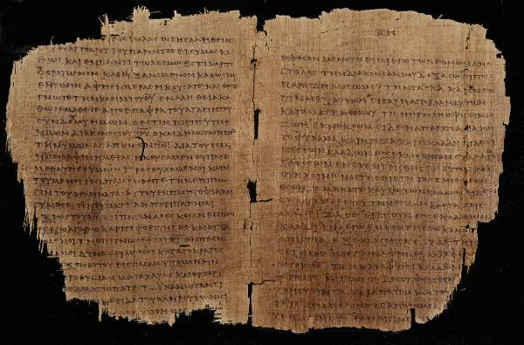
What Paul’s Letters May Have Looked Like p46 (Chester Beatty Papyri Collection, Dublin): Romans 11: 13-22 and Colossians 1: 5-12, c.AD 200

Slide 169
Paul’s Epistolary
Style
THE PAULINE PATTERN
Opening
Paul, an apostle…to the saints…
Thanksgiving
Greeting…grace and peace
(χαιρειν changed to χαρις)
Body
Central concern and communication
Paraenesis
Indicative and imperative moods (you are…so behave in this way)
Closing
Benediction
Letter-writing in the Greco-Roman world followed stylistic conventions.
Handbooks on letter theory were available as guides to differentiate between business letters, official letters, public letters and discursive letters.
Paul’s letters follow to a large degree the conventions of the times, but he also freely adapted those conventions to suit his own purposes.

Slide 170
Reading Another’s Mail
Reading someone else’s mail from the distance of two millennia creates special challenges.
The writer could assume certain shared information not available to a later reader.
Hence, topics could be addressed without a full explanation.
Especially when Paul addresses heresies or enemies of the Christian faith, the modern reader must, so to speak, “read between the lines” to discover the nature of the problem based on the polemics Paul uses.
In some letters, Paul uses critical vocabulary that helps the reader profile the heresy he addresses.

Slide 171
How to Discern an Author’s Goals
What does he include?
What does he leave out?
What does he emphasize?
What events does he link?
What does he clearly state?
What does he imply?

Slide 172
Spiritual Authority
One of the challenges for new Christian communities was the question of spiritual authority.
The earliest Christians had no New Testament, no creeds, no established church structure and no written guidelines.
Citizens in Asia Minor and Greece may never have heard of Jesus Christ until Paul came.
So, where did spiritual authority lie?

Slide 173
The Authority of Paul’s Letters
Paul clearly considered his letters to be authoritative in the churches.
He instructed churches not only to read them but to share them with other congregations (Col. 4:16).
They were a way of extending his presence when he could not be there personally (1 Cor. 5:3-4; 2 Cor. 10:10-11).
His personal signature at the end authenticated the contents of the letters (1 Cor. 16:21; Gal. 6:11; Col. 4:18; 2 Thess. 3:17).
While he distinguishes between what he writes and what Christ said (1 Cor. 7:10, 12), he also claims the authority of Christ and the Spirit (1 Cor. 2:16; 7:40; Gal. 1:1, 8, 11-12).

Slide 174
The Christian Traditions
Paul refers to Christian tradition handed down to him and in turn delivered to his converts (1 Cor. 11:23; 15:1-4).
These “traditions” were to be faithfully kept (1 Cor. 11:2; 2 Thess. 2:15; 3:6).
They were the “deposit of faith” faithfully passed down to successors (2 Tim. 1:13-14; Tit. 1:9).

Slide 175
Dominical Sayings
Obviously, a clear level of authority resided in the sayings of Christ, which in the earliest period were preserved orally.
As yet, the canonical gospels had not been composed (though smaller accounts of Jesus’ life may have been circulating, cf. Lk. 1:1-2).
Paul draws from the sayings of Jesus as an impeccable authority (1 Cor. 7:10-11; 9:14; 11:23-25; 14:37; cf. Ac. 20:35; Rom. 14:14; 1 Thess. 4:15-17).

Slide 176
The Septuagint
The presence of the Hebrew Scriptures “in every city” (Ac. 15:21) assumes the availability of the LXX translation in Greek.
Paul frequently alludes to the Hebrew Scriptures, assuming that his readers will accept their full authority on the basis of the introductory clause, “It is written…” (1 Cor. 1:19, 31; 2:9; 3:19; 4:6; 9:9-10; 10:7, 11; 14:21; 15:45).
To be sure, he does not merely use the OT to interpret Christ, but also, Christ to interpret the OT.
Though Paul is familiar with the Hebrew text, in all but a few cases his citations agree with the Septuagint renderings.

Slide 177
John’s Circular Literary Structure
Messiah
2:18-27
In the flesh
4:1-6
God’s Son
4:13-15
Messiah
5:1
Water,
Blood &
Spirit
5:6-12
Name Son of God
5:13-15
Son is True God
5:20
Incarnate
1:1-4
Unlike St. Paul, whose logic in his letters is linear, John uses a literary structure in which he repeats major themes several times.
John’s major themes are Christology, morality and love.
CHRISTOLOGY

Slide 178
John’s Circular Literary Structure cont.--
Light
1:5-7
Forgiveness
1:8—2:2
Obedience
2:3-8
Overcoming
2:12-17
New Life
2:28—3:10
Sin unto Death
5:16-17
Safety from
The Evil One
5:18-19
Avoid
Idolatry
5:21
Love,
not hatred
2:9-11
Brotherly
Love
3:11-14
Love in Action
3:16-18
New Birth
calls for love
4:7-12
God is Love
4:16-21
Expressed
In obedience & faith
5:2-5
New
Commandment
2:7-8
MORALITY
LOVE

Slide 179
Prophetic & Apocalyptic

Slide 180
STYLE OF WRITING
The Book of Revelation claims to be a letter (1:4), a prophecy (1:3; 22:7, 10, 18-19) and an apocalypse (1:1).

Slide 181
As a Letter
As a letter, the Book of Revelation is addressed to seven congregations in Asia Minor (1:3), just as were other NT letters.
Three of these seven cities, Ephesus, Thyatira and Laodicea, are known to us from elsewhere in the NT (Ac. 19, Ep. 1-6, 1 Ti. 1:3; Ac. 16:14; Col. 4:16).
If the book was addressed specifically to these seven congregations, we should expect that the contents of the book will have special relevance to them, especially since they were to read the letter aloud (1:3).

Slide 182
As a Prophecy
Prophecy is both exhortation as well as prediction (cf. 1 Co. 14:3; Ac. 21:10-11).
Repeating words like “soon” and “near,” which frame the book at its beginning and end, refer to the future (1:1, 3; 3:11; 22:6-7, 10, 12, 20).
Inasmuch as these terms are linked to the return of Christ, they must be read as impending, since the time of Christ’s return cannot be known (cf. Mk. 13:32-33).

Slide 183
As an Apocalypse
The very first sentence in the book describes it as an apocalypse, a genre of literature intially arising among the Jews a couple of centuries before Christ.
Apocalyptic literature aimed at providing insight into the invisible world of spiritual forces that raged through human history.
It assured God’s people that while evil might seem to prevail in the present, the triumph of God was assured.
God’s people must remain faithful and not give up!

Slide 184
The Jewish Pseudepigrapha
The Pseudepigrapha, a collection of Jewish writings in the intertestamental period, consists of texts allegedly written by great Jewish heroes of the past, such as, Adam, Enoch, Abraham, etc.
The style of writing is often apocalyptic with visions of heaven, hell, and the invisible war in the spiritual world that would climax in the triumph of God and his people.
Some of the imagery of the heavenlies and the underworld that one finds in the New Testament has roots in this literature.
There are several allusions to these works in the New Testament, and the Book of Jude quotes one of them directly (1 Enoch 1:9).

Slide 185
The Pseudepigraphical Books
(following are some of the more important works)
“And behold! He comes with ten thousands of holy ones to execute judgment upon all, and to destroy the ungodly.”
1 Enoch 1:9
“Enoch, the seventh from Adam, prophesied about these men: ‘See, the Lord is coming with ten thousands of his holy ones to judge everyone and to convict the ungodly…’”
Jude 14-15
1, 2 and 3 Enoch
2, 3 and 4 Baruch
Jubilees
Apocalypse of Abraham
Apocalypse of Adam
Apocalypse of Daniel
Apocalypse of Elijah
Apocryphon of Ezekiel
Greek Apocalypse of Ezra
Martyrdom of Isaiah
Jannes and Jambres
Testament of Job
Joseph and Asenath
Jubilees
Testament of Moses
History of the Recabites
Apocalypse of Sedrach
Sibylline Oracles
Odes of Solomon
Psalms of Solomon
Testament of Solomon
Testaments of the Three Patriarchs
Testaments of the Twelve Patriarchs
Apocalypse of Zephaniah

Slide 186
The Style of Jewish Apocalyptic
Primary Characteristics
    Special Disclosures
    Dualism of Powers and God’s Triumph
    Dualism of Ages
    Symbolism
    Cosmic Disturbances
    Angelology/Demonology
    Messianic Figure and Coming Age

Slide 187
Literary Motifs & Stylistic Features

Slide 188
Matthew

Slide 189
Matthew’s Use of the Old Testament
Matthew’s Gospel contains over sixty explicit quotations from the Old Testament (usually from the LXX) as well as many more allusions.
A favorite term he uses is πληροω (= fulfill, fill, make full, bring to completion).
His usage, however, suggests much more than simply prediction and verification:
  He does not depend strictly upon a historical-grammatical reading of the texts.
  Rather, he often develops a sensus plenior (= deeper sense meaning) which includes the clarification of enigmatic passages (cf. 22:41-46) and the recapitulation of Old Testament events in the life of Jesus along the lines of typology (cf. 2:17-18).
  Most important, he sees a link between the Israelite nation and Jesus so that Jesus was in every way the “true” Israel, i.e., Jesus fulfilled what Israel was intended to be but never became (cf. 2:15; 3:17; 17:5).

Slide 190
The Movement from Israel to the Nations
Matthew’s Gospel shows a marked emphasis on the widening of God’s redemptive purposes beyond the Jewish ethnic circle.
It is true that in his public ministry he clearly indicated his mission was only to Israel (cf. 10:5-6; 15:22-24).
At the same time, this restriction was clearly lifted in the great commission (28:19; cf. 24:14).
In addition, Matthew carefully suggests the universal implications of the coming of Jesus:
  There are four gentile women in his genealogy (1:3, 5, 6).
  The eastern magi who worshipped him were gentiles (2:1)
  In spite of the restriction, Jesus ministered on occasion to non-Jews (4:24:24-25; 8:5-13; 15:22-28).
  Though Jesus’ ministry was in Galilee, it was a “Galilee of the Gentiles” (4:15).

Slide 191
Mark

Slide 192
Mark’s “Messianic Secret”
Because in Mark’s Gospel Jesus consciously silenced those who recognized his messiahship, scholars have come to call this feature the “messianic secret.”
He commanded demons to silence (1:24-25, 34; 3:11-12; 5:6-20).
He enjoined those he healed not to make him known (1:43-44; 5:42-43; 7:35-36; 8:25-26).
He retired from public view as though to conceal himself (1:35-38; 7:24; 9:30-32).
He restricted his disciples from announcing his messiahship (8:30; 9:9).
It was not that Jesus resisted the idea of messiahship, but rather, that his messiahship must not be understood in conventional terms.

Slide 193
Jesus, the “Son of God”
At five crucial points in Mark’s gospel, the title “Son of God” is proclaimed.
In the introduction (1:1)
God’s voice at his baptism (1:11)
God’s voice at the transfiguration (9:7)
Jesus’ self-confession at his trial (14:61-62)
The centurion at the cross (15:39)
As the “Son of God,” Jesus has a unique relationship with the Father, serves as his special representative, and is obedient even to suffering and death.

Slide 194
Jesus, the Son of Man
Mark shows that Jesus’ favorite self-designation was the title “son of man” (in Hebrew, “the son of Adam”).
There was some ambiguity in this title in that it could refer to a human or to a heavenly figure.
  As a human term (cf. Ps. 8:4; Book of Ezekiel) it could refer to Jesus as an earthly human being.
  As a heavenly term (cf. Da. 7:13; 1 Enoch 46-53), it could refer to an eschatological figure to whom is granted sovereignty over the whole earth.
Jesus does not clarify his intent until the very end (14:61-62).

Slide 195
Jesus’ Public Activities
Mark describes Jesus’ public activities in three primary ways:
As a preacher
As a teacher
As a miracle-worker

Slide 196
Jesus, the Preacher
Important to Mark’s vocabulary is the verb “to preach” (κηρυσσω = to proclaim).
The reader is introduced to this vocabulary in the ministry of John, who preached about repentance and forgiveness of sin (1:4).
Shortly, Jesus also is described as preaching repentance and belief in the gospel (1:14-15).
His ministry of preaching extended outward to all the Galilean villages and synagogues (1:38-39).
The essence of his preaching was to “turn” (repent) and believe the gospel, for the kingdom of God was imminent.

Slide 197
The Kingdom of God
The phrase “kingdom of God” looms large in Mark’s Gospel, but it appears without explanation.
Based on the OT concept that God is the true King of Israel and in face of the loss of a political kingdom in the exile, the prophets had begun to suggest that God’s rule was not dependent on the presence of an earthly king.
The hope of Israel was for a day when the Messiah would come and God would be King over the whole world.
In Jewish apocalyptic literature, this hope for the coming of God’s reign became a well-established idea.
When John and Jesus preached that the kingdom was “at hand,” it was a proclamation that the time of fulfillment had arrived.

Slide 198
Jesus, the Teacher
Mark also uses the vocabulary of “teaching” to describe Jesus’ ministry (διδασκω = to teach).
It is difficult to make a hard distinction between preaching and teaching, but the latter generally denotes explanation and exposition more than proclamation.
Mark, more than the other Synoptics, portrays Jesus as a teacher (e.g., 2:13; 4:1-2; 10:1; 14:49, etc.).
Much of his teaching concerned the nature of the kingdom of God (which varied from popular ideas), and often his teaching was in the form of parables (4:2, 33).

Slide 199
Jesus, the Miracle-Worker
In addition to his preaching and teaching, Jesus performed many miracles (δυναμεις = acts of power), and Mark devotes more space to this aspect of Jesus’ ministry than the other gospel writers.
Such acts of power were clearly in the interests of combatting the forces of evil (3:22-27).
Some of his miracles seem to have been simple acts of compassion (e.g., 1:30-31), while others seem to be performed to make a theological point (e.g., 2:1-12).

Slide 200
Luke

Slide 201
THEOLOGICAL THEMES
Several important themes emerge in the Third Gospel.
  In the theme of amazement, Luke uses a cluster of words to demonstrate the power of the Christ event. People are awed, astonished, perplexed, amazed and afraid.
  There is a marked emphasis on prayer, especially the prayers of Jesus.
  The active work of the Holy Spirit figures prominently in Luke, and this emphasis will continue in the Book of Acts.

Slide 202
Amazement
Luke’s vocabulary of amazement is rich and plentiful:
  θαυμαζω = to marvel (1:21, 63; 2:18, 33; 4:22; 8:25; 9:43; 11:14, 38; 20:26; 24:12, 41)
  εκπλησσομαι = to be amazed (2:48; 4:32; 9:43)
  εξιστημι = to be astounded (2:47; 8:56; 24:22)
  εκστασις = bewilderment (5:26)
  θαμβος = wonder (4:36; 5:9)
  φοβεω = to be afraid (2:9; 8:25, 35; 9:34, 45)
  φοβος = fear (1:12, 65; 2:9; 5:26; 7:16; 8:37)
  απορεω = to be at a loss (24:4)

Slide 203
Prayer
Both in Jesus’ own prayer life as well as his teachings, prayer occupies a central role:
  Jesus prayed at his baptism (3:21), in lonely places (5:16), sometimes in the mountains (9:28), sometimes all night (6:12), often in private places (9:18), for Peter (22:32), in Gethsemane (22:39-44) and on the cross (23:46).
  It was the striking prayer life of Jesus that prompted the disciples’ question, “Lord, teach us to pray,” and Jesus’ answer with what we call “The Lord’s Prayer” (11:1ff.).
  It is Luke who provides us with Jesus’ parables about prayer (11:5-13; 18:1-8; cf. 10:2).

Slide 204
The Holy Spirit
Beginning with the birth narratives, Luke heralds the return of the quenched prophetic Spirit which had not been active since the last of the writing prophets.
  John the Baptist (1:15), Mary (1:35), Elizabeth (1:41), Zechariah (1:67) and Simeon (2:26-27) were all filled with the Spirit.
  Jesus himself was full of the Spirit (3:22; 4:1, 14, 18; 10:21)
  Jesus would be both the bearer of the Spirit and the giver of the Spirit (3:16; cf. 11:13; 24:49; Ac. 2:33).

Slide 205
John

Slide 206
The Trial of Truth
A unique feature of the Fourth Gospel is a trial or lawsuit motif that shapes much of its narrative.
  Within this motif, the concepts of witness, judgment and truth bear directly upon the narratives about Jesus’ life and death.
  Related to this motif are:
    Jesus’ controversy with “the Jews”
    Jesus’ trial before Pilate and the question, “What is truth?”
    The appeal to the law of Moses
    The use of Scripture
    The mission of the disciples as “witnesses”
    The promise of the Paraclete (= the counselor, advocate)

Slide 207
The vocabulary in the Fourth Gospel demonstrates the importance of these themes:
  μαρτυρια (= a witness, a testimony)
  (occurs 14 times; only 4 times in the Synoptics)
  μαρτυρειν (= to witness, to testify)
  (occurs 35 times; only 2 times in the Synoptics)
  κρισις (= judgment)
  (occurs 11 times; 6 times in Luke; 6 times in Matthew)
  κρινειν (= to judge)
  (occurs 19 times; 4 times in Luke; 12 times in Matthew)
  αληθεια (= truth)
  (occurs 25 times; only 7 times in the Synoptics)
  αληθης (= true)
  (occurs 14 times; 1 time in Mark; 1 time in Matthew)
  αληθινος (= true, dependable)
  (occurs 9 times in John; 1 time in Luke)

Slide 208
At issue in the Fourth Gospel: Is Jesus the Messiah or not?
Based on Dt. 13:1-5, Israel’s leaders wished to condemn him as a false prophet who led the people astray (7:47-52).
  He was a violator of the Sabbath (5:16; 7:21-24; 9:16, 24)
  He was a blasphemer (5:17-18; 10:30-39; 8:58-59)
  He was a destroyer of the Jewish nation (11:46-53)

Slide 209
Based on key witnesses, the people who heard Jesus were obliged to pass judgment on him.
  The first witness was John the Baptist (1:7-8, 15, 19, 32, 34; cf. 3:28)
  The second witness was Jesus’ own words (3:11, 31-33; 4:41-42; 7:7; 8:14; 18:37)
  The third witness was Jesus’ miracles (1:50; 2:11, 23; 5:36; 10:25, 37-38)
  The fourth witness was God himself (5:37; 8:17-18; 12:28-39)
  The fifth witness was the Scriptures (2:17; 3:14; 5:39-40; 6:31-33)
  The sixth witness was the testimony of others (4:39; 12:17-19; 13:20; 15:27; 17:18; 20:21-22, 29; 21:24)
  The final witness was the Holy Spirit who would come in place of the visible Jesus (14:26; 15:26; 16:13-15)

Slide 210
The final irony was that those who passed judgment on Jesus would themselves be on trial by him.
On the one hand, Jesus’ appearance in the world was not in order to condemn the world, since condemnation was already in effect for those who would not believe.
  The critical factor in this condemnation was whether or not one believed in Jesus himself (3:17-18; 5:24).
  It was in this sense that Jesus said he did not come to judge the world (12:47-50). Each person, in effect, would judge himself by his faith or unbelief.

Slide 211
On the other hand, Jesus’ eschatological role will be as God’s agent in order to deliver God’s judgment.
  As God’s agent, he is authorized to judge (5:22-23, 27).
  Central to his mission in the world is his capacity to judge both the blind and the seeing (9:39).
The Trial of Truth occurs at two levels, one for those who personally saw and heard Jesus, and the other for those who encounter him through the Fourth Gospel.
Every reader of the Fourth Gospel was obliged to pass judgment in response to these witnesses 20:30-31; 21:24.

Slide 212
Concepts of Faith
With respect to faith in Jesus, several groups are distinguishable in the Fourth Gospel
Groups who did not believe in Jesus
The world (1:10; 3:19; 7:7; 14:17; 15:18; 16:20)
The Jews (the Fourth Gospel uses the term “the Jews” some 71 times in the Greek text as opposed to only a few times in the Synoptics)
The disciples of John the Baptist (who survived into the Christian era)
Groups who claimed to believe in Jesus
Those who claimed faith but refused to publicly acknowledge Jesus (3:1-2; 12:42-43)
Those whose faith rested primarily in miraculous signs (2:23-25; 6:41-42, 60-66; 11:45-46)
Those whose faith was fully genuine (6:67-69; 11:25-27; 16:29-31; 17:6-10, 20; 20:24-31)

Slide 213
These groups may well reflect stresses in the Christian community at the time the Fourth Gospel was written (i.e., it is axiomatic that in the range of materials, the author would have chosen those materials most relevant to his audience.)
Presumably, the Fourth Gospel was written after the fall of Jerusalem in AD 70 and the institution of the Birkat ha-Minim (curse upon the deviators) in the synagogue service.
  After the 1st Jewish Revolt, the tension between the Jewish and Christian communities escalated.
  Also, since the Christians did not join in the revolt, it became apparent to the Roman authorities that they no longer could be considered a subset of Judaism.
Jesus seemed to take a reserved view of those whose faith rested primarily on miracles (2:18, 23-25; 7:3-6; 8:31, 33-59; 11:45-46). Rather, genuine faith must include accepting the exclusive claims of his Christhood, not merely admitting to his works of power (20:24-31).

Slide 214
Torah, Temple and Festivals
The Fourth Gospel is closely attuned to Judaism’s major symbols.
The functions of the Torah are totally subsumed by Jesus, who reveals God’s will, judges, offers the Spirit, gives light, sets free and gives life. What the Torah was as a text, Jesus is as the living Son.
  The Father and Jesus are the two witnesses necessary to fulfill Jewish law (8:17-18; cf. Dt. 19:15b).
  The law revealed by Moses finds its fulfillment in the grace and truth revealed by Jesus (1:16-17).
  It is the Scriptures themselves that testify to Jesus (5:39, 46; cf. 1:45).
  Jesus is the one who properly interprets the Torah and the Scriptures (5:8-11; 7:22-24; 8:3-7; 10:34-36).
  Faithfulness to Torah can only lead to faithfulness to Jesus (8:47).

Slide 215
Jesus becomes the new temple, the place of mediation between God and humans.
  He is the “tent” where the glory dwells (1:14).
  He is the gateway to heaven, the house of God (1:51; cf. Ge. 28:12, 16-17)
  He is the temple, both destroyed and restored (2:19-21).
  He is the center of true worship (4:20-26).
Jesus visits Jerusalem for the festivals of Passover (2:13; 6:4; 12:12), an unnamed feast, probably Pentecost (5:1), Hanukkah (10:22-23), and Booths (7:2, 8-10).
  He is the true Passover lamb (1:29, 36; 19:14-16, 36; cf. Ex. 12:46).
  He is the true Passover feast (6:4ff., 32-58).
  He is the true living water symbolized in the water ritual at the Festival of Booths (7:37-39; cf. Is. 12:3).
  He is the truly sanctified temple (10:22, 36-38).

Slide 216
Signs, Healings, and Nature Miracles
Jesus’ miracles function somewhat differently in the Fourth Gospel than in the Synoptics. John does not use the term δυναμις (act of power) to refer to Jesus’ miracles, but instead prefers the word σημειον (a sign).
Synoptics
δυναμις (= act of power)
Acts of compassion
Demonstrations of the in-breaking of God’s kingdom
John
σημειον (= a sign)
Points toward Jesus as the Messiah
Insufficient to create genuine faith; true faith must go beyond signs

Slide 217
The Paraclete
In the Fourth Gospel, Jesus is the bearer of the Spirit so that he might confer the Spirit.
  The Spirit descended on him at his baptism (1:32-34).
  He was given an unlimited endowment of the Spirit (3:34-35).
  The gift of the Spirit was necessary for eternal life (6:63; cf. 3:3-8).
  The gift of the Spirit could not be given to others until after his glorification in the cross (7:37-39).
  In his post-resurrection appearances, he conferred the Spirit upon the apostles (20:21-22).

Slide 218
A unique teaching of the Fourth Gospel concerns the Paraclete.
  The term παρακλητος means Advocate (in a forensic sense, cf. 1 Jn. 2:1). The traditional translation “Comforter” derives from John Wycliffe’s rendering from the Latin Vulgate.
  An Advocate is someone called alongside to mediate.
Jesus spoke of a second Paraclete, the Holy Spirit, who would abide with his disciples forever (14:15-18).
  Paradoxically, Jesus is both the first and the second Paraclete, the first in his incarnation and the second in the gift of the Spirit.
  Further, the gift of the Spirit is both the spiritual presence of the Son as well as the Father (14:20-21, 23).

Slide 219
The “personhood” of the Paraclete:
  In Greek, the word πνευμα (= spirit) is neuter.
  Nevertheless, the Fourth Gospel uses masculine pronouns to refer to “Him” (i.e., εικεινος as opposed to εικεινο, cf. 14:26; 15:26; 16:13-14). This intentional grammatical irregularity reinforces the personality of the Spirit.
The mission of the Paraclete is to:
  Call attention to Christ, the one whom the Spirit represents (14:26; 15:26; 16:14-15)
  Convey truth to Jesus’ followers (14:26; 16:13)
  Offer spiritual empowerment (14:12-14)
  Send conviction—serve as a forensic witness—to a guilty world (16:8-11)

Slide 220
Eschatology
The Fourth Gospel does not contain the eschatological emphasis on the kingdom of God as is found in the Synoptics, nor does it contain a vision of the future parousia of a return in the clouds:
  Some interpreters have championed the view that John’s eschatology was “realized,” that is, that the new age with all its glory has broken into the present age transcendentally through Jesus’ resurrection and the “coming” of Christ through the Spirit.
  Hence, they advocate that there was no future eschatological program. “The future is now.”

Slide 221
However, it is difficult to treat several passages in John as simply realized or vertical eschatology:
  “If I will that he tarry ‘til I come…” (21:22)
  “If I go away…I will come back…” (14:1-3)
  “A time is coming when all who are in the grave will hear his voice…” (5:28-29)
  “I will raise them up at the last day…” (6:39-40, 44, 54; cf. 12:48)
Rather, it is more fair to say that the Fourth Gospel has both a vertical and a horizontal eschatology.

Slide 222
The coming of Jesus…
  Jesus will “come again” in the coming of the Paraclete (14:18, 23)
  Jesus also would “go away to prepare a place”, and he would “come back” (14:2-4, 28). If he willed, some might “tarry ‘til I come” (21:22).
The resurrection of the dead…
  The hour “now is” when the dead will hear the voice of the Son of God (5:25-26).
  There still remains “the last day” with its resurrection to life or to condemnation (5:28-29).
The judgment…
  In the cross and resurrection, Christ judged the world and expelled Satan (12:31; 14:30; 16:8-11).
  Christ’s own word will be the final witness at “the last day” (12:48).

