Slide 1
jonah

Slide 2
Background
Outside the book that bears his name, the only mention of Jonah ben Amittay (or John, meaning “dove”) is 2 Kings 14:25, which puts him in the reign of Jeroboam II (c. 793-753 BC).
He came from a border town in Zebulun (cf. Jos. 19:13) about three miles north of Nazareth. (This, in turn, means the Pharisees were wrong when they said no prophet ever came from Galilee, cf. Jn. 7:52.)
Unlike the other 8th century prophets, Jonah’s oracles do not address the sins of either Israel or Judah. Rather, the book describes a missionary trip to Nineveh, one of the principle cities of the Assyrian Empire.
Further, unlike any other prophetic book, this one is not a collection of oracles, but rather, a narrative.

Slide 3
Two Critical Questions
Was Jonah a Real Person?
Given the uniqueness of this book, the question is raised as to whether the story is parabolic or historical.
There is no external account of Nineveh’s conversion to Hebrew monotheism.
Is the Story Credible?
Here, one question concerns the probability of a man being swallowed by a fish and surviving.
A second question concerns the size of Nineveh as described in the book—120,00 citizens taking a 3-day journey to traverse it (4:11; 3:3).
Some interpreters have opted for a parabolic approach, saying the book intended to emphasize the point that God was not confined to the Israelites, but his mercy extended even to Israel’s enemies.

Slide 4
How plausible is the parabolic approach?
While the main point of the parabolic approach is surely true enough, there are some difficulties with it.
It seems unlikely that a Jewish writer from Judah would choose such an obscure figure as Jonah as a nom de plume for his fiction.
Jesus seems to have considered the story of Jonah to have been a real occurrence (Mt. 12:39-41//Lk. 11:29-30, 32).
If the parabolic approach is adopted merely to avoid the supernatural (which in some interpretations seems to be the case), then this approach says more about the interpreter than it does about the story itself.
Hence, it seems better to allow the story to stand within the historical framework of the 8th century BC.

Slide 5
The Reluctant Prophet (1-2)
Jonah’s decision to run from God’s calling resulted in a downward spiral.
He went down to Joppa (1:3), down below the deck (1:5), down into the water, down into the fish, and down to the bottom of the sea (2:6).
There is pronounced irony in that the pagan sailors prayed while Jonah, a true prophet, slept.
A double irony is that Jonah, who would have preferred to drown rather than preach to the hated Ninevites, was prevented from downing by the great fish. (Incidentally, the Hebrew expression “great fish” was not necessarily a whale, as translated in the KJV.)
Jonah’s prayer in the belly of the fish takes the form of a poem in which he experienced a living death described as the depths of Sheol (2:2b).

Slide 6
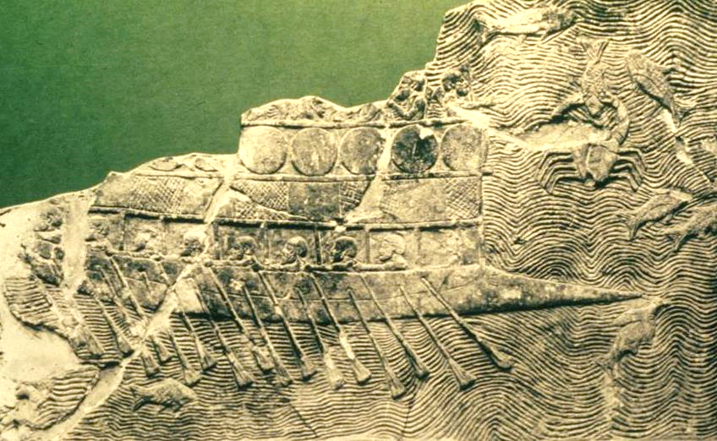
Phoenician vessel depicted on an Assyrian bas-relief from about 700 BC. The ship which carried Jonah was likely similar. (British Museum, London)

Slide 7
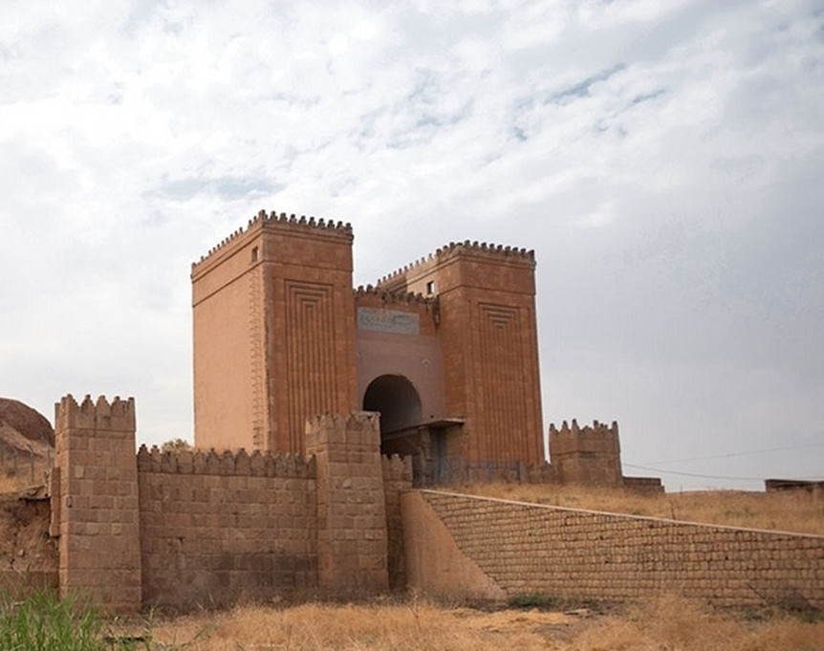
The excavated ruins of Nineveh, one of the oldest cities in antiquity and populated from about 6000 BC, are located near the modern city of Mosul, Iraq on the east bank of the Tigris River. With an estimated population in excess of about 100,000, it served as the capital for the Neo-Assyrian Empire. This Mashki Gate, which was reconstructed by archaeologists in the late 20th century, was significantly damaged by ISIS in 2010, and the ruins of Nineveh remain one of the most endangered archaeological sites in the world.

Slide 8
Jonah’s Second Commission (3-4)
God’s commission to Jonah did not change. After the great fish vomited him up, God again instructed Jonah to go to Nineveh.
His misplaced patriotism did not allow him to escape the long reach of God.
Jonah then preached a message that destruction would come in 40 days, and the Ninevites repented so that God spared them.
Jonah, however, was chagrined at God’s mercy, and there were yet lessons for him to learn:
He was petulant about God being merciful to those whom the Israelites hated.
So God, who had prepared the great fish, now prepared a castor-oil plant to shade Jonah’s bald head from the blazing sun.
Then, God prepared a worm to kill the plant and a scorching wind to blow hot air at Jonah.
God’s final question to Jonah concerned his divine right to care for what he had created, both human and even animal.

