Slide 1
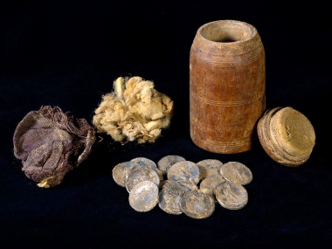
THE INTERTESTAMENTAL PERIOD
1 The End of the Old Testament: Covenant

Slide 2
The Back Story
Before engaging the four centuries that lie between the Old and New Testaments, it will be helpful, indeed necessary, to address the back story of Israel.
The identity of Israel as a covenant people thoroughly shaped their national history.
Out of this covenant context, a serious tension arose between the kings of Israel and the prophets. Each approached the covenants in very different ways, and each claimed to have the final word on interpretation.

Slide 3
The Idea of Covenant
In the ancient Near East, where international law was still a thing of the future, covenants were socially binding agreements enacted between two parties in which one or both made promises under oath to perform certain actions stipulated in advance.
THE VOCABULARY OF COVENANT
tyr9B; tr1KA ( karat berith = to cut a covenant)
fav0bwA (shevu’ah = oath)
fBaw;n9 (nishba’ = swearing)
tOc;m0i (mitswot = obligations)
hkAr!B; (berakah = blessing)
hlAxA (‘ala = curse)

Slide 4
Yahweh’s Covenant “I wills” to Abram
The LORD had said to Abrtam…
“I will make you a great nation, and I will bless you, and make your name great, and so you shall be a blessing. I will bless those who bless you and the one who curses you I will curse. And in you all the families of the earth shall be blessed.”
Ge. 12:1-3
…make you a great nation
…bless you
…make your name great
…bless those who bless you
…curse those who curse you
THE PROMISE: ...all peoples on earth will be blessed through you!

Slide 5
Israel’s National History Begins
From Egypt, Moses led the Israelites southward to the “mountain of God” (Mt. Sinai/Mt. Horeb), where Yahweh entered into a sacred covenant with them.
The form of this covenant was patterned after an ancient Near Eastern suzerainty treaty, a covenant between a great King and his vassal.
Both parties were bound to each other by oath.
Each was responsible for covenant obligations: Yahweh promised to protect and bless the nation; Israel pledged absolute loyalty to Yahweh.
Detailed blessings and curses attended the covenant, blessings for obedience and disciplines/curses for covenant violation.
The most severe consequence for covenant unfaithfulness was exile.

Slide 6
Moses set up twelve stone pillars representing the twelve tribes of Israel. Then he sent young Israelite men, and they offered burnt offerings and sacrificed young bulls as fellowship offerings to the LORD. Moses took half of the blood and put it in bowls, and the other half he sprinkled on the altar. Then he took the Book of the Covenant and read it to the people. They responded, “We will do everything the LORD has said; we will obey.”
Moses then took the blood, sprinkled it on the people and said, “This is the blood of the covenant that the LORD has made with you in accordance with all these words.”
Exodus 24:4b-8

Slide 7
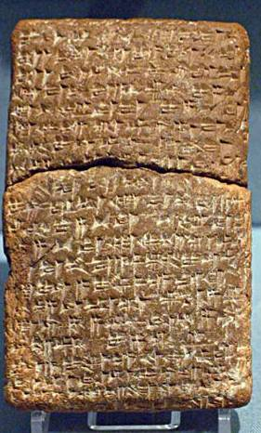
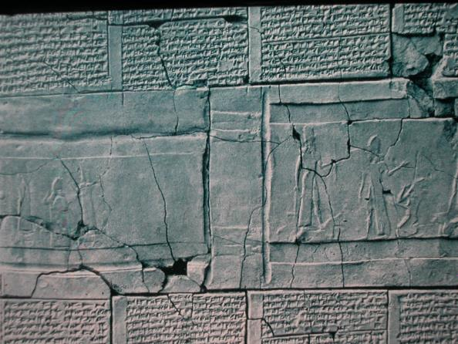
Striking Parallels
Ancient Near Eastern treaties with striking parallels to the biblical covenant material have been found in ancient Hittite culture (15th century BC) and in the vassal treaties of Esarhaddon II of Assyria (7th century BC).
University of Pennsylvania
British Museum, London

Slide 8
Curses from Dt. 28
Yahweh will plague you with diseases…
At midday you’ll grope about like a blind man...
Your carcasses will be food for the birds and the beasts…
You will be pledged to be married…but another will take and ravish her…
Curses from Esarhaddon II
May Sin…clothe you with leprosy…
May Shamash…take away your eyesight…
May Ninurta…give your flesh to eagles and vultures…
May Venus…let your wives lie in the embrace of your enemies…
THE FINAL CURSE
“Then the LORD will scatter you among all nations, from one end of the earth to the other. …among those nations you will find no repose, no resting place for the sole your foot.”
Deuteronomy 28:64-65

Slide 9
Discussion Points
What does it mean to be a covenant people?
Does it surprise you that God would use an ancient Near Eastern institution like covenant to establish his relationship with Abraham and his descendants?
How is the covenant God made with Abraham either similar or dissimilar to the covenant he made with Israel at Mt. Sinai?

Slide 10
The Davidic Covenant (2 Sa. 7:4-29)
The covenant Yahweh made with David is the third major covenant, added to the covenant with Abraham and the covenant through Moses.
God’s covenant promise guaranteed David’s dynastic future, a promise that would link with the other two covenants in the messianic hope (cf. Ge. 12:1-3; Dt. 18:15, 18-19; 34:10).
This covenant was framed in the language of an eternal promise (23:5; cf. Ps. 89:19-37; 132:11-18).

Slide 11
GOD’S PROMISE TO DAVID
“…in the same night, the word of the LORD came to Nathan, ‘Go and tell my servant David, ‘Thus says the LORD… I will provide a place for my people Israel and plant them so they can have a home of their own and no longer be disturbed. Wicked people will not oppress them anymore, as they did at the beginning and have done ever since I appointed leaders over my people Israel. I will also give you rest from all your enemies. The LORD declares to you that the LORD himself will establish a house for you. When your days are over and you rest with your ancestors, I will raise up your offspring to succeed you, your own flesh and blood, and I will establish his kingdom. He is the one who will build a house for my Name, and I will establish the throne of his kingdom forever.’”
2 Samuel 7:3, 10-13

Slide 12
God’s Covenant with David
2 Sa. 7:5-16; Ps. 89:19-37; 132:11-18
A PROMISED DYNASTY
The Davidic lineage from which Yahweh would never retract his favor
A PROMISED LAND
An undisturbed home for Israel and rest from all enemies
A PROMISED KINGDOM
A reign that would endure forever

Slide 13
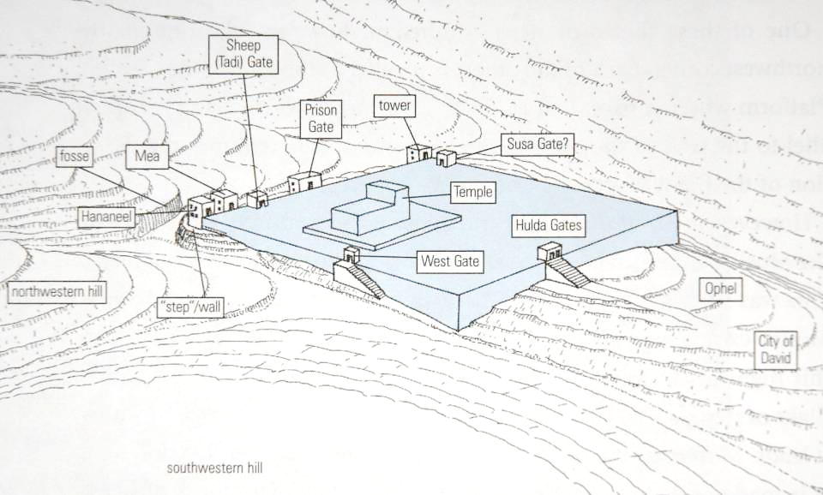
The temple mount, where Solomon built the 1st Temple, was essentially a square, probably with short retaining walls to create a flat surface.
N

Slide 14
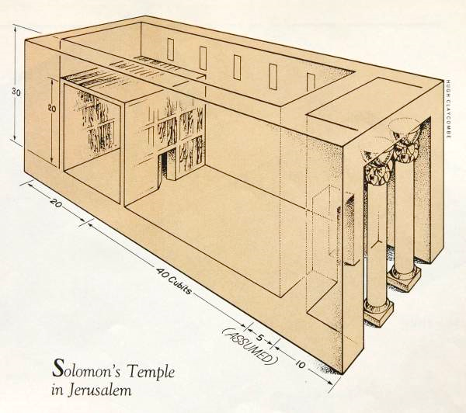
First Temple (basic configuration)
Solomon built the first temple (1 Kg. 6). The temple, like the kingship, was anticipated in the Torah (Dt. 12).

Slide 15
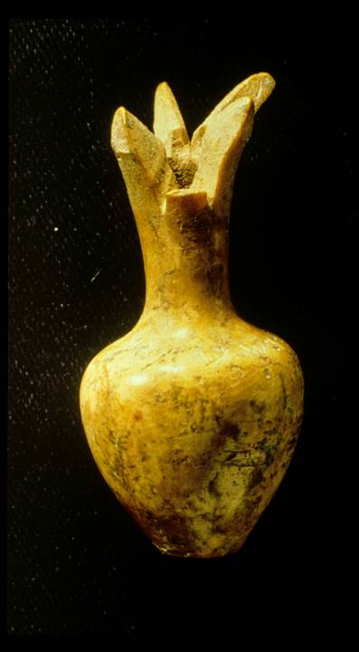
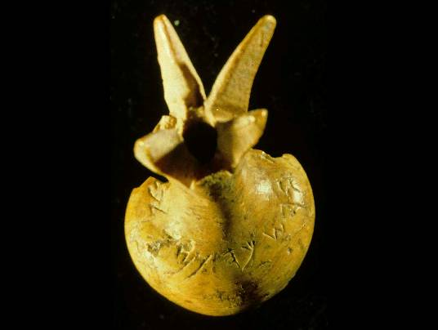
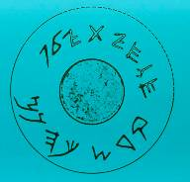
This ivory pomegranate scepter head is perhaps the only surviving relic from Solomon’s temple. The artifact surfaced on the antiquities market and was subsequently purchased by the Israel Museum. Though its authenticity has been questioned, the consensus at present is that it is authentic.
It has an inscription reading, “Belonging to the temple of Yahweh, holy to the priests.”

Slide 16
GOD’S WORD TO SOLOMON:
“As for you, if you walk before me in integrity of heart and uprightness, as David your father did…I will establish your royal throne over Israel forever, as I promised David your father when I said, ‘You shall never fail to have a man on the throne of Israel.’
But if you or your sons turn away from me and do not observe the commands and decrees I have given you and go off to serve other gods and worship them, then I will cut off Israel from the land I have given them and will reject this temple I have consecrated for my Name. …though this temple is now imposing, all who pass by will scoff and say, ‘Why has the LORD done such a thing to this land and to this temple?’ People will answer, ‘Because they have forsaken the LORD their God…’”
1 Kings 9:4-9

Slide 17
Discussion Points
Who was the first of the sons of David to “go off the rails” with regard to covenant faithfulness?
When Solomon died, how would the northern clans regard the three major covenants of Abraham, Moses, and David?

Slide 18
Covenant Tensions
the kings
the prophets
The Promise Seems Secure Forever
“Is not my house right with God? Has he not made with me an everlasting covenant, arranged and secure in every part?” (2 Sa. 23:5)
“I will maintain my love to him forever, and my covenant with him will never fail. I will establish his line forever, his throne as long as the heavens endure.” (Ps. 89:28-29)
The Promise Seems Conditional
“…observe what Yahweh your God requires…so that you may prosper…and so that Yahweh may keep his promise…” (1 Kg. 2:2-4)
“Yahweh swore an oath to David…that he will not revoke…if your sons keep covenant and the statutes I teach them, then their sons will sit on your throne forever and ever.” (Ps. 132:11-12)

Slide 19
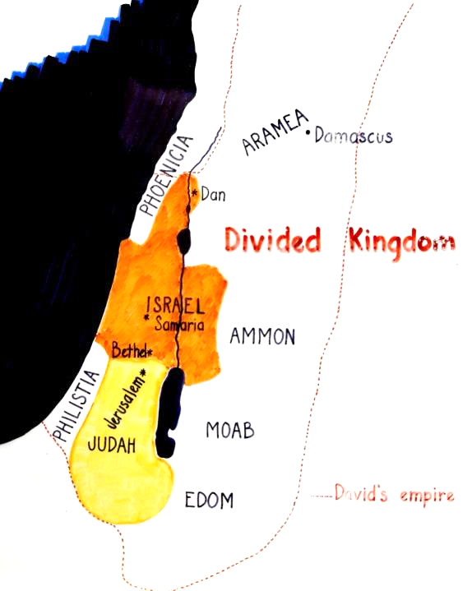
The divided kingdom was considerably smaller than the mini-empire of David.
While Shechem became the initial capital of the north, it later was moved to Tirzah and then to Samaria.
Jerusalem remained the capital of the south.

Slide 20
The Royal Theology based on the Davidic Covenant
The Royal Assumptions
David had been guaranteed a perpetual dynasty (2 Sa. 7:11b-16; 22:51b; 23:5a).
The Davidic covenant was firmly linked with the temple on Mt. Zion (Ps. 2:6-9; 78:65-72; 132:11-18).
The city of Jerusalem and Mt. Zion were impregnable, their security eternally guaranteed by Yahweh (Ps. 46; 125:1-2; 146:10).
The Perspective of the Prophets
Earlier prophets warned that the Davidic covenant must not be viewed as an unconditional guarantee of political security (Am. 2:4-5; 6:1a; Mic. 3:10, 12).
Jeremiah warned that Yahweh had rejected Jehoiakim’s family (Je. 36:30-31; cf. 22:18-19).
Yahweh was now against the kings in David’s line (Je. 21:11-14; 23:1-2).

Slide 21
“Therefore, this is what the LORD says about Jehoiakim king of Judah: He will have no one to sit on the throne of David; his body will be thrown out and exposed to the heat by day and the frost by night. I will punish him and his children and his attendants for their wickedness; I will bring on them and those living in Jerusalem and the people of Judah every disaster I pronounced against them, because they have not listened.”
Jeremiah 36:30-31
“As surely as I live,” declares the LORD, “even if you, Jehoiachin son of Jehoiakim king of Judah, were a signet ring on my right hand, I would still pull you off. I will hand you over to those who seek your life, those you fear—to Nebuchadnezzar king of Babylon and to the Babylonians. I will hurl you and the mother who gave you birth into another country, where neither of you was born, and there you both will die. You will never come back to the land you long to return to.”
Jeremiah 22:24-27

Slide 22
THE INTERTESTAMENTAL PERIOD
2 The End of the Old Testament: Exile

Slide 23
The Task of the Prophets
The burden of the prophets was that unless there was a course correction in the nations of Israel and Judah, the Deuteronomic sentence of exile would surely happen.
The prophets faced an entrenched mood of unmitigated optimism augmented by false prophets, who in support of the kings, predicted the safety of Jerusalem and Judah.
Prophets like Jeremiah and Ezekiel confronted this false optimism with the Word of Yahweh.
Their message was that the nations of Israel and Judah were on the cusp of disaster.

Slide 24
“This is what the LORD says: ‘For three sins, even for four, I will not turn back my wrath. …I will crush you as a cart crushes when loaded with grain.” (Amos 2:6a, 13)
“Samaria and its king will float away like a twig on the surface of the waters.” (Hosea 10:7)
“If you really change your ways and your actions and deal with each other justly, if you do not oppress the alien, the fatherless or the widow and do not shed innocent blood in this place, and if you do not follow other gods to your own harm, then I will let you live in this place, in the land I gave your forefathers for ever and ever. But look, you are trusting in deceptive words that are worthless.” (Jeremiah 7:5-8)

Slide 25
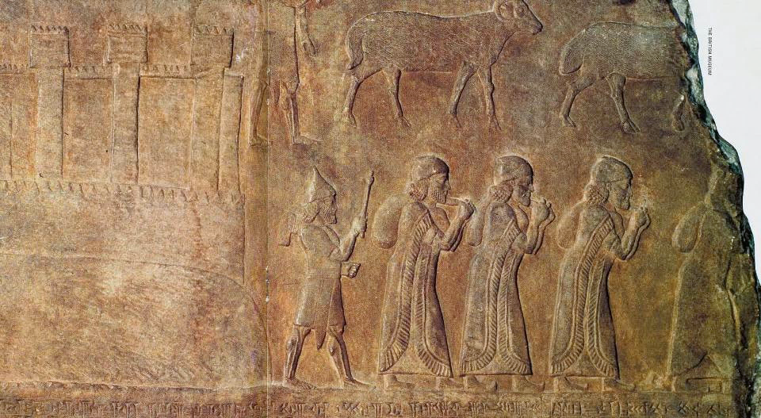
This alabaster relief from the palace of Tiglath-pileser III in Nimrud shows prisoners of war going into exile from Astartu (usually identified as Ashtaroth, a town in Galilee). The refugees carry sacks of their possessions.
The British Museum, London

Slide 26
A Remnant Will Survive
The prophets’ prediction of disaster was not Yahweh’s final word. On the other side of exile, there was still hope for the future.
SOUTHERN NATION
“I will surely gather all of you…the remnant of Israel” (Mic. 2:12a)
“’In that day,’ declares Yahweh, ‘I will assemble the exiles…’ Yahweh will rule over them in Mount Zion from that day and forever.” (Mic. 4:6-7)
“In that day Yahweh Tsabaoth will be a glorious crown…for the remnant of his people” (Is. 28:5)
“In that day Adonay will reach out his hand a second time to reclaim the remnant… He will assemble the scattered people of Judah from the four quarters of the earth.” (Is. 11:11-12)
8th Century Prophets
NORTHERN NATION
“I will bring back my exiled people Israel…” (Am. 9:14a)
“I will plant Israel in their own land never again to be uprooted from the land…” (Am. 9:15)
“The Israelites will live many days without king or prince…afterward they will return…” (Ho. 3:4-5)
“I will plant her for myself in the land… (Ho. 2:23)

Slide 27
I Will Bring You Back
7th and 6th Century Prophets
I will…gather those who have been scattered. At that time I will gather you; at that time I will bring you home. (Zep. 3:19-20)
I myself will gather the remnant of my flock out of all the countries where I have driven them… (Je. 23:3)
I will forgive the remnant I spare. (Je. 50:20)
When seventy years are completed… I will…bring you back to the place from which I carried you into exile. (Je. 29:10-14)
I will gather you from the nations…where you have been scattered, and I will give you back the land of Israel again. (Eze. 11:17)
In the first year of Darius…I, Daniel, understood from the Scriptures…that the desolation of Jerusalem would last seventy years. (Da. 9:1-3)

Slide 28
Discussion Points
Why should we think of the exile as an act of God, not merely as a disaster in ancient political history?
Why is it theologically important to understand that this judgment within history was not God’s final word?
Does exile and the hope of restoration for ancient Israel have anything to say to Christians?

Slide 29
The Return from Babylon
When Babylon fell to Persia in 539 BC, Cyrus the Great reversed the deportation policies of Assyria and Babylon.
In the first year after the fall of Babylon, he issued an edict that the displaced peoples in his realm were free to return to their ancestral homes and rebuild their temples (2 Chr. 36:22-23; Ezr. 1:1-4).
Hence, in 538 BC, a sizeable group of Jews, “everyone whose heart God had moved” (Ezr. 1:5), made the long trek back to Jerusalem.

Slide 30
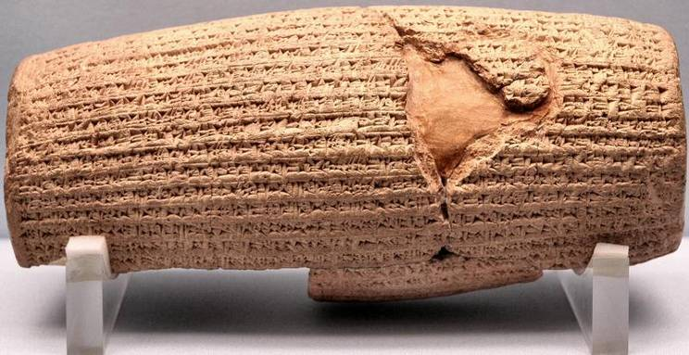
“I returned to these sacred cities on the other side of the Tigris, the sanctuaries of which have been in ruins for a long time, the images which used to live therein and established for them permanent sanctuaries. I also gathered all their former inhabitants and returned to them their habitations.”
Cyrus Cylinder 539-8 BC

Slide 31
The Great Altar and Temple Foundation
The returned Jews began by reconstructing the great sacrificial altar, which would enable them to restore the Tam’id, the morning and evening sacrifices.
Then, they laid the foundation for the 2nd Temple.
There were mixed reactions: older people who had seen the 1st Temple were disappointed, but younger people were elated (Ezr. 3:10-13).
When the locals saw what was happening, they set about discouraging the effort and raised so much opposition that project came to a halt for 16 years.
It was only due to the preaching of Haggai and Zechariah that the people finally reengaged, completing the 2nd Temple in 516 BC (exactly 70 years since the destruction of Solomon’s Temple in 586 BC).

Slide 32
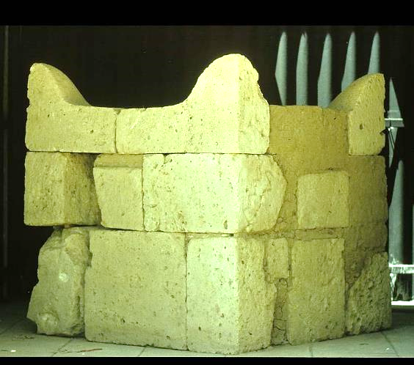
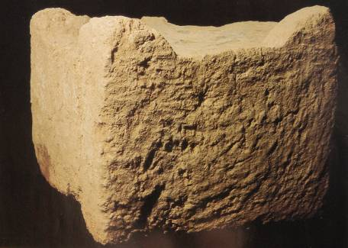
Construction of the Great Altar while the details of the great altar are unknown to us, presumably it looked similar to other altars that have been excavated in Israel
Four horned altar excavated at Beersheba, ca. 8th century BC
Four horned altar excavated at Dan, ca. 9th century BC

Slide 33
Discussion Points
An ancient proverb says, “Without a vision, the people perish” (Pro. 29:18). How might this apply to those rebuilding the temple, and how might it apply to modern Christians as well?

Slide 34
Ezra and Nehemiah
Half a century later, two more leaders arrived in Jerusalem from Babylon.
Ezra was a teaching priest concerned with proper Torah observance. He led the people in repentance and reform.
Nehemiah was a governor concerned with the security of Jerusalem. He directed the reconstruction of Jerusalem’s walls and gates.

Slide 35
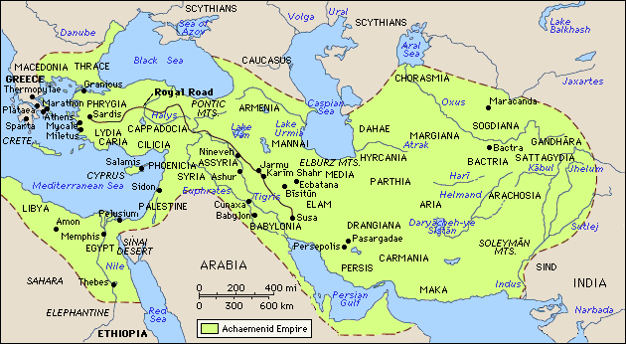
THE DIASPORA: The Jews in the Archaemenid Empire
Jewish settlements (ca. 450 BC)
Additional Jewish settlements (after 350 BC)

Slide 36
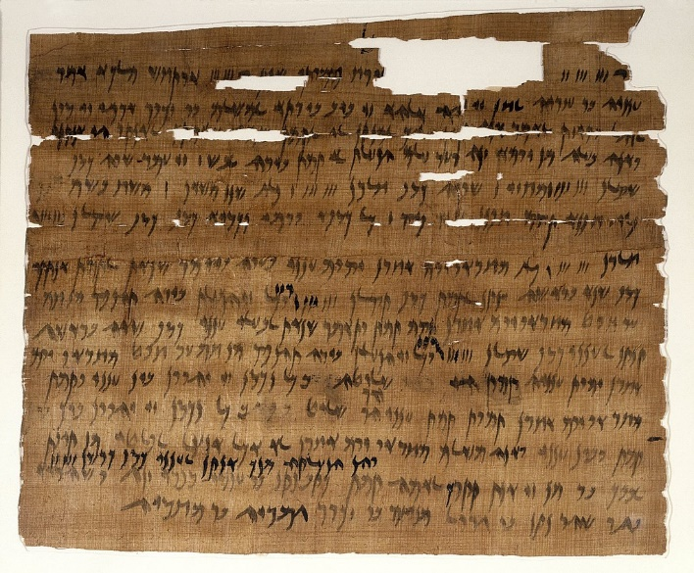
This Jewish marriage contract from the Elephantine documents describes the marriage of Ananiah and Tamut on July 3, 449 BC, about the same time as the writing of the Book of Malachi.
(Brooklyn Museum).

Slide 37
At the close of the Old Testament…
What had happened…
Temple rebuilt
Priesthood installed
Temple sacrifice resumed
The Jews now lived both in the land of Israel and also in the far-flung provinces of the Persian Empire.
What had not happened yet…
No new Davidic king
No new covenant established
No reunion with the northern tribes
No establishment of Mt. Zion as a place of international worship
No outpouring of the Spirit
No return of Yahweh’s glory

Slide 38
“But see, we are slaves today, slaves in the land you gave our forefathers so they could eat its fruit and the other good things it produces. Because of our sins, its abundant harvest goes to the kings you have placed over us. They rule over our bodies and our cattle as they please. We are in great distress.”
Nehemiah 9:36-37

Slide 39
THE EXILE IS NOT OVER
With the Jewish community now scattered between Mesopotamia, Egypt, the Mediterranean and Judah, there was a sense that the exile was not over.
The northern tribes, for the most part, had disappeared, assimilated into Assyrian culture.
Even for those who returned to Jerusalem, the fact remained that they still lived under Persian rule (cf. Ne. 9:36-37).
Daniel recast the 70 years of exile as 490 years—seventy “sevens” of exile (Da. 9:2, 24).

Slide 40
Discussion Points
More than any other world religion, Judaism and Christianity are deeply rooted in history. What are the implications of such an historical faith?
In the 2nd century AD, a Christian leader named Marcion thought that Christians should reject the Old Testament altogether. Today, you might hear some modern person advocating the same thing. Why is this view deeply problematic?

Slide 41
THE INTERTESTAMENTAL PERIOD
3 The Silent Years Begin

Slide 42
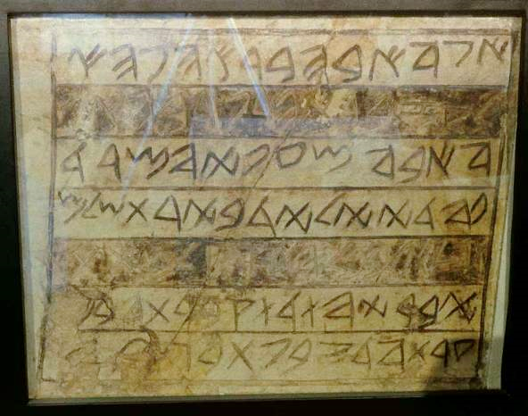
Mattathias Inscription denotes a Jew whose life-span covered the entire exilic period
“…I, Abba, the oppressed and persecuted, who was born in Jerusalem, and went into exile in Babylonia and brought back Mattathiah, son of Judah, and I buried him in the cave, which I acquired by the writ.”
Aramaic inscription from the early 2nd temple period employing old Hebrew script

Slide 43
The Silent Years
The term “silent years” refers to the period between the Old and New Testaments, which was about four centuries long.
It derives from the idea that after the last of the writing prophets (Malachi), no inspired prophetic voice was forthcoming (Josephus) until the ministry of John.
The expression “silent years” can be seriously misleading, however, in that it might suggest that nothing of importance happened in the four centuries between Malachi and the birth of Christ.
Most Christians have only a vague knowledge of what happened during this period.

Slide 44
Significant Events During the Intertestamental Period
Quite a number of historical events should be recognized as critical background for the study of the New Testament, including:
Beginnings of the Jewish Diaspora
Origins of Hellenistic Judaism
Origin of the Samaritans
Development of the synagogue
Shift in language from biblical Hebrew to Aramaic
The translation of the Hebrew Bible into Greek
The writing and collection of the Apocrypha
The Maccabean revolt
The writing and collection of the Pseudepigrapha
The reign of the Hasmonean family
Origins of theological sects, like Pharisees, Sadducees, and Essenes.
The rise of the Herods and the transition to Roman rule
The composition of the Dead Seas Scrolls

Slide 45
The Closing Prophetic Voice
Malachi has a closing function in the Hebrew Bible.
Its closing passages are messianic (3:1ff.; 4:5-6).
Jewish theologians considered Malachi to be the last authentic prophetic voice.
With this last voice, the prophets were now silent and presumably would remain silent until the coming of the Messiah (Josephus, Against Apion 1:8).

Slide 46
Jewish theologians speak of a waiting period until “…there should come a prophet to tell [them] what to do…” or “until a trustworthy prophet should arise.”
1 Maccabees 4:46; 14:41
After the death of Judas Maccabeus, there was “…great distress in Israel, such as had not been since the time that prophets ceased to appear among them.”
1 Maccabees 9:27
Josephus explains that since the time of Artaxerxes, the writings produced “…have not been esteemed of the like authority with the former by our forefathers, because there has not been an exact succession of prophets since that time.”
Against Apion 1:8

Slide 47
Discussion Points
Why do you think God interacts with humans differently at different periods of time?
Were there other times in biblical history when the voice of God was rare?

Slide 48
The Historical Periods for the Jews
Persian (Archaemenid) Empire
539-331 BC
Grecian (Hellenistic) Empire
331-164 BC
Hasmoneans
164-63 BC
Romans
63 BC
500 400 300 200 100 0
331
Alexander the Great defeats Darius III
63
Pompey takes Palestine for Rome
450?
Malachi
168
Maccabean Revolt
4
Birth of Christ

Slide 49
The Book of Esther
The story of Esther describes a concerted effort on the part of a Persian official to exterminate the Jews in the Achaemenid (Persian) Empire.
It is the one book in the Old Testament that describes Jews who did not return to Jerusalem to rebuilt the temple and the city.
While there is no mention of God in the book, the character of the narrative suggests that God was at work behind the scenes to preserve his people.
In the larger view, Haman’s plot against the Jews was equally a plot against the Messiah.

Slide 50
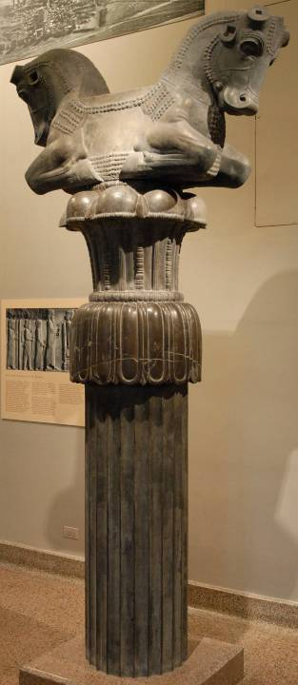
The roof of the Apadana (audience hall) at Susa was supported by thirty-six stone columns, each surmounted by a capital formed by the forequarters of two bulls joined at the middle. The roof beams rested between the bulls almost 65’ above the pavement.
Oriental Institute,
University of Chicago

Slide 51
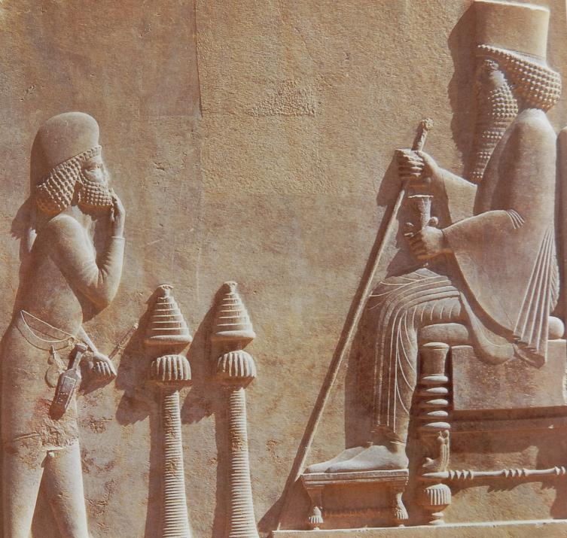
Xerxes I
Persepolis
(husband of Esther)
Called Ahasuerus in the Hebrew Bible
Tehran Museum, Iran

Slide 52
Living Without the Temple
During the exile, the Jews had their first experience of living without the temple, which had been destroyed.
Though they would build a 2nd Temple, many Jews continued to live abroad as the Diaspora, and their experience of living without the temple was extended into the Intertestamental Period.
In particular, the so-called Passover Letter from a certain Hananiah in Jerusalem to the Jews at Elephantine, Egypt signaled the approval of conducting religious festivals at locations other than Jerusalem, which would have been normative (cf. Dt. 12:4-7).

Slide 53
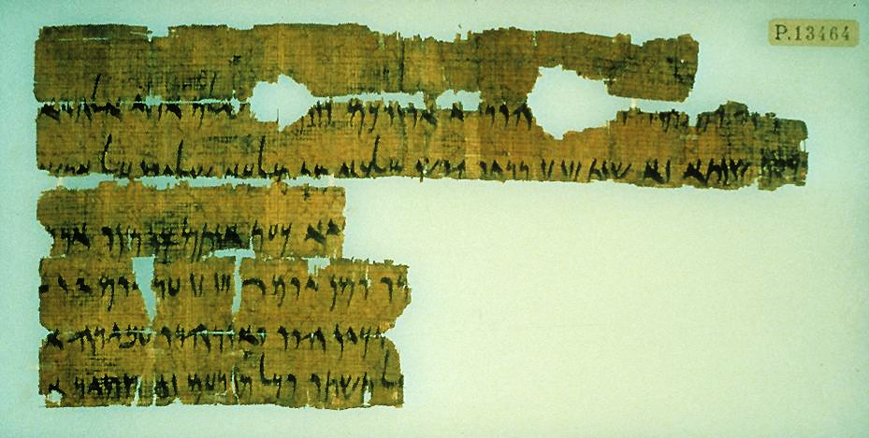
Dated to the 5th year of Darius II (419 BC), this letter from a certain Hananiah in Jerusalem exhorted the Jews in Elephantine, Egypt to celebrate the Passover. Hananiah identifies himself as “the brother,” possibly the brother of Nehemiah (cf. Ne. 1:2), whom Nehemiah placed in charge of Jerusalem (cf. Ne. 7:2).
The letter evidently was written in the atmosphere of reform that prevailed in the aftermath of Nehemiah’s mission and Ezra’s public reading of the Torah.
Staatliche Museen zu Berlin
Passover Letter

Slide 54
Discussion Points
What would be the challenges for the Jews when living without the temple?
Why do you think there is no mention of God in the Book of Esther?

Slide 55
Origins of the Samaritans
The origin of the Samaritans is not as clear as could be wished, especially due to competing claims regarding their ancestry.
2 Kings 17 suggests that they were the descendants of colonists whom the Assyrians brought into northern Israel to repopulate the land.
The Samaritans themselves deny this version, claiming their ancestry to the ancient Israelite tribes of Ephraim and Manasseh.
What is not in doubt is that the Jews and Samaritans, while having much in common, became bitterly opposed to each other.
In particular, the Samaritans contended that the temple should be on Mt. Gerizim based on the Samaritan Pentateuch.

Slide 56
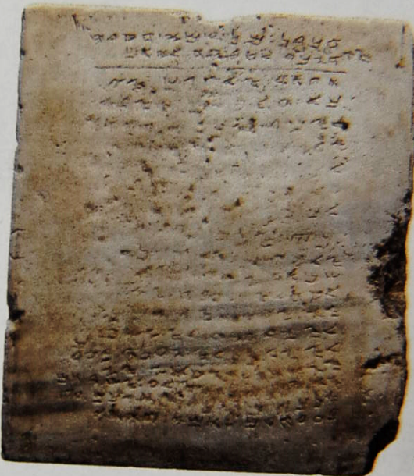
Mt. Gerizim
This Samaritan stone tablet inscription (dated AD 300-500) displays 9 of the 10 commandments, omitting the commandment about taking Yahweh’s name in vain, but including a charge to build a temple on Mt. Gerizim.
From a private collection

Slide 57
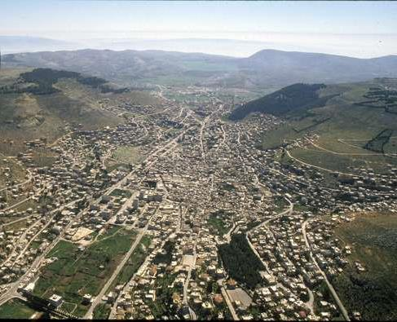
Mt. Ebal (left) and Mt. Gerizim (right) in central Israel. A small group of Samaritans (about 300) still lives in modern Nablus at the foot of the mountain

Slide 58
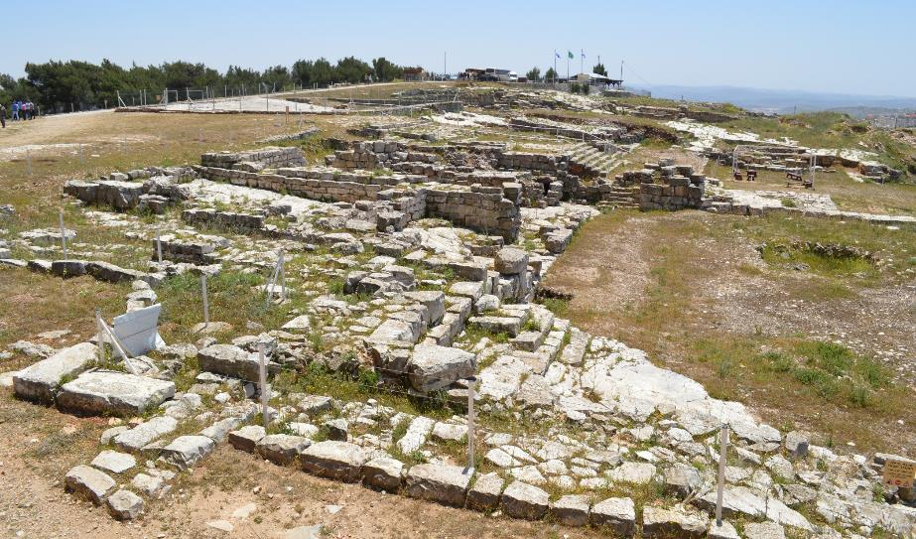
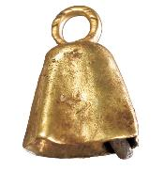
These ruins once belonged to the 2nd Samaritan Temple on Mt. Gerizim. Excavations began in 1982 and have continued uninterrupted ever since.
The first phase of the temple on Mt. Gerizim was erected in the 5th century BC. In the 2nd century BC, a larger edifice was constructed, but John Hyrcanus of Jerusalem, razed it to the ground in the late 2nd century BC. Hostilities continued into the time of Jesus.
Archaeological excavations at Mt. Gerizim have not yet uncovered remains of the 1st temple, but inscriptions in Aramaic as well as a bell of gold (appropriate for a priest, cf. Ex. 28:33-35) testify to its presence.

Slide 59
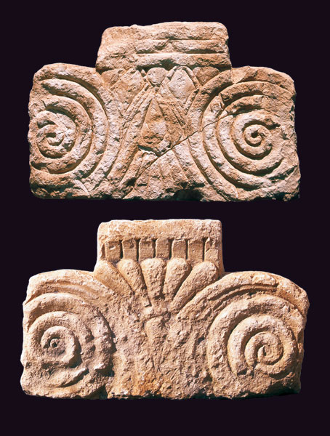
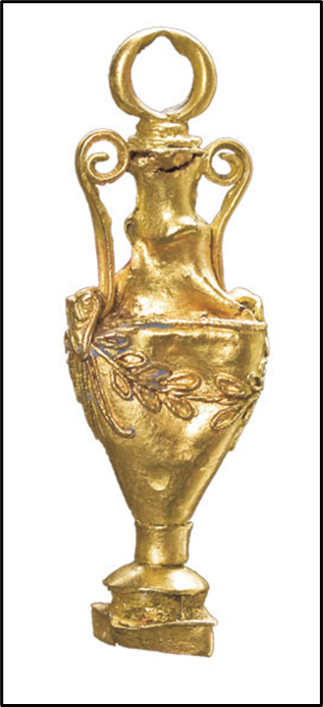
These two proto-Aeolic capitals excavated on Mt. Gerizim probably once adored the original Samaritan temple in the Persian Period. This style of capital was common in temples and royal architecture.
This gold amphora, also excavated on Mt. Gerizim, was likely one of the vessels that held wine and oil for ritual purposes.

Slide 60
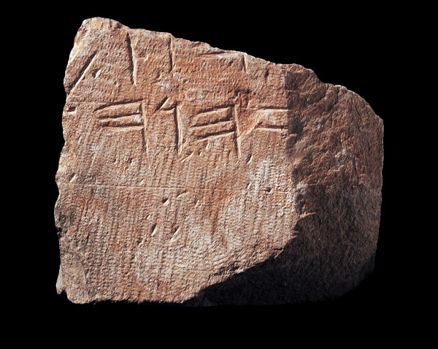
Excavated on Mt. Gerizim is this stone bearing the inscribed name YHWH in ancient script.

Slide 61
Discussion Points
In many ways, the religious ideals of the Samaritans and those of the Jews were similar to the differences between some Christian denominations. How should we think about Christians of other denominational persuasions?
Is there anything in the life and teachings of Jesus that might guide our thinking?

Slide 62
THE INTERTESTAMENTAL PERIOD
4 The Change to Hellenism

Slide 63
“In the third year of King Belshazzar’s reign, I, Daniel, had a vision…
…there before me was a ram with two horns… I watched the ram as he charged toward the west, the north, and the south.
…suddenly a goat with a prominent horn between his eyes came from the west… I saw him attack the ram furiously, striking the ram and shattering his two horns. The ram was powerless to stand against him.
The goat became very great, but at the height of his power his large horn was broken off, and in its place four prominent horns grew up toward the four winds of heaven.
The two-horned ram…represents the kings of Media and Persia. The shaggy goat is the king of Greece, and the large horn…is the first king.
Daniel 8:1-8, 20-21

Slide 64
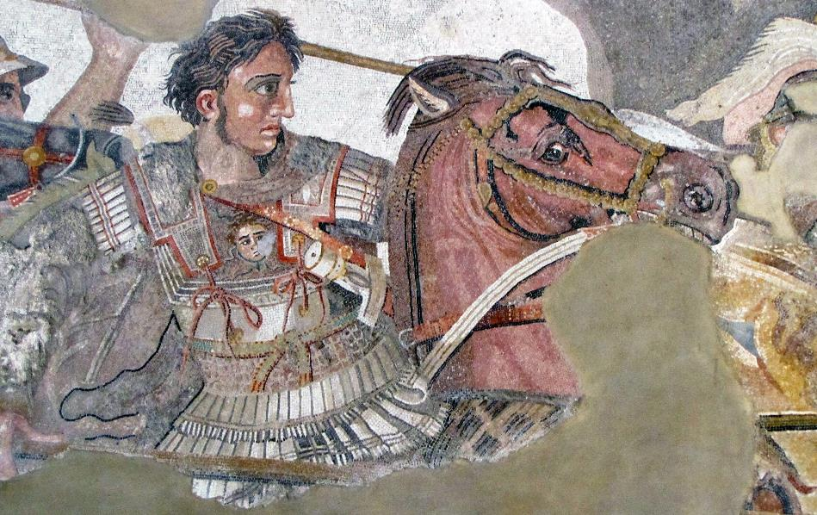
The Alexander Mosaic (c. 100 BC), part of a much larger piece made up of approximately 1 ½ million tesserae, is a Roman copy of a lost Greek painting, House of the Faun, Pompeii, c. 315 BC). The mosaic survives in such good condition, because it was protected by layers of ash from the AD 79 volcanic eruption of Mt. Vesuvius. The battle is usually identified as the Battle of Issus, Nov. 5, 333 BC, when Alexander defeated Darius III (Archaeological Museum, Naples)

Slide 65
Struggle Between Persia & Greece
TWO-HORNED RAM = Medo-Persia
GREAT HORNED GOAT = Greece
(Dan. 8:20-21)
GOAT’S SINGLE HORN = Alexander the Great
Defeated Darius III in 333 BC at the Battle of Issus
Conquered Palestine and Egypt
Defeated Darius III again on the Plain of the Tigris in 331 BC
Died in Babylon in 323 BC at the age of 32
FOUR PROMINENT HORNS = Alexander’s Successors
Seleucus (Persia, Mesopotamia, Syria)
Lysimachus (Asia Minor, Thrace)
Cassander (Macedonia)
Ptolemy (Palestine, Egypt)

Slide 66
Key Historical Events in the Early Hellenistic Period
The Hellenistic Period began when Alexander conquered Darius III of Persia in 331 BC.
When Alexander died at the age of 32, his empire fragmented among his generals.
Of these, Ptolemy seized control of Egypt and made Alexandria his capital (Alexander had named the city, as might be supposed, after himself).
After a power-struggle in the east, Seleucus emerged as the governor of Babylon, and he and his successors began extending their power westward into Syria.
The Ptolemies and the Seleucids coveted the land of Israel, both because of the wealth of the temple and also since it was the land bridge between three continents.

Slide 67
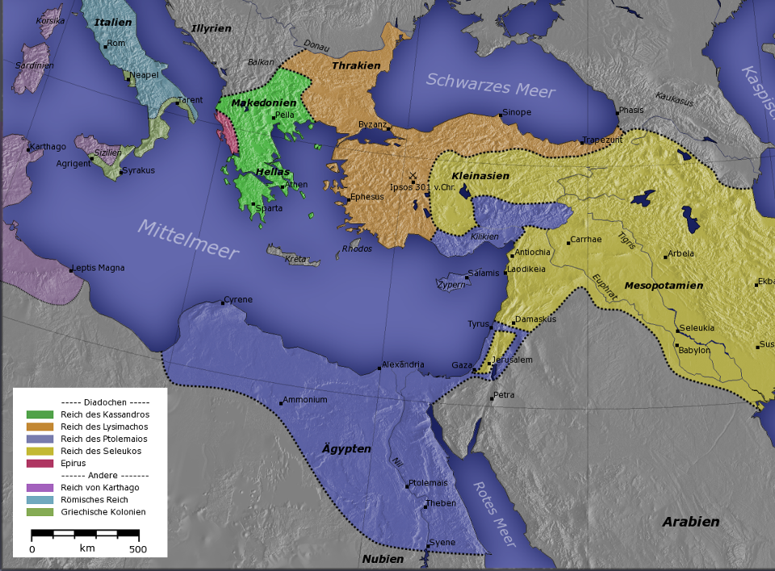
The Seleucid Empire
The Ptolemaic Empire
BREAKUP OF ALEXANDER’S EMPIRE

Slide 68
The Spread of Hellenism
Hellenistic culture spread rapidly, and in a relatively short time, the Greek language became the primary language of the empire.
Little is known of the Jews in Palestine during the first century of the Hellenistic Period other than that they were under the jurisdiction of Ptolemy of Egypt.
The population of Jews in Egypt, however, increased sharply due to migration and prisoners of war.
The Jews in Egypt quickly adopted Greek as their language and by the close of the 3rd century BC had translated their Scriptures into Greek (the Septuagint).
Eventually, the Seleucids gained control of Palestine by the early 2nd century BC.

Slide 69
Discussion Points
What might have been the advantages as well as the intrusiveness of Greek culture for the Jews in the Mediterranean world?
How much pressure might there have been to conform, especially among the Diaspora Jews? (We know from ancient texts, for instance, that some Jews began to practice epispasm, which is a surgical reversal of circumcision. St. Paul in the New Testament seems to weigh in against this procedure, 1 Co. 7:18).

Slide 70
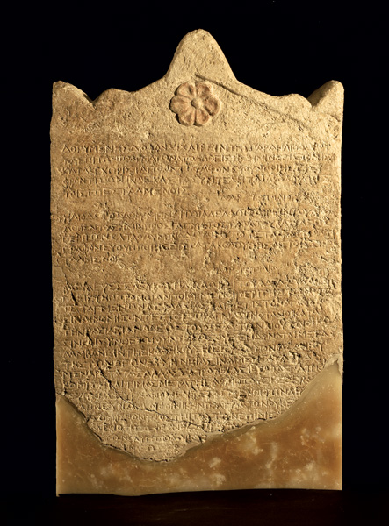
This recently discovered stela documents the efforts of Seleucus IV to confiscate what were described as “infinite sums” from the 2nd Temple (2 Macc. 3:6). His officer, Heliodorus, was sent to seize the temple treasury but was thwarted in his effort and returned empty-handed.
2 Maccabees 3 attributes this failure to a miracle, in which God sent a heavenly rider and two angels, who flogged Heliodorus, wounding him severely.

Slide 71
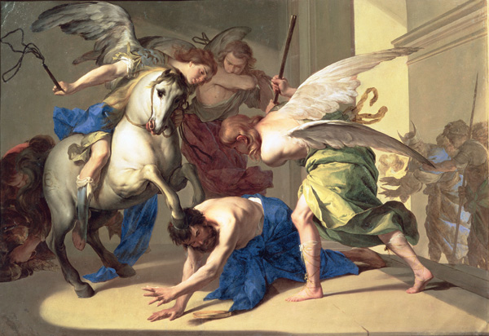
17th century painting by Bernardo Cavallino depicting the flogging of Heliodorus

Slide 72
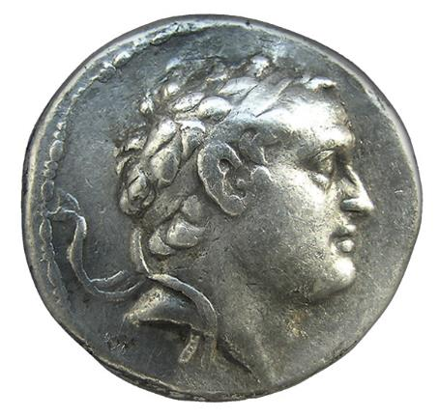
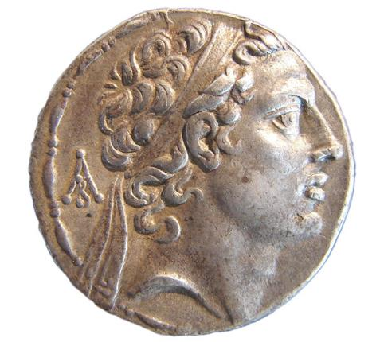
Seleucid Coins
Silver tetradrachm with the head of Seleucus IV, the king who attempted to seize the 2nd Temple treasury.
Silver tetradrachm with the head of Antiochus IV Epiphanes, the king who desecrated the 2nd Temple

Slide 73
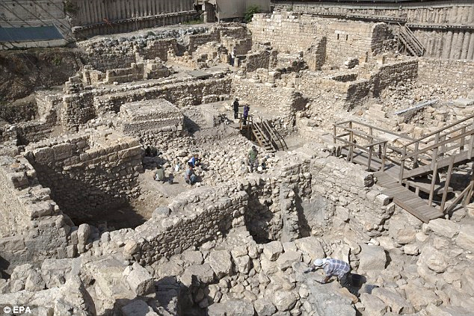
Archaeologists have uncovered a Greek fortress in Jerusalem built by Antiochus IV to control access to the Temple Mount. Called the Acra, this fortress lay between the Temple Mount to the north and the Palestinian village of Silwan to the south. The ruins are the first solid evidence of Hellenistic culture in Jerusalem. While the fortress was known to scholars from Josephus (Antiquities 12:252-253), it was only unearthed in 2014.

Slide 74
Books of the Maccabees
The books of 1 and 2 Maccabees are independent accounts of the Jewish resistance to Hellenism.
The term “Maccabeus” (= the hammer) technically refers to one man, Judas, son of Mattathias, but by extension, came to refer to the entire resistance movement.
1 Maccabees is more of a straightforward history.
2 Maccabees is more of a theological history
While 1 and 2 Maccabees are recognized as canonical by both the Roman Catholic Church and the Orthodox Church, only the Orthodox recognize 3 and 4 Maccabees (with some debate about 4 Maccabees).

Slide 75
Persecution by Antiochus IV Epiphanes
The individual whom the Book of Daniel labels as “a contemptible person” (Da. 11:21a), and which in later works is described as “a sinful root” (1 Macc. 1:10) and “an arrogant and terrible man” (4 Macc. 4:15), made every effort to eradicate Jewish religion.
He sacked Jerusalem and robbed the temple treasury.
He desecrated the 2nd Temple by installing in it an altar to the god Zeus and offering swine flesh on the altar, dripping the burning fat on the Torah scrolls.
He outlawed circumcision, suspended sabbatical and Jewish festival observances, burned Torah scrolls, and executed any opposers.

Slide 76
The Maccabean Revolt
Finally, a priest from Modi’in and his sons rallied 6000 guerilla fighters to take up arms against these horrors.
Though Mattathias, the priest, died in 166 BC, the resistance of the freedom fighters was taken up by Judas, his son.
Though severely outnumbered, the Maccabees successfully drove out the pagan Greeks from Jerusalem, ushering in a century of Jewish political independence.
The descendants of the Maccabees (called the Hasmoneans) continued to rule from Jerusalem until the interference of Rome in 63 BC.

Slide 77
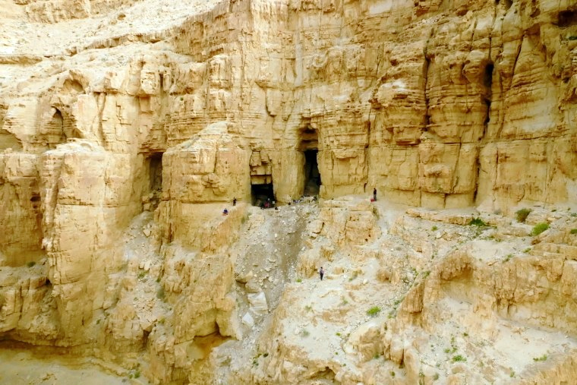
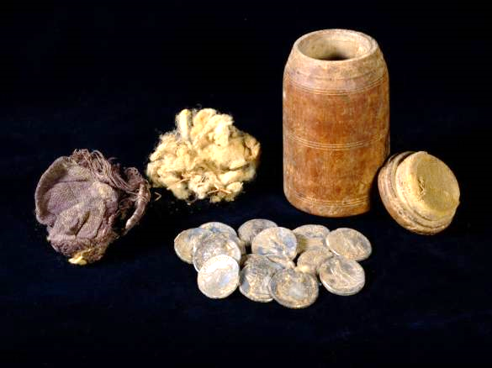
In 2022, archaeologists discovered a cache of silver coins. Scholars from the Israel Antiquities Authority believe them to be a hidden trove left by a refugee fleeing from the Maccabean conflict.

Slide 78
The Cleansing of the Temple
Once the Maccabees regained control of Jerusalem, they could turn their attention to the desecrated second temple.
They rebuilt the great altar entirely, considering it so desecrated that it was beyond redemption (and buried the original stones).
The temple itself they purged of all the intruding elements of paganism.
On December 25, 165 BC (or 164 BC by some scholars), they rededicated the temple to the service of God, extending their celebration for eight days.
Because there was a shortage of pure olive oil, they were unable to replenish the oil for the Menorah, but the lamp burned miraculously for the full eight days.

Slide 79
Hanukkah
In memory of the miracle of the oil, the Jews instituted a new festival, the Festival of Lights or Hanukkah (= dedication).
Though the original menorah in the 2nd Temple had the traditional seven lamps, a new style menorah became popular with nine lamps—eight lamps for the eight days when the oil burned without being replenished and one lamp representing Judaism as a light to the world.
Jesus would attend Hanukkah in Jerusalem during his public ministry (Jn. 10:22-24).

Slide 80
Discussion Points
What is your take on the miracles that attended the Jewish resistance to Hellenism? (In addition to the scourging of Heliodorus and the eight days burning of the menorah oil, other miracles are described in 2 Maccabees, including ominous heavenly riders that that charged through the air for 40 days (5:2-3), the recovery of holy fire that had been hidden before the exile and ignited spontaneously (1:19-22, 32-32, 36), and the five angelic horsemen who protected Judas Maccabeus by hurling thunderbolts at the enemy (10:29-30.)
In the gospels, Jesus made no direct references to the Maccabean revolt, though he did attend Hanukkah at least once. What might have been Jesus’ perspective on this history?

Slide 81
THE INTERTESTAMENTAL PERIOD
5 The Hasmoneans and the Romans

Slide 82
The Hasmoneans
The Maccabean Revolt gained the semi-independence of the Jews under the leadership of the Hasmonean family (Hasmon was an ancestral name for the Maccabees).
After Judas’ death, his brother Jonathan and Simon continued as dynastic leaders “until there should come a faithful prophet” (1 Macc. 14:41).
Under Simon, the dynasty gained recognition from the Roman Senate in 139 BC.
Under John Hyrcanus I, Simon’s son, the Hasmoneans began extending their territorial rule, and by 100 BC, all the area from Galilee in the north to the Negev in the south belonged to Judea.

Slide 83
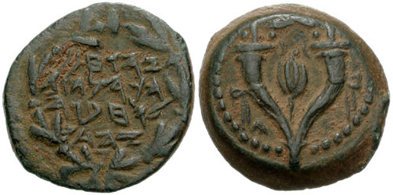
Coin minted under the regime of John Hyrcanus I with the Hebrew inscription (right): Yohohanan (John) the High Priest and the Council of the Jews.
Unlike other nations, the Jews would not mint coinage with the heads of rulers on them. This coin (left) has a double cornucopia adorned with ribbons and a pomegranate between the horns.

Slide 84
Expansionism and the Destruction of Samaria
In his efforts to increase the territory of the Judean state, Hyrcanus I began a military campaign against Samaria in 111 BC, the Transjordan in 110 BC, and Idumea after that.
He put the city of Samaria to a year-long siege, and in the end, totally destroyed it, including the Samaritan temple on Mt.Gerizim.
He consigned the inhabitants of Samaria to slavery and forced non-Jewish populations to adopt Jewish customs.
On the Idumeans (Edomites), he instituted forced conversions to Judaism.

Slide 85
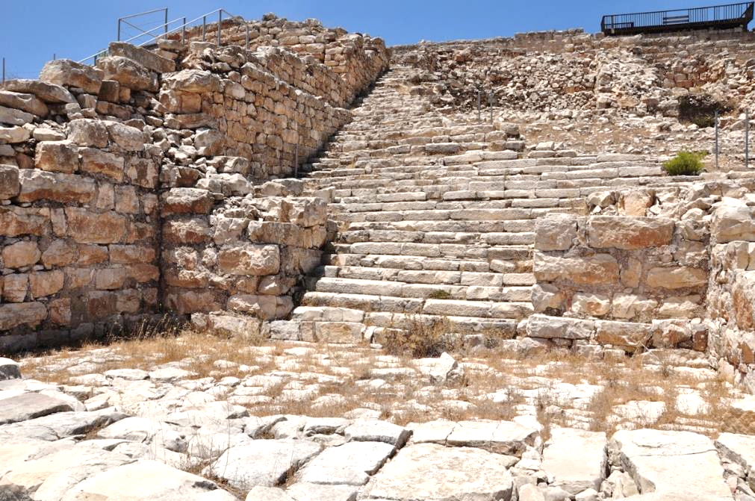
Excavated stairway to the temple platform for the Samaritan temple on Mt. Gerizim.
The destruction of the Samaritan temple would leave a deep and lasting bitterness extending into the period of the NT.

Slide 86
Hasmonean In-fighting
After John Hyrcanus’ death in 104 BC, members of the Hasmonean family engaged in jealous in-fighting for control of Judea.
Aristobulus I, Hyrcanus’ son, jailed his brothers and mother (allowing her to starve in prison).
After only a year of rule, he died, and Alexander Jannaeus, another son now released from prison, assumed leadership for the next quarter of a century.
When he died, his wife, Salome Alexandra, took over for a decade.
She appointed her son, John Hyrcanus II, to succeed her, but another brother, Aristobulus II, vied for control with the help of Antipater, an Idumean.

Slide 87
Discussion Points
How does the political intrigue and nepotism in the Hasmonean family compare with what we might see in modern nation states?
What New Testament stories are related to the Samaritans, and how might the Samaritans have related to a Jewish Messiah?

Slide 88
“And there shall be a fourth kingdom, strong as iron, because iron breaks to pieces and shatters all things. And like iron that crushes, it shall break and crush all these.”
Daniel 2:39-40
“As for the fourth beast, there shall be a fourth kingdom on earth, which shall be different from all the kingdoms, and it shall devour the whole earth, and trample it down, and break it to pieces.”
Daniel 7:23
“And in the days of those kings the God of heaven will set up a kingdom that shall never be destroyed, nor shall the kingdom be left to another people. It shall break in pieces all these kingdoms and bring them to an end, and it shall stand forever…”
Daniel 2:44

Slide 89
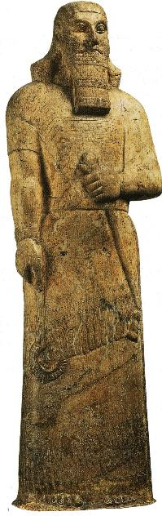
GOLD
BABYLON
Daniel’s Interpretive of Nebuchadnezzar’s Dream:
The head clearly represents Babylon (“you are the head of gold”, Da. 2:38b); all interpretations must begin here.
The following kingdoms are most often interpreted to be Persia, Greece, and Rome.
SILVER
PERSIA
BRONZE
GREECE
Ashurnasirpal
IRON
ROME
Ashurnasirpal II, British Museum

Slide 90
Rome Takes Over
The instability of the Hasmonean family prompted Rome to intervene in Judah and Jerusalem. In 63 BC, Pompey, the Roman General, conquered Jerusalem, reinstalling John Hyrcanus II as the client ruler (but denying him the title “king”).
Pompey, however, was soon involved in the Roman civil war against Julius, and in their own self-interest, Hyrcanus II and Antipater supported Julius.
When Julius [Caesar] emerged the victor, he reinstated Hyrcanus II as High Priest and Antipater as Procurator.
Antipater, in turn, appointed two of his sons to high offices, Phasael over Jerusalem and Herod over Galilee.

Slide 91
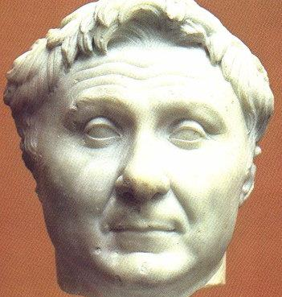
Pompey the Great (106-48 BC), a rival of Julius Caesar, conquered Palestine by putting Jerusalem to siege. The city fell after a three month campaign. Subsequently, he reinstated John Hyrcanus II as the High Priest over the temple and Antipater as Procurator.
Ny Carlsberg Glyptotek,
Copenhagen, Denmark

Slide 92
The Assassination of Julius Caesar
When Julius Caesar was assassinated in 44 BC, Rome was left to deal with considerable turbulence, which in turn left Jerusalem without much interference.
In the political vacuum, the Parthians from the east saw their opportunity to encroach into Roman territory and promptly installed Antigonus, a son of Aristobulus II, as their own client ruler in Jerusalem.
Herod fled to Rome where, unexpectedly, he was nominated by the Senate as the King of Judea (with the proviso that he oust Aristobulus II).
Herod promptly returned, put Jerusalem to siege, and with the help of the Roman army captured it. Antigonus was executed.

Slide 93
Discussion Points
Why might the visions in Daniel 2 and 7 describe the Romans with such intriguing metaphors as “legs of iron” and a “terrifying beast?”
Jesus once told a parable about a nobleman who went into a far country to receive for himself a kingdom (Lk. 19:12)? Do you think he might have been obliquely referring to Herod?

Slide 94
Herod the Great
Herod the Great would rule Palestine from 37 BC to his death in 4 BC.
That he was half Edomite did not endear him to his Jewish constituency.
He is justly famous for his building projects, which included the port at Caesarea Maritima, as well as fortresses at Sebaste, Herodion, Machaerus, Masada, and palaces at Jericho and Jerusalem.
He also built three large temples in honor of Caesar at Caesarea, Sebaste, and Panias, plus he greatly enlarged the 2nd Temple.
He abolished the hereditary and life-time tenures of the Jerusalem High Priests, appointing priests as he saw fit.

Slide 95
Herod’s Temple
Herod’s enlargement of the 2nd Temple platform (temenos), which began in 19 BC, was without question his most elaborate building project.
He increased the temple platform to about 35 acres, quarrying huge ashlars to serve as foundations for the massive retaining walls.
At their highest point, the retaining walls were nine stories high and 16’ thick.
The Court of the Nations was open to people of any ethnicity, but placards warned non-Jews not to go beyond certain limits.

Slide 96
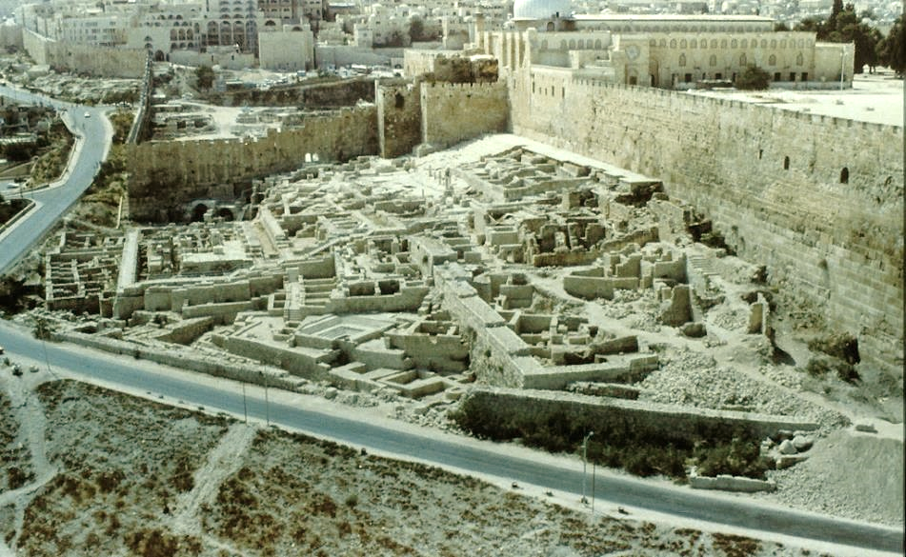
The southern wall of the expanded temple, the lower courses laid by Herod and the upper courses reconstructed by the Muslims some centuries later

Slide 97
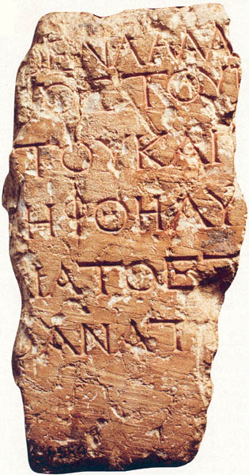
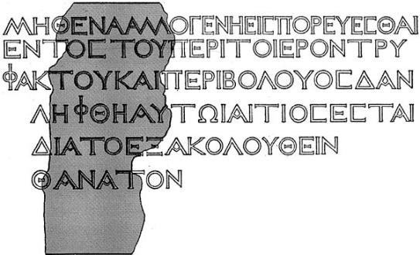
This Greek inscribed placard, discovered in 1935, once warned Gentiles not to enter the inner courts reserved for Jews at the pain of death. The full inscription reads: “No foreigner may enter within the railing and enclosure that surround the Temple. Anyone apprehended shall have himself to blame for his consequent death” (this fuller text is reconstructed from a more complete copy in the Archaeological Museum in Istanbul.
Israel Museum, Jerusalem

Slide 98
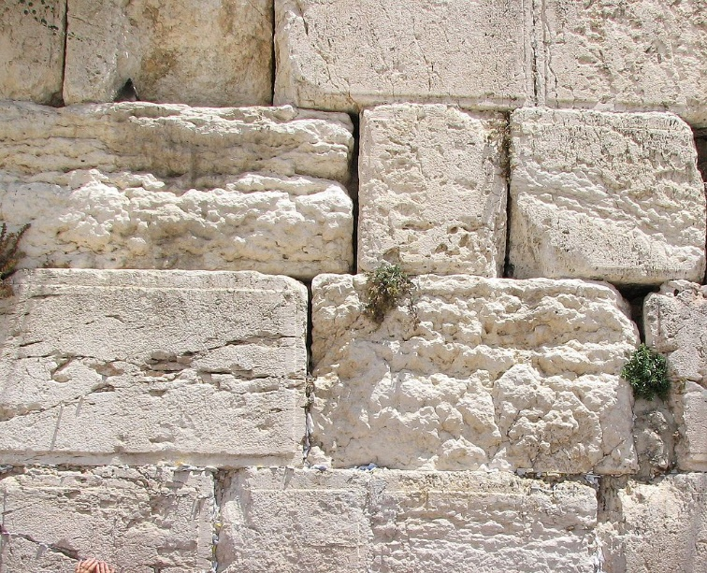
The Herodian ashlars are distinctive with a boss surrounding the outside surface edge.
They are the largest quarried stones in antiquity, considerably larger than the stones in the Egyptian pyramids.

Slide 99
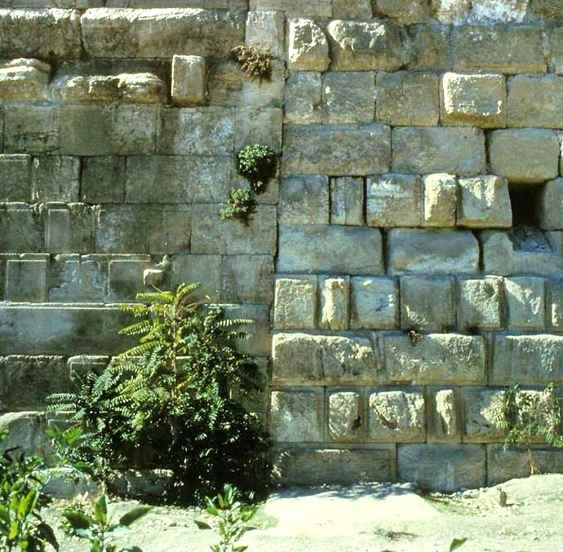
The so-called “straight joint” on the east wall of the Temple Mount shows the contrast between Herodian masonry (left) and an earlier corner of the wall (right), which might go back as far as Nehemiah or even the 1st Temple.
Behind these walls Herod built huge vaulted storage chambers as opposed to simply filling in the space with slag.

Slide 100
Roman Occupation
With the take-over by Rome, the areas of Jewish population saw an influx of Roman military with new fortifications on the major roads and in major towns.
Herod built a huge military barracks in Jerusalem, the Antonia Fortress.
During the emperorship of Augustus, three legions (18,000 soldiers) were assigned to Syria-Palestina. This would increase to 24,000 by the time of Tiberius.
The administration of Judea was carried out by a series of Legates, Prefects, and Procurators. Pontius Pilate would be the most well known Prefect in the New Testament.

Slide 101
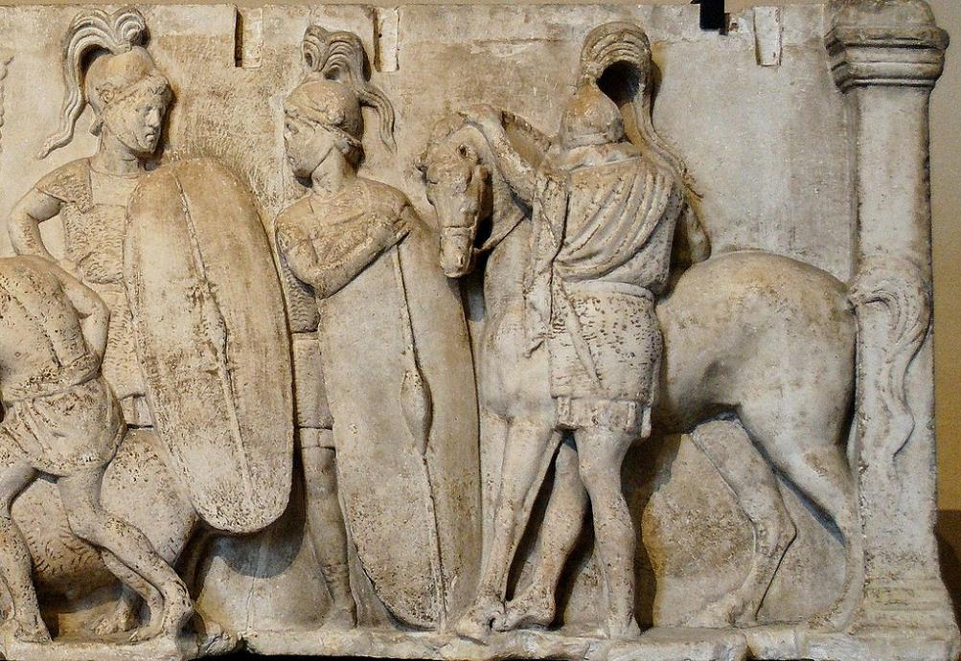
Detail of Roman soldiers

Slide 102
Taxation
Taxation by an occupying government was to be expected, and client kings like Herod as well as other government officers made sure Rome received its revenues.
Tax collection was farmed out to local collectors who contracted with the government to supply a predetermined amount of tax revenue.
There was a head tax, a land tax, a transportation tax, an inheritance tax, plus religious taxes to the 2nd Temple.
Tax collectors were notorious for charging more than required in order to boost their own profit margin, and Jewish tax collectors like Matthew (Mt. 9:9; 10:3) and Zacchaeus (Lk. 19:1-10) were generally perceived to be traitors to the Jewish cause.

Slide 103
Rise of Zealotry
Roman occupation, the burden of taxation, and the luxurious lifestyles of the elites all contributed to the rise of nationalism and resentment toward the Romans.
In 4 BC, Judas ben Ezekias attacked the administrative center of Galilee at Sepphoris, sacking its treasury and weapons. The Legate Varus, according to Josephus, burned the city down and consigned its citizens to slavery.
Judas the Galilean rallied a resistance movement after the census in AD 6 due to tax increases. He and his followers were all crucified.
Zealotry continued well into the 1st century, climaxing in the 1st Jewish Revolt in AD 66-70. One of Jesus’ disciples was a zealot (Mk. 3:18).

Slide 104
Discussion Points
What sorts of things did Jesus say that might have struck his listeners as too lenient to the occupying Romans?
What did Jesus say about paying taxes?
Jesus’ disciples were impressed by Herod’s 2nd Temple reconstruction, commenting on the huge ashlars (Mk. 13:1). What was Jesus’ response?

