Slide 1


The
Incarnation
and the Nicene Creed

Slide 2
“The Logos became flesh and tabernacled among us, and we saw his glory, the glory as of the one and only from the Father…”
John 1:14
(my translation)
If Jesus was the true incarnation of the Son of God, then it was entirely appropriate to worship him, pray to him, and recognize him as divine.

Slide 3

The Triadic Conception of God in the NT
The faith of the earliest Christians revolved around their conception of God as the Father, the Son, and the Holy Spirit.
However, the New Testament does not offer an explanation so much as a declaration and definition of God in this way.
It tells us “what,” but it does not tell us “how.”
Hence, later Christians would wrestle with this question of “how.”

Slide 4
The Synoptic Gospels
Matthew, Mark, and Luke demonstrate this triadic pattern in several ways:
At Jesus’ birth, the Holy Spirit was the active agent in the birth of God’s Son (Mt. 1:20-23; cf. Lk. 1:30-35).
At Jesus’ baptism, the voice from the heavenlies (the Father) invokes a blessing on Jesus (the Son), while the Spirit descends in the form of a dove (the Holy Spirit).
The gospels close with the great commission in which the form of the name used in baptism has three separate definite articles: …the name of the Father and of the Son and of the Holy Spirit” (Mt. 28:19).

Slide 5
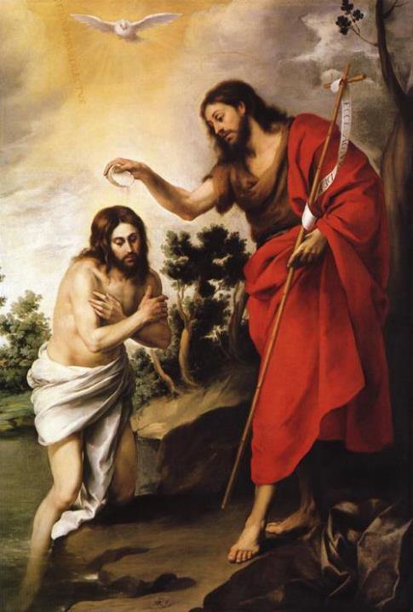
Baptism of the Lord
Bartolome Esteban Murillo
Completed in 1655
Originally painted for the refectory of the Augustinian monastery of San Leandro, Seville, Spain, now in the Berlin Museum
The tree in the center is an allusion to the cross
The verticality of the composition is softened by the gentle tilt of all visual lines

Slide 6
The Fourth Gospel
“No one has ever seen God, but God the one and only [Son], the one who is in the bosom of the Father, that one has declared [him].”
John 1:18
(my translation)
The One (the Father) who commissioned John the Baptist told him that he would see the Spirit (the Holy Spirit) descending upon Jesus (the Son), Jn. 1:32-34.
Jesus prayed, “And now, Father, glorify me in your presence with the glory I had with you before the world began” (Jn. 17:5).

Slide 7
Salutations and Benedictions
In the New Testament letters, the writers regularly refer to the same triadic pattern:
“Praise be to God the Father” (the One who planned) “…he chose us in Him” (the Son who redeemed us with his blood) “You were marked in him with a seal, the promised Holy Spirit” (Ep. 1:3-7, 13).
“May the grace of the Lord Jesus Christ, and the love of God, and the fellowship of the Holy Spirit be with you all” (2 Co. 13:14).

Slide 8
Discussion
What is the difference between incarnation and simply being Spirit-filled?
Why is the presence of the triadic formula in salutations and benedictions so important?

Slide 9
The Triadic Pattern Continues
The triadic language of the New Testament is repeated in the writings of the post-apostolic fathers.
“God lives, and the Lord Jesus Christ, and the Holy Spirit” (Clement of Rome, AD 96).
“Like the stone of a temple…you have been lifted up to the top by the crane of Jesus Christ…and the rope of the Holy Spirit” (Ignatius, AD 115).
“I praise Thee…through Jesus Christ, thy beloved Son, through whom be glory to Thee with Him and the Holy Spirit…” (Polycarp, AD 155).

Slide 10
The Baptismal Formula
The baptismal formula in Mt. 28:19 became the standard one throughout the early church.
“Baptize into the name of the Father, and of the Son, and of the Holy Spirit” (Didache, c. AD 95)
“…for in the name of God, the Father…and of our Savior Jesus Christ, and of the Holy Spirit, they (i.e., Christians) receive the washing with water” (Justin Martyr, AD 140).

Slide 11
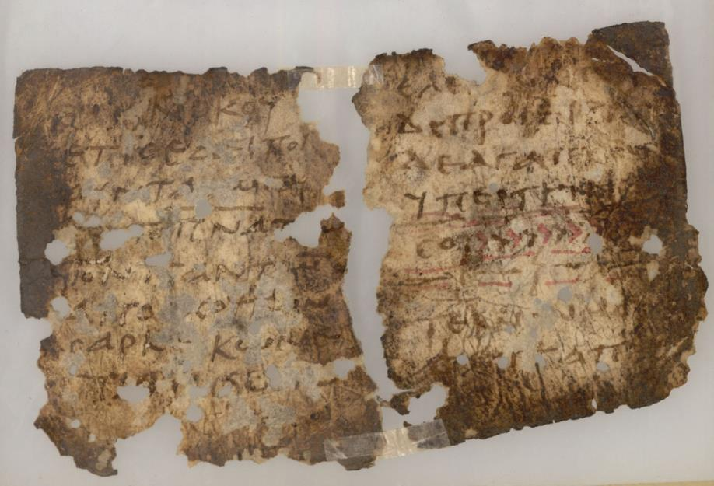
Ancient copy of the Didache, in which appears the baptismal formula of “the Father, the Son, and the Holy Spirit” in about AD 95.

Slide 12
The Early Heresies
A “heresy” is a teaching that the Christian church at large considers to be mistaken and dangerous to the faith.
With respect to the nature of God, a number of heresies have arisen through the centuries, but the two most important in the early period were:
  Modalism
  Arianism
Both were inadequate attempts to explain the Divine Nature, but both were important in that they stimulated the church to better define what it believed.

Slide 13
Modalism
Modalists held that the “Father,” the “Son,” and the “Holy Spirit” were simply successive and temporary forms, not the essential nature of God.
God was the Father in Creation.
He was the Son in redemption.
He was the Holy Spirit in sanctification.
This way of explaining things seemed to imply that the Father was crucified on the cross, since there was no essential distinction between the Father and the Son.

Slide 14
Arianism
Arius, a popular preacher, taught that the Son was not eternal. Rather, he was a created being, and “there was a time when the Son was not.”
This implied that the worship of Christ, the Son, was a form of idolatry, since he was less than God.
According to Arius, Jesus was limited in power and knowledge, and his teaching threatened to divide the church.
It was largely due to Arianism that Emperor Constantine called for a world-wide council of bishops to better define the Christian concept of God.

Slide 15
The Nicene Council
Bishops from all over the Christian world (Athanasius numbered them at 318) convened at Nicaea to address the issue.
Here, they formed a Statement of Faith (Creed) disclaiming Arianism (and implicitly disclaiming Modalism).
The language of the Nicene Creed was to be used world-wide, and it continues to be central to all branches of classical Christianity, Roman Catholic, Eastern Orthodox, and Protestant.

Slide 16
Comparing the Viewpoints
Modalism
God is a simple “one.”
Jesus is the Son of God, but this is a temporary mode.
Father, Son, and Spirit are not the essential nature of God.
The Holy Spirit tends to be impersonal.
Arianism
God is a simple “one.”
The Son is a created being and less than God.
The Son is inferior to the Father.
The Holy Spirit tends to be impersonal.
Trinitarianism
God is a complex “one.”
The Son is eternal.
Jesus is God’s Son incarnate.
The essential nature of God is Father, Son, and Spirit.
Holy Spirit is personal.

Slide 17
FROM THE NICENE CREED
I believe in one God, the Father Almighty…
And in one Lord, Jesus Christ, the only-begotten Son of God; begotten of his Father before all worlds, God of God, Light of Light, very God of very God; Begotten, not made; Being of one substance with the Father…
I believe in the Holy Ghost, the Lord, and Giver of life…

Slide 18
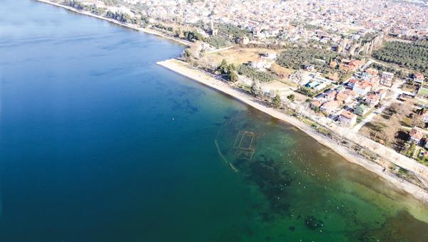
In 2015 near modern Iznik (ancient Nicaea), an early basilica was discovered lying submerged in 6-10’ of water about 165’ offshore. The church is divided into three aisles with an apse on the eastern end. Likely it was built on the site where the Council of Nicaea convened in AD 325.

Slide 19
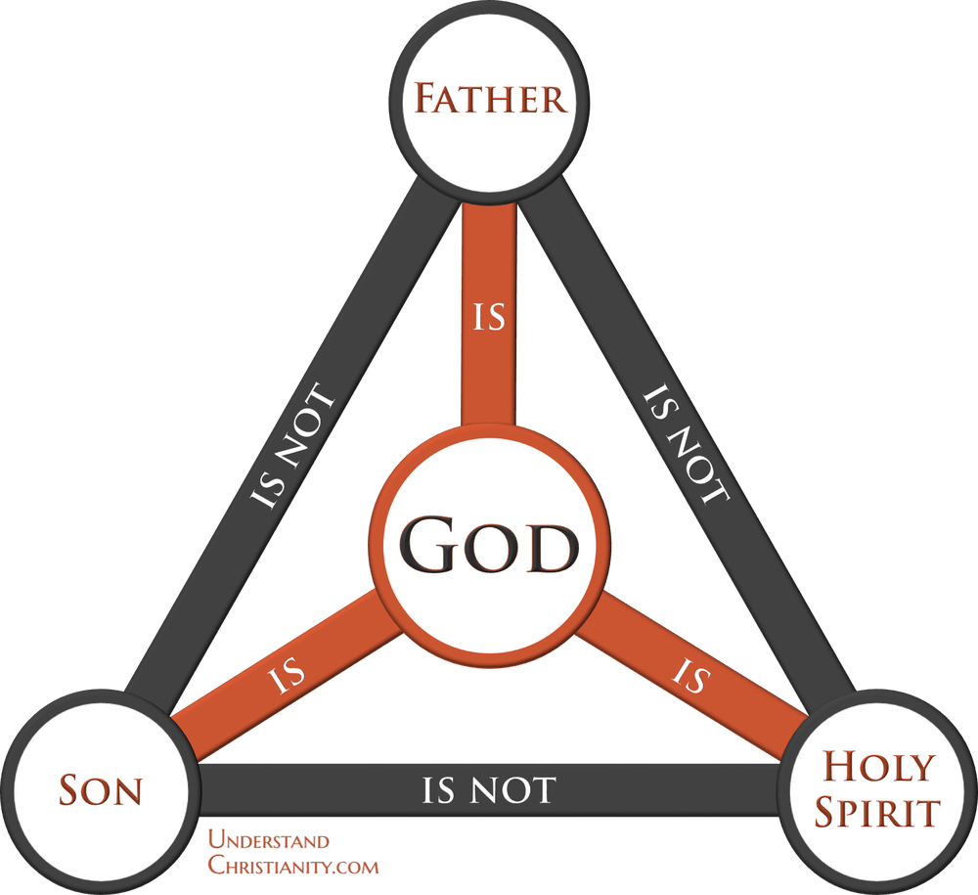
“How much more, then, will the blood of Christ [the Son], who through the eternal Spirit [the Holy Spirit] offered himself unblemished to God [the Father], cleanse our consciences from acts that lead to death so that we may serve the living God?”
He. 9:14
“Father, I want those you have given me to be with me where I am, and to see my glory, the glory you have given me because you loved me before the creation of the world.”
Jn. 17:24

Slide 20
Discussion
Are there any groups today whose viewpoints approximate those of the Modalists and Arians?
Many contemporary progressive Protestant churches are distancing themselves from issues of theology, so that one can “belong” without “believing.” What do you think of this trend?
In a culture that sees history as less and less important, how significant is the history of the Christian church, especially its early history?

