Slide 1
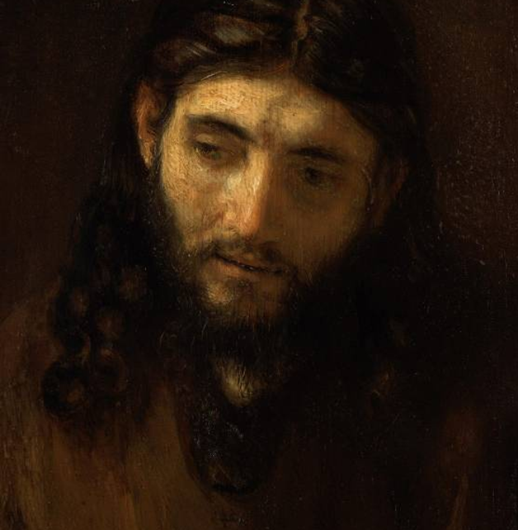
The Parables of Jesus
Understanding Jesus’ parables in their original context
5 – THE SONS OF THE KINGDOM

Slide 2
“He [Jesus] called a little child and had him stand among them. And he said: ‘Amen, I tell you, unless you change and become like little children, you will never enter the kingdom of heaven.’”
Mt. 18:2-3

Slide 3
Sons of the Kingdom
In the Parable of the Weeds (Mt. 13:38), Jesus spoke of the good seed as the “sons of the kingdom” (or we might say children of the kingdom).
The phrase “sons of…” is a Hebrew idiom:
  It is not about physical descendants.
  Rather, it is about moral character and quality of behavior.
Jesus also said that unless one changes and becomes like a child, he could never be part of the kingdom of God (Mt. 18:3-4).
In several parables, Jesus describes what it means to be a “child of the kingdom,” and he often told stories of contrast, such as, two builders, two sons, and two debtors.

Slide 4
Parable of the Two Builders
(Mt. 7:24-27; Lk. 6:47-49)
At the end of the Sermon on the Mount, Jesus offered the story of two builders.
Houses, especially rural ones, were usually built of mud brick, so the stability of the ground was critical.
Further, they usually were built on slopes, since the valley floors were reserved for farming.
The wise builder built his house on solid rock.
The foolish builder built his house on sand, probably referring to the sand in a wadi.

Slide 5
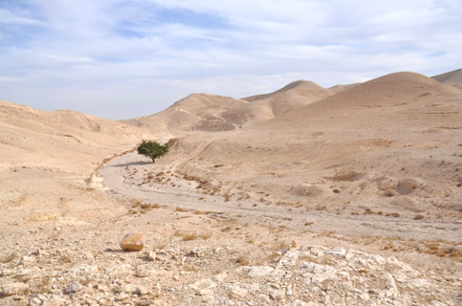
“Everyone who hears these words of mine and does not put them into practice is like a foolish man who built his house on sand” (Mt. 7:26).
Building in a wadi (a dry stream bed) would be an invitation for disaster, since in the wet season the wadi was subject to flash floods.

Slide 6
Parable of Two Sons (Mt. 21:28-32)
In this story, Jesus emphasized obedience and the larger question of who is acceptable to God.
One son initially refused to work in his father’s vineyard, but later, he thought better of it and went.
The other agreed to work, but in the end, didn’t go at all.
The question of who is acceptable to God was usually answered in terms of racial purity (social Elites), Torah intensification (Pharisees), political alignment (Zealots), or support for the Temple (Sadducees).
“Which of the two did what his father wanted?”

Slide 7
Parable of Two Debtors (Lk. 7:36-50)
Jesus told this story in the setting of a meal at the home of Simon the Pharisee.
Meals, especially in hot weather, were taken in a courtyard, usually open to the street.
All sorts of people could wander in and out, some to beg for food and others to listen in the on the conversations.
The guests would recline on their left elbow on low couches or cushions surrounding a low table or a carpet in the center with their feet stretched out behind them.

Slide 8

She had clearly heard the message of the freely-offered love of God for sinners, and her gratitude was deep and overwhelming.
On this occasion, a woman came behind Jesus, kneeling to wash his feet with her tears and, having no towel, to dry them with her hair.
By letting down her hair, she was violating a well-known social protocol (the Talmud indicated a woman could be divorced for letting down her hair in the presence of a man not her husband).
She also kissed Jesus’ feet, anointing them with valuable perfume from the small alabaster flask which she probably wore on a cord around her neck.
Alabaster, a fine-grained stone, was used in the ancient world to make containers for precious ointments.

Slide 9
“Now, which of them will love him more?”
Simon, the host, was scandalized.
Inwardly, he criticized Jesus for failing to recognize this woman as a sinner, reckoning that she was either a prostitute or the wife of a man with a despised trade. Either way, she was unclean, a “sinner.”
In allowing this woman to touch him, he was then unclean.
Perceiving Simon’s cynicism, Jesus told the story of two debtors, one which owed a large sum (about a year and a half of wages) and the other a much smaller sum.
Their creditor cancelled both their debts.

Slide 10
“Do you see this woman? I came into your house. You did not give me any water for my feet, but she wet my feet with her tears and wiped them with her hair. You did not give me a kiss, but this woman, from the time I entered, has not stopped kissing my feet. You did not put oil on my head, but she has poured perfume on my feet. Therefore, I tell you, her many sins have been forgiven—for she loved much. But he who has been forgiven little loves little.’”
Lk. 7:44b-47

Slide 11
DISCUSSION
Even for modern people, the scene of a woman washing Jesus’ feet with tears, drying them with her hair, and perfuming his feet would be socially awkward at a meal. What is the challenge in this story for modern Christians?
What might be the marks of a child of the kingdom in this story?

Slide 12
Parable of the Good Samaritan (Lk. 10:29-37)
In this story, the circumstance was an expert in the Torah who asked, “What must I do to inherit eternal life?”
Jesus responded, as he had on other occasions, with what he regarded as the two most important laws in the Torah (cf. Mt. 22:34-40):
  …to love God will all one’s heart, mind, and strength (cf. Dt. 6:5)
  …to love one’s neighbor as oneself ((cf. Lv. 19:18)
The lawyer, in an effort toward self-justification, then asked, “But who is my neighbor?”
In response Jesus told the story of the Good Samaritan.

Slide 13
The story was about a man brutally attacked by thieves on the road from Jerusalem to Jericho, a notoriously dangerous route winding its way downward through a barren, uninhabited region nicknamed “the path of blood.”
Two holy men passed the victim, a priest and a Levite, and neither gave him any assistance.
Likely, they couldn’t identify his ethnicity, since he had been stripped. To touch a foreigner would result in ritual uncleanness, and to contact blood, or worse to touch a corpse, would do the same.
However, a Samaritan traveler came by and assisted the man, cleaning his wounds with oil, disinfecting them with wine, and bandaging them.
He took him to an inn (probably in Jericho), staying the night to watch over him.
He promised to pay any additional expenses if they occurred.

Slide 14
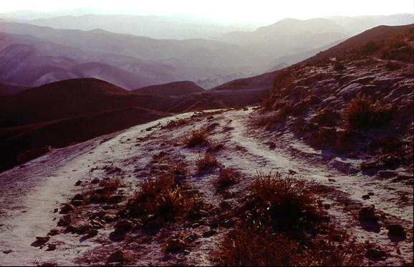
The “Path of Blood” descends some 3300 feet in 17 miles though the rugged Judean mountains. Until the 5th century, it was called the red or bloody way.
The ancient Roman road between Jerusalem and Jericho still survives.

Slide 15
Due to severe antagonism between Samaritans and Jews, this story was strikingly counter-culture.
A century or so earlier, the Jewish ruler John Hyrcanus had seized the Samaritan temple on Mt. Gerizim and destroyed it.
Subsequently, Samaritans had strewn human bones in the Jerusalem temple to desecrate it.
Had Jesus been talking to Samaritans, he may have told the story of the Good Jew, but here, to a Jewish lawyer, he made a half-breed heretic the hero of the story.
Jesus took the lawyer’s question and reversed it, leaving the question unanswered. Instead, Jesus concluded by asking, “Which of these three do you think was neighbor to the man who fell into the hands of thieves?” After the obvious answer, Jesus said, “Go and do likewise.”

Slide 16
Parable of the Laborers in the Vineyard
(Mt. 20:1-16)
In one story, Jesus spoke of a vineyard farmer hiring workers to harvest grapes.
The workers were gleaned from the unemployed who were idling in the marketplace, hoping for work.
To the earliest group he promised a denarius (full day’s wage), and altogether, he hired five groups throughout the day, promising to pay them what was fair.
At the end of the day, he instructed his manager to pay them all a denarius, even those who had not worked but the final hour, starting with those most recently hired.
Those who had worked the whole day complained that they were not paid more, but the vineyard farmer clearly sympathized with the unemployed and chose to be generous.

Slide 17
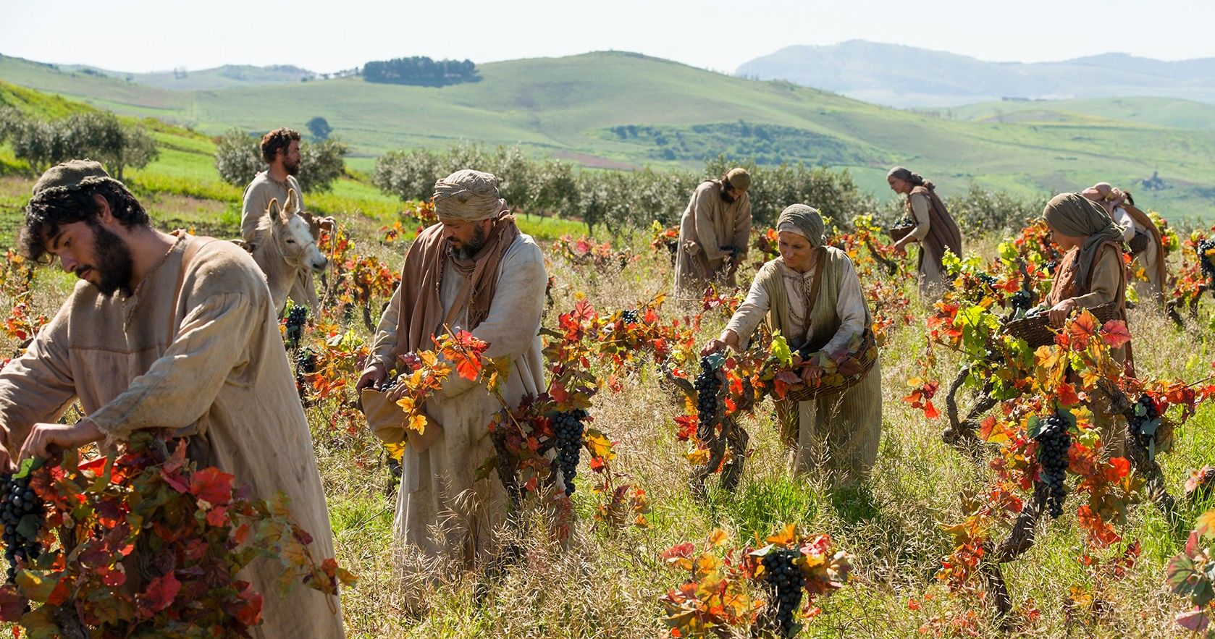
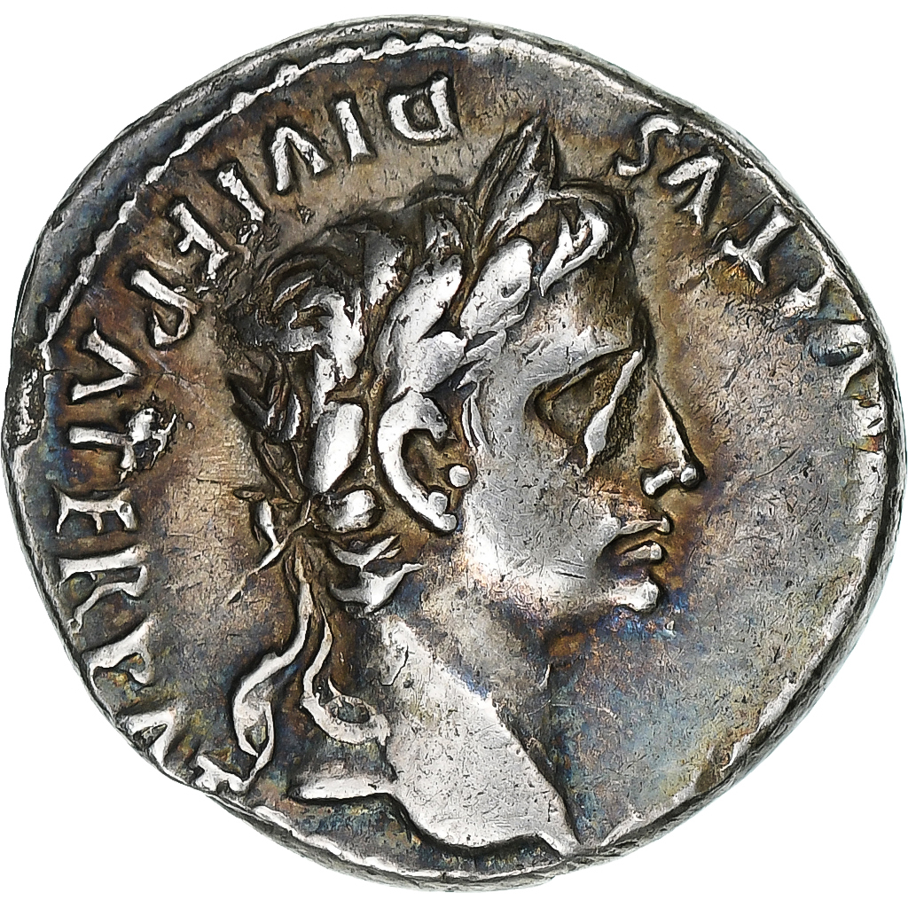
Roman silver denarius minted about the time of Jesus’ birth. It bears the image of Caesar Augustus. A denarius was a typical wage for a day-worker.
Vineyards in the time of Jesus, much as is true today, were cultivated in hillside terraces. The grapes were sometimes used fresh, sometimes dried into raisins, and sometimes pressed for wine or vinegar.

Slide 18
In this story, Jesus demonstrated two important principles about the kingdom and the sons of the kingdom.
It makes no difference whether a person serves his whole life or only responds in old age. Each will receive the reward of eternal life.
The generosity of God should not be denigrated when he gives grace even to those who seemingly have not earned it, for in his kingdom rewards are not reckoned on the basis of merit.
Jesus may well have been implying something about the people of Israel, who in a historical sense had been hired early and had endured the long centuries. Nonetheless, they must not be resentful if God invited Gentiles who were late in coming.
“So the last will be first, and the first last.”

Slide 19
Parable of the Barren Fig Tree (Lk. 13:6-9)
Jesus emphasized that the people in his kingdom were expected to bear fruit.
No figs were to be harvested for the first three years, only in the fourth year did the figs become “holy” (i.e., able to be set aside for an offering), and only in the fifth year could fruit be harvested (Lv. 19:23).
Hence, it was now six years or more, and still there were no figs.
The farmer decided to cut it down, but his vinedresser held out hope for one more year for additional care—if still there were no figs, it could be cut down.
THIS WOULD BE THE LAST CHANCE; IF ISRAEL DID NOT BEAR FRUIT, IT WOULD BE CUT DOWN.

Slide 20
DISCUSSION
Every Sunday in the BCP we hear the words Jesus said were the two greatest of the commandments. Why do you think these two are the greatest?
How does Jesus’ concluding question in the story of the Good Samaritan challenge readers today?
What kind of “fruit” does Jesus call for from modern people, and is this any different than the “fruit” he desired from ancient people?

Slide 21
The Parables of Jesus
Understanding Jesus’ parables in their original context
6 – A KINGDOM OF SPIRITUAL RECIPROCITY

Slide 22
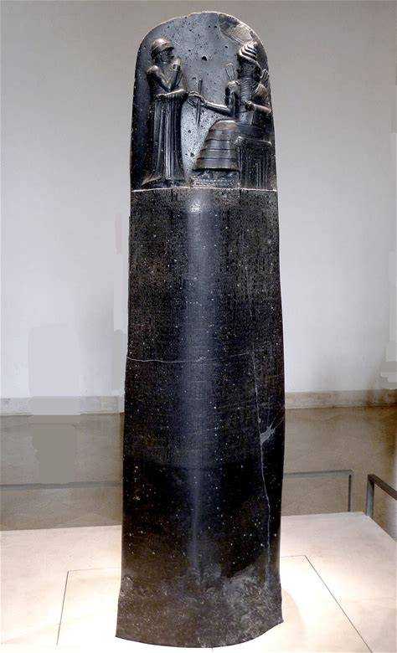
Spiritual Reciprocity
In the traditional way of thinking, reciprocity primarily concerned penal justice, i.e., “an eye for an eye.”
In the kingdom of God, Jesus countered this older understanding with a new kind of reciprocity emphasizing forgiveness and benevolence.
It was exemplified in the Lord’s Prayer in which the heavenly Father forgives generously but calls for his people to forgive others as well, just as they were forgiven (Mt. 6:12; Lk. 11:4).
The Code of Hammurabi (ca. 1750 BC) is the earliest law code to employ the Lex Talionis principle (“eye for an eye”). Later, this same type of law would appear in the Torah (Ex. 21:23-25).
The Louvre, Paris

Slide 23
“You have heard that it was said, ‘Eye for eye, and tooth for tooth.’ But I tell you, Do not resist an evil person. If someone strikes you on the right cheek, turn to him the other also. And if someone wants to sue you and take your tunic, let him have your cloak as well. If someone forces you to go one mile, go with him two miles.”
Mt. 5:38-41

Slide 24
Parable of the Lamp on the Stand
(Mt. 5:14-16; Mk. 4:21-25; Lk. 8:16-18)
Several parables address this new reciprocity, and this reciprocity was for everyone.
In the Parable of the Lamp on a Stand (Mt. 5:14-16; Mk. 4:21-25; Lk. 8:16-18), Jesus urged that his teachings were open to anyone who had ears to hear.
According to the rabbis, the Torah was a divine lamp.
However, Jesus said that the Pharisees had hidden that light by their selfish exclusiveness; instead of helping others into God’s kingdom, they were shutting them out (Mt. 23:13-14).

Slide 25
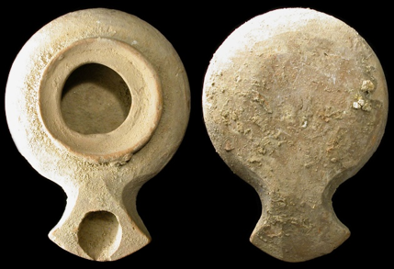
In this oil lamp from the time of Jesus, olive oil was the standard fuel. It floated upon the surface of an underlying layer of water. Water sealed the porous clay of the lamp, while a wick was inserted, and salt could be used for a brighter flame.

Slide 26
Parable of the Pharisee and the Tax Collector
(Lk. 18:9-14)
In this story of divine reciprocity, Jesus described two men who went to the temple to pray, presumably for the Tamid at 9:00 AM or 3:00 PM.
The Tamid (the morning and evening sacrifice) had been instituted by Moses (Ex. 29:38-41; Nu. 28:3-8).
These daily hours for public worship and prayer included the sacrifice of a year-old lamb and the offering of incense (symbolizing prayer).
After the sacrifice of atonement, the worshippers could offer their personal prayers of intercession, since the way to God was now open.

Slide 27
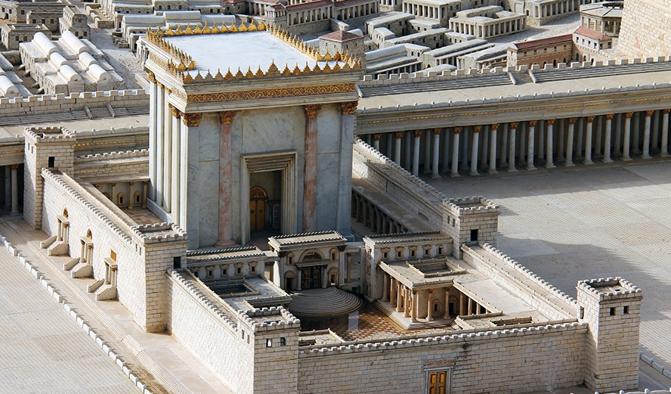
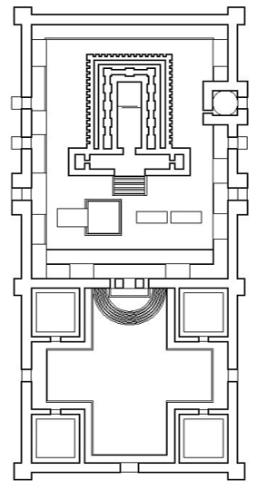
The floorplan of the 2nd Temple was divided into two major spaces, the upper accessible only to the priests and the lower open to the people of Israel.
The 2nd Temple, originally built by Zerubbabel (6th century BC) but reconstructed by Herod the Great (1st century BC), was the largest temple complex in the Roman world.

Slide 28
The Two Men
The two men in Jesus’ story represented the Jews most distant from each other.
The Pharisee was the epitome of precise Torah observance.
The tax collector was widely viewed as a traitor to Israel, a true “sinner,” since he was one of those to whom the Roman government farmed out tax collection.
The two praying men did not stand close to each other, the tax collector standing at a distance, knowing he was ostracized and unworthy.
Their manner of prayer was different: in typical fashion, the Pharisee prayed aloud, while the tax collector lowered his head and beat upon his breast in anguish confessing, “God have mercy on me, a sinner!”

Slide 29
“I tell you that this man, rather than the other, went home justified before God. For everyone who exalts himself will be humbled, and he who humbles himself will be exalted.”
Lk. 18:14

Slide 30
DISCUSSION
What was the goal of justice in the lex talionis, which appears in Hammurabi but also in Moses?
How is the new reciprocity of the kingdom different then the lex talionis?
Jesus said the Pharisees were shutting people out of the kingdom. How did they do this, and how might someone do this today?
In the story of the two men who went to the temple to pray, is there a relationship between liturgy and forgiveness?

Slide 31
Parable of the Friend at Midnight (Lk. 11:5-8)
This parable immediately follows Jesus’ teaching on the Lord’s Prayer in Luke’s Gospel.
The situation was due to the arrival of an unexpected visitor; the host had no bread left from the day’s baking, and it was now midnight.
The setting is a Palestinian village, where no shops would be open until sunrise.
In desperation, the host went to the home of a friend to borrow three loaves of bread, but his request was initially turned down.
The door had been bolted, the house was dark, the children were asleep, and it would upset the whole family to get up and unbolt the door.

Slide 32
Persistence!
Despite the refusal, the man continued to knock, even though annoyed, until his friend got up and loaned him the bread.
This story is an a fortiori type parable: if in village life a reluctant neighbor will respond to a need, how much more will God respond to the petitions of his children.
God is not like some stingy neighbor!
Therefore, Jesus says, “Ask!” “Seek!” “Knock!”
James, the brother of Jesus, adds a qualifier: “When you ask, you do not receive, because you ask with wrong motives, that you may spend what you get on your pleasures” (Ja. 4:3).

Slide 33
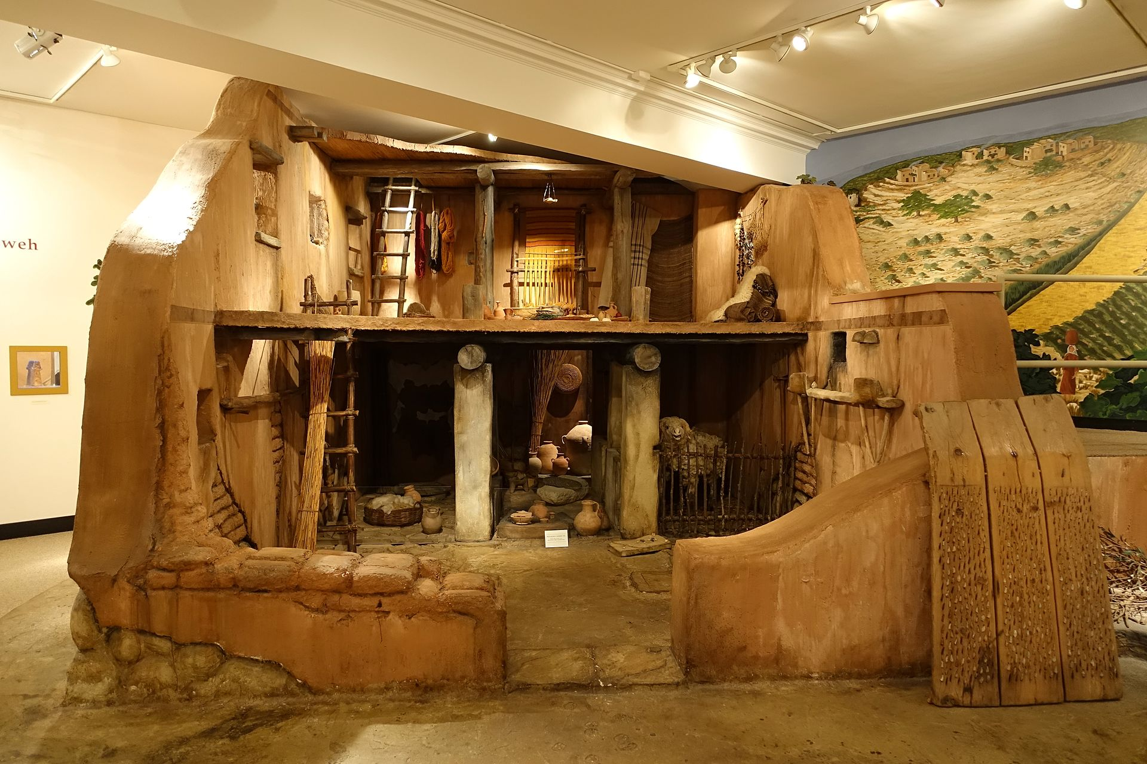
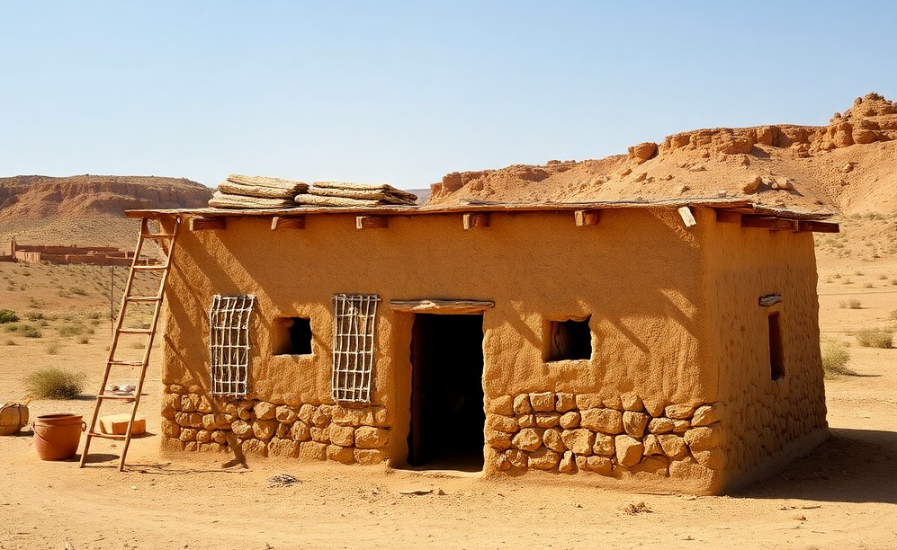
Reconstructed ancient Israelite house based on archaeological excavations
Semitic Museum, Harvard University
A simple, typical house from the time of Jesus was made of stone and mud. The roof was accessible by a ladder or staircase. A central doorway and small windows allowed some light into the home.

Slide 34
Parable of the Unjust Judge (Lk. 18:1-8)
Widows were particularly vulnerable in the ancient Middle East, and in this story, a widow pled with a local magistrate for justice.
Her case concerned a settlement, probably either regarding a debt or a pledge or part of an inheritance.
The judge neither feared God nor cared for the opinion of others. (He expected a bribe.)
The widow was alone in a man’s world, without money or influential friends, but she kept coming.

Slide 35
How Much More…
As in the previous parable, the story has an a fortiori character.
The judge cares nothing for the widow, but in order to get rid of her, he settles her case.
How much more will God hear the pleas of his people!
The listener is not to suppose that God is like an unjust judge who must be badgered into action or that prayer can “batter down” the walls of God.
Rather, if an unjust judge can be moved to action by persistency, how much more will God give justice to those who have been exploited, since he truly cares for the poor and powerless.

Slide 36
Jesus May Have Been Referencing an Ancient Text
Luke 18:2-8
Sirach 35:15-19
“In a certain town there was a judge… And there was a widow in that town who kept coming to him…
…and will not God bring about justice for his chosen ones, who cry out to him day and night?”
“Do not the tears of the widow run down her check as she cries out against him who has caused them to fall?
…and the Lord will not delay…’til he crushes…the unmerciful.”

Slide 37
DISCUSSION
Both the Parable of the Friend at Midnight and the Parable of the Unjust Judge were given in the context of Jesus’ teaching on prayer: how do these two parables shape the way Christians ought to pray?
What might be inappropriate conclusions about how to prayer?

Slide 38
Parable of the Unmerciful Servant (Mt. 18:21-25)
In this story, Jesus responded to Peter’s question, “How often should I forgive my brother when he sins against me?”
To illustrate forgiveness, Jesus told of a king settling accounts in which a creditor owed him an astronomical sum of 10,000 talents (750,000 pounds), a debt beyond all imagination.
Because he could not repay it, everything he owned would be sold, including slavery for his family members.
When he pled for time, the king, out of pity, forgave him the incredible debt.
However, he then turned on a creditor who owed him a relatively small sum and threw him in prison.

Slide 39
When the king heard what had happened, he delivered the umerciful servant to be tortured.
In the same way, Jesus said, God the Father will treat those who do not show mercy, forgiving others from the heart.
The reciprocity of the kingdom of God is epitomized in Jesus’ beatitude: “Blessed are the merciful, for they shall be shown mercy” (Mt. 5:7).
But woe to the one who does not show mercy!

Slide 40
Parable of Lazarus and the Dives
(Lk. 16:19-31)
With respect to reciprocity, Jesus also told the story of a crippled beggar and a rich man.
The beggar, Lazarus (= “God helps”), sat at the rich man’s gate, begging for scraps.
The rich man lived a life of luxury, dressing in a mantle of purple wool and underwear of Egyptian fine linen.
In popular view, one’s economic level was a reflection of either God’s blessing or his disfavor.
Both men died.
Lazarus was taken by the angels to a place of honor beside Abraham.
The rich man ended up in the flames of hell.

Slide 41
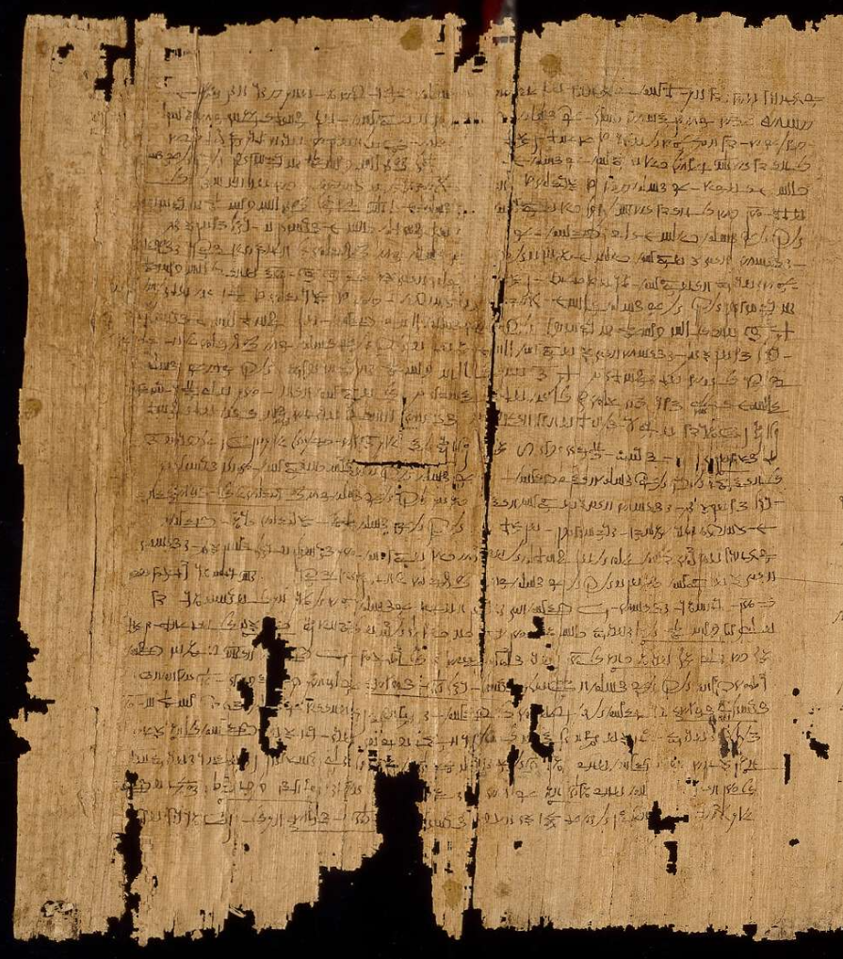
Jesus’ parable of Lazarus and the rich man may well have been an intentional aside to a known story in the Middle East, the story of Si-Osiris.
Originally from Egypt, this story was brought to Palestine by Alexandrian Jews and found its way into Jewish folklore.
In the story, a rich man had a sumptuous funeral but after death ended up in torment.
A poor man, who had been buried without ceremony, was rewarded in the afterlife.
EA 10822.1, British Museum, London

Slide 42
The Stubbornness of Unbelief
In hell, the rich man could see Lazarus in a place of comfort, and he asked Abraham to send him with a drop of water to cool his tongue.
Abraham refused. The reciprocity of their reversals was fixed by death.
Then the rich man asked if Lazarus could be sent to warn his five brothers not to come to this awful place.
But Abraham again refused: the rich man’s brothers had Moses and the prophets, and if they would not listen to them, they would not be convinced, even if someone came back from the dead to warn them.

Slide 43
DISCUSSION
What kind of person is the hardest to forgive?
Can you forgive a person who doesn’t ask?
Because a personal name is used, some have urged that the story of Lazarus and the rich man is historical. What do you think?
How far should one go in using this parable to discribe the nature of the afterlife?

Slide 44
The Parables of Jesus
Understanding Jesus’ parables in their original context
7 – AWAITING THE CLIMAX OF THE
KINGDOM

Slide 45
Once, having been asked by the Pharisees when the kingdom of God would come, Jesus replied, “The kingdom of God does not come visibly, nor will people say, ‘Here it is,’ or ‘There it is,’ because the kingdom of God is within you.”
Lk. 17:20-21
Once the owner of the house gets up and closes the door, you will stand outside knocking and pleading, “Sir, open the door for us.” But he will answer, “I don’t know you or where you come from.” …there will be weeping there, and gnashing of teeth, when you see Abraham, Isaac, and Jacob and all the prophets in the kingdom of God, but you yourselves thrown out.
Lk. 13:25, 28

Slide 46
The Already-Not Yet Tension
Jesus taught an inaugurated eschatology, which is to say, his disciples participated in both the present while anticipating the future.
ALREADY
…the kingdom is within you (Lk. 17:20-21).
…it is a reign more than a realm (Mt. 5:3-10).
…it is not outwardly visible but is like a seed growing silently (Mk. 4:26-29).
…the kingdom will not come in the immediate future (Lk. 19:11).
NOT YET
…there will be a climax of the kingdom (Mt. 6:10).
…some, seeking to enter, will be shut out, but others, coming from every direction, will be included (Lk. 13:23-30).
….every follower of Jesus is obliged to be watchful and faithful, for the time of climax is unknown (Mk. 13:33-37).

Slide 47
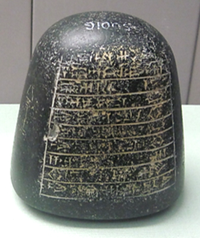
Parable of the Ten Minas/Talents
(Lk. 19:11-27; Mt. 25:14-30)
Jesus may have told this story more than once, since the setting in Luke, as well as several details, are different in Matthew.
Luke speaks of minas, while Matthew speaks of talents. Both are measurements of weight, but with different values.
Luke mentions ten servants; Matthew only mentions three.
In Matthew’s version, jurisdiction over cities is not mentioned as it is Luke’s version.
One mina weight (about 1 ¼ pounds)
British Museum, London

Slide 48
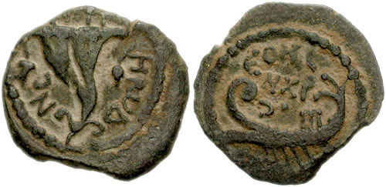
The Setting for the Parable
Jesus’ story was about an elite who traveled to a far country to secure an appointment as a client king.
This actually happened in 4 BC, when Herod the Great died.
His son, Archelaus, went to Rome to secure his status as the client king over Judah, which he received (though Caesar titled him an ethnarch, not a king).
His listeners would surely have recalled this incident, since it was still within their historical memory.
Coin of Archelaus

Slide 49
The Story
Before leaving, the elite assembled ten trusted servants and gave to each a mina, charging them to invest the wealth in his absence.
When he returned and examined them, one servant had earned another ten minas and another five minas.
Another servant, out of excessive caution, hid his mina and did not invest it at all, offering the lame excuse that he knew his lord was a hard man and he was afraid to risk anything.
In the end, the new king took away his mina and gave it to the servant who had ten.

Slide 50
Two Primary Points…
The master would be absent for a long period, and he expected his servants to be productive.
Irresponsibility would be inexcusable, for “…to everyone who has, more will be given, but as for the one who has nothing, even what he has will be taken away.”
Christians have long understood the absence of the king to represent the interval between Christ’s 1st and 2nd coming.

Slide 51
DISCUSSION
How would you describe “being productive” in the kingdom of God?
How should contemporary Christians regard the promise of Christ to return and what should they do to prepare for it?

Slide 52
Parable of the Servant’s Duty (Lk. 17:7-10)
This story of a small-scale farmer who could only afford one farm-hand emphasizes the ideal of stewardship.
The one worker was responsible for plowing, watching the sheep, and then serving inside the house as well.
Still, he would not expect the master to say, “Why don’t you sit down to eat (and I will serve you).”
Much more likely, the master would say, “Prepare my meal, and afterwards you may eat.”
The farmer doesn’t thank his worker, because he is only doing his duty.
Similarly, God has every right to expect the best stewardship. People are not doing him a favor by being faithful: they are only doing their duty.

Slide 53
Parable of the Rich Farmer (Lk. 12:16-21)
This story accentuates the fact that the crisis of the hour may not be in waiting for the end of the age, since death is a constant specter.
Jesus gave this parable when pressed by a listener to urge his older brother to share an inheritance.
Jesus refused to become involved in a family dispute, but he did offer a story warning against greed and the transitory nature of material wealth.

Slide 54
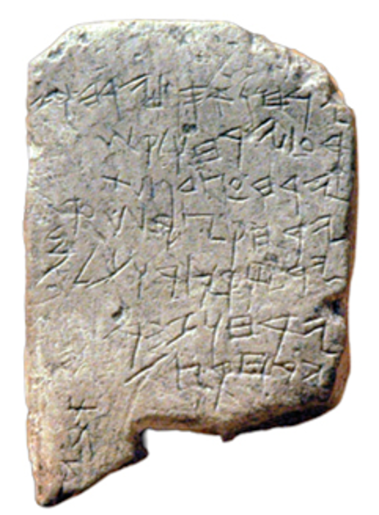
In the parable, a wealthy farmer intended to construct larger storage facilities in which to store his reaped grain.
His primary thought was only what his wealth could bring—the satisfaction of eating well, drinking well, and a relaxed state of happy well-being.
Unknown to him, that night he would die.
Jesus went on to say that the meaning and value of life is not to be found in possessions, food, clothing, or even a longer life-span (Lk. 12:15, 23, 25). At the end of life, none of these things matter.
Rather, what his disciples should seek first were the values of the kingdom of God (Lk. 12:31).
An ancient agricultural almanac describing the seasons for olive harvest, grain planting, hoeing flax, vine-tending, and summer fruit.

Slide 55
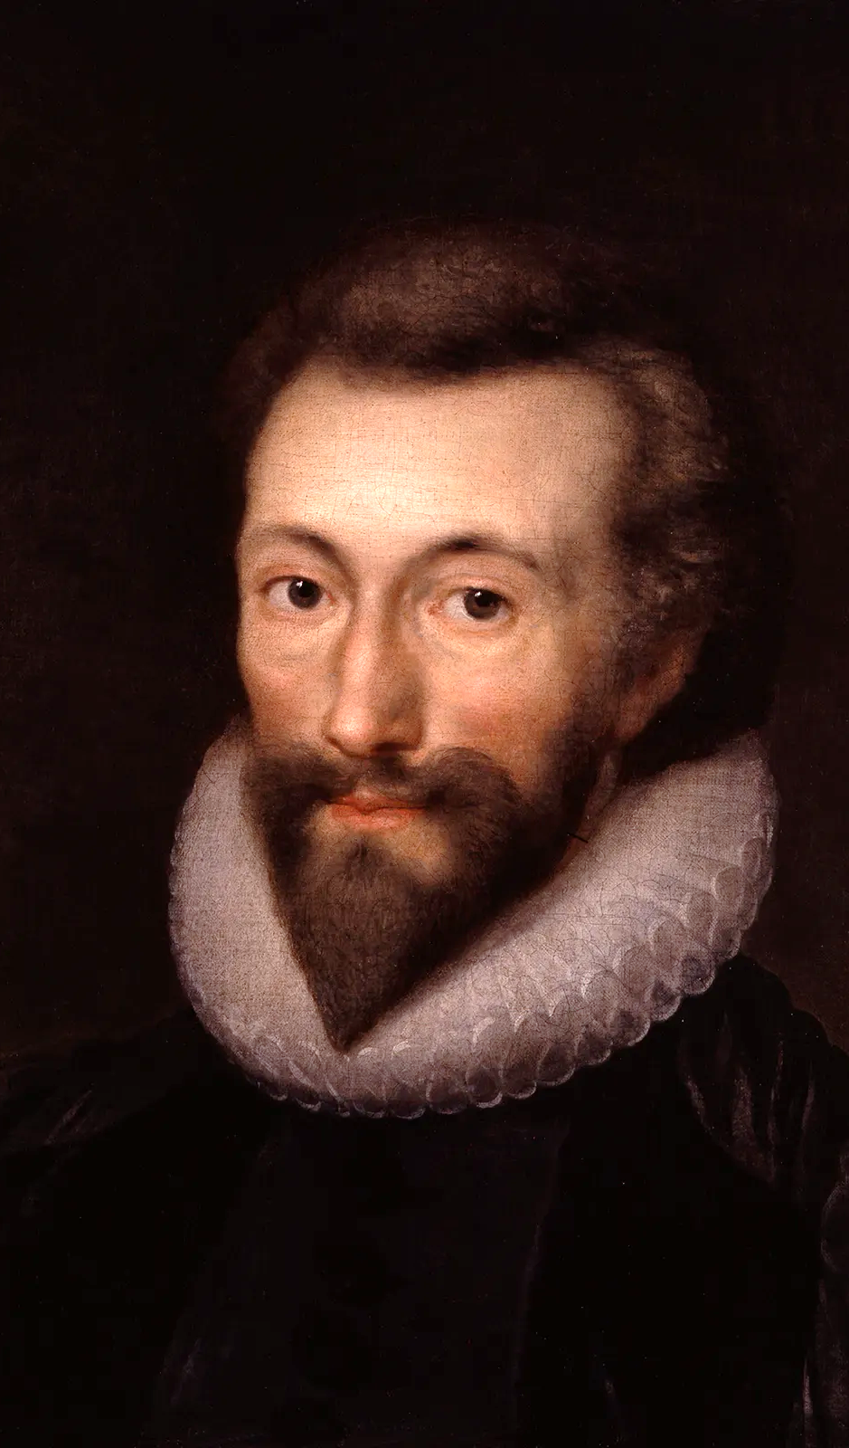
“Never send to know for whom the bell tolls; it tolls for thee.”
John Donne, Anglican Cleric and Dean of St. Paul’s Cathedral
Meditation 17
Devotions Upon Emergent Occasions
Published 1624

Slide 56
DISCUSSION
Jesus spoke about faith and faithfulness, but also about duty. What is the relationship between faith and duty?
How similar is the rich farmer’s mindset to our modern plans for retirement--eating well, drinking well, and achieving a relaxed state of happy well-being.

Slide 57
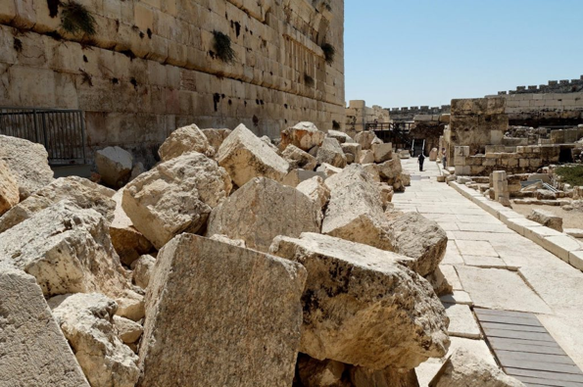
Parables About the End of the Age
As Jesus drew near the end of his public ministry, he became more explicit in predicting the end of the 2nd Temple.
What is usually called his Olivet Discourse (Mt. 24-25; Mk. 13; Lk. 21) brings together the events of the temple’s destruction with the final events at the end of the age.
He gave several parables in this regard.
Stones from the 2nd Temple, when the Romans destroyed it, lie just as they fell two millennia ago. Jesus said “not one stone would be left on another” (Mt. 24:2).

Slide 58
Parable of the Burglar
(Mt. 24:42-44; Lk. 12:39-40)
In order to stress that his disciples should always be awaiting his return, Jesus gave the short parable of the burglar.
No burglar sends out notices when he intends to rob someone’s home! It always is at an unexpected time.
In the same way, the time of Christ’s return is unknown, so his followers must always be watching and ready.

Slide 59
Parable of the Trusted Servant
(Mt. 24:45-51; Lk. 12:42-46)
There are two versions of this parable, one in Matthew and the other in Luke, and each has its own distinct setting. Likely, Jesus told this story more than once.
In the story, a manager was put in charge of the household while his master was away.
Should be master be delayed in his return, the supervisor still must be responsible to keep trust and not take advantage of the circumstance.
As such, Jesus’ followers must be faithful to their work, even though the time of the Master’s return is unknown.
In this parable, Jesus clearly calls for watchfulness and fidelity.

Slide 60
Parable on Watchfulness
(Mk. 13:33-37; Lk. 12:35-38)
Similar to the previous parable, Jesus told the story of a master returning from a wedding festival, and once again, there are distinct settings for this story in Mark and Luke.
The master’s servants know he will return soon, but they don’t know precisely when, since travel in the ancient world is always susceptible to interruptions and delays.
The master could return at any of the four watches of the night, so his servants must always be ready.
WATCHES OF THE NIGHT
Originally, the night seems to have been divided into three periods (cf. Jg. 7:19), but by the New Testament, it was four, according to the Roman system. Presumably, the “watches” were from sunset to sunrise, each approximately three hours long.

Slide 61
Parable of the Ten Virgins (Mt. 25:1-13)
Jesus’ story of the waiting virgins has as its background the Jewish wedding.
Jewish marriage occurred in two stages, the betrothal (a private arrangement between two sets of parents for the marriage of their children) and the home-taking (the transfer of the bride to the home of the groom).
The setting for the parable is the second of these stages, which typically included a processional with attendants accompanying the bride to the site of the wedding feast.

Slide 62
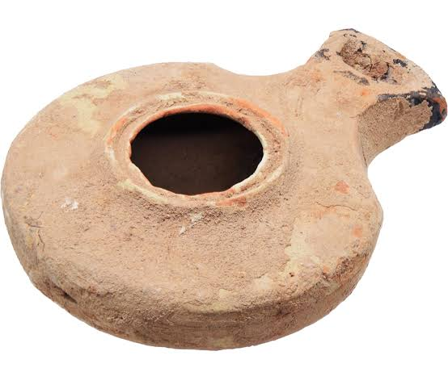
Ten girls awaited the processional, probably at the home of the bride.
They carried torches or lamps for celebration and light.
Five brought extra oil, and five did not.
As it turned out, the groom was delayed, and the girls fell asleep.
Suddenly, in the middle of the night, a shout went up that the bridegroom was finally on his way.
The girls without oil saw that their torches or lamps were about to go out, so they went to get more oil.
While they were away, the bridegroom arrived, and everyone processed to the new home and the festival.
When the five girls returned, they were too late. The door was now closed, and they were refused entry!
TORCHES OR LAMPS?
It is unclear whether or not the girls carried torches or lamps, since the Greek word lampaj serves for both implements. If torches, they would be hand-held sticks with the ends wrapped in oil-soaked rags. If lamps, they would be terracotta receptacles holding oil and a wick. Most English Versions opt for lamps.
1st century Jewish lamp

Slide 63
“But while they were on their way to buy oil, the bridegroom arrived. The virgins who were ready went in with him to the wedding banquet. And the door was shut. Later the others also came. ‘Sir! Sir!’ they said. ‘Open the door for us.’ But he replied, ‘I tell you the truth, I don’t know you.’ Therefore keep watch, because you do not know the day or the hour.”
Matthew 25:10-13

Slide 64
DISCUSSION
What seems to have been the main point of the various parables about awaiting the return of Christ?
The Nicene Creed simply states of Christ’ second coming, “…and he shall come again, with glory...” What do you make of those Christians who attempt to calculate the time of Christ’s return?

Slide 65
The Parables of Jesus
Understanding Jesus’ parables in their original context
8 – THE FINAL RECKONING

Slide 66
“On this mountain Yahweh Tsabaoth will prepare a feast of rich food for all peoples, a banquet of aged wine—the best of meats and the finest of wines. On this mountain he will destroy the shroud that enfolds all peoples, and the sheet that covers all nations; and he will swallow up death forever. The Sovereign LORD will wipe away the tears from all faces; he will remove the disgrace of his people from all the earth.
Yahweh has spoken.”
Isaiah 25:6-8

Slide 67
The Feast of the Kingdom of God
Eight centuries before Christ, Isaiah predicted the climax of God’s great purpose for the nations (Is. 25:6-9).
He described a great banquet for all peoples.
This prediction captured the imagination of the people of Israel, and it became the basis for several of Jesus’ parables about banquets.
This banquet represented more than just a meal, however:
  It symbolized the restoration of relationships, the fulfillment of God’s covenants, and the joy of eternal life.
  It would serve as a reminder of God’s faithfulness, and it prompted the hope of redemption for all who would put their trust in him.
In the banquet parables, Jesus indicated that the invitations to this “feast of the kingdom of God” was even then being issued in his own life and ministry. Alas, the Jewish leaders were not interested.

Slide 68
Parable of the Playing Children
(Mt. 11:16-19; Lk. 7:31-35)
The setting for the story seems to be children in the marketplace playing make-believe, mimicking what they have seen at weddings and funerals.
The short poetic lines speak of “dancing” (appropriate for a wedding) and “singing a dirge” (appropriate for a funeral).
Some children refused to participate in the antics of their fellows, even though the flute called them to dance and the dirge called them to grieve.
In the same way, the Jewish leaders had rejected John the Baptist and now were rejecting Jesus.

Slide 69
Parable of the Great Banquet (Lk. 14:15-24)
The stimulus for this parable came at a formal meal, where one of the guests, after listening to Jesus, offered the pious platitude, “Blessed is the man who will eat at the feast in the kingdom of God.”
In response, Jesus told the story of a great man who staged a banquet.
  Typical of the Middle East, there was a double invitation.
  The first enabled the host to determine how many people would come before he slaughtered meat.
  The second was issued on the day of the feast when the meal was ready.
The host invited many guests in the first invitation, and presumably, they all responded positively that they would come.

Slide 70
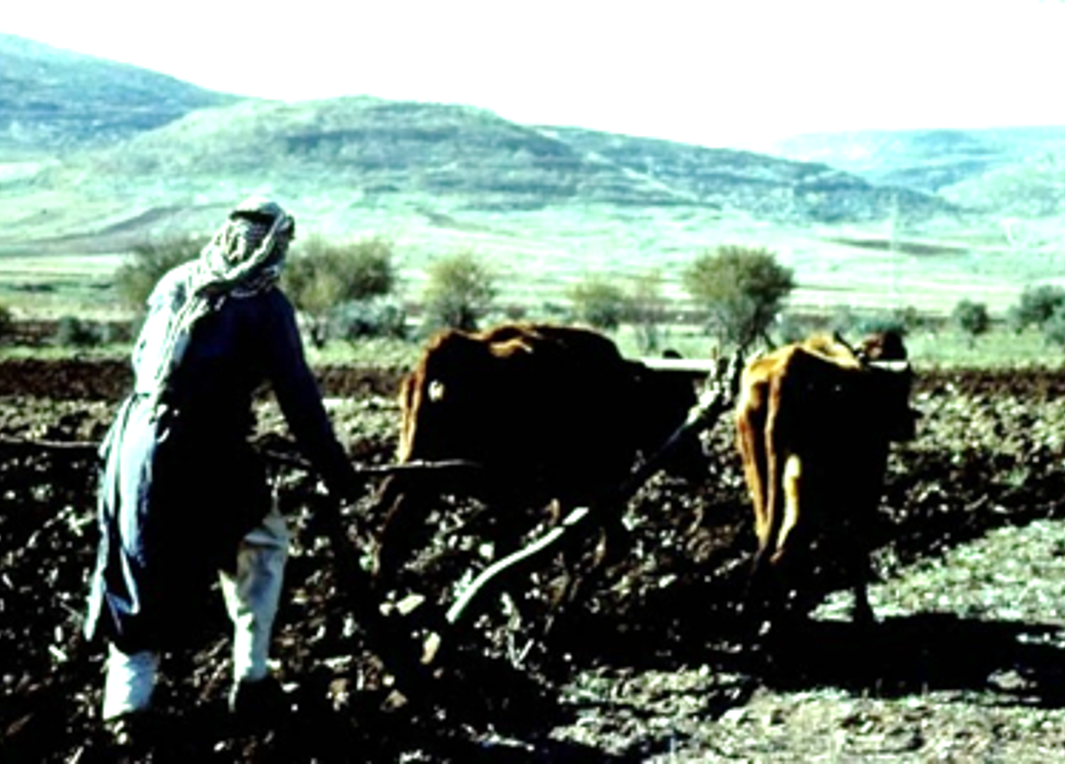
At the second invitation, after the feast had been prepared, the invited guests declined to come and offered only flimsy excuses.
The one said he had bought a field and needed to go have a look at it (no one in the Middle East buys a field sight unseen without knowing its full history).
Another, apparently a wealthy farmer, said he had purchased five yoke of oxen but need to examine them (again, no farmer would buy ten animals without first trying them out).
Still another said he was recently married (but he would only be gone for the afternoon and home in the same evening).
Since most farmers had a small plot that would support only one or at the most two yoke of oxen, a farmer buying five yoke was clearly wealthy.

Slide 71
Since the meat for the meal was already cooked, and the invited guests wouldn’t come, the host instructed his servants to quickly invite the outcasts of the village—the poor, the crippled, the blind, and the lame.
Since there was still space and sufficient food, he also sent servants to invite outsiders traveling along the public roads.
Jesus then concluded that none of those originally invited would ever eat at the banquet feast of the kingdom of God, but those considered to be outsiders would be welcome!
THERE IS MORE THAN A HINT IN THIS PARABLE OF AN INVITATION FOR SALVATION TO THE GENTILES.

Slide 72
DISCUSSION
Despite the signs in his miracles, why do you think so many of Jesus’ contemporaries, especially the leaders, refused to accept him?
Why do people today refuse to accept him?

Slide 73
Parable of the Wedding Banquet (Mt. 22:1-14)
Similar to the previous story, Jesus also told the story of a wedding banquet with many of the same themes.
This time, the host was a king, and the wedding was for his son.
Such a royal invitation was not much less than a royal command.
As before, the original invitees refused to come (again, at the last minute after the food was already prepared), but this version was far more violent.
  Some simply ignored the invitation with flimsy excuses.
  Others, however, abused and even killed the messengers.
Enraged, the king sent an army to destroy the city of the shirkers who had shown such violence and disloyalty.

Slide 74
As in the previous story, the king now summoned ordinary people from the streets.
When surveying the guests, the king observed a man inappropriately dressed.
  A common explanation is that in this period wedding robes were provided by the host (you will see this on multiple websites).
  However, scholars point out that there is no historical support for this theory from the time of Jesus, so just how the man’s clothing was inappropriate is unclear.
Either way, the man was summarily expelled.
HERE, THE MESSAGE IS THAT WHILE EVERYONE IS INVITED, ALL WHO COME MUST ATTEND IN AN APPROPRIATE WAY. TO SEEK ENTRANCE OTHERWISE WILL LEAD TO DISASTER!

Slide 75
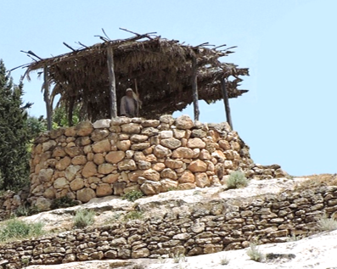
Parable of the Wicked Tenants
(Mt. 21:33-44; Mk. 12:1-11; Lk. 20:9-18)
In this story, there is an even more ominous tone.
Jesus drew on the ancient “Song of the Vineyard,” where Isaiah used the metaphor of an unproductive vineyard to describe the people of Israel.
In this parable, a landowner planted a vineyard, walling it for protection, and building a guard tower and a press for making wine.
He leased it out to sharecroppers, while he departed on a long trip.
Vineyard guard tower

Slide 76
When it was time for harvesting grapes (after about 4-5 years), he sent servants to collect the produce.
All the servants he sent were abused, one was murdered. Repeatedly, he sent servants, and they were all treated the same.
Finally, as a last resort, the vineyard owner sent his own son thinking that they surely would respect him.
  They murdered the son, throwing his corpse over the wall without even a burial.
THEN COMES THE QUESTION: “What will the vineyard owner do?”
The answer was obvious: he would bring those wretches to a wretched end!

Slide 77
The Meaning of the Parable
The vineyard owner, as in Isaiah’s Song of the Vineyard, is God himself.
The vineyard was the people of Israel.
The sharecroppers were the leaders of Israel.
The servants were the prophets.
The son was Christ Jesus, who would be rejected and killed.
The only thing left was retribution.
“As he approached Jerusalem, he wept… ‘The days will come upon you when your enemies will build an embankment against you… They will not leave one stone on another, because you did not recognize the time of God’s coming to you.’” (Lk. 19:41-44)

Slide 78
The Cornerstone
In concluding this story, Jesus drew from Psalm 118, the passage chanted by pilgrims on their way to Jerusalem with the familiar, “Blessed is he who comes in the name of the LORD.”
Here, however, Jesus quoted the section about how the stone masons passed over one stone—but in the end, it would become the most important stone in the building!
In the building of Solomon’s temple, this rejected stone that became the cornerstone probably referred to an actual incident that was preserved in the collective memory of the nation.
It came to symbolize the nation’s rejection of the Messiah, who would be the one to fulfill all that the prophets had foretold.

Slide 79
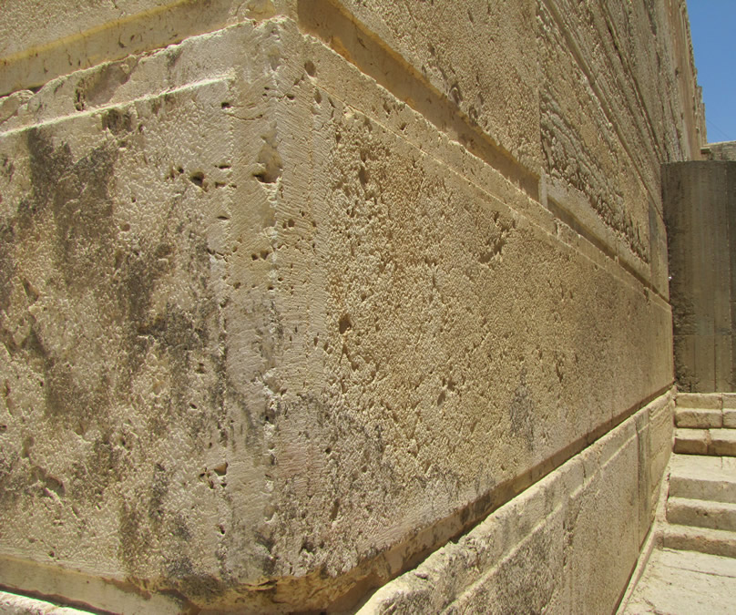
Huge cornerstone located at the southwest corner of the 2nd Temple mount. This large ashlar is called the “Master Course Stone” and weighs about 80 tons. Everything below and above it is solidified by its great weight.

Slide 80
“When the Son of Man comes in his glory, and all the angels with him, he will sit on his throne in heavenly glory. All the nations will be gathered before him, and he will separate the people one from another as a shepherd separates the sheep from the goats.”
Matthew 25:31-32

Slide 81
Parable of the Sheep and the Goats (Mt. 25:31-40)
Jesus concluded his discourse against the temple with a description of the last judgment using a metaphor of dividing sheep from goats.
The sheep represent the righteous who will inherit the kingdom prepared for them from the foundation of the world.
The goats represent the unrighteous, those who are cursed and consigned to eternal punishment.
The basis for their separation will be according to how they treated those whom Christ called “the least of these my brothers,” people who were hungry, thirsty, imprisoned, homeless, and without clothing.

Slide 82
To whom was Jesus referring when he used the expression “my brothers?”
POPULAR INTERPRETATION
CONTEXTUAL INTERPRETATION
It has long been a popular interpretation that the “sheep” to whom Jesus referred were those who lived lives of generosity to the poor, the disadvantaged, and the persecuted.
If so, then salvation is awarded by philanthropy and generosity.
Alternatively, on the basis of Mt. 12:48-50 and 28:10, others have suggested that salvation is based on the way they treated the bearers of the gospel.
To show generosity to those preaching the gospel is to accept Christ himself (Mt. 10:40).
HOW ONE INTERPRETS THIS PARABLE IS RELATED TO HOW ONE UNDERSTANDS SALVATION: IS IT BY GRACE AND THROUGH FAITH OR IS IT BY GOOD WORKS?

Slide 83
DISCUSSION
What do you make of the violence in the parables of the banquets, and why do you think Jesus used this element?
What are the pros and cons of the two interpretations of the “brothers” of Jesus in the story of the sheep and goats?

